Slide 1
Emu: Rapid FPGA Prototyping of Network Services in C#
Salvator Galea*, Nik Sultana*, Pietro Bressana†, David Greaves*,
Robert Soulé†, Andrew W. Moore*, Noa Zilberman*
*University of Cambridge, †Università della Svizzera italiana
DATE¹⁷ : Design and Automation in Europe

Slide 2
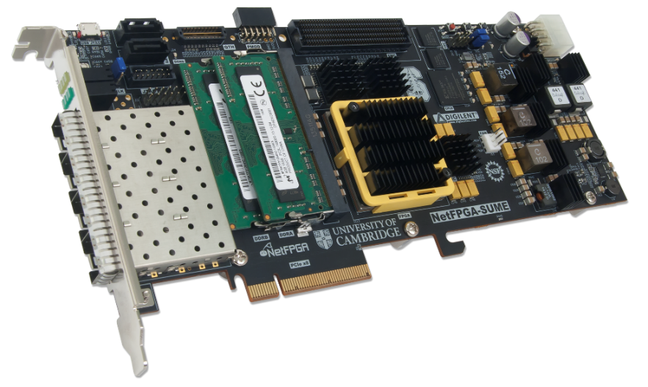
Emu : Accelerating Network Services
Goals
Accelerate network services
C# coding
Compile to multiple targets
Accelerate development
Improve performance
Rapid prototyping
Implemented examples
Memcached server
NAT
DNS server
L2 learning switch
Ping (ICMP, TCP)

Slide 3
Kiwi Compiler
Kiwi is a High-Level Synthesis (HLS) system that:
Generates FPGA designs from C# source code
Targets scientific computing applications
Kiwi supports:
Multi-dimensional arrays
Threading
File-server I/O
Object management
Limited recursion
Kiwi is developing a methodology for algorithm
acceleration using parallel programming and the C# language. Specifically, Kiwi consists of a run-time library for hardware FPGA execution of algorithms expressed within C# and a compiler, KiwiC, that converts .NET bytecode into Verilog RTL for further compilation for FPGA execution.
David Greaves, and Satnam Singh. "Distributing C# methods and threads over Ethernet-connected FPGAs using Kiwi." Formal Methods and Models for Codesign (MEMOCODE), 2011 9th IEEE/ACM International Conference on. IEEE, 2011.

Slide 4
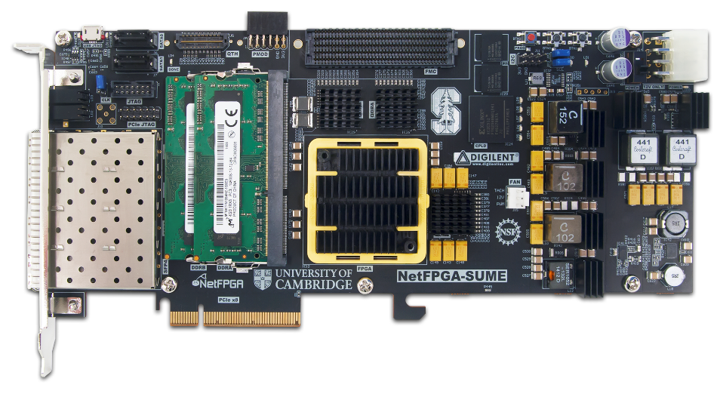
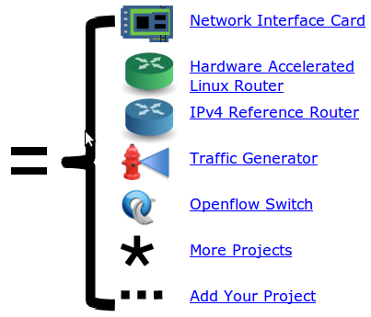
NetFPGA-SUME
A line-rate, flexible, open-networking platform
for teaching and research.
Xilinx Virtex-7 690T
4 x 10Gbps Ethernet Ports
8 GB DDR3 SoDIMM 1800MT/s
27 MB QDRII+ SRAM, 500MHz
x8 PCI Express Gen.3
18 x 13.1Gb/s additional serial links
SATA connectors
Micro-SD slot

Slide 5
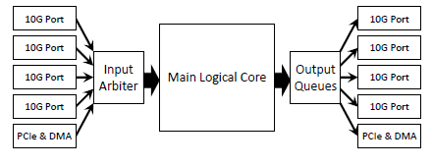
Emu Framework
C#
L2 switch
TCP ping
ICMP echo
NAT
DNS
Memcached
Emu Framework provides
A library to support network related high level programming
A reference design which compiles into the NetFPGA-SUME main logical core
Programming and networking abstractions to bus protocols, memory interfaces, and basic frame-handling functionalities
.NET CIL
PAX
x86 Simulation
Verilog
code
HW Tests
SIM Tests

Slide 6
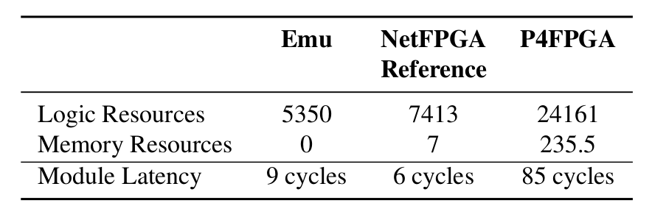
Emu: Evaluation
Performance Comparison Between Services Running on a Host and Emu Based Services (written in C#)
Comparison Between Emu Switch (written in C#), NetFPGA Reference Switch (written in Verilog) and P4FPGA Switch (written in P4), using 64B packets

Slide 7
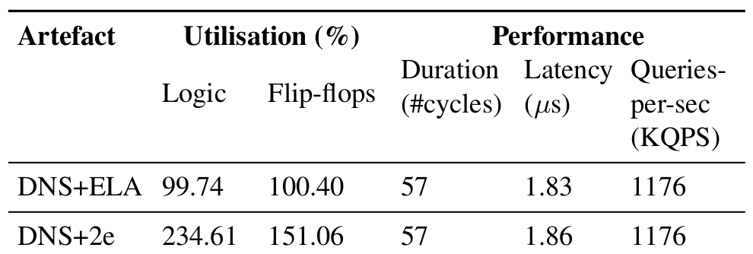
Emu extends Debug capabilities
Use Directed Packets to inspect the state of a device in the field
Support extension points in the code
Observe the program from that point
Influence program state
Example supported commands:
Print, trace, count, (un)break,(un)watch, backtrace
Implemented using an embedded controller and a program director

Slide 8
Acknowledgments

Slide 9
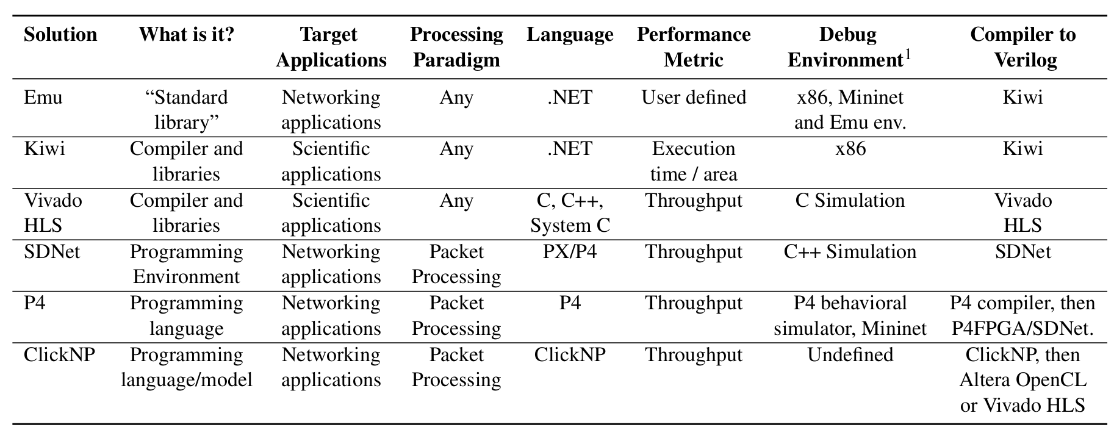
Comparison Between Different Representing Solutions Enabling Networking Services in Hardware

