Slide 1
The Tragedy of Smart Metering
Nick Hunn

Slide 2
Why do we need Smart Meters?
Because they will save money for utilities?
Because they’ll reduce the cost of energy bills?
Because they will make disconnects easier?
Because meter manufacturers want to reduce the replacement cycle?
Because we’re all going to buy electric vehicles?
Because they’ll help manage demand through Time-of-Use tariffs?
Because they’ll prepare us for a distributed grid?
Because they’ll solve the generation shortfall in 2017?
Because the Government needs an IT disaster in 2017 to distract attention from the generation shortfall?
Because it’s the next step towards a Big Brother state?
To meet the European 20-20 Mandate?

Slide 3
Because DECC thought Smart Meters could save the world?

Slide 4
The European 20-20-20 Directive
The directive encourages the introduction of smart metering “where economically reasonable and cost effective”.
Despite the wording, it is regularly cited as a binding mandate.

Slide 5
The Problem
As a means of automated billing smart meters are not cost effective. If they were, utilities would have already installed them.
Various assessments by DECC consultants repeated that verdict.
That gave DECC a problem:
They could tell ministers to change policy, or
They could try to find other benefits.
They chose the latter.

Slide 6
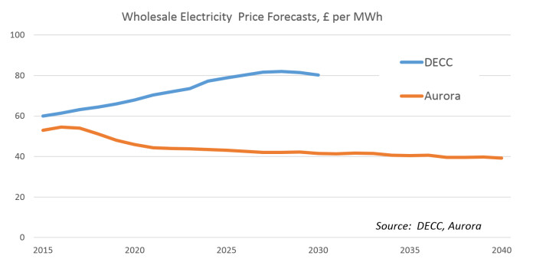
Another underlying problem
Almost every DECC decision is based on their vision of how the world should be, not how it is.

Slide 7
It’s a classic case of Policy leading Evidence, not Evidence leading Policy.

Slide 8
So they made up some savings.
Savings from consumer behaviour change
Reduced site visits to read meters
Reduced need for customer support
Associated carbon savings
Generation and Grid efficiency benefits
£4.6bn
£3.2bn
£2.1bn
£1.1bn
£0.8bn

Slide 9
With the following explanation

Slide 10
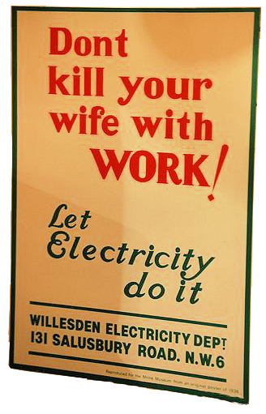
Consumer Engagement
Utilities don’t have a good history of consumer engagement.

Slide 11
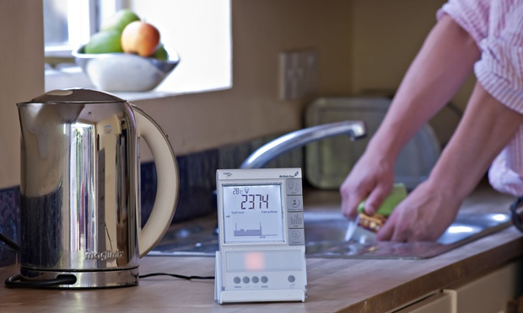
If you can see it, you won’t use it.
So DECC decided to give everyone an In Home Display.

Slide 12
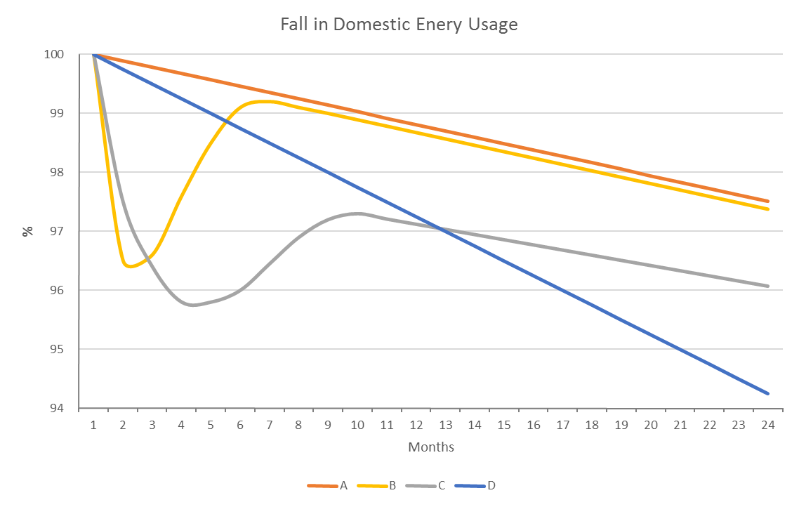
But where’s the evidence?
Annual Decrease
3 Month Wonder
DECC Projection
Appliance Change

Slide 13
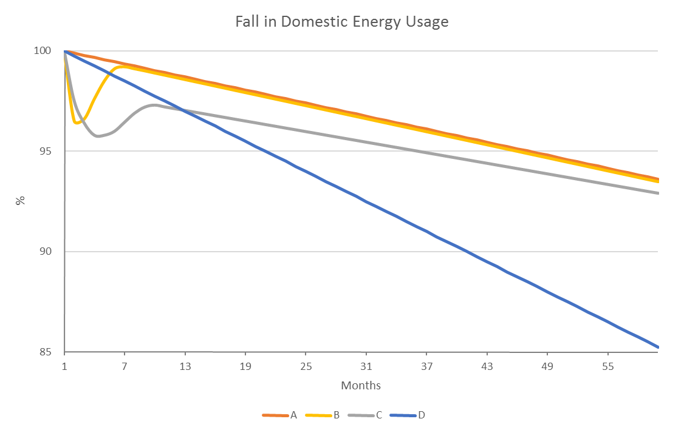
Over the long term, savings revert
Annual Decrease
3 Month Wonder
DECC Projection
Appliance Change

Slide 14
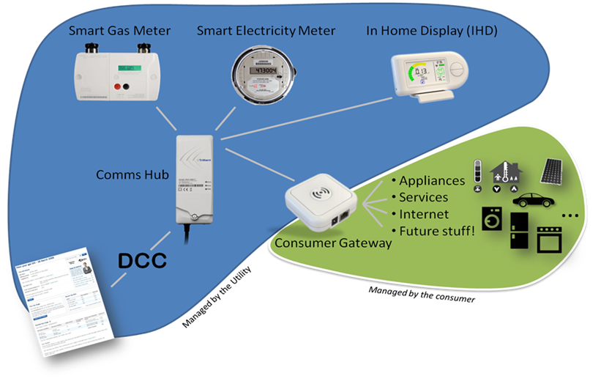
Bad evidence. Worse consequences.
To affect domestic savings DECC decided to give everyone an In Home Display.
That required a wireless link to the electricity and gas meters.
This all required a specification for product in the home.

Slide 15
The next big mistake
In every other country with a deregulated industry, meters have been owned and fitted by the grid operators.
They supply data from the meters to the current energy supplier.
It means that meters don’t need to be interoperable.
In the UK, meters are fitted by energy suppliers, each of whom has a favourite supplier.
To enable switching they need to be interoperable.
It’s also needs a central authority to read and forward the data – the DCC.
Interoperability carries a massive additional cost.

Slide 16
Choosing Technology.
The choice for wireless technology in the home was made by non-technical people.
The decision was largely based on PowerPoint and PR.
The choice – ZigBee was little used and known to have major faults, but its suppliers were desperate to win the programme.
Once chosen, the utilities decided it didn’t do enough. So despite having no expertise, they rewrote it. Four times.
Meter vendors also wanted to keep their own standard, so they merged ZigBee with the old DLMS and COSEM metering standards.
The result was the SMETS1 specification.
GCHQ deemed it insecure, so it’s been rewritten again to form the SMETS2 standard.
It needs a massive GB companion specification.

Slide 17
Choosing more Technology.
The choice for wide area connectivity was left open to companies bidding for the CSP contracts.
Telefonica won two areas using GPRS (2G)
Arqiva won the Northern area using a proprietary radio network.
Allowing different options requires a separate comms hub, adding more cost and complexity.
As the 2G network will probably be turned off by 2026, around 20 million comms hubs will need replacing between 2020 and 2026.
Smart meters look like having a very short life.

Slide 18
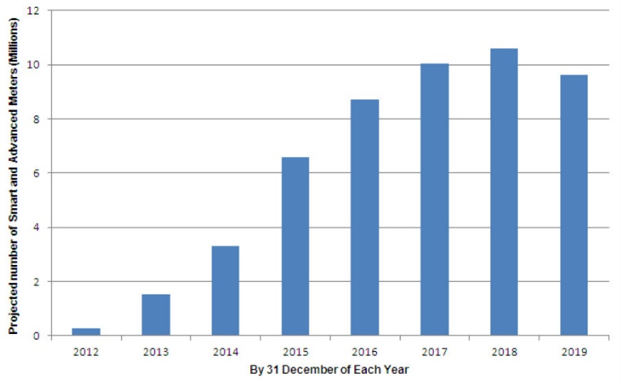
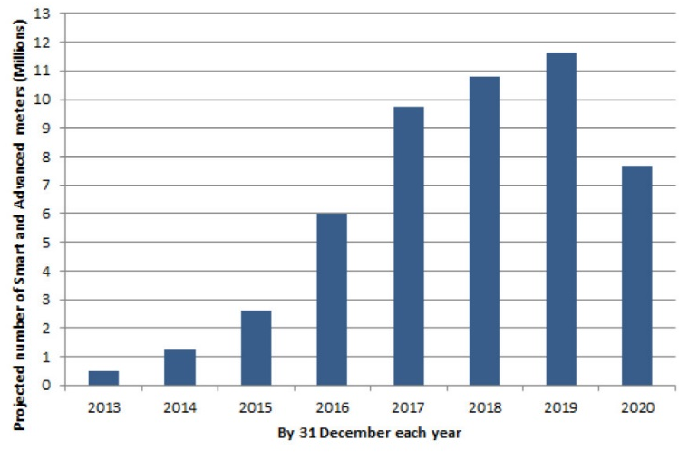
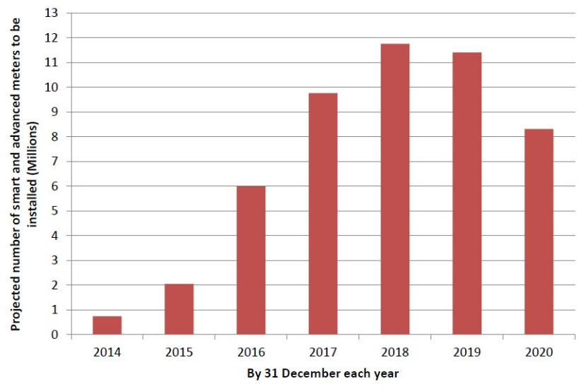
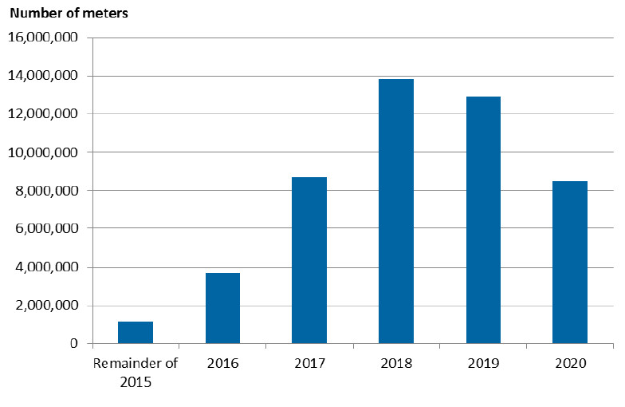
Complexity adds delays
2012
2013
2014
2015

Slide 19
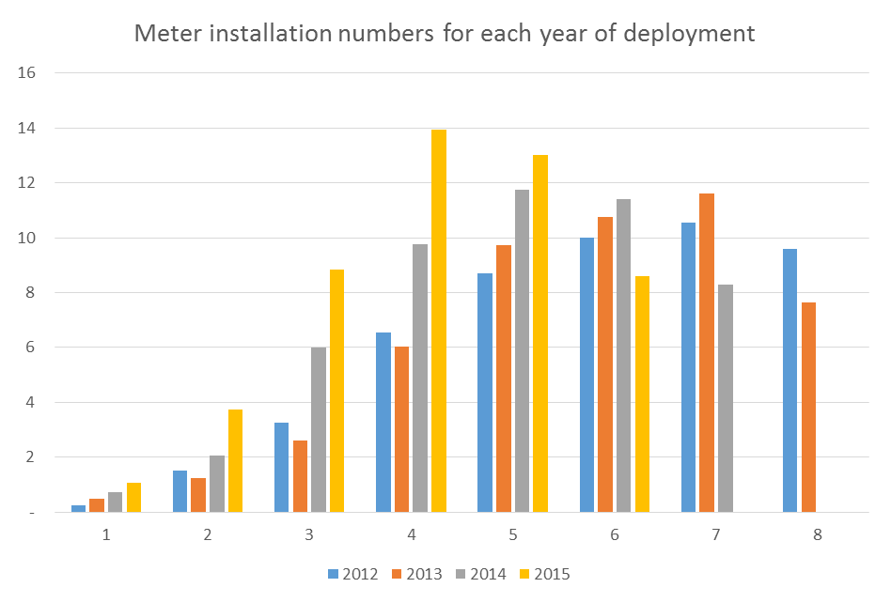
Complexity adds delays
Projected number of smart meters (millions)
Years into deployment

Slide 20
The inevitable consequence
Number of meters to be installed
60,000,000
50,000,000
40,000,000
30,000,000
20,000,000
10,000,000
2020

Slide 21
The Alleged Grid Benefit
and the folly of tariffs.

Slide 22
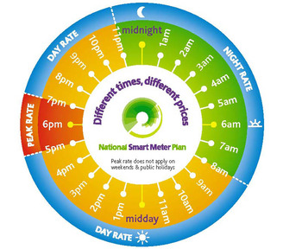
Tariffs, Tariffs and more Tariffs

Slide 23
In the beginning there was Economy 7
Simple Time of Use (ToU) Tariff
Price / kWh
20p
Day Rate
10p
Night Rate
0:00
4:00
8:00
12:00
16:00
20:00
0:00

Slide 24
Then we had Critical Peak Pricing
Peak Time of Use (ToU) Tariff
Price / kWh
30p
Peak
18p
Rate
Shoulder
10p
Low Rate
Rate
0:00
4:00
8:00
12:00
16:00
20:00
0:00

Slide 25
Mitigated by “Eat All U Like” weekends
Peak Time of Use & Weekend Tariff
Price / kWh
30p
18p
10p
4p
Weekend Rate
Mon
Tue
Wed
Thu
Fri
Sat
Sun

Slide 26
Next we have Rising Block
Block Tariffs
Monthly Usage
30p
/kWh
All usage above 300kWh
300 kWh
Next 100kWh
20p
/kWh
200 kWh
15p
/kWh
First 200kWh each month
0 kWh

Slide 27
Which hit you when it’s too late
Monthly Cost
Cumulative Energy Usage
(kWh)
Monthly Cost
£80
30p
/kWh
400
£30
£50
20p
/kWh
300
Energy Usage
£20
200
£30
15p
/kWh
£15
100
£15
£15
0
Week 1
Week 2
Week 3
Week 4
Week 1
Billing Period

Slide 28
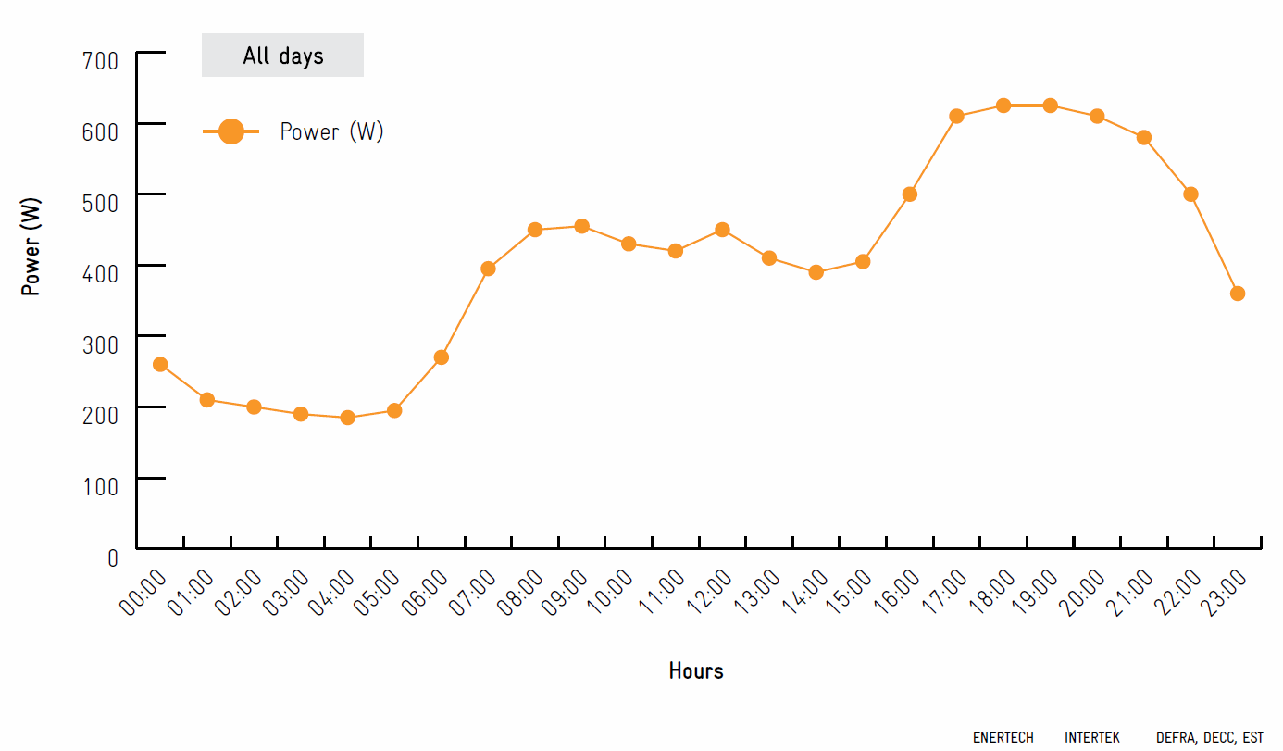
Then they start showing off…
Tier 1
Tier 2
Tier 3
Block 3
Block 2
Block 1

Slide 29
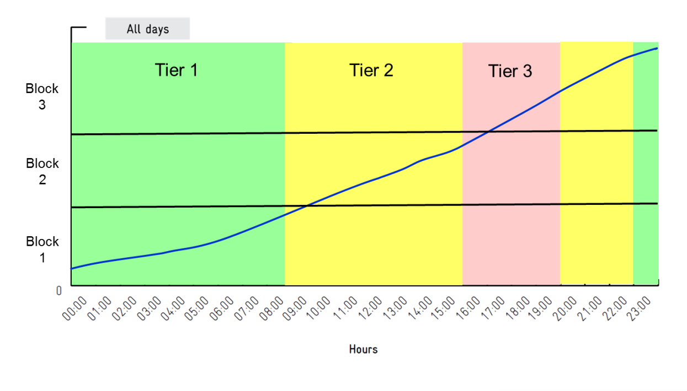
To the point that consumers are lost…
18p
24p
40p
14p
18p
30p
10p
15p
20p
The current SMETS specification allows 8x8 matrices, which can be different on every day of the year.
And the block levels can be different in each tier.
Consumer engagement has been discarded in favour of technology.

Slide 30
It’s not as if the UK has extreme weather
4 000
Texas electricity usage
Texas electricity usage with air conditioning
UK usage without heating
3 000
Power (W)
2 000
1 000

Slide 31
Security
Smart meters could be hacked. The standards used have not been widely tested.
Meters could contain malware.
Remote software upgrades could contain bugs.
As meters contain a disconnect switch, if large numbers were turned off simultaneously it could cause major damage to the grid.
Losing the power grid is possibly the biggest threat to a country, but no-one appears to be taking this seriously.

Slide 32
Questions?
Nick Hunn
CTO
mob: +44 7768 890 148
email: nick@wifore.com
web: www.wifore.com
Smart Metering Articles: http://www.nickhunn.com/gb-smart-metering/
Creative Connectivity Blog: www.nickhunn.com
LinkedIn: www.linkedin.com/in/nickhunn

