Slide 1


VoShield: Voice Liveness Detection with
Sound Field Dynamics
Qiang Yang¹, Kaiyan Cui^{1,2}, Yuanqing Zheng¹
¹The Hong Kong Polytechnic University, Hong Kong SAR
²Xi’an Jiaotong University, China
INFOCOM 2023

Slide 2
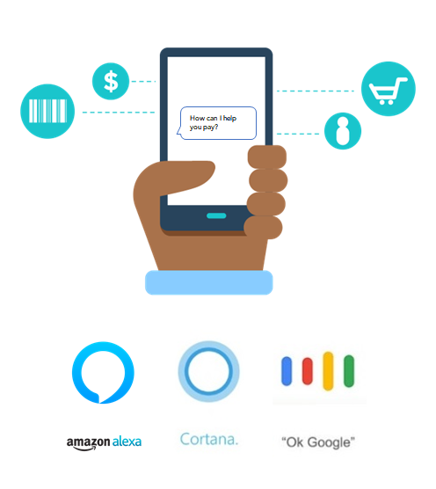
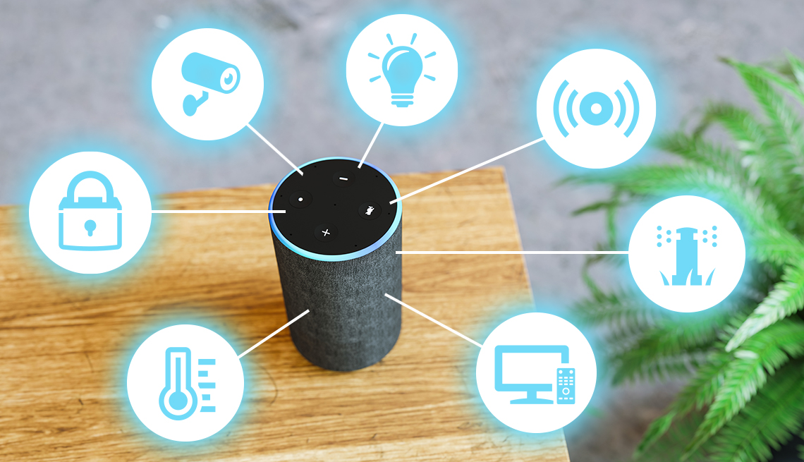
Voice assistant as a powerful tool
Voice assistants can perform daily tasks and even critical functions.
Controlling home appliances
Online shopping and payment

Slide 3

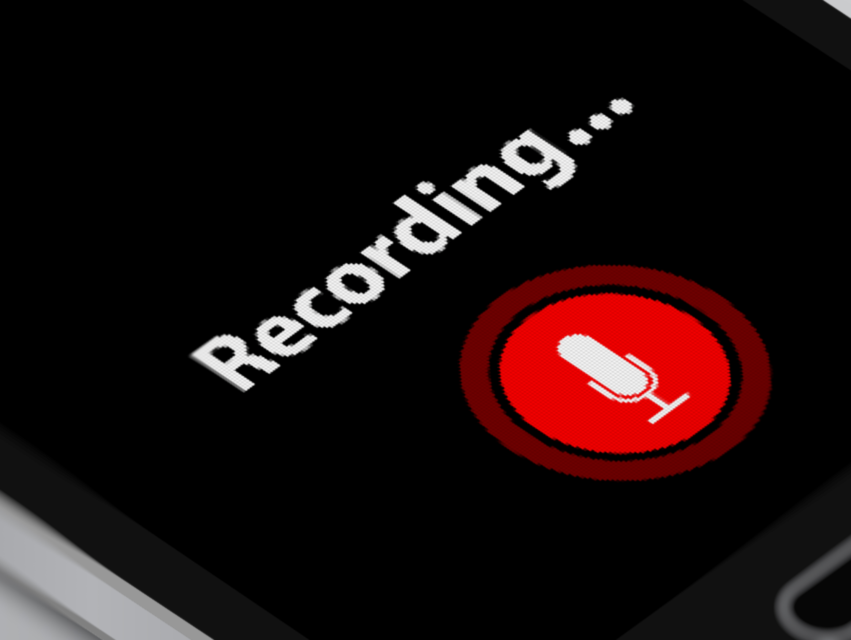





Voice commands are not safe!
Voice commands are easily leaked.
Secret recording
Online media
“Transfer $100 to Bob”
Fake voice command

Slide 4




Replay attack can pass voice verification
Current voice verification systems are vulnerable to replay attacks.
The voice clip is originally from the same user.
“Transfer $100 to Bob”
Pass!
Attacker
Voice assistant
Voice verification
Cloud server

Slide 5

VoShield: a liveness detection system
Empowering voice verification with liveness detection
The voice clip is originally from the same user, but from a loudspeaker.
“Transfer $100 to Bob”
Pass!
No!
Attacker
Voice assistant
Voice verification
Liveness detection
Cloud server
VoShield provides two factor protection for voice assistants.

Slide 6

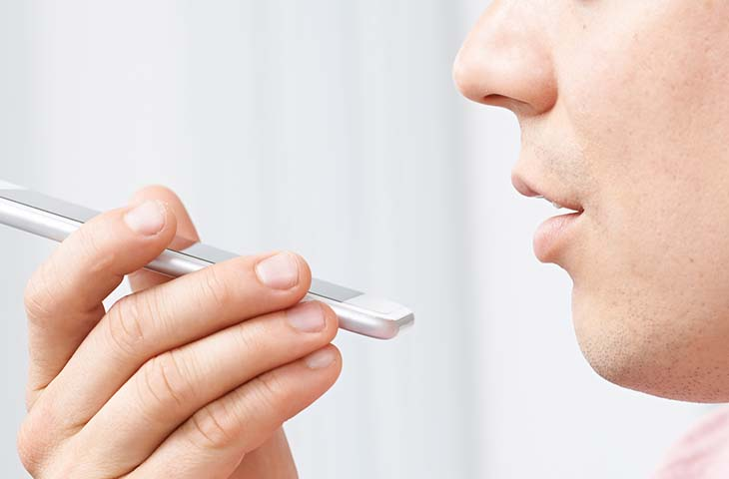
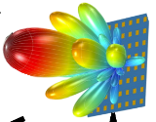
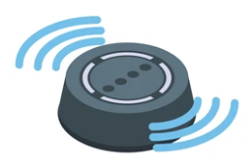

VoShield vs. Existing work
Active
Passive
Actively transmitting signals to sense the motion of the human mouth
Capture physiological features in voice
REVOLT [Ubicomp’19]
Wivo [MobiHoc’18]
WISE [UbiComp’21]
…
Voicelive [CCS’2016]
VoicePop [INFOCOM’19]
CaField [CCS’19]
…
 Short distance
 Extra hardware required
 Fixed gesture
Wi-Fi
Vocalprint [SenSys’20]
…
 Long distance
mmWave
VoShield
 Different locations
VoiceGesture [CCS’17]
Lippass [INFOCOM’18]
Silentkey [UbiComp’18] SONAR [UbiComp’20]
ChestLive[UbiComp’21]
…
 Extra power consumption
Suitable for distant smart devices, such as smart speakers
 Harmful to babies and pets
Acoustics

Slide 7
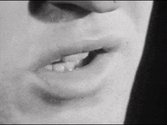
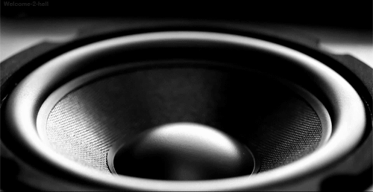
VoShield: basic idea
The replay attack is always conducted by a loudspeaker.
Key difference
The size of the loudspeaker is stable and fixed.
The size of the human mouth is dynamic and varied.
Loudspeaker
Human mouth
Liveness detection: whose aperture size is time-variant?

Slide 8
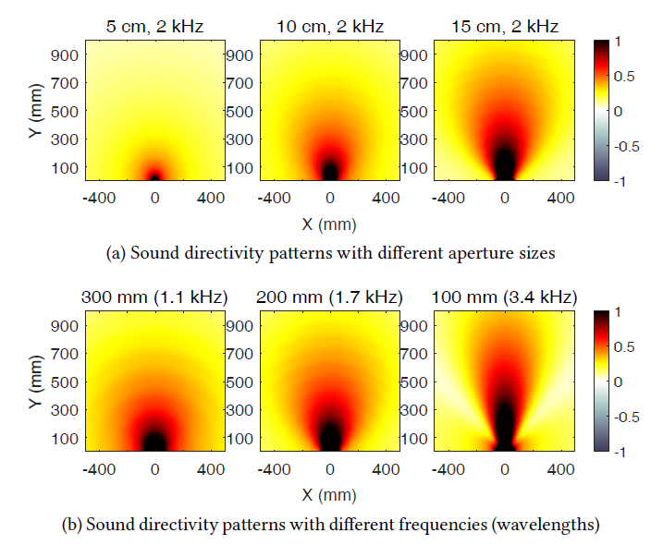


Sound directivity and sound field
Sound directivity: sound is not radiated uniformly
Sound field: energy distribution caused by sound directivity
Three dependent factors: size 𝑠, frequency 𝑓, and volume $v$.
Different sizes 𝑠
$$F(f,s,v)$$
Different frequencies 𝑓

Slide 9
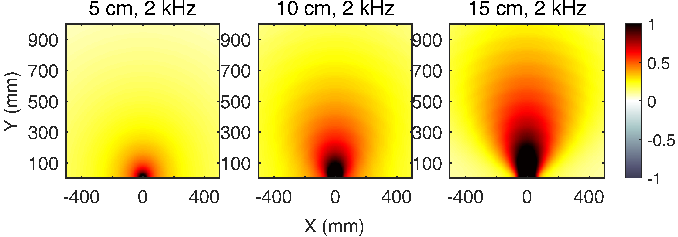


Changing size leads to a more dynamic sound field
For a fixed frequency and volume, time-variant mouth leads to a more dynamic sound field.
$$F(f,s,v)$$
Dynamic sound size
Dynamic sound directivity
Dynamic sound filed
How to measure the dynamic level of the sound field?

Slide 10


Measure sound field dynamics
See the dynamic level of sound energy with a microphone?
Affected by the sound volume
$$F(f,s,v)$$

Slide 11

Measure sound field dynamics
See the dynamic level of sound energy with a microphone?
Use to energy ratio of two microphones to remove the volume effect
Time-variant voice contents also cause the dynamics.
Look at the energy ratio in the frequency domain
$$F(f,s,v)$$
$$f$$
2 kHz
0
$$f$$
2 kHz
0
Window index
Sound Field Dynamics: the energy ratio in the frequency domain

Slide 12
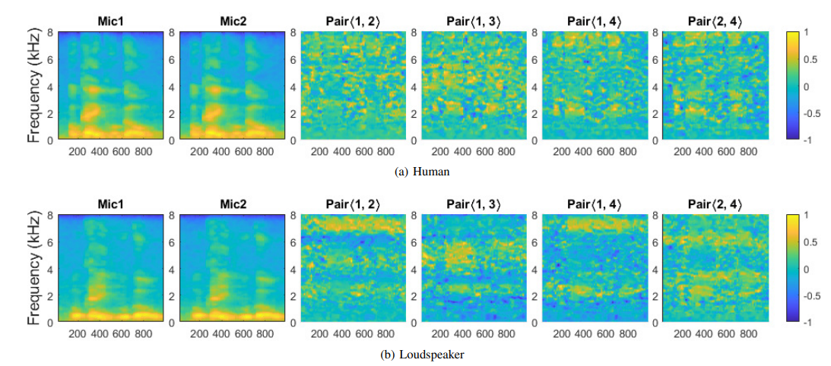
Sound Filed Dynamics (SFD): an example
Voice command: “OK, google”
The SFD spectrograms of loudspeakers exhibit clear “strip” patterns.
Human
Loudspeaker

Slide 13


Data augmentation
Enhance the representation diversity
Voice content: ‘Strip’ pattern may appear at different locations
Voice speed: ‘Strip’ pattern may be stretched or compressed
Horizontal & vertical translation and scaling
Content diversity
Vertical stretching and compression
Speed diversity

Slide 14
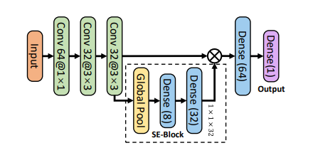
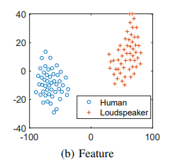
Liveness detection
Learn strip patterns in SFD spectrogram with deep learning models
Fuse multiple microphone pairs: a self-attention mechanism
frequency
pair
time
Samples in the latent space

Slide 15
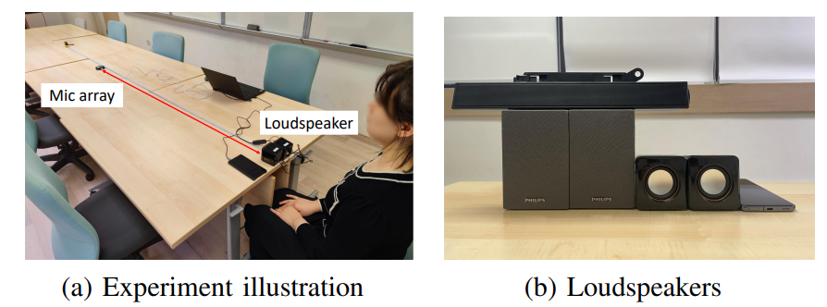
Experiment
12 participants
Four loudspeakers
For each user
Human-spoken voice commands: true
Record-and-replay voice commands: false
Different locations, distances, orientations: 13,000+ samples

Slide 16
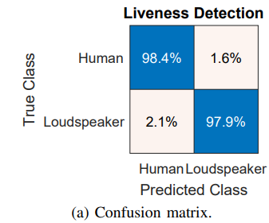
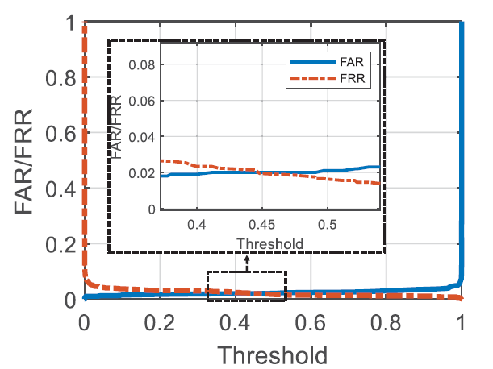
Overall accuracy
Equal Error Rate (EER): 2%
Overall accuracy: 98.2%
False acceptance rate = False rejection rate = 2%

Slide 17
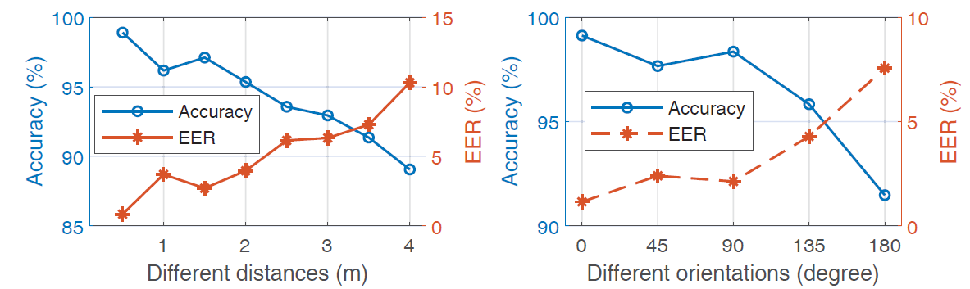
Impact of distance and orientation
Accuracy remains 92.9% at 3 m.
Accuracy is 91.5% when users face backward to microphones.
More evaluation results in the paper …

Slide 18
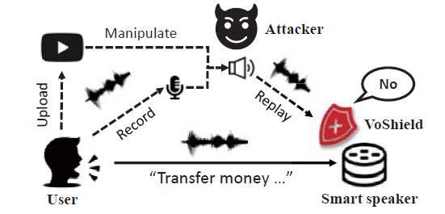
Conclusion and Takeaway
Voice assistants are vulnerable to replay attacks.
We propose VoShield to protect voice assistants against replay attacks at room-scale without relying on extra hardware.
We explore sound field dynamics to indicate voice liveness and hereby distinguishes between humans and loudspeakers.

Slide 19
THANKS
Qiang Yang
qiangyang@polyu.edu.hk

