Slide 1


AquaHelper: Underwater SOS Transmission and Detection in Swimming Pools
Qiang Yang, Yuanqing Zheng
The Hong Kong Polytechnic University

Slide 2
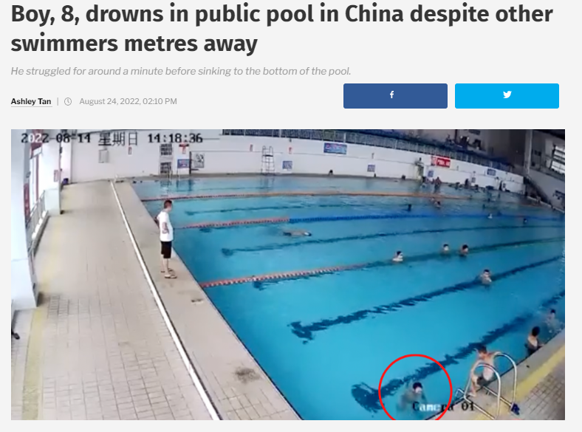
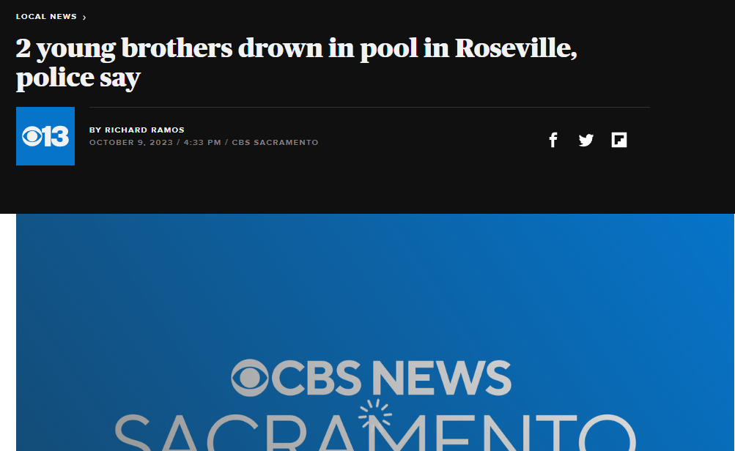
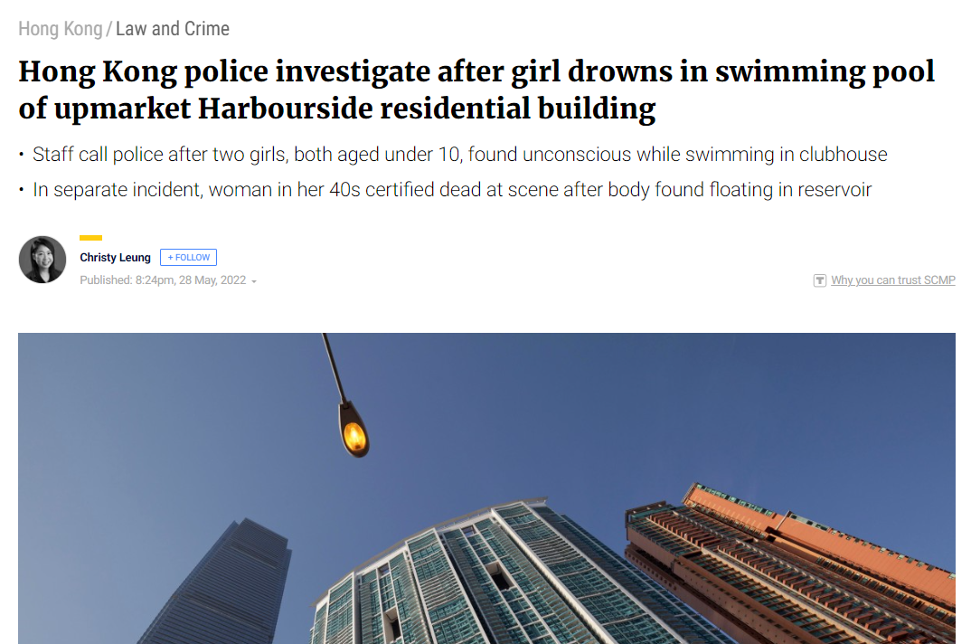
Drowning Incidents are a Pressing Public Safety Concern

Slide 3
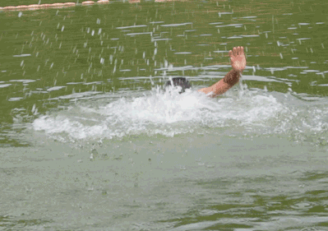
What We Imagine about Drowning
The swimmer will splash and yell for help

Slide 4
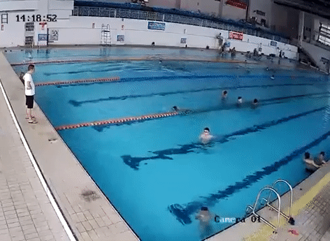
In Reality…
Drowning is silent and fast

Slide 5
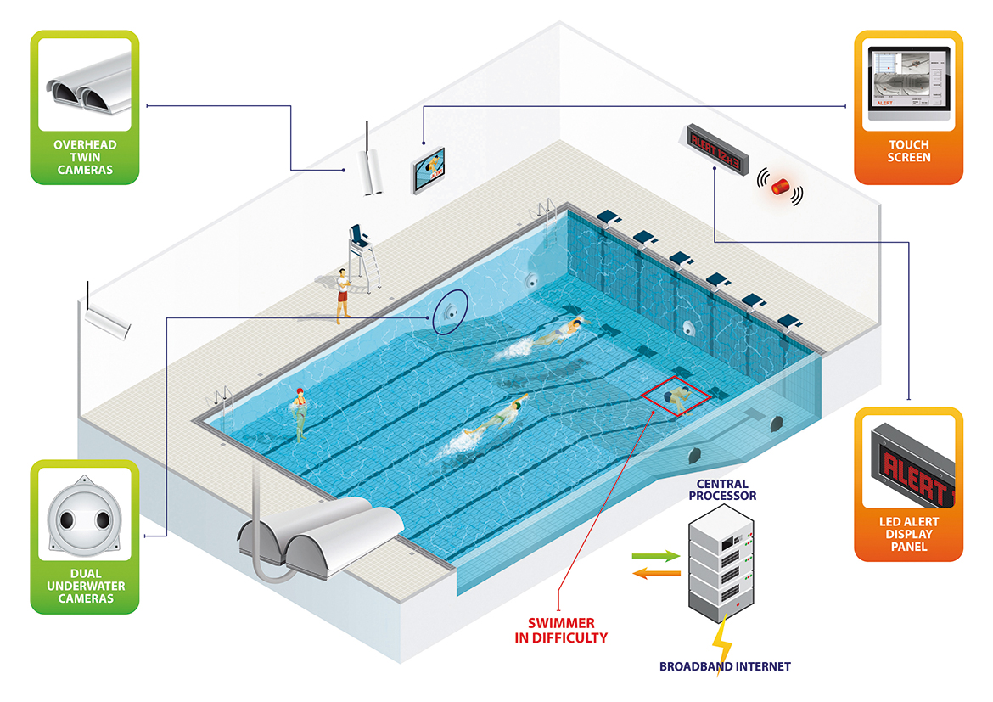
Existing Vision-based Drowning Monitoring Systems
Already suffocate
Cannot call for help actively
Triggering an alert when the swimmer keeps motionless at the bottom for 10 seconds
Poseidon - Drowning detection system for swimming pools. https://poseidon-tech.com/en-GB/technology-2/.

Slide 6
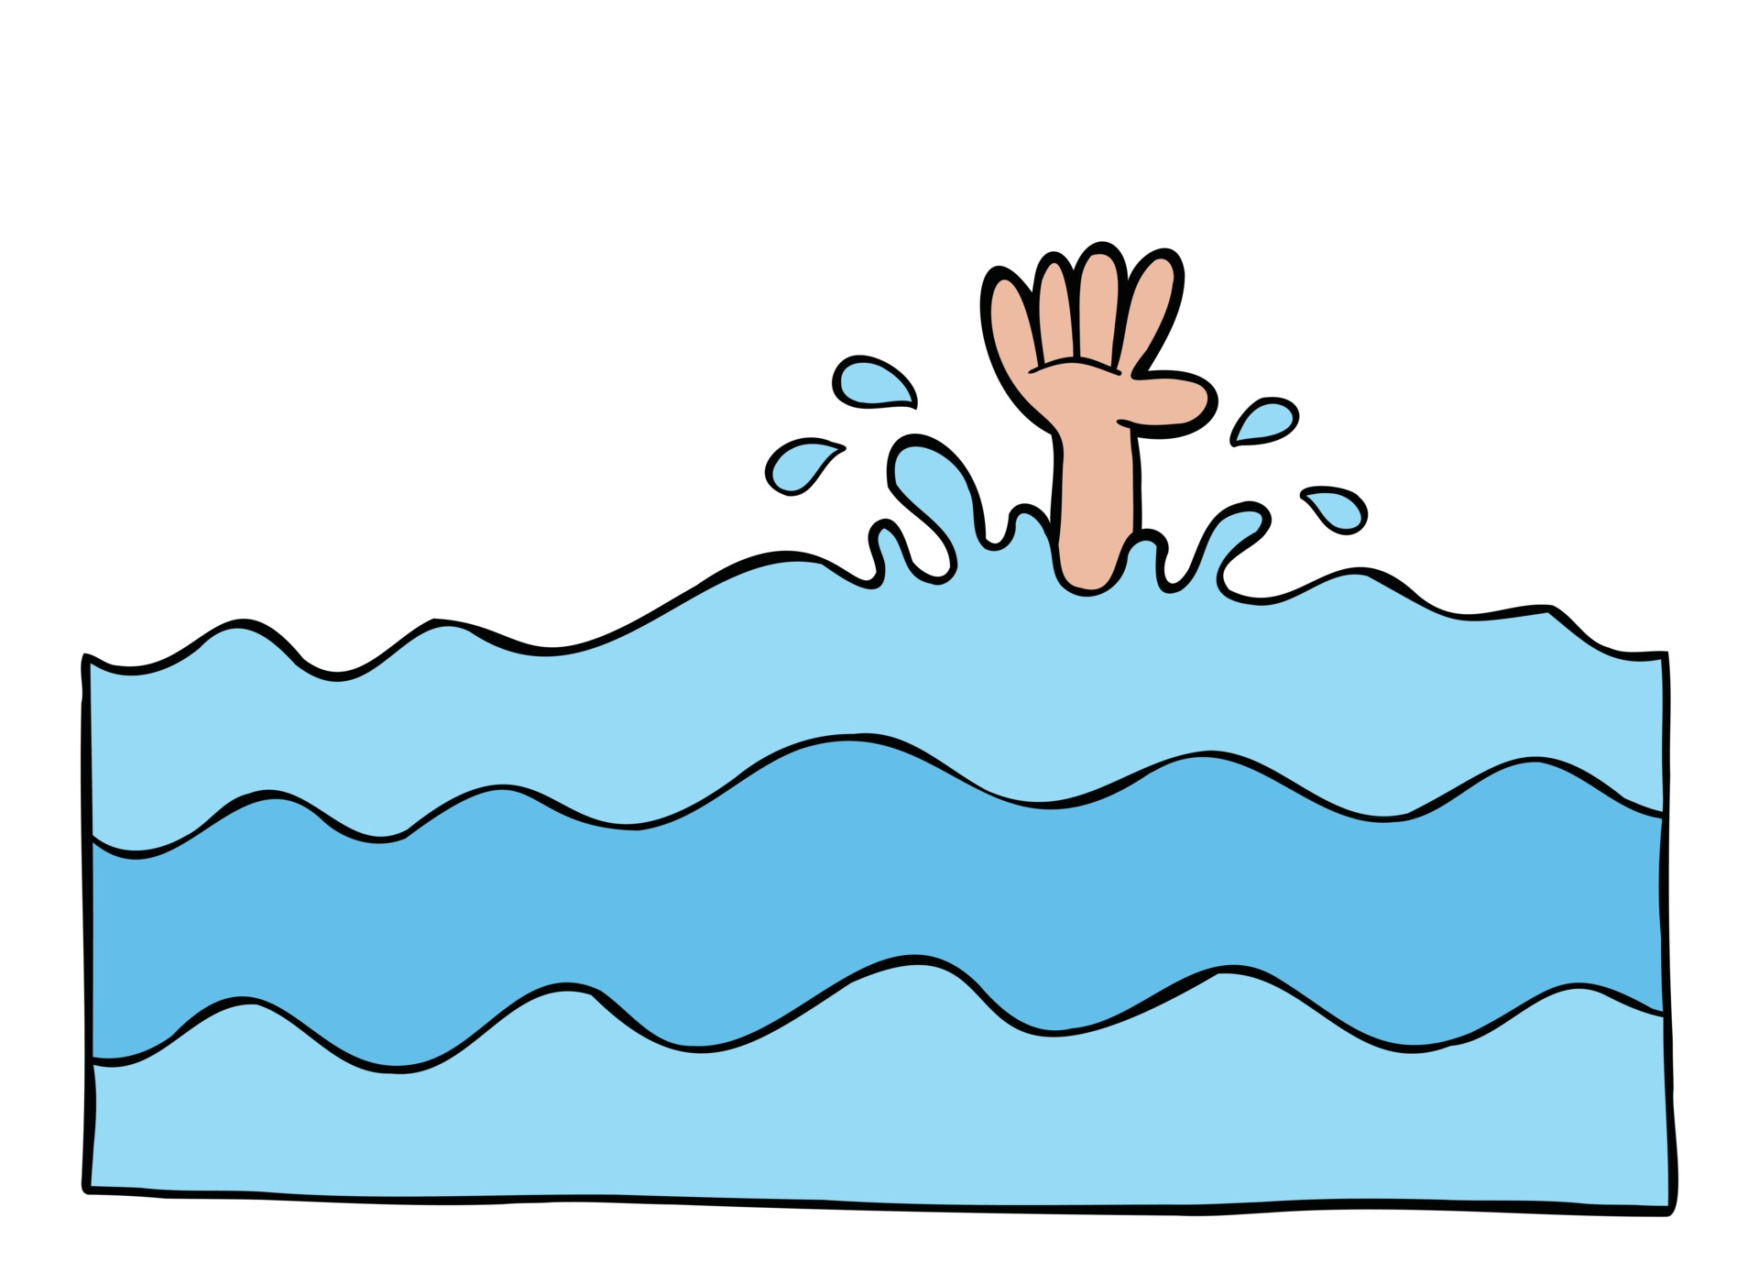
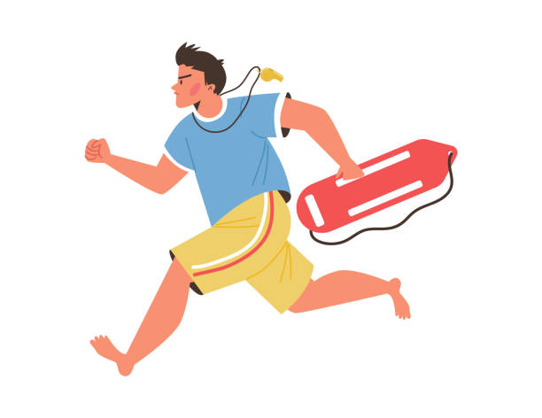
Find a Method…
Building an SOS channel between swimmers and lifeguards
Actively asking for help at the very early drowning stage
Complementary to the vision-based drowning monitoring system

Slide 7
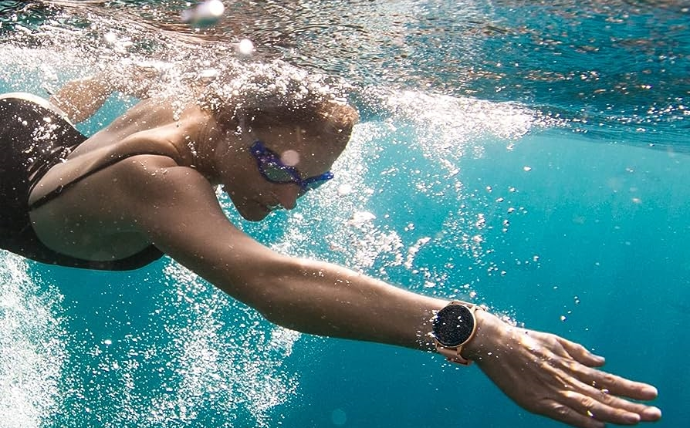
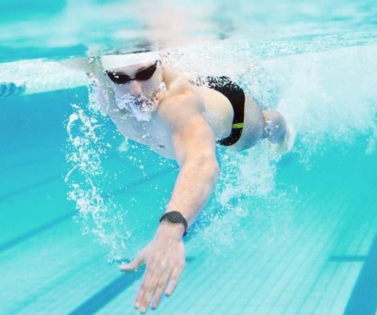
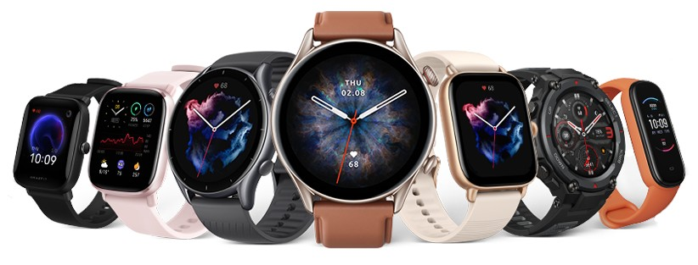


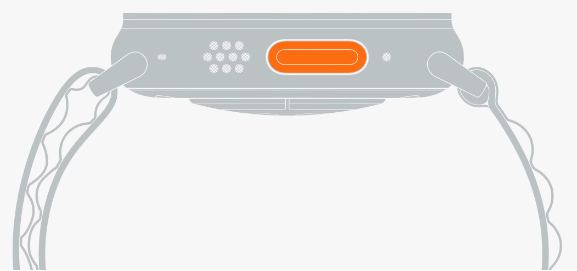



AquaHelper: SOS Transmission with Wearable Devices
One-button SOS transmission

Slide 8



Challenges: SOS Detection in Low SNR!
Noise
Interference
Multipath
Attenuation
Low transmission power
Limited bandwidth
Drowning movements
Lightweight smartwatches
Dynamic underwater scenarios

Slide 9
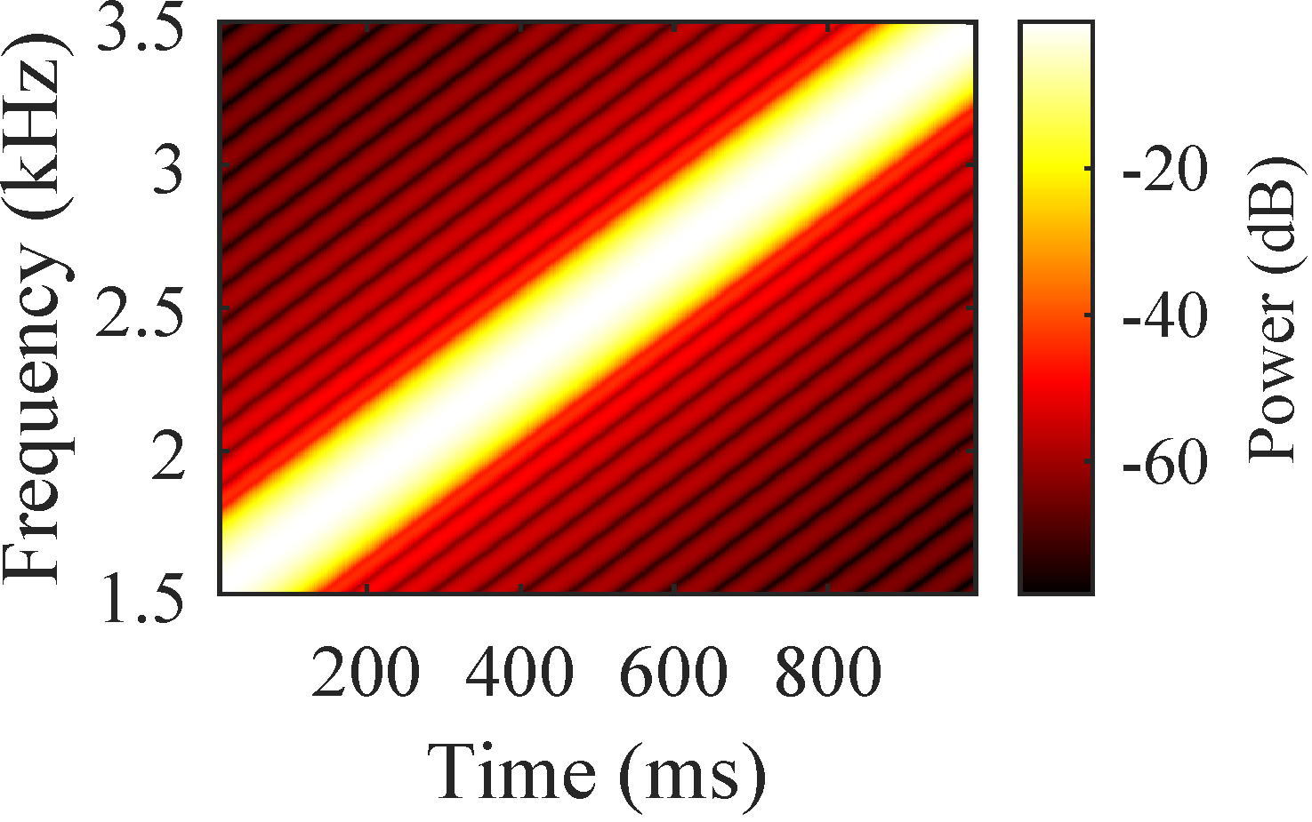






SOS Transmission: Acoustic Chirp Signals
Frequency band: 1.5~3.5 kHz, duration: 1s
More attenuation
Noise floor
$$f$$
$$f$$
$$f$$
$$t$$
$$t$$
$$Amplitude$$
More noise
Dechirp-based Signal detection

Slide 10












SOS Detection: Multiple Window Aggregation
Dechirp
$$Amp.$$
Noise floor
Dechirp
$$0$$
$$f$$
$$Amp.$$
Noise floor
$$f$$
…
$$Amp.$$
$$0$$
$$f$$
$$f_{0}$$
$$t$$
$$0$$
$$f$$
$$Amp.$$
Noise floor
Dechirp
$$Amp.$$
$$0$$
$$f$$
$$0$$
$$f$$

Slide 11







SOS Detection: High-order Chirp Incorporation
The SOS chirp is dispersed due to hardware imperfection at the Rx side.
$$f$$
Downsample
$$3Bw$$
$$Amp.$$
$$Amp.$$
$$f$$
$$f$$
$$Bw$$
$$t$$
$$Amp.$$
Dechirp & FFT
Nonlinearity Effect

Slide 12
















SOS Detection: Multiple Receiver Combination
$$f$$
$$Amp.$$
Noise floor
$$f_{0}$$
$$0$$
$$Rx_{1}$$
$$t$$
$$f$$
$$Amp.$$
Noise floor
$$f$$
$$0$$
$$f$$
$$Amp.$$
$$f_{0}$$
$$0$$
$$Rx_{2}$$
$$t$$
$$f$$
Coherently combining the signals from multiple receivers

Slide 13

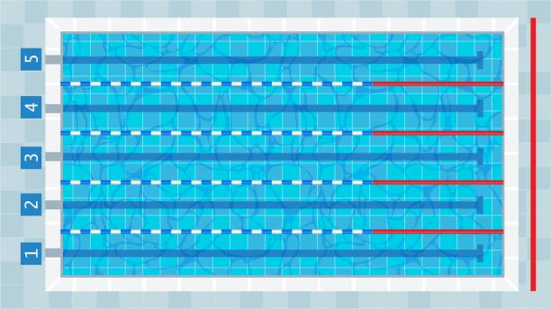



SOS Alerting and Visualization
$$Amplitude$$
Noise floor
$$f$$
Light
Sound
Location
Distributed receivers are not synchronized!

Slide 14



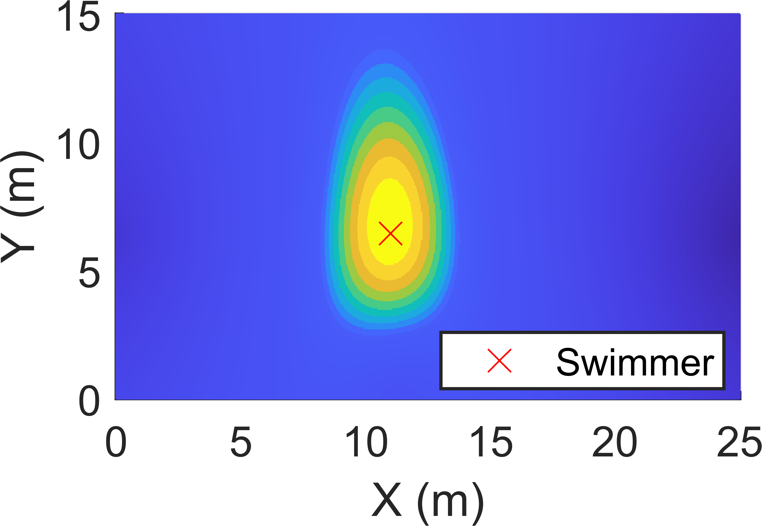
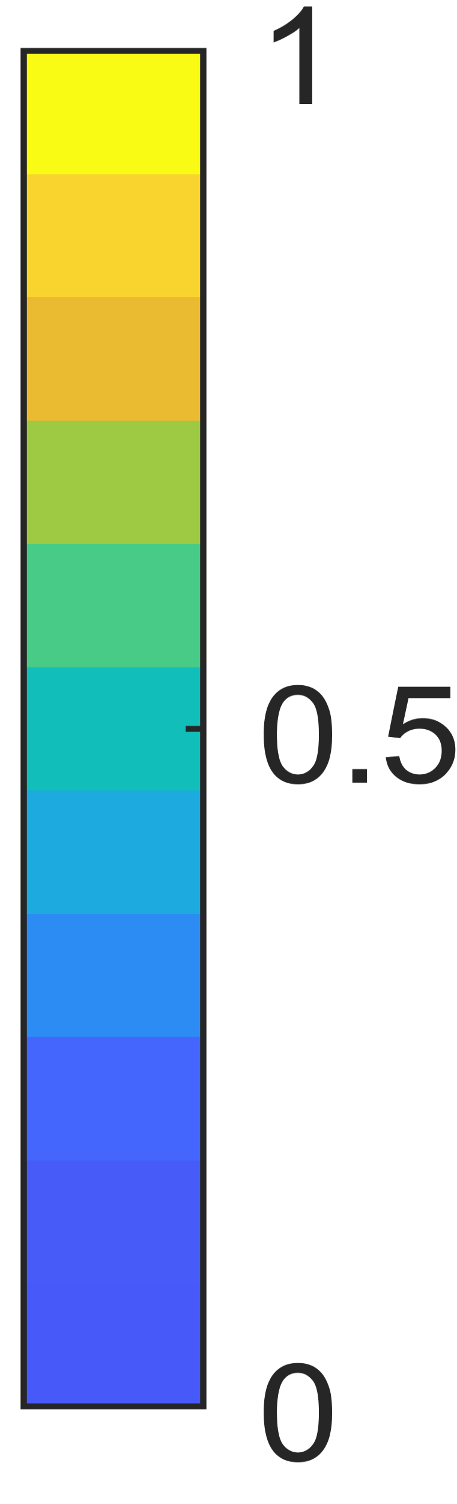








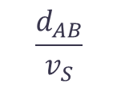



Receivers Calibration
$$Rx_{A}$$
$$Rx_{A}$$
$$d$$
$$m_{A_{1}}$$
$$t$$
$$Rx_{B}$$
$$d$$
$$m_{B_{1}}^{′}$$
$$m_{B_{1}}$$
$$Rx_{B}$$
$$t$$
$$\frac{d_{AB}}{v_{S}}$$
Calibrating the reception buffers of different receivers with the known distance.

Slide 15
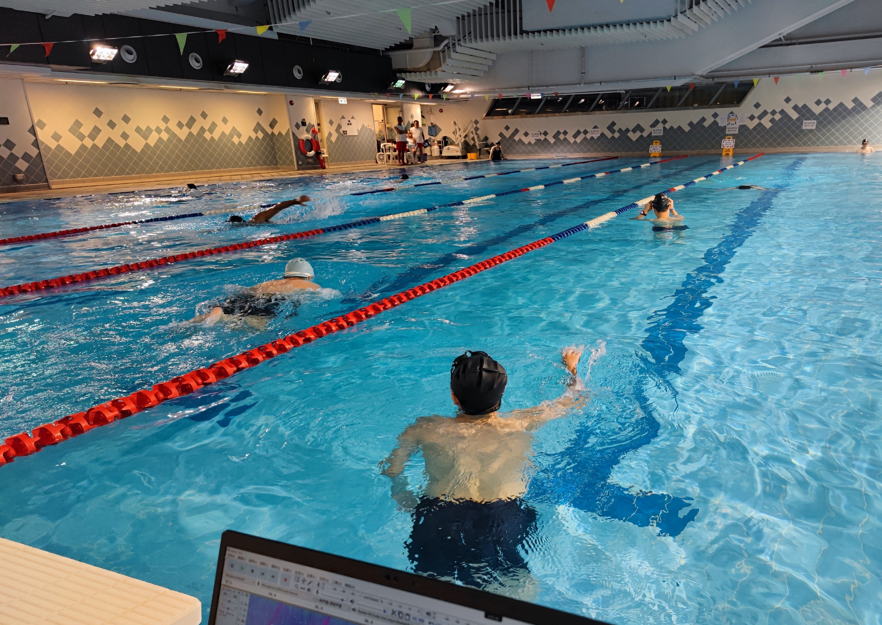
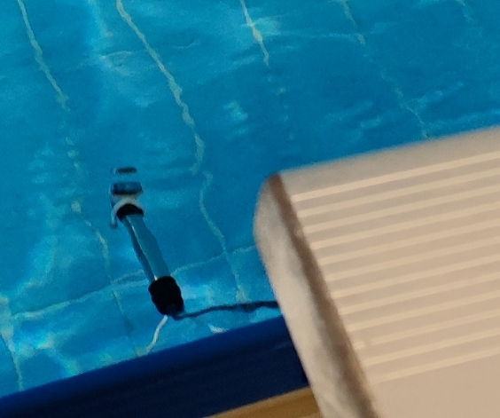
Experiment
Lifeguard
User
Interferer
Hydrophone
25 m
Server

Slide 16
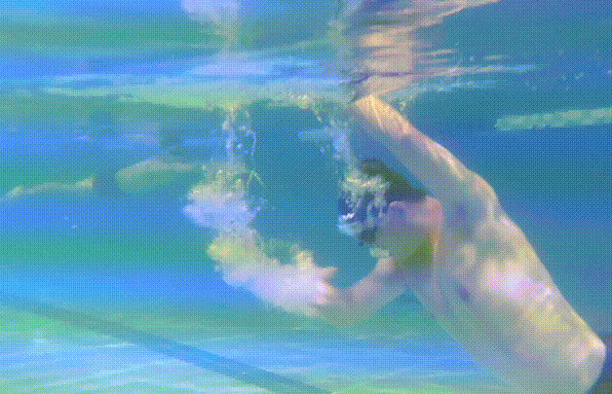
Experiment

Slide 17
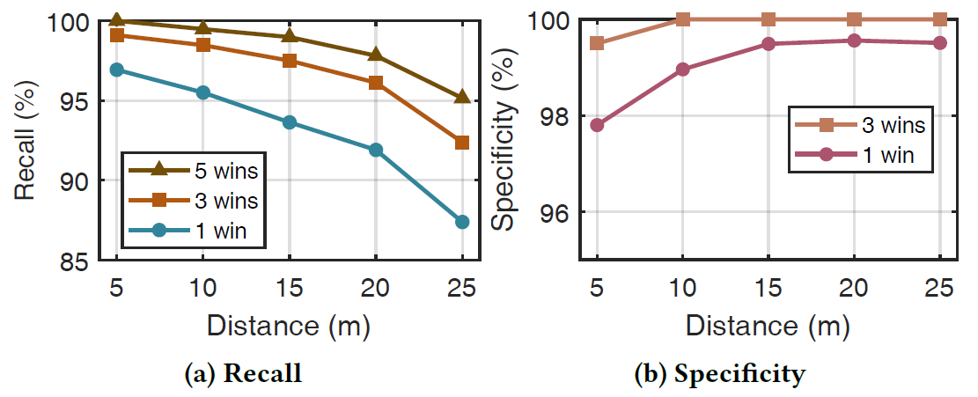
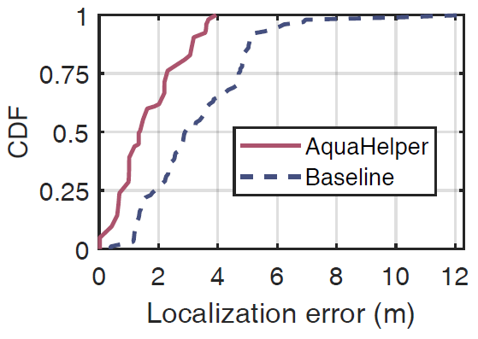
Evaluation
Recall
93.1% (1 win)
96.7% (3 wins)
98.3 (5 wins)
Specificity
99.1% (1 win)
99.9% (3 wins)
Localization
  Mean absolute error: 1.36m
  The higher, the better

Slide 18
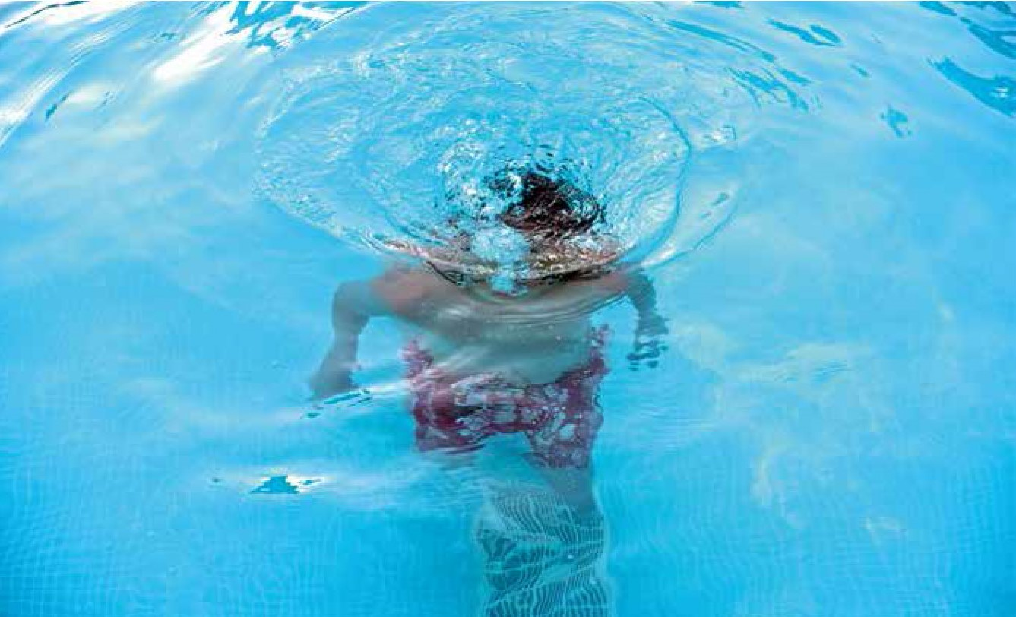
Conclusion and Takeaway
Drowning incidents can happen even with the professional lifeguards present.
We propose AquaHelper, the first underwater SOS system that transforms lightweight wearable devices into SOS transmitters for swimmer safety.
We fully leverage the signal diversities in the temporal, spectral, and spatial domains to significantly improve the SNR and achieve reliable SOS detection.

Slide 19
THANKS
Qiang Yang
The Hong Kong Polytechnic University
qiangyang@polyu.edu.hk

