Slide 1

Addressing the Scalability of Ethernet with MOOSE
Malcolm Scott, Andrew Moore and Jon Crowcroft
University of Cambridge Computer Laboratory

Slide 2
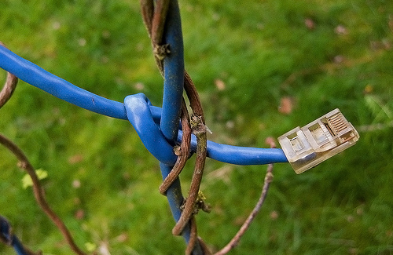
Ethernet in the data centre
1970s protocol; still ubiquitous
  Usually used with IP, but not always
  (ATA-over-Ethernet)
Density of Ethernet addresses is increasing
  Larger data centres, more devices, more NICs
  Virtualisation: each VM has a unique Ethernet address
    (or more than one!)
Photo: “Ethernet Cable” by pfly. Used under Creative Commons license. http://www.flickr.com/photos/pfly/130659908/

Slide 3
Why not Ethernet?
Heavy use of broadcast
destination
Broadcast ARP required for
source
Capacity wasted
interaction with IP
on needlessly
switch
broadcast frames!
On large networks, broadcast can overwhelm slower links e.g. wireless
Inefficient routing:
Switches’ address tables
Spanning
T
ree
MAC
a
dd
r
e
s
s
Po
r
t
01:23:45:67:89:a
1
2
b
00:a1:b2:c3:d4:e
1
6
5
…
…
•
Maintained by every switch
Shortest path
•
Automatically learned
disabled!
•
T
able capacity: ~16000 addresses
•
Full table results in unreliabilit
y
,
or at best heavy flooding

Slide 4
Spanning tree switching illustrated
Notes:
Densely-connected mesh, but spanning tree protocol disables links

Slide 5
Spanning tree switching illustrated
destination
Notes:
ANIM: data from [here] to [here]
Direct link, but can’t use [CLICK]
Packet takes long way round

Slide 6
Ethernet in the data centre: divide and conquer?
Traditional solution: artificially subdivide network
at the IP layer: subnetting and routing
  Administrative burden
  More expensive equipment
  Hampers mobility
    IP Mobility has not (yet) taken off
  Scalability problems remain within
  each subnet

Slide 7
Ethernet in the data centre: ...mobility?
Mobility is relevant in the data centre
  Seamless virtual machine migration
  Easy deployment:
  no location-dependent configuration
...and between data centres
  Large multi-data-centre WANs are becoming common
Ethernet is pretty good at mobility
Notes:
Google

Slide 8
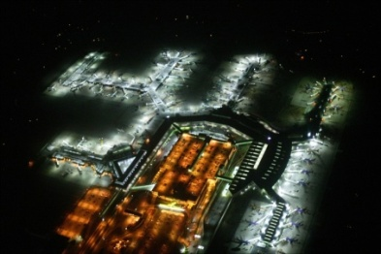
Large networks
Converged airport network
  Must support diverse commodity equipment
  Roaming required throughout entire airport complex
  Ideally, would use one large Ethernet-like network
This work funded by “The INtelligent Airport”
UK EPSRC project
The INtelligent
Airport

Slide 9
Large networks
Airports have surpassed the capabilities of Ethernet
  London Heathrow Airport: Terminal 5 alone is too big
  MPLS-VPLS: similar problems to IP subnetting
    VPLS adds more complexity:
      LERs map every destination MAC address to a LSP: up to O(hosts)
      LSRs map every LSP to a next hop: could be O(hosts²) in core!
    Encapsulation does not help

Slide 10
Geographically-diverse networks
Fibre-to-the-Premises
  Currently, Ethernet is only used for small deployments
“last mile” link
Telco network
ISP
customers

Slide 11
Geographically-diverse networks
Now:
Future:
Everything goes via circuit to ISP
Legacy reasons (dial-up, ATM)
Nonsensical for peer-to-peer use
Bottleneck becoming significant as number of customers and capacity of links increase
In the UK: BT 21CN
Take advantage of fully-switched infrastructure
Peer-to-peer traffic travels directly between customers
Data link layer protocol is crucial

Slide 12
The underlying problem with Ethernet
MAC addresses provide
no location information

Slide 13
Flat vs. Hierarchical address spaces
Flat-addressed Ethernet: manufacturer-assigned MAC address valid anywhere on any network
  But every switch must discover and store the location of every host
Hierarchical addresses: address depends on location
  Route frames according to successive stages of hierarchy
  No large forwarding databases needed
LAAs? High administrative overhead if done manually

Slide 14
MOOSE: Multi-level Origin-Organised Scalable Ethernet
A new way to switch Ethernet
  Perform MAC address rewriting on ingress
  Enforce dynamic hierarchical addressing
  No host configuration required
Good platform for shortest-path routing
Appears to connected equipment as standard Ethernet

Slide 15
MOOSE: Multi-level Origin-Organised Scalable Ethernet
Switches assign each host a MOOSE address = switch ID . host ID
(MOOSE address must form a valid unicast LAA: two bits in switch ID fixed)
Placed in source field in Ethernet header as each frame enters the network
(no encapsulation, therefore no costly rewriting of destination address!)
Notes:
Flat, manufacturer-allocated namespace → hierarchy
Split MAC address
Reiterate: switches rewrite addresses so hosts don’t have to

Slide 16
Allocation of host identifiers
Only the switch which allocates a host ID ever uses it for switching (more distant switches just use the switch ID)
Therefore the detail of how host IDs are allocated can vary between switches
  Sequential assignment
  Port number and sequential portion
  (isolates address exhaustion attacks)
  Hash of manufacturer-assigned MAC address
  (deterministic: recoverable after crash)

Slide 17
The journey of a frame
Host: “00:16:17:6D:B7:CF”
From: 00:16:17:6D:B7:CF
To: broadcast
New frame,
so rewrite
02:11:11
From: 02:11:11:00:00:01
To: broadcast
02:22:22
02:33:33
Host: “00:0C:F1:DF:6A:84”
Notes:
ANIM: Host transmits broadcast frame (simplicity) [CLICK]
Switch one sees non-MOOSE source address → [CLICK] new frame on net → rewrite
[CLICK] Packet makes its way to all destinations

Slide 18
The return journey of a frame
Host: “00:16:17:6D:B7:CF”
Destination is local
Each switch in this setup
only ever has three address table entries
(regardless of the number of hosts)
02:11:11
From: 02:33:33:00:00:01
To: 00:16:17:6D:B7:CF
Destination is on 02:11:11
02:22:22
Destination is on 02:11:11
New frame,
so rewrite
From: 02:33:33:00:00:01
To: 02:11:11:00:00:01
02:33:33
From: 02:33:33:00:00:01
To: 02:11:11:00:00:01
Host: “00:0C:F1:DF:6A:84”
From: 00:0C:F1:DF:6A:84
To: 02:11:11:00:00:01
Notes:
ANIM: now transmit reply. Note dest addr MOOSE. [CLICK]
As before, [CLICK] rewrite source
Now route frame using switch ID ONLY: [CLICK] each sw on path knows where sw one is
Last switch [CLICK] rewrites dest to avoid confusion
[CLICK] Deterministic address tables

Slide 19








Security and isolation benefits
The number of switch IDs is predictable, unlike the number of MAC addresses
  Address flooding attacks are ineffective
  Resilience of dynamic networks (e.g. wireless) is increased
Host-specified MAC address
is not used for switching
  Spoofing is ineffective

Slide 20
Shortest path routing
MOOSE switch ≈ layer 3 router
  One “subnet” per switch
    02:11:11:00:00:00/24
    Don’t advertise individual MAC addresses!
  Run a routing protocol between switches, e.g. OSPF variant
    OSPF-OMP may be particularly desirable: optimised multipath routing for increased performance

Slide 21
Beyond unicast
Broadcast: unfortunate legacy
  DHCP, ARP, NBNS, NTP, plethora of discovery protocols...
  Deduce spanning tree using reverse path forwarding (PIM): no explicit spanning tree protocol
  Can optimise away most common sources, however
Multicast and anycast for free
  SEATTLE suggested generalised VLANs (“groups”) to emulate multicast
  Multicast-aware routing protocol can provide a true L2 multicast feature

Slide 22
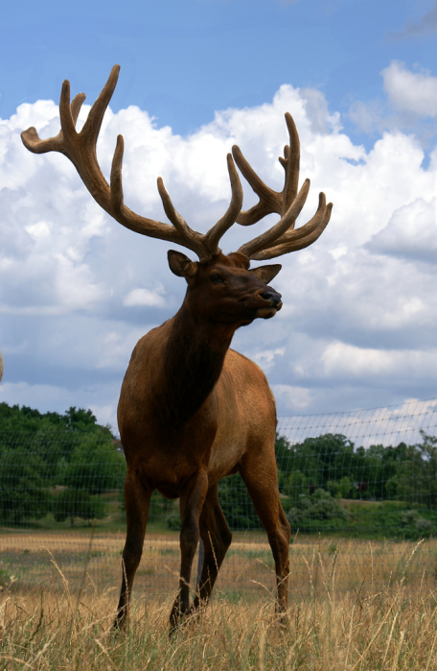
ELK: Enhanced Lookup
General-purpose directory service
  Master database: held on one or more
  servers in core of network
  Slaves can be held near edge of network
  to reduce load on masters
    Read: anycast to nearest slave
    Write: multicast to all masters
    Entire herd of ELK kept in sync by masters
    via multicast + unicast
Photo: “Majestic Elk” by CaptPiper. Used under Creative Commons license. http://www.flickr.com/photos/piper/798173545/

Slide 23
ELK: Enhanced Lookup
Primary aim: handle ARP & DHCP without broadcast
  ELK stores (MAC address, IP address) tuples
    Learned from sources of ARP queries
    Acts as DHCP server, populating directory as it grants leases
  Edge switch intercepts broadcast ARP / DHCP query and converts into anycast ELK query
  ELK is not guaranteed to know the answer, but it usually will
    (ARP request for long-idle host that isn’t using DHCP)

Slide 24
Mobility
If a host moves, it is allocated a new MOOSE address by its new switch
Other hosts may have the old address in ARP caches
  Forward frames, IP Mobility style
  (new switch discovers host’s old location by querying other switches for its real MAC address)
  Gratuitous ARP,
  Xen VM migration style

Slide 25

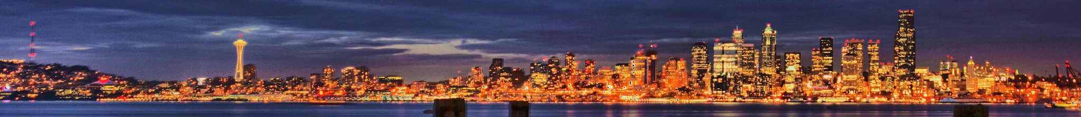
Related work
Encapsulation
(MPLS-VPLS, IEEE TRILL, ...)
  Destination address lookup:
  Big lookup tables
Complete redesign
(Myers et al.)
  To be accepted, must be Ethernet-compatible
Domain-narrowing
(PortLand – Mysore et al., UCSD)
  Is everything really a strict tree topology?
DHT for host location
(SEATTLE – Kim et al., Princeton)
  Unpredictable performance; topology changes are costly
Left photo: “Pdx Bridge to Bridge Panorama” by Bob I Am. Used under Creative Commons license. http://www.flickr.com/photos/bobthebritt/219722612/
Right photo: “Seattle Pan HDR” by papalars. Used under Creative Commons license. http://www.flickr.com/photos/papalars/2575135046/

Slide 26
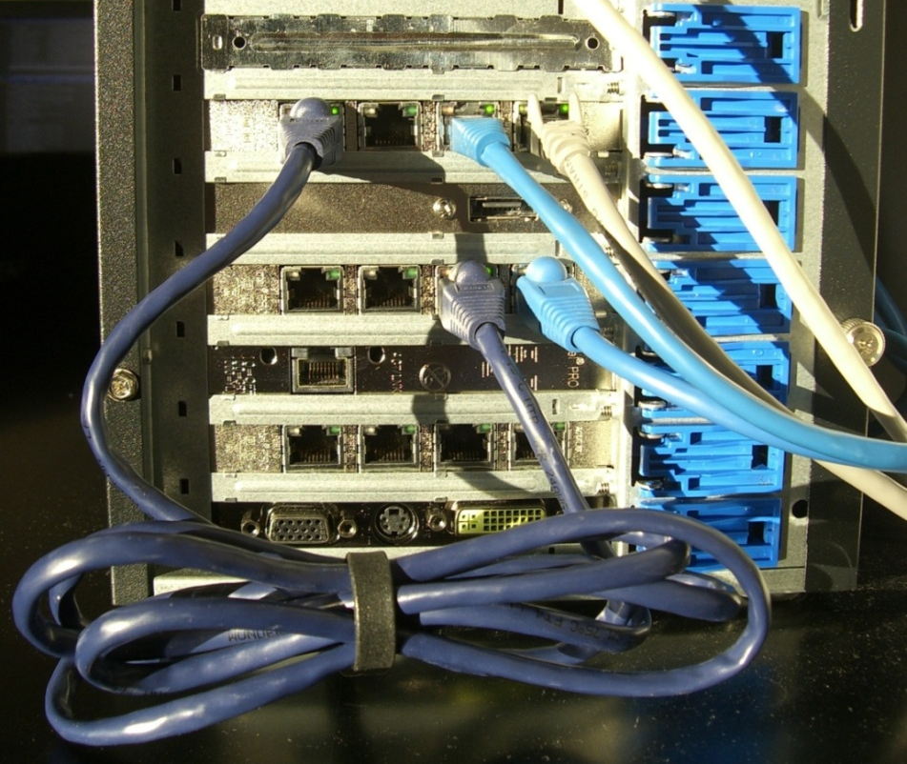
Prototype implementation
Proof-of-concept in threaded, object-oriented Python
  Designed for clarity and to mimic a potential hardware design
    Modularity
    Separation of control and
    data planes
  Capable of up to 100 Mbps
  switching on a modern PC
  Could theoretically handle
  very large number of nodes
Notes:
Off-the-shelf PC with a few server NICs added

Slide 27
Prototype implementation: Data plane
Port
Port
Port
Forwarding database
Forwarding database
Forwarding database
Frame receiver
Frame transmitter
Frame receiver
Frame transmitter
Frame receiver
Frame transmitter
Source rewriting
Source rewriting
Source rewriting
raw sockets
raw sockets
raw sockets
Network interface card
Network interface card
Network interface card
Notes:
Modular design; should map onto hardware
Generic switch + rewriting module
Frame receiver (rewrites if necessary)
Forwarding database
Frame transmitter

Slide 28
Prototype implementation: Data plane
Two forwarding databases:
  Locally-connected hosts (MAC address, host ID, Port)
  Remote switches (switch ID, Port)
Inside the Frame Receiver:
  Received frame from raw socket packaged in Frame object
  DHCP or ARP? Send to control plane (“software”)
  Rewrite source if not already MOOSE
    Allocate host ID if necessary: port number, sequential ID
  Update locally-connected-host forwarding database
  Consult relevant forwarding database for output Port; enqueue frame with that Port’s Frame Transmitter

Slide 29
Prototype implementation: Control plane
Separate thread
Routing protocol: PWOSPF
  Only for proof-of-concept: real implementation would likely need OSPF’s authentication features etc.
  Map switch IDs onto PWOSPF’s 4-byte address fields by padding RHS with null bytes
    02.11.11.00/24
  Maintain Ports’ remote-switches forwarding databases
  (routing tables, really)

Slide 30
Prototype evaluation
Unmodified
PC’s ARP
cache:
Virtual network (Xen)
  Six virtual switches, 10 VMs each: MOOSE vs. Linux bridging
    Linux bridge FDBs: 60 entries on each switch: O(hosts)
    MOOSE FDBs: 5 switch entries + 10 host entries on each switch:
    the latter will remain constant in larger deployments, so O(switches)
Address HWtype HWaddress Iface
10.100.11.1 ether 02:00:0c:01:00:01 eth1
10.100.11.3 ether 02:00:0a:01:00:01 eth1
10.100.11.4 ether 02:00:0a:03:00:01 eth1
10.100.11.8 ether 02:00:0b:02:00:01 eth1

Slide 31
Future work
NetFPGA implementation
  (Dan Wagner-Hall)
Enterprise Ethernet features
  Quality-of-Service
  802.1Q-compatible VLANs: opportunities to explore

Slide 32
Final thoughts
Ethernet: another 35 years?
  Not an ideal starting point, but it’s what we’ve got
  If it is to last, it needs to scale yet remain compatible
  MOOSE is a simple, novel and easily-implementable approach
    Address the cause, not the symptom
“we choose to achieve reliability through simplicity”
– Robert M. Metcalfe and David R. Boggs

Slide 33
Thank you
http://www.cl.cam.ac.uk/~mas90/MOOSE/
Malcolm.Scott@cl.cam.ac.uk

Slide 34
Related work
Encapsulation-based solutions:
(MPLS-VPLS, Hadžić, SmartBridge, Rbridges / IEEE TRILL, ...)
  Effective shortest-path routing, but...
  Big lookup tables everywhere
  Replace one scalability problem with another
Complete redesigns: (Myers et al.)
  The only “perfect” solution
  But to be accepted, must be Ethernet-compatible

Slide 35
Related work: domain-narrowing
PortLand: (Mysore et al., UCSD)
  Observe that data centres are usually “fat trees”
  Optimise for strict hierarchical network
  No provision for other topologies
    Real deployments may come unstuck
  Consider entire network to be a single fabric
Photo: “Pdx Bridge to Bridge Panorama” by Bob I Am. Used under Creative Commons license. http://www.flickr.com/photos/bobthebritt/219722612/

Slide 36
Related work: SEATTLE (Kim et al., Princeton)
Forward frames through a Distributed Hash Table (DHT)
  Elegant idea; effectively solves most of the problems
But, likely to cause unpredictable performance
  DHTs are variable-latency
  May forward some hosts’ frames through distant, slow switches
  Cache mitigates this to an extent, but could be flooded
Photo: “Seattle Pan HDR” by papalars. Used under Creative Commons license. http://www.flickr.com/photos/papalars/2575135046/

Slide 37
Related work: SEATTLE (Kim et al., Princeton)
Topology changes are very expensive
(when the set of reachable switches changes)
  Any such change leads to DHT reorganisation
  ...Which involves switches throughout the network
Data plane complexity:
  SEATTLE switch must do much more for each frame than Ethernet
    (MOOSE’s data plane is quite simple)

