Slide 1
Fireside on Re-Decentralization
https://networkingchannel.eu
September 17, 2025

Slide 2
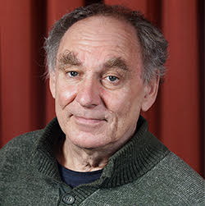
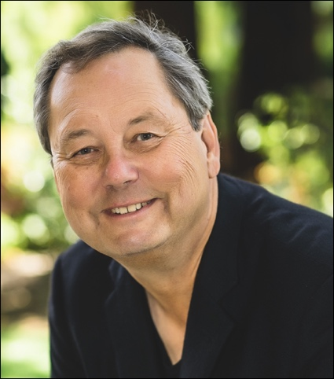
Fireside on Re-Decentralization
Jon Crowcroft
University of Cambridge, UK
Organiser: Paul Mockapetris
The Inventor of the DNS

Slide 3
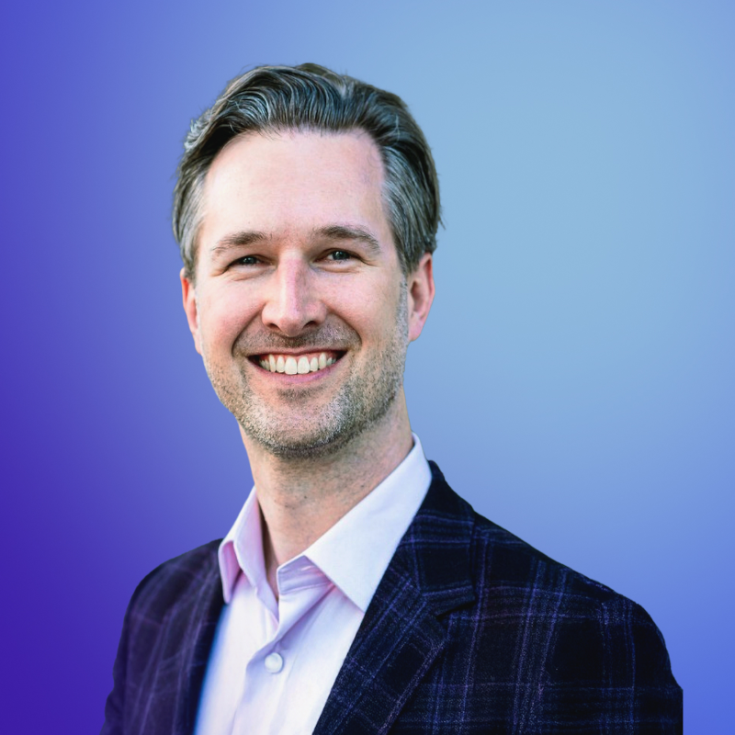
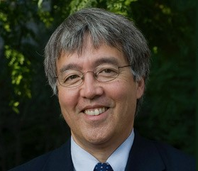
Next event: A fireside chat with Brendan Ittelson, chief ecosystem officer at Zoom (1/10/2025)
Brendan Ittelson – Chief Ecosystem Officer at Zoom
Organiser: Jim Kurose – U. Massachusetts

Slide 4
Follow theNetworkingChannel
Follow our slack channel at:
https://join.slack.com/t/sigcomm/shared_invite/zt-2qs5p677q-kx8M2CaLQdYvI4coeudguQ
The recordings are available at our YouTube Channel at:
https://www.youtube.com/@thenetworkingchannel/featured

