Slide 1
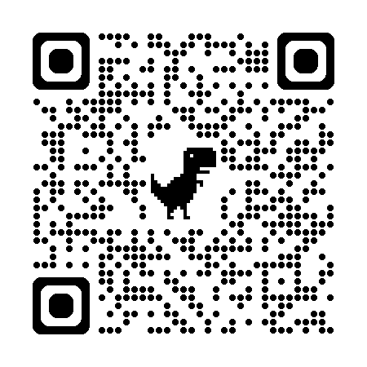
UKRI Future Internet
@Coseners NGN/MSN
Community Engagement #3

Slide 2
UKRI asked us (three groups) to map out Future Internet
Creatives, Business, Technologies
Interdisciplinariness (moving far beyond Telecom, and AI)
Methodologies: workshops, interviews, surveys
Result will be prioritized list of challenges & topics
Depending on other factors, may or may lead to calls for proposals
*EPSRC/ESRC/AHRC

Slide 3
Challenge Areas Identified*
Sovereign & Resilience
New Internet Modalities
Inclusion, Accessibility, Trust & Privacy
Digital Culture & Platforms
Ecology, sustainability and the material internet
*EPSRC/ESRC/AHRC

Slide 4
What’s the Ask of You?
Are there Glaring Gaps in Challenge Lists/Topics?
Are the Priorities Right?
Where are you all currently getting your Future Internet funding from?

