Slide 1
edge ai
Jon Crowcroft,
http://www.cl.cam.ac.uk/~jac22

Slide 2
2. Distributed Analytics
Motives e.g.
  Move code to data
  Keep data close to owner/primary user
  Guarantee can audit trail access
  Add yours here
Challenges
  Depends on ML technology of choice & goal
    PCA/Clustering, random forests
    Curve fittign (regression etc)
    Model Inferencing – e.g. Bayesian inference
  Distrubuted differential privacy tricky
  Hierarchical versus P2P?

Slide 3
A word on edges
Just inside the network is not “edge”
  True edge to edge is end to end
A cloud is already distributed –
  small data centers in cell towers are just more cloud – no use.
Barriers to true edge include:
  NATs/lack of v4 or v6 addresses
  Asymmetric bandwidth
  Misguided firewall or other middle box tech/limiters
  Ossification
Motives for edge include
  Better privacy, energy,latency,availability, and the law.

Slide 4
Future Proof for GDPR
Privacy by Design and by Default – HAT address all GDPR privacy requirement from its design principle to its security solution.
  HAT ecosystem data exchange is based on fully specified privacy terms - time specific, recipient specific, minimum data points specific with full intention disclosed. Violation against any of such terms may result a ban from the Ecosystem.
Consent by design and by default -
  the PCST PoC mandates a “specific, informed and freely given and unambiguous” intension disclosure of data usage, for every single personal data access instances.
  HAT technology ensures that an exchange is only authorised and kept valid by individual’s case specific consent
Rights for Individuals by design and by default – encapsulated personal data containers isolated for each individual, allows an individual is in full control of its HAT, hence inherently owns all of the following:
  Right to Access | Right to be informed | Right to rectification | Right to restrict processing | Right to object to market
  Right of data portability | Right to be forgotten | Right to object to automated decision making and profiling
Accountability and governance - PCST CoP mandates every ecosystem member to higher level of accountability and governance practice.
  Record keeping – HAT ecosystem automatically tracks data exchange, even at a much more granular level than GDPR requires – it documents the exchange parties, time of access, detailed data points, intension and T&C, for every single transaction.
  Data protection by design and by default - The HATDeX-serviced HAT is designed with multiple layers of protection, covering Data at Rest, Data in Transit and Data in Use. ( http://www.hatdex.org/wp-content/uploads/2016/06/hatdex-briefing-Issue-2_FINAL.pdf)
Mandatory breach notification - HAT’s API driven ecosystem automatically records all exchanges breach tracking and investigation
GDPR Roundtable discussion consulted a few HAT research team members for the design of the legislation. HAT ecosystem can ensure GDPR compliance, and further mandates tighter terms than GDPR as entry requirements from all parties who wish to operate within this ecosystem following its PCST (Privacy, Confidentiality, Security and Trust) Code of Practice (http://hatcommunity.org/other-resources/).
Notes:
GDPR 101 for internal use - https://docs.google.com/spreadsheets/d/1Z4kct1PH3scJ1f2WolNEUODP2Afjp9I8yiwFMLRc5ec/edit#gid=0

Slide 5

Distributed Analytics outline
Part I: Quick Overview of Owl
Part II: Probabilistic Synchronous Parallel

Slide 6
What Is Owl
An experimental and above all scientific computing system.
Designed in functional programming paradigm.
Goal: as concise as Python yet as fast as C, and safe.
A comprehensive set of classic numerical functions.
A fundamental tooling for modern data analytics (ML & DNN).
Native support for algorithmic differentiation, distributed & parallel computing, and GPGPU computing.

Slide 7














Vision Beyond Research Prototype
Write code once, then deploy it everywhere …
MirageOS
Unikernel
Owl
Owl system provides us a complete set of tooling from the powerful numerical supports in development to the deployment on various platforms.

Slide 8
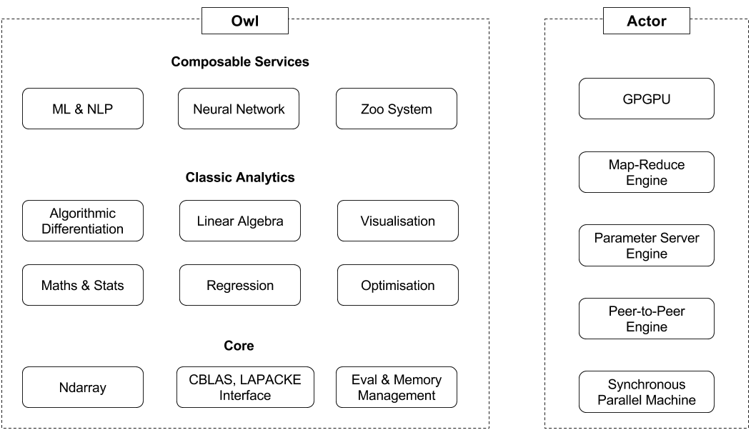
Owl’s Architecture
Owl + Actor = Distributed & Parallel Analytics
Owl provides numerical backend; whereas Actor implements the mechanisms of distributed and parallel computing. Two parts are connected with functors.
Various system backends allows us to write code once, then run it from cloud to edge devices, even in browsers.
Same code can run in both sequential and parallel mode with Actor engine.

Slide 9
Research
6
1. Jiaxin Zhao - Composable Analytical Services using Session Types for Distributed Personal Data
2. Ben Catterall - Probabilistic Synchronous Parallel - A New Barrier Control Method for Distributed Machine Learning
3. D.S.R Royson - Optimising Adaptive Learning in Distributed Machine Learning
4. Dhruv Makwana - Memory Management using Linear Types for High-Performance GPGPU Numerical Computing
5. Tudor Tiplea - Deploying Browser-based Data Analytics at Network Edge
1
3
5
4
2
6. Liang Wang - Owl: A General-Purpose Numerical Library in OCaml
Presented in ICFP’17 OCaml meeting, tutorial in CUFP’17.

Slide 10
Parallel and Distributed Computing
Parallel and distributed computing is achieved by composing the different data structures in Owl’s core library with specific engines in Actor system.

Slide 11
Owl + Actor : Ndarray Example
A map function on local ndarray x in Owl looks like this
Dense.Ndarray.S.map sin x
How to implement a distributed map on distributed ndarray?

Slide 12
Owl + Actor : Ndarray Example
Like playing LEGO, we plug Ndarray into Distribution Engine to make a distributed Ndarray.
module M = Owl.Parallel.Make (Dense.Ndarray.S) (Actor.Mapre)
Composed by a functor in Owl_parallel module, which connects two systems and hides details.
M.map sin x

Slide 13
Owl + Actor : Neural Network Example
Similarly, this also applies to more advanced and complicated data structures such as neural network. This is how we define a NN in Owl:
let network =
input [|28;28;1|]
|> lambda (fun x -> Maths.(x / F 256.))
|> conv2d [|5;5;1;32|] [|1;1|] ~act_typ:Activation.Relu
|> max_pool2d [|2;2|] [|2;2|]
|> dropout 0.1
|> fully_connected 1024 ~act_typ:Activation.Relu
|> linear 10 ~act_typ:Activation.Softmax
|> get_network
Then we can perform training locally as below
Owl.Neural.S.Graph.train network

Slide 14
Owl + Actor : Neural Network Example
To enable the parallel training on a computer cluster, we can combine Graph with Param engine.
module M = Owl.Parallel.Make (Owl.Neural.S.Graph) (Actor.Param)
We only write code once, Owl’s functor stack generates both sequential and parallel version for us!
M.train network

Slide 15
Key to Scalability
Actor implements three engines, maybe more in future.
All reply on a module called Synchronous Parallel which handles synchronisation.
Corner stone of large scale distributed learning :)

Slide 16
Synchronous Parallel Machine
An abstract computer for designing parallel algorithms.
Three components:
  A local processor equipped with fast memory;
  A network that routes messages between computers;
  A (hw/sw) component to synchronise all computers;
Powerful model for designing and programming parallel systems, building block of Apache Hadoop, Spark, Hama, etc.

Slide 17
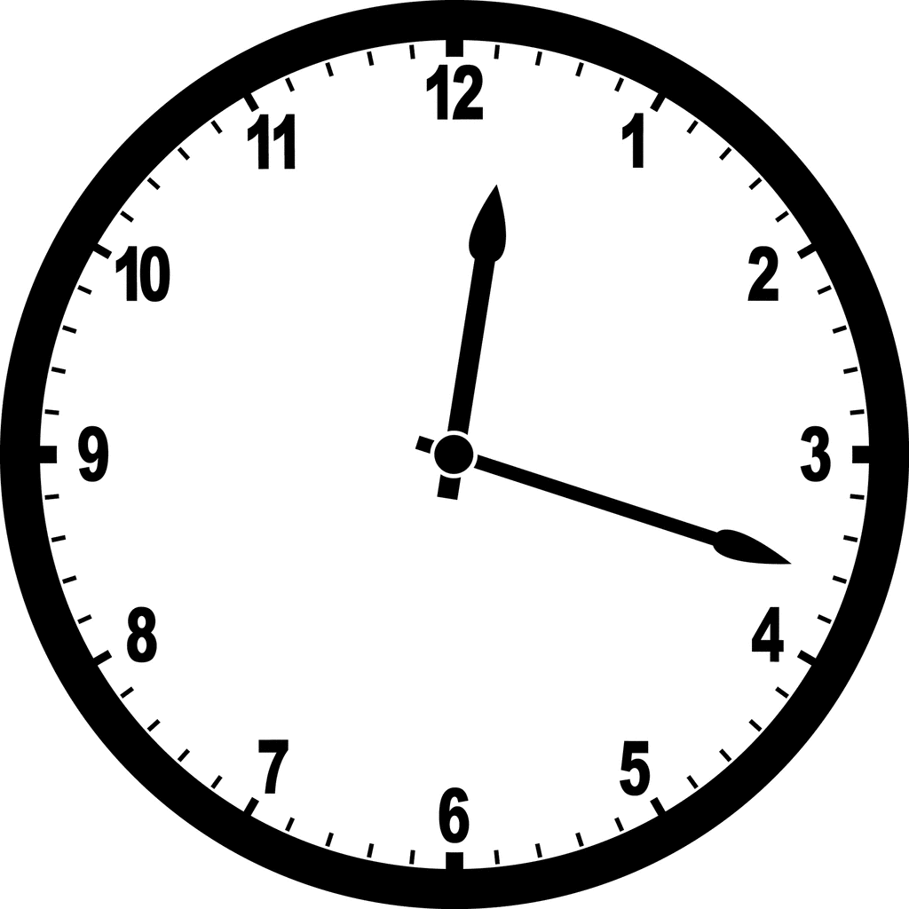

Barrier Synchronisation
The third component barrier synchronisation, is the core of SPM. It’s all about how to coordinate computation on different computers to achieve certain consistency.
Progress is measured by supersteps (iterations).
That’s where we need a central server, in order to maintain the global state.
Progress
Global state
# 0
# 1
# 2
P#0
Comm may happen here, to ensure the consistency through the global state.
P#1
Processes
P#2
P#3
Barrier Synchronisation

Slide 18
Consistency Is Not Free Lunch
Real world iterative learning algorithm aims fast convergence.
Convergence rate decreases if iteration rate is slow or updates are noisy.
Synchronisation can reduce the noise in updates (improved consistency).
Tight synchronisation is sensitive to stragglers and has poor scalability.
Tight synchronisation renders high communication cost in large systems.

Slide 19
Existing Models in Use
Bulk synchronous parallel (BSP)
Stale Synchronous parallel (SSP)
Asynchronous parallel (ASP)
BSP
SSP
ASP
P#0
P#0
P#0
P#1
P#1
P#1
P#2
P#2
P#2
P#3
P#3
P#3
Hadoop, Spark, Parameter Server, Pregel, Owl+Actor ...
Parameter Server, Hogwild!, Cyclic Delay, Yahoo! LDA, Owl+Actor ...
Parameter Server, Hogwild!, Yahoo! LDA, Owl+Actor ...

Slide 20
A 10,000 Foot View
BSP
SSP
ASP
P#0
P#0
P#0
P#1
P#1
P#1
P#2
P#2
P#2
P#3
P#3
P#3
Most strict lockstep synchronisation; all the nodes are coordinated by a central server.
BSP is sensitive to stragglers so is very slow. But it is simple due to its deterministic nature, easy to write application on top of it.
SSP relaxes consistency by allowing difference in iteration rate. The difference is controlled by the bounded staleness.
SSP is supposed to mitigate the negative effects of stragglers. But the server still requires global state.
Least strict synchronisation, no communication among workers for barrier synchronisation all all.
Every computer can progress as fast as it can. It is fast and scalable, but often produces noisy updates. No theoretical guarantees on consistency and algorithm’s convergence.

Slide 21

Consistency vs. Iteration Rate
We must balance consistency vs. iteration rate , we can think in the following way to understand the trade-off:
Convergence Consistency Degree x Iteration Rate
SSP aims to cover this spectrum between BSP and ASP by parameterising the staleness.
Convergence rate
SSP parameterises the consistency by staleness.
ASP
BSP
Weak consistency
Fast iteration rate
Strong consistency
Slow iteration rate
Question: Is SSP really a generalisation of of BSP and ASP?
BSP and SSP are both centralised whereas ASP are fully distributed. It feels like SSP has missed something in this spectrum. What is it?

Slide 22
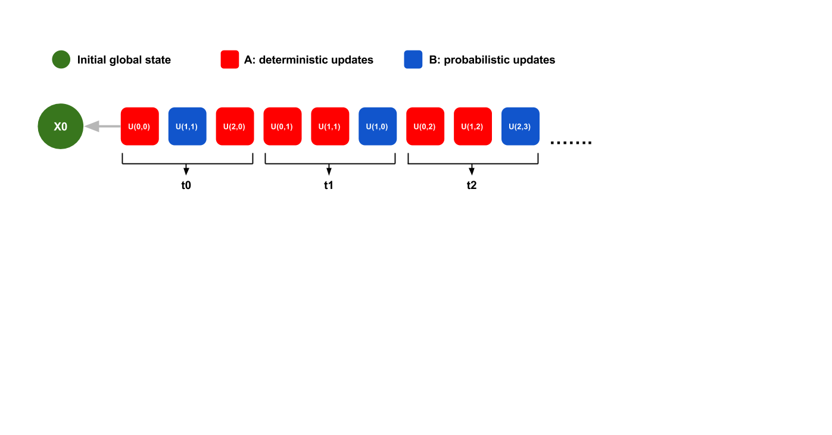
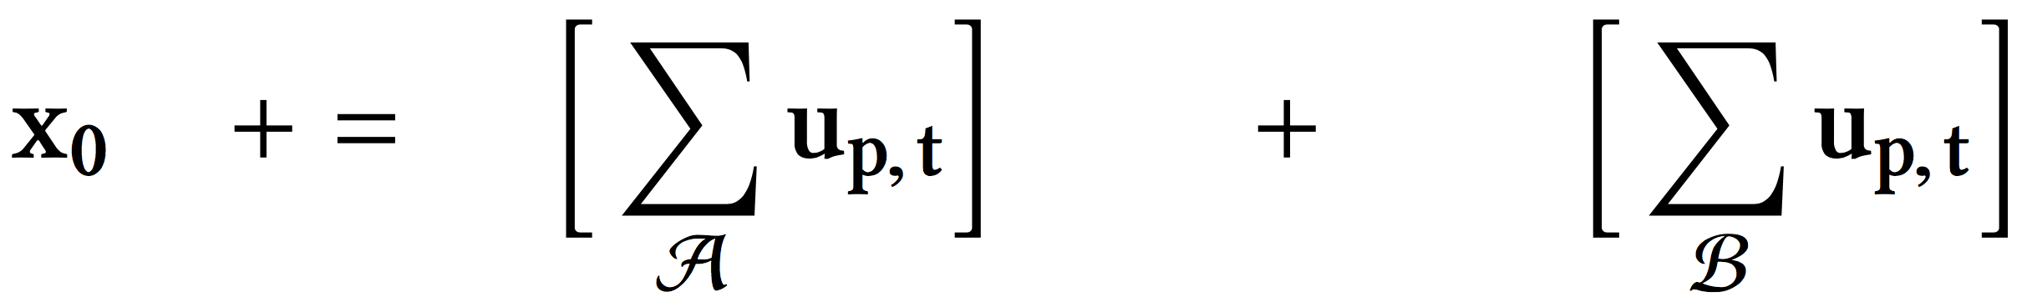
Analytical Model
The model is simple: a sequence of updates applying to an initial global state x0. The updates can be “noisy” hence are divided into two sets.
Although simple, it can model most iterative learning algorithms.
u(p,t)is update(node id, timestamp), sum over all the nodes and clock ticks ...

Slide 23
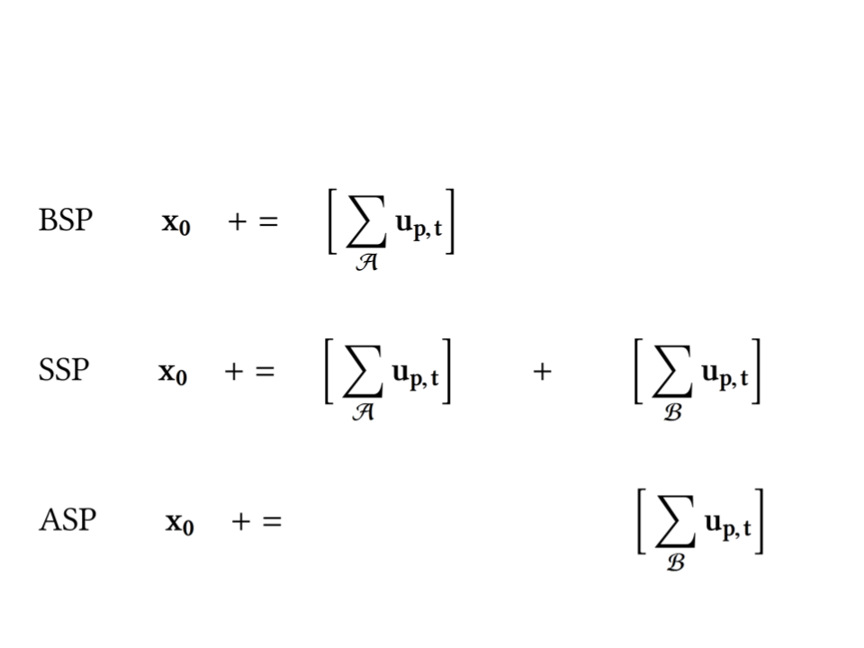
Decompose Synchronous Parallel Machine
Then we use the analytical model to express each synchronous parallel machine on the left.
The formulation reveals some very interesting structures from a system design perspective.
Let’s decompose these machines.

Slide 24
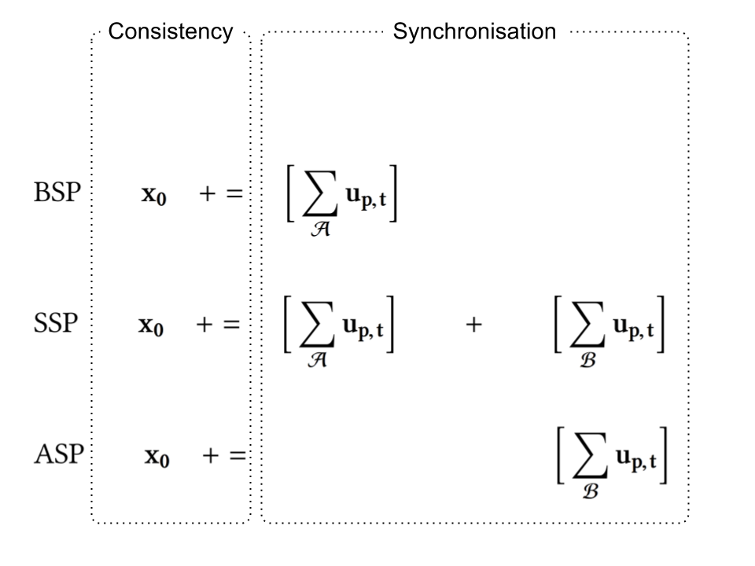
Decompose Synchronous Parallel Machine
Left part deals with the Consistency. += operator is the server logic about how to incorporate updates submitted to the central server into the global state.
Right part deals with synchronisation, computers either communicate to each other or contact the central server to coordinate their progress.

Slide 25
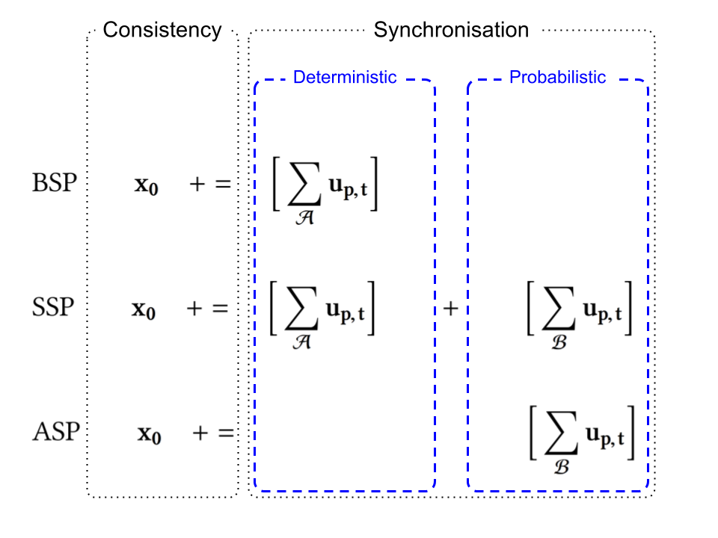
Decompose Synchronous Parallel Machine
Inside the synchronisation part, the synchronous parallel machine processes two types of updates.
The deterministic one is those we always expect if everything goes well as in BSP.
The probabilistic one is those out of order updates due to packet loss, network delay, node failure, and etc.

Slide 26
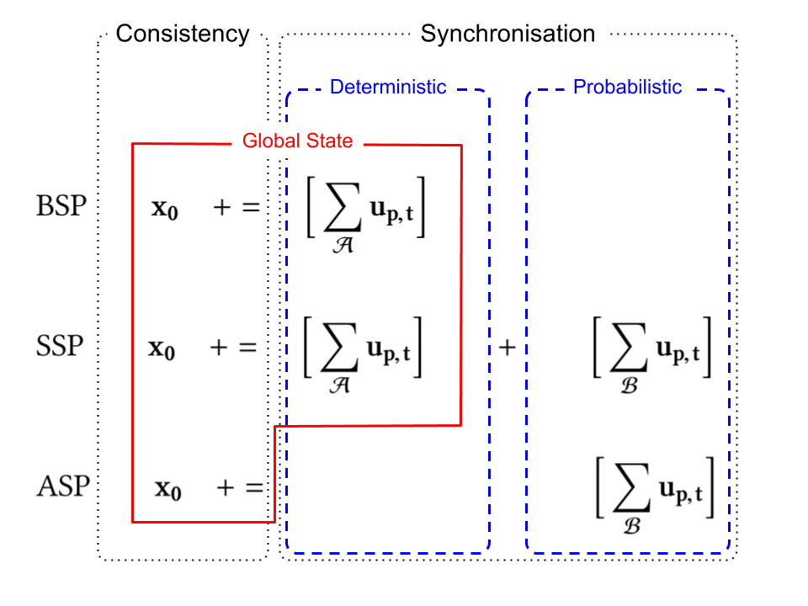
Decompose Synchronous Parallel Machine
The global state is maintained by a logic central server. In a distributed system, this is often the bottleneck and single point of failure.
Moreover, note that the server couples the consistency with the synchronisation two parts, for BSP and SSP.
ASP avoids such coupling by giving up synchronisation, consistency completely.

Slide 27
Missing Dimension in Design Space
SSP
BSP
??? the missing dimension in synchronisation
Strong consistency
Slow iteration rate
Fully centralised
Consistency
Weak consistency
Fast iteration rate
Fully distributed
ASP

Slide 28
Key Insights from Decomposition
Is it necessary to couple the consistency with synchronisation? No
Is it necessary to give up synchronisation completely in order to decouple consistency and synchronisation? No
Is it necessary to divide the updates into deterministic and probabilistic two parts? No
Is SSP really a generalisation of BSP and ASP, then what is the missing dimension in the design space? Completeness

Slide 29
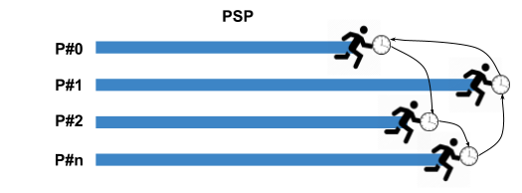
Probabilistic Synchronous Parallel
Core idea: combine both deterministic and probabilistic components, replace it with a sample distribution.
Each computer synchronises with a small group of others and the consistency is only enforced within the group.
The server decides how to incorporate the submitted updates.
No central server to coordinate them, instead each node synchronises within their groups. The consistency “propagates” by the possible overlapping of different groups.

Slide 30
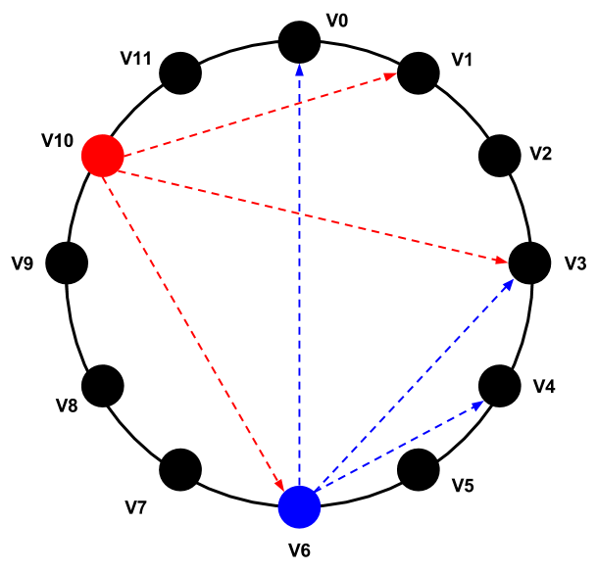
Sampling Primitive
How to implement PSP atop of current data analytics frameworks?
  Quite straightforward, add a new primitive - sample
How to guarantee the random sampling?
  Organise the nodes into a structural overlay, e.g. DHT
The random sampling is based on the fact that node identifiers are uniformly distributed in a name space.
Node can estimate the population size based on the allocated ID density in the name space.

Slide 31
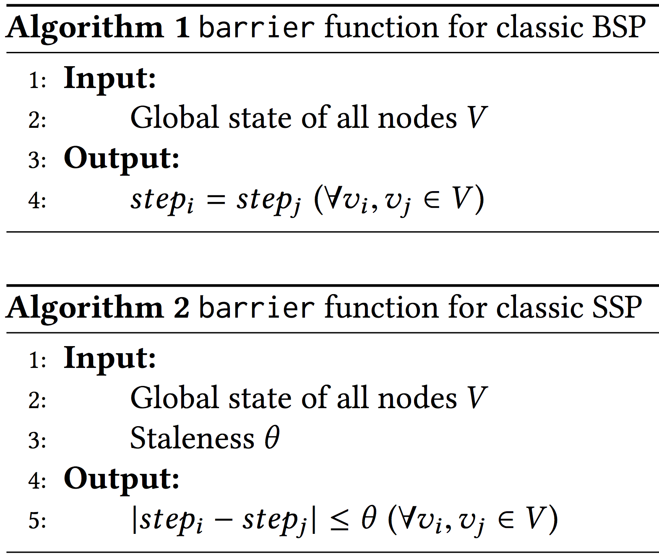
As A Higher-Order Function
PSP is a generalisation of BSP, SSP, ASP.
PSP can be applied to other synchronous machine as a higher-order function, to further derive a fully distributed version.
pBSP
Local state of sampled nodes V
Sample function ○ Barrier function
pSSP
Local state of sampled nodes V
Fully compatible with existing systems due to its generality.

Slide 32
A Newly Discovered Dimension
The degree of consistency is enforced upon a sample rather than the whole population.
PSP adds a new dimension to the existing synchronous parallel models, i.e. the degree of completeness in a sample, which renders a distribution of degree of consistency.
PSP allows us to parameterise the degree of completeness (or level of coordination), ranging from a fully centralised system to a fully distributed one.
PSP parameterised completeness by adjusting the sample size
Complete view
Centralised global state
Partial view
Distributed local state

Slide 33
Factorise Consistency by Completeness
PSP parameterised completeness by adjusting the sample size
Complete view
Centralised global state
Partial view
Distributed local state
Because of this new dimension, Consistency Degree is now factorised into two parts.
Convergence Consistency Degree x Iteration Rate
Convergence Consistency Degree in Sample x Completeness of Sample x Iteration Rate

Slide 34
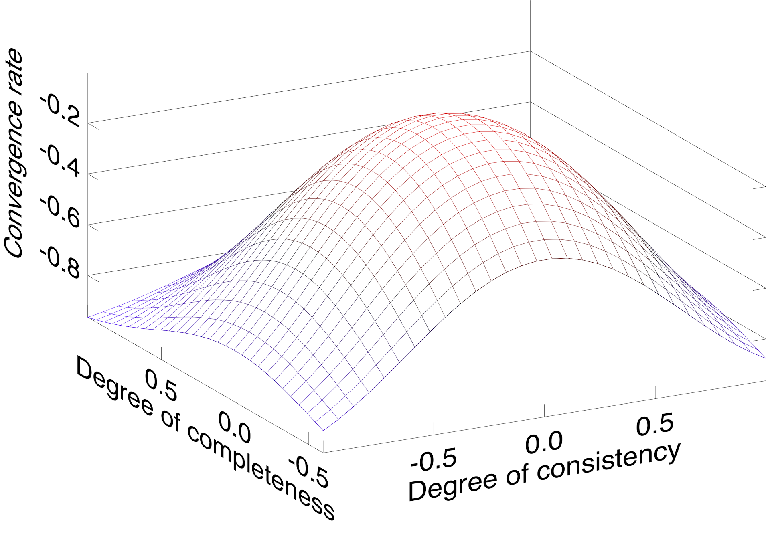
Trade-off in a Larger Design Space
Convergence = Consistency Degree in Sample x Completeness of Sample x Iteration Rate
The new dimension allows us to explore a larger design space, which further makes it possible to find better a trade-off to achieve better convergence rate.
ASP doesn’t really fall on the same Convergence - Consistency plane.
Degree of consistency along the new dimension becomes a distribution now.
pSSP
pBSP
ASP
SSP
ASP
BSP
Note this figure is plotted with Owl.

Slide 35
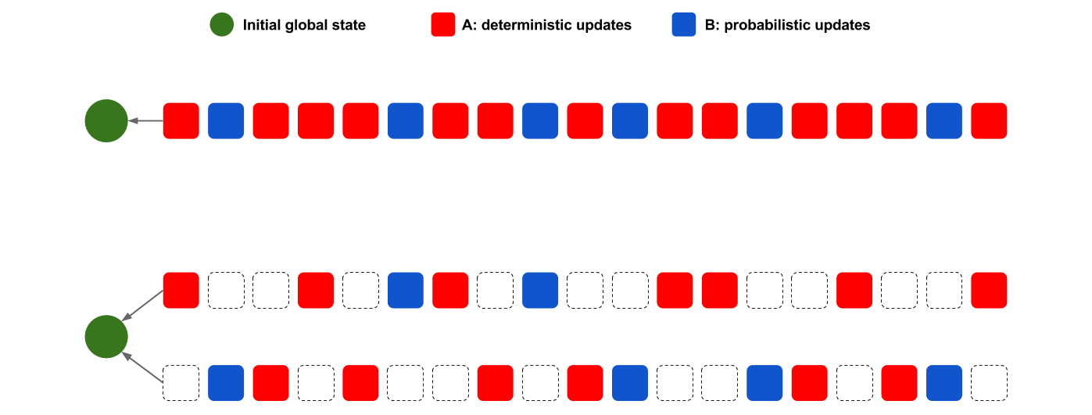
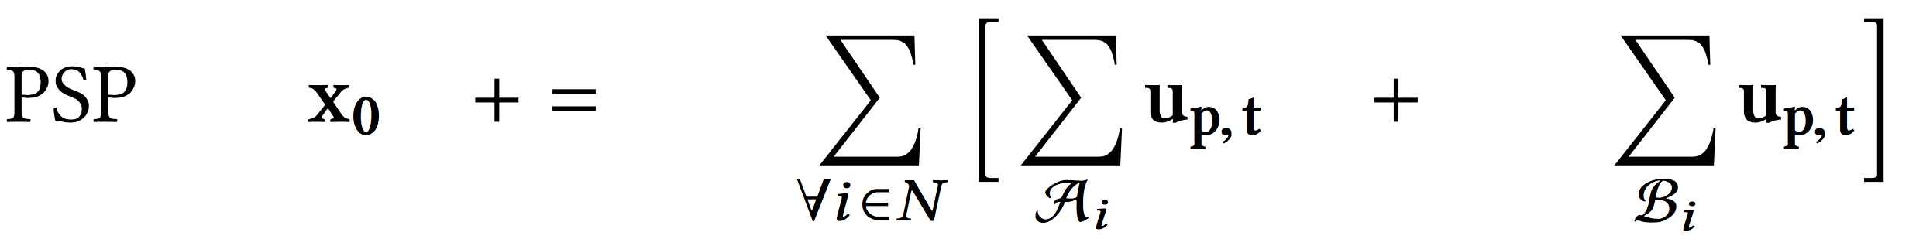
Effects of Sampling Primitive
PSP
Sampling primitive decomposes the original sequence into multiple sampling processes (assuming no replacement for simplicity), and each has a partial view of the original one
#0:A0, B0
#1:A1, B1

Slide 36
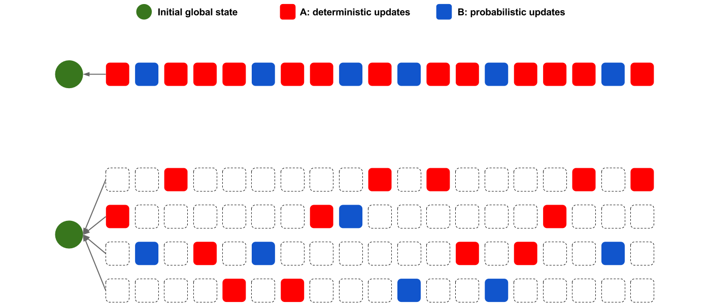
Effects of Smaller Samples
PSP
Smaller sample size results in more sampling processes, each has even less complete view of the original one (i.e. less completeness), further reduces synchronisation level.
#0:A0, B0
#1:A1, B1
#2:A2, B2
#3:A3, B3

Slide 37
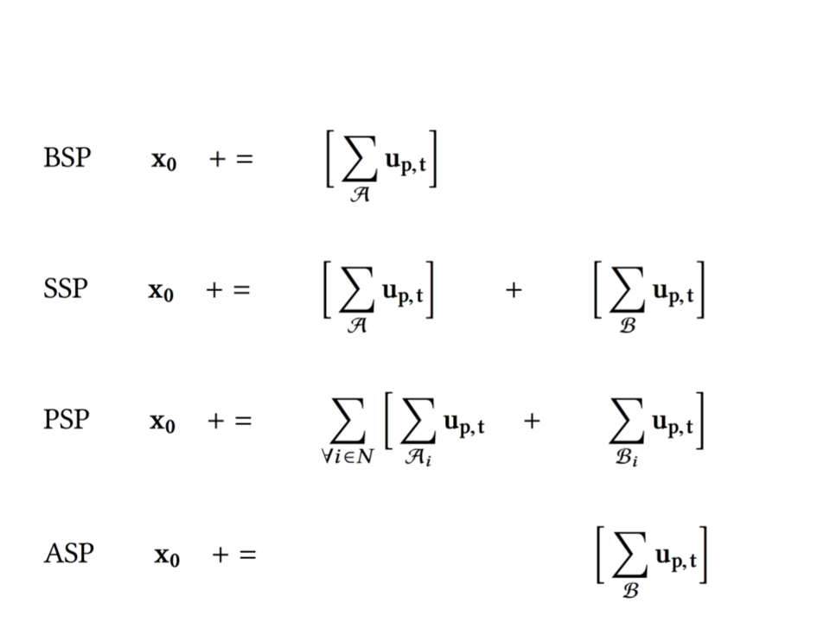
Revisit System Decomposition
PSP now bridges the gap between SSP and ASP by unifying the deterministic and probabilistic components with the updates of a distribution of clock ticks.

Slide 38
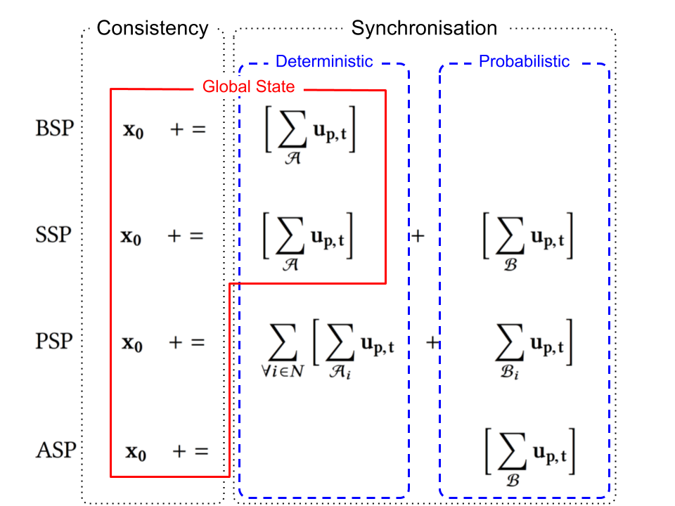
Revisit System Decomposition
First two (BSP, SSP) are centralised; whereas last two (PSP, ASP) are distributed.
Unlike SSP, PSP decouples the consistency and the synchronisation.
Unlike ASP, PSP does not give up synchronisation because of decoupling.

Slide 39
Indication on System Design
With decoupling, the server becomes a stream server, i.e. processes a sequence of submitted updates only, much easier to implement an efficient system.
Nodes coordination is fully distributed, mitigates bottleneck and single point failure to some extent.
Increment deployment as a higher-order function, compatible with existing data analytics frameworks.

Slide 40
Comparison Summary
PSP vs BSP: faster iteration, faster convergence, decentralised.
PSP vs SSP : faster iteration, faster convergence, decentralised.
PSP vs ASP: stronger consistency with synchronisation, stronger guarantees on convergence.
SSP
BSP
Strong consistency
Slow iteration rate
Fully centralised
Completeness
PSP
Consistency
Weak consistency
Fast iteration rate
Fully distributed
ASP

Slide 41
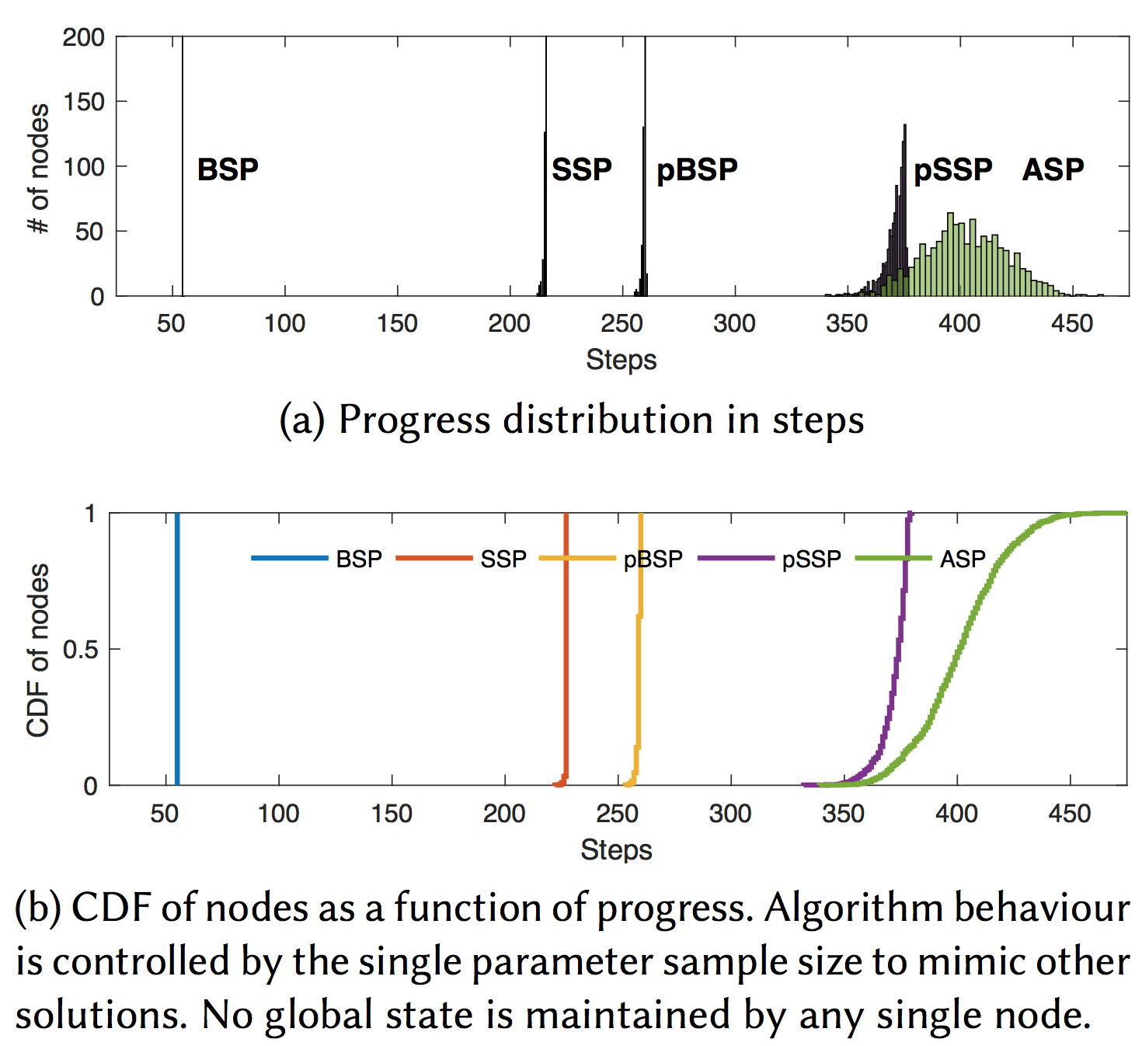
Step Distribution
Let’s look at a system of 1000 nodes, running stochastic gradient descent algorithm for a linear regression task.
Step distribution reflects the level of coordination, or how tightly the nodes are synchronised, or degree of consistency ...
Sample size is 10, and staleness is 4. PSP trade-off reasonable consistency for much faster iteration rate.
Note the trade-off betw. the speed and spread!

Slide 42
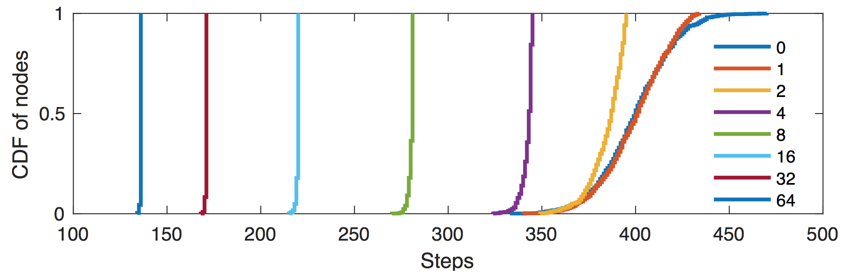
Reduce Discrepancy
CDF of step distribution at a given time in the system, we experimented with different sample size from 0 to 64. Increasing the sample size make the curves shift from right to left with decreasing spread, covering the whole spectrum from the most lenient ASP to the most strict BSP.
The smaller spread is at the price of slower iteration rate. Small sample sets seem very effective in reducing the spread.

Slide 43
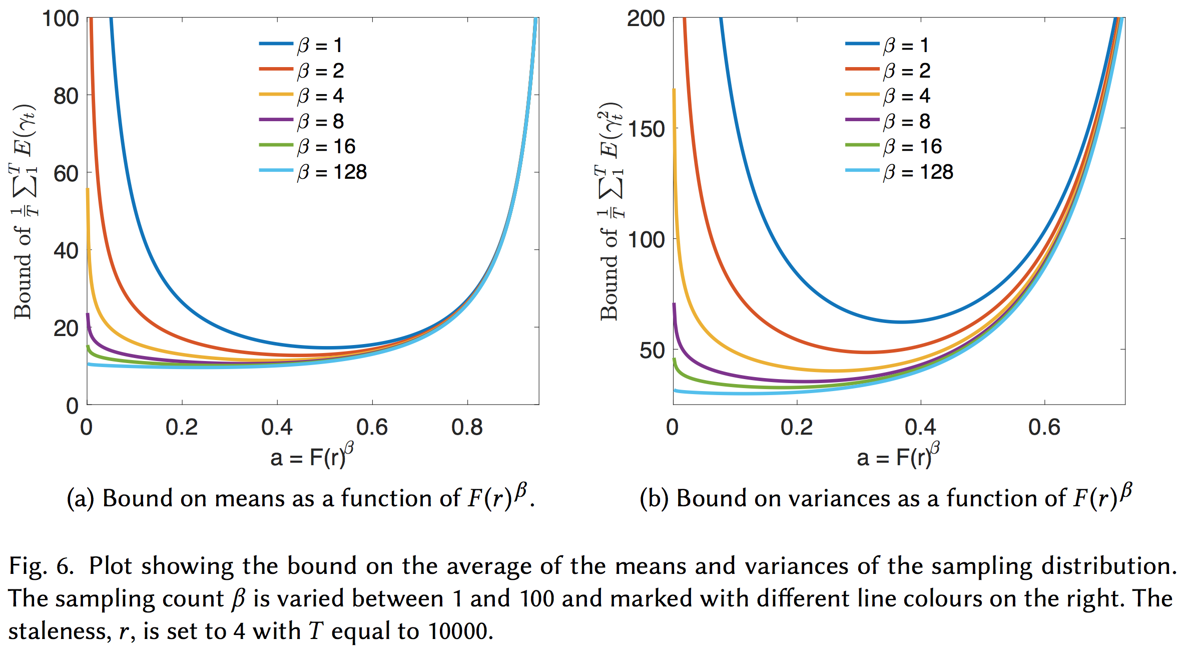
Tighten the Bounds
The smaller the area below the curve is, the tighter the bound becomes, leads to stronger guarantee on convergence.

Slide 44
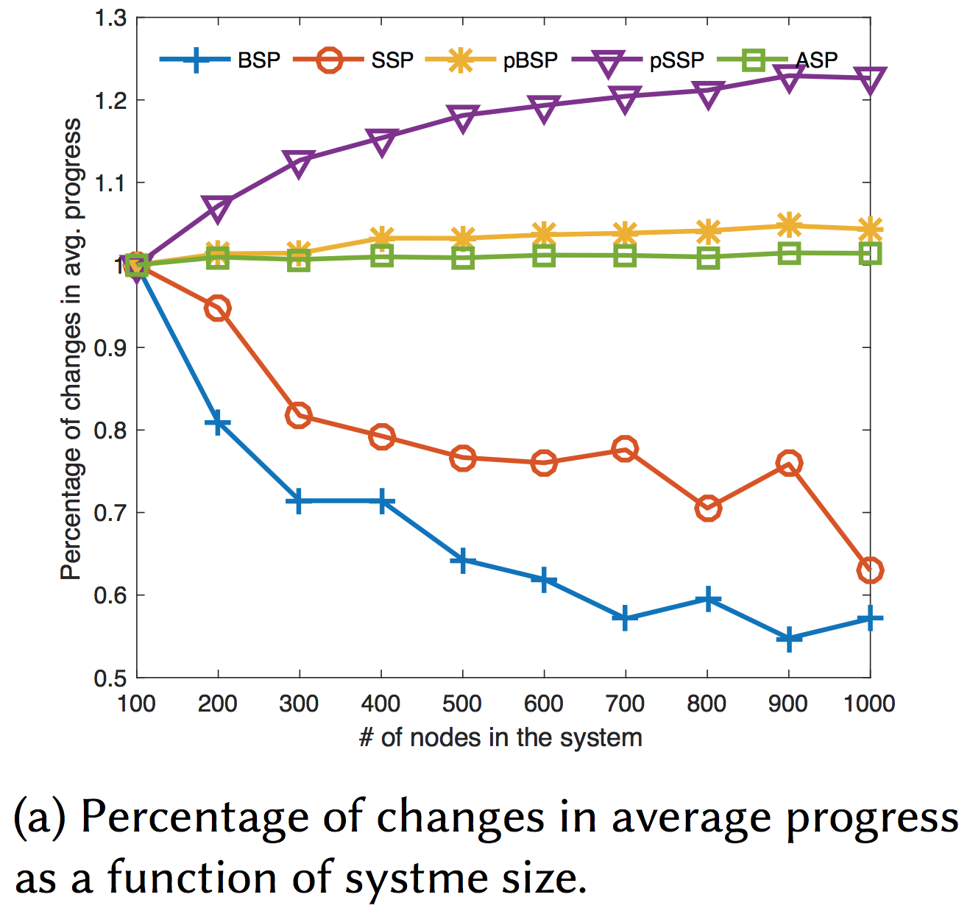
Scalability
Now, we increase the system size step by step, then check how much it will degrade the performance. (Note sample size is fixed as 10.)
Performance degradation is measured by checking the percent of changes regarding the accuracy of regression model at a fixed timestamp in each experiment (with varying system sizes).
ASP is a straight line as expected, due to no synchronisation is need so the system is very scalable. On the other hand, BSP and SSP are both degraded.
Interestingly, PSP improves the performance. Why is that?

Slide 45
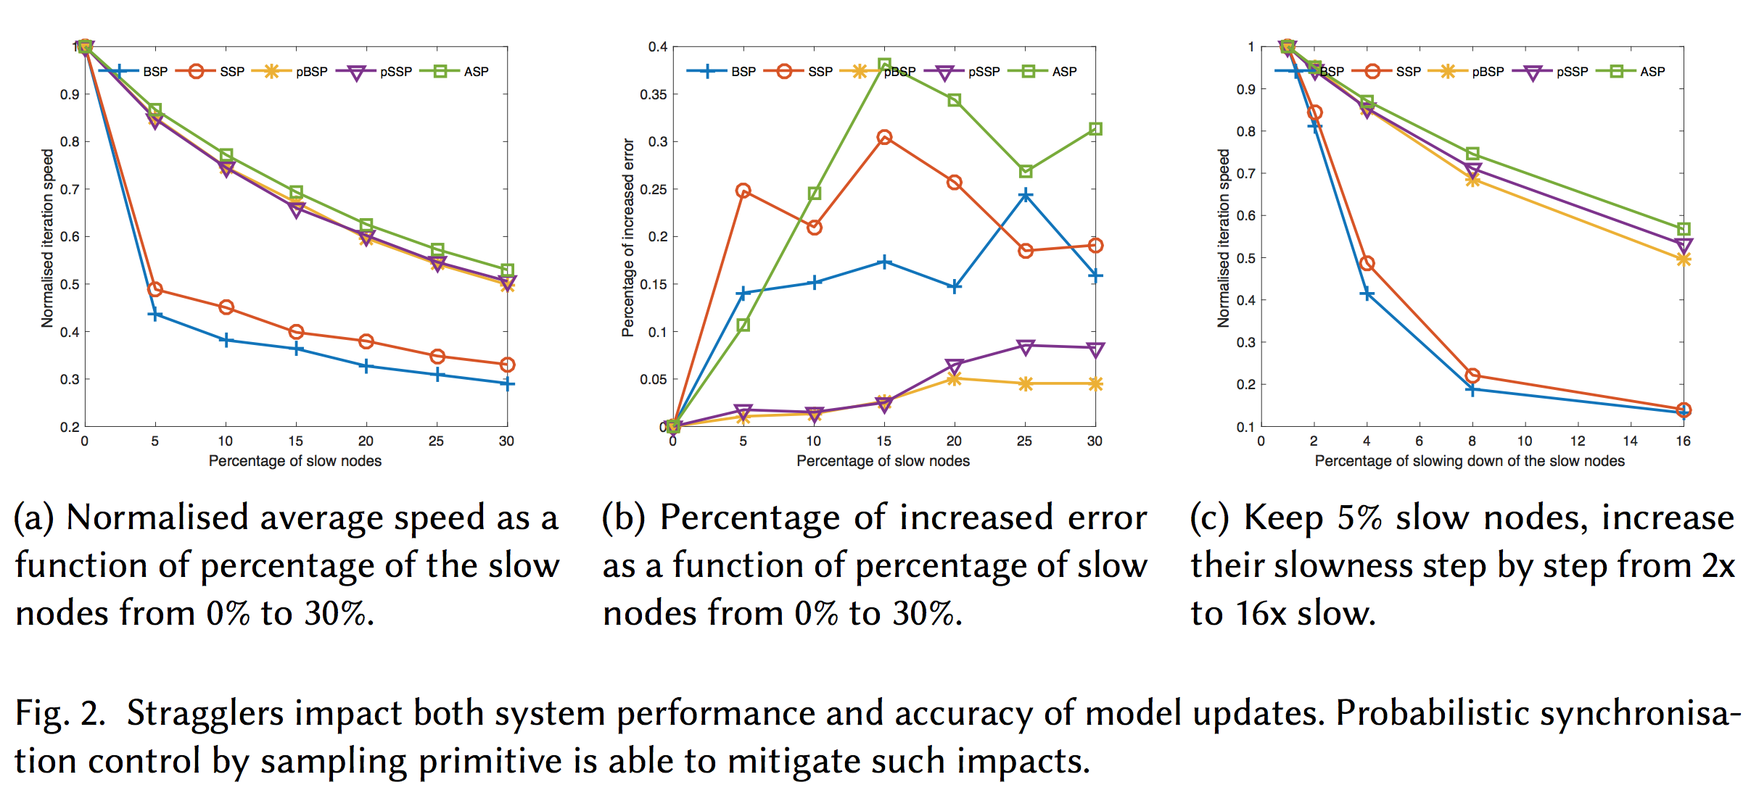
Robustness against Stragglers

Slide 46
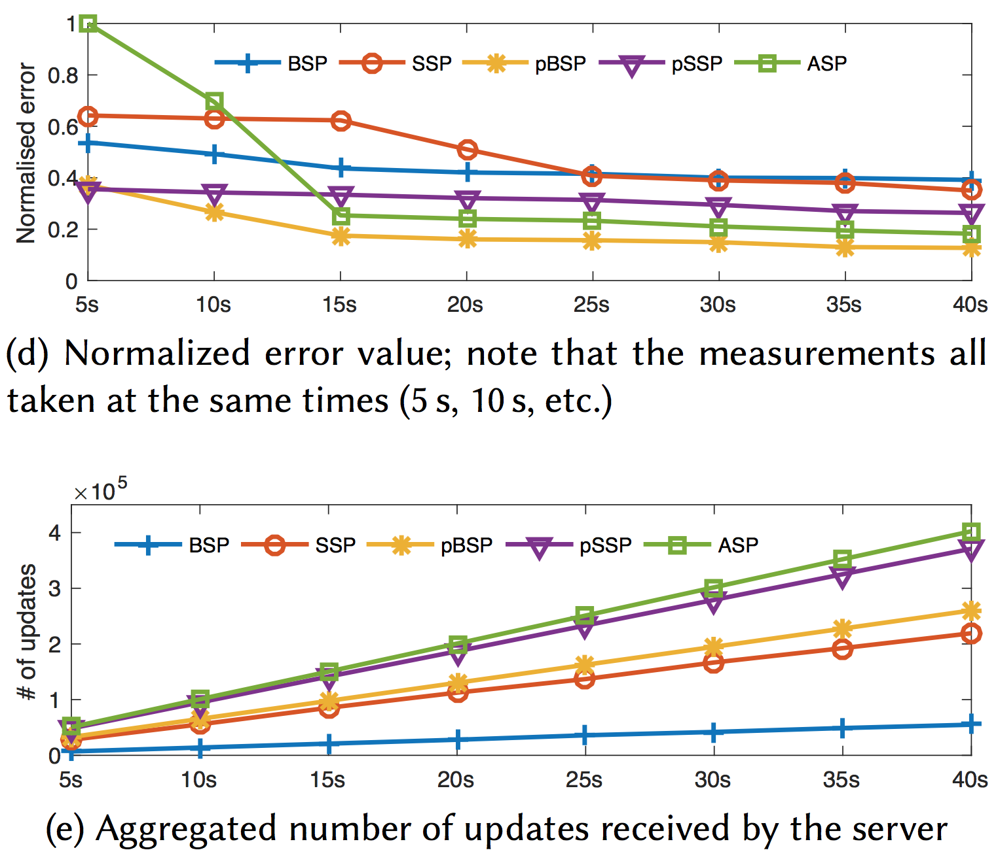
Convergence Rate
PSP can effectively accelerate convergence rate due to both increased iteration rate and improved consistency.
The number of submitted updates increases due to PSP’s faster iteration rate.

Slide 47
Implementation in Actor
type barrier =
| ASP (* Asynchronous Parallel *)
| BSP (* Bulk Synchronous Parallel *)
| SSP (* Stale Synchronous Parallel *)
| PSP (* Probabilistic Synchronous Parallel *)
val start : ?barrier:barrier -> string -> string -> unit
(** start running the model loop *)
val register_barrier : ps_barrier_typ -> unit
(** register user-defined barrier function at p2p server *)
val register_schedule : ('a, 'b, 'c) ps_schedule_typ -> unit
(** register user-defined scheduler *)
val register_pull : ('a, 'b, 'c) ps_pull_typ -> unit
(** register user-defined pull function executed at master *)
…….
PSP and other synchronous parallel machines are implemented in Actor system in a very modular way.
They can be plugged into different engines (Parameter Sever, Mapreduce) with register_barrier function

Slide 48
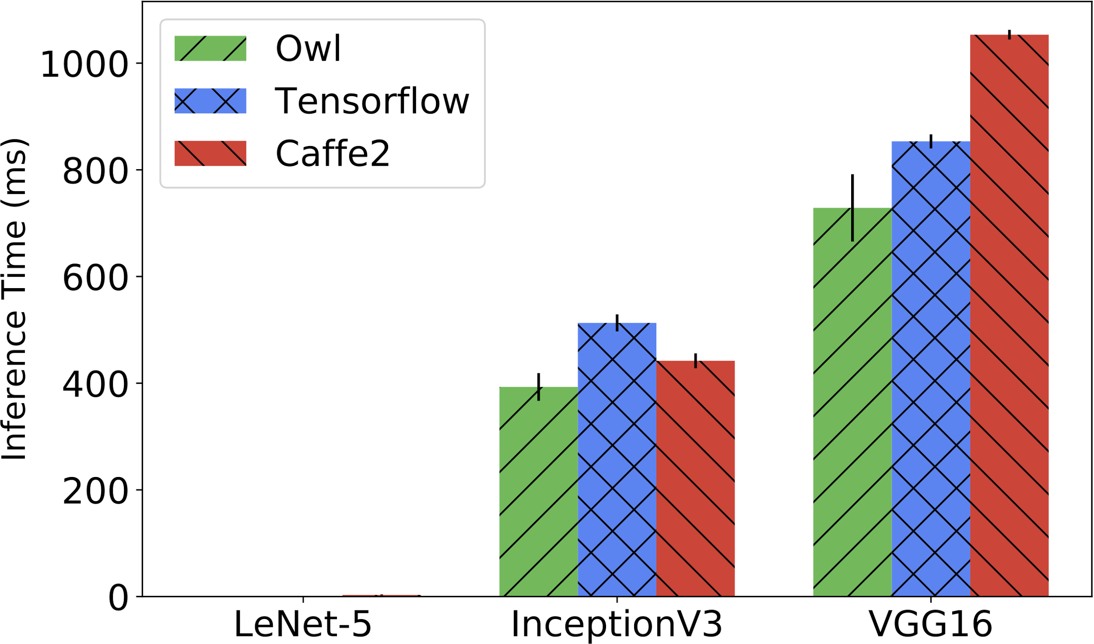
Owl’s Performance

Slide 49

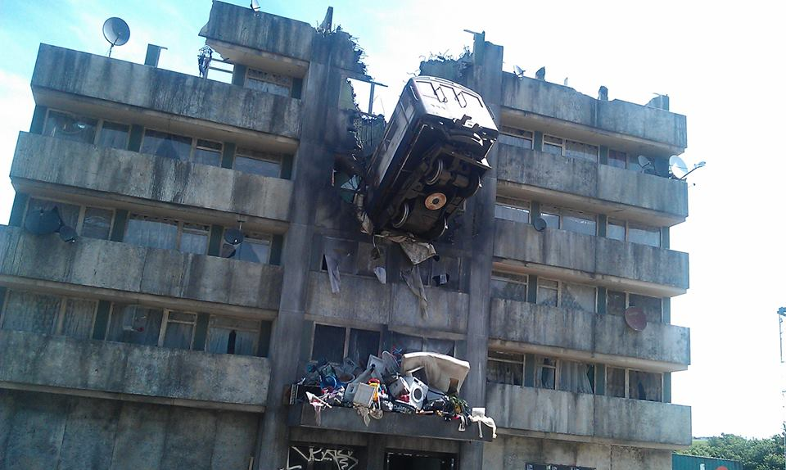
Who Am I? & lets not speculate further ☺
Thanks to EPSRC/databox
&Liang Wang, Cambridge
Thanks to Turing/Maru
&Peter Pietzuch, Imperial

