Slide 1
Games & P2P->Social->P2P :-
Some historical observations
Jon Crowcroft,
http://www.cl.cam.ac.uk/~jac22
Feb 23 2012
Notes:
1

Slide 2
Outline
Brief History of VR, P2P, OSNs
Two Main Tech. Items
  Real Life and Virtual Space/Affinity
  P2P Capacity Lessons for Games etc
AOB

Slide 3
What I do…
I don’t play games
I don’t download of P2P systems
I don’t like Online Social Networks
I’ve done extensive research on both
Since 1981…I’ve mostly mucked about with IP

Slide 4
Before the Internet
Lots of proprietary, closed nets
And Usenet (UUCP ++ )
Muds, and Moos and Usenet
HLA – first go at multicast/p2p games
Napster and Freenet
MMORPG – mostly Big Iron Server
Facebook, Peerson, Diaspora – P2P OSNs
Angry Birds and Ed Milliband
Trust, Clouds and Fiber to the Home

Slide 5
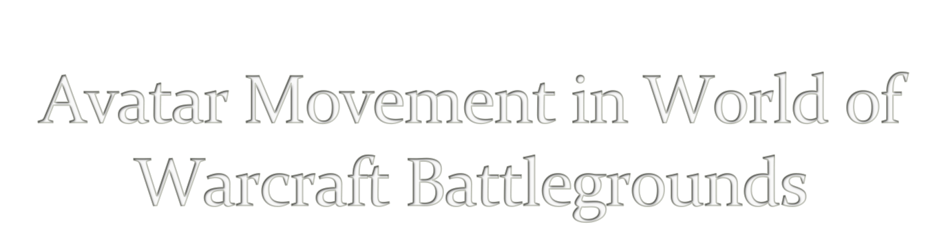
1. John L. Miller and Jon Crowcroft
from at NetGames 2009
5

Slide 6

Lots of Online Game / DVE research proposing new message propagation models
Typically evaluated against synthetic workloads
  How do these compare to real workloads?
Most DVE users play World of Warcraft (WoW)
  Battlegrounds are a tractable, dynamic scenario
6

Slide 7

Based in a fantasy environment: knights and wizards…
Avatars organized into two teams: ‘factions’
Compete over resources or objectives
  Dominate combat and geography
  Mixtures of melee and spell/missile combat
Battle duration: ~5 to ~30 minutes
Battle participants: 10 - 240
Both sides rewarded, winner > loser
7

Slide 8

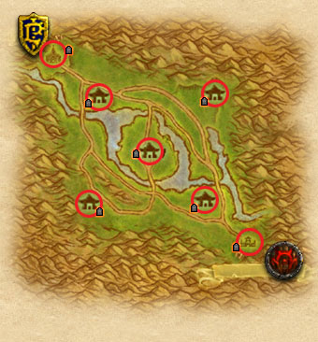
Scenario
10-30 players
Control stationary flags
First team to 1600 wins
Movement
7 yards/s Running
14 yards/s Riding
Interaction
~5 yard Melee range
30 (45) yard Spell range
~500 yard visual range
500 yards
8

Slide 9

Battle Excerpt Video
Abstracted Moves (8x speed)
9

Slide 10

Capture data using Windows Network Monitor 3.3
Custom move extraction library
  Parse .cap files into TCP payloads
  Process payloads and extract movement data
  Output .csv movement trace
Gather landmark data
  Join battle, circle around landmarks ☺
10

Slide 11

Join battleground with two grouped Avatars
  Ensures they join the same battleground
Move to opposite ends of the map, stealth
Try not to fight or die
  Team-mates don’t like this
Save resulting capture, filter observers
11

Slide 12

Analyzed 13 Battles
  Scores from 1600-0 to 1600-1590
  Observer team won 6, lost 7
392 unique avatars, 456 avatar instances
Average avatar play interval: 69% of battle
Average data continuity: 73% of interval
12

Slide 13

Expecting:
  Hotspots. Avatars spend most of their time concentrated in a few common areas
  Waypoint navigation. Avatars move along well-defined paths to well-defined destinations
  Grouping. Avatars move together to their destination
    Avatars start together: this should be a no-brainer
13

Slide 14

Determine hotspots by counting seconds spent at each location in the battleground
  Divide battleground into a grid
  Sum avatar seconds spent in each cell
  Cells with highest count are hotspots for that battle
Hotspots were found where expected, but not in every battle
  Hotspots typically at flags and graveyards
Some hotspots on heavy travel paths: ambush!
Top five hotspots vary battle to battle
14

Slide 15
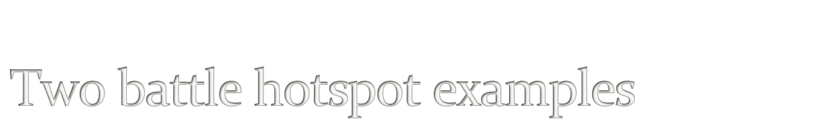
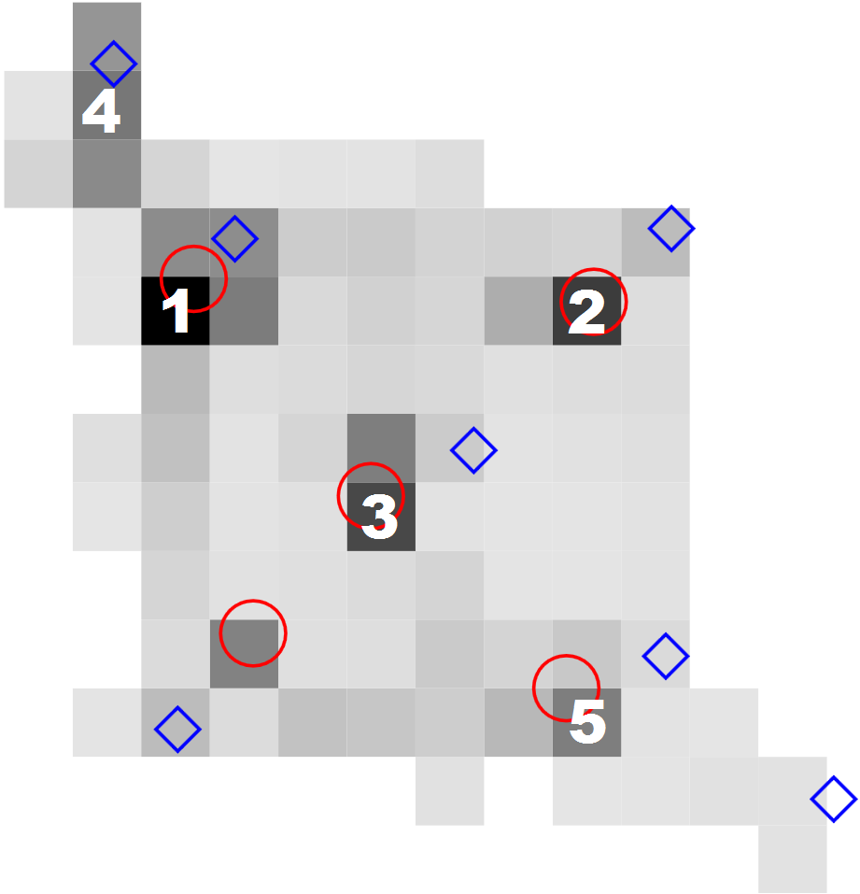
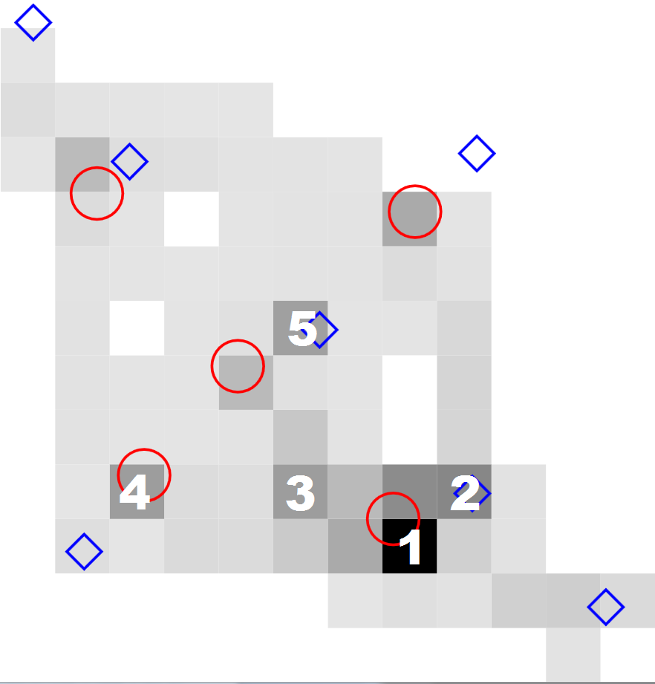
15

Slide 16

Waypoint movement should follow fixed paths
Movement geographically constrained
  Avoid water, which slows to 25% of riding speed
  Cliffs / hills / rivers channel movement
We found many paths used between hotspots
  ‘Patrollers’ (16% of avatars) follow waypoints
  ‘Guards’ (12%) move around a preferred area
  ‘Wanderers’ (49%) move throughout the map
  (23% of avatars observed too little to classify)
Waypoints useful, but not sufficient
16

Slide 17
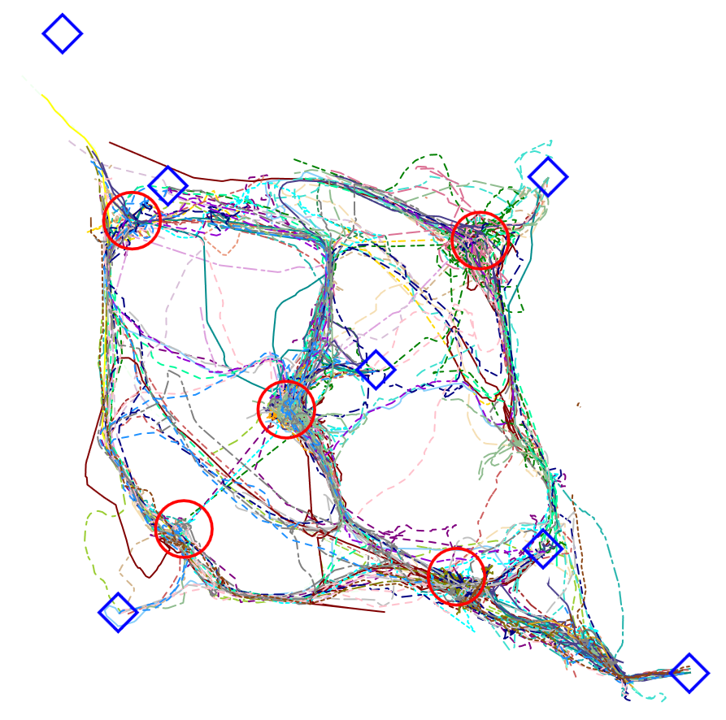
17

Slide 18
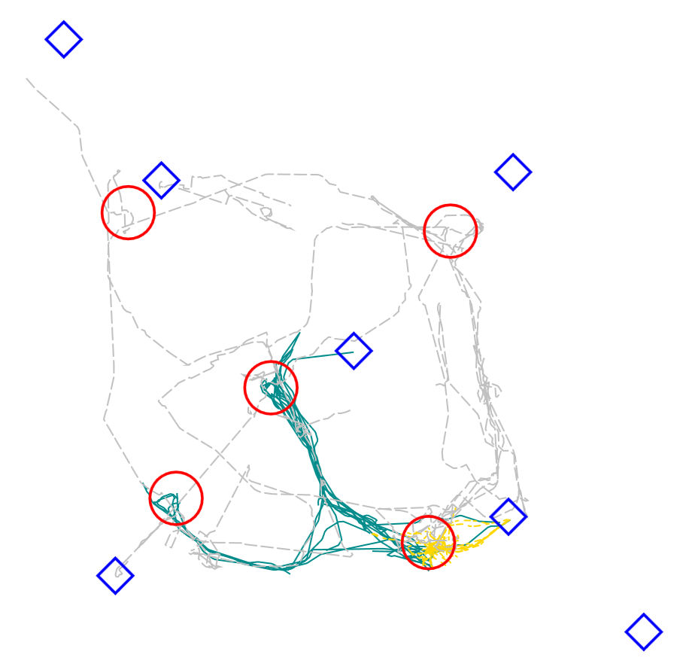
18

Slide 19

Logically, Avatars should stick together
  They start together, and resurrect together
  Outnumber the enemy to stay alive
In fact, they seem to go out of their way NOT to stick together
Analysis: sum up all player seconds where avatar is within 30 yards of another avatar
  Ideally, should include movement requirement, but this is a much looser / more generous metric.
19

Slide 20

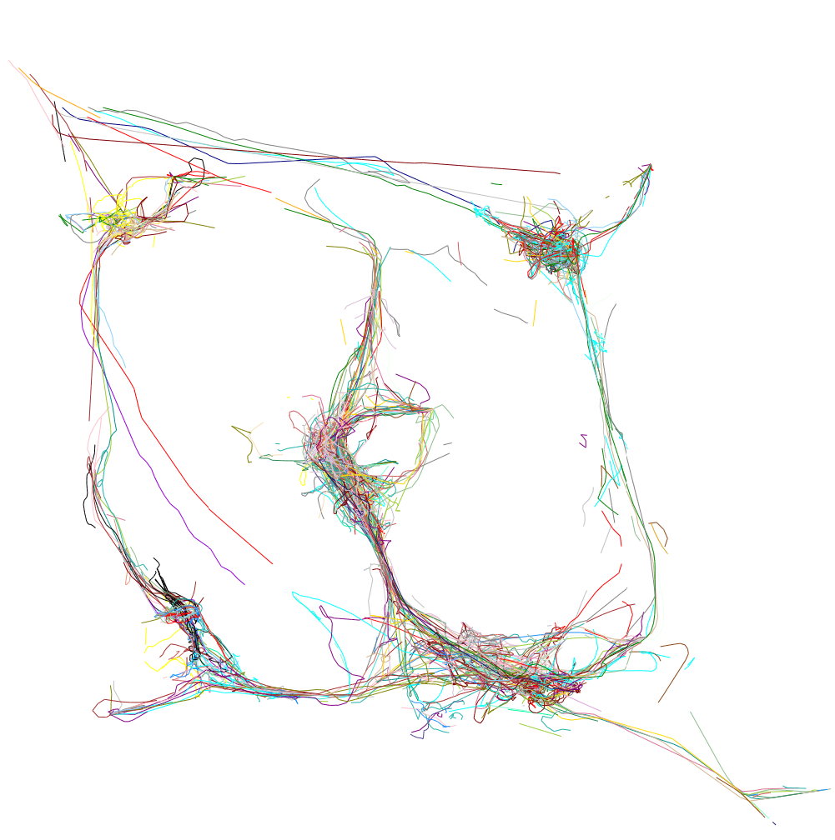
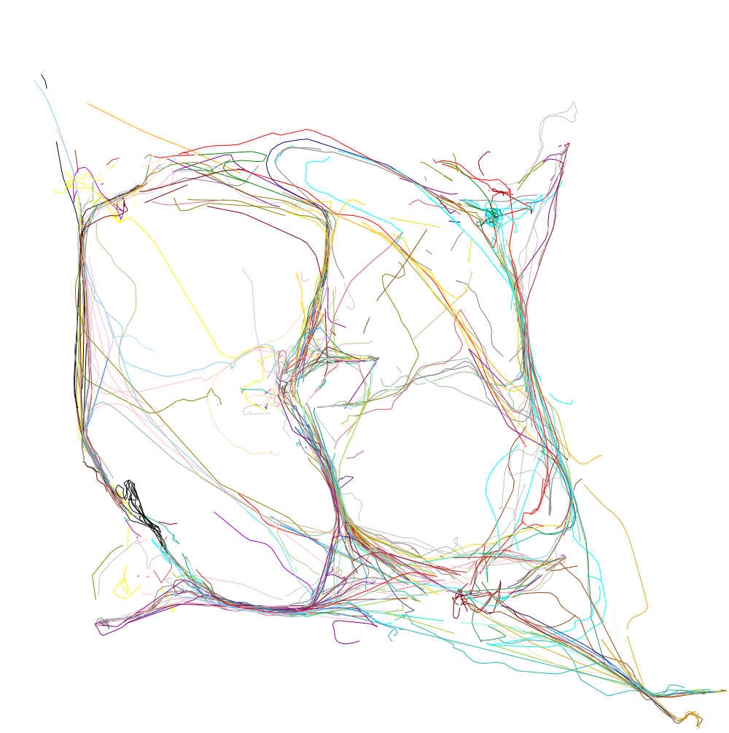
Affinity Map
Non-Affinity Map
20

Slide 21
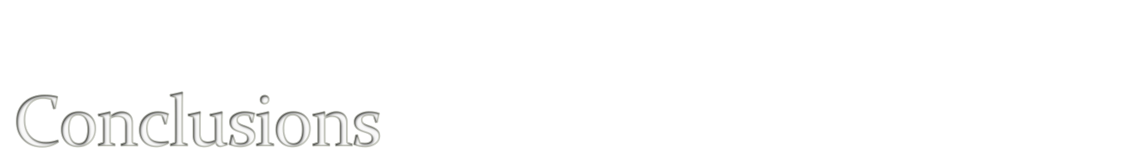
Existing Avatar movement models insufficient
  Hotspots useful, but not consistent
  Waypoints useful for a (small) subset of avatars
  Grouping / flocking useful for a minority of avatars
A new synthetic movement model is needed
  In the meantime, use real data
21

Slide 22
Now what about Social Nets
Lets look at movement in the real world
4 examples –
  Conference
  Building
  Disaster
  Epidemic

Slide 23
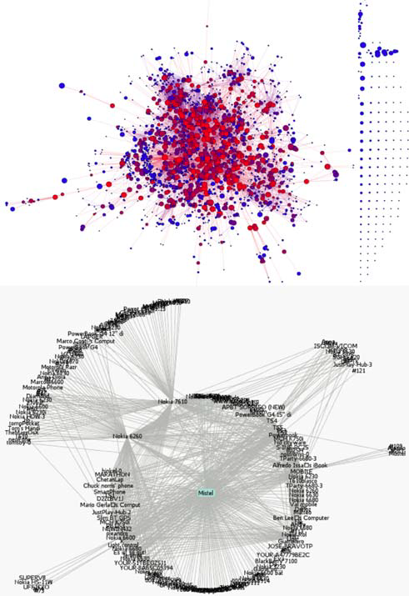

Slide 24
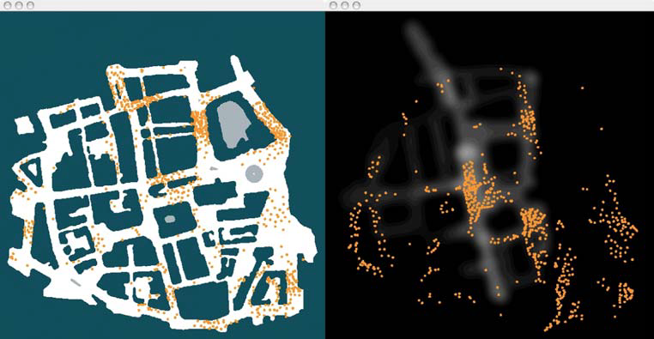

Slide 25
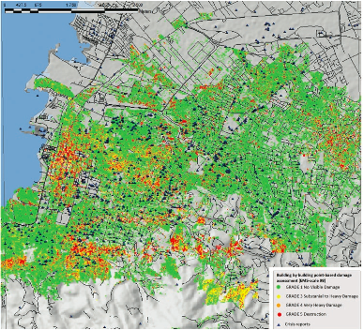

Slide 26
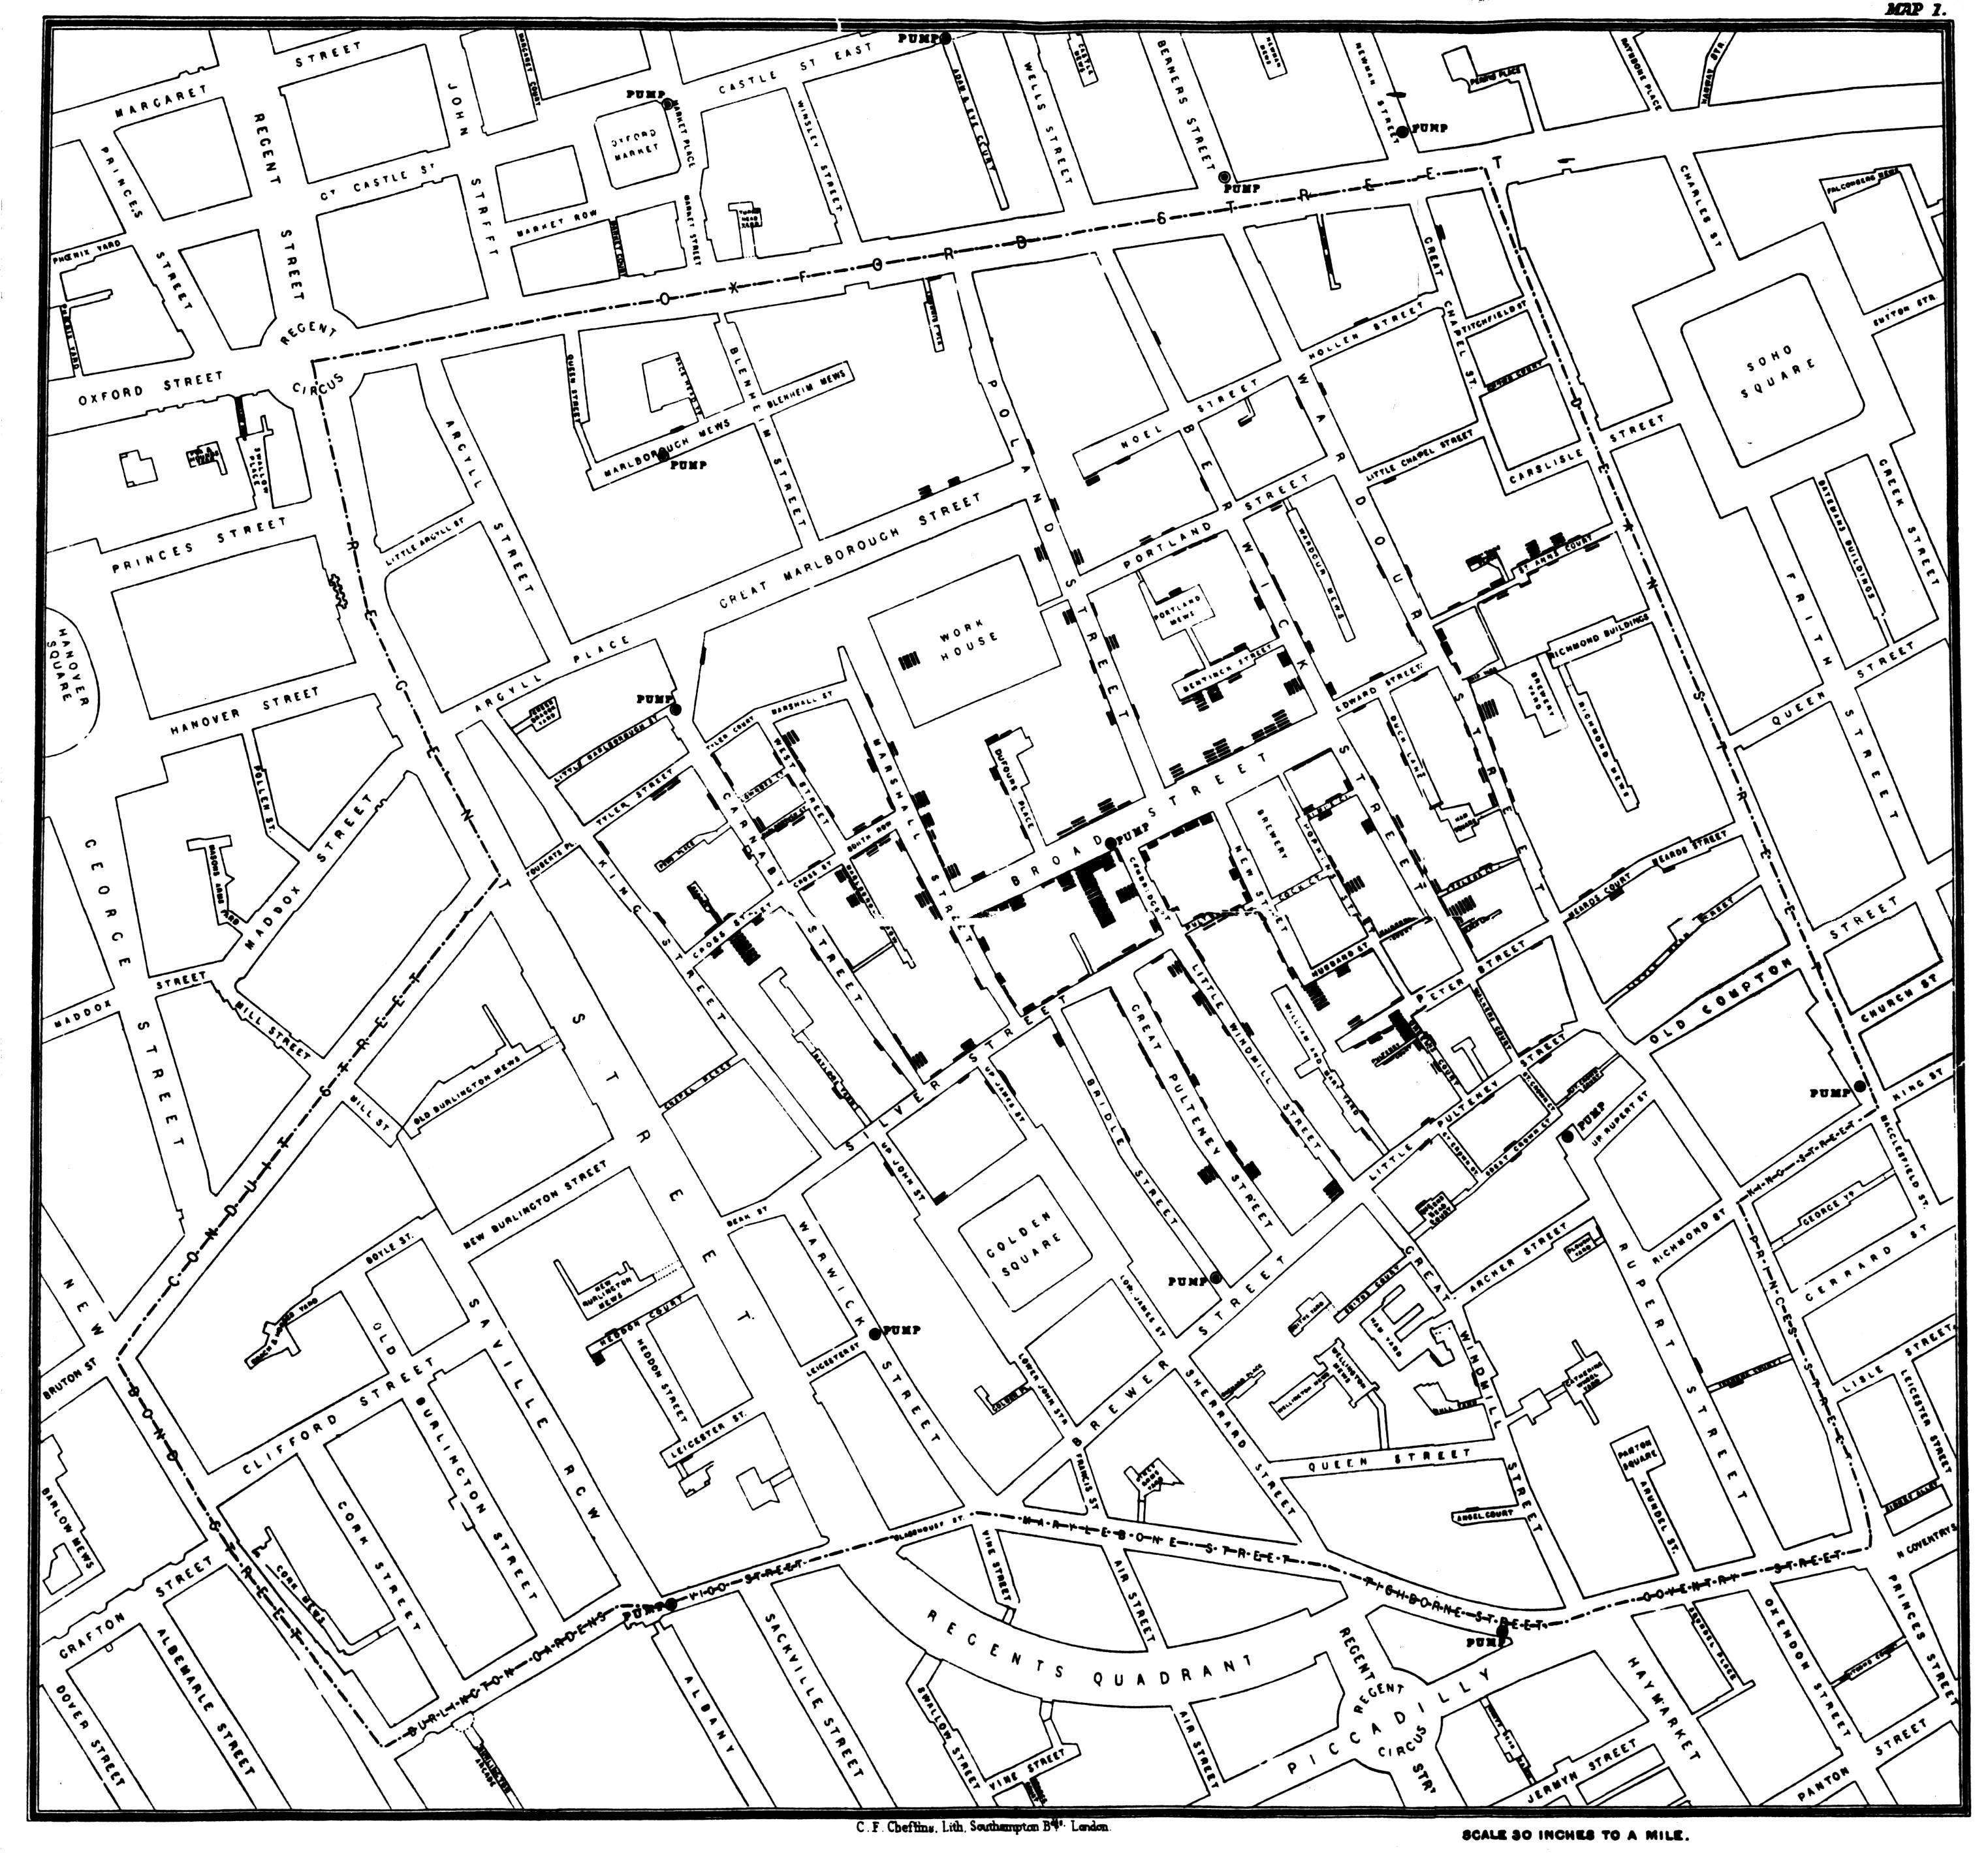
Ghost Maps

Slide 27

27
Look similar???

Slide 28
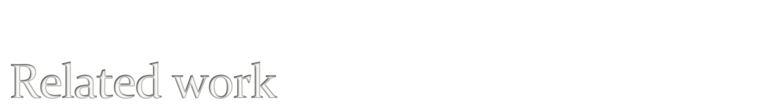
Pittman / GauthierDickey: “Measurement Study of Virtual Populations” (WoW Census+)
Suznjevic et. al. “Action specific MMORPG traffic analysis: Case study of World of Warcraft”
Svoboda et. al. “Traffic Analysis and Modeling for World of Warcraft” (mobile packet traces)
Thawonmas et. al. “Detection of Landmarks for Clustering of Online-Game Players” (ICE / Angel’s Love)
Chen and Lei – “Network game design: hints and implications of Player Interaction” (ShenZou network traces)
La and Michiardi – “Characterizing user mobility in second life”
Liang et al. – “Avatar Mobility in Networked Virtual Environments: Measurements, Analysis, and Implications” (second life)
28

Slide 29

Further analysis of network traces
  Message attribution
Simulate proposed DVE architectures
  Client-server, application-layer multicast, mesh
  Aggregation / per message transmission
Capture Wintergrasp data
  Most challenges are practical, not technical
Contact me for access to anonymized traces: johnmil@microsoft.com
29

Slide 30

Battleground | Players | Type
Warsong Gulch | 20 | Flag Capture
Arathi Basin | 30 | Territory
Alterac Valley | 80 | Kill the General
Eye of the Storm | 30 | Territory + Flag Capture
Strand of the Ancients | 30 | Assault
Isle of Conquest | 80 | Kill the General
Wintergrasp | 240 | Assault
30

Slide 31

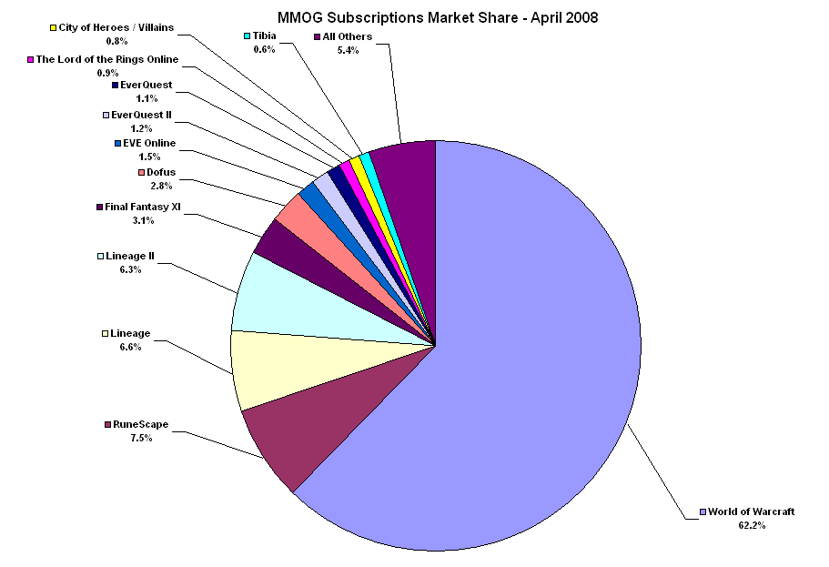
Source: www.mmogchart.com/Chart7.html (Bruce Woodcock)
31

Slide 32
The Near-Term (in)Feasibility of P2P MMOG’s
2. John L. Miller and Jon Crowcroft
From NetGames 2010

Slide 33
Outline
Motivation
Data Capture and Processing
Operational Assumptions
Simulator
Results
Conclusions
Notes:
In discussing this work, we’ll start with the motivation behind the research.
Our results are based on simulation, which in turn is based upon captured World of Warcraft data. We describe the capturing and processing of World of Warcraft data at a high level, outline some of our simulation assumptions, then describe the operation of our simulator.
Finally, we discuss the main results of our simulation work, and finish up with conclusions and suggested future work.

Slide 34

Paper Motivation
Challenges in DVE’s well known
  Scalability, latency, security
Lots of great proposals, especially P2P
  No significant adoption. Why?
→Search real examples for answers
  World of Warcraft or Second Life
  Realistic network conditions
    Everything works differently in the real world
Notes:
DVE and MMOG research has been around for a while. The problems in the space are fairly well understood.
Areas for work can be characterized as scalability – enabling larger-scale experiences; latency, ensuring clients receive up-to-date information and propagate their changes into the system with a minimum of delay; and security, helping ensure system integrity and preventing attacks and cheating.
We’ve seen a fair amount of research in each of these areas over the years, yet little – if any – of it has found its way into industry or large-scale deployment. Why could this be? There are any number of answers. One possibility which occurred to us is that perhaps the technologies being proposed simply aren’t viable, given the state of typical consumer’s connections today.
To investigate this hypothesis, we decided to work with a practical example. The most broadly deployed DVE’s today are World of Warcraft, an MMOG, and Second Life, a social virtual reality experience. We chose to evaluate World of Warcraft and the MMOG environment, in part because of the more highly interactive nature of the experience.
An important part of our evaluation is to use realistic network measurements which are relevant, such as host broadband capacity and inter-node latency.

Slide 35

Data Acquisition
Getting network traces is hard
  Players are (rightly) paranoid
  Even online affiliation provided little incentive
Interpreting network traces is hard
  WoW protocol is pithy and partly secured
  Mitigation: internet is a treasure trove of information
End result: simulation input traces which include:
  Avatar position, movement, and some activities
  ‘Attribution’ of most message bytes which were not successfully parsed
  Non-parsed, non-attributed bytes discarded
Notes:
Rather than generating a synthetic data workload, we wanted to base our evaluation on actual message streams from World of Warcraft. Some of our previous work provided us ways to extract Avatar positions and other relevant data from World of Warcraft data streams. We extend that work by applying it to scenarios other than World of Warcraft battlegrounds.
We wanted to obtain captures from third parties to diversify our data set. Unfortunately we found people were not in general willing to run the required software to capture network traces for us, and then return the traces to us. We believe this is due to the commonplace event of ‘account hacking,’ where peoples accounts are compromised, and their avatars possessions (and sometimes the avatars themselves!) are hijacked. To our surprise, even online affiliation did little to mitigate these fears. John Miller had been a member of a particular guild for more than three years and was an officer in that guild who knew many of the 400+ other members through online contact. Despite this fact, none were willing to capture data for study, even given in-game incentives such as virtual currency. As a result, the traces studied were taken primarily by John and his wife over the course of a few months.
Once the traces were acquired, converting them was still a substantial amount of work. The WoW protocol is very pithy – which is to say, requires a small number of bytes to communicate fairly complex concepts. Message headers which include the message type and message length are encrypted, complicating parsing. We had to focus on parsing complex message types based upon inter-relationships of their data fields, and ‘known good’ value ranges. Smaller messages – some of which were as small as the encrypted header, just four bytes – we generally couldn’t parse.
We used another technique – attribution – to assign unparsed parts of byte streams to a particular avatar. As long as we know the position of each avatar over time – which we do, with high confidence – then as long as we know which avatar originates a given message, we know the radius it needs to be propagated to, effectively that avatars AoI, 250 yards for our simulation. Using parsing plus attribution, we were able to assign most bytes to specific avatars for transmission. Any bytes which couldn’t be either parsed or attributed were discarded, to keep from biasing the simulation.

Slide 36
Data Parsing Results
Categories as proposed in earlier research, e.g. Suznjevic, Dobrijevic, Matijasevic, 2009
Notes:
This chart shows our success at parsing or attributing data in the traces we captured. Earlier research, such as the 2009 paper by Suznjevic, Dobrijevic, and Matijasevic, propose five categories of player activity. We captured data in all five categories, then parsed the captured data. The blue part of each bar shows the percent we successfully parsed with high confidence. The green segment of the bar shows bytes which were not fully parsed, but which were attributed based on the presence of a given avatar’s unique identifier in the message stream. The red bar shows the fraction of captured messages which were neither parsed nor attributed, and were instead discarded to keep from biasing the simulation.
Out of all the scenarios, Questing is the least interesting from our point of view. Traffic demands (as will be shown later) are extremely light, and it tends to be a largely solo activity taking place out of range of other avatars. Capital cities (trading) and Raids are the two most interesting categories, and we got good fidelity information for both of them. PVP and Dungeons (5-person instances) are also quite interesting, so we were happy to get high fidelity parses of those activities.

Slide 37

Operational Assumptions
Residential players with typical broadband
  Actual, not advertised speeds
Messages
  Originate at ‘sender’ Avatar position
  Transmitted by originator to each receiver
Propagation determined by Area of Interest (AoI)
  (Optimistic) perfect, zero-cost knowledge available
Transport is TCP/IP
  Guaranteed once, in-order message delivery
Notes:
Like any work, we had to make a number of assumptions to enable our simulation to move forward. Some of the more significant assumptions are listed here.
First, we are most interested in people playing from their residence, not from universities or work. University nodes tend to be disproportionately well connected, and indeed there are examples in earlier literature of peer-to-peer solutions surviving on the backs of University networks: rather than being purely peer-to-peer, I would argue these are de-facto super-node solutions with the university footing the bill. We’re interested in simulating pure peer-to-peer solutions in this work.
Fortunately there has been renewed interest in the UK in characterizing actual – as opposed to advertised or ‘headline’ – broadband speeds in the past year or two. We rely upon OfCom statistics (shown on the next slide) to characterize users actual speeds.
For message propagation, we assume that messages on behalf of a given Avatar originate at that avatar’s position, and must be propagated to all other Avatars based on distance. Avatars have an ‘area of interest’ or AoI that dictates a game distance they’re interested in events. Each avatar’s node is responsible for propagating its messages to all other avatars within AoI of itself. To simplify the simulation – and to error on the side of saying P2P is possible – we assume perfect information is available to each node as to which other nodes should receive a given message, and that this information requires no resources to maintain.
Finally, we assume TCP/IP as the game transport. TCP-like guarantees are required for the majority of game traffic, and the easiest way to get those guarantees is to use TCP, as (for example) World of Warcraft does.

Slide 38

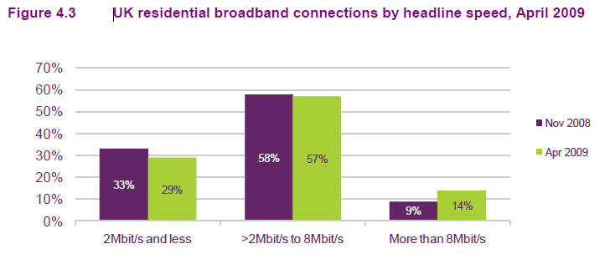
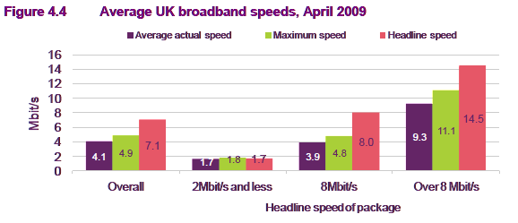
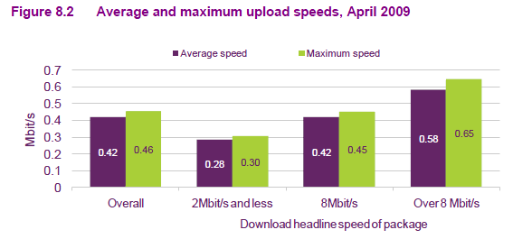
Node Profiles from
Notes:
This slide shows select tables taken directly from the UK Office of Communication 2009 report on broadband speeds. This report reflects the measured characteristics of ISP’s covering 90% of the UK’s broadband subscribers.
Figure 4.3 shows the percentage of UK subscribers in each of three categories OfCom uses to describe its users. 29% of users have broadband advertised with a download speed of 2 Mbps or less. 57% have a subscription with advertised speed between 2 and 8 Mbps, and 14% have connections with greater than 8 Mbps advertised speed.
The purple bars in Figure 4.4 show the actual speeds these users are receiving: 4.1 Mbps download on average. Broken down by category, we see that the 2 Mbps subscribers actually get about 1.7 Mbps, 8 Mbps subscribers get 3.9 Mbps actual download speed, and the remaining subscribers get an average of 9.3 Mbps. In general users received about 60% of their advertised bandwidth for downloads.
Figure 8.2 shows the limiting factor for P2P networks, actual upload bandwidth. Across all users, we find the average upload bandwidth available is 420 kilobits per second, with the breakdown per category shown to the right of the first bar.
In addition to these figures, OfCom also provides latency figures which show average user-to-server latency of 55 MS in the UK. We used this figure to design our latency space. Individual nodes are scattered in a cartesian ‘latency space’ where inter-node latency is calculated by their distance from each other in that space. We configure the space so the average distance of nodes to the center is 55 unit (MS), and if any servers are present, they are placed in the center of the space. While not a perfect latency model, this provides at least a first-order approximation of inter-node latency.
Our simulation is based upon these figures, and so can be considered as modeling potential P2P behavior in a network similar to the UK, circa 2009.

Slide 39
Simulator
Accepts our WoW simulation traces as input
Time resolution: 1 millisecond
Includes modelling of
  TCP Windowing, packet framing
  Last hop uplink, downlink capacity and contention
  Latency
Node bandwidth assignments based upon OfCom 2009 UK survey
Notes:
We wrote a network simulator which accepted our WoW network traces and node bandwidth and latency models, and executed message transmission until all messages had been received. The simulator evaluates transfers in one millisecond slices, and includes modeling of TCP windowing – which impacts maximum throughput for very fast nodes such as servers – and the overheads involved in packet framing.
We model bandwidth constraints on the first- and last- hop of each message – but assume infinite cloud capacity between those hops. The first and last hops are typically the constrained hops for residential broadband users, so we feel this is an accurate model. We model standard NIC transmission and receipt of packets, namely that packets are transmitted or received in the order they appear, regardless of sender. Each packet must be completely transmitted or received before processing of the next packet can begin. Packet transmission is based upon the order the local TCP stack for each node passed them down to the NIC in our simulation. Packet receipt is based upon the order packets arrive at the last hop, after taking into account transmission latency and inter-node latency modeling.
Bandwidth characteristics from each node are selected with weighted probability from the set of bandwidth characteristics suggested by the OfCom survey mentioned earlier.

Slide 40
Results
Even without overhead, P2P protocols consume too many resources
  For intense scenarios, nodes can ‘fall behind’
  Most messages important and difficult to discard
‘Falling behind’ increases node load
  new messages + catch-up
Aggregation of messages useful
  Introduces sender delay
  Offset by fewer bytes to transmit
Notes:
We ran our simulator across the set of all data captures we took, approximately 62 hours of captured data covering thousands of unique avatars.
We found that in general a pure P2P solution – where nodes are responsible for propagating messages originated by their avatar – cannot work, even for a relatively efficient MMOG like WoW. The overall bandwidth requirements are too great in most scenarios.
A common occurrence in the simulation was that most nodes were able to keep up most of the time, but then during a period of heavy activity – many avatars converging, or concerted efforts with a sustained higher message rate for heavy combat – message propagation falls behind. Assuming messages cannot be dropped, the node then has to not only continue transmitting its messages, but clear out its message backlog.
Previous work has suggested that messages can be dropped without penalty. This is true for some types of messages, but certainly not all. Even dropping messages which *can* be safely dropped (such as a subset of movement messages) can reduce experience fidelity. A priority scheme for dropping messages is worth investigating, but at the end of the day the simulation requires reasonable data fidelity to create a good experience for the user.
One surprising result from our simulations that we will discuss later: aggregating messages improves overall performance. In other words, if each node waits a short period before transmitting messages, and combines together the messages awaiting transmission during that interval, the reduction in packet framing overheads can actually result in the message being transmitted and received with less latency, and reduced bandwidth consumption.

Slide 41
Results: Bandwidth
P2P Upload bandwidth scales with number of peers in AoI, 10 x to 100 x the Client-server load on average
Client-server Download slightly larger because nearby AI is communicated from server rather than locally calculated
Notes:
These two figures show the average upload and download bandwidth consumption for client-server (green) vs. peer-to-peer pub-sub (red) for the simulation traces by category.
Again, the main difference is: in peer-to-peer scenarios, the avatar’s node is responsible for transmitting each message to every other node which needs it. In the client-server model, the client only transmits a single copy of the message, and the Server does message fanout. In our simulation we assume the server has 1 Gbps symmetric bandwidth available for the simulation.
In the left table, we see that the highest average upload rate is for Capital cities (trading), raids, and PvP. For capital cities and raids this is primarily a function of a large number of avatars being within each others AoI. For raids, the number of avatars is a little smaller, but periods of peak activity tend to be heavier, with a large number of both player and AI avatars partaking in a large variety of activities (spells, combat, etc.) resulting in very heavy peak activity. To get an idea how much of a category’s bandwidth is from activity vs. number of nearby nodes, look at the client-server upload figures, as those reflect the level of activity per node.
We see a small difference between client-server and peer-to-peer download rates, where P2P download rates are slightly lower. This is because in the client-server model the server models and transmits AI behavior to the client, but in the peer-to-peer model, AI is modeled on the closest peer, and that peer doesn’t need to transmit the AI’s behavior to itself, just to other nodes. As a result, it requires slightly less data be received overall.

Slide 42
Results: Latency
Latency is usually a function of message creation, upload bandwidth, and neighbors
Average latency OK with small number of neighbors, but as expected, scenarios with large number of neighbors and high message rates have highest latency
Differences from Client: server: Ignoring questing, 40:1 to 445:1
Notes:
These figures shows the average latency in seconds for each scenario, please note the left and right diagrams are to different scales. Again we find that client-server latency is relatively small, while peer-to-peer latency can be as high as 9 seconds on average. If you look at the peak average latency (average of the peak latency encountered at each node) in the figure to the right for P2P, you can see that at its worst, latency is quite extreme, as high as two minutes.
Some of the worst problems come when a node in the smallest bandwidth category (e.g. < 2 Mbps download capacity) happens to also be in an area with heavy activity and a high concentration of nodes.
As expected, Questing doesn’t see many problems, as it involves relatively little inter-node messaging.

Slide 43
Message Aggregation
Message aggregation: bundling together time-proximate messages to send together
  Reduces overhead by up to a factor of 10
Delays message transmission, but mitigated by shorter transmission time and smaller transmission queue
Note: some ‘bundling’ artifacts in traces
  Many message types lack internal timestamp, so we used capture time as timestamp
  Wow client-server does some aggregation, biases our measurement with bundles of messages
Notes:
As an experiment, we introduced message aggregation to try to reduce the impact of transmitting a large number of messages between pairs of nodes. In aggregation, a client buffers messages intended for a specific destination address for a short period, combining their payloads together before transmission. Typical WoW message payloads are small, typically a couple dozen bytes. If we manage to aggregate even two messages together, this can result in transmitting a smaller overall message, e.g. 64 bytes instead of 104 bytes. (40 byte IP + TCP overhead per packet).
The small delay in sending the message should intuitively increase latency, but since there is less data to transmit – and less contention to transmit it – the net effect tends to be a decrease in end-to-end latency of the message.
It’s worth mentioning that our traces don’t provide perfect information for this evaluation. Messages which are attributed rather than parsed – as well as some of the parsed messages – don’t have game timestamps, so we use their packet capture time as their origination time. The WoW server does some aggregation, which means we can wind up stamping several messages as having identical transmit timestamps. For future work we hope to get higher-fidelity data which doesn’t include this artifact.

Slide 44
P2P Message Aggregation
Impact of 1 millisecond of aggregation on average latency measurements, relative to original measurements
 | Upload Bandwidth | Download Bandwidth | Latency
Capital | -6.50% | -7.10% | -22.30%
Raid | -34.30% | -35.70% | -76.90%
Dungeon | -28.80% | -29.00% | -60.20%
PVP | -17.50% | -18.60% | -52.50%
Quest | -10.20% | -13.60% | 2.20%
Notes:
This table shows the impact of doing a single MS of aggregation on the sender. Upload and download bandwidth are both reduced, as expected. However, the big surprise is the massive reduction in latency in most scenarios. In particular, raids which are characterized by the heaviest per-user activity, benefits the most, with latency dropping to a quarter of its previous value. While this still results in too much latency to be playable, it is promising, and suggests that aggregation can be used to allow P2P to be deployed earlier in the lifecycle of residential broadband improvements than would be possible without it.

Slide 45
Client-Server Aggregation
Impact of 1 millisecond of aggregation on average latency measurements, relative to original measurements
 | Upload Bandwidth | Download Bandwidth | Latency
Capital | -25.00% | -31.80% | 0.80%
Raid | -6.10% | -17.70% | 0.20%
Dungeon | -17.60% | -20.40% | 0.60%
PVP | -31.70% | -38.60% | -0.30%
Quest | -9.00% | -14.30% | 0.00%
Notes:
This table shows the impact of message aggregation on client-server transmissions. What we find is that, as in the peer-to-peer case, message aggregation can significantly reduce bandwidth consumption. The patterns are different because while a P2P node can aggregate only messages its avatar creates and needs to propagate, the server in a client-server model can aggregate messages across all avatars which happen to be destined for a given node.
Despite the reduction in bandwidth requirements using client-server aggregation, latency still goes up, as the simulated server is sufficiently provisioned and inter-node latency dominates compared to transmission size for relatively small messages.

Slide 46
Conclusions
P2P wow-like MMOG’s are not feasible with today’s residential broadband
  Hybrid solutions may be possible
Message aggregation useful
  Reduce bandwidth and in many cases latency
Future work:
  Recommend focus on non-P2P solutions
  Identify ‘average’ node attributes required to support P2P
Notes:
In conclusion, we believe we’ve shown that pure peer-to-peer MMOG’s are simply not feasible given the state of todays residential broadband. Typical home nodes lack the upload capacity to keep up with peak – and in some cases, average – messaging requirements. Our simulation was performed with World of Warcraft, a relatively efficient protocol which typically requires less than 10 kbps upload and less than 20 kbps download capacity for the client-server scenario.
We find that message aggregation can help mitigate bandwidth consumption and latency, especially when bandwidth capacity is saturated (e.g. in P2P). Even in the client-server case, aggregation reduces bandwidth requirements with relatively little cost in terms of latency.
We recommend that research intended for near-term adoption by DVEs and MMOG’s do not focus on pure peer-to-peer solutions, as these are not feasible with todays network characteristics.
It might also be worth performing additional research to estimate the bandwidth requirements to enable P2P messaging solutions for MMOG’s, to help forecast when typical residential broadband might meet those requirements.

Slide 47
How do P2P OSNs do?
3 main attempts
Diaspora, Peerson and Safebook
Complexity is high
Reliability is low
Downlink capacity not, yet, a problem, compared to games
Gamers (FPS) have to cope with field of view/realestate, so natural limit on total players
C.f. regions in first part of talk, gives scale
Would same region idea work for OSNs
i.e. spatial affinity in real world, for relevance
Research (out there recently) says YES!

Slide 48
Take Home
We’re not there yet…
Server based systems for many-to-many Games and OSNs
  +ve ordering/cheat proofing
  +ve mix/filter
  -ve scale of server
  -ve control/privacy
With fiber roll-out happening, this will work (as well as lower latency)
Using Affinity for relevance filtering in OSN update traffic could work too☺

