Slide 1
CSAP research -> policy
Jon Crowcroft
http://www.cl.cam.ac.uk/~jac22
9th June 2026

Slide 2
Trustworthiness of Digital Id
Gates funded work in Global South
Interesting breadth of culture
Citizens versus Government

Slide 3
Data Minimisation - Principle
Attribute Verification
Just want to check a fact about a person
  Need to link person&fact
  Do not need to identify person
  Nearly zero knowledge techniques
  Two Tech Examples
    Decentralized Service
    Feature Phone based verified credentials

Slide 4
1.0 “Where” are Id Services?
Spectrum of Id Services
  To date, most Centralized
    usually somewhat replicated/distributed
  Some Federated
  Few Decentralized
Decentralised minimizes risk
  Can also be used to federate
  Disintermediates government (which they don’t like)

Slide 5
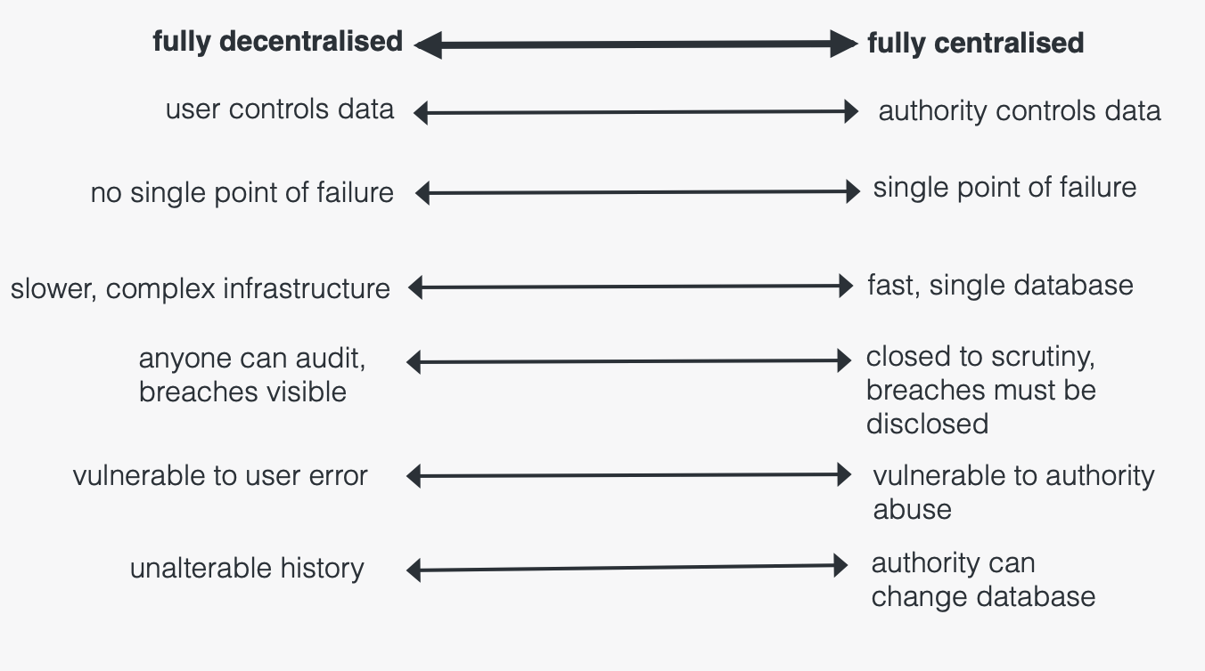
1.1 Central v. Decentralised spectrum

Slide 6
2.0 Client verification tech - Users
We want to verify a person’s attribute
  Over 18, Has a vote, E.g. food discount
Could use biometric + database look up (bad idea!)
Or Client provide OTP/token
  only encodes attribute type and a right to one lookup – much better
  Can do via smart card or
  Or phone SIM (secure co-processor!)
    Cheaper than a smart card!

Slide 7
2.1 e.g. SIMple Id app
Use SIM on feature phone
  Similar cost to smart card
  More useful..
  Don’t need always on connection
  Verifier may need net access
  Comms via screen/QR code
  User check via photo or remote voice

Slide 8
Lessons for Tech > Policy
Takes a long time (decade) for policy maker and citizens to understand/internalize trade-offs
Large scale infrastructures take a long time (decades) to deploy to near 100%

Slide 9
Acknowledgements
Bill&Melinda Gates Foundation
Turing Institute
IETF, ITU, W3C, et al

