Slide 1
Deployment Environment for Machine Learning Models with Kubernetes
Stefan Ivanov
Open Source Project Study

Slide 2
Motivation
High-level component overview of a machine learning platform.
Figure taken from [1] on TensorFlow Extended (TFX).

Slide 3
Significance of Project
Setting: Existing production environment handling inference requests
Training, comparing and deploying new machine learning models
non-trivial in a high-availability environment
non-trivial even when iterating on a single design [1]
Challenges:
No downtime for the deployed model
Models comparison should be easy and consistent
Consistent use of training data

Slide 4
Goals of the Project
The goal of the project is to build a minimal platform/microservice application on top of Kubernetes allow a researcher to:
Train a new machine learning model on a specific data set in a controlled environment
Comparison between previous models in the same environment
Deploy the new model without downtime for users of the model
* Be as minimal as possible

Slide 5
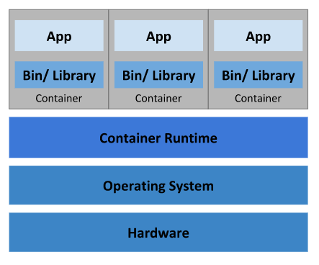
Kubernetes
Kubernetes [2] is an open-source container orchestration system for automating application deployment, scaling, and management.
Use in the project:
Start containers for training models
Keep track of previously trained models
Manage high availability of the deployed model
Scaling and monitoring of the pipeline
Visualization of the Container Deployment [3]

Slide 6
TensorFlow
TensorFlow [4] is an end-to-end open source platform for machine learning.
Use in the project:
Entirety of the training microservices
Distributed learning of models
Handling online inference requirements

Slide 7
Progress
Current
Future TM
Researched data science/machine learning company requirements
Explored basic capabilities of Kubernetes
Pods, Nodes, Deployments, Services
Tested simple distributed TensorFlow 2 model
Explore Kubeflow, TensorFlow Extended (TFX) and other similar project
Choose reasonable baseline inference tasks for a high-availability service (image recognition API, Tweet sentiment analysis, etc.)
Design Kubernetes deployments and services for the main components of the framework: storage, training, inference
Set up a simulated user – continuous queries
Benchmark on several iterations of the model

Slide 8
Questions and Suggestions

Slide 9
Thank you for your attention!

Slide 10
References
[1] D. Baylor et al.: TFX: A TensorFlow-Based Production-Scale Machine Learning Platform, KDD, 2017.
[2] Kubernetes: https://kubernetes.io/
[3] What is Kubernetes: https://kubernetes.io/docs/concepts/overview/what-is-kubernetes/
[4] M. Abadi et al. Tensorflow: A system for large-scale machine learning. OSDI, 2016.

