Slide 1
TensorFlow Eager vs. PyTorch Sentiment Classification Using TreeLSTM
Presented by Ari Ball-Burack for R244, November 2019

Slide 2
What are TF and PyTorch?
Two most popular deep learning frameworks
Developed by Google (TF) and Facebook (PT)
Both operate on tensors flowing through DAG
Static vs. dynamic computation graphs (!!!)
TF (native) requires graph definition (Session, Placeholder) before run -> declarative
PT is more Pythonic (change & execute as you go) -> imperative, better for RNN with variable-length input

Slide 3
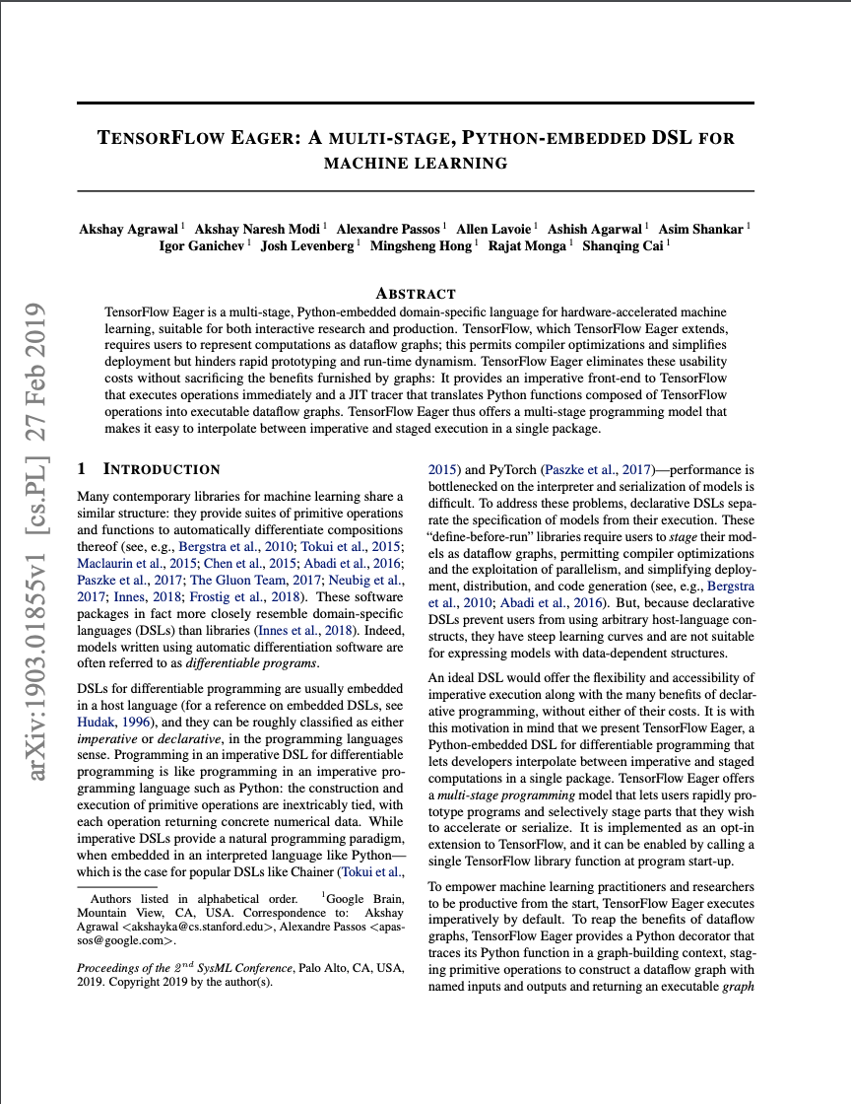
TensorFlow Eager Changes the Game
Described by Agrawal et al. 2019
“Multi-stage, Python-embedded DSL”
Imperative frontend to TensorFlow
Executes operations immediately
JIT tracer
Translates Python TensorFlow functions into executable dataflow graphs

Slide 4
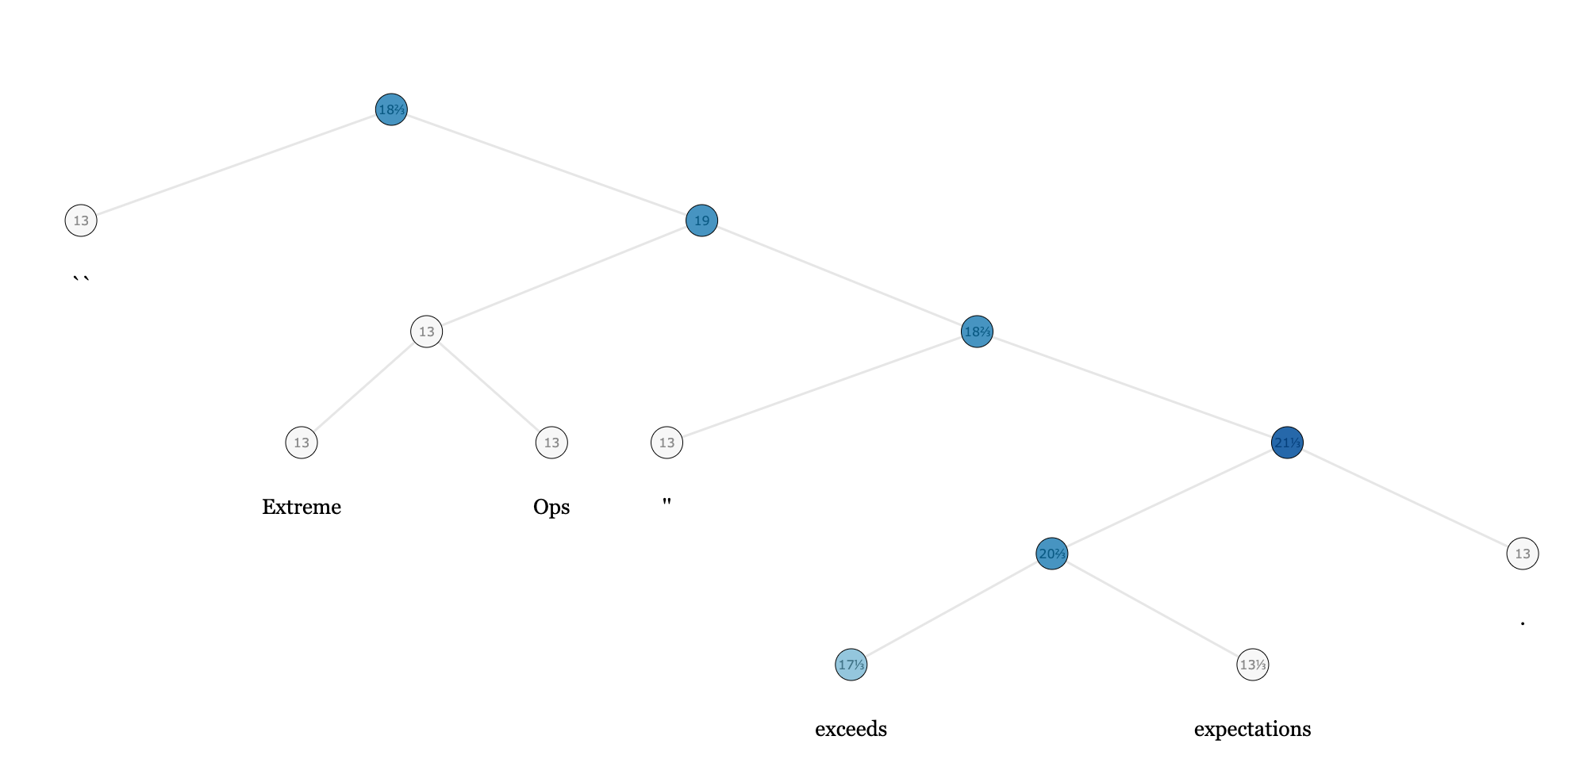
Tree-LSTM
Introduced by Tai et al. 2015
Generalization of LSTM (good for preserving sequence information over time) to tree-structured topologies
Potential usage: sentiment classification of parsed sentences from movie reviews

Slide 5
A Fair Fight?
PyTorch generally recommended for RNNs
Simpler implementation and shorter running time without graph construction overhead
How will TensorFlow Eager implementation compare
Does eager execution better accommodate variable-length input in terms of running time? Ease of implementation?
Work plan: Implement both and compare:
Quantitatively: running time to train & classify, accuracy
Qualitatively: ease & intuitiveness of implementation

Slide 6
Questions?

