Slide 1
Fast Bayesian Optimization of Machine Learning Hyperparameters on Large Datasets
Aaron Klein, Stefan Falknet, Simon Bartels, Philipp Henning, Frank Hutter
Presented by: Stefan Ivanov

Slide 2
Background – Hyperparameter Black-Box Optimization
Hyperparameter: A parameter that is set before the learning phase which can substantially affect the performance of the model or algorithm
Hyperparameter optimization: Finding a tuple of hyperparameters optimizing a learning algorithm for a specific goal
Solving optimization problems of the form: $x_{∗}={arg min}_{x∈X}{f\left(x\right)}$
Observe only function values
Evaluation of f is expensive
Observation may be noisy

Slide 3
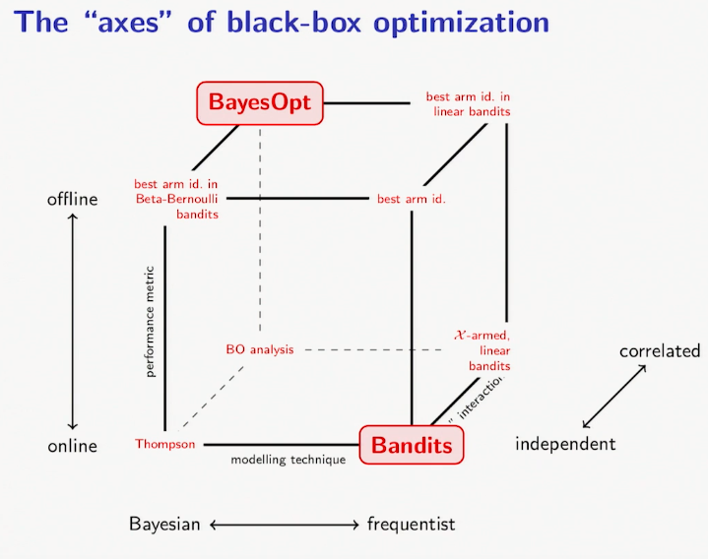
Bayesian Optimization
Black-box optimization technique involving Gaussian Processes
Requires prior over the function being optimized and acquisition function quantifying the utility of evaluation the function at some configuration
Prior → a Gaussian Process
Acquisition functions
→ “exploration vs. exploitation”
Entropy Search (ES)
Expected Improvement (EI)
Upper Confidence Bound (UCB)
Predictive Entropy Search (PES)
Positioning of Bayesian optimization among
Other black-box optimizers. Image courtesy of [6].

Slide 4
Problems with Regular Bayesian Optimization
Evaluation of the function optimized can be very expensive
Large datasets required for the performance of the underlying system might even be unoptimizable
No notion of good result on a small data set

Slide 5
Fast Bayesian Optimization for Large Data Sets - Idea
FAst Bayesian Optimization on LArge data Sets (FABOLAS).
Motivation: Human experts study algorithm performance on smaller data sets to determine optimal hyperparameters (i.e. prune bad ones) before using larger sets of data
The subsampled data $N_{sub}$ is an additional input to the black box function and the optimizer is free to choose it at each step.
However, $N_{sub}$ is not hyperparameter
The goal is to optimize performance for $N_{sub}=N$ , i.e. $f(x, N)$

Slide 6
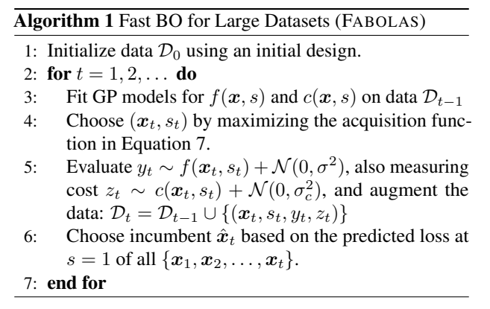
Fast Bayesian Optimization for Large Data Sets - Design
Environment variable for the model:
$s=\frac{N_{sub}}{N}$
Changed during optimization but set to 1 during evaluation
Extend GP by the extra dimension of $s$
Encode the behaviour that the loss function of a machine learning algorithm decreases with more data
The FABOLAS algorithm as see in the paper. [1]

Slide 7
Alternative Techniques for Hyperparameter Optimization
Standard Bayesian Optimization (using Entropy Search or Expected Improvement)
Multi-task Bayesian Optimization (MTBO) [5]
Optimization for different by correlated tasks
Can model the current approach but the number of tasks is discrete and evaluation on the full data set is required for correlation
Hyperband [4]
Multi-arm bandit strategy
Dynamically allocates resources to better performing configurations
SMAC (Random forests of regression trees) [3]
Extrapolation of learning curves [2]
Cancel configurations if after some evaluation time they are deemed to be insufficient

Slide 8
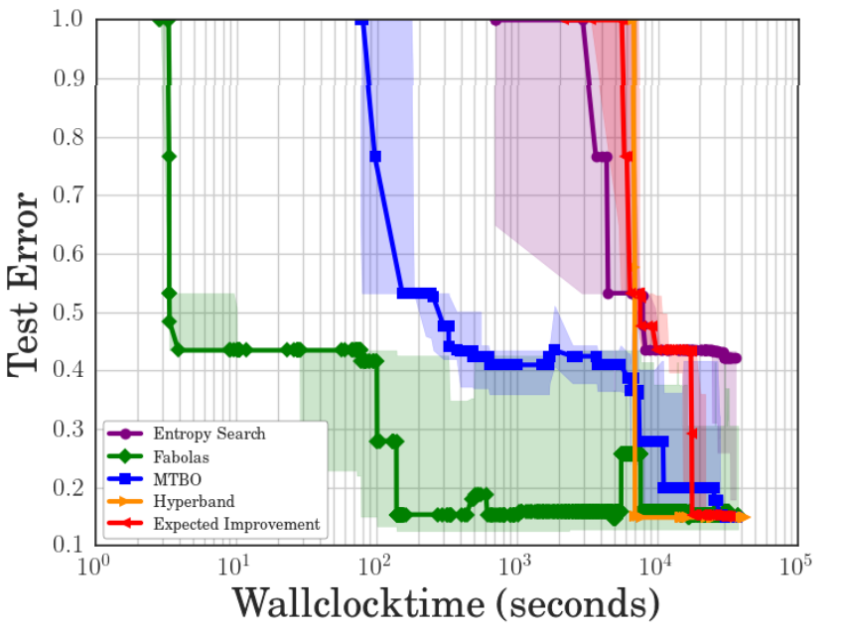
Assessment, I
Compared to (1) BO with EI, (2) BO with ES, (3) MTBO and (4) Hyperband
Tracked wall clock time relative to validation error
Experiments, ML models and data:
Support vector machine grid on MNIST
Support vector machines on various datasets
Convolutional neural networks on CIFAR-10 and SVHN
Residual neural network on CIFAR-10
General results
Hyperband performs well, if it actually proposes something (could not be used on the last experiment)
FABOLAS achieved superior performance when it comes to finding decent parameters quickly
All methods converge to a common test error
SVM hyperparameter optimization on the datasets covertype. [1]

Slide 9
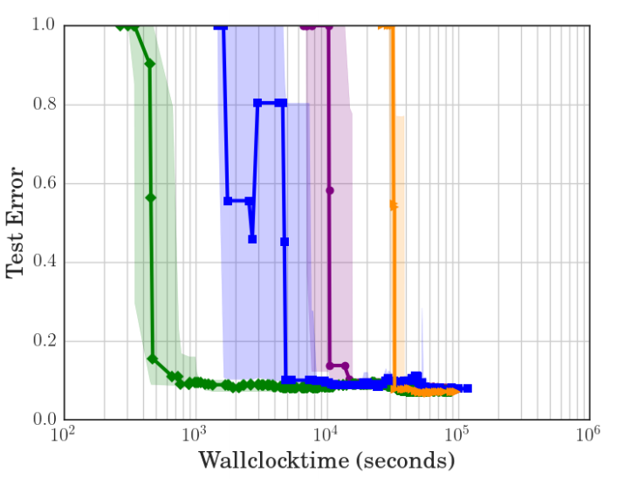
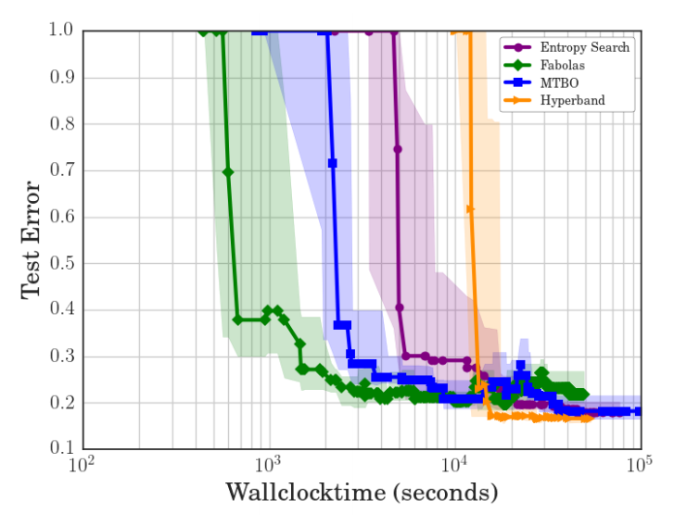
Assessment, II
Test performance of a convolutional neural network on CIFAR10. [1]
Test performance of a convolutional neural network on SVHN. [1]

Slide 10
Critique
Very little discussion on how the data set is divided for subset evaluation and whether that is important
Insufficient comparisons to other methods. In particular, no comparison to Extrapolation of learning curves [2] which showed superior performance to methods in its evaluation
Greater performance error in the long run on CIFAR10 is never explained or analyzed
The way the environment parameter s (the relative size of the subset evaluated on) is based on evaluation and intuition on one example

Slide 11
Questions

Slide 12
References
[1] A. Klein, S. Falkner, S. Bartels, P. Hennig, F. Hutter: Fast Bayesian Optimization of Machine Learning Hyperparameters on Large Datasets, AISTAS, 2017.
[2] T. Domhan, J. T. Springenberg, F. Hutter: Speeding up automatic hyperparameter optimization of deep neural networks by extrapolation of learning curves, IJCAI, 2015.
[3] F. Hutter et al.: Algorithm runtime prediction: Methods & evaluation, Elsevier J. AI, 2014.
[4] Li, Lisha, et al.: Hyperband: A novel bandit-based approach to hyperparameter optimization, arXiv preprint arXiv:1603.06560, 2016.
[5] K, Swersky, J. Snoek, R. Adams: Multi-task Bayesian Optimization, NIPS, 2013
[6] M. Hoffman: Bayesian Optimization with extensions, applications and other sundry items, UAI 2018, https://youtu.be/C5nqEHpdyoE

