Slide 1
TVM: An Automated End-to-End Optimizing Compiler for Deep Learning
T. Chen, T. Moreau, Z. Jiang, L. Zheng, S. Jiao, E. Yan, H. Shen, M. Cowan, L. Wang, Y. Hu, L. Ceze, C. Guestrin, and A. Krishnamurthy
Presentation by Grzegorz wilk

Slide 2
Background
Goal:
Rewrite the computational graphs to functionally equivalent, but more efficient ones.
Subject to what hardware backend we are running on.
High level computation graph optimizations as well as operator level optimizations.

Slide 3
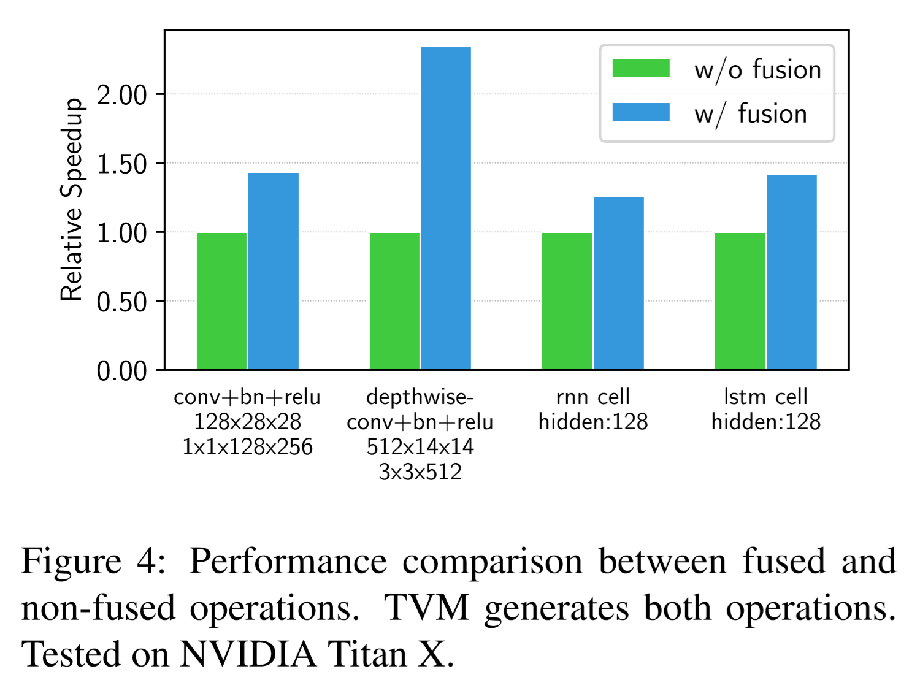
TVM Computational Graph Optimizations
Fuses whichever operators it can to reduce memory operations
Transforms the shapes of intermediate tensor data to allow for more efficient execution on the used hardware

Slide 4
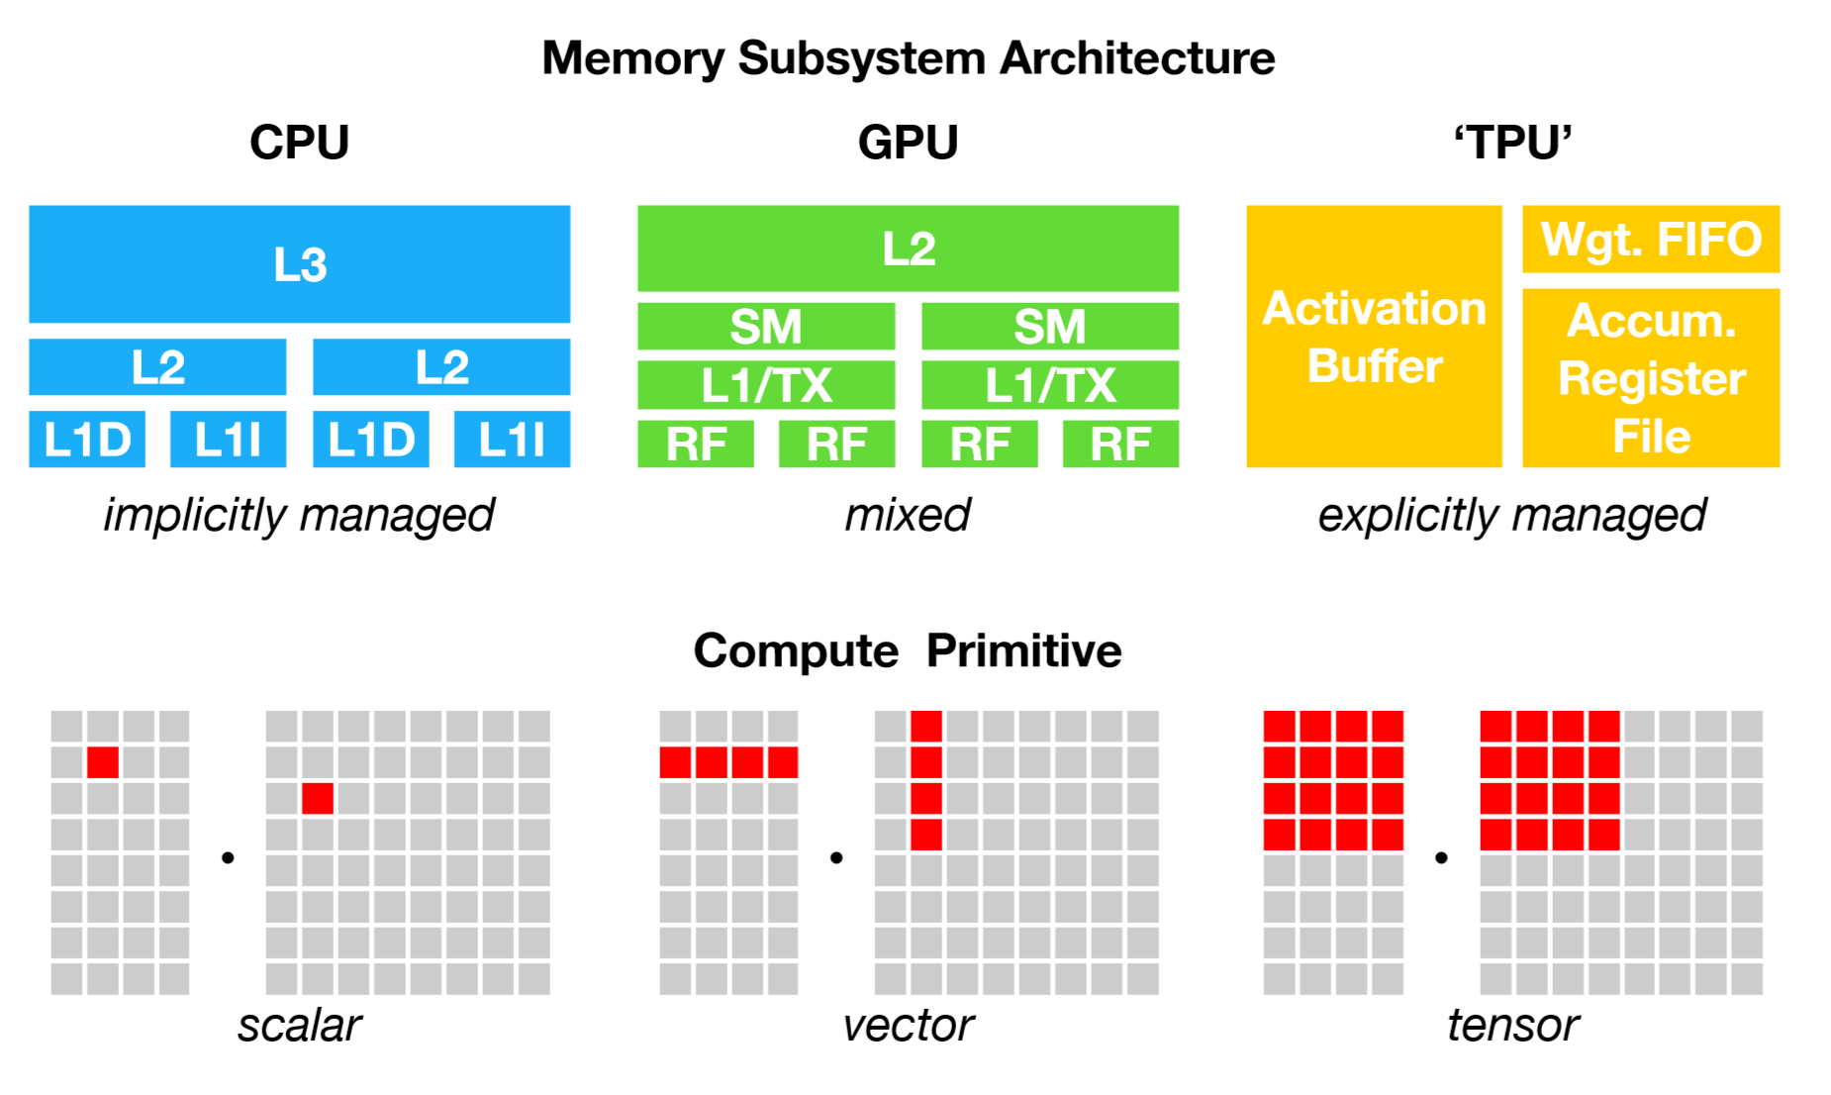
But what about low-level?
ML computational graphs are often too high level to allow for hardware back-end speciﬁc operator-level optimizations.
Tensor-Flow, PyTorch, MXNet all leave it to vendor libraries.

Slide 5
Separation of computation definition and low-level scheduling
Halide’s approach extended with new optimizations.

Slide 6
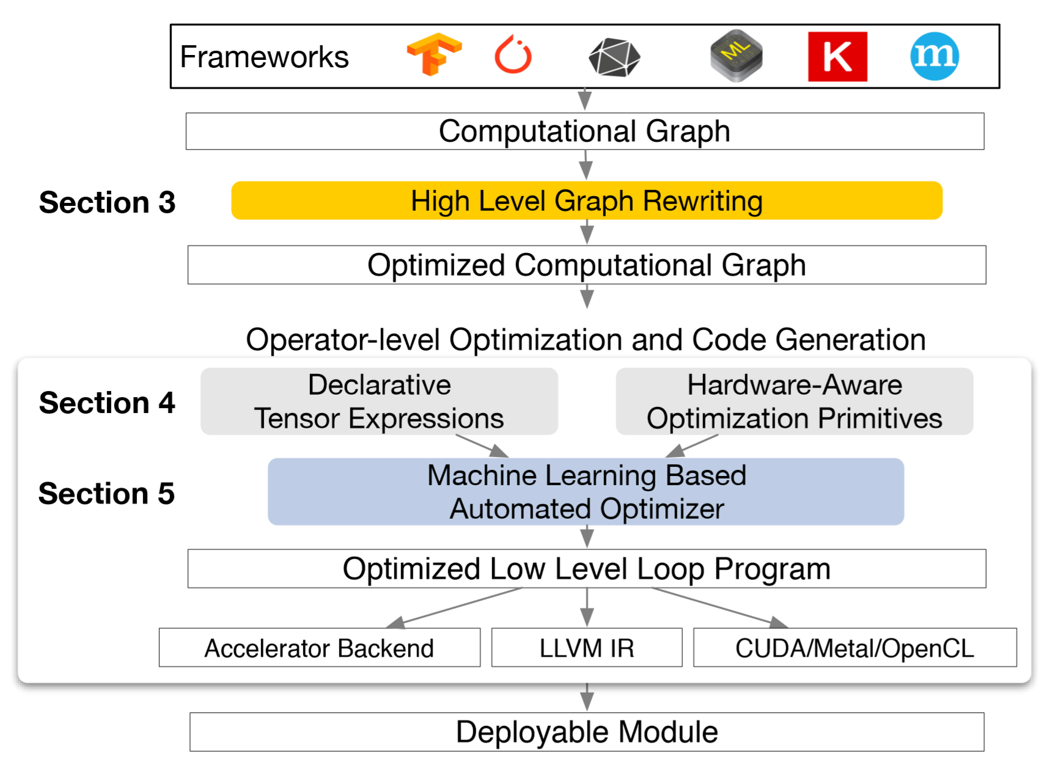
Operator-level optimizations
loop transformations
thread binding
locality computation
special memory scope
tensorization
latency hiding

Slide 7
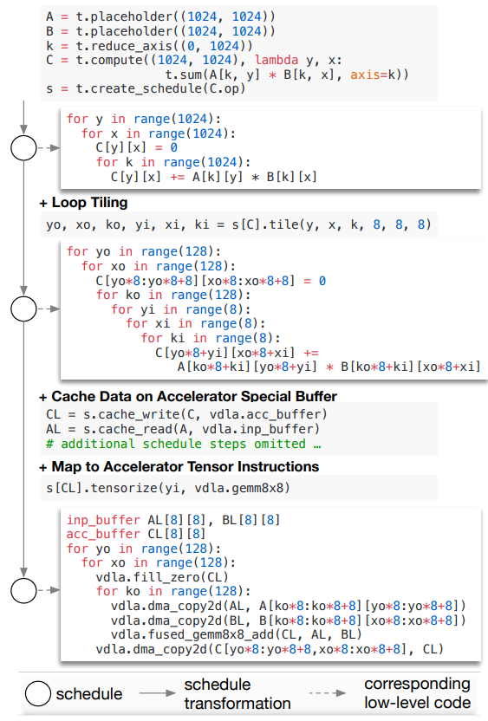
Operator-level optimizations
loop transformations
thread binding
locality computation
special memory scope
tensorization
latency hiding

Slide 8
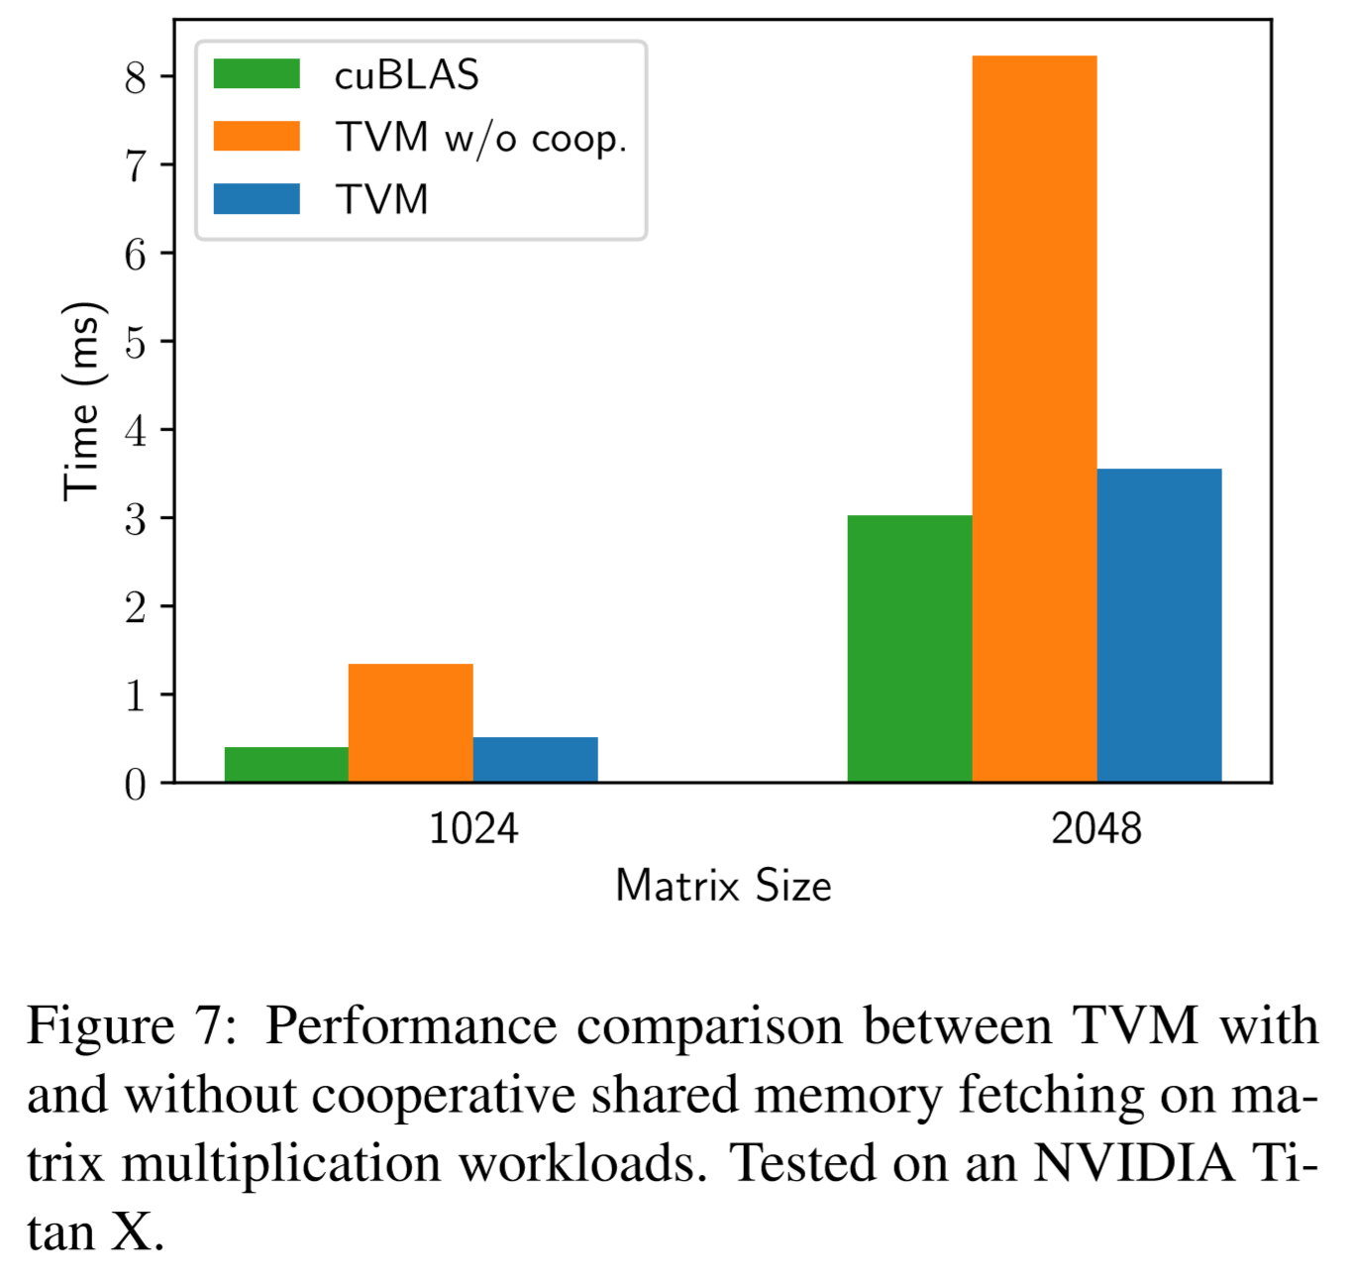
Memory scoping
Take advantage of memory locality in parallel settings (e.g. GPUs).

Slide 9
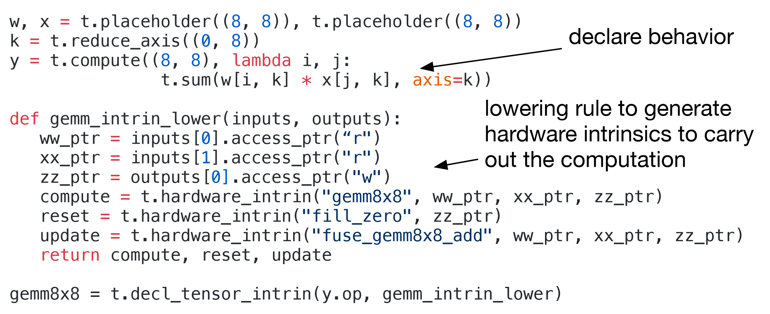
Tensorization
Means of generically describing arbitrary tensor operations, to allow for seamlessly using TVM with new hardware capabilities.

Slide 10
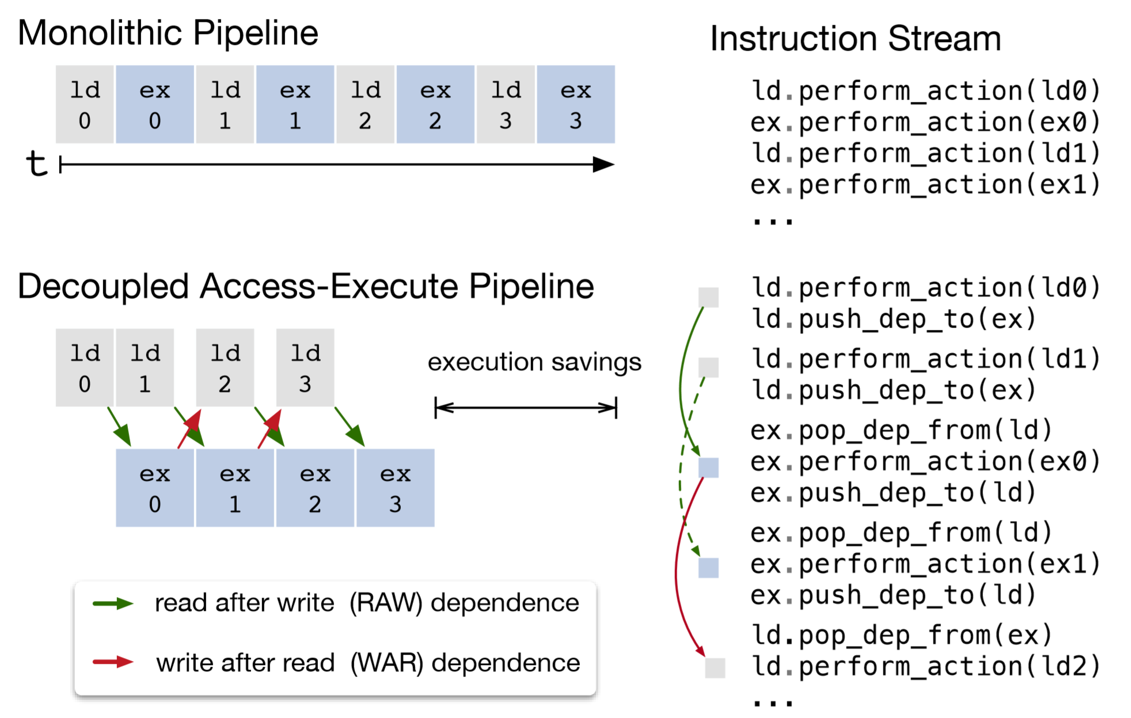
Latency hiding
Takes advantage of rearranging memory transfer operations to overlap computation with waiting on memory.

Slide 11
Automatic optimization search space exploration
Cost model estimated using machine learning.
Used to predict the strategies performance.
Guides the automatic optimization exploration.
Runs experiments which then feedback to the cost model.

Slide 12
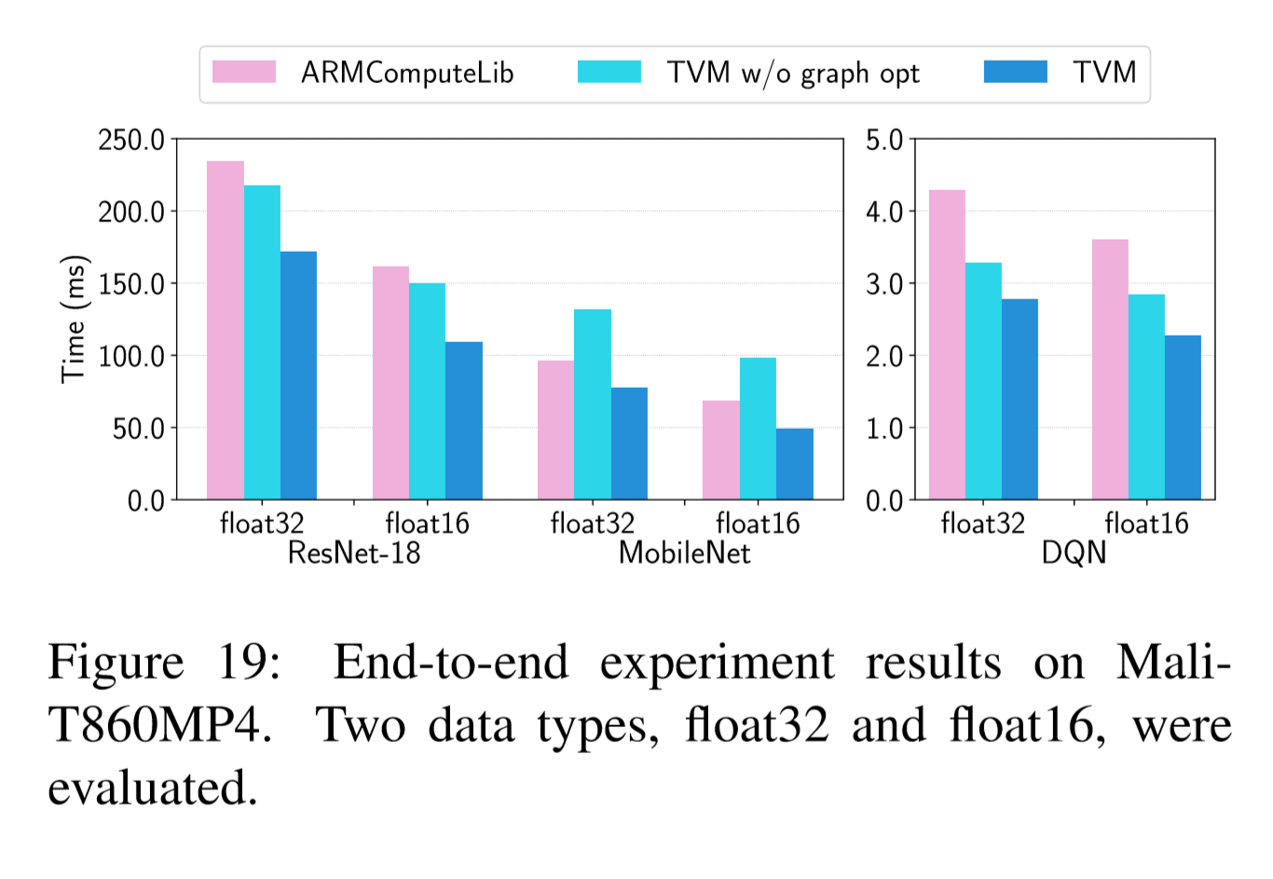
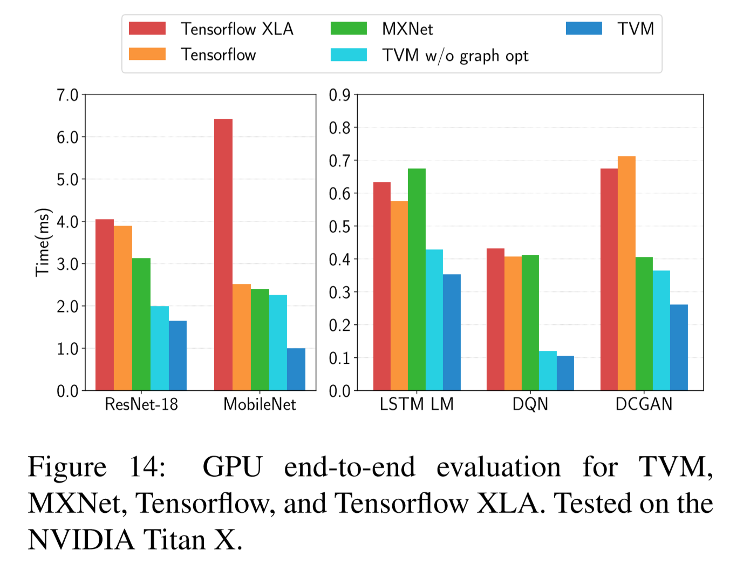
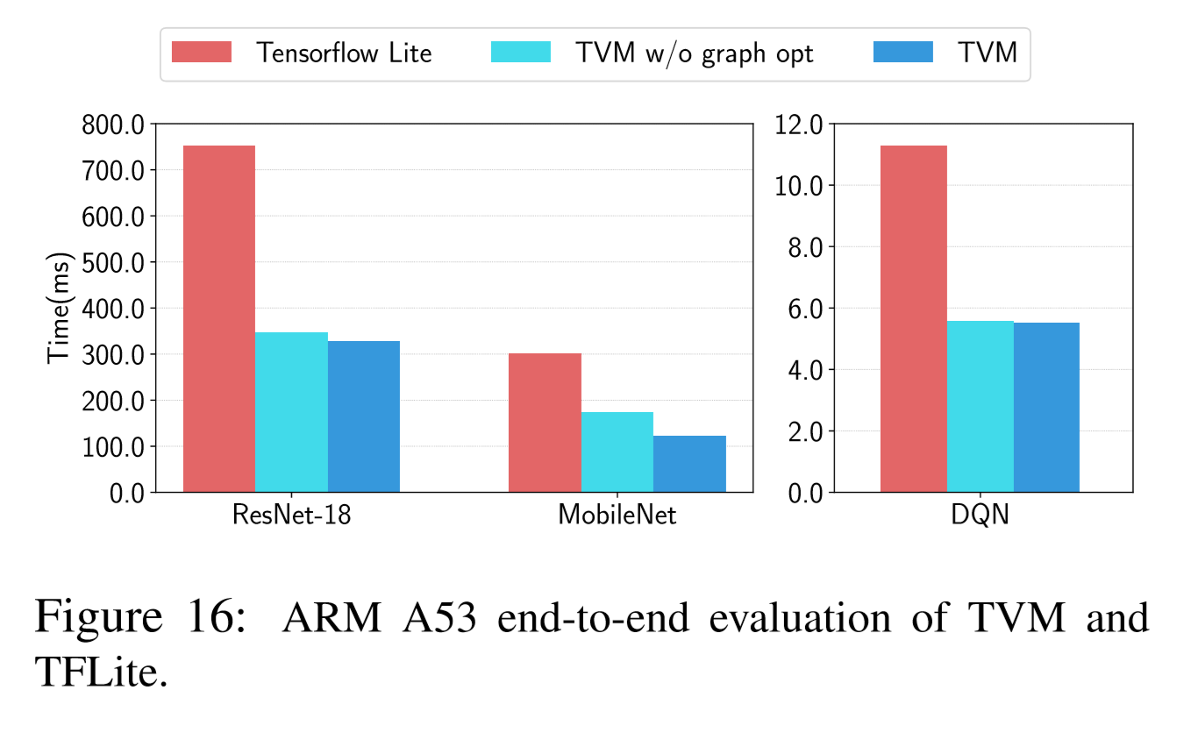
Evaluation

Slide 13
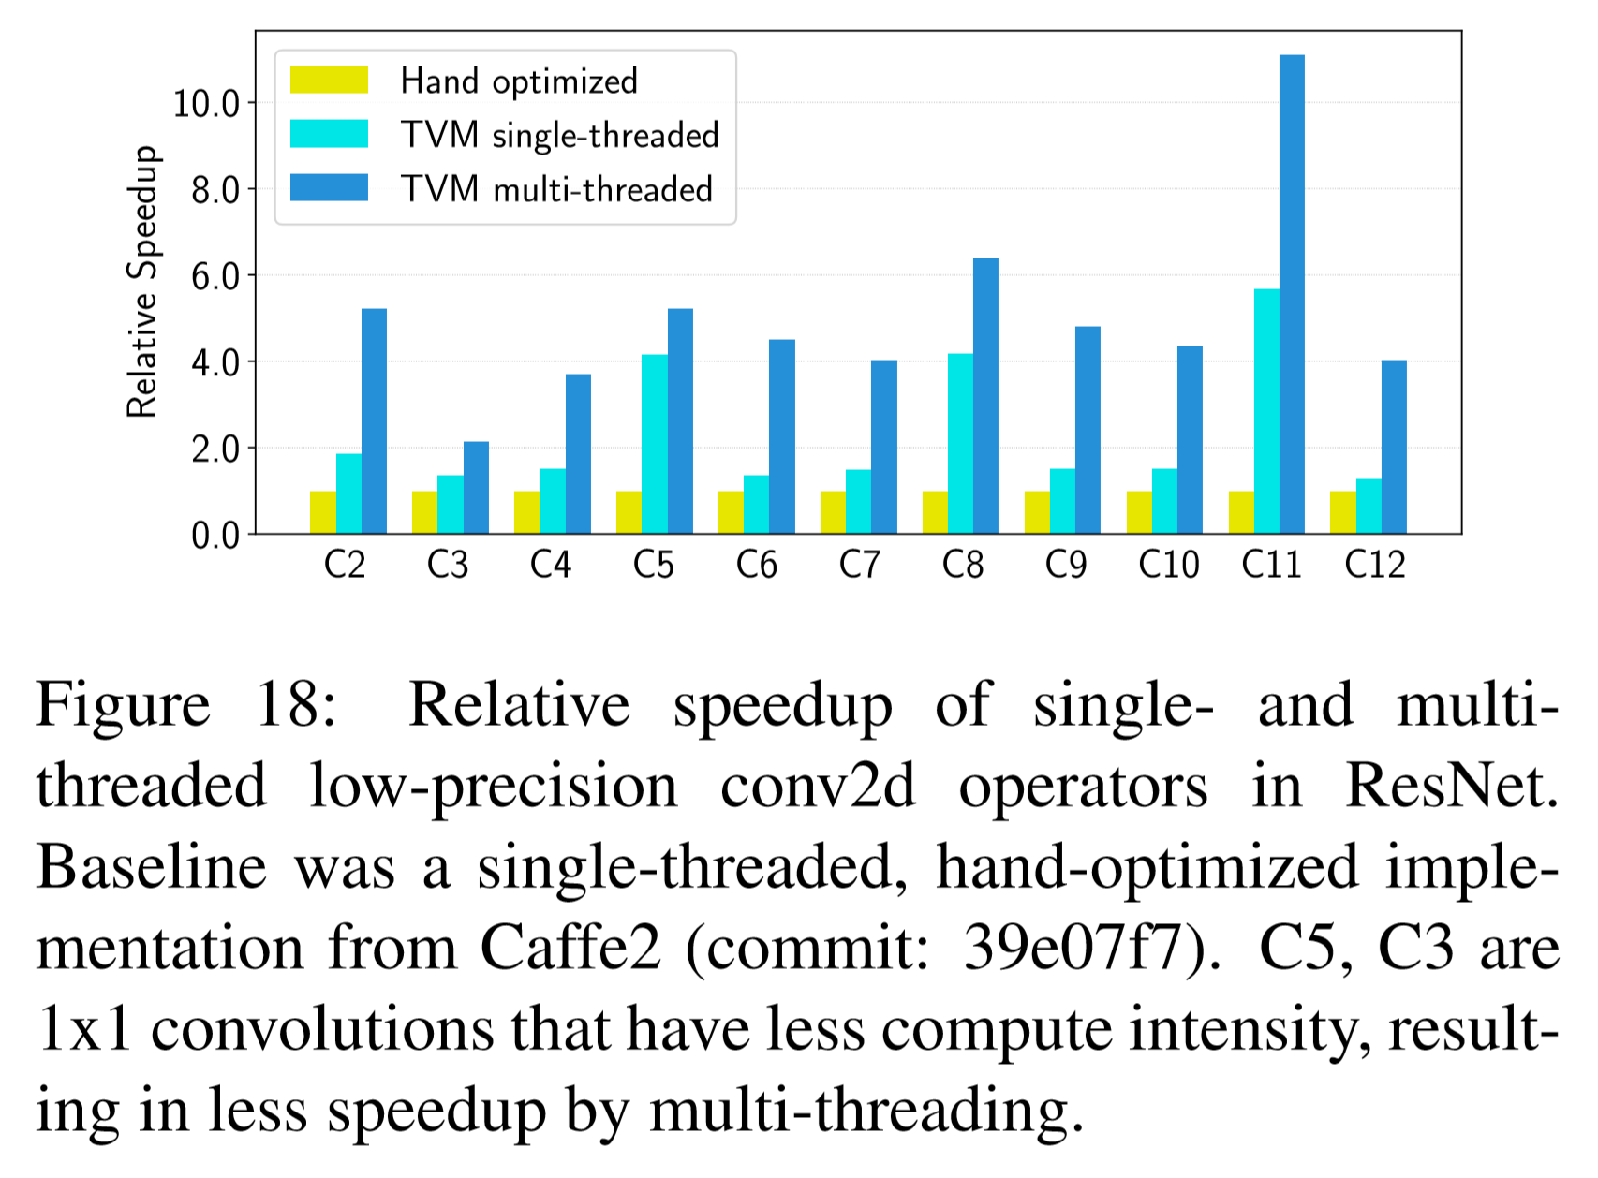
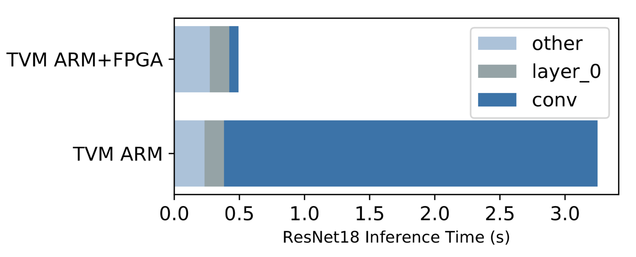

Slide 14
Critique
Positives Negatives
Solves the problem it poses
Evaluates each proposed optimization
…as well as the end-to-end computational pipeline across 4 hardware platforms across 5 ML workloads
…including specific operators within these workloads
Optimization search limited to one device, can’t take advantage of multi-GPU.
Missing descriptions of the operation optimizations which are included in TVM but weren’t introduced by it.
Limited evaluation of how long it takes to explore the optimization search space to produce the chosen strategy (example on just one conv2d operator).

Slide 15
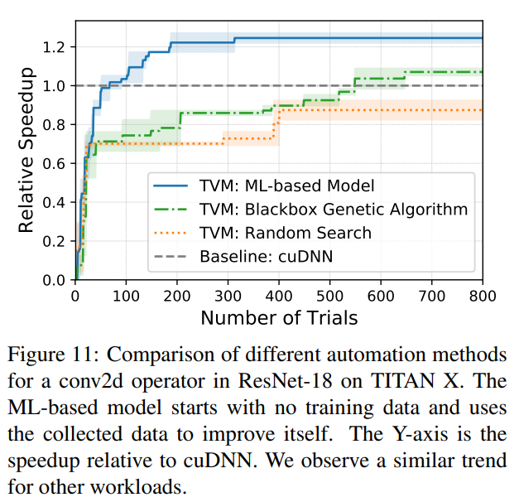
Critique
Positives Negatives
Solves the problem it poses
Evaluates each proposed optimization
…as well as the end-to-end computational pipeline across 4 hardware platforms across 5 ML workloads
…including specific operators within these workloads
Optimization search limited to one device, can’t take advantage of multi-GPU.
Missing descriptions of the operation optimizations which are included in TVM but weren’t introduced by it.
Limited evaluation of how long it takes to explore the optimization search space to produce the chosen strategy (example on just one conv2d operator).

Slide 16
fin

