Slide 1
Naiad: A Timely Dataflow System
Derek G. Murray
Michael Isard
Frank McSherry
Paul Barham
Rebecca Isaacs
Martín Abadi
Microsoft Research

Slide 2
Batch processing
Stream processing
Graph processing
Timely dataflow

Slide 3
#x
In
@y
⋈
max
⋈
z?
⋈

Slide 4
< 1s batch updates
#x
In
@y
⋈
max
⋈
< 1ms iterations
z?
⋈
< 100ms interactive queries

Slide 5
Outline
Revisiting dataflow
How to achieve low latency
Evaluation

Slide 6
Dataflow
Stage
Connector

Slide 7
Dataflow: parallelism
Vertex
B
C
Edge

Slide 8
Dataflow: iteration

Slide 9
Batching Streaming
vs.
(synchronous)
(asynchronous)
Requires coordination
Supports aggregation
No coordination needed
Aggregation is difficult

Slide 10
Batch iteration



Slide 11
Streaming iteration




Slide 12
Timely dataflow

 – timestamp
Supports asynchronous and fine-grained synchronous execution

Slide 13
How to achieve low latency
Programming model
Distributed progress tracking protocol
System performance engineering

Slide 14
Programming model
2×
C.Operation(x, y, z)
B
C
D
2×
C.OnCallback(u, v)

Slide 15
Messages
B.SendBy(edge, message, time)
B
C
D

C.OnRecv(edge, message, time)
Messages are delivered asynchronously

Slide 16
Notifications
C.SendBy(_, _, time)
D.NotifyAt(time)
B
C
D

No more messages at time or earlier
D.OnRecv(_, _, time)
D.OnNotify(time)
Notifications support batching

Slide 17
Programming frameworks
input.SelectMany(x => x.Split())
.Where(x => x.StartsWith("#"))
.Count(x => x);
Frameworks
GraphLINQ
BLOOM
LINQ
AllReduce
BSP (Pregel)
Differential dataflow
Timely dataflow API
Distributed runtime

Slide 18
How to achieve low latency
Programming model
Asynchronous and fine-grained synchronous execution
Distributed progress tracking protocol
System performance engineering

Slide 19
How to achieve low latency
Programming model
Asynchronous and fine-grained synchronous execution
Distributed progress tracking protocol
System performance engineering

Slide 20
Progress tracking
Epoch t is complete
E.NotifyAt(t)
A
B
C
D
E
C.OnRecv(_, _, t)
C.SendBy(_, _, tʹ)
tʹ ≥ t

Slide 21
Progress tracking
C.NotifyAt(t)
B
C
A
E
D
Problem: C depends on its own output

Slide 22
B.SendBy(_, _, (1, 7))
C.NotifyAt(t)
A.SendBy(_, _, 1)
C.NotifyAt((1, 6))
E.NotifyAt(?)
E.NotifyAt(1)
B
C
A
E
D
F
Advances loop counter
Advances timestamp
D.SendBy(1, 6)
Solution: structured timestamps in loops

Slide 23
Graph structure leads to an order on events
(1, 6)
(1, 6)
⊤
B
C
1
A
E
D
F
(1, 5)
(1, 6)

Slide 24
Graph structure leads to an order on events
(1, 6)
(1, 6)
Maintain the set of outstanding events
Sort events by could-result-in (partial) order
Deliver notifications in the frontier of the set
⊤
B
C
1
A
E
D
F
OnNotify(t) is called after all calls to OnRecv(_, _, t)
(1, 5)
(1, 6)

Slide 25
E.NotifyAt(1)
C.SendBy(_, _, (1, 5))
Optimizations make doing this practical
D.OnRecv(_, _, (1, 5))
E.OnNotify(1)

Slide 26
How to achieve low latency
Programming model
Asynchronous and fine-grained synchronous execution
Distributed progress tracking protocol
Enables processes to deliver notifications promptly
System performance engineering

Slide 27
How to achieve low latency
Programming model
Asynchronous and fine-grained synchronous execution
Distributed progress tracking protocol
Enables processes to deliver notifications promptly
System performance engineering

Slide 28
Performance engineering
Microstragglers are the primary challenge
Garbage collection O(1–10 s)
TCP timeouts O(10–100 ms)
Data structure contention O(1 ms)
For detail on how we handled these, see paper (Sec. 3)

Slide 29
How to achieve low latency
Programming model
Asynchronous and fine-grained synchronous execution
Distributed progress tracking protocol
Enables processes to deliver notifications promptly
System performance engineering
Mitigates the effect of microstragglers

Slide 30
Outline
Revisiting dataflow
How to achieve low latency
Evaluation

Slide 31
System design
64 × 8-core 2.1 GHz AMD Opteron
16 GB RAM per server
Gigabit Ethernet
Data
S
S
S
S
S
S
S
S
Control
Progress tracker
Progress tracker
Limitation:
Fault tolerance via checkpointing/logging (see paper)

Slide 32
Iteration latency
64 × 8-core 2.1 GHz AMD Opteron
16 GB RAM per server
Gigabit Ethernet
95th percentile: 2.2 ms
Median: 750 μs

Slide 33
Applications
PageRank
Iterative machine learning
Word count
Interactive graph analysis
Frameworks
GraphLINQ
BLOOM
LINQ
AllReduce
BSP (Pregel)
Differential dataflow
Timely dataflow API
Distributed runtime

Slide 34
PageRank
Twitter graph
42 million nodes
1.5 billion edges
64 × 8-core 2.1 GHz AMD Opteron
16 GB RAM per server
Gigabit Ethernet
Pregel (Naiad)
GraphLINQ
GAS (PowerGraph)
GAS (Naiad)

Slide 35
Interactive graph analysis
#x
32K tweets/s
In
@y
⋈
max
⋈
10 queries/s
z?
⋈

Slide 36
Query latency
32 × 8-core 2.1 GHz AMD Opteron
16 GB RAM per server
Gigabit Ethernet
Max: 140 ms
99th percentile: 70 ms
Median: 5.2 ms

Slide 37
Conclusions
Low-latency distributed computation enables Naiad to:
achieve the performance of specialized frameworks
provide the flexibility of a generic framework
The timely dataflow API enables parallel innovation
Now available for download:
http://github.com/MicrosoftResearchSVC/naiad/

Slide 38
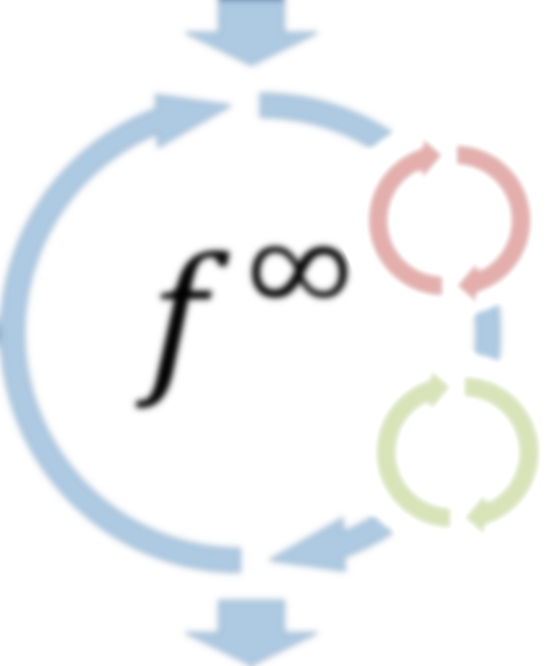
For more information
Visit the project website and blog
http://research.microsoft.com/naiad/ http://bigdataatsvc.wordpress.com/
Now available for download:
http://github.com/MicrosoftResearchSVC/naiad/

Slide 39
Naiad



Now available for download:
http://github.com/MicrosoftResearchSVC/naiad

