Slide 1
The history of the Internet
1974: First draft of TCP/IP
“A protocol for packet network interconnection”,
Vint Cerf and Robert Kahn
1983: ARPANET switches on TCP/IP
1986: Congestion collapse
1988: Congestion control for TCP
“Congestion avoidance and control”, Van Jacobson

Slide 2
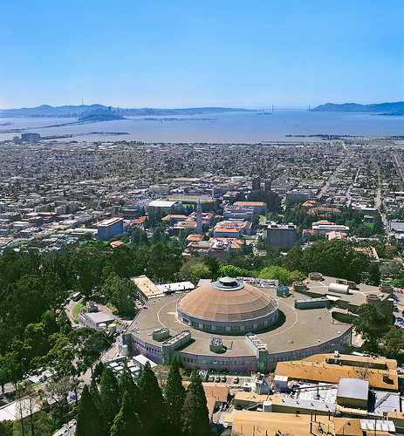
“In October of ’86, the Internet had the first of what became a series of ‘congestion collapses’. During this period, the data throughput from LBL to UC Berkeley (sites separated by 400 yards and two IMP hops) dropped from 32 Kbps to 40 bps. We were fascinated by this sudden factor-of-thousand drop in bandwidth and embarked on an investigation of why things had gotten so bad. In particular, we wondered if the 4.3BSD (Berkeley UNIX) TCP was mis-behaving or if it could be tuned to work better under abysmal network conditions.”
Van Jacobson, “Congestion avoidance and control”, 1988
Notes:
It turned out that the coordination game was being played badly.
Users would send data, it failed to get through, so they retransmit, the network gets even more congested, and so on.

Slide 3
Windowed flow control
acknowledgements
User
Server
(TCP)
data
Suppose the sender has a certain number of tokens/permits. Each time he sends a packet he uses up a token; each time he receives an acknowledgement he regenerates one token.

Slide 4
A network control problem: how big a window should each source have?
Maybe the receiver needs to receive data at some average rate x_{min}, to ensure smooth video playback. It could tell the sender “Use w=x_{min}×RTT tokens”.
The transmit rate is x=w/RTT. There could be centralized admission control, like the Erlang link—issue new tokens only if the total traffic rate will not exceed the service rate.
If the receiver has a buffer of 10 packets, it could tell the sender “Start with 10 tokens; I’ll issue you a new token whenever a packet is cleared from my buffer”. This ensures that the receiver’s buffer cannot overflow.

Slide 5
How TCP detects drops
The sender puts a sequence number on each packet
When the receiver receives a packet, it send back an ACK with the highest contiguous sequence number it has received
If the sender receives duplicate ACKs, it knows that a packet was dropped (or that something was delivered out of order)
User
Server
(TCP)
5
1
2
3
4
*
data
acknowledgements
User
2
2
1
Server
(TCP)

Slide 6
Congestion collapse
User
Server
(TCP)
Server
(TCP)
User
is when the system’s response to congestion ends up causing effort to be wasted

Slide 7
Congestion collapse
User
Server
(TCP)
Server
(TCP)
User
is when the system’s response to congestion ends up causing effort to be wasted

Slide 8
To avoid congestion collapse, can we design clever end-systems that reduce their window sizes when they detect congestion in the network?

Slide 9
Jacobson’s algorithm
*
*
*
Notes:
Increase rule: increase transmission rate at 1/RTT^2 pkt/sec/sec
Decrease rule: decrease transmission rate by half every packet drop
Let x(t) be the transmission rate at time t.
average change from x(t) to x(t+delta) is + delta*1/RTT^2 – delta*x(t)*p* x(t)/2
In equilibrium, x(t) doesn’t change, hence the equilibrium throughput x solves 1/RTT^2 – x*p*x/2=0, hence x=sqrt(2)/RTT*sqrt(p)

Slide 10
if (seqno > _last_acked) {
if (!_in_fast_recovery) {
_last_acked = seqno;
_dupacks = 0;
inflate_window();
send_packets(now);
_last_sent_time = now;
return;
}
if (seqno < _recover) {
uint32_t new_data = seqno - _last_acked;
_last_acked = seqno;
if (new_data < _cwnd) _cwnd -= new_data;
else _cwnd=0;
_cwnd += _mss;
retransmit_packet(now);
send_packets(now);
return;
}
uint32_t flightsize = _highest_sent - seqno;
_cwnd = min(_ssthresh, flightsize + _mss);
_last_acked = seqno;
_dupacks = 0;
_in_fast_recovery = false;
send_packets(now);
return;
}
if (_in_fast_recovery) {
_cwnd += _mss;
send_packets(now);
return;
}
_dupacks++;
if (_dupacks!=3) {
send_packets(now);
return;
}
_ssthresh = max(_cwnd/2, (uint32_t)(2 * _mss));
retransmit_packet(now);
_cwnd = _ssthresh + 3 * _mss;
_in_fast_recovery = true;
_recover = _highest_sent;
}
transmission rate [0–100 kB/sec]
time [0–8 sec]
Notes:
Multiplicative decrease -- when network is congested, load grows exponentially (transmit, retransmit, reretransmit...)
Additive increase -- helps with fairness (of relatively greater benefit to low-bandwidth users)
Devised by Jain+Ramakrishnan (1988) DECbit

Slide 11
*
*
*
Each user increases his/her transmission rate when the network seems underused, and cuts it when one of his/her packets is dropped.
*
*
*
*
*
*
*
*
*
*
*
*
*
*
*
If all users do this, the network should end up near-100% used, and the capacity should be shared fairly.
The Internet is the first large-scale network to be able to regulate itself – to share capacity fairly – without a central controller.

Slide 12
+
+
individual flow rates
+
+
=
=
aggregate flow rate
time

