Slide 1
Network Performance
Dr D. J. Wischik

Slide 2
A brief history of society

Slide 3
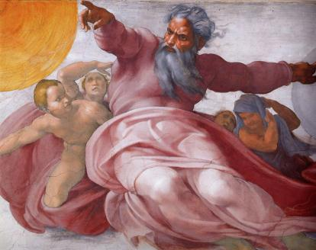
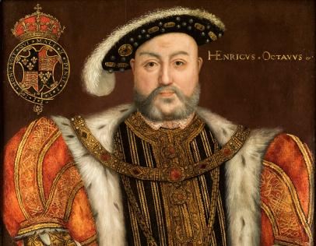
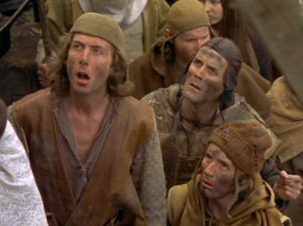
peons

Slide 4
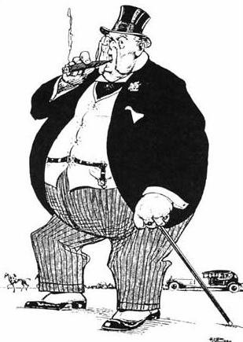
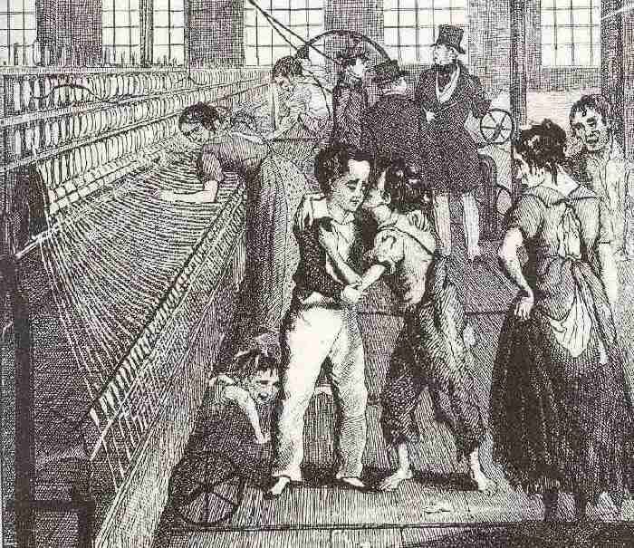
proletariat

Slide 5
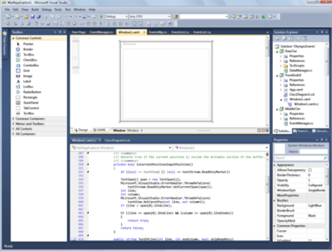
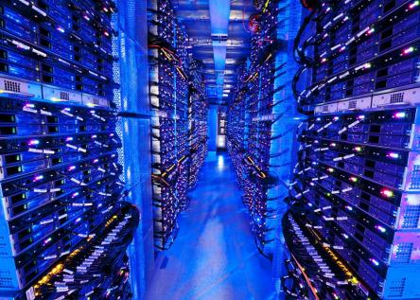
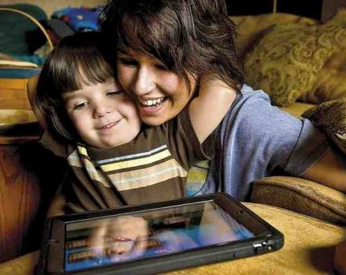
programmed (dumb consumers)

Slide 6
Be an expert in the aesthetics and psychology of design.
Data is smarter than algorithms. The smartest data is about how things relate to each other, i.e. about networks. Learn to listen to data.
Turn the richness of the world into APIs.
Never ever do repetitive tasks on the computer.

Slide 7
Zadie Smith’s comments on ‘You are not a gadget: a manifesto’ by Jaron Lanier in the New York Review of Books
‘Information systems’, he writes, ‘need to have information in order to run, but information underrepresents reality’. In Lanier’s view, there is no perfect computer analogue for what we call a ‘person’. In life, we all profess to know this, but when we get online it becomes easy to forget. In Facebook, as it is with other online social networks, life is turned into a database, and this is a degradation, Lanier argues, which is
based on [a] philosophical mistake…the belief that computers can presently represent human thought or human relationships. These are things computers cannot currently do.

Slide 8
Zadie Smith’s review of ‘The social network’, screenplay by Aaron Sorkin, in the New York Review of Books
Watching this movie, even though you know Sorkin wants your disapproval, you can’t help feel a little swell of pride in this 2.0 generation. They’ve spent a decade being berated for not making the right sorts of paintings or novels or music or politics. Turns out the brightest 2.0 kids have been doing something else extraordinary. They’ve been making a world.

Slide 9
What does this have to do with you?
`How everything is related to everything else’ is too big a problem. The most interesting tractable network in the world today is the Internet. Let’s hone our tools by working out how it works.
Communications networks and big data will change society as fundamentally as the invention of agriculture or the industrial revolution. This change has barely begun. Be part of it.
The UCL networks group is above all a systems research group. Learn from us how to be systems builders.

