Slide 1
Queueing theory and
Internet congestion control
Damon Wischik, UCL
Mark Handley, UCL
Gaurav Raina, Cambridge / IIT Madras

Slide 2
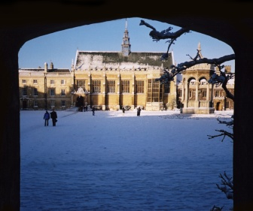
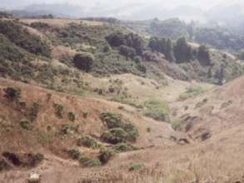

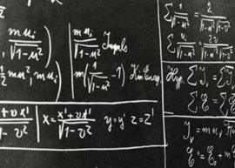
A little bit about me
I did a PhD in mathematics at Cambridge and I continued there afterwards as a research fellow
except for a year at Stanford, in the Electrical Engineering department.
I decided to change to a computer science department, because this is where all the exciting problems come from,
and where theory can have an impact.
I still like equations.
Notes:
And of course I chose UCL because it has the best networks department in the UK, and I am “all about” the Internet!

Slide 3
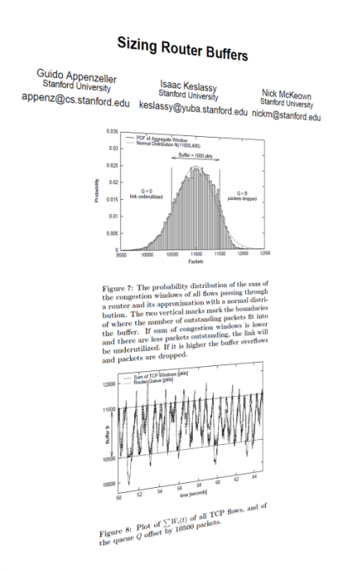
A debate about buffer-sizing led me to ask: how does queueing theory relate to congestion control?
The conventional wisdom was that, for TCP to work well, routers should provide a buffer equal to bandwidth × delay
This was challenged in 2004 by Appenzeller, Keslassy and McKeown, who argued that much smaller buffers are sufficient in core routers

Slide 4
A debate about buffer-sizing led me to ask: how does queueing theory relate to congestion control?
The conventional wisdom was that, for TCP to work well, routers should provide a buffer equal to bandwidth × delay
This was challenged in 2004 by Appenzeller, Keslassy and McKeown, who argued that much smaller buffers are sufficient in core routers
They now propose buffers should be even smaller, on over-provisioned links

Slide 5
A debate about buffer-sizing led me to ask: how does queueing theory relate to congestion control?
Small buffers are attractive because
  small buffers are cheaper than large buffers
  they allow new faster architectures for switches
  delay and jitter are kept low
Both of these proposals for small buffers used novel mathematical models. They ignored many years of research, on queueing theory and congestion control. Why?

Slide 6
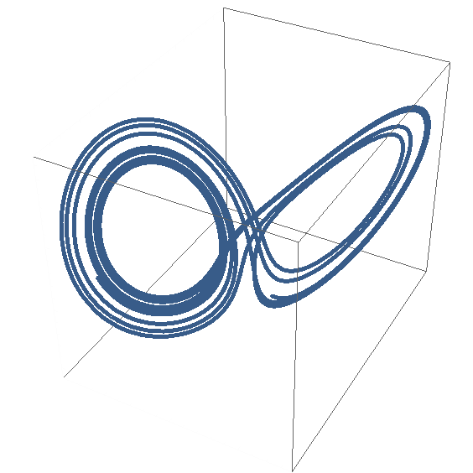
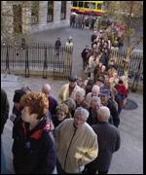
What previous work might be relevant?
What questions might we hope to answer?
congestion control theory
queueing theory

Slide 7
Fluid model for TCP
[Kelly+Maulloo+Tan (1998), Misra+Gong+Towsley (2000), Baccelli+McDonald+Reynier (2002), and many others]

Slide 8
Fluid model for CUBIC-like congestion control
[based on Prabhakar et al. (2009)]

Slide 9
Stochastic models of queues,
applied to communications networks
Erlang (1909)
M/M/1 queues
Poisson models
Long-range dependence
and much much more
Notes:
sui2 ji1

Slide 10
What previous work might be relevant?
What questions might we hope to answer?
Is this fluid & stochastic theory consistent with the result of Appenzeller et al.?
Does it suggest alternatives? Can we make the buffer even smaller?
We need buffers to absorb bursts in traffic. How can a router tell the difference between short bursts and long-term overload?
What causes synchronization between TCP flows?
What about other types of congestion control?

Slide 11
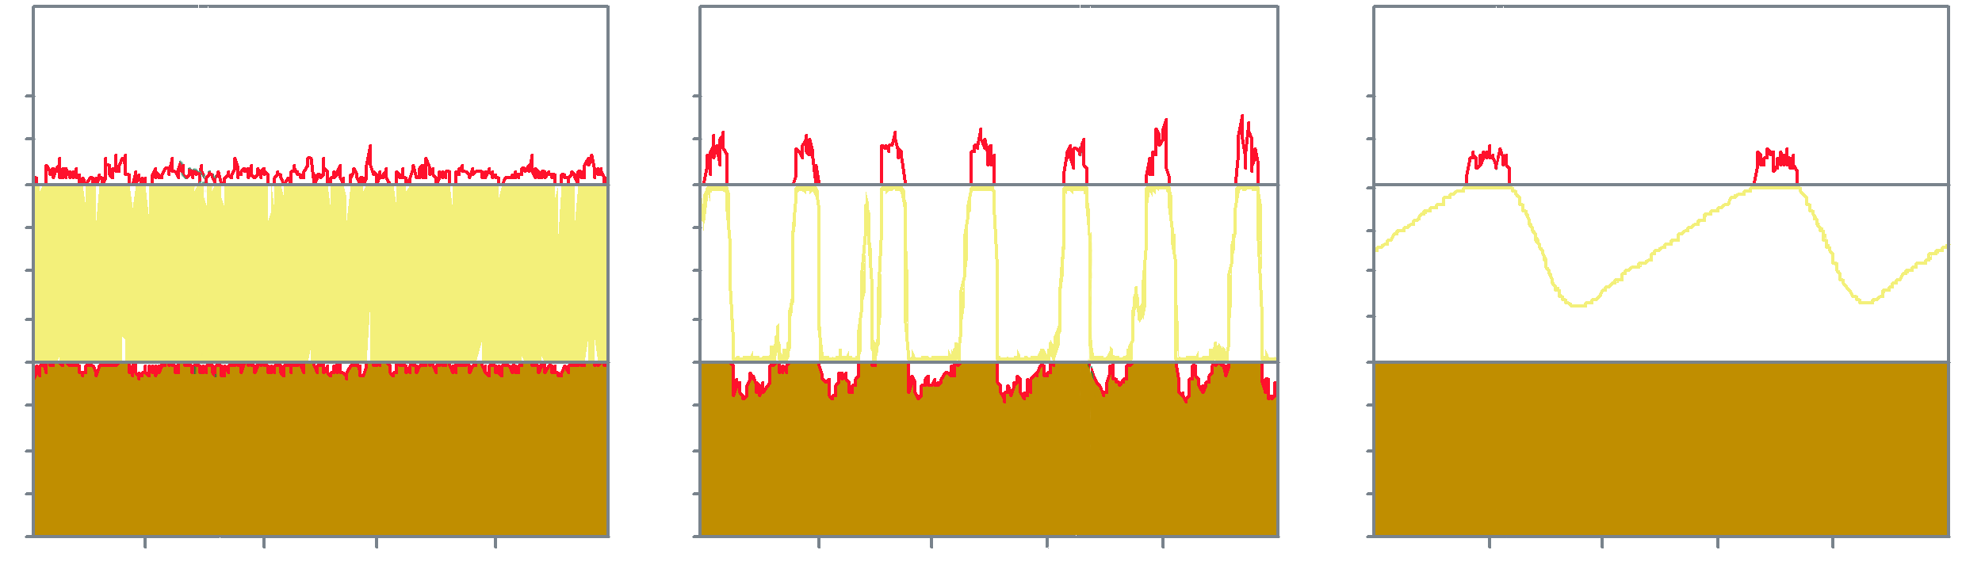
We simulated a simple dumbbell topology with different buffer sizes, and saw very different types of behaviour
RTT 150—200ms
5000
TCP flows
link speed
3Gb/s = 250k pkt/s
drop
probability
[0–30%]
queue
size
[0–100%]
link
utilization
[0–100%]
time [0–5s]
buff = 25 pkt
buff = 619 pkt
(as Appenzeller et al. suggest)
  buff = 44 000 pkt
  (conventional wisdom)
Notes:
Custom simulator by Mark Handley, v. fast
Everyone gets different answers from simulations. It’s very delicate…

Slide 12
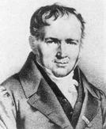
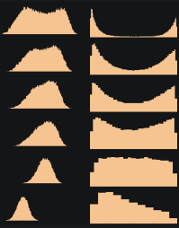
I shall develop a theoretical model for queueing behaviour at a queue fed by TCP flows. I will only model a simple topology, with long-lived flows.
The model only applies to a queue serving many flows. It is based on the statistical regularities that are seen in any large aggregate population.
The model proposes that buffers should be no more than 150 packets or so, no matter what the link speed. It also gives useful insight into the interpretation of fluid models of congestion control, and the controllability of queues in the Internet.
Siméon-Denis Poisson 1781–1840

Slide 13
We will start by modeling a simple topology with one bottleneck link. What is the limiting behaviour of this system as the number of flows → ∞?
(And why is this an appropriate limit?)
common round trip time RTT
N
TCP flows
buffer size B√N
link speed NC

Slide 14
To gain intuition, it is useful to look first at an open-loop version of the system
link speed NC
N
TCP flows
buffer size B√N
link speed NC
N Poisson sources, each with rate x
buffer size B√N
Let us remove the control loop and assume that the N traffic sources each generate Poisson traffic at rate x
(We’ll bring back the control loop later!)
Then this is a classic M_{Nx}/D_{NC} /1/B√N queue
Notes:
Drop probability formula was proposed by Srikant.

Slide 15
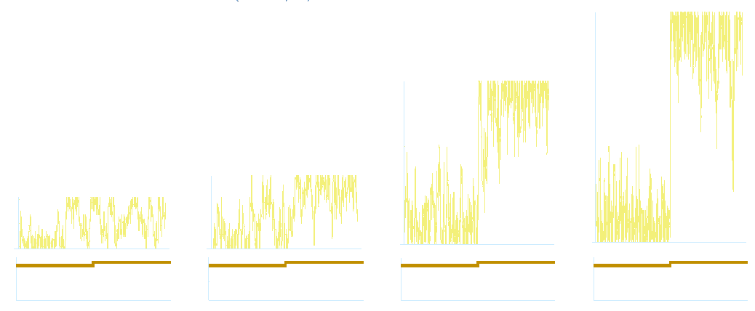
Simulation shows that when there are many flows, the queue has two different modes of operation: near-empty and near-full.
M_{Nx}/D_{NC} /1/B√N queue
N Poisson sources, each with rate x,
x=0.95 then 1.05 pkt/s
buffer size B√N,
B = 3 pkt
link speed NC, C = 1 pkt/s
95
67
30
queue
size
21
0
0
0
0
Nx / NC
1
0
time [0—80]
N=50
N=100
N=500
N=1000
Notes:
This is like a M_{x}/D_{C}/1/B√N queue, but running N times faster. Hence busy cycles are O(1/N).
When x<C, the queue size never gets much more than 30 pkts, even at r=0.95. When x>C, the loss rate is (x-C)/x.
If the queue is empty and suddenly x goes >C, how long does it take to fill up? B√N/(Nx-NC) = O(1/√N). So it flips near-instantaneously.

Slide 16
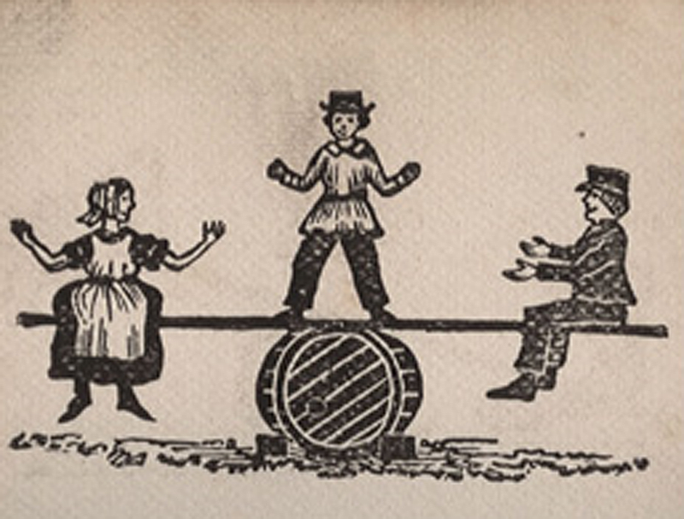

Slide 17
Busy periods at the queue last for time O(1/N).
The queue is very sensitive to traffic intensity Nx / NC, and the loss rate is max(0,(x-C)/x)
M_{Nx}/D_{NC} /1/B√N queue
N Poisson sources, average rate x,
x=0.95 then 1.05 pkt/s
buffer size B√N,
B = 3 pkt
link speed NC, C = 1 pkt/s
95
queue
size
0
Nx / NC
time [0—80]
N=1000
Notes:
This is like a M_{x}/D_{C}/1/B√N queue, but running N times faster. Hence busy cycles are O(1/N).
When x<C, the queue size never gets much more than 30 pkts, even at r=0.95. When x>C, the loss rate is (x-C)/x.
If the queue is empty and suddenly x goes >C, how long does it take to fill up? B√N/(Nx-NC) = O(1/√N). So it flips near-instantaneously.

Slide 18
In the closed-loop system, does TCP have any chance of preventing overflow at the queue?
We know that the aggregate traffic rate x(t) varies smoothly, according to a differential equation. Suppose it goes just above C.
Notes:
Drop probability formula was proposed by Srikant.

Slide 19
In the closed-loop system, does TCP have any chance of preventing overflow at the queue?
Over short intervals of time, the aggregate traffic can be approximated by a Poisson process [Cao and Ramanan 2002]
Notes:
Drop probability formula was proposed by Srikant.

Slide 20
In the closed-loop system, does TCP have any chance of preventing overflow at the queue?
The queue will quickly flip from empty to full.
Notes:
Drop probability formula was proposed by Srikant.

Slide 21
In the closed-loop system, does TCP have any chance of preventing overflow at the queue?
There will be no drops at first, then all of a sudden the packet loss rate will be high.
Notes:
Drop probability formula was proposed by Srikant.

Slide 22
In the closed-loop system, does TCP have any chance of preventing overflow at the queue?
The congestion signal goes back to the TCP sources.
Notes:
Drop probability formula was proposed by Srikant.

Slide 23
In the closed-loop system, does TCP have any chance of preventing overflow at the queue?
One round trip time later, the sources will react.
(They will probably over-react.)
Notes:
Drop probability formula was proposed by Srikant.

Slide 24
The queue fluctuates very quickly, and TCP reacts too slowly to be able to stabilize it.
One round trip time later, the sources will react.
(They will probably over-react.)
Notes:
Drop probability formula was proposed by Srikant.

Slide 25
We have derived the formula for packet drop probability, to put into the differential equation for TCP. The formula relies on the fact that the queue changes much faster than TCP.
N
TCP flows
buffer size B√N
link speed NC
Let x(t) be the average transmission rate of the N flows at time t .
x(t) evolves according to the standard differential equation for TCP
The loss rate is
Notes:
Drop probability formula was proposed by Srikant.

Slide 26
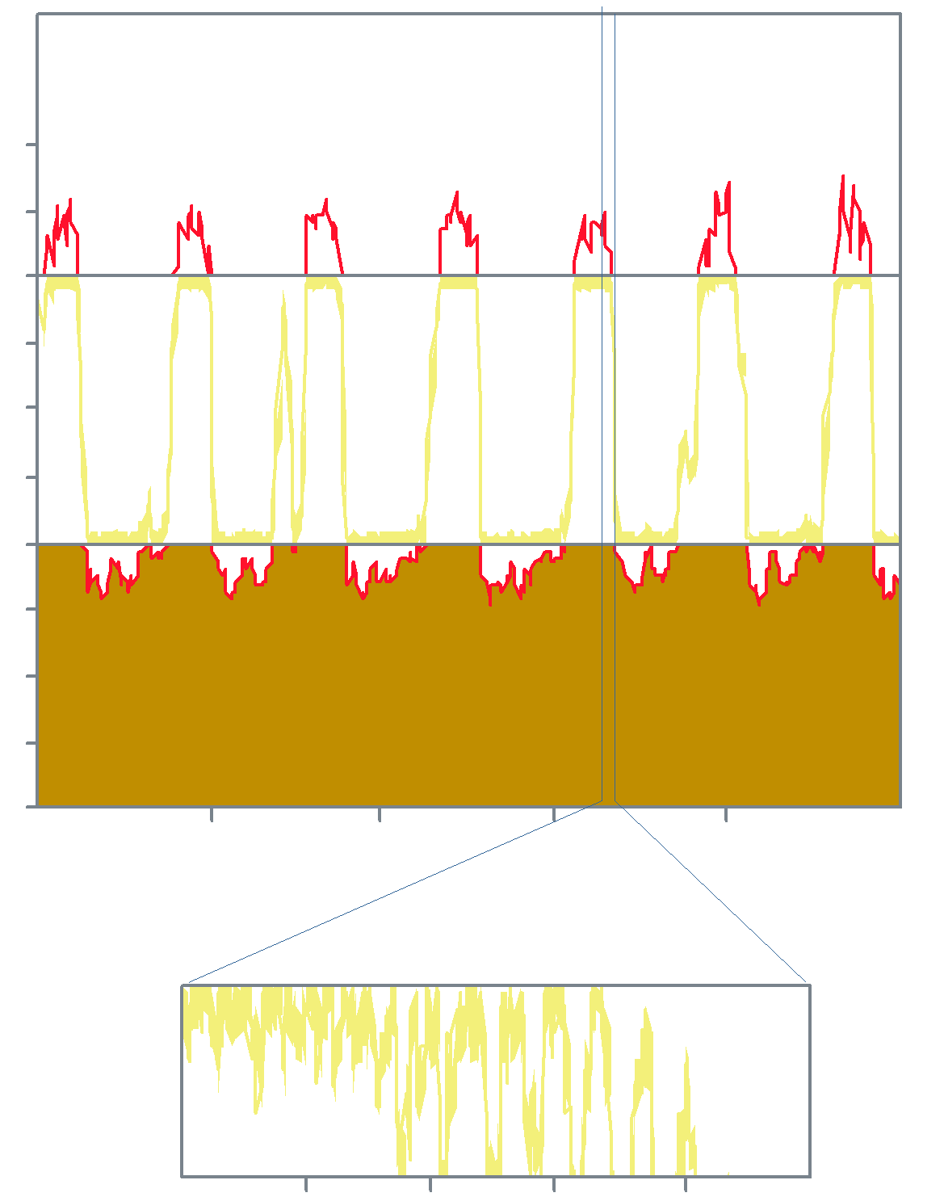
A simulation of the closed-loop dumbbell topology confirms our theoretical prediction about how the queue size fluctuates
RTT 150—200ms
N=5000
TCP flows
link speed
3Gb/s = 250k pkt/s
buffer size
619pkt =
250k x 0.175/√5000
drop
probability
[0–30%]
queue
size
[0–619pkt]
traffic
intensity
[0–100%]
time [0–5s]
queue
size
[594–619pkt]
time [50ms]

Slide 27
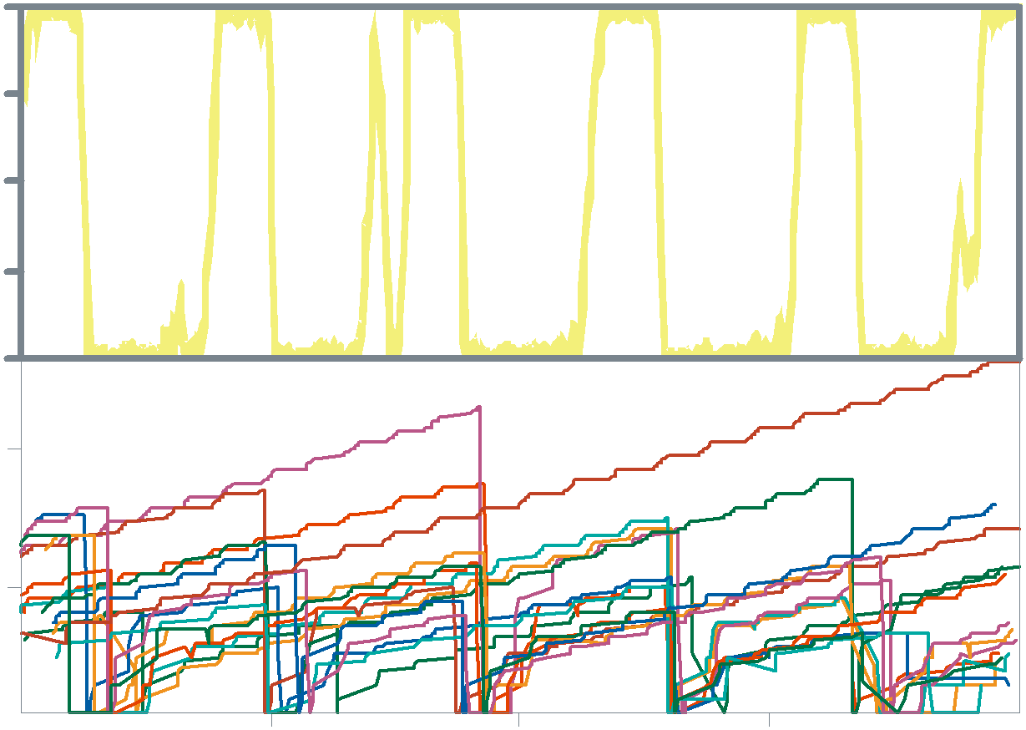
For buffers of this size, there are periods of no loss followed by periods of concentrated loss, hence the flows become synchronized
RTT 150—200ms
N=5000
TCP flows
link speed
3Gb/s = 250k pkt/s
buffer size
619pkt =
250k x 0.175/√5000
queue
size
[0–619pkt]
TCP
window sizes
[0-25pkt]
time [0–5s]

Slide 28
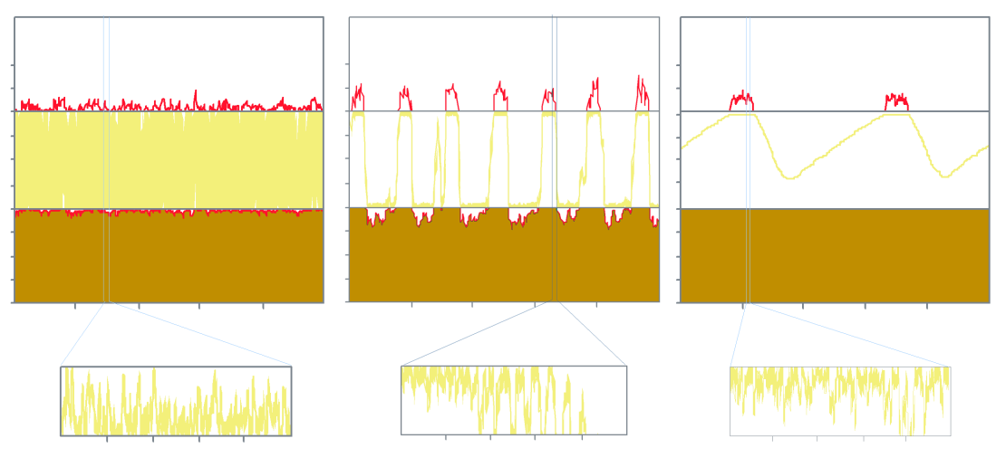
Similar reasoning tells us what happens for other buffer sizing rules
buff = constant
buff ~ √N
  buff ~ N
drop
probability
[0–30%]
queue
size
[0–100%]
link
utilization
[0–100%]
time [0–5s]
zoomed-in queue size, over a range of 25pkts
time range of 50ms

Slide 29
Similar reasoning tells us what happens for other buffer sizing rules
buff = constant
buff ~ √N
  buff ~ N
drop
probability
[0–30%]
queue
size
[0–100%]
link
utilization
[0–100%]
time [0–5s]
zoomed-in queue size, over a range of 25pkts
time range of 50ms

Slide 30
Similar reasoning tells us what happens for other buffer sizing rules
buff = constant
buff ~ √N
  buff ~ N
drop
probability
[0–30%]
queue
size
[0–100%]
link
utilization
[0–100%]
time [0–5s]
zoomed-in queue size, over a range of 25pkts
time range of 50ms
Notes:
So, it’s no use looking at queue size to detect when we’re on the verge of congestion. We can only detect that we’re on the verge of congestion by looking at the arrival rate. We therefore need to be sure that the queue sends back feedback when it’s on the verge of congestion.

Slide 31
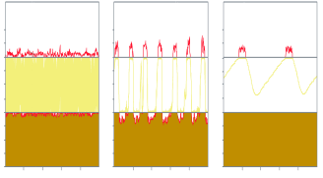
We have analyzed how the queue behaves. We have only modeled a simple dumbbell topology with persistent flows, but simulations suggest that the qualitative answers apply more widely.
The description only applies to queues with many flows, e.g. queues at core routers. The model is based on statistical regularities of large aggregates, and it only applies to large aggregates.
We can use the model to
give guidance on the design of active queue management schemes
recommend the buffer size

Slide 32
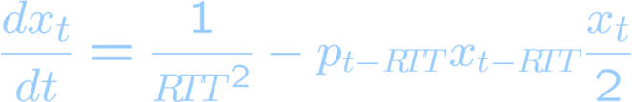

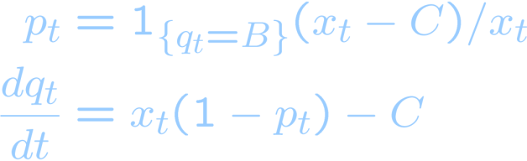
Mathematical summary: we have derived differential equations for the loss rate, to complement the standard differential equation for TCP
Let x_{t} = average traffic rate and p_{t} = packet loss probability at time t
C = available bandwidth per flow RTT = round trip time N=# flows
TCP traffic model
buffer = B
buffer ~ √N
buffer = NB (the conventional buffer-sizing rule)
Notes:
Note: predictability at fluid level (diffeq for TCP) AND at stochastic level (Poisson limit)

Slide 33
Differential equations can be used to help design congestion control schemes. But there are pitfalls!
traffic intensity
time
For some parameter values the differential equations have a stable solution
  we can calculate the steady-state link utilization, loss probability etc.
For others it is unstable and there are oscillations
  this corresponds to synchronization between the flows
  we can calculate the size of the oscillations, either by algebra or by numerical computation
We’d like to choose parameters to make the equations stable

Slide 34
We used the differential equations to predict the effect of different buffer sizes, and confirmed our predictions by simulation
ρ=1
On the basis of this analysis, we claimed
  a buffer of 30–50 packets should be sufficient
  any smaller, and utilization is too low
  any larger, and there is too much synchronization
Other people ran simulations and found
  small buffers lead to terribly low utilization
  intermediate buffers are much better
B=100pkt
B=50pkt
B=40pkt
B=30pkt
B=20pkt
B=10pkt
traffic intensity distribution
[85–110%]
queue size distribution
[0–100%]
Plot by Darrell Newman, Cambridge

Slide 35
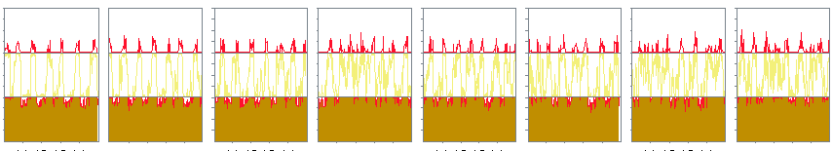
Burstiness affects the answer.
It is straightforward to incorporate burstiness into our model. The conclusion is that buffers should be sized to hold 30—50 bursts, not packets
It turned out that the simulations were being affected by access link speeds.
  With a fast access link, packets are sent back-to-back in bursts
  With a slow access link, packets are spaced out
Burstiness has the interesting effect of ‘softening’ the congestion response, which enables the TCP flows to react to avert congestion. Small buffers have the same effect.
slow access links
fast access links

Slide 36

We are currently developing a multipath version of TCP. Here also one needs careful analysis of how fluid models and stochastic effects fit together.
If TCP could send its traffic over multiple paths simultaneously, and adaptively choose the least loaded, then the Internet would be more resilient and flexible.
(W.+Handley+Bagnulo 2009)
The control theory differential equations have all been worked out
(Kelly+Voice 2006, Towsley+Srikant+al. 2006)
But they lead to bad algorithms which send all their traffic one way then the other, and flip randomly. To solve this problem, we are working on how to link stochastic packet-level behaviour with the differential equations.

Slide 37
Similar issues arise when designing high-speed congestion control for data centres
QCN is a proposed congestion control algorithm for Ethernet
It is intended for networks with latencies up to 500μs, with 10 Gb/s links, and a small number of active flows
It is being standardized in IEEE 802.1Qau
What are the right differential equations to write down, when there are a small number of very big flows?

Slide 38
Conclusion
Internet congestion control can be analyzed using a mixture of control theory and stochastic analysis
  Control theory = how do aggregates react to each other?
  It is fairly well understood.
  Stochastic analysis = how does the behaviour of an aggregate arise out of its individual parts?
  It is poorly understood.
We have developed the stochastic analysis for queues fed by TCP traffic
The analysis told us that core Internet routers can get by with tiny buffers, small enough to be integrated into the switching fabric. This will permit new designs for high-speed routers.

