Slide 1

Resource Pooling
Damon Wischik, UCL
second year review
Notes:
Resource Pooling is the technical concept at the heart of the project. I’ll explain what it’s all about.

Slide 2
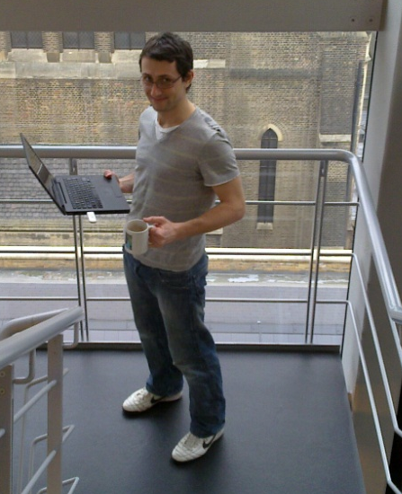
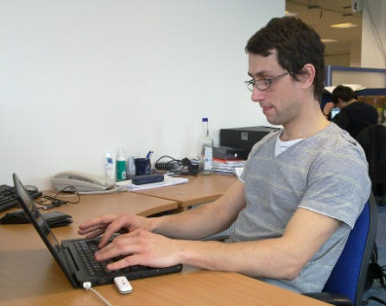
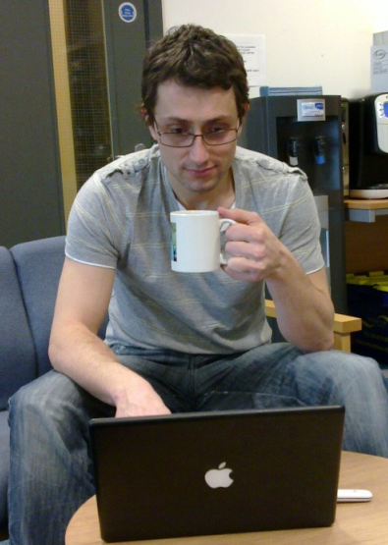
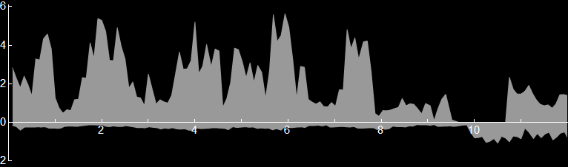
We have a working implementation of multipath transport
wifi
laptop with multipath TCP
server with multipath TCP
3G
wifi through-put [Mb/s]
3G through-put [Mb/s]
time
[min]

Slide 3
This user clearly benefits from multipath. But is it safe for the network and other users? Or does it cause instability, route flap, unfairness, disaster?
Notes:
I’ll describe the theory that we needed to get right, in order to ensure that this behaviour is not just safe for the network, but positively good.
Multipath transport is “in the DNA of the Internet”.

Slide 4
This user clearly benefits from multipath. But is it safe for the network and other users? Or does it cause instability, route flap, unfairness, disaster?
Resource pooling as a design principle
The earliest design goal of the Internet aimed to achieve “resource pooling”. Multipath transport is a natural extension. It can improve resilience to traffic surges and link failures.
A metric for resource pooling (WP1+WP2)
If multipath load balancing is done right, then the network achieves some degree of resource pooling. We have a metric for measuring how much, given the topology and traffic matrix.
A coupled congestion control algorithm (WP2)
We have designed and implemented a multipath congestion control algorithm that balances load, and we can guarantee it’s safe to deploy (but it’s harder than you’d think to do it right)
Notes:
I’ll describe the theory that we needed to get right, in order to ensure that this behaviour is not just safe for the network, but positively good.
Multipath transport is “in the DNA of the Internet”.

Slide 5
I. Resource pooling as a design principle
Resource pooling means “making a collection of resources behave like a single pooled resource”. It has been a design goal of the Internet from the beginning.
A single link, split into two circuits
Packet switching “pools” the two circuits
Multipath “pools” the two links
Notes:
Here, pooling is used to better accommodate surges in traffic.
The RHS looks like it’s just ECMP… but there are cases where a single ISP can’t get the benefits, only end-systems can. It’s a big research question, how to combine the best of route choice inside an AS with end-to-end route choice.

Slide 6
Resource pooling means the network is better able to accommodate a surge in traffic
or a loss of capacity
by shifting traffic and thereby “diffusing” congestion across the network.
Notes:
These problems would cause there to be lots of localized congestion. In each case, multipath resource pooling shifts some load, so it alleviates the congestion hotspot.
The surge shown here is on the right link. It could just as well be on the left link; the same multipath routing lets you accommodate either type of surge. Idea: keep the same multipath routes over a long timescale, traffic balances itself very quickly over short timescales.
Can we make the Internet pool resources automatically, without needing explicit setup by operators?
but allowing operators to influence the outcome if they want to
but bearing in mind that there are cases where end-systems can (and will) achieve better resource pooling than ISPs can
These pictures are simple cases of two parallel links where ECMP would work fine. But the mechanism we’re proposing is more general, it’s load-balancing over end-to-end paths.

Slide 7
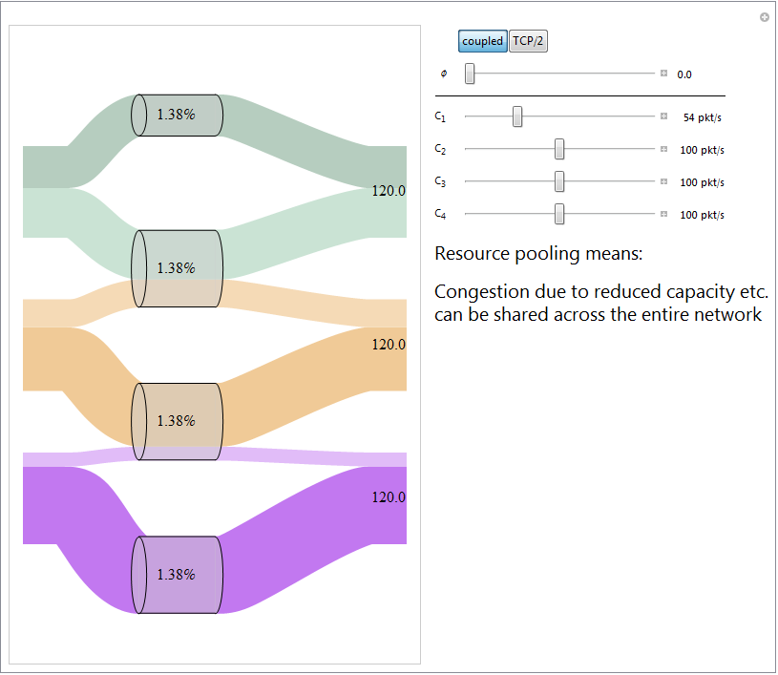

Slide 8
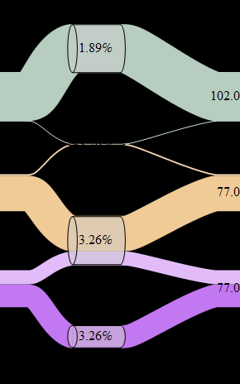
Resource pooling relies on there being enough path choices, and enough traffic that can make a choice
The network has split into two resource pools, because neither of the bottom two flows can access the top resource pool.
Topic II. How much resource pooling can be achieved, given a set of multipath routes and a traffic matrix?
Will there be one big pool, or many small pools?

Slide 9
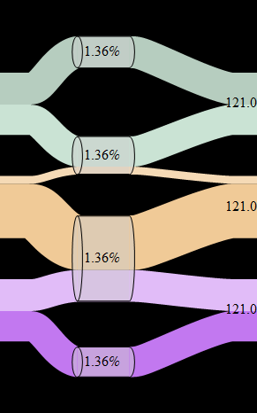
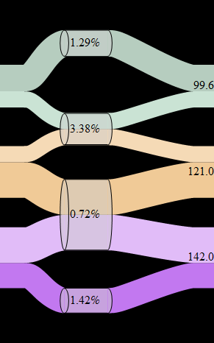
Resource pooling relies on proper load-balancing by the end-systems
Using an idealized coupled congestion controller, there is resource pooling
Using separate TCP controllers for each path, congestion is not equalized and capacity is not shared
Topic III. Can we design a congestion controller such that users react in the right way to achieve resource pooling?
If they don’t, there may be a single pool but it won’t be shared properly.

Slide 10
Topic II. How much resource pooling can be achieved, given a set of multipath routes and a traffic matrix?
For the purposes of network-wide resource pooling,
  Is it sufficient to use end-host addressing?
  How much path diversity is enough, and what sort of diversity is useful?
To answer this, we first need a metric for the amount of resource pooling that a network achieves.

Slide 11
How should we measure resource pooling? It means
“making a collection of resources
behave like a single pooled resource”.
To measure resource pooling, we need to decide what we mean by “behave” and “like a single resource”.
“Like a single resource”
Suppose for example that
at an isolated link with capacity 100Mb/s, the loss of 50Mb/s increases packet loss by a factor of 20
at an isolated link with capacity 1Gb/s, the loss of 50Mb/s increases packet loss by a factor of 1.03
at a resource-pooling link with capacity 100Mb/s, the loss of 50Mb/s increases packet loss by a factor of 1.03
Then we’ll say that the “effective pooled capacity at that link” is 1Gb/s.
“Behave”
We’ve seen that resource pooling has the effect that congestion hotspots can be diffused across the network. So the behaviour I shall examine is “what is the change in congestion at a link, in response to a change in the capacity at that link?”

Slide 12
Theorem
In a network with idealized multipath congestion control, the change in loss rate at link j in response to a given drop in capacity is the same as would be experienced by an isolated link whose capacity is C_{j} /(1-Ψ_{jj}) where C_{j} is the actual link’s capacity.
I call Ψ_{jj} the “poolability score”, and C_{j}/(1-Ψ_{jj}) the “effective pooled capacity”.

Slide 13
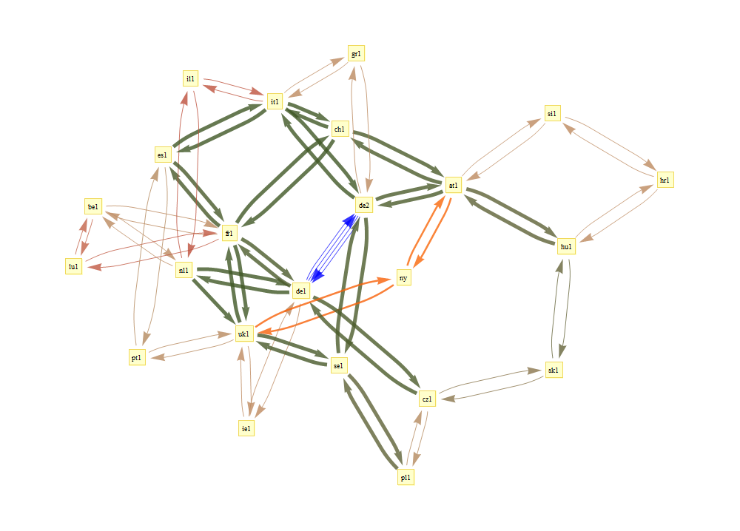
GEANT data provided by WP1—
multipath routes, link capacities, and traffic matrices

Slide 14
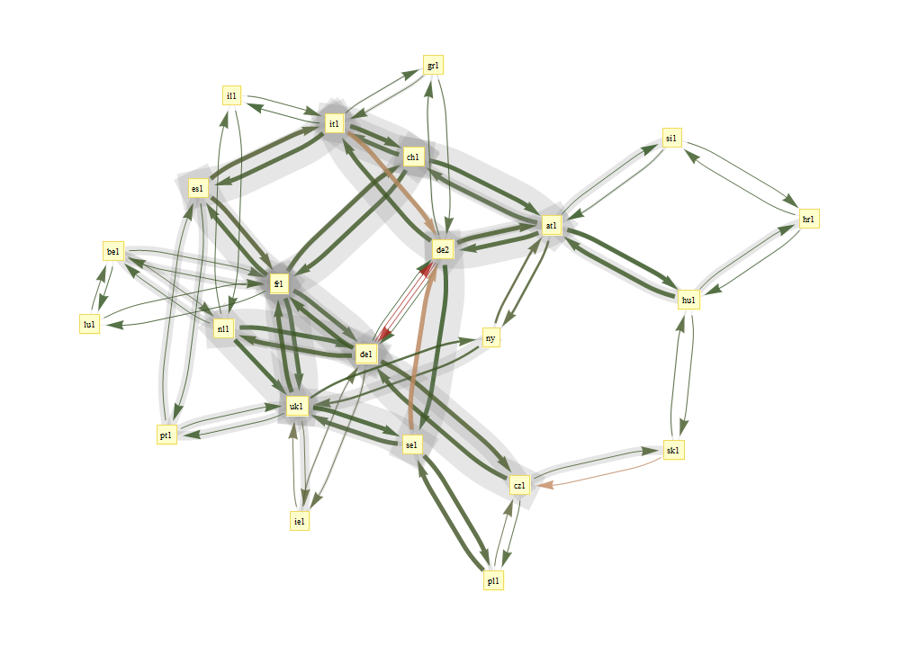
2005-05-04 16:30:00
Colours show utilization
Grey shows effective pooled capacity
Notes:
Some of the assumptions behind this:
I used the traffic matrix to estimate the number of flows between each pair, and then I made each flow run the idealized congestion controller. I assumed that there is no congestion at the access links. If I had data about access links, I could incorporate it into the computation.
Note: not all of the possible routes are made available. I just used the routes that were chosen by the WP1 algorithm. The multipath routing algorithm used local state to produce loop-free routes, and this prevented it from selecting certain paths.

Slide 15
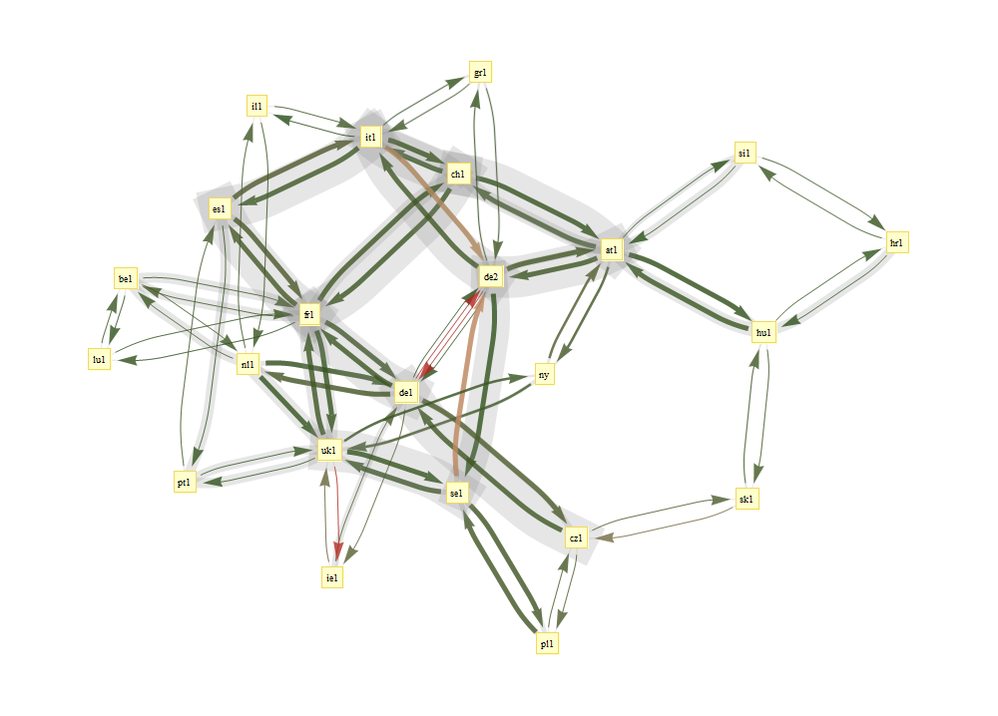
2005-05-04 17:45:00
Colours show utilization
Grey shows effective pooled capacity

Slide 16
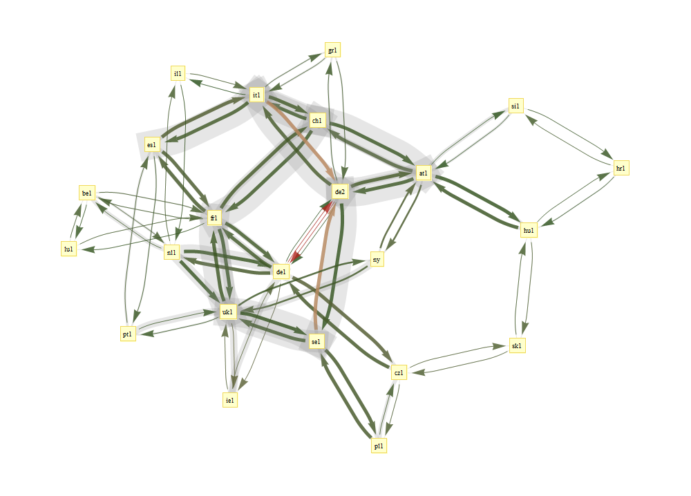
2005-05-04 19:00:00
Colours show utilization
Grey shows effective pooled capacity

Slide 17
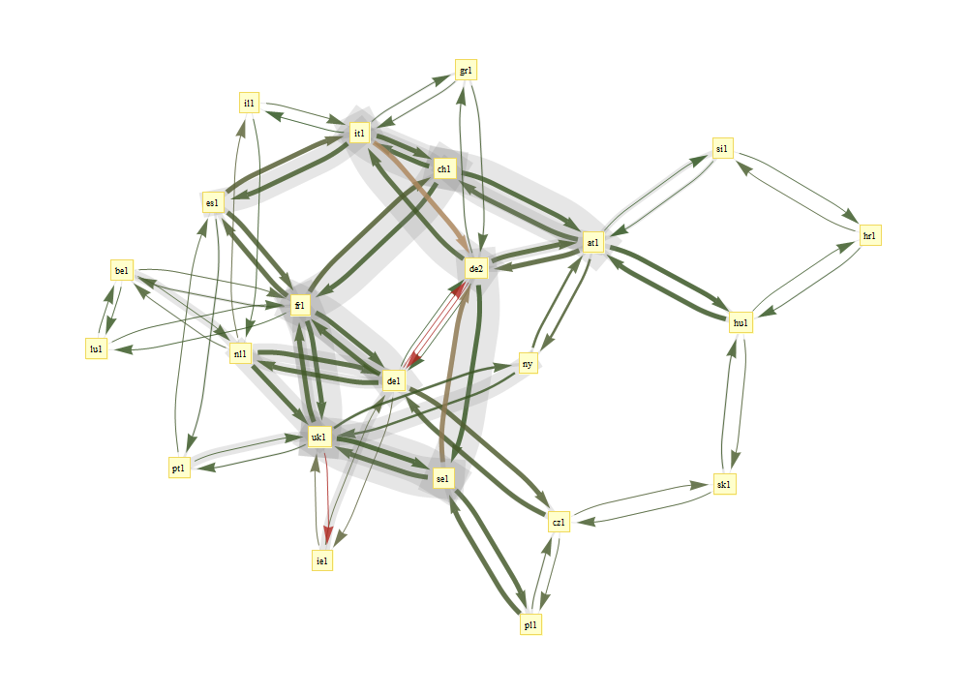
2005-05-04 20:15:00
Colours show utilization
Grey shows effective pooled capacity
Notes:
Summary: we have produced a metric, the “effective pooled capacity” at a link. This measures the beneficial effect of resource pooling. Hopefully, we’ll be able to use this to answer questions like “Is it sufficient to use end-host addressing?”

Slide 18
Topic III. Can we design a congestion controller such that users react in the right way to achieve resource pooling?
In the analysis of resource pooling, I assumed an idealized congestion controller: one which knows exactly the level of congestion on each path, and shifts its traffic onto the least congested.
To achieve this, we thought it would be a simple matter of taking a published “fluid model” of a load-balancing congestion controller, and implementing it. [Kelly+Voice, 2005]
We were wrong.

Slide 19
The idealized congestion control algorithm puts all its traffic on the least congested path. This can a failure of load balancing, when congestion levels vary.
Each flow should get 1/5 of the pool.
The multipath flow is not using the lower link, so it never learns it should shift back.
The multipath flow should shift to using the top link. Then each flow gets 1/4 of the pool.
Notes:
You might think the answer is: just send a little bit on each path, so you get steady feedback about congestion levels. But this doesn’t work, because small rate implies infrequent drops implies noisy congestion signals. And noisy congestion signals can lead to unreliable inference… see next slide.

Slide 20
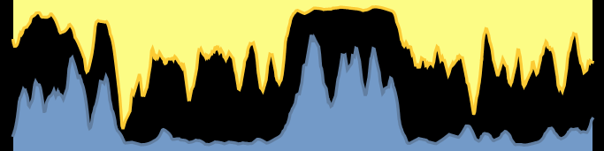
The noisy nature of congestion feedback makes it difficult to estimate congestion levels.
I better switch to the bottom link.
The top link is so congested!
loss rate 1%
random
drops
▼
▼
▼
▼
▼
▼
▼
▼
▼
▼
▼
▼
▼
▼
▼
▼
random
drops
▲
▲
loss rate 1%
▲
▲
▲
▲
▲
▲
▲
▲
▲
▲
▲
▲
▲
Now the bottom link is more congested!
Notes:
If you send very little data, you’ll have very poor quality information about the level of congestion, so you won’t have any sound basis for your inference.

Slide 21
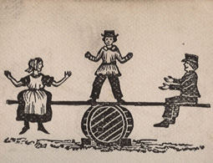
The information feedback stream (packet drops, delays) is noisy. To get a good measure of the true state of the link, we have to average the signal.
But congestion is not static. To react promptly to changes in congestion, we have to look only at recent data about congestion, and we should constantly probe all paths.
The Zen of resource pooling
To pool resources effectively, the end-system should not try too hard to pool resources.
Instead, it should maintain equipoise, i.e. balance its traffic rate across its paths, to the extent necessary to achieve resource pooling.
Notes:
This is really asking: how should the end-system distinguish between transient congestion and persistent congestion?

Slide 22
We devised a parameterized family of multipath congestion control algorithms, indexed by φϵ[0,2], to investigate the tradeoff between load balancing and equipoise.
φ=0
the idealized congestion controller, inspired by Kelly+Voice
φ=2
run independent TCP control on each path

Slide 23
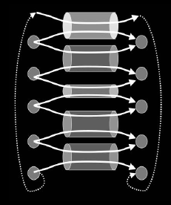
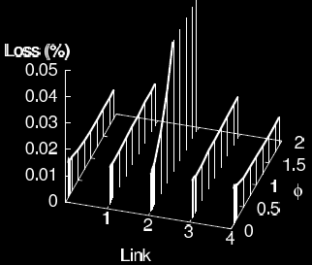
How good is this congestion controller at achieving resource pooling, in a static network?
φ=0
good at resource pooling:
even though the links have unequal capacities, congestion is balanced perfectly
φ=2
bad at resource pooling:
the low-capacity link is highly congested

Slide 24
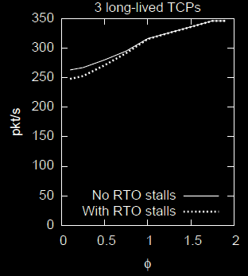
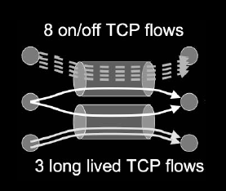
How good is this congestion controller at achieving resource pooling, in a dynamic network?
φ=0
bad at resource pooling:
shifts too enthusiastically to the less loaded link, and is slow to learn when the other link improves
φ=2
good at resource pooling:
constantly probes both links, so learns quickly when congestion levels change

Slide 25
the naïve coupled congestion controller, inspired by Kelly+Voice
φ=0
good at resource pooling:
even though the links have unequal capacities, congestion is balanced perfectly
bad at resource pooling:
shifts too enthusiastically to the less loaded link, and is slow to learn when the other link improves
run independent TCP control on each path
φ=2
bad at resource pooling:
the low-capacity link is highly congested
good at resource pooling:
constantly probes both links, so learns quickly when congestion levels change
static
network
dynamic network

Slide 26
We tweaked the φ algorithm, to ensure fairness with TCP.
We assign a weight to each link, and run a weighted version of the φ-algorithm. We have an adaptive algorithm for choosing the weights, to guarantee that
the multipath user gets as least as much throughput as if he/she used the best single path
the multipath user takes no more bandwidth on any link than a single-path TCP would.
more congested
short RTT
less congested
long RTT
Notes:
Ex 1: The multipath flow should only take as much capacity at a shared bottleneck as a single-path TCP flow.
Ex 2: Resource pooling prefers the less congested path, even if has longer RTT. But TCP only gives low throughput on long RTT paths.

Slide 27
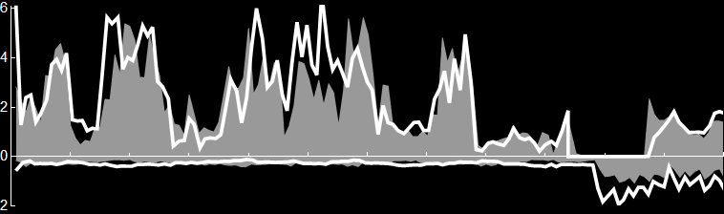
The 3G link has lower drop probability. We’d prefer to use the 3G link, to get resource pooling.
But the 3G link has a long RTT, so single-path TCP gets low throughput. We shouldn’t take any more than single-path TCP would.
Therefore we need to keep some traffic on the wifi link, so that the multipath user gets as good throughput as if he used single-path TCP.
what a single-path TCP flow gets
what a multipath flow gets
wifi throughput
[Mb/s]
Congested, short RTT
time [0—12 min]
3G throughput
[Mb/s]
Uncongested, long RTT

Slide 28
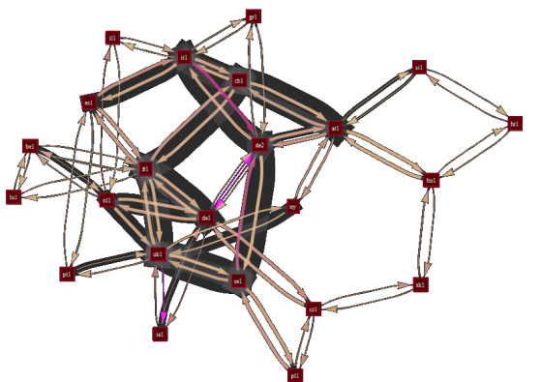

We have a working implementation of multipath transport.
It achieves a reasonable degree of load balancing.
This means that the network achieves some degree of resource pooling (subject to having good enough routes).
It maintains a reasonable degree of equipoise. This means it adapts sensibly to fluctuating congestion.
It is guaranteed to be fair compared to TCP.
The algorithm is ready for deployment. It is an experimental RFC in the mptcp working group at the IETF.
The work has been submitted to a top conference.

Slide 29
Ongoing research topics
How can we use poolability scores to help design a multipath routing algorithm? Is it sufficient to rely on end-host addressing?
The poolability analysis assumed idealized congestion control, which shifts all its traffic onto the least congested paths. But equipoise and fairness mean that such behaviour is not good. How does this impact resource pooling?
What is a principled way to choose the tradeoff between load balancing and equipoise?
What is the impact of resource pooling on competition and pricing?

