Slide 1

Multipath TCP
Mark Handley
Costin Raiciu
Damon Wischik
UCL
Notes:
Resource Pooling is the technical concept at the heart of the project. I’ll explain what it’s all about.

Slide 2
We have a working implementation of multipath transport
wifi
laptop with multipath TCP
server with multipath TCP
3G

Slide 3
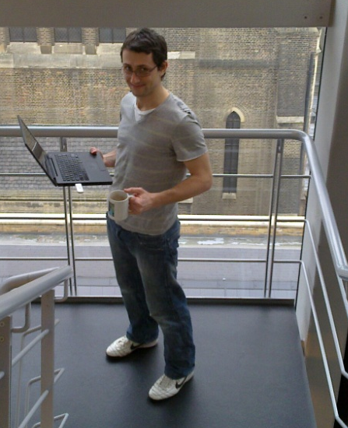

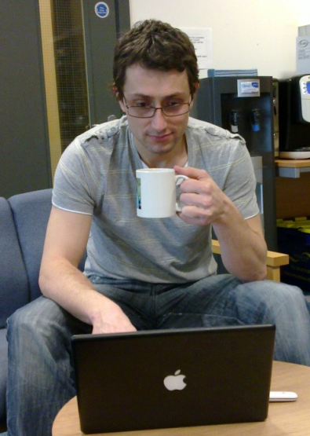
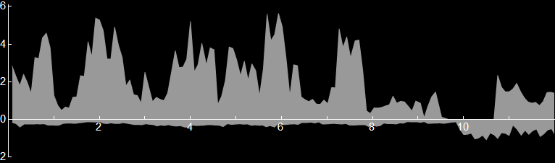
We have a working implementation of multipath transport
wifi
laptop with multipath TCP
server with multipath TCP
3G
wifi through-put [Mb/s]
3G through-put [Mb/s]
time
[min]

Slide 4
This user clearly benefits from multipath. But is it safe for the network and other users? Or does it cause instability, route flap, unfairness, disaster?
Notes:
I’ll describe the theory that we needed to get right, in order to ensure that this behaviour is not just safe for the network, but positively good.
Multipath transport is “in the DNA of the Internet”.

Slide 5
This user clearly benefits from multipath. But is it safe for the network and other users? Or does it cause instability, route flap, unfairness, disaster?
Resource pooling as a design principle
The earliest design goal of the Internet aimed to achieve “resource pooling”, and multipath transport is a natural extension.
How to measure the pooling potential of a multipath topology
We have a metric for measuring how much resource pooling there can be, given the topology and traffic matrix. This will be useful for designing multipath routing algorithms.
A coupled congestion control algorithm
We have designed and implemented a multipath congestion control algorithm that balances load, and we can guarantee it’s safe to deploy (but it’s harder than you’d think to do it right)
Notes:
I’ll describe the theory that we needed to get right, in order to ensure that this behaviour is not just safe for the network, but positively good.
Multipath transport is “in the DNA of the Internet”.

Slide 6
I. Resource pooling as a design principle
Resource pooling means “making a collection of resources behave like a single pooled resource”. It has been a design goal of the Internet from the beginning.
A single link, split into two circuits
Packet switching “pools” the two circuits
Multipath “pools” the two links
Notes:
Here, pooling is used to better accommodate surges in traffic.
The RHS looks like it’s just ECMP… but there are cases where a single ISP can’t get the benefits, only end-systems can. It’s a big research question, how to combine the best of route choice inside an AS with end-to-end route choice.

Slide 7
Resource pooling means the network is better able to accommodate a surge in traffic
or a loss of capacity
by shifting traffic and thereby “diffusing” congestion across the network.
Notes:
These problems would cause there to be lots of localized congestion. In each case, multipath resource pooling shifts some load, so it alleviates the congestion hotspot.
The surge shown here is on the right link. It could just as well be on the left link; the same multipath routing lets you accommodate either type of surge. Idea: keep the same multipath routes over a long timescale, traffic balances itself very quickly over short timescales.
Can we make the Internet pool resources automatically, without needing explicit setup by operators?
but allowing operators to influence the outcome if they want to
but bearing in mind that there are cases where end-systems can (and will) achieve better resource pooling than ISPs can
These pictures are simple cases of two parallel links where ECMP would work fine. But the mechanism we’re proposing is more general, it’s load-balancing over end-to-end paths.

Slide 8
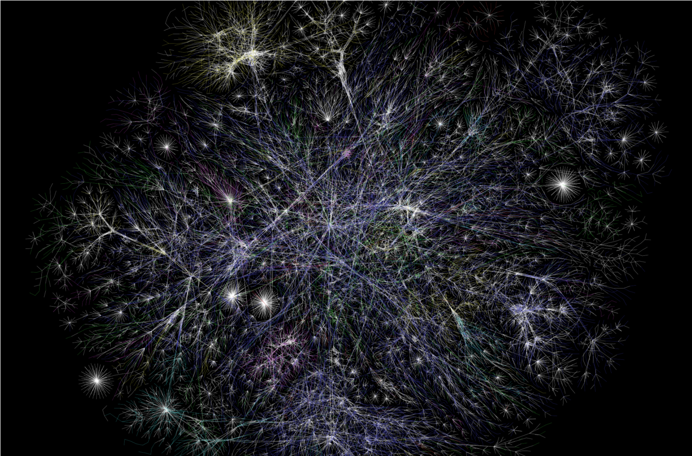
The Internet already has resource pooling, in the form of multi-homing, BGP, etc.
Notes:
* = congestion hotspots, flash crowds, link failures, DDOS attacks

Slide 9
The Internet already has resource pooling, in the form of multi-homing, BGP, etc.
Notes:
* = congestion hotspots, flash crowds, link failures, DDOS attacks

Slide 10
The Internet already has resource pooling, in the form of multi-homing, BGP, etc.
Notes:
* = congestion hotspots, flash crowds, link failures, DDOS attacks

Slide 11
The Internet already has resource pooling, in the form of multi-homing, BGP, etc.
We think resource pooling should be achieved by end-system multipath. This would harness the rapid responsiveness of end systems.
Notes:
* = congestion hotspots, flash crowds, link failures, DDOS attacks

Slide 12
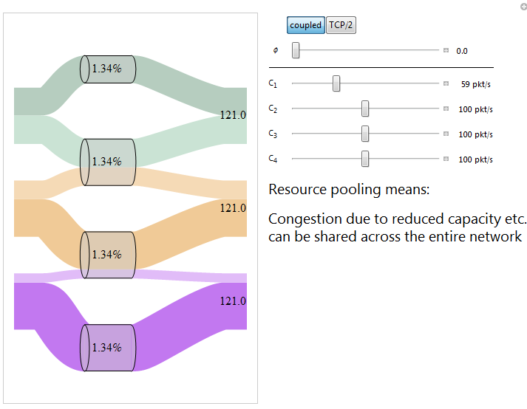

Slide 13
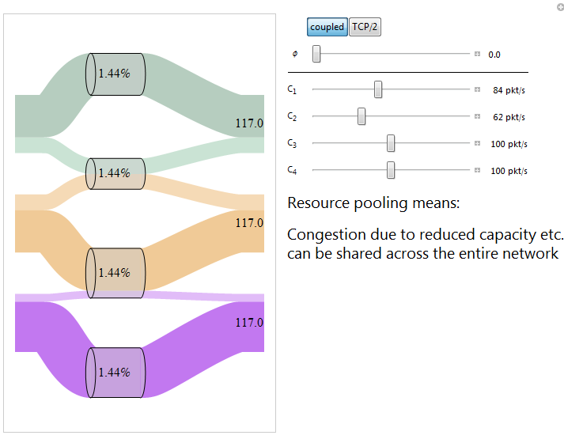

Slide 14
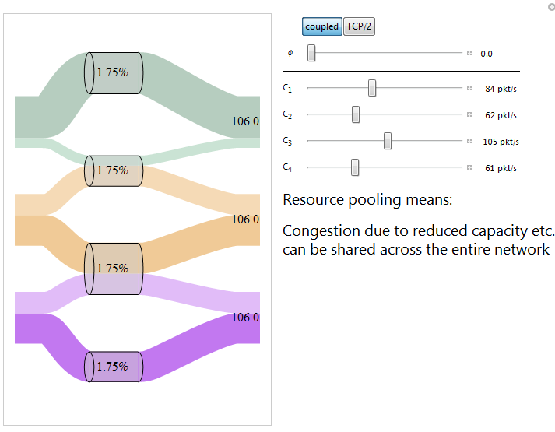

Slide 15
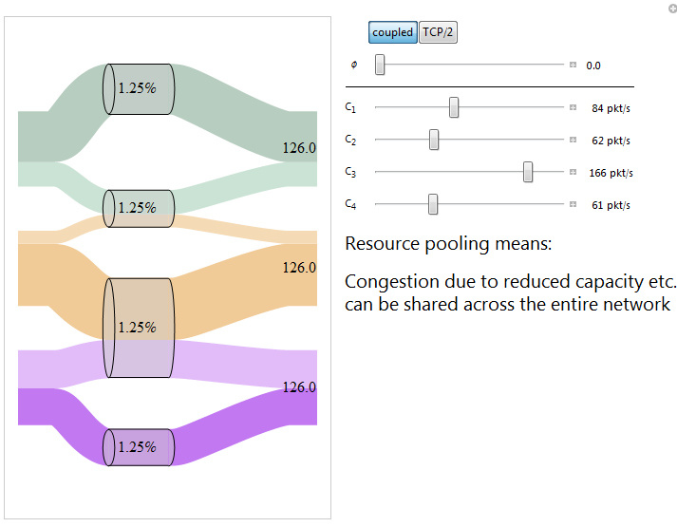

Slide 16
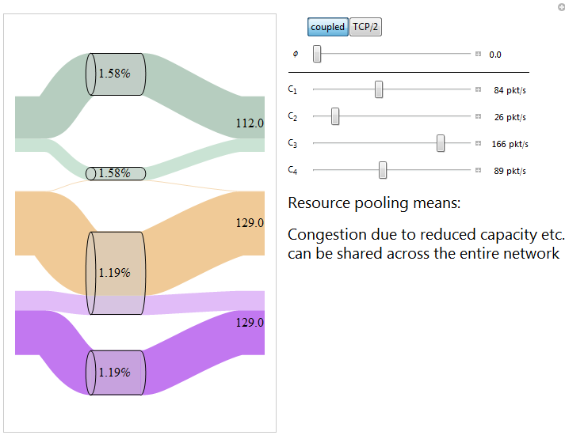

Slide 17
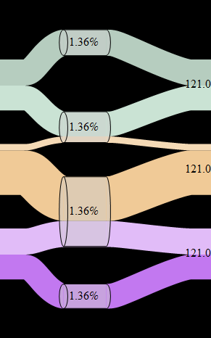
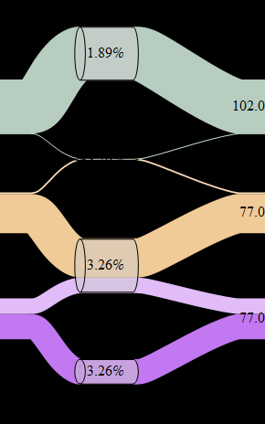
Resource pooling relies on there being enough path choices, and enough traffic that can make a choice.
There is enough diversity of useful paths to achieve complete resource pooling.
The network has split into two resource pools, because neither of the bottom two flows can access the top resource pool.
Topic II. How much resource pooling can be achieved, given a set of multipath routes and a traffic matrix?
Will there be one big pool, or many small pools?

Slide 18
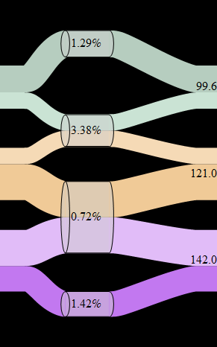
Resource pooling relies on proper load-balancing by the end-systems.
Using an idealized coupled congestion controller, there is resource pooling
Using separate TCP controllers for each path, congestion is not equalized and capacity is not shared
Topic III. Can we design a congestion controller such that users react in the right way to achieve resource pooling?
If they don’t, there may be a single pool but it won’t be shared properly.

Slide 19
Topic II. How much resource pooling can be achieved, given a set of multipath routes and a traffic matrix?
For the purposes of network-wide resource pooling,
  Is it sufficient to use end-host addressing?
  How much path diversity is enough, and what sort of diversity is useful?
To answer this, we first need a metric for the amount of resource pooling that a network achieves.

Slide 20
How should we measure resource pooling? It means
“making a collection of resources
behave like a single pooled resource”.
To measure resource pooling, we need to decide what we mean by “behave” and “like a single resource”.

Slide 21
How should we measure resource pooling? It means
“making a collection of resources
behave like a single pooled resource”.
To measure resource pooling, we need to decide what we mean by “behave” and “like a single resource”.
“Behave”
Resource pooling has the consequence that congestion hotspots can be diffused across the network. So the behaviour I shall examine is “what is the change in congestion at a link, in response to a change in the capacity at that link?”

Slide 22
How should we measure resource pooling? It means
“making a collection of resources
behave like a single pooled resource”.
To measure resource pooling, we need to decide what we mean by “behave” and “like a single resource”.
“Like a single resource”
Suppose for example that
at an isolated link with capacity 100Mb/s, the loss of 50Mb/s increases packet loss by a factor of 20
at an isolated link with capacity 1Gb/s, the loss of 50Mb/s increases packet loss by a factor of 1.03
at a resource-pooling link with capacity 100Mb/s, the loss of 50Mb/s increases packet loss by a factor of 1.03
Then we’ll say that the “effective pooled capacity at that link” is 1Gb/s.
“Behave”
Resource pooling has the consequence that congestion hotspots can be diffused across the network. So the behaviour I shall examine is “what is the change in congestion at a link, in response to a change in the capacity at that link?”

Slide 23
A simple flow allocation problem

Slide 24
A simple flow allocation problem (matrix form)

Slide 25
A simple flow allocation problem (relaxed)
Notes:
This is interesting, because K+V and K+L+T have congestion control algorithms that are distributed ways of solving this problem.

Slide 26
We want to know how the solution changes when capacities change.
I shall take y to be fixed, and only look at how x changes.
Notes:
This is interesting, because K+V and K+L+T have congestion control algorithms that are distributed ways of solving this problem.

Slide 27
We want to know how the solution changes when capacities change.
I shall take y to be fixed, and only look at how x changes.
Write out the complementary slackness conditions
Take the total derivative with respect to C_{j} for some j
Solve for dz_{i}/dC_{j} using linear algebra

Slide 28
Theorem
At an isolated link,
In a network with idealized multipath congestion control
I call Ψ_{jj} the “poolability score”, and C_{j}/(1-Ψ_{jj}) the “effective pooled capacity”.

Slide 29
If the poolability score is Ψ_{jj} ≈1 then the link sheds load easily.
If the poolability score is Ψ_{jj} ≈0 then the link is “solitary”.
Notes:
“Behaviour” – response to small changes in capacity.
(Circle the resource pools, and draw the pooled diagram. LHS: complete resource pooling.)
Typically, there are only a small number of resource pool configurations – either there is a pool, or there isn’t, it’s not a matter of degree.
We’d like paths such that there are as few resource pools as possible.

Slide 30
If the poolability score is Ψ_{jj} ≈1 then the link sheds load easily.
If the poolability score is Ψ_{jj} ≈0 then the link is “solitary”.

Slide 31




There is a close link between the multi-commodity flow problem, and the multipath rate problem.

Slide 32
There is a close link between the workloads in heavy traffic, and poolability.

Slide 33
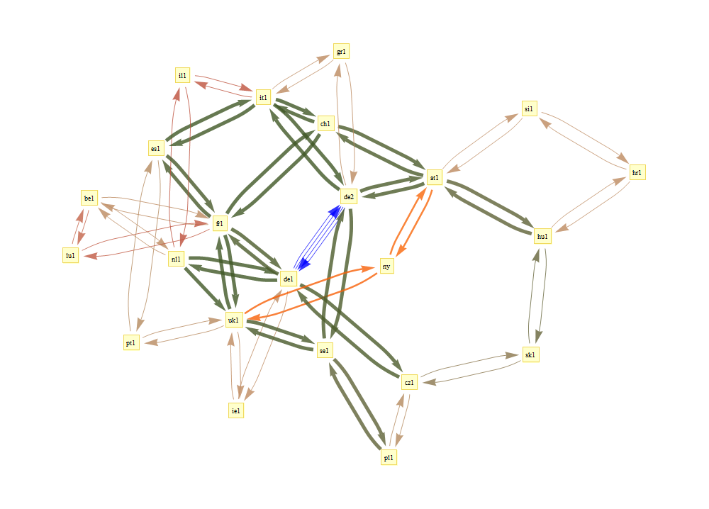
GEANT data provided by UCL Belgium
multipath routes, link capacities, and traffic matrices

Slide 34
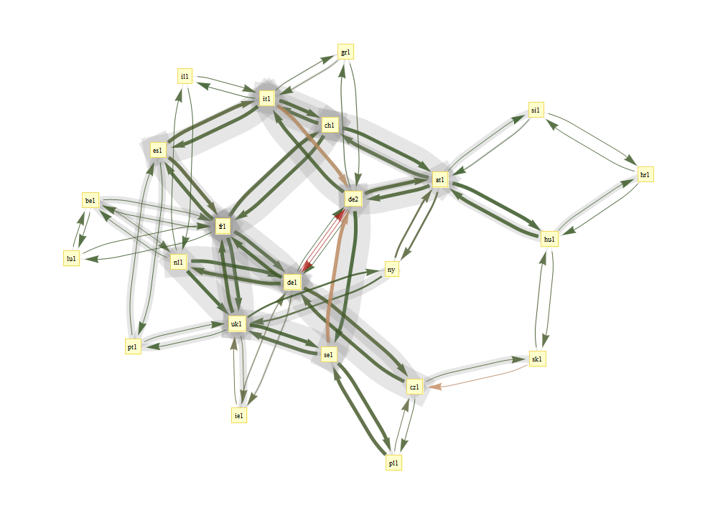
2005-05-04 16:30:00
Colours show utilization
Grey shows effective pooled capacity
Notes:
Some of the assumptions behind this:
I used the traffic matrix to estimate the number of flows between each pair, and then I made each flow run the idealized congestion controller. I assumed that there is no congestion at the access links. If I had data about access links, I could incorporate it into the computation.
Note: not all of the possible routes are made available. I just used the routes that were chosen by the WP1 algorithm. The multipath routing algorithm used local state to produce loop-free routes, and this prevented it from selecting certain paths.

Slide 35
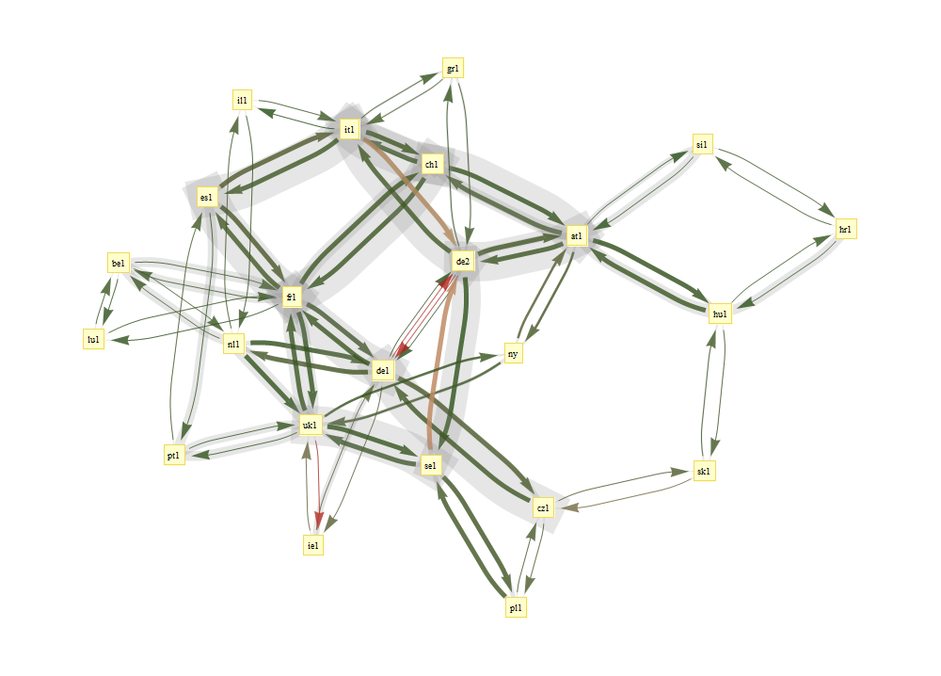
2005-05-04 17:45:00
Colours show utilization
Grey shows effective pooled capacity

Slide 36
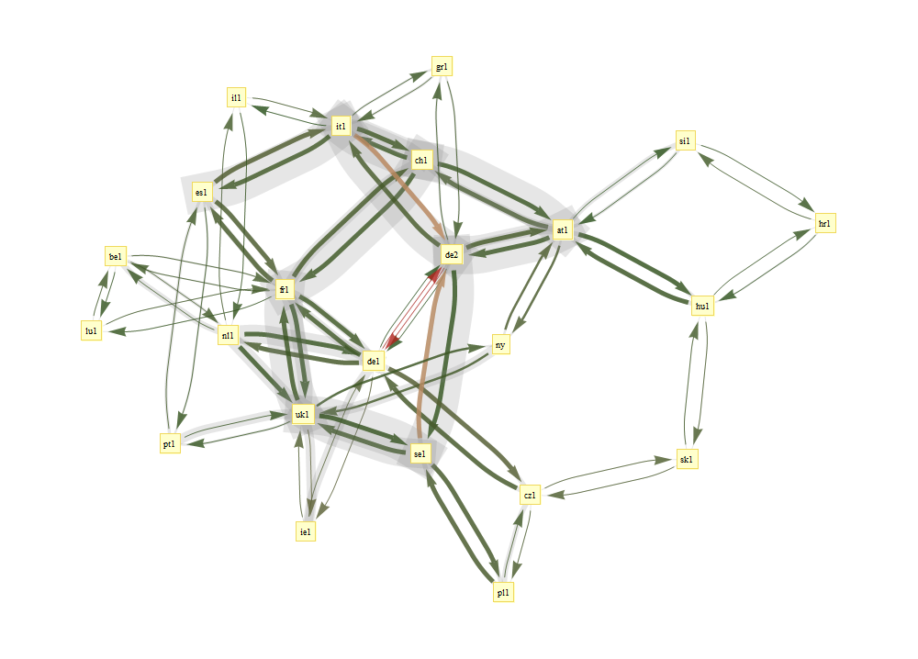
2005-05-04 19:00:00
Colours show utilization
Grey shows effective pooled capacity

Slide 37
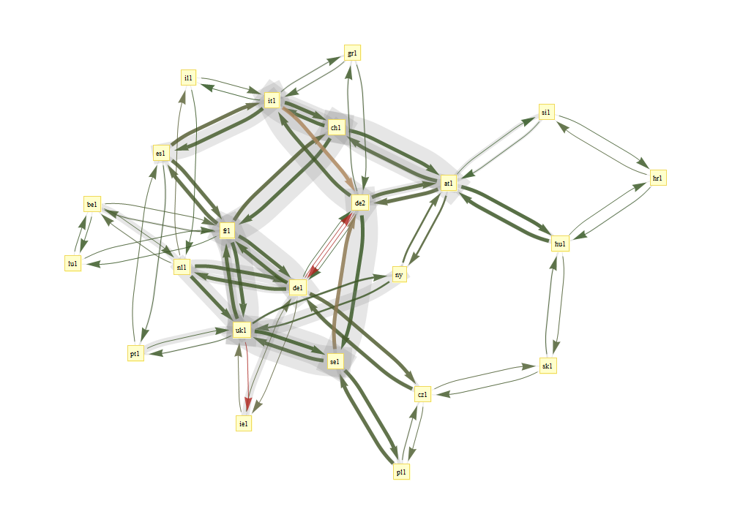
2005-05-04 20:15:00
Colours show utilization
Grey shows effective pooled capacity
Notes:
Summary: we have produced a metric, the “effective pooled capacity” at a link. This measures the beneficial effect of resource pooling. Hopefully, we’ll be able to use this to answer questions like “Is it sufficient to use end-host addressing?”

Slide 38
Topic III. Can we design a congestion controller such that users react in the right way to achieve resource pooling?
In the analysis of resource pooling, I assumed an idealized congestion controller: one which knows exactly the level of congestion on each path, and shifts its traffic onto the least congested.
To achieve this, we thought it would be a simple matter of taking a published “fluid model” of a load-balancing congestion controller, and implementing it.
[Kelly+Voice, 2005; Han, Shakkottai, Hollot, Srikant, Towsley (2006)]

Slide 39
Topic III. Can we design a congestion controller such that users react in the right way to achieve resource pooling?
In the analysis of resource pooling, I assumed an idealized congestion controller: one which knows exactly the level of congestion on each path, and shifts its traffic onto the least congested.
To achieve this, we thought it would be a simple matter of taking a published “fluid model” of a load-balancing congestion controller, and implementing it.
[Kelly+Voice, 2005; Han, Shakkottai, Hollot, Srikant, Towsley (2006)]
We were wrong.

Slide 40
The idealized congestion control algorithm puts all its traffic on the least congested path. This can a failure of load balancing, when congestion levels vary.
Each flow should get 1/5 of the pool.
The multipath flow is not using the lower link, so it never learns it should shift back.
The multipath flow should shift to using the top link. Then each flow gets 1/4 of the pool.
Notes:
You might think the answer is: just send a little bit on each path, so you get steady feedback about congestion levels. But this doesn’t work, because small rate implies infrequent drops implies noisy congestion signals. And noisy congestion signals can lead to unreliable inference… see next slide.

Slide 41
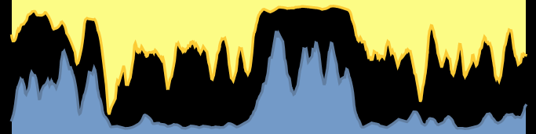
The noisy nature of congestion feedback makes it difficult to estimate congestion levels.
I better switch to the bottom link.
The top link is so congested!
loss rate 1%
random
drops
▼
▼
▼
▼
▼
▼
▼
▼
▼
▼
▼
▼
▼
▼
▼
▼
random
drops
▲
▲
loss rate 1%
▲
▲
▲
▲
▲
▲
▲
▲
▲
▲
▲
▲
▲
Now the bottom link is more congested!
Notes:
If you send very little data, you’ll have very poor quality information about the level of congestion, so you won’t have any sound basis for your inference.

Slide 42
There is a large body of work on fluid models of congestion control:
• write down a network utility maximization problem,
• write down a system of differential equations,
• show that the (unique) fixed point solves the utility maximization,
• and interpret it as a discrete congestion control algorithm.
Multipath congestion control theory has been developed by Kelly and Voice (2005), and by Han, Shakkottai, Hollot, Srikant, Towsley (2006).
Interpretation
  Increase x_{r} by a constant, every time you get an acknowledgement on path r
  Decrease x_{r} by an amount proportional to y_{s(r)} if you detect a drop on path r

Slide 43
How we expect the fluid model to behave:
Notes:
Consider a flow with two paths, with equal drop probability. Let x1 and x2 be the transmit rates on the two paths. According to the fluid model, (x1,x2) should head straight for the dotted line and then stay there. It should stay steady at any point on the dotted line.

Slide 44
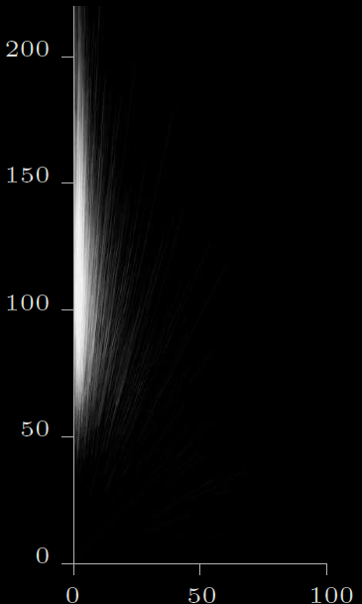
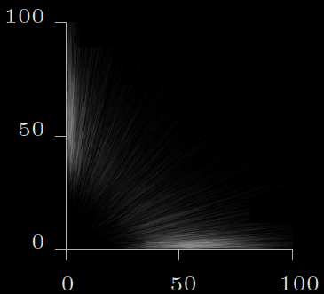
How they behave in simulation:
When there are many flows, then each flow will flip independently, and the aggregate will behave how the fluid models predict.
Notes:
When path 2 is less congested, it does indeed send nearly all its traffic on path 2, as expected.
When the two paths are equally congested, it flips at random between “all on 1” or “all on 2”, whereas we had expected it to balance.
The differential equation holds in a fluid limit: if there are N flows, and each flips randomly and independently between “all on 1” and “all on 2”, then the average should do a random walk on the line x1+x2=const. But this isn’t what we were hoping for…
We devised a nasty hack fix: a different differential equation with a smoothing term built in, which stays around the middle. It doesn’t solve the utility maximization (or rather, it corresponds to a different unnatural utility function). I don’t know what poolability is like for this different utility function.

Slide 45
The information feedback stream (packet drops, delays) is noisy. To get a good measure of the true state of the link, we have to average the signal.
But congestion is not static. To react promptly to changes in congestion, we have to look only at recent data about congestion, and we should constantly probe all paths.
Notes:
This is really asking: how should the end-system distinguish between transient congestion and persistent congestion?

Slide 46
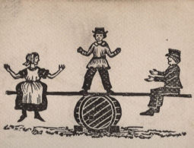
The information feedback stream (packet drops, delays) is noisy. To get a good measure of the true state of the link, we have to average the signal.
But congestion is not static. To react promptly to changes in congestion, we have to look only at recent data about congestion, and we should constantly probe all paths.
The Zen of resource pooling
To pool resources effectively, the end-system should not try too hard to pool resources.
Instead, it should maintain equipoise, i.e. balance its traffic rate across its paths, to the extent necessary to achieve resource pooling.
Notes:
This is really asking: how should the end-system distinguish between transient congestion and persistent congestion?

Slide 47
We devised a parameterized family of multipath congestion control algorithms, indexed by φϵ[0,2], to investigate the tradeoff between load balancing and equipoise.
φ=0
the idealized congestion controller, inspired by Kelly+Voice
φ=2
run independent TCP control on each path

Slide 48
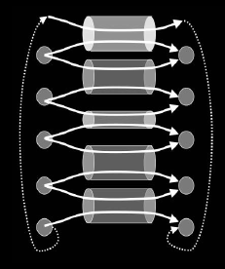
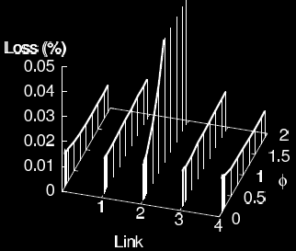
How good is this congestion controller at achieving resource pooling, in a static network?
φ=0
good at resource pooling:
even though the links have unequal capacities, congestion is balanced perfectly
φ=2
bad at resource pooling:
the low-capacity link is highly congested

Slide 49
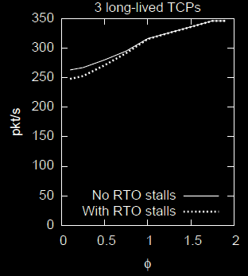
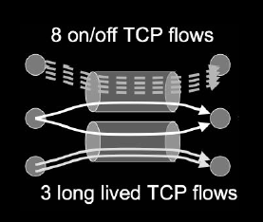
How good is this congestion controller at achieving resource pooling, in a dynamic network?
φ=0
bad at resource pooling:
shifts too enthusiastically to the less loaded link, and is slow to learn when the other link improves
φ=2
good at resource pooling:
constantly probes both links, so learns quickly when congestion levels change

Slide 50
the naïve coupled congestion controller, inspired by Kelly+Voice
φ=0
good at resource pooling:
even though the links have unequal capacities, congestion is balanced perfectly
bad at resource pooling:
shifts too enthusiastically to the less loaded link, and is slow to learn when the other link improves
run independent TCP control on each path
φ=2
bad at resource pooling:
the low-capacity link is highly congested
good at resource pooling:
constantly probes both links, so learns quickly when congestion levels change
static
network
dynamic network

Slide 51
the naïve coupled congestion controller, inspired by Kelly+Voice
φ=0
good at resource pooling:
even though the links have unequal capacities, congestion is balanced perfectly
bad at resource pooling:
shifts too enthusiastically to the less loaded link, and is slow to learn when the other link improves
run independent TCP control on each path
φ=2
bad at resource pooling:
the low-capacity link is highly congested
good at resource pooling:
constantly probes both links, so learns quickly when congestion levels change
static
network
dynamic network

Slide 52
We tweaked the φ algorithm, to ensure fairness with TCP.
We assign a weight to each link, and run a weighted version of the φ-algorithm. We have an adaptive algorithm for choosing the weights, to guarantee that
the multipath user gets as least as much throughput as if he/she used the best single path
the multipath user takes no more bandwidth on any link than a single-path TCP would.
more congested
short RTT
less congested
long RTT
Notes:
Ex 1: The multipath flow should only take as much capacity at a shared bottleneck as a single-path TCP flow.
Ex 2: Resource pooling prefers the less congested path, even if has longer RTT. But TCP only gives low throughput on long RTT paths.

Slide 53
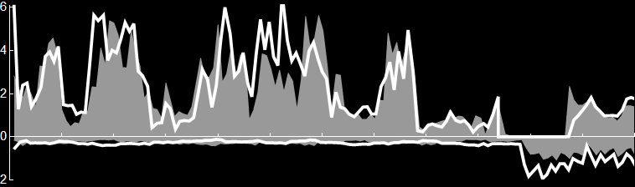
The 3G link has lower drop probability. We’d prefer to use the 3G link, to get resource pooling.
But the 3G link has a long RTT, so single-path TCP gets low throughput. We shouldn’t take any more than single-path TCP would.
Therefore we need to keep some traffic on the wifi link, so that the multipath user gets as good throughput as if he used single-path TCP.
what a single-path TCP flow gets
what a multipath flow gets
wifi throughput
[Mb/s]
Congested, short RTT
time [0—12 min]
3G throughput
[Mb/s]
Uncongested, long RTT

Slide 54
Theorem
Let x_{r} be the fixed-point throughput on path r of our multipath algorithm, and let x_{r}^{TCP} be the throughput that a single-path TCP flow on that path. Assume that packet drop probabilities are given. Then

Slide 55
But is there a principled way to think about the congestion control problem?

Slide 56
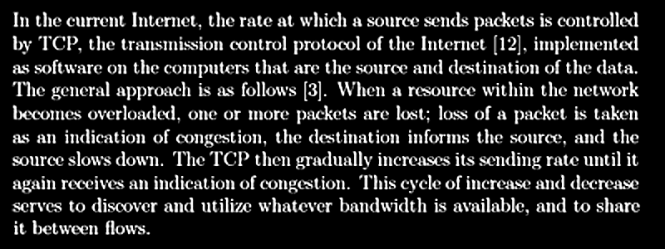
But is there a principled way to think about the congestion control problem?
*
*
*
“Resource pricing and the evolution of congestion control”,
Gibbens and Kelly, 1999.

Slide 57
But is there a principled way to think about the congestion control problem?

Slide 58
Control: at what rate the user should send packets
State: the user’s current belief about the network
Plant: Bayesian update of user’s beliefs, based on acknowledgements and drops, and incorporating a preconceived notion of how quickly congestion levels might fluctuate
This is the Bellman equation for a long-term average-cost dynamic programming problem.
Note: this equation is a toy model for single-path congestion control, not multipath.
!

Slide 59
We consider a model in which, each round trip time (RTT), the user chooses how many packets to send in that RTT. We assume u ϵ {0,1,…,u_{max}}.
D is the number of dropped packets. The reward is u-D, the number of delivered packets. The cost is γD, for some constant γ>0.

Slide 60
The distribution of D depends on the packet drop probability, Q.
The user’s current Bayesian belief about Q is specified by a Beta distribution, parameterized by n and p. (Here, p is the expected drop probability and n is the “amount of evidence” for p.)
The user’s belief about q is updated every RTT, in two ways:
the user gains information about the distribution of Q, from observing D
congestion levels may change over an RTT, which adds uncertainty to the distribution of Q. That is, the network is a restless bandit.

Slide 62
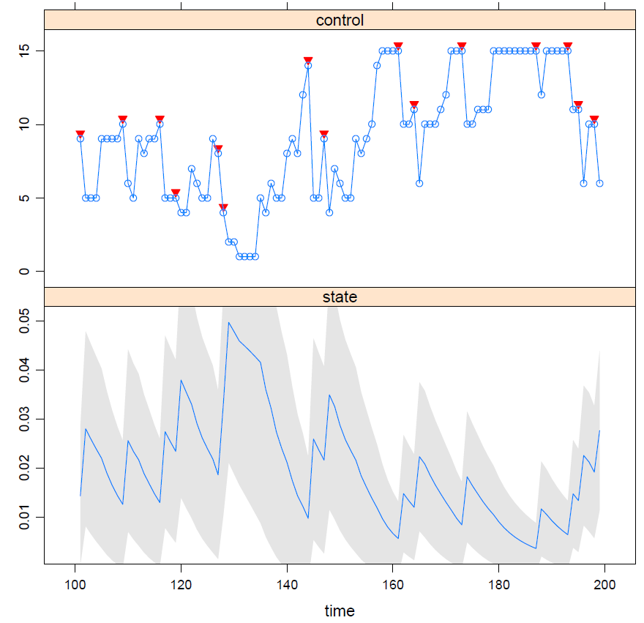
I solved the Bellman equation numerically, and derived an optimal congestion control algorithm.
I then ran this algorithm on a link with packet drop probability 0.02.
Notes:
Internet congestion control can be analyzed using a mixture of control theory and stochastic analysis
Control theory = how do aggregates react to each other?
It is fairly well understood.
Stochastic analysis = how do individual parts act, and how does the behaviour of an aggregate arise out of its individual parts?
It is poorly understood.
How does a dynamic-programming congestion control algorithm fit in with the Network Utility Maximization approach?

Slide 63
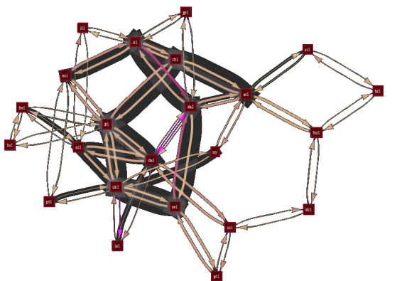

SUMMARY. We have a working implementation of multipath transport.
It achieves a reasonable degree of load balancing.
This means that the network achieves some degree of resource pooling (subject to having good enough routes).
It maintains a reasonable degree of equipoise. This means it adapts sensibly to fluctuating congestion.
It is guaranteed to be fair compared to TCP.
The algorithm is ready for deployment. It is an experimental RFC in the mptcp working group at the IETF.

Slide 64
Ongoing research topics
How can we use poolability scores to help design a multipath routing algorithm? Is it sufficient to rely on end-host addressing?
Can multipath TCP help achieve resource pooling in data centres?
Can multipath TCP make good routing choices in ad-hoc wireless networks?
Does the dynamic programming approach shed light on CUBIC, Compound TCP etc.? Why has classic TCP worked so well?
What is the impact of resource pooling on competition and pricing? Will it drive network operators to switch to congestion volume pricing?
Notes:
Arguably, recent practical developments in congestion control can be better understood by dynamic programming than by control theory.

