Slide 1

Multipath TCP design, and application to data centers
Damon Wischik, Mark Handley, Costin Raiciu,
Christopher Pluntke
Notes:
ultipath TCP working group at the IETF, which is about to produce an experimental standard called MPTCP. We’ve been closely involved in that effort, and what I’m going to describe is the congestion control component of MPTCP.

Slide 2
Packet switching ‘pools’ circuits.
Multipath ‘pools’ links : it is Packet Switching 2.0.
TCP controls how a link is shared.
How should a pool be shared? What is TCP 2.0?
Two circuits
A link
Two separate links
A pool of links
Notes:
In a circuit-switched network, there is a dedicated channel for each flow. It’s rigid and inflexible: when one flow is silent, the other flow can’t fill in. Packet switching gives you much more flexibility (whether you use it for ATM virtual circuits, or for full-blown IP).
Multipath brings flexibility of the same sort. Pic 3 is rigid and inflexible, Pic 4 is flexible.
In the case of packet switching, you need to be careful about how the flows share the link. Pic 1 circuits made it easy – they give strict isolation between flows. But with Pic 2 packet switching, you need a control plane. It could be with ATM and admission control. Or it could be TCP congestion control, which says how end-systems should adapt their rates so that the network shares its capacity fairly.
What sort of control plane do we need, to ensure that a multipath network works well?

Slide 3
In a data center, can we use multipath to get higher throughput?
Initially, there is one flow.

Slide 4
In a data center, can we use multipath to get higher throughput?
Initially, there is one flow.
A new flow starts. Its direct route collides with the first flow.

Slide 5
In a data center, can we use multipath to get higher throughput?
Initially, there is one flow.
A new flow starts. Its direct route collides with the first flow.
But it also has longer routes available, which don’t collide.

Slide 6
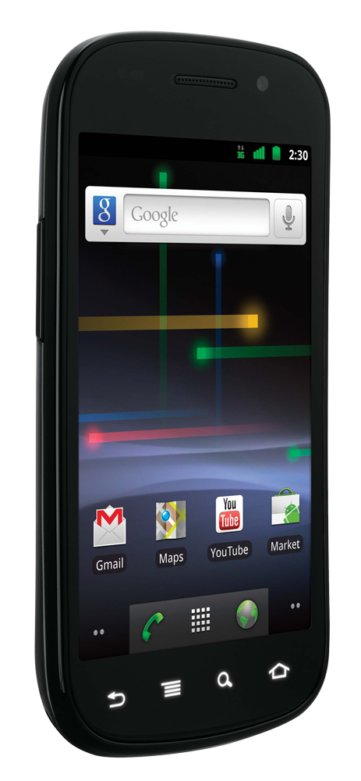
Can multipath help with mobile hand-offs?
wifi hotspot
wifi hotspot
3G cell
internet

Slide 7
Can multipath help with mobile hand-offs?
wifi hotspot
wifi hotspot
3G cell
internet

Slide 8
Can multipath help with mobile hand-offs?
wifi hotspot
wifi hotspot
3G cell
internet

Slide 9
Can multipath help with mobile hand-offs?
wifi hotspot
wifi hotspot
3G cell
internet

Slide 10
Can multipath help with mobile hand-offs?
wifi hotspot
wifi hotspot
3G cell
internet

Slide 11
Can multipath help with mobile hand-offs?
If your phone uses both radios simultaneously, you needn’t experience any interruption.

Slide 12
Can multipath help with mobile hand-offs?
If your phone uses both radios simultaneously, you needn’t experience any interruption.

Slide 13
Can multipath help with mobile hand-offs?
If your phone uses both radios simultaneously, you needn’t experience any interruption.

Slide 14
Can multipath help with mobile hand-offs?
If your phone uses both radios simultaneously, you needn’t experience any interruption.

Slide 15
Can multipath help with mobile hand-offs?
If your phone uses both radios simultaneously, you needn’t experience any interruption.
How should it balance traffic across dissimilar paths?
3G path:
low loss rate, large RTT
Wifi path:
high loss rate, small RTT

Slide 16
We designed the MPTCP protocol to be a general-purpose multipath replacement for TCP.
I will describe our design process behind MPTCP’s congestion control algorithm.
MPTCP should be beneficial in data centers.
I will describe experimental & simulation results.

Slide 17
What is the MPTCP protocol?
MPTCP is a replacement for TCP which lets you use multiple paths simultaneously.
user space
socket API
The sender stripes packets across paths
MPTCP
The receiver puts the packets in the correct order
TCP
MPTCP
IP
addr
addr₁
addr₂
Notes:
I’m interested in the congestion control component.
What I talk about is generic: if you want multipath CompoundTCP, or multipath SCTP, or multipath CubicTCP, you’ll need to face the same design issues. We have made our algorithm fit nicely with TCP, but merely as a starting point.

Slide 18
What is the MPTCP protocol?
MPTCP is a replacement for TCP which lets you use multiple paths simultaneously.
user space
socket API
The sender stripes packets across paths
MPTCP
The receiver puts the packets in the correct order
TCP
MPTCP
IP
addr
addr
port p₁
a switch with port-based routing
port p₂
Notes:
I’m interested in the congestion control component.
What I talk about is generic: if you want multipath CompoundTCP, or multipath SCTP, or multipath CubicTCP, you’ll need to face the same design issues. We have made our algorithm fit nicely with TCP, but merely as a starting point.

Slide 19
Design goal 1:
Multipath TCP should be fair to regular TCP at shared bottlenecks
To be fair, Multipath TCP should take as much capacity as TCP at a bottleneck link, no matter how many paths it is using.
A multipath TCP flow with two subflows
Regular TCP
Strawman solution:
Run “½ TCP” on each path
Notes:
This is the very first thing that comes to mind with multipath TCP, and it’s something that many other people have solved in different ways.
This is just a warm-up... Design Goal 3 is a much “richer” generalization of this goal, which accommodates different topologies, different RTTs. So there’s no point giving an evaluation here.

Slide 20
Design goal 2:
MPTCP should use efficient paths
Each flow has a choice of a 1-hop and a 2-hop path.
How should split its traffic?
12Mb/s
12Mb/s
12Mb/s
Notes:
I’m thinking of the paths as given. MPTCP has the choice of how to split its traffic over those given paths.

Slide 21
Design goal 2:
MPTCP should use efficient paths
If each flow split its traffic 1:1 ...
12Mb/s
8Mb/s
12Mb/s
8Mb/s
8Mb/s
12Mb/s

Slide 22
Design goal 2:
MPTCP should use efficient paths
If each flow split its traffic 2:1 ...
12Mb/s
9Mb/s
12Mb/s
9Mb/s
9Mb/s
12Mb/s

Slide 23
Design goal 2:
MPTCP should use efficient paths
If each flow split its traffic 4:1 ...
12Mb/s
10Mb/s
12Mb/s
10Mb/s
10Mb/s
12Mb/s

Slide 24
Design goal 2:
MPTCP should use efficient paths
If each flow split its traffic ∞:1 ...
12Mb/s
12Mb/s
12Mb/s
12Mb/s
12Mb/s
12Mb/s

Slide 25
Design goal 2:
MPTCP should use efficient paths
12Mb/s
12Mb/s
12Mb/s
12Mb/s
12Mb/s
12Mb/s
Theoretical solution (Kelly+Voice 2005; Han, Towsley et al. 2006)
MPTCP should send all its traffic on its least-congested paths.
Theorem. This will lead to the most efficient allocation possible, given a network topology and a set of available paths.

Slide 26
MPTCP chooses efficient paths in a BCube data center, hence it gets high throughput.
MPTCP shifts its traffic away from the congested link.
Initially, there is one flow.
A new flow starts. Its direct route collides with the first flow.
But it also has longer routes available, which don’t collide.

Slide 27
Design goal 3:
MPTCP should be fair compared to TCP
Design goal 2 says to put all your traffic on the least congested path.
Here, 3G is always the least congested path. But if we only used 3G, we’d get worse throughput.
c
d
Goal 3a. A Multipath TCP user should get at least as much throughput as a single-path TCP would on the best of the available paths.
Goal 3b. A Multipath TCP flow should take no more capacity on any link than a single-path TCP would.
Notes:
Let’s get back to fairness. This is a more systematic and general way to think about fairness, than the simple bottleneck idea I started with.
If we follow Design Goal 2, we’ll push all our traffic onto the low-loss path, i.e. 3G. But 3G has high RTT, which means that a TCP flow would get low throughput. In order to be fair to TCP, we shouldn’t send very much traffic over 3G. But then the user is suffering because of MPTCP, which is no good.
We want the user to have an incentive to use MPTCP, and we want the network to have an incentive to permit MPTCP. Here’s a more precise way to put it.

Slide 28
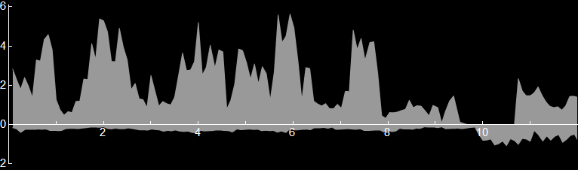
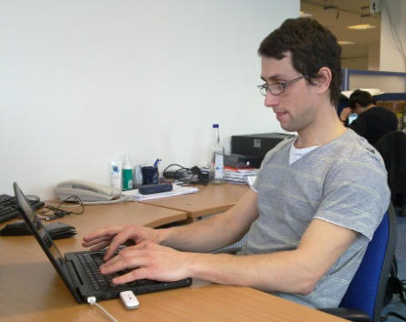
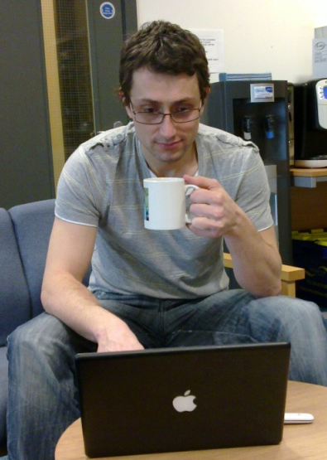
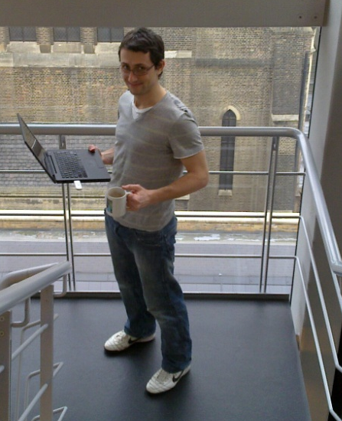
MPTCP gives fair throughput.
wifi through-put [Mb/s]
3G through-put [Mb/s]
time
[min]
User in his office, using wifi and 3G
In the kitchen
Going downstairs
Notes:
Note: the total shaded area indicates the total throughput.

Slide 29
MPTCP gives fair throughput.
wifi through-put [Mb/s]
3G through-put [Mb/s]
time
[min]
3G has lower loss rate. Design Goal 2 says to shift traffic onto 3G ...
MPTCP sends
0.4Mb/s over 3G, and the remaining 1.8Mb/s over wifi.
But, today, TCP over 3G was only getting 0.4Mb/s, so don’t take more than that …
But, today, TCP over wifi was getting 2.2Mb/s, so user is entitled to this much…

Slide 30
MPTCP gives fair throughput.
wifi through-put [Mb/s]
3G through-put [Mb/s]
time
[min]
We measured throughput , for both
½ TCP (strawman) and MPTCP, in the office.
½ TCP is unfair to the user, and its throughput is 25% worse than MPTCP.

Slide 31
Design goals
Goal 1. Be fair to TCP at bottleneck links
Goal 2. Use efficient paths ...
Goal 3. as much as we can, while being fair to TCP
Goal 4. Adapt quickly when congestion changes
Goal 5. Don’t oscillate
redundant
How does MPTCP achieve all this?
Notes:
“Goal 3. Be fair to TCP” means two things:
fair to the user, i.e. user doesn’t suffer by switching from TCP to MPTCP;
fair to the network, i.e. network doesn’t suffer when users switch from TCP to MPTCP.
It subsumes Goal 1.
There are two more goals.
Paper discusses Goal 4 at length.
Goal 5: we didn’t see any oscillations in our evaluation; theory papers predict no oscillation, for an idealized model.

Slide 32
How does TCP congestion control work?
Maintain a congestion window w.
Increase w for each ACK, by 1/w
Decrease w for each drop, by w/2

Slide 33

How does MPTCP congestion control work?
Maintain a congestion window w_{r}, one window for each path, where r ∊ R ranges over the set of available paths.
Increase w_{r} for each ACK on path r, by
Decrease w_{r} for each drop on path r, by w_{r} /2
Notes:
MPTCP works pretty much like TCP, i.e. window increases and window decreases on each path. The decrease is the same as TCP. When there is only one path available, this formula reduces to the TCP formula.
We derived a throughput formula for this congestion control algorithm, and checked that it satisfies the design goals.

Slide 34
How does MPTCP congestion control work?
Maintain a congestion window w_{r}, one window for each path, where r ∊ R ranges over the set of available paths.
Increase w_{r} for each ACK on path r, by
Decrease w_{r} for each drop on path r, by w_{r} /2
Design goal 3:
At any potential bottleneck S that path r might be in,
look at the best that a single-path TCP could get,
and compare to what I’m getting.

Slide 35
How does MPTCP congestion control work?
Maintain a congestion window w_{r}, one window for each path, where r ∊ R ranges over the set of available paths.
Increase w_{r} for each ACK on path r, by
Decrease w_{r} for each drop on path r, by w_{r} /2
Design goal 2:
We want to shift traffic away from congestion.
To achieve this, we increase windows in proportion to their size.

Slide 36
Related work
on multipath congestion control
pTCP , CMT over SCTP, and M/TCP
that meets goal 1 (fairness at shared bottleneck)
mTCP, ≈ R-MTP
and goal 2 (choosing efficient paths)
Honda et al. (2009), ≈ Tsao and Sivakumar (2009)
and goal 5 (non-oscillation)
Kelly and Voice (2005), Han et al. (2006)
and goal 3 (fairness)
and goal 4 (rapid adjustment)
(none)

Slide 37
Why we like MPTCP for data centers, and why ECMP and per-packet scattering have problems.

Slide 38
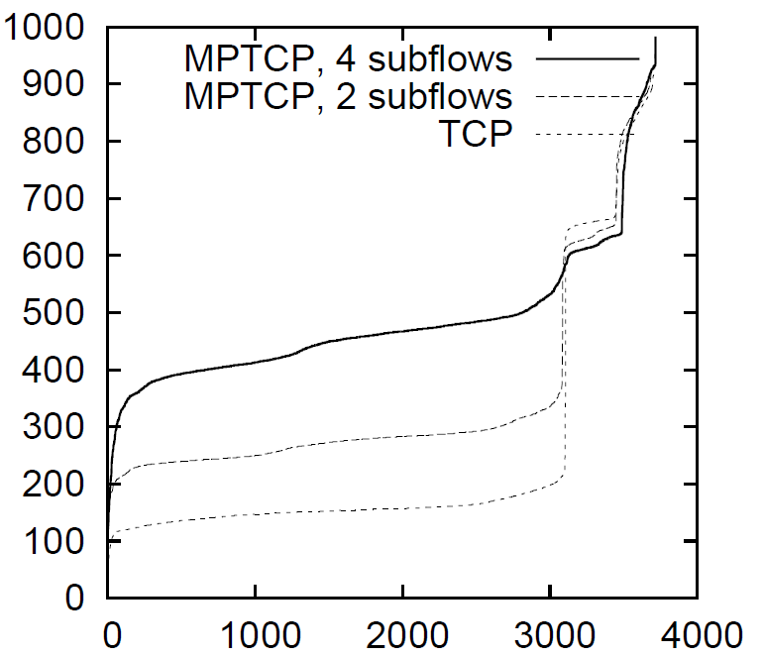
MPTCP is a simple way to automatically pick the best of several available paths.
throughput [Mb/s]
Amazon EC2 (USEast1d).
24 hours.
10 hosts, each sending to the 9 others in turn, over and over again.
Background traffic levels vary.
Traceroute shows 26% of paths were local (i.e. no alternative paths), 74% were four- or five-hop.
Flow rank

Slide 39
MPTCP discovers available capacity
An obvious way to balance load is to use ECMP, i.e. pick randomly from available paths for each TCP flow.
This balances traffic nicely, as long as there are enough flows.

Slide 40
MPTCP discovers available capacity
An obvious way to balance load is to use ECMP, i.e. pick randomly from available paths for each TCP flow.
This balances traffic nicely, as long as there are enough flows. But if there are fewer flows,
there may be collisions and wasted capacity.

Slide 41
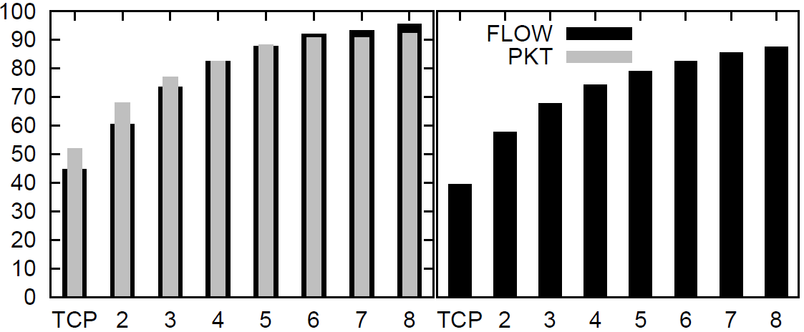
MPTCP discovers available capacity, and it doesn’t need much path choice.
Throughput
(% of optimal)
FatTree, 128 nodes
FatTree, 8192 nodes
Num. paths
Simulations of FatTree, 100Mb/s links, permutation traffic matrix,
one flow per host, TCP+ECMP versus MPTCP.
If each node-pair balances its traffic over 8 paths, chosen at random, then utilization is around 90% of optimal.

Slide 42
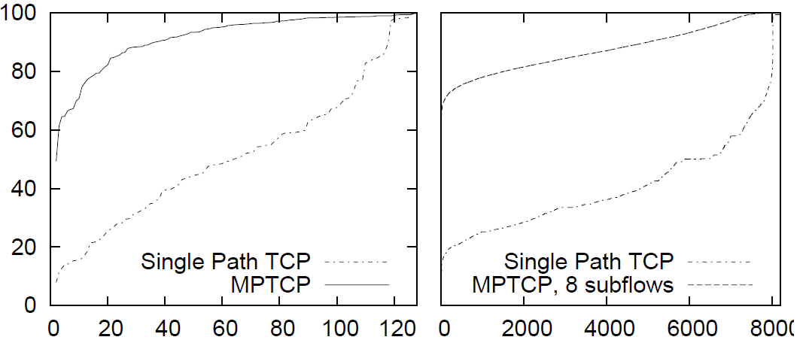
MPTCP discovers available capacity, and it shares it out more fairly than TCP+ECMP.
Throughput
(% of optimal)
FatTree, 128 nodes
FatTree, 8192 nodes
Flow rank
Simulations of FatTree, 100Mb/s links, permutation traffic matrix,
one flow per host, TCP+ECMP versus MPTCP.

Slide 43
MPTCP can make good path choices, better than per-packet load balancing.
12Mb/s
12Mb/s
12Mb/s

Slide 44
MPTCP can make good path choices, better than per-packet load balancing.
100Mb/s
12Mb/s
12Mb/s
12Mb/s
100Mb/s
At the point where the switching decision is made, is there enough information to make the right switching choice?
The right choice might even be different for different destinations.

Slide 45
MPTCP can make good path choices, and it’s robust against a range of traffic matrices.
Simulations of BCube, with 125 three-interface hosts, 25 switches, 100Mb/s links.
Pkt scatter: switches run per-packet load balancing across all available paths; use modified TCP which copes with reordering
TCP+ECMP: only use shortest-hop paths
½ TCP, MPTCP: split traffic across multiple paths
per-host throughput [Mb/s]
½ TCP
perm. traffic matrix
sparse traffic matrix
local traffic matrix
ECMP, using only shortest-hop paths, is wasteful when traffic is light
per-packet scattering might send traffic over longer paths, which is a bad choice when traffic is local
Notes:
Local traffic matrix: each host reads from 12 other hosts, chosen to be the 12 neighbours in BCube’s three levels.

Slide 46
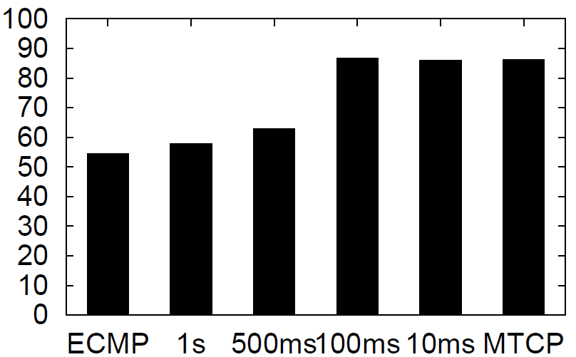
MPTCP can make good path choices, as good as a very fast centralized scheduler.
Throughput [% of optimal]
Simulation of FatTree with 128 hosts.
Permutation traffic matrix
Closed-loop flow arrivals (one flow finishes, another starts)
Flow size distributions from VL2 dataset
MPTCP
Hedera first-fit heuristic

Slide 47
MPTCP permits flexible topologies
FatTree and VL2 aim to mimic a non-blocking switch, i.e. to support any permutation traffic matrix.
(They achieve this, to varying degrees, depending on the level of statistical multiplexing and/or flow placement.)
But maybe it’s the wrong objective.
What if we want a cheaper “right-provisioned” network core, e.g. which lets ¼ of the hosts send at full NIC rate? What if we give them multiple NICs to allow bursts?
Notes:
Amazon EC2 gave us 200-300Mb/s, which maybe means they have 1Gb/s interfaces, but a congested core.

Slide 48
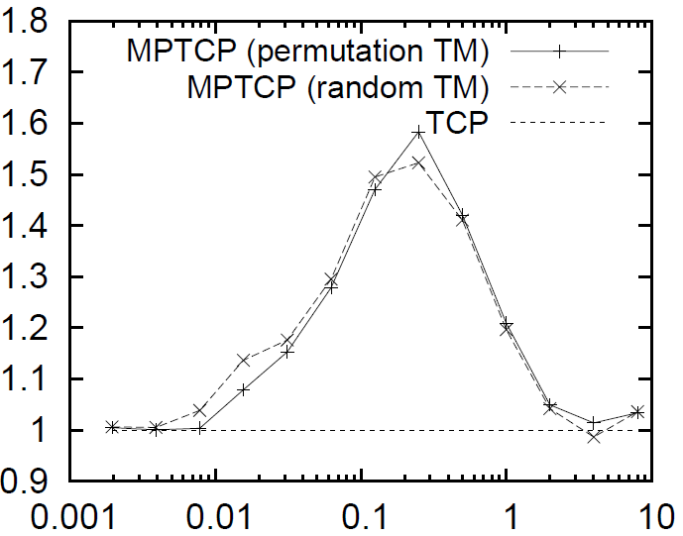
MPTCP permits flexible topologies
Ratio of throughputs, MPTCP/TCP
Simulation of a FatTree-like topology with 512 nodes, but with 4 hosts for every up-link from a top-of-rack switch, i.e. the core is oversubscribed 4:1.
Permutation TM: each host sends to one other, each host receives from one other
Random TM: each host sends to one other, each host may receive from any number
Connections per host
At low loads, there are few collisions, and NICs are saturated, so TCP ≈ MPTCP
At high loads, the core is severely congested, and TCP can fully exploit all the core links, so TCP ≈ MPTCP
When the core is “right-provisioned”, i.e. just saturated, MPTCP > TCP

Slide 49
MPTCP permits flexible topologies
FatTree
(5 ports per host in total,
1Gb/s bisection bandwidth)
Dual-homed FatTree
(5 ports per host in total,
1Gb/s bisection bandwidth)
1Gb/s
1Gb/s
If only 50% of hosts are active, you’d like each host to be able to send at 2Gb/s, faster than one NIC can support.
If a reasonable amount of traffic is local, you’d like to carry more total traffic than 1Gb/s NICs allow. (And dual-homing increases resilience to ToR failure, which encourages you to localize traffic.)

Slide 50
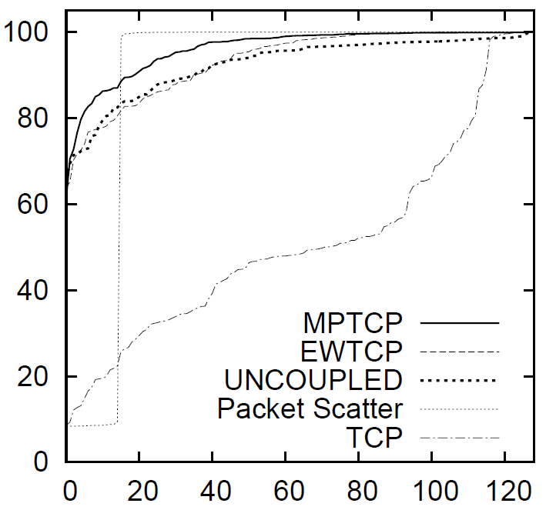
MPTCP permits flexible topologies
Average throughput
[% of optimal]
Simulation of 128-node FatTree, when one of the 1Gb/s core links is cut to 100Mb/s
Rank of flow
Because an MPTCP flow shifts its traffic onto its least congested paths, congestion hotspots are made to “diffuse” throughout the network. Non-adaptive congestion control, on the other hand, does not cope well with non-homogenous topologies.
Notes:
This is a very plausible sort of failure!

Slide 51
What is MPTCP really trying to do?

Slide 52
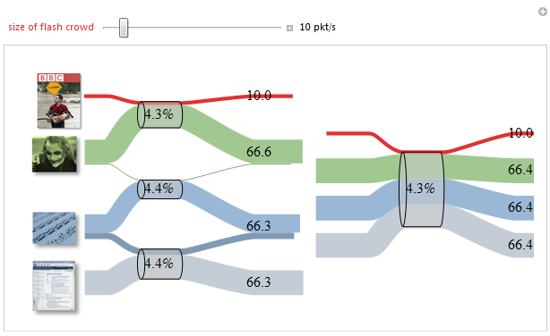
Three links,
80 Mb/s, 50 Mb/s, 60 Mb/s
One link,
190 Mb/s

Slide 53
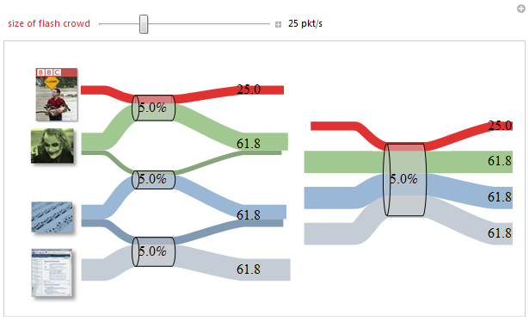
Three links,
80 Mb/s, 50 Mb/s, 60 Mb/s
One link,
190 Mb/s

Slide 54
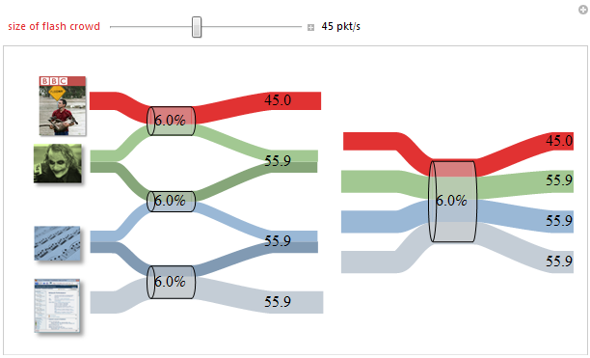
Three links,
80 Mb/s, 50 Mb/s, 60 Mb/s
One link,
190 Mb/s

Slide 55
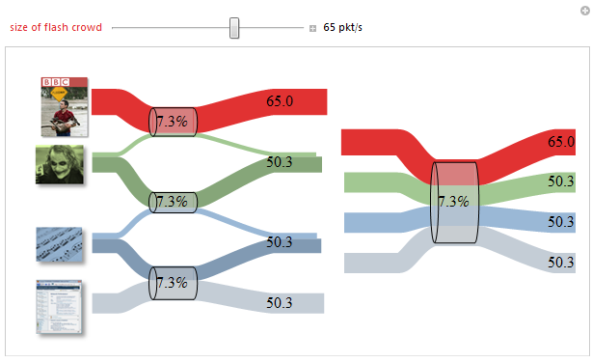
Three links,
80 Mb/s, 50 Mb/s, 60 Mb/s
One link,
190 Mb/s

Slide 56
MPTCP tries to make a network behave like a simple pool of capacity.
Can we design a data center topology that enables MPTCP to achieve its goal, over a good range of traffic matrices?

Slide 57
Further questions
How should we fit multipath congestion control to CompoundTCP or CubicTCP or DCTCP?
Is it worth using multipath for small flows?

Slide 58
Conclusion
Multipath is Packet Switching 2.0
It lets you share capacity between links.
MPTCP is TCP 2.0
It is a control plane to allocate resource pools.
MPTCP is traffic engineering, done by end-systems, on a timescale of milliseconds
which means fairer and more effective use of data center capacity.
MPTCP means that a given network can support a wider range of traffic matrices, so it gives you more flexibility to customize the network topology.
Notes:
There are obviously schemes in place for traffic engineering -- link-bonding, ECMP, BGB prefixes etc. What distinguishes MPTCP is that it’s end-system-based, it’s a single clean solution, it doesn’t screw up your BGP tables. It just arose out of the sensible design goals we started with.
It can reach the parts that core-based TE cannot reach. Conversely, there may be things that core-based cannot do. We don’t yet know how they should live together – it’s not either/or.
This is on last call before being published as an experimental standard in the IETF.

