Slide 1
What mathematicians should
know about the Internet:
a case study

Slide 2
Overlay TCP for multi-path routing and congestion control Han, Shakkottai, Hollot, Srikant, Towsley, ENS-INRIA ARC-TCP Workshop 2003
ABSTRACT. We consider the problem of multi-path routing in the Internet. Currently, Internet routing protocols select only a single path between a source and a destination. However, due to many policy routing decisions, single-path routing may limit the achievable throughput. In this paper, we envision a scenario where application-level routers are overlaid on the Internet to allow multi-path routing. Using minimal congestion feedback signals from the overlay routers, we present an algorithm that can be implemented at the sources to stably and optimally split the flow between each source-destination pair. We then show that the connection-level throughput region of such a multi-path routing/congestion control scheme can be larger than that of a single-path congestion control scheme.

Slide 3
Stability of end-to-end algorithms for joint routing and rate control Kelly and Voice, Computer Communication Review 2005
ABSTRACT. Dynamic multi-path routing has the potential to improve the reliability and performance of a communication network, but carries a risk. Routing needs to respond quickly to achieve the potential benefits, but not so quickly that the network is destabilized. This paper studies how rapidly routing can respond, without compromising stability.
We present a sufficient condition for the local stability of end-to-end algorithms for joint routing and rate control. The network model considered allows an arbitrary interconnection of sources and resources, and heterogeneous propagation delays. The sufficient condition we present is decentralized: the responsiveness of each route is restricted by the round-trip time of that route alone, and not by the roundtrip times of other routes. Our results suggest that stable, scalable load-sharing across paths, based on end-to-end measurements, can be achieved on the same rapid time-scale as rate control, namely the time-scale of round-trip times.

Slide 4
What problem is being solved by joint routing and rate control?
Given a network consisting of
a set of links indexed by j, each with its own penalty function C_{j}
a set of users indexed by s, each with his/her own utility function U_{s}
and a set of routes indexed by r,

Slide 5
What problem is being solved by end-to-end algorithms for joint routing and rate control?
Find a distributed algorithm for solving the network utility maximization problem. That is,
where the fixed point of this system of equations solves the utility maximization problem.

Slide 6
What problem is being solved by stable end-to-end algorithms for joint routing and rate control?
Find a distributed algorithm for solving the network utility maximization problem.
The system of differential equations should be stable (or at least locally stable, in y and z) about the equilibrium.

Slide 7
What are the limits of this solution?
It is tricky to evolve TCP to implement the principles of the Kelly+Voice algorithm.
Network systems people don’t see the applicability of fluid stability results.
Network systems people don’t see the point in utility maximization.
Notes:
So what is it about this paper that made it so influential?
Frank is exceptionally good at listening. I think the paper was answering a real need, it’s just not the need that you think from the maths. This talk is my attempt to explain the need.

Slide 8
“Mathematicians are like Frenchmen: whatever you say to them they translate into their own language and forthwith it is something entirely different.”
Goethe, 1829
Notes:
(Frank turns it into an optimization problem and an M/M/1 queue, and straight away it gets to the heart of the problem.)

Slide 9
“All mathematical models are wrong. Some are good wrong, some are bad wrong.”
Notes:
(Frank turns it into an optimization problem and an M/M/1 queue, and straight away it gets to the heart of the problem.)

Slide 10
Han, Shakkottai, Hollot, Srikant, Towsley, 2003
Kelly+Voice, 2005
UCL / Trilogy project, 2008
IETF working group, 2009
IETF experimental standard, 2011?
widespread interest, 2011

Slide 11
What does multipath look like to an Internet systems person? Why does the Internet need multipath?
If the Internet needs multipath, why don’t we have it already?
Notes:
Let me try to listen to networking systems people...

Slide 12
sender
receiver
user space
socket API
TCP
IP
addr
addr
Notes:
We’ve been working on multipath TCP.
It’s just been standardized at the IETF. More importantly, it’s now a Hot Topic, so companies and researchers will be using this standard as the basis for developing it.
It all came from a paper by Frank and Tom Voice in 2005...

Slide 13
We designed MPTCP to be a drop-in replacement for TCP.
sender
receiver
user space
socket API
The sender stripes packets across paths
MPTCP
MPTCP
The receiver puts the packets in the correct order
TCP
IP
addr
addr₁
addr
addr₂
Either the receiver or the sender has multiple addresses, so the sender can use multiple paths
Notes:
We’ve been working on multipath TCP.
It’s just been standardized at the IETF. More importantly, it’s now a Hot Topic, so companies and researchers will be using this standard as the basis for developing it.
It all came from a paper by Frank and Tom Voice in 2005...

Slide 14
We designed MPTCP to be a drop-in replacement for TCP.
sender
receiver
user space
socket API
The sender stripes packets across paths
MPTCP
MPTCP
The receiver puts the packets in the correct order
TCP
IP
addr
addr
Or, the Internet has some direct mechanisms for giving you ‘lucky dip’ access to multiple paths
Notes:
We’ve been working on multipath TCP.
It’s just been standardized at the IETF. More importantly, it’s now a Hot Topic, so companies and researchers will be using this standard as the basis for developing it.
It all came from a paper by Frank and Tom Voice in 2005...

Slide 15
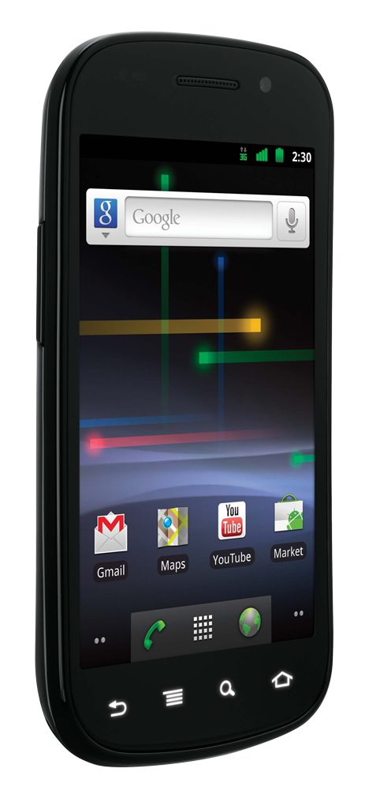
Can multipath help with mobile hand-offs?
wifi hotspot
wifi hotspot
3G cell
internet

Slide 16
Can multipath help with mobile hand-offs?
wifi hotspot
wifi hotspot
3G cell
internet

Slide 17
Can multipath help with mobile hand-offs?
wifi hotspot
wifi hotspot
3G cell
internet

Slide 18
Can multipath help with mobile hand-offs?
wifi hotspot
wifi hotspot
3G cell
internet

Slide 19
Can multipath help with mobile hand-offs?
wifi hotspot
wifi hotspot
3G cell
internet

Slide 20
Can multipath help with mobile hand-offs?
If your phone uses both radios simultaneously, you needn’t experience any interruption.

Slide 21
Can multipath help with mobile hand-offs?
If your phone uses both radios simultaneously, you needn’t experience any interruption.

Slide 22
Can multipath help with mobile hand-offs?
If your phone uses both radios simultaneously, you needn’t experience any interruption.

Slide 23
Can multipath help with mobile hand-offs?
If your phone uses both radios simultaneously, you needn’t experience any interruption.

Slide 24
Can multipath help with mobile hand-offs?
If your phone uses both radios simultaneously, you needn’t experience any interruption.
How should it balance traffic across dissimilar paths?
3G path:
low loss rate, large RTT
Wifi path:
high loss rate, small RTT

Slide 25
Multi-homed web sites (a) with classic hierarchical routing
Google.com
12.1.0
12.*.*
AT&T
“You can reach 12.* via me”
other operators
“I’ll use AT&T for 12.*”

Slide 26
Multi-homed web sites (b) with redundancy, in case links fail
Google.com
12.1.0
8.*.*
12.*.*
Level3
AT&T
“You can reach 8.* and 12.1.0 via me”
“You can reach 12.* via me”
other operators
“I’ll use AT&T for 12.*, but if AT&T fails I can use Level3 to reach 12.1.0”

Slide 27
Multi-homed web sites (c) with load balancing across the gateway machines
“Users: for google.com, pick randomly between 12.1.0, .1 and .2”
12.1.0
12.1.1
12.1.2
Google.com
0
1
2
8.*.*
12.*.*
Level3
AT&T
“You can reach 8.* and 12.1.0 to 12.1.2 via me”
“You can reach 12.* via me”
other operators

Slide 28
Multi-homed web sites (c) with load balancing across the gateway machines
“Users: for google.com, pick randomly between 12.1.0, .1 and .2”
12.1.0
12.1.1
12.1.2
Google.com
“Path to 2 is costly”
“Path to 0 is costly”
0
1
2
8.*.*
12.*.*
Level3
AT&T
“You can reach 8.* and 12.1.0 to 12.1.2 via me, but 12.1.0 is costly”
“You can reach 8.* and 12.1.0 to 12.1.2 via me”
“You can reach 12.* via me, but 12.1.2 is costly”
“You can reach 12.* via me”
other operators
“I’ll use AT&T for 12.1.0 and 12.1.1, and Level3 for 12.1.2, but if either fails I can use the other”

Slide 29
Multi-homed web sites
The limited resources are the memory and CPU needed by routers to remember specific paths and costs.
It can take hours or days for path choices to stabilize.
12.1.0
12.1.1
12.1.2
“Users: for google.com, pick randomly between 12.1.0 to 12.1.2”
“Path 2 is costly”
Google.com
“Path 0 is costly”
0
1
2
g
h
8.*.*
12.*.*
Level3
AT&T
“You can reach 8.* and 12.1.0 to 12.1.2 via me, but 12.1.0 is costly”
“You can reach 12.* via me, but 12.1.2 is costly”
other operators
“I’ll use AT&T for 12.1.0 and 12.1.1, and Level3 for 12.1.2, but if either fails I can use the other”

Slide 30
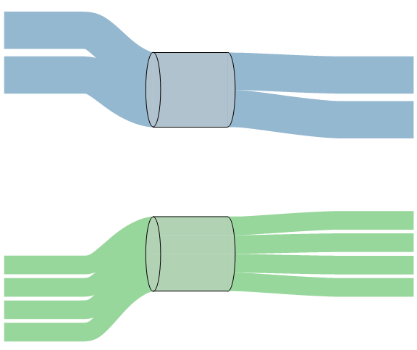
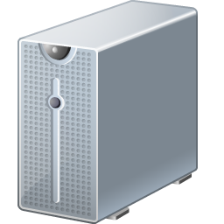
Multi-homed web sites (d) with Kelly+Voice multipath TCP to balance traffic
2 TCPs @ 50Mb/s
100Mb/s
100Mb/s
4 TCPs @ 25Mb/s
Notes:
Web server, dual-homed. ... This is, ideally, what should happen.

Slide 31
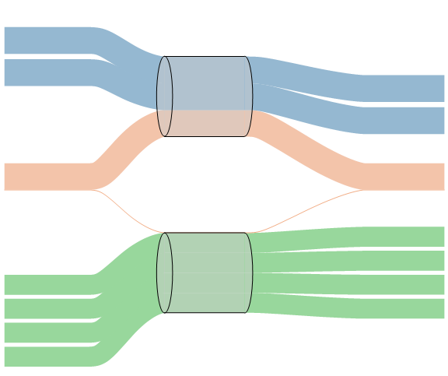
Multi-homed web sites (d) with Kelly+Voice multipath TCP to balance traffic
2 TCPs @ 33Mb/s
100Mb/s
1 MPTCP @ 33Mb/s
100Mb/s
4 TCPs @ 25Mb/s

Slide 32
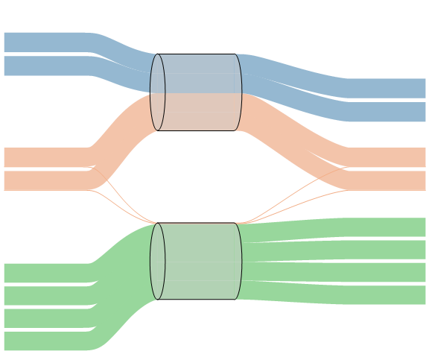
Multi-homed web sites (d) with Kelly+Voice multipath TCP to balance traffic
2 TCPs @ 25Mb/s
100Mb/s
2 MPTCPs @ 25Mb/s
100Mb/s
4 TCPs @ 25Mb/s
The total capacity, 200Mb/s, is shared out evenly between all 8 flows.
Notes:
At this point, the total access capacity is shared evenly between all the flows.

Slide 33
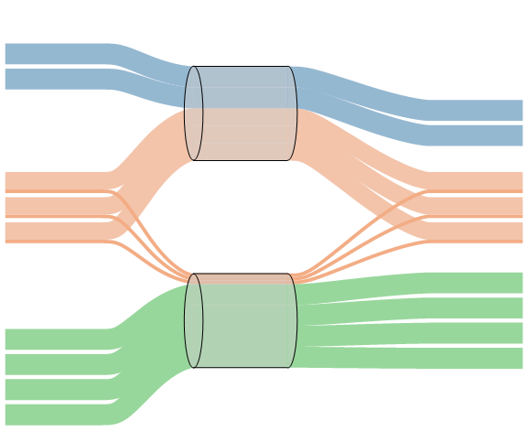
Multi-homed web sites (d) with Kelly+Voice multipath TCP to balance traffic
2 TCPs @ 22Mb/s
100Mb/s
3 MPTCPs @ 22Mb/s
100Mb/s
4 TCPs @ 22Mb/s
The total capacity, 200Mb/s, is shared out evenly between all 9 flows.
It’s as if they were all sharing a single 200Mb/s link. The two links can be said to form a 200Mb/s pool.

Slide 34
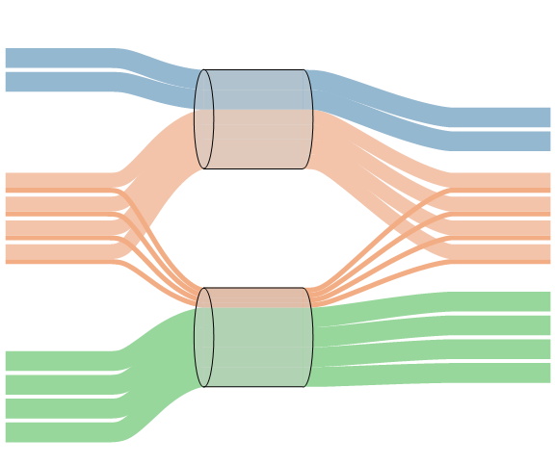
Multi-homed web sites (d) with Kelly+Voice multipath TCP to balance traffic
2 TCPs @ 20Mb/s
100Mb/s
4 MPTCPs @ 20Mb/s
100Mb/s
4 TCPs @ 20Mb/s
The total capacity, 200Mb/s, is shared out evenly between all 10 flows.
It’s as if they were all sharing a single 200Mb/s link. The two links can be said to form a 200Mb/s pool.

Slide 35
Load-balancing in data centers
An obvious way to balance load is to pick randomly from available paths for each TCP flow.
This balances traffic nicely, as long as there are enough flows.

Slide 36
Load-balancing in data centers
An obvious way to balance load is to pick randomly from available paths for each TCP flow.
This balances traffic nicely, as long as there are enough flows. But if there are fewer flows,
there may be collisions and wasted capacity.

Slide 37
Can a data center be made to behave like a simple easily-managed resource pool?
Can this be achieved across a range of traffic patterns? For data centers of different sizes?

Slide 38
The spectrum of Internet research
incremental improvement
?
blue-sky research

Slide 39
The spectrum of Internet research
incremental improvement
?
blue-sky research
smtp, http, rtp
tcp, udp, sctp
The Internet’s standards for carrying data are an hourglass. This has made it easy to build new new things.
IP
ethernet, wifi, atm
fibre, cat5, wireless

Slide 40
The spectrum of Internet research
incremental improvement
?
blue-sky research
slow death by a thousand fixes
tcp
sctp
sip
sdp
rtcp
bgp
The Internet’s standards for control are an accumulation of fixes to specific problems.
dpi
atm
mpls
ntp
shim6
diameter
ecmp
leap
eap
ipsec
isis
gsmp
dhcp
radius
stun
l2tp
netconf
diffserv
arp
ospf
xcp

Slide 41
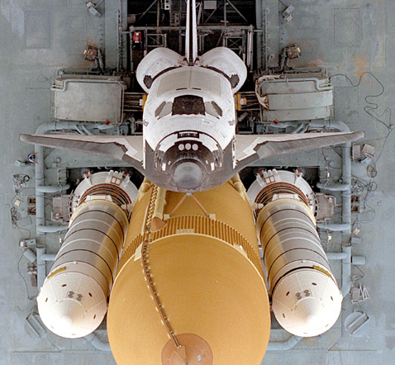
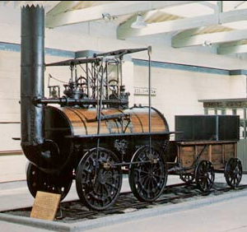
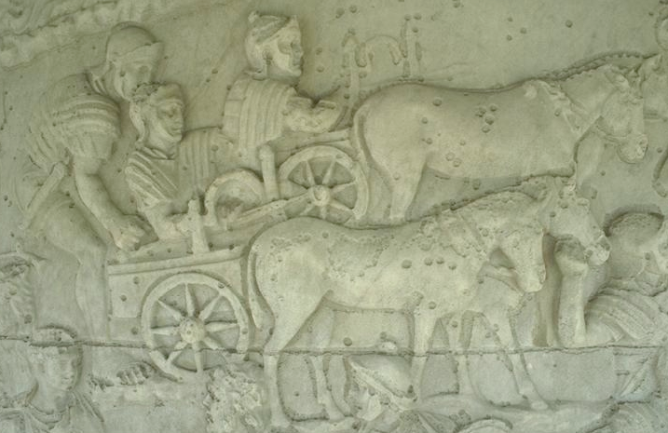
The spectrum of Internet research
incremental improvement
?
blue-sky research
slow death by a thousand fixes
undeployable without starting again from scratch
The Power of Legacy
The Power of Legacy

Slide 42
The spectrum of Internet research
incremental improvement
radical long-term change via small re-purposable steps
blue-sky research
slow death by a thousand fixes
undeployable without starting again from scratch

Slide 43
The spectrum of Internet research
incremental improvement
radical long-term change via
blue-sky research
slow death by a thousand fixes
undeployable without starting again from scratch
small re-purposable steps
End-system multipath congestion control will succeed because it is a re-purposable interface for solving many different problems — so it can become the ‘narrow waist’ of the Internet’s control architecture.
“Network utility maximization” is mathematician’s shorthand for this.

Slide 44
Multipath is Packet Switching 2.0, and multipath congestion control is TCP 2.0.
Two circuits
A link
Two separate links
A pool of links
Notes:
In a circuit-switched network, there is a dedicated channel for each flow. It’s rigid and inflexible: when one flow is silent, the other flow can’t fill in. Packet switching gives you much more flexibility (whether you use it for ATM virtual circuits, or for full-blown IP).
Multipath brings flexibility of the same sort. Pic 3 is rigid and inflexible, Pic 4 is flexible.
In the case of packet switching, you need to be careful about how the flows share the link. Pic 1 circuits made it easy – they give strict isolation between flows. But with Pic 2 packet switching, you need a control plane. It could be with ATM and admission control. Or it could be TCP congestion control, which says how end-systems should adapt their rates so that the network shares its capacity fairly.
What sort of control plane do we need, to ensure that a multipath network works well?

Slide 45
How did the theoretical results of Han et al. and Kelly+Voice help?
(beyond the fundamental idea of distributed network utility maximization—the idea that end-systems can by themselves manage to allocate the Internet’s resources sensibly, in many different multipath settings)
What extra work did we need to do, to sell multipath?
Notes:
Let me try to listen to networking systems people...

Slide 46
The big theoretical result is ‘local stability of a fluid model of multipath congestion control’.
Internet engineers have tried load-sensitive routing before, and observed route flap, and decided it’s unsafe.
We can point to the theory and say “The maths guarantees our multipath TCP is safe”.
This theoretical result is unhelpful, on two counts.
The same theory says the current Internet is unstable, and engineers do not believe this.
At low levels of aggregation (e.g. access links, which are the most congested part of today’s Internet), the fluid model is misleading.
Notes:
e.g. CompoundTCP solves the problem of bloated buffers at the access link, and doesn’t attempt to address the core.
The core is a much harder problem, but it’s not a pressing issue yet.

Slide 47
Why does the fluid model fail?
I better switch to the bottom link.
The top link is so congested!
loss rate 1%
random
drops
▼
▼
▼
▼
▼
▼
▼
▼
▼
▼
▼
▼
▼
▼
▼
▼
random
drops
▲
▲
loss rate 1%
▲
▲
▲
▲
▲
▲
▲
▲
▲
▲
▲
▲
▲
Now the bottom link is more congested!
The Kelly+Voice algorithm puts all its traffic on the least congested path. The noisy nature of congestion feedback makes it difficult to estimate congestion levels, leading to bistability. But the fluid limit (the average of many bistable flows) is stable!
Notes:
Network people will test the algorithm on a small scale, see what looks to them like instability, and conclude it’s nonsense.

Slide 48
What changes did we need, to make it incrementally deployable?
wifi path: 4% loss, 10ms RTT
, single-path TCP would get 707pkt/s
3G path: 1% loss, 100ms RTT
, single-path TCP would get 141pkt/s
The Kelly+Voice algorithm makes you shift all your traffic onto the least-congested path, in this case 3G.
Do you end up with 141pkt/s (fair to other 3G users)? Or with 707pkt/s (what you would get without multipath)?

Slide 49
Conclusion
End-system multipath congestion control will be the biggest change to the architecture of the Internet since packet switching and TCP.
Network utility maximization is a goal which in itself is moot. But network algorithms which can maximize arbitrary utilities are necessarily rich enough to solve any control problem.
Interesting new mathematical models may arise when you try to make theory work.
Notes:
There are obviously schemes in place for traffic engineering -- link-bonding, ECMP, BGB prefixes etc. What distinguishes MPTCP is that it’s end-system-based, it’s a single clean solution, it doesn’t screw up your BGP tables. It just arose out of the sensible design goals we started with.
It can reach the parts that core-based TE cannot reach. Conversely, there may be things that core-based cannot do. We don’t yet know how they should live together – it’s not either/or.
This is on last call before being published as an experimental standard in the IETF.

Slide 50
What should mathematicians know about the Internet?
Cool stuff is better than correctness. What sort of maths makes the cool stuff work?
Under the hood of BitTorrent, Bram Cohen, 2005
The Internet is barely manageable, and it barely works. What sort of maths helps us make it autonomic?
End-to-end arguments in system design, Saltzer, Reed, Clark, 1981
Why the Internet only just works, Handley, 2006
No one can tell you what the Internet is for. What sort of maths gives us tools, not solutions?
Notes:
ancient Greek νόμος usage, custom, law, melody, composition < an ablaut variant of the base of νέμειν to deal, distribute, hold, manage
The coolest thing of all would be a genuinely autonomic Internet!

Slide 51
How does TCP congestion control work?
Maintain a congestion window w.
Increase w for each ACK, by 1/w
Decrease w for each drop, by w/2

Slide 52
How does MPTCP congestion control work?
Maintain a congestion window w_{r}, one window for each path, where r ∊ R ranges over the set of available paths.
Increase w_{r} for each ACK on path r, by
Decrease w_{r} for each drop on path r, by w_{r} /2
Notes:
MPTCP works pretty much like TCP, i.e. window increases and window decreases on each path. The decrease is the same as TCP. When there is only one path available, this formula reduces to the TCP formula.
We derived a throughput formula for this congestion control algorithm, and checked that it satisfies the design goals.

Slide 53
How does MPTCP congestion control work?
Maintain a congestion window w_{r}, one window for each path, where r ∊ R ranges over the set of available paths.
Increase w_{r} for each ACK on path r, by
Decrease w_{r} for each drop on path r, by w_{r} /2
We want to shift traffic away from congestion.
To achieve this, we increase windows in proportion to their size.

Slide 54
How does MPTCP congestion control work?
Maintain a congestion window w_{r}, one window for each path, where r ∊ R ranges over the set of available paths.
Increase w_{r} for each ACK on path r, by
Decrease w_{r} for each drop on path r, by w_{r} /2
MPTCP puts an amount of flow on path r proportional to 1/p_{r}
(whereas Kelly+Voice put all the flow on the least-congested paths).
We do this so that we send more probe traffic, so we react faster to changes.

Slide 55
How does MPTCP congestion control work?
Maintain a congestion window w_{r}, one window for each path, where r ∊ R ranges over the set of available paths.
Increase w_{r} for each ACK on path r, by
Decrease w_{r} for each drop on path r, by w_{r} /2
Take no more than TCP would, at any potential bottleneck S:
look at the best that a single-path TCP could get,
and compare to what I’m getting.

