Slide 1
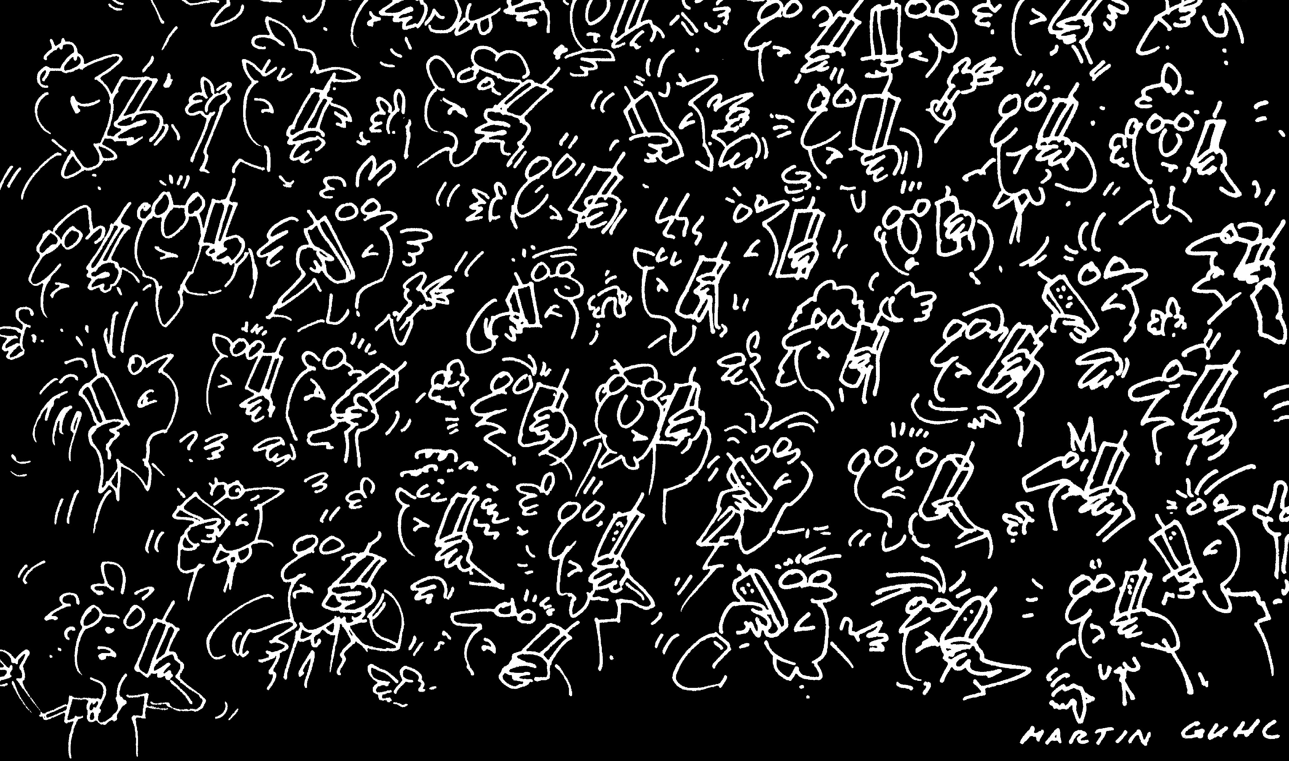
The teleology of
Internet congestion control
Damon Wischik, Computer Science, UCL
Notes:
I'm from Networks Research Group. We work on the design of the Internet's infrastructure.

Slide 2
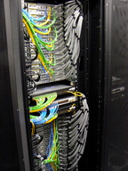
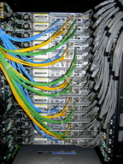

What network am I looking at?
There is the physical network, that describes which computers and switches are connected by which links.
There is the logical network, that describes which users are using which paths through the network.
This talk is about traffic flows. Each traffic flow belongs to some user, and is carried over some collection of computers and switches. One user's traffic flow influences other users' flows indirectly, by virtue of the links they use in common.

Slide 3
teleology
from the Greek τελος (end) + -λογια (discourse, study)
The doctrine or study of ends or final causes, especially as related to the evidences of design or purpose in nature; also transf. such design as exhibited in natural objects or phenomena.
Notes:
The word is used by creationists and intelligent design people. But it's such a lovely word, and I don't want to yield it to them.

Slide 4
The history of the Internet
1974: First draft of TCP/IP
“A protocol for packet network interconnection”,
Vint Cerf and Robert Kahn
1983: ARPANET switches on TCP/IP
1986: Congestion collapse

Slide 5
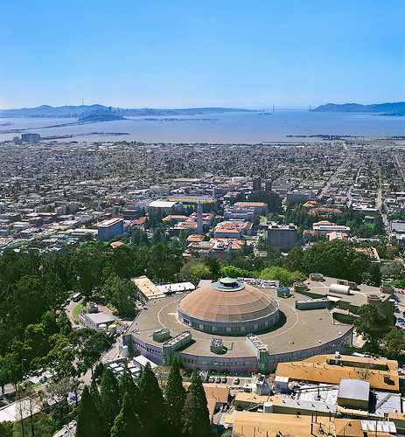
“In October of ’86, the Internet had the first of what became a series of ‘congestion collapses’. During this period, the data throughput from LBL to UC Berkeley (sites separated by 400 yards and two IMP hops) dropped from 32 Kbps to 40 bps. We were fascinated by this sudden factor-of-thousand drop in bandwidth and embarked on an investigation of why things had gotten so bad.”
Van Jacobson, “Congestion avoidance and control”, 1988
Notes:
The problem:
Internet traffic uses reliable delivery. When I send a packet, I wait for the receiver to acknowledge it. If I don't get an acknowledgement, I infer the packet was dropped, so I resend it. But if there are lots of congested links: I may squeeze you out on link A, and then someone else may squeeze me out on link B, and then it will be in vain that I squeezed you out. In other words, the network may end up in a state where a lot of the work it is doing is futile.
Jacobson realized this, and came up with a fix.

Slide 6
The history of the Internet
1974: First draft of TCP/IP
“A protocol for packet network interconnection”,
Vint Cerf and Robert Kahn
1983: ARPANET switches on TCP/IP
1986: Congestion collapse
1988: Congestion control for TCP
“Congestion avoidance and control”, Van Jacobson
and not much has happened since (apart from the web, Google, eBay, Facebook, BitTorrent, …)
Notes:
Jacobson's fix enabled the Internet to work as a sound platform – it can then support lots of exciting diversity of uses.

Slide 7
Jacobson’s big idea
*
*
*
Each user should increase his/her transmission rate when the network seems underused, and cut it when one of his/her packets is dropped (which signifies congestion).
*
*
*
*
*
*
*
*
*
*
*
*
*
*
*
If all users do this, the network ends up near-100% used, and the capacity is shared fairly.

Slide 8
if (seqno > _last_acked) {
if (!_in_fast_recovery) {
_last_acked = seqno;
_dupacks = 0;
inflate_window();
send_packets(now);
_last_sent_time = now;
return;
}
if (seqno < _recover) {
uint32_t new_data = seqno - _last_acked;
_last_acked = seqno;
if (new_data < _cwnd) _cwnd -= new_data;
else _cwnd=0;
_cwnd += _mss;
retransmit_packet(now);
send_packets(now);
return;
}
uint32_t flightsize = _highest_sent - seqno;
_cwnd = min(_ssthresh, flightsize + _mss);
_last_acked = seqno;
_dupacks = 0;
_in_fast_recovery = false;
send_packets(now);
return;
}
if (_in_fast_recovery) {
_cwnd += _mss;
send_packets(now);
return;
}
_dupacks++;
if (_dupacks!=3) {
send_packets(now);
return;
}
_ssthresh = max(_cwnd/2, (uint32_t)(2 * _mss));
retransmit_packet(now);
_cwnd = _ssthresh + 3 * _mss;
_in_fast_recovery = true;
_recover = _highest_sent;
}
transmission rate [0–100 kB/sec]
time [0–8 sec]
Notes:
It's only 43 lines of code, but it's what makes the Internet work!

Slide 9
Jacobson’s big idea was that congestion could be controlled by relying on users to respond sensibly.
Notes:
This may seem obvious...

Slide 10
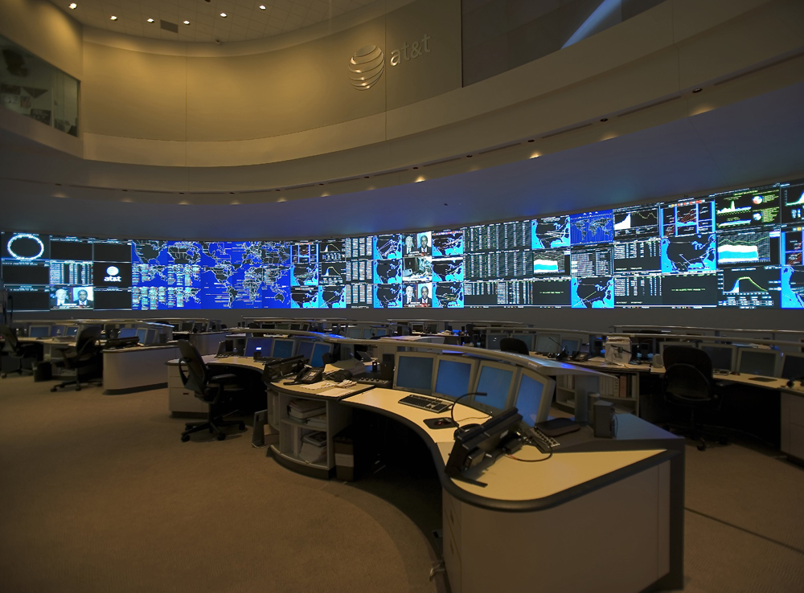
The big telecoms companies did not believe him. (They still don’t want to.)
Why should they?
Notes:
Jacobson’s idea was that the Internet could manage itself, without any centralized control. Arguably, this is why it has become THE network. All the other centralized attempts by phone companies are defunct.
Telecoms companies don't like to believe this. They want to keep managing their networks, because that way they think they're adding value, and they can charge lots. And in some ways they have a point… does Jacobson's algorithm really manage itself and keep the network running how we want it to?

Slide 11
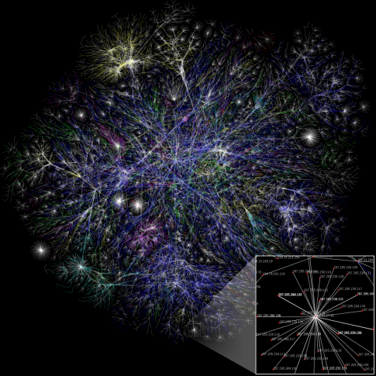
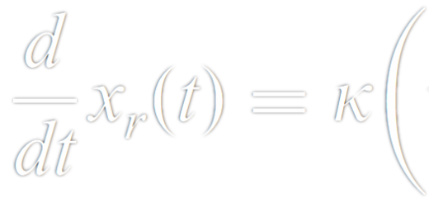
We know the microscopic rules of behaviour of the Internet, i.e. the code.
We can derive macroscopic formulae which tell us about the average behaviour of each component.
But how does the whole behave?
if (seqno > _last_acked) {
if (!_in_fast_recovery) {
_last_acked = seqno;
_dupacks = 0;
inflate_window();
send_packets(now);
_last_sent_time = now;
return;
}
if (seqno < _recover) {
uint32_t new_data = seqno - _last_acked;
_last_acked = seqno;
if (new_data < _cwnd) _cwnd -= new_data;
else _cwnd=0;
_cwnd += _mss;
retransmit_packet(now);
send_packets(now);
return;
}
uint32_t flightsize = _highest_sent - seqno;
_cwnd = min(_ssthresh, flightsize + _mss);
_last_acked = seqno;
_dupacks = 0;
_in_fast_recovery = false;
send_packets(now);
return;
}
if (_in_fast_recovery) {
_cwnd += _mss;
send_packets(now);
return;
}
_dupacks++;
if (_dupacks!=3) {
send_packets(now);
return;
}
_ssthresh = max(_cwnd/2, (uint32_t)(2 * _mss));
retransmit_packet(now);
_cwnd = _ssthresh + 3 * _mss;
_in_fast_recovery = true;
_recover = _highest_sent;
}
Notes:
Restate the question. Why does the Internet work? What sort of analysis can tell us about how it behaves?

Slide 12
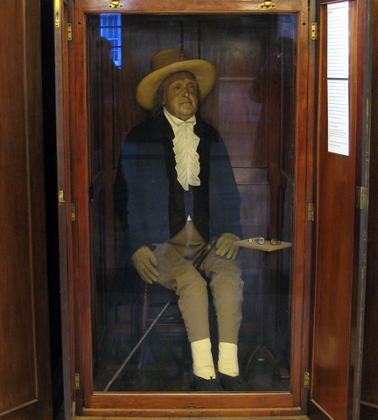
Theorem
(Kelly et al. 1998, Towsley et al. 2000)
The Internet shares capacity as if there were an intelligent designer+controller who seeks to maximize the sum total of every user’s happiness with his/her lot, subject to available capacity on each link.
Notes:
This is what economists call a “social welfare maximization problem”.
Who is the designer? Certainly not Jacobson – his paper ¼ brilliant, ¾ “engineer’s maths”, i.e. plausible but wrong. He had no idea that this is what he was achieving; it just arose spontaneously from his code.
Meaning: if Jacobson runs experiments and measures the average throughput of each user, and if Bentham solves a centralized social welfare optimization, then they both come up with the same answer.
This is why the Internet succeeded – it has a distributed control mechanism for allocating resources, and this mechanism is trying to solve a sensible problem. No one had ever come up with a distributed control for such a large system before.

Slide 13
The Internet's algorithms behave as if the network as a whole were trying to solve an optimization problem.
I call this emergent teleology.

Slide 14
Theorem
(Kelly et al. 1998, Towsley et al. 2000)
Notes:
(I'm not allowed to use a fraught term like "teleology" without giving it some rigorous backing.)

Slide 15
Your implied utility function
Notes:
It’s interesting to know what the Internet “thinks” we want! (It is weird to talk about “the Internet’s intentions”, when all I am really describing is the operations of the code on your computer’s operating system! But this is a good way to describe its holistic behaviour.)
As far as the Internet is concerned, users are made very happy going from 56kb/s dialup to 4Mb/s broadband. But increments beyond that give marginal extra benefit – if the Internet has a choice between increasing your rate by 2Mb/s from 8 to 10, or of increasing my rate by 0.5Mb/s from 1 to 1.5, it will give the bandwidth to me, not you.

Slide 16

Research agenda
Microscopic rules of behaviour, specified by the code |  | Macroscopic formulae for average behaviour of a component |  | Teleological descriptions of how the whole behaves
if (seqno > _last_acked) {
if (!_in_fast_recovery) {
_last_acked = seqno;
_dupacks = 0;
inflate_window();
send_packets(now);
_last_sent_time = now;
return;
}
if (seqno < _recover) {
uint32_t new_data = seqno - _last_acked;
_last_acked = seqno;
if (new_data < _cwnd) _cwnd -= new_data;
else _cwnd=0;
_cwnd += _mss;
retransmit_packet(now);
send_packets(now);
return;
}
uint32_t flightsize = _highest_sent - seqno;
_cwnd = min(_ssthresh, flightsize + _mss);
_last_acked = seqno;
_dupacks = 0;
_in_fast_recovery = false;
send_packets(now);
return;
}
if (_in_fast_recovery) {
_cwnd += _mss;
send_packets(now);
return;
}
_dupacks++;
if (_dupacks!=3) {
send_packets(now);
return;
}
_ssthresh = max(_cwnd/2, (uint32_t)(2 * _mss));
retransmit_packet(now);
_cwnd = _ssthresh + 3 * _mss;
_in_fast_recovery = true;
_recover = _highest_sent;
}
Notes:
Teleology: what coherent wide-scale behaviour do we see, and how does it relate to the microscopic rules?
This is what all the big success stories in Stochastic Network Modeling look like – scheduling problems for queueing systems, routing and management in job shops, Internet congestion control, peer-to-peer topology selection, electrical networks, …
The Internet is a great place to start looking, because
we can inspect the code – we don’t need to guess the laws of physics
we don’t have any fuzzy human-stuff to deal with, so it’s easier to analyze

Slide 17
form + function
topology + algorithms
There has been much work on the structure of complex networks (scale free topologies etc.)
In Internet architecture, we are more interested in how algorithms function over the network. We treat the topology as a given, and we seek robust algorithms that work well with any topology or traffic pattern.
There is one area where the two fields overlap…
Notes:
Work on descriptive analysis of network topologies has not gotten anywhere, at least it hasn't produced useful engineering outcomes.
Topology is influenced by lots of things – in any particular situation, we can always find specific reasons why the topology turned out as it did, e.g. we had some extra money and the price of the next generation of hardware just reduced. And topology is massively heterogeneous – core links are 10^6 faster than in 1988, and we still use slow mobile phone links and fast broadband links. We want our algorithms to just work, regardless of the network. And Jacobson's algorithm produces an optimal outcome, for any network at all you throw at it. (At least, for its own notion of optimality!)

Slide 18
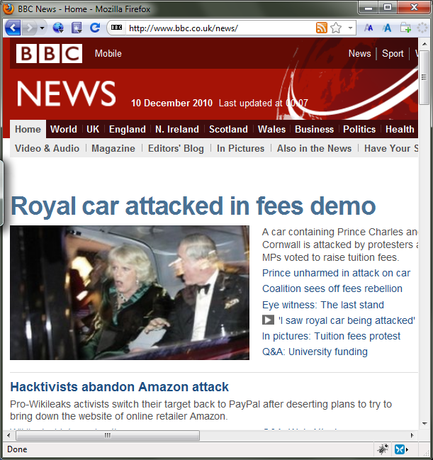
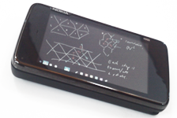
Where topology and algorithms overlap:
We conjecture that if users have sufficiently diverse paths, and they balance their traffic appropriately, then the Internet will achieve resource pooling, i.e. it will behave as if there were a single giant link, fairly shared between all users.
Notes:
In the networks research group at UCL, we are building a multipath replacement for Jacobson’s congestion control algorithm. Our algorithm balances traffic across available paths, in proportion to their quality. Why do we think this is interesting?
Because of resource pooling. Resource pooling means: as far as users are concerned, it's as if all the capacity of the links in the Internet was added up into a single giant pool, which could then be shared fairly between everyone. (We don't think we can achieve full pooling across the entire Internet, but we do at least want to get some big resource pools.)
This is a hot topic, where form and function coincide.

Slide 19
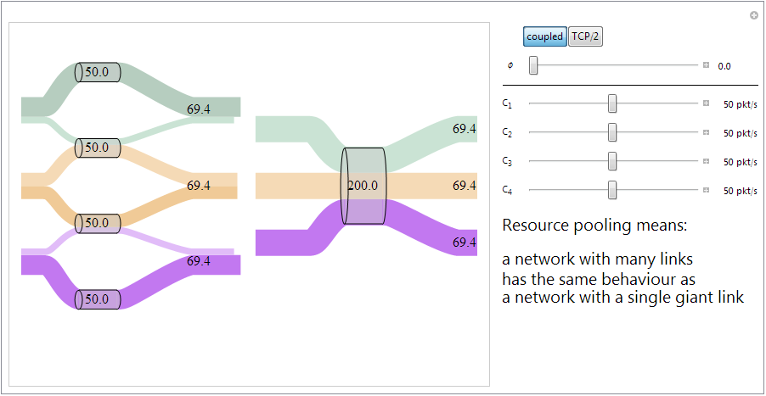

Slide 20


Slide 21
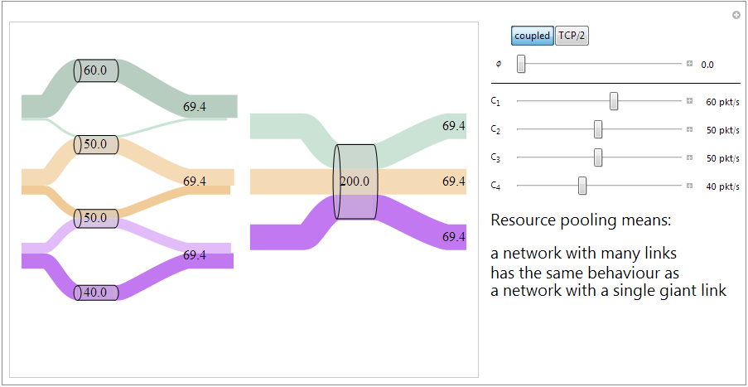

Slide 22
“I want to book a train to Aberdeen. There’s spare capacity on the train to Bristol. Therefore my booking will be accepted.”
Notes:
Imagine if there was resource pooling in rail transit…

Slide 23
Formally speaking, we believe that multipath congestion control will change the constraint in the teleology.

Slide 24
Engineering agenda
Invent microscopic code that yields this macroscopic behaviour
Work out macroscopic formulae for the average behaviour of a component
Decide on the teleology that we want
if (seqno > _last_acked) {
if (!_in_fast_recovery) {
_last_acked = seqno;
_dupacks = 0;
inflate_window();
send_packets(now);
_last_sent_time = now;
return;
}
if (seqno < _recover) {
uint32_t new_data = seqno - _last_acked;
_last_acked = seqno;
if (new_data < _cwnd) _cwnd -= new_data;
else _cwnd=0;
_cwnd += _mss;
retransmit_packet(now);
send_packets(now);
return;
}
uint32_t flightsize = _highest_sent - seqno;
_cwnd = min(_ssthresh, flightsize + _mss);
_last_acked = seqno;
_dupacks = 0;
_in_fast_recovery = false;
send_packets(now);
return;
}
if (_in_fast_recovery) {
_cwnd += _mss;
send_packets(now);
return;
}
_dupacks++;
if (_dupacks!=3) {
send_packets(now);
return;
}
_ssthresh = max(_cwnd/2, (uint32_t)(2 * _mss));
retransmit_packet(now);
_cwnd = _ssthresh + 3 * _mss;
_in_fast_recovery = true;
_recover = _highest_sent;
}
(We don't want network topology to be a constraint, only total network capacity.)
Notes:
The teleology we want:
we want the objective to match our needs, and we want the constraint to be as loose as possible given what’s in there
Ideally, we want to be constrained only hard physical limits on the total amount of resources in the network. The topology of the network is just a plumbing detail, and we shouldn't have to bother with what's connected to what.
How can we come up with code that achieves what we want?

