Slide 1

THE ROYAL
SOCIETY
Damon Wischik
School House (1987—1992), Cambridge (1992—2005), UCL (2005—)

Slide 2
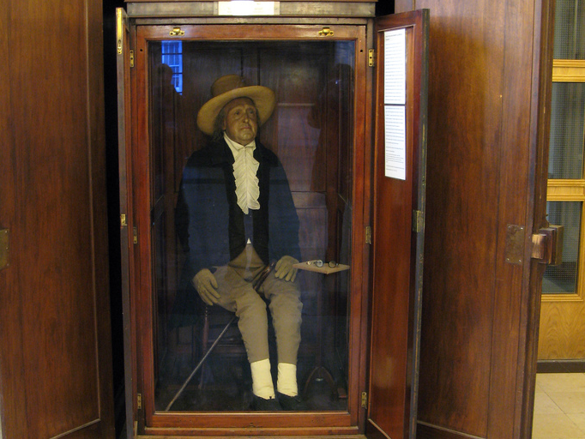
THE ROYAL
SOCIETY
Jeremy Bentham (1748—1832)
Radical political theorist, secularist, founder of UCL, and father of utilitarianism
“The good is whatever brings the greatest happiness to the greatest number of people”

Slide 3
teleology
from the Greek τελος (end) + -λογια (discourse, study)
The doctrine or study of ends or final causes, especially as related to the evidences of design or purpose in nature
Notes:
Final cause: the purpose or end that a thing is supposed to serve

Slide 4
The coordination game
Eyes shut. No peeking or talking
The game has up to three rounds
I will tell you when the round starts and ends
In each round you may raise your hand,
and if you do you might win £20
  If exactly two people raise their hand,
  they both win the prize, and the game ends
  Otherwise, I will tell you how many hands were raised

Slide 5
If everyone is rational, what’s the chance I’ll have to pay out in the first round?
Notes:
Player types:
sociopath. “If I don’t raise my hand, then I don’t win. If I do raise my hand, then I might win. Therefore I should always raise my hand”.
rationalist. “Everyone should play with probability p=2/n.”
Observe that q→2/e² as n→∞

Slide 6
If everyone is a rational introvert, what is the chance I’ll have to pay out by round 2? by round 3?
Notes:
In the next round
sociopaths will presumably play as they did before.
The rationalists might be introverts, and continue with the same strategy regardless of what they hear: “I shall continue to use probability 2/N, and everyone else should do the same.”

Slide 7
If everyone is a rational extravert, what is the chance I’ll have to pay out by round 2?
What if everyone is a rational extravert, but they guessed p wrongly on the first round?
Notes:
Alternatively, the rationalists might be “rational extraverts”, who listen to what happened the previous round, and adjust their strategy, and assume everyone else will adjust too. For example...
Suppose in the first round there were R hands raised. If everyone played with probability p, the expected value of R is N*p.
If R=2, the game is over.
If R>2, I expect that everyone used a value of p that was too high. Everyone should adapt: they should use p*2/R as their new value of p.
If R<2, I expect that everyone used a value of p that was too low. As above, we should all use p*2 as the new value of p. The problem is: what if R=0? Then we truly have no information, and all we can do is a stab in the dark.
If players are all rational extraverts, and the initial guess was p then R~Binom(n,p), i.e. Prob(R=r)=C(n,r)p^{r}(1-p)^{n-r}. So the probability of a win in the second round, assuming there was not a win in the first round, is E[q(N,2p/R) | R!=2], taking q(N,∞)=0 (or whatever else we think it might sensibly be).
This doesn’t do as well as the rational introvert…
UNLESS the initial guess was wrong. If everyone overestimated in the first place, then they won’t win in the first round, but the rational extraverts have a very good chance of winning in the second round. If they underestimated in the first place, they’ll take a few more rounds, but get there eventually.
If we didn’t know n in the first place (as would be the case in the Internet, where we don’t know how many other people have data to send), then the rational extravert strategy is best.

Slide 8

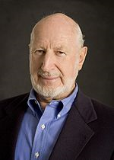

Norman Abramson (1932—)
Notes:
Norman Abramson.
Harvard Physics BA (age 21), UCLA Physics MA (age 23), Stanford Electrical Engineering PhD (26).
Stanford faculty. Short time in Berkeley (age 34). Moved to Hawaii Electrical Engineering + Computer Science (age 36).

Slide 16
Norman Abramson’s
network, called ALOHA,
was deployed in 1970.
It is the basis for wi-fi
communication today.

Slide 17








Slide 18



Slide 19





Slide 21


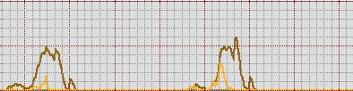
total
traffic levels
drop rate
[0—20%]
18:00 | 00:00 | 06:00 | 12:00 | 18:00 | 00:00 | 06:00 | 12:00
Notes:
http://www.plus.net/support/network_performance/broadband_bandwidth_usage.shtml
PlusNet splits traffic into classes, and offers different packages.
Brown drops = “premium non-interactive traffic”
yellow drops = “plus non-interactive traffic”

Slide 22
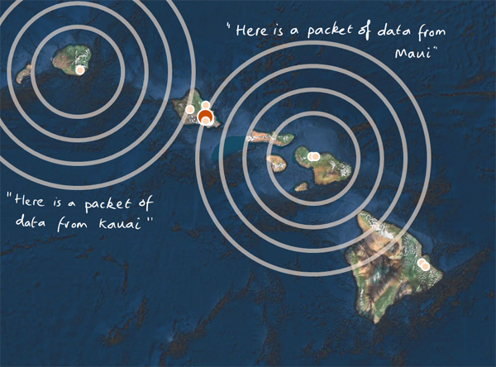
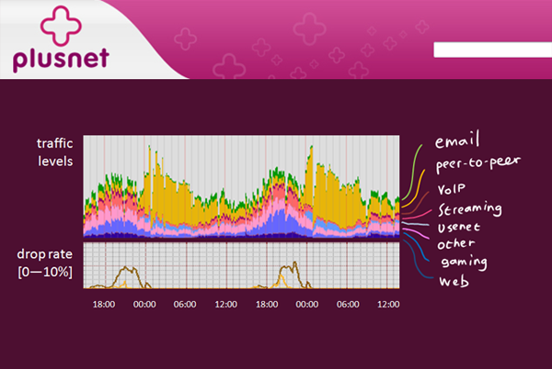
Only one transmission can get through at a time. If users send more, then nothing gets through
Users should wait before re-transmitting a packet
If users send too much, then the network discards the excess
Users should adapt their transmission rates
Notes:
The coordination game is similar to these two problems, though with slightly different rewards + penalties.
The big difference is that the Internet games are played repeatedly. “Eventually I’ll get through, if everyone cooperates. No one ever gets through, if everyone is a sociopath. Therefore I have nothing to lose by cooperating.”

Slide 23
The history of the Internet
1974: First draft of TCP/IP
“A protocol for packet network interconnection”,
Vint Cerf and Robert Kahn
1983: ARPANET switches on TCP/IP
1986: Congestion collapse

Slide 24
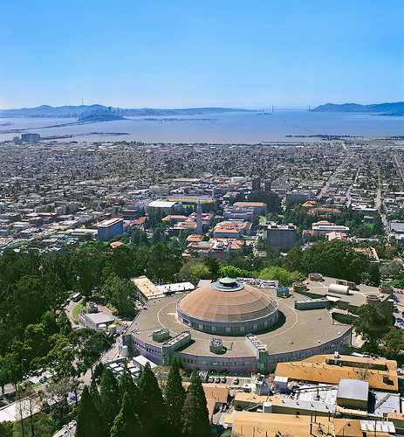
“In October of ’86, the Internet had the first of what became a series of ‘congestion collapses’. During this period, the data throughput from LBL to UC Berkeley (sites separated by 400 yards and two IMP hops) dropped from 32 Kbps to 40 bps. We were fascinated by this sudden factor-of-thousand drop in bandwidth and embarked on an investigation of why things had gotten so bad. In particular, we wondered if the 4.3BSD (Berkeley UNIX) TCP was mis-behaving or if it could be tuned to work better under abysmal network conditions.”
Van Jacobson, “Congestion avoidance and control”, 1988
Notes:
It turned out that the coordination game was being played badly.
Users would send data, it failed to get through, so they retransmit, the network gets even more congested, and so on.

Slide 25
Jacobson’s TCP algorithm
if (seqno > _last_acked) {
if (!_in_fast_recovery) {
_last_acked = seqno;
_dupacks = 0;
inflate_window();
send_packets(now);
_last_sent_time = now;
return;
}
if (seqno < _recover) {
uint32_t new_data = seqno - _last_acked;
_last_acked = seqno;
if (new_data < _cwnd) _cwnd -= new_data;
else _cwnd=0;
_cwnd += _mss;
retransmit_packet(now);
send_packets(now);
return;
}
uint32_t flightsize = _highest_sent - seqno;
_cwnd = min(_ssthresh, flightsize + _mss);
_last_acked = seqno;
_dupacks = 0;
_in_fast_recovery = false;
send_packets(now);
return;
}
if (_in_fast_recovery) {
_cwnd += _mss;
send_packets(now);
return;
}
_dupacks++;
if (_dupacks!=3) {
send_packets(now);
return;
}
_ssthresh = max(_cwnd/2, (uint32_t)(2 * _mss));
retransmit_packet(now);
_cwnd = _ssthresh + 3 * _mss;
_in_fast_recovery = true;
_recover = _highest_sent;
}
transmission rate [0–100 kB/sec]
time [0–8 sec]
Notes:
Multiplicative decrease -- when network is congested, load grows exponentially (transmit, retransmit, reretransmit...)
Additive increase -- helps with fairness (of relatively greater benefit to low-bandwidth users)
Devised by Jain+Ramakrishnan (1988) DECbit

Slide 26
*
*
*
Each user increases his/her transmission rate when the network seems underused, and cuts it when one of his/her packets is dropped.
*
*
*
*
*
*
*
*
*
*
*
*
*
*
*
If all users do this, the network should end up near-100% used, and the capacity should be shared fairly.
The Internet is the first large-scale network to be able to regulate itself – to share capacity fairly – without a central controller.
The Internet relies on a social contract – it trusts users to run Jacobson’s algorithm. Peer-to-peer traffic violates the social contract, and so ISPs have stepped in to enforce it, crudely.

Slide 27
*
*
*
Each user increases his/her transmission rate steadily, by 1/RTT² packets/sec²
If a user’s packet is dropped, he/she cuts transmission rate by half
Notes:
Increase rule: increase transmission rate at 1/RTT^2 pkt/sec/sec
Decrease rule: decrease transmission rate by half every packet drop
Let x(t) be the transmission rate at time t.
average change from x(t) to x(t+delta) is + delta*1/RTT^2 – delta*x(t)*p* x(t)/2
In equilibrium, x(t) doesn’t change, hence the equilibrium throughput x solves 1/RTT^2 – x*p*x/2=0, hence x=sqrt(2)/RTT*sqrt(p)

Slide 28



Slide 29
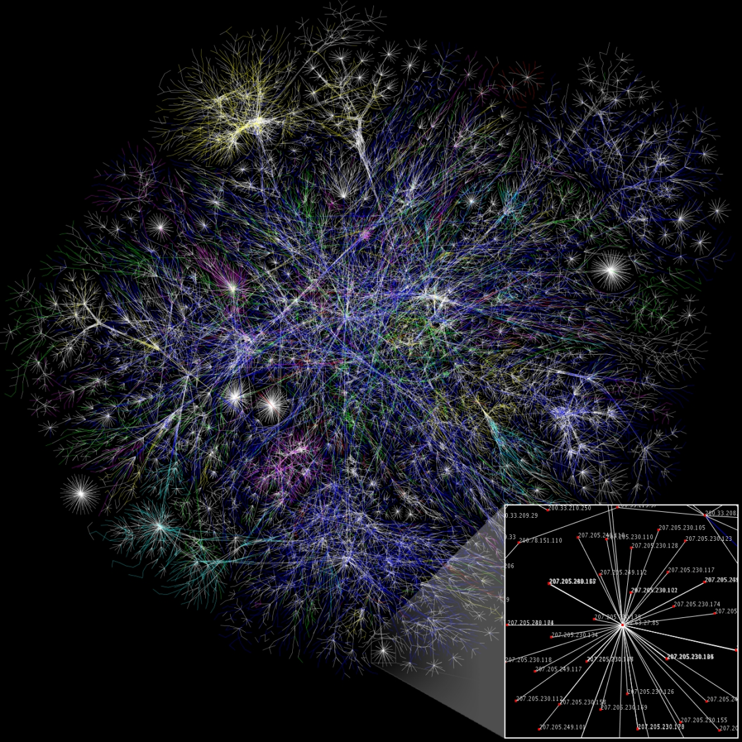

Slide 30
p=(x-c)/x
x=^{√2}/_{RTT√p}
x=^{√2}/_{RTT√p}
x=^{√2}/_{RTT√p}
x=^{√2}/_{RTT√p}
p=(x-c)/x
p=(x-c)/x
p=(x-c)/x
x=^{√2}/_{RTT√p}
x=^{√2}/_{RTT√p}
x=^{√2}/_{RTT√p}
x=^{√2}/_{RTT√p}
x=^{√2}/_{RTT√p}
p=(x-c)/x
x=^{√2}/_{RTT√p}
p=(x-c)/x
x=^{√2}/_{RTT√p}
p=(x-c)/x
x=^{√2}/_{RTT√p}
x=^{√2}/_{RTT√p}
x=^{√2}/_{RTT√p}
x=^{√2}/_{RTT√p}
x=^{√2}/_{RTT√p}
x=^{√2}/_{RTT√p}
x=^{√2}/_{RTT√p}
x=^{√2}/_{RTT√p}
x=^{√2}/_{RTT√p}
x=^{√2}/_{RTT√p}
p=(x-c)/x
x=^{√2}/_{RTT√p}
x=^{√2}/_{RTT√p}
x=^{√2}/_{RTT√p}
x=^{√2}/_{RTT√p}
x=^{√2}/_{RTT√p}
p=(x-c)/x
p=(x-c)/x
x=^{√2}/_{RTT√p}
x=^{√2}/_{RTT√p}
x=^{√2}/_{RTT√p}
x=^{√2}/_{RTT√p}
x=^{√2}/_{RTT√p}
p=(x-c)/x
p=(x-c)/x
x=^{√2}/_{RTT√p}
x=^{√2}/_{RTT√p}
x=^{√2}/_{RTT√p}
x=^{√2}/_{RTT√p}
x=^{√2}/_{RTT√p}
x=^{√2}/_{RTT√p}
x=^{√2}/_{RTT√p}
x=^{√2}/_{RTT√p}
x=^{√2}/_{RTT√p}
x=^{√2}/_{RTT√p}
x=^{√2}/_{RTT√p}

Slide 31
We know the microscopic rules of behaviour of the Internet.
We can derive macroscopic formulae which tell us about the average behaviour of each component.
But how should we think about the Internet as a whole?
Notes:
Final cause: the purpose or end that a thing is supposed to serve

Slide 32
Ohm’s law:
V = I R
Kirchhoff’s laws:
current in = current out
voltage around a loop = 0
What is the total resistance of the circuit?

Slide 35
The total resistance of this circuit is 1.34Ω
If I add an extra connection, does the total resistance increase or decrease?
Notes:
We could recalculate the total resistance with the extra connection added, and just compare to the old value.
But this is daft! Common sense tells us: adding an extra connection should make the resistance go down. Why won’t the maths tell us this directly?

Slide 36
Here is an optimization problem:
“Given a total current I_{tot} flowing into the circuit, find currents on each link so as to minimize total heat dissipation ΣI²_{ij}/R_{ij} over all links i→j, subject to Kirchhoff’s Current Law”
THEOREM. Solving this problem, and solving all equations from Ohm’s Law, give exactly the same value for the total resistance
EXERCISE. Use this optimization problem to prove that adding an extra connection will lower the total resistance

Slide 37
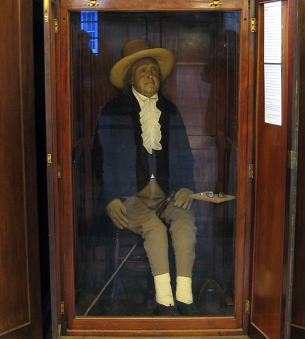
Theorem
(Kelly et al. 1998, Towsley et al. 2000)
The Internet shares capacity as if there were an intelligent designer+controller who seeks to maximize the sum total of every user’s happiness with his/her lot.
Notes:
This is what economists call a “social welfare maximization problem”
Who is the designer? Certainly not Jacobson – his paper ¼ brilliant, ¾ “engineer’s maths”, i.e. plausible but wrong. He had no idea that this is what he was achieving; it just arose spontaneously from his code.
This is why the Internet succeeded – it has a distributed control mechanism for allocating resources, and this mechanism is trying to solve a sensible problem. No one had ever come up with a distributed control for such a large system before.

Slide 38

Theorem
(Kelly et al. 1998, Towsley et al. 2000)
The Internet shares capacity as if there were an intelligent designer+controller who seeks to maximize the sum total of every user’s happiness with his/her lot.
I call this “emergent teleology”.
Notes:
This is what economists call a “social welfare maximization problem”
Who is the designer? Certainly not Jacobson – his paper ¼ brilliant, ¾ “engineer’s maths”, i.e. plausible but wrong.
Jacobson had no idea that this is what he was doing; the teleology emerged from his algorithm.
This is why the Internet succeeded – it has a distributed control mechanism for allocating resources, and this mechanism is trying to solve a sensible problem. No one had ever come up with a distributed control for such a large system before.

Slide 39
The Internet’s teleology
Notes:
What I mean is: if Van Jacobson writes out all those throughput equations, and solves them; and Jeremy Bentham writes out this optimization and solves it; then both of them will come up with exactly the same answer.
It’s interesting to know what the Internet “thinks” we want! (It is weird to talk about “the Internet’s intentions”, when all I am really describing is the operations of the code on your computer’s operating system!)
As far as the Internet is concerned, users are made very happy going from 56kb/s dialup to 4Mb/s broadband. But increments beyond that give marginal extra benefit – if the Internet has a choice between increasing your rate by 2Mb/s from 8 to 10, or of increasing my rate by 0.5Mb/s from 1 to 1.5, it will give the bandwidth to me, not you.

Slide 40
The Internet’s teleology
Notes:
If there are two flows getting started, and they’re both competing to use a 1Mb/s link:
the Internet “thinks” that the local flow will be made very very much happier, whereas the transatlantic flow will be made just a little bit happier. Therefore it gives most of the capacity to the local flow.
This is why you get higher download rates from nearby peers. It isn’t because of “the cost of transporting goods”, because it costs the same regardless of distance; it’s because of the utility function.

Slide 41
Research agenda
How does coherent system-wide behaviour emerge out of small-scale rules for how entities interact?
i.e. how does teleology emerge from microscopic rules of behaviour?
This is the most important question today in
networking research.
Mathematical analysis of the Internet is a great place to start looking.
Notes:
We can use this to
work out what price to charge, to give users an incentive to cooperate
work out how to change Jacobson’s TCP, to get a utility function that matches what we want
The Internet is a great place to start looking, because
we can inspect the code – we don’t need to guess the laws of physics
we don’t have any fuzzy human-stuff to deal with, so it’s easier to analyze

Slide 42




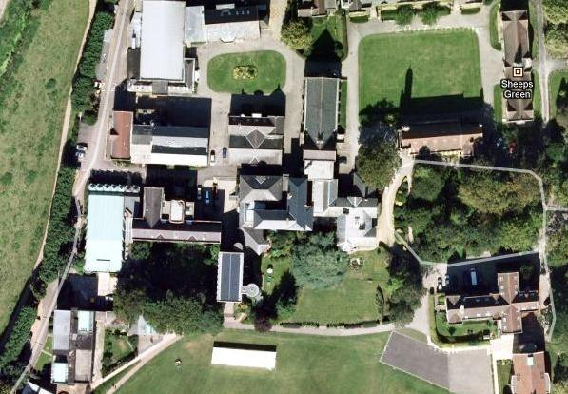


Slide 43
Karma
Sorry, Doc Gidden, for crashing the school network.
As penance, I have spent the last eight years working on congestion control.

