Slide 1
IA Scientific Computing
BRIEFING LECTURE
In this years performance of IA Scientific Computing
Damon Wischik‘s part will be played by
the understudy Andrew Moore

Slide 2
Notes:
….Waving not drowning….

Slide 3
Scientific computing
✦ computing as a tool for doing science
Computer science
✦ the study of computation
Notes:
Scientific Computing = use comptuiers to help do science.
Vs.
Study of computing with scientific methods.

Slide 4
“A mathematician is a device for turning coffee into theorems” – Erdős / Rényi
requirements
code
thought process
data
insight
code
Notes:
Coffee to theorems
(waste product)
Soft Eng
Requirements input
Code as output
(thinking is the waste product)
In science
Data from natural world (input)
Insights conclusions and so forth (output)
Code is the “garbage”

Slide 5
SCIENTIFIC COMPUTING
Try out an idea  see what happens  refine your idea  try something else  iterate …  share what you’ve learnt
Notes:
Scientists with lots of ideas buzzing around your head
Test them
Elaborate
Throw away bad ideas
Iterate
Iterate
Prune Dead end
Finally conclusions to share …

Slide 6
CODE AT THE SPEED OF THOUGHT
✦ Concise one- or two-liners for one-off tasks
✦ Rich, expressive libraries & glue code
Notes:
Explore territory
FAST
Most code is one-off
A slittle typing as possible
So rich and powerful libraries and you do the GLUE

Slide 7
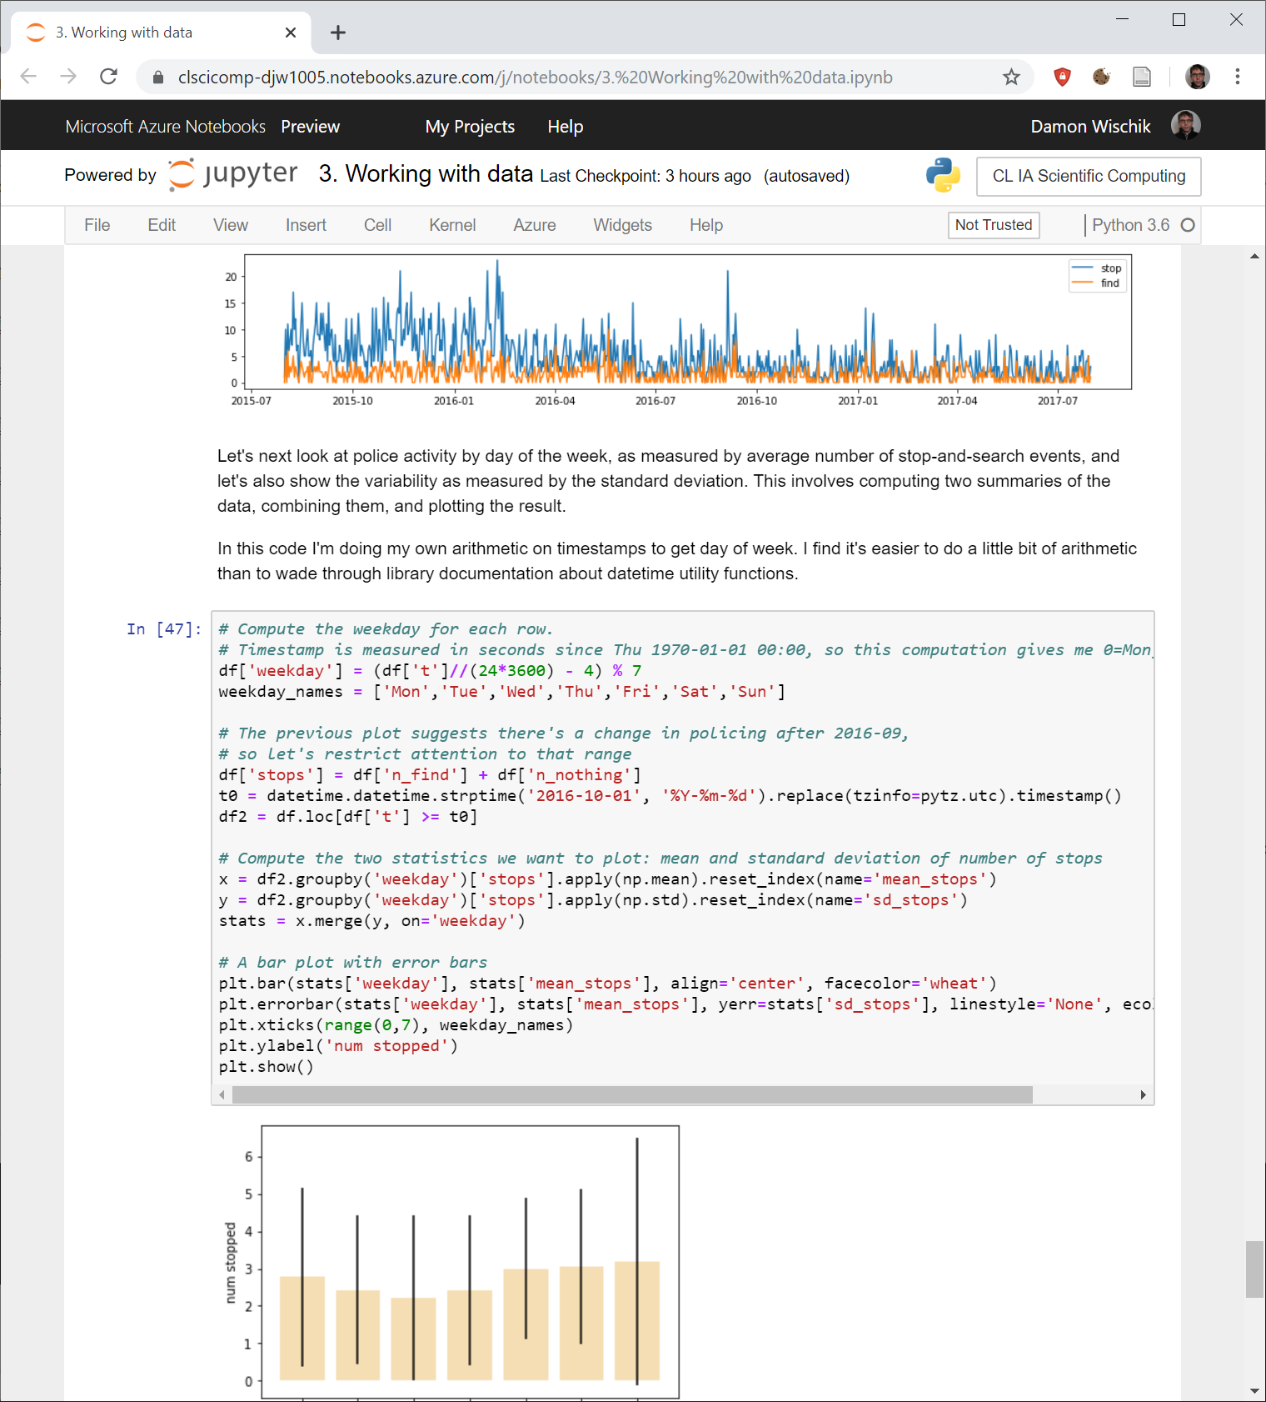
Scientific computing
= Python + numpy + plotting + pandas
+ Jupyter notebooks
Notes:
So course is all about “standard libraries”
For numerical processing.
For data ingestion
For graph production
And so forth.
Jypyter notebooks (as used in Founbdation )
Bounce bounce
Up down all around
Nightmare!

Slide 8
Lecture notes from IA OOP
Notes:
We do not do Computer artifact engineering!
So its less useless – not a good fit for rapid dev elopment.

Slide 9
Marie Kondo,
de-cluttering guru
Look at each line of your code and ask yourself: ‘does this spark joy?’ If not, delete it.
Notes:
Paraphrasing….

Slide 10
while working
after you’ve finished
imports
experiment 1
debug code
tweaked experiment 1
experiment 2
update to experiment 1
forgotten import
imports
utility functions
run-once setup code
functions that implement your solutions
submit solutions to autograder

Slide 11
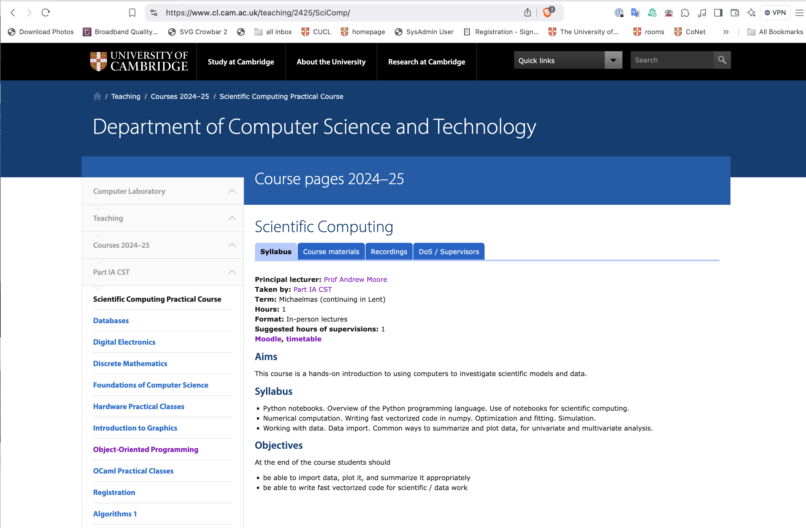

Slide 12
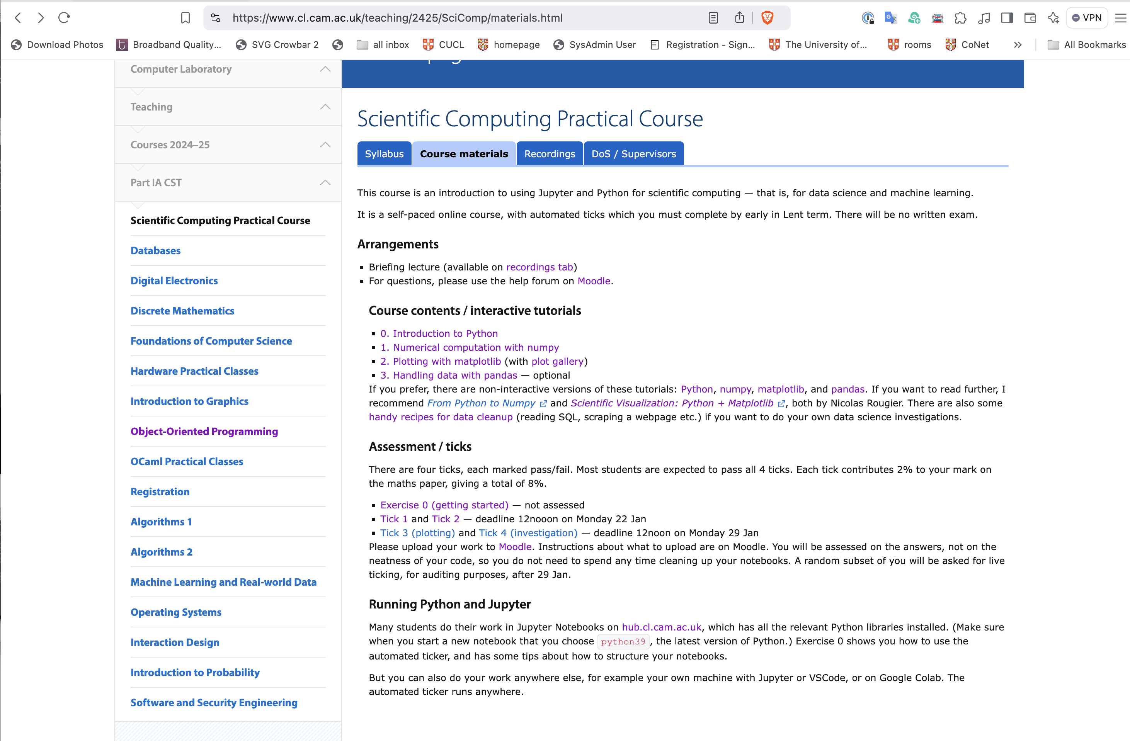

Slide 13
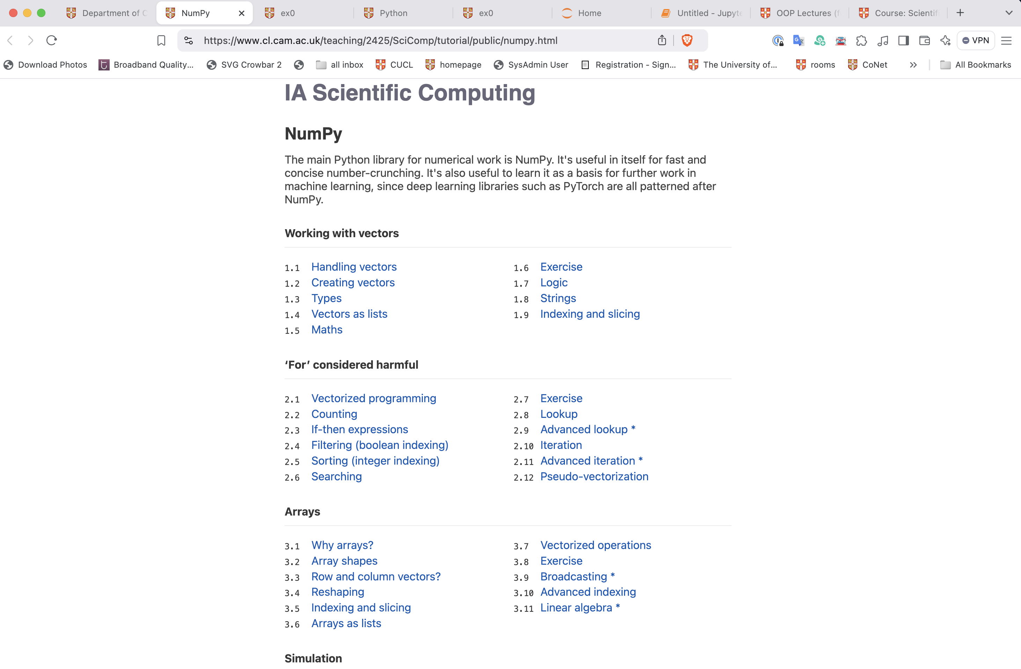

Slide 14
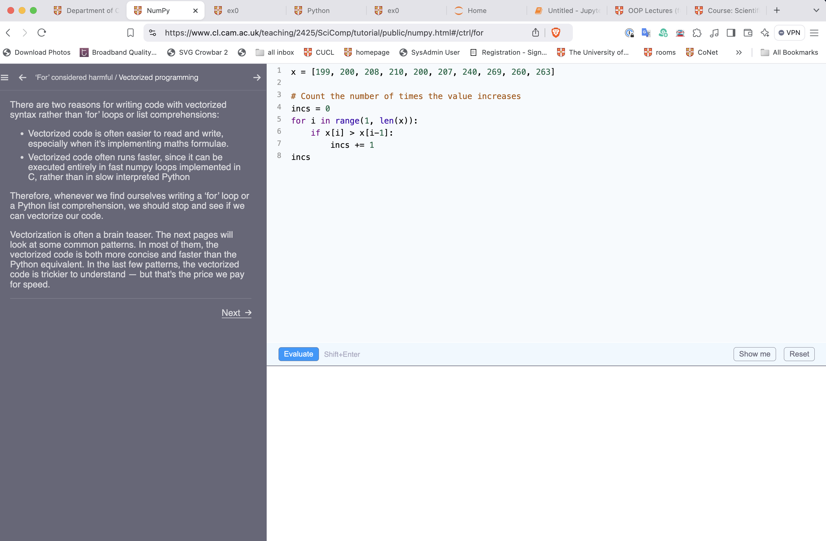

Slide 16
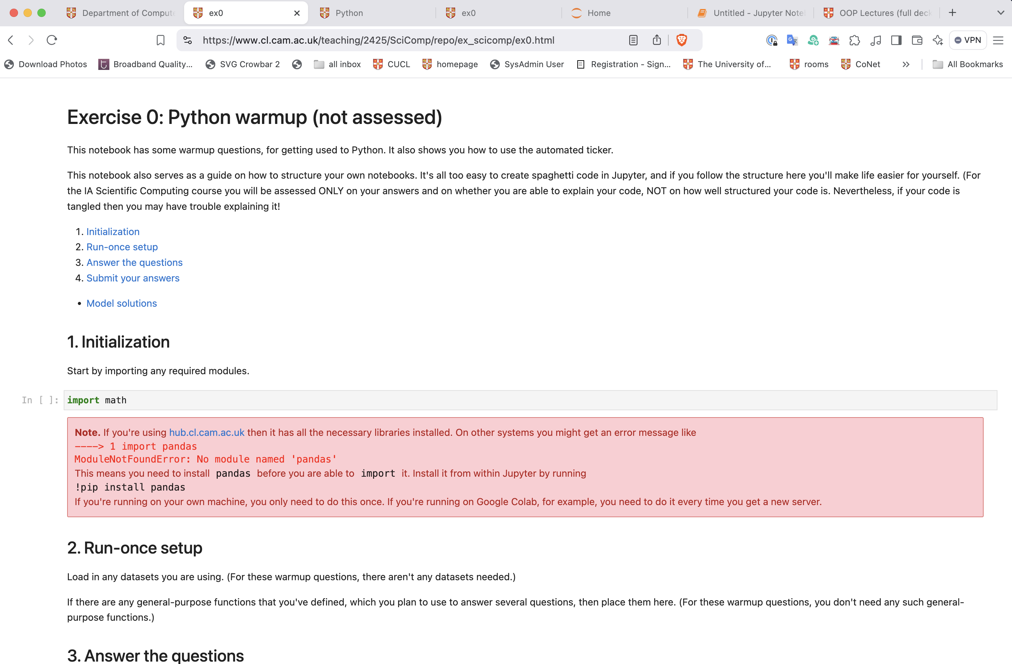

Slide 17
TUTORIALS
ASSESSMENT (maths paper mark = 92% exam + 8% Scientific Computing ticks)
0. Programming in Python language quirks
1. Numerical computation numpy
2. Plotting data matplotlib
3. Working with data pandas
A. Data scraping recipes
No written exam
Four ticks, each marked pass/fail
Ticks 1 and 2: pass the autograder & submit notebook by 27 Jan
Ticks 3 and 4: submit pdfs and notebook by 3 Feb
Some of you will have a viva.
Notes:
8 percent of Math paper
NST math is 92% of paper
This is 8
It is presumed you pass ticks, each tick is pas—fail
Panda is optional but is helpful for ”working with data” in the future…
10-15 hours is typical (apparently)
Vivas are random intended to encourage careful thinking. (not explicitly part of the grading)

Slide 18
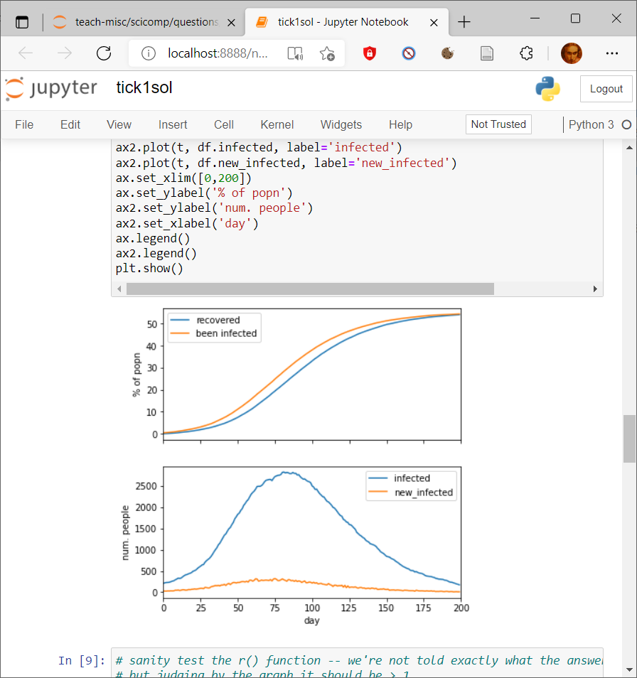
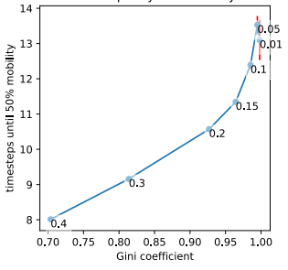
Tick 1,2: Econo-physics simulator (with answers checked by autograder)
Tick 3: plots
Tick 4: One-page scientific report
Impact of redistribution on inequality and mobility
GOALS. This report analyses the relationship between inequality and social mobility, as it is affected by taxation and redistribution.
METHODOLOGY. I investigated on a system of economic exchange of a flat-rate tax on wealth combined with a universal basic income. For each tax rate in a range of values, I simulate a population of 10,000 individuals, and measured the GINI coefficient. I ensure my simulator has reached steady state by magic.
RESULTS:
CONCLUSION: There is no tradeoff between inequality and mobility: redistribution not only reduces inequality, it also increases mobility.
Notes:
Tick 1 and 2 simulator
Physics simluator (gas model, cow model, exchange energy velocity, deriving rules for pressure temp etc
Physicians in Economy models simliarly – each person gets some money and exchanges it with others on some basis….
The ticks look at this the GINI coefficient and relate this with social mobility to forecast equality/inequality….

Slide 19
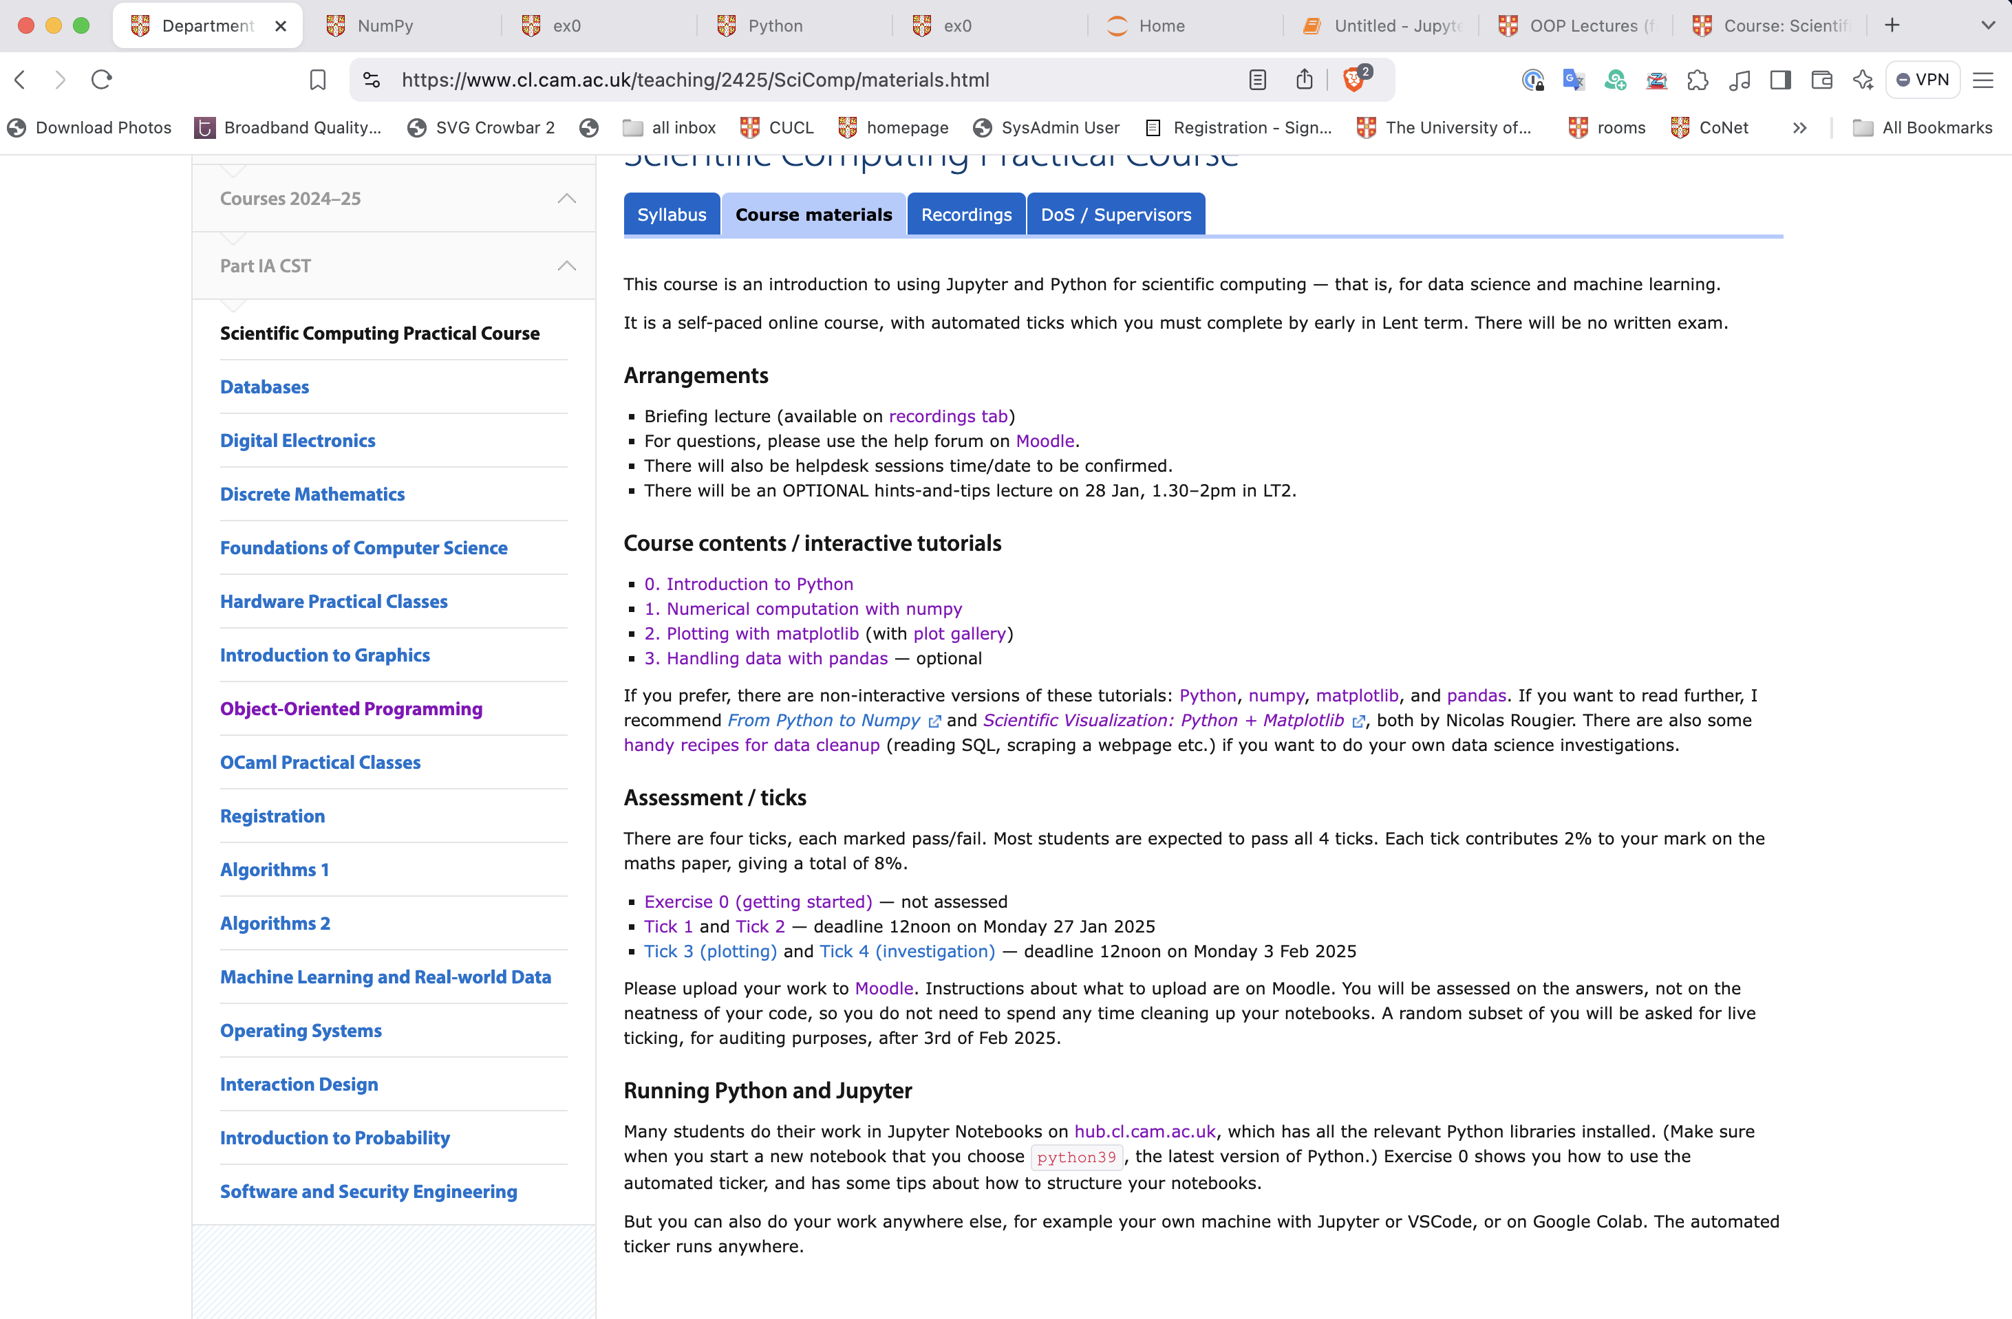

Slide 23
Tick 1,2: Econo-physics simulator (with answers checked by autograder)
Tick 3: plots
Tick 4: One-page scientific report
Impact of redistribution on inequality and mobility
GOALS. This report analyses the relationship between inequality and social mobility, as it is affected by taxation and redistribution.
METHODOLOGY. I investigated on a system of economic exchange of a flat-rate tax on wealth combined with a universal basic income. For each tax rate in a range of values, I simulate a population of 10,000 individuals, and measured the GINI coefficient. I ensure my simulator has reached steady state by magic.
RESULTS:
CONCLUSION: There is no tradeoff between inequality and mobility: redistribution not only reduces inequality, it also increases mobility.
Notes:
Tick 1 and 2 simulator
Physics simluator (gas model, cow model, exchange energy velocity, deriving rules for pressure temp etc
Physicians in Economy models simliarly – each person gets some money and exchanges it with others on some basis….
The ticks look at this the geni coefficient and relate this with social mobility to forecast equality/inequality….

Slide 24
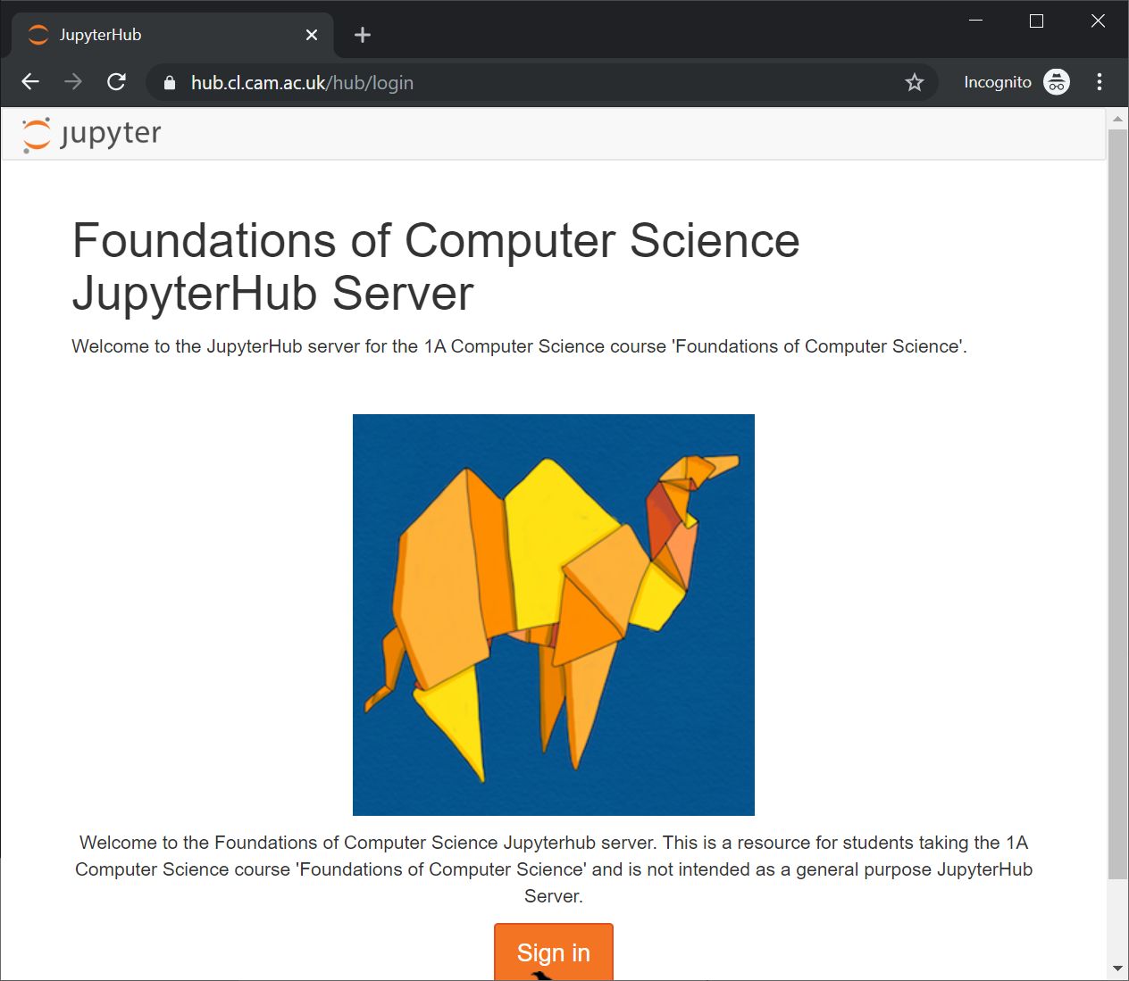
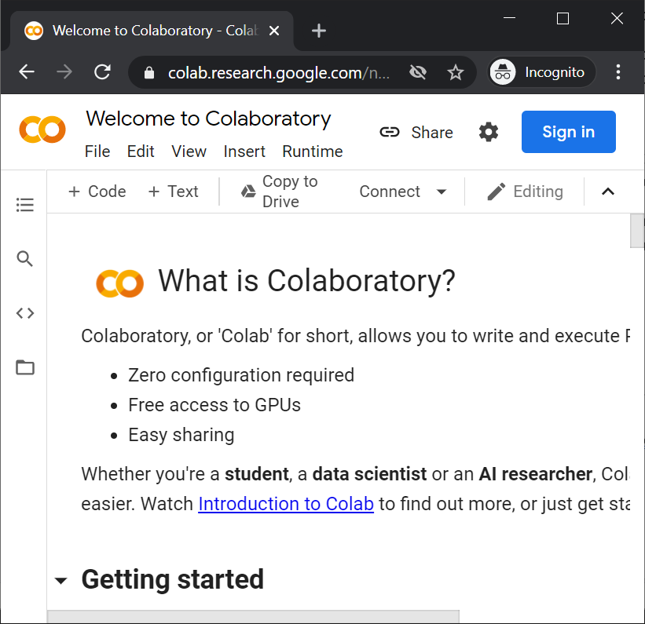
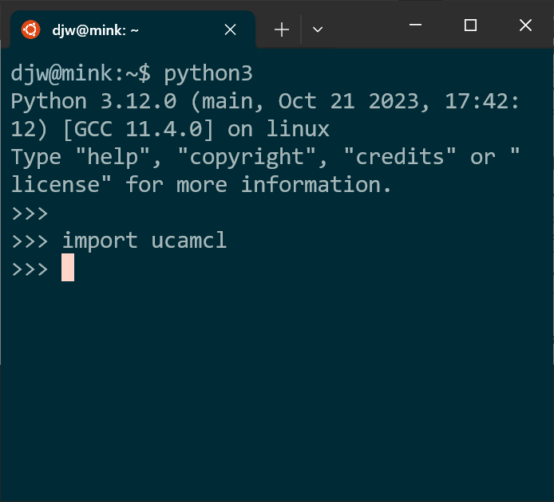
The autograder will run wherever you run Python3
hub.cl.cam.ac.uk
Google colab
VSCode
Command line

Slide 25
Help and support
Moodle help forum
Helpdesk sessions early in Lent term
Optional hints-and-tips lecture early in Lent term

Slide 26
My code passed TEST 2.
But it was buggy code, and it took me ages to debug and pass TEST 3.
Your grader sucks.
Scientific computing isn’t about meeting requirements, it’s about discovery.
✦ chart your own path  write your own tests
✦ invent a few small test cases  work them out with pen and paper  make sure your code agrees

Slide 27
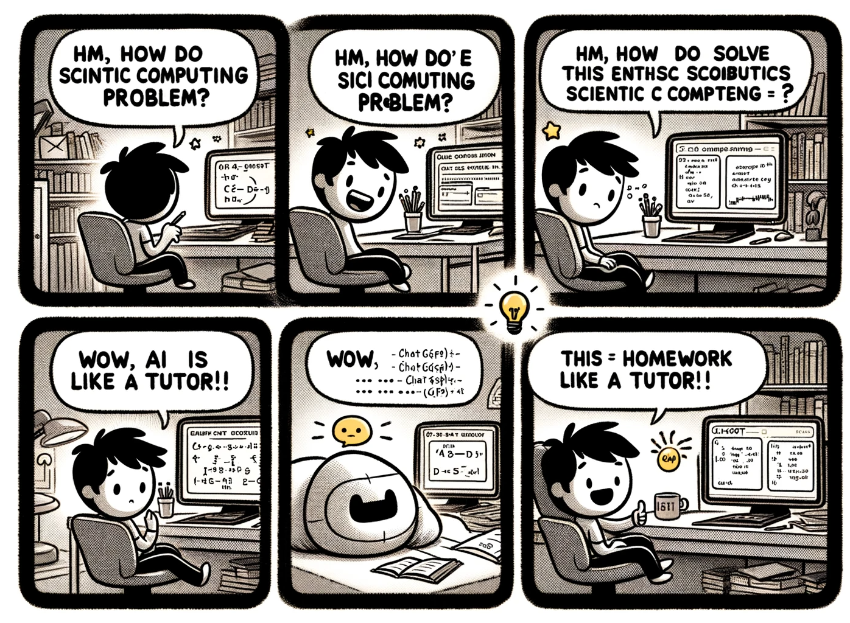
Can I use ChatGPT?

Slide 28
Can I use ChatGPT?
Yes, feel free.
Can I use ChatGPT to save me time and effort?
Unlikely.
Can I use ChatGPT to sharpen my thinking?
Yes !!!👍🔥👍🔥👍

