Slide 1
Computer Networking
Slide Set 1
Andrew W. Moore
Andrew.Moore@cl.cam.ac.uk
2024-2025 update

Slide 2
Topic 1 Foundation
Administrivia
Networks
Channels
Multiplexing
Performance: loss, delay, throughput

Slide 3
Course Administration
Commonly Available Texts
Computer Networks: A Systems Approach
  Peterson and Davie
  https://book.systemsapproach.org
  https://github.com/SystemsApproach/book
Computer Networking : Principles, Protocols and Practice
Olivier Bonaventure (and friends)
Less GitHub but more practical exercises
https://www.computer-networking.info/
Other textbooks are available, details on the materials tab of webpage.

Slide 4
Thanks
Slides are a fusion of material from
  to Stephen Strowes, Tilman Wolf & Mike Zink, Ashish Padalkar , Evangelia Kalyvianaki, Brad Smith, Ian Leslie, Richard Black, Jim Kurose, Keith Ross, Larry Peterson, Bruce Davie, Jen Rexford, Ion Stoica, Vern Paxson, Scott Shenker, Frank Kelly, Stefan Savage, Jon Crowcroft , Mark Handley, Sylvia Ratnasamy, Adam Greenhalgh, and Anastasia Courtney.
Supervision material is drawn from
  Stephen Kell, Andy Rice, and the TA teams of 144 and 168
Finally thanks to the fantastic past Part 1b students and Andrew Rice for all the tremendous feedback.

Slide 5
What is a network?
A system of “links” that interconnect “nodes” in order to move “information” between nodes
Yes, this is all rather abstract

Slide 6
What is a network?
We also talk about
or
or even
Yes, abstract, vague, and under-defined….

Slide 7
There are many different types of networks
Internet
Telephone network
Transportation networks
Cellular networks
Supervisory control and data acquisition networks
Optical networks
Sensor networks
Satellite networks
We will focus almost exclusively on the Internet

Slide 8
The Internet has transformed everything
The way we do business
  E-commerce, advertising, cloud-computing
The way we have relationships
  Facebook friends, E-mail, IM, virtual worlds
The way we learn
  Wikipedia, search engines
The way we govern and view law
  E-voting, censorship, copyright, cyber-attacks

Slide 9
A few defining characteristics of the Internet

Slide 10
A federated system
The Internet ties together different networks
  >22,000 ISP networks (the definition is fuzzy)
Internet
user
ISP A
ISP B
ISP C
user
Tied together by IP -- the “Internet Protocol” : a single common interface between users and the network and between networks
Notes:
one big cloud is actually…
snip here or there..

Slide 11
A federated system
The Internet ties together different networks
  >22,000 ISP networks
A single, common interface is great for interoperability…
…but tricky for business
Why does this matter?
  ease of interoperability is the Internet’s most important goal
  practical realities of incentives, economics and real-world trust,
  drive topology, route selection and service evolution

Slide 12
Tremendous scale
(2020 numbers – so some ‘weird’)
4.57 Billion users (58% of world population)
1.8 Billion web sites
  34.5% of which are powered by the WordPress!
4.88 Billion smartphones (45.4% of population)
500 Million Tweets a day
100 Billion WhatsApp messages per day
1 Billion hours of YouTube video watched per day
500 hours of Youtube video added per minute
2+ billion TikTok installs
60% video streaming
  12.5% of the Internet traffic is native Netflix

Slide 13
Tremendous scale
(2020 numbers – so some ‘weird’)
4.57 Billion users (58% of world population)
1.8 Billion web sites
  34.5% of which are powered by the WordPress!
4.88 Billion smartphones (45.4% of population)
500 Million Tweets a day
100 Billion WhatsApp messages per day
1 Billion hours of YouTube video watched per day
500 hours of Youtube video added per minute
2+ billion TikTok installs
60% video streaming
  12.5% of the Internet traffic is native Netflix
“Internet Scale” refers to such systems

Slide 14
Enormous diversity and dynamic range
Communication latency: nanoseconds to seconds (10⁹)
Bandwidth: 100bits/second to 1.600 Terabits/second (10¹²)
Packet loss: 0 – 90%
Technology: optical, wireless, satellite, copper
Endpoint devices: from sensors and cell phones to datacenters and supercomputers
Applications: social networking, file transfer, skype,
live TV, gaming, remote medicine, backup, IM
Users: the governing, governed, operators, malicious,
naïve, savvy, embarrassed, paranoid, addicted, cheap …

Slide 15
Constant Evolution
1970s:
56kilobits/second “backbone” links
<100 computers, a handful of sites in the US (and one UK)
Telnet and file transfer were the “killer” applications
Today
400+Gigabits/second backbone links
40B+ devices, all over the globe
  27B+ IoT devices alone

Slide 16
Asynchronous Operation
Fundamental constraint: speed of light
Consider:
  How many cycles does your 3GHz CPU in Cambridge execute before it can possibly get a response from a message it sends to a server in Palo Alto?
    Cambridge to Palo Alto: 8,609 km
    Traveling at 300,000 km/s: 28.70 milliseconds
    Then back to Cambridge: 2 x 28.70 = 57.39 milliseconds
    3,000,000,000 cycles/sec * 0.05739 = 172,179,999 cycles!
Thus, communication feedback is always dated
    How much can change with 172 Million instructions

Slide 17
Prone to Failure
To send a message, all components along a path must function correctly
  software, wireless access point, firewall, links, network interface cards, switches,…
  Including human operators
Consider: 50 components in a system, each working correctly 99% of time → 39.5% chance communication will fail
Plus, recall
  scale → lots of components
  asynchrony → takes a long time to hear (bad) news
  federation (internet) → hard to identify fault or assign blame

Slide 18
Recap: The Internet is…
A complex federation
Of enormous scale
Dynamic range
Diversity
Constantly evolving
Asynchronous in operation
Failure prone
Constrained by what’s practical to engineer
Too complex for (simple) theoretical models
“Working code” doesn’t mean much
Performance benchmarks are too narrow
Notes:
vvvv

Slide 19
An Engineered System
Constrained by what technology is practical
  Link bandwidths
  Switch port counts
  Bit error rates
  Cost
  …

Slide 20

Nodes and Links
A
B
Channels = Links
Peer entities = Nodes

Slide 21
Properties of Links (Channels)
bandwidth
delay x bandwidth
Latency
Bandwidth (capacity): “width” of the links
  number of bits sent (or received) per unit time (bits/sec or bps)
Latency (delay): “length” of the link
  propagation time for data to travel along the link (seconds)
Bandwidth-Delay Product (BDP): “volume” of the link
  amount of data that can be “in flight” at any time
  propagation delay × bits/time = total bits in link
Notes:
• Amount of data that can be transmitted per time unit ⇒ transmitted = put into the pipe (wire)
BDP: how many bits the sender must tx. before the 1st bit arrives at the receiver
⇒ the amount of data that could be in transit

Slide 22
Examples of Bandwidth-Delay
Same city over a slow link:
  BW~100Mbps
  Latency~10msec
  BDP ~ 10⁶bits ~ 125KBytes
To California over a fast link:
  BW~10Gbps
  Latency~140msec
  BDP ~ 1.4x10⁹bits ~ 175MBytes
Intra Datacenter:
  BW~100Gbps
  Latency~30usec
  BDP ~ 10⁶bits ~ 375KBytes
Intra (inside) Host:
  BW~800Gbps
  Latency~16nsec
  BDP ~ 12x10³bits ~ 5KBytes
17km / c = 56μs << 10ms
750m / c = 56μs ≅ 30μs
9708km / c = 32ms << 140ms
25cm / c = 83ps << 16ns
Notes:
17km
750 m
5584km
0.025m

Slide 23
Packet Delay
Sending a 100B packet from A to B?
A
B
1Mbps, 1ms
100Byte packet
time=0
Time to transmit
one bit = 1/10⁶s
Time when that
bit reaches B
= 1/10⁶+1/10³s
Time to transmit
800 bits=800x1/10⁶s
The last bit
reaches B at
(800x1/10⁶)+1/10³s
= 1.8ms
Packet Delay = Transmission Delay + Propagation Delay
Packet Delay =
(Packet Size ÷ Link Bandwidth) + Link Latency
Time
Notes:
2020-1-17

Slide 24
Packet Delay
Sending a 100B packet from A to B?
1GB file in 100B packets
1Gbps, 1ms?
A
B
1Mbps, 1ms
100Byte packet
10⁷ x 100B packets
The last bit in the file
reaches B at
(10⁷x800x1/10⁹)+1/10³s
= 8001ms
The last bit
reaches B at
(800x1/10⁹)+1/10³s
= 1.0008ms
The last bit
reaches B at
(800x1/10⁶)+1/10³s
= 1.8ms
Time
Notes:
small message (e.g., 1 byte): [1ms vs 100ms] (latency) dominates [1Mbps vs 100Mbps]
large message (e.g., 25 MB): [1Mbps vs 100Mbps] (BW) dominates [1ms vs 100ms]

Slide 25
Packet Delay: The “pipe” view
Sending 100B packets from A to B?
A
B
100Byte packet
1Mbps, 10ms
Packet Transmission
Time
100Byte packet
100Byte packet
BW →
time →
Time

Slide 26
Packet Delay: The “pipe” view
Sending 100B packets from A to B?
1Mbps, 10ms (BDP=10,000)
BW →
time →
1Mbps, 5ms (BDP=5,000)
10Mbps, 1ms (BDP=10,000)
BW →
BW →
time →
time →

Slide 27
Packet Delay: The “pipe” view
Sending 100B packets from A to B?
1Mbps, 10ms (BDP=10,000)
BW →
time →
What if we used 200Byte packets??
1Mbps, 10ms (BDP=10,000)
BW →
time →

Slide 28
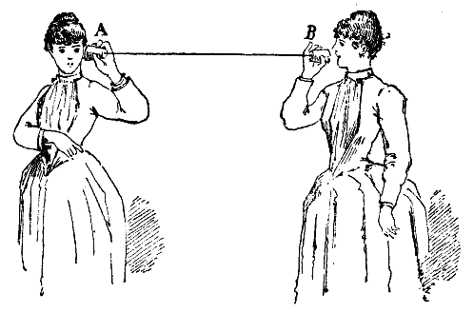
Recall Nodes and Links
A
B
Notes:
Start from here 24th of Jan

Slide 29
What if we have more nodes?
One link for every node?
Need a scalable way to interconnect nodes
Notes:
2024-01-19

Slide 30
Solution: A switched network
Nodes share network link resources
How is this sharing implemented?
Notes:
multiple conversations in parallel
resources are shared
Start here lecture 2

Slide 31
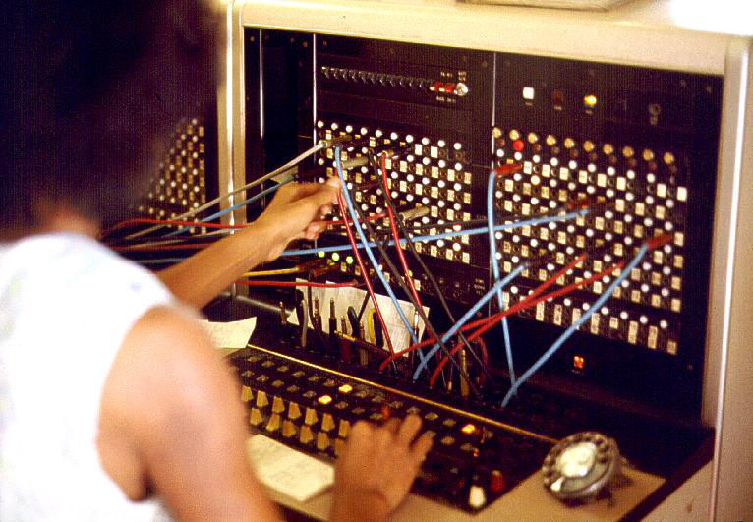
Two examples of switched networks
Circuit switching (used in the POTS: Plain Old Telephone system) emphasis on old
Packet switching (used in the Internet)
Notes:
borrow mckeown’s slides (of network with image); add Berkeley and MIT.
box -- links (incoming and outgoing)
packet -- data + header.
header has an address.

Slide 32
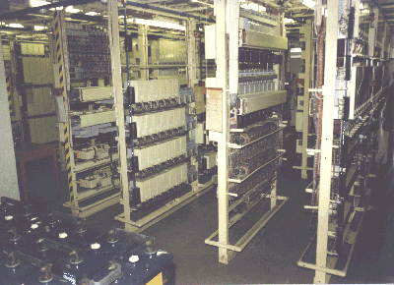


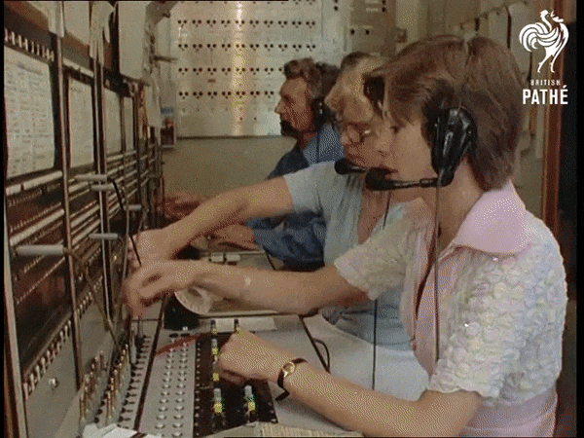
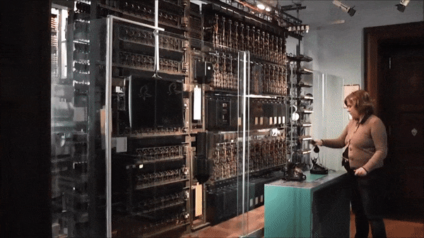
Circuit switching
Telephone
Exchange
Exchange
Telephone

Slide 33
Circuit switching
Idea: source reserves network capacity along a path
10Mb/s?
B
A
10Mb/s?
10Mb/s?
(1) Node A sends a reservation request
(2) Interior switches establish a connection -- i.e., “circuit”
(3) A starts sending data
(4) A sends a “teardown circuit” message
Notes:
multiple conversations in parallel
resources are shared

Slide 34
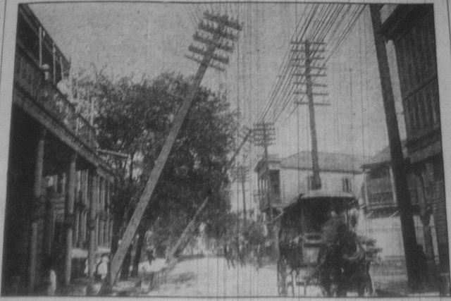
Multiplexing
Sharing makes things efficient (cost less)
One airplane/train for 100’s of people
One telephone for many calls
One lecture theatre for many classes
One computer for many tasks
One network for many computers
One datacenter many applications

Slide 35
Multiplexing
Sharing makes things efficient (cost less)
One airplane/train for 100’s of people
One telephone for many calls
One lecture theatre for many classes
One computer for many tasks
One network for many computers
One datacenter many applications
Lecturer?

Slide 36
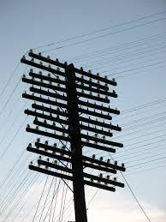
Old Time Multiplexing

Slide 37
Sharing Circuit Switching: FDM and TDM
Example:
Frequency Division Multiplexing
4 users
Radio2 88.9 MHz
Radio3 91.1 MHz
Radio4 93.3 MHz
RadioX 95.5 MHz
frequency
time
Time Division Multiplexing
Radio Schedule
…,News, Sports, Weather, Local, News, Sports,…
frequency
time
Notes:
start here 23-jan-2023

Slide 38
Time-Division Multiplexing/Demultiplexing
Frames
Slots =
0
1
2
3
4
5
0
1
2
3
4
5
Time divided into frames; frames into slots
Relative slot position inside a frame determines to which conversation data belongs
  e.g., slot 0 belongs to orange conversation
Slots are reserved (released) during circuit setup (teardown)
If a conversation does not use its circuit capacity is lost!

Slide 39
Timing in Circuit Switching
Information
Circuit
Establishment
Transfer
time
Circuit
Tear-down
Notes:
Why the delays in the first pass of the establishment, but not in subsequent passes (or in teardown)?

Slide 40
Circuit switching: pros and cons
Pros
  guaranteed performance
  fast transfer (once circuit is established)
Cons

Slide 41
Timing in Circuit Switching
Information
Circuit
Establishment
Transfer
time
Circuit
Tear-down
Notes:
Why the delays in the first pass of the establishment, but not in subsequent passes (or in teardown)?

Slide 42
Circuit switching: pros and cons
Pros
  guaranteed performance
  fast transfer (once circuit is established)
Cons
  wastes bandwidth if traffic is “bursty”

Slide 43
Timing in Circuit Switching
Information
Circuit
Establishment
Transfer
time
Circuit
Tear-down
Notes:
Why the delays in the first pass of the establishment, but not in subsequent passes (or in teardown)?

Slide 44
Timing in Circuit Switching
Information
Circuit
Establishment
Transfer
Circuit
Tear-down
time
Notes:
Why the delays in the first pass of the establishment, but not in subsequent passes (or in teardown)?

Slide 45
Circuit switching: pros and cons
Pros
  guaranteed performance
  fast transfers (once circuit is established)
Cons
  wastes bandwidth if traffic is “bursty”
  connection setup time is overhead

Slide 46
Circuit switching
A
B
Circuit switching doesn’t “route around failure”

Slide 47
Circuit switching: pros and cons
Pros
  guaranteed performance
  fast transfers (once circuit is established)
Cons
  wastes bandwidth if traffic is “bursty”
  connection setup time is overhead
  recovery from failure is slow

Slide 48
Numerical example
How long does it take to send a file of 640,000 bits from host A to host B over a circuit-switched network?
  All links are 1.536 Mbps
  Each link uses TDM with 24 slots/sec
  500 msec to establish end-to-end circuit
Let’s work it out!
1 / 24 * 1.536Mb/s = 64kb/s
640,000 / 64kb/s = 10s
10s + 500ms = 10.5s
Notes:
640,000b * (1/24) * 1/536Mbps + 500ms
640,000b @ 64kbps = 10s
PLUS 500ms setup

Slide 49


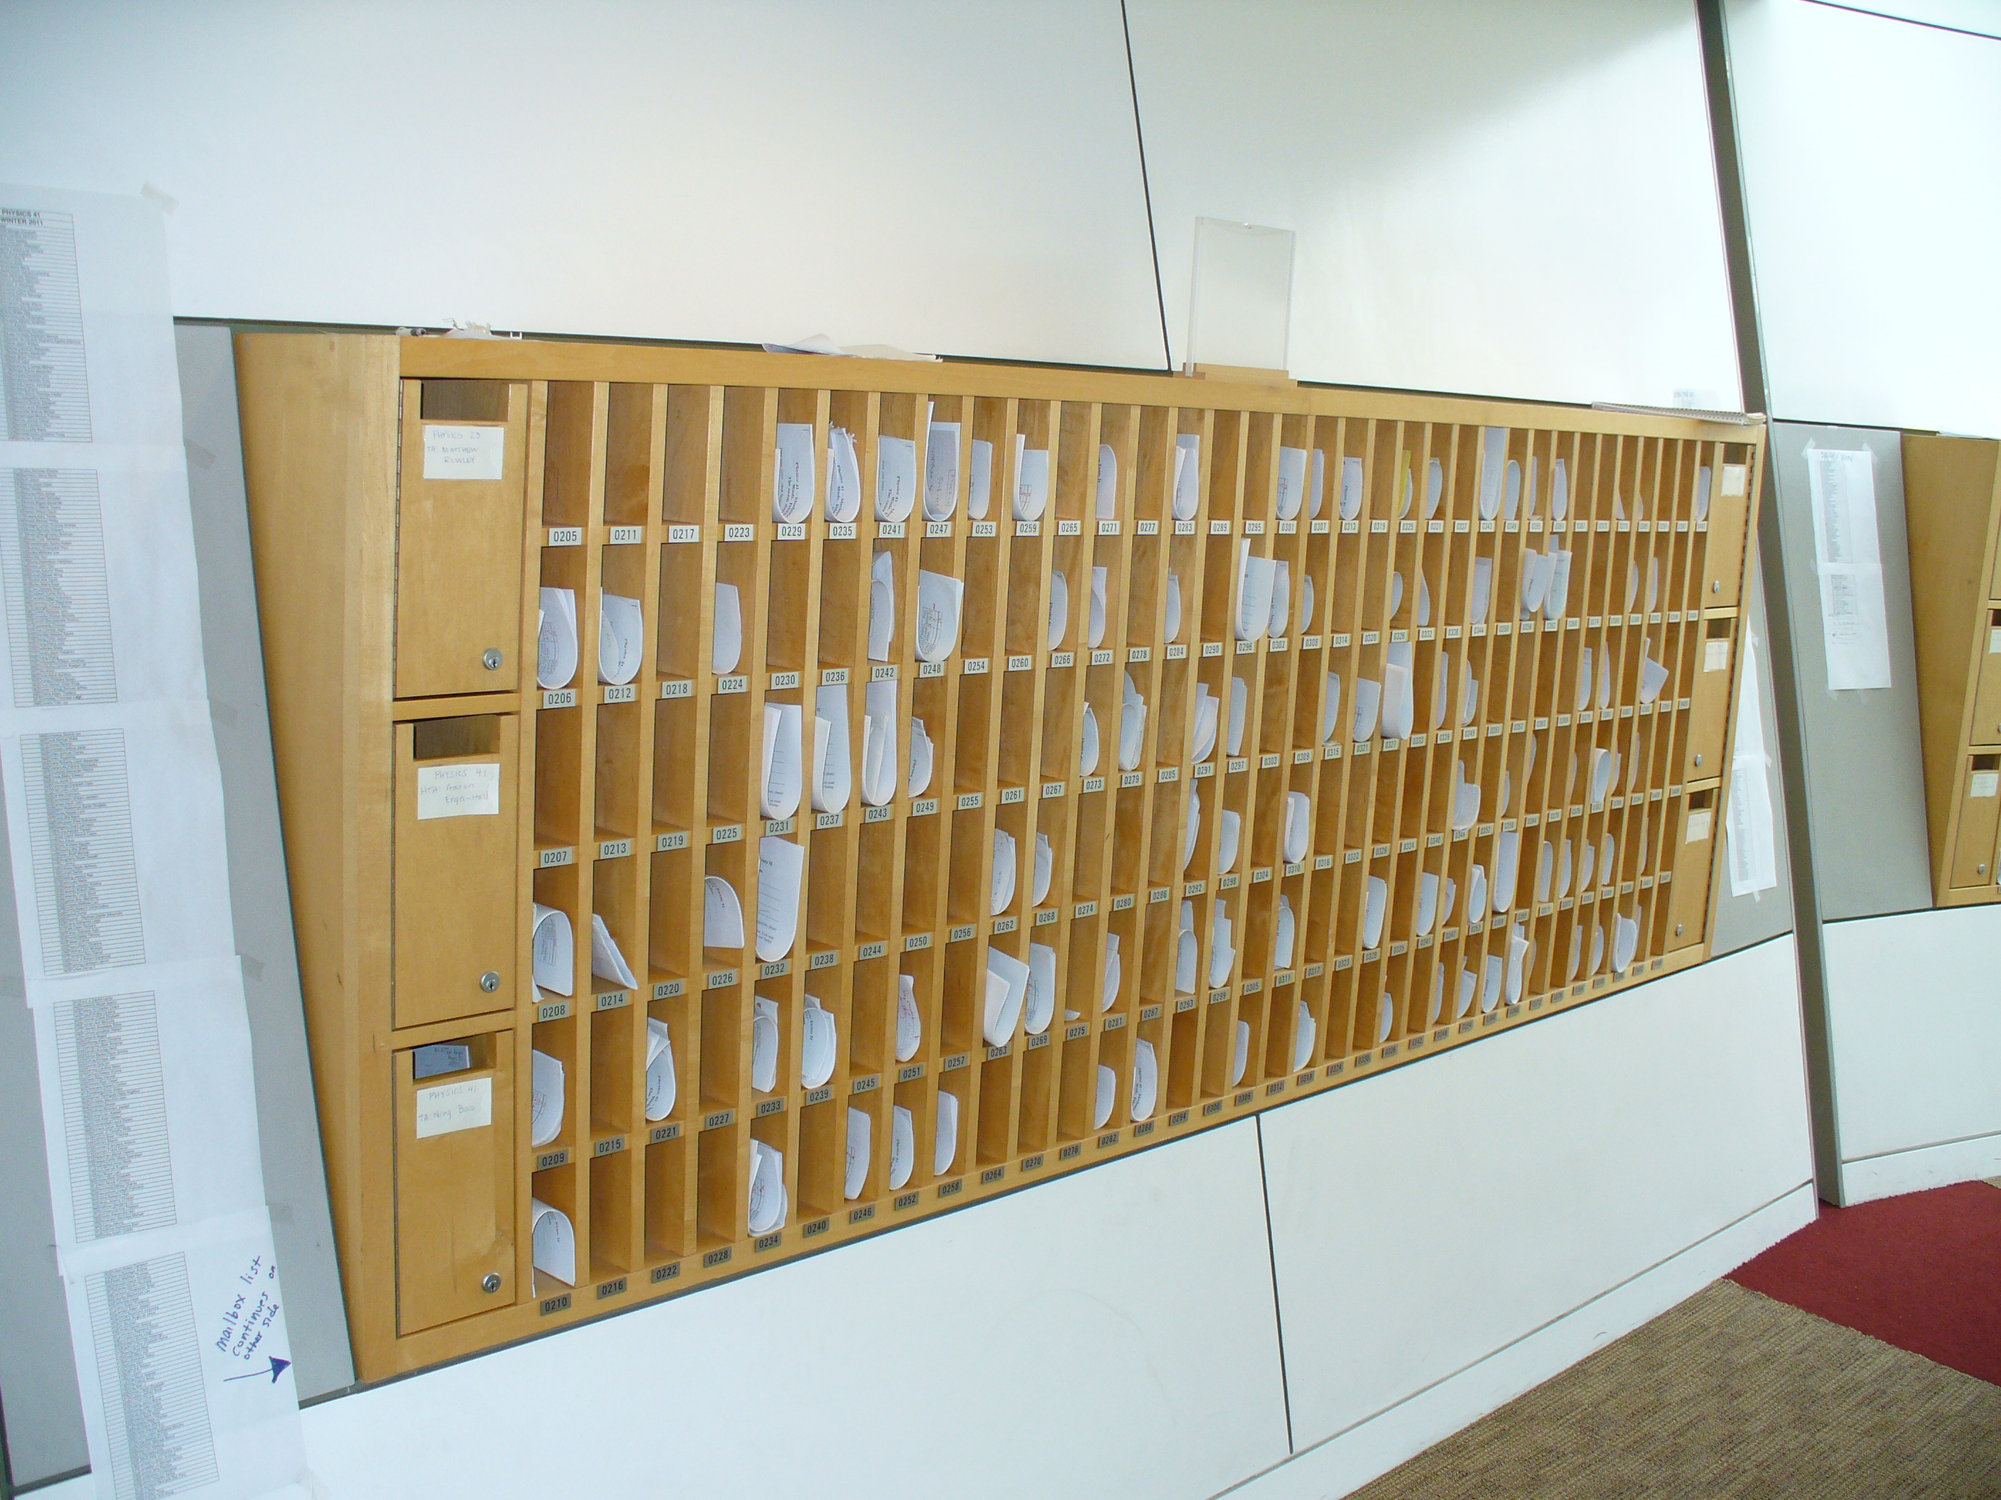

Two examples of switched networks
Circuit switching (used in the POTS: Plain Old Telephone system)
Packet switching (used in the Internet)
Notes:
borrow mckeown’s slides (of network with image); add Berkeley and MIT.
box -- links (incoming and outgoing)
packet -- data + header.
header has an address.

Slide 50


Packet Switching
Data is sent as chunks of formatted bits (Packets)
Packets consist of a “header” and “payload”*
Internet Address
Age (TTL)
Checksum to protect header
Data
Header
payload
header
01000111100010101001110100011001

Slide 51
Packet Switching
Data is sent as chunks of formatted bits (Packets)
Packets consist of a “header” and “payload”*
Destination Address
Data
Header
payload
header
01000111100010101001110100011001

Slide 52
Packet Switching
Data is sent as chunks of formatted bits (Packets)
Packets consist of a “header” and “payload”*
  payload is the data being carried
  header holds instructions to the network for how to
  handle packet (think of the header as an API)
  In this example, the header has a destination address
  More complex headers may include
    How this traffic should be handled? (first class, second class, etc)
    Do I acknowledge this? Who signed for it?
    Were the contents ok?

Slide 53
Packet Switching
Data is sent as chunks of formatted bits (Packets)
Packets consist of a “header” and “payload”
Switches “forward” packets based on their headers
A switch looks at the header and
immediately decides which physical port
In a switch: address maps to port

Slide 54

Switches forward packets
GLASGOW
EDINBURGH
switch#4
switch#2
Forwarding Table
111010010
EDIN
Destination | Next Hop
GLASGOW | 4
OXFORD | 5
EDIN | 2
UCL | 3
switch#5
OXFORD
UCL
switch#3

Slide 55
Timing in Packet Switching
payload
hdr
time
What about the time to process the packet at the switch?
We’ll assume it’s relatively negligible (mostly true)

Slide 56
Timing in Packet Switching
payload
hdr
Could the switch start transmitting as
soon as it has processed the header?
time
Yes! This would be called
a “cut through” switch

Slide 57
Timing in Packet Switching
payload
hdr
We will always assume a switch processes/forwards
a packet after it has received it entirely.
This is called “store and forward” switching
time

Slide 58
Packet Switching
Data is sent as chunks of formatted bits (Packets)
Packets consist of a “header” and “payload”
Switches “forward” packets based on their headers

Slide 59
Packet Switching
Data is sent as chunks of formatted bits (Packets)
Packets consist of a “header” and “payload”
Switches “forward” packets based on their headers
Each packet travels independently
  no notion of packets belonging to a “circuit”

Slide 60
Packet Switching
Data is sent as chunks of formatted bits (Packets)
Packets consist of a “header” and “payload”
Switches “forward” packets based on their headers
Each packet travels independently
No link resources are reserved in advance. Instead packet switching leverages statistical multiplexing (stat muxing)

Slide 61
Multiplexing
Sharing makes things efficient (cost less)
One airplane/train for 100’s of people
One telephone for many calls
One lecture theatre for many classes
One computer for many tasks
One network for many computers
One datacenter many applications

Slide 62

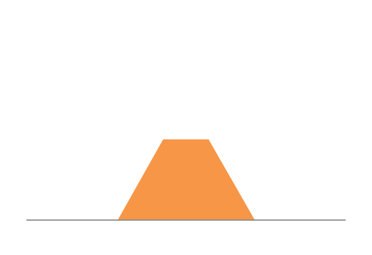
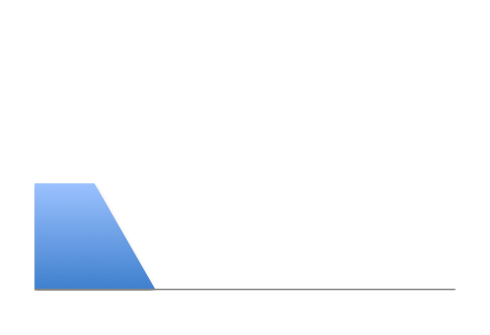
Three Flows with Bursty Traffic
Data Rate 1
Time
Data Rate 2
Capacity
Time
Data Rate 3
Time

Slide 63
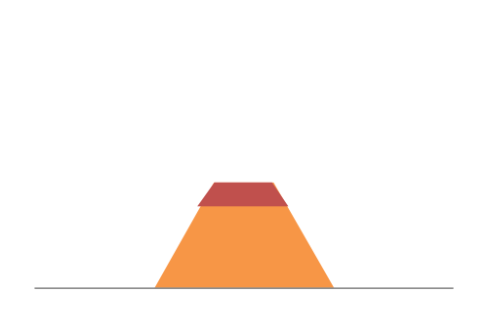
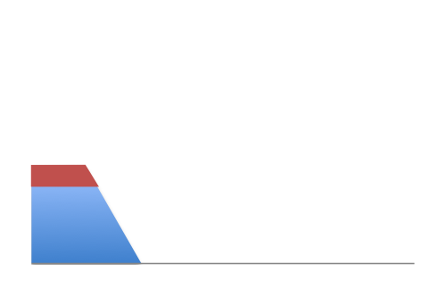
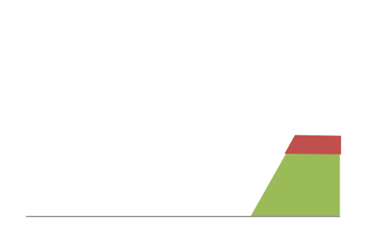
When Each Flow Gets 1/3rd of Capacity
Frequent Overloading
Data Rate 1
Time
Data Rate 2
Time
Data Rate 3
Time

Slide 64
When Flows Share Total Capacity
Time
No Overloading
Time
Statistical multiplexing relies on the assumption
that not all flows burst at the same time.
Very similar to insurance, and has same failure case
Time

Slide 65
Three Flows with Bursty Traffic
Data Rate 1
Time
Data Rate 2
Capacity
Time
Data Rate 3
Time

Slide 66

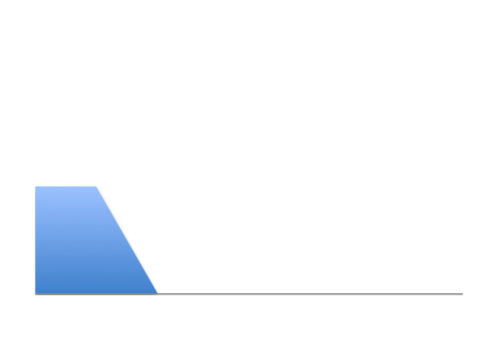
Three Flows with Bursty Traffic
Data Rate 1
Time
Data Rate 2
Capacity
Time
Data Rate 3
Time

Slide 67


Three Flows with Bursty Traffic
Data Rate 1+2+3 >> Capacity
Time
Capacity
Time
What do we do under overload?

Slide 68

Statistical multiplexing: pipe view
pkt tx
time
BW →
time →

Slide 69
Statistical multiplexing: pipe view

Slide 70
Statistical multiplexing: pipe view
No Overload

Slide 71
Statistical multiplexing: pipe view
Queue overload
into Buffer
Transient Overload
Not such a rare event

Slide 72
Statistical multiplexing: pipe view
Queue overload
into Buffer
Transient Overload
Not such a rare event

Slide 73
Statistical multiplexing: pipe view
Queue overload
into Buffer
Transient Overload
Not such a rare event

Slide 74
Statistical multiplexing: pipe view
Queue overload
into Buffer
Transient Overload
Not such a rare event

Slide 75
Statistical multiplexing: pipe view
Queue overload
into Buffer
Transient Overload
Not such a rare event

Slide 76
Statistical multiplexing: pipe view
Queue overload
into Buffer
Transient Overload
Buffer absorbs transient bursts
But NOT additional capacity
Not a rare event!

Slide 77
Statistical multiplexing: pipe view
Queue overload
into Buffer
What about persistent overload?
Will eventually drop packets

Slide 78
Queues introduce queuing delays
Recall,
packet delay = transmission delay + propagation delay (*)
With queues (statistical multiplexing)
  packet delay = transmission delay + propagation delay + queuing delay (*)
Queuing delay caused by “packet interference”
Made worse at high load
  less “idle time” to absorb bursts
  think about traffic jams at rush hour
  or rail network failure
  (* plus per-hop processing delay that we define as negligible)

Slide 79
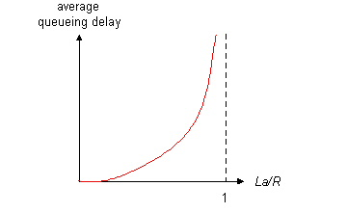
Queuing delay extremes
R=link bandwidth (bps)
L=packet length (bits)
a=average packet arrival rate
traffic intensity = La/R
La/R ~ 0: average queuing delay small
La/R -> 1: delays become large
La/R > 1: more “work” arriving than can be serviced, average delay infinite – or data is lost (dropped).
Notes:
2016-11-16

Slide 80
Recall the Internet federation
The Internet ties together different networks
  >20,000 ISP networks
user
ISP A
ISP B
ISP C
user
We can see (hints) of the nodes and links using traceroute…
Notes:
one big cloud is actually…
snip here or there..

Slide 81
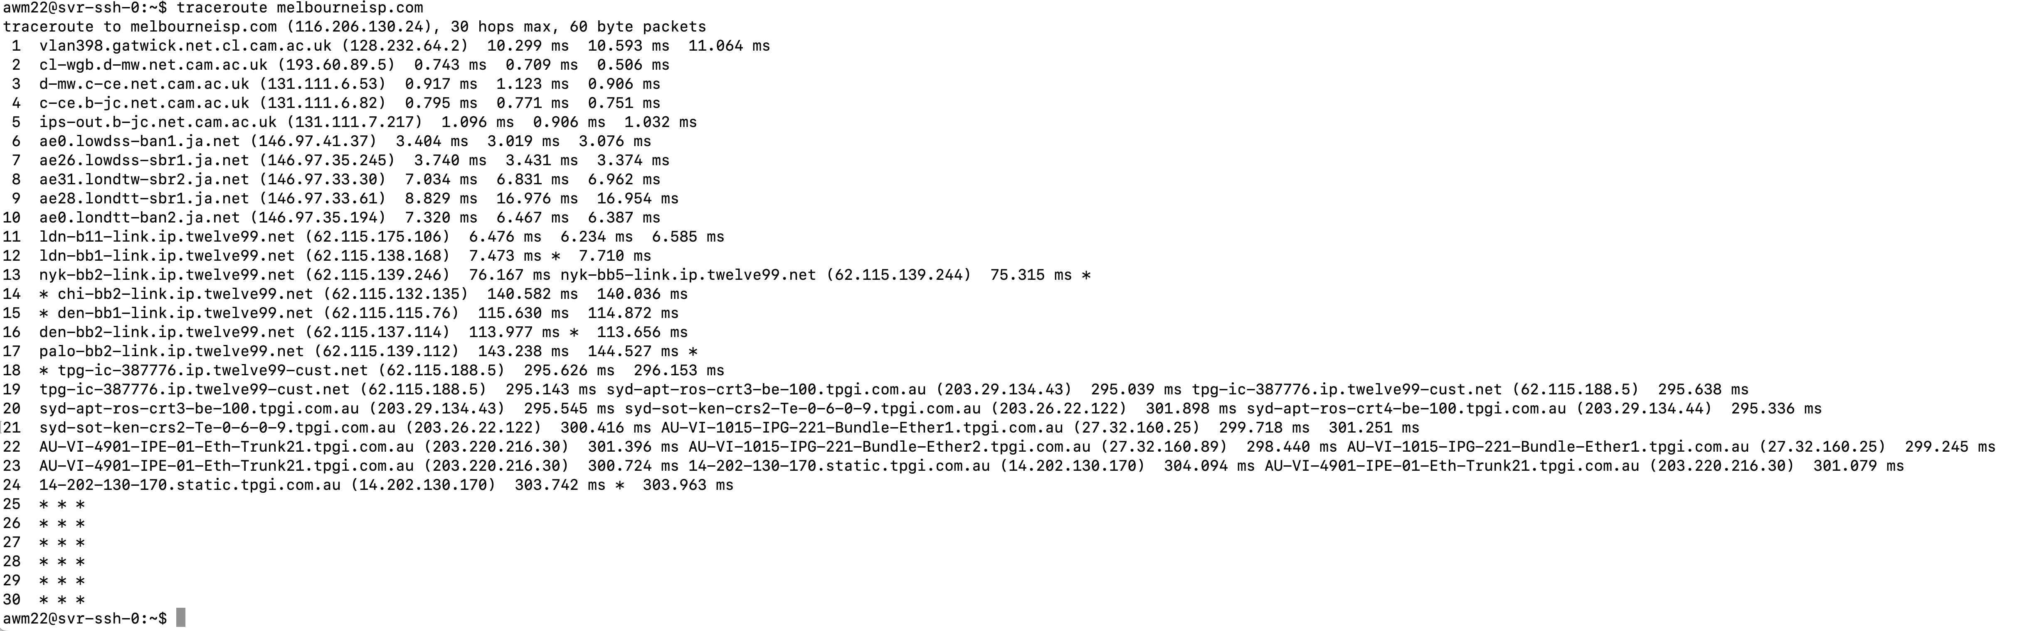
“Real” Internet delays and routes
traceroute: department ssh server to melbourneisp.com (Melbourne Australia
(tracepath on winows is similar)
Three delay measurements from
rio.cl.cam.ac.uk to London JaNet gateway
Crossing the Atlantic Ocean
Crossing the Pacific Ocean
* means no response (probe or reply lost, router not replying)
300ms RTT, 150ms one way Internet, 59.4ms by photon, 42ms by neutron
Notes:
Where did the delay come from??
2015-11-18

Slide 82
Internet structure: network of networks
a packet passes through many networks!
local
ISP
Tier 3
ISP
local
ISP
local
ISP
local
ISP
Tier-2 ISP
Tier-2 ISP
Tier 1 ISP
Tier 1 ISP
Tier 1 ISP
Tier-2 ISP
Tier-2 ISP
Tier-2 ISP
local
ISP
local
ISP
local
ISP
local
ISP

Slide 83
Internet structure: network of networks
“Tier-3” ISPs and local ISPs
  last hop (“access”) network (closest to end systems)
local
ISP
Tier 3
ISP
local
ISP
local
ISP
local
ISP
Local and tier- 3 ISPs are customers of
higher tier ISPs
connecting them to rest of Internet
Tier-2 ISP
Tier-2 ISP
Tier 1 ISP
Tier 1 ISP
Tier 1 ISP
Tier-2 ISP
Tier-2 ISP
Tier-2 ISP
local
ISP
local
ISP
local
ISP
local
ISP

Slide 84
Internet structure: network of networks
“Tier-2” ISPs: smaller (often regional) ISPs
  Connect to one or more tier-1 ISPs, possibly other tier-2 ISPs
Tier-2 ISPs also peer privately with each other.
Tier-2 ISP pays tier-1 ISP for connectivity to rest of Internet
tier-2 ISP is customer of
tier-1 provider
Tier-2 ISP
Tier-2 ISP
Tier 1 ISP
Tier 1 ISP
Tier 1 ISP
Tier-2 ISP
Tier-2 ISP
Tier-2 ISP

Slide 85
Internet structure: network of networks
roughly hierarchical
at center: “tier-1” ISPs (e.g., Verizon, Sprint, AT&T, Cable and Wireless), national/international coverage
  treat each other as equals
Tier-1 providers interconnect (peer) privately
Tier 1 ISP
Tier 1 ISP
Tier 1 ISP

Slide 86
Tier-1 ISP: e.g., Sprint
POP: point-of-presence
to/from backbone
…
peering
….
…
…
…
to/from customers
Notes:
Switched Private Network Telecommunications
South Pacific Railway
-=-=-
End of lecture 23rd Jan 2012

Slide 87
Packet Switching
Data is sent as chunks of formatted bits (Packets)
Packets consist of a “header” and “payload”
Switches “forward” packets based on their headers
Each packet travels independently
No link resources are reserved in advance. Instead, packet switching depends on statistical multiplexing
  allows efficient use of resources
  but introduces queues and queuing delays
Notes:
Restart here 23-1-23

Slide 88
Packet switching versus circuit switching
Packet switching may (does!) allow more users to use network
1 Mb/s link
each user:
  100 kb/s when “active”
  active 10% of time
circuit-switching:
  10 users
packet switching:
  with 35 users, probability > 10 active at same time is less than .0004
N users
1 Mbps link
Q: how did we get value 0.0004?

Slide 89
Packet switching versus circuit switching
Q: how did we get value 0.0004?
1 Mb/s link
each user:
  100 kb/s when “active”
  active 10% of time
circuit-switching:
  10 users
packet switching:
  with 35 users, probability > 10 active at same time is less than .0004

Slide 90
Packet switching versus circuit switching
Q: how did we get value 0.0004?
1 Mb/s link
each user:
  100 kb/s when “active”
  active 10% of time
circuit-switching:
  10 users
packet switching:
  with 35 users, probability > 10 active at same time is less than .0004
Let U be number of users active
N the total users
P is 0.1 in our example to get 0.0004

Slide 92
Circuit switching: pros and cons
Pros
  guaranteed performance
  fast transfers (once circuit is established)
Cons
  wastes bandwidth if traffic is “bursty”
  connection setup adds delay
  recovery from failure is slow

Slide 93
Packet switching: pros and cons
Pros
  efficient use of bandwidth (stat. muxing)
  no overhead due to connection setup
  resilient -- can `route around trouble’
Cons
  no guaranteed performance
  header overhead per packet
  queues and queuing delays

Slide 94
Summary
A sense of how the basic `plumbing’ works
  links and switches
  packet delays= transmission + propagation + queuing + (negligible) per-switch processing
  statistical multiplexing and queues
  circuit vs. packet switching
Notes:
21 Jan 2019

