Slide 1
Computer Networking
Slide Set 1
Andrew W. Moore
Andrew.Moore@cl.cam.ac.uk

Slide 2
Topic 1 Foundation
Administrivia
Networks
Channels
Multiplexing
Performance: loss, delay, throughput

Slide 3
Course Administration
Commonly Available Texts
Computer Networks: A Systems Approach
Peterson and Davie
https://book.systemsapproach.org
https://github.com/SystemsApproach/book
Computer Networking : Principles, Protocols and Practice
Olivier Bonaventure (and friends)
Less GitHub but more practical exercises
https://www.computer-networking.info/
Other textbooks are available.

Slide 4
Thanks
Slides are a fusion of material from
to Stephen Strowes, Tilman Wolf & Mike Zink, Ashish Padalkar , Evangelia Kalyvianaki, Brad Smith, Ian Leslie, Richard Black, Jim Kurose, Keith Ross, Larry Peterson, Bruce Davie, Jen Rexford, Ion Stoica, Vern Paxson, Scott Shenker, Frank Kelly, Stefan Savage, Jon Crowcroft , Mark Handley, Sylvia Ratnasamy, Adam Greenhalgh, and Anastasia Courtney.
Supervision material is drawn from
Stephen Kell, Andy Rice, and the TA teams of 144 and 168
Finally thanks to the fantastic past Part 1b students and Andrew Rice for all the tremendous feedback.

Slide 5
What is a network?
A system of “links” that interconnect “nodes” in order to move “information” between nodes
Yes, this is all rather abstract

Slide 6
What is a network?
We also talk about
or
or even
Yes, abstract, vague, and under-defined….

Slide 7
There are many different types of networks
Internet
Telephone network
Transportation networks
Cellular networks
Supervisory control and data acquisition networks
Optical networks
Sensor networks
We will focus almost exclusively on the Internet

Slide 8
The Internet has transformed everything
The way we do business
E-commerce, advertising, cloud-computing
The way we have relationships
Facebook friends, E-mail, IM, virtual worlds
The way we learn
Wikipedia, search engines
The way we govern and view law
E-voting, censorship, copyright, cyber-attacks

Slide 9

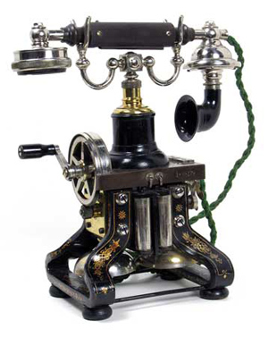
The Internet transforms everything
The way we do business
E-commerce, advertising, cloud-computing
The way we have relationships
Facebook friends, E-mail, IM, virtual worlds
The way we learn
Wikipedia, search engines
The way we govern and view law
E-voting, censorship, copyright, cyber-attacks
Taking the dissemination of information to the next level

Slide 10
Internet research has impact
The Internet started as a research experiment!
Many successful companies have emerged from networking research(ers)

Slide 11
The Internet is big business
Many large and influential networking companies
Huawei, Broadcom, AT&T, Verizon, Akamai, Cisco, …
$132B+ industry (carrier and enterprise alone)
Networking central to most technology companies
Apple, Google, Facebook, Intel, Amazon, VMware, …

Slide 12
But why is the Internet interesting?
“What’s your formal model for the Internet?” -- theorists
“Aren’t you just writing software for networks” – hackers
“You don’t have performance benchmarks???” – hardware folks
“Isn’t it just another network?” – old timers at BT
“What’s with all these TLA protocols?” – all
“But the Internet seems to be working…” – my mother

Slide 13
A few defining characteristics of the Internet

Slide 14
A federated system
The Internet ties together different networks
>20,000 ISP networks (the definition is fuzzy)
Internet
user
ISP A
ISP B
ISP C
user
Tied together by IP -- the “Internet Protocol” : a single common interface between users and the network and between networks
Notes:
one big cloud is actually…
snip here or there..

Slide 15
A federated system
The Internet ties together different networks
>20,000 ISP networks
A single, common interface is great for interoperability…
…but tricky for business
Why does this matter?
ease of interoperability is the Internet’s most important goal
practical realities of incentives, economics and real-world trust, drive topology, route selection and service evolution

Slide 16
Tremendous scale (2020 numbers – so some ‘weird’)
4.57 Billion users (58% of world population)
1.8 Billion web sites
34.5% of which are powered by the WordPress!
4.88 Billion smartphones (45.4% of population)
500 Million Tweets a day
100 Billion WhatsApp messages per day
1 Billion hours of YouTube video watched per day
500 hours of Youtube video added per minute
2+ billion TikTok installs
60% video streaming
12.5% of the Internet traffic is native Netflix

Slide 17
Tremendous scale (2020 numbers – so some ‘weird’)
4.57 Billion users (58% of world population)
1.8 Billion web sites
34.5% of which are powered by the WordPress!
4.88 Billion smartphones (45.4% of population)
500 Million Tweets a day
100 Billion WhatsApp messages per day
1 Billion hours of YouTube video watched per day
500 hours of Youtube video added per minute
2+ billion TikTok installs
60% video streaming
12.5% of the Internet traffic is native Netflix
“Internet Scale” refers to such systems

Slide 18
Enormous diversity and dynamic range
Communication latency: nanoseconds to seconds (10⁹)
Bandwidth: 100bits/second to 400 Gigabits/second (10⁹)
Packet loss: 0 – 90%
Technology: optical, wireless, satellite, copper
Endpoint devices: from sensors and cell phones to datacenters and supercomputers
Applications: social networking, file transfer, skype, live TV, gaming, remote medicine, backup, IM
Users: the governing, governed, operators, malicious, naïve, savvy, embarrassed, paranoid, addicted, cheap …

Slide 19
Constant Evolution
1970s:
56kilobits/second “backbone” links
<100 computers, a handful of sites in the US (and one UK)
Telnet and file transfer are the “killer” applications
Today
400+Gigabits/second backbone links
40B+ devices, all over the globe
27B+ IoT devices alone

Slide 20
Asynchronous Operation
Fundamental constraint: speed of light
Consider:
How many cycles does your 3GHz CPU in Cambridge execute before it can possibly get a response from a message it sends to a server in Palo Alto?
Cambridge to Palo Alto: 8,609 km
Traveling at 300,000 km/s: 28.70 milliseconds
Then back to Cambridge: 2 x 28.70 = 57.39 milliseconds
3,000,000,000 cycles/sec * 0.05739 = 172,179,999 cycles!
Thus, communication feedback is always dated
How much can change with 172 Million instructions

Slide 21
Prone to Failure
To send a message, all components along a path must function correctly
software, wireless access point, firewall, links, network interface cards, switches,…
Including human operators
Consider: 50 componentsin a system, each working correctly 99% of time → 39.5% chance communication will fail
Plus, recall
scale → lots of components
asynchrony → takes a long time to hear (bad) news
federation (internet) → hard to identify fault or assign blame

Slide 22
A detour

Slide 23
8 fallacies of Distributed Systems

Slide 24
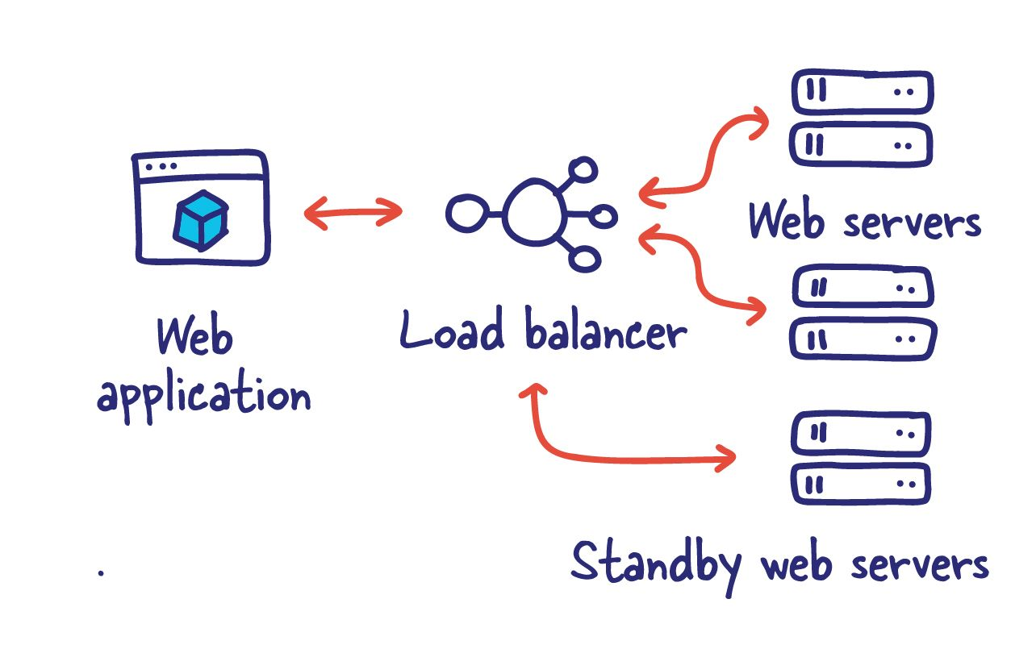

Slide 25
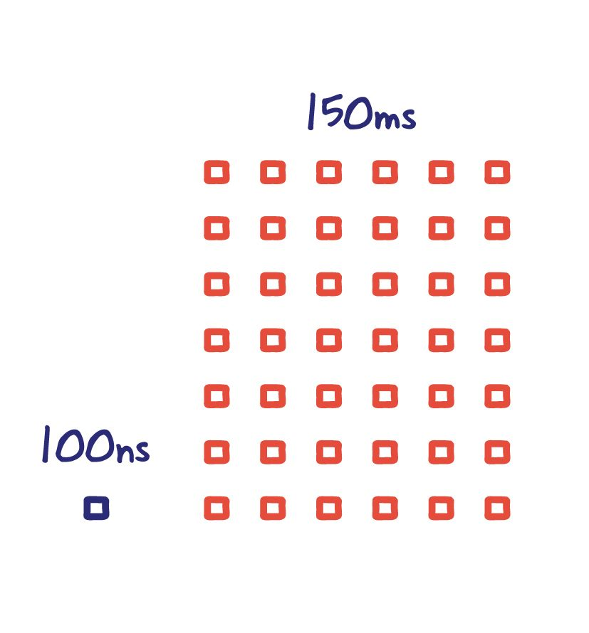

Slide 26
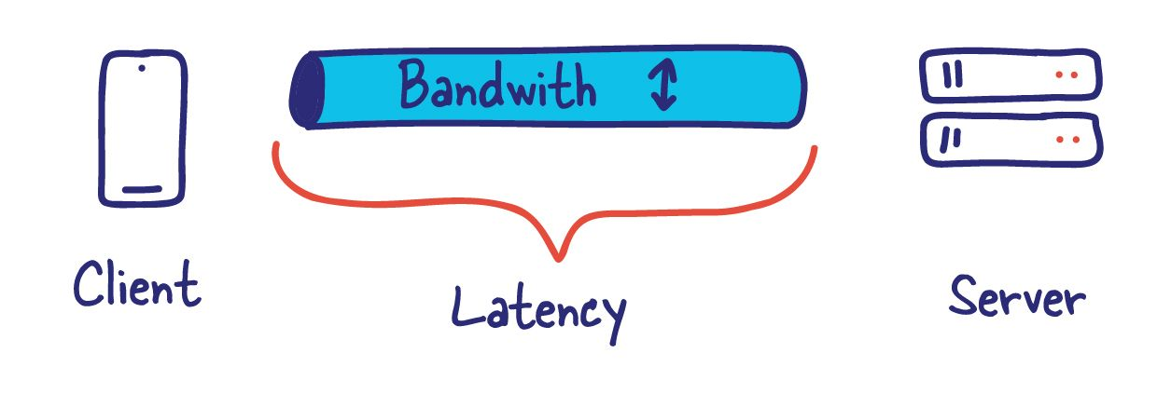

Slide 27


Slide 28
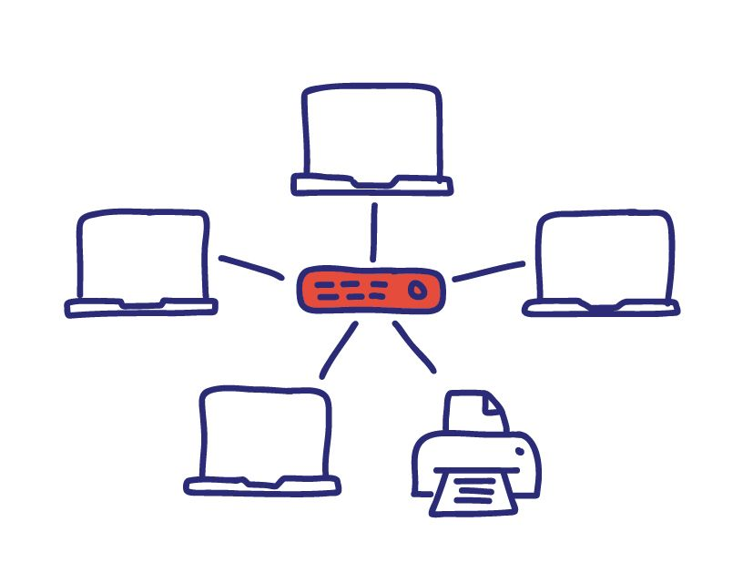

Slide 29


Slide 30


Slide 31
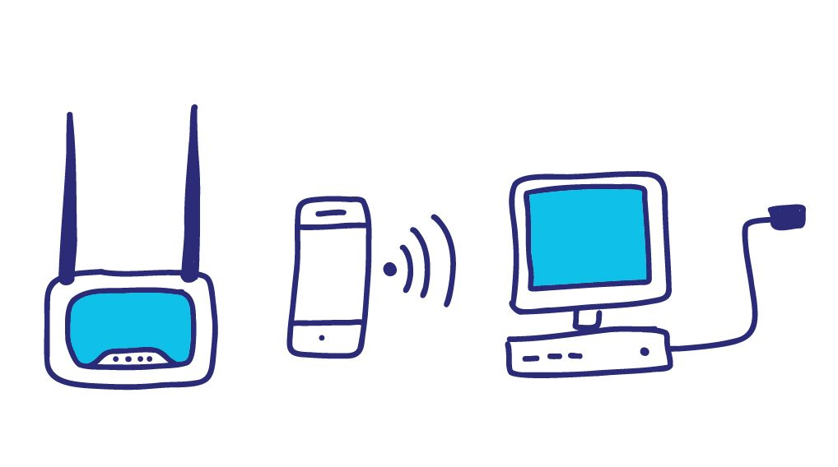

Slide 34
Recap: The Internet is…
A complex federation
Of enormous scale
Dynamic range
Diversity
Constantly evolving
Asynchronous in operation
Failure prone
Constrained by what’s practical to engineer
Too complex for (simple) theoretical models
“Working code” doesn’t mean much
Performance benchmarks are too narrow
Notes:
vvvv

Slide 35
An Engineered System
Constrained by what technology is practical
Link bandwidths
Switch port counts
Bit error rates
Cost
…

Slide 36

Nodes and Links
A
B
Channels = Links
Peer entities = Nodes

Slide 37
Properties of Links (Channels)
bandwidth
delay x bandwidth
Latency
Bandwidth (capacity): “width” of the links
number of bits sent (or received) per unit time (bits/sec or bps)
Latency (delay): “length” of the link
propagation time for data to travel along the link (seconds)
Bandwidth-Delay Product (BDP): “volume” of the link
amount of data that can be “in flight” at any time
propagation delay × bits/time = total bits in link
Notes:
• Amount of data that can be transmitted per time unit ⇒ transmitted = put into the pipe (wire)
BDP: how many bits the sender must tx. before the 1st bit arrives at the receiver ⇒ the amount of data that could be in transit

Slide 38
Examples of Bandwidth-Delay
Same city over a slow link:
BW~100Mbps
Latency~10msec
BDP ~ 10⁶bits ~ 125KBytes
To California over a fast link:
BW~10Gbps
Latency~140msec
BDP ~ 1.4x10⁹bits ~ 175MBytes
Intra Datacenter:
BW~100Gbps
Latency~30usec
BDP ~ 10⁶bits ~ 375KBytes
Intra Host:
BW~100Gbps
Latency~16nsec
BDP ~ 1600bits ~ 200Bytes
17km * c = 56μs << 10ms
750m * c = 56μs ≅ 30μs
9708km * c = 32ms << 140ms
25cm * c = 83ps << 16ns
Notes:
17km
750 m
5584km
0.025m

Slide 39
Packet Delay Sending a 100B packet from A to B?
A
B
1Mbps, 1ms
100Byte packet
time=0
Time to transmit one bit = 1/10⁶s
Time when that bit reaches B = 1/10⁶+1/10³s
Time to transmit 800 bits=800x1/10⁶s
The last bit reaches B at
(800x1/10⁶)+1/10³s
= 1.8ms
Packet Delay = Transmission Delay + Propagation Delay
Packet Delay =
(Packet Size ÷ Link Bandwidth) + Link Latency
Time
Notes:
2020-1-17

Slide 40
Packet Delay Sending a 100B packet from A to B?
1GB file in 100B packets
1Gbps, 1ms?
A
B
1Mbps, 1ms
100Byte packet
10⁷ x 100B packets
The last bit in the file reaches B at
(10⁷x800x1/10⁹)+1/10³s
= 8001ms
The last bit reaches B at
(800x1/10⁹)+1/10³s
= 1.0008ms
The last bit reaches B at
(800x1/10⁶)+1/10³s
= 1.8ms
Time
Notes:
small message (e.g., 1 byte): [1ms vs 100ms] (latency) dominates [1Mbps vs 100Mbps]
large message (e.g., 25 MB): [1Mbps vs 100Mbps] (BW) dominates [1ms vs 100ms]

Slide 41
Packet Delay: The “pipe” view Sending 100B packets from A to B?
A
B
100Byte packet
1Mbps, 10ms
Packet Transmission Time
100Byte packet
100Byte packet
BW →
time →
Time

Slide 42
Packet Delay: The “pipe” view Sending 100B packets from A to B?
1Mbps, 10ms (BDP=10,000)
BW →
time →
1Mbps, 5ms (BDP=5,000)
10Mbps, 1ms (BDP=10,000)
BW →
BW →
time →
time →

Slide 43
Packet Delay: The “pipe” view Sending 100B packets from A to B?
1Mbps, 10ms (BDP=10,000)
BW →
time →
What if we used 200Byte packets??
1Mbps, 10ms (BDP=10,000)
BW →
time →

Slide 44
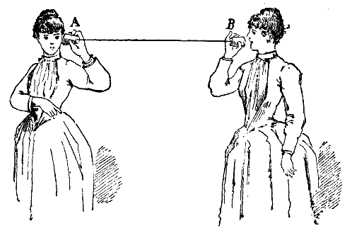
Recall Nodes and Links
A
B
Notes:
Start from here 24th of Jan

Slide 45
What if we have more nodes?
One link for every node?
Need a scalable way to interconnect nodes

Slide 46
Solution: A switched network
Nodes share network link resources
How is this sharing implemented?
Notes:
multiple conversations in parallel
resources are shared

Slide 47
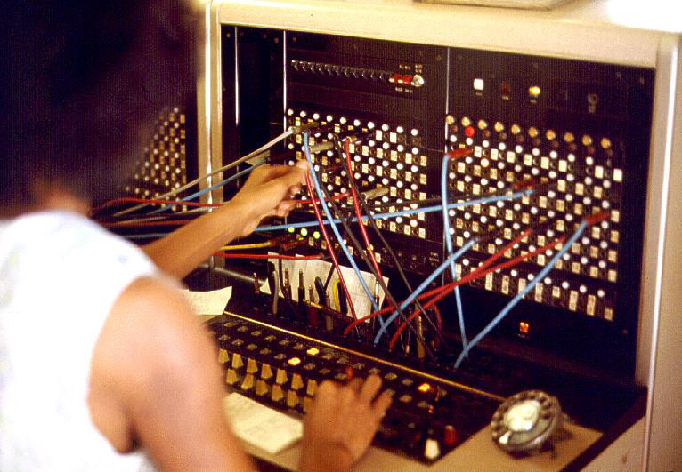
Two examples of switched networks
Circuit switching (used in the POTS: Plain Old Telephone system)
Packet switching (used in the Internet)
Notes:
borrow mckeown’s slides (of network with image); add Berkeley and MIT.
box -- links (incoming and outgoing)
packet -- data + header.
header has an address.

Slide 48
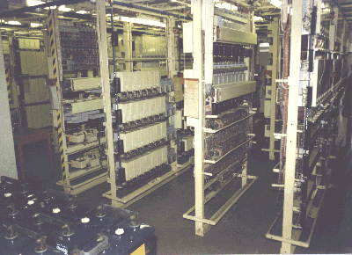



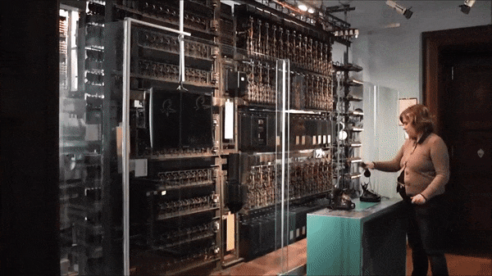
Circuit switching
Telephone
Exchange
Exchange
Telephone

Slide 49
Circuit switching
Idea: source reserves network capacity along a path
10Mb/s?
B
A
10Mb/s?
10Mb/s?
(1) Node A sends a reservation request
(2) Interior switches establish a connection -- i.e., “circuit”
(3) A starts sending data
(4) A sends a “teardown circuit” message
Notes:
multiple conversations in parallel
resources are shared

Slide 50
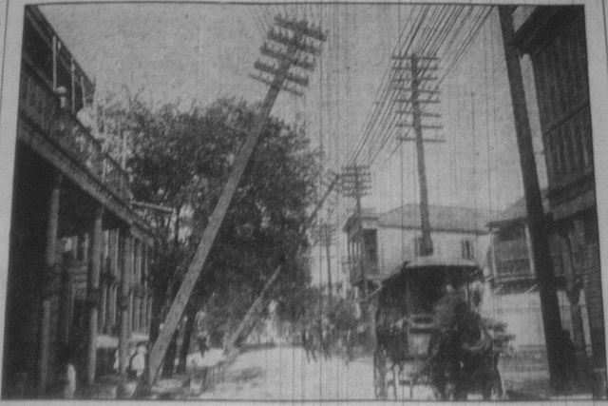
Multiplexing
Sharing makes things efficient (cost less)
One airplane/train for 100’s of people
One telephone for many calls
One lecture theatre for many classes
One computer for many tasks
One network for many computers
One datacenter many applications

Slide 51
Multiplexing
Sharing makes things efficient (cost less)
One airplane/train for 100’s of people
One telephone for many calls
One lecture theatre for many classes
One computer for many tasks
One network for many computers
One datacenter many applications
Lecturer?

Slide 52
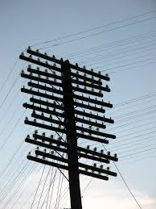
Old Time Multiplexing

Slide 53
Sharing Circuit Switching: FDM and TDM
Example:
Frequency Division Multiplexing
4 users
Radio2 88.9 MHz
Radio3 91.1 MHz
Radio4 93.3 MHz
RadioX 95.5 MHz
frequency
time
Time Division Multiplexing
Radio Schedule
…,News, Sports, Weather, Local, News, Sports,…
frequency
time
Notes:
start here 23-jan-2023

Slide 54
Time-Division Multiplexing/Demultiplexing
Frames
Slots =
0
1
2
3
4
5
0
1
2
3
4
5
Time divided into frames; frames into slots
Relative slot position inside a frame determines to which conversation data belongs
e.g., slot 0 belongs to orange conversation
Slots are reserved (released) during circuit setup (teardown)
If a conversation does not use its circuit capacity is lost!

Slide 55
Timing in Circuit Switching
Information
Circuit Establishment
Transfer
time
Circuit
Tear-down
Notes:
Why the delays in the first pass of the establishment, but not in subsequent passes (or in teardown)?

Slide 56
Circuit switching: pros and cons
Pros
guaranteed performance
fast transfer (once circuit is established)
Cons

Slide 57
Timing in Circuit Switching
Information
Circuit Establishment
Transfer
time
Circuit
Tear-down
Notes:
Why the delays in the first pass of the establishment, but not in subsequent passes (or in teardown)?

Slide 58
Circuit switching: pros and cons
Pros
guaranteed performance
fast transfer (once circuit is established)
Cons
wastes bandwidth if traffic is “bursty”

Slide 59
Timing in Circuit Switching
Information
Circuit Establishment
Transfer
time
Circuit
Tear-down
Notes:
Why the delays in the first pass of the establishment, but not in subsequent passes (or in teardown)?

Slide 60
Timing in Circuit Switching
Information
Circuit Establishment
Transfer
Circuit
Tear-down
time
Notes:
Why the delays in the first pass of the establishment, but not in subsequent passes (or in teardown)?

Slide 61
Circuit switching: pros and cons
Pros
guaranteed performance
fast transfers (once circuit is established)
Cons
wastes bandwidth if traffic is “bursty”
connection setup time is overhead

Slide 62
Circuit switching
A
B
Circuit switching doesn’t “route around failure”

Slide 63
Circuit switching: pros and cons
Pros
guaranteed performance
fast transfers (once circuit is established)
Cons
wastes bandwidth if traffic is “bursty”
connection setup time is overhead
recovery from failure is slow

Slide 64
Numerical example
How long does it take to send a file of 640,000 bits from host A to host B over a circuit-switched network?
All links are 1.536 Mbps
Each link uses TDM with 24 slots/sec
500 msec to establish end-to-end circuit
Let’s work it out!
1 / 24 * 1.536Mb/s = 64kb/s
640,000 / 64kb/s = 10s
10s + 500ms = 10.5s
Notes:
640,000b * (1/24) * 1/536Mbps + 500ms
640,000b @ 64kbps = 10s
PLUS 500ms setup

Slide 65


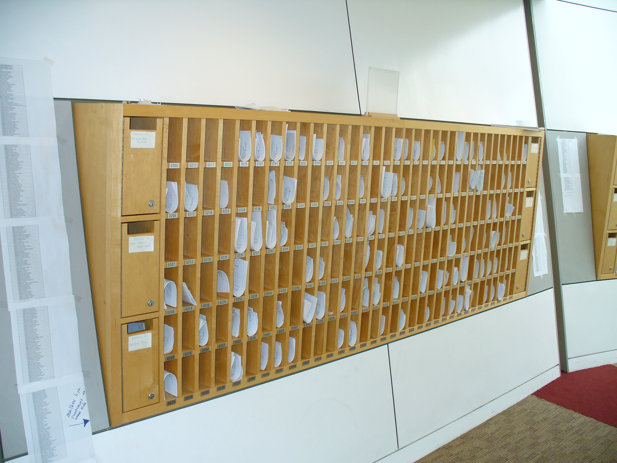

Two examples of switched networks
Circuit switching (used in the POTS: Plain Old Telephone system)
Packet switching (used in the Internet)
Notes:
borrow mckeown’s slides (of network with image); add Berkeley and MIT.
box -- links (incoming and outgoing)
packet -- data + header.
header has an address.

Slide 66


Packet Switching
Data is sent as chunks of formatted bits (Packets)
Packets consist of a “header” and “payload”*
Internet Address
Age (TTL)
Checksum to protect header
Data
Header
payload
header
01000111100010101001110100011001

Slide 67
Packet Switching
Data is sent as chunks of formatted bits (Packets)
Packets consist of a “header” and “payload”*
Destination Address
Data
Header
payload
header
01000111100010101001110100011001

Slide 68
Packet Switching
Data is sent as chunks of formatted bits (Packets)
Packets consist of a “header” and “payload”*
payload is the data being carried
header holds instructions to the network for how to handle packet (think of the header as an API)
In this example, the header has a destination address
More complex headers may include
How this traffic should be handled? (first class, second class, etc)
Do I acknowledge this? Who signed for it?
Were the contents ok?

Slide 69
Packet Switching
Data is sent as chunks of formatted bits (Packets)
Packets consist of a “header” and “payload”
Switches “forward” packets based on their headers
A switch looks at the header and
immediately decides which physical port
In a switch: address maps to port

Slide 70

Switches forward packets
GLASGOW
EDINBURGH
switch#4
switch#2
Forwarding Table
111010010
EDIN
Destination | Next Hop
GLASGOW | 4
OXFORD | 5
EDIN | 2
UCL | 3
switch#5
OXFORD
UCL
switch#3

Slide 71
Timing in Packet Switching
payload
hdr
time
What about the time to process the packet at the switch?
We’ll assume it’s relatively negligible (mostly true)

Slide 72
Timing in Packet Switching
payload
hdr
Could the switch start transmitting as soon as it has processed the header?
time
Yes! This would be called a “cut through” switch

Slide 73
Timing in Packet Switching
payload
hdr
We will always assume a switch processes/forwards a packet after it has received it entirely. This is called “store and forward” switching
time

Slide 74
Packet Switching
Data is sent as chunks of formatted bits (Packets)
Packets consist of a “header” and “payload”
Switches “forward” packets based on their headers

Slide 75
Packet Switching
Data is sent as chunks of formatted bits (Packets)
Packets consist of a “header” and “payload”
Switches “forward” packets based on their headers
Each packet travels independently
no notion of packets belonging to a “circuit”

Slide 76
Packet Switching
Data is sent as chunks of formatted bits (Packets)
Packets consist of a “header” and “payload”
Switches “forward” packets based on their headers
Each packet travels independently
No link resources are reserved in advance. Instead packet switching leverages statistical multiplexing (stat muxing)

Slide 77
Multiplexing
Sharing makes things efficient (cost less)
One airplane/train for 100’s of people
One telephone for many calls
One lecture theatre for many classes
One computer for many tasks
One network for many computers
One datacenter many applications

Slide 78

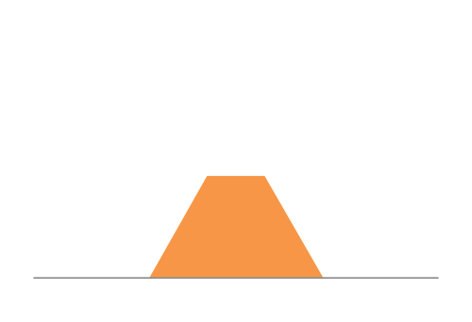
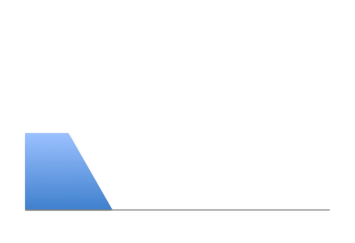
Three Flows with Bursty Traffic
Data Rate 1
Time
Data Rate 2
Capacity
Time
Data Rate 3
Time

Slide 79
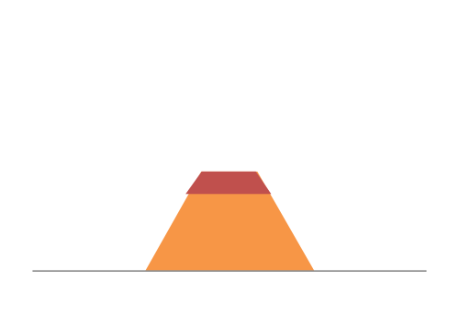
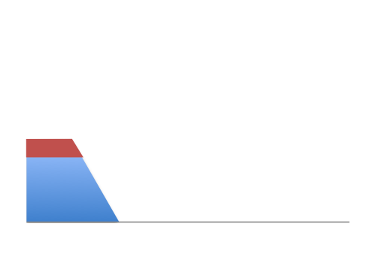
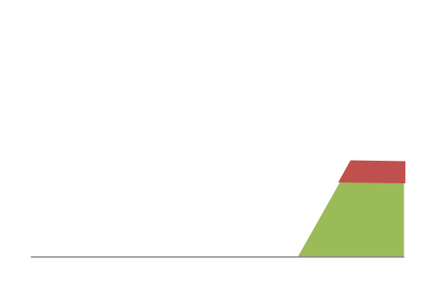
When Each Flow Gets 1/3rd of Capacity
Frequent Overloading
Data Rate 1
Time
Data Rate 2
Time
Data Rate 3
Time

Slide 80
When Flows Share Total Capacity
Time
No Overloading
Time
Statistical multiplexing relies on the assumption
that not all flows burst at the same time.
Very similar to insurance, and has same failure case
Time

Slide 81
Three Flows with Bursty Traffic
Data Rate 1
Time
Data Rate 2
Capacity
Time
Data Rate 3
Time

Slide 82

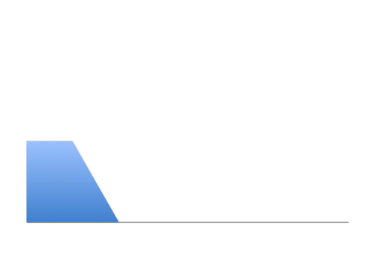
Three Flows with Bursty Traffic
Data Rate 1
Time
Data Rate 2
Capacity
Time
Data Rate 3
Time

Slide 83


Three Flows with Bursty Traffic
Data Rate 1+2+3 >> Capacity
Time
Capacity
Time
What do we do under overload?

Slide 84

Statistical multiplexing: pipe view
pkt tx time
BW →
time →

Slide 85
Statistical multiplexing: pipe view

Slide 86
Statistical multiplexing: pipe view
No Overload

Slide 87
Statistical multiplexing: pipe view
Queue overload
into Buffer
Transient Overload
Not such a rare event

Slide 88
Statistical multiplexing: pipe view
Queue overload
into Buffer
Transient Overload
Not such a rare event

Slide 89
Statistical multiplexing: pipe view
Queue overload
into Buffer
Transient Overload
Not such a rare event

Slide 90
Statistical multiplexing: pipe view
Queue overload
into Buffer
Transient Overload
Not such a rare event

Slide 91
Statistical multiplexing: pipe view
Queue overload
into Buffer
Transient Overload
Not such a rare event

Slide 92
Statistical multiplexing: pipe view
Queue overload
into Buffer
Transient Overload
Buffer absorbs transient bursts
But NOT additional capacity
Not a rare event!

Slide 93
Statistical multiplexing: pipe view
Queue overload
into Buffer
What about persistent overload?
Will eventually drop packets

Slide 94
Queues introduce queuing delays
Recall,
packet delay = transmission delay + propagation delay (*)
With queues (statistical multiplexing)
packet delay = transmission delay + propagation delay + queuing delay (*)
Queuing delay caused by “packet interference”
Made worse at high load
less “idle time” to absorb bursts
think about traffic jams at rush hour
or rail network failure
(* plus per-hop processing delay that we define as negligible)

Slide 95
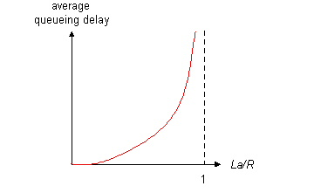
Queuing delay extremes
R=link bandwidth (bps)
L=packet length (bits)
a=average packet arrival rate
traffic intensity = La/R
La/R ~ 0: average queuing delay small
La/R -> 1: delays become large
La/R > 1: more “work” arriving than can be serviced, average delay infinite – or data is lost (dropped).
Notes:
2016-11-16

Slide 96
Recall the Internet federation
The Internet ties together different networks
>20,000 ISP networks
user
ISP A
ISP B
ISP C
user
We can see (hints) of the nodes and links using traceroute…
Notes:
one big cloud is actually…
snip here or there..

Slide 97
“Real” Internet delays and routes
traceroute: rio.cl.cam.ac.uk to people.eng.unimelb.edu.au
(tracepath on winows is similar)
Three delay measurements from
rio.cl.cam.ac.uk to gatwick.net.cl.cam.ac.uk
awm22@rio:~$ traceroute people.eng.unimelb.edu.au
traceroute to people.eng.unimelb.edu.au (128.250.59.37), 30 hops max, 60 byte packets
1 vlan101.gatwick.net.cl.cam.ac.uk (128.232.32.2) 1.520 ms 1.822 ms 0.709 ms
2 cl-wgb.d-mw.net.cam.ac.uk (193.60.89.5) 0.259 ms 0.256 ms 0.227 ms
3 d-mw.c-ce.net.cam.ac.uk (131.111.6.53) 0.231 ms 0.381 ms 0.357 ms
4 c-ce.b-ec.net.cam.ac.uk (131.111.6.82) 0.317 ms 0.481 ms 0.476 ms
5 ae0.lowdss-ban1.ja.net (146.97.41.37) 2.842 ms 2.846 ms 2.821 ms
6 ae26.lowdss-sbr1.ja.net (146.97.35.245) 2.877 ms 2.805 ms 2.795 ms
7 ae28.londhx-sbr1.ja.net (146.97.33.17) 6.191 ms 6.109 ms 6.325 ms
8 janet.mx1.lon.uk.geant.net (62.40.124.197) 6.319 ms 6.245 ms 6.258 ms
9 138.44.226.6 (138.44.226.6) 169.704 ms 169.722 ms 169.682 ms
10 et-7-3-0.pe1.wmlb.vic.aarnet.net.au (113.197.15.28) 250.954 ms 251.163 ms 251.116 ms
11 * * *
12 4000v-eng-web-people-l.eng.unimelb.edu.au (128.250.59.37) 251.943 ms 251.952 ms 251.962 ms
13 4000v-eng-web-people-l.eng.unimelb.edu.au (128.250.59.37) 252.053 ms 252.018 ms 251.966 ms
14 * * *
15 4000v-eng-web-people-l.eng.unimelb.edu.au (128.250.59.37) 252.215 ms 252.088 ms 252.118 ms
16 4000v-eng-web-people-l.eng.unimelb.edu.au (128.250.59.37) 253.361 ms 253.109 ms 253.461 ms
17 4000v-eng-web-people-l.eng.unimelb.edu.au (128.250.59.37) 253.077 ms 253.832 ms 253.298 ms
18 * * *
….
29 * * *
30 * * *
Direct London-Perth
Australian
link
* means no response (probe or reply lost, router not replying)
Notes:
Where did the delay come from??
2015-11-18

Slide 98
traceroute: rio.cl.cam.ac.uk to www.caida.org
rio:~$ traceroute --resolve-hostnames www.caida.org
traceroute to www.caida.org (192.172.226.122), 64 hops max
1 128.232.64.2 (vlan398.gatwick.net.cl.cam.ac.uk) 3.760ms 2.060ms 1.226ms
2 193.60.89.5 (cl-wgb.d-mw.net.cam.ac.uk) 53.777ms 67.458ms 0.556ms
3 131.111.7.53 (d-mw.c-hi.net.cam.ac.uk) 0.638ms 0.621ms 0.658ms
4 131.111.7.82 (c-hi.b-jc.net.cam.ac.uk) 0.353ms 0.346ms 0.338ms
5 131.111.7.217 (ips-out.b-jc.net.cam.ac.uk) 0.582ms 0.441ms 0.397ms
6 146.97.41.37 (ae0.lowdss-ban1.ja.net) 2.754ms 2.648ms 2.701ms
7 146.97.35.245 (ae26.lowdss-sbr1.ja.net) 2.852ms 2.728ms 2.738ms
8 146.97.33.25 (ae30.erdiss-sbr2.ja.net) 5.412ms 5.177ms 4.474ms
9 146.97.33.21 (ae31.londpg-sbr2.ja.net) 8.408ms 8.213ms 8.293ms
10 62.40.125.57 (janet-bckp.mx1.lon2.uk.geant.net) 9.199ms 9.140ms 9.108ms
11 62.40.98.64 (ae2.mx1.lon.uk.geant.net) 10.119ms 9.818ms 9.756ms
12 62.40.124.45 (internet2-gw.mx1.lon.uk.geant.net) 95.065ms 95.962ms 95.434ms
13 163.253.1.120 (fourhundredge-0-0-0-0.4079.core2.ashb.net.internet2.edu) 152.834ms 153.562ms 154.448ms
14 163.253.1.139 (fourhundredge-0-0-0-1.4079.core2.clev.net.internet2.edu) 154.008ms 153.800ms 154.429ms
15 163.253.2.17 (fourhundredge-0-0-0-2.4079.core2.eqch.net.internet2.edu) 155.463ms 154.863ms 154.334ms
16 163.253.1.66 (fourhundredge-0-0-0-18.4079.core1.eqch.net.internet2.edu) 153.802ms 153.600ms 154.553ms
17 163.253.1.206 (fourhundredge-0-0-0-1.4079.core1.chic.net.internet2.edu) 154.783ms 154.926ms 154.796ms
18 163.253.2.29 (fourhundredge-0-0-0-1.4079.core2.kans.net.internet2.edu) 152.851ms 152.414ms 154.916ms
19 163.253.1.250 (fourhundredge-0-0-0-1.4079.core2.denv.net.internet2.edu) 155.571ms 155.047ms 154.572ms
20 163.253.1.169 (fourhundredge-0-0-0-3.4079.core2.salt.net.internet2.edu) 153.369ms 153.824ms 154.321ms
21 163.253.1.114 (fourhundredge-0-0-0-8.4079.core1.losa.net.internet2.edu) 153.786ms 153.549ms 154.839ms
22 137.164.26.200 (hpr-lax-agg10--i2.cenic.net) 152.552ms 153.465ms 152.493ms
23 137.164.25.89 (hpr-sdg-agg4--lax-agg10-100ge.cenic.net) 154.682ms 154.604ms 154.752ms
24 137.164.26.43 (hpr-sdsc-100ge--sdg-hpr3.cenic.net) 167.094ms 154.553ms 154.627ms
25 192.12.207.46 (medusa-mx960.sdsc.edu) 154.854ms 154.646ms 156.379ms
26 192.172.226.122 (proxy.caida.org) 154.581ms 154.390ms 154.477ms
A little more interesting because each hop resolves to a name (caida is in San Diego)

Slide 99
Internet structure: network of networks
a packet passes through many networks!
local
ISP
Tier 3
ISP
local
ISP
local
ISP
local
ISP
Tier-2 ISP
Tier-2 ISP
Tier 1 ISP
Tier 1 ISP
Tier 1 ISP
Tier-2 ISP
Tier-2 ISP
Tier-2 ISP
local
ISP
local
ISP
local
ISP
local
ISP

Slide 100
Internet structure: network of networks
“Tier-3” ISPs and local ISPs
last hop (“access”) network (closest to end systems)
local
ISP
Tier 3
ISP
local
ISP
local
ISP
local
ISP
Local and tier- 3 ISPs are customers of
higher tier ISPs
connecting them to rest of Internet
Tier-2 ISP
Tier-2 ISP
Tier 1 ISP
Tier 1 ISP
Tier 1 ISP
Tier-2 ISP
Tier-2 ISP
Tier-2 ISP
local
ISP
local
ISP
local
ISP
local
ISP

Slide 101
Internet structure: network of networks
“Tier-2” ISPs: smaller (often regional) ISPs
Connect to one or more tier-1 ISPs, possibly other tier-2 ISPs
Tier-2 ISPs also peer privately with each other.
Tier-2 ISP pays tier-1 ISP for connectivity to rest of Internet
tier-2 ISP is customer of
tier-1 provider
Tier-2 ISP
Tier-2 ISP
Tier 1 ISP
Tier 1 ISP
Tier 1 ISP
Tier-2 ISP
Tier-2 ISP
Tier-2 ISP

Slide 102
Internet structure: network of networks
roughly hierarchical
at center: “tier-1” ISPs (e.g., Verizon, Sprint, AT&T, Cable and Wireless), national/international coverage
treat each other as equals
Tier-1 providers interconnect (peer) privately
Tier 1 ISP
Tier 1 ISP
Tier 1 ISP

Slide 103
Tier-1 ISP: e.g., Sprint
POP: point-of-presence
to/from backbone
…
peering
….
…
…
…
to/from customers
Notes:
Switched Private Network Telecommunications
South Pacific Railway
-=-=-
End of lecture 23rd Jan 2012

Slide 104
Packet Switching
Data is sent as chunks of formatted bits (Packets)
Packets consist of a “header” and “payload”
Switches “forward” packets based on their headers
Each packet travels independently
No link resources are reserved in advance. Instead packet switching depends on statistical multiplexing
allows efficient use of resources
but introduces queues and queuing delays
Notes:
Restart here 23-1-23

Slide 105
Packet switching versus circuit switching
Packet switching may (does!) allow more users to use network
1 Mb/s link
each user:
100 kb/s when “active”
active 10% of time
circuit-switching:
10 users
packet switching:
with 35 users, probability > 10 active at same time is less than .0004
N users
1 Mbps link
Q: how did we get value 0.0004?

Slide 106
Packet switching versus circuit switching
Q: how did we get value 0.0004?
1 Mb/s link
each user:
100 kb/s when “active”
active 10% of time
circuit-switching:
10 users
packet switching:
with 35 users, probability > 10 active at same time is less than .0004

Slide 107
Packet switching versus circuit switching
Q: how did we get value 0.0004?
1 Mb/s link
each user:
100 kb/s when “active”
active 10% of time
circuit-switching:
10 users
packet switching:
with 35 users, probability > 10 active at same time is less than .0004
Let U be number of users active
N the total users
P is 0.1 in our example to get 0.0004

Slide 108
Packet switching versus circuit switching
Q: how did we get value 0.0004?
1 Mb/s link
each user:
100 kb/s when “active”
active 10% of time
circuit-switching:
10 users
packet switching:
with 35 users, probability > 10 active at same time is less than .0004
Let U be number of users active
N the total users
P is 0.1 in our example to get 0.0004
Notes:
(check this)

Slide 110
Circuit switching: pros and cons
Pros
guaranteed performance
fast transfers (once circuit is established)
Cons
wastes bandwidth if traffic is “bursty”
connection setup adds delay
recovery from failure is slow

Slide 111
Packet switching: pros and cons
Pros
efficient use of bandwidth (stat. muxing)
no overhead due to connection setup
resilient -- can `route around trouble’
Cons
no guaranteed performance
header overhead per packet
queues and queuing delays

Slide 112
Summary
A sense of how the basic `plumbing’ works
links and switches
packet delays= transmission + propagation + queuing + (negligible) per-switch processing
statistical multiplexing and queues
circuit vs. packet switching
Notes:
21 Jan 2019

