Slide 1
P51(bis): High Performance Networked-Systems
Prof. Andrew W. Moore
Lecture 5/6
A huge thank you to Eben Upton, Raspberry Pi Foundation, and PiHut people for enabling this incarnation of the module at incredibly short notice.
With great appreciation to Dick Sites for sharing wisdom, patience, and teaching materials.
With ongoing gratitude to Dr Noa Zilberman

Slide 2
Introduction to the course

Slide 3
Administrivia
Scope:
High performance networking design and usage.
Course structure:
Lectures – 6 hours – FS07
Supervised Labs – 10 hours - SW02 (ACS lab)
Assessment:
Practical Assignment (100%) – 24/04/2018 12:00

Slide 4
Schedule
Week | Lecture | Lab
1 | General architecture of high performance network devices | Introduction to NetFPGA (SW01)
2 | High throughput devices – Part I | Introduction to NetFPGA (Cont.) Project selection
3 | High throughput devices – Part II | Project architecture
4 | Low latency devices - Part I | Performance profile
5 | Low latency devices - Part II | Evaluation
6 | Programmable devices
6/3, same place and time – Special talk:
Steve Pope (CTO, Solarflare) – Architecture of Solarflare’s low latency NICs

Slide 5
Project
Starting point: a reference design of a network device
Goal: Increase the performance of the device
Examples:
  x2 Throughput
  50% latency
  More examples on the website
Projects done in pairs
More information tomorrow

Slide 6
Some logistics for 2017-18
Web page: http://www.cl.cam.ac.uk/teaching/current/P51/
Mailing list: cl-acs-p51-announce@cam.ac.uk
Grades:
Mphil (ACS) – Pass / Fail - based on a mark out of 100
All others (DTC) – Mark out of 100

Slide 7
Next steps
Explore the web page
http://www.cl.cam.ac.uk/teaching/current/P51/
Decide if you still want to take the class – promptly
Project:
  Pair with a classmate
  Register to NetFPGA repository
  http://netfpga.org/site/#/SUME_reg_form/

Slide 8
General architecture of high performance network devices

Slide 9
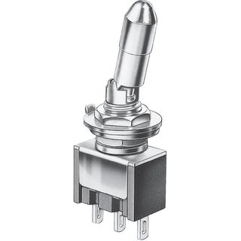

What Is a Switch?
We use switches all the time!
ON / OFF
Left / Right

Slide 10
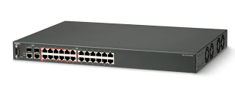
What Is a Network Switch?
Conceptually, a left / right switch…
Receives a packet through port <N>
Decides through which port to send it
  A forwarding decision
+ Some “real world” considerations

Slide 11
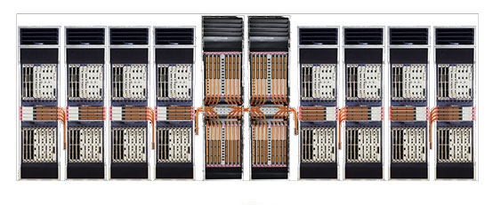
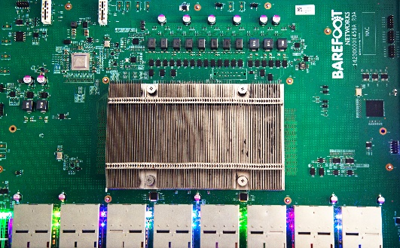
Real World Switches
High Throughput Switch Silicon: 6.4Tbps (64x100G) – 12.8Tbps (32x400G) Top of Rack Switches
  E.g. Broadcom Tomahawk III, Barefoot Tofino, Mellanox spectrum II
High Throughput Core Switch System: >100Tbps
  E.g. Arista 7500R series, Huawei NE5000E, Cisco CRS Multishelf

Slide 12
Real World Switches
Low latency switch (Layer 1): ~5ns fan-out, ~55ns aggregation
Low latency switch (Layer 2): 95ns - 300ns
  Examples: g. Mellanox spectrum II, Exablaze Fusion
Low latency NIC: <1us (loopback)
  E.g. Mellanox Connect-X, Solarflare 8000, Chelsio T6, Exablaze ExaNIC
Low latency switches don’t always support full line rate!

Slide 13
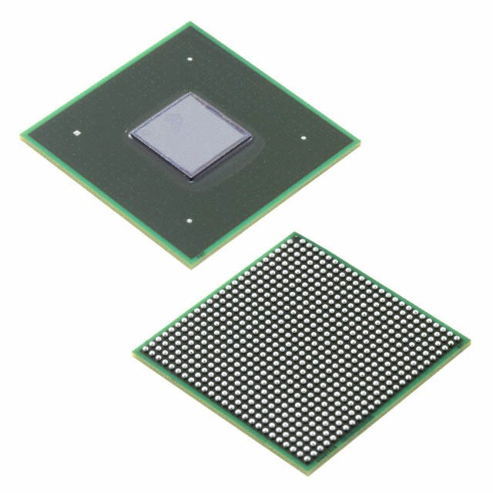
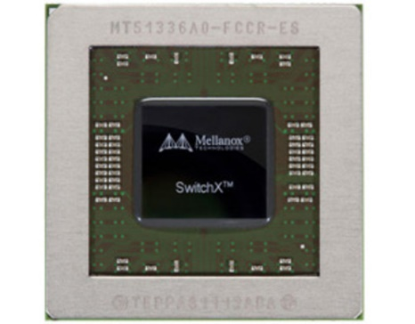
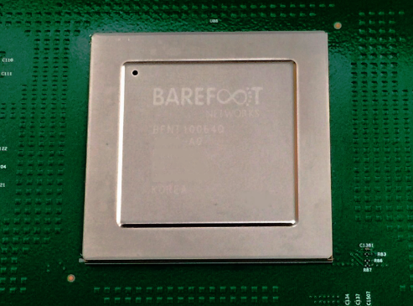
Real World Switch Silicon in Numbers
Over 7 Billion Transistors
Silicon size: 400 to 600 square mm
Clock Rate: ~1GHz (typical)
Packet Rate: ~10 Billion packets per second
Buffer Memory: ~16MB-30MB on-chip
Ports: Up to 256
Power: ~100W-300W
2017 Numbers

Slide 14

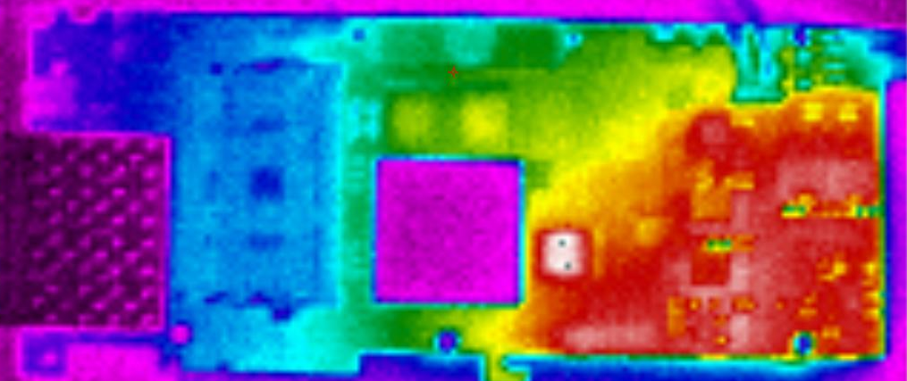

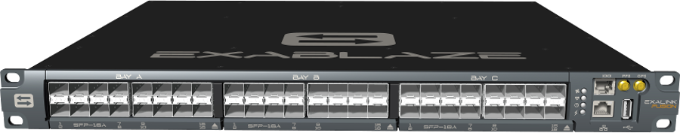
What Drives The Architecture of a Switch?
Cost
Manufacturing limitations (e.g. maximum silicon size)
Power consumption
General purpose or user specific?
I/O on the package
Number of ports:
  Front panel size (24,32,48 ports in 19inch rack)
  MAC area

Slide 15
Packet Rate as a Performance Metric
Bandwidth is misleading
  For example: full line rate for 1024B packets
  but not for 64B packets…
Packet Rate: how many packets can be processed every second?
Unit: packets per second (PPS)
An easy way to calculate the packet rate:
  (Clock Frequency) / (Number of Clock Cycles per Packet)

Slide 16
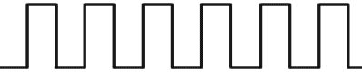
Packet Rate as a Performance Metric
Example:
Clock rate 200MHz
Bus width of 32B
Assume no stalls in the pipeline
For 64B Packets: Cycles per packet = 64B / 32B =2
  Packet rate = 200M / 2 = 100Mpps
For 65B Packets: Cycles per packet = 65B / 32B =3
There are no partial cycles!
  Packet rate = 200M / 3 = 66Mpps
32B
32B

Slide 17
Switch Internals 101
What defines the architecture of a switch?

Slide 18
Input Ports

Slide 19
Output Ports

Slide 20
Header Processing
HP
HP
HP
HP

Slide 21
Network Interfaces
NIF
NIF
HP
NIF
NIF
HP
NIF
NIF
HP
NIF
HP
NIF

Slide 22
Switching
NIF
NIF
HP
NIF
NIF
HP
NIF
NIF
HP
NIF
HP
NIF

Slide 23
Output Queues
NIF
NIF
HP
OQ
NIF
NIF
HP
OQ
NIF
NIF
HP
OQ
NIF
HP
NIF
OQ

Slide 24
Scheduling
NIF
NIF
HP
SCH
OQ
NIF
NIF
HP
OQ
NIF
NIF
HP
OQ
NIF
HP
NIF
OQ

Slide 25
Is This A Real Switch?
NIF
NIF
HP
SCH
OQ
NIF
NIF
HP
OQ
NIF
NIF
HP
OQ
NIF
HP
NIF
OQ

Slide 26
Recall What Drives Real World Switches
Cost
Power
Area

Slide 27
Sharing Resources Is Good!
Single header processor (if possible)
Shared memories
No concurrency problems
  Also no need to synchronise tables, no need to send updates, ….

Slide 28
Rethinking The Switch Architecture
NIF
NIF
OQ
NIF
NIF
OQ
NIF
NIF
OQ
NIF
NIF
OQ

Slide 29
Rethinking The Switch Architecture
NIF
SCH
HP
NIF
OQ
NIF
NIF
OQ
NIF
NIF
OQ
NIF
NIF
OQ

Slide 30
Where Is The Switching?
NIF
SCH
HP
NIF
OQ
NIF
NIF
OQ
NIF
NIF
OQ
NIF
NIF
OQ

Slide 31
Output Queueing
NIF
OQ
Schedule &
Rate limit
OQ
OQ
NIF
OQ
OQ

Slide 32
Input Queueing
NIF
SCH
HP
NIF
IQ
OQ
NIF
NIF
IQ
OQ
NIF
NIF
IQ
OQ
NIF
NIF
IQ
OQ

Slide 33
Virtual Output Queueing
HP
NIF
IQ
SCH
OQ
NIF
IQ
OQ
NIF
IQ
OQ
NIF
IQ
OQ

Slide 34
Virtual Output Queueing
HP
NIF
VOQ
SCH
OQ
NIF
VOQ
OQ
NIF
VOQ
OQ
NIF
VOQ
OQ

Slide 35
Virtual Output Queueing
HP
NIF
VOQ
SCH
OQ
NIF
VOQ
OQ
NIF
VOQ
OQ
NIF
VOQ
OQ

Slide 36
Deep Buffers
Queues
Manager
Q
External Memory
Q
External Memory Controller
External Memory PHY
Q
Q

Slide 37
Scheduling
Different operations within the switch:
  Arbitration
  Scheduling
  Rate limiting
  Shaping
  Policing
Many different scheduling algorithms
  Strict priority, Round robin, weighted round robin, deficit round robin, weighted fair queueing…

Slide 38
Scheduling Hierarchies
SCH (Priority)
SCH
SCH
SCH
SCH
SCH
SCH
SCH
SCH
SCH
SCH (RR)
SCH (WFQ)
SCH (WFQ)
SP
Pn+RL
BE
SP – Strict Priority
Pn – Priority <n>
BE – Best Effort
RL – Rate Limiting
WFQ – Weighted Fair Queueing
RR – Round Robin

Slide 39
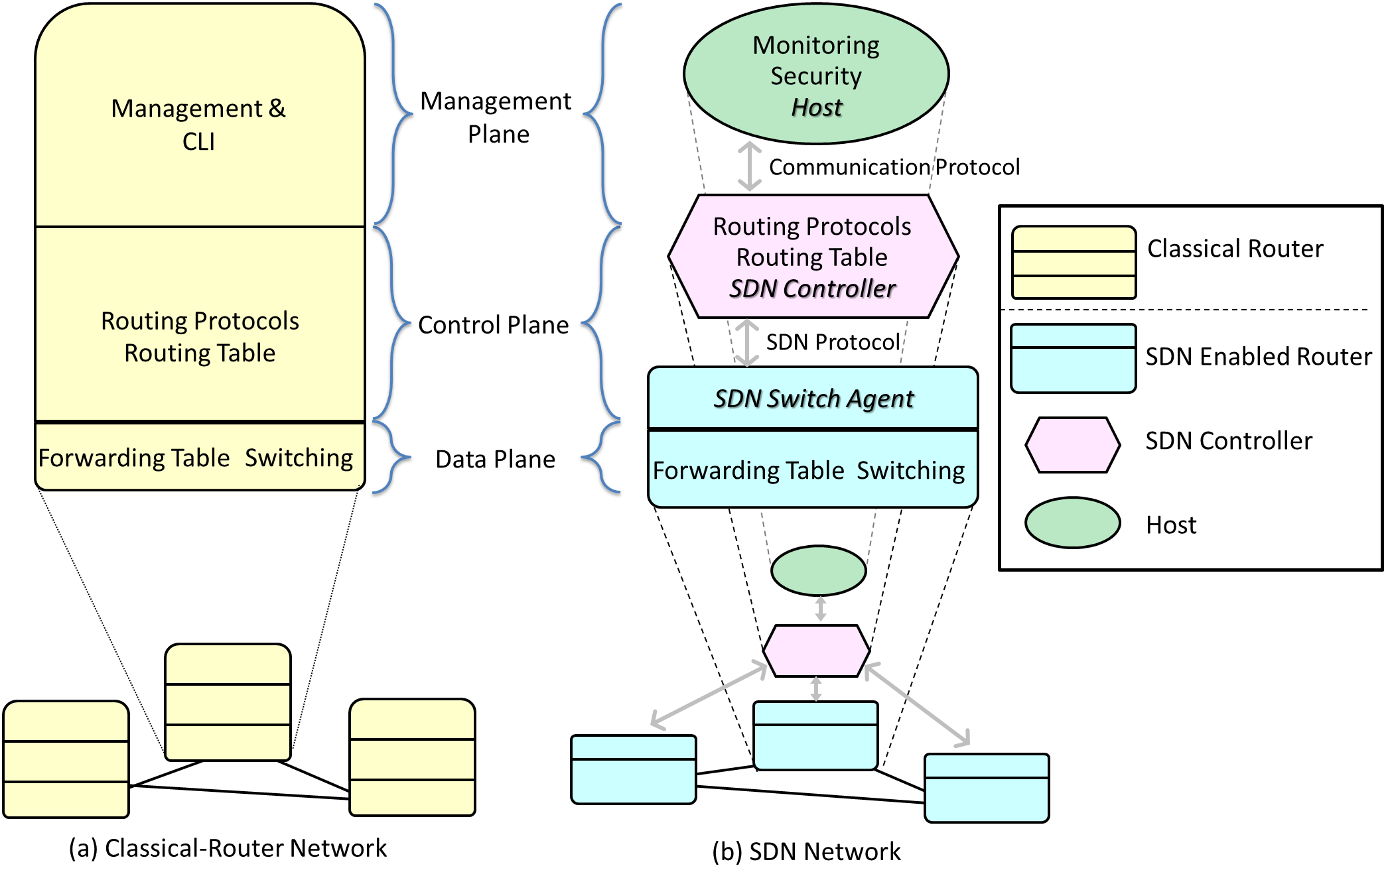
Software Defined Networking (SDN)
Key Idea: Separation of Data and Control Planes

Slide 40
Switch Architecture and SDN
NIF
SCH
HP
NIF
OQ
NIF
NIF
OQ
NIF
NIF
OQ
NIF
NIF
OQ

Slide 41
P51: High Performance Networking
Lecture 2: High Throughput Devices
Dr Noa Zilberman
noa.zilberman@cl.cam.ac.uk
Lent 2017/18

Slide 42
High Throughput Switching

Slide 43
  High throughput metrics
  Types of high performance switches
    cut through vs. store and forward
    ToR vs. Core switch
    General purpose vs. proprietary ASIC
  High throughput switch architectures (including silicon vs system vs network)

Slide 44
Bandwidth, Throughput and Goodput
Bandwidth – how much data can pass through a channel.
Throughput – how much data actually travels through a channel.
Goodput is often referred to as application level throughput.
But bandwidth can be limited below link’s capacity and vary over time, throughput can be measured differently from bandwidth etc…..

Slide 45
Speed and Bandwidth
Higher bandwidth does not necessarily mean higher speed
E.g. can mean the aggregation of links
  100G = 2x50G or 4x25G or 10x10G
  A very common practice in interconnects

Slide 46
Packet Rate
Throughput may change under different conditions, e.g. packet size
Packet Rate: how many packets can be processed in a given amount of time
  Also changes under different conditions
  But often provides better insights

Slide 47

Switch Models
A perfect fluid mental model:

Slide 48
Switch Models
A single packet mental model:
PACKET
PACKET

Slide 49
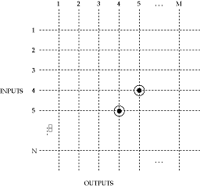
Circuit Switches
Input A is connected to output X
Example: a crossbar
  Not the only option
Used mostly in optical switching
  No header processing!
But also in electrical switching
  E.g. high frequency trading (HFT)
Scheduling is a limiting factor

Slide 50
Packet Switches
In a circuit switch:
  The path of a sample is determined at time of connection establishment
In a packet switch, packets carry a destination field
Need to look up destination port on-the-fly
  Two sequential packets may head to a different destination

Slide 51
Pipelining
To achieve high throughput, packet switches are pipelined:
PKT
NIF
IQ
Scheduler
PP
OQ
NIF
PKT
NIF
IQ
NIF
OQ
PKT
NIF
NIF
IQ
OQ
NIF
NIF
IQ
OQ

Slide 52
Store and Forward
Wait for the entire packet to arrive
Check the FCS, then start processing
  FCS – frame check sequence, terminates the packet
Once the packet is checked, it starts propagating through the pipeline
  Not necessarily the entire packet
PKT
NIF
Scheduler
PP
NIF
IQ
OQ
NIF
IQ
OQ
NIF
NIF
IQ
OQ
NIF
NIF
IQ
OQ
NIF

Slide 53
Cut Through
Start processing the packet as soon as the first chunk arrives
  Do not wait for the FCS
If FCS error is detected, the packet is dropped somewhere along the pipeline
PKT
NIF
NIF
2
3
1
IQ
Scheduler
PP
OQ
NIF
IQ
OQ
NIF
NIF
IQ
OQ
NIF
NIF
IQ
OQ
NIF

Slide 54
Measuring Performance
Bandwidth: number of bits (or bytes) through the channel every unit of time
  One way to calculate: bus width × clock frequency

Slide 55
Measuring Performance
Throughput = clock frequency x bus width ?
PACKET
512B
256B
256B
Data path
Width
e.g. 256B
CLOCK CLOCK
CYCLE2 CYCLE1

Slide 56
The Truth About Switch Silicon Design
Throughput ≠ clock frequency x bus width !
PACKET
257B
1B
256B
Data path
Width
e.g. 256B
CLOCK CLOCK
CYCLE2 CYCLE1

Slide 57
Internal Switching
Switch Models
  Crossbar
  Shared Memory
  Bus
  Benes, Clos, Banyan

Slide 58
Example: ToR Switch
Cut Through

Slide 59
Example: Spine Switch

Slide 60
Example: Google’s Jupiter

Slide 61
Understanding Performance Limitations

Slide 62
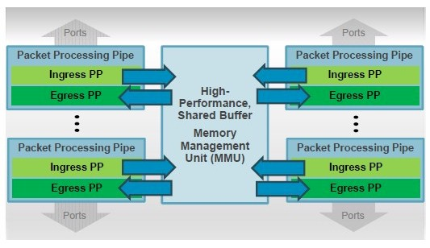
Barefoot Tofino
Broadcom Tomahawk 3

Slide 63
Packet Packing
Evaluated on NetFPGA
64B Cells
150MHz Clock
Throughput using FB traces:
  Stardust: 100%
  Reference Switch: 87%-90%

Slide 64
P51: High Performance Networking
Lecture 3: Low Latency Devices
Dr Noa Zilberman
noa.zilberman@cl.cam.ac.uk
Lent 2017/18

Slide 65
The Truth About Switch Silicon Design
12.8Tbps Switches!
Lets convert this to packet rate requirements:
5.8 Gpps @ 256B
19.2 Gpps @ 64B
But clock rate is only ~1GHz….

Slide 66
Multi-Core Switch Design
Barefoot Tofino
Broadcom Tomahawk 3
Image sources: https://p4.org/assets/p4_d2_2017_programmable_data_plane_at_terabit_speeds.pdf
https://www.nextplatform.com/2018/01/20/flattening-networks-budgets-400g-ethernet/

Slide 67
Low Latency Switches

Slide 68
How to lower the latency of a switch?
Obvious option 1: Increase clock frequency
  E.g. change core clock frequency from 100MHz to 200MHz
  Half the time through the pipeline
NIF
IQ
Scheduler
PP
OQ
NIF
NIF
IQ
OQ
NIF
NIF
IQ
OQ
NIF
NIF
IQ
OQ
NIF

Slide 69
How to lower the latency of a switch?
Obvious option 1: Increase clock frequency
Limitations:
  Frequency is often a property of manufacturing process
  Some modules (e.g. PCS) must work at a specific frequency (multiplications)
NIF
IQ
Scheduler
PP
OQ
NIF
NIF
IQ
OQ
NIF
NIF
IQ
OQ
NIF
NIF
IQ
OQ
NIF

Slide 70
How to lower the latency of a switch?
Obvious option 2: Reduce the number of pipeline stages
  Can you do the same in 150 pipeline stages instead of 200?
  Limitation: hard to achieve.
NIF
IQ
Scheduler
PP
OQ
NIF
NIF
IQ
OQ
NIF
NIF
IQ
OQ
NIF
NIF
IQ
OQ
NIF

Slide 71
How to lower the latency of a switch?
Can we achieve ~0 latency switch?
  Is there a lower bound on switch latency?
NIF
IQ
Scheduler
PP
OQ
NIF
NIF
IQ
OQ
NIF
NIF
IQ
OQ
NIF
NIF
IQ
OQ
NIF

Slide 72
Cut Through Switching

Slide 73
Cut Through Switch
Cut through switch ≠ Low latency switch
  A cut through switch can implement a very long pipeline…
But:
  For the smallest packet, the latency is ~same
  As packet size grows, latency saving grows

Slide 74
What is a cut-through switch?
Kermani & Kleinrock, “Virtual cut-through: A new computer communication switching technique”, 1976
“when a message arrives in an intermediate node and its selected outgoing channel is free (just after the reception of the header), then, in contrast to message switching, the message is sent out to the adjacent node towards its destination before it is received completely at the node; only if the message is blocked due to a busy output channel is a message buffered in an intermediate node.”
Source
Node 1
Node 2

Slide 75
What is a cut-through switch?
Past (far back):
  Networks were slow
  Memory was fast
  Writing packets to the DRAM took “negligible” time
With time:
  Networks become faster
  Memory access time is no longer “negligible”

Slide 76
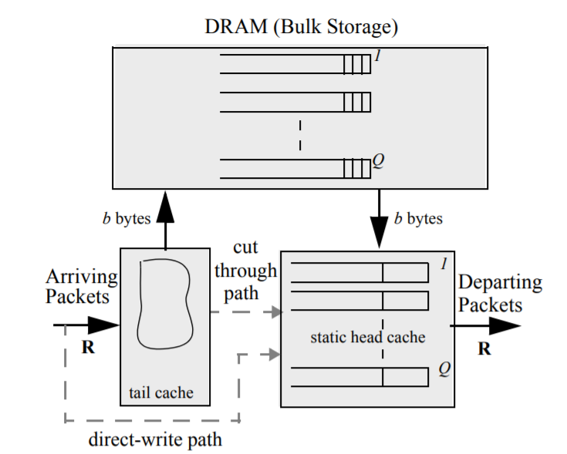
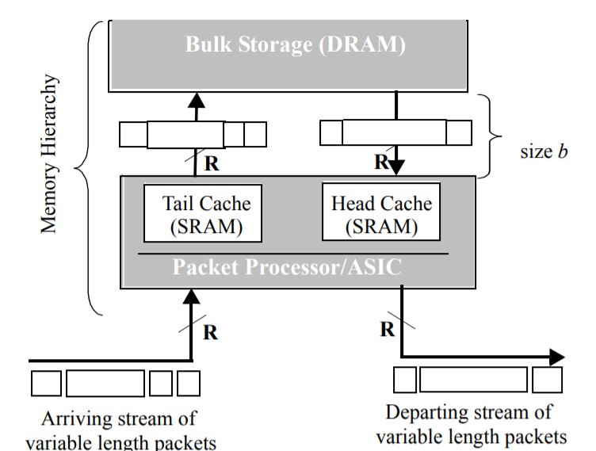
What is a cut-through switch?
Sundar, Kompella, and McKeown. "Designing packet buffers for router line cards." 2002.

Slide 77
What is a cut-through switch?
But what does a REAL silicon implementation looks like?
Tip 1: search for patents on Google Scholar
Tip 2: read carefully performance evaluation reports
  We’ll discuss some examples next (time permitting).

Slide 78
Latency considerations within modules
Notes:
Restart here.

Slide 79
Network Interfaces
Data arrives at (up to) ~50Gbps per link.
Let us ignore clock recovery, signal detection etc.
Feasible clock rate is ~1GHz
But if data rate is ×50 times faster…
Observation: data bus width will be no less than incoming data rate and feasible clock rate

Slide 80
Network Interfaces
Line coding often directs the bus widths:
  E.g., 8b/10b coding led to bus widths of 16b (20b) or 64b (80b)
A port is commonly an aggregation of multiple serial links
  10G XAUI = 4 × 3.125Gbps
  100G CAUI4 = 4 × 25Gbps
  400G PSM4 = 8 × 50Gbps
  Need to take care of aligning the data arriving from multiple links on the same port.

Slide 81
Network Interfaces
Role: check the validity of the packet (e.g., FCS)
What to do if an error is detected?
  Forward an error using a “fast path”
  Mark the last cycle of the packet
    E.g., to cause drop in the next hop
Other roles need to be maintained too
  Frame delimiting and recognition, flow control, enforcing IFG, …

Slide 82
Packet Processing
A likely flow:
Possible implementations:
  The entire packet goes through the header processing unit
  Just the header goes through the header processing unit
  “Better” depends on your performance profile (what are the bottlenecks? Resource limitations?)
Header
starts
Header
parsed
Match
(table look up)
Action
(set output port)
Header
sent

Slide 83
Packet Processing
A likely flow:
Challenges:
  A field may arrive over multiple clock cycles (e.g. 32b field, 16b on clock 2 and 16b on clock 3)
  Memory access taking more than 1 clock cycle
    E.g. request on clock 1, reply on clock 3
    Some memories allow multiple concurrent accesses, some don’t
    The bigger the memory, the more time it takes
Header
starts
Header
parsed
Match
(table look up)
Action
(set output port)
Header
sent

Slide 84
Packet Processing
A likely flow:
Solutions:
  Pipelining!
  Don’t stall, add NOP stages in your pipe.
  Reorder operations (where possible)
    E.g. Lookup 1 → Action 1 → Lookup 2 → Action 2 turns:
    Lookup 1 → Lookup 2 → Action 1 → Action 2
    Don’t create hazards!
Header
starts
Header
parsed
Match
(table look up)
Action
(set output port)
Header
sent

Slide 85
Arbitration
NIF
Arbiter
Simple example:
  Packets arriving from 4 ports
  (approximately) same arrival time
  Arbiter uses Round Robin
Problem: arbitration on packet
boundaries?
  No: interleaved packets within the pipeline
  Need to track which cycle belongs to which packet
  May require multiple concurrent header lookups
  Order is not guaranteed (e.g. P1-P2-P3-P1-P2-P2-…), due to NIF timing
IQ
NIF
IQ
PP
NIF
IQ
NIF
IQ

Slide 86
Arbitration
NIF
Arbiter
Simple example:
  Packets arriving from 4 ports
  (approximately) same arrival time
  Arbiter uses Round Robin
Problem: arbitration on packet
boundaries?
  Yes: packets need to wait for previous packets to be handled before being admitted.
  Worst case waiting with <N> inputs is <N-1>×Packet time
IQ
NIF
IQ
PP
NIF
IQ
NIF
IQ

Slide 87
Arbitration
Solutions to the previous problem:
  Scheduled (or slotted) traffic
  Multiple pipelines
  …

Slide 88
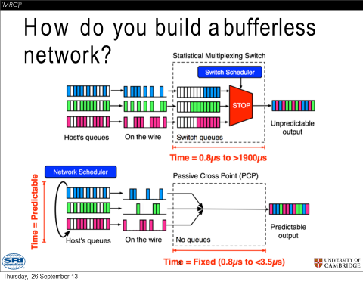
M Grosvenor et al “The Resilient Realtime Data Delivery Network Architecture” (R2D2) 2013

Slide 89
Arbitration
This example solves the arbitration problem entering the device
Resource inefficient:
  Pipeline overdesign
  Inefficient use of memories
  Concurrency issues
One solution:
  Shared memories / tables
  Highly complex
NIF
PP
SCH
OQ
NIF
NIF
PP
OQ
NIF
NIF
PP
OQ
NIF
NIF
PP
OQ
NIF

Slide 90
Switching
The previous arbitration solution “pushed” the problem to the switching unit
But now the problem is only when multiple packets compete over the same output – that’s fine!
Assuming your switch can
handle multiple packets
per cycle
  E.g. crossbar
NIF
PP
SCH
OQ
NIF
NIF
PP
OQ
NIF
NIF
PP
OQ
NIF
NIF
PP
OQ
NIF

Slide 91
Switching
NIF
1
PP
2
NIF
3
4
NIF
PP
NIF
PP
1
NIF
2
NIF
PP
3
4

Slide 92
Switching
… This is also queueing
Challenge: SCALE
  So you can do it with 4 ports
  Can you do it with 32? 128? 256?
Not just resource / area
  Computation time – being able to examine and choose between all available inputs
Eventually:
Packets must be sent out on packet boundaries
do not interleave packets!

Slide 93
P51: High Performance Networking
Lecture 4: Low Latency Devices
Dr Noa Zilberman
noa.zilberman@cl.cam.ac.uk
Lent 2017/18

Slide 94
Low Latency Devices

Slide 95
Crossing Clock Domains
We have discussed the need for differing clock frequencies required in different places in the design.
Crossing clock domains requires careful handling
Data In
4 x 25G
Clk In
Write Clk
Write Ptr
Clk Out
Read Clk
Read Ptr
Data Out
10 x 10G
Asynchronous FIFO
Gear Box
Synchronizer

Slide 96
Crossing Clock Domains
Why do we care about clock domain crossing?
Adds latency
The latency is not deterministic
  But bounded
Crossing clock domains multiple times increases the jitter
Using a single clock is often not an option:
  Insufficient packet processing rate
  Multiple interface clocks
  Need speed up (e.g., to handle control events)

Slide 97
Flow Control
The flow of the data through the device (the network) needs to be regulated
Different events may lead to stopping the data:
  An indication from the destination to stop
  Congestion (e.g. 2 ports sending to 1 port)
  Crossing clock domains
  Rate control
  …
Data
Back pressure

Slide 98
Flow Control
Providing back pressure is not always allowed
In such cases, need to make amendments in the design
NIF
IQ
Scheduler
PP
OQ
NIF
NIF
IQ
OQ
NIF
NIF
IQ
NIF
OQ
NIF
NIF
IQ
OQ

Slide 99
Flow Control
What to do if an output queue is congested?
NIF
IQ
Scheduler
PP
OQ
NIF
NIF
IQ
OQ
NIF
NIF
IQ
NIF
OQ
NIF
NIF
IQ
OQ

Slide 100
Flow Control and Buffering
Back pressure may take time
Need to either:
  Assert back pressure sufficient time before traffic needs to stop
  OR
  Provide sufficient buffering
Stop
triggered
Data
stops
time

Slide 101
Flow Control and Buffering
Calculating buffer size:
Intuitively:
Nearby sender: Buffer size ≥ Reaction time × Data rate
Remote sender: Buffer size ≥ RTT × Data rate
Buffer size ≥ (RTT + Reaction time) × Data rate
1. Stop
triggered
2. Data stops
Sender
Buffer
3. In-flight
data arrives

Slide 102
Flow Control and Buffering
Calculating buffer size:
2 switches, connected using 100m fibre, 10G port, instantaneous response time:
Propagation delay in a fibre is 5ns/m
Buffer size ≥ 1us × 10Gbps = ~1.25KB
1. Stop
triggered
2. Data stops
Sender
Buffer
3. In-flight
data arrives

Slide 103
DMA

Slide 104
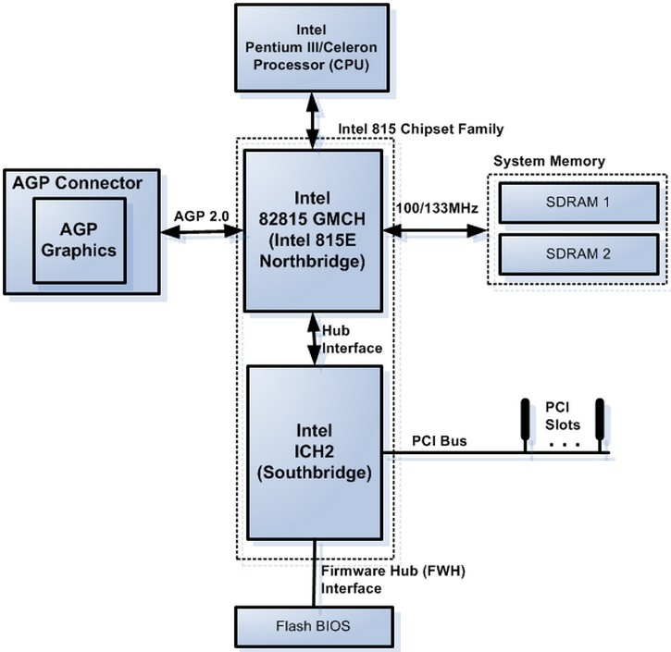
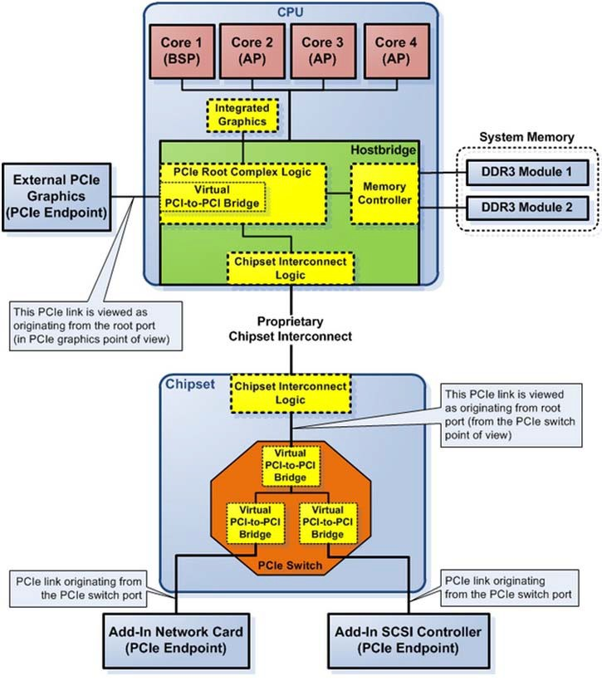
Host architecture
Legacy vs. Recent (courtesy of Intel)

Slide 105
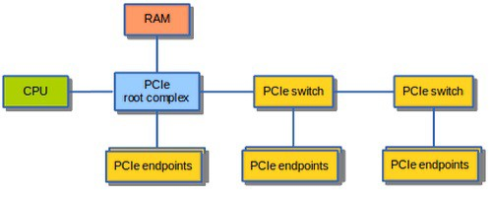
Interconnecting components
Need interconnections between
  CPU, memory, storage, network, I/O controllers
Shared Bus: shared communication channel
  A set of parallel wires for data and synchronization of data transfer
  Can become a bottleneck
Performance limited by physical factors
  Wire length, number of connections
More recent alternative: high-speed serial connections with switches
  Like networks

Slide 106
I/O System Characteristics
Performance measures
  Latency (response time)
  Throughput (bandwidth)
  Desktops & embedded systems
    Mainly interested in response time & diversity of devices
  Servers
    Mainly interested in throughput & expandability of devices
Reliability
  Particularly for storage devices (fault avoidance, fault tolerance, fault forecasting)

Slide 107
I/O Management and strategies
I/O is mediated by the OS
  Multiple programs share I/O resources
    Need protection and scheduling
  I/O causes asynchronous interrupts
    Same mechanism as exceptions
  I/O programming is fiddly
    OS provides abstractions to programs
Strategies characterize the amount of work done by the CPU in the I/O operation:
      Polling
      Interrupt Driven
      Direct Memory Access

Slide 108
The I/O Access Problem
Question: how to transfer data from I/O devices to memory (RAM)?
Trivial solution:
  Processor individually reads or writes every word
  Transferred to/from I/O through an internal register to memory
Problems:
  Extremely inefficient – can occupy a processor for 1000’s of cycles
  Pollute cache

Slide 109
DMA
DMA – Direct Memory Access
A modern solution to the I/O access problem
The peripheral I/O can issue read/write commands directly to the memory
  Through the main memory controller
  The processor does not need to execute any operation
Write: The processor is notified when a transaction is completed (interrupt)
Read: The processor issues a signal to the I/O when the data is ready in memory

Slide 110
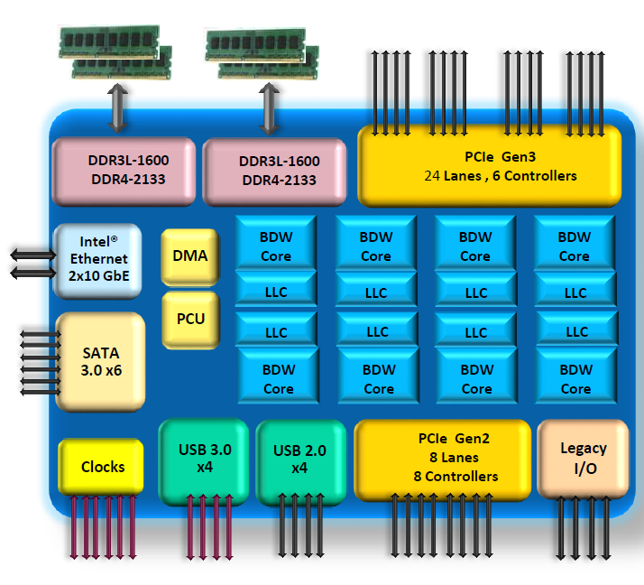
Example – Intel Xeon D

Slide 111
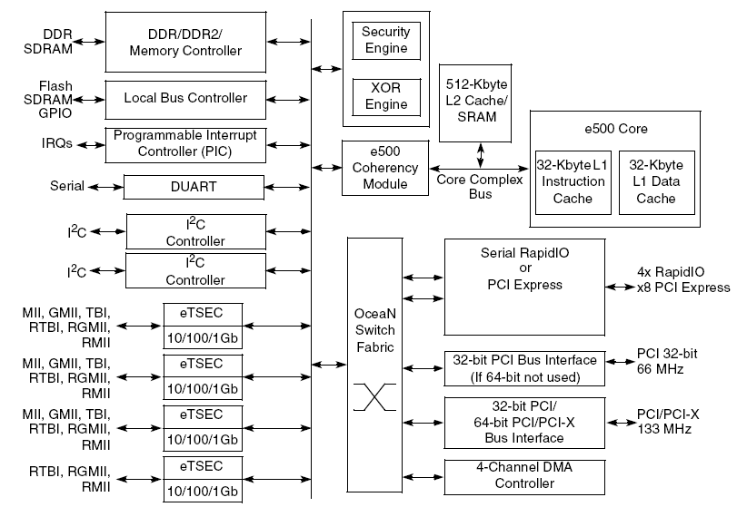

Example (Embedded Processor)
Message arrives on I/O interface.
Message is decoded to Mem read/write.
Address is converted to internal address.
Memory Mapped Access
3
Mem Read/Write command goes through the switch to the internal bus and memory controller.
2
1
Memory controller executes the command to the DRAM.
Returns data if required in the same manner.

Slide 112
DMA
DMA accesses are usually handled in buffers
  Single word/block is typically inefficient
The processors assigns the peripheral unit the buffers in advance
The buffers are typically handled by buffer descriptors
  Pointer to the buffer in the memory
  May point to the next buffer as well
  Indicates buffer status: owner, valid etc.
  May include additional buffer properties as well

Slide 113
Example (Embedded Processor)
Transfers blocks of data between external interfaces and local address space
DMA Access
1
2
A transfer is started by SW writing to DMA engine configuration registers
SW Polls DMA channel state to idle and sets trigger
DMA engine fetches a descriptor from memory
DMA engine reads block of data from source
DMA engine writes data to destination
3
4
5

Slide 114
Intel Data Direct I/O (DDIO)
Data is written and read directly to/from the last level cache (LLC)

Slide 115
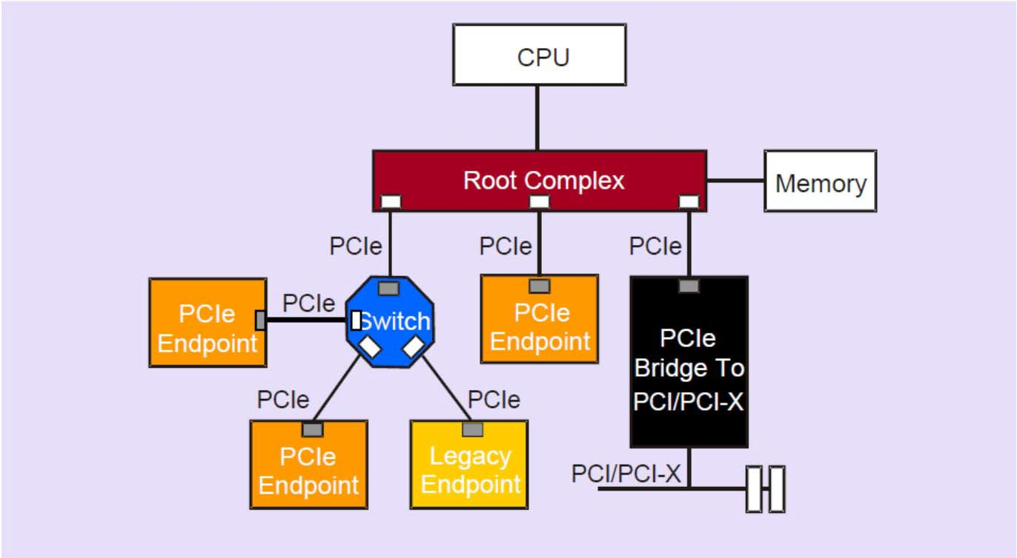
PCIe introduction
PCIe is a serial point-to-point interconnect between two devices
Implements packet based protocol (TLPs) for information transfer
Scalable performance based on # of signal Lanes implemented on the PCIe interconnect
Supports credit-based point-to-point flow control (not end-to-end)
Provides:
  Processor independence & buffered isolation
  Bus mastering
  Plug and Play operation

Slide 116
PCIe transaction types
Memory Read or Memory Write. Used to transfer data from or to a memory mapped location
I/O Read or I/O Write. Used to transfer data from or to an I/O location
Configuration Read or Configuration Write. Used to discover device capabilities, program features, and check status in the 4KB PCI Express configuration space.
Messages. Handled like posted writes. Used for event signaling and general purpose messaging.

Slide 117
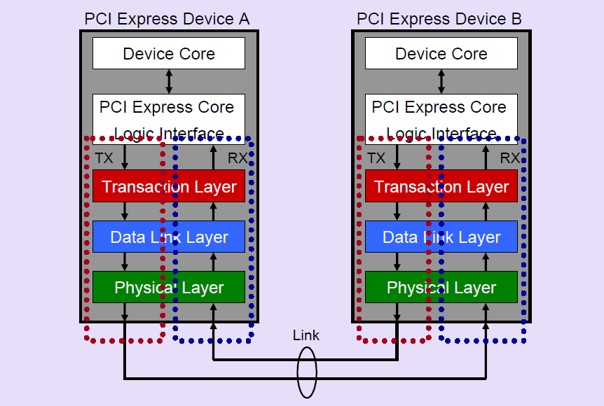
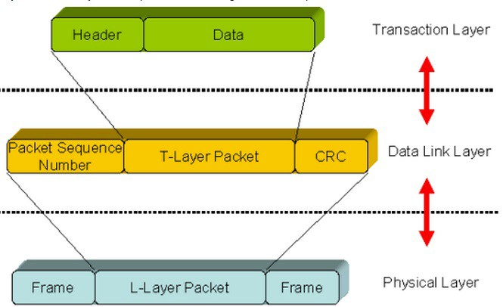
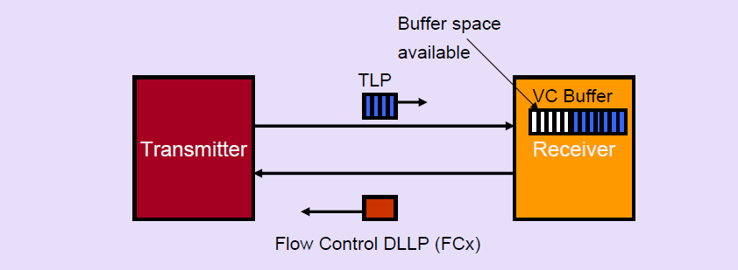
PCIe architecture

Slide 118
Interrupt Model
PCI Express supports three interrupt reporting mechanisms:
Message Signaled Interrupts (MSI)
- interrupt the CPU by writing to a specific address in memory with a payload of 1 DW
Message Signaled Interrupts - X (MSI-X)
- MSI-X is an extension to MSI, allows targeting individual interrupts to different processors
INTx Emulation
four physical interrupt signals INTA-INTD are messages upstream
  ultimately be routed to the system interrupt controller

Slide 119
NetFPGA Reference Projects
10GE
Host system
PCI endpoint
Direct Memory Access
Output Port Lookup
10GE
Input Arbiter
Output Queues
10GE
AXI
Interconnect
10GE

Slide 120
Processing Overheads
Processing in the kernel takes a lot of time…
Source: Yasukata et al. “StackMap: Low-Latency Networking with the OS Stack and Dedicated NICs”, Usenix ATC 2016
Component | Time [us]
Driver RX | 0.60
Ethernet & IPv4 RX | 0.19
TCP RX | 0.53
Socket Enqueue | 0.06
TCP TX | 0.70
IPv4 & Ethernet TX | 0.06
Driver TX | 0.43

Slide 121
Processing Overheads
Processing in the kernel takes a lot of time…
Order of microseconds (~2-4us on Xeon E5-v4)
×10 the time through a switch
Solution: don’t go through the kernel!

Slide 122
Kernel Bypass
The Kernel is slow – lets bypass the Kernel!
There are many ways to achieve kernel bypass
Some examples:
  Device drivers:
    Customized kernel device driver. E.g. Netmap forks standard Intel drivers with extensions to map I/O memory into userspace.
    Custom hardware and use bespoke device drivers for the specialized hardware.
  Userspace library: anything from basic I/O to the entire TCP/IP stack

Slide 123
Kernel Bypass - Examples
User
space
Application
User
space
Application
User
space
Application
Socket API
Framework
TCP/IP/ETH
TCP/IP/ETH
Buffers
Kernel
Kernel
OS packet I/O
Library
Device driver
Device driver
Device driver
Hardware
NIC
Hardware
NIC
Hardware
NIC
No Bypass
Partly within Kernel
Completely in
User Space

Slide 124
DPDK
DPDK is a popular set of libraries and drivers for fast packet processing.
Originally designed for Intel processors
  Now running also on ARM and Power CPUs
Runs mostly in Linux User space.
Main libraries: multicore framework, huge page memory, ring buffers, poll-mode drivers (networking, crypto etc)
It is not a networking stack

Slide 125
DPDK
Usage examples:
  Send and receive packets within minimum number of CPU cycles
    E.g. less than 80 cycles
  Fast packet capture algorithms
  Running third-party stacks
Some projects demonstrated 100’s of millions packets per seconds
  But with limited functionality
  E.g. as a software switch / router

Slide 126
P51: High Performance Networking
Lecture 5: High Throughput Devices
Dr Noa Zilberman
noa.zilberman@cl.cam.ac.uk
Lent 2017/18

Slide 127
High Throughput Switches

Slide 128
The Truth About Switch Silicon Design
12.8Tbps Switches!
Lets convert this to packet rate requirements:
5.8 Gpps @ 256B
19.2 Gpps @ 64B
But clock rate is only ~1GHz….

Slide 129
Multi-Core Switch Design
Barefoot Tofino
Broadcom Tomahawk 3
Image sources: https://p4.org/assets/p4_d2_2017_programmable_data_plane_at_terabit_speeds.pdf
https://www.nextplatform.com/2018/01/20/flattening-networks-budgets-400g-ethernet/

Slide 130
Multi Core Switch Design
So what? Multi-core in CPUs for over a decade
Network devices are not like CPUs:
  CPU: Pipeline - instructions, memory – data
  Switch: pipeline – data, memory – control
Network devices have a strong notion of time
  Must process the header on cycle X
  Headers are split across clock cycles
  Pipelining is the way to achieve performance

Slide 131
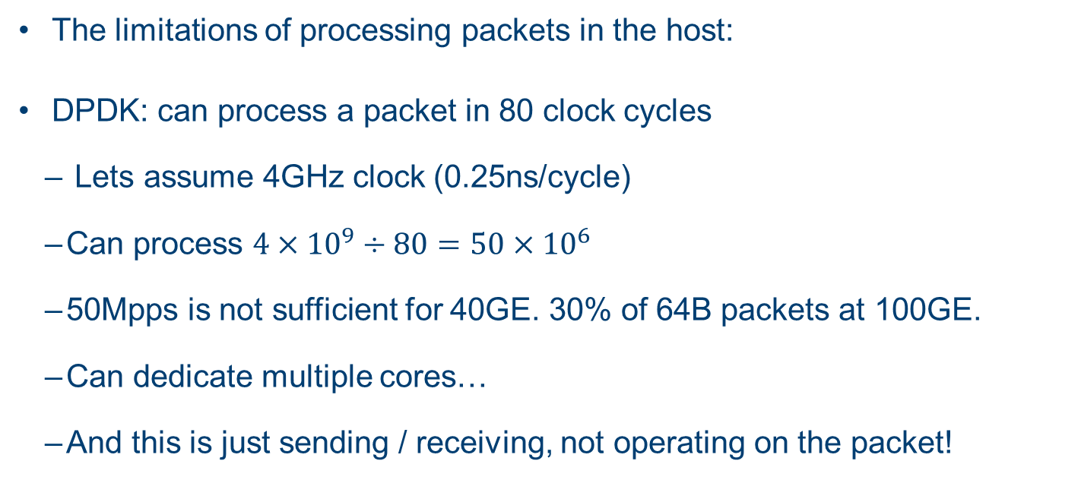
Multi Core Switch Design
The limitations of processing packets in the host:
DPDK: can process a packet in 80 clock cycles
  Lets assume 4GHz clock (0.25ns/cycle)
  Can process $4×{10}^{9}÷80=50×{10}^{6}$
  50Mpps is not sufficient for 40GE. 30% of 64B packets at 100GE.
  Can dedicate multiple cores…
  And this is just sending / receiving, not operating on the packet!

Slide 132
Multi Core Switch Design
The problem with multi-core switch design: look up tables.
  Shared tables:
    need to allow access from multiple pipelines
    need to support query rate at packet rate
  Separate tables:
    wastes resources
    need to maintain consistency
      Not everyone agree with this assumption

Slide 133
Multi Core Switch Design
Table PP1
Table PP2
DST MAC | DST Port
aa:bb:cc:dd:ee:ff | 3
DST MAC | DST Port
aa:bb:cc:dd:ee:ff | 3
DST MAC | DST Port
aa:bb:cc:dd:ee:ff | 2
DST MAC | DST Port
aa:bb:cc:dd:ee:ff | 2
PKT
NIF
PP
SCH
NIF
OQ
PKT
NIF
PP
NIF
OQ
NIF
PP
NIF
OQ
NIF
PP
NIF
OQ

Slide 134
Inferring Switch Architecture

Slide 135
refer to: http://www.mellanox.com/tolly/

Slide 136
All interpretations in the following slides are a guess, and not based on internal information

Slide 137
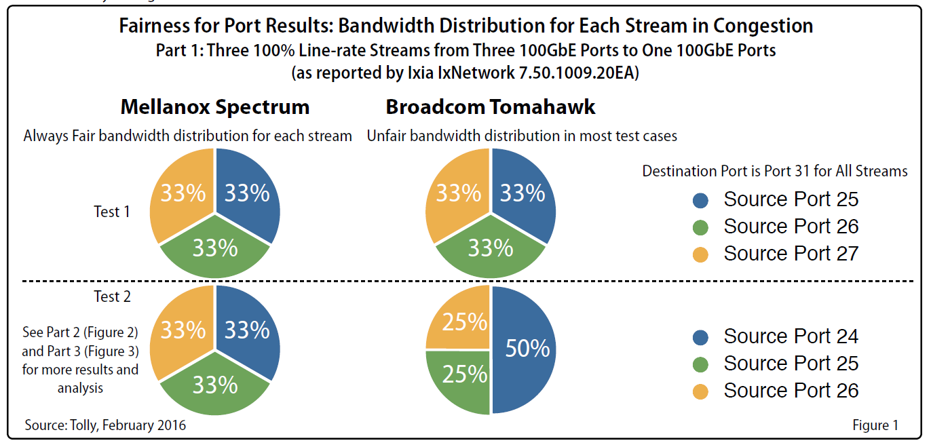
What is wrong with Broadcom Tomahawk?

Slide 138
Broadcom Tomahawk
32 x 100GE
In packet rate: 32 x 150Mpps = 4800 Mpps
Manufacturing process: 28nm
  Therefore clock frequency likely <1GHz
More than 7 billion transistor
  Reference: Intel debut around the same time 18-core Xeon
  E5-2600 v3 with 5.57 billion transistors
… now lets think of these experimental results in a multi core switch…

Slide 139
What is wrong with Broadcom Tomahawk?
Let us assume the same architecture as used by Tomahawk 3:

Slide 140
What is wrong with Broadcom Tomahawk?
Let us assume the same architecture as used by Tomahawk 3:

Slide 141
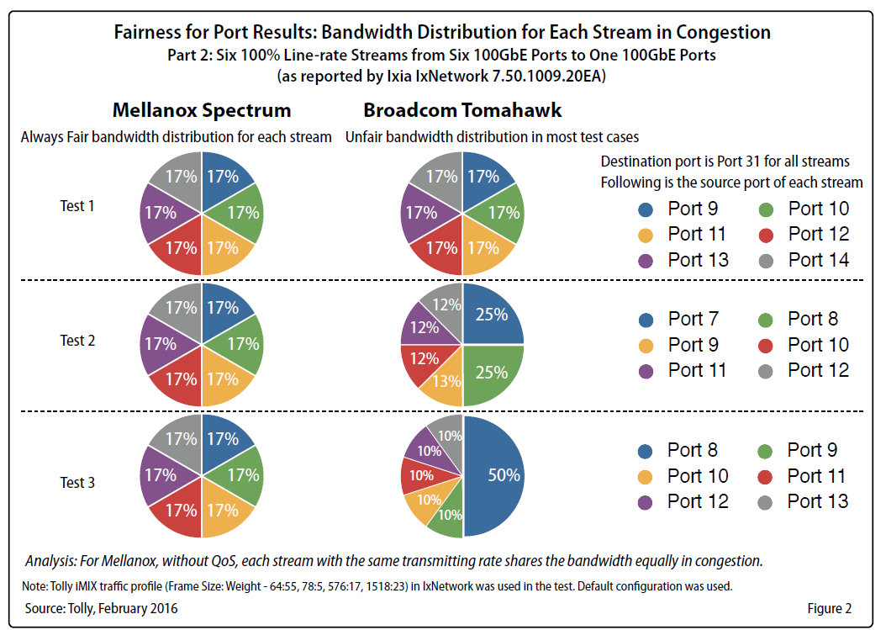
What is wrong with Broadcom Tomahawk?

Slide 142
Inferring NetFPGA Switch Architecture
The following graph shows the latency CDF of a single packet going through the switch:
What does this graph tell us?

Slide 143
Inferring NetFPGA Switch Architecture
The following graph shows the latency CDF of packets sent from Port 0 to Port 1, where there are (in parallel) packets sent from Port 1 to Port 0:
What does this graph tell us?

Slide 144
Inferring NetFPGA Switch Architecture
The following graph shows the maximum latency of packets sent from Port 0 to Port 1, (a) when there is not other traffic and (b) when there are (in parallel) packets sent from Port 1 to Port 0:
What does this graph tell us?

Slide 145
High Throughput Interfaces

Slide 146
Performance Limitations
So far we discussed performance limitations due to:
  Data path
  Network Interfaces
Other common critical paths include:
  Memory interfaces
    Lookup tables, packet buffers
  Host interfaces
    PCIe, DMA engine

Slide 147
Memory Interfaces
On chip memories
  Advantage: fast access time
  Disadvantage: limited size (10’s of MB)
Off chip memory:
  Advantage: large size (up to many GB)
  Disadvantage: access time, cost, area, power
New technologies
  Offer mid-way solutions

Slide 148
Example: QDR-IV SRAM
QDR SRAM
Does 4 operations every clock: 2 READs, 2 WRITEs
Constant latency
Maximum random transaction rate: 2132 MT/s
Maximum bandwidth: 153.3Gbps
Maximum density: 144Mb
Example applications: Statistics, head-tail cache, descriptors lists
Switch

Slide 149
Example: QDR-IV SRAM
Does 4 operations every clock: 2 READs, 2 WRITEs
  DDR4 DRAM: 2 operations every clock
Constant latency
  DDR4 DRAM: variable latency
Maximum random transaction rate: 2132 MT/s
  DDR4 DRAM: 20MT/s (worst case! t_{RC}~50ns)
    DDR4 theoretical best case 3200MT/s
Maximum bandwidth: 153.3Gbps
  DDR4 DRAM maximum bandwidth: 102.4Gbps (for 32b (2x16) bus)
Maximum density: 144Mb
  DDR4 maximum density: 16Gb
Example applications: Statistics, head-tail cache, descriptors lists
  No longer applicable: packet buffer
QDR SRAM
Switch

Slide 150
Random Memory Access
Random access is a “killer” when accessing DRAM based memories
  Due to strong timing constraints
Examples: rules access, packet buffer access
DRAMs perform well (better) when there is strong locality or when accessing large chunks of data
  E.g. large cache lines, files etc.
  Large enough to hide timing constraints
    E.g. for 3200MT/s, 64b bus: 50ns~ 1KB

Slide 151
Example: PCI Express Gen 3, x8
The theoretical performance profile:
PCIe Gen 3 – each lane runs at 8Gbps
~97% link utilization (128/130 coding, scrambling)
Data overhead – 24B-28B
(including headers and CRC)
Configurable MTU
(e.g., 128B, 256B, …)

Slide 152
Example: PCI Express Gen 3, x8
Actual throughput on VC709, using Xilinx reference project:
(same FPGA as NetFPGA SUME)
This is so far for the
performance profile…
Why?
Note: the graph is for illustration purposes only.
There were slight differences between the evaluated systems.

Slide 153
Thank you

