Slide 1
P51(bis): High Performance Networked-Systems
Prof. Andrew W. Moore
Lecture 4
With great appreciation to Dick Sites for sharing wisdom, patience, and teaching materials.
A huge thank you to Eben Upton, Raspberry Pi Foundation, and PiHut people for enabling this incarnation of the module at incredibly short notice.

Slide 2
What we will cover
Characteristics of a datacenter environment
goals, constraints, workloads, etc.
How and why DC networks are different (vs. WAN)
e.g., latency, geo, autonomy, …
How traditional solutions fare in this environment
e.g., IP, Ethernet, TCP, ARP, DHCP
Not details of how datacenter networks operate

Slide 3
Disclaimer
Material is a snapshot of evolving (not established) wisdom
Material is incomplete
many details on how and why datacenter networks operate aren’t public

Slide 4
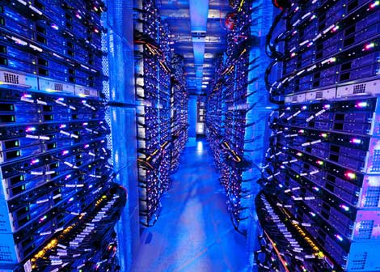
Datacenter networks
10’s to 100’s of thousands of hosts, often closely coupled, in close proximity:
e-business (e.g. Amazon)
content-servers (e.g., YouTube, Akamai, Apple, Microsoft)
search engines, data mining (e.g., Google)
challenges:
multiple applications, each serving massive numbers of clients
reliability
managing/balancing load, avoiding processing, networking, data bottlenecks
Inside a 40-ft Microsoft container, Chicago data center

Slide 5
Datacenter networks: network elements
Border routers
connections outside datacenter
Tier-1 switches
connecting to ~16 T-2s below
Tier-2 switches
connecting to ~16 TORs below
…
…
…
…
Top of Rack (TOR) switch
one per rack
40-100Gbps Ethernet to blades
…
…
…
…
Server racks
20- 40 server blades: hosts

Slide 7
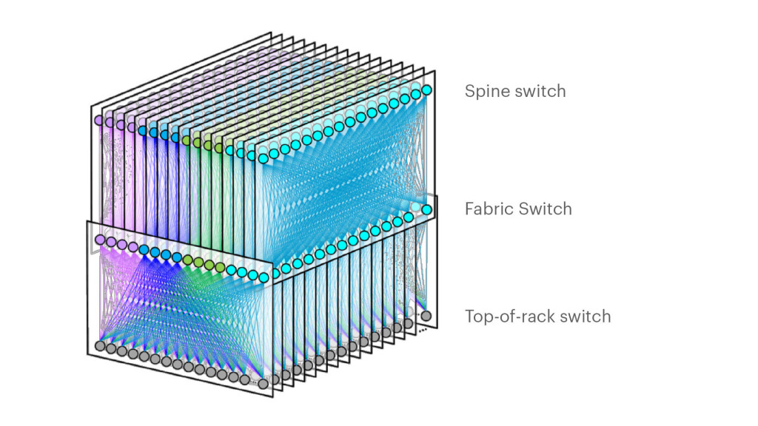
Datacenter networks: network elements
Facebook F16 data center network topology:
https://engineering.fb.com/data-center-engineering/f16-minipack/ (posted 3/2019)

Slide 8
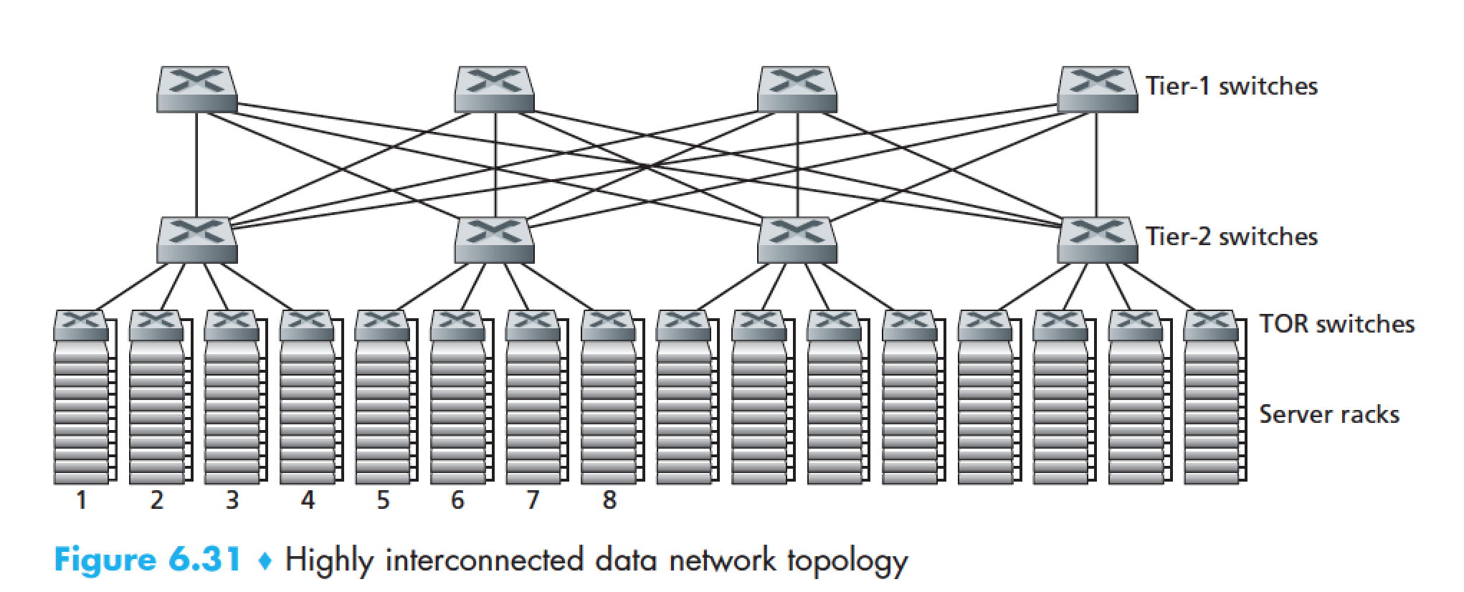
Datacenter networks: multipath
rich interconnection among switches, racks:
increased throughput between racks (multiple routing paths possible)
increased reliability via redundancy
9
10
11
12
13
14
15
16
two disjoint paths highlighted between racks 1 and 11

Slide 9
Datacenter networks: application-layer routing
Internet
load balancer: application-layer routing
receives external client requests
directs workload within data center
Load
balancer
…
…
…
…
returns results to external client (hiding data center internals from client)
…
…
…
…

Slide 10
Why Datacenters?
Your <public-life, private-life, banks, government> live in my datacenter.
Security, Privacy, Control, Cost, Energy, (breaking) received wisdom; all this and more come together into sharp focus in datacenters.
Do I need to labor the point?

Slide 11
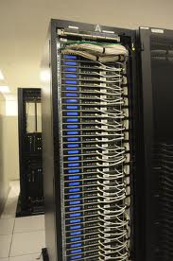
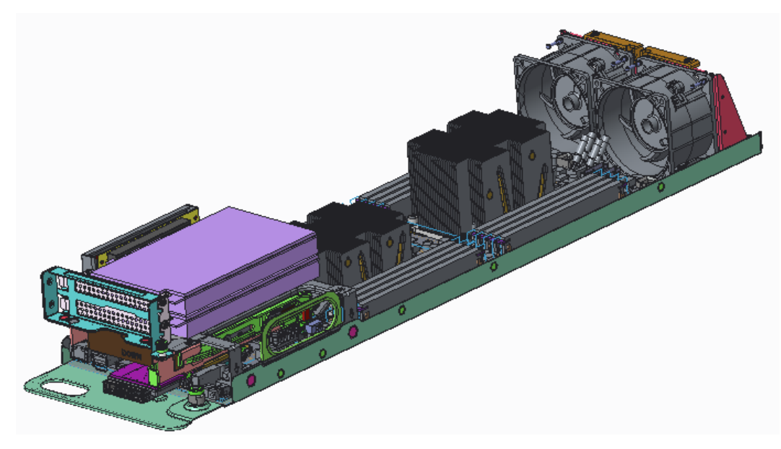
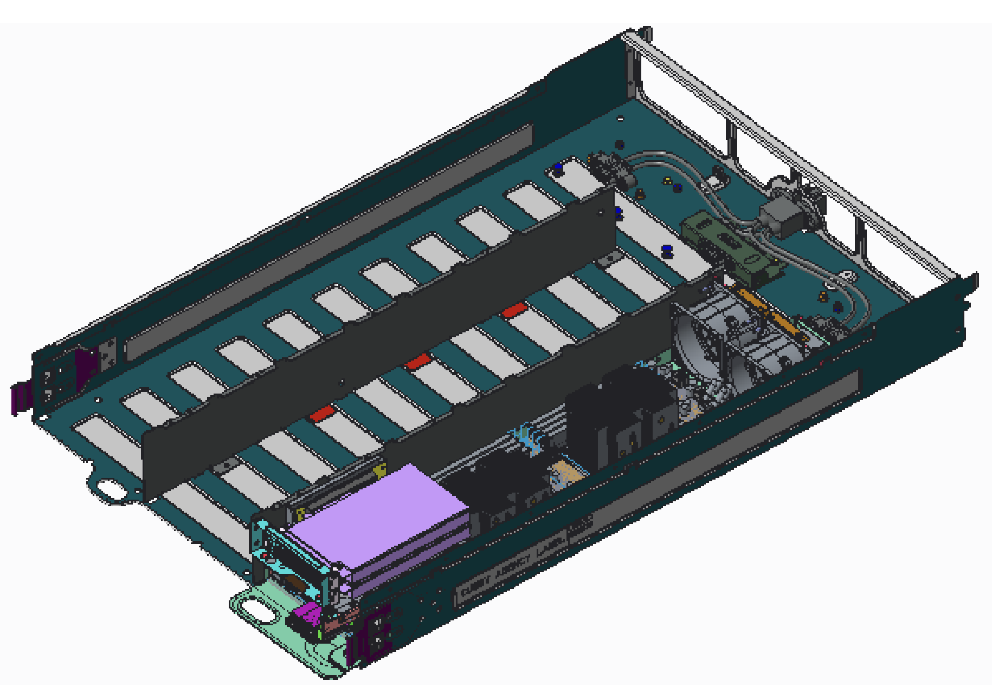
What goes into a datacenter (network)?
Servers organized in racks

Slide 12
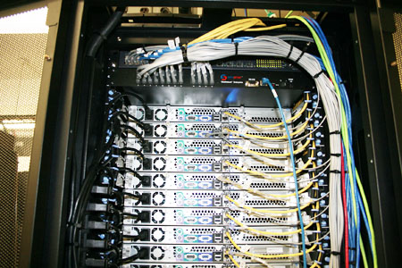
What goes into a datacenter (network)?
Servers organized in racks
Each rack has a `Top of Rack’ (ToR) switch

Slide 13
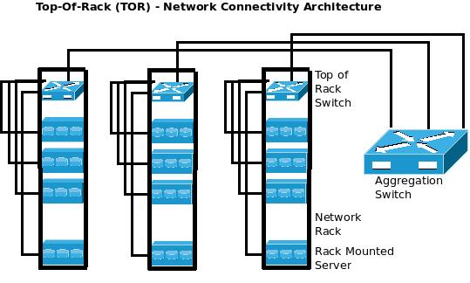
What goes into a datacenter (network)?
Servers organized in racks
Each rack has a `Top of Rack’ (ToR) switch
An `aggregation fabric’ interconnects ToR switches

Slide 14
What goes into a datacenter (network)?
Servers organized in racks
Each rack has a `Top of Rack’ (ToR) switch
An `aggregation fabric’ interconnects ToR switches
Connected to the outside via `core’ switches
note: blurry line between aggregation and core
With network redundancy of ~2x for robustness

Slide 15
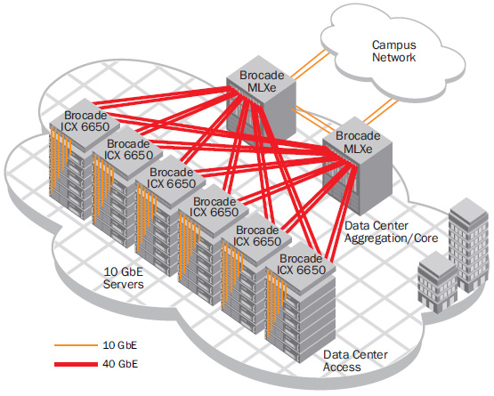
Example 1
Brocade reference design (circa 2007)

Slide 16
Example 2
Internet
CR
CR
. . .
AR
AR
AR
AR
S
S
S
S
S
S
. . .
A
A
…
A
A
A
…
A
~ 40-80 servers/rack
Cisco reference design

Slide 17
Observations on DC architecture
Regular, well-defined arrangement
Hierarchical structure with rack/aggr/core layers
Mostly homogenous within a layer
Supports communication between servers and between servers and the external world
Contrast: ad-hoc structure, heterogeneity of WANs

Slide 18
What’s different?

Slide 19
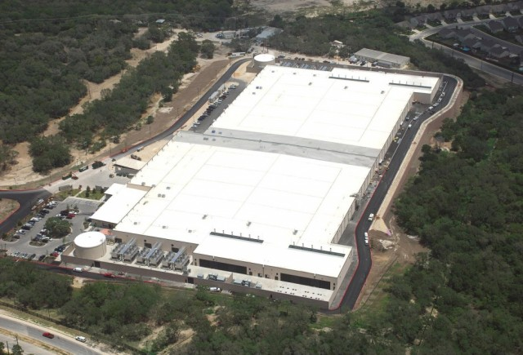
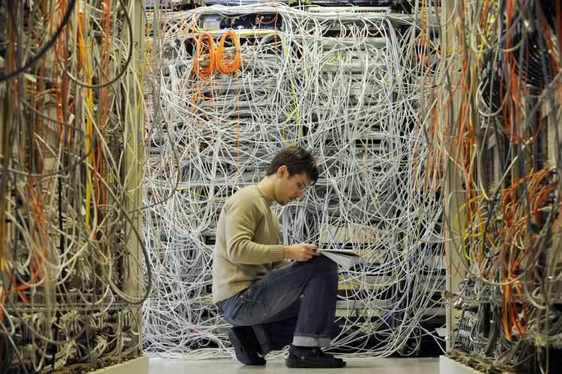
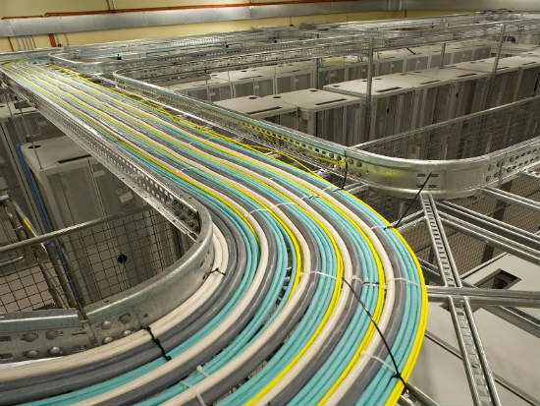
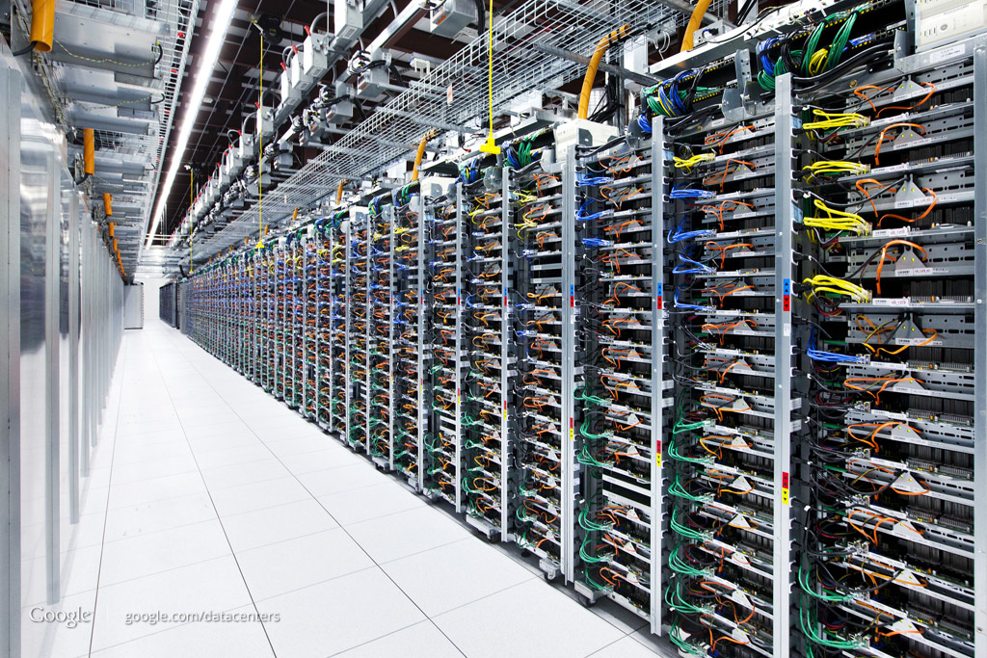
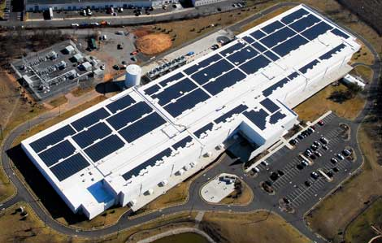
SCALE!

Slide 20
How big exactly?
1Million servers [Microsoft]
less than google, more than amazon
> $1B to build one site [Facebook]
>$20M/month/site operational costs [Microsoft ’09]
But only O(10-100) sites

Slide 21
What’s new?
Scale
Service model
user-facing, revenue generating services
multi-tenancy
jargon: SaaS, PaaS, DaaS, IaaS, …

Slide 22
Implications
Scale
need scalable solutions
improving efficiency, lowering cost is critical
`scale out’ solutions w/ commodity technologies
Service model
performance means $$
virtualization for isolation and portability

Slide 23
Multi-Tier Applications
Applications decomposed into tasks
Many separate components
Running in parallel on different machines

Slide 24
Componentization leads to different types of network traffic
“North-South traffic”
Traffic between external clients and the datacenter
Handled by front-end (web) servers, mid-tier application servers, and back-end databases
Traffic patterns fairly stable, though diurnal variations

Slide 25
North-South Traffic
user requests from the Internet
You Live Here
Router
Front-End
Proxy
Front-End
Proxy
Web Server
Web Server
Web Server
Data
Cache
Data
Cache
Database
Database

Slide 26
Componentization leads to different types of network traffic
“North-South traffic”
Traffic between external clients and the datacenter
Handled by front-end (web) servers, mid-tier application servers, and back-end databases
Traffic patterns fairly stable, though diurnal variations
“East-West traffic”
Traffic between machines in the datacenter
Comm within “big data” computations (e.g. Map Reduce)
Traffic may shift on small timescales (e.g., minutes)

Slide 27
East-West Traffic
Distributed
Storage
Map
Tasks
Reduce
Tasks
Distributed
Storage

Slide 28
East-West Traffic
CR
CR
AR
AR
AR
AR
S
S
S
S
S
S
S
S
. . .
S
S
S
S
A
A
…
A
A
A
…
A
A
A
…
A
A
A
…
A

Slide 29
East-West Traffic
Often doesn’t cross the network
Some fraction (typically 2/3) crosses the network
Distributed
Storage
Map
Tasks
Reduce
Tasks
Distributed
Storage
Always goes over the network

Slide 30
East-West vs North-South
Notes:
Taken from https://code.facebook.com/posts/360346274145943/introducing-data-center-fabric-the-next-generation-facebook-data-center-network/

Slide 31
What’s different about DC networks?
Characteristics
Huge scale:
~20,000 switches/routers
contrast: AT&T ~500 routers

Slide 32
What’s different about DC networks?
Characteristics
Huge scale:
Limited geographic scope:
High bandwidth: 10/40/100G
Contrast: Cable/aDSL/WiFi
Very low RTT: 10s of microseconds
Contrast: 100s of milliseconds in the WAN

Slide 33
What’s different about DC networks?
Characteristics
Huge scale
Limited geographic scope
Single administrative domain
Can deviate from standards, invent your own, etc.
“Green field” deployment is still feasible

Slide 34
What’s different about DC networks?
Characteristics
Huge scale
Limited geographic scope
Single administrative domain
Control over one/both endpoints
can change (say) addressing, congestion control, etc.
can add mechanisms for security/policy/etc. at the endpoints (typically in the hypervisor)

Slide 35
What’s different about DC networks?
Characteristics
Huge scale
Limited geographic scope
Single administrative domain
Control over one/both endpoints
Control over the placement of traffic source/sink
e.g., map-reduce scheduler chooses where tasks run
alters traffic pattern (what traffic crosses which links)

Slide 36
What’s different about DC networks?
Characteristics
Huge scale
Limited geographic scope
Single administrative domain
Control over one/both endpoints
Control over the placement of traffic source/sink
Regular/planned topologies (e.g., trees/fat-trees)
Contrast: ad-hoc WAN topologies (dictated by real-world geography and facilities)

Slide 37
What’s different about DC networks?
Characteristics
Huge scale
Limited geographic scope
Single administrative domain
Control over one/both endpoints
Control over the placement of traffic source/sink
Regular/planned topologies (e.g., trees/fat-trees)
Limited heterogeneity
link speeds, technologies, latencies, …

Slide 38
What’s different about DC networks?
Goals
Extreme bisection bandwidth requirements
recall: all that east-west traffic
target: any server can communicate at its full link speed
problem: server’s access link is 10Gbps!

Slide 39
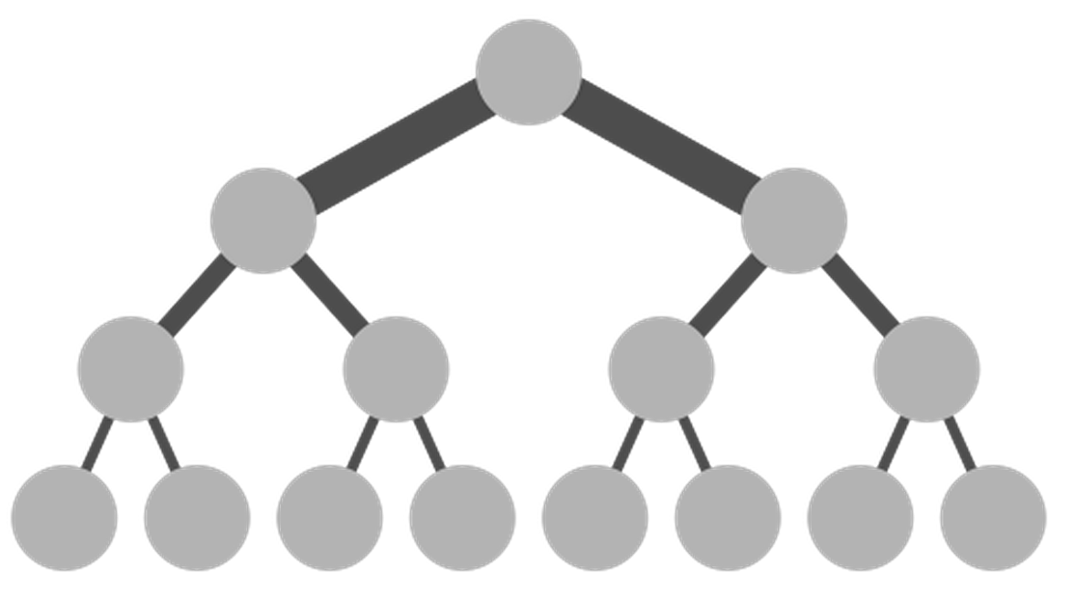
Full Bisection Bandwidth
O(40x10x100)Gbps
Internet
CR
CR
O(40x10)Gbps
. . .
AR
AR
AR
AR
10Gbps
S
S
S
S
S
S
. . .
Traditional tree topologies “scale up”
full bisection bandwidth is expensive
typically, tree topologies “oversubscribed”
A
A
…
A
A
A
…
A
~ 40-80 servers/rack

Slide 40
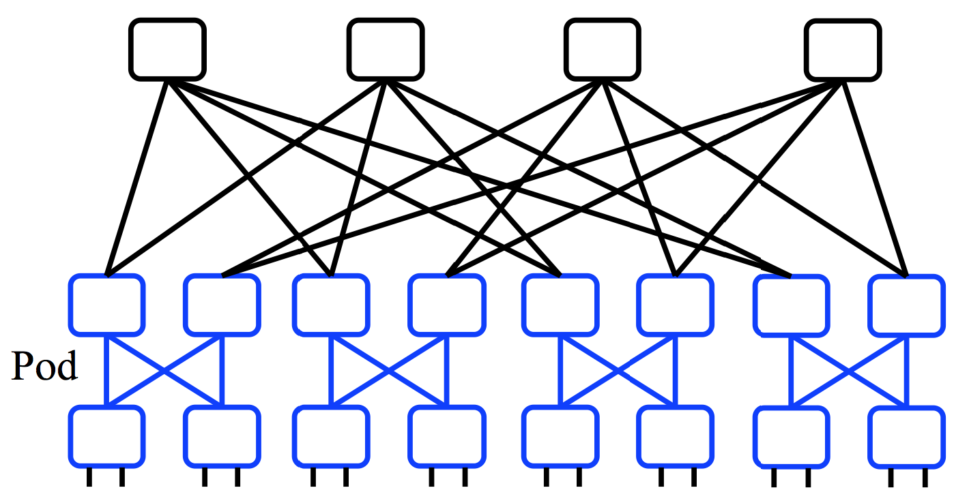
A “Scale Out” Design
Build multi-stage `Fat Trees’ out of k-port switches
k/2 ports up, k/2 down
Supports k³/4 hosts:
48 ports, 27,648 hosts
All links are the same speed (e.g. 10Gps)

Slide 41
Full Bisection Bandwidth Not Sufficient
To realize full bisectional throughput, routing must spread traffic across paths
Enter load-balanced routing
How? (1) Let the network split traffic/flows at random (e.g., ECMP protocol -- RFC 2991/2992)
How? (2) Centralized flow scheduling?
Many more research proposals

Slide 42
What’s different about DC networks?
Goals
Extreme bisection bandwidth requirements
Extreme latency requirements
real money on the line
current target: 1μs RTTs
how? cut-through switches making a comeback
reduces switching time

Slide 43
What’s different about DC networks?
Goals
Extreme bisection bandwidth requirements
Extreme latency requirements
real money on the line
current target: 1μs RTTs
how? cut-through switches making a comeback
how? avoid congestion
reduces queuing delay

Slide 44
What’s different about DC networks?
Goals
Extreme bisection bandwidth requirements
Extreme latency requirements
real money on the line
current target: 1μs RTTs
how? cut-through switches making a comeback (lec. 2!)
how? avoid congestion
how? fix TCP timers (e.g., default timeout is 500ms!)
how? fix/replace TCP to more rapidly fill the pipe

Slide 45
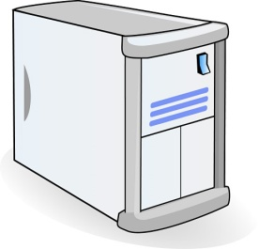
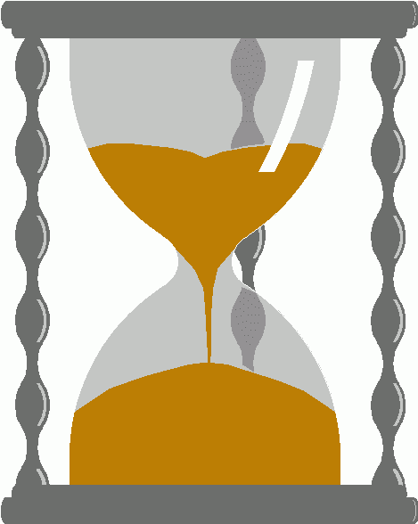
An example problem at scale - INCAST
Worker 1
Synchronized mice collide.
Caused by Partition/Aggregate.
Aggregator
Worker 2
Worker 3
RTO_{min} = 300 ms
Worker 4
TCP timeout

Slide 46
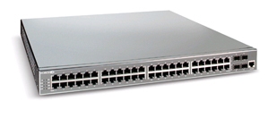
The Incast Workload
Data Block
Synchronized Read
1
R
R
R
R
2
3
Client
Switch
1
2
3
4
Server
Request Unit
(SRU)
4
Client now sends
next batch of requests
Storage Servers
46

Slide 47
Incast Workload Overfills Buffers
Synchronized Read
1
R
R
R
R
2
4
3
Client
Switch
1
2
3
4
Server
Request Unit
(SRU)
4
4
Requests
Received
Responses 1-3 completed
Link Idle!
Requests Sent
Response 4
dropped
Response 4
Resent
47

Slide 48
Queue Buildup
Sender 1
Big flows buildup queues.
Increased latency for short flows.
Receiver
Sender 2
Measurements in Bing cluster
For 90% packets: RTT < 1ms
For 10% packets: 1ms < RTT < 15ms

Slide 49
Link-Layer Flow Control Common between switches but this is flow-control to the end host too…
Another idea to reduce incast is to employ Link-Layer Flow Control…..
Recall: the Data-Link can use specially coded symbols in the coding to say “Stop” and “Start”

Slide 50
Link Layer Flow Control – The Dark side Head of Line Blocking….
Such HOL blocking does not even differentiate processes so this can occur between competing processes on a pair of machines – no datacenter required.
Waiting for no good reason….

Slide 51
Link Layer Flow Control But its worse that you imagine….
Double down on trouble….
Did I mention this is Link-Layer!
That means no (IP) control traffic, no routing messages….
a whole system waiting for one machine
Incast is very unpleasant.
…
Reducing the impact of Head of Line (blocking) in Link Layer Flow Control can be done through priority queues and overtaking….

Slide 52
What’s different about DC networks?
Goals
Extreme bisection bandwidth requirements
Extreme latency requirements
Predictable, deterministic performance
“your packet will reach in Xms, or not at all”
“your VM will always see at least YGbps throughput”
Resurrecting `best effort’ vs. `Quality of Service’ debates
How is still an open question

Slide 53
What’s different about DC networks?
Goals
Extreme bisection bandwidth requirements
Extreme latency requirements
Predictable, deterministic performance
Differentiating between tenants is key
e.g., “No traffic between VMs of tenant A and tenant B”
“Tenant X cannot consume more than XGbps”
“Tenant Y’s traffic is low priority”

Slide 54
What’s different about DC networks?
Goals
Extreme bisection bandwidth requirements
Extreme latency requirements
Predictable, deterministic performance
Differentiating between tenants is key
Scalability (of course)
Q: How’s that Ethernet spanning tree looking?

Slide 55
What’s different about DC networks?
Goals
Extreme bisection bandwidth requirements
Extreme latency requirements
Predictable, deterministic performance
Differentiating between tenants is key
Scalability (of course)
Q: How’s that Ethernet spanning tree looking?

Slide 56
What’s different about DC networks?
Goals
Extreme bisection bandwidth requirements
Extreme latency requirements
Predictable, deterministic performance
Differentiating between tenants is key
Scalability (of course)
Cost/efficiency
focus on commodity solutions, ease of management
some debate over the importance in the network case

Slide 57
Summary
new characteristics and goals
some liberating, some constraining
scalability is the baseline requirement
more emphasis on performance
less emphasis on heterogeneity
less emphasis on interoperability
Notes:
-- incast?
-- one big switch abstraction…

Slide 58
Datacenter overview

Slide 59
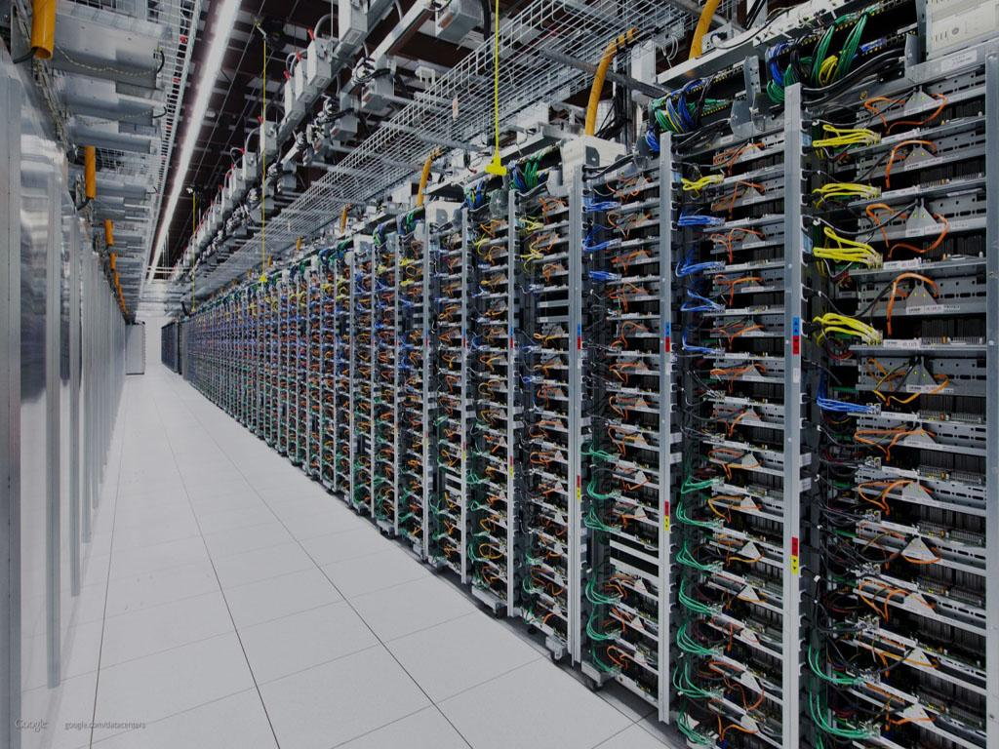
Datacenter Computers modern challenges in CPU design
Dick Sites
Google Inc.

Slide 60
Enough with Datacenter networks, what about CPU?

Slide 61
Modern challenges in CPU design
Lots of memory
Multi-issue CPU instructions every cycle that drive full bandwidth
Full bandwidth all the way to RAM, not just to L1 cache
More prefetching in software
Bigger page size(s)
Notes:
20 min

Slide 62
Thesis: Servers and
desktops require
different design emphasis

Slide 63
Goals
Draw a vivid picture of a computing environment that may be foreign to your experience so far
Expose some ongoing research problems
Perhaps inspire contributions in this area

Slide 64
Datacenter Servers are Different
Server programs start and run for months
Tens of programs per server
Real-time user-facing transactions, not batch
Minimize latency, not CPU idle time
Big fanout: one transaction to 1000+ servers
only 1-10ms CPU time per server
10K+ computers, 100K+ disks, 1000k+ network connections

Slide 65
Datacenter Servers are Different
① Move data: big and small
② Real-time transactions: 1000s per second
③ Isolation between programs
④ Measurement underpinnings
Notes:
5 min

Slide 66
① Move data: big and small

Slide 67
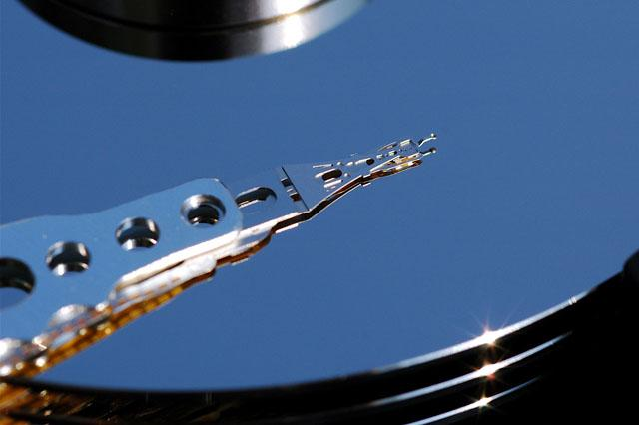
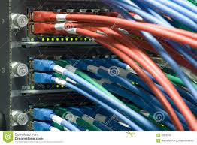
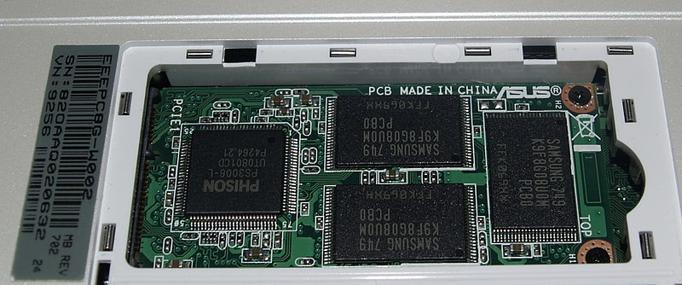
Move data: big and small
Move lots of data
Disk to/from RAM
Network to/from RAM
SSD to/from RAM
Within RAM
Bulk data
Short data: variable-length items
Compress, encrypt, checksum, hash, sort

Slide 68
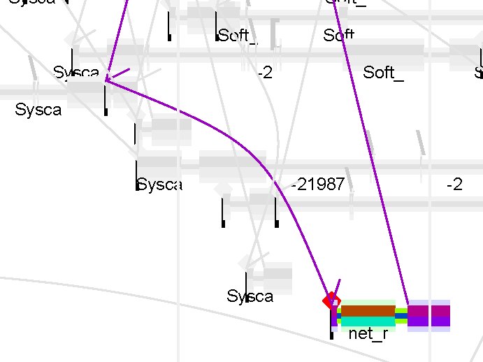
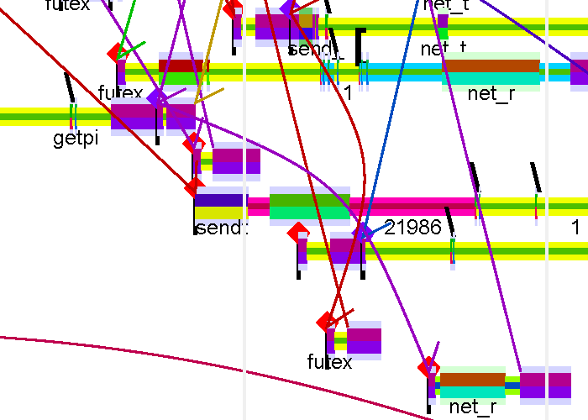
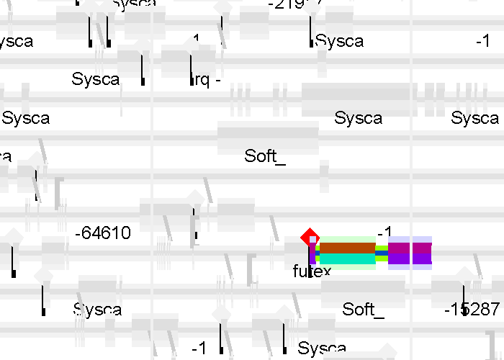
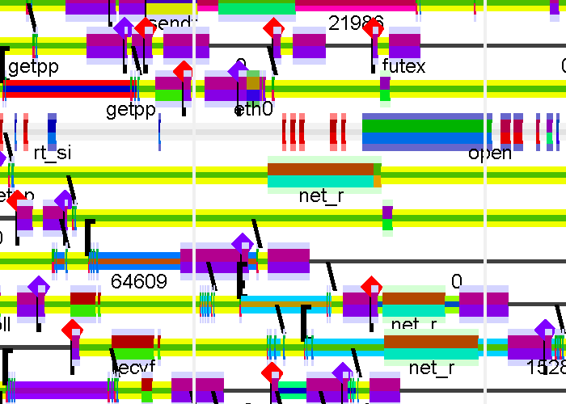
Wakeup Detail
Target CPU was busy; kernel waited
THREADs
50 us
50us
CPU 9 busy;
But 3 was idle
CPUs

Slide 69
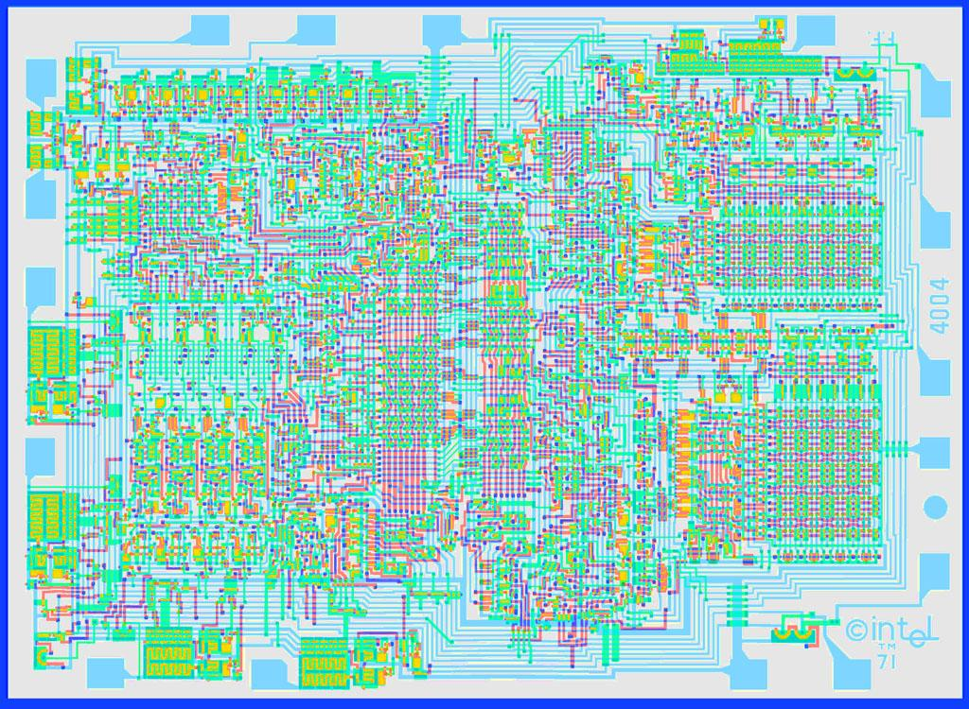
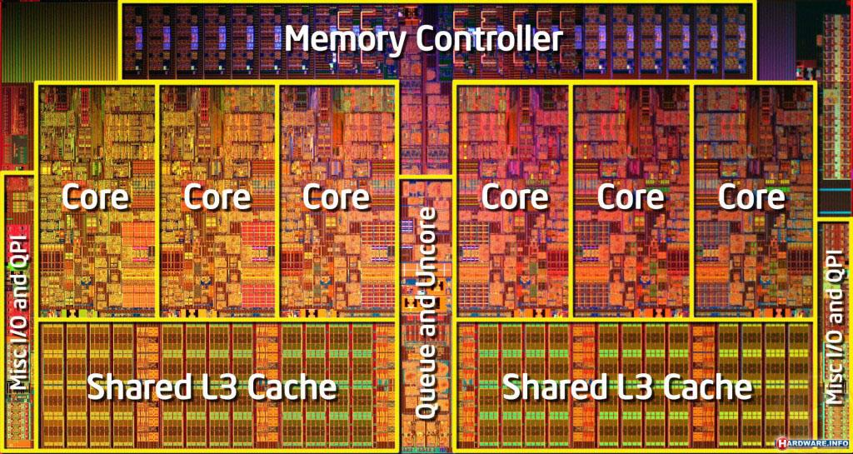
Lots of memory
4004: no memory
i7: 12MB L3 cache

Slide 70
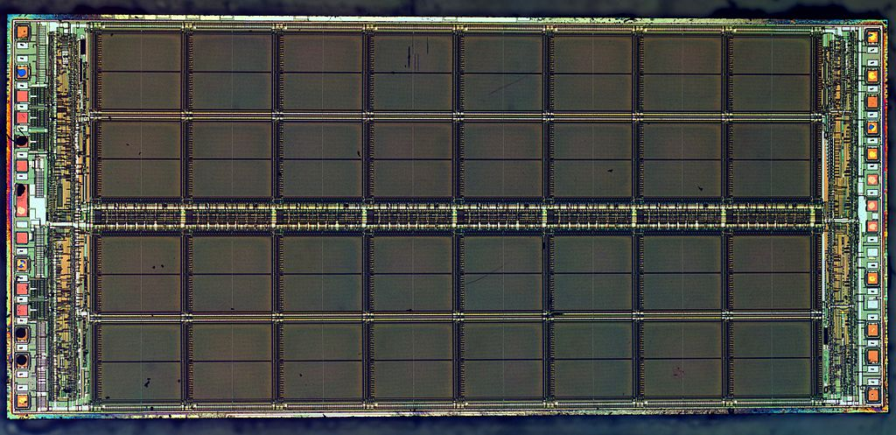
Little brain, LOTS of memory
Server 64GB-1TB
Drinking straw access

Slide 71
② Real-time transactions: 1000s per second

Slide 72
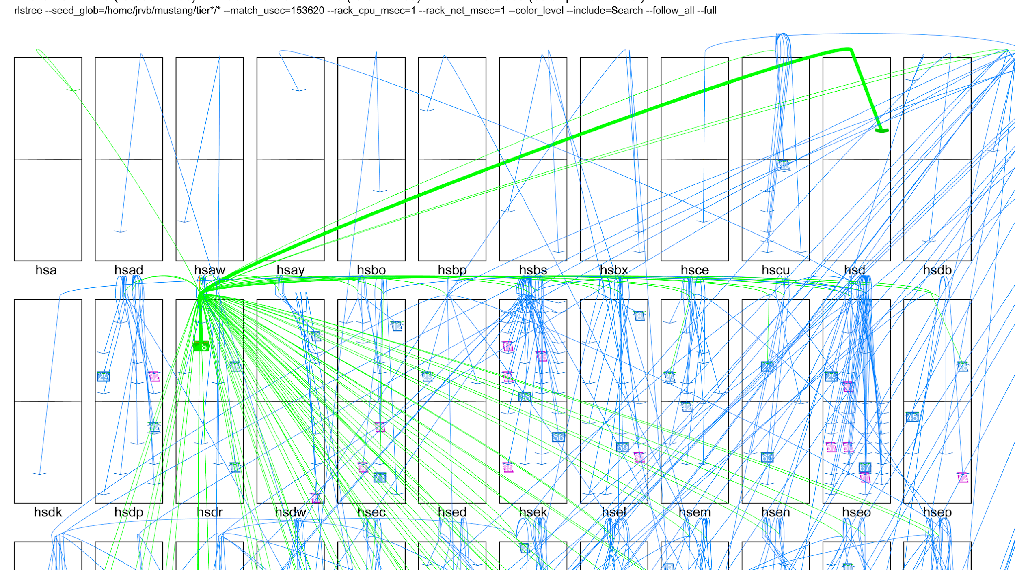
A Single Transaction Across ~40 Racks of ~60 Servers
Each arc is a related client-server RPC (remote procedure call)

Slide 73
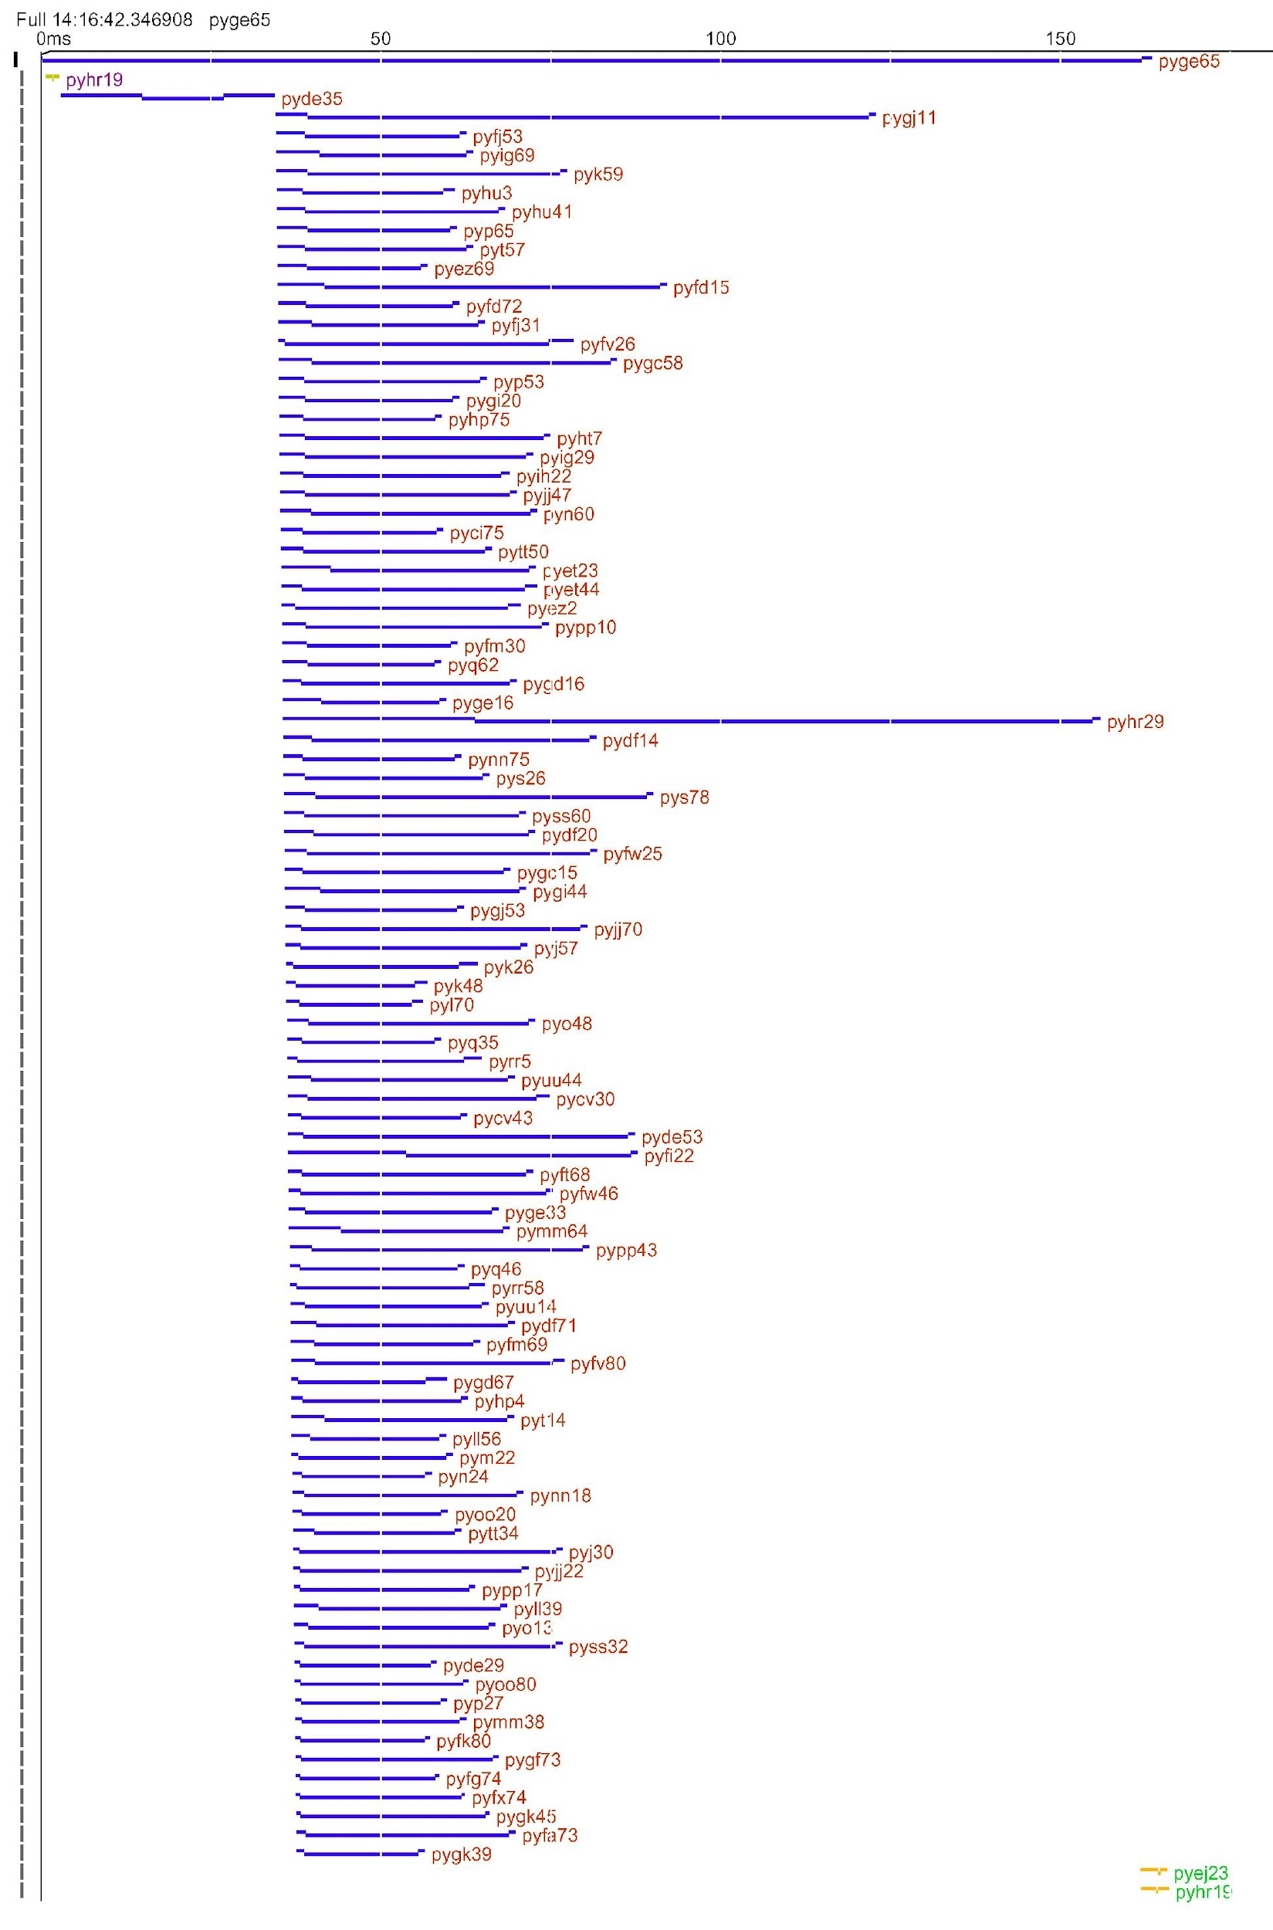
A Single Transaction RPC Tree: Client & 93 Servers
?
?

Slide 74
Single Transaction Tail Latency
Canary transaction

Slide 75
Single Transaction Tail Latency
One slow response out of 93 parallel RPCs slows the entire transaction

Slide 76
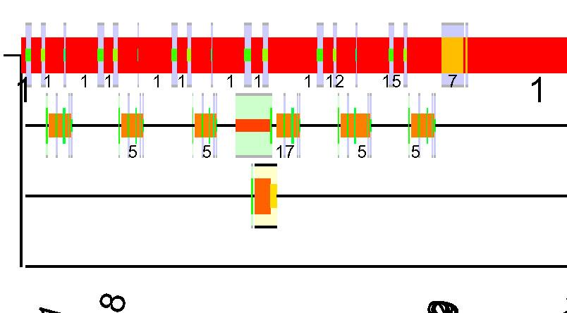
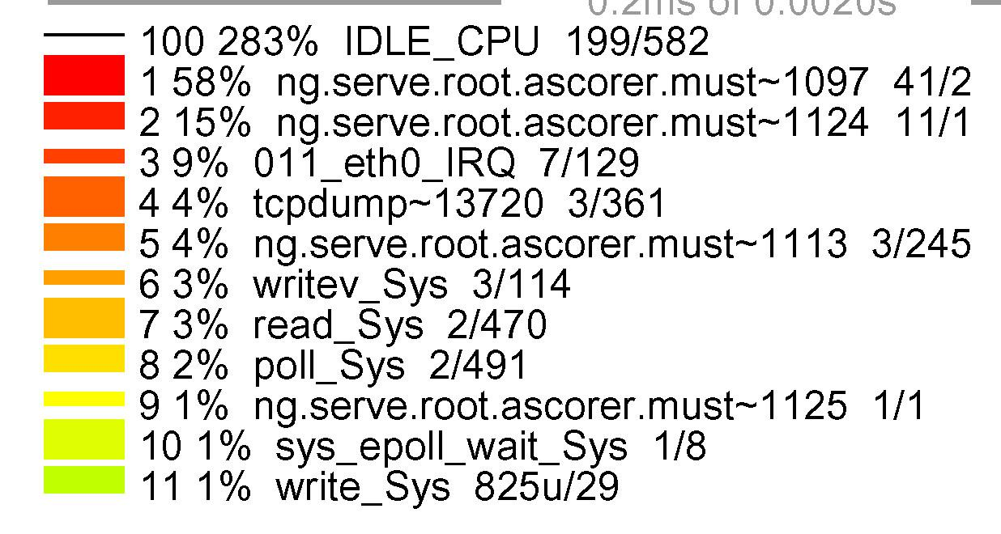
One Server, Four CPUs: User/kernel transitions
every CPU every nanosecond (Ktrace)
CPU 0
CPU 1
CPU 2
CPU 3
200 usec

Slide 77
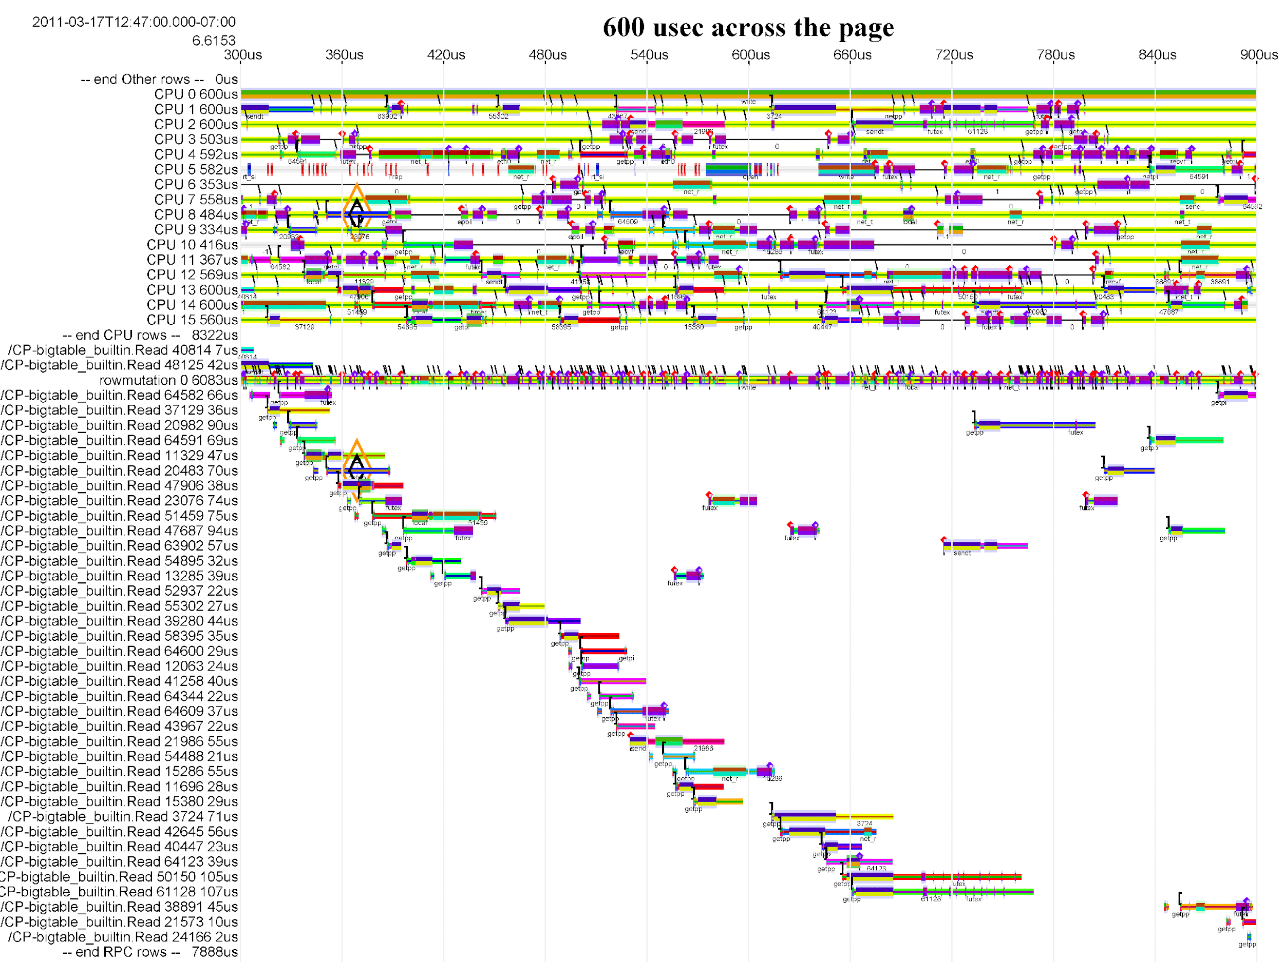
16 CPUs, 600us, Many RPCs
CPUs 0..15
RPCs 0..39

Slide 78
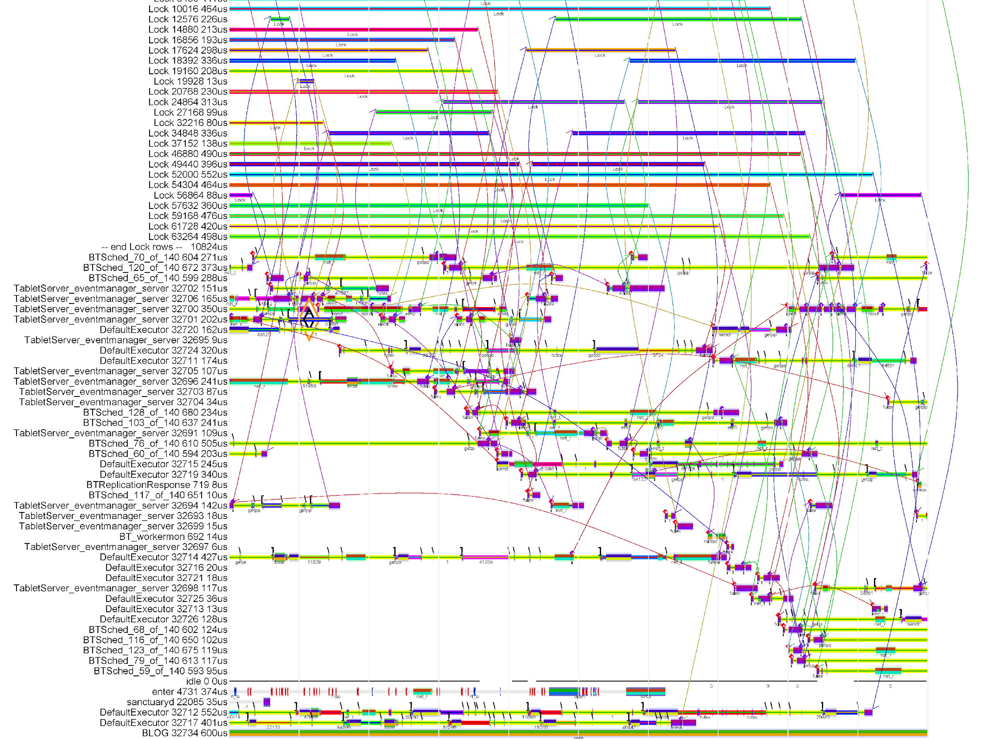
16 CPUs, 600us, Many RPCs
LOCKs 0..22
THREADs 0..46

Slide 79
That is A LOT going on at once
Let’s look at just one long-tail RPC in context

Slide 80
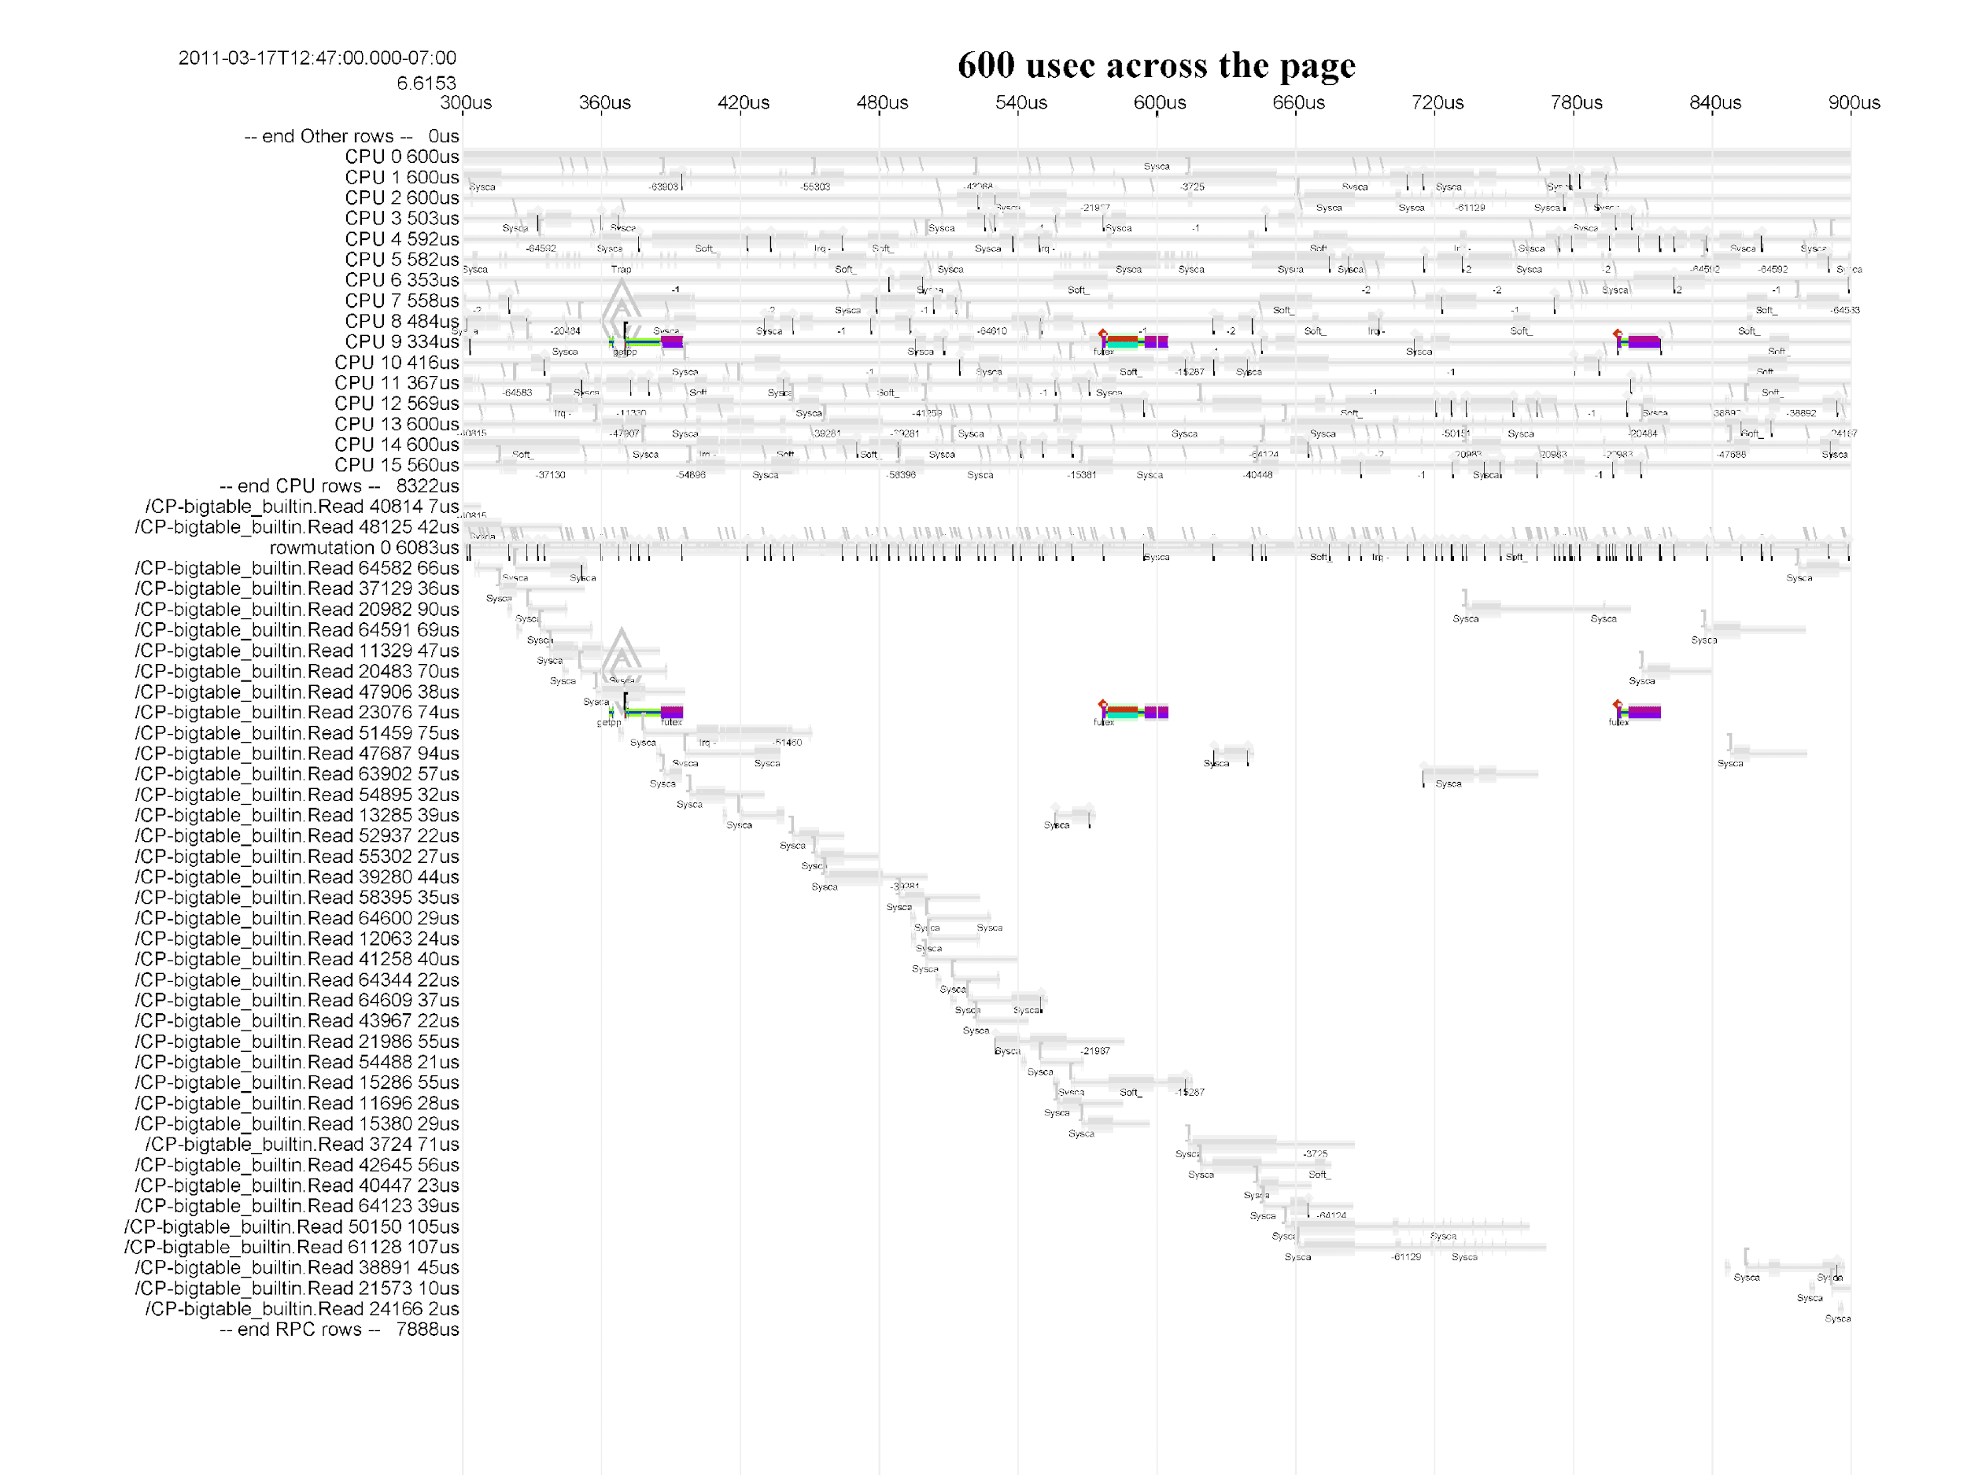
16 CPUs, 600us, one RPC
CPUs 0..15
RPCs 0..39

Slide 81
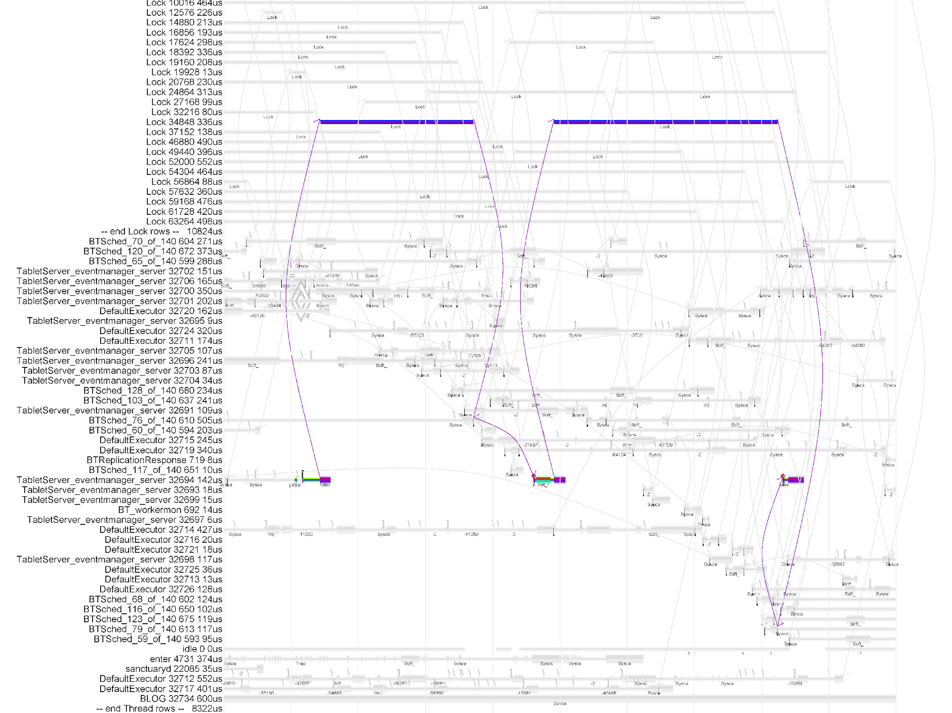
16 CPUs, 600us, one RPC
LOCKs 0..22
THREADs 0..46

Slide 82
Wakeup Detail
Thread 19 frees lock, sends wakeup to waiting thread 25
50us wakeup delay ??
Thread 25 actually runs
50 us

Slide 83
CPU Scheduling, 2 Designs
Re-dispatch on any idle CPU core
But if idle CPU core is in deep sleep, can take 75-100us to wake up
Wait to re-dispatch on previous CPU core, to get cache hits
Saves nothing if could use same L1 cache
Saves ~10us if could use same L2 cache
Saves ~100us if could use same L3 cache
Expensive if cross-socket cache refills
Don’t wait too long…

Slide 84
Real-time transactions: 1000s per second
Not your father’s SPEC benchmarks
To understand delays, need to track simultaneous transactions across servers, CPU cores, threads, queues, locks

Slide 85
Modern challenges in CPU design
A single transaction can touch thousands of servers in parallel
The slowest parallel path dominates
Tail latency is the enemy
Must control lock-holding times
Must control scheduler delays
Must control interference via shared resources
Notes:
29 min

Slide 86
③ Isolation between programs

Slide 87
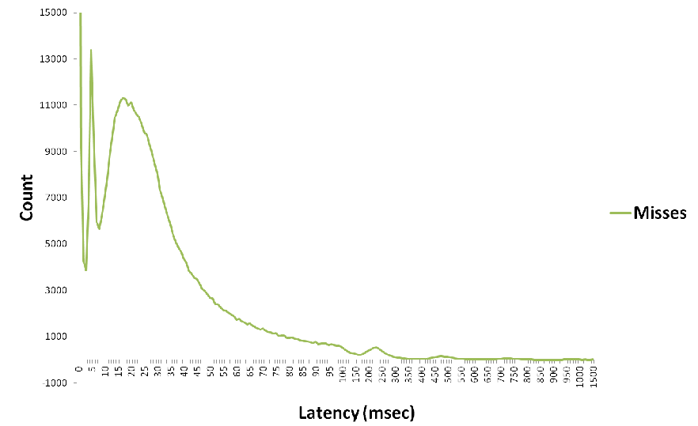
Histogram: Disk Server Latency; Long Tail
Latency 99th %ile = 696 msec

Slide 88
Non-repeatable Tail Latency Comes from Unknown Interference
Isolation of programs reduces tail latency.
Reduced tail latency = higher utilization.
Higher utilization = $$$.

Slide 89
Many Sources of Interference
Most interference comes from software
But a bit from the hardware underpinnings
In a shared apartment building, most interference comes from jerky neighbors
But thin walls and bad kitchen venting can be the hardware underpinnings

Slide 90
Isolation issue: Cache Interference
CPU thread 0 is moving 16B/cycle flat out, filling caches
0 1 2 3
4 5 6 7
…
60 61 62 63 PCs
Core 0
Core 1
Core 15
00000000
L1 caches
L1 caches
…
0000000000000000000
L2 cache
0000000000000000000000000000000000
DRAM
000
DRAM
000
DRAM
DRAM
DRAM
DRAM
DRAM
DRAM
DRAM
DRAM
DRAM
DRAM

Slide 91
Isolation issue: Cache Interference
CPU thread 0 is moving 16B/cycle flat out, filling caches
0 1 2 3
4 5 6 7
…
60 61 62 63 PCs
Core 0
Core 1
Core 15
00000000
L1 caches
L1 caches
…
0000000000000000000
L2 cache
0000000000000000000000000000000000
DRAM
000
DRAM
000
DRAM
DRAM
DRAM
DRAM
DRAM
DRAM
DRAM
DRAM
DRAM
DRAM

Slide 92
Isolation issue: Cache Interference
CPU thread 0 is moving 16B/cycle flat out
Today
Desired
0 1 2 3
4 5 6 7
0 1 2 3
4 5 6 7
Core 0
Core 1
Core 0
Core 1
00000000
77777777
~00112233
~44556677
000000000000000000000…
~000111222333444555666777…

Slide 93
Isolation between programs
Good fences make good neighbors
We need better hardware support for program isolation in shared memory systems

Slide 94
Modern challenges in CPU design
Isolating programs from each other on a shared server is hard
As an industry, we do it poorly
Shared CPU scheduling
Shared caches
Shared network links
Shared disks
More hardware support needed
More innovation needed
Notes:
36 min

Slide 95
④ Measurement underpinnings

Slide 96
Differences from desktop software
Tens of thousands of user-facing transactions per second
Distributed computation across thousands of servers
The important metric is response time, i.e. latency
Excessive tail latency is the most important performance problem
As an industry, we have poor tools for observing and understanding tail latency

Slide 97
Tail latency
Some transactions, total latency for each one
We seek to understand why the one is slow

Slide 98
Easy case
A particular transaction is slow every time it is run
It is straightforward to run the transaction repeatedly offline on a few load-test servers
Existing profiling tools, disk byte counts, network byte counts, etc. will reveal where the time goes

Slide 99
"Interesting" case
A particular transaction is usually fast, but occasionally quite slow
It is only slow under live load during the busiest hour of the day
Running it again it runs fast
Until the reason for slowness is found, we cannot reproduce the problem offline
Existing tools are unable to reveal where the time goes

Slide 100
"Interesting" case -- why it matters
Until the reason for slowness is found, we cannot reproduce the problem offline
At 10,000 transactions/second and no call tree, the 99th percentile slow cases happen 100 times per second
But, for software with 100:1 fanout transaction call trees, almost everything runs at the 99th percentile slow rate
Existing tools are unable to reveal where the time goes

Slide 101
Tail latency
Some transactions, total latency
We seek to understand why the one is slow

Slide 102
Tail latency
Possible tool: average latency
Tells us nothing about the slow one
average

Slide 103
Tail latency
Possible tool: average latency
Tells us nothing about the slow one
Average is the wrong tool for understanding variance
average

Slide 104
Tail latency
Possible tool: latency histogram
Tells us what we have but not why
count
latency

Slide 105
Tail latency
Possible tool: latency histogram
Tells us what we have but not why
Histogram is the wrong tool for understanding variance
count
latency

Slide 106
Tail latency
Possible tool: Profile of CPU time per source function
But where is the slow transaction?
gather_inputs()
process_item()
process_more()
calculate()
produce_output()

Slide 107
Tail latency
Possible tool: Profile of CPU time per source function
But where is the slow transaction?
Profiling is the wrong tool for understanding variance
gather_inputs()
process_item()
process_more()
calculate()
produce_output()

Slide 108
Profiling: the wrong tool for understanding variance
Possible tool: Profile of CPU time per source function
It merges together many normal transactions with few slow ones, hiding the 1% signal in 99% noise
gather_inputs()
process_item()
process_more()
calculate()
produce_output()

Slide 109
Tail latency
Possible tool: Profile of CPU time per source function
But where is the slow transaction?
CPU Profiling is the wrong tool for a second reason ...
gather_inputs()
process_item()
process_more()
calculate()
produce_output()

Slide 110
CPU Profiling: the wrong tool for a second reason
Some transactions, total time
The delay may not be using CPU time at all; it may be waiting for something. CPU profiling is blind to non-CPU wait time

Slide 111
Tail latency
Possible tool: trace events for each transaction
Now we can see what is different about the slow one.
But we don't know why it is different

Slide 112
Tail latency
Possible tool: trace events for each transaction, lined up in time
Now we can see what is different about the slow one.
And the time alignment of 6's end-of-green (A) with 8's green blocking until B.
1
2
3
A
4
5
6
7
B
8
9
10

Slide 113
Tail latency
Possible tool: trace events for each transaction, lined up in time
More detailed events at A or B will reveal the reason for starting or stopping blocking. (Possibly a race condition or a contended software lock.)
1
2
3
A
4
5
6
7
B
8
9
10

Slide 114
Tail latency, summary
Average is the wrong tool for understanding variance
Histogram is the wrong tool for understanding variance
Profile is the wrong tool for understanding variance
Event tracing is a good tool for understanding variance
Event tracing lined up in time is a great tool for understanding variance --
it can show causes of delay directly
More detailed events at A or B will reveal the reason for starting or stopping blocking. (Possibly a race condition or a contended software lock.)

Slide 115
Trace: Disk Server, 13 disks, 1.5 sec
Latencies: 250ms, 500ms, … for nine minutes
5
4
4
Read
Read hit
Write
Write hit

Slide 116
Why?
Probably not on your guessing radar…
Kernel throttling the CPU use of any process that is over purchased quota
Only happened on old, slow servers

Slide 117
Disk Server, CPU Quota bug
Understanding Why sped up 25% of entire disk fleet worldwide!
Had been going on for three years
Savings paid my salary for 10 years
Hanlon's razor: Never attribute to malice that which is adequately explained by stupidity.
Sites’ corollary: Never attribute to stupidity that which is adequately explained by software complexity.
4

Slide 118
Measurement Underpinnings
All performance mysteries are simple once they are understood
“Mystery” means that the picture in your head is wrong; software engineers are singularly inept at guessing how their view differs from reality

Slide 119
Modern challenges in CPU design
Need low-overhead tools to observe the dynamics of performance anomalies
Transaction IDs
RPC trees
Timestamped transaction begin/end
Traces
CPU kernel+user, RPC, lock, thread traces
Disk, network, power-consumption
Notes:
43 min

Slide 120
Summary: Datacenter Servers are Different

Slide 121
Datacenter Servers are Different
① Move data: big and small
② Real-time transactions: 1000s per second
③ Isolation between programs
④ Measurement underpinnings

Slide 122
References
Claude Shannon, A Mathematical Theory of Communication, The Bell System Technical Journal, Vol. 27, pp. 379–423, 623–656, July, October, 1948.
http://cs.ucf.edu/~dcm/Teaching/COP5611-Spring2013/Shannon48-MathTheoryComm.pdf
Richard Sites, It’s the Memory, Stupid!, Microprocessor Report August 5, 1996.
http://cva.stanford.edu/classes/cs99s/papers/architects_look_to_future.pdf
Ravi Iyer, CQoS: A Framework for Enabling QoS in Shared Caches of CMP Platforms, ACM International Conference on Supercomputing, 2004.
http://cs.binghamton.edu/~apatel/cache_sharing/CQoS_iyer.pdf
M Bligh, M Desnoyers, R Schultz , Linux Kernel Debugging on Google-sized clusters, Linux Symposium, 2007
https://www.kernel.org/doc/mirror/ols2007v1.pdf#page=29

Slide 123
References
Daniel Sanchez and Christos Kozyrakis , The ZCache: Decoupling Ways and Associativity. IEEE/ACM Symp. on Microarchitecture (MICRO-43), 2010.
http://people.csail.mit.edu/sanchez/papers/2010.zcache.micro.pdf
Benjamin H. Sigelman, Luiz Andre Barroso, Mike Burrows, Pat Stephenson, Manoj Plakal, Donald Beaver, Saul Jaspan, Chandan Shanbhag, Dapper, a Large-Scale Distributed Systems Tracing Infrastructure, Google Technical Report dapper-2010-1, April 2010
http://scholar.google.com/scholar?q=Google+Technical+Report+dapper-2010-1&btnG=&hl=en&as_sdt=0%2C5&as_vis=1

Slide 124
References
Daniel Sanchez, Christos Kozyrakis, Vantage: Scalable and Efficient Fine-Grained Cache Partitioning, Symp. on Computer Architecture ISCA 2011.
http://ppl.stanford.edu/papers/isca11-sanchez.pdf
Luiz André Barroso and Urs Hölzle , The Datacenter as a Computer An Introduction to the Design of Warehouse-Scale Machines, 2nd Edition 2013.
http://www.morganclaypool.com/doi/pdf/10.2200/S00516ED2V01Y201306CAC024

Slide 125
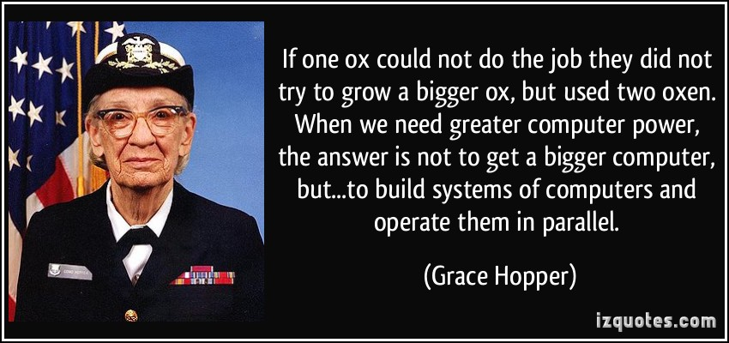
Thank You, Questions?

