Slide 1
P51a - KUtrace
Andrew W. Moore
With many slides adapted or stolen from Dick Sites Comp790 material

Slide 2
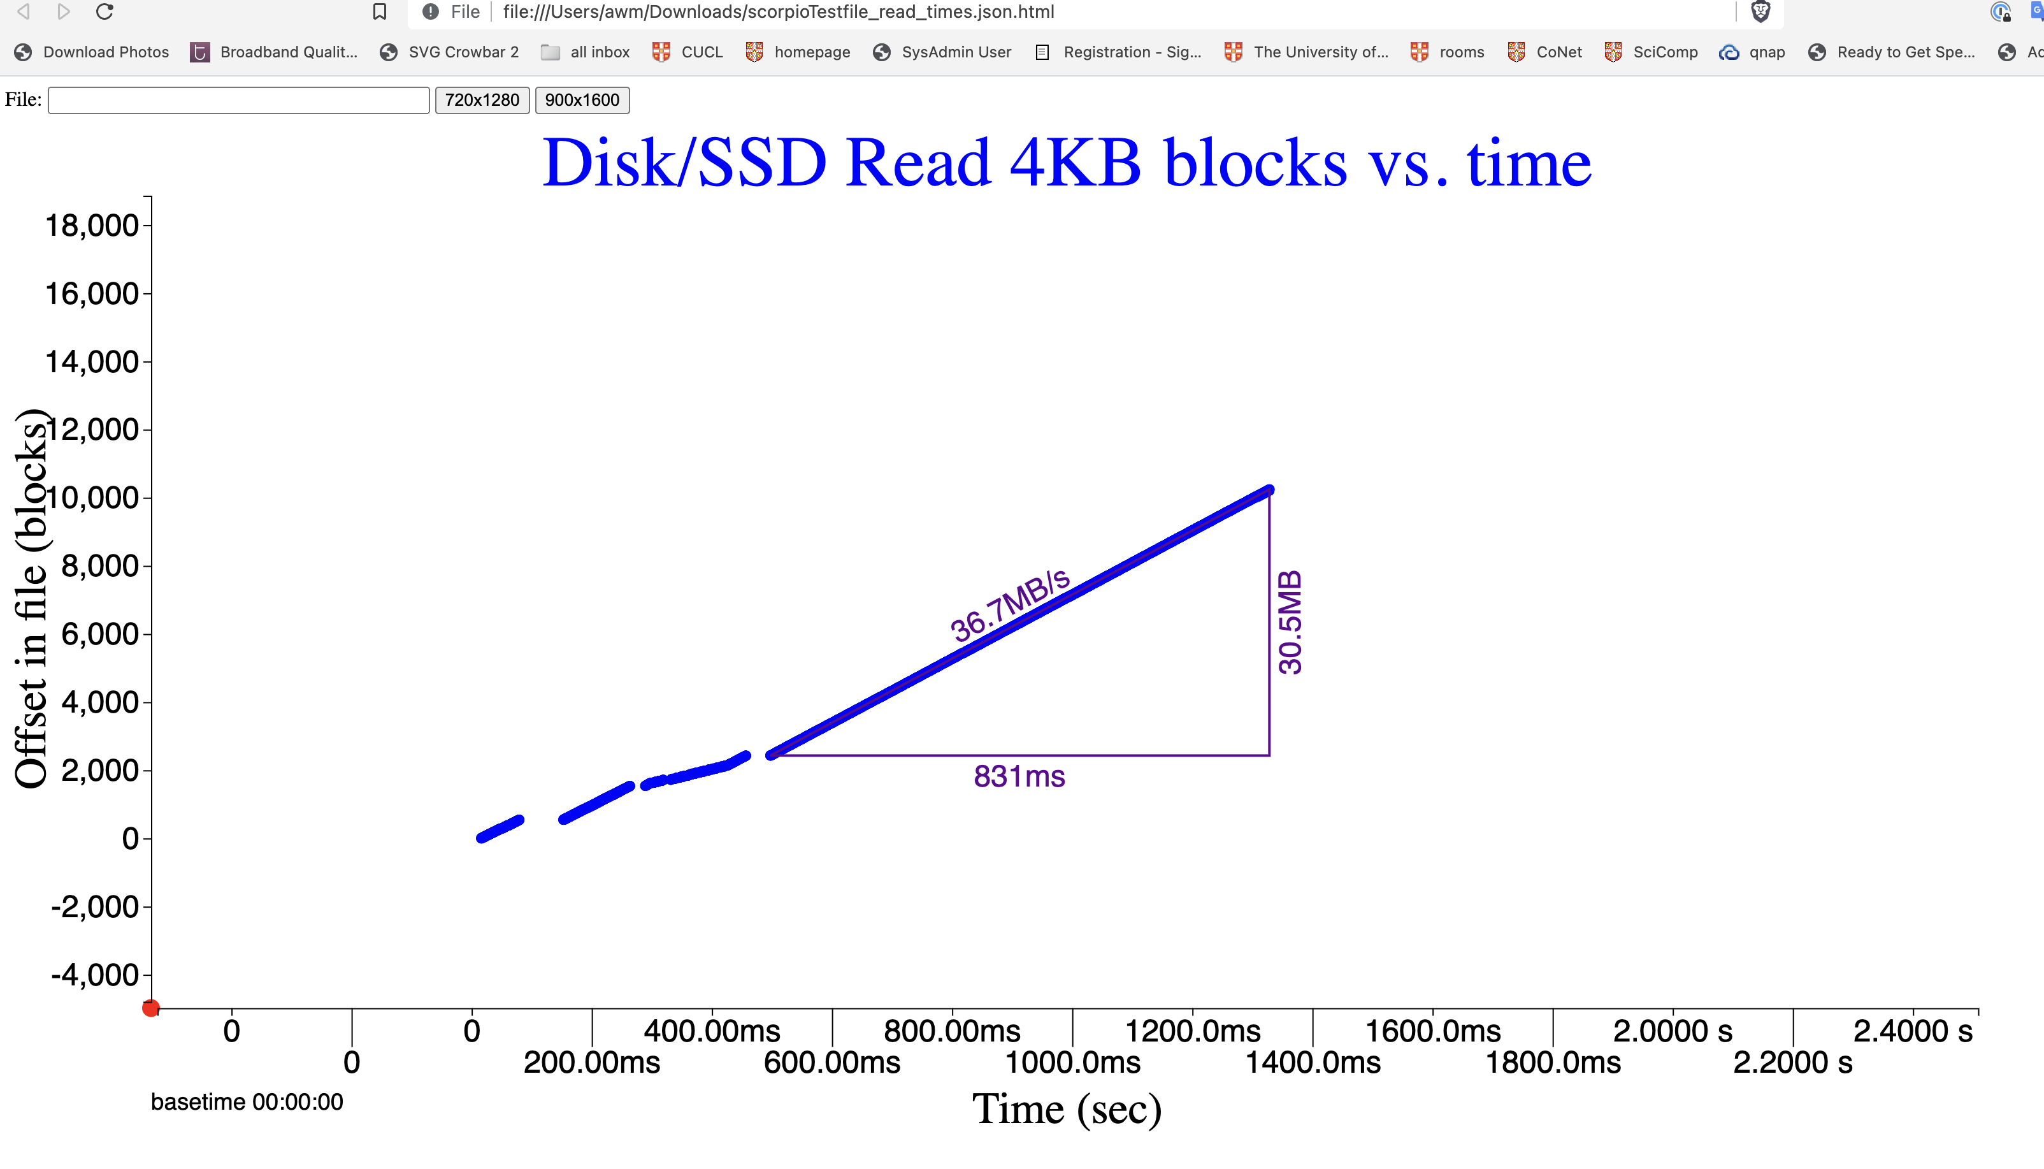
Disk / time / throughput measuring tool
(left shift and drag, it will snap)

Slide 3
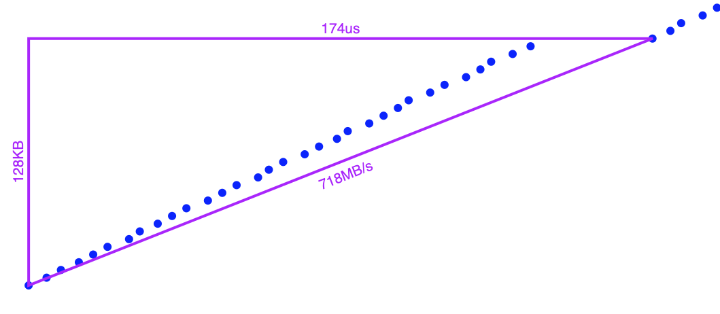
HTML: shift-click-drag for measurement triangle

Slide 4
Why are our lives so hard?
Computers do not behave the way we want them to.
Multiplexing is both wonderful and a pain
Quality of service cross-talk
We don’t have exclusive access to all the things we need
  If we did – life would be VERY expensive.
We don’t share well and sometimes….

Slide 5
Many Sources of Interference
Most interference comes from software
But a bit from the hardware underpinnings
In a shared college stairwell, most interference comes from jerky neighbors
But thin walls and bad kitchen venting maybe the hardware underpinnings

Slide 6
Kernel-user tracing

Slide 7
Recall: Measurement methods
Trade intrusiveness vs. overhead vs. information vs. complexity
Trace information in a program is useful.
  “printf” as debugging tool?
The kernel (operating system) is a program too….
KUtrace specifically traces transitions across the KERNEL/USER barrier

Slide 8
What is KUtrace?
A complete trace of all transitions between kernel mode and user mode on all CPU cores of one server machine.
Minimal events to assign 100% of the CPU time for all cores
Not so many events that tracing quickly is impractical
Can be postprocessed into complete timelines
Tracing is the only tool that can capture unexpected interactions or interference between programs

Slide 9
Kernel-User implementation

Slide 10
control
on/off/
etc.
Linux
Kernel
User
code
User
code
User
code
trace
mod
post-
proc.
syscall, interrupt,
trap, context switch
trace buffer in kernel RAM

Slide 11
kutrace_control program
$ ./kutrace_control
> go
> stop
ku_xxxx.trace written

Slide 12
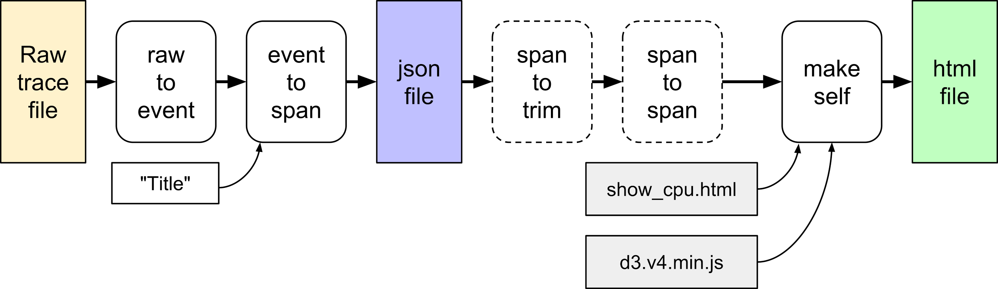
Postprocessing

Slide 13
Postprocessing quick summary
export LC_ALL=C
cat ku_xxxx.trace |./rawtoevent | sort -n | ./eventtospan "title" | sort > ku_xxxx.json
cat ku_xxxx.json | ./makeself show_cpu >ku_xxxx.html
google-chrome ku_xxxx.html

Slide 14
rawtoevent

Slide 15
rawtoevent
Convert raw binary trace file to readable text lines, one per event
extend timestamps, convert to 10ns increments
linear interpolation between trace start/end time pairs:
<gettimeofday, time counter>
propagate cpu, pid, rpcid
so every event has each value
put in names
so every event has the syscall name, IRQ name, process name, etc.

Slide 16
rawtoevent output sample (text)
# [1] 2018-06-24_12:48:58.335301
# T DUR EVENT CPU PID RPC (10ns time)
| | | | | | ARG0 RETVAL IPC NAME
| | | | | | | | | |
5940928129 0 1038 3 10870 0 0 0 13 page_fault (40e)
5940928563 0 1550 3 10870 0 0 0 10 /page_fault (60e)
5940928949 0 2050 3 10870 0 7520 0 13 open (802)
5940929482 0 2562 3 10870 0 0 3 13 /open (a02) not merged, dur > 255
5940929517 0 2048 3 10870 0 3 0 0 read (800)
5940929761 0 2560 3 10870 0 0 832 2 /read (a00) not merged, ret > 127
5940929967 59 2053 3 10870 0 3 0 3 fstat (805) merged call/ret
5940930094 0 2057 3 10870 0 0 0 0 mmap (809) ...

Slide 17
Ten event fields
timestsamp Start time for a span in seconds and fractions. For easy correlation with logs and other files, the seconds part be offset from an exact multiple of one minute in the gettimeofday() time domain, rather than starting at zero.
duration Duration of a span in seconds and fractions.
cpu CPU number as a small integer.
pid Process ID (actually thread ID; the kernel calls this "pid"), low 16 bits.
rpcid RPC ID for datacenter work; may be used for anything
event Event number that starts the time span. Values 0-512 are names, markers, and other specials. 512-4096 kernel events system call, interrupt, fault. 64K+pid are user-mode.

Slide 18
Ten event fields
arg0 The low 16 bits of the first argument to a syscall, else 0.
retval For a call/return span, the low 16 bits of the return value. Byte counts, etc. can
be considered unsigned. Return codes can be considered signed.
ipc Instructions per cycle, quantized via truncation into 4 bits.
Values 0-7 are multiples of 0.125 IPC, i.e. less than one instruction per cycle.
Values 8-11 are 1.0, 1.25, 1.5, and 1.75 IPC.
Values 12-15 are 2.0, 2.5, 3.0, and 3.5+ IPC.
name Name of the kernel routine or user PID (originally from the kernel 16-byte command
field per pid). These names come from naming entries in the raw trace itself.

Slide 19
eventtospan

Slide 20
eventtospan
Convert event text file to timespans, formatted as proper JSON
Start a timespan at each call transition, end it at each return transition
Run a small stack of pending executions: Before call, push current execution name, after return pop back to previous. This is how we know what is running after each return.
If a process migrates to a different CPU core, migrate its execution stack also.
Add synthetic sine waves to indicate coming out of deep sleep
Add some causality arcs from make-runnable to that process actually running

Slide 21
eventtospan output sample (JSON)
# T DUR CPU PID RPC EVENT
| | | | | | ARG0 RET IPC NAME
| | | | | | | | | |
[ 59.40928129, 0.00000434, 3, 10870, 0, 1038, 0, 0, 10, "page_fault"],
[ 59.40928563, 0.00000386, 3, 10870, 0, 76406, 0, 0, 13, "bash.10870"],
[ 59.40928949, 0.00000533, 3, 10870, 0, 2050, 7520, 3, 13, "open"],
[ 59.40929482, 0.00000035, 3, 10870, 0, 76406, 0, 3, 0, "bash.10870"],
[ 59.40929517, 0.00000244, 3, 10870, 0, 2048, 3, 832, 2, "read"],
[ 59.40929761, 0.00000206, 3, 10870, 0, 76406, 0, 832, 3, "bash.10870"],
[ 59.40929967, 0.00000059, 3, 10870, 0, 2053, 3, 0, 0, "fstat"],
[ 59.40930026, 0.00000068, 3, 10870, 0, 76406, 0, 832, 0, "bash.10870"],
[ 59.40930094, 0.00000300, 3, 10870, 0, 2057, 0, 12288, 9, "mmap"],

Slide 22
Transitions vs. timespans: 12 raw trace entries
Time Event delta,ret,arg0
22c51 5fd 0000 0000 reschedule_ipi interrupt
22ca3 9ff 0000 0000 enter scheduler
22d19 200 0000 434d context switch(17229)
22d77 bff 0000 0000 exit scheduler
22ea6 40e 0000 0000 fault page fault
2303c 60e 0000 0000 faultreturn page fault
230a1 20a 0003 ef1a mark_a("read")
2334d 40e 0000 0000 fault page fault
2348a 60e 0000 0000 faultreturn page fault
234a8 88f 7b00 434d syscall+ret sched_getparam
23593 891 1c00 434d syscall+ret sched_getscheduler
2378e 40e f500 0000 fault+ret page fault

Slide 23
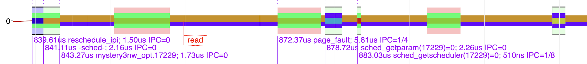
Transitions vs. timespans: 12 raw trace entries
+- 22c51 5fd +- 2334d 40e
| +- 22ca3 9ff | +- 2348a 60e
| | +- 22d77 bff | |
| | |+- 22d19 200 0000 434d | |+-+- 234a8 88f 7b00 434d
| | || +- 22ea6 40e | || | ++- 23593 891 1c00 434d
| | || | +- 2303c 60e | || | || +----+- 2378e 40e f500 0000
| | || | | +- 230a1 20a 0003 ef1a || | |
| | || | | | | || | || | |

Slide 24
JSON format

Slide 25
JSON; note leading spaces to sort properly
{
"Comment" : "V2 with IPC field",
"axisLabelX" : "Time (sec)",
"axisLabelY" : "CPU Number",
"flags" : 128,
"shortMulX" : 1,
"shortUnitsX" : "s",
"thousandsX" : 1000,
"title" : "Hello World",
"tracebase" : "2018-01-18_22:54:21",
"version" : 2,
"events" : [
[ 23.66655382, 0.00000218, 2, 1995, 0, 2055, 59216, 1, 0, "poll"],
...
[999.0, 0.0, 0, 0, 0, 0, 0, 0, 0, ""]
]}

Slide 26
Postprocessing
browser

Slide 27
KUtrace display of timelines

Slide 28
Play with the html interface
(on each pi)
~/KUtrace/hello_world_demo.json
and it’s
~/KUtrace/hello_world_demo.html
Make a copy to your own machine, display, and play.
Textbook Chapter 19 pp257-266 provide a manual for the GUI
The following slides provide insight into the design decisions.

Slide 29
Display issues
Problem:
Possibly 1-10 million execution spans to display
Solutions:
spantospan reduces granularity, so fewer spans
spantotrim keeps only a subset time interval, so fewer spans
HTML initially shows entire trace at modest resolution, allows user to pan and zoom to reveal detail at various different places.
HTML elides spans that are narrower than 1 pixel, combining several until they total at least one pixel. The total is then displayed with a single-color line, not three or four different colors -- just idle or kernel or user.

Slide 30
Display issues
Problem:
Showing different processes or syscalls in different colors is too hard to distinguish -- only about 12-20 distinct colors on screen
Solutions:
Use pairs of colors, PID mod 15 to pick one, PID mod 17 to pick the other, giving 15x17 = 255 combinations total. Display as two stacked vertical lines.
For kernel-mode, add third lightened background color to distinguish syscall, interrupt, and fault code.

Slide 31
Display issues
Problem:
Display CPU timelines plus PID timelines plus RPC timelines, but now the vertical dimension is too crowded
Solutions:
Group the spans: CPU, PID, RPC
Make groups collapsible, and by default collapse PID and RPC.
Allow Y-axis to pan and zoom
Suppress lines whose non-idle content is off-screen
Allow shift-click on Y-axis labels to highlight one or more only
Allow shift-click on group labels to collapse un-highlighted rows
Show vertically narrow spans as single-color lines, to speed up display

Slide 32
Display issues
Problem:
Color-blind users
Solutions:
Try limited gray-scale combinations of three lines per span -- fails
Try color-Brewer color-blind safe colors http://colorbrewer2.org -- fails with not enough distinct colors (about 7-9).
Equal-luminance and thus low-contrast syscall/IRQ/fault background colors are particularly problematic. So add high-contrast one-pixel edges -- black, gray, white
Add CB button that simply toggles RGB channels to GBR

Slide 33
Display issues
Problem:
Too many digits in X-axis time labels
Solutions:
Give overall base (start) time in HH:MM:SS and then just seconds from there on the X-axis.
When zoomed in, move millisecond digits to base time and just give milliseconds from there on the X-axis.
When zoomed in further, move millisecond and microsecond digits to base time and just give microseconds from there on the X-axis.
Change axis units to match

Slide 34
More display issues
easy to get lost -- how to get back? -- red button
hard to get overview -- user button to label all processes, just first instance, short names
hard to click on one span at a time to see detail -- all button to label all spans on screen
want to know details about one span -- long label has start time, full name, syscall(arg)=ret, process id, duration, IPC.
Labels overlap -- stack them vertically in ~3 tracks, use semi-opaque white background
labelling all takes forever to display when 1M spans -- at most one label start per pixel location
same with search results

Slide 35
More display issues
easy to lose place after pan/zoom -- retain nearest label and redisplay it after pan/zoom
want grid, but not intrusive -- almost-white vertical grid lines
straight-line wakeup arrows blend into span lines, not visible if overlapping -- curve them
want to search for unusually long or short spans -- usec min/max range
can't find a particular rarely-executed process -- use search by name or pid number
hard to distinguish IPC triangle angles -- color-code groups of four, notch alternate shapes

Slide 36
More display issues
want to see total time for particular spans -- search result gives count and total time
want labels to show which row they label -- put just underneath that row
want to line up labelled items across different rows -- extend solid line below label row, dotted line above
want to determine time between events -- click-drag snaps to event row and start time, giving elapsed time

Slide 37
More display issues
clutter from too many identical PID labels -- only label user-mode once at first time from left edge
clutter from too many marks -- suppress if too close together, button to suppress them all
clutter from IPC triangles -- suppress if too close together or X width is too small, button to suppress them all, off by default
too much clutter with wakeup arcs -- suppress short ones if X width is too small, button to suppress them all

Slide 38
More display issues
in a presentation, want to quickly show specific subsets of a trace -- 1..5 buttons to save/restore pan, zoom, and buttons
fonts too small for presentations -- click title to change font sizes
explain UI without taking much space -- single Usage() line at bottom, with [more} to expand to a screenful of detail

