Slide 1
P51(bis): High Performance Networked-Systems
Prof. Andrew W. Moore
Part 2
Finally, a huge thank you to Eben Upton, Raspberry Pi Foundation, and PiHut people for enabling this incarnation of the module at incredibly short notice.

Slide 2
X§xcSo you want to know what is going on….

Slide 3
Lessons from Lab1
Ping isn’t the best tool for latency measurements
Iperf isn’t the best tool for bandwidth measurements
Control, variability, accuracy, ….
If you didn’t conclude that; go back and look at your results….
What should you expect? (do the math)

Slide 4
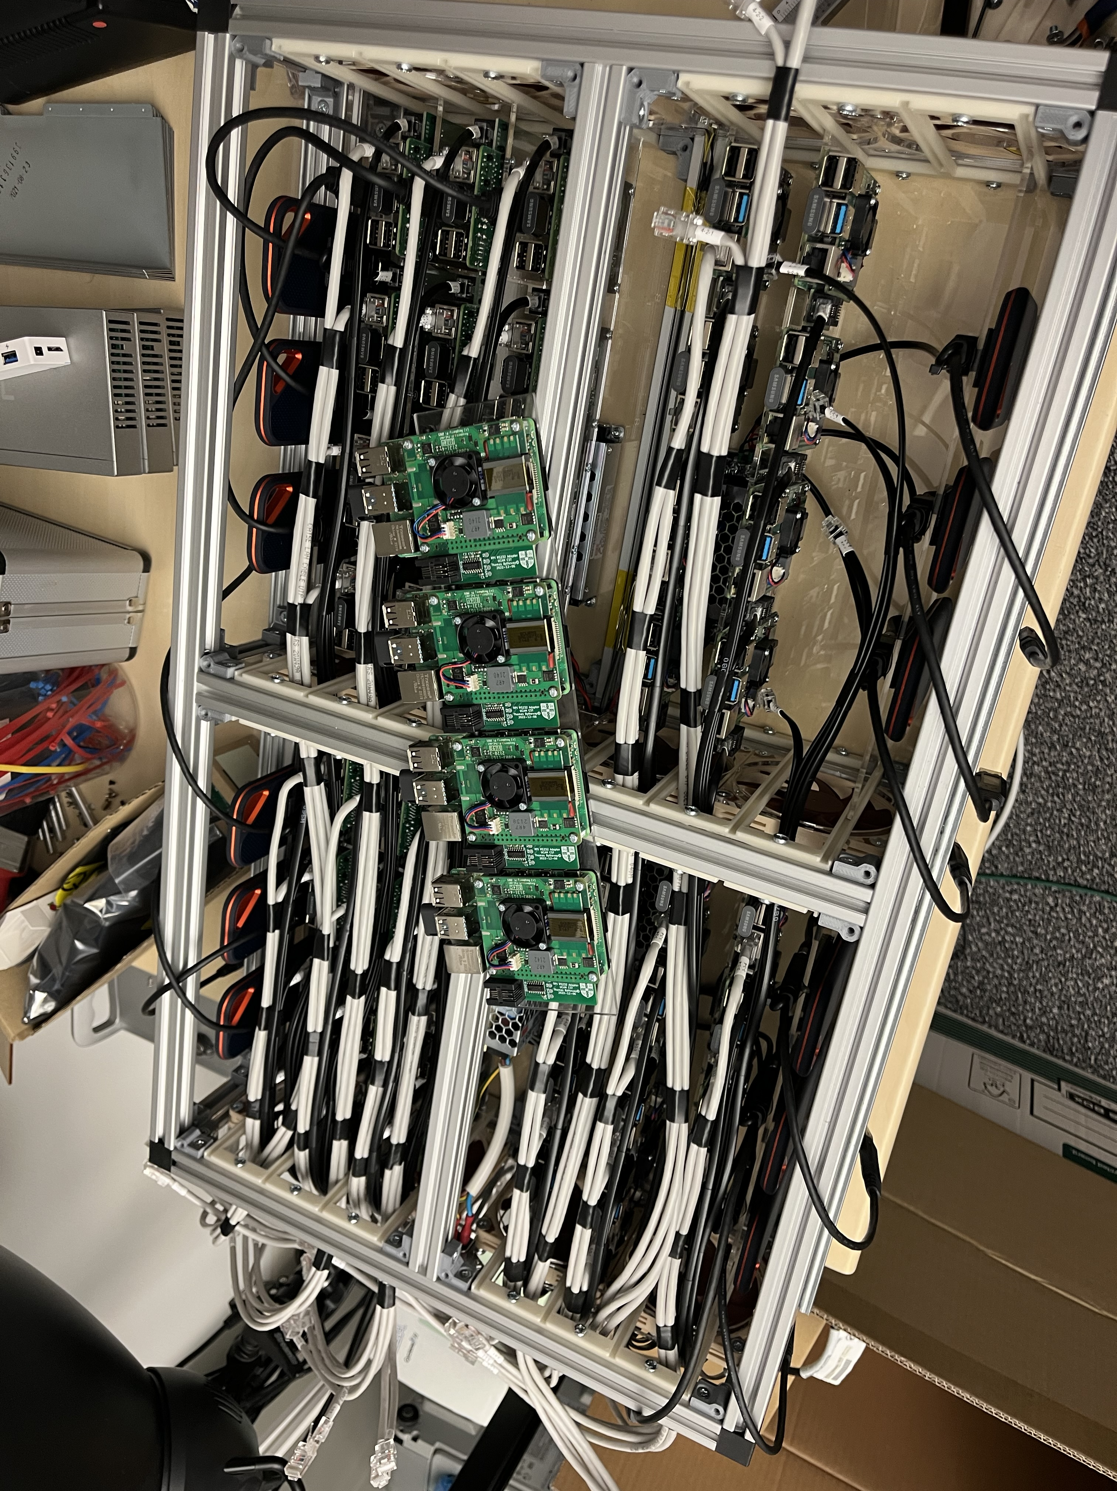
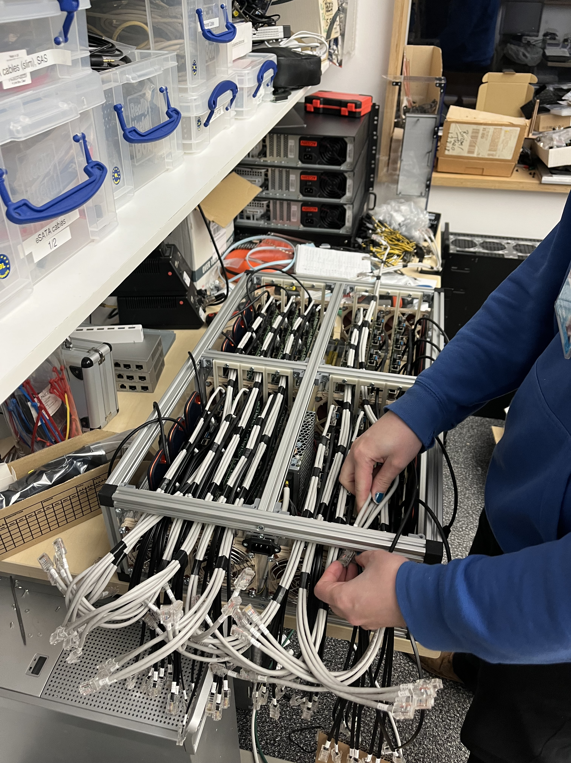
Ethernet switch (48 x 1Gbps)
1m
Twisted pair (UTP)
1Gbps
1m
Twisted pair (UTP)
1Gbps
? Delay ?
? Delay ?
? Delay ?
? Delay ?
? Delay ?
<0.4ns
Latency < 10 µs
<0.4ns

Slide 5
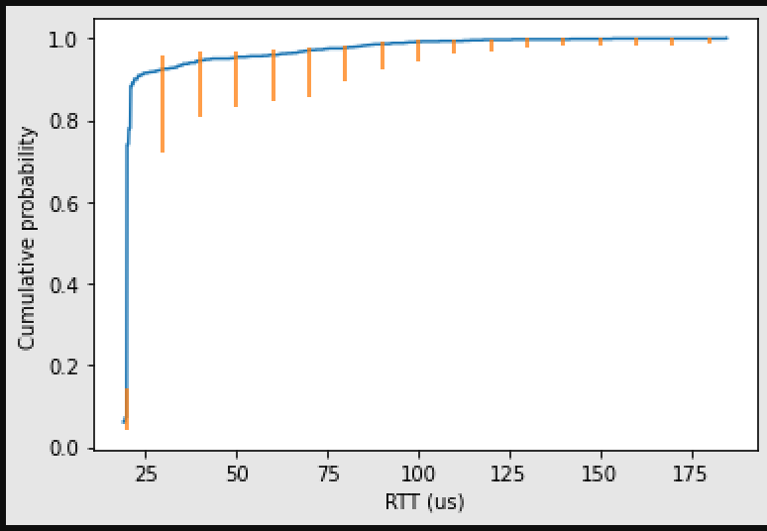
Ethernet switch (48 x 1Gbps)
1m
Twisted pair (UTP)
1Gbps
1m
Twisted pair (UTP)
1Gbps
<0.4ns
Latency < 10 µs
<0.4ns

Slide 6
Ethernet switch (48 x 1Gbps)
1m
Twisted pair (UTP)
1Gbps
1m
Twisted pair (UTP)
1Gbps
<0.4ns
Latency < 10 µs
<0.4ns
Ping reported ~90% results ~20 µs so ~2 x switch…. plus a bit….

Slide 7
Ethernet switch (48 x 1Gbps)
1m
Twisted pair (UTP)
1Gbps
1m
Twisted pair (UTP)
1Gbps
<0.4ns
Latency < 10 µs
<0.4ns
Ping reported ~90% results ~20 µs so ~2 x switch…. plus a bit….

Slide 8
So even if the end hosts added no extra time (they do); what about the rest of the 150µs?
Systematic errors: clocks, speed of light
Non-systematic errors: scheduling in host, competing demands on resources,
BUFFERING in the switch
“Where has my time gone?” https://www.repository.cam.ac.uk/handle/1810/263038

Slide 10
queue

Slide 11
Example: Network Congestion
queue

Slide 12
How to control generated traffic?
What is the packet format? (e.g. protocol, payload)
How many packets?
What is the packet size(s)?
What is the average data rate?
What is the peak data rate? (e.g. burst control)
…

Slide 13
Traffic Generation Tools
$$$$$, Hardware, high quality (Ixia, Spirent,..)
$$ Software/hardware based, medium quality (OSNT, MoonGen,…)
Commodity, Software, low quality
(TCPReply,… )

Slide 14
TCP Replay
Free, software-based
Replays network traffic stored in pcap files
Not just TCP
(not just pcap)
Included in Linux
Packets are sent according to pcap file timestamps

Slide 15
Software based traffic generators
Traditional tools (e.g., D-ITG, trafgen):
Rely on the interface provided by the kernel for packet IO
Modern tools (e.g., MoonGen, pktgen, zsend):
Use special frameworks which bypass the network stack of an OS
Optimized for high speed and low latency
Cost: compatibility and support for high-level features

Slide 16
MoonGen (Lab 3)
A packet generator for ≥10 Gbit/s Ethernet
Uses DPDK (an Intel originated idea – optimised for CPU consumption)
A set of libraries and drivers for fast packet processing
(Sub-)microsecond timestamp accuracy
Using the NIC
Rate control

Slide 17
OSNT (Labs 2+3)
Open source hardware/software traffic generator and capture system
Built on top of NetFPGA platform
Traffic generation using pcap file (currently)
Rate controlled in hardware
~6ns resolution
Recall (for 10Gb/s)
10bits = 1ns and 1us ≅ 1kByte packet

Slide 18
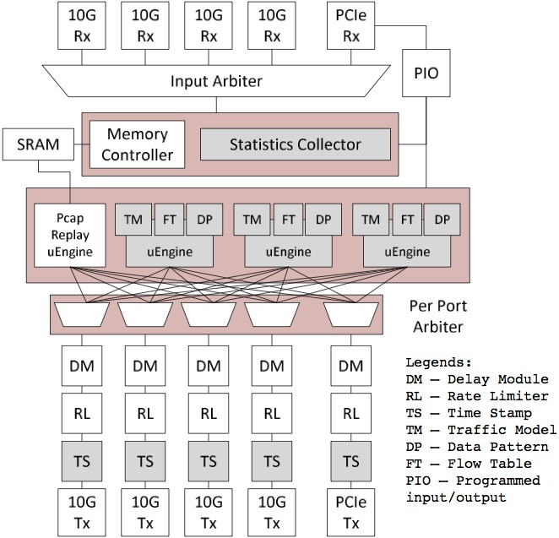
OSNT-TG architecture
DRAM/SRAM used to store the packets
DM and RL guarantee the output packet rate is the one assigned by the user

Slide 19
High End Tools
Cost from 1K’s to 100K’s of $
Typically hardware based
With many software packages
Scale to 400Gbit/second (per port)
Accuracy: <1ns and many, (many,) features(*)
(* features (extra $$$$) may include: human readable output, 1982 era traffic model, trivial network model, no tracing, data samples smaller than 100 entries, first order statistics only, packet capture – any packet capture, synchronized clocks, ….)

Slide 20
Measuring what happened.
Recall: Active measurement (ping/iperf) &
Passive measurement (tcpdump/intercept)
Passive measurement means we control the clocks, and we see what really happened (at least in one particular place)

Slide 21
How to capture traffic?
When did the packet arrive?
A hard question!
Can part / all of the packet be captured?
How many packets can be captured?
What is the maximal rate of packets that can be captured?
…

Slide 22
What is the time?
Free running clocks, e.g.,
CPU’s time stamp counter (TSC)
NIC’s on board oscillator
Clocks drift!
Synchronization signals, e.g.,
1 PPS (pulse-per-second)
Synchronization protocols, e.g.,
Network Time Protocol (NTP) – milliseconds accuracy
Precision Time Protocol (PTP) – microseconds accuracy (nanoseconds, depending on deployment)

Slide 23
Timestamping
Host
User
Space
At the port – highest accuracy
If you want to measure the network
At the NIC – less accurate
Buffering, clock domain crossing etc.
At the OS
Exhibits PCIe effects, scheduling dependencies
At the Application – least accurate
Unless you are interested in the user’s perspective – then it’s the only place
OS
Driver
PCIe
NIC
Port
Port

Slide 24
Traffic Capture
$$$$$, Hardware, high quality (Ixia, Spirent,..)
$$ Software/hardware based, medium quality (DAG, OSNT, NIC based,…)
Commodity, Software, low quality
(tcpdump, tshark, wireshark,… )

Slide 25
tcpdump (libpcap)
Software only
libpcap (historically tcpdump)
Other applications: tshark, wireshark…
Captures data and <does stuff> including write stuff to a file
Uses the pcap format (and others…)
Timestamp comes from the Linux network stack (default: kernel clock)

Slide 26
PCAP Files
PCAP – Packet CAPture
libpcap file format
Commonly used for packet capture/generation
Format:
Global header: magic number, version, timezone, max length of packet, L2 type, etc.
PCAP Packet header:
Global Header | Packet Header | Packet Data | Packet Header | Packet Data | Packet Header | Packer Data
ts_sec | ts_usec | incl_len | orig_len

Slide 27
PCAP Files – a one slide outline
PCAP – Packet CAPture
libpcap file format
Commonly used for packet capture/generation
Format:
Global header: magic number, version, timezone, max length of packet, L2 type, etc.
PCAP Packet header:
Global Header | Packet Header | Packet Data | Packet Header | Packet Data | Packet Header | Packer Data
ts_sec | ts_usec | incl_len | orig_len

Slide 28
Packet Capture
Common example:
$ sudo tcpdump -i en0 -tt -nn host www.cl.cam.ac.uk
tcpdump: verbose output suppressed, use -v or -vv for full protocol decode
listening on en0, link-type EN10MB (Ethernet), capture size 65535 bytes
1507838714.207271 IP 192.168.1.107.50650 > 128.232.0.20.80: Flags [S], seq 3761395339, win 65535, options [mss 1460,nop,wscale 5,nop,nop,TS val 256908862 ecr 0,sackOK,eol], length 0
1507838714.207736 IP 192.168.1.107.50651 > 128.232.0.20.80: Flags [S], seq 527865303, win 65535, options [mss 1460,nop,wscale 5,nop,nop,TS val 256908862 ecr 0,sackOK,eol], length 0
….

Slide 29
Where do I trace?
Sometimes on the interface of a host (eg ‘eth0’)
Tcpdump -i en1 # this will spew entries to the console one line per packet approximately
-tt -nn # useful options long form timestamps & numbers not names
Interception using “Tap”
(think wire-tapping)

Slide 30
Endace (DAG)
DAG - Data Acquisition and Generation
A commercial data capture card
Packet capture at line rate
Timestamping in the hardware (at the port)
Nanosecond resolution
Clock synronization possible
Will be used in the labs

Slide 31
erf. binary dec …..0001 232ps, …..0010 466ps, …..0011 698ps, …..0100 931ps, …..0101 1163ps, …..0110 1397ps …..0111 1629ps …..1000 1862ps
erf = extensible record format
Why 232ps?

Slide 32
Measuring (latency/change) between locations
Common time base: ntp? Ptp? GPS?
Where do I measure?
Nic?
When the packet turns into useful work?
Measuring inside the system (tracing a system)

Slide 33
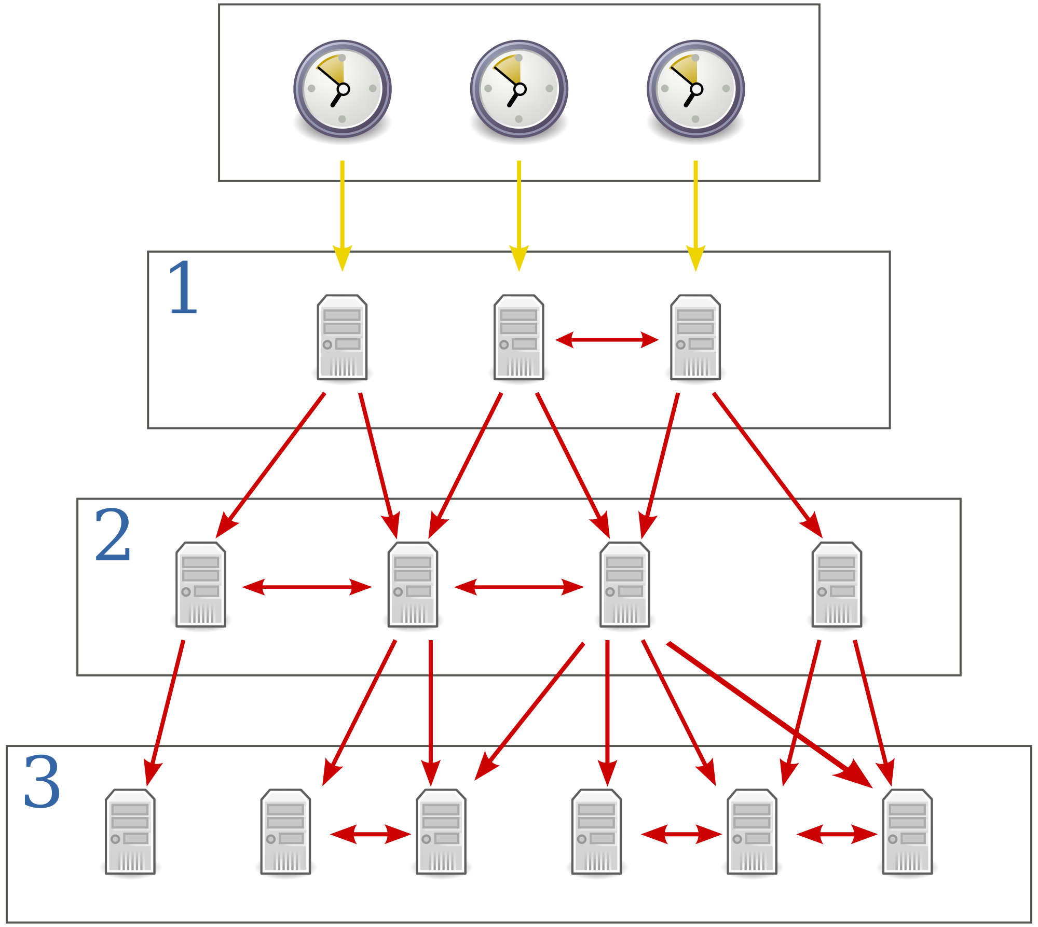
NTP
Designed for Internet-scale synchronization
E.g., email sent time < email received time
Milliseconds scale – emphasises frequency not phase
A hierarchical system
Using a few reference clocks
Typically:
Host polls a few servers
Compensates for RTT and time offset
NTPv4 – RFC5905

Slide 34
PTP
IEEE standard 1588 (v2 – 1588-2008)
Designed for local systems
Microsecond level accuracy or better
Uses a hierarchical master-slave architecture for clock distribution
Grandmaster – root timing reference clock
Boundary clock – has multiple network connections, can synchronize different segments
Ordinary clock – has a single network connection (can be master or slave)
(And many more details)

Slide 35
PTP – clock synchronization
Timestamps known by slave:
t₂
t_{1,} t₂
t_{1,} t_{2,} t₃
t_{1,} t_{2,} t_{3,} t₄
t₂
t₃
Slave
sync
delay_req
delay_resp
Follow_up
Master
t₁
t₄
t_{mater-slave}
t_{slave-master}
Offset =(t_{mater-slave}-t_{slave-master})/2=t_{mater-slave}-propagation time
mean propagation time =(t_{mater-slave}+t_{slave-master})/2

Slide 36
Using NIC
Either implement PTP-derived timestamps
or just timestamp the packets
sometimes in hardware
most times… not…
Not all NICs support time stamping
Result: captured packets include a timestamp
If PTP is used, end hosts are synchronized
Else – free running counter

Slide 37
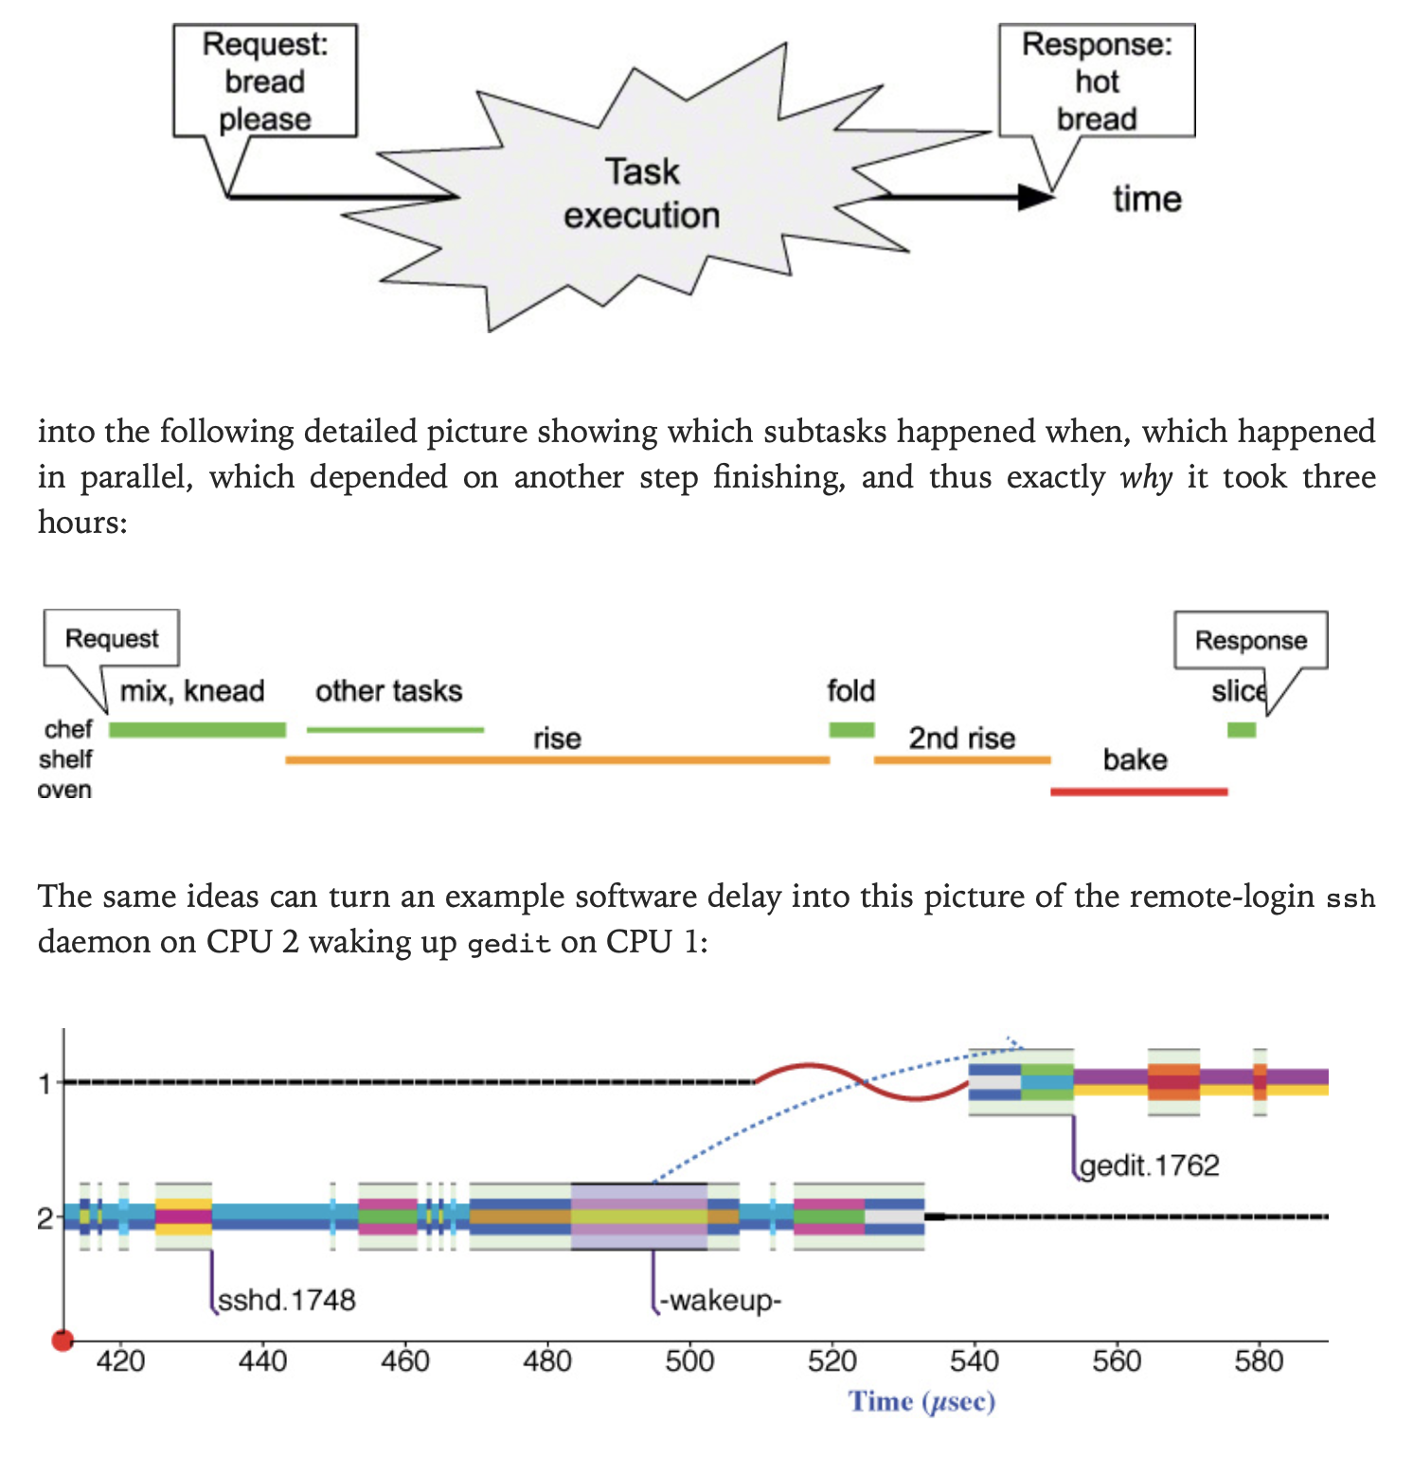
Taken from Understanding Software Dynamics R. Sites

Slide 38
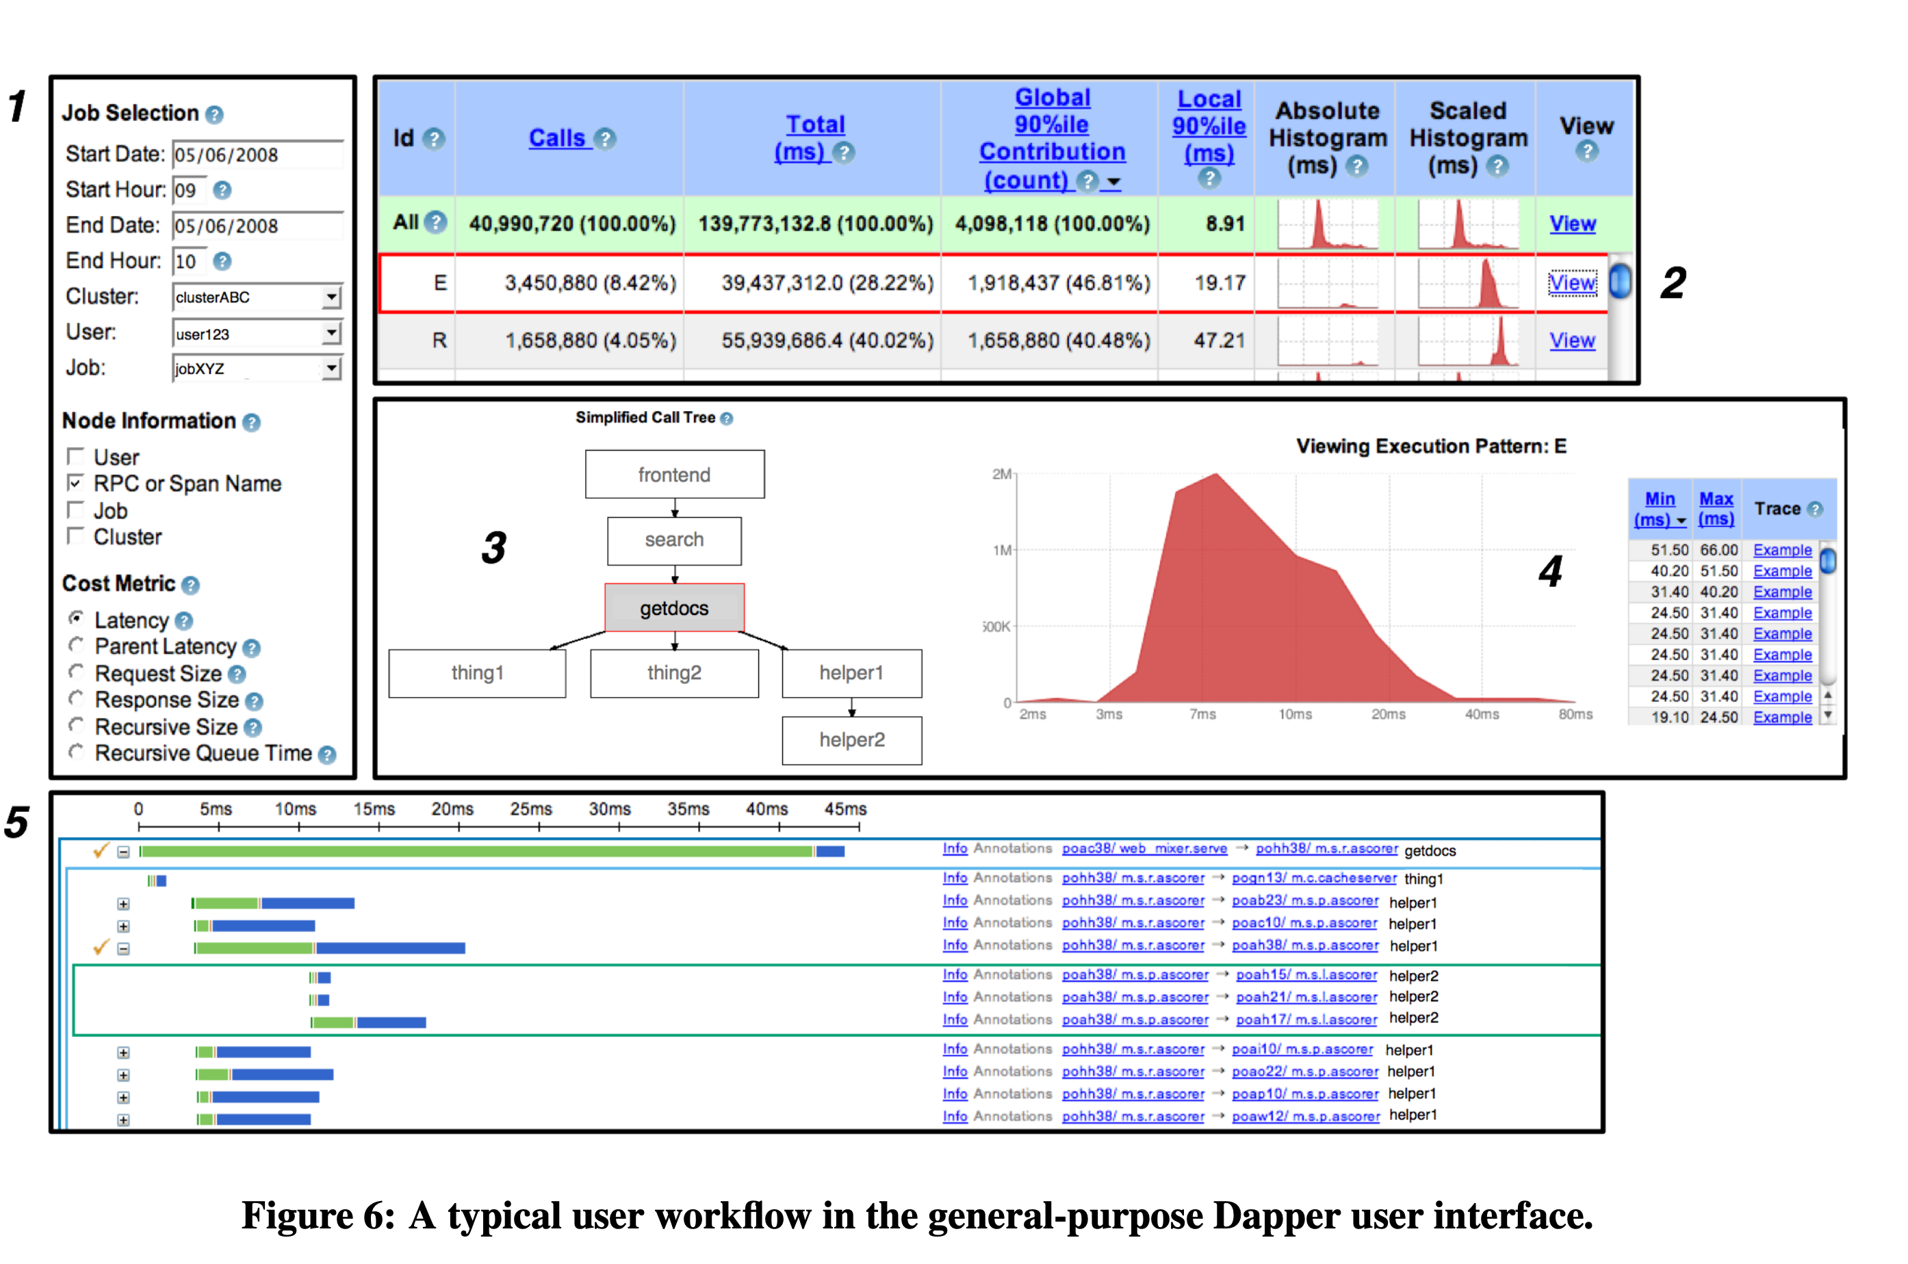
Taken from https://static.googleusercontent.com/media/research.google.com/en//archive/papers/dapper-2010-1.pdf

Slide 39
Capturing to disk…..
Most (physical) disk systems can not capture 10Gb/s of data
Capture takes resources!
Format wars…. PCAP vs PCAP-ng vs others
Binary representations / digital representations

Slide 40
What makes high-speed capture hard?
Disk bandwidth
Host bandwidth (memory, CPU, PCIe)
Data management
Lousy OS and software APIs
Byte primitives are dreadful when you want information on events, packets, & transactions…
A lot of effort has been invested into reinventing ring-buffers (circular buffers) to accelerate network interface cards.
Performance networking was done for capture first….

Slide 41
What makes high-speed capture work (better)?
NVMe Disks
Big machines, latest interfaces
Collect metadata (version OS/system/hw/DNS)
Bypass the OS
Older dedicated capture cards (e.g., Endace) pioneered kernel bypass capture
Any modern NIC 10Gb/s uses tricks that are useful for capture too

Slide 42
Measuring – Do’s and Don’t
Make sure that you capture correctly
Disk, PCIe/DMA and other bottlenecks
Make sure that your measurement does not affect the results
E.g., separate the capture unit from the device under test
Understand what you are measuring
E.g. single host, application-to-application, network device etc.
Make sure your measurement system does not affect the results

Slide 43
perf (not to be confused with iperf)
So far we discussed performance
What about events?
Perf is a Linux profiler tool
Allows us to instrument CPU performance counters, tracepoints and probes (kernel, user)

Slide 44
perf
list – find events
stat – count events
record – write event data to a file
report – browse summary
script – event dump for post processing

Slide 45
Perf - example
:~/.ssh$ perf stat ps
PID TTY TIME CMD
8747 pts/2 00:00:00 bash
11667 pts/2 00:00:00 perf
11670 pts/2 00:00:00 ps
Performance counter stats for 'ps':
12.745507 task-clock (msec) # 0.929 CPUs utilized
4 context-switches # 0.314 K/sec
0 cpu-migrations # 0.000 K/sec
140 page-faults # 0.011 M/sec
32,322,489 cycles # 2.536 GHz (40.80%)
<not supported> stalled-cycles-frontend
<not supported> stalled-cycles-backend
27,644,922 instructions # 0.86 insns per cycle (68.86%)
5,133,583 branches # 402.776 M/sec (68.92%)
157,503 branch-misses # 3.07% of all branches (94.06%)
0.013726555 seconds time elapsed
the tool scales the count based on
total time enabled vs time running

Slide 46
Flame Graphs: an example of clever visualization
Parsing traces is like finding a needle in a haystack
Flame graphs - Visualise the outputs of profiling tools
E.g., using perf, dtrace
Easy to understand
Open source
https://github.com/brendangregg/FlameGraph
Brendan Gregg has several other useful performance-related tools

Slide 48
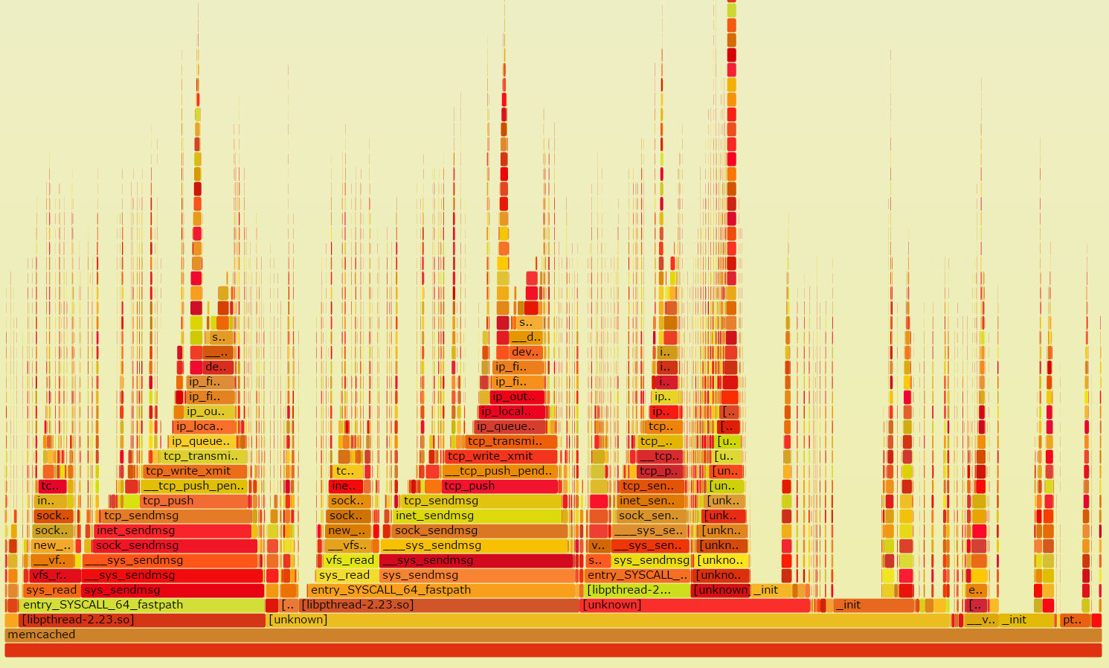
Flame Graphs
Width is relative to “how much time spent running on the CPU”
Top-down shows ancestry
Not good for idles – so don’t try to use for profiling network events!
Different types of flame graphs
E.g. CPU, memory, differential

Slide 49
Conclusion
There are many …. So so many …. tools
each is shaped by its heritage
Select carefully (understand the limitations)
Consider and collect metadata – always
How will you find/process/interpret/visualize your data?

