Slide 1
P51(bis): High Performance Networked-Systems
Prof. Andrew W. Moore
With copious thanks to Dr Noa Zilberman (Oxford), Richard Sites (formerly DEC, HP, MSR, Google), and many others whom I’ve bounced off ideas.
Finally, a huge thank you to Eben Upton, Raspberry Pi Foundation, and PiHut people for enabling this incarnation of the module at incredibly short notice.

Slide 2
An explanation
This subject is not as advertised:
Popularity + Equipment constraints meant refactoring
Things that are the same:
Hands on
Performance-centered
Deadlines are similar (one intermediate submission around week 5/6 and one end of term submission) 20% and 80% respectively.
Thanks that are better:
More than Networks: Systems and Networks; together.
Prerequisites: Undergraduate courses in digital communication, good working knowledge of C/C++, ECAD, Unix (look at https://www.cl.cam.ac.uk/teaching/current/UnixTools/)
All work is assessed as individual (no team submissions); however, collaborations are fine*
Things that are uncertain:
How things will go. Regardless of planning, there are always issues.
* Always credit all work of others.

Slide 3
Administrivia
Scope:
Understanding high-performance networked-systems
Course structure:
Lectures – 6 x 1 hour – Tuesday P51 SW02: (Wks 1,2,4,5,6,7)
Lab time – 5 x 2 hours – Friday P51 SW02 (Friday 15:00-17:00)
P51 SW02: (Wks 2,4,5,6,7) - We skip next Friday
Assessment:
Lab writeup (20%) – 23/02/2023 12:00
Principle Assignment (80%) – 16/03/2023 12:00

Slide 4
Some logistics for Michaelmas 2022-2023
Web page: http://www.cl.cam.ac.uk/teaching/current/P51/
Repository: https://github.com/cucl-srg/P51a/ NOTE THE ‘a’. Work in progress
Moodle: https://www.vle.cam.ac.uk/course/view.php?id=245002
Grades:
MPhil (ACS) – Mark out of 100
All others (DTC/CDT) – Mark out of 100

Slide 5
High Performance Networked-Systems
On completion of this module, students should:
Describe the role of high performance networked-systems and where they are used;
Develop an appreciation of best-practices by performing hands-on measurement and analysis;
Understand the architecture of a high performance networked-system;
Understand with greater insight high performance networking devices;
Understand challenges and solutions to high performance measurement;
Understand how to select or implement tools to measure high performance measurement;
Utilise representation techniques to understand and interpret networked-systems;
Evaluate the performance of example high performance networked-systems

Slide 6
Textbook
Includes a number of discussions about getting information mostly leading to the kutrace tool
We will loan you a copy for the duration of the course.
The book says “Software” but don’t be fooled, computer software is our (human) gateway.
If the hardware doesn’t make the software go fast – it isn’t high-performance.
This book covers much more than we will have time to cover here – consider investing in a copy for your professional library.
Yes I do want the loaners back at the end of term.

Slide 7
High Performance Networked Systems
The disks get faster
The CPUs get faster (at least a bit faster)
The Memory get faster
The Networks get faster – a lot faster
So why doesn’t your program go faster too?
Because nothing is simple. Sorry.

Slide 8
High Performance Networked-Systems
High Performance….
“My system is performing badly”
“Well, how badly should it be performing?”
Just how good should your system be?

Slide 9
Jeff Dean’s ‘Numbers Everyone Should Know’
L1 cache reference | 0.5 ns | O(1) ns
Branch mispredict | 3.0 ns | O(10) ns
L2 cache reference | 4.0 ns | O(10) ns
Mutex lock/unlock | 17.0 ns | O(10) ns
Main memory reference | 100.0 ns | O(100) ns
Compress 1K bytes with Zippy | 2,000.0 ns | O(1) us
Read 1 MB sequentially from memory | 4,000.0 ns | O(10) us
Send 2K bytes over 1 Gbps network | 20,000.0 ns | O(10) us
Read 1 MB sequentially from SSD | 62,000.0 ns | O(10) ms
Round trip within same datacenter | 500,000.0 ns | O(1) ms
Read 1 MB sequentially from spinning disk | 947,000.0 ns | O(10) ms
Disk seek | 3,000,000.0 ns | O(10) ms
Read 1 MB sequentially from network | 10,000,000.0 ns | O(10) ms
Send packet CA->Netherlands->CA | 150,000,000.0 ns | O(100) ms
Taken from a mashup of two slides stacks and some updated numbers from URL below
http://static.googleusercontent.com/external_content/untrusted_dlcp/research.google.com/en/us/people/jeff/stanford-295-talk.pdf
http://www.cs.cornell.edu/projects/ladis2009/talks/dean-keynote-ladis2009.pdf
https://kousiknath.medium.com/must-know-numbers-for-every-computer-engineer-6338a12c292c
https://norvig.com/21-days.html#answers

Slide 10
So….
How long does it take to read a file?
a 10KByte file
With random seeking
Over the network
…..
How long does it take to finish a matrix multiplication?
Of 10,000,000 elements
8,000,000 times?
How quickly will a particular web page be retrieved and rendered?
How many frames of graphics per second can I render?
How does everything affect me so?
Don’t be afraid to do the math

Slide 11
Networked Systems – some sad news – nothing is straightforward
Two computers connected with 100GbE will .never. NEVER move data from one computer memory to another computer memory at 100Gbit/s
Spinning disks are very weird and techniques to make them go faster have been around since the 50’s
Main memory is SERIOUSLY not sensible
SSD and NVMe disks are just memory that (hopefully) remembers without power
Don’t get me started on the sneaky tricks CPUs use!

Slide 12
Measure what is measurable, and make measurable what is not so Galileo Galilei
If you don’t measure something – how do you know its too slow?
Measurements are mostly over time – sometimes we want to understand quantities too.
How fast is the CPU? – frequency
How long will this job take? - seconds
How big is the file? – storage size
How much power is used? – watts (literally power)

Slide 13
System Measurements
Can be used to answer questions such as:
Is this system working as expected?
Is this system better that another system?
What are the limitations of my system?
Where are the system’s bottleneck?

Slide 14
Performance – not just bits per second
Second order effects
Image/Audio quality
Other metrics…
Network efficiency (good-put versus throughput)
User Experience? (World Wide Wait)
Network connectivity expectations
Others?

Slide 15
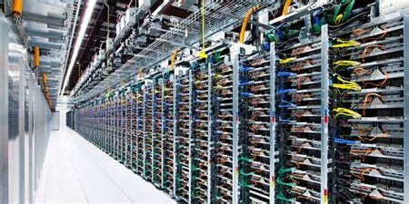
What is a high-performance system?
Now it’s datacenters
At least at the extreme
Supercomputer?
Maybe in the 1980’s

Slide 16
Statistics in Measurements Terms and limits
Mean
Median
Standard deviation
Independence
Heavy tail distribution (and where it all goes wrong)
Probability density function / Histogram
Cumulative density function (CDF) and CCDF
Tests (two variable or hypothesis: t-test, multivariable: ANOVA)
Notes:
stats things
definitions
StdDev is meaningless
How to read a CDF
heavy tail buggers world.
use the same damn units.
t-test (under heavy tail

Slide 17
Standard Deviation in a Normal Distribution

Slide 18
Two sets of samples with the same mean and different Standard Deviations

Slide 19
Confidence Intervals? Error Bars? Sample Size?
Confidence Interval is the interval (range) of values you have confidence a given sample will fall within….
Error Bar represents the range
of all values for an experiment
(sometimes the confidence
interval is used – this makes
assumptions!)
Sample Size is the number of (measurements) made
certain tests (eg t-test) can assist us in deciding on a sample size
when we don’t choose the sample size those same tests will declare
the confidence to hold in how representative the sample-set was

Slide 20
Why our most-basic assumptions are wrong
or Why Independence is not a great assumption…
We measure the use of electricity in a neighbourhood over a day
There is a popular TV programme
A commercial break sees much of the population in the neighbourhood putting the kettle on
This is a correlated event (non-independent)
Correlation is common in the Internet too
At many timescales (weekly, daily, hourly, predictable functions of time, distance, computer-type, application-type, favourite soda….)

Slide 21
Why our most-basic assumptions are wrong
Independence – why we care
Some(many/most) analysis techniques assume independence
Highly correlated events may mean non-representative measurements
We might use measured data as-if it was independent/representative
What can we do?
Constant vigilance:
Look at the data, best-practice, think.

Slide 22
Why our most-basic assumptions are wrong
Why Poisson distribution is not a great assumption…
We measure the use of electricity of 1000 households to determine average use as a representation (informed guess) for the nation….
Households have a high prevalence of solar panels
Not so presentative…..
This example might give a skewed distribution
This is only one cause of normal distribution failure

Slide 23
Distributions
Normal Poisson Binomial….. Not the same and often ‘jumbled up’
A Normal distribution is continuous
A Poisson distribution is discrete
A Poisson random variable is always [0,∞)
It is common to mean Poisson even if people say Normal….

Slide 24
Why our most-basic assumptions are wrong
Poisson distributions– why we care
Poisson distributions make analysis and interpretation easy
(e.g. mean, standard deviation, etc.)
What can we do?
Look at the data, best-practice, think.
Particularly when the dataset is small
Did I mention that normal distributions assume independence? <sad face>

Slide 25
Central Limit Theorem or “Mix enough to get Normal”
CLT says that statistics computed from the mean (eg the mean itself) are approximately normally distributed – regardless of the distribution of the population
(OR ANOTHER WAY)
CLT says the more data you have the more the observed mean will become the true mean
Sadly CLT can say nothing about variance!

Slide 26
Law of Large Numbers or “You just need more data”
LLN is actually a handy idea that says ”given enough data and obey the rules, the sample (measurements/overvations) will better represent the population (causal) characteristics”
Sadly the rules are
Independence (again)
Population should not be skewed (eg be larger than 30, or is it 40? 400?....)
LLN is useful, it tells us lots of things:
<if rules> - the average of more data observations becomes the mean of the source of observations
But LLN says nothing about the variance.

Slide 27
When Standard Deviations go wrong…
Standard Deviations (SD) indicate the dispersion of the underlying data
but SD measures build in some assumptions: symmetry and common computation assume a Poisson distribution….
Sometimes they simply don’t capture the nature of the data, nothing showed this up more clearly than the heavy-tail distribution…..

Slide 28
Heavy Tails… (condensing a lot into a slide)
Certain phenomena (eg correlated events) can cause unusual (rare) events
These events led to very large (wide) distributions, ones where the tail(s) has more values than a Poisson distribution would predict
The more dispersed the data : the larger the Standard Deviation measure
One definition of heavy tails is where Standard Deviation tends to infinity….
Sadly, heavy tail distributions are very (VERY) common
“1 in a million events occur about 9 times out of ten” – T. Pratchett

Slide 29
How to read a PDF CDF and CCDF…..
A Probability Density Function tells me the probability for a specific value
A Cumulative Density Function is a
sum of probabilities
That is: “is the probability that the random
variable will take a value less than or
equal to a particular level.”

Slide 30
How to read a (C)CDF…..
A Complementary Cumulative Density Function 1-the sum of probabilities
Useful for “how often the random variable is(at or) above a particular level.”

Slide 31
How to read a (C)CDF…..
A Complementary Cumulative Density Function 1-the sum of probabilities
Useful for “how often the random variable is(at or) above a particular level.”
<- CDF
80% of the time it was less than 55 minutes between births
CCDF ->
Over half the
time between births
Were longer than 20 minutes

Slide 32
Terminology Matters!
… in greater depth in following weeks

Slide 33
Precision, Accuracy and Resolution
Accuracy – How close is the measured value to the real value?
Precision – How variable are the results?
high accuracy
high precision
high accuracy
low precision
low accuracy
high precision
low accuracy
low precision

Slide 34
Precision, Accuracy and Resolution
Resolution – The smallest measurable interval.
The resolution sets an upper limit on the precision.
high resolution
low resolution
In our experiments, resolution many times is determined by clock frequency (directly or indirectly)

Slide 35
Bandwidth, Throughput and Goodput
Bandwidth – how much data can pass through a channel.
Throughput – how much data actually travels through a channel.
Goodput is often referred to as application level throughput.
But bandwidth can be limited below link’s capacity and vary over time, throughput can be measured differently from bandwidth etc…..

Slide 36
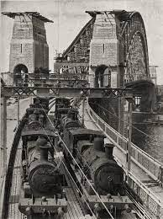
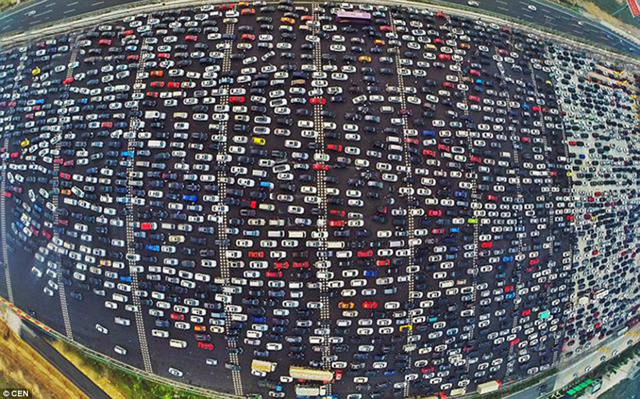
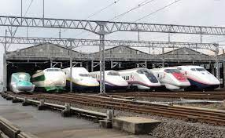
Speed and Bandwidth
Higher bandwidth does not necessarily mean higher speed
E.g. can mean the aggregation of links
100G = 2x50G or 4x25G or 10x10G
A very common practice in interconnects

Slide 37
RTT, Latency and FCT
Measures of time:
Latency – The time interval between two events.
Round Trip Time (RTT) – The time interval between a signal being transmitted and a reply is being received.
Flow Completion Time (FCT) – The lifetime of a flow.

Slide 38
Performance Metrics
Throughput, FCT etc. are measures of Performance.
Bandwidth, RTT, packet loss etc. don’t indicate (directly) how good or bad the application / system / network perform

Slide 39
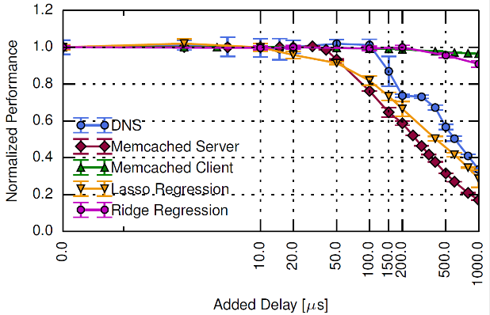
Example: The Effect of Latency on Application’s Performance

Slide 40
Example: The Effect of Latency on Application’s Performance
Memcached Server performance
drops to 60% with the addition
of 200μs of additional latency

Slide 41
Types of Measurements

Slide 42
Measurement Techniques
Active
Issue probe, Analyse response
Passive
Observe events

Slide 43
Example: Active vs. Passive RTT Measurement
Active measurement – ping
Sends ICMP Echo Request message
Waits for Echo Reply message
RTT is the time gap between the request and the reply.
Passive measurement – tcptrace
Uses TCP dump files
Calculates RTT according to timestamps logged in the dump.

Slide 44
Comparison
Passive | Active
Can only measure in the presence of activity / traffic | Measures even when tapping activity / traffic is not possible
Measures user experience, behaviour Measures protocol exchanges | Measures system, network, application performance
Raise privacy concerns | Adds probing load: - Overload system/network - May bias inferences

Slide 45
Measurement Vantage Point
Point where measurement host connects to system / network
Observations often depend on vantage point
Do you have enough vantage points?
How are the vantage points distributed?
Can affect, e.g.:
Topology discovery
Bandwidth analysis

Slide 46
Possible Vantage Points
End-hosts
Active measurements of end-to-end paths
Passive measurements of host’s traffic
Routers/Measurement hosts in network
Active measurements of network paths
Passive measurements of traffic, protocol exchanges, configuration

