Slide 1
Learned Incremental Representations for Parsing
Nikita Kitaev, Thomas Lu, Dan Klein
May 2022

Slide 2
Motivation
Language comprehension in humans is an incremental process.
The highest-performing machine models for syntactic parsing require a full sentence input before they can perform a bidirectional process.
Human capabilities suggest that we should be able to build parsers that operate incrementally.
Notes:
Language comprehension in humans is an incremental process. Human speech is heard word by word. As I’m speaking, you, the listeners, are not waiting for me to finish my sentences before you start any processing or understanding.
Contrast this to the highest-performing machine models for syntactic parsing which require a full sentence as input, before performing deeply bidirectional processing, to produce their outputs.
Human capabilities suggest that we should also be able to build accurate parsers that instead operate incrementally.

Slide 3
Motivation
Incrementality in NLP is often equated with left-to-right processing.
For e.g. Incremental transition-based parsers, CCG parsers.
Such parsers are frequently speculative: the parsers commits to a certain syntactic decision without having (yet) seen the evidence for it.
Notes:
Incrementality in NLP is often equated with left-to-right processing.
This includes incremental transition-based parsers which receive their input one word at a time, and — after each word — output any number of actions such as shift or reduce. The full sequence of actions represents a syntactic analysis of the input, and you build it as you go. Similarly, Combinatory Categorial Grammar (CCG) parsing, the representation of a CCG analysis in the form of a sequence of supertags
Such left-to-right parsers are frequently speculative. By speculative we mean that the parser commits to a certain syntactic decision without having yet seen the evidence for it, because the evidence for that decision is not present in the prefix of the input.
Let’s look at an example.

Slide 4
Example
Figure 1. Nikita Kitaev, Thomas Lu, Dan Klein. 2022. Learned Incremental Representations for Parsing.
Notes:
We give an example sentence here: “The Council approved the proposal on…”
A decision must be made regarding whether the preposition “on” attaches to noun “proposal” or the verb “approved.”
Transition-based approaches such as shift-reduce or attach-juxtapose place the action that determines the preposition attachment earlier in the left-to-right processing pattern than the disambiguating word (“Monday” or “taxes”) that reveals the correct analysis.
This example demonstrates how left-to-right parsing of a sentence introduces two valid branches which must both be considered. One path is valid, but the other would lead an incremental parser to a dead-end.

Slide 5
Motivation
Speculation is impractical and expensive.
A true representation of syntactic information is not a single sequence of actions but a belief state (or beam state) that contains multiple candidate analyses.
This is non-speculative incrementality.
Notes:
We find that speculation is computationally expensive. Further, committing to the highest-scoring option at each each point where a decision must be made with incomplete evidence seems impractical.
We must instead consider multiple analyses in parallel, and later throw out analyses that are inconsistent with the sentence; this can be done through a procedure like beam search. The authors argue that true representation of syntactic information at each point in the sentence is not a single sequence of actions (or supertags for CCG), but rather a belief state (beam state) that contains multiple candidate analyses.
This brings us to a stronger notion of incrementality, based on a belief state rather than a sequence of actions. Which we will refer to as non-speculative incrementality, and is what this paper is interested in.

Slide 6
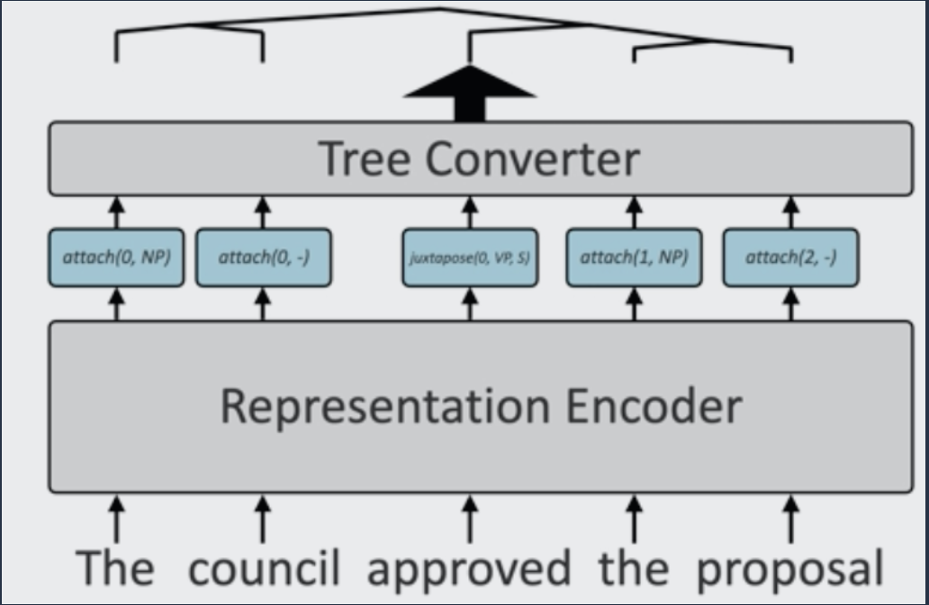
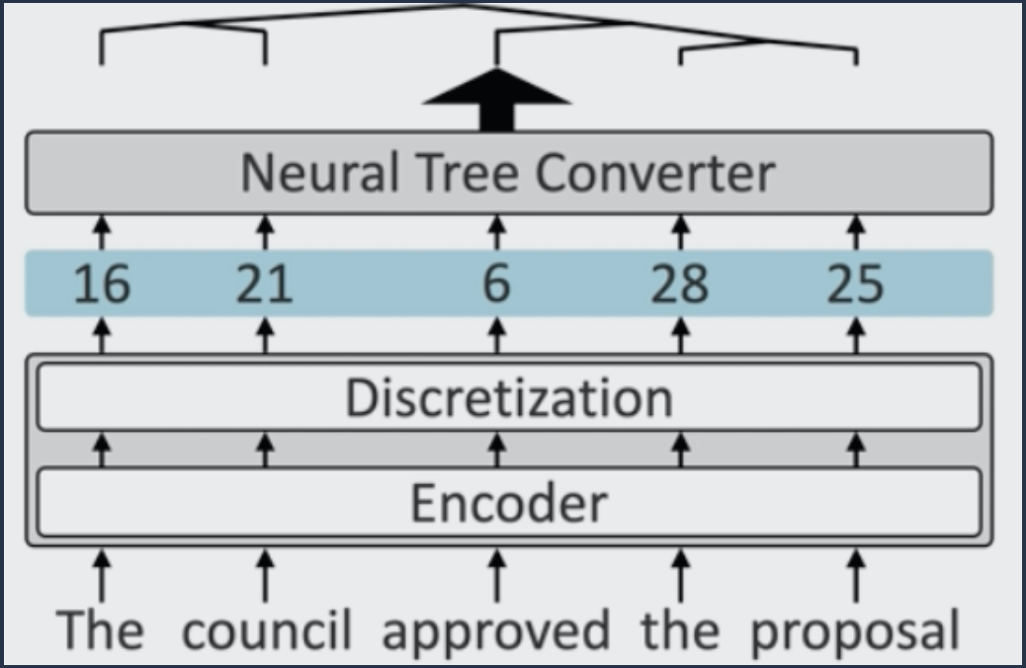
Approach
James Thorn. https://jamesthorne.com/blog/acl-2022-best-papers/
Previous work
New approach
Notes:
Conventional incremental parsers use a tree equivalent schema. The bulk of the work is at the encoder layer. Each token in the sentence is assigned a label and that sequence of labels yields a set of instructions that can be directly compiled into a tree. The issue with this approach is that in some cases, the model must commit to one of these labels in the presence of incomplete evidence – which may yield an incorrect tree. We want to avoid any speculation.
The novelty of this paper is that the model learns a *latent* set of actions that is tree equivalent. How does it do that? The model is based on a parsing architecture from a previous 2018 paper of theirs. It contains an encoder layer that uses the pre-trained GPT-2 as a base which does the bulk of the computation and a neural tree converter which is relatively lightweight.
At the interface between the pre-trained encoder and subsequent parts of the model (which they call the read-out network), they introduced a discretization step that collapses the continuous, high-dimensional vectors from the encoder network to a small inventory of discrete symbols (they limited the size of the discrete token vocabulary to 32 – more on this later). Here we show the output of the discretization layer of the encoder module as a sequence of numeric tags.
Note that the read-out network only has access to these discrete symbols and not to the original text of the input. So, the sequence of discrete symbols must encode all information necessary to represent the syntactic structure of the sentence.
After discretization, each symbol from the sequence is associated with a learned embedding. These vectors are fed as an input to the bidirectional read-out network, which consists of Transformer layers and an MLP-based span classification layer.

Slide 7
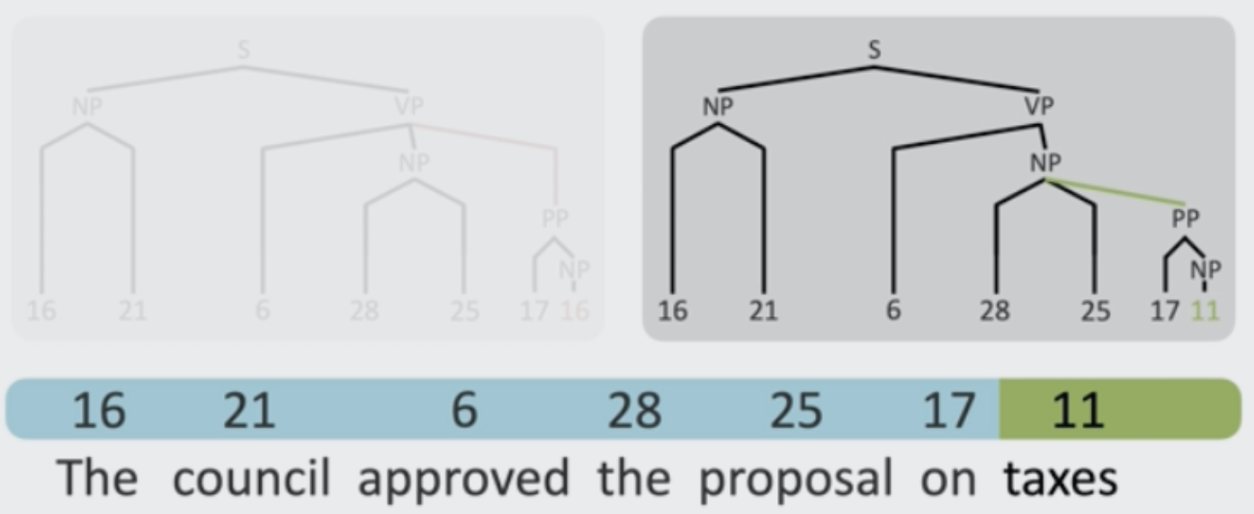
Approach
James Thorn. https://jamesthorne.com/blog/acl-2022-best-papers/
Notes:
The output of the network is a chart of scores representing each possible constituent span of the sentence.
Going back to our initial example. Despite the ambiguity in the sentence, the tag sequence up to and including the ambiguous tag is the same. The different tree structure is only resolved after the final tag is observed.
The tags act as representations of the tokens as they arrive, rather than concrete actions.

Slide 8
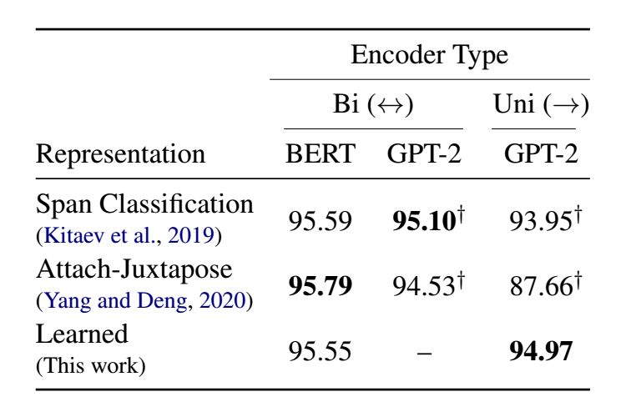
Results
Table 1. Nikita Kitaev, Thomas Lu, Dan Klein. 2022. Learned Incremental Representations for Parsing.
Notes:
They applied this approach to the labelled constituent trees of the English Penn Treebank.
As you can see, it performs on-par with contemporary approaches. While Span classification and Attach-Juxtapose have marginally higher F1 scores in tree construction, both of these approaches exploit bidirectional encodings with a BERT model.
The final incremental model generated using this setup achieves a score of 94.97 F1 on the Penn Treebank WSJ test set, surpassing the baseline performance of a clustered lexicon. This model uses only 8 bits per token (256 symbols) to define the discrete symbol set using a unidirectional pretrained model (GPT2-medium).

Slide 9
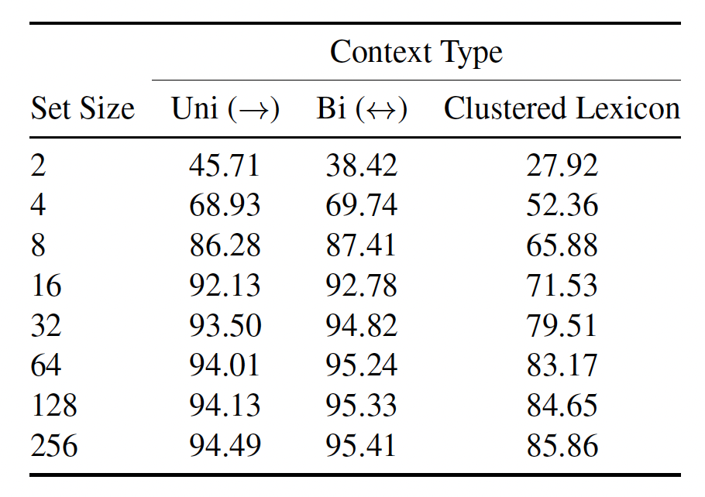
Results
Table 2. Nikita Kitaev, Thomas Lu, Dan Klein. 2022. Learned Incremental Representations for Parsing.
Notes:
The decision to label each token with a single symbol was partially rooted in prior research providing evidence that syntactic decisions among human speakers adhere to the uniform information density hypothesis, thus each token may convey similar amounts of syntactic information. Now, to enforce an “information bottleneck” (limiting the information that can be associated with each token) they limited the size of the discrete token vocabulary. That is the number of distinct discrete symbols per raw input token.
They then evaluated this approach by training a number of models while varying the size of the symbol set.
While the best-performing unidirectional model uses 8 bits per token, using as few as 5 bits per token (32 symbols) retains a performance of 93.72 F1 on the test set.

Slide 10
Insights
Why did this paper received the ACL 2022 Best Paper Award?
Undoing Research: better schemas can be learned.
Faster decoding: no speculation, no backtracking.
Analysis: rich discussions which justify design choices.
Notes:
This year's ACL 2022 best paper was on the topic of incremental parsing. Parsing is something that's been well studied in the NLP, Computational Linguistics fields before. So why does this year's best paper laud a work on a topic that some might have considered out of fashion since deep learning and transformers have taken over the majority of NLP tasks?
Undoing research: the task setting an established dataset with decades of research in building linearized incremental parsers. Many state of the art methods are a result of manual choices of label schemas as well as advancements in modelling with bidirectional representations. From Shift Reduce Parsing Arc-Eager to Juxtapose, researchers have devised hand-crafted tagsets and schemas to linearize the tree construction process. This paper indicates that better schemas can be learned.
Faster decoding: without beam search or need for backtracking, the real-time runtime of this algorithm can be much faster. Performing greedy search instead of 5-beam search gives a 5x speedup. The model appears to be trained to induce the optimal path through the tagset and doesn't require the beam search to find this. Similarly, because there is no speculation at the "heavy" encoder phase, there is no backtracking.
Analysis: not all papers perform a rich analysis of why the method works and what can be learned from the technique. This paper has several studies that help the reader better understand why this method is interesting and show patterns and regularities that help justify the design choices in the paper.

Slide 11
Conclusion
Notes:
This paper presented an approach to inducing syntactic representations that associate each token in the input with a discrete symbol from an arbitrarily-sized vocabulary, where the representations can be predicted incrementally in a strictly append-only manner.
The model did not exceed state-of-the-art. Is this a problem? No. The models achieve high F1 on the Wall Street Journal test set despite a steep information bottleneck limiting the information that can be associated with each token.
What's actually quite exciting is that this paper achieves a on-par F1 score using only a unidirectional encoder. This means that the parse tree can be constructed while the token sequence is being streamed in.
Applications for real time uses such as voice assistants. What is also interesting is that without the bidirectional encoders, the "state of the art" systems perform less well than the proposed method highlighting a dependency on fixed encoder schemes to "look ahead" rather than incrementally parse the sentence.

