Slide 1
Comparing Automatic and Human Evaluation of Local Explanations for Text Classification by Dong Nguyen
Presentation by Bruce Cheung

Slide 2
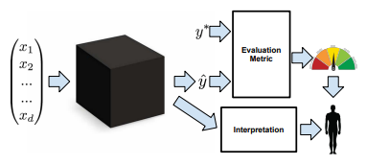
Model Interpretability
Globally interpretable
Can informatively describe the model i.e., how does the model work?
Transparency: are the parameters intuitive? Decision tree / linear classifier vs DNN
But how comprehendible are big models?
Enables qualitative evaluation of model (data leakage)
Causal inference?
Local explanation
Post-hoc interpretation of individual predictions
Highlight most impactful features
Informative explanations to assist human’s decision making
Checking for biases: fair / ethical decision making
Zachary C. Lipton. 2016. The mythos of model interpretability

Slide 3
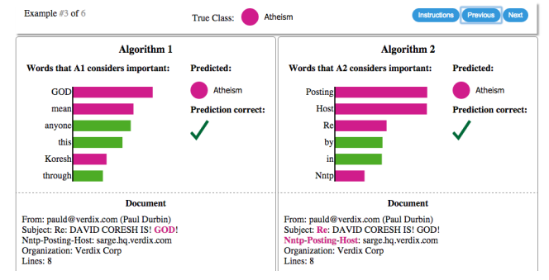
Trustworthiness
Global interpretation
Two dimensions:
Do we trust in a model enough to deploy it in the real world?
Can we trust a model’s prediction and make decisions from it?
Local explanation
Marco Tulio Ribeiro, Sameer Singh, and Carlos Guestrin. 2016. “Why should I trust you?”: Explaining the predictions of any classifier.

Slide 4
Experimental Setup
Two datasets:
Twenty newsgroups – Christianity and Atheism
Movie reviews – Positive and Negative sentiment
Two classifiers:
Logistic regression
Feedforward neural network
Objective: Compare and evaluate three local explanation methods

Slide 5
Local Explanation Methods
Random: Randomly select words from the input document
LIME: Perturb the input and see how predictions change
Word omission: Estimate contribution of words by deleting them and measuring effect
First derivative saliency: Compute gradient of the output with respect to each input word
Four ways to order words by “importance”

Slide 6
Automatic Evaluation Metrics
Most important
Less important
Random: | alive | true | stated | equal | martin | laugh | movie | find | …
LIME: | funniest | hilarious | best | laugh | film | true | enjoyed | theatres | …
Word omission: | funniest | best | laugh | hilarious | film | enjoyed | theatres | place | …
1st derivative saliency: | hilarious | funniest | laugh | film | best | theatres | true | place | …

Slide 7
Automatic Evaluation Metrics
Most important
Less important
Random: | alive | true | stated | equal | martin | laugh | movie | find | …
LIME: | funniest | hilarious | best | laugh | film | true | enjoyed | theatres | …
Word omission: | funniest | best | laugh | hilarious | film | enjoyed | theatres | place | …
1st derivative saliency: | hilarious | funniest | laugh | film | best | theatres | true | place | …
Switching Point
Proportion of top words that need to be removed for prediction to flip

Slide 8
Automatic Evaluation Metrics
Most important
Less important
Random: | alive | true | stated | equal | martin | laugh | movie | find | …
LIME: | funniest | hilarious | best | laugh | film | true | enjoyed | theatres | …
Word omission: | funniest | best | laugh | hilarious | film | enjoyed | theatres | place | …
1st derivative saliency: | hilarious | funniest | laugh | film | best | theatres | true | place | …
e.g., K = 6
Output with top k words removed

Slide 9
Results of Automatic Evaluation
Based on AOPC: word omission performs best in almost all cases
Based on switching point: saliency performs best (where applicable), followed by word omission
Other findings:
For random, switching point of between 0.65 and 0.9 (compared to best of 0.04-0.22)
LIME performs better with a larger sample size
The higher the prediction confidence, the more words need to be deleted to change prediction
Evaluating faithfulness!
Just a mathematical property?

Slide 10
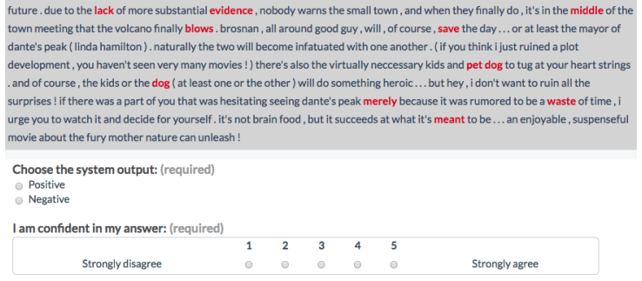
Human Evaluation
Forward prediction task: based on text and highlighted words, guess model’s prediction
Dong Nguyen. 2018. Comparing Automatic and Human Evaluation of Local Explanations for Text Classification.

Slide 11
Results of Human Evaluation
 |  | Actual
 |  | Positive | Negative
Predicted | Positive | True Positive <94% accuracy | False Positive <85% accuracy
 | Negative | False Negative <81% accuracy | True Negative <92% accuracy
Correlation between automatic evaluation and human guesses:
More faithful local explanations => better crowd accuracy

Slide 12
Limitations
Assumes that each input word is an independent feature and has predictive power
Only explored one approach to local explanations, i.e., highlighting important words
Some of the explanation methods do not work on black-box models (word omission on LR and derivative saliency)

Slide 13
Insights
Automatic evaluation is useful for measuring faithfulness of local explanations
Humans are generally able to decipher text classifiers given explanations
2. Can we trust a model’s prediction and make decisions from it?
If explanation is faithful, mostly yes.

Slide 14
Critiques
Automatic evaluation does not evaluate quality of explanation – double dip on word importance, which was learnt by the models
Crowdsourced human evaluations: inadequate expertise; time constrained
Marco Tulio Ribeiro, Sameer Singh, and Carlos Guestrin. 2016. “Why should I trust you?”: Explaining the predictions of any classifier.
$0.03 per judgement = 15 seconds (based on minimum wage)

Slide 15
Critiques
Comparing Automatic and Human Evaluation of Local Explanations for Text Classification
Comparing Local Explanation Methods for Text Classification with Automatic and Human Evaluation

Slide 16
Questions?

