Slide 1
Computer Networking
Lent Term
M/W/F 11:00-12:00
LT1 in Gates Building
Handout 4 (Topic 6)
Andrew W. Moore
Andrew.Moore@cl.cam.ac.uk
2018-2019

Slide 2
Topic 6 – Applications
Overview
Infrastructure Services (DNS)
Traditional Applications (web)
Multimedia Applications (SIP)
P2P Networks
Notes:
Applications need their own protocols.
These applications are part network protocol (in the sense that they exchange messages with their peers on other machines) and part traditional application program (in the sense that they interact with the windowing system, the file system, and ultimately, the user).
This topic explores some of the most popular network applications available today.

Slide 3

Client-server paradigm
server:
  always-on host
  permanent IP address
  server farms for scaling
clients:
  communicate with server
  may be intermittently connected
  may have dynamic IP addresses
  do not communicate directly with each other
client/server

Slide 4
Pure P2P architecture
no always-on server
arbitrary end systems directly communicate
peers are intermittently connected and change IP addresses
Highly scalable but difficult to manage
peer-peer

Slide 5
Hybrid of client-server and P2P
Skype
  voice-over-IP P2P application
  centralized server: finding address of remote party:
  client-client connection: direct (not through server)
Instant messaging
  chatting between two users is P2P
  centralized service: client presence detection/location
    user registers its IP address with central server when it comes online
    user contacts central server to find IP addresses of buddies

Slide 6
File Distribution: Server-Client vs P2P
Question : How much time to distribute file from one server to N peers?
u_{s}: server upload bandwidth
Server
u_{i}: peer i upload bandwidth
u₁
d₁
u₂
u_{s}
d₂
d_{i}: peer i download bandwidth
File, size F
d_{N}
Network (with
abundant bandwidth)
u_{N}

Slide 7
File distribution time: server-client
Server
server sequentially sends N copies:
  NF/u_{s} time
client i takes F/d_{i} time to download
F
u₁
d₁
u₂
u_{s}
d₂
d_{N}
Network (with
abundant bandwidth)
u_{N}
Time to distribute F
to N clients using
client/server approach
= d_{cs} = max { NF/u_{s}, F/min(d_{i}) }
i
increases linearly in N
(for large N)

Slide 8
File distribution time: P2P
Server
server must send one copy: F/u_{s} time
client i takes F/d_{i} time to download
NF bits must be downloaded (aggregate)
F
u₁
d₁
u₂
u_{s}
d₂
d_{N}
Network (with
abundant bandwidth)
u_{N}
fastest possible upload rate: u_{s} + Σu_{i}
d_{P2P} = max { F/u_{s}, F/min(d_{i}) , NF/(u_{s} + Σu_{i}) }
i

Slide 9
Server-client vs. P2P: example
Client upload rate = u, F/u = 1 hour, u_{s} = 10u, d_{min} ≥ u_{s}
Notes:
25-frb-2015

Slide 10
Addressing processes
to receive messages, process must have identifier
host device has unique 32-bit IP address
Q: does IP address of host on which process runs suffice for identifying the process?
  A: No, many processes can be running on same host
identifier includes both IP address and port numbers associated with process on host.
Example port numbers:
  HTTP server: 80
  Mail server: 25
to send HTTP message to yuba.stanford.edu web server:
  IP address: 171.64.74.58
  Port number: 80
more shortly…

Slide 11
Recall: Multiplexing is a service provided by (each) layer too!
Application: one web-server multiple sets of content
Host: one machine multiple services
Network: one physical box multiple addresses (like vns.cl.cam.ac.uk)
….
UNIX: /etc/protocols = examples of different transport-protocols on top of IP
UNIX: /etc/services = examples of different (TCP/UDP) services – by port
(These files are an example of a (static) approach to name services)

Slide 12
App-layer protocol defines
Types of messages exchanged,
  e.g., request, response
Message syntax:
  what fields in messages & how fields are delineated
Message semantics
  meaning of information in fields
Rules for when and how processes send & respond to messages
Public-domain protocols:
defined in RFCs
allows for interoperability
e.g., HTTP, SMTP
Proprietary protocols:
e.g., Skype

Slide 13
What transport service does an app need?
Data loss
some apps (e.g., audio) can tolerate some loss
other apps (e.g., file transfer, telnet) require 100% reliable data transfer
Throughput
some apps (e.g., multimedia) require minimum amount of throughput to be “effective”
other apps (“elastic apps”) make use of whatever throughput they get
Security
Encryption, data integrity, …
Timing
some apps (e.g., Internet telephony, interactive games) require low delay to be “effective”
Mysterious secret of Transport
There is more than one transport layer
Shocked?
I seriously doubt it…
Recall the two most common TCP and UDP
Notes:
11-feb-2015

Slide 14
Naming
Internet has one global system of addressing: IP
  By explicit design
And one global system of naming: DNS
  Almost by accident
At the time, only items worth naming were hosts
  A mistake that causes many painful workarounds
Everything is now named relative to a host
  Content is most notable example (URL structure)

Slide 15
Logical Steps in Using Internet
Human has name of entity she wants to access
  Content, host, etc.
Invokes an application to perform relevant task
  Using that name
App invokes DNS to translate name to address
App invokes transport protocol to contact host
  Using address as destination

Slide 16
Addresses vs Names
Scope of relevance:
  App/user is primarily concerned with names
  Network is primarily concerned with addresses
Timescales:
  Name lookup once (or get from cache)
  Address lookup on each packet
When moving a host to a different subnet:
  The address changes
  The name does not change
When moving content to a differently named host
  Name and address both change!

Slide 17
Relationship Between Names&Addresses
Addresses can change underneath
  Move www.bbc.co.uk to 212.58.246.92
  Humans/Apps should be unaffected
Name could map to multiple IP addresses
  www.bbc.co.uk to multiple replicas of the Web site
  Enables
    Load-balancing
    Reducing latency by picking nearby servers
Multiple names for the same address
  E.g., aliases like www.bbc.co.uk and bbc.co.uk
  Mnemonic stable name, and dynamic canonical name
    Canonical name = actual name of host

Slide 18
Mapping from Names to Addresses
Originally: per-host file /etc/hosts
  SRI (Menlo Park) kept master copy
  Downloaded regularly
  Flat namespace
Single server not resilient, doesn’t scale
  Adopted a distributed hierarchical system
Two intertwined hierarchies:
  Infrastructure: hierarchy of DNS servers
  Naming structure: www.bbc.co.uk
Notes:
Could have one without the other…

Slide 19
Domain Name System (DNS)
Top of hierarchy: Root
  Location hardwired into other servers
Next Level: Top-level domain (TLD) servers
  .com, .edu, etc.
  .uk, .au, .to, etc.
  Managed professionally
Bottom Level: Authoritative DNS servers
  Actually do the mapping
  Can be maintained locally or by a service provider

Slide 20
Distributed Hierarchical Database
unnamed root
com
edu
org
ac
uk
zw
arpa
generic domains
country domains
bar
Top-Level Domains (TLDs)
ac
in-
addr
west
east
cam
foo
my
cl
my.east.bar.edu
cl.cam.ac.uk

Slide 21
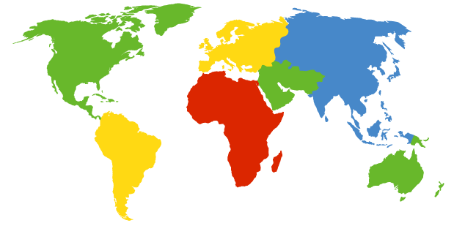
DNS Root
Located in Virginia, USA
How do we make the root scale?
Verisign, Dulles, VA

Slide 22
DNS Root Servers
13 root servers (see http://www.root-servers.org/)
  Labeled A through M
Does this scale?
A Verisign, Dulles, VA
C Cogent, Herndon, VA
D U Maryland College Park, MD
G US DoD Vienna, VA
H ARL Aberdeen, MD
J Verisign
K RIPE London
I Autonomica, Stockholm
E NASA Mt View, CA
F Internet Software
Consortium
Palo Alto, CA
M WIDE Tokyo
B USC-ISI Marina del Rey, CA
L ICANN Los Angeles, CA

Slide 23
DNS Root Servers
13 root servers (see http://www.root-servers.org/)
  Labeled A through M
Replication via any-casting (localized routing for addresses)
A Verisign, Dulles, VA
C Cogent, Herndon, VA (also Los Angeles, NY, Chicago)
D U Maryland College Park, MD
G US DoD Vienna, VA
H ARL Aberdeen, MD
J Verisign (21 locations)
K RIPE London (plus 16 other locations)
I Autonomica, Stockholm (plus 29 other locations)
E NASA Mt View, CA
F Internet Software
Consortium,
Palo Alto, CA
(and 37 other locations)
M WIDE Tokyo
plus Seoul, Paris,
San Francisco
B USC-ISI Marina del Rey, CA
L ICANN Los Angeles, CA

Slide 24
Using DNS
Two components
  Local DNS servers
  Resolver software on hosts
Local DNS server (“default name server”)
  Usually near the endhosts that use it
  Local hosts configured with local server (e.g., /etc/resolv.conf) or learn server via DHCP
Client application
  Extract server name (e.g., from the URL)
  Do gethostbyname() to trigger resolver code
Notes:
6/Mar/2013

Slide 25
How Does Resolution Happen?
(Iterative example)
root DNS server
Host at cl.cam.ac.uk wants IP address for www.stanford.edu
2
3
TLD DNS server
local DNS server
dns.cam.ac.uk
4
5
iterated query:
Host enquiry is delegated to local DNS server
Consider
transactions 2 – 7 only
contacted server replies with name of next server to contact
“I don’t know this name, but ask this server”
7
6
1
8
authoritative DNS server
dns.stanford.edu
requesting host
cl.cam.ac.uk
www.stanford.edu
Notes:
FIX THIS – expanded example? and better differentiation between this and recursive

Slide 26
DNS name resolution recursive example
root DNS server
recursive query:
puts burden of name resolution on contacted name server
heavy load?
2
3
7
6
TLD DNS server
local DNS server
dns.cam.ac.uk
5
4
1
8
authoritative DNS server
dns.stanford.edu
requesting host
cl.cam.ac.uk
www.stanford.edu

Slide 27
Recursive and Iterative Queries - Hybrid case
Recursive query
  Ask server to get answer for you
  E.g., requests 1,2 and responses 9,10
Iterative query
  Ask server who
  to ask next
  E.g., all other request-response pairs
root DNS server
3
4
TLD DNS server
5
Site DNS server
dns.cam.ac.uk
6
2
9
Site DNS server
dns.cl.cam.ac.uk
8
7
1
10
authoritative DNS server
dns.stanford.edu
requesting host
my-host.cl.cam.ac.uk
Notes:
Most common case: this mixed usage: host to local: recursive; local: iterative

Slide 28
DNS Caching
Performing all these queries takes time
  And all this before actual communication takes place
  E.g., 1-second latency before starting Web download
Caching can greatly reduce overhead
  The top-level servers very rarely change
  Popular sites (e.g., www.bbc.co.uk) visited often
  Local DNS server often has the information cached
How DNS caching works
  DNS servers cache responses to queries
  Responses include a “time to live” (TTL) field
  Server deletes cached entry after TTL expires
Notes:
2019-2-25

Slide 29
Negative Caching
Remember things that don’t work
  Misspellings like bbcc.co.uk and www.bbc.com.uk
  These can take a long time to fail the first time
  Good to remember that they don’t work
  … so the failure takes less time the next time around
But: negative caching is optional
  And not widely implemented

Slide 30
Reliability
DNS servers are replicated (primary/secondary)
  Name service available if at least one replica is up
  Queries can be load-balanced between replicas
Usually, UDP used for queries
  Need reliability: must implement this on top of UDP
  Spec supports TCP too, but not always implemented
Try alternate servers on timeout
  Exponential backoff when retrying same server
Same identifier for all queries
  Don’t care which server responds

Slide 31
DNS and Security
No way to verify answers
  Opens up DNS to many potential attacks
  DNSSEC fixes this
Most obvious vulnerability: recursive resolution
  Using recursive resolution, host must trust DNS server
  When at Starbucks, server is under their control
  And can return whatever values it wants
More subtle attack: Cache poisoning
  Those “additional” records can be anything!
Notes:
2017-2-24

Slide 32




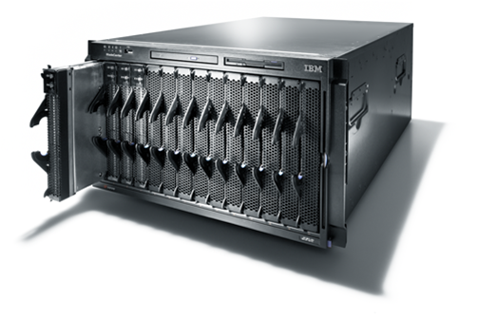


Data flow through the DNS
Where are the vulnerable
points?
Registrars
& Registrants
Server vulnarability
Secondary
DNS
Man in the Middle
primary
DNS
spoofing
&
Man in the Middle
Registry
Secondary
DNS

Slide 33
DNSSEC protects all these end-to-end
provides message authentication and integrity verification through cryptographic signatures
  You know who provided the signature
  No modifications between signing and validation
It does not provide authorization
It does not provide confidentiality
It does not provide protection against DDOS

Slide 34
DNSSEC in practice
Scaling the key signing and key distribution
Solution: Using the DNS to Distribute Keys
Distributing keys through DNS hierarchy:
  Use one trusted key to establish authenticity of other keys
  Building chains of trust from the root down
  Parents need to sign the keys of their children
Only the root key needed in ideal world
  Parents always delegate security to child

Slide 35
Why is the web so successful?
What do the web, youtube, facebook, twitter, instagram, ….. have in common?
  The ability to self-publish
Self-publishing that is easy, independent, free
No interest in collaborative and idealistic endeavor
  People aren’t looking for Nirvana (or even Xanadu)
  People also aren’t looking for technical perfection
Want to make their mark, and find something neat
  Two sides of the same coin, creates synergy
  “Performance” more important than dialogue….
Notes:
16-Feb-2015

Slide 36
Web Components
Infrastructure:
  Clients
  Servers
  Proxies
Content:
  Individual objects (files, etc.)
  Web sites (coherent collection of objects)
Implementation
  HTML: formatting content
  URL: naming content
  HTTP: protocol for exchanging content
        Any content not just HTML!

Slide 37
HTML: HyperText Markup Language
A Web page has:
  Base HTML file
  Referenced objects (e.g., images)
HTML has several functions:
  Format text
  Reference images
  Embed hyperlinks (HREF)
Notes:
Each object is uniquely identified. How?

Slide 38
URL Syntax
protocol://hostname[:port]/directorypath/resource
protocol | http, ftp, https, smtp, rtsp, etc.
hostname | DNS name, IP address
port | Defaults to protocol’s standard port e.g. http: 80 https: 443
directory path | Hierarchical, reflecting file system
resource | Identifies the desired resource Can also extend to program executions: http://us.f413.mail.yahoo.com/ym/ShowLetter?box=%40B%40Bulk&MsgId=2604_1744106_29699_1123_1261_0_28917_3552_1289957100&Search=&Nhead=f&YY=31454&order=down&sort=date&pos=0&view=a&head=b

Slide 39
HyperText Transfer Protocol (HTTP)
Request-response protocol
Reliance on a global namespace
Resource metadata
Stateless
ASCII format (ok this changed….)
$ telnet www.cl.cam.ac.uk 80
GET /win HTTP/1.0
<blank line, i.e., CRLF>

Slide 40
Steps in HTTP Request
HTTP Client initiates TCP connection to server
  SYN
  SYNACK
  ACK
Client sends HTTP request to server
  Can be piggybacked on TCP’s ACK
HTTP Server responds to request
Client receives the request, terminates connection
TCP connection termination exchange
How many RTTs for a single request?
Notes:
Know this
Draw!!!

Slide 41
Client-Server Communication
two types of HTTP messages: request, response
HTTP request message: (GET POST HEAD ….)
request line
(GET, POST,
HEAD commands)
GET /somedir/page.html HTTP/1.1
Host: www.someschool.edu
User-agent: Mozilla/4.0
Connection: close
Accept-language:fr
(extra carriage return, line feed)
HTTP response message
header
lines
status line
(protocol
status code
status phrase)
HTTP/1.1 200 OK
Connection close
Date: Thu, 06 Aug 1998 12:00:15 GMT
Server: Apache/1.3.0 (Unix)
Last-Modified: Mon, 22 Jun 1998 …...
Content-Length: 6821
Content-Type: text/html
data data data data data ...
Carriage return,
line feed
indicates end
of message
header
lines
data, e.g.,
requested
HTML file

Slide 42
Different Forms of Server Response
Return a file
  URL matches a file (e.g., /www/index.html)
  Server returns file as the response
  Server generates appropriate response header
Generate response dynamically
  URL triggers a program on the server
  Server runs program and sends output to client
Return meta-data with no body

Slide 43
HTTP Resource Meta-Data
Meta-data
  Info about a resource, stored as a separate entity
Examples:
  Size of resource, last modification time, type of content
Usage example: Conditional GET Request
  Client requests object “If-modified-since”
  If unchanged, “HTTP/1.1 304 Not Modified”
  No body in the server’s response, only a header
Notes:
Pause for a second--- stateless…!

Slide 44
HTTP is Stateless
Each request-response treated independently
  Servers not required to retain state
Good: Improves scalability on the server-side
  Failure handling is easier
  Can handle higher rate of requests
  Order of requests doesn‘t matter
Bad: Some applications need persistent state
  Need to uniquely identify user or store temporary info
  e.g., Shopping cart, user profiles, usage tracking, …
Notes:
Fate sharing

Slide 45
State in a Stateless Protocol:
Cookies
Client-side state maintenance
  Client stores small^{(?)} state on behalf of server
  Client sends state in future requests to the server
Can provide authentication
Request
Response
Set-Cookie: XYZ
Request
Cookie: XYZ
Notes:
Creates a notion of a “SESSION” for the user
Customize the user experience
Statefulness comes from the client side

Slide 46
HTTP Performance
Most Web pages have multiple objects
  e.g., HTML file and a bunch of embedded images
How do you retrieve those objects (naively)?
  One item at a time
Put stuff in the optimal place?
  Where is that precisely?
    Enter the Web cache and the CDN

Slide 47
Fetch HTTP Items: Stop & Wait
Client
Server
Start fetching
page
Request item 1
Transfer item 1
Time
Request item 2
≥2 RTTs
per
object
Transfer item 2
Request item 3
Transfer item 3
Finish; display
page
Notes:
No timer, no resend
NOT concurrent!

Slide 48


Improving HTTP Performance:
Concurrent Requests & Responses
Use multiple connections in parallel
Does not necessarily maintain order of responses
R2
R3
R1
T2
T3
Client = ☺
Server = ☺
Network = ☹ Why?
T1

Slide 49
Improving HTTP Performance:
Pipelined Requests & Responses
Batch requests and responses
  Reduce connection overhead
  Multiple requests sent in a single batch
  Maintains order of responses
  Item 1 always arrives before item 2
How is this different from concurrent requests/responses?
  Single TCP connection
Client
Server
Request 1
Request 2
Request 3
Transfer 1
Transfer 2
Transfer 3
Notes:
HTTP/1.1 allows multiple HTTP requests to be written out to a socket together without waiting for the corresponding responses. The requestor then waits for the responses to arrive in the order in which they were requested. The act of pipelining the requests can result in a dramatic improvement in page loading times, especially over high latency connections.

Slide 50
Improving HTTP Performance:
Persistent Connections
Enables multiple transfers per connection
  Maintain TCP connection across multiple requests
  Including transfers subsequent to current page
  Client or server can tear down connection
Performance advantages:
  Avoid overhead of connection set-up and tear-down
  Allow TCP to learn more accurate RTT estimate
  Allow TCP congestion window to increase
  i.e., leverage previously discovered bandwidth
Default in HTTP/1.1
Notes:
got here 8/Mar/2013

Slide 51
HTTP evolution
1.0 – one object per TCP: simple but slow
Parallel connections - multiple TCP, one object each: wastes b/w, may be svr limited, out of order
1.1 pipelining – aggregate retrieval time: ordered, multiple objects sharing single TCP
1.1 persistent – aggregate TCP overhead: lower overhead in time, increase overhead at ends (e.g., when should/do you close the connection?)

Slide 52
Scorecard: Getting n Small Objects
Time dominated by latency
One-at-a-time: ~2n RTT
Persistent: ~ (n+1)RTT
M concurrent: ~2[n/m] RTT
Pipelined: ~2 RTT
Pipelined/Persistent: ~2 RTT first time, RTT later

Slide 53
Scorecard: Getting n Large Objects
Time dominated by bandwidth
One-at-a-time: ~ nF/B
M concurrent: ~ [n/m] F/B
  assuming shared with large population of users
Pipelined and/or persistent: ~ nF/B
  The only thing that helps is getting more bandwidth..

Slide 54
Improving HTTP Performance:
Caching
Many clients transfer the same information
  Generates redundant server and network load
  Clients experience unnecessary latency
Server
Backbone ISP
ISP-1
ISP-2
Clients

Slide 55
Improving HTTP Performance:
Caching: How
Modifier to GET requests:
  If-modified-since – returns “not modified” if resource not modified since specified time
Response header:
  Expires – how long it’s safe to cache the resource
  No-cache – ignore all caches; always get resource directly from server

Slide 56
Improving HTTP Performance:
Caching: Why
Motive for placing content closer to client:
  User gets better response time
  Content providers get happier users
    Time is money, really!
  Network gets reduced load
Why does caching work?
  Exploits locality of reference
How well does caching work?
  Very well, up to a limit
  Large overlap in content
  But many unique requests

Slide 57
Improving HTTP Performance:
Caching on the Client
Example: Conditional GET Request
Return resource only if it has changed at the server
  Save server resources!
How?
  Client specifies “if-modified-since” time in request
  Server compares this against “last modified” time of desired resource
  Server returns “304 Not Modified” if resource has not changed
  …. or a “200 OK” with the latest version otherwise
Request from client to server:
GET /~awm22/win HTTP/1.1
Host: www.cl.cam.ac.uk
User-Agent: Mozilla/4.03
If-Modified-Since: Sun, 27 Aug 2006 22:25:50 GMT
<CRLF>

Slide 58
Improving HTTP Performance:
Caching with Reverse Proxies
Cache documents close to server
→ decrease server load
Typically done by content providers
Only works for static(*) content
(*) static can also be snapshots
of dynamic content
Server
Reverse proxies
Backbone ISP
ISP-1
ISP-2
Clients

Slide 59
Improving HTTP Performance:
Caching with Forward Proxies
Cache documents close to clients
→ reduce network traffic and decrease latency
Typically done by ISPs or corporate LANs
Server
Reverse proxies
Backbone ISP
ISP-1
ISP-2
Forward proxies
Clients

Slide 60
Improving HTTP Performance:
Caching w/ Content Distribution Networks
Integrate forward and reverse caching functionality
  One overlay network (usually) administered by one entity
  e.g., Akamai
Provide document caching
  Pull: Direct result of clients’ requests
  Push: Expectation of high access rate
Also do some processing
  Handle dynamic web pages
  Transcoding
  Maybe do some security function – watermark IP
Notes:
Transcoding = change compression rate per user’s bandwidth

Slide 61
Improving HTTP Performance:
Caching with CDNs (cont.)
Server
CDN
Backbone ISP
ISP-1
ISP-2
Forward proxies
Clients

Slide 62
Improving HTTP Performance:
CDN Example – Akamai
Akamai creates new domain names for each client content provider.
  e.g., a128.g.akamai.net
The CDN’s DNS servers are authoritative for the new domains
The client content provider modifies its content so that embedded URLs reference the new domains.
  “Akamaize” content
  e.g.: http://www.bbc.co.uk/popular-image.jpg becomes http://a128.g.akamai.net/popular-image.jpg
Requests now sent to CDN’s infrastructure…
Notes:
18-feb-2014

Slide 63
Hosting: Multiple Sites Per Machine
Multiple Web sites on a single machine
  Hosting company runs the Web server on behalf of multiple sites (e.g., www.foo.com and www.bar.com)
Problem: GET /index.html
  www.foo.com/index.html or www.bar.com/index.html?
Solutions:
  Multiple server processes on the same machine
    Have a separate IP address (or port) for each server
  Include site name in HTTP request
    Single Web server process with a single IP address
    Client includes “Host” header (e.g., Host: www.foo.com)
    Required header with HTTP/1.1

Slide 64
Hosting: Multiple Machines Per Site
Replicate popular Web site across many machines
  Helps to handle the load
  Places content closer to clients
Helps when content isn’t cacheable
Problem: Want to direct client to particular replica
  Balance load across server replicas
  Pair clients with nearby servers

Slide 65
Multi-Hosting at Single Location
Single IP address, multiple machines
  Run multiple machines behind a single IP address
  Ensure all packets from a single
  TCP connection go to the same replica
Load Balancer
64.236.16.20

Slide 66
Multi-Hosting at Several Locations
Multiple addresses, multiple machines
  Same name but different addresses for all of the replicas
  Configure DNS server to return closest address
12.1.1.1
64.236.16.20
Internet
173.72.54.131

Slide 67
CDN examples round-up
CDN using DNS
  DNS has information on loading/distribution/location
CDN using anycast
  same address from DNS name but local routes
CDN based on rewriting HTML URLs
  (akami example just covered – akami uses DNS too)
Notes:
HTTP CACHING

Slide 68
After HTTP/1.1
SPDY (speedy) and its moral successor HTTP/2
Binary protocol
  More efficient to parse
  More compact on the wire
  Much less error prone as compared
  to textual protocols

Slide 69
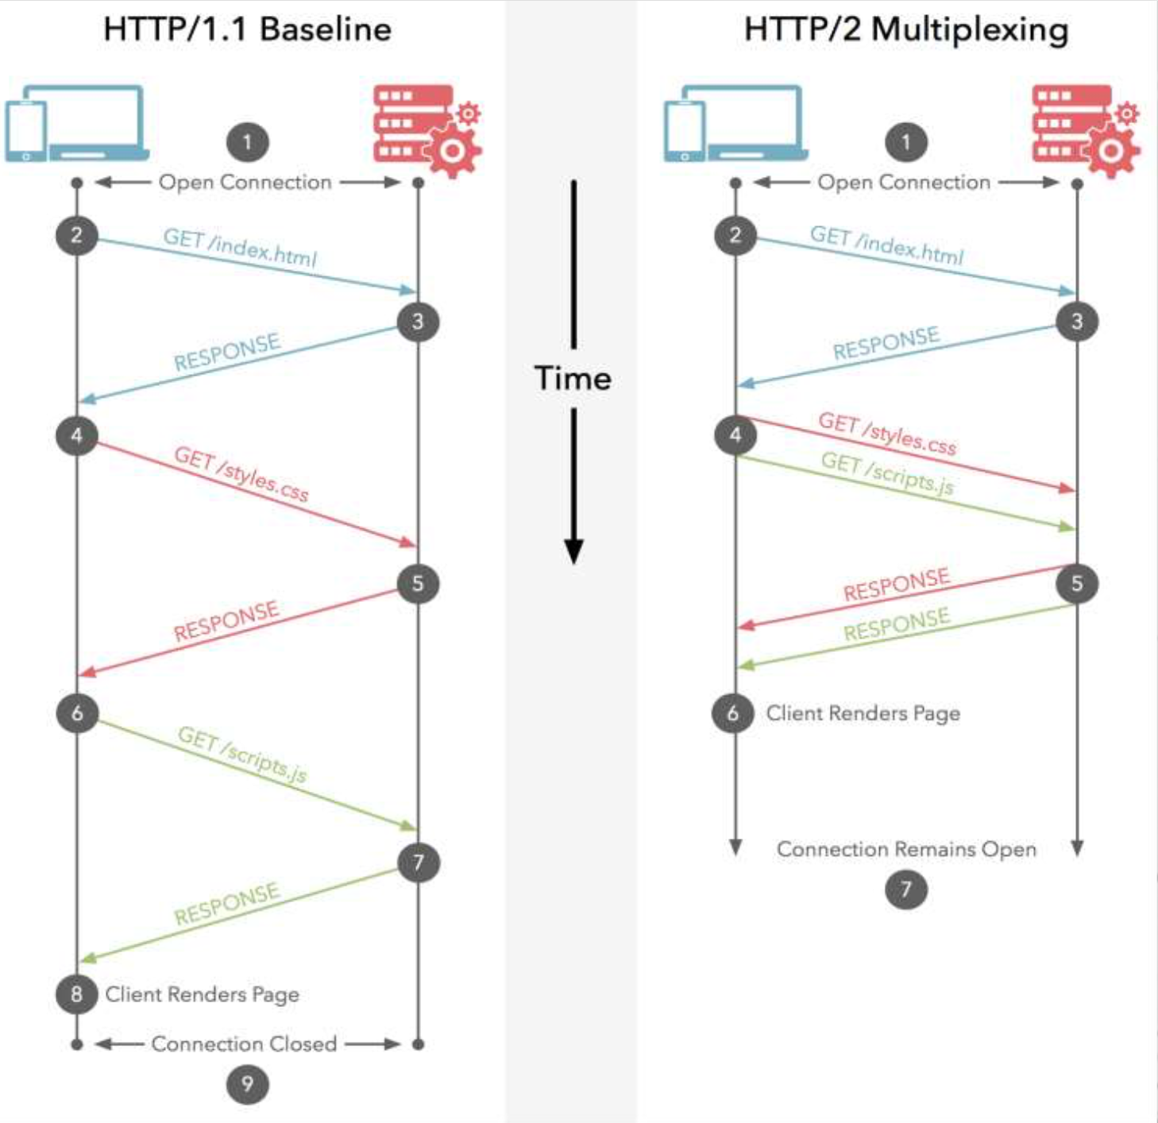
After HTTP/1.1
SPDY (speedy) and its moral successor HTTP/2
Binary protocol
Multiplexing
  Interleaved

Slide 70
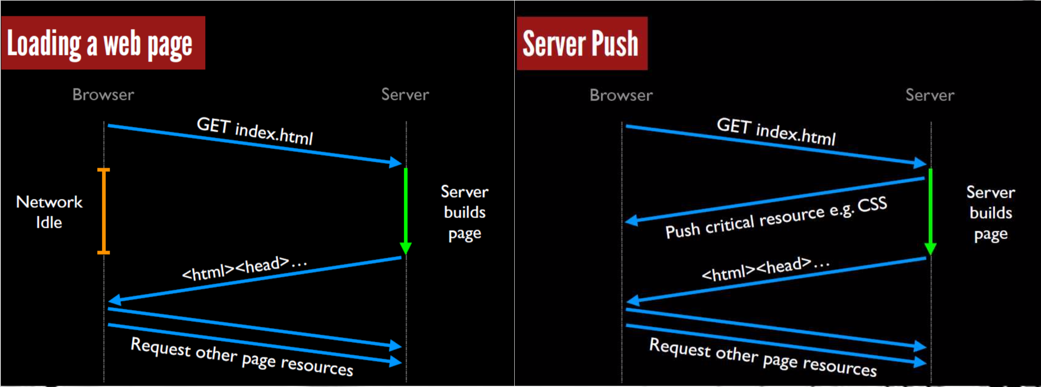
After HTTP/1.1
SPDY (speedy) and its moral successor HTTP/2
Binary protocol
Multiplexing
Priority control over Frames
Header Compression
Server Push
  Proactively push stuff to client that it will need

Slide 71
After HTTP/1.1
SPDY (speedy) and its moral successor HTTP/2
Binary protocol
Multiplexing
Priority control over Frames
Header Compression
Server Push

Slide 72
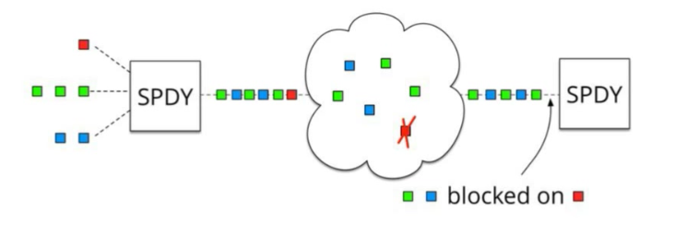
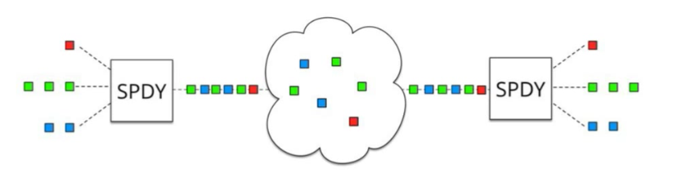
SPDY
SPDY + HTTP/2: One single TCP connection instead of multiple
Downside: Head of line blocking
In TCP, packets need to be processed in correct order

Slide 73
Add QUIC and stir…
Quick UDP Internet Connections
Objective: Combine speed of UDP protocol with TCP’s reliability
Very hard to make changes to TCP
Faster to implement new protocol on top of UDP
Roll out features in TCP if they prove theory
QUIC:
Reliable transport over UDP (seriously)
Uses FEC
Default crypto
Restartable connections

Slide 74
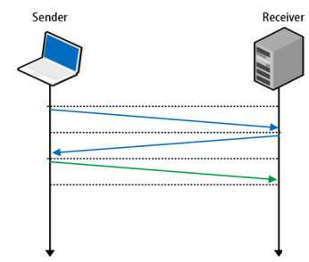
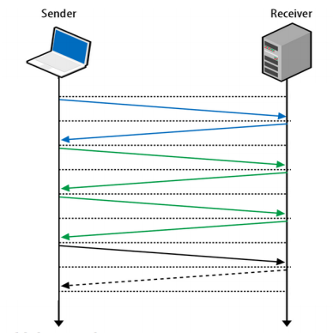
3-Way Handshake
Without TLS
With TLS

Slide 75
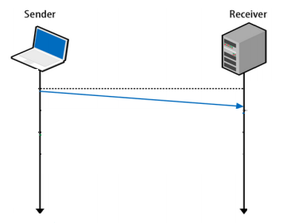
UDP
Fire and forget
  Less time spent to validate packets
  Downside - no reliability, has to be built on top of UDP

Slide 76
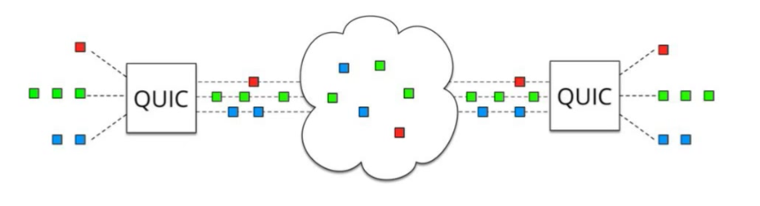
QUIC
UDP does NOT depend on order of arriving packets
Lost packets will only impact an individual resource, e.g., CSS or JS file.
QUIC is combining best parts of HTTP/2 over UDP:
  Multiplexing on top of non-blocking transport protocol

Slide 77
QUIC – more than just UDP
QUIC outshines TCP under poor network conditions, shaving a full second off the Google Search page load time for the slowest 1% of connections.
These benefits are even more apparent for video services like YouTube. Users report 30% fewer rebuffers when watching videos over QUIC.

Slide 78
SIP – Session Initiation Protocol
Session?
Anyone smell an OSI / ISO standards document burning?

Slide 79
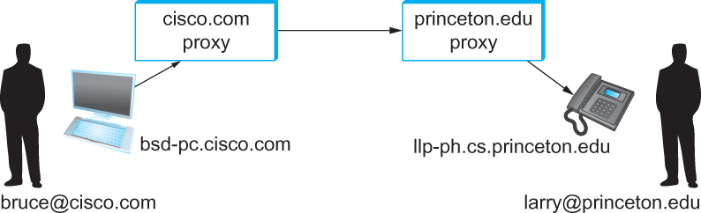

SIP - VoIP
Establishing communication through SIP proxies.

Slide 80
SIP?
SIP – bringing the fun/complexity of telephony to the Internet
  User location
  User availability
  User capabilities
  Session setup
  Session management
    (e.g. “call forwarding”)

Slide 81
H.323 – ITU
Why have one standard when there are at least two….
The full H.323 is hundreds of pages
  The protocol is known for its complexity – an ITU hallmark
SIP is not much better
  IETF grew up and became the ITU….

Slide 82
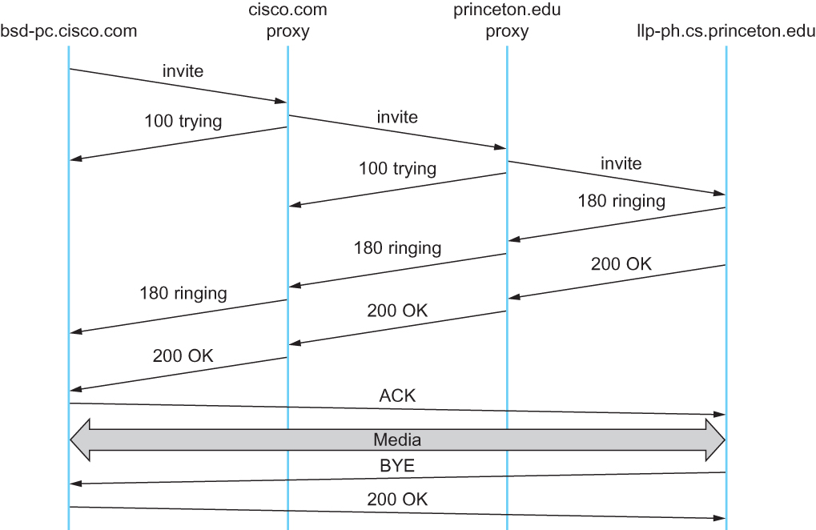
Multimedia Applications
Message flow for a basic SIP session

Slide 83
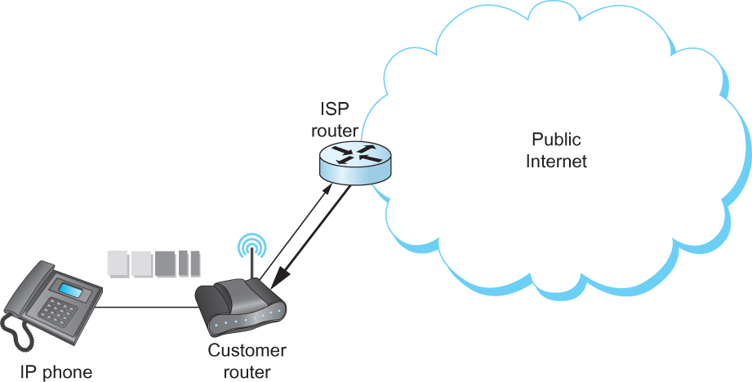
The (still?) missing piece:
Resource Allocation for Multimedia Applications
I can ‘differentiate’ VoIP from data but…
I can only control data going into the Internet

Slide 84
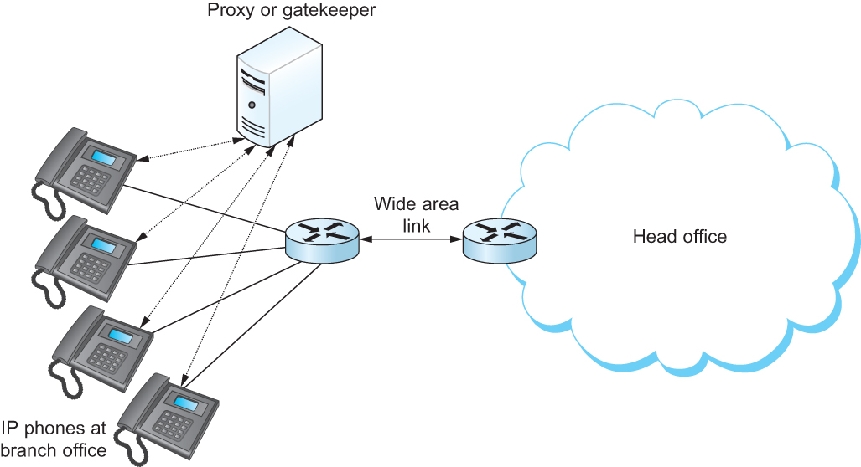
Multimedia Applications
Resource Allocation for Multimedia Applications
Admission control using session control protocol.

Slide 85
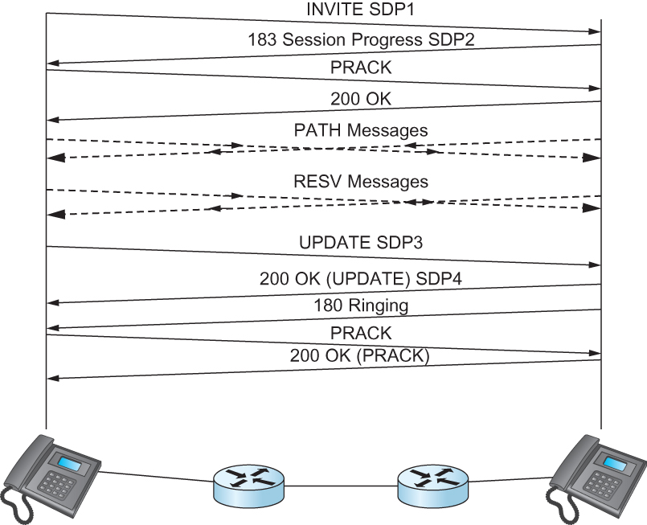
Resource Allocation for Multimedia Applications
So where does it happen?
Inside single institutions or domains of control…..
(Universities, Hospitals, big corp…)
What about my aDSL/CABLE/etc it combines voice and data?
Phone company controls the multiplexing on the line
and throughout their own network too……
Coming soon… 1995
2000
2010
who are we kidding??
Co-ordination of SIP signaling and
resource reservation.

Slide 86
P2P – efficient network use that annoys the ISP

Slide 87
Pure P2P architecture
no always-on server
arbitrary end systems directly communicate
peers are intermittently connected and change IP addresses
Three topics:
  File distribution
  Searching for information
  Case Study: Skype
peer-peer
Notes:
Skype hybrid, Bittorrent - pure

Slide 88
File Distribution: Server-Client vs P2P
Question : How much time to distribute file from one server to N peers?
u_{s}: server upload bandwidth
Server
u_{i}: peer i upload bandwidth
u₁
d₁
u₂
u_{s}
d₂
d_{i}: peer i download bandwidth
File, size F
d_{N}
Network (with
abundant bandwidth)
u_{N}

Slide 89
File distribution time: server-client
Server
server sequentially sends N copies:
  NF/u_{s} time
client i takes F/d_{i} time to download
F
u₁
d₁
u₂
u_{s}
d₂
d_{N}
Network (with
abundant bandwidth)
u_{N}
Time to distribute F
to N clients using
client/server approach
= d_{cs} = max { NF/u_{s}, F/min(d_{i}) }
i
increases linearly in N
(for large N)

Slide 90
File distribution time: P2P
Server
server must send one copy: F/u_{s} time
client i takes F/d_{i} time to download
NF bits must be downloaded (aggregate)
F
u₁
d₁
u₂
u_{s}
d₂
d_{N}
Network (with
abundant bandwidth)
u_{N}
fastest possible upload rate: u_{s} + Σu_{i}
d_{P2P} = max { F/u_{s}, F/min(d_{i}) , NF/(u_{s} + Σu_{i}) }
i

Slide 91
Server-client vs. P2P: example
Client upload rate = u, F/u = 1 hour, u_{s} = 10u, d_{min} ≥ u_{s}
Notes:
25-frb-2015

Slide 92

File distribution: BitTorrent*
*rather old BitTorrent
P2P file distribution
tracker: tracks peers
participating in torrent
torrent: group of
peers exchanging
chunks of a file
obtain list
of peers
trading
chunks
peer

Slide 93
BitTorrent (1)
file divided into 256KB chunks.
peer joining torrent:
  has no chunks, but will accumulate them over time
  registers with tracker to get list of peers, connects to subset of peers (“neighbors”)
while downloading, peer uploads chunks to other peers.
peers may come and go
once peer has entire file, it may (selfishly) leave or (altruistically) remain

Slide 94
BitTorrent (2)
Pulling Chunks
at any given time, different peers have different subsets of file chunks
periodically, a peer (Alice) asks each neighbor for list of chunks that they have.
Alice sends requests for her missing chunks
  rarest first
Sending Chunks: tit-for-tat
Alice sends chunks to four neighbors currently sending her chunks at the highest rate
  re-evaluate top 4 every 10 secs
every 30 secs: randomly select another peer, starts sending chunks
  newly chosen peer may join top 4
  “optimistically unchoke”

Slide 95

BitTorrent: Tit-for-tat
(1) Alice “optimistically unchokes” Bob
(2) Alice becomes one of Bob’s top-four providers; Bob reciprocates
(3) Bob becomes one of Alice’s top-four providers
With higher upload rate,
can find better trading
partners & get file faster!
Notes:
GOT HERE 6/Feb/2011

Slide 96
Distributed Hash Table (DHT)
DHT = distributed P2P database
Database has (key, value) pairs;
  key: ss number; value: human name
  key: content type; value: IP address
Peers query DB with key
  DB returns values that match the key
Peers can also insert (key, value) peers
Notes:
SKIP ME 85-91

Slide 97
Distributed Hash Table (DHT)
DHT = distributed P2P database
Database has (key, value) pairs;
  key: ss number; value: human name
  key: content type; value: IP address
Peers query DB with key
  DB returns values that match the key
Peers can also insert (key, value) peers
Notes:
SKIP ME 85-91

Slide 98
DHT Identifiers
Assign integer identifier to each peer in range [0,2^{n}-1].
  Each identifier can be represented by n bits.
Require each key to be an integer in same range.
To get integer keys, hash original key.
  eg, key = h(“Game of Thrones season 29”)
  This is why they call it a distributed “hash” table

Slide 99
How to assign keys to peers?
Central issue:
  Assigning (key, value) pairs to peers.
Rule: assign key to the peer that has the closest ID.
Convention in lecture: closest is the immediate successor of the key.
Ex: n=4; peers: 1,3,4,5,8,10,12,14;
  key = 13, then successor peer = 14
  key = 15, then successor peer = 1

Slide 100
Circular DHT (1)
1
3
15
4
12
5
10
8
Each peer only aware of immediate successor and predecessor.
“Overlay network”

Slide 101
Circle DHT (2)
O(N) messages
on avg to resolve
query, when there
are N peers
0001
Who’s resp
for key 1110 ?
I am
0011
1111
1110
1110
0100
1110
1100
1110
0101
1110
Define closest
as closest
successor
1110
1010
1000

Slide 102
Circular DHT with Shortcuts
1
Who’s resp
for key 1110?
3
15
4
12
5
10
8
Each peer keeps track of IP addresses of predecessor, successor, short cuts.
Reduced from 6 to 2 messages.
Possible to design shortcuts so O(log N) neighbors, O(log N) messages in query

Slide 103
Peer Churn
1
To handle peer churn, require
each peer to know the IP address
of its two successors.
Each peer periodically pings its
two successors to see if they
are still alive.
3
15
4
12
5
10
8
Peer 5 abruptly leaves
Peer 4 detects; makes 8 its immediate successor; asks 8 who its immediate successor is; makes 8’s immediate successor its second successor.
What if peer 13 wants to join?

Slide 104

P2P Case study: Skype (pre-Microsoft)
Skype clients (SC)
inherently P2P: pairs of users communicate.
proprietary application-layer protocol (inferred via reverse engineering)
hierarchical overlay with SNs
Index maps usernames to IP addresses; distributed over SNs
Skype
login server
Supernode
(SN)

Slide 105
Peers as relays
Problem when both Alice and Bob are behind “NATs”.
  NAT prevents an outside peer from initiating a call to insider peer
Solution:
  Using Alice’s and Bob’s SNs, Relay is chosen
  Each peer initiates session with relay.
  Peers can now communicate through NATs via relay

Slide 106
Summary.
Apps need protocols too
We covered examples from
  Traditional Applications (web)
  Scaling and Speeding the web (CDN/Cache tricks)
Infrastructure Services (DNS)
  Cache and Hierarchy
Multimedia Applications (SIP)
  Extremely hard to do better than worst-effort
P2P Network examples

