Slide 1
Computer Networking
Lent Term
M/W/F 11:00-12:00
LT1 in Gates Building
Slide Set 2 (Topics 4)
Andrew W. Moore
Andrew.Moore@cl.cam.ac.uk
2018-2019

Slide 2
Topic 4: Network Layer
Our goals:
understand principles behind network layer services:
  network layer service models
  forwarding versus routing (versus switching)
  how a router works
  routing (path selection)
  IPv6 – With slides gratuitously borrowed from
  Stephen Strowes RIPE (formerly Yahoo!)
For the most part, the Internet is our example – again.

Slide 3
Name: a something
Address: Where a something is
Routing: How do I get to the something

Slide 4
Addressing (at a conceptual level)
Assume all hosts have unique IDs
No particular structure to those IDs
Later in topic I will talk about real IP addressing
Do I route on location or identifier?
If a host moves, should its address change?
  If not, how can you build scalable Internet?
  If so, then what good is an address for identification?
Notes:
20-jan-17

Slide 5
Packets (at a conceptual level)
Assume packet headers contain:
  Source ID, Destination ID, and perhaps other information
Destination
Identifier
Why include
this?
Source
Identifier
Payload

Slide 6
Switches/Routers
Multiple ports (attached to other switches or hosts)
Ports are typically duplex (incoming and outgoing)
incoming links
Switch
outgoing links

Slide 7
A Variety of Networks
ISPs: carriers
  Backbone
  Edge
  Border (to other ISPs)
Enterprises: companies, universities
  Core
  Edge
  Border (to outside)
Datacenters: massive collections of machines
  Top-of-Rack
  Aggregation and Core
  Border (to outside)
Notes:
19-jan-2015

Slide 8

Switches forward packets
GLASGOW
EDINBURGH
switch#4
switch#2
Forwarding Table
111010010
EDIN
Destination | Next Hop
GLASGOW | 4
OXFORD | 5
EDIN | 2
UCL | 3
switch#5
OXFORD
UCL
switch#3

Slide 9
Forwarding Decisions
When packet arrives..
  Must decide which outgoing port to use
  In single transmission time
  Forwarding decisions must be simple
Routing state dictates where to forward packets
  Assume decisions are deterministic
Global routing state means collection of routing state in each of the routers
  Will focus on where this routing state comes from
  But first, a few preliminaries….

Slide 10
Forwarding vs Routing
Forwarding: “data plane”
  Directing a data packet to an outgoing link
  Individual router using routing state
Routing: “control plane”
  Computing paths the packets will follow
  Routers talking amongst themselves
  Jointly creating the routing state
Two very different timescales….
Notes:
8/Feb/2012

Slide 11
Router definitions
1
N
2
N-1
3
R bits/sec
…
4
5
N = number of external router “ports”
R = speed (“line rate”) of a port
Router capacity = N x R

Slide 12
Networks and routers
JANET
edge (enterprise)
INTEL
AT&T
home,
small business
core
edge (ISP)
MIT
core
Notes:
Bunch of different kinds of routers: small for homes, routers that connect different ISPs or ISPs to enterprises (edge)

Slide 13
What’s inside a router?
Input and Output for
the same port are on one
physical linecard
Processes packets
on their way in
Route/Control
Processor
Processes packets
before they leave
Linecards (input)
Linecards (output)
1
1
2
2
Interconnect
(Switching)
Fabric
Transfers packets
from input to
output ports
N
N

Slide 14
What’s inside a router?
(1) Implement IGP
and BGP protocols;
compute routing tables
(2) Push forwarding
tables to the line cards
Route/Control
Processor
Linecards (input)
Linecards (output)
1
1
2
2
Interconnect
(Switching)
Fabric
N
N

Slide 15
What’s inside a router?
Makes decisions over long time horizons : network change
Constitutes the
control plane
Route/Control
Processor
Constitutes the
data plane
Linecards (input)
Linecards (output)
1
1
2
2
Interconnect
Fabric
A decision for each packet.
N
N
Notes:
Control plane: software. Makes decisions over long time horizons.
Data plane: mostly hardware. A decision for each packet.

Slide 16

Context and Terminology
“Autonomous System (AS)” or “Domain”
Region of a network under a single administrative entity
“End hosts”
“Clients”, “Users”
“End points”
“Border Routers”
“Route” or “Path”
“Interior Routers”
Notes:
2015-12-2

Slide 17
Context and Terminology
Destination
Destination
Destination
111010010
MIT
Destination
Destination
Destination
Destination
Destination
Internet routing protocols are responsible for constructing
and updating the forwarding tables at routers
MIT
Notes:
Go through this one fast or remove all together

Slide 18
Routing Protocols
Routing protocols implement the core function of a network
  Establish paths between nodes
  Part of the network’s “control plane”
Network modeled as a graph
  Routers are graph vertices
  Links are edges
  Edges have an associated “cost”
    e.g., distance, loss
Goal: compute a “good” path from source to destination
  “good” usually means the shortest (least cost) path
5
B
3
C
2
5
A
2
1
F
3
1
2
D
E
1

Slide 19
Internet Routing
Internet Routing works at two levels
Each AS runs an intra-domain routing protocol that
establishes routes within its domain
  (AS -- region of network under a single administrative entity)
  Link State, e.g., Open Shortest Path First (OSPF)
  Distance Vector, e.g., Routing Information Protocol (RIP)
ASes participate in an inter-domain routing protocol that establishes routes between domains
  Path Vector, e.g., Border Gateway Protocol (BGP)

Slide 20
Addressing (for now)
Assume each host has a unique ID (address)
No particular structure to those IDs
Later in course will talk about real IP addressing

Slide 21
Outline
Popular Routing Algorithms:
  Link State Routing
  Distance Vector Algorithm
Routing: goals and metrics

Slide 22
Link-State Routing

Slide 23
Link State Routing
Each node maintains its local “link state” (LS)
  i.e., a list of its directly attached links and their costs
(N1,N2)
(N1,N4)
(N1,N5)
Host C
Host A
Host D
N1
N2
N3
N5
Host B
N4
Host E
N6
N7

Slide 24
Link State Routing
Each node maintains its local “link state” (LS)
Each node floods its local link state
  on receiving a new LS message, a router forwards the message
  to all its neighbors other than the one it received the message from
Host C
Host A
Host D
(N1,N2)
(N1, N4)
(N1, N5)
(N1,N2)
(N1, N4)
(N1, N5)
N1
N2
(N1,N2)
(N1, N4)
(N1, N5)
N3
(N1,N2)
(N1, N4)
(N1, N5)
(N1,N2)
(N1, N4)
(N1, N5)
N5
(N1,N2)
(N1, N4)
(N1, N5)
(N1,N2)
(N1, N4)
(N1, N5)
(N1,N2)
(N1, N4)
(N1, N5)
Host B
N4
Host E
(N1,N2)
(N1, N4)
(N1, N5)
(N1,N2)
(N1, N4)
(N1, N5)
N6
N7

Slide 25
Link State Routing
Each node maintains its local “link state” (LS)
Each node floods its local link state
Hence, each node learns the entire network topology
  Can use Dijkstra’s to compute the shortest paths between nodes
A
C
D
Host C
C
A
D
Host A
Host D
B
E
B
E
N1
N2
A
C
D
C
A
D
N3
B
E
N5
A
C
D
A
C
D
B
E
Host B
N4
B
Host E
E
B
E
A
C
D
N6
N7
B
E
Notes:
21.8 in Forouzan

Slide 26
Dijkstra’s Shortest Path Algorithm
INPUT:
  Network topology (graph), with link costs
OUTPUT:
  Least cost paths from one node to all other nodes
Iterative: after k iterations, a node knows the least cost path to its k closest neighbors
This is covered in Algorithms
Notes:
How many people know this algorithm?
Well, last year….

Slide 27
The Forwarding Table
Running Dijkstra at node A gives the shortest path from A to all destinations
We then construct the forwarding table
Destination | Link
B | (A,B)
C | (A,D)
D | (A,D)
E | (A,D)
F | (A,D)
5
B
3
C
2
5
A
2
1
F
3
1
2
D
E
1
Notes:
Separate routing and forwarding tables - not always the case. For efficiency, hardware implementation

Slide 28
Issue #1: Scalability
How many messages needed to flood link state messages?
  O(N x E), where N is #nodes; E is #edges in graph
Processing complexity for Dijkstra’s algorithm?
  O(N²), because we check all nodes w not in S at each iteration and we have O(N) iterations
  more efficient implementations: O(N log(N))
How many entries in the LS topology database? O(E)
How many entries in the forwarding table? O(N)

Slide 29
Issue#2: Transient Disruptions
Inconsistent link-state database
  Some routers know about failure before others
  The shortest paths are no longer consistent
  Can cause transient forwarding loops
B
C
B
C
A
F
A
F
D
E
Loop!
D
E
A and D think that this
is the path to C
E thinks that this
is the path to C
Notes:
here. 12/jan/2014

Slide 30
Distance Vector Routing
Notes:
intra-routing is for LSR and inter is for Distance Vector

Slide 31
Learn-By-Doing
Let’s try to collectively develop
distance-vector routing from first principles

Slide 32
Experiment
Your job: find the (route to) the youngest person in the room
Ground Rules
  You may not leave your seat, nor shout loudly
  across the class
  You may talk with your immediate neighbors
  (N-S-E-W only)
  (hint: “exchange updates” with them)
At the end of 5 minutes, I will pick a victim and ask:
  who is the youngest person in the room? (date&name)
  which one of your neighbors first told you this info.?

Slide 33
Go!

Slide 34
Distance-Vector Routing

Slide 35
Example of Distributed Computation
I am three hops away
I am two hops away
I am one hop away
I am two hops away
I am two hops away
I am three hops away
I am one hop away
Destination
I am three hops away
I am one hop away
I am two hops away

Slide 36
Distance Vector Routing
Each router sends its knowledge about the “whole” network to its neighbors. Information sharing at regular intervals.
Each router knows the links to its neighbors
  Does not flood this information to the whole network
Each router has provisional “shortest path” to
every other router
  E.g.: Router A: “I can get to router B with cost 11”
Routers exchange this distance vector information with their neighboring routers
  Vector because one entry per destination
Routers look over the set of options offered by their neighbors and select the best one
Iterative process converges to set of shortest paths
Notes:
Whole means as much as they know 21.7 in Forouzan
A link has a single cost, the cost is based on hop count

Slide 37
A few other inconvenient truths
What if we use a non-additive metric?
  E.g., maximal capacity
What if routers don’t use the same metric?
  I want low delay, you want low loss rate?
What happens if nodes lie?
Notes:
23-Jan-17

Slide 38
Can You Use Any Metric?
I said that we can pick any metric. Really?
What about maximizing capacity?

Slide 39
What Happens Here?
A high capacity link gets reduced to low capacity
All nodes want to maximize capacity
Problem:“cost” does not change around loop
Additive measures avoid this problem!

Slide 40
No agreement on metrics?
If the nodes choose their paths according to different criteria, then bad things might happen
Example
  Node A is minimizing latency
  Node B is minimizing loss rate
  Node C is minimizing price
Any of those goals are fine, if globally adopted
  Only a problem when nodes use different criteria
Consider a routing algorithm where paths are described by delay, cost, loss

Slide 41
What Happens Here?
Cares about price,
then loss
Cares about delay,
then price
Low price link
Low loss link
Low delay link
Cares about loss,
then delay
Low delay link
Low loss link
Low price link
Notes:
Figure this out. Break into groups….

Slide 42
Must agree on loop-avoiding metric
When all nodes minimize same metric
And that metric increases around loops
Then process is guaranteed to converge

Slide 43
What happens when routers lie?
What if a router claims a 1-hop path to everywhere?
All traffic from nearby routers gets sent there
How can you tell if they are lying?
Can this happen in real life?
  It has, several times….

Slide 44
Link State vs. Distance Vector
Core idea
  LS: tell all nodes about your immediate neighbors
  DV: tell your immediate neighbors about (your least cost distance to) all nodes

Slide 45
Link State vs. Distance Vector
LS: each node learns the complete network map; each node computes shortest paths independently and in parallel
DV: no node has the complete picture; nodes cooperate to compute shortest paths in a distributed manner
  LS has higher messaging overhead
  LS has higher processing complexity
  LS is less vulnerable to looping

Slide 46
Link State vs. Distance Vector
Message complexity
LS: O(NxE) messages;
  N is #nodes; E is #edges
DV: O(#Iterations x E)
  where #Iterations is ideally
  O(network diameter) but varies due to routing loops or the
  count-to-infinity problem
Processing complexity
LS: O(N²)
DV: O(#Iterations x N)
Robustness: what happens if router malfunctions?
LS:
  node can advertise incorrect link cost
  each node computes only its own table
DV:
  node can advertise incorrect path cost
  each node’s table used by others; error propagates through network

Slide 47
Routing: Just the Beginning
Link state and distance-vector are the deployed routing paradigms for intra-domain routing
Inter-domain routing (BGP)
  more Part II (Principles of Communications)
  A version of DV

Slide 48
What are desirable goals for a routing solution?
“Good” paths (least cost)
Fast convergence after change/failures
  no/rare loops
Scalable
  #messages
  table size
  processing complexity
Secure
Policy
Rich metrics (more later)

Slide 49
Delivery models
What if a node wants to send to more than one destination?
  broadcast: send to all
  multicast: send to all members of a group
  anycast: send to any member of a group
What if a node wants to send along more than one path?

Slide 50
Metrics
Propagation delay
Congestion
Load balance
Bandwidth (available, capacity, maximal, bbw)
Price
Reliability
Loss rate
Combinations of the above
In practice, operators set abstract “weights” (much like our costs); how exactly is a bit of a black art

Slide 51
From Routing back to Forwarding
Routing: “control plane”
  Computing paths the packets will follow
  Routers talking amongst themselves
  Jointly creating the routing state
Forwarding: “data plane”
  Directing a data packet to an outgoing link
  Individual router using routing state
Two very different timescales….

Slide 52
Basic Architectural Components of an IP Router
Management
& CLI
Control Plane
network-change
processing
Routing
Protocols
Software
Routing
Table
Datapath
per-packet
processing
Forwarding
Table
Switching
Hardware

Slide 53
Independent operation!
If the control-plane fails…..
The data-path is not affected…
like a loyal pet it will keep going using the current (last) table update
This is a feature not a bug
Management
& CLI
Control Plane
network-change
processing
Routing
Protocols
Software
Routing
Table
Datapath
per-packet
processing
Forwarding
Table
Switching
Hardware

Slide 54
Per-packet processing in an IP Router
1. Accept packet arriving on an incoming link.
2. Lookup packet destination address in the forwarding table, to identify outgoing port(s).
3. Manipulate packet header: e.g., decrement TTL, update header checksum.
4. Send packet to the outgoing port(s).
5. Buffer packet in the queue.
6. Transmit packet onto outgoing link.

Slide 55
Generic Router Architecture
Header Processing
Data
Hdr
Lookup
IP Address
Update
Header
Queue
Packet
Data
Hdr
IP Address
Next Hop
Address
Table
Buffer
Memory
~1M prefixes
Off-chip DRAM
~1M packets
Off-chip DRAM

Slide 56
Generic Router Architecture
Data
Hdr
Data
Header Processing
Hdr
Buffer
Manager
Lookup
IP Address
Update
Header
Address
Table
Buffer
Memory
Data
Hdr
Data
Header Processing
Hdr
Buffer
Manager
Lookup
IP Address
Update
Header
Address
Table
Buffer
Memory
Data
Hdr
Data
Hdr
Header Processing
Buffer
Manager
Lookup
IP Address
Update
Header
Address
Table
Buffer
Memory

Slide 57
Forwarding tables
IP address
32 bits wide → ~ 4 billion unique address
Naïve approach:
One entry per address
Entry | Destination | Port
1 2 ⋮ 2³² | 0.0.0.0 0.0.0.1 ⋮ 255.255.255.255 | 1 2 ⋮ 12
~ 4 billion entries
Improved approach:
Group entries to reduce table size
Entry | Destination | Port
1 2 ⋮ 50 | 0.0.0.0 – 127.255.255.255 128.0.0.1 – 128.255.255.255 ⋮ 248.0.0.0 – 255.255.255.255 | 1 2 ⋮ 12

Slide 58
IP addresses as a line
Your computer
My computer
Cambridge
Oxford
USA
Europe
0
2³²-1
All IP addresses
Entry | Destination | Port
1 2 3 4 5 | Cambridge Oxford Europe USA Everywhere (default) | 1 2 3 4 5

Slide 59
Longest Prefix Match (LPM)
Entry | Destination | Port
1 2 3 4 5 | Cambridge Oxford Europe USA Everywhere (default) | 1 2 3 4 5
Universities
Continents
Planet
Matching entries:
Cambridge
Europe
Everywhere
Most specific
To: Cambridge
Data

Slide 60
Longest Prefix Match (LPM)
Entry | Destination | Port
1 2 3 4 5 | Cambridge Oxford Europe USA Everywhere (default) | 1 2 3 4 5
Universities
Continents
Planet
Matching entries:
Europe
Everywhere
Most specific
To: France
Data

Slide 61
Implementing Longest Prefix Match
Entry | Destination | Port
1 2 3 4 5 | Cambridge Oxford Europe USA Everywhere (default) | 1 2 3 4 5
Searching
Most specific
FOUND
Least specific
Notes:
2014-1-23

Slide 62
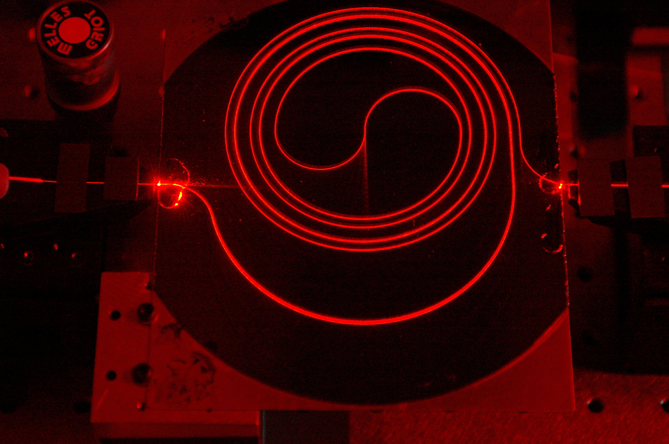
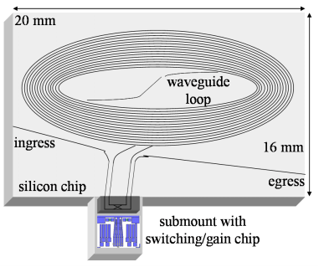
Buffers in Routers
So how large should the buffers be?
Buffer size matters
  End-to-end delay
    Transmission, propagation, and queueing delay
    The only variable part is queueing delay
  Router architecture
    Board space, power consumption, and cost
    On chip buffers: higher density, higher capacity
    Optical buffers: all-optical routers
1.4m long spiral waveguide with input from HeNe laser
You are now touching the edge of the research zone……
Notes:
Check @transport

Slide 63





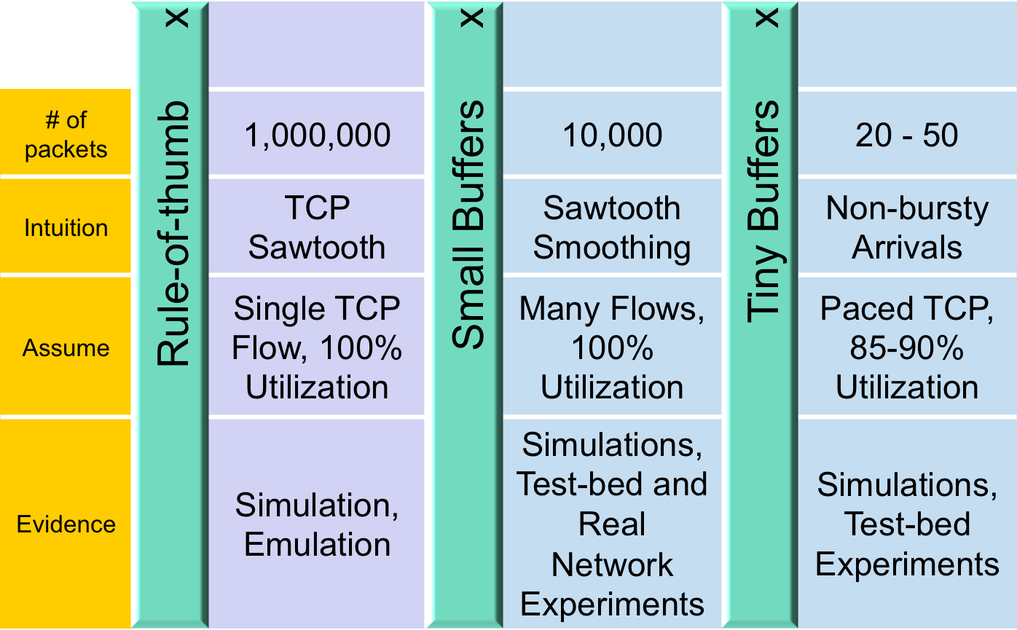
Buffer Sizing Story
Notes:
@transport

Slide 64
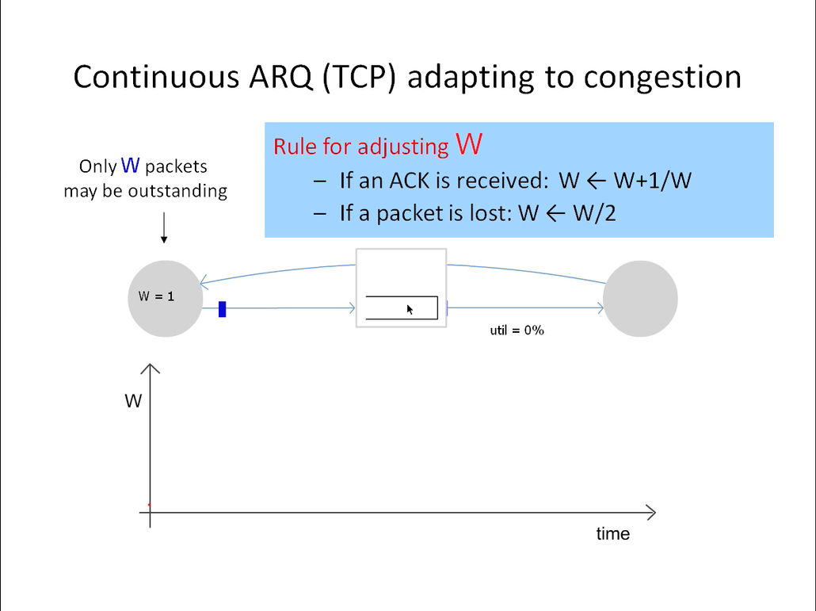
Notes:
@Transport

Slide 65


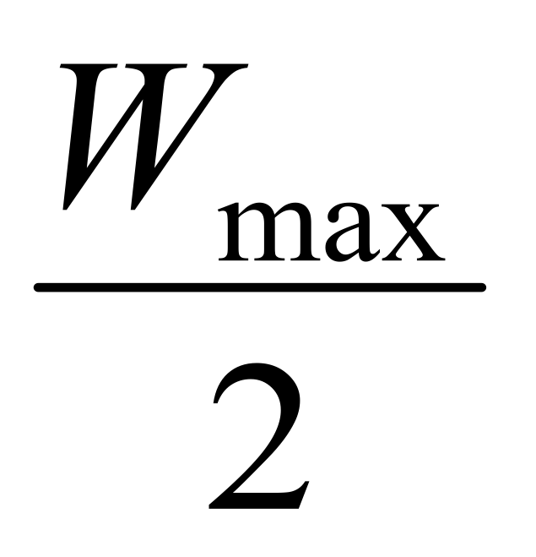
Rule-of-thumb – Intuition
Rule for adjusting W
If an ACK is received: W ← W+1/W
If a packet is lost: W ← W/2
Only W packets
may be outstanding
Source
Dest
Window size
t
Notes:
@transport

Slide 66
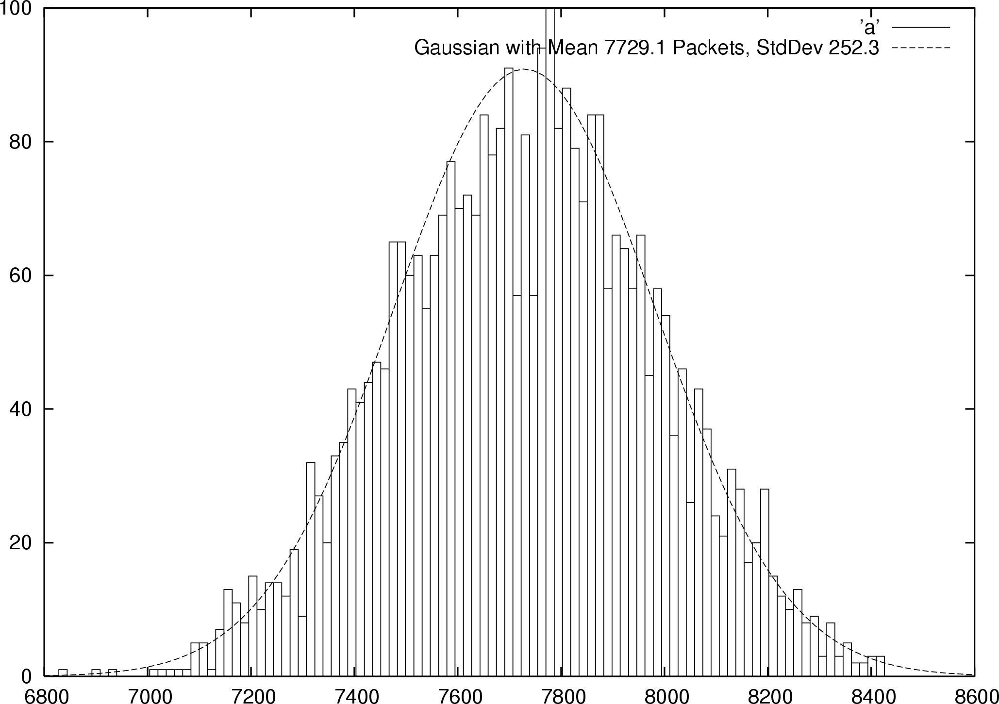


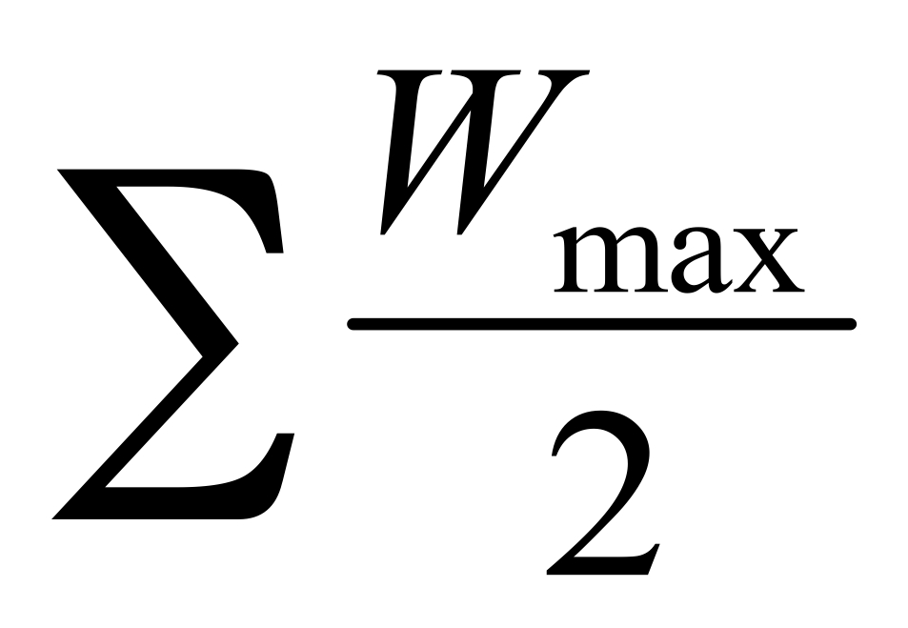

Small Buffers – Intuition
Synchronized Flows
Many TCP Flows
Aggregate window has same dynamics
Therefore buffer occupancy has same dynamics
Rule-of-thumb still holds.
Independent, desynchronized
Central limit theorem says the aggregate becomes Gaussian
Variance (buffer size) decreases as N increases
Buffer Size
Probability
Distribution
t
t
Notes:
@transport

Slide 67
The Internet version of a Network layer
Host, router network layer functions:
Transport layer: TCP, UDP
Routing protocols
path selection
RIP, OSPF, BGP
IP protocol
addressing conventions
datagram format
packet handling conventions
Network
layer
forwarding
table
ICMP protocol
error reporting
router “signaling”
Link layer
physical layer
Notes:
Mv 2nd slide

Slide 68
IPv4 Packet Structure
20 Bytes of Standard Header, then Options
4-bit
Version
4-bit
Header
Length
8-bit
Type of Service
(TOS)
16-bit Total Length (Bytes)
16-bit Identification
3-bit
Flags
13-bit Fragment Offset
8-bit Time to
Live (TTL)
8-bit Protocol
16-bit Header Checksum
32-bit Source IP Address
32-bit Destination IP Address
Options (if any)
Payload
Notes:
24.2 in Forouzan

Slide 69
(Packet) Network Tasks One-by-One
Read packet correctly
Get packet to the destination
Get responses to the packet back to source
Carry data
Tell host what to do with packet once arrived
Specify any special network handling of the packet
Deal with problems that arise along the path

Slide 70
Reading Packet Correctly
4-bit
Version
4-bit
Header
Length
8-bit
Type of Service
(TOS)
16-bit Total Length (Bytes)
16-bit Identification
3-bit
Flags
13-bit Fragment Offset
8-bit Time to
Live (TTL)
8-bit Protocol
16-bit Header Checksum
32-bit Source IP Address
32-bit Destination IP Address
Options (if any)
Payload
Version number (4 bits)
  Indicates the version of the IP protocol
  Necessary to know what other fields to expect
  Typically “4” (for IPv4), and sometimes “6” (for IPv6)
Header length (4 bits)
  Number of 32-bit words in the header
  Typically “5” (for a 20-byte IPv4 header)
  Can be more when IP options are used
Total length (16 bits)
  Number of bytes in the packet
  Maximum size is 65,535 bytes (2¹⁶ -1)
  … though underlying links may impose smaller limits

Slide 71
Getting Packet to Destination and Back
4-bit
Version
4-bit
Header
Length
8-bit
Type of Service
(TOS)
16-bit Total Length (Bytes)
16-bit Identification
3-bit
Flags
13-bit Fragment Offset
8-bit Time to
Live (TTL)
8-bit Protocol
16-bit Header Checksum
32-bit Source IP Address
32-bit Destination IP Address
Two IP addresses
  Source IP address (32 bits)
  Destination IP address (32 bits)
Destination address
  Unique identifier/locator for the receiving host
  Allows each node to make forwarding decisions
Source address
  Unique identifier/locator for the sending host
  Recipient can decide whether to accept packet
  Enables recipient to send a reply back to source
Options (if any)
Payload

Slide 72
Telling Host How to Handle Packet
4-bit
Version
4-bit
Header
Length
8-bit
Type of Service
(TOS)
16-bit Total Length (Bytes)
16-bit Identification
3-bit
Flags
13-bit Fragment Offset
8-bit Time to
Live (TTL)
8-bit Protocol
16-bit Header Checksum
32-bit Source IP Address
32-bit Destination IP Address
Options (if any)
Protocol (8 bits)
  Identifies the higher-level protocol
  Important for demultiplexing at receiving host
Most common examples
  E.g., “6” for the Transmission Control Protocol (TCP)
  E.g., “17” for the User Datagram Protocol (UDP)
Payload
protocol=6
protocol=17
IP header
IP header
TCP header
UDP header

Slide 73
Special Handling
4-bit
Version
4-bit
Header
Length
8-bit
Type of Service
(TOS)
16-bit Total Length (Bytes)
16-bit Identification
3-bit
Flags
13-bit Fragment Offset
8-bit Time to
Live (TTL)
8-bit Protocol
16-bit Header Checksum
32-bit Source IP Address
32-bit Destination IP Address
Options (if any)
Payload
Type-of-Service (8 bits)
  Allow packets to be treated differently based on needs
  E.g., low delay for audio, high bandwidth for bulk transfer
  Has been redefined several times
Options
Notes:
26-jan-2015

Slide 74
Potential Problems
Header Corrupted: Checksum
Loop: TTL
Packet too large: Fragmentation

Slide 75
Header Corruption
4-bit
Version
4-bit
Header
Length
8-bit
Type of Service
(TOS)
16-bit Total Length (Bytes)
16-bit Identification
3-bit
Flags
13-bit Fragment Offset
8-bit Time to
Live (TTL)
8-bit Protocol
16-bit Header Checksum
32-bit Source IP Address
32-bit Destination IP Address
Options (if any)
Payload
Checksum (16 bits)
  Particular form of checksum over packet header
If not correct, router discards packets
  So it doesn’t act on bogus information
Checksum recalculated at every router
  Why?
  Why include TTL?
  Why only header?

Slide 76
_{Preventing Loops}
_{(aka} _{Internet Zombie plan)}
4-bit
Version
4-bit
Header
Length
8-bit
Type of Service
(TOS)
16-bit Total Length (Bytes)
16-bit Identification
3-bit
Flags
13-bit Fragment Offset
8-bit Time to
Live (TTL)
8-bit Protocol
16-bit Header Checksum
32-bit Source IP Address
32-bit Destination IP Address
Options (if any)
Forwarding loops cause packets to cycle forever
  As these accumulate, eventually consume all capacity
Time-to-Live (TTL) Field (8 bits)
  Decremented at each hop, packet discarded if reaches 0
  …and “time exceeded” message is sent to the source
    Using “ICMP” control message; basis for traceroute
Payload

Slide 77
Fragmentation
(some assembly required)
4-bit
Version
4-bit
Header
Length
8-bit
Type of Service
(TOS)
16-bit Total Length (Bytes)
16-bit Identification
3-bit
Flags
13-bit Fragment Offset
8-bit Time to
Live (TTL)
8-bit Protocol
16-bit Header Checksum
32-bit Source IP Address
32-bit Destination IP Address
Options (if any)
Payload
Fragmentation: when forwarding a packet, an Internet router can split it into multiple pieces (“fragments”) if too big for next hop link
Must reassemble to recover original packet
  Need fragmentation information (32 bits)
  Packet identifier, flags, and fragment offset
Notes:
Is not frequently used, send big packets, subdivides, never repacks

Slide 78
IP Fragmentation & Reassembly
network links have MTU (max.transfer size) - largest possible link-level frame.
  different link types, different MTUs
large IP datagram divided (“fragmented”) within net
  one datagram becomes several datagrams
  “reassembled” only at final destination
  IP header bits used to identify, order related fragments
IPv6 does things differently…
fragmentation:
in: one large datagram
out: 3 smaller datagrams
reassembly

Slide 79
IP Fragmentation and Reassembly
length
=4000
ID
=x
fragflag
=0
offset
=0
Example
4000 byte datagram
MTU = 1500 bytes
One large datagram becomes
several smaller datagrams
length
=1500
ID
=x
fragflag
=1
offset
=0
1480 bytes in
data field
length
=1500
ID
=x
fragflag
=1
offset
=185
offset =
1480/8
length
=1040
ID
=x
fragflag
=0
offset
=370
Question: What happens when a fragment is lost?

Slide 80
Fragmentation Details
4-bit
Version
4-bit
Header
Length
8-bit
Type of Service
(TOS)
16-bit Total Length (Bytes)
16-bit Identification
3-bit
Flags
13-bit Fragment Offset
8-bit Time to
Live (TTL)
8-bit Protocol
16-bit Header Checksum
32-bit Source IP Address
32-bit Destination IP Address
Options (if any)
Payload
Identifier (16 bits): used to tell which fragments belong together
Flags (3 bits):
  Reserved (RF): unused bit
  Don’t Fragment (DF): instruct routers to not fragment the packet even if it won’t fit
    Instead, they drop the packet and send back a “Too Large” ICMP control message
    Forms the basis for “Path MTU Discovery”
  More (MF): this fragment is not the last one
Offset (13 bits): what part of datagram this fragment covers in 8-byte units
Pop quiz question: Why do frags use offset and not a frag number?
Notes:
map into memory
further downstream locations doing fragmentation would be v. hard with frag number (you would need reissue or reassemble or some craziness

Slide 81
Options
4-bit
Version
4-bit
Header
Length
8-bit
Type of Service
(TOS)
16-bit Total Length (Bytes)
16-bit Identification
3-bit
Flags
13-bit Fragment Offset
8-bit Time to
Live (TTL)
8-bit Protocol
16-bit Header Checksum
32-bit Source IP Address
32-bit Destination IP Address
Options (if any)
Payload
End of Options List
No Operation (padding between options)
Record Route
Strict Source Route
Loose Source Route
Timestamp
Traceroute
Router Alert
…..
Notes:
Very briefly

Slide 82
IP Addressing: introduction
IP address: 32-bit identifier for host, router interface
interface: connection between host/router and physical link
  router’s typically have multiple interfaces
  host typically has one interface
  IP addresses associated with each interface
223.1.1.1
223.1.2.1
223.1.1.2
223.1.1.4
223.1.2.9
223.1.2.2
223.1.1.3
223.1.3.27
223.1.3.1
223.1.3.2
223.1.1.1 = 11011111 00000001 00000001 00000001
223
1
1
1

Slide 83
Subnets
IP address:
  subnet part (high order bits)
  host part (low order bits)
What’s a subnet ?
  device interfaces with same subnet part of IP address
  can physically reach each other without intervening router
223.1.1.0/24
223.1.2.0/24
223.1.1.1
223.1.2.1
223.1.1.2
223.1.1.4
223.1.2.9
223.1.1.3
223.1.2.2
223.1.3.27
subnet
223.1.3.1
223.1.3.2
subnet
part
host
part
11011111 00000001 00000011 00000000
223.1.3.0/24
223.1.3.0/24
CIDR: Classless InterDomain Routing
  subnet portion of address of arbitrary length
  address format: a.b.c.d/x, where x is # bits in subnet portion of address
Subnet mask: /24
network consisting of 3 subnets
Notes:
We further divide a network into smaller networks called subnet

Slide 84
IP addresses: how to get one?
Q: How does a host get IP address?
hard-coded by system admin in a file
  Windows: control-panel->network->configuration->tcp/ip->properties
  UNIX: /etc/rc.config (circa 1980’s your mileage will vary)
DHCP: Dynamic Host Configuration Protocol: dynamically get address from as server
  “plug-and-play”

Slide 85
DHCP client-server scenario
Goal: allow host to dynamically obtain its IP address from network server when it joins network
  Can renew its lease on address in use
  Allows reuse of addresses (only hold address while connected an “on”)
  Support for mobile users who want to join network (more shortly)
DHCP server: 223.1.2.5
arriving
client
DHCP discover
src : 0.0.0.0, 68
dest.: 255.255.255.255,67
yiaddr: 0.0.0.0
transaction ID: 654
DHCP offer
src: 223.1.2.5, 67
dest: 255.255.255.255, 68
yiaddrr: 223.1.2.4
transaction ID: 654
Lifetime: 3600 secs
DHCP request
src: 0.0.0.0, 68
dest:: 255.255.255.255, 67
yiaddrr: 223.1.2.4
transaction ID: 655
Lifetime: 3600 secs
A
223.1.1.1
DHCP
223.1.2.1
server
223.1.1.2
time
223.1.1.4
223.1.2.9
DHCP ACK
B
src: 223.1.2.5, 67
dest: 255.255.255.255, 68
yiaddrr: 223.1.2.4
transaction ID: 655
Lifetime: 3600 secs
223.1.2.2
E
arriving DHCP
client needs
address in this
network
223.1.1.3
223.1.3.27
223.1.3.1
223.1.3.2

Slide 86
IP addresses: how to get one?
Q: How does network get subnet part of IP addr?
A: gets allocated portion of its provider ISP’s address space
ISP's block 11001000 00010111 00010000 00000000 200.23.16.0/20
Organization 0 11001000 00010111 00010000 00000000 200.23.16.0/23
Organization 1 11001000 00010111 00010010 00000000 200.23.18.0/23
Organization 2 11001000 00010111 00010100 00000000 200.23.20.0/23
... ….. …. ….
Organization 7 11001000 00010111 00011110 00000000 200.23.30.0/23

Slide 87
Hierarchical addressing: route aggregation
Hierarchical addressing allows efficient advertisement of routing
information:
Organization 0
200.23.16.0/23
Organization 1
200.23.18.0/23
“Send me anything
with addresses
beginning
200.23.16.0/20”
Organization 2
200.23.20.0/23
.
Fly-By-Night-ISP
.
.
.
.
Internet
Organization 7
.
200.23.30.0/23
ISPs-R-Us
“Send me anything
with addresses
beginning
199.31.0.0/16”

Slide 88
Hierarchical addressing: more specific routes
ISPs-R-Us has a more specific route to Organization 1
Organization 0
200.23.16.0/23
“Send me anything
with addresses
beginning
200.23.16.0/20”
Organization 2
200.23.20.0/23
.
Fly-By-Night-ISP
.
.
.
.
Internet
Organization 7
.
200.23.30.0/23
ISPs-R-Us
“Send me anything
with addresses
beginning 199.31.0.0/16
or 200.23.18.0/23”
Organization 1
200.23.18.0/23
Notes:
18 feb 2013

Slide 89
IP addressing: the last word...
Q: How does an ISP get a block of addresses?
A: ICANN: Internet Corporation for Assigned
Names and Numbers
  allocates addresses
  manages DNS
  assigns domain names, resolves disputes

Slide 90
NAT: Network Address Translation
Cant get more IP addresses? well there is always…..
rest of
Internet
local network
(e.g., home network)
10.0.0/24
10.0.0.1
10.0.0.4
10.0.0.2
138.76.29.7
10.0.0.3
All datagrams leaving local
network have same single source NAT IP address: 138.76.29.7,
different source port numbers
Datagrams with source or
destination in this network
have 10.0.0/24 address for
source, destination (as usual)
Notes:
28 Jan 2015

Slide 91
NAT: Network Address Translation
Motivation: local network uses just one IP address as far as outside world is concerned:
  range of addresses not needed from ISP: just one IP address for all devices
  can change addresses of devices in local network without notifying outside world
  can change ISP without changing addresses of devices in local network
  devices inside local net not explicitly addressable, visible by outside world (a security plus).

Slide 92
NAT: Network Address Translation
Implementation: NAT router must:
  outgoing datagrams: replace (source IP address, port #) of every outgoing datagram to (NAT IP address, new port #)
    . . . remote clients/servers will respond using (NAT IP address, new port #) as destination addr.
  remember (in NAT translation table) every (source IP address, port #) to (NAT IP address, new port #) translation pair
  incoming datagrams: replace (NAT IP address, new port #) in dest fields of every incoming datagram with corresponding (source IP address, port #) stored in NAT table

Slide 93
NAT: Network Address Translation
NAT translation table
WAN side addr LAN side addr
1: host 10.0.0.1
sends datagram to
128.119.40.186, 80
2: NAT router
changes datagram
source addr from
10.0.0.1, 3345 to
138.76.29.7, 5001,
updates table
138.76.29.7, 5001 10.0.0.1, 3345
…… ……
S: 10.0.0.1, 3345
D: 128.119.40.186, 80
10.0.0.1
1
2
S: 138.76.29.7, 5001
D: 128.119.40.186, 80
10.0.0.4
10.0.0.2
138.76.29.7
S: 128.119.40.186, 80
D: 10.0.0.1, 3345
4
S: 128.119.40.186, 80
D: 138.76.29.7, 5001
3
10.0.0.3
4: NAT router
changes datagram
dest addr from
138.76.29.7, 5001 to 10.0.0.1, 3345
3: Reply arrives
dest. address:
138.76.29.7, 5001
Notes:
2016-1-20

Slide 94
NAT: Network Address Translation
16-bit port-number field:
  60,000 simultaneous connections with a single LAN-side address!
NAT is controversial:
  routers should only process up to layer 3
  violates end-to-end argument (?)
    NAT possibility must be taken into account by app designers, eg, P2P applications
  address shortage should instead be solved by IPv6

Slide 95
NAT traversal problem
client wants to connect to server with address 10.0.0.1
  server address 10.0.0.1 local to LAN (client can’t use it as destination addr)
  only one externally visible NATted address: 138.76.29.7
solution 1: statically configure NAT to forward incoming connection requests at given port to server
  e.g., (138.76.29.7, port 2500) always forwarded to 10.0.0.1 port 25000
10.0.0.1
Client
?
10.0.0.4
138.76.29.7
NAT
router

Slide 96
NAT traversal problem
solution 2: Universal Plug and Play (UPnP) Internet Gateway Device (IGD) Protocol. Allows NATted host to:
  learn public IP address (138.76.29.7)
  add/remove port mappings (with lease times)
  i.e., automate static NAT port map configuration
10.0.0.1
IGD
10.0.0.4
138.76.29.7
NAT
router
Notes:
2017-2-1

Slide 97


NAT traversal problem
solution 3: relaying (used in Skype)
  NATed client establishes connection to relay
  External client connects to relay
  relay bridges packets between to connections
2. connection to
relay initiated
by client
1. connection to
relay initiated
by NATted host
10.0.0.1
3. relaying
established
Client
138.76.29.7
NAT
router

Slide 98
Remember this? Traceroute at work…
traceroute: rio.cl.cam.ac.uk to munnari.oz.au
(tracepath on windows is similar)
Three delay measurements from
rio.cl.cam.ac.uk to gatwick.net.cl.cam.ac.uk
traceroute munnari.oz.au
traceroute to munnari.oz.au (202.29.151.3), 30 hops max, 60 byte packets
1 gatwick.net.cl.cam.ac.uk (128.232.32.2) 0.416 ms 0.384 ms 0.427 ms
2 cl-sby.route-nwest.net.cam.ac.uk (193.60.89.9) 0.393 ms 0.440 ms 0.494 ms
3 route-nwest.route-mill.net.cam.ac.uk (192.84.5.137) 0.407 ms 0.448 ms 0.501 ms
4 route-mill.route-enet.net.cam.ac.uk (192.84.5.94) 1.006 ms 1.091 ms 1.163 ms
5 xe-11-3-0.camb-rbr1.eastern.ja.net (146.97.130.1) 0.300 ms 0.313 ms 0.350 ms
6 ae24.lowdss-sbr1.ja.net (146.97.37.185) 2.679 ms 2.664 ms 2.712 ms
7 ae28.londhx-sbr1.ja.net (146.97.33.17) 5.955 ms 5.953 ms 5.901 ms
8 janet.mx1.lon.uk.geant.net (62.40.124.197) 6.059 ms 6.066 ms 6.052 ms
9 ae0.mx1.par.fr.geant.net (62.40.98.77) 11.742 ms 11.779 ms 11.724 ms
10 ae1.mx1.mad.es.geant.net (62.40.98.64) 27.751 ms 27.734 ms 27.704 ms
11 mb-so-02-v4.bb.tein3.net (202.179.249.117) 138.296 ms 138.314 ms 138.282 ms
12 sg-so-04-v4.bb.tein3.net (202.179.249.53) 196.303 ms 196.293 ms 196.264 ms
13 th-pr-v4.bb.tein3.net (202.179.249.66) 225.153 ms 225.178 ms 225.196 ms
14 pyt-thairen-to-02-bdr-pyt.uni.net.th (202.29.12.10) 225.163 ms 223.343 ms 223.363 ms
15 202.28.227.126 (202.28.227.126) 241.038 ms 240.941 ms 240.834 ms
16 202.28.221.46 (202.28.221.46) 287.252 ms 287.306 ms 287.282 ms
17 * * *
18 * * *
19 * * *
20 coe-gw.psu.ac.th (202.29.149.70) 241.681 ms 241.715 ms 241.680 ms
21 munnari.OZ.AU (202.29.151.3) 241.610 ms 241.636 ms 241.537 ms
trans-continent
link
* means no response (probe lost, router not replying)
Notes:
Where did the delay come from??

Slide 99
Traceroute and ICMP
Source sends series of UDP segments to dest
  First has TTL =1
  Second has TTL=2, etc.
  Unlikely port number
When nth datagram arrives to nth router:
  Router discards datagram
  And sends to source an ICMP message (type 11, code 0)
  Message includes name of router& IP address
When ICMP message arrives, source calculates RTT
Traceroute does this 3 times
Stopping criterion
UDP segment eventually arrives at destination host
Destination returns ICMP “host unreachable” packet (type 3, code 3)
When source gets this ICMP, stops.

Slide 100
ICMP: Internet Control Message Protocol
used by hosts & routers to communicate network-level information
  error reporting: unreachable host, network, port, protocol
  echo request/reply (used by ping)
network-layer “above” IP:
  ICMP msgs carried in IP datagrams
ICMP message: type, code plus first 8 bytes of IP datagram causing error
Type Code description
0 0 echo reply (ping)
3 0 dest. network unreachable
3 1 dest host unreachable
3 2 dest protocol unreachable
3 3 dest port unreachable
3 6 dest network unknown
3 7 dest host unknown
4 0 source quench (congestion
control - not used)
8 0 echo request (ping)
9 0 route advertisement
10 0 router discovery
11 0 TTL expired
12 0 bad IP header

Slide 101
Gluing it together:
How does my Network (address) interact
with my Data-Link (address) ?

Slide 102
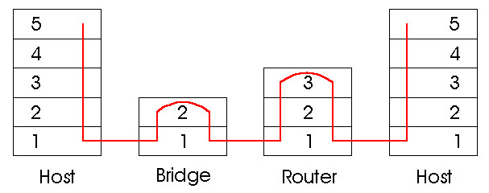
Switches vs. Routers Summary
both store-and-forward devices
  routers: network layer devices (examine network layer headers)
  switches are link layer devices
routers maintain routing tables, implement routing algorithms
switches maintain switch tables, implement filtering, learning algorithms
Notes:
FINAL SLIDE IN PART 5

Slide 103
MAC Addresses (and IPv4 ARP) or How do I glue my network to my data-link?
32-bit IP address:
  network-layer address
  used to get datagram to destination IP subnet
MAC (or LAN or physical or Ethernet) address:
  function: get frame from one interface to another physically-connected interface (same network)
  48 bit MAC address (for most LANs)
    burned in NIC ROM, also (commonly) software settable

Slide 104
LAN Addresses and ARP
Each adapter on LAN has unique LAN address
1A-2F-BB-709-AD
Ethernet
Broadcast address =
FF-FF-FF-FF-FF-FF
LAN
(wired or
wireless)
= adapter
71-6F7-2B-08-53
58-23-D7-FA-20-B0
0C-C4-11-6F-E3-98

Slide 105
Address Resolution Protocol
Every node maintains an ARP table
  <IP address, MAC address> pair
Consult the table when sending a packet
  Map destination IP address to destination MAC address
  Encapsulate and transmit the data packet
But: what if IP address not in the table?
  Sender broadcasts: “Who has IP address 1.2.3.156?”
  Receiver responds: “MAC address 58-23-D7-FA-20-B0”
  Sender caches result in its ARP table
Notes:
Wed 7th start here.

Slide 106
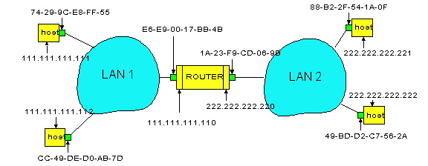
Example: A Sending a Packet to B
How does host A send an IP packet to host B?
A
R
B

Slide 107
Example: A Sending a Packet to B
How does host A send an IP packet to host B?
A
R
B
1. A sends packet to R.
2. R sends packet to B.

Slide 108
Host A Decides to Send Through R
Host A constructs an IP packet to send to B
  Source 111.111.111.111, destination 222.222.222.222
Host A has a gateway router R
  Used to reach destinations outside of 111.111.111.0/24
  Address 111.111.111.110 for R learned via DHCP/config
A
R
B

Slide 109
Host A Sends Packet Through R
Host A learns the MAC address of R’s interface
  ARP request: broadcast request for 111.111.111.110
  ARP response: R responds with E6-E9-00-17-BB-4B
Host A encapsulates the packet and sends to R
A
R
B

Slide 110
R Decides how to Forward Packet
Router R’s adaptor receives the packet
  R extracts the IP packet from the Ethernet frame
  R sees the IP packet is destined to 222.222.222.222
Router R consults its forwarding table
  Packet matches 222.222.222.0/24 via other adaptor
A
R
B

Slide 111
R Sends Packet to B
Router R’s learns the MAC address of host B
  ARP request: broadcast request for 222.222.222.222
  ARP response: B responds with 49-BD-D2-C7-52A
Router R encapsulates the packet and sends to B
A
R
B

Slide 112

Security Analysis of ARP
Impersonation
  Any node that hears request can answer …
  … and can say whatever they want
Actual legit receiver never sees a problem
  Because even though later packets carry its IP address, its NIC doesn’t capture them since not its MAC address
Notes:
1/Fab/2013

Slide 113
Key Ideas in Both ARP and DHCP
Broadcasting: Can use broadcast to make contact
  Scalable because of limited size
Caching: remember the past for a while
  Store the information you learn to reduce overhead
  Remember your own address & other host’s addresses
Soft state: eventually forget the past
  Associate a time-to-live field with the information
  … and either refresh or discard the information
  Key for robustness in the face of unpredictable change

Slide 114
Why Not Use DNS-Like Tables?
When host arrives:
  Assign it an IP address that will last as long it is present
  Add an entry into a table in DNS-server that maps MAC to IP addresses
Answer:
  Names: explicit creation, and are plentiful
  Hosts: come and go without informing network
    Must do mapping on demand
  Addresses: not plentiful, need to reuse and remap
    Soft-state enables dynamic reuse
Notes:
Two key points

Slide 115
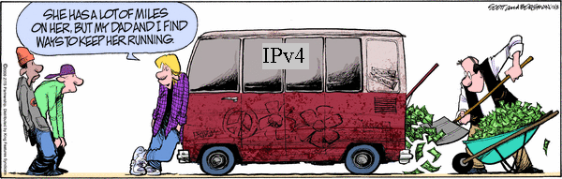
IPv6
prematurely
Motivated by address exhaustion
  addresses are larger
  packet headers are laid out differently
  address management and configuration are completely different
  some DNS behavior changes
  some sockets code changes
  everybody now has a hard time parsing IP addresses
Steve Deering focused on simplifying IP
  Got rid of all fields that were not absolutely necessary
  “Spring Cleaning” for IP
Result is an elegant, if unambitious, protocol

Slide 116
Why do we care about IPv6? Registries are out of space
► We (as in, globally) are effectively out of IPv4
► APNIC ran out on the 15th of April, 2011
► RIPE ran out on the 14th of September, 2012
► ARIN ran out on the 23rd of April, 2014
► LACNIC ran out on the 10th of June, 2014
► IPv6 was standardised in 1998
► IPv6 is now, at last, carrying significant volumes of traffic
Wolves are real….. (they just had further to come)
or if you prefer: Winter was coming after all…*
*Voted most likely to date reference in slides

Slide 117
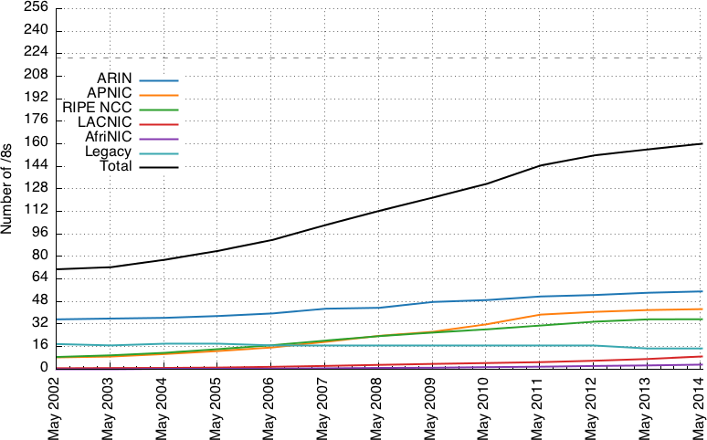
Why do we care about IPv6?
Most of IPv4 space is already routable

Slide 118
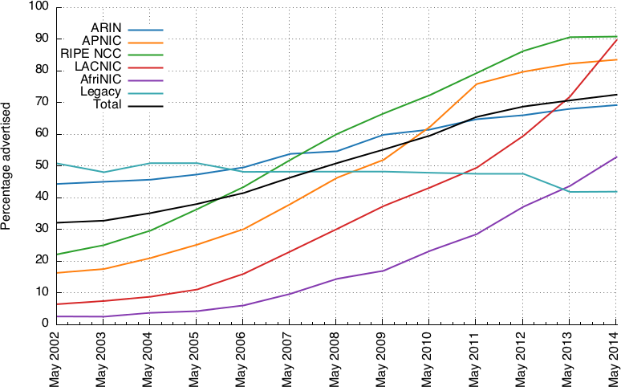
Why do we care about IPv6?
Most of IPv4 space is already routable

Slide 119
Why do we care about IPv6?
IPv4 starts to get expensive
► “Microsoft pays Nortel $7.5 million for 666k IPv4 addresses” (2011)
► “A first look at IPv4 transfer markets”, CoNEXT 2013
http://dl.acm.org/citation.cfm?id=2535416
► “Microsoft Azure’s use of non-US IPv4 address space in US regions”

Slide 120
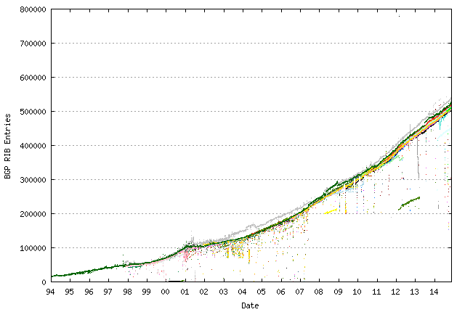
Why do we care about IPv6?
IPv4 BGP growth

Slide 121
IPv6
Larger address space
Auto-configuration (not new but better than IPv4)
Cleanup
  Eliminate fragmentation
  Eliminate checksum
    Pseudo-header (w/o Hop Limit) covered by transport layer
  Flow label
  Increase minimum MTU from 576 to 1280
  Replace broadcasts with multicast
2018/2019 IPv6 slides are hugely improved thanks to Stephen Strowes

Slide 122
IPv4 | IPv6
Addresses are 32 bits (4 bytes) in length. | Addresses are 128 bits (16 bytes) in length
Address (A) resource records in DNS to map host names to IPv4 addresses. | Address (AAAA) resource records in DNS to map host names to IPv6 addresses.
Pointer (PTR) resource records in the IN-ADDR.ARPA DNS domain to map IPv4 addresses to host names. | Pointer (PTR) resource records in the IP6.ARPA DNS domain to map IPv6 addresses to host names.
IPSec is optional and should be supported externally | IPSec support is not optional
Header does not identify packet flow for QoS handling by routers | Header contains Flow Label field, which Identifies packet flow for QoS handling by router.
Both routers and the sending host fragment packets. | Routers do not support packet fragmentation. Sending host fragments packets
Header includes a checksum. | Header does not include a checksum.
Header includes options. | Optional data is supported as extension headers.
ARP uses broadcast ARP request to resolve IP to MAC/Hardware address. | Multicast Neighbor Solicitation messages resolve IP addresses to MAC addresses.
Internet Group Management Protocol (IGMP) manages membership in local subnet groups. | Multicast Listener Discovery (MLD) messages manage membership in local subnet groups.
Broadcast addresses are used to send traffic to all nodes on a subnet. | IPv6 uses a link-local scope all-nodes multicast address.
Configured either manually or through DHCP. | Does not require manual configuration or DHCP.
Must support a 576-byte packet size (possibly fragmented). | Must support a 1280-byte packet size (without fragmentation).

Slide 123
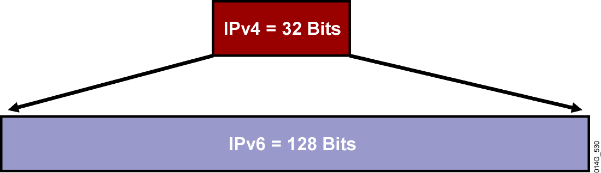
Larger Address Space
IPv4 = 4,294,967,295 addresses
IPv6 = 340,282,366,920,938,463,374,607,432,768,211,456 addresses
4x in number of bits translates to huge increase in address space!

Slide 124
Other Significant Protocol Changes - 1
Increased minimum MTU from 576 to 1280
No enroute fragmentation… fragmentation only at source
Header changes (20bytes to 40bytes)
Replace broadcast with multicast
IPv4
Version
IHL
Type of
Service
Total Length
IPv6
Version
Traffic
Class
Flow Label
Identification
Flags
Fragment
Offset
Payload Length
Next
Header
Hop Limit
Time to Live
Protocol
Header Checksum
Source Address
Source Address
Destination Address
Options
Padding
Field’s Name Kept from IPv4 to IPv6
Fields Not Kept in IPv6
Name and Position Changed in IPv6
New Field in IPv6 ☺
Destination Address
Legend

Slide 125
Other Significant Protocol Changes - 2
operation is intended to be simpler within the network:
no in-network fragmentation
no checksums in UP header
UDP checksum required (wasn’t in IPv4) rfc6936: No more zero
optional state carried in extension headers
  Extension headers notionally replace IP options
  Each extension header indicates the type of the following header, so they can be chained
  The final ‘next header’ either indicates there is no ‘next’, or escapes into an upper-layer header (e.g., TCP)

Slide 126

IPv6 Basic Address Structure
IPv6 addresses are split into two primary parts:
► 64 bits is dedicated to an addressable interface (equivalent to the host, if it only has one interface)
► The network prefix allocated to a network by a registry can be up to 64-bits long
► An allocation of a /64 (i.e. a 64-bit network prefix) allows one
subnet (it cannot be subdivided)
► A /63 allows two subnets; a /62 offers four, etc. /48s are common for older allocations (RFC 3177, obsoleted by RFC 6177).
► Longest-prefix matching operates as in IPv4.

Slide 127
IPv6 Address Representation (quick)
IPv6 addresses represented as eight 16-bit blocks (4 hex chars) separated by colons:
2001:4998:000c:0a06:0000:0000:0002:4011
But we can condense the representation by removing leading zeros in each block:
2001:4998:c:a06:0:0:2:4011
And further by reducing consecutive blocks of zeros to a “::”:
2001:4998:c:a06::2:4011

Slide 128
IPv6 Address Families
The address space is carved, like v4, into certain categories ¹:
host-local : localhost; ::1 is equivalent to 127.0.0.1
link-local : not routed: fe80::/10 is equivalent to
169.254.0.0/16
site-local : not routed globally: fc00::/7 is equivalent to
192.168.0.0/16 or 10.0.0.0/8
global unicast : 2000::/3 is basically any v4 address not reserved in some other way
multicast : ff00::/8 is equivalent to 224.0.0.0/4
¹http://www.ripe.net/lir-services/new-lir/ipv6_reference_card.pdf

Slide 129
Problem with /64 Subnets
Scanning a subnet becomes a DoS attack!
  Creates IPv6 version of 2⁶⁴ ARP entries in routers
  Exhaust address-translation table space
So now we have:
ping6 ff02::1 All nodes in broadcast domain
ping6 ff02::2 All routers in broadcast domain
Solutions
  RFC 6164 recommends use of /127 to protect router-router links
  RFC 3756 suggest “clever cache management” to address more generally

Slide 130
Neighbour Discovery
The Neighbour Discovery Protocol² specifies a set of ICMPv6 message types that allow hosts to discover other hosts or routing hardware on the network
  neighbour solicitation
  neighbour advertisement
  router solicitation
  router advertisement
  redirect
In short, a host can solicit neighbour (host) state to determine the layer-2 address of a host or to check whether an address is in use
or it can solicit router state to learn more about the network configuration
In both cases, the solicit message is sent to a well-known multicast address
²http://tools.ietf.org/html/rfc4861

Slide 131
IPv6 Dynamic Address Assignment
We have the two halves of the IPv6 address: the network component and the host component. Those are derived in different ways.
Network (top 64 bits):
  Router Advertisements (RAs) Interface
Identifier (bottom 64 bits):
  Stateless, automatic: SLAAC
  Stateful, automatic: DHCPv6

Slide 132
SLAAC: overview
SLAAC is:
... intended to make network configuration easy without manual configuration or even a DHCP server
... an algorithm for hosts to automatically configure their network interfaces (set up addresses, learn routes) without intervention

Slide 133
SLAAC: overview
When a host goes live or an interface comes up, the system wants to know more about its environment
It can configure link-local addresses for its interfaces: it uses the interface identifier, the EUI-64
It uses this to ask (solicit) router advertisements sooner than the next periodic announcements; ask the network for information

Slide 134
SLAAC: overview
The algorithm (assuming one interface):
Generate potential link-local address
Ask the network (multicast⁴) if that address is in use: neighbour solicitation
Assuming no responses, assign to interface
⁴https://tools.ietf.org/html/rfc2373

Slide 135
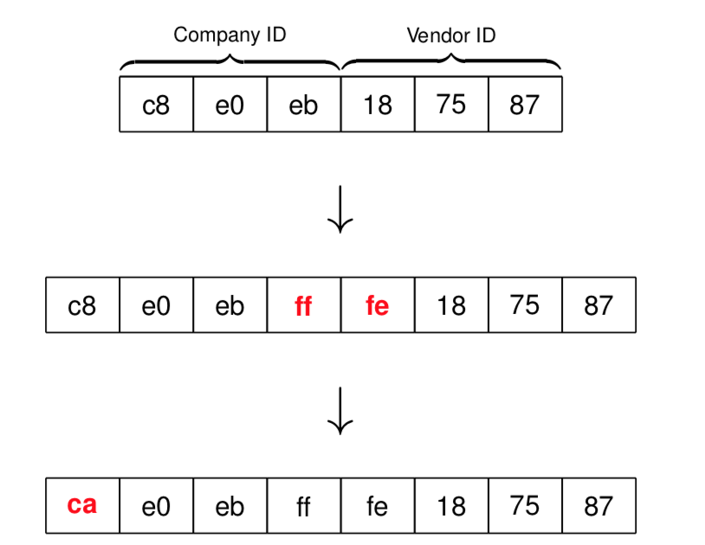
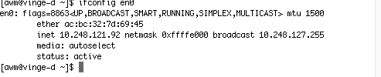
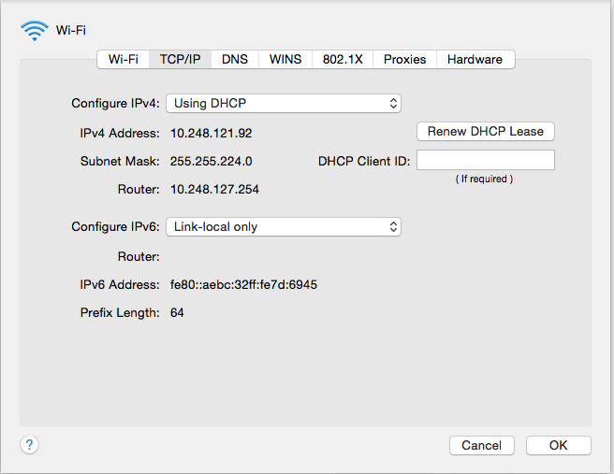
The EUI-64 Interface Identifier
IEEE 64-bit Extended Unique Identifier (EUI-64)³
There are various techniques to derive a 64-bit value, but often times we derive from the 48-bit MAC address
³http://tools.ietf.org/html/rfc2373

Slide 136
SLAAC: overview; Router Solicitation
Then,
Once the host has a unique link-local address, it can send packets to anything else sharing that link substrate
... but the host doesn’t yet know any routers, or public routes
... bootstrap: routers listen to a well-known multicast address
host asks the network (multicast) for router information: router solicitation
responses from the routers are sent directly (unicast) to the host that sent the router solicitation
the responses may indicate that the host should do more (e.g., use DHCP to get DNS information)

Slide 137
Router Advertisement
Without solicitation, router advertisements are generated intermittently by routing hardware.
Router Advertisements:
nodes that forward traffic periodically advertise themselves to the network
periodicity and expiry of the advertisement are configurable
Router Advertisement (RA), among other things, tells a host where to derive its network state with two flags: M(anaged) and O(ther info):
M: “Managed Address Configuration”, which means: use DHCPv6 to find your host address (and ignore option O)
O: Other information is available via DHCPv6, such as DNS configuration

Slide 138
Uh-oh
What problem(s) arises from totally decentralised address configuration?
Concerns that arise from using an EUI-64:
Privacy: SLAAC interface identifiers don’t change over time, so a host can be identified across networks
Security: embedding a MAC address into an IPv6 address will carry that vendor’s ID(s)⁵, a possible threat vector
⁵http://standards.ieee.org/develop/regauth/oui/public.html

Slide 139
Address Configuration: SLAAC Privacy Addresses
Privacy extensions for SLAAC⁶
  temporary addresses for initiating outgoing sessions
  generate one temporary address per prefix
  when they expire, they are not used for new sessions, but can continue to be used for existing sessions
  the addresses should appear random, such that they are difficult to predict
  lifetime is configurable; this OSX machine sets an 86400s timer (1 day)
⁶https://tools.ietf.org/html/rfc4941

Slide 140
Address Configuration: SLAAC Privacy Addresses
The algorithm:
Assume: a stored 64-bit input value from previous iterations, or a pseudo-randomly generated value
take that input value and append it to the EUI-64
compute the MD5 message digest of that value
set bit 6 to zero
compare the leftmost 64-bits against a list of reserved interface identifiers and those already assigned to an address on the local device. If the value is unacceptable, re-run using the rightmost 64 bits of the result instead of the historic input value in step 1
use the leftmost 64-bits as the randomised interface identifier
store the rightmost 64-bits as the history value to be used in the next iteration of the algorithm

Slide 141
IPv6: why has the transition taken so long?
IPv4 and IPv6 are not compatible:
  different packet formats
  different addressing schemes
as the Internet has grown bigger and accumulated more IPv4-only services, transition has proven ... tricky

Slide 142
IPv6: why has the transition taken so long?
IPv4 has/had the momentum
... which led to CIDR
... and encouraged RFC1918 space and NAT
the details of IPv4 NAT are not worth discussion here, but in essence: your ISP hands you only one IPv4 address, and you share that across multiple devices in your household. The NAT handles all the translation between internal (“private”) and external (“public”) space

Slide 143
Transition tech: outline
Tunnelling
dual-stacked services, and happy eyeballs
DNS64 and NAT64⁸
464XLAT
DNS behaviour
⁸https://tools.ietf.org/html/rfc6146

Slide 144
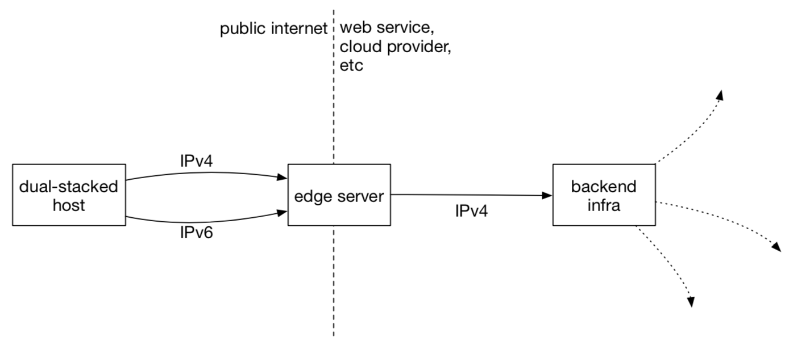
Dual-Stack Services: Common Deployment
It’s common for web services to play conservatively: dual-stack your edge services (e.g., load balancers), leaving some legacy infrastructure for later:

Slide 145
Dual-Stack Services: Common Deployment
Aim is to reduce the pain:
  You can dual-stack the edge hosts, and carry state in, say, HTTP headers indicating the user’s IP address (common over v4 anyway)
  You can dual-stack the backend opportunistically, over a longer period of time
  You use DNS to enable/disable the v6 side last (if there is no AAAA record in DNS, no real users will connect to the IPv6 infrastructure

Slide 146
Happy Eyeballs
The introduction of IPv6 carried with it an obligation that applications attempt to use IPv6 before falling back to IPv4.
What happens though if you try to connect to a host which doesn’t exist?⁹
But the presence of IPv6 modifies the behaviour of DNS responses and response preference¹⁰
⁹https://tools.ietf.org/html/rfc5461
¹⁰https://tools.ietf.org/html/rfc3484

Slide 147
Happy Eyeballs
Happy Eyeballs¹¹ was the proposed solution
  the eyeballs in question are yours, or mine, or whoever is sitting in front of their browser getting mad that things are unresponsive
Modifies application behaviour
¹¹https://tools.ietf.org/html/rfc8305

Slide 148
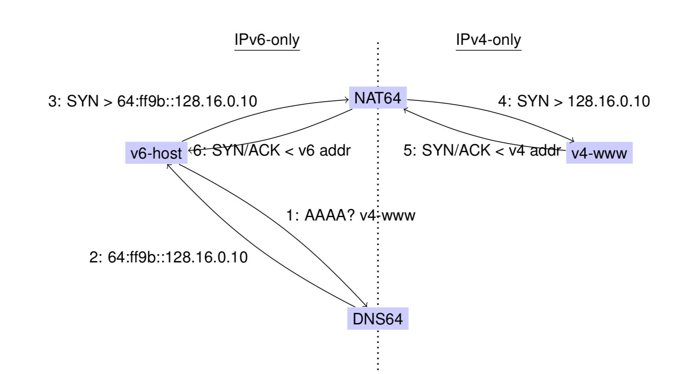
DNS64 & NAT64

Slide 149
464XLAT
Problem: IPv6-only to the host, but an IPv4-only app trying to access an IPv4-only service
  Some applications do not understand IPv6, so having an IPv6 address doesn’t help
  464XLAT¹² solves this problem
  In essence, DNS64 + NAT64 + a shim layer on the host itself to offer IPv4 addresses to apps
¹²https://tools.ietf.org/html/rfc6877

Slide 150
Where are we now? BGP Connectivity 2005

Slide 151
Where are we now? BGP Connectivity 2015

Slide 152
Improving on IPv4 and IPv6?
Why include unverifiable source address?
  Would like accountability and anonymity (now neither)
  Return address can be communicated at higher layer
Why packet header used at edge same as core?
  Edge: host tells network what service it wants
  Core: packet tells switch how to handle it
    One is local to host, one is global to network
Some kind of payment/responsibility field?
  Who is responsible for paying for packet delivery?
  Source, destination, other?
Other ideas?

Slide 153
Summary Network Layer
understand principles behind network layer services:
  network layer service models
  forwarding versus routing (versus switching)
  how a switch & router works
  routing (path selection)
  IPv6
Algorithms
  Two routing approaches (LS vs DV)
  One of these in detail (LS)
  ARP
Notes:
30-jan-2015 / 25-jan-2016

