Slide 1
Non-blocking data structures and transactional memory
Tim Harris, 24 November 2017

Slide 2
Lecture 8
Problems with locks
Atomic blocks and composition
Hardware transactional memory
Software transactional memory

Slide 3
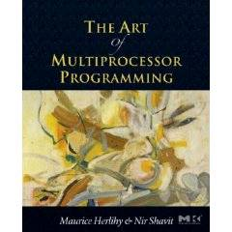
Transactional Memory
Companion slides for
The Art of Multiprocessor Programming
by Maurice Herlihy & Nir Shavit
Notes:
3

Slide 4
Our Vision for the Future
In this course, we covered ….
Best practices …
New and clever ideas …
And common-sense observations.
Art of Multiprocessor Programming
4
Notes:
4

Slide 5
Our Vision for the Future
In this course, we covered ….
Nevertheless …
Best practices …
Concurrent programming is still too hard …
New and clever ideas …
Here we explore why this is ….
And common-sense observations.
And what we can do about it.
Art of Multiprocessor Programming
5
Notes:
5

Slide 6
Locking
Art of Multiprocessor Programming
6
Notes:
6

Slide 7
Coarse-Grained Locking
Easily made correct …
But not scalable.
Art of Multiprocessor Programming
7
Notes:
7

Slide 8
Fine-Grained Locking
Can be tricky …
Art of Multiprocessor Programming
8
Notes:
8

Slide 9
Locks are not Robust
If a thread holding
a lock is delayed …
No one else can make progress
Art of Multiprocessor Programming
9
Notes:
9

Slide 10
Locking Relies on Conventions
Relation between
  Locks and objects
  Exists only in programmer’s mind
Actual comment from Linux Kernel
(hat tip: Bradley Kuszmaul)
  /*
  * When a locked buffer is visible to the I/O layer
  * BH_Launder is set. This means before unlocking
  * we must clear BH_Launder, mb() on alpha and then
  * clear BH_Lock, so no reader can see BH_Launder set
  * on an unlocked buffer and then risk to deadlock.
  */
Art of Multiprocessor Programming

Slide 11
Simple Problems are hard
enq(x)
double-ended queue
enq(y)
No interference if ends “far apart”
Interference OK if queue is small
Clean solution is publishable result:
[Michael & Scott PODC 97]
Art of Multiprocessor Programming
11
Notes:
11

Slide 12
Locks Not Composable
Transfer item from one queue to another
Must be atomic :
No duplicate or missing items
Art of Multiprocessor Programming
12
Notes:
12

Slide 13
Locks Not Composable
Lock source
Unlock source & target
Lock target
Art of Multiprocessor Programming
13
Notes:
13

Slide 14
Locks Not Composable
Lock source
Methods cannot provide internal synchronization
Unlock source & target
Objects must expose locking protocols to clients
Lock target
Clients must devise and follow protocols
Abstraction broken!
Art of Multiprocessor Programming
14
Notes:
14

Slide 15
Monitor Wait and Signal
Empty
zzz
buffer
Yes!
If buffer is empty,
wait for item to show up
Art of Multiprocessor Programming
15
Notes:
15

Slide 16
Wait and Signal do not Compose
empty
empty
zzz…
Wait for either?
Art of Multiprocessor Programming
16
Notes:
16

Slide 17

The Transactional Manifesto
Current practice inadequate
  to meet the multicore challenge
Research Agenda
  Replace locking with a transactional API
  Design languages or libraries
  Implement efficient run-time systems
17

Slide 18
Transactions
Block of code ….
Atomic: appears to happen instantaneously
Serializable: all appear to happen in one-at-a-time order
Commit: takes effect (atomically)
Abort: has no effect (typically restarted)
18

Slide 19

Atomic Blocks
atomic {
x.remove(3);
y.add(3);
}
atomic {
y = null;
}
19

Slide 20
Atomic Blocks
atomic {
x.remove(3);
y.add(3);
}
atomic {
y = null;
}
No data race
20
Notes:
20

Slide 21
A Double-Ended Queue
public void LeftEnq(item x) {
Qnode q = new Qnode(x);
q.left = left;
left.right = q;
left = q;
}
Write sequential Code
21
Notes:
21

Slide 22
A Double-Ended Queue
public void LeftEnq(item x)
atomic {
Qnode q = new Qnode(x);
q.left = left;
left.right = q;
left = q;
}
}
22

Slide 23
A Double-Ended Queue
public void LeftEnq(item x) {
atomic {
Qnode q = new Qnode(x);
q.left = left;
left.right = q;
left = q;
}
}
Enclose in atomic block
23

Slide 24
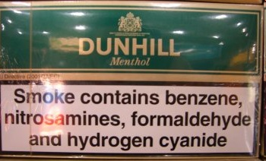
Warning
Not always this simple
  Conditional waits
  Enhanced concurrency
  Complex patterns
But often it is…
24

Slide 25
Composition?
Art of Multiprocessor Programming
25
Notes:
25

Slide 26
Composition?
public void Transfer(Queue<T> q1, q2)
{
atomic {
T x = q1.deq();
q2.enq(x);
}
}
Trivial or what?
Art of Multiprocessor Programming
26
Notes:
26

Slide 27
Conditional Waiting
public T LeftDeq() {
atomic {
if (left == null)
retry;
…
}
}
Roll back transaction and restart when something changes
27

Slide 28
Composable Conditional Waiting
atomic {
x = q1.deq();
} orElse {
x = q2.deq();
}
Run 1st method. If it retries …
Run 2nd method. If it retries …
Entire statement retries
28

Slide 29
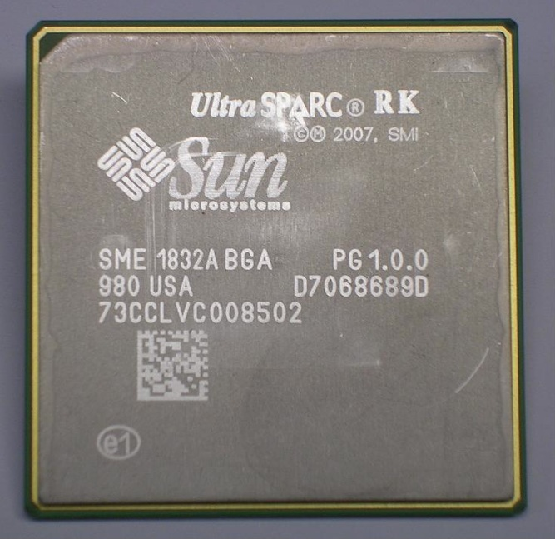

Hardware Transactional Memory
Exploit Cache coherence
Already almost does it
  Invalidation
  Consistency checking
Speculative execution
  Branch prediction = optimistic synch!
Art of Multiprocessor Programming
29
29
Notes:
29
Original TM proposal by Herlihy and Moss 1993…

Slide 30
HW Transactional Memory
read
active
T
caches
Interconnect
memory
Art of Multiprocessor Programming
30
30
Notes:
30

Slide 31
Transactional Memory
read
active
active
T
T
caches
memory
Art of Multiprocessor Programming
31
31
Notes:
31

Slide 32
Transactional Memory
active
committed
active
T
T
caches
memory
Art of Multiprocessor Programming
32
32
Notes:
32

Slide 33
Transactional Memory
write
committed
active
T
D
caches
memory
Art of Multiprocessor Programming
33
33
Notes:
33

Slide 34
Rewind
write
aborted
active
active
T
T
D
caches
memory
Art of Multiprocessor Programming
34
34
Notes:
34

Slide 35
Transaction Commit
Art of Multiprocessor Programming
35
35
At commit point
  If no cache conflicts, we win.
Mark transactional entries
  Read-only: valid
  Modified: dirty (eventually written back)
That’s all, folks!
  Except for a few details …
Notes:
35

Slide 36


Not all Skittles and Beer
Art of Multiprocessor Programming
36
36
Limits to
  Transactional cache size
  Scheduling quantum
Transaction cannot commit if it is
  Too big
  Too slow
  Actual limits platform-dependent
Notes:
36

Slide 37
HTM Strengths & Weaknesses
Ideal for lock-free data structures

Slide 38
HTM Strengths & Weaknesses
Ideal for lock-free data structures
Practical proposals have limits on
  Transaction size and length
  Bounded HW resources
  Guarantees vs best-effort

Slide 39
HTM Strengths & Weaknesses
Ideal for lock-free data structures
Practical proposals have limits on
  Transaction size and length
  Bounded HW resources
  Guarantees vs best-effort
On fail
  Diagnostics essential
  Try again in software?

Slide 40
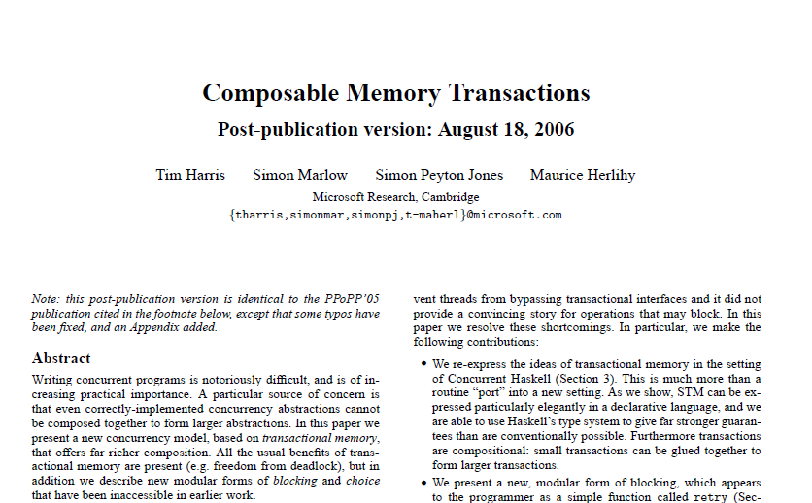
Composition
Locks don’t compose, transactions do.
Composition necessary for Software Engineering.
But practical HTM doesn’t really support composition!
Why we need STM
Notes:
Let’s stop and make a radical shift in view, from low-level hardware to high-level software.
The nice thing about sequential software is that it composes: you don’t need to write your own cosecant function, you can use one from a library, without knowing how it is implemented.
Unfortunately, the same is not true of lock-based synchronization. Given, say, two collections whose methods use locks, you cannot compose them to atomically transfer an item from one to the other!
Transactions, if they can be nested allow you to do Except, if they are HW transactions, because combining two transactions that individually run in HW may exhaust limited HW resources.
This is why we need STM.

Slide 41
Transactional Consistency
Memory Transactions are collections of reads and writes executed atomically
They should maintain consistency
  External: with respect to the interleavings of other transactions (linearizability).
  Internal: the transaction itself should operate on a consistent state.

Slide 42
External Consistency
Invariant x = 2y
4
X
8
Transaction A:
Write x
Write y
2
Y
4
Transaction B:
Read x
Read y
Compute z = 1/(x-y) = 1/2
Application
Memory

Slide 43
A Simple Lock-Based STM
STMs come in different forms
  Lock-based
  Lock-free
Here : a simple lock-based STM
Lets start by Guaranteeing External Consistency
Notes:
You will be using Deuce: A Java Framework for STM. Added as a library without any modifications to the JVM.

Slide 44
Synchronization
Transaction keeps
  Read set: locations & values read
  Write set: locations & values to be written
Deferred update
  Changes installed at commit
Lazy conflict detection
  Conflicts detected at commit

Slide 45
STM: Transactional Locking
Map
V#
Application
Memory
Array of version #s & locks
V#
V#
45

Slide 46
Reading an Object
Mem
Locks
V#
Add version numbers & values to read set
V#
V#
V#
V#
46

Slide 47
To Write an Object
Mem
Locks
V#
Add version numbers & new values to write set
V#
V#
V#
V#
47

Slide 48
To Commit
Mem
Locks
Acquire write locks
V#
Check version numbers unchanged
X
V#+1
V#
Install new values
Increment version numbers
V#
Unlock.
V#
Y
V#+1
V#
48

Slide 49
Encounter Order Locking (Undo Log)
Mem Locks
V# 0
To Read: load lock + location
Check unlocked add to Read-Set
To Write: lock location, store value
Add old value to undo-set
Validate read-set v#’s unchanged
Release each lock with v#+1
V# 0
V# 0
V# 0
V#+1 0
X
V#+1 0
V# 0
X
V# 1
V# 0
V# 0
Y
V#+1 0
V#+1 0
V# 0
Y
V# 1
V# 0
V# 0
V# 0
V# 0
V# 0
V# 0
V# 0
V# 0
V# 0
V# 0
Quick read of values freshly
written by the reading transaction

Slide 50
Commit Time Locking (Write Buff)
Mem Locks
V# 0
V# 0
V# 0
V# 0
To Read: load lock + location
Location in write-set? (Bloom Filter)
Check unlocked add to Read-Set
To Write: add value to write set
Acquire Locks
Validate read/write v#’s unchanged
Release each lock with v#+1
X
V#+1 0
X
V# 1
V# 1
V#+1 0
V# 0
V# 0
V# 0
V# 0
Y
V#+1 0
Y
V# 0
V#+1 0
V# 1
V# 1
V#+1 0
V# 0
V# 0
V# 0
V# 0
V# 0
V# 0
V# 0
V# 0
V# 0
V# 0
V# 0
Hold locks for very short duration

Slide 51
COM vs. ENC High Load
Red-Black Tree 20% Delete 20% Update 60% Lookup
Hand
COM
ENC
MCS
Notes:
Holding locks long exposes COM to contention. Order of magnitude faster than MCS lock

Slide 52
COM vs. ENC Low Load
Red-Black Tree 5% Delete 5% Update 90% Lookup
Hand
COM
ENC
MCS
Notes:
Hanke 10-12 times faster than lock

Slide 53


Problem: Internal Inconsistency
A Zombie is an active transaction destined to abort.
If Zombies see inconsistent states bad things can happen

Slide 54
Internal Consistency
Invariant: x = 2y
4
x
8
Transaction A: reads x = 4
Transaction B: writes
8 to x, 16 to y, aborts A )
2
y
4
Transaction A: (zombie)
reads y = 4
computes 1/(x-y)
Divide by zero FAIL!
Notes:
Zombie transactiosn are ones that are doomed to fail (here trans will fail validatuon at the end) but go on
Computing in a way that can cause problems

Slide 55
Solution: The Global Clock (The TL2 Algorithm)
Have one shared global clock
Incremented by (small subset of) writing transactions
Read by all transactions
Used to validate that state worked on is always consistent

Slide 56
Read-Only Transactions
Mem
Locks
Copy version clock to local read version clock
12
32
56
19
100
100
17
Shared Version Clock
Private Read Version (RV)
56

Slide 57
Read-Only Transactions
Mem
Locks
Copy version clock to local read version clock
12
Read lock, version #, and memory
32
56
19
100
100
17
Shared Version Clock
Private Read Version (RV)
Art of Multiprocessor Programming
57
57

Slide 58
Read-Only Transactions
Mem
Locks
Copy version clock to local read version clock
12
Read lock, version #, and memory, check version # less than read clock
32
On Commit:
check unlocked & version #s less than local read clock
56
19
100
100
17
Shared Version Clock
Private Read Version (RV)
Art of Multiprocessor Programming
58
58

Slide 59
Read-Only Transactions
Mem
Locks
Copy version clock to local read version clock
12
Read lock, version #, and memory
32
We have taken a snapshot without keeping an explicit read set!
On Commit:
check unlocked & version #s less than local read clock
56
19
100
100
17
Shared Version Clock
Private Read Version (RV)
Art of Multiprocessor Programming
59
59

Slide 60
Example Execution: Read Only Trans
Mem Locks
100
Shared Version Clock
87 0
87 0
87 0
87 0
RV ← Shared Version Clock
On Read: read lock, read mem, read lock: check unlocked, unchanged, and v# <= RV
Commit.
34 0
34 0
34 0
34 0
88 0
88 0
99 0
99 0
99 0
99 0
V# 0
V# 0
44 0
44 0
Reads form a snapshot of memory.
No read set!
50 0
50 0
50 0
50 0
V# 0
V# 0
100
RV

Slide 61
Ordinary (Writing) Transactions
Mem
Locks
Copy version clock to local read version clock
12
32
56
19
100
100
17
Shared Version Clock
Private Read Version (RV)
Art of Multiprocessor Programming
61
61

Slide 62
Ordinary Transactions
Mem
Locks
Copy version clock to local read version clock
12
On read/write, check:
Unlocked & version # < RV
Add to R/W set
32
56
19
100
100
17
Shared Version Clock
Private Read Version (RV)
Art of Multiprocessor Programming
62
62

Slide 63
On Commit
Mem
Locks
Acquire write locks
12
32
56
19
100
100
17
Private Read Version (RV)
Shared Version Clock
63

Slide 64
On Commit
Mem
Locks
Acquire write locks
12
Increment Version Clock
32
56
19
100
100
101
17
Private Read Version (RV)
Shared Version Clock
Art of Multiprocessor Programming
64
64

Slide 65
On Commit
Mem
Locks
Acquire write locks
12
Increment Version Clock
Check version numbers ≤ RV
32
56
19
100
100
101
17
Private Read Version (RV)
Shared Version Clock
Art of Multiprocessor Programming
65
65

Slide 66
On Commit
Mem
Locks
Acquire write locks
12
Increment Version Clock
Check version numbers ≤ RV
x
32
Update memory
56
19
100
100
101
y
17
Private Read Version (RV)
Shared Version Clock
Art of Multiprocessor Programming
66
66

Slide 67
On Commit
Mem
Locks
Acquire write locks
12
Increment Version Clock
Check version numbers ≤ RV
x
101
32
Update memory
Update write version #s
56
19
100
100
101
y
101
17
Private Read Version (RV)
Shared Version Clock
Art of Multiprocessor Programming
67
67

Slide 68
Example: Writing Trans
100
120
121
100
Shared Version Clock
Mem Locks
87 0
87 0
87 0
87 0
87 0
RV ← Shared Version Clock
On Read/Write: check unlocked and v# <= RV then add to Read/Write-Set
Acquire Locks
WV = F&I(VClock)
Validate each v# <= RV
Release locks with v# ← WV
X
121 0
X
34 0
34 0
34 1
121 0
34 0
88 0
88 0
121 0
Y
V# 0
Y
99 0
99 0
99 0
99 1
121 0
44 0
44 0
50 0
V# 0
50 0
V# 0
50 0
50 0
50 0
Reads+Inc+Writes
=serializable
100
Commit
RV

Slide 69
TM Design Issues
Implementation choices
Language design issues
Semantic issues

Slide 70
Granularity
Object
  managed languages, Java, C#, …
  Easy to control interactions between transactional & non-trans threads
Word
  C, C++, …
  Hard to control interactions between transactional & non-trans threads

Slide 71
Direct/Deferred Update
Deferred
  modify private copies & install on commit
  Commit requires work
  Consistency easier
Direct
  Modify in place, roll back on abort
  Makes commit efficient
  Consistency harder

Slide 72
Conflict Detection
Eager
  Detect before conflict arises
  “Contention manager” module resolves
Lazy
  Detect on commit/abort
Mixed
  Eager write/write, lazy read/write …

Slide 73
Conflict Detection
Eager detection may abort transactions that could have committed.
Lazy detection discards more computation.

Slide 74

Contention Management & Scheduling
How to resolve conflicts?
Who moves forward and who rolls back?
Lots of empirical work but formal work in infancy

Slide 75

Contention Manager Strategies
Exponential backoff
Priority to
  Oldest?
  Most work?
  Non-waiting?
None Dominates
But needed anyway
Judgment of Solomon

Slide 76

I/O & System Calls?
Some I/O revocable
  Provide transaction-safe libraries
  Undoable file system/DB calls
Some not
  Opening cash drawer
  Firing missile

Slide 77

I/O & System Calls
One solution: make transaction irrevocable
  If transaction tries I/O, switch to irrevocable mode.
There can be only one …
  Requires serial execution
No explicit aborts
  In irrevocable transactions

Slide 78

Exceptions
int i = 0;
try {
atomic {
i++;
node = new Node();
}
} catch (Exception e) {
print(i);
}

Slide 79
Exceptions
Throws OutOfMemoryException!
int i = 0;
try {
atomic {
i++;
node = new Node();
}
} catch (Exception e) {
print(i);
}

Slide 80
Exceptions
Throws OutOfMemoryException!
int i = 0;
try {
atomic {
i++;
node = new Node();
}
} catch (Exception e) {
print(i);
}
What is printed?

Slide 81

Unhandled Exceptions
Aborts transaction
  Preserves invariants
  Safer
Commits transaction
  Like locking semantics
  What if exception object refers to values modified in transaction?

Slide 82

Nested Transactions
atomic void foo() {
bar();
}
atomic void bar() {
…
}

Slide 83
Nested Transactions
Needed for modularity
  Who knew that cosine() contained a transaction?
Flat nesting
  If child aborts, so does parent
First-class nesting
  If child aborts, partial rollback of child only

Slide 84
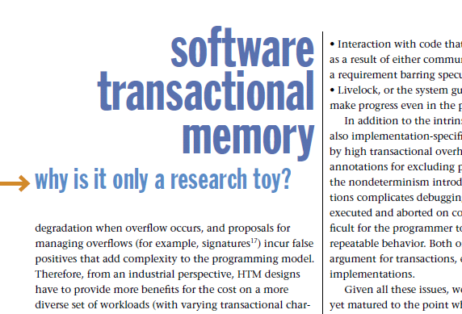
Hatin’ on TM
STM is too inefficient
Notes:
Inexplicably, not everyone thinks TM is all that and more.
Here are some of the common criticisms you will find in published papers and blogs.
Some claim that STM is inherently too inefficient.

Slide 85
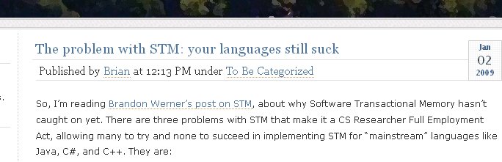
Hatin’ on TM
Requires radical change in programming style
Notes:
Some claim that programmers will never learn to program in a different style.

Slide 86
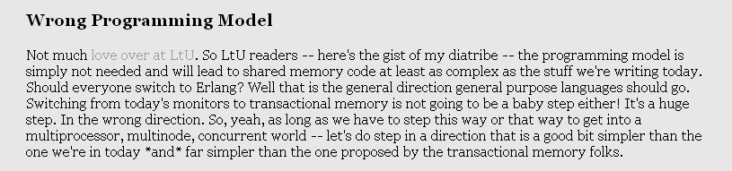
Hatin’ on TM
Erlang-style shared nothing only true path to salvation
Notes:
The sandal-wearing vegetarian Esperanto-speaking faction thinks that shared-memory computation is hopeless, and efforts to improve it are evil.

Slide 87
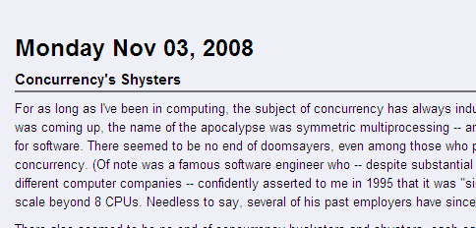
Hatin’ on TM
There is nothing wrong with what we do today.
Notes:
The Austro-Hungarian Empire checks in with the critique that there is nothing wrong with what we do today, do why change?

Slide 88
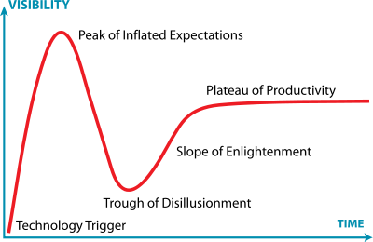
Gartner Hype Cycle
You are here
Hat tip: Jeremy Kemp
Notes:
Long story short, here is my view of the big picture.
Every new technology goes through some form of the “Gartner Hype Cycle”, named after the consulting firm that invented the notion.
An idea is born, and as it becomes known, people expect it to lead them out of the wilderness. Gradually, the community discovers that things are complicated, and that the new technology is not going to pay their mortgages, wash their cars, or solve perpetual motion. A reaction sets in, and some become bitter.
All along, researchers are patiently working on getting the damn thing to work, and eventually the technology settles into a stable, useful mode, less useful than the hype suggested, but better than the haters expect.

Slide 89

Thanks ! תודה

Slide 90
Overview
Building shared memory data structures
  Lists, queues, hashtables, …
Why?
  Used directly by applications (e.g., in C/C++, Java, C#, …)
  Used in the language runtime system (e.g., management of work, implementations of message passing, …)
  Used in traditional operating systems (e.g., synchronization between top/bottom-half code)
Why not?
  Don’t think of “threads + shared data structures” as a default/good/complete/desirable programming model
  It’s better to have shared memory and not need it…

Slide 91
Different techniques for different problems
Ease to
write
Correctness
When can it be used?
How fast is it?
How well does it scale?

