Slide 1
Computer Networking
Michaelmas/Lent Term
M/W/F 11:00-12:00
LT1 in Gates Building
Slide Set 3
Andrew W. Moore
andrew.moore@cl.cam.ac.uk
2016-2017

Slide 2
Topic 3: The Data Link Layer
Our goals:
understand principles behind data link layer services:
  (these are methods & mechanisms in your networking toolbox)
  error detection, correction
  sharing a broadcast channel: multiple access
  link layer addressing
  reliable data transfer, flow control:
instantiation and implementation of various link layer technologies
  Wired Ethernet (aka 802.3)
  Wireless Ethernet (aka 802.11 WiFi)
Algorithms
  Binary Exponential Backoff
  Spanning Tree

Slide 3

Link Layer: Introduction
Some terminology:
hosts and routers are nodes
communication channels that connect adjacent nodes along communication path are links
  wired links
  wireless links
  LANs
layer-2 packet is a frame, encapsulates datagram
data-link layer has responsibility of
transferring datagram from one node
to adjacent node over a link

Slide 4
Link Layer (Channel) Services
framing, link access:
  encapsulate datagram into frame, adding header, trailer
  channel access if shared medium
  “MAC” addresses used in frame headers to identify source, dest
    different from IP address!
reliable delivery between adjacent nodes
  we see some of this again in the Transport Topic
  seldom used on low bit-error link (fiber, some twisted pair)
  wireless links: high error rates
    Q: why both link-level and end-end reliability?

Slide 5
Link Layer (Channel) Services - 2
flow control:
  pacing between adjacent sending and receiving nodes
error detection:
  errors caused by signal attenuation, noise.
  receiver detects presence of errors:
    signals sender for retransmission or drops frame
error correction:
  receiver identifies and corrects bit error(s) without resorting to retransmission
half-duplex and full-duplex
  with half duplex, nodes at both ends of link can transmit, but not at same time

Slide 6
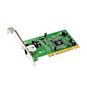
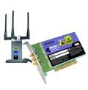
Where is the link layer implemented?
in each and every host
link layer implemented in “adaptor” (aka network interface card NIC)
  Ethernet card, PCMCI card, 802.11 card
  implements link, physical layer
attaches into host’s system buses
combination of hardware, software, firmware
host schematic
application
transport
network
link
cpu
memory
link
physical
host
bus
(e.g., PCI)
controller
physical
transmission
network adapter
card

Slide 7
Adaptors Communicating
datagram
datagram
controller
controller
sending host
receiving host
datagram
frame
sending side:
  encapsulates datagram in frame
  encodes data for the physical layer
  adds error checking bits, provide reliability, flow control, etc.
receiving side
  decodes data from the physical layer
  looks for errors, provide reliability, flow control, etc
  extracts datagram, passes to upper layer at receiving side

Slide 8
Coding – a channel function
Change the representation of data.
Encoding
Given Data
Changed Data
Decoding

Slide 9


MyPasswd
MyPasswd
AA$$$$ff
AA$$$$ff
AA$$$$ffff
AA$$$$ffff

Slide 10
Coding
Change the representation of data.
Encoding
Given Data
Changed Data
Decoding
Encryption: MyPasswd <-> AA$$$$ff
Error Detection: AA$$$$ff <-> AA$$$$ffff
Compression: AA$$$$ffff <-> A2$4f4
Analog: A2$4f4 <->

Slide 11
Line Coding Examples
where Baud=bit-rate
Non-Return-to-Zero (NRZ)
0
1
0
1
1
0
0
1
0
1
Non-Return-to-Zero-Mark (NRZM) 1 = transition 0 = no transition
0
1
0
1
1
0
0
1
0
1
Non-Return-to-Zero Inverted (NRZI) (note transitions on the 1)
0
1
0
1
1
0
0
1
0
1

Slide 12
Line Coding Examples
Non-Return-to-Zero (NRZ) (Baud = bit-rate)
0
1
0
0
1
0
0
1
1
1
Clock
Manchester example (Baud = 2 x bit-rate)
0
1
0
0
1
0
0
1
1
1
Clock
Quad-level code (2 x Baud = bit-rate)
0
1
0
0
1
0
0
1
1
1
Notes:
----- Meeting Notes (28/11/2014 11:55) -----
28-nov-2014

Slide 13
Line Coding – Block Code example
Data to send
0
1
0
0
1
0
0
1
1
1
Line-(Wire) representation
0
1
0
1
0
1
0
0
1
1
Name 4b 5b Description
0 0000 11110 hex data 0
1 0001 01001 hex data 1
2 0010 10100 hex data 2
3 0011 10101 hex data 3
4 0100 01010 hex data 4
5 0101 01011 hex data 5
6 0110 01110 hex data 6
7 0111 01111 hex data 7
8 1000 10010 hex data 8
9 1001 10011 hex data 9
A 1010 10110 hex data A
B 1011 10111 hex data B
C 1100 11010 hex data C
D 1101 11011 hex data D
E 1110 11100 hex data E
F 1111 11101 hex data F
Name 4b 5b Description
Q -NONE- 00000 Quiet
I -NONE- 11111 Idle
J -NONE- 11000 SSD #1
K -NONE- 10001 SSD #2
T -NONE- 01101 ESD #1
R -NONE- 00111 ESD #2
H -NONE- 00100 Halt
Block coding transfers data with a fixed
overhead: 20% less information per Baud in the case of 4B/5B
So to send data at 100Mbps; the line rate
(the Baud rate) must be 125Mbps.
1Gbps uses an 8b/10b codec; encoding
entire bytes at a time but with 25% overhead
Notes:
2016-11-23

Slide 14

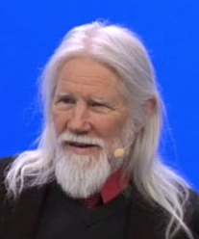

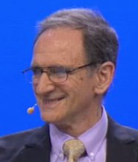
Line Coding Scrambling – with secrecy
Step 1
….G8wDFrB
EAFDSWbzQ7
BW2fbdTqeT
ImrukTYwQY
ndYdKb4….
Scrambling
Sequence
REPLICATE
SECURELY
Scrambling
Sequence
Step 2
DUPLICATE
SECURELY
Scrambling
Sequence
Scrambling
Sequence
Communications
Channel
Message
Message
Message
XOR
Sequence
Message
XOR
Sequence
Step 3
Don’t ever reuse Scrambling sequence, ever. <<< this is quite important

Slide 15
Line Coding Scrambling– no secrecy
Scrambling
Sequence
Scrambling
Sequence
Communications
Channel
Message
Message
Message
XOR
Sequence
Message
XOR
Sequence
e.g. (Self-synchronizing) scrambler
δ
δ
δ
δ
δ
Notes:
Got here 23/Nov/2015
got here 25/Jan/2013

Slide 16
Line Coding Examples (Hybrid)
…100111101101010001000101100111010001010010110101001001110101110100…
…10011110110101000101000101100111010001010010110101001001110101110100…
Inserted bits marking “start of frame/block/sequence”
Scramble / Transmit / Unscramble
δ
δ
δ
δ
δ
δ
δ
δ
δ
δ
…0100010110011101000101001011010100100111010111010010010111011101111000…
Identify (and remove) “start of frame/block/sequence”
This gives you the Byte-delineations for free
64b/66b combines a scrambler and a framer. The start of frame is a pair of bits 01 or 10: 01 means “this frame is data” 10 means “this frame contains data and control” – control could be configuration information, length of encoded data or simply “this line is idle” (no data at all)

Slide 17
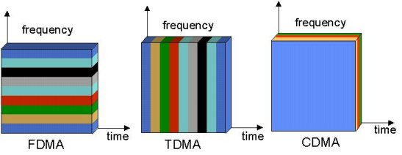
Multiple Access Mechanisms
Each dimension is orthogonal (so may be trivially combined)
There are other dimensions too; can you think of them?
Notes:
polarization (Phase)
weird (electron spin)

Slide 18


Slide 21
Code Division Multiple Access (CDMA)
(not to be confused with CSMA!)
used in several wireless broadcast channels (cellular, satellite, etc) standards
unique “code” assigned to each user; i.e., code set partitioning
all users share same frequency, but each user has own “chipping” sequence (i.e., code) to encode data
encoded signal = (original data) XOR (chipping sequence)
decoding: inner-product of encoded signal and chipping sequence
allows multiple users to “coexist” and transmit simultaneously with minimal interference (if codes are “orthogonal”)

Slide 22
CDMA Encode/Decode
channel output Z_{i,m}
Z_{i,m}= d_{i}.c_{m}
data
bits
d₀ = 1
1
1
1
1
1
d₁ = -1
1
1
1
-
-
-
-
1
-
-
-
1
-
1
1
1
1
1
sender
adds code
1
1
slot 1
channel
output
slot 0
channel
output
1
1
1
1
1
code
1
1
-
-
-
1
-
1
1
1
-
-
-
1
-
1
1
1
slot 1
slot 0
M
D_{i} = Σ Z_{i,m}.c_{m}
m=1
M
received
input
1
1
1
1
1
1
1
1
d₀ = 1
-
-
-
-
1
-
-
-
1
-
1
1
1
1
1
1
d₁ = -1
1
slot 1
channel
output
slot 0
channel
output
1
1
1
1
1
code
1
1
-
-
-
1
-
1
1
1
-
-
-
1
-
1
1
receiver
removes code
1
slot 1
slot 0

Slide 23
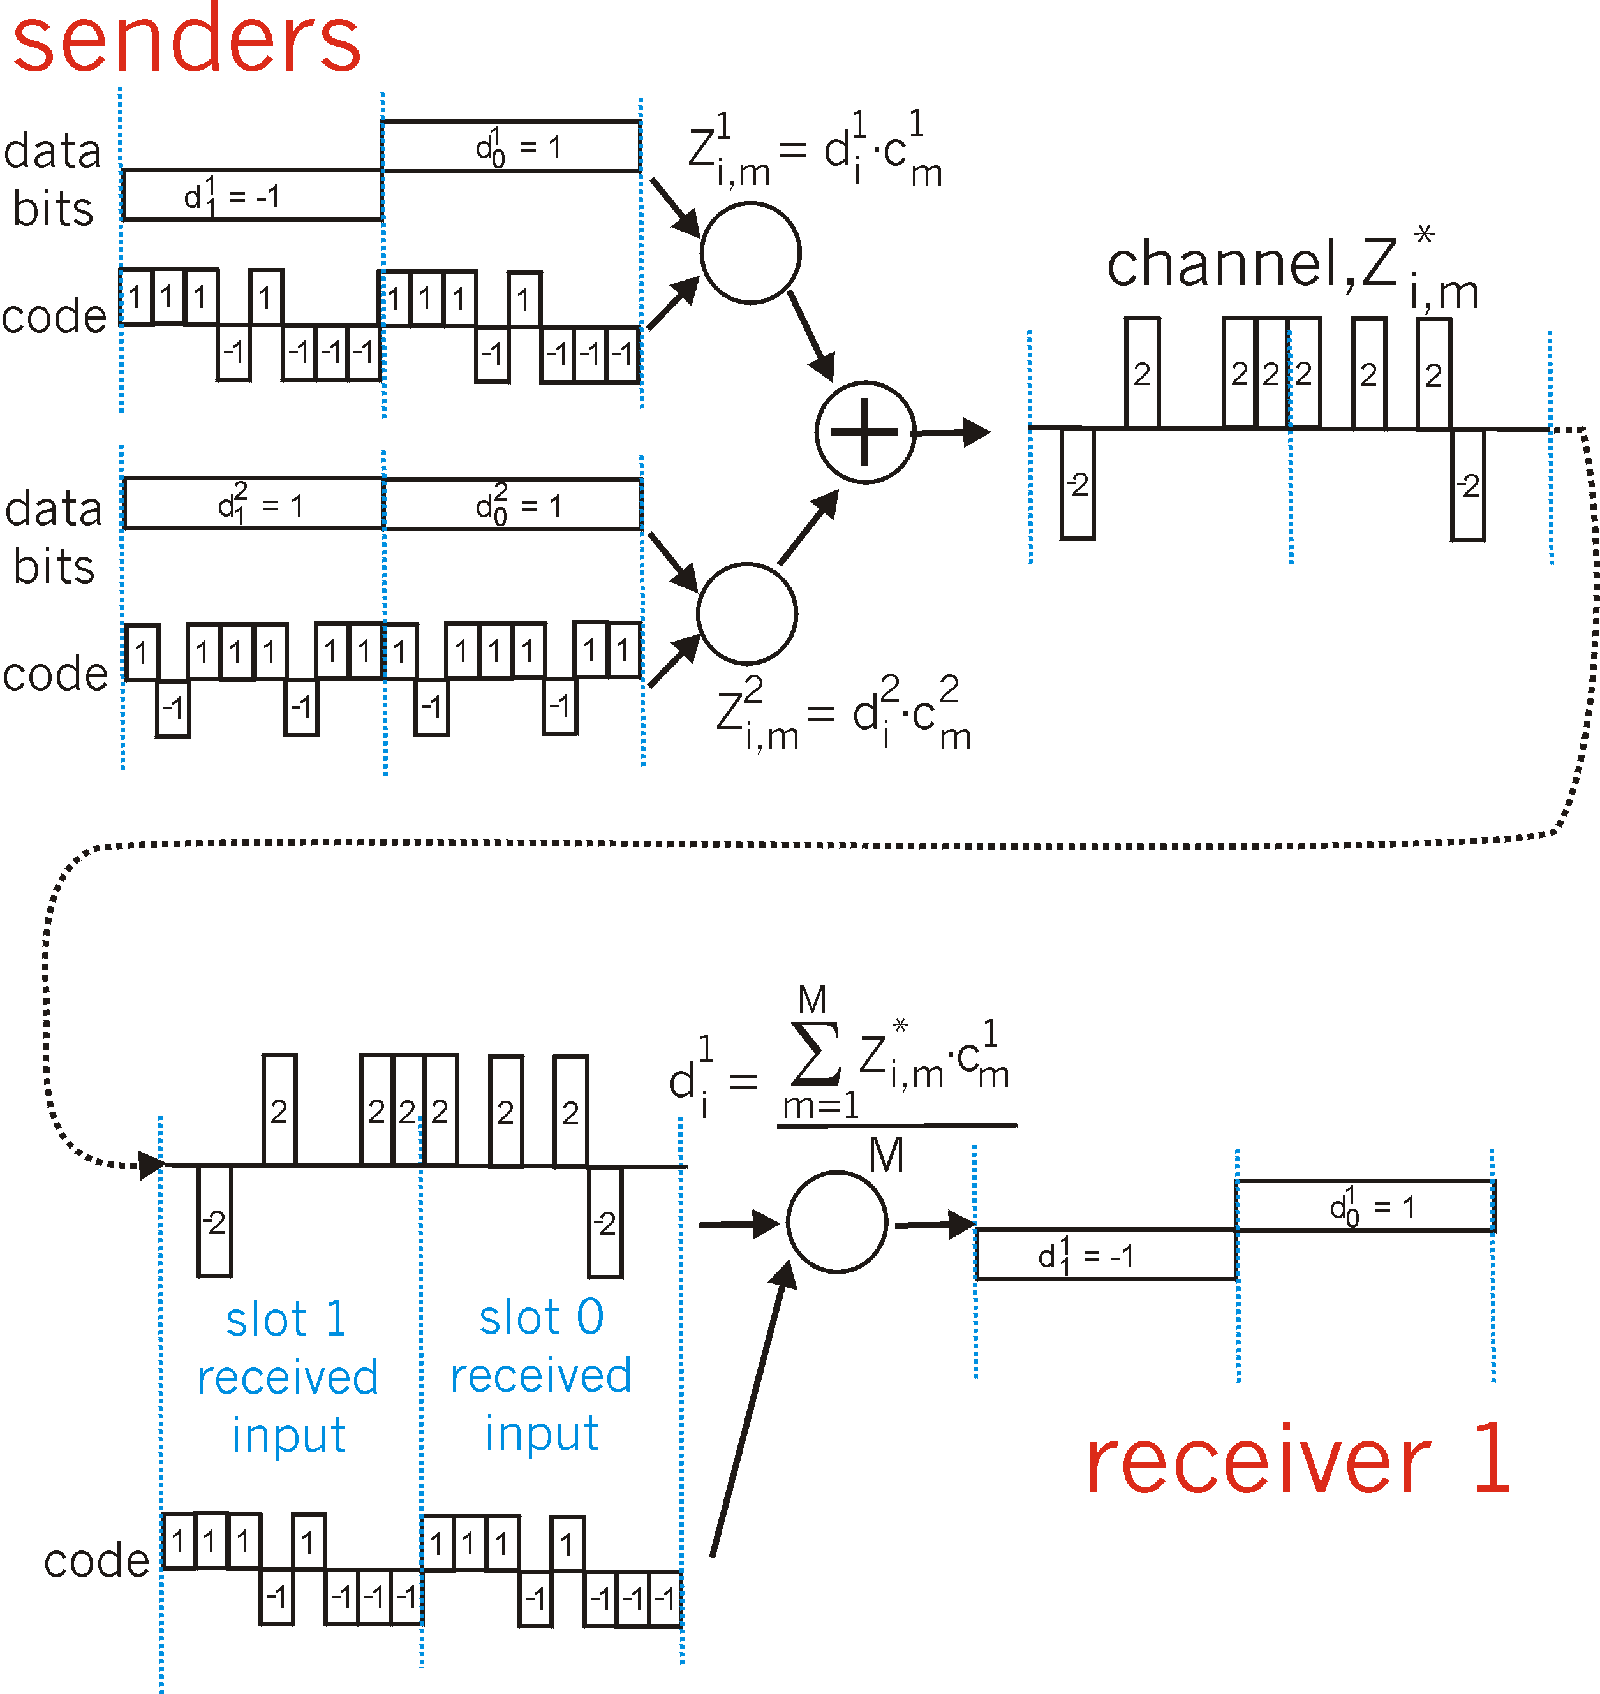
CDMA: two-sender interference
Each sender adds a unique
code
sender
removes
its unique
code

Slide 24
Coding Examples summary
Common Wired coding
  Block codecs: table-lookups
    fixed overhead, inline control signals
  Scramblers: shift registers
    overhead free
Like earlier coding schemes and error correction/detection; you can combine these
  e.g, 10Gb/s Ethernet may use a hybrid
CDMA (Code Division Multiple Access)
  coping intelligently with competing sources
  Mobile phones

Slide 25

Error Detection and Correction
How to use coding to deal with errors in data communication?
Noise
0000
0000
0001
0000
Basic Idea :
Add additional information to a message.
Detect an error and re-send a message.
Or, fix an error in the received message.

Slide 26
Error Detection and Correction
How to use coding to deal with errors in data communication?
Noise
0000
0000
0000
0000
Basic Idea :
Add additional information to a message.
Detect an error and re-send a message.
Or, fix an error in the received message.

Slide 27
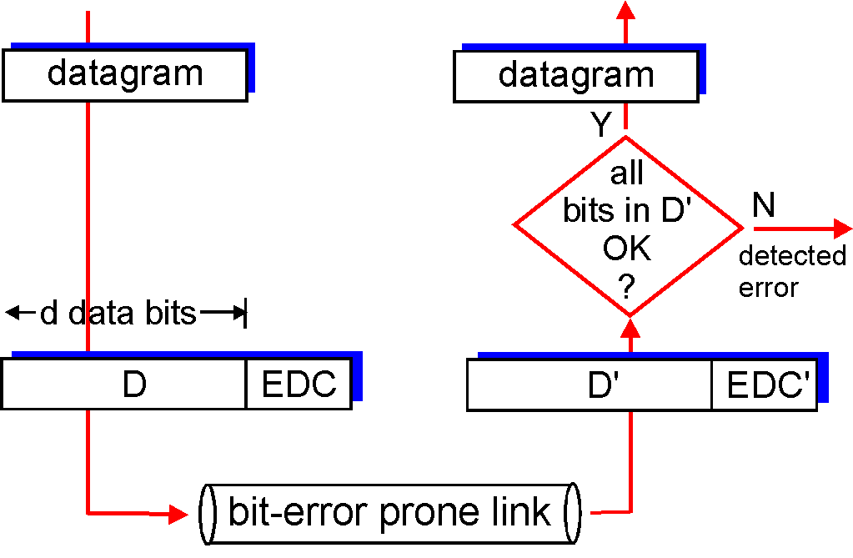
Error Detection
EDC= Error Detection and Correction bits (redundancy = overhead)
D = Data protected by error checking, may include header fields
Error detection not 100% reliable!
  protocol may miss some errors, but rarely
  larger EDC field yields better detection and correction
otherwise

Slide 28
Error Detection Code
Sender:
Y = generateCheckBit(X);
send(XY);
Receiver:
receive(X1Y1);
Y2=generateCheckBit(X1);
if (Y1 != Y2) ERROR;
else NOERROR
Noise
==

Slide 29
Error Detection Code: Parity
Add one bit, such that the number of 1’s is even.
Noise
0000
0

0001
0
0001
1

0001
1
1001
0

1111
0
Problem: This simple parity cannot detect two-bit errors.

Slide 30
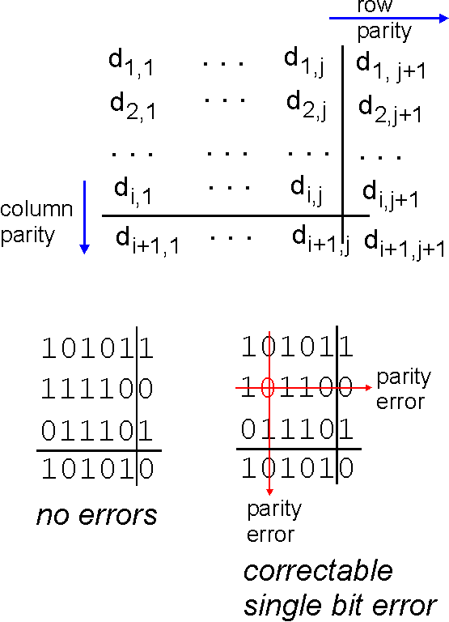
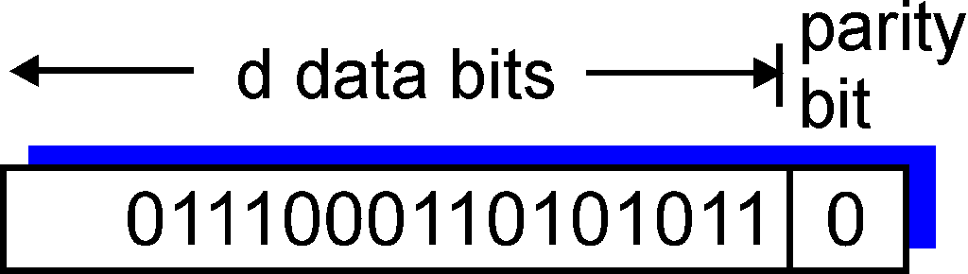
Parity Checking
Single Bit Parity:
Detect single bit errors
Two Dimensional Bit Parity:
Detect and correct single bit errors
0
0

Slide 31
Internet checksum
Goal: detect “errors” (e.g., flipped bits) in transmitted packet (note: used at transport layer only)
Sender:
treat segment contents as sequence of 1bit integers
checksum: addition (1’s complement sum) of segment contents
sender puts checksum value into UDP checksum field
Receiver:
compute checksum of received segment
check if computed checksum equals checksum field value:
  NO - error detected
  YES - no error detected. But maybe errors nonetheless?
Notes:
Start here March 2nd 2012

Slide 32
Error Detection Code: CRC
CRC means “Cyclic Redundancy Check”.
More powerful than parity.
  It can detect various kinds of errors, including 2-bit errors.
More complex: multiplication, binary division.
Parameterized by n-bit divisor P.
  Example: 3-bit divisor 101.
  Choosing good P is crucial.

Slide 33
CRC with 3-bit Divisor 101
1111
00
0
1001
11
0
CRC
Parity
1111000
same check bits from Parity,
but different ones from CRC
1001000
Multiplication by 2³
D2 = D * 2³
Binary Division by 101
CheckBit = (D2) rem (101)
Add three 0’s at the end
Kurose p478 §5.2.3
Peterson p97 §2.4.3

Slide 34
The divisor (P) – Secret sauce of CRC
If the divisor were 100, instead of 101, data 1111 and 1001 would give the same check bit 00.
Mathematical analysis about the divisor:
  Last bit should be 1.
  Should contain at least two 1’s.
  Should be divisible by 11.
ATM, HDLC, Ethernet each use a CRC with well-chosen fixed divisors
Divisor analysis keeps mathematicians in jobs
(a branch of pure math: combinatorial mathematics)
FYI: in K&R P is called the Generator: G

Slide 35
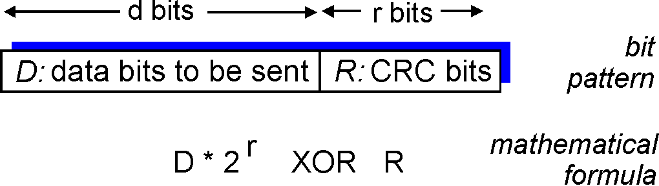
Checksumming: Cyclic Redundancy Check recap
view data bits, D, as a binary number
choose r+1 bit pattern (generator), P
goal: choose r CRC bits, R, such that
  <D,R> exactly divisible by G (modulo 2)
  receiver knows G, divides <D,R> by G. If non-zero remainder: error detected!
  can detect all burst errors less than r+1 bits
widely used in practice (Ethernet, 802.11 WiFi, ATM)
FYI: in K&R P is called the Generator: G

Slide 36
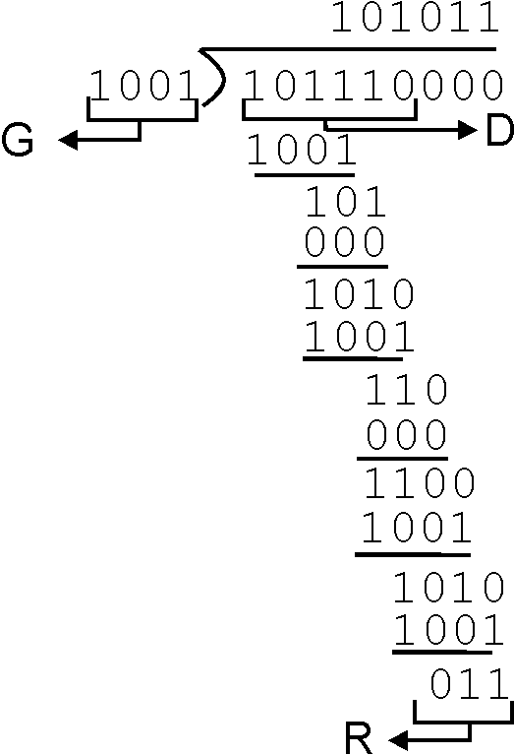
CRC Another Example – this time with long division
Want:
  D.2^{r} XOR R = nP
equivalently:
  D.2^{r} = nP XOR R
equivalently:
if we divide D.2^{r} by P, want remainder R
P
D.2^{r}
P
R = remainder[ ]
FYI: in K&R P is called the Generator: G

Slide 37
Error Detection Code becomes….
Sender:
Y = generateCheckBit(X);
send(XY);
Receiver:
receive(X1Y1);
Y2=generateCheckBit(X1);
if (Y1 != Y2) ERROR;
else NOERROR
Noise
==

Slide 38
Forward Error Correction (FEC)
Sender:
Y = generateCheckBit(X);
send(XY);
Receiver:
receive(X1Y1);
Y2=generateCheckBit(X1);
if (Y1 != Y2) FIXERROR(X1Y1);
else NOERROR
Noise
!=

Slide 39
Forward Error Correction (FEC)
Sender:
Y = generateCheckBit(X);
send(XY);
Receiver:
receive(X1Y1);
Y2=generateCheckBit(X1);
if (Y1 != Y2) FIXERROR(X1Y1);
else NOERROR
Noise
==

Slide 40
Basic Idea of Forward Error Correction
Replace erroneous data
by its “closest” error-free data.
Good
Good
00
000
10
101
3
2
Bad
Bad
Bad
11
101
01
000
10
110
4
01
011
1
11
110
Good
Good

Slide 41
Error Detection vs Correction
Error Correction:
Cons: More check bits. False recovery.
Pros: No need to re-send.
Error Detection:
Cons: Need to re-send.
Pros: Less check bits.
Usage:
Correction: A lot of noise. Expensive to re-send.
Detection: Less noise. Easy to re-send.
Can be used together.

Slide 42


Multiple Access Links and Protocols
Two types of “links”:
point-to-point
  point-to-point link between Ethernet switch and host
broadcast (shared wire or medium)
  old-fashioned wired Ethernet (here be dinosaurs – extinct)
  upstream HFC (Hybrid Fiber-Coax – the Coax may be broadcast)
  Home plug / Powerline networking
  802.11 wireless LAN
humans at a
cocktail party
(shared air, acoustical)
shared wire (e.g.,
cabled Ethernet)
shared RF
(e.g., 802.11 WiFi)
shared RF
(satellite)
Notes:
2016-11-25

Slide 43
Multiple Access protocols
single shared broadcast channel
two or more simultaneous transmissions by nodes: interference
  collision if node receives two or more signals at the same time
multiple access protocol
distributed algorithm that determines how nodes share channel, i.e., determine when node can transmit
communication about channel sharing must use channel itself!
  no out-of-band channel for coordination

Slide 44
Ideal Multiple Access Protocol
Broadcast channel of rate R bps
1. when one node wants to transmit, it can send at rate R
2. when M nodes want to transmit, each can send at average rate R/M
3. fully decentralized:
  no special node to coordinate transmissions
  no synchronization of clocks, slots
4. simple
Notes:
2015-11-25pac

Slide 45
MAC Protocols: a taxonomy
Three broad classes:
Channel Partitioning
  divide channel into smaller “pieces” (time slots, frequency, code)
  allocate piece to node for exclusive use
Random Access
  channel not divided, allow collisions
  “recover” from collisions
“Taking turns”
  nodes take turns, but nodes with more to send can take longer turns

Slide 46
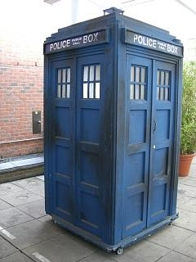
Channel Partitioning MAC protocols: TDMA
(time travel warning – we mentioned this earlier)
TDMA: time division multiple access
access to channel in "rounds"
each station gets fixed length slot (length = pkt trans time) in each round
unused slots go idle
example: station LAN, 1,3,4 have pkt, slots 2,5,6 idle
slot
frame
1
3
4
1
3
4

Slide 47
Channel Partitioning MAC protocols: FDMA
(time travel warning – we mentioned this earlier)
FDMA: frequency division multiple access
channel spectrum divided into frequency bands
each station assigned fixed frequency band
unused transmission time in frequency bands go idle
example: station LAN, 1,3,4 have pkt, frequency bands 2,5,6 idle
time
frequency bands
FDM cable

Slide 48
“Taking Turns” MAC protocols
channel partitioning MAC protocols:
  share channel efficiently and fairly at high load
  inefficient at low load: delay in channel access, 1/N bandwidth allocated even if only 1 active node!
Random access MAC protocols
  efficient at low load: single node can fully utilize channel
  high load: collision overhead
“taking turns” protocols
  look for best of both worlds!

Slide 49
“Taking Turns” MAC protocols
Polling:
master node “invites” slave nodes to transmit in turn
typically used with “dumb” slave devices
concerns:
  polling overhead
  latency
  single point of failure (master)
data
poll
master
data
slaves

Slide 50
“Taking Turns” MAC protocols
Token passing:
control token passed from one node to next sequentially.
token message
concerns:
  token overhead
  latency
  single point of failure (token)
concerns fixed in part by a slotted ring (many simultaneous tokens)
T
(nothing
to send)
T
Cambridge students – this is YOUR heritage
Cambridge RING, Cambridge Fast RING,
Cambridge Backbone RING, these things gave us ATDM (and ATM)
data

Slide 51
ATM
In TDM a sender may only use a pre-allocated slot
slot
frame
1
3
4
1
3
4
In ATM a sender transmits labeled cells whenever necessary
1
1
3
4
4
3
1
ATM = Asynchronous Transfer Mode – an ugly expression
think of it as ATDM – Asynchronous Time Division Multiplexing
That’s a variant of PACKET SWITCHING to the rest of us – just like Ethernet
but using fixed length slots/packets/cells
Use the media when you need it, but
ATM had virtual circuits and these needed setup….
Worse ATM had an utterly irrational size

Slide 52
Random Access MAC Protocols
When node has packet to send
  Transmit at full channel data rate
  No a priori coordination among nodes
Two or more transmitting nodes ⇒ collision
  Data lost
Random access MAC protocol specifies:
  How to detect collisions
  How to recover from collisions
Examples
  ALOHA and Slotted ALOHA
  CSMA, CSMA/CD, CSMA/CA (wireless)

Slide 53
Key Ideas of Random Access
Carrier sense
  Listen before speaking, and don’t interrupt
  Checking if someone else is already sending data
  … and waiting till the other node is done
Collision detection
  If someone else starts talking at the same time, stop
  Realizing when two nodes are transmitting at once
  …by detecting that the data on the wire is garbled
Randomness
  Don’t start talking again right away
  Waiting for a random time before trying again

Slide 54
CSMA (Carrier Sense Multiple Access)
CSMA: listen before transmit
  If channel sensed idle: transmit entire frame
  If channel sensed busy, defer transmission
Human analogy: don’t interrupt others!
Does this eliminate all collisions?
  No, because of nonzero propagation delay

Slide 55
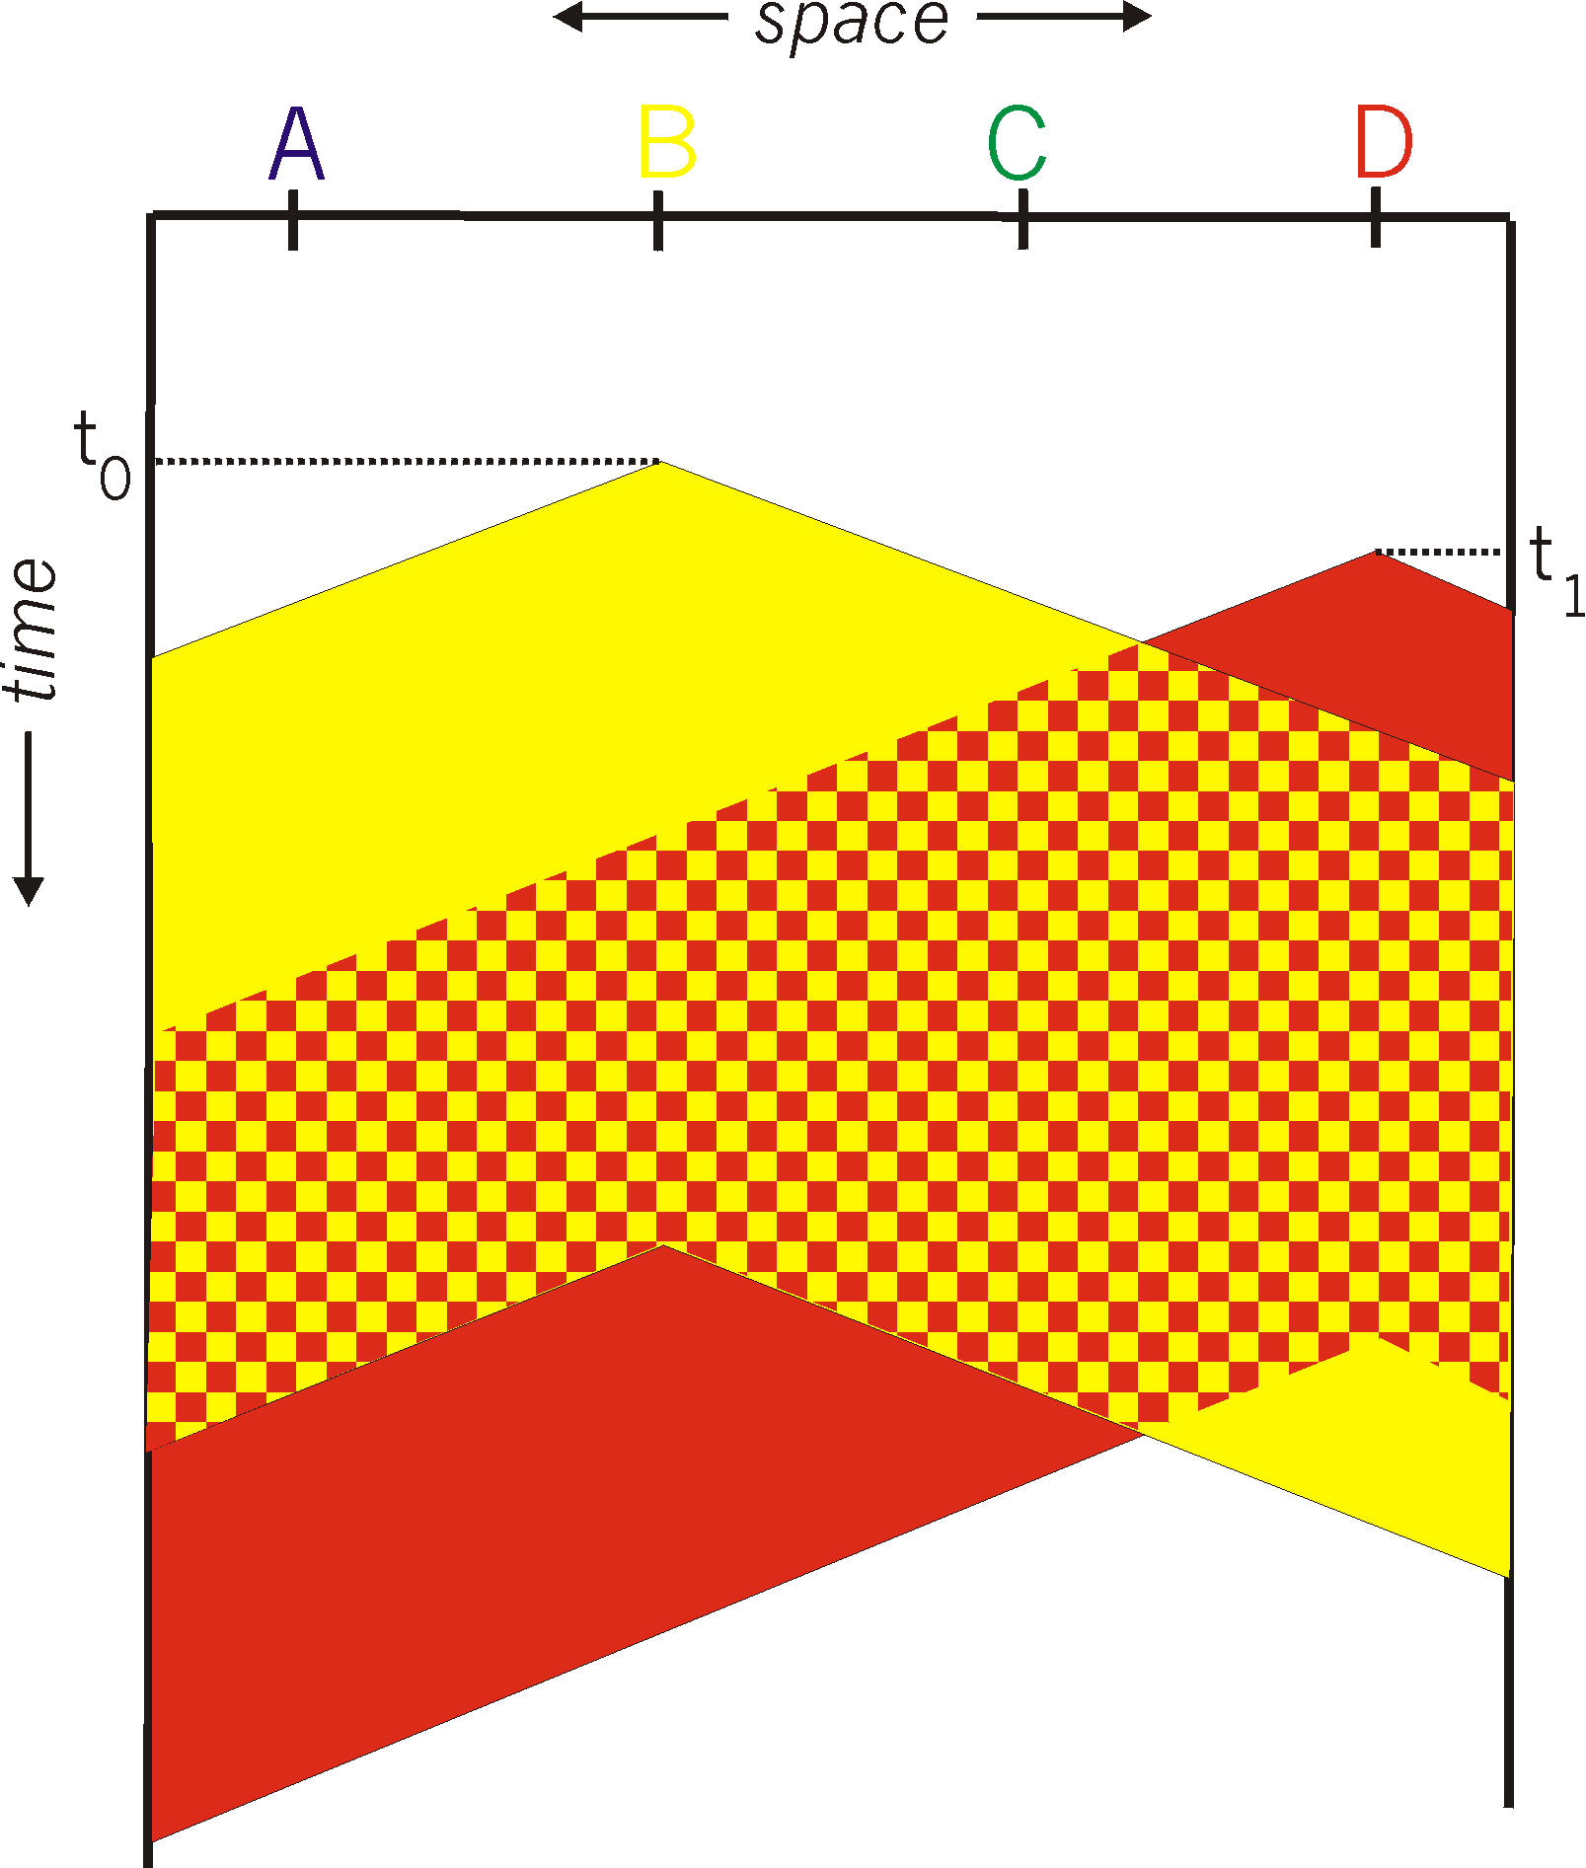
CSMA Collisions
Propagation delay: two nodes may not hear each other’s before sending.
Would slots hurt or help?
CSMA reduces but does not eliminate collisions
Biggest remaining problem?
Collisions still take full slot!
How do you fix that?
Notes:
Ask: who knows? (from knowing ethernet)?
Someone who doesn’t, how to do this?
Listen before sending to detect possible collision
Why not listen to detect current collision!

Slide 56
CSMA/CD (Collision Detection)
CSMA/CD: carrier sensing, deferral as in CSMA
  Collisions detected within short time
  Colliding transmissions aborted, reducing wastage
Collision detection easy in wired LANs:
  Compare transmitted, received signals
Collision detection difficult in wireless LANs:
  Reception shut off while transmitting (well, perhaps not)
  Not perfect broadcast (limited range) so collisions local
  Leads to use of collision avoidance instead (later)
Notes:
30/Jan/2013

Slide 57
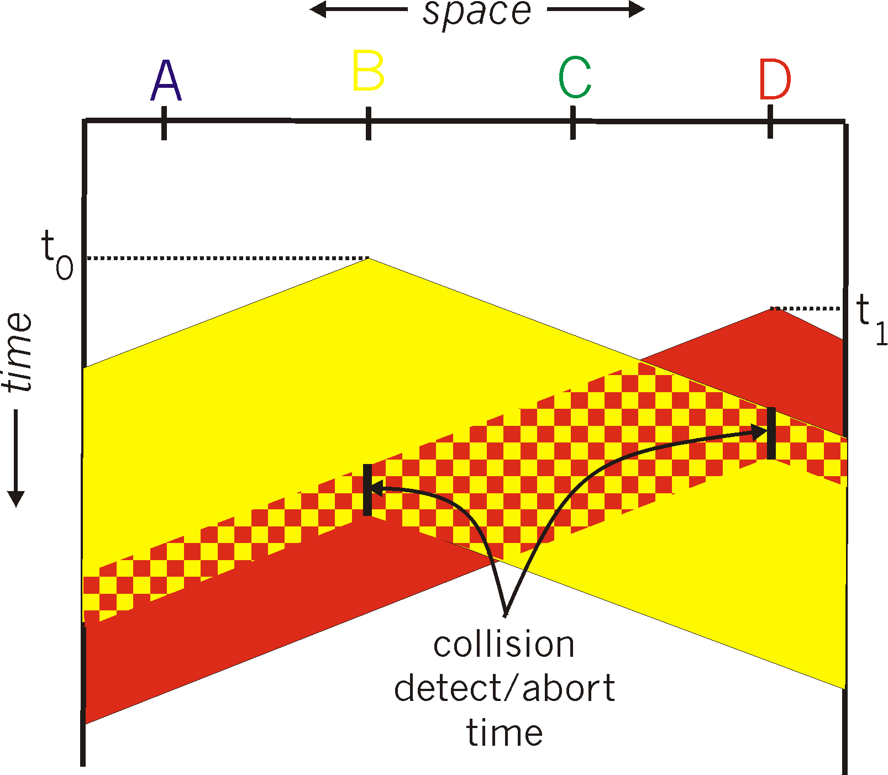
CSMA/CD Collision Detection
B and D can tell that collision occurred.
Note: for this to work, need restrictions on minimum frame size and maximum distance. Why?
Notes:
Draw failed collision detection….

Slide 58
Limits on CSMA/CD Network Length
A
B
latency d
Latency depends on physical length of link
  Time to propagate a packet from one end to the other
Suppose A sends a packet at time t
  And B sees an idle line at a time just before t+d
  … so B happily starts transmitting a packet
B detects a collision, and sends jamming signal
  But A can’t see collision until t+2d

Slide 59

Performance of CSMA/CD
Time wasted in collisions
  Proportional to distance d
Time spend transmitting a packet
  Packet length p divided by bandwidth b
Rough estimate for efficiency (K some constant)
Note:
  For large packets, small distances, E ~ 1
  As bandwidth increases, E decreases
  That is why high-speed LANs are all switched
Notes:
K represents number of collisions per transmission….

Slide 60
Benefits of Ethernet
Easy to administer and maintain
Inexpensive
Increasingly higher speed
Evolvable!

Slide 61
Evolution of Ethernet
Changed everything except the frame format
  From single coaxial cable to hub-based star
  From shared media to switches
  From electrical signaling to optical
Lesson #1
  The right interface can accommodate many changes
  Implementation is hidden behind interface
Lesson #2
  Really hard to displace the dominant technology
  Slight performance improvements are not enough

Slide 62
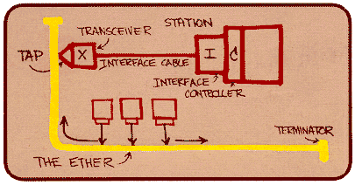
Ethernet: CSMA/CD Protocol
Carrier sense: wait for link to be idle
Collision detection: listen while transmitting
  No collision: transmission is complete
  Collision: abort transmission & send jam signal
Random access: binary exponential back-off
  After collision, wait a random time before trying again
  After m^{th} collision, choose K randomly from {0, …, 2^{m}-1}
  … and wait for K*512 bit times before trying again
    Using min packet size as “slot”
    If transmission occurring when ready to send, wait until end of transmission (CSMA)
Notes:
2016-11-28

Slide 63
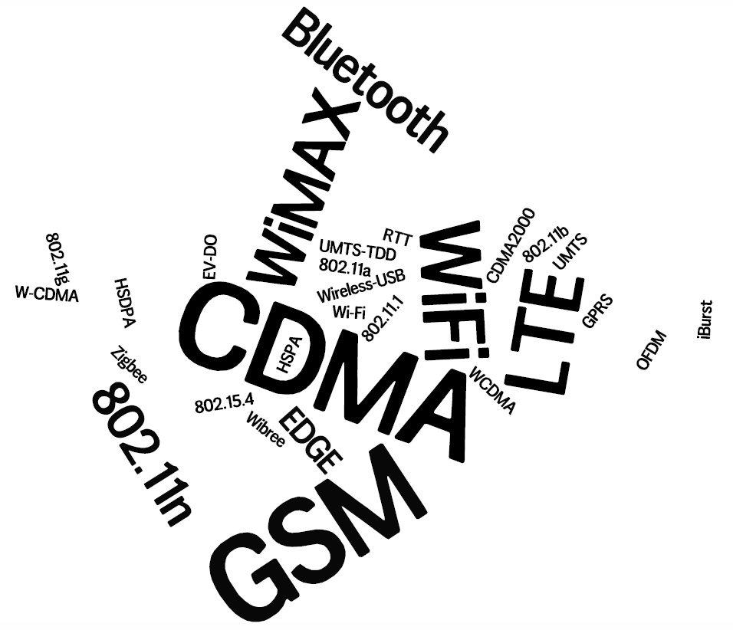
Notes:
Rapid evolution in the wireless eco-system – hard to keep up
With either technologies or business-models

Slide 64
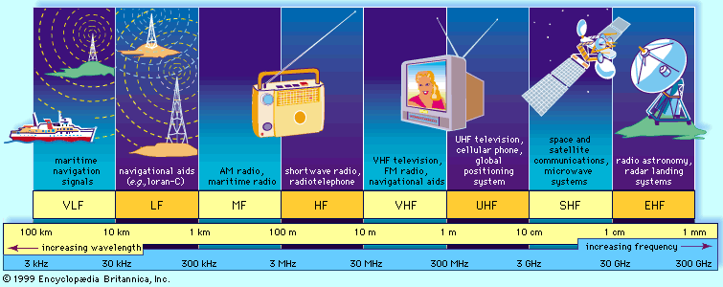
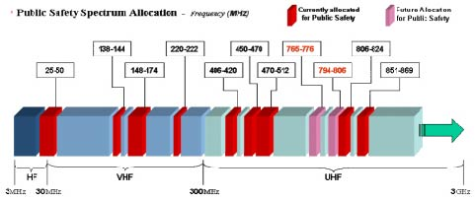
The Wireless Spectrum
Notes:
FCC allocates spectrum to users – who are these?
Govt. itself (various agencies), military.
Public-safety.
Broadcasters
Telecommunications providers (aka operators) – license holders.
Different bands behave differently …
Most wave propagation properties are frequency/wave-length dependent:

Slide 65

Metrics for evaluation / comparison of wireless technologies
Bitrate or Bandwidth
Range - PAN, LAN, MAN, WAN
Two-way / One-way
Multi-Access / Point-to-Point
Digital / Analog
Applications and industries
Frequency – Affects most physical properties:
Distance (free-space loss)
Penetration, Reflection, Absorption
Energy proportionality
Policy: Licensed / Deregulated
Line of Sight (Fresnel zone)
Size of antenna
Determined by wavelength – )
Notes:
Bitrate or Bandwidth
Range - PAN, LAN, MAN, WAN
Two-way / One-way
Multi-Access / Point-to-Point
Digital / Analog
Applications and industries
Frequency – Affects most physical properties:
Distance (free-space loss)
Penetration, Reflection, Absorption
Energy proportionality
Policy: Licensed / Deregulated
Line of Sight (Fresnel zone)
Size of antenna
(determined by wavelength – )

Slide 66
Wireless Communication Standards
Cellular (800/900/1700/1800/1900Mhz):
  2G: GSM / CDMA / GPRS /EDGE
  3G: CDMA2000/UMTS/HSDPA/EVDO
  4G: LTE, WiMax
IEEE 802.11 (aka WiFi): (some examples)
  b: 2.4Ghz band, 11Mbps (~4.5 Mbps operating rate)
  g: 2.4Ghz, 54-108Mbps (~19 Mbps operating rate)
  a: 5.0Ghz band, 54-108Mbps (~25 Mbps operating rate)
  n: 2.4/5Ghz, 150-600Mbps (4x4 mimo)
  ac: 2.4/5Ghz, 433-1300Mbps (improved coding 256-QAM)
  ad: 60Ghz, 7Gbps
  af: 54/790Mhz, 26-35Mbps (TV whitespace)
IEEE 802.15 – lower power wireless:
  802.15.1: 2.4Ghz, 2.1 Mbps (Bluetooth)
  802.15.4: 2.4Ghz, 250 Kbps (Sensor Networks)
Notes:
got to here 4/Feb/2013

Slide 67
What Makes Wireless Different?
Broadcast and multi-access medium…
  err, so….
BUT, Signals sent by sender don’t always end up at receiver intact
  Complicated physics involved, which we won’t discuss
  But what can go wrong?

Slide 68
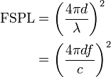
Path Loss / Path Attenuation
Free Space Path Loss:
d = distance
λ = wave length
f = frequency
c = speed of light
Reflection, Diffraction, Absorption
Terrain contours (Urban, Rural, Vegetation).
Humidity
Notes:
2015-11-27
reduction in power density (attenuation) of an electromagnetic wave as it propagates through space.
Path loss may be due to many effects, such as free-space loss,refraction, diffraction, reflection, aperture-medium coupling loss, and absorption. Path loss is also influenced by terrain contours, environment (urban or rural, vegetation and foliage), propagation medium (dry or moist air), the distance between the transmitter and the receiver, and the height and location of antennas.

Slide 69
Multipath Effects
Ceiling
S
R
Floor
Signals bounce off surface and interfere with one another
Self-interference
Notes:
3-dec-2014

Slide 70
Interference from Other Sources
External Interference
  Microwave is turned on and blocks your signal
  Would that affect the sender or the receiver?
Internal Interference
  Hosts within range of each other collide with one another’s transmission
We have to tolerate path loss, multipath, etc., but we can try to avoid internal interference

Slide 71
Wireless Bit Errors
The lower the SNR (Signal/Noise) the higher the Bit Error Rate (BER)
We could make the signal stronger…
Why is this not always a good idea?
  Increased signal strength requires more power
  Increases the interference range of the sender, so you interfere with more nodes around you
    And then they increase their power…….
Local link-layer Error Correction schemes can correct some problems

Slide 72
Lets focus on 802.11
aka - WiFi …
What makes it special?
Deregulation > Innovation > Adoption > Lower cost = Ubiquitous technology
JUST LIKE ETHERNET – not lovely but sufficient
Notes:
72
JUST LIKE ETHERNET – not lovely but sufficient

Slide 73
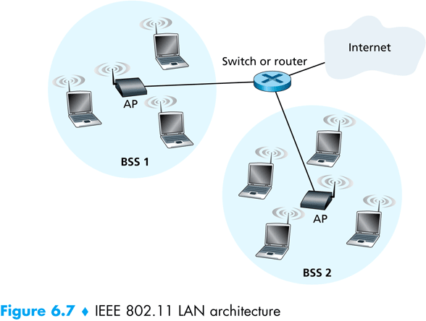
802.11 Architecture
Designed for limited area
AP’s (Access Points) set to specific channel
Broadcast beacon messages with SSID (Service Set Identifier) and MAC Address periodically
Hosts scan all the channels to discover the AP’s
  Host associates with AP
802.11 frames exchanges
802.3 (Ethernet) frames exchanged

Slide 74
Wireless Multiple Access Technique?
Carrier Sense?
  Sender can listen before sending
  What does that tell the sender?
Collision Detection?
  Where do collisions occur?
  How can you detect them?

Slide 75
Hidden Terminals
A
B
C
transmit range
A and C can both send to B but can’t hear each other
  A is a hidden terminal for C and vice versa
Carrier Sense will be ineffective
Notes:
75

Slide 76
Exposed Terminals
Exposed node: B sends a packet to A; C hears this and decides not to send a packet to D (despite the fact that this will not cause interference)!
Carrier sense would prevent a successful transmission.
A
B
C
D
Notes:
76

Slide 77
Key Points
No concept of a global collision
  Different receivers hear different signals
  Different senders reach different receivers
Collisions are at receiver, not sender
  Only care if receiver can hear the sender clearly
  It does not matter if sender can hear someone else
  As long as that signal does not interfere with receiver
Goal of protocol:
  Detect if receiver can hear sender
  Tell senders who might interfere with receiver to shut up

Slide 78
Basic Collision Avoidance
Since can’t detect collisions, we try to avoid them
Carrier sense:
  When medium busy, choose random interval
  Wait that many idle timeslots to pass before sending
When a collision is inferred, retransmit with binary exponential backoff (like Ethernet)
  Use ACK from receiver to infer “no collision”
  Use exponential backoff to adapt contention window
Notes:
Why do we wait?
Why not just send right away as medium becomes clear?
6/Feb/2013

Slide 79
CSMA/CA -MA with Collision Avoidance
sender
receiver
other node in
sender’s range
RTS
CTS
data
ACK
Before every data transmission
  Sender sends a Request to Send (RTS) frame containing the length of the transmission
  Receiver respond with a Clear to Send (CTS) frame
  Sender sends data
  Receiver sends an ACK; now another sender can send data
When sender doesn’t get a CTS back, it assumes collision
Notes:
79

Slide 80
CSMA/CA, con’t
receiver
other node in
sender’s range
sender
RTS
CTS
data
data
If other nodes hear RTS, but not CTS: send
  Presumably, destination for first sender is out of node’s range …
Notes:
80

Slide 81
CSMA/CA, con’t
sender
receiver
other node in
sender’s range
RTS
CTS
data
ACK
If other nodes hear RTS, but not CTS: send
  Presumably, destination for first sender is out of node’s range …
  … Can cause problems when a CTS is lost
When you hear a CTS, you keep quiet until scheduled transmission is over (hear ACK)
Notes:
81

Slide 82
RTS / CTS Protocols (CSMA/CA)
B sends to C
RTS
A
B
C
D
Overcome hidden terminal problems with contention-free protocol
  B sends to C Request To Send (RTS)
  A hears RTS and defers (to allow C to answer)
  C replies to B with Clear To Send (CTS)
  D hears CTS and defers to allow the data
  B sends to C
CTS
Notes:
82
Does not solve the exposed terminal problem.
High overhead and especially increase latency.
assumes symmetric signal qualities - if node A hears node B - than also node B hears node A. - not always the case. (Especially local interference at receiver).

Slide 83
Preventing Collisions Altogether
Frequency Spectrum partitioned into several channels
  Nodes within interference range can use separate channels
  Now A and C can send without any interference!
Most cards have only 1 transceiver
  Not Full Duplex: Cannot send and receive at the same time
  Aggregate Network throughput doubles
B
A
C
D

Slide 84
CSMA/CA and RTS/CTS
sender
receiver
sender
receiver
RTS
data
CTS
data
ACK
ACK
RTS/CTS
helps with hidden terminal
good for high-traffic Access Points
often turned on/off dynamically
Without RTS/CTS
lower latency -> faster!
reduces wasted b/w
if the Pr(collision) is low
good for when net is small and not weird
  eg no hidden/exposed terminals
Notes:
84

Slide 85
CSMA/CD vs CSMA/CA
(without RTS/CTS)
CD Collision Detect
CA Collision Avoidance
wired – listen and talk
Listen for others
Busy? goto 1.
Send message (and listen)
Collision?
  JAM
  increase your BEB
  sleep
  goto 1.
wireless – talk OR listen
Listen for others
Busy?
  increase your BEB
  sleep
  goto 1.
Send message
Wait for ACK (MAC ACK)
Got No ACK from MAC?
  increase your BEB
  sleep
  goto 1.

Slide 86
Changing the rules: an 802.11 feature
Rate Adaptation
(for a variety of out-of-context reasons often unused)
base station, mobile dynamically change transmission rate (physical layer modulation technique) as mobile moves, SNR varies
10⁻¹
10⁻²
10⁻³
BER
10⁻⁴
10⁻⁵
10⁻⁶
10⁻⁷
10
20
30
40
SNR(dB)
1. SNR decreases, BER increase as node moves away from base station
QAM256 (8 Mbps)
QAM16 (4 Mbps)
2. When BER becomes too high, switch to lower transmission rate but with lower BER
BPSK (1 Mbps)
operating point

Slide 87
Summary of MAC protocols
channel partitioning, by time, frequency or code
  Time Division, Frequency Division
random access (dynamic),
  ALOHA, S-ALOHA, CSMA, CSMA/CD
  carrier sensing: easy in some technologies (wire), hard in others (wireless)
  CSMA/CD used in Ethernet
  CSMA/CA used in 802.11
taking turns
  polling from central site, token passing
  Bluetooth, FDDI, IBM Token Ring
Notes:
2016-11-30 last lecture of michaelmas 2016

Slide 88
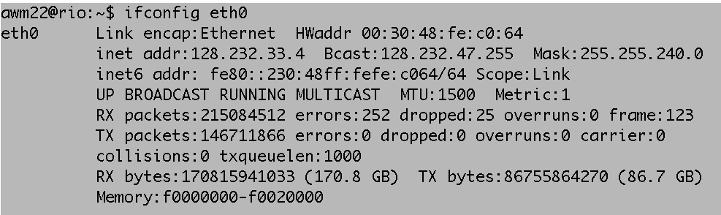
MAC Addresses
MAC (or LAN or physical or Ethernet) address:
  function: get frame from one interface to another physically-connected interface (same network)
  48 bit MAC address (for most LANs)
    burned in NIC ROM, nowadays usually software settable and set at boot time

Slide 89
LAN Address (more)
MAC address allocation administered by IEEE
manufacturer buys portion of MAC address space (to assure uniqueness)
analogy:
(a) MAC address: like Social Security Number
(b) IP address: like postal address
MAC flat address ➜ portability
  can move LAN card from one LAN to another
IP hierarchical address NOT portable
  address depends on IP subnet to which node is attached
Notes:
16-Jan-2014

Slide 90
Hubs
… physical-layer (“dumb”) repeaters:
  bits coming in one link go out all other links at same rate
  all nodes connected to hub can collide with one another
  no frame buffering
  no CSMA/CD at hub: host NICs detect collisions
Collision Domain
in CSMA/CD speak
Co-ax or twisted pair
hub

Slide 91
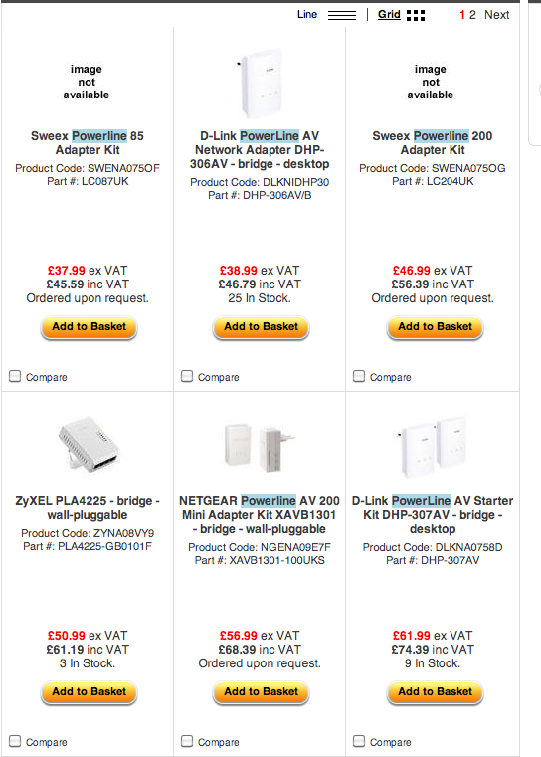

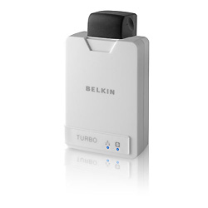
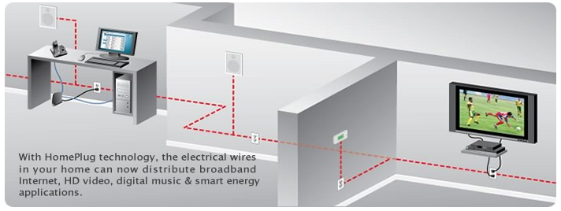
CSMA/CD Lives….
Home Plug and similar Powerline Networking….

Slide 92
Switch
(like a Hub but smarter)
link-layer device: smarter than hubs, take active role
  store, forward Ethernet frames
  examine incoming frame’s MAC address, selectively forward frame to one-or-more outgoing links when frame is to be forwarded on segment, uses CSMA/CD to access segment
transparent
  hosts are unaware of presence of switches
plug-and-play, self-learning
  switches do not need to be configured

Slide 93
Switch: allows multiple simultaneous transmissions
A
hosts have dedicated, direct connection to switch
switches buffer packets
Ethernet protocol used on each incoming link, but no collisions; full duplex
  each link is its own collision domain
switching: A-to-A’ and B-to-B’ simultaneously, without collisions
  not possible with dumb hub
C’
B
1
2
6
3
5
4
C
B’
A’
switch with six interfaces
(1,2,3,4,5,6)

Slide 94
Switch Table
A
Q: how does switch know that A’ reachable via interface 4, B’ reachable via interface 5?
A: each switch has a switch table, each entry:
  (MAC address of host, interface to reach host, time stamp)
looks like a routing table!
Q: how are entries created, maintained in switch table?
  something like a routing protocol?
C’
B
1
2
6
3
5
4
C
B’
A’
switch with six interfaces
(1,2,3,4,5,6)

Slide 95
Switch: self-learning (recap)
Source: A
Dest: A’
A
A A’
switch learns which hosts can be reached through which interfaces
  when frame received, switch “learns” location of sender: incoming LAN segment
  records sender/location pair in switch table
C’
B
1
2
6
3
5
4
C
B’
A’
MAC addr interface TTL
A
1
60
Switch table
(initially empty)
Notes:
2015-11-30

Slide 96
Switch: frame filtering/forwarding
When frame received:
1. record link associated with sending host
2. index switch table using MAC dest address
3. if entry found for destination
then {
if dest on segment from which frame arrived
then drop the frame
else forward the frame on interface indicated
}
else flood
forward on all but the interface
on which the frame arrived

Slide 97
Self-learning, forwarding: example
Source: A
Dest: A’
A
A A’
C’
B
frame destination unknown:
1
2
flood
6
3
A A’
A A’
A A’
A A’
A A’
5
4
destination A location known:
C
selective send
A’ A
B’
A’
MAC addr interface TTL
A
1
60
Switch table
(initially empty)
A’
4
60

Slide 98
Interconnecting switches
switches can be connected together
S₄
S₁
S₃
A
S₂
F
I
B
C
D
E
G
H
Q: sending from A to G - how does S₁ know to forward frame destined to F via S₄ and S₃?
A: self learning! (works exactly the same as in single-switch case – flood/forward/drop)

Slide 99
Flooding Can Lead to Loops
Flooding can lead to forwarding loops
  E.g., if the network contains a cycle of switches
  “Broadcast storm”

Slide 100

Solution: Spanning Trees
Ensure the forwarding topology has no loops
  Avoid using some of the links when flooding
  … to prevent loop from forming
Spanning tree
  Sub-graph that covers all vertices but contains no cycles
  Links not in the spanning tree do not forward frames
Graph Has Cycles!
Graph Has
No Cycles!

Slide 101
What Do We Know?
Shortest paths to (or from) a node form a tree
So, algorithm has two aspects :
  Pick a root
  Compute shortest paths to it
Only keep the links on shortest-path

Slide 102
Constructing a Spanning Tree
Switches need to elect a root
  The switch w/ smallest identifier (MAC addr)
Each switch determines if each interface
is on the shortest path from the root
  Excludes it from the tree if not
Messages (Y, d, X)
  From node X
  Proposing Y as the root
  And the distance is d
root
One hop
Three hops

Slide 103
Steps in Spanning Tree Algorithm
Initially, each switch proposes itself as the root
  Switch sends a message out every interface
  … proposing itself as the root with distance 0
  Example: switch X announces (X, 0, X)
Switches update their view of the root
  Upon receiving message (Y, d, Z) from Z, check Y’s id
  If new id smaller, start viewing that switch as root
Switches compute their distance from the root
  Add 1 to the distance received from a neighbor
  Identify interfaces not on shortest path to the root
  … and exclude them from the spanning tree
If root or shortest distance to it changed, “flood” updated message (Y, d+1, X)

Slide 104
Example From Switch #4’s Viewpoint
Switch #4 thinks it is the root
  Sends (4, 0, 4) message to 2 and 7
Then, switch #4 hears from #2
  Receives (2, 0, 2) message from 2
  … and thinks that #2 is the root
  And realizes it is just one hop away
Then, switch #4 hears from #7
  Receives (2, 1, 7) from 7
  And realizes this is a longer path
  So, prefers its own one-hop path
  And removes 4-7 link from the tree
1
3
5
2
#root
4
6
7

Slide 105
Example From Switch #4’s Viewpoint
Switch #2 hears about switch #1
  Switch 2 hears (1, 1, 3) from 3
  Switch 2 starts treating 1 as root
  And sends (1, 2, 2) to neighbors
Switch #4 hears from switch #2
  Switch 4 starts treating 1 as root
  And sends (1, 3, 4) to neighbors
Switch #4 hears from switch #7
  Switch 4 receives (1, 3, 7) from 7
  And realizes this is a longer path
  So, prefers its own three-hop path
  And removes 4-7 Iink from the tree
1
3
5
#root
2
4
6
7

Slide 106
Robust Spanning Tree Algorithm
Algorithm must react to failures
  Failure of the root node
    Need to elect a new root, with the next lowest identifier
  Failure of other switches and links
    Need to recompute the spanning tree
Root switch continues sending messages
  Periodically reannouncing itself as the root (1, 0, 1)
  Other switches continue forwarding messages
Detecting failures through timeout (soft state)
  If no word from root, times out and claims to be the root
  Delay in reestablishing spanning tree is major problem
  Work on rapid spanning tree algorithms…

Slide 107
Topic 3: Summary
principles behind data link layer services:
  error detection, correction
  sharing a broadcast channel: multiple access
  link layer addressing
instantiation and implementation of various link layer technologies
  Ethernet
  switched LANS
  WiFi
algorithms
  Binary Exponential Backoff
  Spanning Tree

