Slide 1
Computer Networking
Michaelmas/Lent Term
M/W/F 11:00-12:00
LT1 in Gates Building
Slide Set 1
Andrew W. Moore
andrew.moore@cl.cam.ac.uk
2016-2017

Slide 2
Computer Networking UROP
Assessed Practicals for Computer Networking.
  so supervisors can set/use work
  so we can have a Computer Networking tick
  running over summer 2017
  Talk to me.
Part 2 projects for 16-17
Fancy doing something at scale or speed?
  Talk to me.

Slide 3
Topic 1 Foundation
Administrivia
Networks
Channels
Multiplexing
Performance: loss, delay, throughput

Slide 4


Course Administration
Commonly Available Texts
Computer Networking: A Top-Down Approach
  Kurose and Ross, 7th edition 2016, Addison-Wesley
  (6th and 5th edition is also commonly available)
Computer Networks: A Systems Approach
  Peterson and Davie, 5th edition 2011, Morgan-Kaufman
Other Selected Texts (non-representative)
Internetworking with TCP/IP, vol. I + II
Comer & Stevens, Prentice Hall
UNIX Network Programming, Vol. I
Stevens, Fenner & Rudoff, Prentice Hall

Slide 5
Thanks
Slides are a fusion of material from
  Brad Smith, Ian Leslie, Richard Black, Jim Kurose, Keith Ross, Larry Peterson, Bruce Davie, Jen Rexford, Ion Stoica, Vern Paxson, Scott Shenker, Frank Kelly, Stefan Savage, Jon Crowcroft , Mark Handley, Sylvia Ratnasamy, and Adam Greenhalgh (and to those others I’ve forgotten, sorry.)
Supervision material is drawn from
  Stephen Kell, Andy Rice, and the fantastic TA teams of 144 and 168
I want practicals too…. ☹
Finally thanks to the Part 1b students past and Andrew Rice for all the tremendous feedback.

Slide 6
What is a network?
A system of “links” that interconnect “nodes” in order to move “information” between nodes
Yes, this is very vague

Slide 7
There are many different types of networks
Internet
Telephone network
Transportation networks
Cellular networks
Supervisory control and data acquisition networks
Optical networks
Sensor networks
We will focus almost exclusively on the Internet

Slide 8

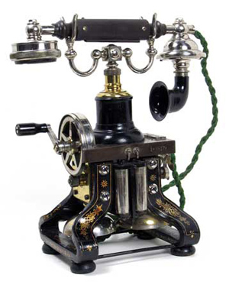
The Internet is transforming everything
The way we do business
  E-commerce, advertising, cloud-computing
The way we have relationships
  Facebook friends, E-mail, IM, virtual worlds
The way we learn
  Wikipedia, MOOCs, search engines
The way we govern and view law
  E-voting, censorship, copyright, cyber-attacks
Took the dissemination of information to the next level

Slide 9
The Internet is big business
Many large and influential networking companies
  Cisco, Broadcom, AT&T, Verizon, Akamai, Huawei, …
  $132B+ industry (carrier and enterprise alone)
Networking central to most technology companies
  Google, Facebook, Intel, HP, Dell, VMware, …

Slide 10
Internet research has impact
The Internet started as a research experiment!
5 of 10 most cited authors work in networking
Many successful companies have emerged from networking research(ers)

Slide 11
But why is the Internet interesting?
“What’s your formal model for the Internet?” -- theorists
“Aren’t you just writing software for networks” – hackers
“You don’t have performance benchmarks???” – hardware folks
“Isn’t it just another network?” – old timers at AT&T
“What’s with all these TLA protocols?” – all
“But the Internet seems to be working…” – my mother

Slide 12
A few defining characteristics of the Internet

Slide 13
A federated system
The Internet ties together different networks
  >18,000 ISP networks
Internet
user
ISP A
ISP B
ISP C
user
Tied together by IP -- the “Internet Protocol” : a single common interface between users and the network and between networks
Notes:
one big cloud is actually…
snip here or there..

Slide 14
A federated system
The Internet ties together different networks
  >18,000 ISP networks
A single, common interface is great for interoperability…
…but tricky for business
Why does this matter?
  ease of interoperability is the Internet’s most important goal
  practical realities of incentives, economics and real-world trust
  drive topology, route selection and service evolution

Slide 15
Tremendous scale
3.42 Billion users (46% of world population)
1.3+ Trillion unique URLs from 1.1 Trillion web servers
219 Billion emails sent per day
2+ Billion smartphones
1.79 Billion Facebook users
34 Billion WhatsApp messages per day
11.6 Billion YouTube videos watched per day
800 hours of Youtube video added per minute
Switches that move 300+ Terabits/second
Network links that carry 1.5 Terabits/second
“Internet Scale” refers to such systems

Slide 16
Enormous diversity and dynamic range
Communication latency: microseconds to seconds (10⁶)
Bandwidth: 1Kbits/second to 100 Gigabits/second (10⁷)
Packet loss: 0 – 90%
Technology: optical, wireless, satellite, copper
Endpoint devices: from sensors and cell phones to datacenters and supercomputers
Applications: social networking, file transfer, skype,
live TV, gaming, remote medicine, backup, IM
Users: the governing, governed, operators, malicious,
naïve, savvy, embarrassed, paranoid, addicted, cheap …

Slide 17
Constant Evolution
1970s:
56kilobits/second “backbone” links
<100 computers, a handful of sites in the US (and one UK)
Telnet and file transfer are the “killer” applications
Today
100+Gigabits/second backbone links
10B+ devices, all over the globe
20M Facebook apps installed per day

Slide 18
Asynchronous Operation
Fundamental constraint: speed of light
Consider:
  How many cycles does your 3GHz CPU in Cambridge execute before it can possibly get a response from a message it sends to a server in Palo Alto?
    Cambridge to Palo Alto: 8,609 km
    Traveling at 300,000 km/s: 28.70 milliseconds
    Then back to Cambridge: 2 x 28.70 = 57.39 milliseconds
    3,000,000,000 cycles/sec * 0.05739 = 172,179,999 cycles!
Thus, communication feedback is always dated

Slide 19
Prone to Failure
To send a message, all components along a path must function correctly
  software, modem, wireless access point, firewall, links, network interface cards, switches,…
  Including human operators
Consider: 50 components, that work correctly 99% of time → 39.5% chance communication will fail
Plus, recall
  scale → lots of components
  asynchrony → takes a long time to hear (bad) news
  federation (internet) → hard to identify fault or assign blame

Slide 20
An Engineered System
Constrained by what technology is practical
  Link bandwidths
  Switch port counts
  Bit error rates
  Cost
  …

Slide 21
Recap: The Internet is…
A complex federation
Of enormous scale
Dynamic range
Diversity
Constantly evolving
Asynchronous in operation
Failure prone
Constrained by what’s practical to engineer
Too complex for theoretical models
“Working code” doesn’t mean much
Performance benchmarks are too narrow

Slide 22





Performance – not just bits per second
Second order effects
Image/Audio quality
Other metrics…
Network efficiency (good-put versus throughput)
User Experience? (World Wide Wait)
Network connectivity expectations
Others?

Slide 23
Channels Concept
(This channel definition is very abstract)
Peer entities communicate over channels
Peer entities provide higher-layer peers with higher-layer channels
A channel is that into which an entity puts symbols and which causes those symbols (or a reasonable approximation) to appear somewhere else at a later point in time.

Slide 24
Channel Characteristics
Symbol type: bits, packets, waveform
Capacity: bandwidth, data-rate, packet-rate
Delay: fixed or variable
Fidelity: signal-to-noise, bit error rate, packet error rate
Cost: per attachment, for use
Reliability
Security: privacy, unforgability
Order preserving: always, almost, usually
Connectivity: point-to-point, to-many, many-to-many
Examples:
Fibre Cable
1 Gb/s channel in a network
Sequence of packets transmitted between hosts
A telephone call (handset to handset)
The audio channel in a room
Conversation between two people

Slide 25
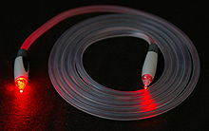
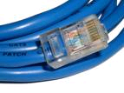
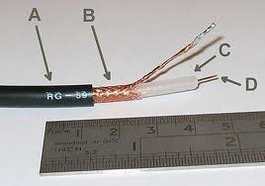


Example Physical Channels these example physical channels are also known as Physical Media
Twisted Pair (TP)
two insulated copper wires
  Category 3: traditional phone wires, 10 Mbps Ethernet
  Category 6:
  1Gbps Ethernet
Shielded (STP)
Unshielded (UTP)
Coaxial cable:
two concentric copper conductors
bidirectional
baseband:
  single channel on cable
  legacy Ethernet
broadband:
  multiple channels on cable
  HFC (Hybrid Fiber Coax)
Fiber optic cable:
high-speed operation
point-to-point transmission
(10’s-100’s Gps)
low error rate
immune to electromagnetic noise

Slide 26
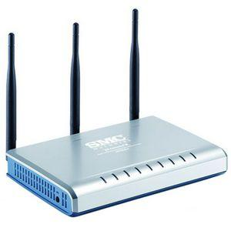
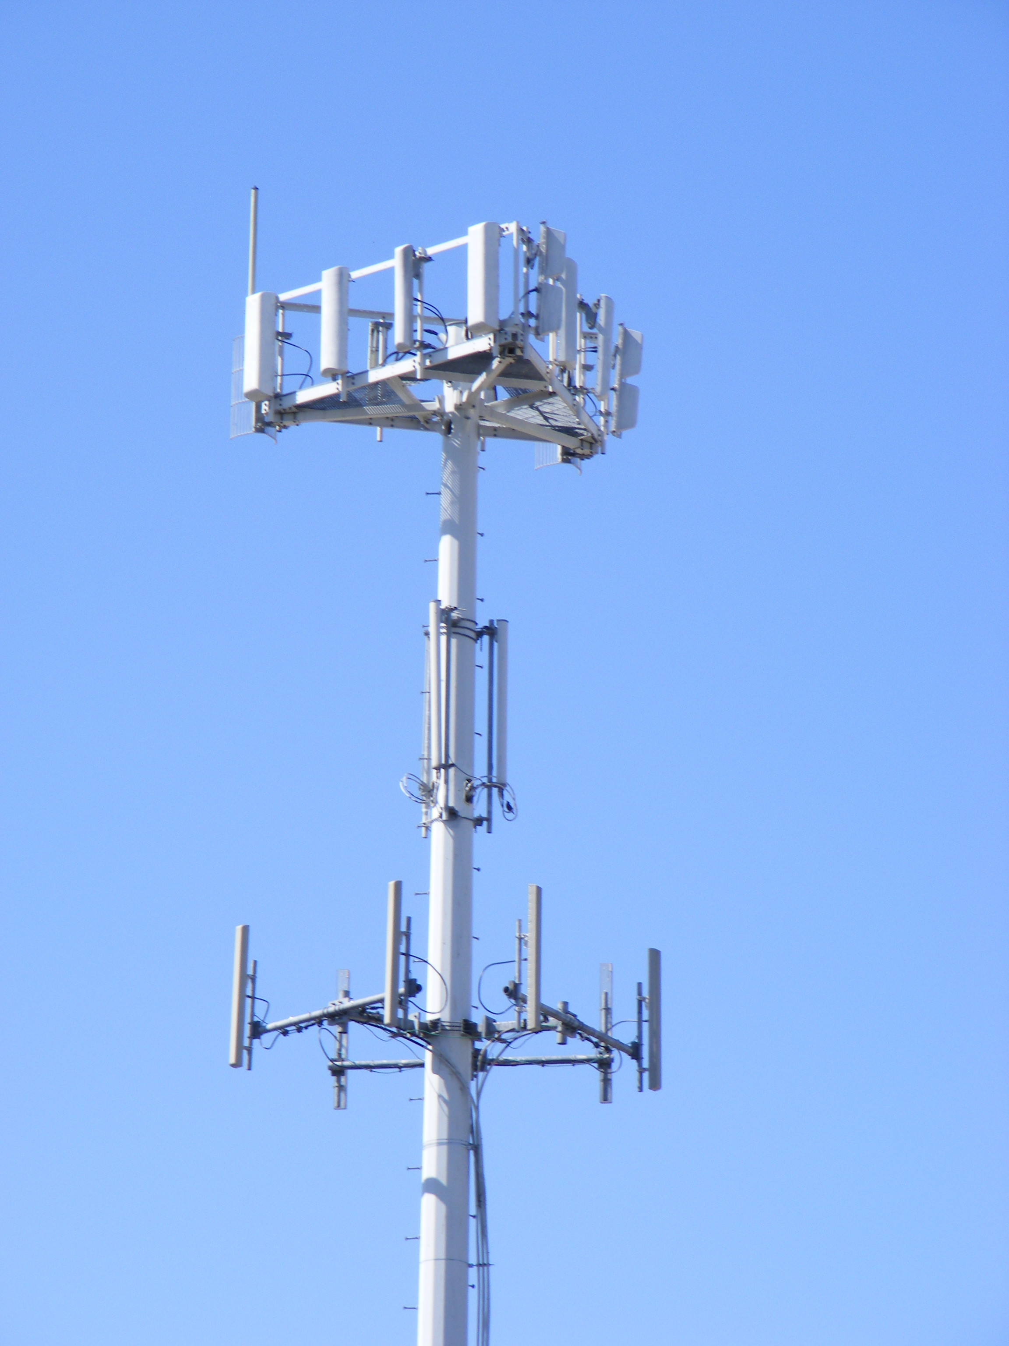
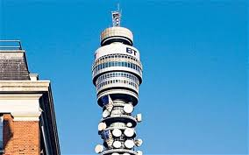
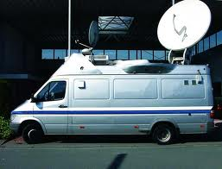
More Physical media: Radio
Bidirectional and multiple access
propagation environment effects:
  reflection
  obstruction by objects
  interference
Radio link types:
terrestrial microwave
  e.g. 45 Mbps channels
LAN (e.g., Wifi)
  11Mbps, 54 Mbps, 200 Mbps
wide-area (e.g., cellular)
  4G cellular: ~ 4 Mbps
satellite
  Kbps to 45Mbps channel (or multiple smaller channels)
  270 msec end-end delay
  geosynchronous versus low altitude
Notes:
Think of the CHANNEL between entities.

Slide 27

Nodes and Links
A
B
Channels = Links
Peer entities = Nodes

Slide 28
Properties of Links (Channels)
bandwidth
delay x bandwidth
Latency
Bandwidth (capacity): “width” of the links
  number of bits sent (or received) per unit time (bits/sec or bps)
Latency (delay): “length” of the link
  propagation time for data to travel along the link(seconds)
Bandwidth-Delay Product (BDP): “volume” of the link
  amount of data that can be “in flight” at any time
  propagation delay × bits/time = total bits in link

Slide 29
Examples of Bandwidth-Delay
Same city over a slow link:
  BW~10Mbps
  Latency~0.1msec
  BDP ~ 10⁶bits ~ 125KBytes
Cross-country over fast link:
  BW~10Gbps
  Latency~10msec
  BDP ~ 10⁸bits ~ 12.5MBytes

Slide 30
Packet Delay
Sending a 100B packet from A to B?
A
B
1Mbps, 1ms
100Byte packet
time=0
Time to transmit
one bit = 1/10⁶s
Time when that
bit reaches B
= 1/10⁶+1/10³s
Time to transmit
800 bits=800x1/10⁶s
The last bit
reaches B at
(800x1/10⁶)+1/10³s
= 1.8ms
Packet Delay = Transmission Delay + Propagation Delay
Packet Delay =
(Packet Size ÷ Link Bandwidth) + Link Latency
Time

Slide 31
Packet Delay
Sending a 100B packet from A to B?
1GB file in 100B packets
1Gbps, 1ms?
A
B
1Mbps, 1ms
100Byte packet
10⁷ x 100B packets
The last bit in the file
reaches B at
(10⁷x800x1/10⁹)+1/10³s
= 8001ms
The last bit
reaches B at
(800x1/10⁹)+1/10³s
= 1.0008ms
The last bit
reaches B at
(800x1/10⁶)+1/10³s
= 1.8ms
Time
Notes:
14/nov/16

Slide 32
Packet Delay: The “pipe” view
Sending 100B packets from A to B?
A
B
100Byte packet
1Mbps, 10ms
Packet Transmission
Time
100Byte packet
100Byte packet
BW →
time →
Time

Slide 33
Packet Delay: The “pipe” view
Sending 100B packets from A to B?
1Mbps, 10ms (BDP=10,000)
BW →
time →
1Mbps, 5ms (BDP=5,000)
10Mbps, 1ms (BDP=10,000)
BW →
BW →
time →
time →

Slide 34
Packet Delay: The “pipe” view
Sending 100B packets from A to B?
1Mbps, 10ms (BDP=10,000)
BW →
time →
What if we used 200Byte packets??
1Mbps, 10ms (BDP=10,000)
BW →
time →

Slide 35
Recall Nodes and Links
A
B

Slide 36
What if we have more nodes?
One link for every node?
Need a scalable way to interconnect nodes

Slide 37
Solution: A switched network
Nodes share network link resources
How is this sharing implemented?
Notes:
multiple conversations in parallel
resources are shared

Slide 38
Two forms of switched networks
Circuit switching (used in the POTS: Plain Old Telephone system)
Packet switching (used in the Internet)
Notes:
borrow mckeown’s slides (of network with image); add Berkeley and MIT.
box -- links (incoming and outgoing)
packet -- data + header.
header has an address.

Slide 39
Circuit switching
Idea: source reserves network capacity along a path
10Mb/s?
B
A
10Mb/s?
10Mb/s?
(1) Node A sends a reservation request
(2) Interior switches establish a connection -- i.e., “circuit”
(3) A starts sending data
(4) A sends a “teardown circuit” message
Notes:
multiple conversations in parallel
resources are shared

Slide 40
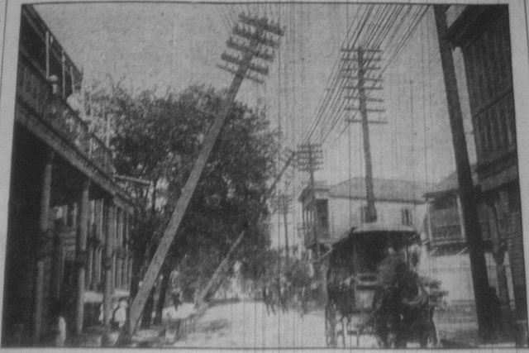
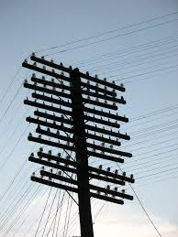
Old Time Multiplexing

Slide 41
Circuit Switching: FDM and TDM
Example:
Frequency Division Multiplexing
4 users
Radio2 88.9 MHz
Radio3 91.1 MHz
Radio4 93.3 MHz
RadioX 95.5 MHz
frequency
time
Time Division Multiplexing
Radio Schedule
…,News, Sports, Weather, Local, News, Sports,…
frequency
time
Notes:
Can use more than one!
16-nov-2015

Slide 42
Time-Division Multiplexing/Demultiplexing
Frames
Slots =
0
1
2
3
4
5
0
1
2
3
4
5
Time divided into frames; frames into slots
Relative slot position inside a frame determines to which conversation data belongs
  e.g., slot 0 belongs to orange conversation
Slots are reserved (released) during circuit setup (teardown)
If a conversation does not use its circuit capacity is lost!

Slide 43
Timing in Circuit Switching
Information
Circuit
Establishment
Transfer
time
Circuit
Tear-down
Notes:
Why the delays in the first pass of the establishment, but not in subsequent passes (or in teardown)?

Slide 44
Circuit switching: pros and cons
Pros
  guaranteed performance
  fast transfer (once circuit is established)
Cons

Slide 45
Timing in Circuit Switching
Information
Circuit
Establishment
Transfer
time
Circuit
Tear-down
Notes:
Why the delays in the first pass of the establishment, but not in subsequent passes (or in teardown)?

Slide 46
Circuit switching: pros and cons
Pros
  guaranteed performance
  fast transfer (once circuit is established)
Cons
  wastes bandwidth if traffic is “bursty”

Slide 47
Timing in Circuit Switching
Information
Circuit
Establishment
Transfer
time
Circuit
Tear-down
Notes:
Why the delays in the first pass of the establishment, but not in subsequent passes (or in teardown)?

Slide 48
Timing in Circuit Switching
Information
Circuit
Establishment
Transfer
Circuit
Tear-down
time
Notes:
Why the delays in the first pass of the establishment, but not in subsequent passes (or in teardown)?

Slide 49
Circuit switching: pros and cons
Pros
  guaranteed performance
  fast transfers (once circuit is established)
Cons
  wastes bandwidth if traffic is “bursty”
  connection setup time is overhead

Slide 50
Circuit switching
A
B
Circuit switching doesn’t “route around failure”
Notes:
multiple conversations in parallel
resources are shared

Slide 51
Circuit switching: pros and cons
Pros
  guaranteed performance
  fast transfers (once circuit is established)
Cons
  wastes bandwidth if traffic is “bursty”
  connection setup time is overhead
  recovery from failure is slow
Notes:
got here 18 Nov 2014

Slide 52
Numerical example
How long does it take to send a file of 640,000 bits from host A to host B over a circuit-switched network?
  All links are 1.536 Mbps
  Each link uses TDM with 24 slots/sec
  500 msec to establish end-to-end circuit
Let’s work it out!
1 / 24 * 1.536Mb/s = 64kb/s
640,000 / 64kb/s = 10s
10s + 500ms = 10.5s
Notes:
640,000b * (1/24) * 1/536Mbps + 500ms
640,000b @ 64kbps = 10s
PLUS 500ms setup

Slide 53
Two forms of switched networks
Circuit switching (e.g., telephone network)
Packet switching (e.g., Internet)
Notes:
borrow mckeown’s slides (of network with image); add Berkeley and MIT.
box -- links (incoming and outgoing)
packet -- data + header.
header has an address.

Slide 54
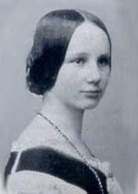

Packet Switching
Data is sent as chunks of formatted bits (Packets)
Packets consist of a “header” and “payload”*
Internet Address
Age (TTL)
Checksum to protect header
Data
Header
payload
header
01000111100010101001110100011001

Slide 55
Packet Switching
Data is sent as chunks of formatted bits (Packets)
Packets consist of a “header” and “payload”*
  payload is the data being carried
  header holds instructions to the network for how to
  handle packet (think of the header as an API)

Slide 56
Packet Switching
Data is sent as chunks of formatted bits (Packets)
Packets consist of a “header” and “payload”
Switches “forward” packets based on their headers

Slide 57

Switches forward packets
GLASGOW
EDINBURGH
switch#4
switch#2
Forwarding Table
111010010
EDIN
Destination | Next Hop
GLASGOW | 4
OXFORD | 5
EDIN | 2
UCL | 3
switch#5
OXFORD
UCL
switch#3

Slide 58
Timing in Packet Switching
payload
hdr
time
What about the time to process the packet at the switch?
We’ll assume it’s relatively negligible (mostly true)

Slide 59
Timing in Packet Switching
payload
hdr
Could the switch start transmitting as
soon as it has processed the header?
time
Yes! This would be called
a “cut through” switch

Slide 60
Timing in Packet Switching
payload
hdr
We will always assume a switch processes/forwards
a packet after it has received it entirely.
This is called “store and forward” switching
time

Slide 61
Packet Switching
Data is sent as chunks of formatted bits (Packets)
Packets consist of a “header” and “payload”
Switches “forward” packets based on their headers

Slide 62
Packet Switching
Data is sent as chunks of formatted bits (Packets)
Packets consist of a “header” and “payload”
Switches “forward” packets based on their headers
Each packet travels independently
  no notion of packets belonging to a “circuit”

Slide 63
Packet Switching
Data is sent as chunks of formatted bits (Packets)
Packets consist of a “header” and “payload”
Switches “forward” packets based on their headers
Each packet travels independently
No link resources are reserved in advance. Instead packet switching leverages statistical multiplexing (stat muxing)

Slide 64
Multiplexing
Sharing makes things efficient (cost less)
One airplane/train for 100’s of people
One telephone for many calls
One lecture theatre for many classes
One computer for many tasks
One network for many computers
One datacenter many applications

Slide 65

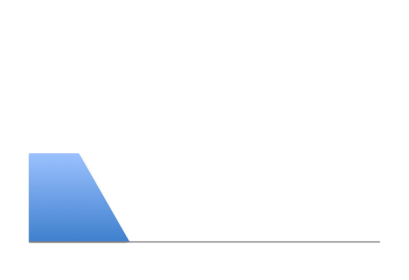
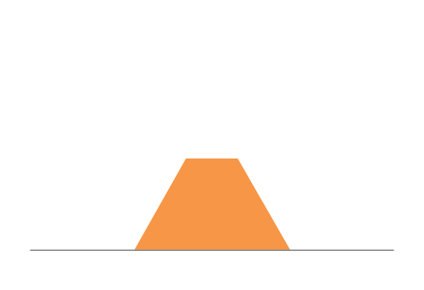
Three Flows with Bursty Traffic
Data Rate 1
Time
Data Rate 2
Capacity
Time
Data Rate 3
Time

Slide 66
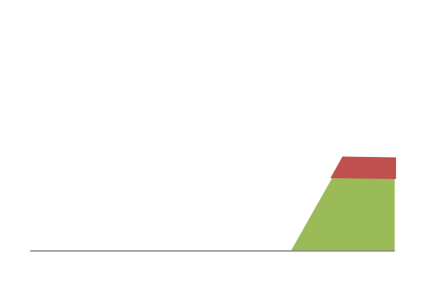
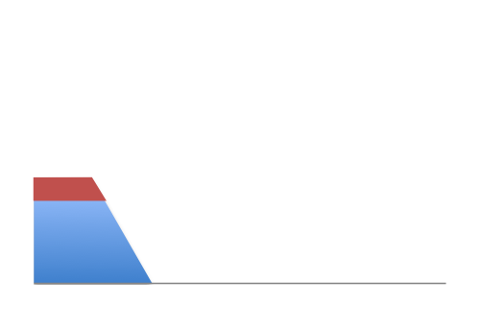
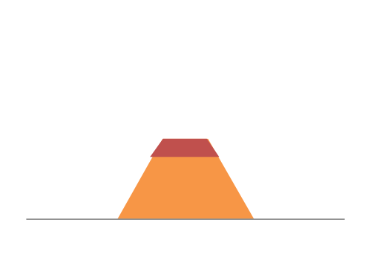
When Each Flow Gets 1/3rd of Capacity
Frequent Overloading
Data Rate 1
Time
Data Rate 2
Time
Data Rate 3
Time

Slide 67
When Flows Share Total Capacity
Time
No Overloading
Time
Statistical multiplexing relies on the assumption
that not all flows burst at the same time.
Very similar to insurance, and has same failure case
Time

Slide 68
Three Flows with Bursty Traffic
Data Rate 1
Time
Data Rate 2
Capacity
Time
Data Rate 3
Time

Slide 69

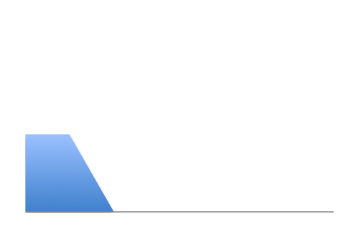
Three Flows with Bursty Traffic
Data Rate 1
Time
Data Rate 2
Capacity
Time
Data Rate 3
Time

Slide 70


Three Flows with Bursty Traffic
Data Rate 1+2+3 >> Capacity
Time
Capacity
Time
What do we do under overload?

Slide 71

Statistical multiplexing: pipe view
pkt tx
time
BW →
time →

Slide 72
Statistical multiplexing: pipe view

Slide 73
Statistical multiplexing: pipe view
No Overload

Slide 74
Statistical multiplexing: pipe view
Queue overload
into Buffer
Transient Overload
Not such a rare event

Slide 75
Statistical multiplexing: pipe view
Queue overload
into Buffer
Transient Overload
Not such a rare event

Slide 76
Statistical multiplexing: pipe view
Queue overload
into Buffer
Transient Overload
Not such a rare event

Slide 77
Statistical multiplexing: pipe view
Queue overload
into Buffer
Transient Overload
Not such a rare event

Slide 78
Statistical multiplexing: pipe view
Queue overload
into Buffer
Transient Overload
Not such a rare event

Slide 79
Statistical multiplexing: pipe view
Queue overload
into Buffer
Transient Overload
Buffer absorbs transient bursts
Not a rare event!

Slide 80
Statistical multiplexing: pipe view
Queue overload
into Buffer
What about persistent overload?
Will eventually drop packets

Slide 81
Queues introduce queuing delays
Recall,
packet delay = transmission delay + propagation delay (*)
With queues (statistical multiplexing)
  packet delay = transmission delay + propagation delay + queuing delay (*)
Queuing delay caused by “packet interference”
Made worse at high load
  less “idle time” to absorb bursts
  think about traffic jams at rush hour
  or rail network failure
  (* plus per-hop processing delay that we define as negligible)

Slide 82
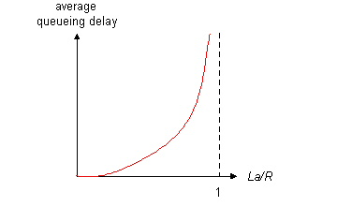
Queuing delay
R=link bandwidth (bps)
L=packet length (bits)
a=average packet arrival rate
traffic intensity = La/R
La/R ~ 0: average queuing delay small
La/R -> 1: delays become large
La/R > 1: more “work” arriving than can be serviced, average delay infinite – or data is lost (dropped).
Notes:
2016-11-16

Slide 83
Recall the Internet federation
The Internet ties together different networks
  >18,000 ISP networks
user
ISP A
ISP B
ISP C
user
We can see (hints) of the nodes and links using traceroute…
Notes:
one big cloud is actually…
snip here or there..

Slide 84
“Real” Internet delays and routes
traceroute: rio.cl.cam.ac.uk to munnari.oz.au
(tracepath on pwf is similar)
Three delay measurements from
rio.cl.cam.ac.uk to gatwick.net.cl.cam.ac.uk
traceroute munnari.oz.au
traceroute to munnari.oz.au (202.29.151.3), 30 hops max, 60 byte packets
1 gatwick.net.cl.cam.ac.uk (128.232.32.2) 0.416 ms 0.384 ms 0.427 ms
2 cl-sby.route-nwest.net.cam.ac.uk (193.60.89.9) 0.393 ms 0.440 ms 0.494 ms
3 route-nwest.route-mill.net.cam.ac.uk (192.84.5.137) 0.407 ms 0.448 ms 0.501 ms
4 route-mill.route-enet.net.cam.ac.uk (192.84.5.94) 1.006 ms 1.091 ms 1.163 ms
5 xe-11-3-0.camb-rbr1.eastern.ja.net (146.97.130.1) 0.300 ms 0.313 ms 0.350 ms
6 ae24.lowdss-sbr1.ja.net (146.97.37.185) 2.679 ms 2.664 ms 2.712 ms
7 ae28.londhx-sbr1.ja.net (146.97.33.17) 5.955 ms 5.953 ms 5.901 ms
8 janet.mx1.lon.uk.geant.net (62.40.124.197) 6.059 ms 6.066 ms 6.052 ms
9 ae0.mx1.par.fr.geant.net (62.40.98.77) 11.742 ms 11.779 ms 11.724 ms
10 ae1.mx1.mad.es.geant.net (62.40.98.64) 27.751 ms 27.734 ms 27.704 ms
11 mb-so-02-v4.bb.tein3.net (202.179.249.117) 138.296 ms 138.314 ms 138.282 ms
12 sg-so-04-v4.bb.tein3.net (202.179.249.53) 196.303 ms 196.293 ms 196.264 ms
13 th-pr-v4.bb.tein3.net (202.179.249.66) 225.153 ms 225.178 ms 225.196 ms
14 pyt-thairen-to-02-bdr-pyt.uni.net.th (202.29.12.10) 225.163 ms 223.343 ms 223.363 ms
15 202.28.227.126 (202.28.227.126) 241.038 ms 240.941 ms 240.834 ms
16 202.28.221.46 (202.28.221.46) 287.252 ms 287.306 ms 287.282 ms
17 * * *
18 * * *
19 * * *
20 coe-gw.psu.ac.th (202.29.149.70) 241.681 ms 241.715 ms 241.680 ms
21 munnari.OZ.AU (202.29.151.3) 241.610 ms 241.636 ms 241.537 ms
trans-continent
link
* means no response (probe lost, router not replying)
Notes:
Where did the delay come from??
2015-11-18

Slide 85
Internet structure: network of networks
a packet passes through many networks!
local
ISP
Tier 3
ISP
local
ISP
local
ISP
local
ISP
Tier-2 ISP
Tier-2 ISP
Tier 1 ISP
Tier 1 ISP
Tier 1 ISP
Tier-2 ISP
Tier-2 ISP
Tier-2 ISP
local
ISP
local
ISP
local
ISP
local
ISP

Slide 86
Internet structure: network of networks
“Tier-3” ISPs and local ISPs
  last hop (“access”) network (closest to end systems)
local
ISP
Tier 3
ISP
local
ISP
local
ISP
local
ISP
Local and tier- 3 ISPs are customers of
higher tier ISPs
connecting them to rest of Internet
Tier-2 ISP
Tier-2 ISP
Tier 1 ISP
Tier 1 ISP
Tier 1 ISP
Tier-2 ISP
Tier-2 ISP
Tier-2 ISP
local
ISP
local
ISP
local
ISP
local
ISP

Slide 87
Internet structure: network of networks
“Tier-2” ISPs: smaller (often regional) ISPs
  Connect to one or more tier-1 ISPs, possibly other tier-2 ISPs
Tier-2 ISPs also peer privately with each other.
Tier-2 ISP pays tier-1 ISP for connectivity to rest of Internet
tier-2 ISP is customer of
tier-1 provider
Tier-2 ISP
Tier-2 ISP
Tier 1 ISP
Tier 1 ISP
Tier 1 ISP
Tier-2 ISP
Tier-2 ISP
Tier-2 ISP

Slide 88
Internet structure: network of networks
roughly hierarchical
at center: “tier-1” ISPs (e.g., Verizon, Sprint, AT&T, Cable and Wireless), national/international coverage
  treat each other as equals
Tier-1 providers interconnect (peer) privately
Tier 1 ISP
Tier 1 ISP
Tier 1 ISP

Slide 89
Tier-1 ISP: e.g., Sprint
POP: point-of-presence
to/from backbone
…
peering
….
…
…
…
to/from customers
Notes:
Switched Private Network Telecommunications
South Pacific Railway
-=-=-
End of lecture 23rd Jan 2012

Slide 90
Packet Switching
Data is sent as chunks of formatted bits (Packets)
Packets consist of a “header” and “payload”
Switches “forward” packets based on their headers
Each packet travels independently
No link resources are reserved in advance. Instead packet switching leverages statistical multiplexing
  allows efficient use of resources
  but introduces queues and queuing delays
Notes:
21 Nov 2014

Slide 91
Packet switching versus circuit switching
Packet switching may (does!) allow more users to use network
1 Mb/s link
each user:
  100 kb/s when “active”
  active 10% of time
circuit-switching:
  10 users
packet switching:
  with 35 users, probability > 10 active at same time is less than .0004
N users
1 Mbps link
Q: how did we get value 0.0004?

Slide 92
Packet switching versus circuit switching
Q: how did we get value 0.0004?
1 Mb/s link
each user:
  100 kb/s when “active”
  active 10% of time
circuit-switching:
  10 users
packet switching:
  with 35 users, probability > 10 active at same time is less than .0004

Slide 93
Circuit switching: pros and cons
Pros
  guaranteed performance
  fast transfers (once circuit is established)
Cons
  wastes bandwidth if traffic is “bursty”
  connection setup adds delay
  recovery from failure is slow

Slide 94
Packet switching: pros and cons
Cons
  no guaranteed performance
  header overhead per packet
  queues and queuing delays
Pros
  efficient use of bandwidth (stat. muxing)
  no overhead due to connection setup
  resilient -- can `route around trouble’

Slide 95
Summary
A sense of how the basic `plumbing’ works
  links and switches
  packet delays= transmission + propagation + queuing + (negligible) per-switch processing
  statistical multiplexing and queues
  circuit vs. packet switching

