Slide 1
Computer Networking
Lent Term M/W/F 11-midday
LT1 in Gates Building
Slide Set 7
Andrew W. Moore
andrew.moore@cl.cam.ac.uk
2015-2016

Slide 2
Topic 7: Datacenters

Slide 3
What we will cover
Characteristics of a datacenter environment
goals, constraints, workloads, etc.
How and why DC networks are different (vs. WAN)
e.g., latency, geo, autonomy, …
How traditional solutions fare in this environment
e.g., IP, Ethernet, TCP, ARP, DHCP
Not details of how datacenter networks operate

Slide 4
Disclaimer
Material is emerging (not established) wisdom
Material is incomplete
many details on how and why datacenter networks operate aren’t public

Slide 5
Why Datacenters?
Your <public-life, private-life, banks, government> live in my datacenter.
Security, Privacy, Control, Cost, Energy, (breaking) received wisdom; all this and more come together into sharp focus in datacenters.
Do I need to labor the point?
Notes:
Please identify your research field; why is it strategic and growth area for research in the UK and beyond …?
25-Feb-2015

Slide 6
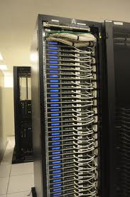
What goes into a datacenter (network)?
Servers organized in racks

Slide 7
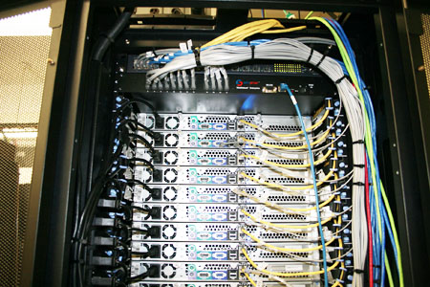
What goes into a datacenter (network)?
Servers organized in racks
Each rack has a `Top of Rack’ (ToR) switch

Slide 8
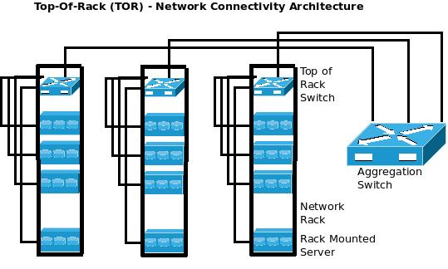
What goes into a datacenter (network)?
Servers organized in racks
Each rack has a `Top of Rack’ (ToR) switch
An `aggregation fabric’ interconnects ToR switches

Slide 9
What goes into a datacenter (network)?
Servers organized in racks
Each rack has a `Top of Rack’ (ToR) switch
An `aggregation fabric’ interconnects ToR switches
Connected to the outside via `core’ switches
note: blurry line between aggregation and core
With network redundancy of ~2x for robustness

Slide 10
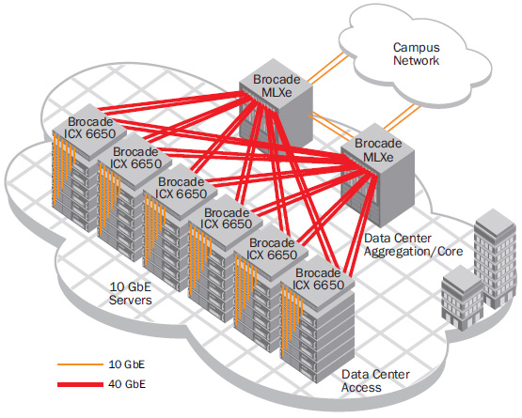
Example 1
Brocade reference design

Slide 11
Example 2
Internet
CR
CR
. . .
AR
AR
AR
AR
S
S
S
S
S
S
. . .
A
A
…
A
A
A
…
A
~ 40-80 servers/rack
Cisco reference design

Slide 12
Observations on DC architecture
Regular, well-defined arrangement
Hierarchical structure with rack/aggr/core layers
Mostly homogenous within a layer
Supports communication between servers and between servers and the external world
Contrast: ad-hoc structure, heterogeneity of WANs

Slide 13
What’s new?

Slide 14
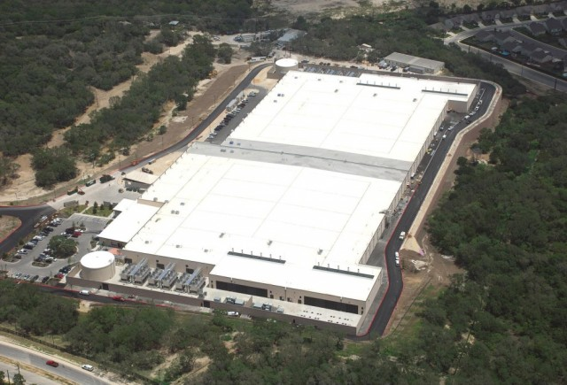
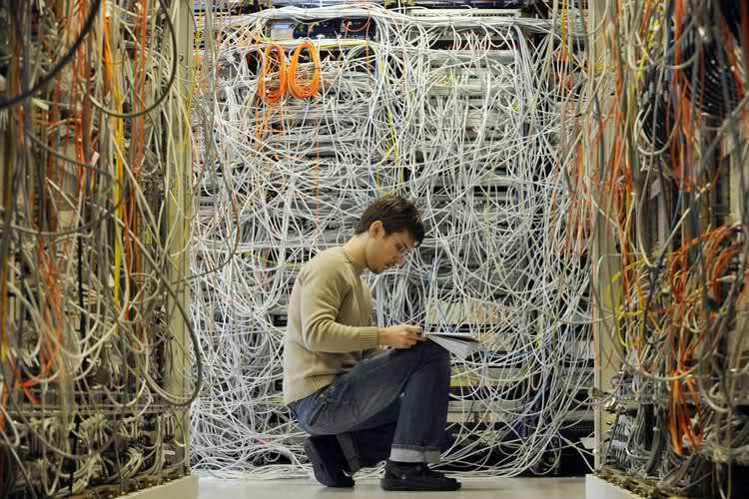
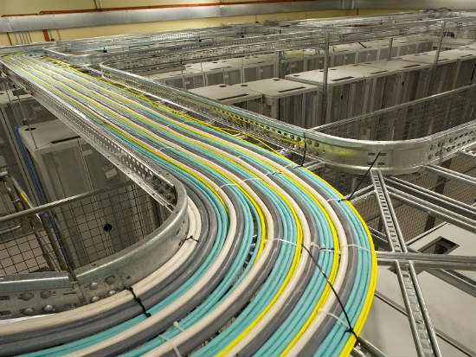
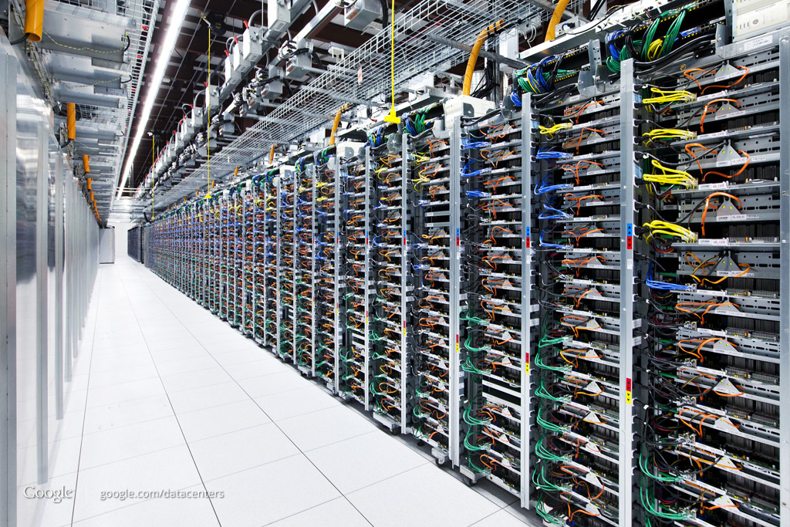
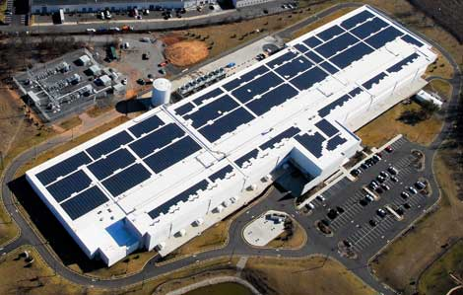
SCALE!

Slide 15
How big exactly?
1M servers [Microsoft]
less than google, more than amazon
> $1B to build one site [Facebook]
>$20M/month/site operational costs [Microsoft ’09]
But only O(10-100) sites

Slide 16
What’s new?
Scale
Service model
user-facing, revenue generating services
multi-tenancy
jargon: SaaS, PaaS, DaaS, IaaS, …

Slide 17
Implications
Scale
need scalable solutions (duh)
improving efficiency, lowering cost is critical
`scale out’ solutions w/ commodity technologies
Service model
performance means $$
virtualization for isolation and portability

Slide 18
Multi-Tier Applications
Applications decomposed into tasks
Many separate components
Running in parallel on different machines

Slide 19
Componentization leads to different types of network traffic
“North-South traffic”
Traffic between external clients and the datacenter
Handled by front-end (web) servers, mid-tier application servers, and back-end databases
Traffic patterns fairly stable, though diurnal variations

Slide 20
North-South Traffic
user requests from the Internet
You Live Here
Router
Front-End
Proxy
Front-End
Proxy
Web Server
Web Server
Web Server
Data
Cache
Data
Cache
Database
Database

Slide 21
Componentization leads to different types of network traffic
“North-South traffic”
Traffic between external clients and the datacenter
Handled by front-end (web) servers, mid-tier application servers, and back-end databases
Traffic patterns fairly stable, though diurnal variations
“East-West traffic”
Traffic between machines in the datacenter
Comm within “big data” computations (e.g. Map Reduce)
Traffic may shift on small timescales (e.g., minutes)

Slide 22
East-West Traffic
Distributed
Storage
Map
Tasks
Reduce
Tasks
Distributed
Storage

Slide 23
East-West Traffic
CR
CR
AR
AR
AR
AR
S
S
S
S
S
S
S
S
. . .
S
S
S
S
A
A
…
A
A
A
…
A
A
A
…
A
A
A
…
A

Slide 24
East-West Traffic
Often doesn’t cross the network
Some fraction (typically 2/3) crosses the network
Distributed
Storage
Map
Tasks
Reduce
Tasks
Distributed
Storage
Always goes over the network

Slide 25
What’s different about DC networks?
Characteristics
Huge scale:
~20,000 switches/routers
contrast: AT&T ~500 routers

Slide 26
What’s different about DC networks?
Characteristics
Huge scale:
Limited geographic scope:
High bandwidth: 10/40/100G
Contrast: Cable/aDSL/WiFi
Very low RTT: 10s of microseconds
Contrast: 100s of milliseconds in the WAN

Slide 27
What’s different about DC networks?
Characteristics
Huge scale
Limited geographic scope
Single administrative domain
Can deviate from standards, invent your own, etc.
“Green field” deployment is still feasible

Slide 28
What’s different about DC networks?
Characteristics
Huge scale
Limited geographic scope
Single administrative domain
Control over one/both endpoints
can change (say) addressing, congestion control, etc.
can add mechanisms for security/policy/etc. at the endpoints (typically in the hypervisor)

Slide 29
What’s different about DC networks?
Characteristics
Huge scale
Limited geographic scope
Single administrative domain
Control over one/both endpoints
Control over the placement of traffic source/sink
e.g., map-reduce scheduler chooses where tasks run
alters traffic pattern (what traffic crosses which links)

Slide 30
What’s different about DC networks?
Characteristics
Huge scale
Limited geographic scope
Single administrative domain
Control over one/both endpoints
Control over the placement of traffic source/sink
Regular/planned topologies (e.g., trees/fat-trees)
Contrast: ad-hoc WAN topologies (dictated by real-world geography and facilities)

Slide 31
What’s different about DC networks?
Characteristics
Huge scale
Limited geographic scope
Single administrative domain
Control over one/both endpoints
Control over the placement of traffic source/sink
Regular/planned topologies (e.g., trees/fat-trees)
Limited heterogeneity
link speeds, technologies, latencies, …

Slide 32
What’s different about DC networks?
Goals
Extreme bisection bandwidth requirements
recall: all that east-west traffic
target: any server can communicate at its full link speed
problem: server’s access link is 10Gbps!

Slide 33
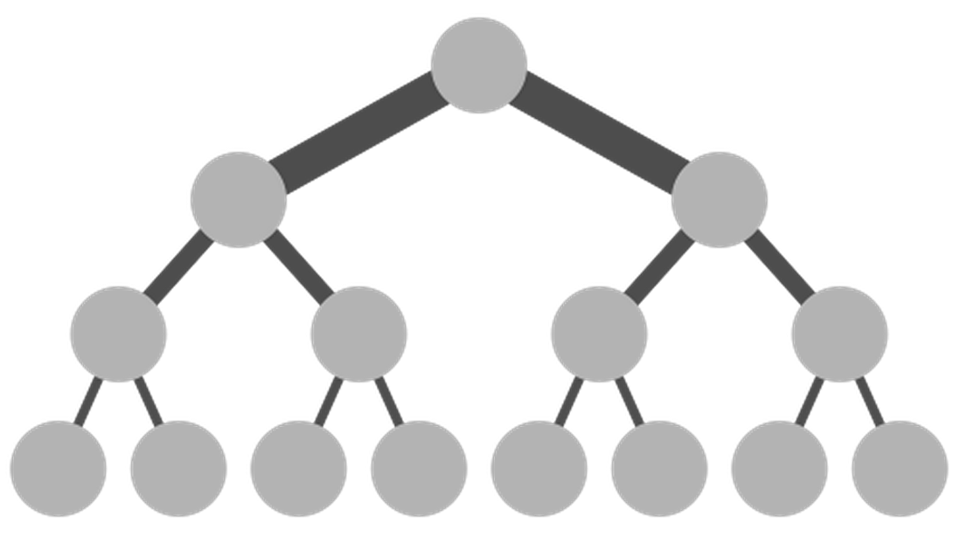
Full Bisection Bandwidth
O(40x10x100)Gbps
Internet
CR
CR
O(40x10)Gbps
. . .
AR
AR
AR
AR
10Gbps
S
S
S
S
S
S
. . .
Traditional tree topologies “scale up”
full bisection bandwidth is expensive
typically, tree topologies “oversubscribed”
A
A
…
A
A
A
…
A
~ 40-80 servers/rack

Slide 34
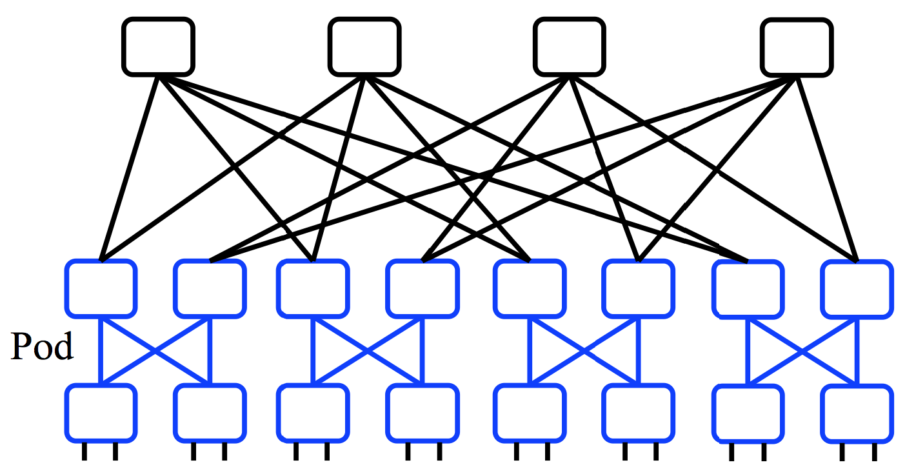
A “Scale Out” Design
Build multi-stage `Fat Trees’ out of k-port switches
k/2 ports up, k/2 down
Supports k³/4 hosts:
48 ports, 27,648 hosts
All links are the same speed (e.g. 10Gps)

Slide 35
Full Bisection Bandwidth Not Sufficient
To realize full bisectional throughput, routing must spread traffic across paths
Enter load-balanced routing
How? (1) Let the network split traffic/flows at random (e.g., ECMP protocol -- RFC 2991/2992)
How? (2) Centralized flow scheduling?
Many more research proposals

Slide 36
What’s different about DC networks?
Goals
Extreme bisection bandwidth requirements
Extreme latency requirements
real money on the line
current target: 1μs RTTs
how? cut-through switches making a comeback
reduces switching time

Slide 37
What’s different about DC networks?
Goals
Extreme bisection bandwidth requirements
Extreme latency requirements
real money on the line
current target: 1μs RTTs
how? cut-through switches making a comeback
how? avoid congestion
reduces queuing delay

Slide 38
What’s different about DC networks?
Goals
Extreme bisection bandwidth requirements
Extreme latency requirements
real money on the line
current target: 1μs RTTs
how? cut-through switches making a comeback (lec. 2!)
how? avoid congestion
how? fix TCP timers (e.g., default timeout is 500ms!)
how? fix/replace TCP to more rapidly fill the pipe

Slide 39
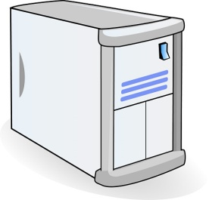
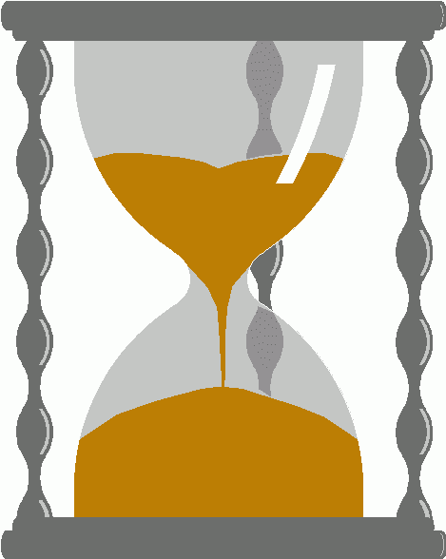
An example problem at scale - INCAST
Worker 1
Synchronized mice collide.
Caused by Partition/Aggregate.
Aggregator
Worker 2
Worker 3
RTO_{min} = 300 ms
Worker 4
TCP timeout

Slide 40
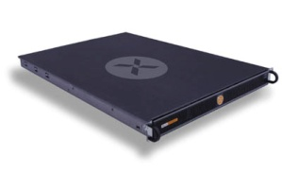
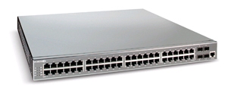
The Incast Workload
Data Block
Synchronized Read
1
R
R
R
R
2
3
Client
Switch
1
2
3
4
Server
Request Unit
(SRU)
4
Client now sends
next batch of requests
Storage Servers
40

Slide 41
Incast Workload Overfills Buffers
Synchronized Read
1
R
R
R
R
2
4
3
Client
Switch
1
2
3
4
Server
Request Unit
(SRU)
4
4
Requests
Received
Responses 1-3 completed
Link Idle!
Requests Sent
Response 4
dropped
Response 4
Resent
41

Slide 42
Queue Buildup
Sender 1
Big flows buildup queues.
Increased latency for short flows.
Receiver
Sender 2
Measurements in Bing cluster
For 90% packets: RTT < 1ms
For 10% packets: 1ms < RTT < 15ms

Slide 43
Link-Layer Flow Control Common between switches but this is flow-control to the end host too…
Another idea to reduce incast is to employ Link-Layer Flow Control…..
Recall: the Data-Link can use specially coded symbols in the coding to say “Stop” and “Start”

Slide 44
Link Layer Flow Control – The Dark side Head of Line Blocking….
Such HOL blocking does not even differentiate processes so this can occur between competing processes on a pair of machines – no datacenter required.
Waiting for no good reason….

Slide 45
Link Layer Flow Control But its worse that you imagine….
Double down on trouble….
Did I mention this is Link-Layer!
That means no (IP) control traffic, no routing messages….
a whole system waiting for one machine
Incast is very unpleasant.
…
Reducing the impact of HOL in Link Layer Flow Control can be done through priority queues and overtaking….

Slide 46
What’s different about DC networks?
Goals
Extreme bisection bandwidth requirements
Extreme latency requirements
Predictable, deterministic performance
“your packet will reach in Xms, or not at all”
“your VM will always see at least YGbps throughput”
Resurrecting `best effort’ vs. `Quality of Service’ debates
How is still an open question

Slide 47
What’s different about DC networks?
Goals
Extreme bisection bandwidth requirements
Extreme latency requirements
Predictable, deterministic performance
Differentiating between tenants is key
e.g., “No traffic between VMs of tenant A and tenant B”
“Tenant X cannot consume more than XGbps”
“Tenant Y’s traffic is low priority”

Slide 48
What’s different about DC networks?
Goals
Extreme bisection bandwidth requirements
Extreme latency requirements
Predictable, deterministic performance
Differentiating between tenants is key
Scalability (of course)
Q: How’s that Ethernet spanning tree looking?

Slide 49
What’s different about DC networks?
Goals
Extreme bisection bandwidth requirements
Extreme latency requirements
Predictable, deterministic performance
Differentiating between tenants is key
Scalability (of course)
Cost/efficiency
focus on commodity solutions, ease of management
some debate over the importance in the network case

Slide 50
Summary
new characteristics and goals
some liberating, some constraining
scalability is the baseline requirement
more emphasis on performance
less emphasis on heterogeneity
less emphasis on interoperability
Notes:
-- incast?
-- one big switch abstraction…

Slide 52
Computer Networking UROP
Assessed Practicals for Computer Networking.
so supervisors can set/use work
so we can have a Computer Networking tick
running over summer 2016
Talk to me.
Part 2 projects for 16-17
Fancy doing something at scale or speed?
Talk to me.

