Slide 1
Computer Networking
Lent Term M/W/F 11-midday
LT1 in Gates Building
Slide Set 7
Andrew W. Moore
andrew.moore@cl.cam.ac.uk
February 2014

Slide 2
Datacenters
(Optional fun)

Slide 3
What we will cover
(Datacenter Topic 7 is not examinable in 2013-14)
Characteristics of a datacenter environment
  goals, constraints, workloads, etc.
How and why DC networks are different (vs. WAN)
  e.g., latency, geo, autonomy, …
How traditional solutions fare in this environment
  e.g., IP, Ethernet, TCP, ARP, DHCP
Not details of how datacenter networks operate

Slide 4
Disclaimer
Material is emerging (not established) wisdom
Material is incomplete
  many details on how and why datacenter networks
  operate aren’t public

Slide 5
Why Datacenters?
Your <public-life, private-life, banks, government> live in my datacenter.
Security, Privacy, Control, Cost, Energy, (breaking) received wisdom; all this and more come together into sharp focus in datacenters.
Do I need to labor the point?
Notes:
Please identify your research field; why is it strategic and growth area for research in the UK and beyond …?

Slide 6
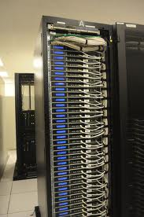
What goes into a datacenter (network)?
Servers organized in racks

Slide 7
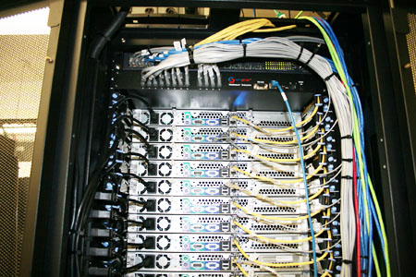
What goes into a datacenter (network)?
Servers organized in racks
Each rack has a `Top of Rack’ (ToR) switch

Slide 8
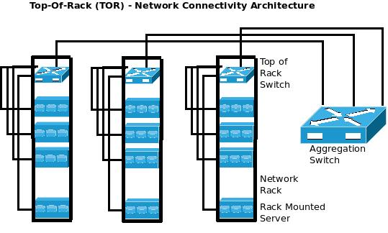
What goes into a datacenter (network)?
Servers organized in racks
Each rack has a `Top of Rack’ (ToR) switch
An `aggregation fabric’ interconnects ToR switches

Slide 9
What goes into a datacenter (network)?
Servers organized in racks
Each rack has a `Top of Rack’ (ToR) switch
An `aggregation fabric’ interconnects ToR switches
Connected to the outside via `core’ switches
  note: blurry line between aggregation and core
With network redundancy of ~2x for robustness

Slide 10
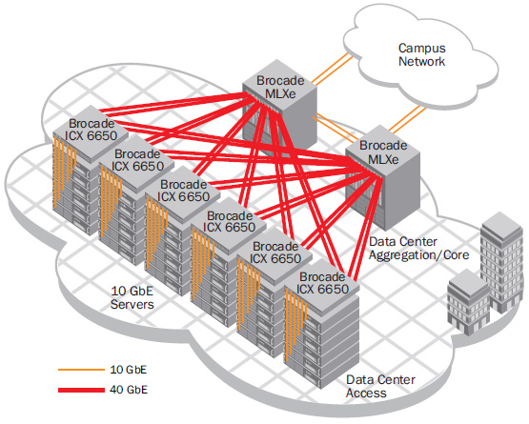
Example 1
Brocade reference design

Slide 11
Example 2
Internet
CR
CR
. . .
AR
AR
AR
AR
S
S
S
S
S
S
. . .
A
A
…
A
A
A
…
A
~ 40-80 servers/rack
Cisco reference design

Slide 12
Observations on DC architecture
Regular, well-defined arrangement
Hierarchical structure with rack/aggr/core layers
Mostly homogenous within a layer
Supports communication between servers and between servers and the external world
Contrast: ad-hoc structure, heterogeneity of WANs

Slide 13
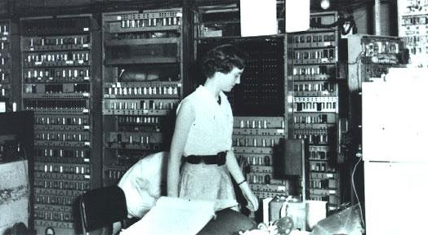
Datacenters have been around for a while
1949, EDSAC

Slide 14
What’s new?

Slide 15
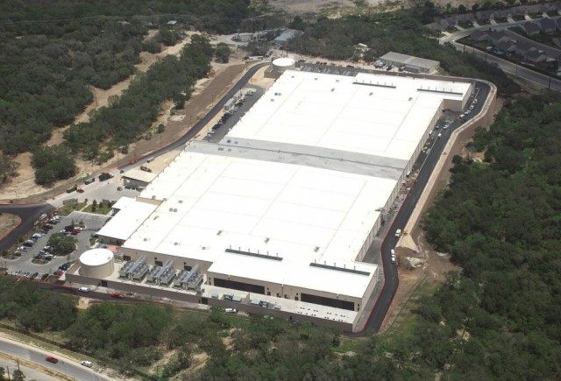
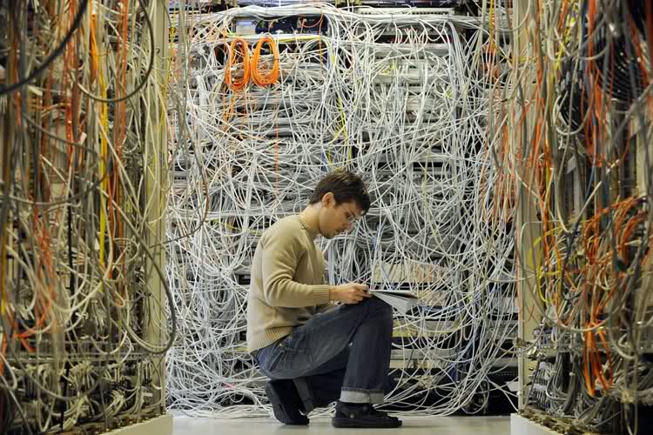
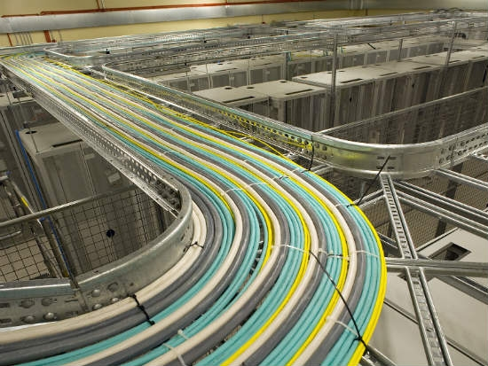
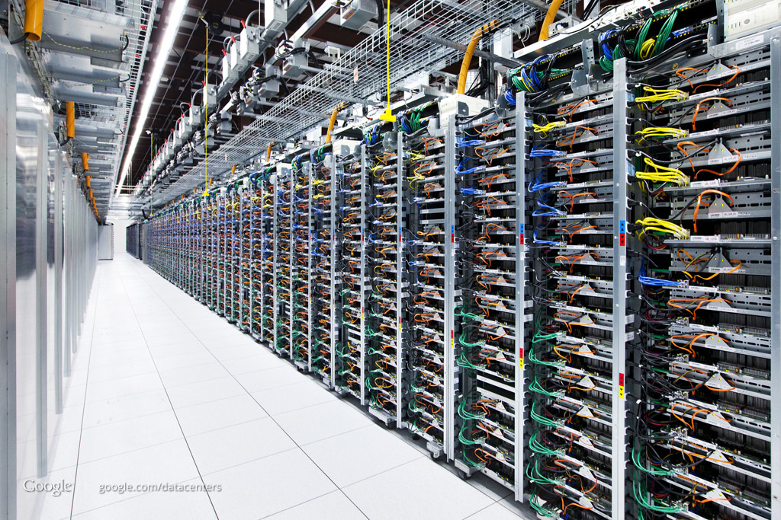
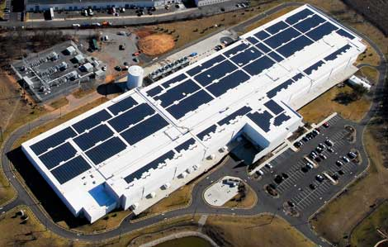
SCALE!

Slide 16
How big exactly?
1M servers [Microsoft]
  less than google, more than amazon
> $1B to build one site [Facebook]
>$20M/month/site operational costs [Microsoft ’09]
But only O(10-100) sites

Slide 17
What’s new?
Scale
Service model
  user-facing, revenue generating services
  multi-tenancy
  jargon: SaaS, PaaS, DaaS, IaaS, …

Slide 18
Implications
Scale
  need scalable solutions (duh)
  improving efficiency, lowering cost is critical
  `scale out’ solutions w/ commodity technologies
Service model
  performance means $$
  virtualization for isolation and portability

Slide 19
Multi-Tier Applications
Applications decomposed into tasks
  Many separate components
  Running in parallel on different machines

Slide 20
Componentization leads to different types of network traffic
“North-South traffic”
  Traffic between external clients and the datacenter
  Handled by front-end (web) servers, mid-tier application servers, and back-end databases
  Traffic patterns fairly stable, though diurnal variations

Slide 21
North-South Traffic
user requests from the Internet
Router
Front-End
Proxy
Front-End
Proxy
Web Server
Web Server
Web Server
Data
Cache
Data
Cache
Database
Database

Slide 22
Componentization leads to different types of network traffic
“North-South traffic”
  Traffic between external clients and the datacenter
  Handled by front-end (web) servers, mid-tier application servers, and back-end databases
  Traffic patterns fairly stable, though diurnal variations
“East-West traffic”
  Traffic between machines in the datacenter
  Comm within “big data” computations (e.g. Map Reduce)
  Traffic may shift on small timescales (e.g., minutes)

Slide 23
East-West Traffic
Distributed
Storage
Map
Tasks
Reduce
Tasks
Distributed
Storage

Slide 24
East-West Traffic
CR
CR
AR
AR
AR
AR
S
S
S
S
S
S
S
S
. . .
S
S
S
S
A
A
…
A
A
A
…
A
A
A
…
A
A
A
…
A

Slide 25
East-West Traffic
Often doesn’t cross the network
Some fraction (typically 2/3) crosses the network
Distributed
Storage
Map
Tasks
Reduce
Tasks
Distributed
Storage
Always goes over the network

Slide 26
What’s different about DC networks?
Characteristics
Huge scale:
  ~20,000 switches/routers
  contrast: AT&T ~500 routers

Slide 27
What’s different about DC networks?
Characteristics
Huge scale:
Limited geographic scope:
  High bandwidth: 10/40/100G
  Contrast: Cable/aDSL/WiFi
  Very low RTT: 10s of microseconds
  Contrast: 100s of milliseconds in the WAN

Slide 28
What’s different about DC networks?
Characteristics
Huge scale
Limited geographic scope
Single administrative domain
  Can deviate from standards, invent your own, etc.
  “Green field” deployment is still feasible

Slide 29
What’s different about DC networks?
Characteristics
Huge scale
Limited geographic scope
Single administrative domain
Control over one/both endpoints
  can change (say) addressing, congestion control, etc.
  can add mechanisms for security/policy/etc. at the endpoints (typically in the hypervisor)

Slide 30
What’s different about DC networks?
Characteristics
Huge scale
Limited geographic scope
Single administrative domain
Control over one/both endpoints
Control over the placement of traffic source/sink
  e.g., map-reduce scheduler chooses where tasks run
  alters traffic pattern (what traffic crosses which links)

Slide 31
What’s different about DC networks?
Characteristics
Huge scale
Limited geographic scope
Single administrative domain
Control over one/both endpoints
Control over the placement of traffic source/sink
Regular/planned topologies (e.g., trees/fat-trees)
  Contrast: ad-hoc WAN topologies (dictated by
  real-world geography and facilities)

Slide 32
What’s different about DC networks?
Characteristics
Huge scale
Limited geographic scope
Single administrative domain
Control over one/both endpoints
Control over the placement of traffic source/sink
Regular/planned topologies (e.g., trees/fat-trees)
Limited heterogeneity
  link speeds, technologies, latencies, …

Slide 33
What’s different about DC networks?
Goals
Extreme bisection bandwidth requirements
  recall: all that east-west traffic
  target: any server can communicate at its full link speed
  problem: server’s access link is 10Gbps!

Slide 34
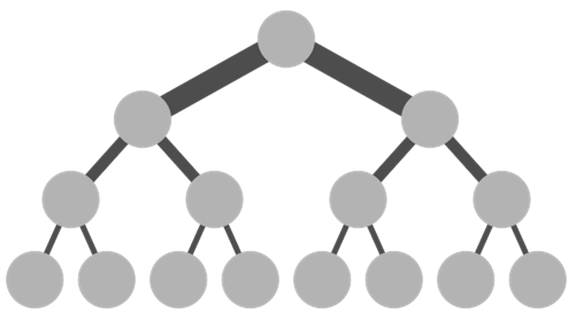
Full Bisection Bandwidth
O(40x10x100)Gbps
Internet
CR
CR
O(40x10)Gbps
. . .
AR
AR
AR
AR
10Gbps
S
S
S
S
S
S
. . .
Traditional tree topologies “scale up”
full bisection bandwidth is expensive
typically, tree topologies “oversubscribed”
A
A
…
A
A
A
…
A
~ 40-80 servers/rack

Slide 35
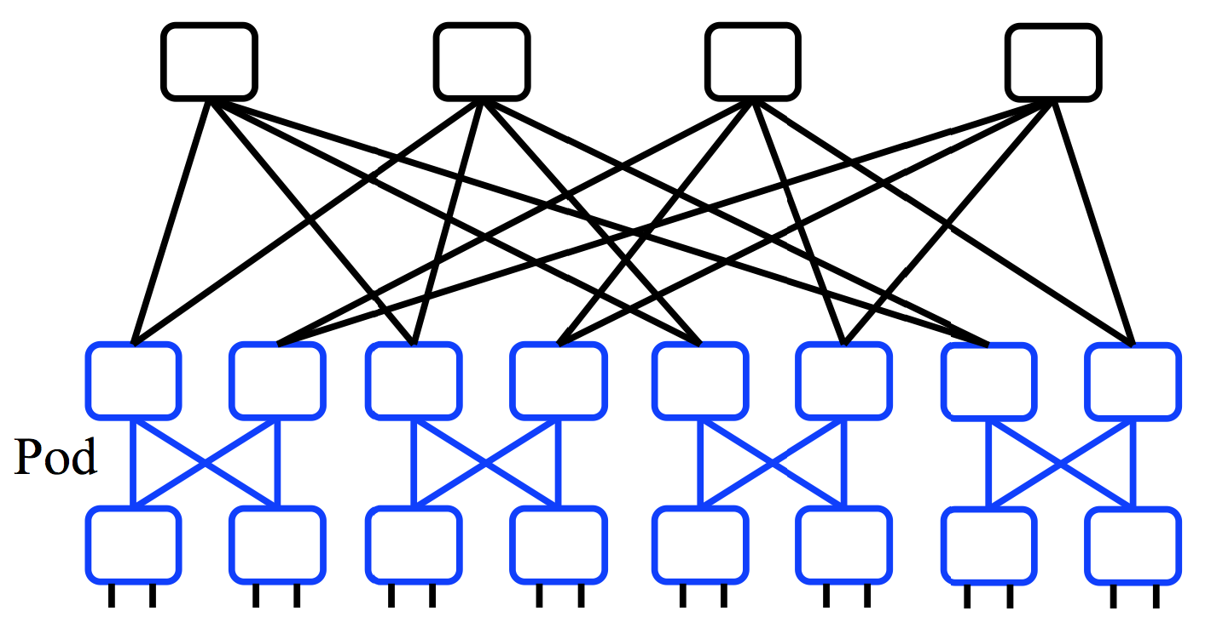
A “Scale Out” Design
Build multi-stage `Fat Trees’ out of k-port switches
  k/2 ports up, k/2 down
  Supports k³/4 hosts:
    48 ports, 27,648 hosts
All links are the same speed (e.g. 10Gps)

Slide 36
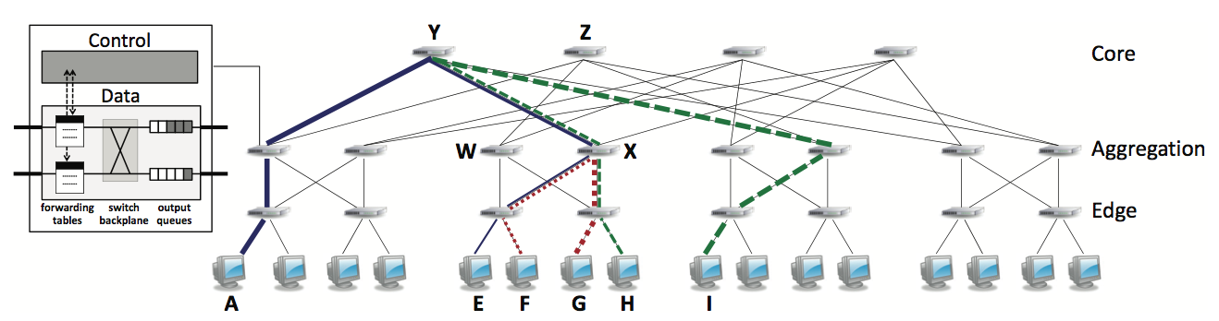
Full Bisection Bandwidth Not Sufficient
To realize full bisectional throughput, routing must spread traffic across paths
Enter load-balanced routing
  How? (1) Let the network split traffic/flows at random
  (e.g., ECMP protocol -- RFC 2991/2992)
  How? (2) Centralized flow scheduling?
  Many more research proposals

Slide 37
What’s different about DC networks?
Goals
Extreme bisection bandwidth requirements
Extreme latency requirements
  real money on the line
  current target: 1μs RTTs
  how? cut-through switches making a comeback
    reduces switching time

Slide 38
What’s different about DC networks?
Goals
Extreme bisection bandwidth requirements
Extreme latency requirements
  real money on the line
  current target: 1μs RTTs
  how? cut-through switches making a comeback
  how? avoid congestion
    reduces queuing delay

Slide 39
What’s different about DC networks?
Goals
Extreme bisection bandwidth requirements
Extreme latency requirements
  real money on the line
  current target: 1μs RTTs
  how? cut-through switches making a comeback (lec. 2!)
  how? avoid congestion
  how? fix TCP timers (e.g., default timeout is 500ms!)
  how? fix/replace TCP to more rapidly fill the pipe

Slide 40


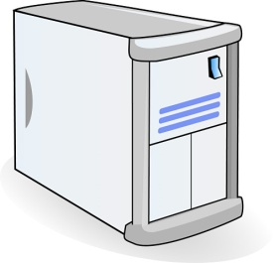
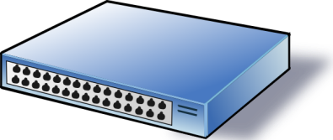
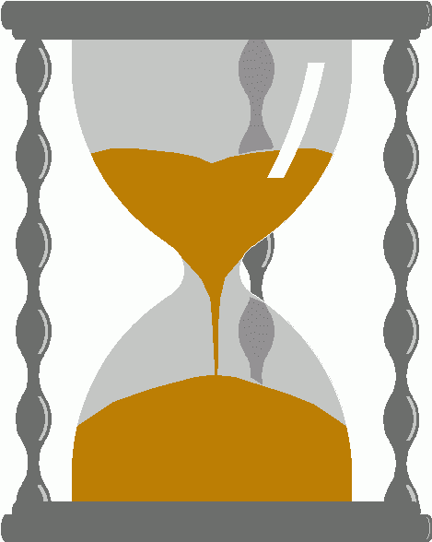
An example problem at scale - INCAST
Worker 1
Synchronized mice collide.
  Caused by Partition/Aggregate.
Aggregator
Worker 2
Worker 3
RTO_{min} = 300 ms
Worker 4
TCP timeout

Slide 41


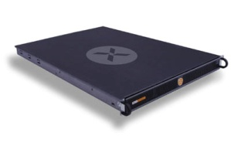
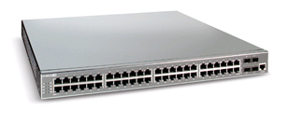
The Incast Workload
Data Block
Synchronized Read
1
R
R
R
R
2
3
Client
Switch
1
2
3
4
Server
Request Unit
(SRU)
4
Client now sends
next batch of requests
Storage Servers
41

Slide 42
Incast Workload Overfills Buffers
Synchronized Read
1
R
R
R
R
2
4
3
Client
Switch
1
2
3
4
Server
Request Unit
(SRU)
4
4
Requests
Received
Responses 1-3 completed
Link Idle!
Requests Sent
Response 4
dropped
Response 4
Resent
42

Slide 43
Queue Buildup
Sender 1
Big flows buildup queues.
  Increased latency for short flows.
Receiver
Sender 2
Measurements in Bing cluster
  For 90% packets: RTT < 1ms
  For 10% packets: 1ms < RTT < 15ms

Slide 44

Link-Layer Flow Control
Common between switches but this is flow-control to the end host too…
Another idea to reduce incast is to employ Link-Layer Flow Control…..
Recall: the Data-Link can use specially coded symbols in the coding to say “Stop” and “Start”

Slide 45
Link Layer Flow Control – The Dark side
Head of Line Blocking….
Such HOL blocking does not even differentiate processes so this can occur between competing processes on a pair of machines – no datacenter required.
Waiting for no good reason….

Slide 46
Link Layer Flow Control
But its worse that you imagine….
Double down on trouble….
Did I mention this is Link-Layer!
That means no (IP) control traffic, no routing messages….
a whole system waiting for one machine
Incast is very unpleasant.
…
Reducing the impact of HOL in Link Layer Flow Control can be done through priority queues and overtaking….

Slide 47
What’s different about DC networks?
Goals
Extreme bisection bandwidth requirements
Extreme latency requirements
Predictable, deterministic performance
  “your packet will reach in Xms, or not at all”
  “your VM will always see at least YGbps throughput”
  Resurrecting `best effort’ vs. `Quality of Service’ debates
  How is still an open question

Slide 48
What’s different about DC networks?
Goals
Extreme bisection bandwidth requirements
Extreme latency requirements
Predictable, deterministic performance
Differentiating between tenants is key
  e.g., “No traffic between VMs of tenant A and tenant B”
  “Tenant X cannot consume more than XGbps”
  “Tenant Y’s traffic is low priority”

Slide 49
What’s different about DC networks?
Goals
Extreme bisection bandwidth requirements
Extreme latency requirements
Predictable, deterministic performance
Differentiating between tenants is key
Scalability (of course)
  Q: How’s Ethernet spanning tree looking?

Slide 50
What’s different about DC networks?
Goals
Extreme bisection bandwidth requirements
Extreme latency requirements
Predictable, deterministic performance
Differentiating between tenants is key
Scalability (of course)
Cost/efficiency
  focus on commodity solutions, ease of management
  some debate over the importance in the network case

Slide 51
Summary
new characteristics and goals
some liberating, some constraining
scalability is the baseline requirement
more emphasis on performance
less emphasis on heterogeneity
less emphasis on interoperability
Notes:
-- incast?
-- one big switch abstraction…

