Slide 1
Computer Networking
Lent Term M/W/F 11-midday
LT1 in Gates Building
Slide Set 4
Andrew W. Moore
andrew.moore@cl.cam.ac.uk
February 2014

Slide 2
Topic 5a – Transport
Our goals:
understand principles behind transport layer services:
  multiplexing/demultiplexing
  reliable data transfer
  flow control
  congestion control
learn about transport layer protocols in the Internet:
  UDP: connectionless transport
  TCP: connection-oriented transport
  TCP congestion control

Slide 3

Transport Layer
Commonly a layer at end-hosts, between the application and network layer
Application
Application
Transport
Transport
Network
Network
Network
Datalink
Datalink
Datalink
Physical
Physical
Physical
Router
Host A
Host B

Slide 4
Why a transport layer?
IP packets are addressed to a host but end-to-end communication is between application processes at hosts
  Need a way to decide which packets go to which applications (more multiplexing)

Slide 5
Why a transport layer?
Application
Application
Transport
Transport
Network
Network
Datalink
Datalink
Physical
Physical
Host A
Host B

Slide 6
Why a transport layer?
many application
processes
browser
telnet
ftp
browser
mmedia
Application
Operating
System
Transport
Network
IP
Datalink
Physical
Drivers
+NIC
Datalink
Physical
Host A
Host B

Slide 7
Why a transport layer?
many application
processes
Communication
between processes
at hosts
telnet
ftp
HTTP
server
ftp
browser
telnet
browser
mmedia
Transport
Transport
IP
IP
Datalink
Physical
Datalink
Physical
Communication
between hosts
(128.4.5.6 ←→162.99.7.56)
Host A
Host B

Slide 8
Why a transport layer?
IP packets are addressed to a host but end-to-end communication is between application processes at hosts
  Need a way to decide which packets go to which applications (mux/demux)
IP provides a weak service model (best-effort)
  Packets can be corrupted, delayed, dropped, reordered, duplicated
  No guidance on how much traffic to send and when
  Dealing with this is tedious for application developers

Slide 9
Role of the Transport Layer
Communication between application processes
  Multiplexing between application processes
  Implemented using ports

Slide 10
Role of the Transport Layer
Communication between application processes
Provide common end-to-end services for app layer [optional]
  Reliable, in-order data delivery
  Paced data delivery: flow and congestion-control
    too fast may overwhelm the network
    too slow is not efficient

Slide 11
Role of the Transport Layer
Communication between processes
Provide common end-to-end services for app layer [optional]
TCP and UDP are the common transport protocols
  also SCTP, MTCP, SST, RDP, DCCP, …

Slide 12
Role of the Transport Layer
Communication between processes
Provide common end-to-end services for app layer [optional]
TCP and UDP are the common transport protocols
UDP is a minimalist, no-frills transport protocol
  only provides mux/demux capabilities

Slide 13
Role of the Transport Layer
Communication between processes
Provide common end-to-end services for app layer [optional]
TCP and UDP are the common transport protocols
UDP is a minimalist, no-frills transport protocol
TCP is the totus porcus protocol
  offers apps a reliable, in-order, byte-stream abstraction
  with congestion control
  but no performance (delay, bandwidth, ...) guarantees

Slide 14
Role of the Transport Layer
Communication between processes
  mux/demux from and to application processes
  implemented using ports

Slide 15
Context: Applications and Sockets
Socket: software abstraction by which an application process exchanges network messages with the (transport layer in the) operating system
  socketID = socket(…, socket.TYPE)
  socketID.sendto(message, …)
  socketID.recvfrom(…)
Two important types of sockets
  UDP socket: TYPE is SOCK_DGRAM
  TCP socket: TYPE is SOCK_STREAM

Slide 16
Ports
Problem: deciding which app (socket) gets which packets
  Solution: port as a transport layer identifier
    16 bit identifier
  OS stores mapping between sockets and ports
  a packet carries a source and destination port number in its
  transport layer header
For UDP ports (SOCK_DGRAM)
  OS stores (local port, local IP address) ←→ socket
For TCP ports (SOCK_STREAM)
  OS stores (local port, local IP, remote port, remote IP) ←→ socket

Slide 17
4-bit
Version
4-bit
Header
Length
8-bit
Type of Service
(TOS)
16-bit Total Length (Bytes)
16-bit Identification
3-bit
Flags
13-bit Fragment Offset
8-bit Time to
Live (TTL)
8-bit Protocol
16-bit Header Checksum
32-bit Source IP Address
32-bit Destination IP Address
Options (if any)
IP Payload

Slide 18
4
5
8-bit
Type of Service
(TOS)
16-bit Total Length (Bytes)
16-bit Identification
3-bit
Flags
13-bit Fragment Offset
8-bit Time to
Live (TTL)
8-bit Protocol
16-bit Header Checksum
32-bit Source IP Address
32-bit Destination IP Address
IP Payload

Slide 19
4
5
8-bit
Type of Service
(TOS)
16-bit Total Length (Bytes)
16-bit Identification
3-bit
Flags
13-bit Fragment Offset
8-bit Time to
Live (TTL)
6 = TCP
17 = UDP
16-bit Header Checksum
32-bit Source IP Address
32-bit Destination IP Address
TCP or
UDP
header and Payload

Slide 20
4
5
8-bit
Type of Service
(TOS)
16-bit Total Length (Bytes)
16-bit Identification
3-bit
Flags
13-bit Fragment Offset
8-bit Time to
Live (TTL)
6 = TCP
17 = UDP
16-bit Header Checksum
32-bit Source IP Address
32-bit Destination IP Address
16-bit Source Port
16-bit Destination Port
More transport header fields ….
TCP or
UDP
header and Payload

Slide 21
Recap: Multiplexing and Demultiplexing
Host receives IP packets
  Each IP header has source and destination IP address
  Each Transport Layer header has source and destination port number
Host uses IP addresses and port numbers to direct the message to appropriate socket

Slide 22
More on Ports
Separate 16-bit port address space for UDP and TCP
“Well known” ports (0-1023): everyone agrees which
services run on these ports
  e.g., ssh:22, http:80
  helps client know server’s port
Ephemeral ports (most 1024-65535): dynamically selected: as the source port for a client process

Slide 23
UDP: User Datagram Protocol
Lightweight communication between processes
  Avoid overhead and delays of ordered, reliable delivery
UDP described in RFC 768 – (1980!)
  Destination IP address and port to support demultiplexing
  Optional error checking on the packet contents
    (checksum field of 0 means “don’t verify checksum”)
SRC port
DST port
checksum
length
DATA

Slide 24
Why a transport layer?
IP packets are addressed to a host but end-to-end communication is between application processes at hosts
  Need a way to decide which packets go to which applications (mux/demux)
IP provides a weak service model (best-effort)
  Packets can be corrupted, delayed, dropped, reordered, duplicated

Slide 25
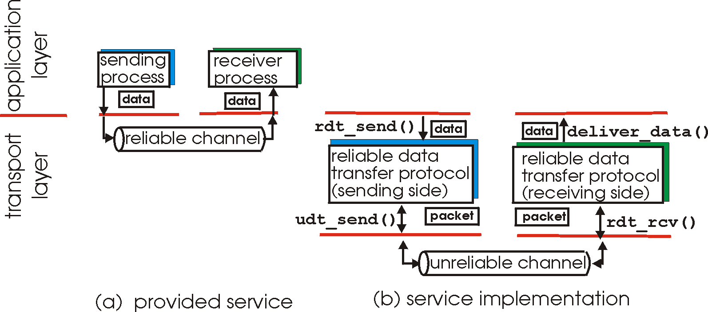
Principles of Reliable data transfer
important in app., transport, link layers
top-10 list of important networking topics!
In a perfect world, reliable transport is easy
But the Internet default is best-effort
All the bad things best-effort can do
  a packet is corrupted (bit errors)
  a packet is lost
  a packet is delayed (why?)
  packets are reordered (why?)
  a packet is duplicated (why?)
Notes:
MAKE CLEAR THE OBJECTIVE (function)
- RELIABLE data transfer

Slide 26
Principles of Reliable data transfer
important in app., transport, link layers
top-10 list of important networking topics!
characteristics of unreliable channel will determine complexity of reliable data transfer protocol (rdt)

Slide 27
Principles of Reliable data transfer
important in app., transport, link layers
top-10 list of important networking topics!
rdt_rcv()
udt_rcv()
characteristics of unreliable channel will determine complexity of reliable data transfer protocol (rdt)

Slide 28
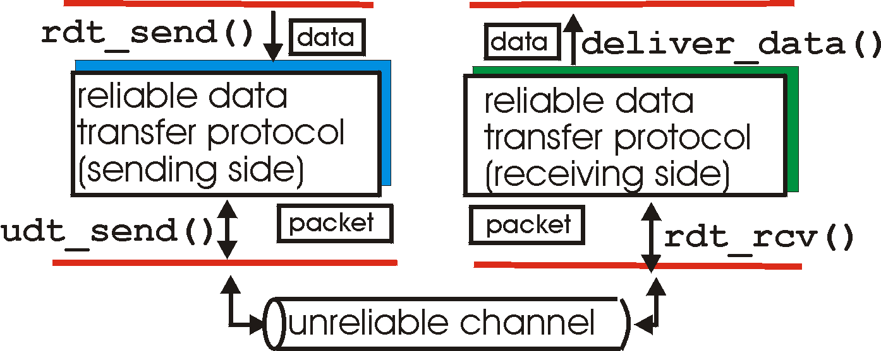
Reliable data transfer: getting started
rdt_send(): called from above, (e.g., by app.). Passed data to
deliver to receiver upper layer
rdt_rcv(): called by rdt to deliver data to upper
rdt_rcv()
send
side
receive
side
udt_rcv()
udt_send(): called by rdt,
to transfer packet over
unreliable channel to receiver
udt_rcv(): called when packet arrives on rcv-side of channel

Slide 29
Reliable data transfer: getting started
We’ll:
incrementally develop sender, receiver sides of reliable data transfer protocol (rdt)
consider only unidirectional data transfer
  but control info will flow on both directions!
use finite state machines (FSM) to specify sender, receiver
event causing state transition
actions taken on state transition
state: when in this “state” next state uniquely determined by next event
state
1
state
2
event
actions

Slide 30
KR state machines – a note.
Beware
Kurose and Ross has a confusing/confused attitude to state-machines.
I’ve attempted to normalise the representation.
UPSHOT: these slides have differing information to the KR book (from which the RDT example is taken.)
in KR “actions taken” appear wide-ranging, my interpretation is more specific/relevant.
Relevant event causing state transition
state: when in this “state” next state uniquely determined by next event
Relevant action taken on state transition
State
name
State
name
event
actions

Slide 31
Rdt1.0: reliable transfer over a reliable channel
underlying channel perfectly reliable
  no bit errors
  no loss of packets
separate FSMs for sender, receiver:
  sender sends data into underlying channel
  receiver read data from underlying channel
Event
rdt_send(data)
udt_rcv(packet)
IDLE
udt_send(packet)
IDLE
rdt_rcv(data)
Action
sender
receiver

Slide 32
Rdt2.0: channel with bit errors
underlying channel may flip bits in packet
  checksum to detect bit errors
the question: how to recover from errors:
  acknowledgements (ACKs): receiver explicitly tells sender that packet received is OK
  negative acknowledgements (NAKs): receiver explicitly tells sender that packet had errors
  sender retransmits packet on receipt of NAK
new mechanisms in rdt2.0 (beyond rdt1.0):
  error detection
  receiver feedback: control msgs (ACK,NAK) receiver->sender

Slide 33
Dealing with Packet Corruption
1
☑
ack
2
☒
nack
.
.
.
2
Sender
Receiver
Time

Slide 34
rdt2.0: FSM specification
rdt_send(data)
udt_send(packet)
receiver
udt_rcv(reply) &&
isNAK(reply)
Waiting
for reply
udt_rcv(packet) && corrupt(packet)
IDLE
udt_send(packet)
udt_send(NAK)
udt_rcv(reply) && isACK(reply)
Λ
IDLE
sender
udt_rcv(packet) && notcorrupt(packet)
Note: the sender holds a copy of the packet being sent until the delivery is acknowledged.
rdt_rcv(data)
udt_send(ACK)

Slide 35
rdt2.0: operation with no errors
rdt_send(data)
udt_send(packet)
udt_rcv(reply) &&
isNAK(reply)
Waiting
for reply
udt_rcv(packet) && corrupt(packet)
IDLE
udt_send(packet)
udt_send(NAK)
udt_rcv(reply) && isACK(reply)
Λ
IDLE
udt_rcv(packet) && notcorrupt(packet)
rdt_rcv(data)
udt_send(ACK)

Slide 36
rdt2.0: error scenario
rdt_send(data)
udt_send(packet)
udt_rcv(reply) &&
isNAK(reply)
Waiting
for reply
udt_rcv(packet) && corrupt(packet)
IDLE
udt_send(packet)
udt_send(NAK)
udt_rcv(reply) && isACK(reply)
Λ
IDLE
udt_rcv(packet) && notcorrupt(packet)
rdt_rcv(data)
udt_send(ACK)

Slide 37
rdt2.0 has a fatal flaw!
What happens if ACK/NAK corrupted?
sender doesn’t know what happened at receiver!
can’t just retransmit: possible duplicate
Handling duplicates:
sender retransmits current packet if ACK/NAK garbled
sender adds sequence number to each packet
receiver discards (doesn’t deliver) duplicate packet
stop and wait
Sender sends one packet,
then waits for receiver
response

Slide 38
Dealing with Packet Corruption
1
P(1)
☑
ack(1)
☒
1
P(1)
Packet
#1 or #2?
ack(1)
2
P(2)
Data and ACK packets carry sequence numbers
What if the ACK/NACK is corrupted?
Sender
Receiver
Time

Slide 39
rdt2.1: sender, handles garbled ACK/NAKs
rdt_send(data)
sequence=0
udt_send(packet)
udt_rcv(reply) &&
( corrupt(reply) ||
isNAK(reply) )
Waiting
For reply
IDLE
udt_send(packet)
udt_rcv(reply)
&& notcorrupt(reply)
&& isACK(reply)
udt_rcv(reply)
&& notcorrupt(reply)
&& isACK(reply)
Λ
Λ
Waiting
for reply
IDLE
udt_rcv(reply) &&
( corrupt(reply) ||
isNAK(reply) )
rdt_send(data)
udt_send(packet)
sequence=1
udt_send(packet)

Slide 40
rdt2.1: receiver, handles garbled ACK/NAKs
udt_rcv(packet) && not corrupt(packet)
&& has_seq0(packet)
udt_send(ACK)
rdt_rcv(data)
receive(packet) && corrupt(packet)
udt_rcv(packet) && corrupt(packet)
udt_send(NAK)
udt_send(NAK)
Wait for
0 from below
Wait for
1 from below
receive(packet) &&
not corrupt(packet) &&
has_seq1(packet)
receive(packet) &&
not corrupt(packet) &&
has_seq0(packet)
udt_send(ACK)
udt_send(ACK)
udt_rcv(packet) && not corrupt(packet)
&& has_seq1(packet)
udt_send(ACK)
rdt_rcv(data)

Slide 41
rdt2.1: discussion
Sender:
seq # added to pkt
two seq. #’s (0,1) will suffice. Why?
must check if received ACK/NAK corrupted
twice as many states
  state must “remember” whether “current” pkt has a
  0 or 1 sequence number
Receiver:
must check if received packet is duplicate
  state indicates whether 0 or 1 is expected pkt seq #
note: receiver can not know if its last ACK/NAK received OK at sender

Slide 42
rdt2.2: a NAK-free protocol
same functionality as rdt2.1, using ACKs only
instead of NAK, receiver sends ACK for last pkt received OK
  receiver must explicitly include seq # of pkt being ACKed
duplicate ACK at sender results in same action as NAK: retransmit current pkt

Slide 43
rdt2.2: sender, receiver fragments
rdt_send(data)
sequence=0
udt_send(packet)
rdt_rcv(reply) &&
( corrupt(reply) ||
isACK1(reply) )
Wait for call 0 from above
Wait for ACK
0
udt_send(packet)
sender FSM
fragment
udt_rcv(reply)
&& not corrupt(reply)
&& isACK0(reply)
udt_rcv(packet) &&
(corrupt(packet) ||
has_seq1(packet))
Λ
Wait for
0 from below
receiver FSM
fragment
udt_send(ACK1)
receive(packet) && not corrupt(packet)
&& has_seq1(packet)
send(ACK1)
rdt_rcv(data)

Slide 44
rdt3.0: channels with errors and loss
New assumption: underlying channel can also lose packets (data or ACKs)
  checksum, seq. #, ACKs, retransmissions will be of help, but not enough
Approach: sender waits “reasonable” amount of time for ACK
retransmits if no ACK received in this time
if pkt (or ACK) just delayed (not lost):
  retransmission will be duplicate, but use of seq. #’s already handles this
  receiver must specify seq # of pkt being ACKed
requires countdown timer

Slide 45
rdt3.0 sender
rdt_send(data)
udt_rcv(reply) &&
( corrupt(reply) ||
isACK(reply,1) )
sequence=0
udt_send(packet)
udt_rcv(reply)
Λ
Λ
IDLE
state 0
Wait for ACK0
timeout
udt_send(packet)
udt_rcv(reply)
&& notcorrupt(reply)
&& isACK(reply,1)
udt_rcv(reply)
&& notcorrupt(reply)
&& isACK(reply,0)
Λ
Λ
Wait for ACK1
IDLE
state 1
timeout
udt_send(packet)
udt_rcv(reply)
rdt_send(data)
Λ
udt_rcv(packet) &&
( corrupt(packet) ||
isACK(reply,0) )
sequence=1
udt_send(packet)
Λ

Slide 46
Dealing with Packet Loss
1
P(1)
☒
Timeout
1
P(1)
ack(1)
P(2)
Sender
Receiver
Timer-driven loss detection
Set timer when packet is sent; retransmit on timeout
Time

Slide 47
Dealing with Packet Loss
1
P(1)
Timeout
☒
1
P(1)
duplicate!
ack(1)
P(2)
Sender
Receiver
Time

Slide 48
Dealing with Packet Loss
1
P(1)
Timeout
1
P(1)
ack(1)
.
.
.
duplicate!
ack(1)
P(2)
Sender
Receiver
Timer-driven retx. can lead to duplicates
Time

Slide 49
Performance of rdt3.0
rdt3.0 works, but performance stinks
ex: 1 Gbps link, 15 ms prop. delay, 8000 bit packet:
  U _{sender}: utilization – fraction of time sender busy sending
  1KB pkt every 30 msec -> 33kB/sec throughput over 1 Gbps link
  network protocol limits use of physical resources!

Slide 50
rdt3.0: stop-and-wait operation
sender
receiver
Inefficient if
t << RTT
first packet bit transmitted, t = 0
last packet bit transmitted, t = L / R
first packet bit arrives
RTT
last packet bit arrives, send ACK
ACK arrives, send next
packet, t = RTT + L / R
Notes:
29th end

Slide 51
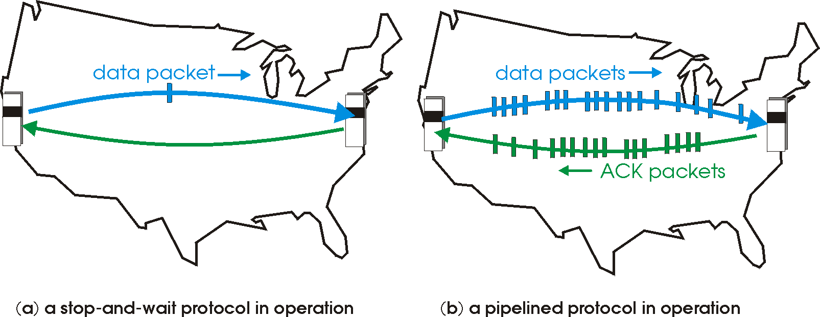
Pipelined (Packet-Window) protocols
Pipelining: sender allows multiple, “in-flight”, yet-to-be-acknowledged pkts
  range of sequence numbers must be increased
  buffering at sender and/or receiver

Slide 52
A Sliding Packet Window
window = set of adjacent sequence numbers
  The size of the set is the window size; assume window size is n
General idea: send up to n packets at a time
  Sender can send packets in its window
  Receiver can accept packets in its window
  Window of acceptable packets “slides” on successful reception/acknowledgement

Slide 53
A Sliding Packet Window
Let A be the last ack’d packet of sender without gap;
then window of sender = {A+1, A+2, …, A+n}
Let B be the last received packet without gap by receiver,
then window of receiver = {B+1,…, B+n}
n
Already ACK’d
A
Sent but not ACK’d
Cannot be sent
sequence number →
n
Received and ACK’d
B
Acceptable but not
yet received
Cannot be received

Slide 54
Acknowledgements w/ Sliding Window
Two common options
  cumulative ACKs: ACK carries next in-order sequence number that the receiver expects

Slide 55
Cumulative Acknowledgements (1)
At receiver
n
Received and ACK’d
B
Acceptable but not
yet received
Cannot be received
After receiving B+1, B+2
B_{new}= B+2
n
Receiver sends ACK(B_{new}+1)

Slide 56
Cumulative Acknowledgements (2)
At receiver
n
Received and ACK’d
B
Acceptable but not
yet received
Cannot be received
After receiving B+4, B+5
B
n
How do we recover?
Receiver sends ACK(B+1)

Slide 57
Go-Back-N (GBN)
Sender transmits up to n unacknowledged packets
Receiver only accepts packets in order
  discards out-of-order packets (i.e., packets other than B+1)
Receiver uses cumulative acknowledgements
  i.e., sequence# in ACK = next expected in-order sequence#
Sender sets timer for 1st outstanding ack (A+1)
If timeout, retransmit A+1, … , A+n

Slide 58
Sliding Window with GBN
Let A be the last ack’d packet of sender without gap;
then window of sender = {A+1, A+2, …, A+n}
Let B be the last received packet without gap by receiver,
then window of receiver = {B+1,…, B+n}
n
Already ACK’d
A
Sent but not ACK’d
Cannot be sent
sequence number →
n
Received and ACK’d
B
Acceptable but not
yet received
Cannot be received

Slide 59
GBN Example w/o Errors
Sender Window
Window size = 3 packets
Receiver Window
{1}
1
{1, 2}
2
{1, 2, 3}
3
{2, 3, 4}
4
{3, 4, 5}
5
.
.
.
{4, 5, 6}
6
.
.
.
Sender
Receiver
Time

Slide 60
GBN Example with Errors
Window size = 3 packets
1
2
3
4
5
Timeout
Packet 4
6
4
5
6
Sender
Receiver

Slide 61
GBN: sender extended FSM
rdt_send(data)
if (nextseqnum < base+N) {
udt_send(packet[nextseqnum])
nextseqnum++
}
else
refuse_data(data) Block?
Λ
base=1
nextseqnum=1
timeout
Wait
udt_send(packet[base])
udt_send(packet[base+1])
…
udt_send(packet[nextseqnum-1])
udt_rcv(reply)
&& corrupt(reply)
Λ
udt_rcv(reply) &&
notcorrupt(reply)
base = getacknum(reply)+1

Slide 62
GBN: receiver extended FSM
Λ
udt_send(reply)
udt_rcv(packet)
&& notcurrupt(packet)
&& hasseqnum(rcvpkt,expectedseqnum)
Λ
Wait
rdt_rcv(data)
udt_send(ACK)
expectedseqnum++
expectedseqnum=1
ACK-only: always send an ACK for correctly-received packet with the highest in-order seq #
  may generate duplicate ACKs
  need only remember expectedseqnum
out-of-order packet:
  discard (don’t buffer) -> no receiver buffering!
  Re-ACK packet with highest in-order seq #

Slide 63
Acknowledgements w/ Sliding Window
Two common options
  cumulative ACKs: ACK carries next in-order sequence number the receiver expects
  selective ACKs: ACK individually acknowledges correctly received packets
Selective ACKs offer more precise information but require more complicated book-keeping
Many variants that differ in implementation details

Slide 64
Selective Repeat (SR)
Sender: transmit up to n unacknowledged packets
Assume packet k is lost, k+1 is not
Receiver: indicates packet k+1 correctly received
Sender: retransmit only packet k on timeout
Efficient in retransmissions but complex book-keeping
  need a timer per packet

Slide 65
SR Example with Errors
Window size = 3 packets
{1}
1
{1, 2}
2
{1, 2, 3}
3
{2, 3, 4}
4
{3, 4, 5}
5
Timeout
Packet 4
{4, 5, 6}
6
ACK=5
{4,5,6}
ACK=6
4
{4,5,6}
Time
ACK=4
{7, 8, 9}
7
Sender
Receiver

Slide 66
Observations
With sliding windows, it is possible to fully utilize a link, provided the window size is large enough. Throughput is ~ (n/RTT)
  Stop & Wait is like n = 1.
Sender has to buffer all unacknowledged packets, because they may require retransmission
Receiver may be able to accept out-of-order packets, but only up to its buffer limits
Implementation complexity depends on protocol details (GBN vs. SR)

Slide 67
Recap: components of a solution
Checksums (for error detection)
Timers (for loss detection)
Acknowledgments
  cumulative
  selective
Sequence numbers (duplicates, windows)
Sliding Windows (for efficiency)
Reliability protocols use the above to decide when and what to retransmit or acknowledge

Slide 68
What does TCP do?
Most of our previous tricks + a few differences
Sequence numbers are byte offsets
Sender and receiver maintain a sliding window
Receiver sends cumulative acknowledgements (like GBN)
Sender maintains a single retx. timer
Receivers do not drop out-of-sequence packets (like SR)
Introduces fast retransmit : optimization that uses duplicate
ACKs to trigger early retx (next time)
Introduces timeout estimation algorithms (next time)
More in Topic 5b

