Slide 1
Computer Networking
Lent Term M/W/F 11-midday
LT1 in Gates Building
Slide Set 3
Andrew W. Moore
andrew.moore@cl.cam.ac.uk
January 2014

Slide 2
Topic 4: Network Layer
Our goals:
understand principles behind network layer services:
  network layer service models
  forwarding versus routing (versus switching)
  how a router works
  routing (path selection)
  IPv6
For the most part, the Internet is our example – again.

Slide 3
Name: a something
Address: Where a something is
Routing: How do I get to the something

Slide 4
Addressing (at a conceptual level)
Assume all hosts have unique IDs
No particular structure to those IDs
Later in topic I will talk about real IP addressing
Do I route on location or identifier?
If a host moves, should its address change?
  If not, how can you build scalable Internet?
  If so, then what good is an address for identification?

Slide 5
Packets (at a conceptual level)
Assume packet headers contain:
  Source ID, Destination ID, and perhaps other information
Destination
Identifier
Why include
this?
Source
Identifier
Payload

Slide 6
Switches/Routers
Multiple ports (attached to other switches or hosts)
Ports are typically duplex (incoming and outgoing)
incoming links
Switch
outgoing links

Slide 7
A Variety of Networks
ISPs: carriers
  Backbone
  Edge
  Border (to other ISPs)
Enterprises: companies, universities
  Core
  Edge
  Border (to outside)
Datacenters: massive collections of machines
  Top-of-Rack
  Aggregation and Core
  Border (to outside)

Slide 8

Switches forward packets
GLASGOW
EDINBURGH
switch#4
switch#2
Forwarding Table
111010010
EDIN
Destination | Next Hop
GLASGOW | 4
OXFORD | 5
EDIN | 2
UCL | 3
switch#5
OXFORD
UCL
switch#3

Slide 9
Forwarding Decisions
When packet arrives..
  Must decide which outgoing port to use
  In single transmission time
  Forwarding decisions must be simple
Routing state dictates where to forward packets
  Assume decisions are deterministic
Global routing state means collection of routing state in each of the routers
  Will focus on where this routing state comes from
  But first, a few preliminaries….

Slide 10
Forwarding vs Routing
Forwarding: “data plane”
  Directing a data packet to an outgoing link
  Individual router using routing state
Routing: “control plane”
  Computing paths the packets will follow
  Routers talking amongst themselves
  Jointly creating the routing state
Two very different timescales….
Notes:
8/Feb/2012

Slide 11

Context and Terminology
“Autonomous System (AS)” or “Domain”
Region of a network under a single administrative entity
“End hosts”
“Clients”, “Users”
“End points”
“Border Routers”
“Route” or “Path”
“Interior Routers”

Slide 12
Context and Terminology
Destination
Destination
Destination
111010010
MIT
Destination
Destination
Destination
Destination
Destination
Internet routing protocols are responsible for constructing
and updating the forwarding tables at routers
MIT

Slide 13
Routing Protocols
Routing protocols implement the core function of a network
  Establish paths between nodes
  Part of the network’s “control plane”
Network modeled as a graph
  Routers are graph vertices
  Links are edges
  Edges have an associated “cost”
    e.g., distance, loss
Goal: compute a “good” path from source to destination
  “good” usually means the shortest (least cost) path
5
B
3
C
2
5
A
2
1
F
3
1
2
D
E
1

Slide 14
Internet Routing
Internet Routing works at two levels
Each AS runs an intra-domain routing protocol that
establishes routes within its domain
  (AS -- region of network under a single administrative entity)
  Link State, e.g., Open Shortest Path First (OSPF)
  Distance Vector, e.g., Routing Information Protocol (RIP)
ASes participate in an inter-domain routing protocol that establishes routes between domains
  Path Vector, e.g., Border Gateway Protocol (BGP)

Slide 15
Addressing (for now)
Assume each host has a unique ID (address)
No particular structure to those IDs
Later in course will talk about real IP addressing

Slide 16
Outline
Link State
Distance Vector
Routing: goals and metrics (if time)

Slide 17
Link-State

Slide 18
Link State Routing
Each node maintains its local “link state” (LS)
  i.e., a list of its directly attached links and their costs
(N1,N2)
(N1,N4)
(N1,N5)
Host C
Host A
Host D
N1
N2
N3
N5
Host B
N4
Host E
N6
N7

Slide 19
Link State Routing
Each node maintains its local “link state” (LS)
Each node floods its local link state
  on receiving a new LS message, a router forwards the message
  to all its neighbors other than the one it received the message from
Host C
Host A
Host D
(N1,N2)
(N1, N4)
(N1, N5)
(N1,N2)
(N1, N4)
(N1, N5)
N1
N2
(N1,N2)
(N1, N4)
(N1, N5)
N3
(N1,N2)
(N1, N4)
(N1, N5)
(N1,N2)
(N1, N4)
(N1, N5)
N5
(N1,N2)
(N1, N4)
(N1, N5)
(N1,N2)
(N1, N4)
(N1, N5)
(N1,N2)
(N1, N4)
(N1, N5)
Host B
N4
Host E
(N1,N2)
(N1, N4)
(N1, N5)
(N1,N2)
(N1, N4)
(N1, N5)
N6
N7

Slide 20
Link State Routing
Each node maintains its local “link state” (LS)
Each node floods its local link state
Hence, each node learns the entire network topology
  Can use Dijkstra’s to compute the shortest paths between nodes
A
C
D
Host C
C
A
D
Host A
Host D
B
E
B
E
N1
N2
A
C
D
C
A
D
N3
B
E
N5
A
C
D
A
C
D
B
E
Host B
N4
B
Host E
E
B
E
A
C
D
N6
N7
B
E

Slide 21
Dijkstra’s Shortest Path Algorithm
INPUT:
  Network topology (graph), with link costs
OUTPUT:
  Least cost paths from one node to all other nodes
Iterative: after k iterations, a node knows the least cost path to its k closest neighbors
Notes:
How many people know this algorithm?
Well, last year….

Slide 22
Example
5
3
B
C
2
5
A
2
1
F
3
1
2
D
E
1

Slide 23
Notation
c(i,j): link cost from node i
to j; cost is infinite if not direct neighbors; ≥ 0
D(v): total cost of the current least cost path from source to destination v
p(v): v’s predecessor along path from source to v
S: set of nodes whose least cost path definitively known
5
B
3
C
2
5
A
2
1
F
3
1
2
D
E
1
Source

Slide 24
Dijkstra’s Algorithm
c(i,j): link cost from node i to j
D(v): current cost source → v
p(v): v’s predecessor along path from source to v
S: set of nodes whose least cost path definitively known
1 Initialization:
2 S = {A};
3 for all nodes v
4 if v adjacent to A
5 then D(v) = c(A,v);
6 else D(v) = ;
7
8 Loop
9 find w not in S such that D(w) is a minimum;
10 add w to S;
11 update D(v) for all v adjacent to w and not in S:
12 if D(w) + c(w,v) < D(v) then
// w gives us a shorter path to v than we’ve found so far
13 D(v) = D(w) + c(w,v); p(v) = w;
14 until all nodes in S;

Slide 25
Example: Dijkstra’s Algorithm
Step
0
1
2
3
4
5
set S
A
D(B),p(B)
2,A
D(C),p(C)
5,A
D(D),p(D)
1,A
D(E),p(E)
D(F),p(F)
5
1 Initialization:
2 S = {A};
3 for all nodes v
4 if v adjacent to A
5 then D(v) = c(A,v);
6 else D(v) = ;
…
B
3
C
2
5
A
2
1
F
3
1
2
D
E
1

Slide 26
Example: Dijkstra’s Algorithm
Step
0
1
2
3
4
5
set S
A
D(B),p(B)
2,A
D(C),p(C)
5,A
D(D),p(D)
1,A
D(E),p(E)
D(F),p(F)
…
8 Loop
9 find w not in S s.t. D(w) is a minimum;
10 add w to S;
update D(v) for all v adjacent
to w and not in S:
If D(w) + c(w,v) < D(v) then
D(v) = D(w) + c(w,v); p(v) = w;
14 until all nodes in S;
5
B
3
C
2
5
A
2
1
F
3
1
2
D
E
1

Slide 27
Example: Dijkstra’s Algorithm
Step
0
1
2
3
4
5
set S
A
AD
D(B),p(B)
2,A
D(C),p(C)
5,A
D(D),p(D)
1,A
D(E),p(E)
D(F),p(F)
…
8 Loop
9 find w not in S s.t. D(w) is a minimum;
10 add w to S;
update D(v) for all v adjacent
to w and not in S:
If D(w) + c(w,v) < D(v) then
D(v) = D(w) + c(w,v); p(v) = w;
14 until all nodes in S;
5
B
3
C
2
5
A
2
1
F
3
1
2
D
E
1

Slide 28
Example: Dijkstra’s Algorithm
Step
0
1
2
3
4
5
set S
A
AD
D(B),p(B)
2,A
D(C),p(C)
5,A
4,D
D(D),p(D)
1,A
D(E),p(E)
2,D
D(F),p(F)
…
8 Loop
9 find w not in S s.t. D(w) is a minimum;
10 add w to S;
update D(v) for all v adjacent
to w and not in S:
If D(w) + c(w,v) < D(v) then
D(v) = D(w) + c(w,v); p(v) = w;
14 until all nodes in S;
5
B
3
C
2
5
A
2
1
F
3
1
2
D
E
1

Slide 29
Example: Dijkstra’s Algorithm
Step
0
1
2
3
4
5
set S
A
AD
ADE
D(B),p(B)
2,A
D(C),p(C)
5,A
4,D
3,E
D(D),p(D)
1,A
D(E),p(E)
2,D
D(F),p(F)
4,E
…
8 Loop
9 find w not in S s.t. D(w) is a minimum;
10 add w to S;
update D(v) for all v adjacent
to w and not in S:
If D(w) + c(w,v) < D(v) then
D(v) = D(w) + c(w,v); p(v) = w;
14 until all nodes in S;
5
B
3
C
2
5
A
2
1
F
3
1
2
D
E
1

Slide 30
Example: Dijkstra’s Algorithm
Step
0
1
2
3
4
5
set S
A
AD
ADE
ADEB
D(B),p(B)
2,A
D(C),p(C)
5,A
4,D
3,E
D(D),p(D)
1,A
D(E),p(E)
2,D
D(F),p(F)
4,E
…
8 Loop
9 find w not in S s.t. D(w) is a minimum;
10 add w to S;
update D(v) for all v adjacent
to w and not in S:
If D(w) + c(w,v) < D(v) then
D(v) = D(w) + c(w,v); p(v) = w;
14 until all nodes in S;
5
B
3
C
2
5
A
2
1
F
3
1
2
D
E
1

Slide 31
Example: Dijkstra’s Algorithm
Step
0
1
2
3
4
5
set S
A
AD
ADE
ADEB
ADEBC
D(B),p(B)
2,A
D(C),p(C)
5,A
4,D
3,E
D(D),p(D)
1,A
D(E),p(E)
2,D
D(F),p(F)
4,E
…
8 Loop
9 find w not in S s.t. D(w) is a minimum;
10 add w to S;
update D(v) for all v adjacent
to w and not in S:
If D(w) + c(w,v) < D(v) then
D(v) = D(w) + c(w,v); p(v) = w;
14 until all nodes in S;
5
B
3
C
2
5
A
2
1
F
3
1
2
D
E
1

Slide 32
Example: Dijkstra’s Algorithm
Step
0
1
2
3
4
5
set S
A
AD
ADE
ADEB
ADEBC
ADEBCF
D(B),p(B)
2,A
D(C),p(C)
5,A
4,D
3,E
D(D),p(D)
1,A
D(E),p(E)
2,D
D(F),p(F)
4,E
…
8 Loop
9 find w not in S s.t. D(w) is a minimum;
10 add w to S;
update D(v) for all v adjacent
to w and not in S:
If D(w) + c(w,v) < D(v) then
D(v) = D(w) + c(w,v); p(v) = w;
14 until all nodes in S;
5
B
3
C
2
5
A
2
1
F
3
1
2
D
E
1

Slide 33
Example: Dijkstra’s Algorithm
Step
0
1
2
3
4
5
set S
A
AD
ADE
ADEB
ADEBC
ADEBCF
D(B),p(B)
2,A
D(C),p(C)
5,A
4,D
3,E
D(D),p(D)
1,A
D(E),p(E)
2,D
D(F),p(F)
4,E
5
To determine path A → C (say), work backward from C via p(v)
B
3
C
2
5
A
2
1
F
3
1
2
D
E
1

Slide 34
The Forwarding Table
Running Dijkstra at node A gives the shortest path from A to all destinations
We then construct the forwarding table
Destination | Link
B | (A,B)
C | (A,D)
D | (A,D)
E | (A,D)
F | (A,D)
5
B
3
C
2
5
A
2
1
F
3
1
2
D
E
1
Notes:
Separate routing and forwarding tables - not always the case. For efficiency, hardware implementation

Slide 35
Issue #1: Scalability
How many messages needed to flood link state messages?
  O(N x E), where N is #nodes; E is #edges in graph
Processing complexity for Dijkstra’s algorithm?
  O(N²), because we check all nodes w not in S at each iteration and we have O(N) iterations
  more efficient implementations: O(N log(N))
How many entries in the LS topology database? O(E)
How many entries in the forwarding table? O(N)

Slide 36
Issue#2: Transient Disruptions
Inconsistent link-state database
  Some routers know about failure before others
  The shortest paths are no longer consistent
  Can cause transient forwarding loops
B
C
B
C
A
F
A
F
D
E
Loop!
D
E
A and D think that this
is the path to C
E thinks that this
is the path to C

Slide 37
Distance Vector

Slide 38
Learn-By-Doing
Let’s try to collectively develop
distance-vector routing from first principles

Slide 39
Experiment
Your job: find the (route to) the youngest person in the room
Ground Rules
  You may not leave your seat, nor shout loudly
  across the class
  You may talk with your immediate neighbors
  (N-S-E-W only)
  (hint: “exchange updates” with them)
At the end of 5 minutes, I will pick a victim and ask:
  who is the youngest person in the room? (date&name)
  which one of your neighbors first told you this info.?

Slide 40
Go!

Slide 41
Distance-Vector

Slide 42
Example of Distributed Computation
I am three hops away
I am two hops away
I am one hop away
I am two hops away
I am two hops away
I am three hops away
I am one hop away
Destination
I am three hops away
I am one hop away
I am two hops away

Slide 43
Distance Vector Routing
Each router knows the links to its neighbors
  Does not flood this information to the whole network
Each router has provisional “shortest path” to
every other router
  E.g.: Router A: “I can get to router B with cost 11”
Routers exchange this distance vector information with their neighboring routers
  Vector because one entry per destination
Routers look over the set of options offered by their neighbors and select the best one
Iterative process converges to set of shortest paths

Slide 44
A few other inconvenient aspects
What if we use a non-additive metric?
  E.g., maximal capacity
What if routers don’t use the same metric?
  I want low delay, you want low loss rate?
What happens if nodes lie?

Slide 45
Can You Use Any Metric?
I said that we can pick any metric. Really?
What about maximizing capacity?

Slide 46
What Happens Here?
A high capacity link gets reduced to low capacity
All nodes want to maximize capacity
Problem:“cost” does not change around loop
Additive measures avoid this problem!

Slide 47
No agreement on metrics?
If the nodes choose their paths according to different criteria, then bad things might happen
Example
  Node A is minimizing latency
  Node B is minimizing loss rate
  Node C is minimizing price
Any of those goals are fine, if globally adopted
  Only a problem when nodes use different criteria
Consider a routing algorithm where paths are described by delay, cost, loss

Slide 48
What Happens Here?
Cares about price,
then loss
Cares about delay,
then price
Low price link
Low loss link
Low delay link
Cares about loss,
then delay
Low delay link
Low loss link
Low price link
Notes:
Figure this out. Break into groups….

Slide 49
Must agree on loop-avoiding metric
When all nodes minimize same metric
And that metric increases around loops
Then process is guaranteed to converge

Slide 50
What happens when routers lie?
What if a router claims a 1-hop path to everywhere?
All traffic from nearby routers gets sent there
How can you tell if they are lying?
Can this happen in real life?
  It has, several times….

Slide 51
Link State vs. Distance Vector
Core idea
  LS: tell all nodes about your immediate neighbors
  DV: tell your immediate neighbors about (your least cost distance to) all nodes

Slide 52
Link State vs. Distance Vector
LS: each node learns the complete network map; each node computes shortest paths independently and in parallel
DV: no node has the complete picture; nodes cooperate to compute shortest paths in a distributed manner
  LS has higher messaging overhead
  LS has higher processing complexity
  LS is less vulnerable to looping

Slide 53
Link State vs. Distance Vector
Message complexity
LS: O(NxE) messages;
  N is #nodes; E is #edges
DV: O(#Iterations x E)
  where #Iterations is ideally
  O(network diameter) but varies due to routing loops or the
  count-to-infinity problem
Processing complexity
LS: O(N²)
DV: O(#Iterations x N)
Robustness: what happens if router malfunctions?
LS:
  node can advertise incorrect link cost
  each node computes only its own table
DV:
  node can advertise incorrect path cost
  each node’s table used by others; error propagates through network

Slide 54
Routing: Just the Beginning
Link state and distance-vector are the deployed routing paradigms for intra-domain routing
Inter-domain routing (BGP)
  more Part II (Principles of Communications)
  A version of DV

Slide 55
What are desirable goals for a routing solution?
“Good” paths (least cost)
Fast convergence after change/failures
  no/rare loops
Scalable
  #messages
  table size
  processing complexity
Secure
Policy
Rich metrics (more later)

Slide 56
Delivery models
What if a node wants to send to more than one destination?
  broadcast: send to all
  multicast: send to all members of a group
  anycast: send to any member of a group
What if a node wants to send along more than one path?

Slide 57
Metrics
Propagation delay
Congestion
Load balance
Bandwidth (available, capacity, maximal, bbw)
Price
Reliability
Loss rate
Combinations of the above
In practice, operators set abstract “weights” (much like our costs); how exactly is a bit of a black art

Slide 58
From Routing back to Forwarding
Routing: “control plane”
  Computing paths the packets will follow
  Routers talking amongst themselves
  Jointly creating the routing state
Forwarding: “data plane”
  Directing a data packet to an outgoing link
  Individual router using routing state
Two very different timescales….
Notes:
8/Feb/2012

Slide 59
Basic Architectural Components of an IP Router
Management
& CLI
Routing
Protocols
Software
Control Plane
Routing
Table
Datapath
per-packet
processing
Forwarding
Table
Switching
Hardware

Slide 60
Per-packet processing in an IP Router
1. Accept packet arriving on an incoming link.
2. Lookup packet destination address in the forwarding table, to identify outgoing port(s).
3. Manipulate packet header: e.g., decrement TTL, update header checksum.
4. Send packet to the outgoing port(s).
5. Buffer packet in the queue.
6. Transmit packet onto outgoing link.

Slide 61
Generic Router Architecture
Header Processing
Data
Hdr
Lookup
IP Address
Update
Header
Queue
Packet
Data
Hdr
IP Address
Next Hop
Address
Table
Buffer
Memory
~1M prefixes
Off-chip DRAM
~1M packets
Off-chip DRAM

Slide 62
Generic Router Architecture
Data
Hdr
Data
Header Processing
Hdr
Buffer
Manager
Lookup
IP Address
Update
Header
Address
Table
Buffer
Memory
Data
Hdr
Data
Header Processing
Hdr
Buffer
Manager
Lookup
IP Address
Update
Header
Address
Table
Buffer
Memory
Data
Hdr
Data
Hdr
Header Processing
Buffer
Manager
Lookup
IP Address
Update
Header
Address
Table
Buffer
Memory

Slide 63
Forwarding tables
IP address
32 bits wide → ~ 4 billion unique address
Naïve approach:
One entry per address
Entry | Destination | Port
1 2 ⋮ 2³² | 0.0.0.0 0.0.0.1 ⋮ 255.255.255.255 | 1 2 ⋮ 12
~ 4 billion entries
Improved approach:
Group entries to reduce table size
Entry | Destination | Port
1 2 ⋮ 50 | 0.0.0.0 – 127.255.255.255 128.0.0.1 – 128.255.255.255 ⋮ 248.0.0.0 – 255.255.255.255 | 1 2 ⋮ 12

Slide 64
IP addresses as a line
Your computer
My computer
Cambridge
Oxford
USA
Europe
0
2³²-1
All IP addresses
Entry | Destination | Port
1 2 3 4 5 | Cambridge Oxford Europe USA Everywhere (default) | 1 2 3 4 5

Slide 65
Longest Prefix Match (LPM)
Entry | Destination | Port
1 2 3 4 5 | Cambridge Oxford Europe USA Everywhere (default) | 1 2 3 4 5
Universities
Continents
Planet
Matching entries:
Cambridge
Europe
Everywhere
Most specific
To: Cambridge
Data

Slide 66
Longest Prefix Match (LPM)
Entry | Destination | Port
1 2 3 4 5 | Cambridge Oxford Europe USA Everywhere (default) | 1 2 3 4 5
Universities
Continents
Planet
Matching entries:
Europe
Everywhere
Most specific
To: France
Data

Slide 67
Implementing Longest Prefix Match
Entry | Destination | Port
1 2 3 4 5 | Cambridge Oxford Europe USA Everywhere (default) | 1 2 3 4 5
Searching
Most specific
FOUND
Least specific

Slide 68
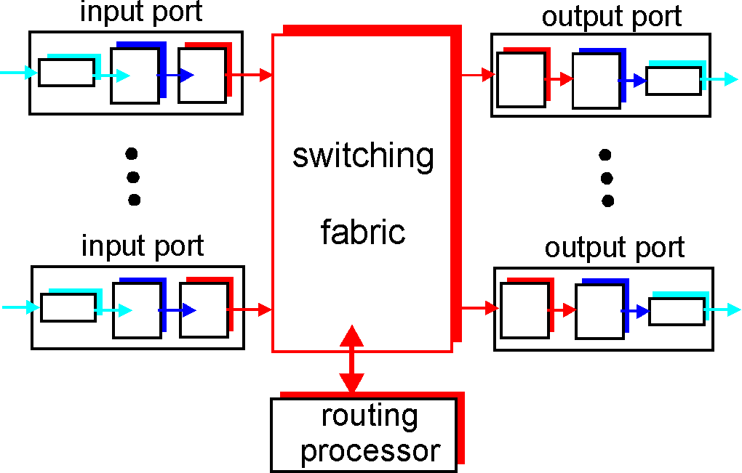
Router Architecture Overview
Two key router functions:
run routing algorithms/protocol (RIP, OSPF, BGP)
forwarding datagrams from incoming to outgoing link

Slide 69
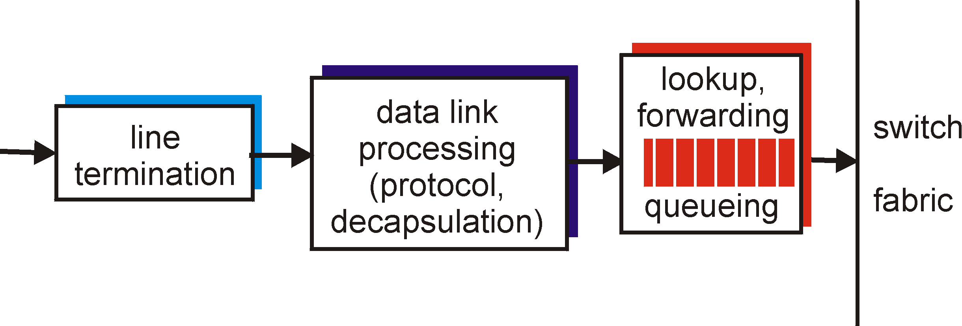
Input Port Functions
Physical layer:
bit-level reception
Data link layer:
e.g., Ethernet
see chapter 5
Decentralized switching:
given datagram dest., lookup output port using forwarding table in input port memory
goal: complete input port processing at ‘line speed’
queuing: if datagrams arrive faster than forwarding rate into switch fabric

Slide 70
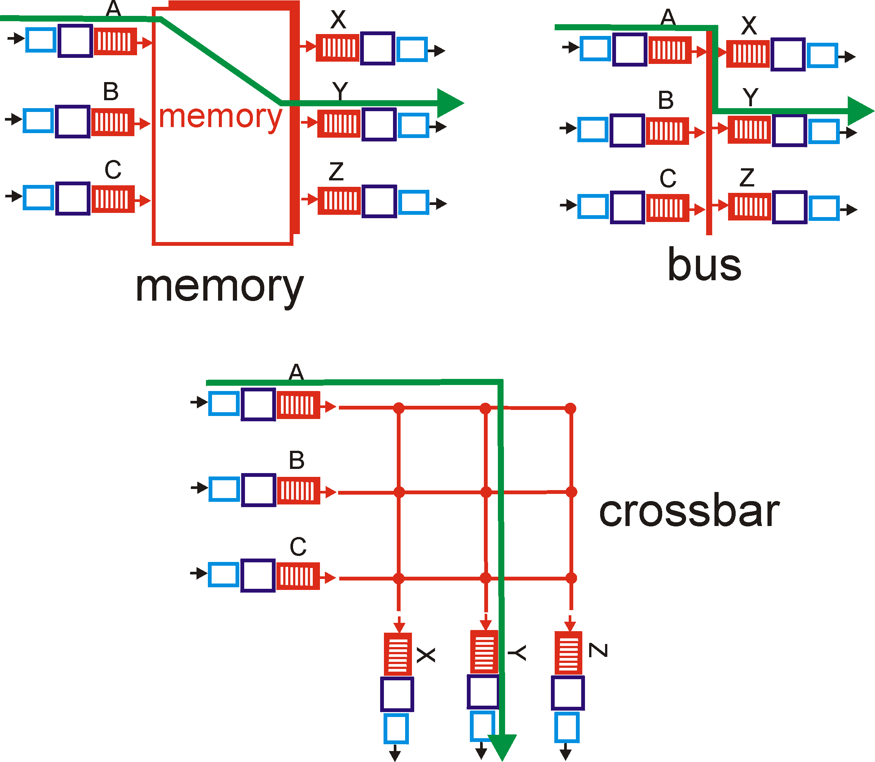
Three types of switching fabrics
(comparison criteria: speed, contention, complexity)

Slide 71
Switching Via Memory
First generation routers:
traditional computers with switching under direct control of CPU
packet copied to system’s memory
speed limited by memory bandwidth (2 bus crossings per datagram)
Input
Port
Memory
Output
Port
System Bus

Slide 72
Switching Via a Bus
datagram from input port memory
to output port memory via a shared bus
bus contention: switching speed limited by bus bandwidth
Lots of ports?? speed up the bus
no contention bus speed =
2 x port speed x port count
32 Gbps bus, Cisco 5600: sufficient speed for access and enterprise routers
72

Slide 73
Switching Via An Interconnection Network
overcome bus bandwidth limitations
Banyan networks, other interconnection nets initially developed to connect processors in multiprocessor
advanced design: fragmenting datagram into fixed length cells, switch cells through the fabric.
Cisco 12000: switches 60 Gbps through the interconnection network

Slide 74
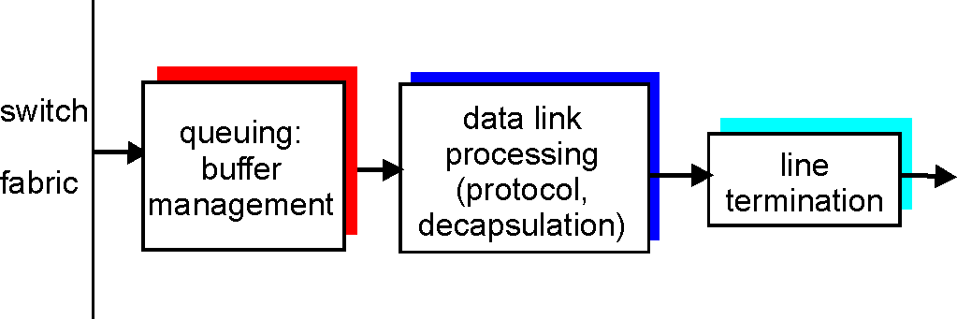
Output Ports
Buffering required when datagrams arrive from fabric faster than the transmission rate
Scheduling discipline chooses among queued datagrams for transmission
➔ Who goes next?

Slide 75
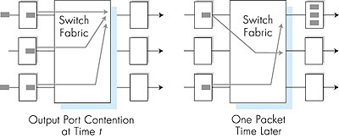
Output port queueing
buffering when arrival rate via switch exceeds output line speed
queueing (delay) and loss due to output port buffer overflow!

Slide 76
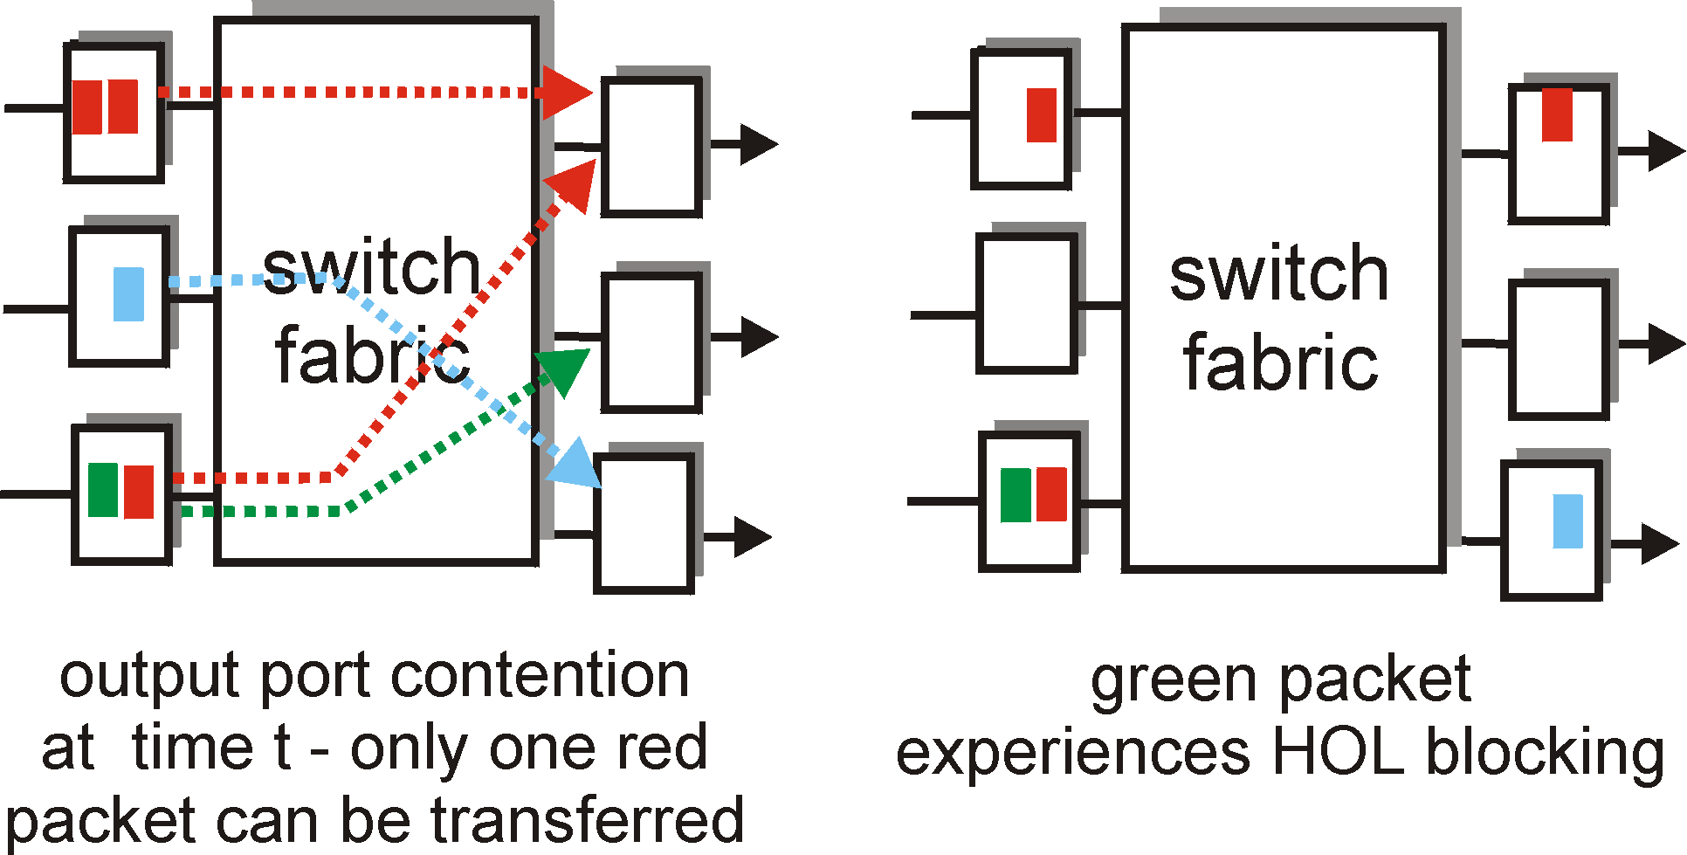
Input Port Queuing
Fabric slower than input ports combined -> queueing may occur at input queues
Head-of-the-Line (HOL) blocking: queued datagram at front of queue prevents others in queue from moving forward
queueing delay and loss due to input buffer overflow!

Slide 77
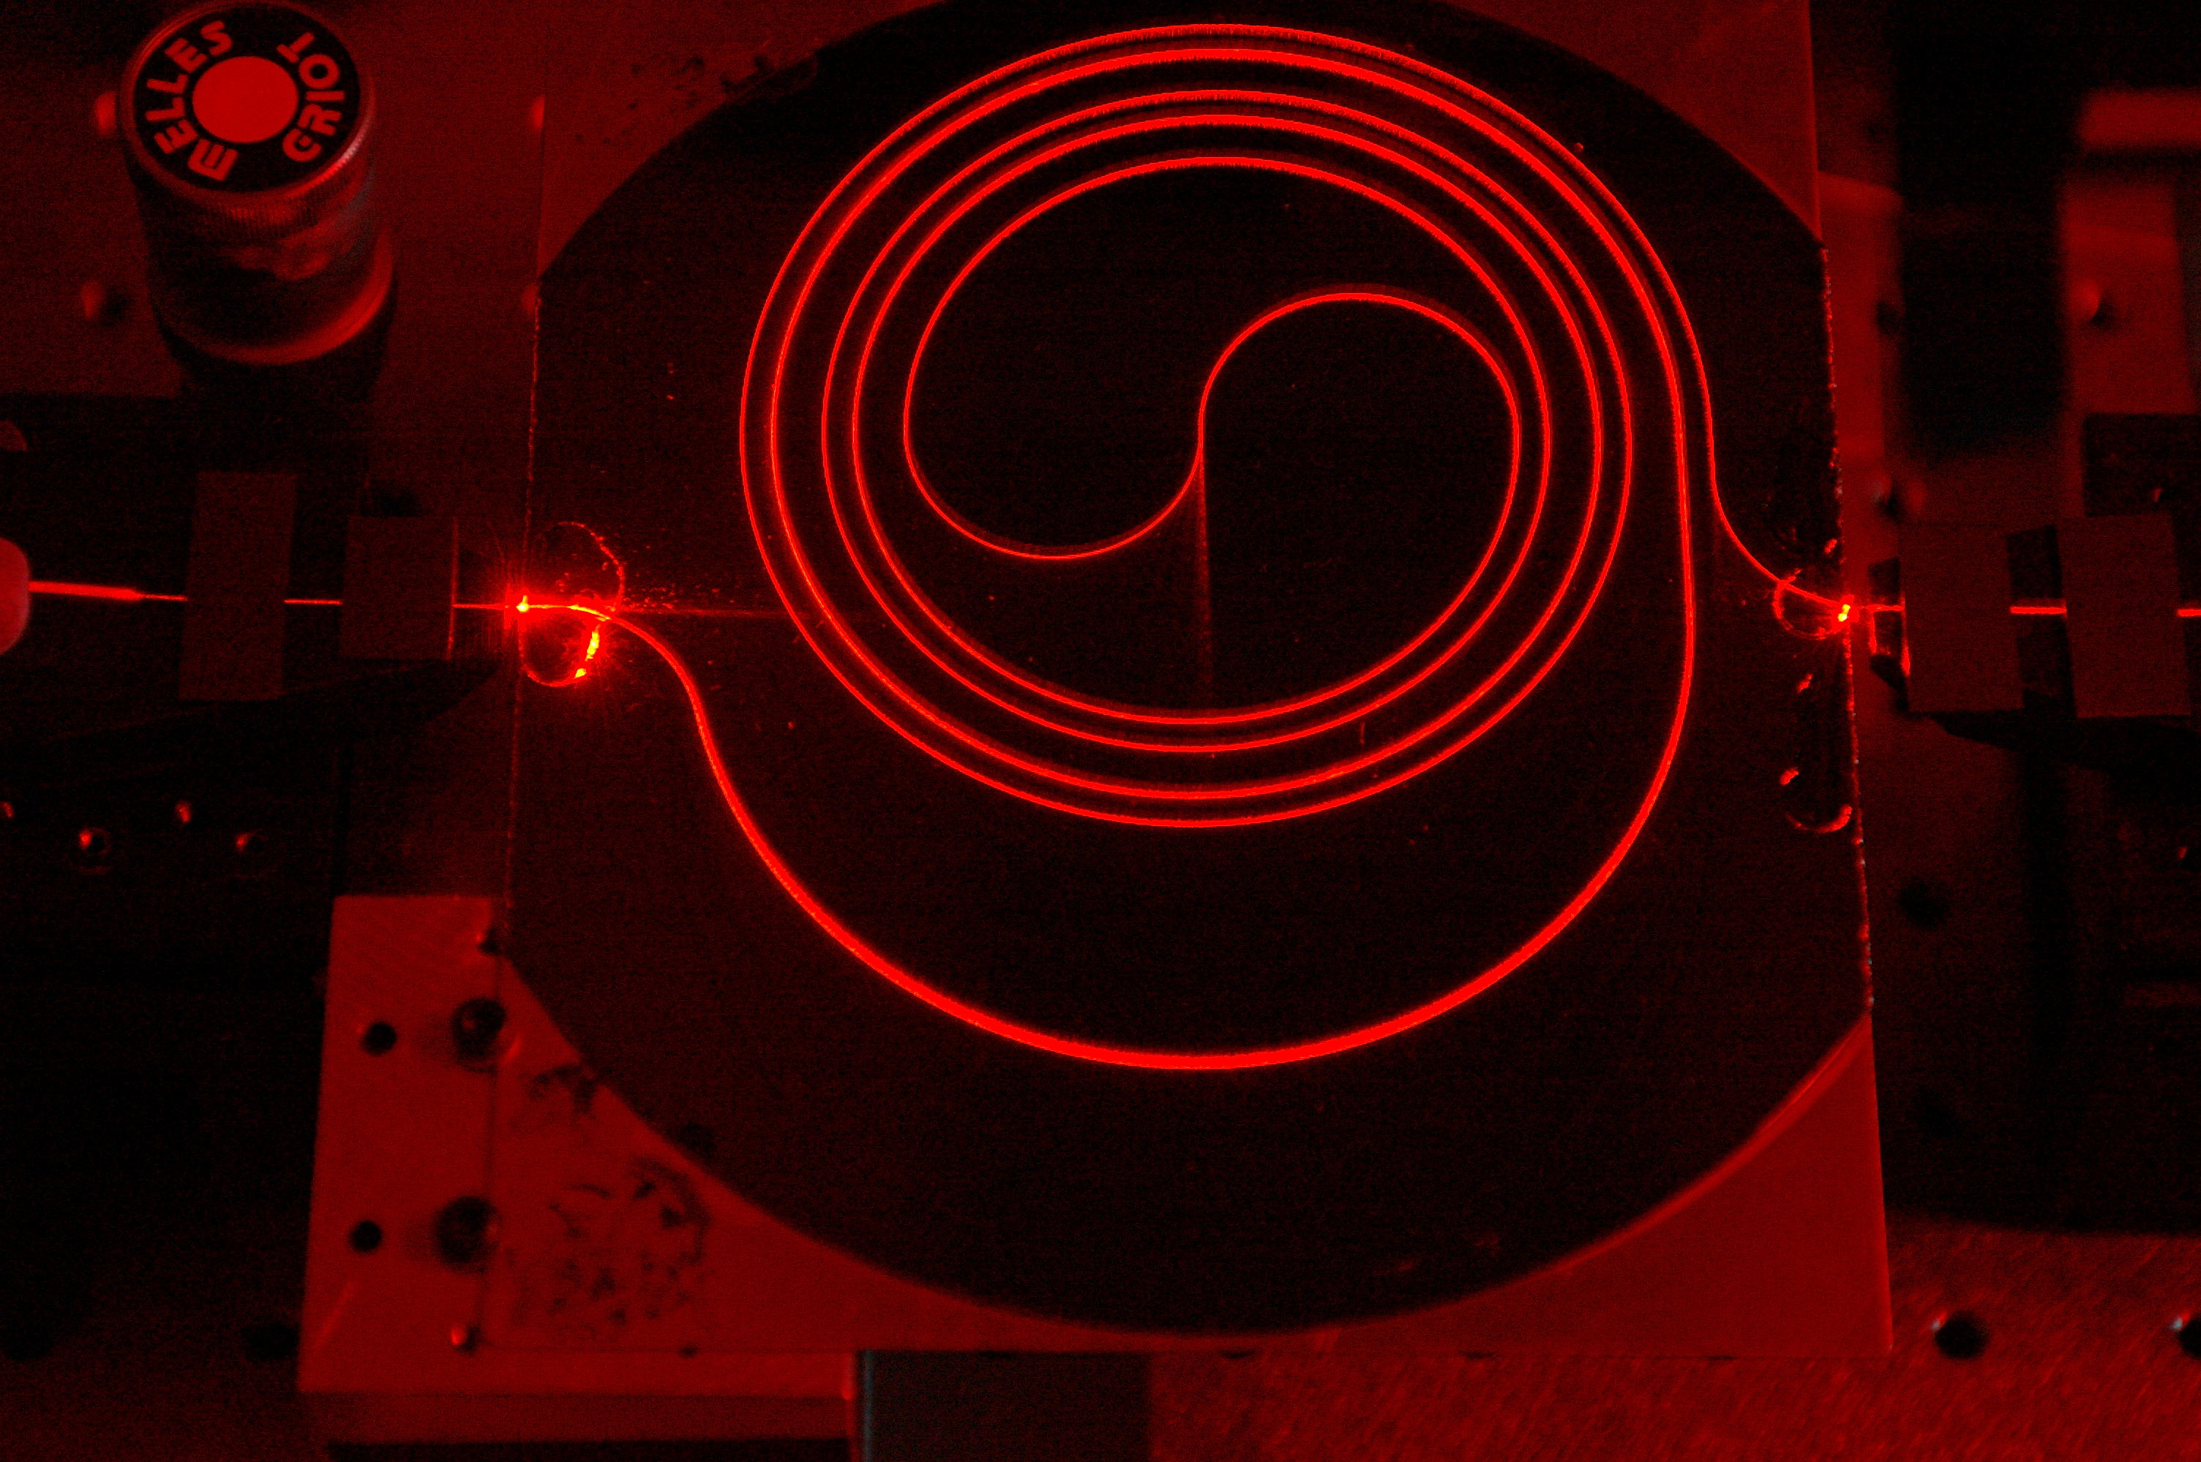
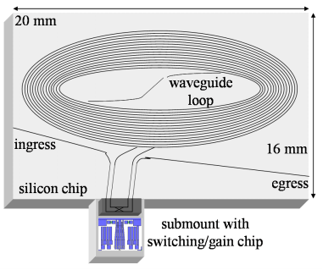
Buffers in Routers
So how large should the buffers be?
Buffer size matters
  End-to-end delay
    Transmission, propagation, and queueing delay
    The only variable part is queueing delay
  Router architecture
    Board space, power consumption, and cost
    On chip buffers: higher density, higher capacity
    Optical buffers: all-optical routers
1.4m long spiral waveguide with input from HeNe laser
You are now touching the edge of the research zone……
Notes:
got to hear 11/Feb/2013

Slide 78





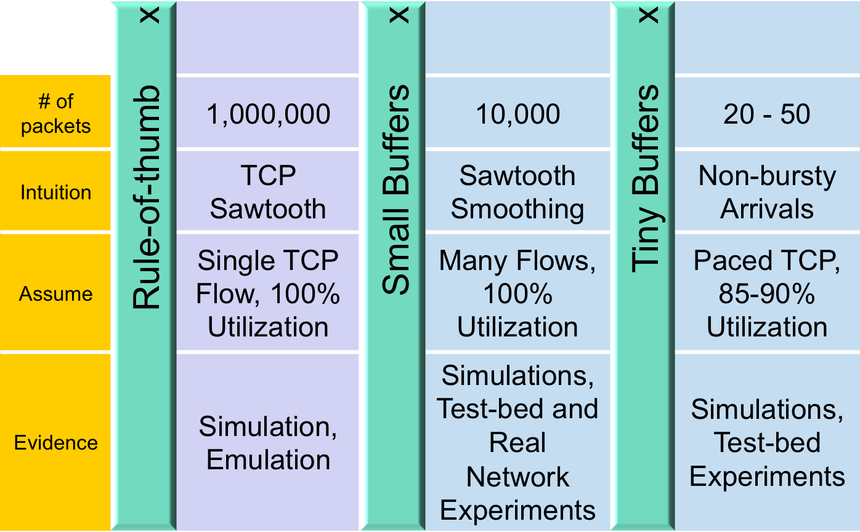
Buffer Sizing Story

Slide 79
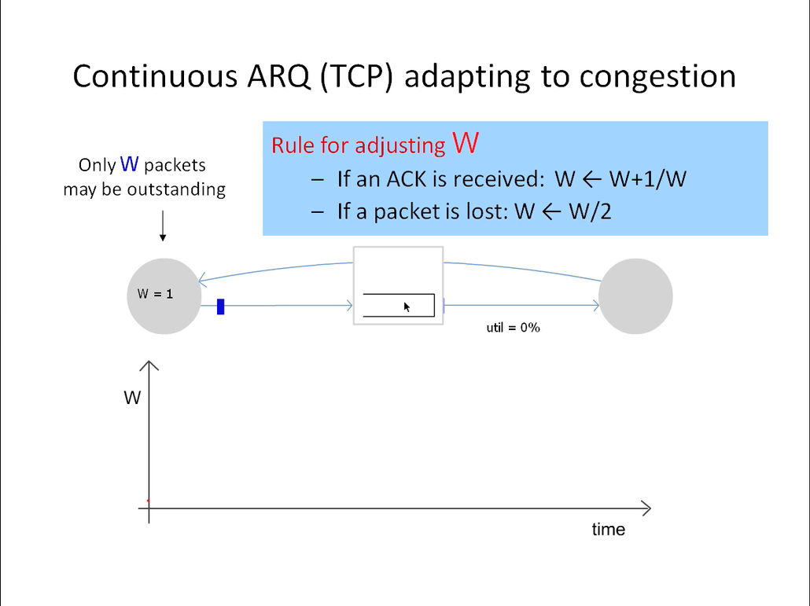

Slide 80


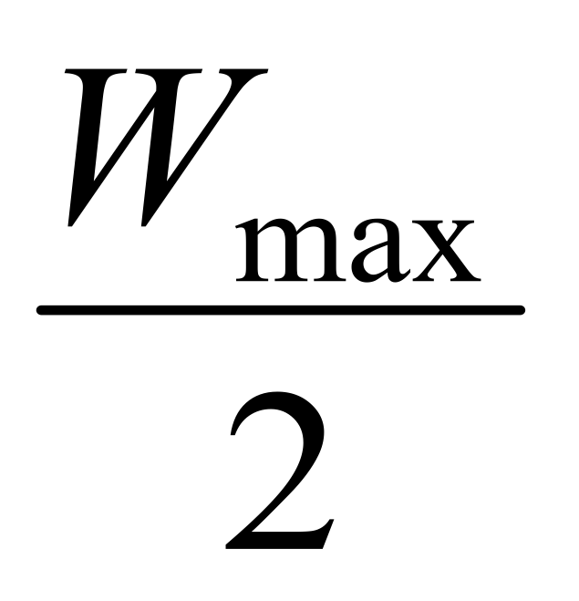
Rule-of-thumb – Intuition
Rule for adjusting W
If an ACK is received: W ← W+1/W
If a packet is lost: W ← W/2
Only W packets
may be outstanding
Source
Dest
Window size
t

Slide 81
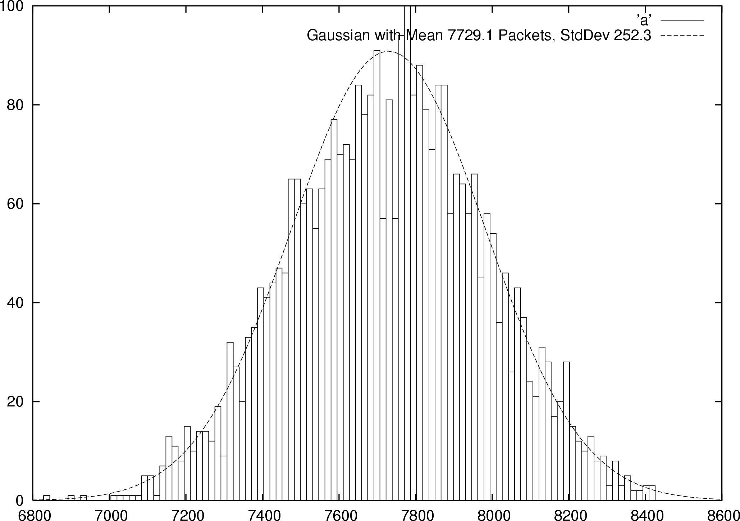


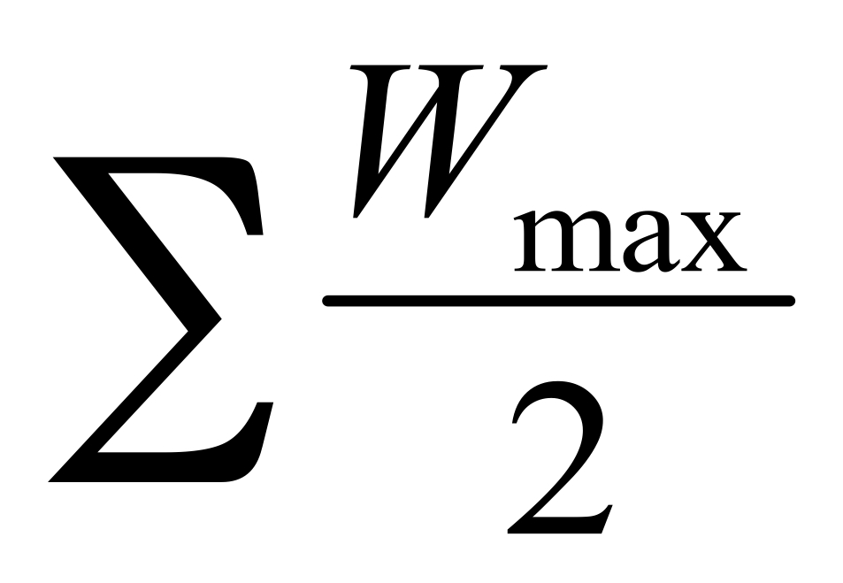

Small Buffers – Intuition
Synchronized Flows
Many TCP Flows
Aggregate window has same dynamics
Therefore buffer occupancy has same dynamics
Rule-of-thumb still holds.
Independent, desynchronized
Central limit theorem says the aggregate becomes Gaussian
Variance (buffer size) decreases as N increases
Buffer Size
Probability
Distribution
t
t

Slide 82
The Internet version of a Network layer
Host, router network layer functions:
Transport layer: TCP, UDP
Routing protocols
path selection
RIP, OSPF, BGP
IP protocol
addressing conventions
datagram format
packet handling conventions
Network
layer
forwarding
table
ICMP protocol
error reporting
router “signaling”
Link layer
physical layer

Slide 83
IPv4 Packet Structure
20 Bytes of Standard Header, then Options
4-bit
Version
4-bit
Header
Length
8-bit
Type of Service
(TOS)
16-bit Total Length (Bytes)
16-bit Identification
3-bit
Flags
13-bit Fragment Offset
8-bit Time to
Live (TTL)
8-bit Protocol
16-bit Header Checksum
32-bit Source IP Address
32-bit Destination IP Address
Options (if any)
Payload
Notes:
15/Feb/2013

Slide 84
(Packet) Network Tasks One-by-One
Read packet correctly
Get packet to the destination
Get responses to the packet back to source
Carry data
Tell host what to do with packet once arrived
Specify any special network handling of the packet
Deal with problems that arise along the path

Slide 85
Reading Packet Correctly
4-bit
Version
4-bit
Header
Length
8-bit
Type of Service
(TOS)
16-bit Total Length (Bytes)
16-bit Identification
3-bit
Flags
13-bit Fragment Offset
8-bit Time to
Live (TTL)
8-bit Protocol
16-bit Header Checksum
32-bit Source IP Address
32-bit Destination IP Address
Options (if any)
Payload
Version number (4 bits)
  Indicates the version of the IP protocol
  Necessary to know what other fields to expect
  Typically “4” (for IPv4), and sometimes “6” (for IPv6)
Header length (4 bits)
  Number of 32-bit words in the header
  Typically “5” (for a 20-byte IPv4 header)
  Can be more when IP options are used
Total length (16 bits)
  Number of bytes in the packet
  Maximum size is 65,535 bytes (2¹⁶ -1)
  … though underlying links may impose smaller limits

Slide 86
Getting Packet to Destination and Back
4-bit
Version
4-bit
Header
Length
8-bit
Type of Service
(TOS)
16-bit Total Length (Bytes)
16-bit Identification
3-bit
Flags
13-bit Fragment Offset
8-bit Time to
Live (TTL)
8-bit Protocol
16-bit Header Checksum
32-bit Source IP Address
32-bit Destination IP Address
Two IP addresses
  Source IP address (32 bits)
  Destination IP address (32 bits)
Destination address
  Unique identifier/locator for the receiving host
  Allows each node to make forwarding decisions
Source address
  Unique identifier/locator for the sending host
  Recipient can decide whether to accept packet
  Enables recipient to send a reply back to source
Options (if any)
Payload

Slide 87
Telling Host How to Handle Packet
4-bit
Version
4-bit
Header
Length
8-bit
Type of Service
(TOS)
16-bit Total Length (Bytes)
16-bit Identification
3-bit
Flags
13-bit Fragment Offset
8-bit Time to
Live (TTL)
8-bit Protocol
16-bit Header Checksum
32-bit Source IP Address
32-bit Destination IP Address
Options (if any)
Protocol (8 bits)
  Identifies the higher-level protocol
  Important for demultiplexing at receiving host
Most common examples
  E.g., “6” for the Transmission Control Protocol (TCP)
  E.g., “17” for the User Datagram Protocol (UDP)
Payload
protocol=6
protocol=17
IP header
IP header
TCP header
UDP header

Slide 88
Special Handling
4-bit
Version
4-bit
Header
Length
8-bit
Type of Service
(TOS)
16-bit Total Length (Bytes)
16-bit Identification
3-bit
Flags
13-bit Fragment Offset
8-bit Time to
Live (TTL)
8-bit Protocol
16-bit Header Checksum
32-bit Source IP Address
32-bit Destination IP Address
Options (if any)
Payload
Type-of-Service (8 bits)
  Allow packets to be treated differently based on needs
  E.g., low delay for audio, high bandwidth for bulk transfer
  Has been redefined several times
Options

Slide 89
Potential Problems
Header Corrupted: Checksum
Loop: TTL
Packet too large: Fragmentation

Slide 90
Header Corruption
4-bit
Version
4-bit
Header
Length
8-bit
Type of Service
(TOS)
16-bit Total Length (Bytes)
16-bit Identification
3-bit
Flags
13-bit Fragment Offset
8-bit Time to
Live (TTL)
8-bit Protocol
16-bit Header Checksum
32-bit Source IP Address
32-bit Destination IP Address
Options (if any)
Payload
Checksum (16 bits)
  Particular form of checksum over packet header
If not correct, router discards packets
  So it doesn’t act on bogus information
Checksum recalculated at every router
  Why?
  Why include TTL?
  Why only header?

Slide 91
_{Preventing Loops}
_{(aka} _{Internet Zombie plan)}
4-bit
Version
4-bit
Header
Length
8-bit
Type of Service
(TOS)
16-bit Total Length (Bytes)
16-bit Identification
3-bit
Flags
13-bit Fragment Offset
8-bit Time to
Live (TTL)
8-bit Protocol
16-bit Header Checksum
32-bit Source IP Address
32-bit Destination IP Address
Options (if any)
Forwarding loops cause packets to cycle forever
  As these accumulate, eventually consume all capacity
Time-to-Live (TTL) Field (8 bits)
  Decremented at each hop, packet discarded if reaches 0
  …and “time exceeded” message is sent to the source
    Using “ICMP” control message; basis for traceroute
Payload

Slide 92
Fragmentation
(some assembly required)
4-bit
Version
4-bit
Header
Length
8-bit
Type of Service
(TOS)
16-bit Total Length (Bytes)
16-bit Identification
3-bit
Flags
13-bit Fragment Offset
8-bit Time to
Live (TTL)
8-bit Protocol
16-bit Header Checksum
32-bit Source IP Address
32-bit Destination IP Address
Options (if any)
Payload
Fragmentation: when forwarding a packet, an Internet router can split it into multiple pieces (“fragments”) if too big for next hop link
Must reassemble to recover original packet
  Need fragmentation information (32 bits)
  Packet identifier, flags, and fragment offset

Slide 93
IP Fragmentation & Reassembly
network links have MTU (max.transfer size) - largest possible link-level frame.
  different link types, different MTUs
large IP datagram divided (“fragmented”) within net
  one datagram becomes several datagrams
  “reassembled” only at final destination
  IP header bits used to identify, order related fragments
IPv6 does things differently…
fragmentation:
in: one large datagram
out: 3 smaller datagrams
reassembly

Slide 94
IP Fragmentation and Reassembly
length
=4000
ID
=x
fragflag
=0
offset
=0
Example
4000 byte datagram
MTU = 1500 bytes
One large datagram becomes
several smaller datagrams
length
=1500
ID
=x
fragflag
=1
offset
=0
1480 bytes in
data field
length
=1500
ID
=x
fragflag
=1
offset
=185
offset =
1480/8
length
=1040
ID
=x
fragflag
=0
offset
=370
Pop quiz question: What happens when a fragment is lost?

Slide 95
Fragmentation Details
4-bit
Version
4-bit
Header
Length
8-bit
Type of Service
(TOS)
16-bit Total Length (Bytes)
16-bit Identification
3-bit
Flags
13-bit Fragment Offset
8-bit Time to
Live (TTL)
8-bit Protocol
16-bit Header Checksum
32-bit Source IP Address
32-bit Destination IP Address
Options (if any)
Payload
Identifier (16 bits): used to tell which fragments belong together
Flags (3 bits):
  Reserved (RF): unused bit
  Don’t Fragment (DF): instruct routers to not fragment the packet even if it won’t fit
    Instead, they drop the packet and send back a “Too Large” ICMP control message
    Forms the basis for “Path MTU Discovery”
  More (MF): this fragment is not the last one
Offset (13 bits): what part of datagram this fragment covers in 8-byte units
Pop quiz question: Why do frags use offset and not a frag number?
Notes:
map into memory
further downstream locations doing fragmentation would be v. hard with frag number (you would need reissue or reassemble or some craziness

Slide 96
Options
4-bit
Version
4-bit
Header
Length
8-bit
Type of Service
(TOS)
16-bit Total Length (Bytes)
16-bit Identification
3-bit
Flags
13-bit Fragment Offset
8-bit Time to
Live (TTL)
8-bit Protocol
16-bit Header Checksum
32-bit Source IP Address
32-bit Destination IP Address
Options (if any)
Payload
End of Options List
No Operation (padding between options)
Record Route
Strict Source Route
Loose Source Route
Timestamp
Traceroute
Router Alert
…..

Slide 97
IP Addressing: introduction
IP address: 32-bit identifier for host, router interface
interface: connection between host/router and physical link
  router’s typically have multiple interfaces
  host typically has one interface
  IP addresses associated with each interface
223.1.1.1
223.1.2.1
223.1.1.2
223.1.1.4
223.1.2.9
223.1.2.2
223.1.1.3
223.1.3.27
223.1.3.1
223.1.3.2
223.1.1.1 = 11011111 00000001 00000001 00000001
223
1
1
1

Slide 98
Subnets
IP address:
  subnet part (high order bits)
  host part (low order bits)
What’s a subnet ?
  device interfaces with same subnet part of IP address
  can physically reach each other without intervening router
223.1.1.0/24
223.1.2.0/24
223.1.1.1
223.1.2.1
223.1.1.2
223.1.1.4
223.1.2.9
223.1.1.3
223.1.2.2
223.1.3.27
subnet
223.1.3.1
223.1.3.2
subnet
part
host
part
11011111 00000001 00000011 00000000
223.1.3.0/24
223.1.3.0/24
CIDR: Classless InterDomain Routing
  subnet portion of address of arbitrary length
  address format: a.b.c.d/x, where x is # bits in subnet portion of address
Subnet mask: /24
network consisting of 3 subnets

Slide 99
IP addresses: how to get one?
Q: How does a host get IP address?
hard-coded by system admin in a file
  Windows: control-panel->network->configuration->tcp/ip->properties
  UNIX: /etc/rc.config
DHCP: Dynamic Host Configuration Protocol: dynamically get address from as server
  “plug-and-play”

Slide 100
DHCP client-server scenario
Goal: allow host to dynamically obtain its IP address from network server when it joins network
  Can renew its lease on address in use
  Allows reuse of addresses (only hold address while connected an “on”)
  Support for mobile users who want to join network (more shortly)
DHCP server: 223.1.2.5
arriving
client
DHCP discover
src : 0.0.0.0, 68
dest.: 255.255.255.255,67
yiaddr: 0.0.0.0
transaction ID: 654
DHCP offer
src: 223.1.2.5, 67
dest: 255.255.255.255, 68
yiaddrr: 223.1.2.4
transaction ID: 654
Lifetime: 3600 secs
DHCP request
src: 0.0.0.0, 68
dest:: 255.255.255.255, 67
yiaddrr: 223.1.2.4
transaction ID: 655
Lifetime: 3600 secs
A
223.1.1.1
DHCP
223.1.2.1
server
223.1.1.2
time
223.1.1.4
223.1.2.9
DHCP ACK
B
src: 223.1.2.5, 67
dest: 255.255.255.255, 68
yiaddrr: 223.1.2.4
transaction ID: 655
Lifetime: 3600 secs
223.1.2.2
E
arriving DHCP
client needs
address in this
network
223.1.1.3
223.1.3.27
223.1.3.1
223.1.3.2

Slide 101
IP addresses: how to get one?
Q: How does network get subnet part of IP addr?
A: gets allocated portion of its provider ISP’s address space
ISP's block 11001000 00010111 00010000 00000000 200.23.16.0/20
Organization 0 11001000 00010111 00010000 00000000 200.23.16.0/23
Organization 1 11001000 00010111 00010010 00000000 200.23.18.0/23
Organization 2 11001000 00010111 00010100 00000000 200.23.20.0/23
... ….. …. ….
Organization 7 11001000 00010111 00011110 00000000 200.23.30.0/23

Slide 102
Hierarchical addressing: route aggregation
Hierarchical addressing allows efficient advertisement of routing
information:
Organization 0
200.23.16.0/23
Organization 1
200.23.18.0/23
“Send me anything
with addresses
beginning
200.23.16.0/20”
Organization 2
200.23.20.0/23
.
Fly-By-Night-ISP
.
.
.
.
Internet
Organization 7
.
200.23.30.0/23
ISPs-R-Us
“Send me anything
with addresses
beginning
199.31.0.0/16”

Slide 103
Hierarchical addressing: more specific routes
ISPs-R-Us has a more specific route to Organization 1
Organization 0
200.23.16.0/23
“Send me anything
with addresses
beginning
200.23.16.0/20”
Organization 2
200.23.20.0/23
.
Fly-By-Night-ISP
.
.
.
.
Internet
Organization 7
.
200.23.30.0/23
ISPs-R-Us
“Send me anything
with addresses
beginning 199.31.0.0/16
or 200.23.18.0/23”
Organization 1
200.23.18.0/23
Notes:
18 feb 2013

Slide 104
IP addressing: the last word...
Q: How does an ISP get block of addresses?
A: ICANN: Internet Corporation for Assigned
Names and Numbers
  allocates addresses
  manages DNS
  assigns domain names, resolves disputes

Slide 105
NAT: Network Address Translation
Cant get more IP addresses? well there is always…..
rest of
Internet
local network
(e.g., home network)
10.0.0/24
10.0.0.1
10.0.0.4
10.0.0.2
138.76.29.7
10.0.0.3
All datagrams leaving local
network have same single source NAT IP address: 138.76.29.7,
different source port numbers
Datagrams with source or
destination in this network
have 10.0.0/24 address for
source, destination (as usual)

Slide 106
NAT: Network Address Translation
Motivation: local network uses just one IP address as far as outside world is concerned:
  range of addresses not needed from ISP: just one IP address for all devices
  can change addresses of devices in local network without notifying outside world
  can change ISP without changing addresses of devices in local network
  devices inside local net not explicitly addressable, visible by outside world (a security plus).

Slide 107
NAT: Network Address Translation
Implementation: NAT router must:
  outgoing datagrams: replace (source IP address, port #) of every outgoing datagram to (NAT IP address, new port #)
    . . . remote clients/servers will respond using (NAT IP address, new port #) as destination addr.
  remember (in NAT translation table) every (source IP address, port #) to (NAT IP address, new port #) translation pair
  incoming datagrams: replace (NAT IP address, new port #) in dest fields of every incoming datagram with corresponding (source IP address, port #) stored in NAT table

Slide 108
NAT: Network Address Translation
NAT translation table
WAN side addr LAN side addr
1: host 10.0.0.1
sends datagram to
128.119.40.186, 80
2: NAT router
changes datagram
source addr from
10.0.0.1, 3345 to
138.76.29.7, 5001,
updates table
138.76.29.7, 5001 10.0.0.1, 3345
…… ……
S: 10.0.0.1, 3345
D: 128.119.40.186, 80
10.0.0.1
1
2
S: 138.76.29.7, 5001
D: 128.119.40.186, 80
10.0.0.4
10.0.0.2
138.76.29.7
S: 128.119.40.186, 80
D: 10.0.0.1, 3345
4
S: 128.119.40.186, 80
D: 138.76.29.7, 5001
3
10.0.0.3
4: NAT router
changes datagram
dest addr from
138.76.29.7, 5001 to 10.0.0.1, 3345
3: Reply arrives
dest. address:
138.76.29.7, 5001

Slide 109
NAT: Network Address Translation
16-bit port-number field:
  60,000 simultaneous connections with a single LAN-side address!
NAT is controversial:
  routers should only process up to layer 3
  violates end-to-end argument (?)
    NAT possibility must be taken into account by app designers, eg, P2P applications
  address shortage should instead be solved by IPv6

Slide 110
NAT traversal problem
client wants to connect to server with address 10.0.0.1
  server address 10.0.0.1 local to LAN (client can’t use it as destination addr)
  only one externally visible NATted address: 138.76.29.7
solution 1: statically configure NAT to forward incoming connection requests at given port to server
  e.g., (138.76.29.7, port 2500) always forwarded to 10.0.0.1 port 25000
10.0.0.1
Client
?
10.0.0.4
138.76.29.7
NAT
router

Slide 111
NAT traversal problem
solution 2: Universal Plug and Play (UPnP) Internet Gateway Device (IGD) Protocol. Allows NATted host to:
  learn public IP address (138.76.29.7)
  add/remove port mappings (with lease times)
  i.e., automate static NAT port map configuration
10.0.0.1
IGD
10.0.0.4
138.76.29.7
NAT
router

Slide 112


NAT traversal problem
solution 3: relaying (used in Skype)
  NATed client establishes connection to relay
  External client connects to relay
  relay bridges packets between to connections
2. connection to
relay initiated
by client
1. connection to
relay initiated
by NATted host
10.0.0.1
3. relaying
established
Client
138.76.29.7
NAT
router

Slide 113
Remember this? Traceroute at work…
traceroute: rio.cl.cam.ac.uk to munnari.oz.au
(tracepath on pwf is similar)
Three delay measurements from
rio.cl.cam.ac.uk to gatwick.net.cl.cam.ac.uk
traceroute munnari.oz.au
traceroute to munnari.oz.au (202.29.151.3), 30 hops max, 60 byte packets
1 gatwick.net.cl.cam.ac.uk (128.232.32.2) 0.416 ms 0.384 ms 0.427 ms
2 cl-sby.route-nwest.net.cam.ac.uk (193.60.89.9) 0.393 ms 0.440 ms 0.494 ms
3 route-nwest.route-mill.net.cam.ac.uk (192.84.5.137) 0.407 ms 0.448 ms 0.501 ms
4 route-mill.route-enet.net.cam.ac.uk (192.84.5.94) 1.006 ms 1.091 ms 1.163 ms
5 xe-11-3-0.camb-rbr1.eastern.ja.net (146.97.130.1) 0.300 ms 0.313 ms 0.350 ms
6 ae24.lowdss-sbr1.ja.net (146.97.37.185) 2.679 ms 2.664 ms 2.712 ms
7 ae28.londhx-sbr1.ja.net (146.97.33.17) 5.955 ms 5.953 ms 5.901 ms
8 janet.mx1.lon.uk.geant.net (62.40.124.197) 6.059 ms 6.066 ms 6.052 ms
9 ae0.mx1.par.fr.geant.net (62.40.98.77) 11.742 ms 11.779 ms 11.724 ms
10 ae1.mx1.mad.es.geant.net (62.40.98.64) 27.751 ms 27.734 ms 27.704 ms
11 mb-so-02-v4.bb.tein3.net (202.179.249.117) 138.296 ms 138.314 ms 138.282 ms
12 sg-so-04-v4.bb.tein3.net (202.179.249.53) 196.303 ms 196.293 ms 196.264 ms
13 th-pr-v4.bb.tein3.net (202.179.249.66) 225.153 ms 225.178 ms 225.196 ms
14 pyt-thairen-to-02-bdr-pyt.uni.net.th (202.29.12.10) 225.163 ms 223.343 ms 223.363 ms
15 202.28.227.126 (202.28.227.126) 241.038 ms 240.941 ms 240.834 ms
16 202.28.221.46 (202.28.221.46) 287.252 ms 287.306 ms 287.282 ms
17 * * *
18 * * *
19 * * *
20 coe-gw.psu.ac.th (202.29.149.70) 241.681 ms 241.715 ms 241.680 ms
21 munnari.OZ.AU (202.29.151.3) 241.610 ms 241.636 ms 241.537 ms
trans-continent
link
* means no response (probe lost, router not replying)
Notes:
Where did the delay come from??

Slide 114
Traceroute and ICMP
Source sends series of UDP segments to dest
  First has TTL =1
  Second has TTL=2, etc.
  Unlikely port number
When nth datagram arrives to nth router:
  Router discards datagram
  And sends to source an ICMP message (type 11, code 0)
  Message includes name of router& IP address
When ICMP message arrives, source calculates RTT
Traceroute does this 3 times
Stopping criterion
UDP segment eventually arrives at destination host
Destination returns ICMP “host unreachable” packet (type 3, code 3)
When source gets this ICMP, stops.

Slide 115
ICMP: Internet Control Message Protocol
used by hosts & routers to communicate network-level information
  error reporting: unreachable host, network, port, protocol
  echo request/reply (used by ping)
network-layer “above” IP:
  ICMP msgs carried in IP datagrams
ICMP message: type, code plus first 8 bytes of IP datagram causing error
Type Code description
0 0 echo reply (ping)
3 0 dest. network unreachable
3 1 dest host unreachable
3 2 dest protocol unreachable
3 3 dest port unreachable
3 6 dest network unknown
3 7 dest host unknown
4 0 source quench (congestion
control - not used)
8 0 echo request (ping)
9 0 route advertisement
10 0 router discovery
11 0 TTL expired
12 0 bad IP header

Slide 116
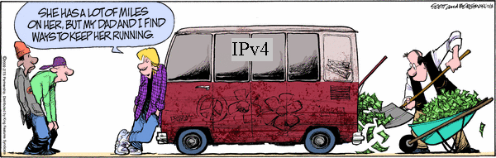
IPv6
Motivated (prematurely) by address exhaustion
  Address field four times as long
Steve Deering focused on simplifying IP
  Got rid of all fields that were not absolutely necessary
  “Spring Cleaning” for IP
Result is an elegant, if unambitious, protocol

Slide 117
IPv4 and IPv6 Header Comparison
IPv4
IPv6
Version | IHL | Type of Service | Total Length
Identification |  |  | Flags | Fragment Offset
Time to Live |  | Protocol | Header Checksum
Source Address
Destination Address
Options |  |  |  |  | Padding
Version | Traffic Class | Flow Label
Payload Length |  |  | Next Header | Hop Limit
Source Address
Destination Address
Field name kept from IPv4 to IPv6
Fields not kept in IPv6
Name & position changed in IPv6
New field in IPv6

Slide 118
Summary of Changes
Eliminated fragmentation (why?)
Eliminated header length (why?)
Eliminated checksum (why?)
New options mechanism (next header) (why?)
Expanded addresses (why?)
Added Flow Label (why?)
Notes:
got here 20 Feb 2013

Slide 119
IPv4 and IPv6 Header Comparison
IPv4
IPv6
Version | IHL | Type of Service | Total Length
Identification |  |  | Flags | Fragment Offset
Time to Live |  | Protocol | Header Checksum
Source Address
Destination Address
Options |  |  |  |  | Padding
Version | Traffic Class | Flow Label
Payload Length |  |  | Next Header | Hop Limit
Source Address
Destination Address
Field name kept from IPv4 to IPv6
Fields not kept in IPv6
Name & position changed in IPv6
New field in IPv6

Slide 120
Philosophy of Changes
Don’t deal with problems: leave to ends
  Eliminated fragmentation
  Eliminated checksum
  Why retain TTL?
Simplify handling:
  New options mechanism (uses next header approach)
  Eliminated header length
    Why couldn’t IPv4 do this?
Provide general flow label for packet
  Not tied to semantics
  Provides great flexibility

Slide 121
Comparison of Design Philosophy
IPv4
IPv6
Version | IHL | Type of Service | Total Length
Identification |  |  | Flags | Fragment Offset
Time to Live |  | Protocol | Header Checksum
Source Address
Destination Address
Options |  |  |  |  | Padding
Version | Traffic Class | Flow Label
Payload Length |  |  | Next Header | Hop Limit
Source Address
Destination Address
To Destination and Back (expanded)
Deal with Problems (greatly reduced)
Read Correctly (reduced)
Special Handling (similar)

Slide 122
Transition From IPv4 To IPv6
Not all routers can be upgraded simultaneous
  no “flag days”
  How will the network operate with mixed IPv4 and IPv6 routers?
Tunneling: IPv6 carried as payload in IPv4 datagram among IPv4 routers

Slide 123
Tunneling
A
B
E
F
Logical view:
tunnel
IPv6
IPv6
IPv6
IPv6
A
B
E
F
Physical view:
IPv6
IPv6
IPv4
IPv4
IPv6
IPv6

Slide 124
Tunneling
A
B
E
F
Logical view:
tunnel
IPv6
IPv6
IPv6
IPv6
A
B
C
D
E
F
Physical view:
IPv6
IPv6
IPv4
IPv4
IPv6
IPv6
Flow: X
Src: A
Dest: F
data
Src:B
Dest: E
Src:B
Dest: E
Flow: X
Src: A
Dest: F
data
Flow: X
Src: A
Dest: F
data
Flow: X
Src: A
Dest: F
data
A-to-B:
IPv6
B-to-C:
IPv6 inside
IPv4
B-to-C:
IPv6 inside
IPv4
E-to-F:
IPv6

Slide 125
Improving on IPv4 and IPv6?
Why include unverifiable source address?
  Would like accountability and anonymity (now neither)
  Return address can be communicated at higher layer
Why packet header used at edge same as core?
  Edge: host tells network what service it wants
  Core: packet tells switch how to handle it
    One is local to host, one is global to network
Some kind of payment/responsibility field?
  Who is responsible for paying for packet delivery?
  Source, destination, other?
Other ideas?

Slide 126
Gluing it together:
How does my Network (address) interact
with my Data-Link (address) ?

Slide 127
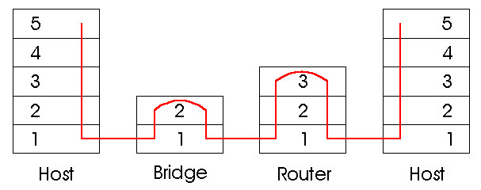
Switches vs. Routers Summary
both store-and-forward devices
  routers: network layer devices (examine network layer headers)
  switches are link layer devices
routers maintain routing tables, implement routing algorithms
switches maintain switch tables, implement filtering, learning algorithms
Notes:
FINAL SLIDE IN PART 5

Slide 128
MAC Addresses (and ARP) or How do I glue my network to my data-link?
32-bit IP address:
  network-layer address
  used to get datagram to destination IP subnet
MAC (or LAN or physical or Ethernet) address:
  function: get frame from one interface to another physically-connected interface (same network)
  48 bit MAC address (for most LANs)
    burned in NIC ROM, also (commonly) software settable

Slide 129
LAN Addresses and ARP
Each adapter on LAN has unique LAN address
1A-2F-BB-709-AD
Ethernet
Broadcast address =
FF-FF-FF-FF-FF-FF
LAN
(wired or
wireless)
= adapter
71-6F7-2B-08-53
58-23-D7-FA-20-B0
0C-C4-11-6F-E3-98

Slide 130
Address Resolution Protocol
Every node maintains an ARP table
  <IP address, MAC address> pair
Consult the table when sending a packet
  Map destination IP address to destination MAC address
  Encapsulate and transmit the data packet
But: what if IP address not in the table?
  Sender broadcasts: “Who has IP address 1.2.3.156?”
  Receiver responds: “MAC address 58-23-D7-FA-20-B0”
  Sender caches result in its ARP table
Notes:
Wed 7th start here.

Slide 131
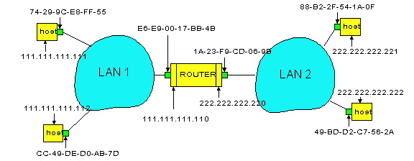
Example: A Sending a Packet to B
How does host A send an IP packet to host B?
A
R
B

Slide 132
Example: A Sending a Packet to B
How does host A send an IP packet to host B?
A
R
B
1. A sends packet to R.
2. R sends packet to B.

Slide 133
Host A Decides to Send Through R
Host A constructs an IP packet to send to B
  Source 111.111.111.111, destination 222.222.222.222
Host A has a gateway router R
  Used to reach destinations outside of 111.111.111.0/24
  Address 111.111.111.110 for R learned via DHCP/config
A
R
B

Slide 134
Host A Sends Packet Through R
Host A learns the MAC address of R’s interface
  ARP request: broadcast request for 111.111.111.110
  ARP response: R responds with E6-E9-00-17-BB-4B
Host A encapsulates the packet and sends to R
A
R
B

Slide 135
R Decides how to Forward Packet
Router R’s adaptor receives the packet
  R extracts the IP packet from the Ethernet frame
  R sees the IP packet is destined to 222.222.222.222
Router R consults its forwarding table
  Packet matches 222.222.222.0/24 via other adaptor
A
R
B

Slide 136
R Sends Packet to B
Router R’s learns the MAC address of host B
  ARP request: broadcast request for 222.222.222.222
  ARP response: B responds with 49-BD-D2-C7-52A
Router R encapsulates the packet and sends to B
A
R
B

Slide 137

Security Analysis of ARP
Impersonation
  Any node that hears request can answer …
  … and can say whatever they want
Actual legit receiver never sees a problem
  Because even though later packets carry its IP address, its NIC doesn’t capture them since not its MAC address
Notes:
1/Fab/2013

Slide 138
Key Ideas in Both ARP and DHCP
Broadcasting: Can use broadcast to make contact
  Scalable because of limited size
Caching: remember the past for a while
  Store the information you learn to reduce overhead
  Remember your own address & other host’s addresses
Soft state: eventually forget the past
  Associate a time-to-live field with the information
  … and either refresh or discard the information
  Key for robustness in the face of unpredictable change

Slide 139
Why Not Use DNS-Like Tables?
When host arrives:
  Assign it an IP address that will last as long it is present
  Add an entry into a table in DNS-server that maps MAC to IP addresses
Answer:
  Names: explicit creation, and are plentiful
  Hosts: come and go without informing network
    Must do mapping on demand
  Addresses: not plentiful, need to reuse and remap
    Soft-state enables dynamic reuse
Notes:
Two key points

Slide 140
Summary Network Layer
understand principles behind network layer services:
  network layer service models
  forwarding versus routing (versus switching)
  how a router works
  routing (path selection)
  IPv6
Algorthims
  Two routing approaches (LS vs DV)
  One of these in detail (LS)
  ARP

