Slide 1
Computer Networking
Lent Term M/W/F 11-midday
LT1 in Gates Building
Slide Set 7
Andrew W. Moore
andrew.moore@cl.cam.ac.uk
January2013

Slide 2
Topic 7: The Datacenter
(DC/Data Center/Data Centre/….)
Our goals:
Datacenters are the new Internet; regular Internet has become mature (ossified); datacenter along with wireless are a leading edge of new problems and new solutions
Architectures and thoughts
  Where do we start?
  old ideas are new again: VL2
  c-Through, Flyways, and all that jazz
Transport layer obsessions:
  TCP for the Datacenter (DCTCP)
  recycling an idea (Multipath TCP)
  Stragglers and Incast

Slide 3
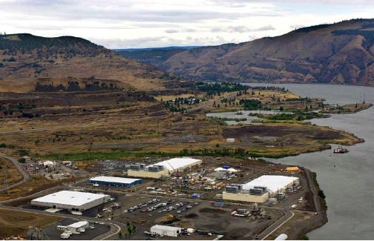
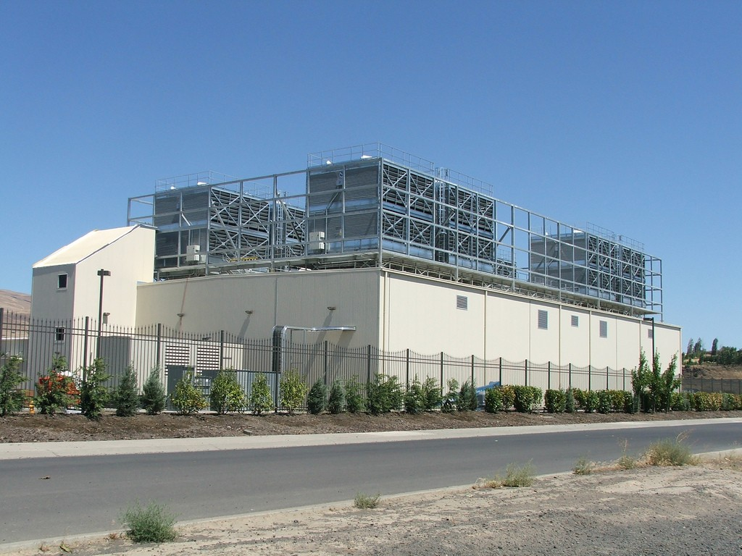
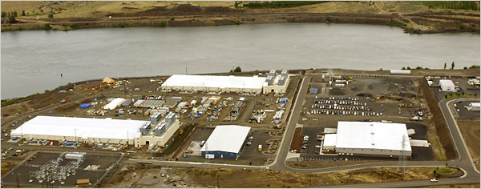
Google Oregon
Warehouse Scale Computer

Slide 4
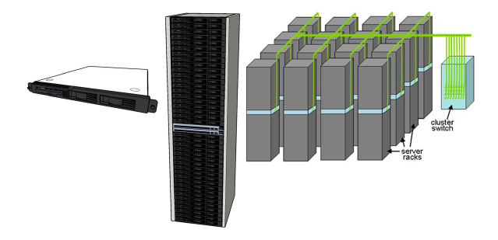
Equipment Inside a WSC
Server (in rack format):
1 ¾ inches high “1U”,
x 19 inches x 16-20 inches: 8 cores, 16 GB DRAM, 4x1 TB disk
Array (aka cluster):
16-32 server racks + larger local area network switch (“array switch”) 10X faster => cost 100X: cost f(N²)
7 foot Rack: 40-80 servers + Ethernet local area network (1-10 Gbps) switch in middle (“rack switch”)

Slide 5
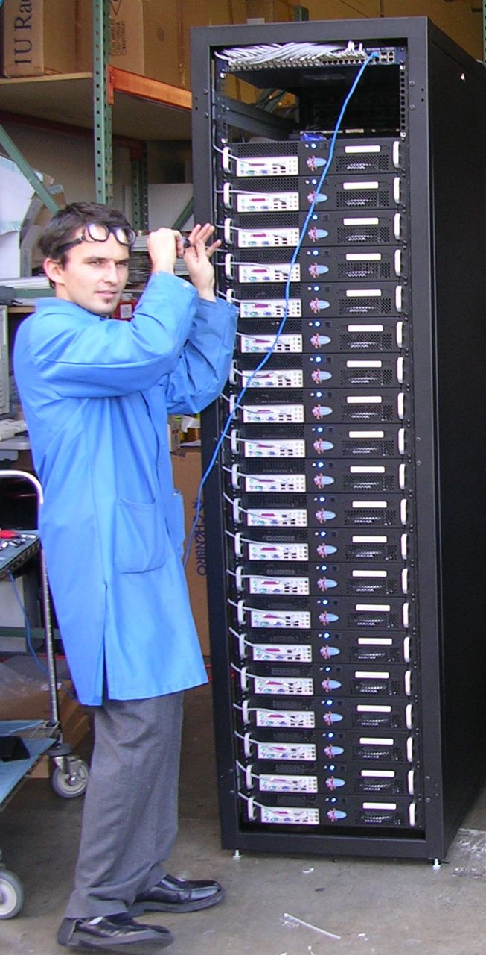
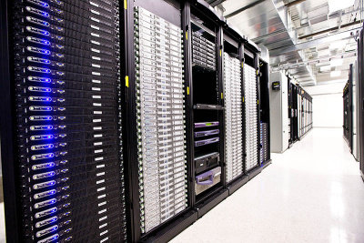
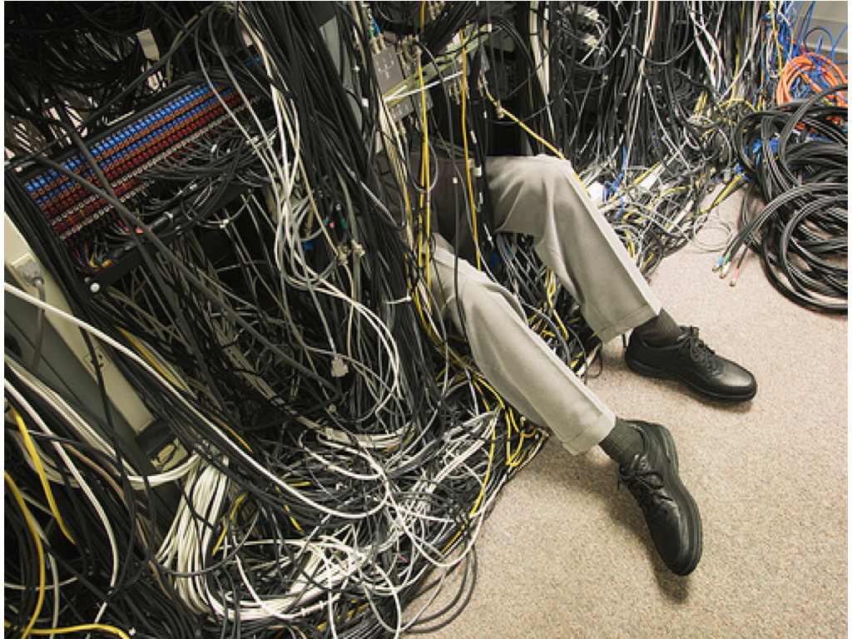
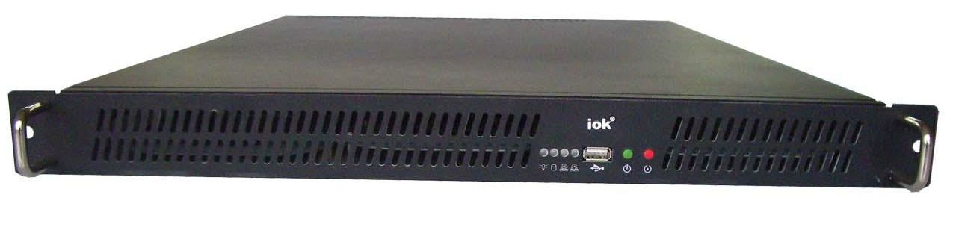
Server, Rack, Array

Slide 6
Data warehouse?
If you have a Petabyte,
you might have a datacenter
If your paged at 3am because you only have a few Petabyte left,
you might have a data warehouse
Luiz Barroso (Google), 2009
The slide most likely to get out of date…

Slide 7
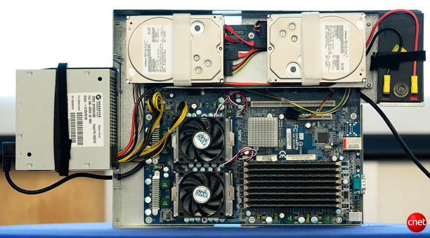
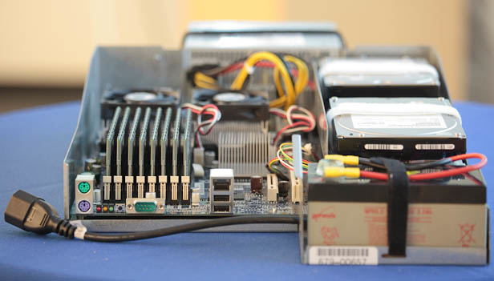
Google Server Internals
Google Server
Notes:
Most companies buy servers from the likes of Dell, Hewlett-Packard, IBM, or Sun Microsystems. But Google, which has hundreds of thousands of servers and considers running them part of its core expertise, designs and builds its own. Ben Jai, who designed many of Google's servers, unveiled a modern Google server before the hungry eyes of a technically sophisticated audience.
Google's big surprise: each server has its own 12-volt battery to supply power if there's a problem with the main source of electricity. The company also revealed for the first time that since 2005, its data centers have been composed of standard shipping containers--each with 1,160 servers and a power consumption that can reach 250 kilowatts.
It may sound geeky, but a number of attendees--the kind of folks who run data centers packed with thousands of servers for a living--were surprised not only by Google's built-in battery approach, but by the fact that the company has kept it secret for years. Jai said in an interview that Google has been using the design since 2005 and now is in its sixth or seventh generation of design.
Read more: http://news.cnet.com/8301-1001_3-10209580-92.html#ixzz0yo8bhTOH

Slide 8
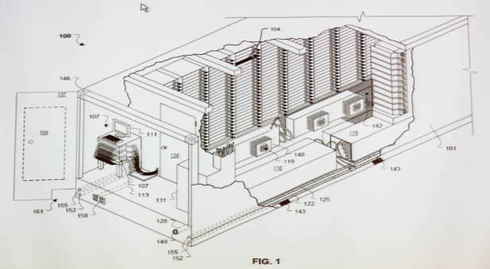
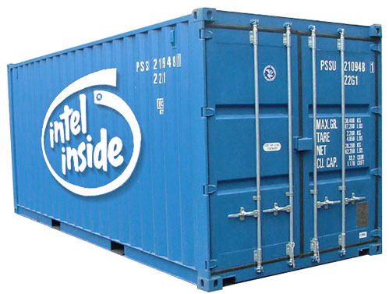
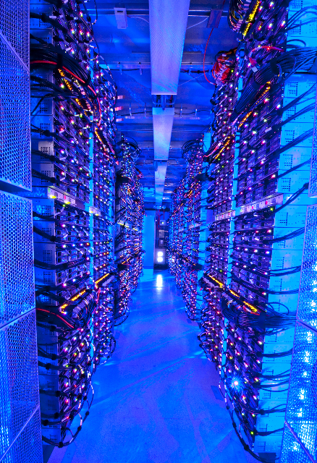
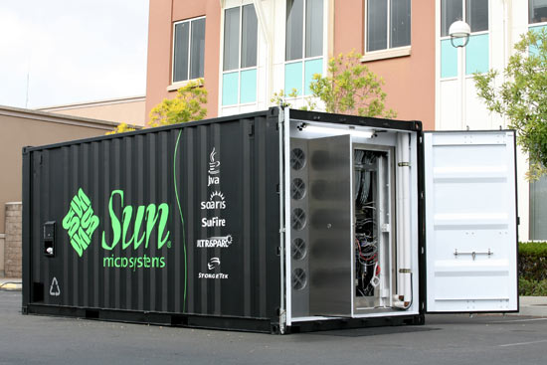
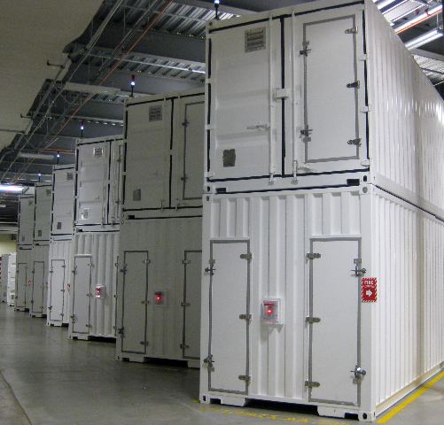
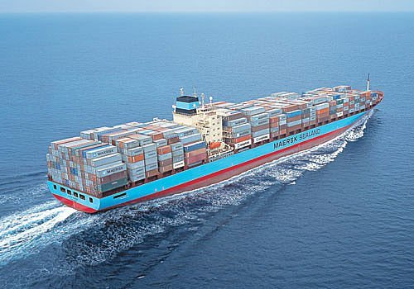

Slide 9
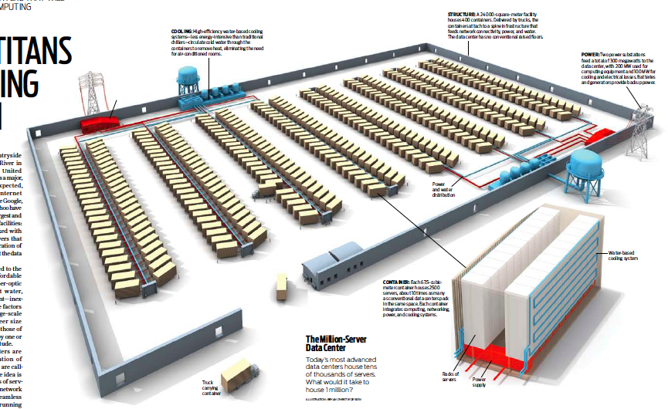
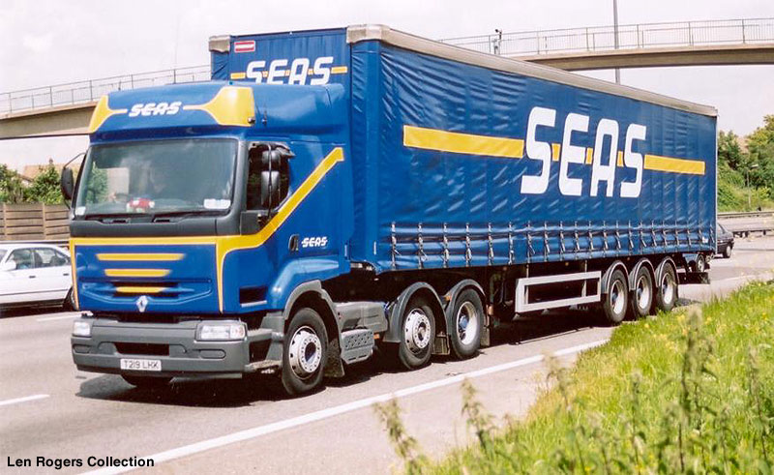
Microsoft’s Chicago
Modular Datacenter
Notes:
An exabyte is a datacenter, a million machines is a datacenter…..
24000 sq. m housing 400 containers
Each container contains 2500 servers
Integrated computing, networking, power, cooling systems
300 MW supplied from two power substations situated on opposite sides of the datacenter
Dual water-based cooling systems circulate cold water to containers, eliminating need for air conditioned rooms

Slide 10
Some Differences Between Commodity DC Networking and Internet/WAN
Characteristic | Internet/WAN | Commodity Datacenter
Latencies | Milliseconds to Seconds | Microseconds
Bandwidths | Kilobits to Megabits/s | Gigabits to 10’s of Gbits/s
Causes of loss | Congestion, link errors, … | Congestion
Administration | Distributed | Central, single domain
Statistical Multiplexing | Significant | Minimal, 1-2 flows dominate links
Incast | Rare | Frequent, due to synchronized responses

Slide 11
Coping with Performance in Array
Lower latency to DRAM in another server than local disk
Higher bandwidth to local disk than to DRAM in another server
 | Local | Rack | Array
Racks | -- | 1 | 30
Servers | 1 | 80 | 2400
Cores (Processors) | 8 | 640 | 19,200
DRAM Capacity (GB) | 16 | 1,280 | 38,400
Disk Capacity (GB) | 4,000 | 320,000 | 9,600,000
DRAM Latency (microseconds) | 0.1 | 100 | 300
Disk Latency (microseconds) | 10,000 | 11,000 | 12,000
DRAM Bandwidth (MB/sec) | 20,000 | 100 | 10
Disk Bandwidth (MB/sec) | 200 | 100 | 10

Slide 12
Datacenter design 101
Naive topologies are tree-based
  same boxes, and same b/w links
  Poor performance
  Not fault tolerant
An early solution; speed hierarchy (fewer expensive boxes at the top)
  Boxes at the top run out of capacity (bandwidth)
  but even the $ boxes needed
    $$$ abilities (forwarding table size)
…
$$$
$$
$
…

Slide 13
Data Center 102
Tree leads to FatTree
All bi-sections have same bandwidth
This is not the
only solution…
…

Slide 14
Latency-sensitive Apps
Request for 4MB of data sharded across 16 servers (256KB each)
How long does it take for all of the 4MB of data to return?
14

Slide 15
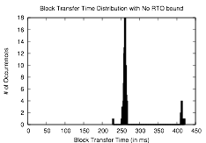
Timeouts Increase Latency
(256KB from 16 servers)
4MB
Ideal
Response
Time
Responses delayed by 200ms TCP timeout(s)
# of
occurrences
15

Slide 16


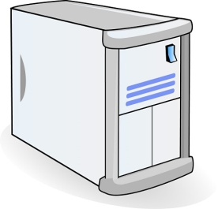
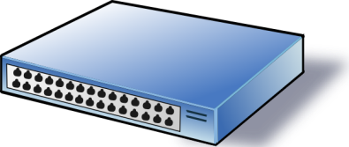

Incast
Worker 1
Synchronized mice collide.
  Caused by Partition/Aggregate.
Aggregator
Worker 2
Worker 3
RTO_{min} = 300 ms
Worker 4
TCP timeout

Slide 17
Applications Sensitive to
200ms TCP Timeouts
“Drive-bys” affecting single-flow request/response
Barrier-Sync workloads
  Parallel cluster filesystems (Incast workloads)
  Massive multi-server queries
    Latency-sensitive, customer-facing
The last result delivered is referred to as a straggler.
Stragglers can be caused by one off (drive-by) events but also by incast congestion which may occur for every map-reduce or database record retrieve or distributed filesystem read….
17

Slide 18
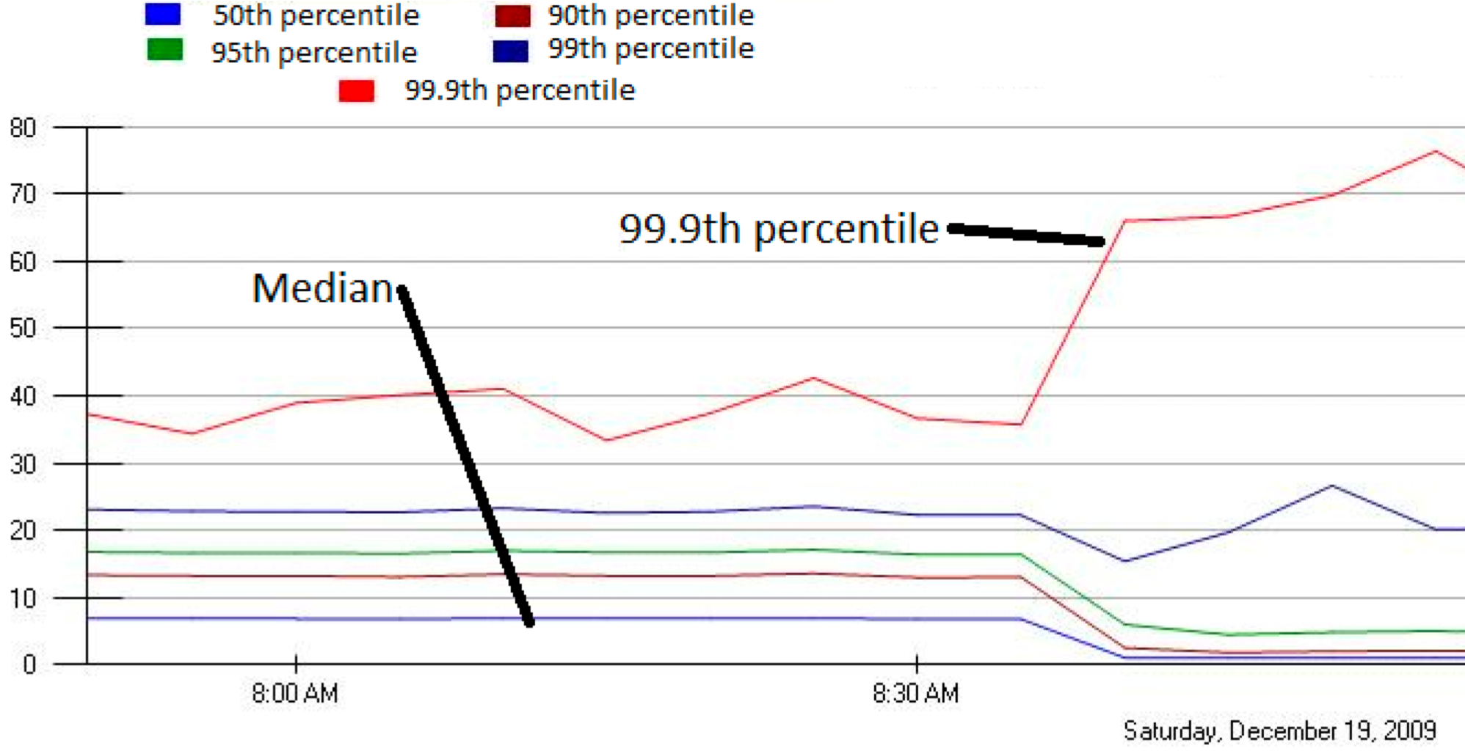
Incast Really Happens
STRAGGLERS
MLA Query Completion Time (ms)
Requests are jittered over 10ms window.
Jittering switched off around 8:30 am.
99.9th percentile is being tracked.
Jittering trades off median against high percentiles.
Notes:
1. Incast really happens – see this actual screenshot from production tool
2. People care, they’ve solved it at application by jittering.
3. They care about the 99.9th percentile, 1-1000 customers

Slide 19


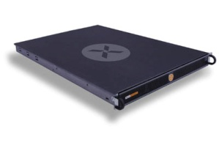
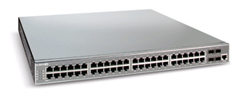
The Incast Workload
Data Block
Synchronized Read
1
R
R
R
R
2
3
Client
Switch
1
2
3
4
Server
Request Unit
(SRU)
4
Client now sends
next batch of requests
Storage Servers
19

Slide 20
Incast Workload Overfills Buffers
Synchronized Read
1
R
R
R
R
2
4
3
Client
Switch
1
2
3
4
Server
Request Unit
(SRU)
4
4
Requests
Received
Responses 1-3 completed
Link Idle!
Requests Sent
Response 4
dropped
Response 4
Resent
20

Slide 21
Queue Buildup
Sender 1
Big flows buildup queues.
  Increased latency for short flows.
Receiver
Sender 2
Measurements in Bing cluster
  For 90% packets: RTT < 1ms
  For 10% packets: 1ms < RTT < 15ms

Slide 22
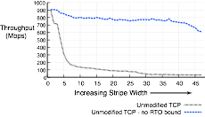
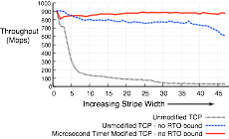
Microsecond timeouts are necessary
Microsecond TCP
+ no RTO Bound
High throughput sustained for up to 47 servers
No RTO Bound
Unmodified TCP
More servers
22

Slide 23
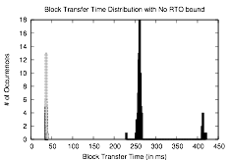
Improvement to Latency
4MB
(256KB from 16 servers)
200ms RTO
Microsecond
RTO
# of
occurrences
All responses returned within 40ms
23

Slide 24

Link-Layer Flow Control
Common between switches but this is flow-control to the end host too…
Another idea to reduce incast is to employ Link-Layer Flow Control…..
Recall: the Data-Link can use specially coded symbols in the coding to say “Stop” and “Start”

Slide 25
Link Layer Flow Control – The Dark side
Head of Line Blocking….
Such HOL blocking does not even differentiate processes so this can occur between competing processes on a pair of machines – no datacenter required.
Waiting for no good reason….

Slide 26
Link Layer Flow Control
But its worse that you imagine….
Double down on trouble….
Did I mention this is Link-Layer!
That means no (IP) control traffic, no routing messages….
a whole system waiting for one machine
Incast is very unpleasant.
…
Reducing the impact of HOL in Link Layer Flow Control can be done through priority queues and overtaking….

Slide 27
Fat Tree Topology
(Fares et al., 2008; Clos, 1953)
K=4
Aggregation Switches
How to efficiently utilize
the capacity?
K Pods with
K Switches
each
Racks of
servers
Notes:
What is the optimal load-balancing strategy?
27

Slide 28
State of the Art
(as discussed in Hedera)
Statically stripe flows across available paths using ECMP
Collision
ECMP: Equal Cost Multi-Path Routing is common in Data Centers but network ninjas may be required to configure it correctly…
Notes:
What has been done in this space? Hedera paper discusses the state of the art in datacenters.
Mention that the bottom link is not utilized.

Slide 29
How about mapping each
flow to a different path?

Slide 30
How about mapping each
flow to a different path?

Slide 31
How about mapping each
flow to a different path?
Not fair

Slide 32
How about mapping each
flow to a different path?
Not fair
Mapping each flow to a path
is the wrong approach!

Slide 33
Instead, pool capacity from links
Notes:
This is the key insight in this paper.

Slide 34
Multipath TCP Primer
(IETF MPTCP WG)
A drop in replacement for TCP
Spreads application data over multiple sub flows
- For each ACK on sub-flow r, increase the window w_{r} by min(α/w_{total}, 1/w_{r})
- For each loss on sub-flow r, decrease the window w_{r} by w_{r}/2
Notes:
The challenging part is to do congestion control. The same group did congestion control for MPTCP which won the best paper award at NSDI 2011

Slide 35
Performance improvements depend on traffic matrix
Underloaded
Overloaded
Sweet Spot
Increase Load

Slide 36
DC: lets add some of redundancy
The 3-layer Data Center
Internet
CR
CR
DC-Layer 3
. . .
AR
AR
AR
AR
DC-Layer 2
S
S
Key
CR = Core Router (L3)
AR = Access Router (L3)
S = Ethernet Switch (L2)
A = Rack of app. servers
S
S
S
S
. . .
A
A
…
A
A
A
…
A
~ 1,000 servers/pod == IP subnet
Reference – “Data Center: Load balancing Data Center Services”, Cisco 2004

Slide 37
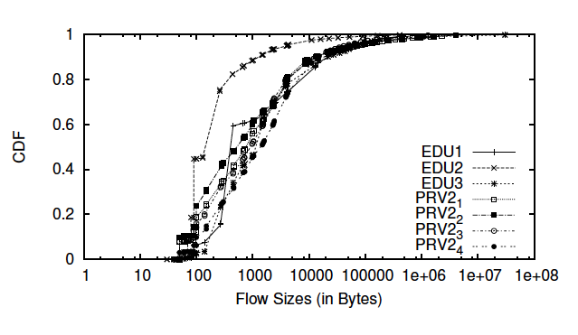
Understanding Datacenter Traffic
“Most flows in the data centers are small in size (<10KB)...”. In other words, elephants are a very small fraction.
Notes:
All the results from this paper are from prolonged flows.

Slide 38
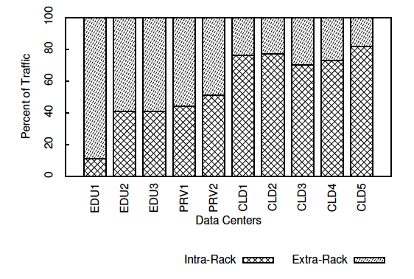
Understanding Datacenter Traffic
Majority of the traffic in cloud datacenters stay within the rack.
Notes:
Does this mean there is no need for load balancing schemes?

Slide 39
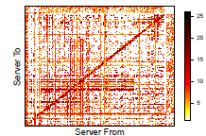
Today, Computation Constrained by Network*
Figure: ln(Bytes/10sec) between servers in operational cluster
Great efforts required to place communicating servers under the same ToR ➔ Most traffic lies on the diagonal (w/o log scale all you see is the diagonal)
Stripes show there is need for inter-ToR communication
*Kandula, Sengupta, Greenberg,Patel

Slide 40
Network has Limited Server-to-Server Capacity, and Requires Traffic Engineering to Use What It Has
Internet
CR
CR
10:1 over-subscription or worse (80:1, 240:1)
…
AR
AR
AR
AR
LB
S
S
LB
LB
S
S
LB
S
S
S
S
…
S
S
S
S
A
A
…
A
A
A
…
A
A
A
…
A
A
A
…
A
Data centers run two kinds of applications:
  Outward facing (serving web pages to users)
  Internal computation (computing search index – think HPC)

Slide 41
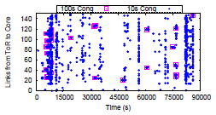

Congestion: Hits Hard When it Hits*
*Kandula, Sengupta, Greenberg, Patel

Slide 42
No Performance Isolation
Internet
CR
CR
…
AR
AR
AR
AR
LB
S
S
LB
LB
S
S
LB
Collateral damage
S
S
S
S
…
S
S
S
S
A
A
…
A
A
A
…
A
A
A
A
A
A
A
A
…
…
VLANs typically provide reachability isolation only
One service sending/receiving too much traffic hurts all services sharing its subtree

Slide 43
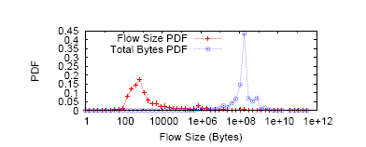
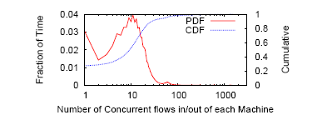
Flow Characteristics
DC traffic != Internet traffic
Most of the flows: various mice
Most of the bytes: within 100MB flows
Median of 10 concurrent flows per server

Slide 44
Network Needs Greater Bisection BW, and Requires Traffic Engineering to Use What It Has
Internet
CR
CR
Dynamic reassignment of servers and Map/Reduce-style computations mean traffic matrix is constantly changing
Explicit traffic engineering is a nightmare
…
AR
AR
AR
AR
LB
S
S
LB
LB
S
S
LB
S
S
S
S
…
S
S
S
S
A
A
…
A
A
A
…
A
A
A
…
A
A
A
…
A
Data centers run two kinds of applications:
  Outward facing (serving web pages to users)
  Internal computation (computing search index – think HPC)

Slide 45
What Do Data Center Faults Look Like?
Need very high reliability near top of the tree
  Very hard to achieve
    Example: failure of a temporarily unpaired core switch affected ten million users for four hours
  0.3% of failure events knocked out all members of a network redundancy group
CR
CR
AR
AR
…
AR
AR
LB
S
S
LB
S
S
S
S
…
…
A
A
…
A
A
A
A
Ref: Data Center: Load Balancing Data Center Services,
Cisco 2004

Slide 46
Data Center: Challenges
From a large cluster used for data mining and identified distinctive traffic patterns
Traffic patterns are highly volatile
  A large number of distinctive patterns even in a day
Traffic patterns are unpredictable
  Correlation between patterns very weak

Slide 47
Data Center: Opportunities
DC controller knows everything about hosts
Host OS’s are easily customizable
Probabilistic flow distribution would work well enough, because …
  Flows are numerous and not huge – no elephants!
  Commodity switch-to-switch links are substantially thicker (~ 10x) than the maximum thickness of a flow

Slide 48
Sometimes we just wish we had a huge L2 switch (L2: data-link)
The Illusion of a Huge L2 Switch
1. L2 semantics
2. Uniform high capacity
3. Performance isolation
A
A
A
…
A
A
…
A
A
A
A
A
A
A
A
A
A
A
A
A
A
A
A
A
…
A
A
…
A
A
A
A
A
A
A
A
A
A
A
A
A

Slide 49
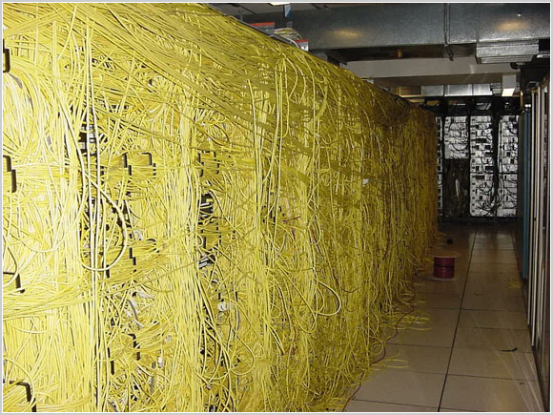
Fat Tree Topology
(Fares et al., 2008; Clos, 1953)
K=4
Aggregation Switches
1Gbps
Hard to construct
Expensive & Complex
K Pods with
K Switches
each
1Gbps
Racks of
servers
Notes:
49

Slide 50

B-Tree Topology
(Guo et al., 2009)
Modular!
but… hard to expand ➔
hard to interconnect modules
BCube

Slide 51

An alternative: hybrid packet/circuit switched data center network
Goal of this work:
  Feasibility: software design that enables efficient use of optical circuits
  Applicability: application performance over a hybrid network
51
Notes:
51

Slide 52
Optical Circuit Switch
Output 1
Output 2
Fixed
Mirror
Lenses
Input 1
Glass Fiber
Bundle
Does not decode packets
Needs take time to reconfigure
Rotate Mirror
Mirrors on Motors
2010-09-02 SIGCOMM
Nathan Farrington
52
Notes:
52

Slide 53
Optical circuit switching v.s.
Electrical packet switching
 | Electrical packet switching | Optical circuit switching
Switching technology | Store and forward | Circuit switching
Switching capacity
Switching time
Switching traffic
16x40Gbps at high end
e.g. Cisco CRS-1
320x100Gbps on market, e.g. Calient FiberConnect
Packet granularity
Less than 10ms
For bursty, uniform traffic
For stable, pair-wise traffic
53
Notes:
53

Slide 54
Hybrid packet/circuit switched network architecture
Electrical packet-switched network for low latency delivery
Optical circuit-switched network for high capacity transfer
Optical paths are provisioned rack-to-rack
  A simple and cost-effective choice
  Aggregate traffic on per-rack basis to better utilize optical circuits
Notes:
54

Slide 55
Design requirements
Traffic demands
Control plane:
  Traffic demand estimation
  Optical circuit configuration
Data plane:
  Dynamic traffic de-multiplexing
  Optimizing circuit utilization (optional)
55
Notes:
55

Slide 56
An alternative to Optical links:
Link Racks by radio
(60GHz gives about 2Gbps at 5m)

Slide 57
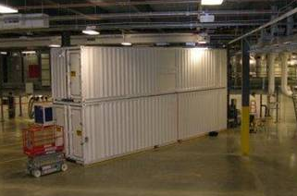

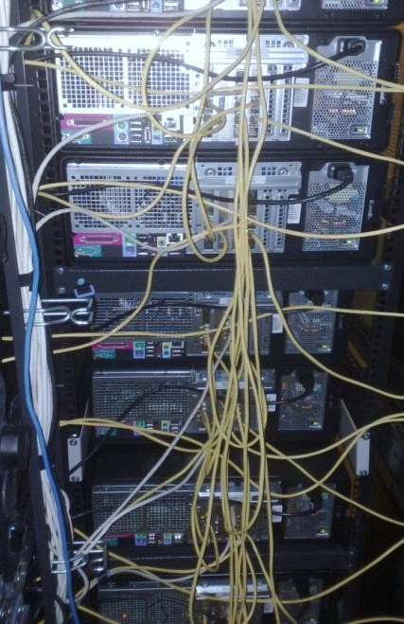
CamCube
Nodes are commodity x86 servers with local storage
  Container-based model 1,500-2,500 servers
Direct-connect 3D torus topology
  Six Ethernet ports / server
  Servers have (x,y,z) coordinates
    Defines coordinate space
  Simple 1-hop API
    Send/receive packets to/from 1-hop neighbours
    Not using TCP/IP
Everything is a service
  Run on all servers
Multi-hop routing is a service
  Simple link state protocol
  Route packets along shortest paths from source to destination
(0,2,0)
y
z
x
Two Downsides (there are others):
complex to use (programming models…)
messy to wire…

Slide 58
MRC²: A new data center approach
Notes:
Today’s system--
- Centralised switches mean common points of failure, poor energy use, poor topology alignment with compute tasks
- Few, if any, primitives for distributed containment; primary tools are host-oriented security or “ACLs”.
- Data flow analysis for large-scale applications maps poorly into both communications topology and security enforcement
Other topologies possible -- but same ingredients

Slide 59
New resource-aware programming framework
Distributed switch fabric: no buffer and smaller per-switch radix
Smarter Transport protocols for minimized disruption
Better characterization for better SLA prediction
Distributed switch
Fabric:
Use-proportional
Use-Proportional MAC
Zero Mbps = Zero watts
Notes:
* CIEL – not in INTERNET, but by being close to the objective of the code (dataflow) we can setup the right network in the DC first time. (that’s the reason its in red – not this project)
* We focus on a small-radix switch per host; this enables complex data-flow specific networks AND, while the prototype will not be built this way, we could consider small-radix SOA-based optical switches (*** this may come as a surprise to IHW ***
) – removing any latency and creating the ultimate cut-through switch (and removing any latency incurred by the fabric-based routing, as well as removing any power required for intermediate stage buffering)
Smarter protocols for minimized disruption (this is what Toby will talk-to)
Characterizing migration SLA = Sherif’s work. (delete as you wish ;-)
Power-proportional MAC - one that has no idle and uses no power when unused (this is what Yury will talk-to)
Distributed switch Fabric – if the nodes are not in use, the switch can be powered off; a much higher fidelity than “port/tray/chassis regimes currrently as the affinity is host-centric not switch centric)
(control infrastructure could be openflow… or some other Software Defined Network…)

Slide 60
    Other problems
    Special class problems/Solutions?
Datacenters are computers too…
What do datacenters to anyway?
Special class problems
Special class data-structures
Special class languages
Special class hardware
Special class operating systems
Special class networks ✔
Special class day-to-day operations

Slide 61
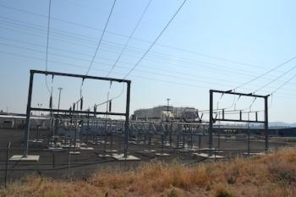
Google Oregon Warehouse Scale

Slide 62
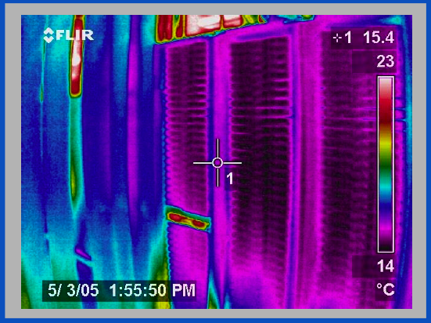
Thermal Image of Typical Data Centre Rack
Rack
Switch
M. K. Patterson, A. Pratt, P. Kumar,
“From UPS to Silicon: an end-to-end evaluation of datacenter efficiency”, Intel Corporation
Notes:
What is wrong with this picture???
All the servers are using the same amount of energy
And the switch is using TONNES

Slide 63
DC futures
Warehouse-Scale Computing: Entering the Teenage Decade
Luiz Barroso (Google)
ISCA Keynote 2011
http://dl.acm.org/citation.cfm?id=2019527
It’s a video. Watch it.

Slide 64
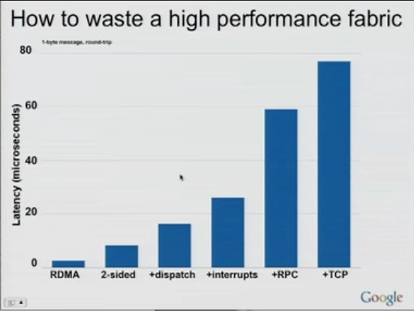
Sample
1-byte message, round-trip time
Are the systems we used for the WAN
appropriate for the datacenter?
Software stacks for milliseconds are not good enough for microseconds
- Just ask the High Frequency Traders…
Probably not.
L. Barroso’s excellent ISCA2011 keynote – go watch it! http://dl.acm.org/citation.cfm?id=2019527
Notes:
just RDMA…
split the binary…
dispatch
interupts
TCP
RPC

Slide 65

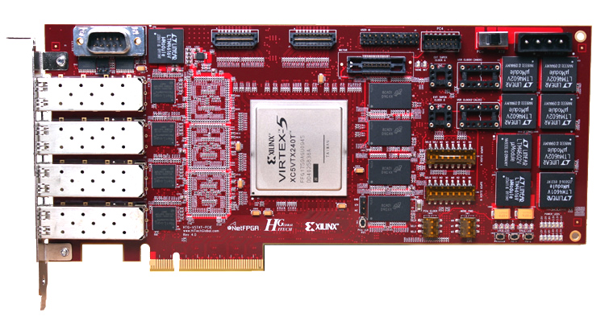
Fancy doing somet exciting computer science? at 10Gbps? 40Gbps? 240Gbps?
Talk to me.
Notes:
Yep – an Advert!!!

