Slide 1
Computer Networking
Lent Term M/W/F 11-midday
LT1 in Gates Building
Slide Set 5
Andrew W. Moore
andrew.moore@cl.cam.ac.uk
January 2013

Slide 2
Topic 5 – Transport
Our goals:
understand principles behind transport layer services:
multiplexing/demultiplexing
reliable data transfer
flow control
congestion control
learn about transport layer protocols in the Internet:
UDP: connectionless transport
TCP: connection-oriented transport
TCP congestion control

Slide 3

Transport services and protocols
application
transport
network
data link
physical
provide logical communication between app processes running on different hosts
transport protocols run in end systems
send side: breaks app messages into segments, passes to network layer
rcv side: reassembles segments into messages, passes to app layer
more than one transport protocol available to apps
Internet: TCP and UDP
logical end-end transport
application
transport
network
data link
physical
Notes:
Difference between Engineers and CS (reliability versus layering)

Slide 4
Transport vs. network layer
network layer: logical communication between hosts
transport layer: logical communication between processes
relies on, enhances, network layer services
Household analogy:
12 kids sending letters to 12 kids
processes = kids
app messages = letters in envelopes
hosts = houses
transport protocol = Ann and Bill
network-layer protocol = postal service

Slide 5
Internet transport-layer protocols
reliable, in-order delivery (TCP)
congestion control
flow control
connection setup
unreliable, unordered delivery: UDP
no-frills extension of “best-effort” IP
services not available:
delay guarantees
bandwidth guarantees
application
transport
network
data link
physical
network
data link
physical
network
data link
physical
logical end-end transport
network
data link
physical
network
data link
physical
network
data link
physical
network
data link
physical
application
transport
network
data link
physical

Slide 6
Multiplexing/demultiplexing (Transport-layer style)
Demultiplexing at rcv host:
Multiplexing at send host:
delivering received segments
to correct socket
gathering data from multiple
sockets, enveloping data with
header (later used for
demultiplexing)
= socket
= process
application
application
application
P4
P3
P1
P2
P1
transport
transport
transport
network
network
network
link
link
link
physical
physical
physical
host 1
host 2
host 3

Slide 7
How transport-layer demultiplexing works
host receives IP datagrams
each datagram has source IP address, destination IP address
each datagram carries 1 transport-layer segment
each segment has source, destination port number
host uses IP addresses & port numbers to direct segment to appropriate socket
32 bits
source port #
dest port #
other header fields
application
data
(message)
TCP/UDP segment format

Slide 8
Connectionless demultiplexing
When host receives UDP segment:
checks destination port number in segment
directs UDP segment to socket with that port number
IP datagrams with different source IP addresses and/or source port numbers directed to same socket
Create sockets with port numbers:
DatagramSocket mySocket1 = new DatagramSocket(12534);
DatagramSocket mySocket2 = new DatagramSocket(12535);
UDP socket identified by two-tuple:
(dest IP address, dest port number)

Slide 9
Connectionless demux (cont)
DatagramSocket serverSocket = new DatagramSocket(6428);
P2
P1
P3
P1
SP: 6428
SP: 6428
DP: 9157
DP: 5775
SP: 9157
SP: 5775
client
IP: A
DP: 6428
server
IP: C
DP: 6428
Client
IP:B
SP provides “return address”

Slide 10
Connection-oriented demux
TCP socket identified by 4-tuple:
source IP address
source port number
dest IP address
dest port number
recv host uses all four values to direct segment to appropriate socket
Server host may support many simultaneous TCP sockets:
each socket identified by its own 4-tuple
Web servers have different sockets for each connecting client
non-persistent HTTP will have different socket for each request

Slide 11
Connection-oriented demux (cont)
P1
P4
P5
P6
P2
P1
P3
SP: 5775
DP: 80
S-IP: B
D-IP:C
SP: 9157
SP: 9157
client
IP: A
DP: 80
server
IP: C
DP: 80
Client
IP:B
S-IP: A
S-IP: B
D-IP:C
D-IP:C

Slide 12
Connection-oriented demux: Threaded Web Server
P1
P4
P2
P1
P3
SP: 5775
DP: 80
S-IP: B
D-IP:C
SP: 9157
SP: 9157
client
IP: A
DP: 80
server
IP: C
DP: 80
Client
IP:B
S-IP: A
S-IP: B
D-IP:C
D-IP:C

Slide 13
UDP: User Datagram Protocol [RFC 768]
“no frills,” “bare bones” Internet transport protocol
“best effort” service, UDP segments may be:
lost
delivered out of order to app
connectionless:
no handshaking between UDP sender, receiver
each UDP segment handled independently of others
Why is there a UDP?
no connection establishment (which can add delay)
simple: no connection state at sender, receiver
small segment header
no congestion control: UDP can blast away as fast as desired

Slide 14
UDP: more
often used for streaming multimedia apps
loss tolerant
rate sensitive
other UDP uses
DNS
SNMP
reliable transfer over UDP: add reliability at application layer
application-specific error recovery!
32 bits
Length, in
bytes of UDP
segment,
including
header
source port #
dest port #
length
checksum
Application
data
(message)
UDP segment format

Slide 15
UDP checksum
Goal: detect “errors” (e.g., flipped bits) in transmitted segment
Sender:
treat segment contents as sequence of 16-bit integers
checksum: addition (1’s complement sum) of segment contents
sender puts checksum value into UDP checksum field
Receiver:
compute checksum of received segment
check if computed checksum equals checksum field value:
NO - error detected
YES - no error detected. But maybe errors nonetheless? More later ….

Slide 16

Internet Checksum (time travel warning – we covered this earlier)
Note
When adding numbers, a carryout from the most significant bit needs to be added to the result
Example: add two 16-bit integers
1 1 1 1 0 0 1 1 0 0 1 1 0 0 1 1 0
1 1 1 0 1 0 1 0 1 0 1 0 1 0 1 0 1
1 1 0 1 1 1 0 1 1 1 0 1 1 1 0 1 1
1 1 0 1 1 1 0 1 1 1 0 1 1 1 1 0 0
1 0 1 0 0 0 1 0 0 0 1 0 0 0 0 1 1
wraparound
sum
checksum
Notes:
Kurose and Ross forgot to say anything about wrapping the carry and adding it to low order bit

Slide 17
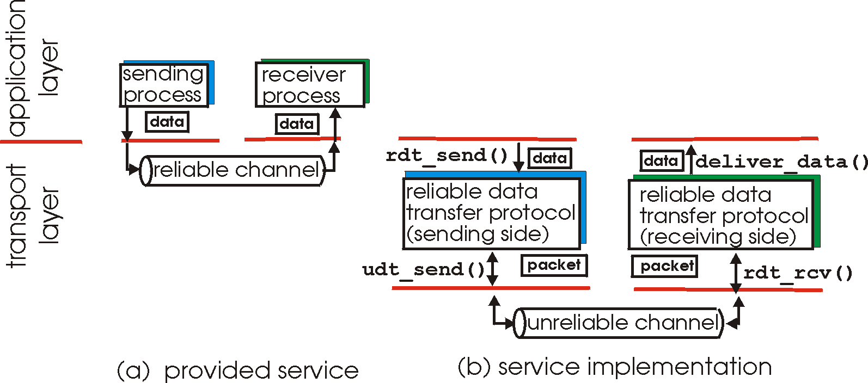
Principles of Reliable data transfer
important in app., transport, link layers
top-10 list of important networking topics!
characteristics of unreliable channel will determine complexity of reliable data transfer protocol (rdt)
Notes:
MAKE CLEAR THE OBJECTIVE (function)
- RELIABLE data transfer

Slide 18
Principles of Reliable data transfer
important in app., transport, link layers
top-10 list of important networking topics!
characteristics of unreliable channel will determine complexity of reliable data transfer protocol (rdt)

Slide 19
Principles of Reliable data transfer
important in app., transport, link layers
top-10 list of important networking topics!
rdt_rcv()
udt_rcv()
characteristics of unreliable channel will determine complexity of reliable data transfer protocol (rdt)

Slide 20
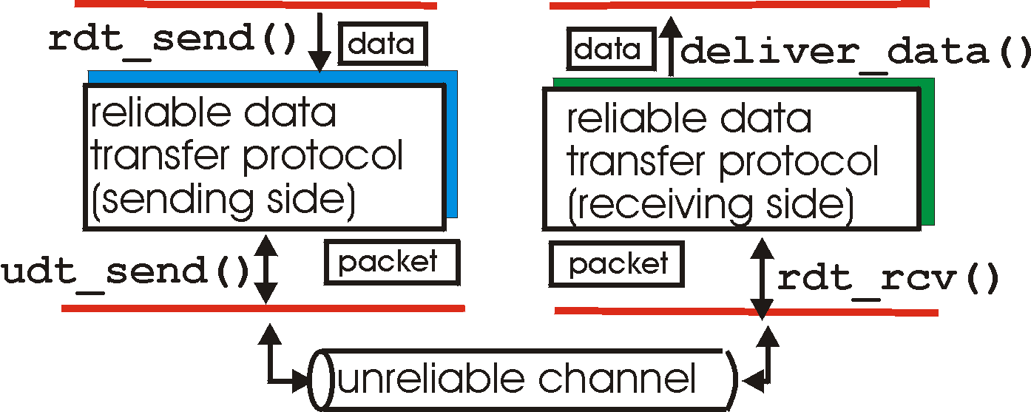
Reliable data transfer: getting started
rdt_send(): called from above, (e.g., by app.). Passed data to
deliver to receiver upper layer
rdt_rcv(): called by rdt to deliver data to upper
rdt_rcv()
send
side
receive
side
udt_rcv()
udt_send(): called by rdt,
to transfer packet over
unreliable channel to receiver
udt_rcv(): called when packet arrives on rcv-side of channel

Slide 21
Reliable data transfer: getting started
We’ll:
incrementally develop sender, receiver sides of reliable data transfer protocol (rdt)
consider only unidirectional data transfer
but control info will flow on both directions!
use finite state machines (FSM) to specify sender, receiver
event causing state transition
actions taken on state transition
state: when in this “state” next state uniquely determined by next event
state
1
state
2
event
actions

Slide 22
KR state machines – a note.
Beware
Kurose and Ross has a confusing/confused attitude to state-machines.
I’ve attempted to normalise the representation.
UPSHOT: these slides have differing information to the KR book (from which the RDT example is taken.)
in KR “actions taken” appear wide-ranging, my interpretation is more specific/relevant.
Relevant event causing state transition
state: when in this “state” next state uniquely determined by next event
Relevant action taken on state transition
State
name
State
name
event
actions

Slide 23
Rdt1.0: reliable transfer over a reliable channel
underlying channel perfectly reliable
no bit errors
no loss of packets
separate FSMs for sender, receiver:
sender sends data into underlying channel
receiver read data from underlying channel
Event
rdt_send(data)
udt_rcv(packet)
IDLE
udt_send(packet)
IDLE
rdt_rcv(data)
Action
sender
receiver

Slide 24
Rdt2.0: channel with bit errors
underlying channel may flip bits in packet
checksum to detect bit errors
the question: how to recover from errors:
acknowledgements (ACKs): receiver explicitly tells sender that packet received is OK
negative acknowledgements (NAKs): receiver explicitly tells sender that packet had errors
sender retransmits packet on receipt of NAK
new mechanisms in rdt2.0 (beyond rdt1.0):
error detection
receiver feedback: control msgs (ACK,NAK) receiver->sender

Slide 25
rdt2.0: FSM specification
rdt_send(data)
udt_send(packet)
receiver
udt_rcv(reply) &&
isNAK(reply)
Waiting
for reply
udt_rcv(packet) && corrupt(packet)
IDLE
udt_send(packet)
udt_send(NAK)
udt_rcv(reply) && isACK(reply)
Λ
IDLE
sender
udt_rcv(packet) && notcorrupt(packet)
Note: the sender holds a copy of the packet being sent until the delivery is acknowledged.
rdt_rcv(data)
udt_send(ACK)

Slide 26
rdt2.0: operation with no errors
rdt_send(data)
udt_send(packet)
udt_rcv(reply) &&
isNAK(reply)
Waiting
for reply
udt_rcv(packet) && corrupt(packet)
IDLE
udt_send(packet)
udt_send(NAK)
udt_rcv(reply) && isACK(reply)
Λ
IDLE
udt_rcv(packet) && notcorrupt(packet)
rdt_rcv(data)
udt_send(ACK)

Slide 27
rdt2.0: error scenario
rdt_send(data)
udt_send(packet)
udt_rcv(reply) &&
isNAK(reply)
Waiting
for reply
udt_rcv(packet) && corrupt(packet)
IDLE
udt_send(packet)
udt_send(NAK)
udt_rcv(reply) && isACK(reply)
Λ
IDLE
udt_rcv(packet) && notcorrupt(packet)
rdt_rcv(data)
udt_send(ACK)

Slide 28
rdt2.0 has a fatal flaw!
What happens if ACK/NAK corrupted?
sender doesn’t know what happened at receiver!
can’t just retransmit: possible duplicate
Handling duplicates:
sender retransmits current packet if ACK/NAK garbled
sender adds sequence number to each packet
receiver discards (doesn’t deliver) duplicate packet
stop and wait
Sender sends one packet,
then waits for receiver
response

Slide 29
rdt2.1: sender, handles garbled ACK/NAKs
rdt_send(data)
sequence=0
udt_send(packet)
udt_rcv(reply) &&
( corrupt(reply) ||
isNAK(reply) )
Waiting
For reply
IDLE
udt_send(packet)
udt_rcv(reply)
&& notcorrupt(reply)
&& isACK(reply)
udt_rcv(reply)
&& notcorrupt(reply)
&& isACK(reply)
Λ
Λ
Waiting
for reply
IDLE
udt_rcv(reply) &&
( corrupt(reply) ||
isNAK(reply) )
rdt_send(data)
udt_send(packet)
sequence=1
udt_send(packet)

Slide 30
rdt2.1: receiver, handles garbled ACK/NAKs
udt_rcv(packet) && not corrupt(packet)
&& has_seq0(packet)
udt_send(ACK)
rdt_rcv(data)
receive(packet) && corrupt(packet)
udt_rcv(packet) && corrupt(packet)
udt_send(NAK)
udt_send(NAK)
Wait for
0 from below
Wait for
1 from below
receive(packet) &&
not corrupt(packet) &&
has_seq1(packet)
receive(packet) &&
not corrupt(packet) &&
has_seq0(packet)
udt_send(ACK)
udt_send(ACK)
udt_rcv(packet) && not corrupt(packet)
&& has_seq1(packet)
udt_send(ACK)
rdt_rcv(data)

Slide 31
rdt2.1: discussion
Sender:
seq # added to pkt
two seq. #’s (0,1) will suffice. Why?
must check if received ACK/NAK corrupted
twice as many states
state must “remember” whether “current” pkt has a
0 or 1 sequence number
Receiver:
must check if received packet is duplicate
state indicates whether 0 or 1 is expected pkt seq #
note: receiver can not know if its last ACK/NAK received OK at sender

Slide 32
rdt2.2: a NAK-free protocol
same functionality as rdt2.1, using ACKs only
instead of NAK, receiver sends ACK for last pkt received OK
receiver must explicitly include seq # of pkt being ACKed
duplicate ACK at sender results in same action as NAK: retransmit current pkt

Slide 33
rdt2.2: sender, receiver fragments
rdt_send(data)
sequence=0
udt_send(packet)
rdt_rcv(reply) &&
( corrupt(reply) ||
isACK1(reply) )
Wait for call 0 from above
Wait for ACK
0
udt_send(packet)
sender FSM
fragment
udt_rcv(reply)
&& not corrupt(reply)
&& isACK0(reply)
udt_rcv(packet) &&
(corrupt(packet) ||
has_seq1(packet))
Λ
Wait for
0 from below
receiver FSM
fragment
udt_send(ACK1)
receive(packet) && not corrupt(packet)
&& has_seq1(packet)
send(ACK1)
rdt_rcv(data)

Slide 34
rdt3.0: channels with errors and loss
New assumption: underlying channel can also lose packets (data or ACKs)
checksum, seq. #, ACKs, retransmissions will be of help, but not enough
Approach: sender waits “reasonable” amount of time for ACK
retransmits if no ACK received in this time
if pkt (or ACK) just delayed (not lost):
retransmission will be duplicate, but use of seq. #’s already handles this
receiver must specify seq # of pkt being ACKed
requires countdown timer

Slide 35
rdt3.0 sender
rdt_send(data)
udt_rcv(reply) &&
( corrupt(reply) ||
isACK(reply,1) )
sequence=0
udt_send(packet)
udt_rcv(reply)
Λ
Λ
IDLE
state 0
Wait for ACK0
timeout
udt_send(packet)
udt_rcv(reply)
&& notcorrupt(reply)
&& isACK(reply,1)
udt_rcv(reply)
&& notcorrupt(reply)
&& isACK(reply,0)
Λ
Λ
Wait for ACK1
IDLE
state 1
timeout
udt_send(packet)
udt_rcv(reply)
rdt_send(data)
Λ
udt_rcv(packet) &&
( corrupt(packet) ||
isACK(reply,0) )
sequence=1
udt_send(packet)
Λ

Slide 36
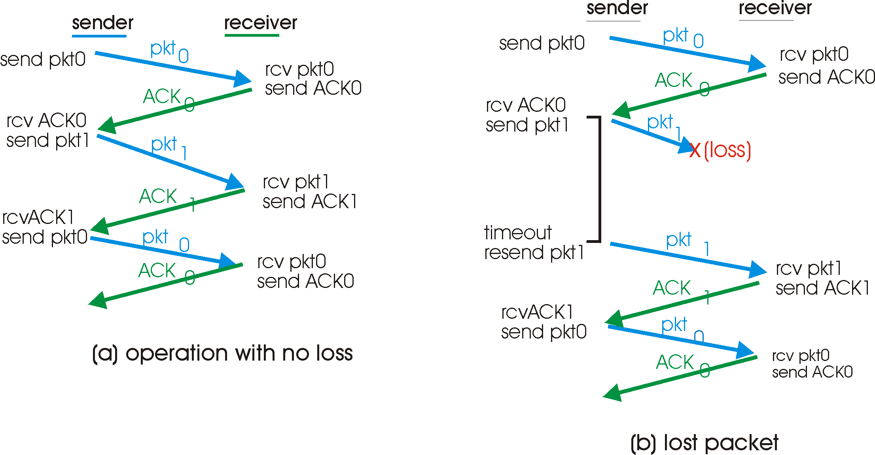
rdt3.0 in action

Slide 37
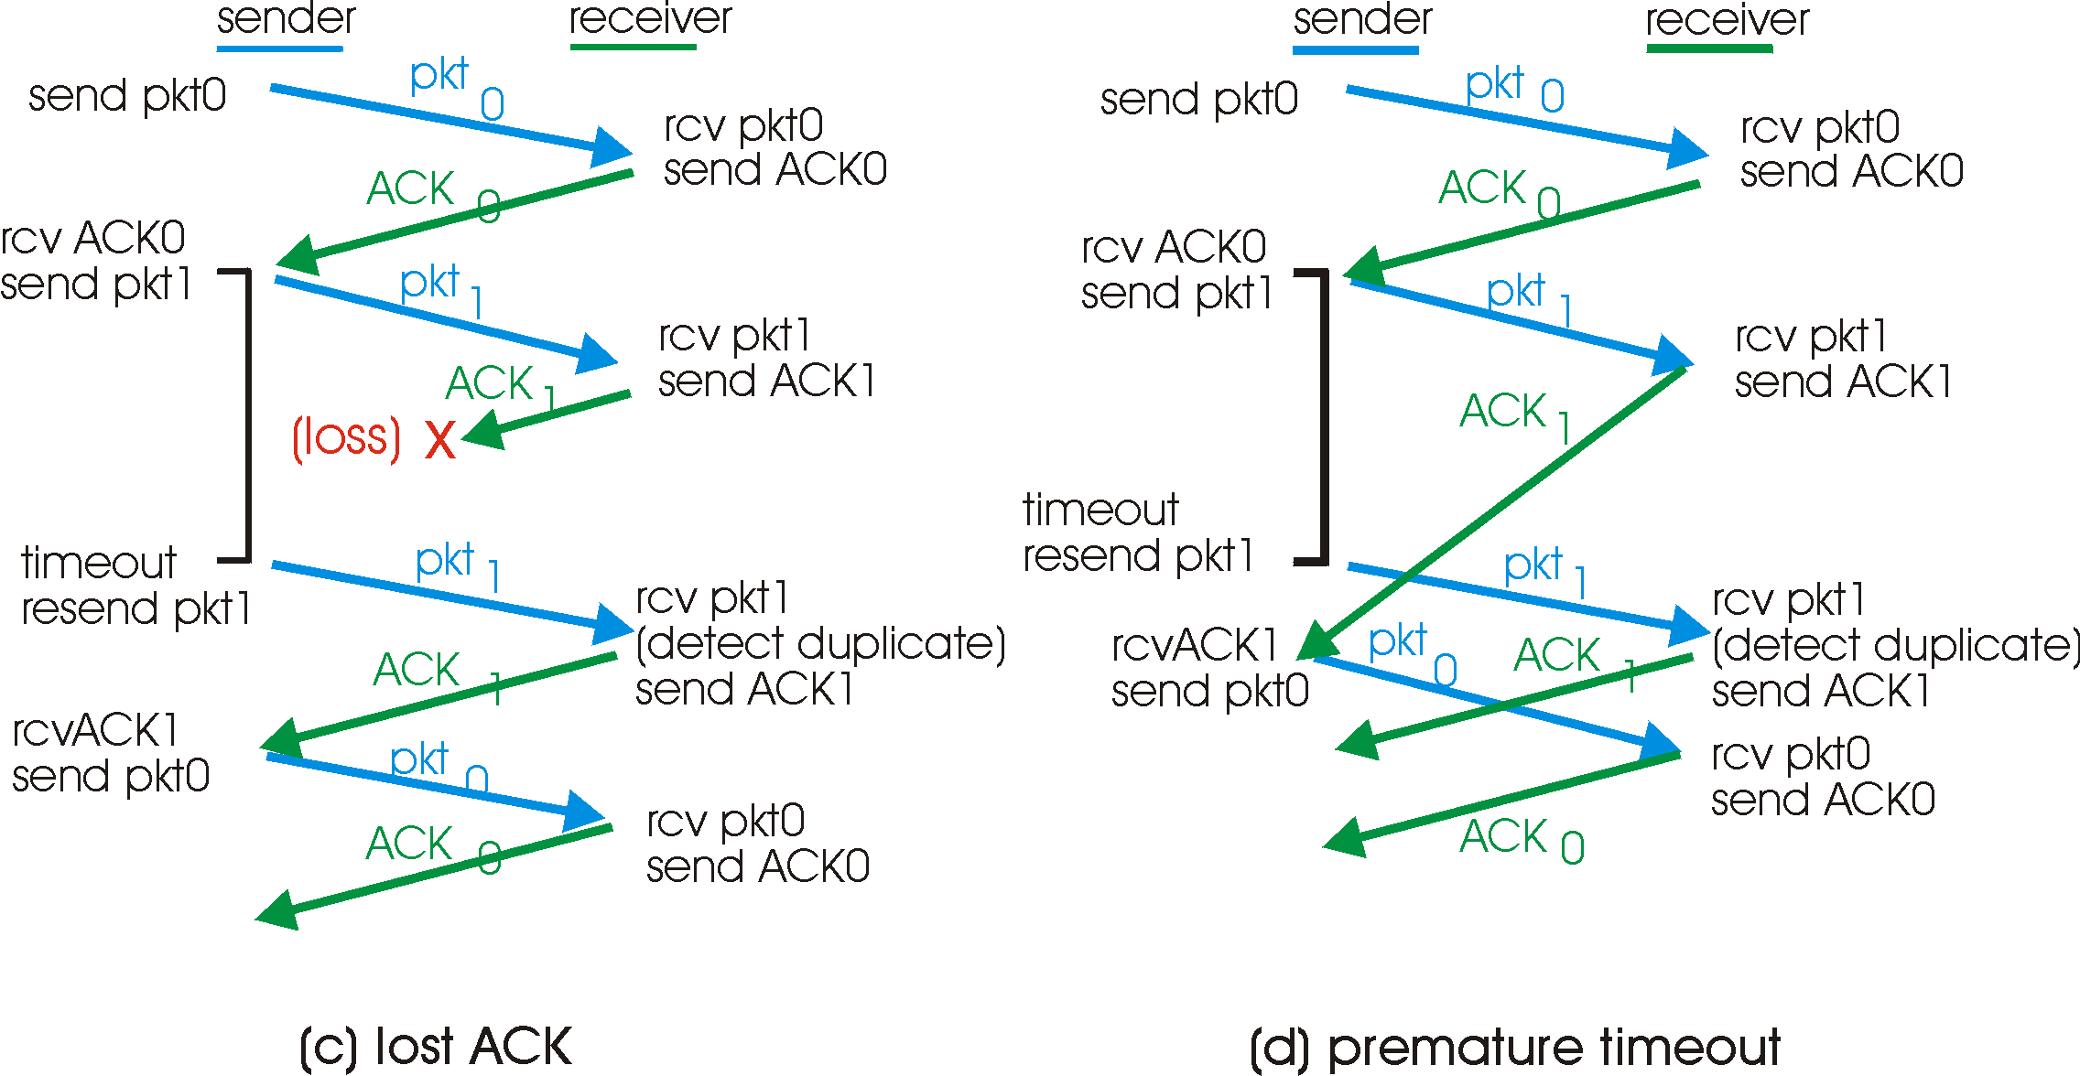
rdt3.0 in action

Slide 38
Performance of rdt3.0
rdt3.0 works, but performance stinks
ex: 1 Gbps link, 15 ms prop. delay, 8000 bit packet:
U _{sender}: utilization – fraction of time sender busy sending
1KB pkt every 30 msec -> 33kB/sec thruput over 1 Gbps link
network protocol limits use of physical resources!

Slide 39
rdt3.0: stop-and-wait operation
sender
receiver
first packet bit transmitted, t = 0
last packet bit transmitted, t = L / R
first packet bit arrives
RTT
last packet bit arrives, send ACK
ACK arrives, send next
packet, t = RTT + L / R
Notes:
29th end

Slide 40
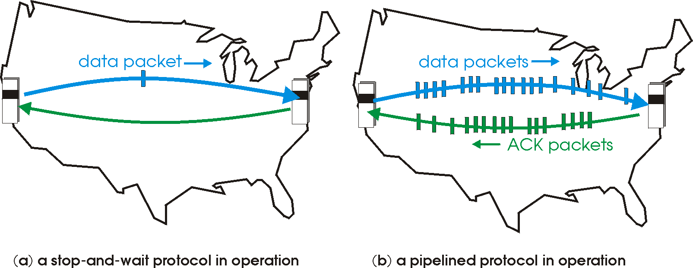
Pipelined (Packet-Window) protocols
Pipelining: sender allows multiple, “in-flight”, yet-to-be-acknowledged pkts
range of sequence numbers must be increased
buffering at sender and/or receiver
Two generic forms of pipelined protocols: go-Back-N, selective repeat

Slide 41
Pipelining: increased utilization
sender
receiver
first packet bit transmitted, t = 0
last bit transmitted, t = L / R
first packet bit arrives
RTT
last packet bit arrives, send ACK
last bit of 2nd packet arrives, send ACK
last bit of 3rd packet arrives, send ACK
ACK arrives, send next
packet, t = RTT + L / R
Increase utilization
by a factor of 3!

Slide 42
Pipelining Protocols
Go-back-N: big picture:
Sender can have up to N unacked packets in pipeline
Rcvr only sends cumulative acks
Doesn’t ack packet if there’s a gap
Sender has timer for oldest unacked packet
If timer expires, retransmit all unacked packets
Selective Repeat: big pic
Sender can have up to N unacked packets in pipeline
Rcvr acks individual packets
Sender maintains timer for each unacked packet
When timer expires, retransmit only unack packet

Slide 43
Selective repeat: big picture
Sender can have up to N unacked packets in pipeline
Rcvr acks individual packets
Sender maintains timer for each unacked packet
When timer expires, retransmit only unack packet

Slide 44
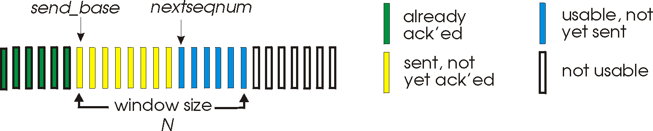
Go-Back-N
Sender:
k-bit seq # in pkt header
“window” of up to N, consecutive unack’ed pkts allowed
ACK(n): ACKs all pkts up to, including seq # n - “cumulative ACK”
may receive duplicate ACKs (see receiver)
timer for each in-flight pkt
timeout(n): retransmit pkt n and all higher seq # pkts in window

Slide 45
GBN: sender extended FSM
rdt_send(data)
if (nextseqnum < base+N) {
udt_send(packet[nextseqnum])
nextseqnum++
}
else
refuse_data(data) Block?
Λ
base=1
nextseqnum=1
timeout
Wait
udt_send(packet[base])
udt_send(packet[base+1])
…
udt_send(packet[nextseqnum-1])
udt_rcv(reply)
&& corrupt(reply)
Λ
udt_rcv(reply) &&
notcorrupt(reply)
base = getacknum(reply)+1

Slide 46
GBN: receiver extended FSM
Λ
udt_send(reply)
udt_rcv(packet)
&& notcurrupt(packet)
&& hasseqnum(rcvpkt,expectedseqnum)
Λ
Wait
rdt_rcv(data)
udt_send(ACK)
expectedseqnum++
expectedseqnum=1
ACK-only: always send an ACK for correctly-received packet with the highest in-order seq #
may generate duplicate ACKs
need only remember expectedseqnum
out-of-order packet:
discard (don’t buffer) -> no receiver buffering!
Re-ACK packet with highest in-order seq #

Slide 47
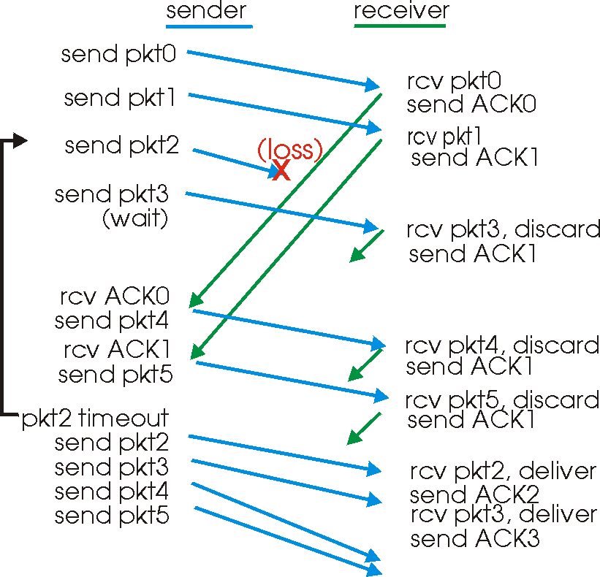
GBN in action

Slide 48
Selective Repeat
receiver individually acknowledges all correctly received pkts
buffers pkts, as needed, for eventual in-order delivery to upper layer
sender only resends pkts for which ACK not received
sender timer for each unACKed pkt
sender window
N consecutive seq #’s
again limits seq #s of sent, unACKed pkts

Slide 49
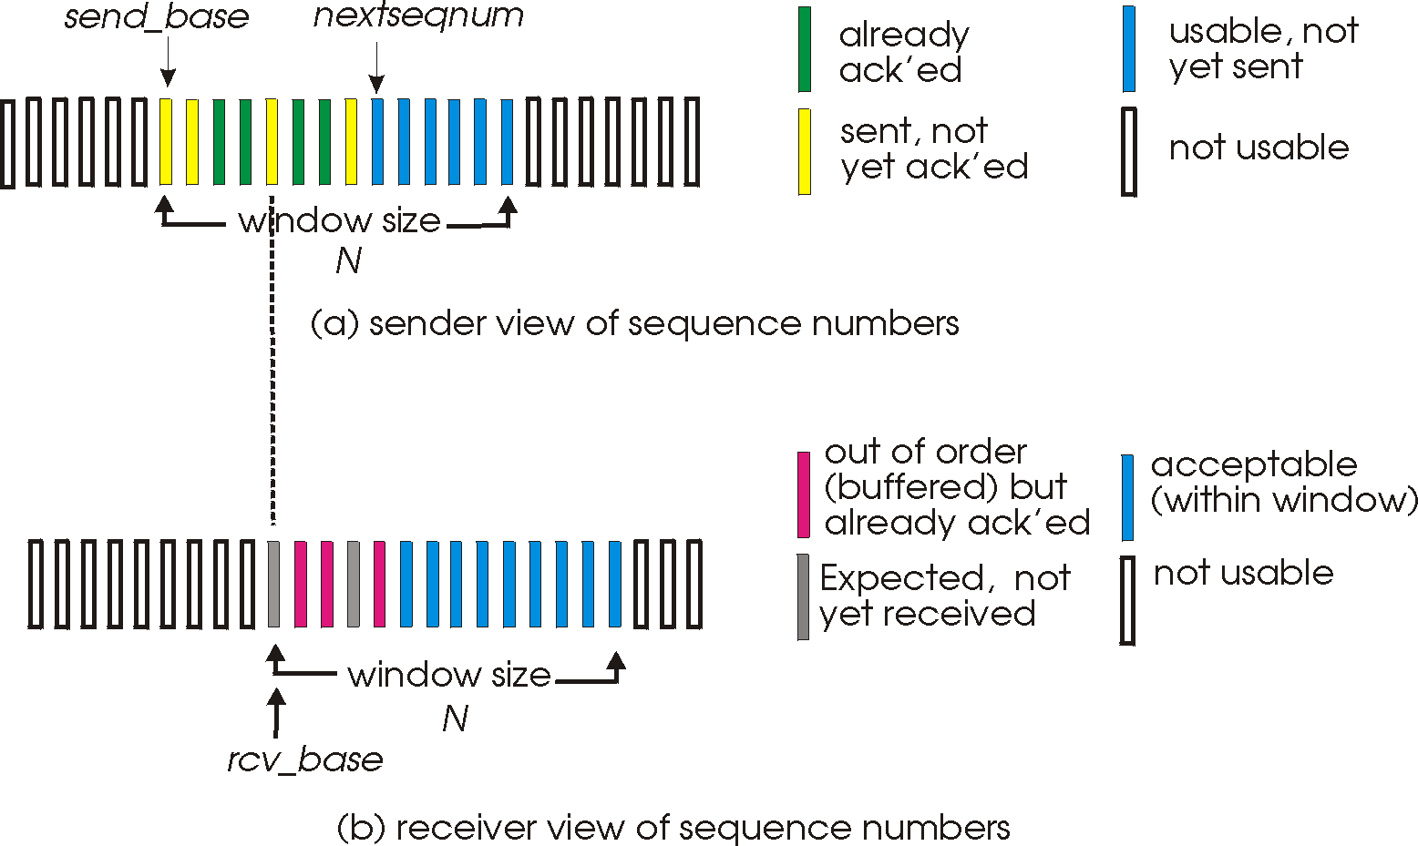
Selective repeat: sender, receiver windows

Slide 50
Selective repeat
sender
receiver
data from above :
if next available seq # in window, send pkt
timeout(n):
resend pkt n, restart timer
ACK(n) in [sendbase,sendbase+N]:
mark pkt n as received
if n smallest unACKed pkt, advance window base to next unACKed seq #
pkt n in [rcvbase, rcvbase+N-1]
send ACK(n)
out-of-order: buffer
in-order: deliver (also deliver buffered, in-order pkts), advance window to next not-yet-received pkt
pkt n in [rcvbase-N,rcvbase-1]
ACK(n)
otherwise:
ignore

Slide 51
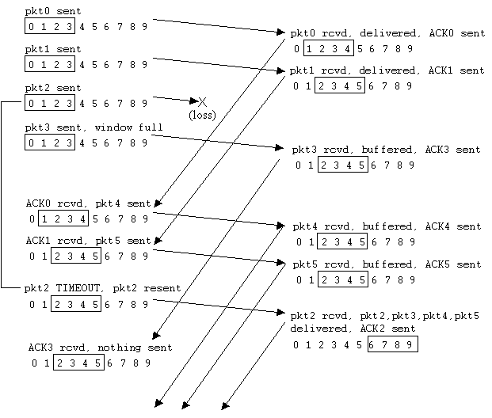
Selective repeat in action

Slide 52
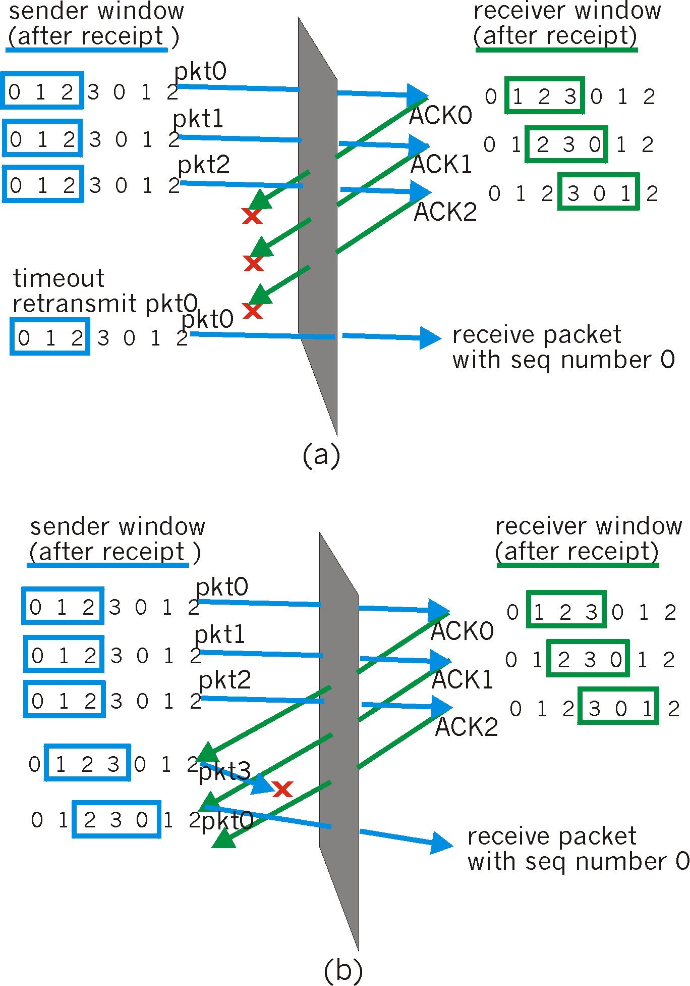
Selective repeat: dilemma
Example:
seq #’s: 0, 1, 2, 3
window size=3
receiver sees no difference in two scenarios!
incorrectly passes duplicate data as new in (a)
Q: what relationship between seq # size and window size?
window size ≤ (½ of seq # size)

Slide 53
Automatic Repeat Request (ARQ)
+ Self-clocking (Automatic)
+ Adaptive
+ Flexible
- Slow to start / adapt
consider high Bandwidth/Delay product
Now lets move from
the generic to the
specific….
TCP arguably the most successful protocol in the Internet…..
its an ARQ protocol

Slide 54
TCP: Overview RFCs: 793, 1122, 1323, 2018, 2581, …
point-to-point:
one sender, one receiver
reliable, in-order byte stream:
no “message boundaries”
pipelined:
TCP congestion and flow control set window size
send & receive buffers
full duplex data:
bi-directional data flow in same connection
MSS: maximum segment size
connection-oriented:
handshaking (exchange of control msgs) init’s sender, receiver state before data exchange
flow controlled:
sender will not overwhelm receiver

Slide 55
TCP segment structure
32 bits
URG: urgent data
(generally not used)
counting
by bytes
of data
(not segments!)
source port #
dest port #
sequence number
ACK: ACK #
valid
acknowledgement number
PSH: push data now
(generally not used)
head
len
not
used
U
A
P
R
S
F
Receive window
# bytes
rcvr willing
to accept
checksum
Urg data pnter
RST, SYN, FIN:
connection estab
(setup, teardown
commands)
Options (variable length)
application
data
(variable length)
Internet
checksum
(as in UDP)

Slide 56
TCP seq. #’s and ACKs
Seq. #’s:
byte stream “number” of first byte in segment’s data
ACKs:
seq # of next byte expected from other side
cumulative ACK
Q: how receiver handles out-of-order segments
A: TCP spec doesn’t say, - up to implementor
Host A
Host B
User
types
‘C’
Seq=42, ACK=79, data = ‘C’
host ACKs
receipt of
‘C’, echoes
back ‘C’
Seq=79, ACK=43, data = ‘C’
host ACKs
receipt
of echoed
‘C’
Seq=43, ACK=80
time
simple telnet scenario
This has led to a world of hurt….

Slide 57
TCP out of order attack
ARQ with SACK means
recipient needs copies of
all packets
Evil attack one:
send a long stream of TCP data to a server but don’t send the first byte
Recipient keeps all the subsequent data and waits…..
Filling buffers.
Critical buffers…
Send a legitimate request
GET index.html
this gets through an intrusion-detection system
then send a new segment replacing bytes 4-13 with
“password-file”
A dumb example.
Neither of these attacks would work on a modern system.

Slide 58
TCP Round Trip Time and Timeout
Q: how to set TCP timeout value?
longer than RTT
but RTT varies
too short: premature timeout
unnecessary retransmissions
too long: slow reaction to segment loss
Q: how to estimate RTT?
SampleRTT: measured time from segment transmission until ACK receipt
ignore retransmissions
SampleRTT will vary, want estimated RTT “smoother”
average several recent measurements, not just current SampleRTT
Notes:
got here 10 feb

Slide 59
TCP Round Trip Time and Timeout
EstimatedRTT = (1- α)*EstimatedRTT + α*SampleRTT
Exponential weighted moving average
influence of past sample decreases exponentially fast
typical value: α = 0.125

Slide 60
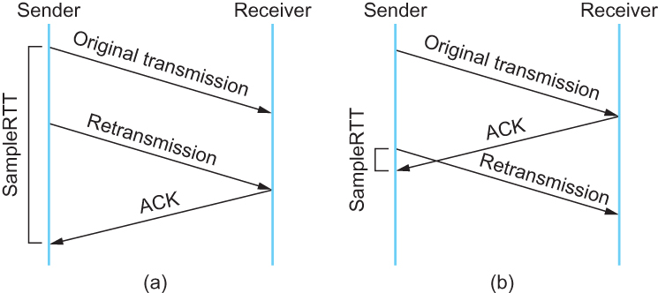
Some RTT estimates are never good
Associating the ACK with (a) original transmission versus (b) retransmission
Karn/Partridge Algorithm – Ignore retransmission in measurements
(and increase timeout; this makes retransmissions decreasingly aggressive)

Slide 61
Example RTT estimation:

Slide 62
TCP Round Trip Time and Timeout
Setting the timeout
EstimtedRTT plus “safety margin”
large variation in EstimatedRTT -> larger safety margin
first estimate of how much SampleRTT deviates from EstimatedRTT:
DevRTT = (1-β)*DevRTT +
β*|SampleRTT-EstimatedRTT|
(typically, β = 0.25)
Then set timeout interval:
TimeoutInterval = EstimatedRTT + 4*DevRTT

Slide 63
TCP reliable data transfer
TCP creates rdt service on top of IP’s unreliable service
Pipelined segments
Cumulative acks
TCP uses single retransmission timer
Retransmissions are triggered by:
timeout events
duplicate acks
Initially consider simplified TCP sender:
ignore duplicate acks
ignore flow control, congestion control

Slide 64
TCP sender events:
data rcvd from app:
Create segment with seq #
seq # is byte-stream number of first data byte in segment
start timer if not already running (think of timer as for oldest unacked segment)
expiration interval: TimeOutInterval
timeout:
retransmit segment that caused timeout
restart timer
Ack rcvd:
If acknowledges previously unacked segments
update what is known to be acked
start timer if there are outstanding segments

Slide 65
TCP sender (simplified)
NextSeqNum = InitialSeqNum
SendBase = InitialSeqNum
loop (forever) {
switch(event)
event: data received from application above
create TCP segment with sequence number NextSeqNum
if (timer currently not running)
start timer
pass segment to IP
NextSeqNum = NextSeqNum + length(data)
event: timer timeout
retransmit not-yet-acknowledged segment with
smallest sequence number
start timer
event: ACK received, with ACK field value of y
if (y > SendBase) {
SendBase = y
if (there are currently not-yet-acknowledged segments)
start timer
}
} /* end of loop forever */
Comment:
SendBase-1: last
cumulatively ack’ed byte
Example:
SendBase-1 = 71; y= 73, so the rcvr wants 73+ ; y > SendBase, so that new data is acked

Slide 66
TCP: retransmission scenarios
Host A
Host B
Host A
Host B
Seq=92, 8 bytes data
Seq=92, 8 bytes data
Seq=100, 20 bytes data
timeout
ACK=100
Seq=92 timeout
X
ACK=100
loss
ACK=120
Seq=92, 8 bytes data
Sendbase
= 100
Seq=92, 8 bytes data
SendBase
= 120
Seq=92 timeout
ACK=120
ACK=100
SendBase
= 100
SendBase
= 120
premature timeout
time
time
lost ACK scenario

Slide 67
TCP retransmission scenarios (more)
Host A
Host B
Seq=92, 8 bytes data
Implicit ACK
(e.g. not Go-Back-N)
ACK=120 implicitly ACK’s 100 too
ACK=100
timeout
Seq=100, 20 bytes data
X
loss
SendBase
= 120
ACK=120
time

Slide 68
TCP ACK generation [RFC 1122, RFC 2581]
Event at Receiver
Arrival of in-order segment with
expected seq #. All data up to
expected seq # already ACKed
Arrival of in-order segment with
expected seq #. One other
segment has ACK pending
Arrival of out-of-order segment
higher-than-expect seq. # .
Gap detected
Arrival of segment that
partially or completely fills gap
TCP Receiver action
Delayed ACK. Wait up to 500ms
for next segment. If no next segment,
send ACK
Immediately send single cumulative
ACK, ACKing both in-order segments
Immediately send duplicate ACK,
indicating seq. # of next expected byte
Immediate send ACK, provided that
segment starts at lower end of gap

Slide 69
Fast Retransmit
Time-out period often relatively long:
long delay before resending lost packet
Detect lost segments via duplicate ACKs.
Sender often sends many segments back-to-back
If segment is lost, there will likely be many duplicate ACKs.
If sender receives 3 duplicate ACKs, it supposes that segment after ACKed data was lost:
fast retransmit: resend segment before timer expires

Slide 70
Host A
Host B
X
timeout
resend 2nd segment
time
Figure 3.37 Resending a segment after triple duplicate ACK

Slide 71
Fast retransmit algorithm:
event: ACK received, with ACK field value of y
if (y > SendBase) {
SendBase = y
if (there are currently not-yet-acknowledged segments)
start timer
}
else {
increment count of dup ACKs received for y
if (count of dup ACKs received for y = 3) {
resend segment with sequence number y
}
a duplicate ACK for
already ACKed segment
fast retransmit

Slide 72
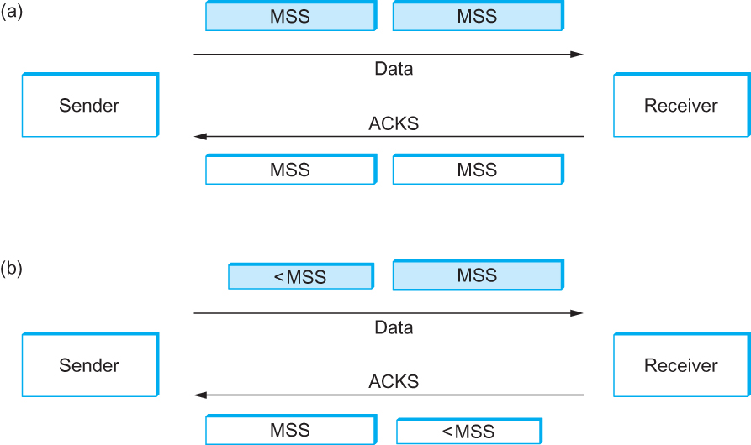
Silly Window Syndrome
MSS advertises the amount a receiver can accept
If a transmitter has something to send – it will.
This means small MSS values may persist
indefinitely.
Solution
Wait to fill each segment, but don’t wait indefinitely.
NAGLE’s Algorithm
If we wait too long interactive traffic is difficult
If we don’t want we get silly window syndrome
Solution: Use a timer, when the timer expires – send the (unfilled) segment.

Slide 73
Flow Control ≠ Congestion Control
Flow control involves preventing senders from overrunning the capacity of the receivers
Congestion control involves preventing too much data from being injected into the network, thereby causing switches or links to become overloaded

Slide 74
Flow Control – (bad old days?)
In-Line flow control
XON/XOFF (^s/^q)
data-link dedicated symbols aka Ethernet
(more in the Advanced Topic on Datacenters)
Dedicated wires
RTS/CTS handshaking
Read (or Write) Ready
signals from memory interface saying slow-down/stop…

Slide 75
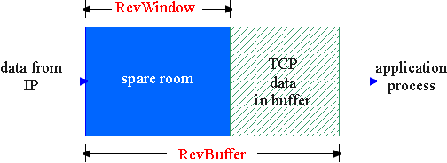
TCP Flow Control
flow control
sender won’t overflow
receiver’s buffer by
transmitting too much,
too fast
receive side of TCP connection has a receive buffer:
speed-matching service: matching the send rate to the receiving app’s drain rate
app process may be slow at reading from buffer
Notes:
1st of Feb

Slide 76
TCP Flow control: how it works
Rcvr advertises spare room by including value of RcvWindow in segments
Sender limits unACKed data to RcvWindow
guarantees receive buffer doesn’t overflow
(Suppose TCP receiver discards out-of-order segments)
spare room in buffer
= RcvWindow
= RcvBuffer-[LastByteRcvd - LastByteRead]

Slide 77
TCP Connection Management
Recall: TCP sender, receiver establish “connection” before exchanging data segments
initialize TCP variables:
seq. #s
buffers, flow control info (e.g. RcvWindow)
client: connection initiator
Socket clientSocket = new Socket("hostname","port number");
server: contacted by client
Socket connectionSocket = welcomeSocket.accept();
Three way handshake:
Step 1: client host sends TCP SYN segment to server
specifies initial seq #
no data
Step 2: server host receives SYN, replies with SYNACK segment
server allocates buffers
specifies server initial seq. #
Step 3: client receives SYNACK, replies with ACK segment, which may contain data

Slide 78
TCP Connection Management (cont.)
Closing a connection:
client closes socket: clientSocket.close();
Step 1: client end system sends TCP FIN control segment to server
Step 2: server receives FIN, replies with ACK. Closes connection, sends FIN.
client
server
close
FIN
ACK
close
FIN
ACK
timed wait
closed

Slide 79
TCP Connection Management (cont.)
Step 3: client receives FIN, replies with ACK.
Enters “timed wait” - will respond with ACK to received FINs
Step 4: server, receives ACK. Connection closed.
Note: with small modification, can handle simultaneous FINs.
client
server
closing
FIN
ACK
closing
FIN
ACK
timed wait
closed
closed

Slide 80
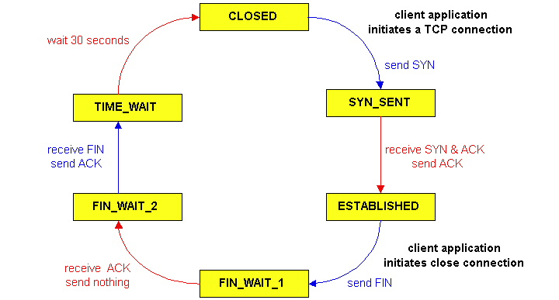
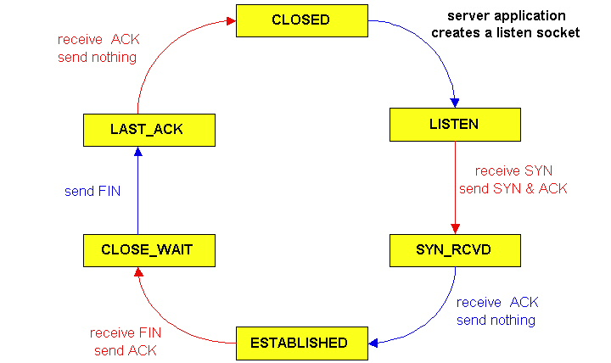
TCP Connection Management (cont)
TCP server
lifecycle
TCP client
lifecycle

Slide 81
Principles of Congestion Control
Congestion:
informally: “too many sources sending too much data too fast for network to handle”
different from flow control!
manifestations:
lost packets (buffer overflow at routers)
long delays (queueing in router buffers)
a top-10 problem!

Slide 82
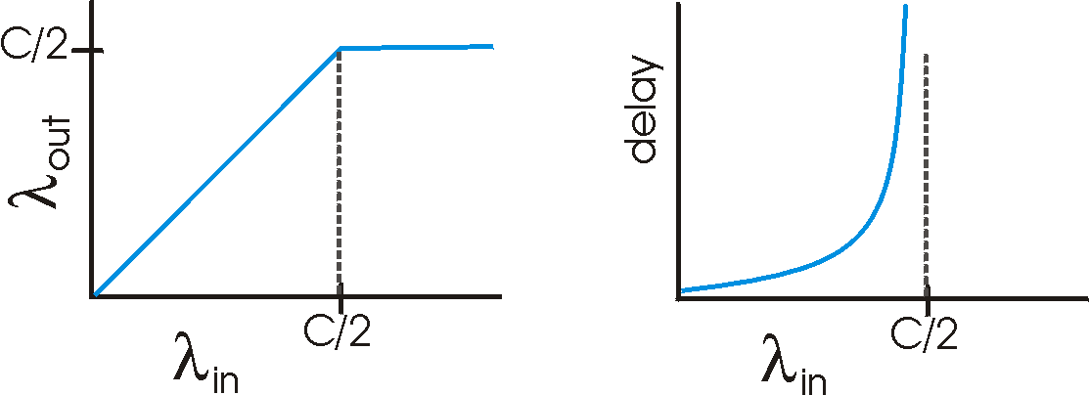
Causes/costs of congestion: scenario 1
two senders, two receivers
one router, infinite buffers
no retransmission
Host A
λ_{in} : original data
λ_{out}
Host B
unlimited shared output link buffers
large delays when congested
maximum achievable throughput

Slide 83
Causes/costs of congestion: scenario 2
one router, finite buffers
sender retransmission of lost packet
Host A
λ_{in} : original data
λ_{out}
λ'_{in} : original data, plus retransmitted data
Host B
finite shared output link buffers

Slide 84
Causes/costs of congestion: scenario 2
λ
λ
always: (goodput)
“perfect” retransmission only when loss:
retransmission of delayed (not lost) packet makes larger (than perfect case) for same
=
in
out
λ
>
λ
in
out
λ
λ
in
out
R/2
R/2
R/2
R/3
λ_{out}
λ_{out}
λ_{out}
R/4
λ_{in}
R/2
λ_{in}
R/2
λ_{in}
R/2
a.
b.
c.
“costs” of congestion:
more work (retrans) for given “goodput”
unneeded retransmissions: link carries multiple copies of pkt
Notes:
----- Meeting Notes (13/02/2012 10:56) -----
Monday 13/2/2012

Slide 85
Causes/costs of congestion: scenario 3
λ
four senders
multihop paths
timeout/retransmit
Q: what happens as and increase ?
λ
in
in
Host A
λ_{in} : original data
λ_{out}
λ'_{in} : original data, plus retransmitted data
finite shared output link buffers
Host B

Slide 86
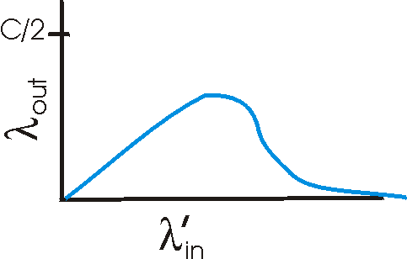
Causes/costs of congestion: scenario 3
Host A
λ_{out}
Host B
Another “cost” of congestion:
when packet dropped, any “upstream transmission capacity used for that packet was wasted!
Congestion Collapse example: Cocktail party effect

Slide 87
Approaches towards congestion control
Two broad approaches towards congestion control:
End-end congestion control:
no explicit feedback from network
congestion inferred from end-system observed loss, delay
approach taken by TCP
Network-assisted congestion control:
routers provide feedback to end systems
single bit indicating congestion (SNA, DECbit, TCP/IP ECN, ATM)
explicit rate sender should send at

Slide 88
TCP congestion control: additive increase, multiplicative decrease
Approach: increase transmission rate (window size), probing for usable bandwidth, until loss occurs
additive increase: increase CongWin by 1 MSS every RTT for each received ACK until loss detected (W W + 1/W)
multiplicative decrease: cut CongWin in half after loss
(W W/2)
Saw tooth
behavior: probing
for bandwidth
congestion window size
time

Slide 89
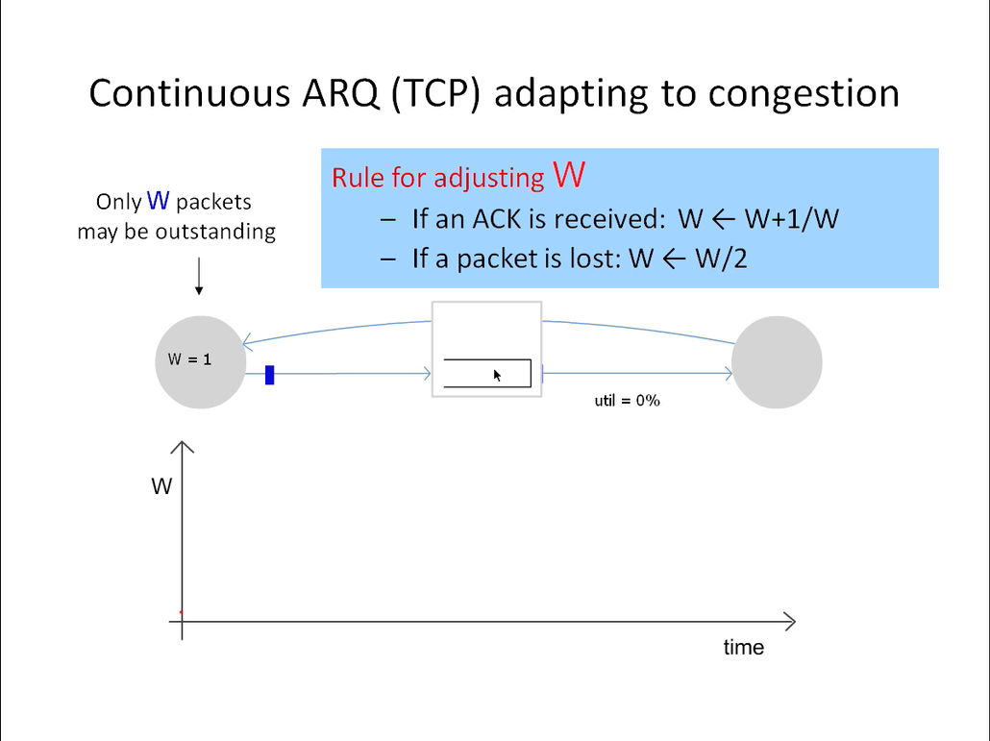
SLOW START IS NOT SHOWN!

Slide 90
TCP Congestion Control: details
sender limits transmission:
LastByteSent-LastByteAcked
≤ CongWin
Roughly,
CongWin is dynamic, function of perceived network congestion
How does sender perceive congestion?
loss event = timeout or 3 duplicate acks
TCP sender reduces rate (CongWin) after loss event
three mechanisms:
AIMD
slow start
conservative after timeout events
CongWin
rate =
Bytes/sec
RTT
Notes:
3rd Feb

Slide 91
AIMD Starts Too Slowly!
Need to start with a small CWND to avoid overloading the network.
Window
It could take a long time to get started!
t

Slide 92
TCP Slow Start
When connection begins, CongWin = 1 MSS
Example: MSS = 500 bytes & RTT = 200 msec
initial rate = 20 kbps
available bandwidth may be >> MSS/RTT
desirable to quickly ramp up to respectable rate
When connection begins, increase rate exponentially fast until first loss event

Slide 93
TCP Slow Start (more)
When connection begins, increase rate exponentially until first loss event:
double CongWin every RTT
done by incrementing CongWin for every ACK received
Summary: initial rate is slow but ramps up exponentially fast
Host A
Host B
one segment
RTT
two segments
four segments
time

Slide 94
Slow Start and the TCP Sawtooth
Window
Loss
Exponential “slow start”
t
Why is it called slow-start? Because TCP originally had
no congestion control mechanism. The source would just start by sending a whole window’s worth of data.

Slide 95
Refinement: inferring loss
After 3 dup ACKs:
CongWin is cut in half
window then grows linearly
But after timeout event:
CongWin instead set to 1 MSS;
window then grows exponentially
to a threshold, then grows linearly
Philosophy:
3 dup ACKs indicates network capable of delivering some segments
timeout indicates a “more alarming” congestion scenario

Slide 96
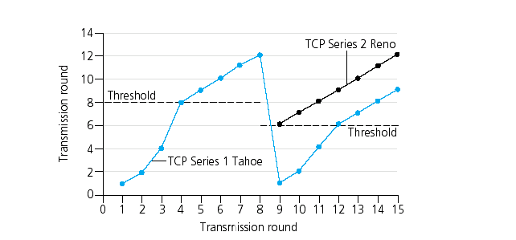
Refinement
Q: When should the exponential increase switch to linear?
A: When CongWin gets to 1/2 of its value before timeout.
Implementation:
Variable Threshold
At loss event, Threshold is set to 1/2 of CongWin just before loss event

Slide 97
Summary: TCP Congestion Control
When CongWin is below Threshold, sender in slow-start phase, window grows exponentially.
When CongWin is above Threshold, sender is in congestion-avoidance phase, window grows linearly.
When a triple duplicate ACK occurs, Threshold set to CongWin/2 and CongWin set to Threshold.
When timeout occurs, Threshold set to CongWin/2 and CongWin is set to 1 MSS.

Slide 98
TCP sender congestion control
State | Event | TCP Sender Action | Commentary
Slow Start (SS) | ACK receipt for previously unacked data | CongWin = CongWin + MSS, If (CongWin > Threshold) set state to “Congestion Avoidance” | Resulting in a doubling of CongWin every RTT
Congestion Avoidance (CA) | ACK receipt for previously unacked data | CongWin = CongWin+MSS * (MSS/CongWin) | Additive increase, resulting in increase of CongWin by 1 MSS every RTT
SS or CA | Loss event detected by triple duplicate ACK | Threshold = CongWin/2, CongWin = Threshold, Set state to “Congestion Avoidance” | Fast recovery, implementing multiplicative decrease. CongWin will not drop below 1 MSS.
SS or CA | Timeout | Threshold = CongWin/2, CongWin = 1 MSS, Set state to “Slow Start” | Enter slow start
SS or CA | Duplicate ACK | Increment duplicate ACK count for segment being acked | CongWin and Threshold not changed

Slide 99
Repeating Slow Start After Timeout
Window
Timeout
SSThresh
Set to Here
Fast Retransmission
Slow start in operation until it reaches half of previous CWND, I.e., SSTHRESH
t
Slow-start restart: Go back to CWND of 1 MSS, but take advantage of knowing the previous value of CWND.

Slide 100
TCP throughput
What’s the average throughout of TCP as a function of window size and RTT?
Ignore slow start
Let W be the window size when loss occurs.
When window is W, throughput is W/RTT
Just after loss, window drops to W/2, throughput to W/2RTT.
Average throughout: .75 W/RTT
Notes:
-=-= started here Fri 17th

Slide 101
TCP Futures: TCP over “long, fat pipes”
Example: 1500 byte segments, 100ms RTT, want 10 Gbps throughput
Requires window size W = 83,333 in-flight segments
Throughput in terms of loss rate p:
➜ L = 2·10⁻¹⁰ Ouch!
New versions of TCP for high-speed

Slide 102
Calculation on Simple Model (cwnd in units of MSS)
Assume loss occurs whenever cwnd reaches W
Recovery by fast retransmit
Window: W/2, W/2+1, W/2+2, …W, W/2, …
W/2 RTTs, then drop, then repeat
Average throughput: .75W(MSS/RTT)
One packet dropped out of (W/2)*(3W/4)
Packet drop rate p = (8/3) W⁻²
Throughput = (MSS/RTT) sqrt(3/2p)
HINT: KNOW THIS SLIDE
Notes:
KNOW THIS!

Slide 103
Three Congestion Control Challenges – or Why AIMD?
Single flow adjusting to bottleneck bandwidth
Without any a priori knowledge
Could be a Gbps link; could be a modem
Single flow adjusting to variations in bandwidth
When bandwidth decreases, must lower sending rate
When bandwidth increases, must increase sending rate
Multiple flows sharing the bandwidth
Must avoid overloading network
And share bandwidth “fairly” among the flows

Slide 104
Problem #1: Single Flow, Fixed BW
Want to get a first-order estimate of the available bandwidth
Assume bandwidth is fixed
Ignore presence of other flows
Want to start slow, but rapidly increase rate until packet drop occurs (“slow-start”)
Adjustment:
cwnd initially set to 1 (MSS)
cwnd++ upon receipt of ACK

Slide 105
Problems with Slow-Start
Slow-start can result in many losses
Roughly the size of cwnd ~ BW*RTT
Example:
At some point, cwnd is enough to fill “pipe”
After another RTT, cwnd is double its previous value
All the excess packets are dropped!
Need a more gentle adjustment algorithm once have rough estimate of bandwidth
Rest of design discussion focuses on this

Slide 106
Problem #2: Single Flow, Varying BW
Want to track available bandwidth
Oscillate around its current value
If you never send more than your current rate, you won’t know if more bandwidth is available
Possible variations: (in terms of change per RTT)
Multiplicative increase or decrease:
cwnd cwnd * / a
Additive increase or decrease:
cwnd cwnd +- b

Slide 107
Four alternatives
AIAD: gentle increase, gentle decrease
AIMD: gentle increase, drastic decrease
MIAD: drastic increase, gentle decrease
too many losses: eliminate
MIMD: drastic increase and decrease
Notes:
What do you think about these options?
Which one is obviously bad?
What do you think about the other ones?

Slide 108
Problem #3: Multiple Flows
Want steady state to be “fair”
Many notions of fairness, but here just require two identical flows to end up with the same bandwidth
This eliminates MIMD and AIAD
As we shall see…
AIMD is the only remaining solution!
Not really, but close enough….

Slide 109
Recall Buffer and Window Dynamics
A
B
x
C = 50 pkts/RTT
No congestion → x increases by one packet/RTT every RTT
Congestion → decrease x by factor 2

Slide 110
AIMD Sharing Dynamics
x₁
A
B
x₂
D
E
No congestion → rate increases by one packet/RTT every RTT
Congestion → decrease rate by factor 2
Rates equalize → fair share

Slide 111
AIAD Sharing Dynamics
x₁
A
B
x₂
D
E
No congestion → x increases by one packet/RTT every RTT
Congestion → decrease x by 1

Slide 112
Simple Model of Congestion Control
Two TCP connections
Rates x₁ and x₂
Congestion when sum>1
Efficiency: sum near 1
Fairness: x’s converge
2 user example
overload
Bandwidth for User 2: x₂
underload
Efficiency
line
Bandwidth for User 1: x₁

Slide 113
Example
1
fairness
line
Total bandwidth 1
Efficient: x₁+x₂=1
Fair
Congested: x₁+x₂=1.2
(0.2, 0.5)
(0.7, 0.5)
User 2: x₂
(0.5, 0.5)
Inefficient: x₁+x₂=0.7
(0.7, 0.3)
Efficient: x₁+x₂=1
Not fair
efficiency
line
User 1: x₁
1

Slide 114
AIAD
(x_{1h}-a_{D}+a_{I}), x_{2h}-a_{D}+a_{I}))
fairness
line
Increase: x + a_{I}
Decrease: x - a_{D}
Does not converge to fairness
(x_{1h},x_{2h})
Bandwidth for User 2: x₂
(x_{1h}-a_{D},x_{2h}-a_{D})
efficiency
line
Bandwidth for User 1: x₁

Slide 115
MIMD
fairness
line
Increase: x*b_{I}
Decrease: x*b_{D}
Does not converge to fairness
(x_{1h},x_{2h})
(b_{I}b_{D}x_{1h}, b_{I}b_{D}x_{2h})
Bandwidth for User 2: x₂
(b_{d}x_{1h},b_{d}x_{2h})
efficiency
line
Bandwidth for User 1: x₁

Slide 116
AIMD
fairness
line
Increase: x+a_{D}
Decrease: x*b_{D}
Converges to fairness
(x_{1h},x_{2h})
(b_{D}x_{1h}+a_{I}, b_{D}x_{2h}+a_{I})
Bandwidth for User 2: x₂
(b_{D}x_{1h},b_{D}x_{2h})
efficiency
line
Bandwidth for User 1: x₁

Slide 117
Why is AIMD fair? (a pretty animation…)
Two competing sessions:
Additive increase gives slope of 1, as throughout increases
multiplicative decrease decreases throughput proportionally
R
equal bandwidth share
loss: decrease window by factor of 2
congestion avoidance: additive increase
Bandwidth for Connection 2
loss: decrease window by factor of 2
congestion avoidance: additive increase
Bandwidth for Connection 1
R

Slide 118
Fairness (more)
Fairness and UDP
Multimedia apps may not use TCP
do not want rate throttled by congestion control
Instead use UDP:
pump audio/video at constant rate, tolerate packet loss
(Ancient yet ongoing) Research area: TCP friendly
Fairness and parallel TCP connections
nothing prevents app from opening parallel connections between 2 hosts.
Web browsers do this
Example: link of rate R supporting 9 connections;
new app asks for 1 TCP, gets rate R/10
new app asks for 11 TCPs, gets R/2 !
Recall Multiple browser sessions (and the potential for syncronized loss)
Notes:
Note about NetBOOST – Fast Speed and other “stack modifiers”
vs
Riverbed “TCP sanitisers” and so on.

Slide 119
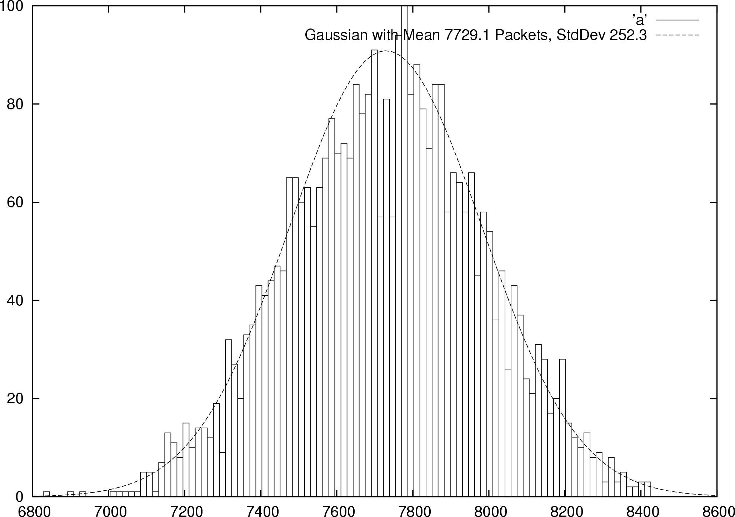
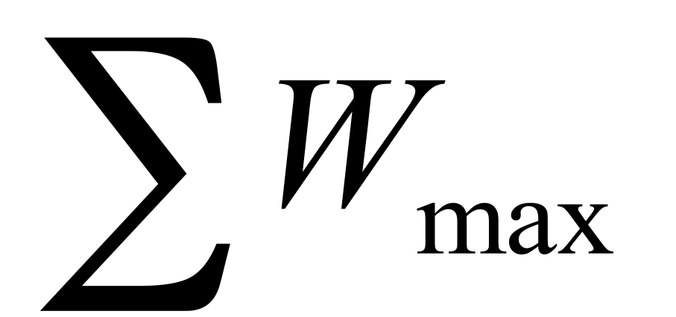

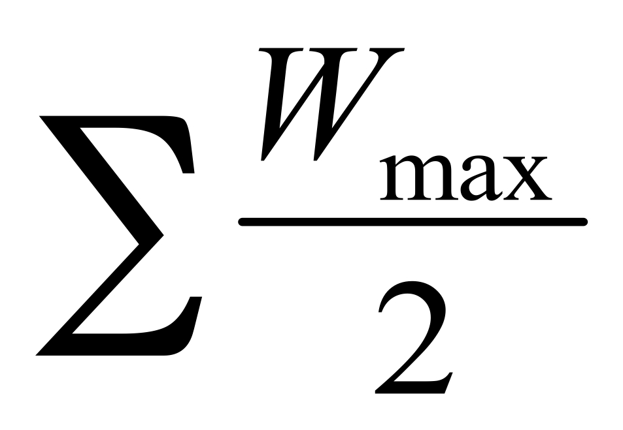
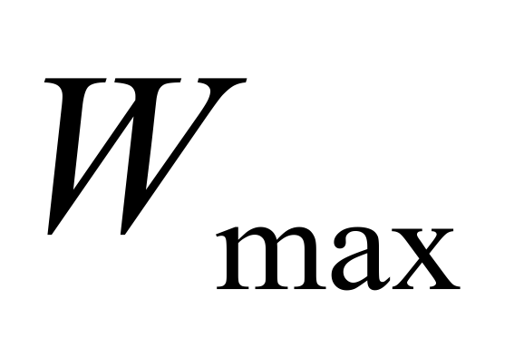
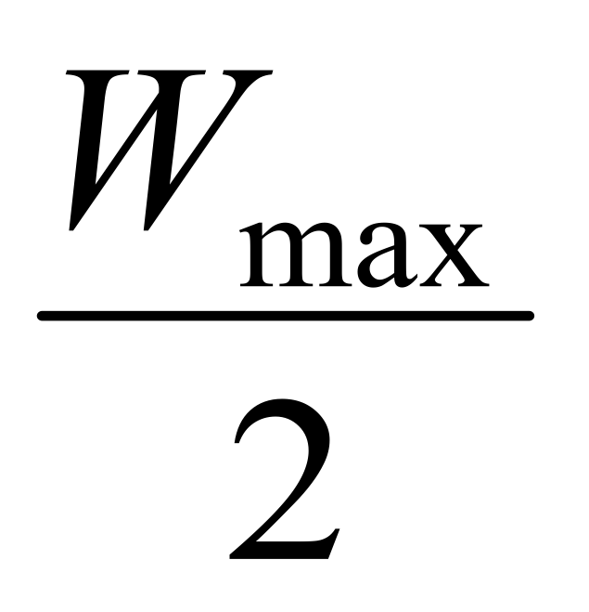
Some TCP issues outstanding…
Synchronized Flows
Many TCP Flows
Aggregate window has same dynamics
Therefore buffer occupancy has same dynamics
Rule-of-thumb still holds.
Independent, desynchronized
Central limit theorem says the aggregate becomes Gaussian
Variance (buffer size) decreases as N increases
Buffer Size
Probability
Distribution
t
t

