Slide 1
Computer Networking
Lent Term M/W/F 11-midday
LT1 in Gates Building
Slide Set 4
Andrew W. Moore
andrew.moore@cl.cam.ac.uk
January 2013

Slide 2
Topic 4: Network Layer
Our goals:
understand principles behind network layer services:
network layer service models
forwarding versus routing (versus switching)
how a router works
routing (path selection)
IPv6
For the most part, the Internet is our example

Slide 3

Network layer
transport segment from sending to receiving host
on sender side encapsulates segments into datagrams
on receiver side, delivers segments to transport layer
network layer protocols in every host, router
router examines header fields in all IP datagrams passing through it
application
transport
network
data link
physical
network
data link
physical
network
data link
physical
network
data link
physical
network
data link
physical
network
data link
physical
network
data link
physical
network
data link
physical
network
data link
physical
network
data link
physical
application
transport
network
data link
physical
network
data link
physical
network
data link
physical

Slide 4
Name: a something
Address: Where a something is
Routing: How do I get to the something

Slide 5
Addressing (at a conceptual level)
Assume all hosts have unique IDs
No particular structure to those IDs
Later in topic I will talk about real IP addressing
Do I route on location or identifier?
If a host moves, should its address change?
If not, how can you build scalable Internet?
If so, then what good is an address for identification?

Slide 6
Packets (at a conceptual level)
Assume packet headers contain:
Source ID, Destination ID, and perhaps other information
Destination
Identifier
Why include
this?
Source
Identifier
Payload

Slide 7
Switches/Routers
Multiple ports (attached to other switches or hosts)
Ports are typically duplex (incoming and outgoing)
incoming links
Switch
outgoing links

Slide 8
Example of Network Graph
Six ports, incoming/outgoing
Four ports, incoming/outgoing

Slide 9
A Variety of Networks
ISPs: carriers
Backbone
Edge
Border (to other ISPs)
Enterprises: companies, universities
Core
Edge
Border (to outside)
Datacenters: massive collections of machines
Top-of-Rack
Aggregation and Core
Border (to outside)

Slide 10
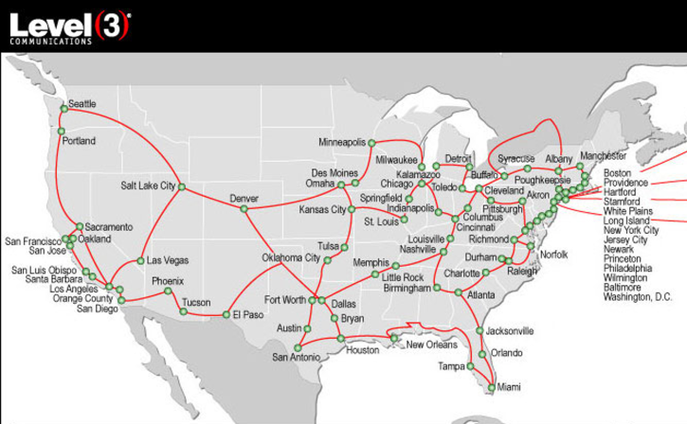
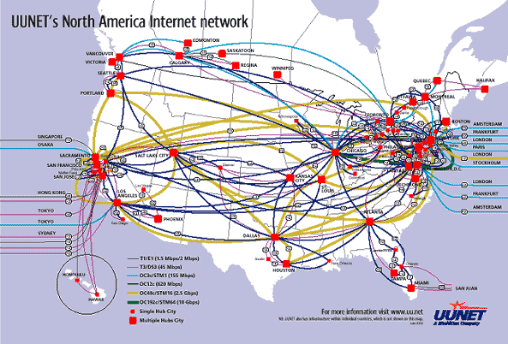
ISP networks

Slide 11
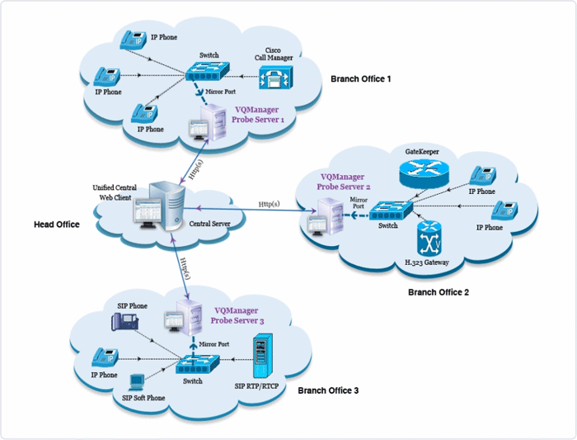
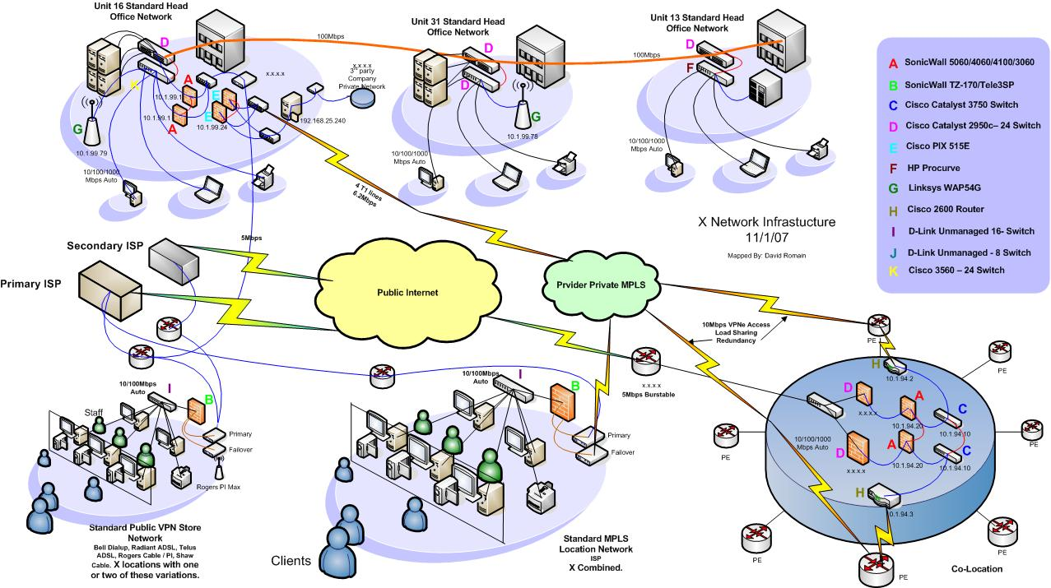
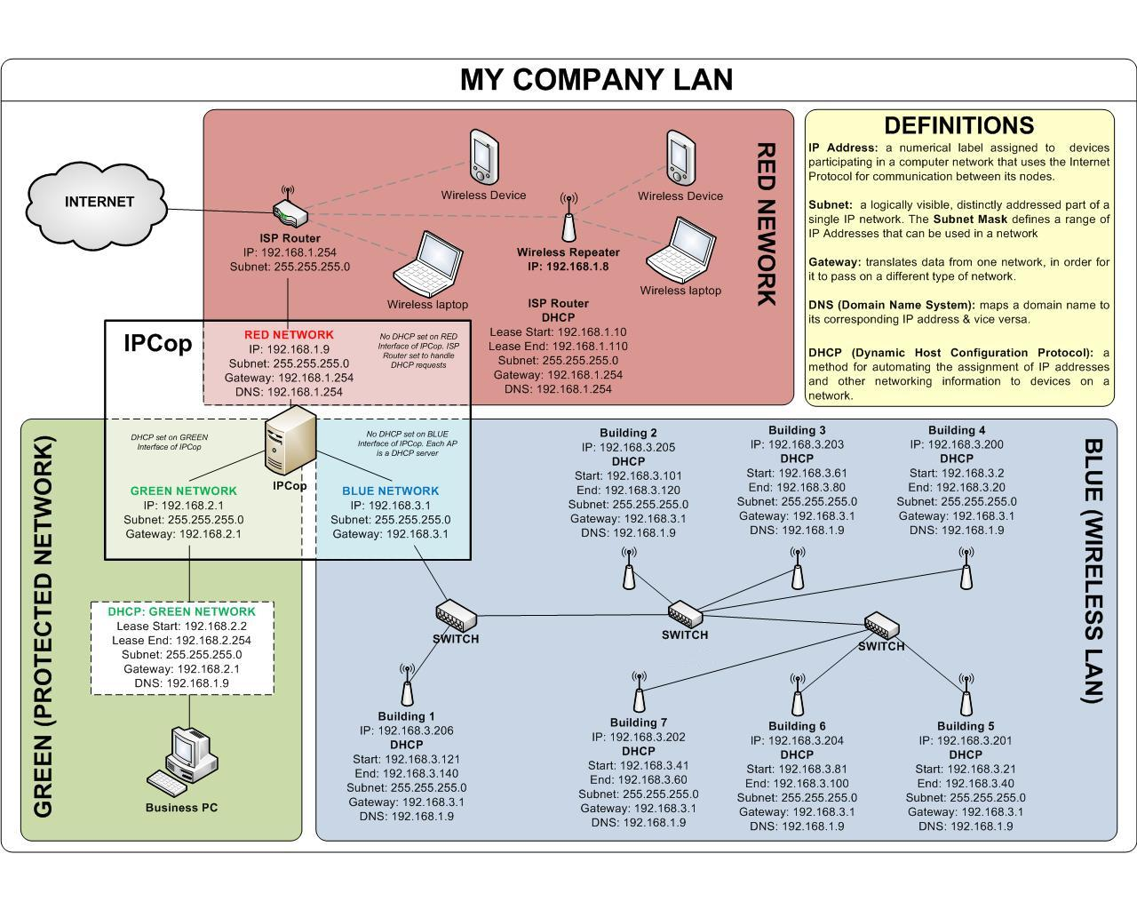
Enterprise Network
Notes:
http://www.ratemynetworkdiagram.com/

Slide 12
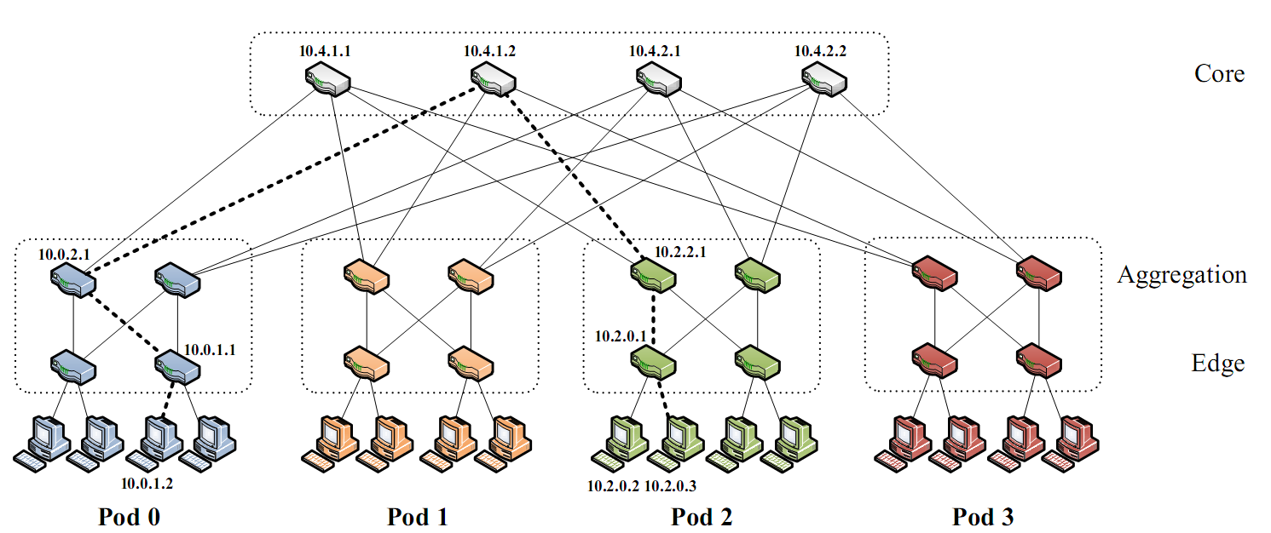
Partial Datacenter Network
Notes:
Only a part of the network, but the takeaway is that the network is very regular, involving levels of hierarchy.

Slide 13
Switches
Enterprise/Edge: typically 24 to 48 ports
Aggregation switches: 192 ports or more
Backbone: typically fewer ports
Border: typically very few ports

Slide 14
Forwarding Decisions
When packet arrives, must choose outgoing port
Decision is based on routing state (table) in switch
incoming links
Switch
outgoing links
Consider
packet header
and routing
table

Slide 15
Forwarding Decisions
When packet arrives..
Must decide which outgoing port to use
In single transmission time
Forwarding decisions must be simple
Routing state dictates where to forward packets
Assume decisions are deterministic
Global routing state means collection of routing state in each of the routers
Will focus on where this routing state comes from
But first, a few preliminaries….

Slide 16
Forwarding vs Routing
Forwarding: “data plane”
Directing a data packet to an outgoing link
Individual router using routing state
Routing: “control plane”
Computing paths the packets will follow
Routers talking amongst themselves
Jointly creating the routing state
Two very different timescales….

Slide 17
Interplay between routing and forwarding
analogy:
routing: process of planning trip from source to dest
forwarding: process of negotiating each intersection
routing algorithm
local forwarding table
header value
output link
0100
0101
0111
1001
3
2
2
1
value in arriving
packet’s header
0111
1
3
2

Slide 18
Connection setup
3rd important function in some network architectures:
ATM, frame relay, X.25,
before datagrams flow, two end hosts and intervening routers establish virtual connection
routers get involved
network vs transport layer connection service:
network: between two hosts (may also involve intervening routers in case of VCs)
transport: between two processes
Remember: Ask youself “what is doing the multiplexing?”
, Software Defined Networks

Slide 19
Network service model
Q: What service model for the “channel” transporting datagrams from sender to receiver?
Example services for individual datagrams:
guaranteed delivery
guaranteed delivery with less than 40 msec delay
Example services for a flow of datagrams:
in-order datagram delivery
guaranteed minimum bandwidth to flow
restrictions on changes in inter-packet spacing

Slide 20
Network layer service models:
Network
Architecture
Internet
ATM
ATM
ATM
ATM
Service
Model
best effort
CBR
VBR
ABR
UBR
Guarantees ?
Congestion
feedback
no (inferred
via loss)
no
congestion
no
congestion
yes
no
Bandwidth
none
constant
rate
guaranteed
rate
guaranteed
minimum
none
Loss
no
yes
yes
no
no
Order
no
yes
yes
yes
yes
Timing
no
yes
yes
no
no

Slide 21
Network layer connection and connection-less service
datagram network provides network-layer connectionless service
Virtual Circuit (VC) – a connection-orientated network – provides network-layer connection service
analogous to the transport-layer services, but:
service: host-to-host
no choice: network provides one or the other
implementation: in network core

Slide 22
Virtual circuits
“source-to-dest path behaves much like telephone circuit”
performance-wise
network actions along source-to-dest path
call setup, teardown for each call before data can flow
each packet carries VC identifier (not destination host address)
every router on source-dest path maintains “state” for each passing connection
link, router resources (bandwidth, buffers) may be allocated to VC (dedicated resources = predictable service)

Slide 23
VC implementation
a VC consists of:
path from source to destination
VC numbers, one number for each link along path
entries in forwarding tables in routers along path
packet belonging to VC carries VC number (rather than dest address)
VC number can be changed on each link.
New VC number comes from forwarding table

Slide 24
Forwarding table
VC number
12
22
32
1
3
2
Forwarding table in
northwest router:
interface
number
Incoming interface Incoming VC # Outgoing interface Outgoing VC #
1 12 3 22
2 63 1 18
3 7 2 17
1 97 3 87
… … … …
Routers maintain connection state information!

Slide 25
Virtual circuits: signaling protocols
used to setup, maintain teardown VC
used in ATM, frame-relay, X.25
not used in today’s Internet
application
transport
network
data link
physical
5. Data flow begins
6. Receive data
application
transport
network
data link
physical
4. Call connected
3. Accept call
1. Initiate call
2. incoming call

Slide 26
Datagram networks
no call setup at network layer
routers: no state about end-to-end connections
no network-level concept of “connection”
packets forwarded using destination host address
packets between same source-dest pair may take different paths
application
transport
network
data link
physical
application
transport
network
data link
physical
1. Send data
2. Receive data
Notes:
----- Meeting Notes (20/02/2012 10:56) -----
20 Feb 2012 got to here

Slide 27
Forwarding tables
IP address
32 bits wide → ~ 4 billion unique address
Naïve approach:
One entry per address
Entry | Destination | Port
1 2 ⋮ 2³² | 0.0.0.0 0.0.0.1 ⋮ 255.255.255.255 | 1 2 ⋮ 12
~ 4 billion entries
Improved approach:
Group entries to reduce table size
Entry | Destination | Port
1 2 ⋮ 50 | 0.0.0.0 – 127.255.255.255 128.0.0.1 – 128.255.255.255 ⋮ 248.0.0.0 – 255.255.255.255 | 1 2 ⋮ 12

Slide 28
IP addresses as a line
Your computer
My computer
Cambridge
Oxford
USA
Europe
0
2³²-1
All IP addresses
Entry | Destination | Port
1 2 3 4 5 | Cambridge Oxford Europe USA Everywhere (default) | 1 2 3 4 5

Slide 29
Longest Prefix Match (LPM)
Entry | Destination | Port
1 2 3 4 5 | Cambridge Oxford Europe USA Everywhere (default) | 1 2 3 4 5
Universities
Continents
Planet
Matching entries:
Cambridge
Europe
Everywhere
Most specific
To: Cambridge
Data

Slide 30
Longest Prefix Match (LPM)
Entry | Destination | Port
1 2 3 4 5 | Cambridge Oxford Europe USA Everywhere (default) | 1 2 3 4 5
Universities
Continents
Planet
Matching entries:
Europe
Everywhere
Most specific
To: France
Data

Slide 31
Implementing Longest Prefix Match
Entry | Destination | Port
1 2 3 4 5 | Cambridge Oxford Europe USA Everywhere (default) | 1 2 3 4 5
Searching
Most specific
FOUND
Least specific

Slide 32
Datagram or VC network: why?
Internet (datagram)
data exchange among computers
“elastic” service, no strict timing req.
“smart” end systems (computers)
can adapt, perform control, error recovery
simple inside network, complexity at “edge”
many link types
different characteristics
uniform service difficult
ATM (VC)
evolved from telephony
human conversation:
strict timing, reliability requirements
need for guaranteed service
“dumb” end systems
telephones
complexity inside network
ETHERNET
aDSL

Slide 33
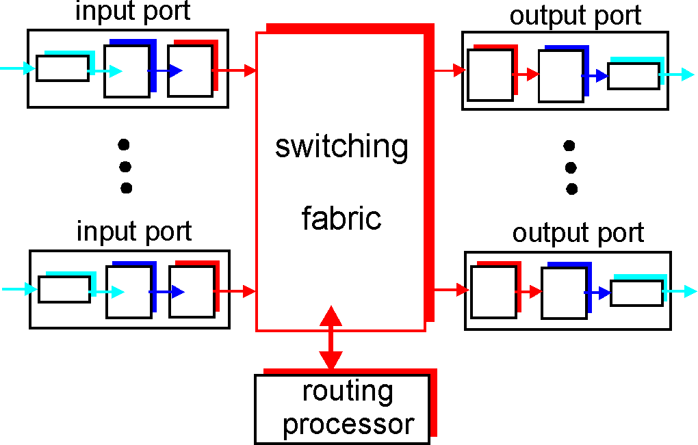
Router Architecture Overview
Two key router functions:
run routing algorithms/protocol (RIP, OSPF, BGP)
forwarding datagrams from incoming to outgoing link

Slide 34
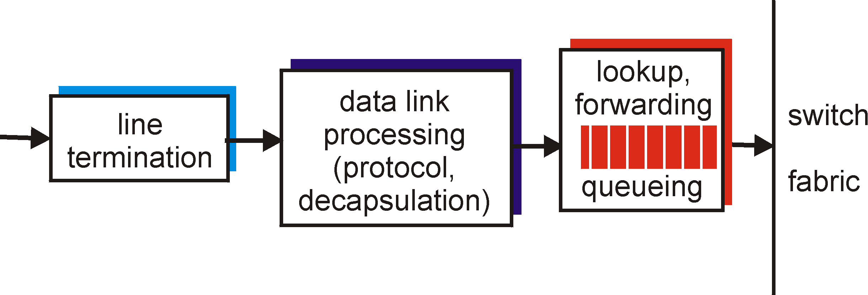
Input Port Functions
Physical layer:
bit-level reception
Data link layer:
e.g., Ethernet
see chapter 5
Decentralized switching:
given datagram dest., lookup output port using forwarding table in input port memory
goal: complete input port processing at ‘line speed’
queuing: if datagrams arrive faster than forwarding rate into switch fabric

Slide 35
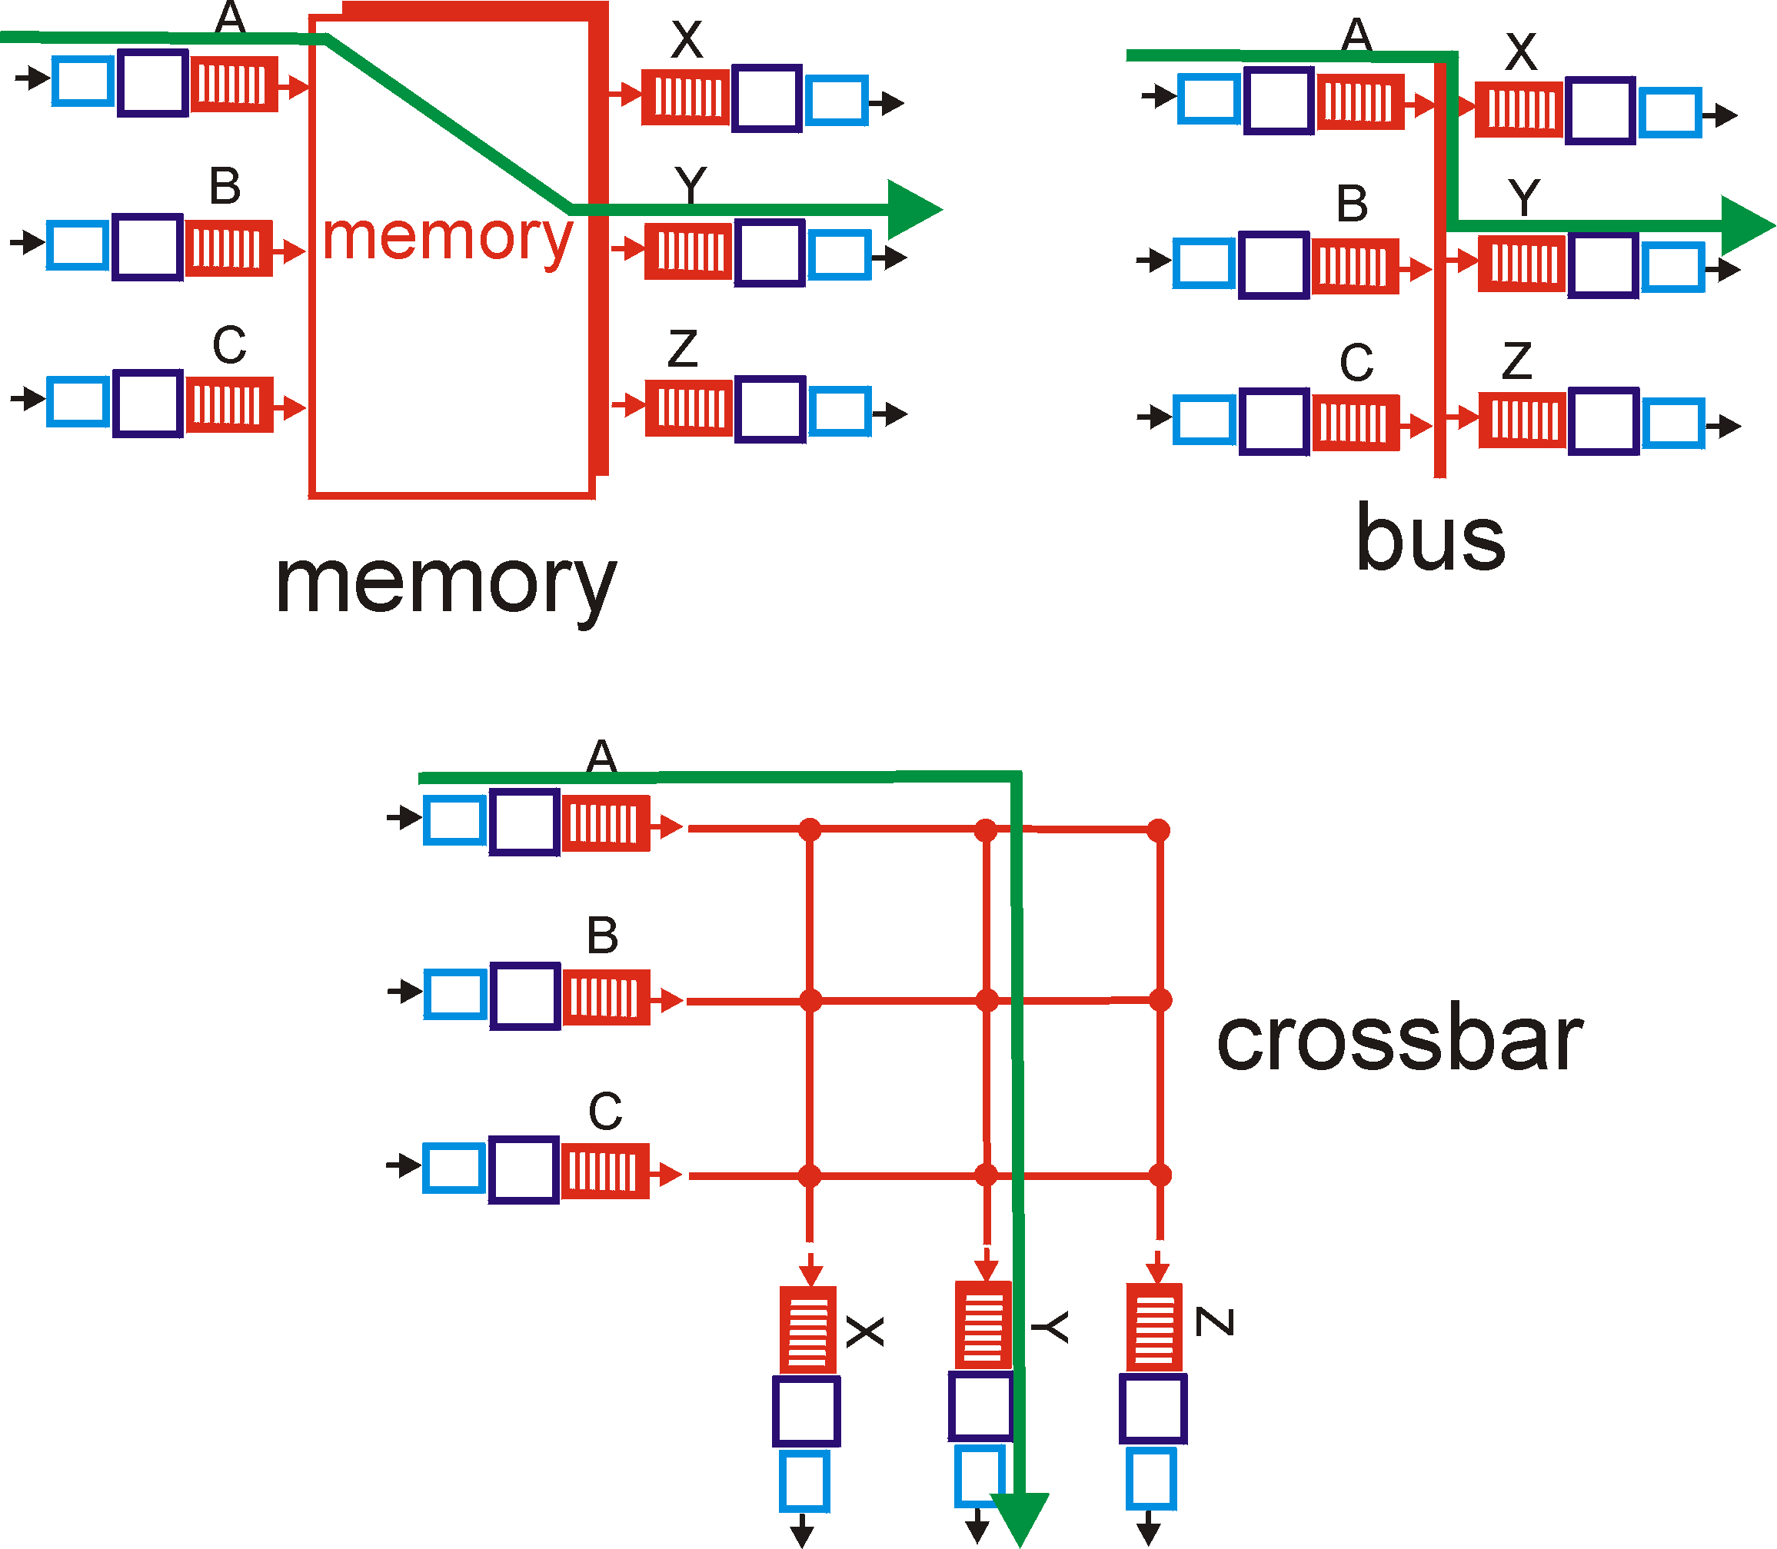
Three types of switching fabrics (comparison criteria: speed, contention, complexity)

Slide 36
Switching Via Memory
First generation routers:
traditional computers with switching under direct control of CPU
packet copied to system’s memory
speed limited by memory bandwidth (2 bus crossings per datagram)
Input
Port
Memory
Output
Port
System Bus

Slide 37
Switching Via a Bus
datagram from input port memory
to output port memory via a shared bus
bus contention: switching speed limited by bus bandwidth
Lots of ports?? speed up the bus
no contention bus speed =
2 x port speed x port count
32 Gbps bus, Cisco 5600: sufficient speed for access and enterprise routers

Slide 38
Switching Via An Interconnection Network
overcome bus bandwidth limitations
Banyan networks, other interconnection nets initially developed to connect processors in multiprocessor
advanced design: fragmenting datagram into fixed length cells, switch cells through the fabric.
Cisco 12000: switches 60 Gbps through the interconnection network

Slide 39
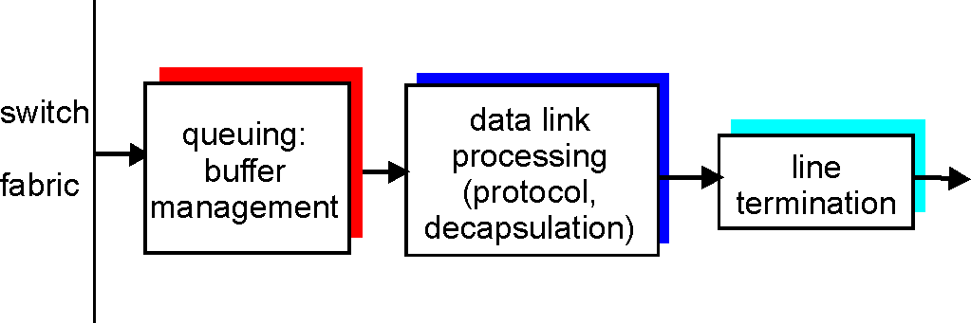
Output Ports
Buffering required when datagrams arrive from fabric faster than the transmission rate
Scheduling discipline chooses among queued datagrams for transmission
➔ Who goes next?

Slide 40
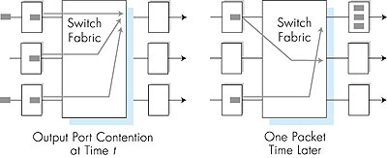
Output port queueing
buffering when arrival rate via switch exceeds output line speed
queueing (delay) and loss due to output port buffer overflow!

Slide 41
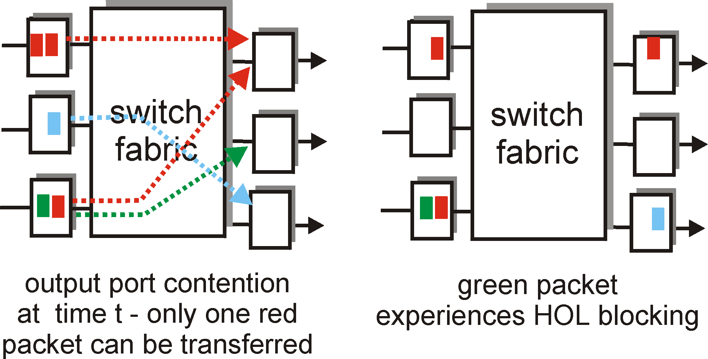
Input Port Queuing
Fabric slower than input ports combined -> queueing may occur at input queues
Head-of-the-Line (HOL) blocking: queued datagram at front of queue prevents others in queue from moving forward
queueing delay and loss due to input buffer overflow!

Slide 42
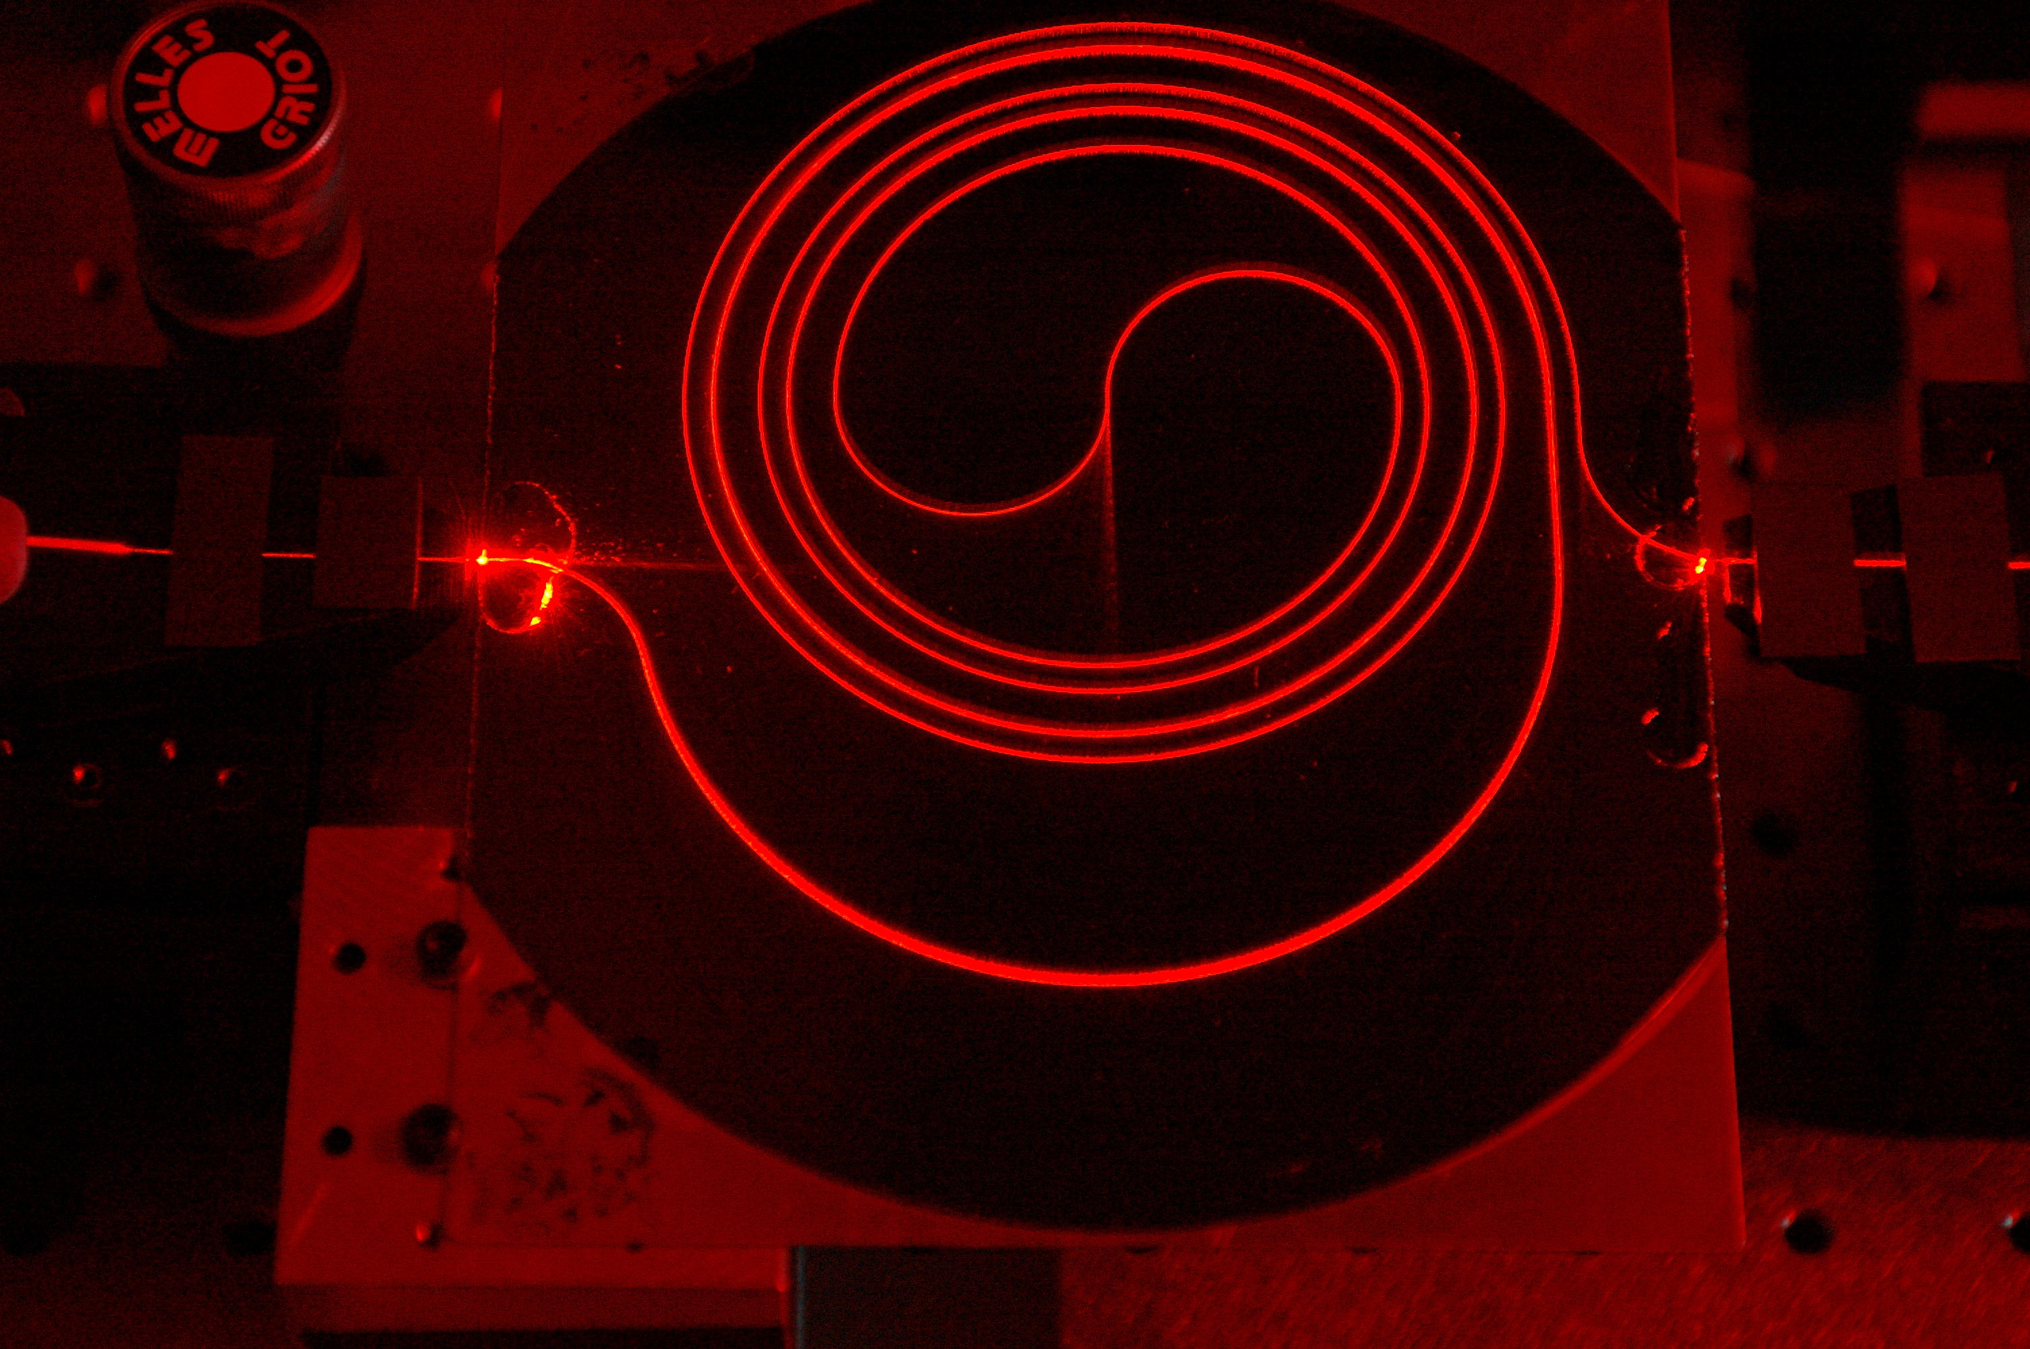
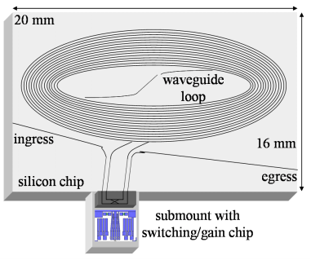
Buffers in Routers
So how large should the buffers be?
Buffer size matters
End-to-end delay
Transmission, propagation, and queueing delay
The only variable part is queueing delay
Router architecture
Board space, power consumption, and cost
On chip buffers: higher density, higher capacity
Optical buffers: all-optical routers
1.4m long spiral waveguide with input from HeNe laser
You are now touching the edge of the research zone……

Slide 43





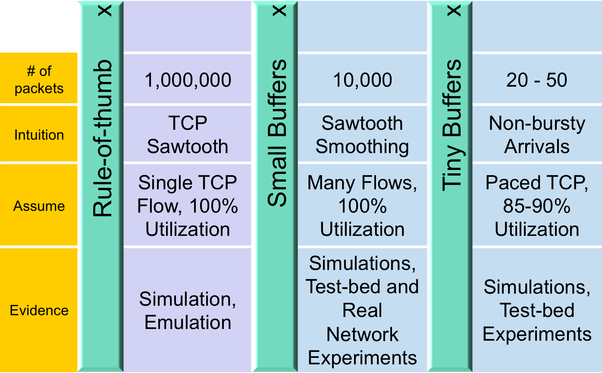
Buffer Sizing Story

Slide 44
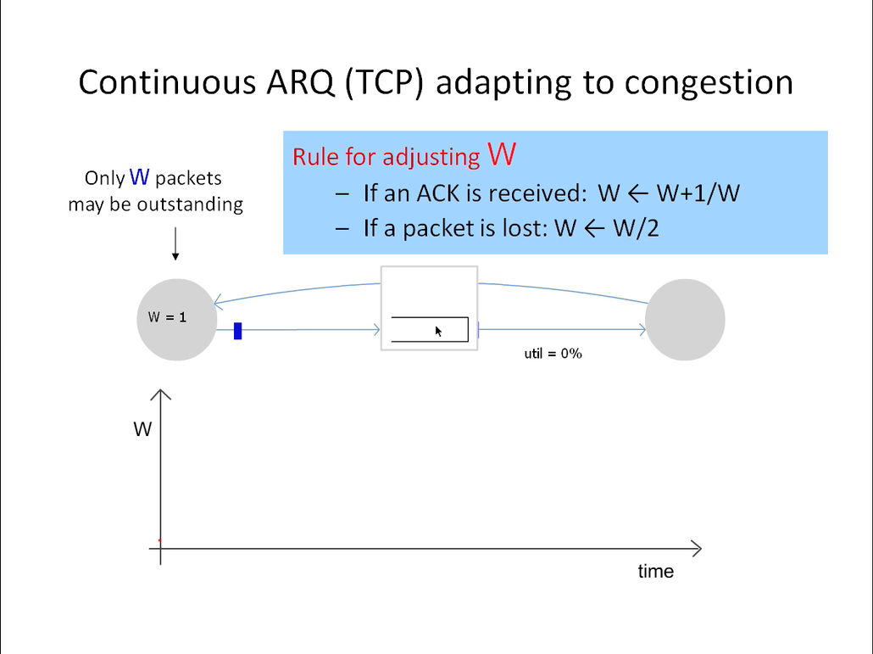

Slide 45

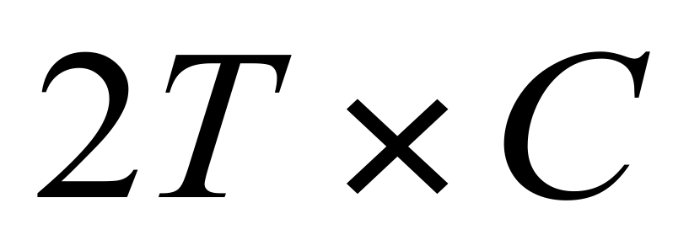
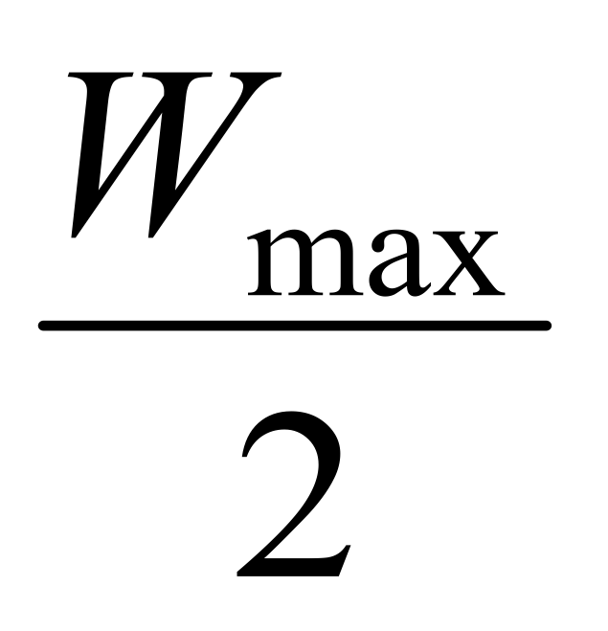
Rule-of-thumb – Intuition
Rule for adjusting W
If an ACK is received: W ← W+1/W
If a packet is lost: W ← W/2
Only W packets may be outstanding
Source
Dest
Window size
t

Slide 46
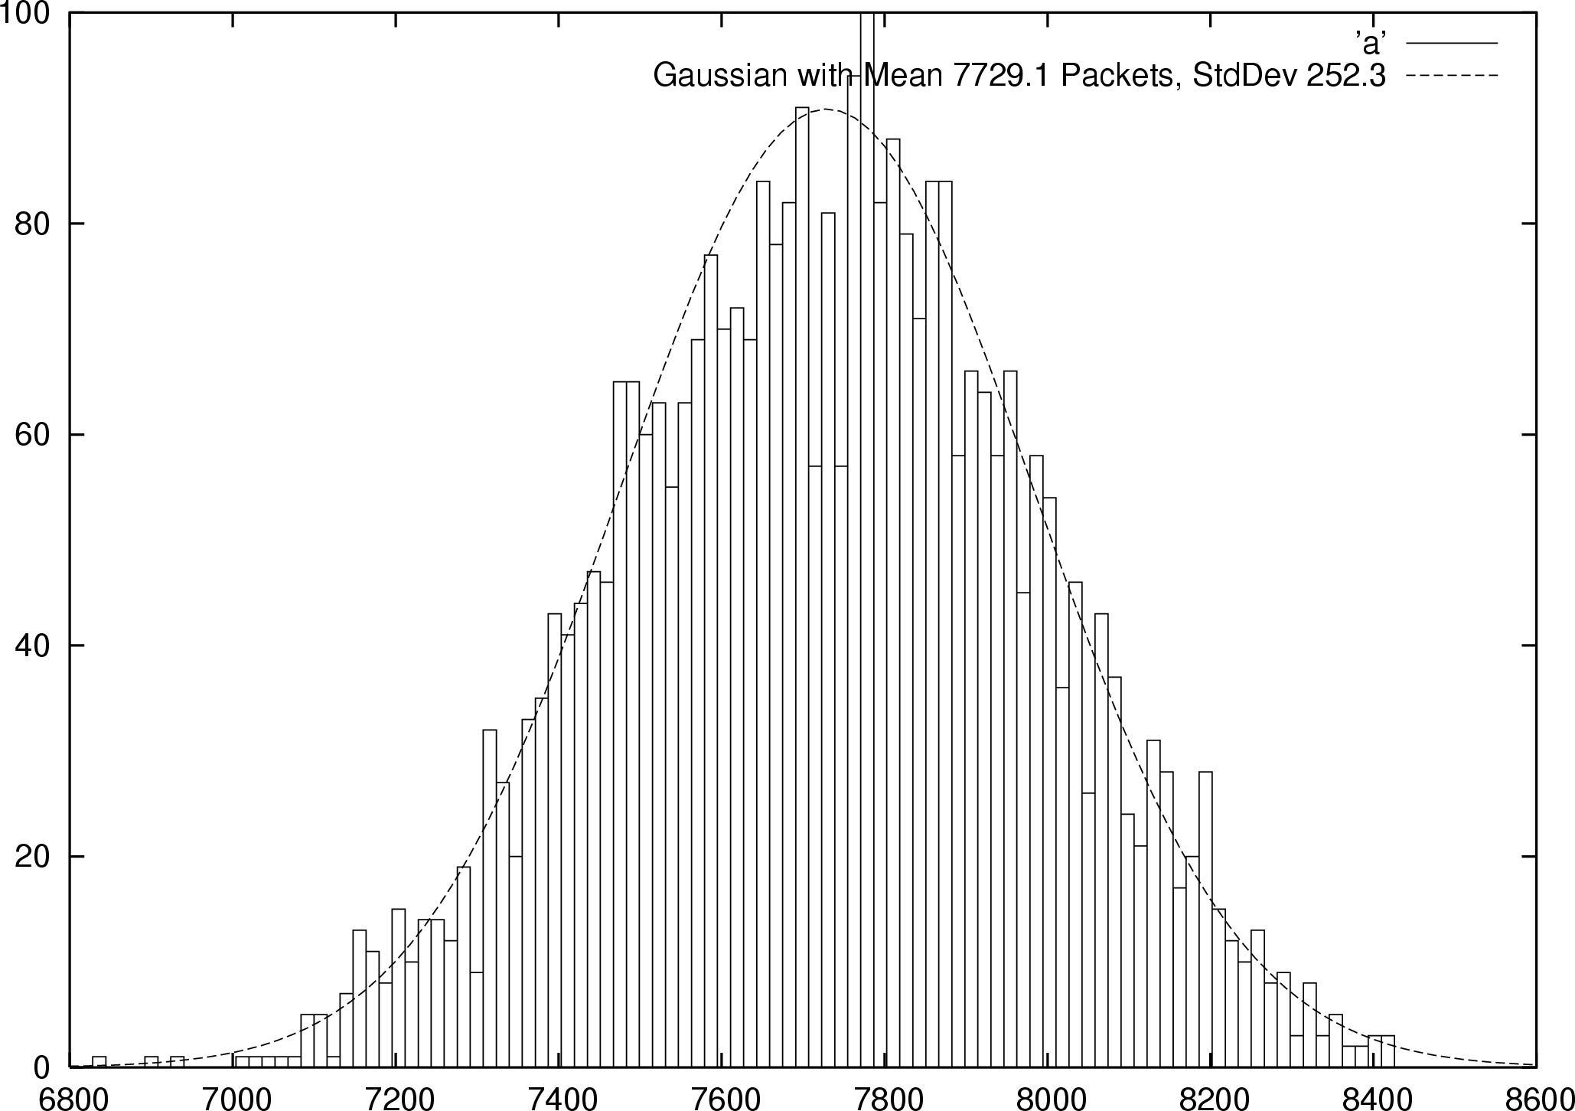


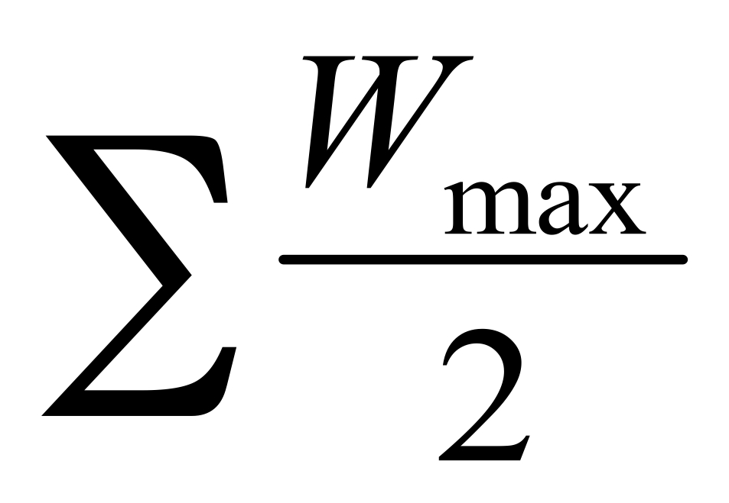

Small Buffers – Intuition
Synchronized Flows
Many TCP Flows
Aggregate window has same dynamics
Therefore buffer occupancy has same dynamics
Rule-of-thumb still holds.
Independent, desynchronized
Central limit theorem says the aggregate becomes Gaussian
Variance (buffer size) decreases as N increases
Buffer Size
Probability
Distribution
t
t

Slide 47
The Internet version of a Network layer
Host, router network layer functions:
Transport layer: TCP, UDP
Routing protocols
path selection
RIP, OSPF, BGP
IP protocol
addressing conventions
datagram format
packet handling conventions
Network
layer
forwarding
table
ICMP protocol
error reporting
router “signaling”
Link layer
physical layer

Slide 48
IPv4 Packet Structure 20 Bytes of Standard Header, then Options
4-bit
Version
4-bit
Header
Length
8-bit
Type of Service
(TOS)
16-bit Total Length (Bytes)
16-bit Identification
3-bit
Flags
13-bit Fragment Offset
8-bit Time to
Live (TTL)
8-bit Protocol
16-bit Header Checksum
32-bit Source IP Address
32-bit Destination IP Address
Options (if any)
Payload

Slide 49
(Packet) Network Tasks One-by-One
Read packet correctly
Get packet to the destination
Get responses to the packet back to source
Carry data
Tell host what to do with packet once arrived
Specify any special network handling of the packet
Deal with problems that arise along the path

Slide 50
Reading Packet Correctly
4-bit
Version
4-bit
Header
Length
8-bit
Type of Service
(TOS)
16-bit Total Length (Bytes)
16-bit Identification
3-bit
Flags
13-bit Fragment Offset
8-bit Time to
Live (TTL)
8-bit Protocol
16-bit Header Checksum
32-bit Source IP Address
32-bit Destination IP Address
Options (if any)
Payload
Version number (4 bits)
Indicates the version of the IP protocol
Necessary to know what other fields to expect
Typically “4” (for IPv4), and sometimes “6” (for IPv6)
Header length (4 bits)
Number of 32-bit words in the header
Typically “5” (for a 20-byte IPv4 header)
Can be more when IP options are used
Total length (16 bits)
Number of bytes in the packet
Maximum size is 65,535 bytes (2¹⁶ -1)
… though underlying links may impose smaller limits

Slide 51
Getting Packet to Destination and Back
4-bit
Version
4-bit
Header
Length
8-bit
Type of Service
(TOS)
16-bit Total Length (Bytes)
16-bit Identification
3-bit
Flags
13-bit Fragment Offset
8-bit Time to
Live (TTL)
8-bit Protocol
16-bit Header Checksum
32-bit Source IP Address
32-bit Destination IP Address
Two IP addresses
Source IP address (32 bits)
Destination IP address (32 bits)
Destination address
Unique identifier/locator for the receiving host
Allows each node to make forwarding decisions
Source address
Unique identifier/locator for the sending host
Recipient can decide whether to accept packet
Enables recipient to send a reply back to source
Options (if any)
Payload

Slide 52
Telling Host How to Handle Packet
4-bit
Version
4-bit
Header
Length
8-bit
Type of Service
(TOS)
16-bit Total Length (Bytes)
16-bit Identification
3-bit
Flags
13-bit Fragment Offset
8-bit Time to
Live (TTL)
8-bit Protocol
16-bit Header Checksum
32-bit Source IP Address
32-bit Destination IP Address
Options (if any)
Protocol (8 bits)
Identifies the higher-level protocol
Important for demultiplexing at receiving host
Most common examples
E.g., “6” for the Transmission Control Protocol (TCP)
E.g., “17” for the User Datagram Protocol (UDP)
Payload
protocol=6
protocol=17
IP header
IP header
TCP header
UDP header

Slide 53
Special Handling
4-bit
Version
4-bit
Header
Length
8-bit
Type of Service
(TOS)
16-bit Total Length (Bytes)
16-bit Identification
3-bit
Flags
13-bit Fragment Offset
8-bit Time to
Live (TTL)
8-bit Protocol
16-bit Header Checksum
32-bit Source IP Address
32-bit Destination IP Address
Options (if any)
Payload
Type-of-Service (8 bits)
Allow packets to be treated differently based on needs
E.g., low delay for audio, high bandwidth for bulk transfer
Has been redefined several times
Options

Slide 54
Potential Problems
Header Corrupted: Checksum
Loop: TTL
Packet too large: Fragmentation

Slide 55
Header Corruption
4-bit
Version
4-bit
Header
Length
8-bit
Type of Service
(TOS)
16-bit Total Length (Bytes)
16-bit Identification
3-bit
Flags
13-bit Fragment Offset
8-bit Time to
Live (TTL)
8-bit Protocol
16-bit Header Checksum
32-bit Source IP Address
32-bit Destination IP Address
Options (if any)
Payload
Checksum (16 bits)
Particular form of checksum over packet header
If not correct, router discards packets
So it doesn’t act on bogus information
Checksum recalculated at every router
Why?
Why include TTL?
Why only header?

Slide 56
_{Preventing Loops} _{(aka} _{Internet Zombie plan)}
4-bit
Version
4-bit
Header
Length
8-bit
Type of Service
(TOS)
16-bit Total Length (Bytes)
16-bit Identification
3-bit
Flags
13-bit Fragment Offset
8-bit Time to
Live (TTL)
8-bit Protocol
16-bit Header Checksum
32-bit Source IP Address
32-bit Destination IP Address
Options (if any)
Forwarding loops cause packets to cycle forever
As these accumulate, eventually consume all capacity
Time-to-Live (TTL) Field (8 bits)
Decremented at each hop, packet discarded if reaches 0
…and “time exceeded” message is sent to the source
Using “ICMP” control message; basis for traceroute
Payload

Slide 57
Fragmentation (some assembly required)
4-bit
Version
4-bit
Header
Length
8-bit
Type of Service
(TOS)
16-bit Total Length (Bytes)
16-bit Identification
3-bit
Flags
13-bit Fragment Offset
8-bit Time to
Live (TTL)
8-bit Protocol
16-bit Header Checksum
32-bit Source IP Address
32-bit Destination IP Address
Options (if any)
Payload
Fragmentation: when forwarding a packet, an Internet router can split it into multiple pieces (“fragments”) if too big for next hop link
Must reassemble to recover original packet
Need fragmentation information (32 bits)
Packet identifier, flags, and fragment offset

Slide 58
IP Fragmentation & Reassembly
network links have MTU (max.transfer size) - largest possible link-level frame.
different link types, different MTUs
large IP datagram divided (“fragmented”) within net
one datagram becomes several datagrams
“reassembled” only at final destination
IP header bits used to identify, order related fragments
IPv6 does things differently
fragmentation:
in: one large datagram
out: 3 smaller datagrams
reassembly

Slide 59
IP Fragmentation and Reassembly
length
=4000
ID
=x
fragflag
=0
offset
=0
Example
4000 byte datagram
MTU = 1500 bytes
One large datagram becomes
several smaller datagrams
length
=1500
ID
=x
fragflag
=1
offset
=0
1480 bytes in data field
length
=1500
ID
=x
fragflag
=1
offset
=185
offset =
1480/8
length
=1040
ID
=x
fragflag
=0
offset
=370
Pop quiz question: What happens when a fragment is lost?

Slide 60
Fragmentation Details
4-bit
Version
4-bit
Header
Length
8-bit
Type of Service
(TOS)
16-bit Total Length (Bytes)
16-bit Identification
3-bit
Flags
13-bit Fragment Offset
8-bit Time to
Live (TTL)
8-bit Protocol
16-bit Header Checksum
32-bit Source IP Address
32-bit Destination IP Address
Options (if any)
Payload
Identifier (16 bits): used to tell which fragments belong together
Flags (3 bits):
Reserved (RF): unused bit
Don’t Fragment (DF): instruct routers to not fragment the packet even if it won’t fit
Instead, they drop the packet and send back a “Too Large” ICMP control message
Forms the basis for “Path MTU Discovery”
More (MF): this fragment is not the last one
Offset (13 bits): what part of datagram this fragment covers in 8-byte units
Pop quiz question: Why do frags use offset and not a frag number?
Notes:
map into memory
further downstream locations doing fragmentation would be v. hard with frag number (you would need reissue or reassemble or some craziness

Slide 61
Options
4-bit
Version
4-bit
Header
Length
8-bit
Type of Service
(TOS)
16-bit Total Length (Bytes)
16-bit Identification
3-bit
Flags
13-bit Fragment Offset
8-bit Time to
Live (TTL)
8-bit Protocol
16-bit Header Checksum
32-bit Source IP Address
32-bit Destination IP Address
Options (if any)
Payload
End of Options List
No Operation (padding between options)
Record Route
Strict Source Route
Loose Source Route
Timestamp
Traceroute
Router Alert
…..

Slide 62
IP Addressing: introduction
IP address: 32-bit identifier for host, router interface
interface: connection between host/router and physical link
router’s typically have multiple interfaces
host typically has one interface
IP addresses associated with each interface
223.1.1.1
223.1.2.1
223.1.1.2
223.1.1.4
223.1.2.9
223.1.2.2
223.1.1.3
223.1.3.27
223.1.3.1
223.1.3.2
223.1.1.1 = 11011111 00000001 00000001 00000001
223
1
1
1

Slide 63
Subnets
IP address:
subnet part (high order bits)
host part (low order bits)
What’s a subnet ?
device interfaces with same subnet part of IP address
can physically reach each other without intervening router
223.1.1.0/24
223.1.2.0/24
223.1.1.1
223.1.2.1
223.1.1.2
223.1.1.4
223.1.2.9
223.1.1.3
223.1.2.2
223.1.3.27
subnet
223.1.3.1
223.1.3.2
subnet
part
host
part
11011111 00000001 00000011 00000000
223.1.3.0/24
223.1.3.0/24
CIDR: Classless InterDomain Routing
subnet portion of address of arbitrary length
address format: a.b.c.d/x, where x is # bits in subnet portion of address
Subnet mask: /24
network consisting of 3 subnets

Slide 64
IP addresses: how to get one?
Q: How does a host get IP address?
hard-coded by system admin in a file
Windows: control-panel->network->configuration->tcp/ip->properties
UNIX: /etc/rc.config
DHCP: Dynamic Host Configuration Protocol: dynamically get address from as server
“plug-and-play”

Slide 65
DHCP client-server scenario
Goal: allow host to dynamically obtain its IP address from network server when it joins network
Can renew its lease on address in use
Allows reuse of addresses (only hold address while connected an “on”)
Support for mobile users who want to join network (more shortly)
DHCP server: 223.1.2.5
arriving
client
DHCP discover
src : 0.0.0.0, 68
dest.: 255.255.255.255,67
yiaddr: 0.0.0.0
transaction ID: 654
DHCP offer
src: 223.1.2.5, 67
dest: 255.255.255.255, 68
yiaddrr: 223.1.2.4
transaction ID: 654
Lifetime: 3600 secs
DHCP request
src: 0.0.0.0, 68
dest:: 255.255.255.255, 67
yiaddrr: 223.1.2.4
transaction ID: 655
Lifetime: 3600 secs
A
223.1.1.1
DHCP
223.1.2.1
server
223.1.1.2
time
223.1.1.4
223.1.2.9
DHCP ACK
B
src: 223.1.2.5, 67
dest: 255.255.255.255, 68
yiaddrr: 223.1.2.4
transaction ID: 655
Lifetime: 3600 secs
223.1.2.2
E
arriving DHCP
client needs
address in this
network
223.1.1.3
223.1.3.27
223.1.3.1
223.1.3.2

Slide 66
IP addresses: how to get one?
Q: How does network get subnet part of IP addr?
A: gets allocated portion of its provider ISP’s address space
ISP's block 11001000 00010111 00010000 00000000 200.23.16.0/20
Organization 0 11001000 00010111 00010000 00000000 200.23.16.0/23
Organization 1 11001000 00010111 00010010 00000000 200.23.18.0/23
Organization 2 11001000 00010111 00010100 00000000 200.23.20.0/23
... ….. …. ….
Organization 7 11001000 00010111 00011110 00000000 200.23.30.0/23

Slide 67
Hierarchical addressing: route aggregation
Hierarchical addressing allows efficient advertisement of routing
information:
Organization 0
200.23.16.0/23
Organization 1
200.23.18.0/23
“Send me anything
with addresses
beginning
200.23.16.0/20”
Organization 2
200.23.20.0/23
.
Fly-By-Night-ISP
.
.
.
.
Internet
Organization 7
.
200.23.30.0/23
ISPs-R-Us
“Send me anything
with addresses
beginning
199.31.0.0/16”

Slide 68
Hierarchical addressing: more specific routes
ISPs-R-Us has a more specific route to Organization 1
Organization 0
200.23.16.0/23
“Send me anything
with addresses
beginning
200.23.16.0/20”
Organization 2
200.23.20.0/23
.
Fly-By-Night-ISP
.
.
.
.
Internet
Organization 7
.
200.23.30.0/23
ISPs-R-Us
“Send me anything
with addresses
beginning 199.31.0.0/16
or 200.23.18.0/23”
Organization 1
200.23.18.0/23

Slide 69
IP addressing: the last word...
Q: How does an ISP get block of addresses?
A: ICANN: Internet Corporation for Assigned
Names and Numbers
allocates addresses
manages DNS
assigns domain names, resolves disputes

Slide 70
NAT: Network Address Translation
rest of
Internet
local network
(e.g., home network)
10.0.0/24
10.0.0.1
10.0.0.4
10.0.0.2
138.76.29.7
10.0.0.3
All datagrams leaving local
network have same single source NAT IP address: 138.76.29.7,
different source port numbers
Datagrams with source or
destination in this network
have 10.0.0/24 address for
source, destination (as usual)

Slide 71
NAT: Network Address Translation
Motivation: local network uses just one IP address as far as outside world is concerned:
range of addresses not needed from ISP: just one IP address for all devices
can change addresses of devices in local network without notifying outside world
can change ISP without changing addresses of devices in local network
devices inside local net not explicitly addressable, visible by outside world (a security plus).

Slide 72
NAT: Network Address Translation
Implementation: NAT router must:
outgoing datagrams: replace (source IP address, port #) of every outgoing datagram to (NAT IP address, new port #)
. . . remote clients/servers will respond using (NAT IP address, new port #) as destination addr.
remember (in NAT translation table) every (source IP address, port #) to (NAT IP address, new port #) translation pair
incoming datagrams: replace (NAT IP address, new port #) in dest fields of every incoming datagram with corresponding (source IP address, port #) stored in NAT table

Slide 73
NAT: Network Address Translation
NAT translation table
WAN side addr LAN side addr
1: host 10.0.0.1
sends datagram to
128.119.40.186, 80
2: NAT router
changes datagram
source addr from
10.0.0.1, 3345 to
138.76.29.7, 5001,
updates table
138.76.29.7, 5001 10.0.0.1, 3345
…… ……
S: 10.0.0.1, 3345
D: 128.119.40.186, 80
10.0.0.1
1
2
S: 138.76.29.7, 5001
D: 128.119.40.186, 80
10.0.0.4
10.0.0.2
138.76.29.7
S: 128.119.40.186, 80
D: 10.0.0.1, 3345
4
S: 128.119.40.186, 80
D: 138.76.29.7, 5001
3
10.0.0.3
4: NAT router
changes datagram
dest addr from
138.76.29.7, 5001 to 10.0.0.1, 3345
3: Reply arrives
dest. address:
138.76.29.7, 5001

Slide 74
NAT: Network Address Translation
16-bit port-number field:
60,000 simultaneous connections with a single LAN-side address!
NAT is controversial:
routers should only process up to layer 3
violates end-to-end argument
NAT possibility must be taken into account by app designers, eg, P2P applications
address shortage should instead be solved by IPv6

Slide 75
NAT traversal problem
client wants to connect to server with address 10.0.0.1
server address 10.0.0.1 local to LAN (client can’t use it as destination addr)
only one externally visible NATted address: 138.76.29.7
solution 1: statically configure NAT to forward incoming connection requests at given port to server
e.g., (123.76.29.7, port 2500) always forwarded to 10.0.0.1 port 25000
10.0.0.1
Client
?
10.0.0.4
138.76.29.7
NAT
router

Slide 76
NAT traversal problem
solution 2: Universal Plug and Play (UPnP) Internet Gateway Device (IGD) Protocol. Allows NATted host to:
learn public IP address (138.76.29.7)
add/remove port mappings (with lease times)
i.e., automate static NAT port map configuration
10.0.0.1
IGD
10.0.0.4
138.76.29.7
NAT
router

Slide 77


NAT traversal problem
solution 3: relaying (used in Skype)
NATed client establishes connection to relay
External client connects to relay
relay bridges packets between to connections
2. connection to
relay initiated
by client
1. connection to
relay initiated
by NATted host
10.0.0.1
3. relaying
established
Client
138.76.29.7
NAT
router

Slide 78
ICMP: Internet Control Message Protocol
used by hosts & routers to communicate network-level information
error reporting: unreachable host, network, port, protocol
echo request/reply (used by ping)
network-layer “above” IP:
ICMP msgs carried in IP datagrams
ICMP message: type, code plus first 8 bytes of IP datagram causing error
Type Code description
0 0 echo reply (ping)
3 0 dest. network unreachable
3 1 dest host unreachable
3 2 dest protocol unreachable
3 3 dest port unreachable
3 6 dest network unknown
3 7 dest host unknown
4 0 source quench (congestion
control - not used)
8 0 echo request (ping)
9 0 route advertisement
10 0 router discovery
11 0 TTL expired
12 0 bad IP header

Slide 79
Traceroute and ICMP
Source sends series of UDP segments to dest
First has TTL =1
Second has TTL=2, etc.
Unlikely port number
When nth datagram arrives to nth router:
Router discards datagram
And sends to source an ICMP message (type 11, code 0)
Message includes name of router& IP address
When ICMP message arrives, source calculates RTT
Traceroute does this 3 times
Stopping criterion
UDP segment eventually arrives at destination host
Destination returns ICMP “host unreachable” packet (type 3, code 3)
When source gets this ICMP, stops.

Slide 80
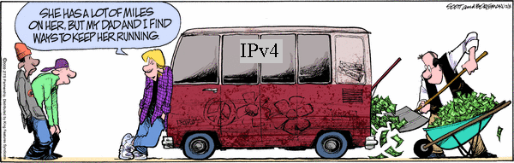
IPv6
Motivated (prematurely) by address exhaustion
Addresses four times as big
Steve Deering focused on simplifying IP
Got rid of all fields that were not absolutely necessary
“Spring Cleaning” for IP
Result is an elegant, if unambitious, protocol

Slide 81
IPv4 and IPv6 Header Comparison
IPv4
IPv6
Version | IHL | Type of Service | Total Length
Identification |  |  | Flags | Fragment Offset
Time to Live |  | Protocol | Header Checksum
Source Address
Destination Address
Options |  |  |  |  | Padding
Version | Traffic Class | Flow Label
Payload Length |  |  | Next Header | Hop Limit
Source Address
Destination Address
Field name kept from IPv4 to IPv6
Fields not kept in IPv6
Name & position changed in IPv6
New field in IPv6

Slide 82
Summary of Changes
Eliminated fragmentation (why?)
Eliminated header length (why?)
Eliminated checksum (why?)
New options mechanism (next header) (why?)
Expanded addresses (why?)
Added Flow Label (why?)

Slide 83
IPv4 and IPv6 Header Comparison
IPv4
IPv6
Version | IHL | Type of Service | Total Length
Identification |  |  | Flags | Fragment Offset
Time to Live |  | Protocol | Header Checksum
Source Address
Destination Address
Options |  |  |  |  | Padding
Version | Traffic Class | Flow Label
Payload Length |  |  | Next Header | Hop Limit
Source Address
Destination Address
Field name kept from IPv4 to IPv6
Fields not kept in IPv6
Name & position changed in IPv6
New field in IPv6

Slide 84
Philosophy of Changes
Don’t deal with problems: leave to ends
Eliminated fragmentation
Eliminated checksum
Why retain TTL?
Simplify handling:
New options mechanism (uses next header approach)
Eliminated header length
Why couldn’t IPv4 do this?
Provide general flow label for packet
Not tied to semantics
Provides great flexibility

Slide 85
Comparison of Design Philosophy
IPv4
IPv6
Version | IHL | Type of Service | Total Length
Identification |  |  | Flags | Fragment Offset
Time to Live |  | Protocol | Header Checksum
Source Address
Destination Address
Options |  |  |  |  | Padding
Version | Traffic Class | Flow Label
Payload Length |  |  | Next Header | Hop Limit
Source Address
Destination Address
To Destination and Back (expanded)
Deal with Problems (greatly reduced)
Read Correctly (reduced)
Special Handling (similar)

Slide 86
Transition From IPv4 To IPv6
Not all routers can be upgraded simultaneous
no “flag days”
How will the network operate with mixed IPv4 and IPv6 routers?
Tunneling: IPv6 carried as payload in IPv4 datagram among IPv4 routers
Notes:
got to here 24/Feb/2012

Slide 87
Tunneling
A
B
E
F
Logical view:
tunnel
IPv6
IPv6
IPv6
IPv6
A
B
E
F
Physical view:
IPv6
IPv6
IPv4
IPv4
IPv6
IPv6

Slide 88
Tunneling
A
B
E
F
Logical view:
tunnel
IPv6
IPv6
IPv6
IPv6
A
B
C
D
E
F
Physical view:
IPv6
IPv6
IPv4
IPv4
IPv6
IPv6
Flow: X
Src: A
Dest: F
data
Src:B
Dest: E
Src:B
Dest: E
Flow: X
Src: A
Dest: F
data
Flow: X
Src: A
Dest: F
data
Flow: X
Src: A
Dest: F
data
A-to-B:
IPv6
B-to-C:
IPv6 inside
IPv4
B-to-C:
IPv6 inside
IPv4
E-to-F:
IPv6

Slide 89
Improving on IPv4 and IPv6?
Why include unverifiable source address?
Would like accountability and anonymity (now neither)
Return address can be communicated at higher layer
Why packet header used at edge same as core?
Edge: host tells network what service it wants
Core: packet tells switch how to handle it
One is local to host, one is global to network
Some kind of payment/responsibility field?
Who is responsible for paying for packet delivery?
Source, destination, other?
Other ideas?

Slide 90
Interplay between routing and forwarding
routing algorithm
local forwarding table
header value
output link
0100
0101
0111
1001
3
2
2
1
value in arriving
packet’s header
0111
1
3
2

Slide 91
“Valid” Routing State
Global routing state is “valid” if it produces forwarding decisions that always deliver packets to their destinations
Valid is not standard terminology
Goal of routing protocols: compute valid state
But how can you tell if routing state if valid?
Notes:
What could go wrong?

Slide 92
Necessary and Sufficient Condition
Global routing state is valid if and only if:
There are no dead ends (other than destination)
There are no loops
A dead end is when there is no outgoing port
A packet arrives, but the forwarding decision does not yield any outgoing port
A loop is when a packet cycles around the same set of nodes forever

Slide 93
Necessary: Obvious
If you run into a deadend before hitting destination, you’ll never reach the destination
If you run into a loop, you’ll never reach destination
With deterministic forwarding, once you loop, you’ll loop forever (assuming routing state is static)

Slide 94
Wandering Packets
Packet reaches deadend and stops
Packet falls into loop and never reaches destination

Slide 95
Sufficient: Easy
Assume no deadends, no loops
Packet must keep wandering, without repeating
If ever enter same switch from same port, will loop
Because forwarding decisions are deterministic
Only a finite number of possible ports for it to visit
It cannot keep wandering forever without looping
Must eventually hit destination
Notes:
Destination is only safe deadend

Slide 96
The “Secret” of Routing
Avoiding deadends is easy
Avoiding loops is hard
The key difference between routing protocols is how they avoid loops!
Don’t focus on details of mechanisms
Just ask “how are loops avoided?”
Will return to this later…. a little this term
a lot more in Part II Principles of Communications
Notes:
Most modern routing research is about how to make the loop-freeness a more fundamental part of the algorithm. In what I’m going to present today, it is only loop-free AFTER convergence. That’s not good enough

Slide 97
Making Forwarding Decisions
Map PacketState+RoutingState into OutgoingPort
At line rates…..
Packet State:
Destination ID
Source ID
Incoming Port (from switch, not packet)
Other packet header information?
Routing State:
Stored in router

Slide 98
Forwarding Decision Dependencies
Must depend on destination
Could also depend on :
Source: requires n² state
Input port: not clear what this buys you
Other header information: let’s ignore for now
We will focus only on destination-based routing
But first consider the alternative

Slide 99
Source/Destination-Based Routing
Paths from two different sources (to same destination) can be very different

Slide 100
Destination-Based Routing
Paths from two different sources (to same destination) must coincide once they overlap
Notes:
Why coincide?

Slide 101
Destination-Based Routing
Paths to same destination never cross
Once paths to destination meet, they never split
Set of paths to destination create a “delivery tree”
Must cover every node exactly once
Spanning Tree rooted at destination
Notes:
You all know what a spanning tree is?

Slide 102
A “Delivery Tree” for a Destination

Slide 103
Checking Validity of Routing State
Focus only on a single destination
Ignore all other routing state
Mark outgoing port with arrow
There can only be one at each node
Eliminate all links with no arrows
Look at what’s left….

Slide 104
Example 1

Slide 105
Pick Destination

Slide 106
Put Arrows on Outgoing Ports

Slide 107
Remove Unused Links
Leaves Spanning Tree: Valid

Slide 108
Second Example

Slide 109
Second Example
Is this valid?

Slide 110
Lesson….
Very easy to check validity of routing state for a particular destination
Deadends are obvious
Node without outgoing arrow
Loops are obvious
Disconnected from rest of graph

Slide 111
Computing Routing State

Slide 112
Forms of Route Computation
Learn from observing….
Not covered in your reading
Centralized computation
One node has the entire network map
Pseudo-centralized computation
All nodes have the entire network map
Distributed computation
No one has the entire network map

Slide 113
How Can You Avoid Loops?
Restrict topology to spanning tree
If the topology has no loops, packets can’t loop!
Central computation
Can make sure no loops
Minimizing metric in distributed computation
Loops are never the solution to a minimization problem

Slide 114
Self-Learning on Spanning Tree

Slide 115
Easiest Way to Avoid Loops
Use a topology where loops are impossible!
Take arbitrary topology
Build spanning tree (algorithm covered later)
Ignore all other links (as before)
Only one path to destinations on spanning trees
Use “learning switches” to discover these paths
No need to compute routes, just observe them

Slide 116
Consider previous graph

Slide 117
A Spanning Tree

Slide 118
Another Spanning Tree

Slide 119
Yet Another Spanning Tree

Slide 120
Flooding on a Spanning Tree
If you want to send a packet that will reach all nodes, then switches can use the following rule:
Ignoring all ports not on spanning tree!
Originating switch sends “flood” packet out all ports
When a “flood” packet arrives on one incoming port, send it out all other ports

Slide 121
Flooding on Spanning Tree

Slide 122
Flooding on Spanning Tree (Again)

Slide 123
Flooding on a Spanning Tree
This works because the lack of loops prevents the flooding from cycling back on itself
Eventually all nodes will be covered, exactly once

Slide 124
This Enables Learning!
There is only one path from source to destination
Each switch can learn how to reach a another node by remembering where its flooding packets came from!
If flood packet from Node A entered switch from port 4, then to reach Node A, switch sends packets out port 4

Slide 125
Learning from Flood Packets
Node A can be reached
through this port
Node A can be reached
through this port
Node A
Once a node has sent a flood message, all other switches know how to reach it….

Slide 126
General Approach
Flood first packet
All switches learn where you are
When destination responds, all switches learn where it is…
Done.

Slide 127
Self-Learning Switch
When a packet arrives
Inspect source ID, associate with incoming port
Store mapping in the switch table
Use time-to-live field to eventually forget mapping
Packet tells switch how to reach A.
B
A
C
D

Slide 128
Self Learning: Handling Misses
When packet arrives with unfamiliar destination
Forward packet out all other ports
Response will teach switch about that destination
B
When in doubt, shout!
A
C
D

Slide 129
General Rule
When switch receives a packet:
index the switch table using destination ID
if entry found for destination {
if dest on port from which packet arrived then drop packet
else forward packet on port indicated
}
else flood
Why do this?
forward on all but the interface
on which the frame arrived

Slide 130
Summary of Learning Approach
Avoids loop by restricting to spanning tree
This makes flooding possible
Flooding allows packet to reach destination
And in the process switches learn how to reach source of flood
No route “computation”

Slide 131
Weaknesses of This Approach?
Requires loop-free topology (Spanning Tree)
Slow to react to failures (entries time out)
Very little control over paths
Spanning Trees suck.
Other route protocols will be covered in
Principles of Communications (Part II)

