Slide 1
Computer Networking
Lent Term M/W/F 11-midday
LT1 in Gates Building
Slide Set 3
Andrew W. Moore
andrew.moore@cl.cam.ac.uk
January 2013

Slide 2
Topic 3: The Data Link Layer
Our goals:
understand principles behind data link layer services:
(these are methods & mechanisms in your networking toolbox)
error detection, correction
sharing a broadcast channel: multiple access
link layer addressing
reliable data transfer, flow control: \
instantiation and implementation of various link layer technologies
Wired Ethernet (aka 802.3)
Wireless Ethernet (aka 802.11 WiFi)

Slide 3

Link Layer: Introduction
Some terminology:
hosts and routers are nodes
communication channels that connect adjacent nodes along communication path are links
wired links
wireless links
LANs
layer-2 packet is a frame, encapsulates datagram
data-link layer has responsibility of
transferring datagram from one node
to adjacent node over a link
Notes:
ended 12th

Slide 4
Link Layer (Channel) Services
framing, link access:
encapsulate datagram into frame, adding header, trailer
channel access if shared medium
“MAC” addresses used in frame headers to identify source, dest
different from IP address!
reliable delivery between adjacent nodes
we learned how to do this already (chapter 3)!
seldom used on low bit-error link (fiber, some twisted pair)
wireless links: high error rates
Q: why both link-level and end-end reliability?

Slide 5
Link Layer (Channel) Services - 2
flow control:
pacing between adjacent sending and receiving nodes
error detection:
errors caused by signal attenuation, noise.
receiver detects presence of errors:
signals sender for retransmission or drops frame
error correction:
receiver identifies and corrects bit error(s) without resorting to retransmission
half-duplex and full-duplex
with half duplex, nodes at both ends of link can transmit, but not at same time

Slide 6
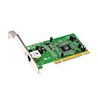
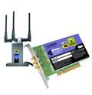
Where is the link layer implemented?
in each and every host
link layer implemented in “adaptor” (aka network interface card NIC)
Ethernet card, PCMCI card, 802.11 card
implements link, physical layer
attaches into host’s system buses
combination of hardware, software, firmware
host schematic
application
transport
network
link
cpu
memory
link
physical
host
bus
(e.g., PCI)
controller
physical
transmission
network adapter
card

Slide 7
Adaptors Communicating
datagram
datagram
controller
controller
sending host
receiving host
datagram
frame
sending side:
encapsulates datagram in frame
encodes data for the physical layer
adds error checking bits, provide reliability, flow control, etc.
receiving side
decodes data from the physical layer
looks for errors, provide reliability, flow control, etc
extracts datagram, passes to upper layer at receiving side

Slide 8
Coding – a channel function
Change the representation of data.
Encoding
Given Data
Changed Data
Decoding

Slide 9


MyPasswd
MyPasswd
AA$$$$ff
AA$$$$ff
AA$$$$ffff
AA$$$$ffff

Slide 10
Coding
Change the representation of data.
Encoding
Given Data
Changed Data
Decoding
Encryption: MyPasswd <-> AA$$$$ff
Error Detection: AA$$$$ff <-> AA$$$$ffff
Compression: AA$$$$ffff <-> A2$4f4
Analog: A2$4f4 <->

Slide 11
Line Coding Examples
where Baud=bit-rate
Non-Return-to-Zero (NRZ)
0
1
0
1
1
0
0
1
0
1
Non-Return-to-Zero-Mark (NRZM) 1 = transition 0 = no transition
0
1
0
1
1
0
0
1
0
1
Non-Return-to-Zero Inverted (NRZI) (note transitions on the 1)
0
1
0
1
1
0
0
1
0
1

Slide 12
Line Coding Examples - II
Non-Return-to-Zero (NRZ) (Baud = bit-rate)
0
1
0
0
1
0
0
1
1
1
Clock
Manchester example (Baud = 2 x bit-rate)
0
1
0
0
1
0
0
1
1
1
Clock
Quad-level code (2 x Baud = bit-rate)
0
1
0
0
1
0
0
1
1
1

Slide 13
Line Coding Examples - III
Data to send
0
1
0
0
1
0
0
1
1
1
Line-(Wire) representation
0
1
0
1
0
1
0
0
1
1
Name 4b 5b Description
0 0000 11110 hex data 0
1 0001 01001 hex data 1
2 0010 10100 hex data 2
3 0011 10101 hex data 3
4 0100 01010 hex data 4
5 0101 01011 hex data 5
6 0110 01110 hex data 6
7 0111 01111 hex data 7
8 1000 10010 hex data 8
9 1001 10011 hex data 9
A 1010 10110 hex data A
B 1011 10111 hex data B
C 1100 11010 hex data C
D 1101 11011 hex data D
E 1110 11100 hex data E
F 1111 11101 hex data F
Name 4b 5b Description
Q -NONE- 00000 Quiet
I -NONE- 11111 Idle
J -NONE- 11000 SSD #1
K -NONE- 10001 SSD #2
T -NONE- 01101 ESD #1
R -NONE- 00111 ESD #2
H -NONE- 00100 Halt
Block coding transfers data with a fixed
overhead: 20% less information per Baud in the case of 4B/5B
So to send data at 100Mbps; the line rate
(the Baud rate) must be 125Mbps.
1Gbps uses an 8b/10b codec; encoding
entire bytes at a time but with 25% overhead

Slide 14
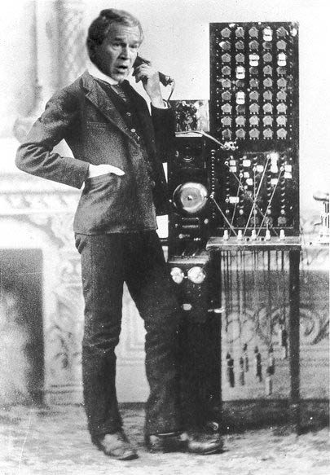



Line Coding Examples - IV
Scrambling
Sequence
Scrambling
Sequence
Communications
Channel
Message
Message
Message
XOR
Sequence
Message
XOR
Sequence

Slide 15
Line Coding Examples - V
Scrambling
Sequence
Scrambling
Sequence
Communications
Channel
Message
Message
Message
XOR
Sequence
Message
XOR
Sequence
e.g. (Self-synchronizing) scrambler
δ
δ
δ
δ
δ

Slide 16
Line Coding Examples – VI
(Hybrid)
…100111101101010001000101100111010001010010110101001001110101110100…
…10011110110101000101000101100111010001010010110101001001110101110100…
Inserted bits marking “start of frame/block/sequence”
Scramble / Transmit / Unscramble
δ
δ
δ
δ
δ
δ
δ
δ
δ
δ
…0100010110011101000101001011010100100111010111010010010111011101111000…
Identify (and remove) “start of frame/block/sequence”
This gives you the Byte-delineations for free
64b/66b combines a scrambler and a framer. The start of frame is a pair of bits 01 or 10: 01 means “this frame is data” 10 means “this frame contains data and control” – control could be configuration information, length of encoded data or simply “this line is idle” (no data at all)

Slide 17

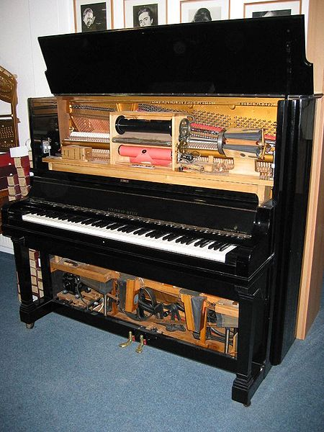
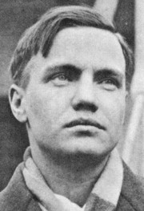
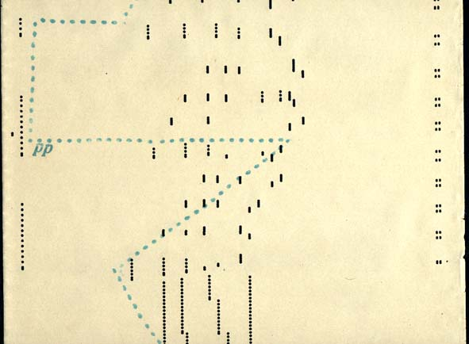
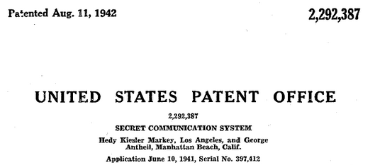
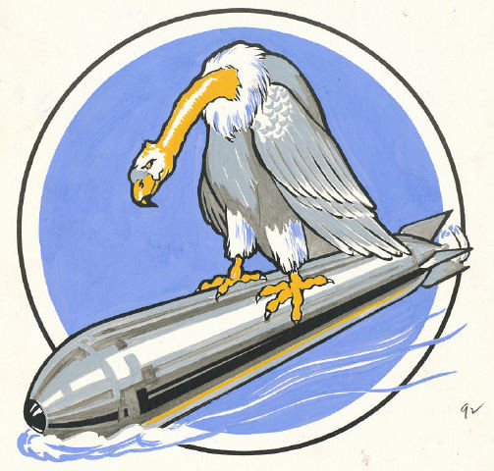
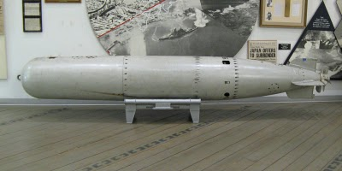

?
CLASSIFIED:
TOP SECRET
NO FORNAT

Slide 18
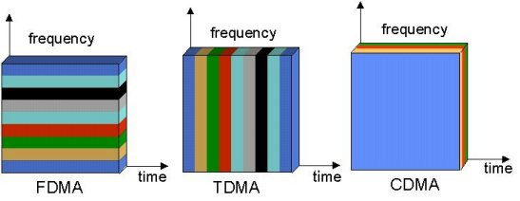
Multiple Access Mechanisms
Each dimension is orthogonal (so may be trivially combined)
There are other dimensions too; can you think of them?
Notes:
polarization (Phase)
weird (electron spin)

Slide 19


Slide 22
Code Division Multiple Access (CDMA)
used in several wireless broadcast channels (cellular, satellite, etc) standards
unique “code” assigned to each user; i.e., code set partitioning
all users share same frequency, but each user has own “chipping” sequence (i.e., code) to encode data
encoded signal = (original data) X (chipping sequence)
decoding: inner-product of encoded signal and chipping sequence
allows multiple users to “coexist” and transmit simultaneously with minimal interference (if codes are “orthogonal”)

Slide 23
CDMA Encode/Decode
channel output Z_{i,m}
Z_{i,m}= d_{i}.c_{m}
data
bits
d₀ = 1
1
1
1
1
1
d₁ = -1
1
1
1
-
-
-
-
1
-
-
-
1
-
1
1
1
1
1
sender
adds code
1
1
slot 1
channel
output
slot 0
channel
output
1
1
1
1
1
code
1
1
-
-
-
1
-
1
1
1
-
-
-
1
-
1
1
1
slot 1
slot 0
M
D_{i} = Σ Z_{i,m}.c_{m}
m=1
M
received
input
1
1
1
1
1
1
1
1
d₀ = 1
-
-
-
-
1
-
-
-
1
-
1
1
1
1
1
1
d₁ = -1
1
slot 1
channel
output
slot 0
channel
output
1
1
1
1
1
code
1
1
-
-
-
1
-
1
1
1
-
-
-
1
-
1
1
receiver
removes code
1
slot 1
slot 0

Slide 24
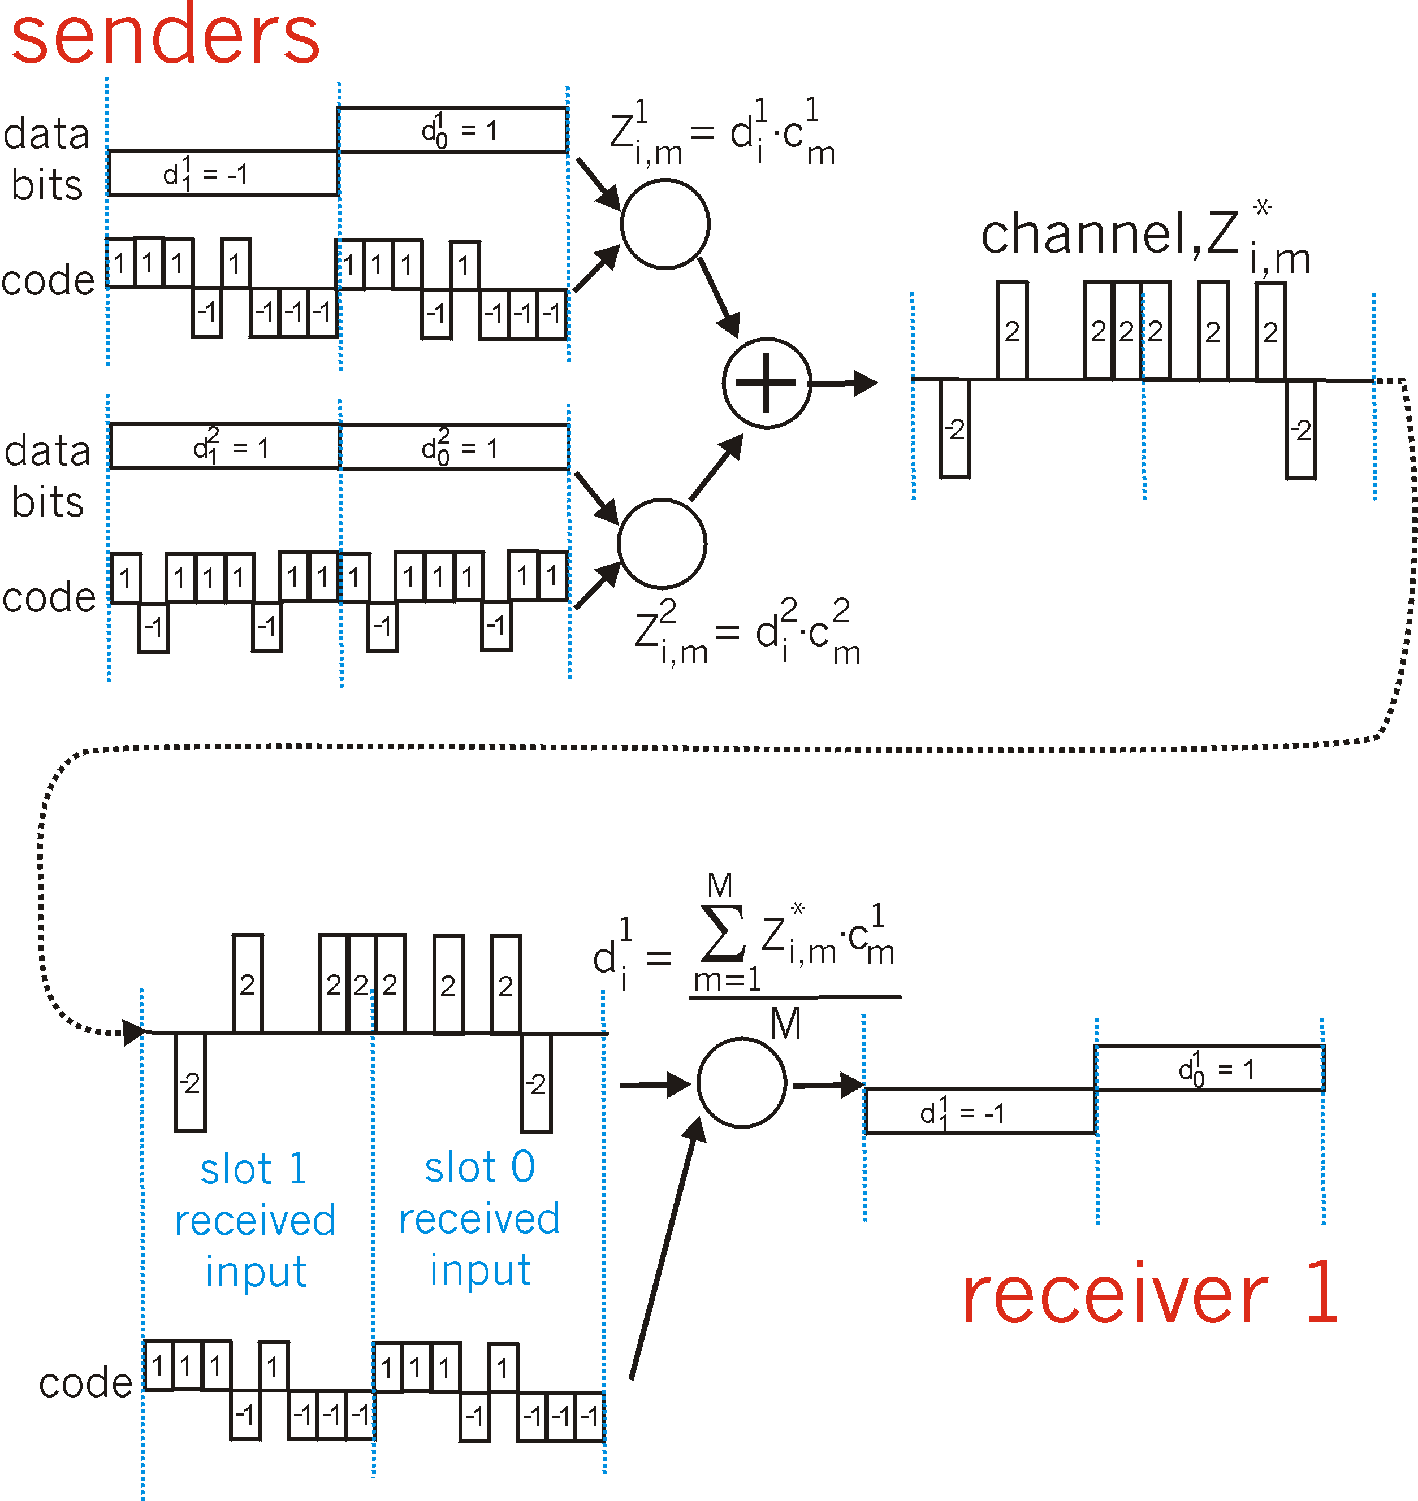
CDMA: two-sender interference
Each sender adds a unique
code
sender
removes
its unique
code

Slide 25
Coding Examples summary
Common Wired coding
Block codecs: table-lookups
fixed overhead, inline control signals
Scramblers: shift registers
overhead free
Like earlier coding schemes and error correction/detection; you can combine these
e.g, 10Gb/s Ethernet may use a hybrid
CDMA (Code Division Multiple Access)
coping intelligently with competing sources
Mobile phones

Slide 26

Error Detection and Correction
How to use coding to deal with errors in data communication?
Noise
0000
0000
0001
0000
Basic Idea :
Add additional information to a message.
Detect an error and re-send a message.
Or, fix an error in the received message.

Slide 27
Error Detection and Correction
How to use coding to deal with errors in data communication?
Noise
0000
0000
0000
0000
Basic Idea :
Add additional information to a message.
Detect an error and re-send a message.
Or, fix an error in the received message.

Slide 28
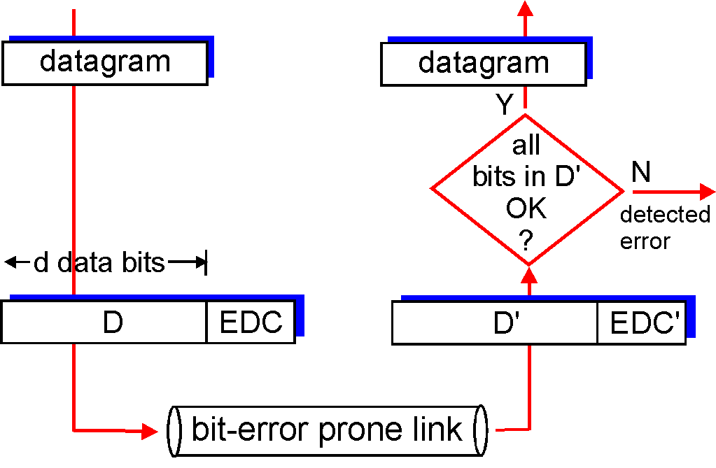
Error Detection
EDC= Error Detection and Correction bits (redundancy = overhead)
D = Data protected by error checking, may include header fields
Error detection not 100% reliable!
protocol may miss some errors, but rarely
larger EDC field yields better detection and correction
otherwise

Slide 29
Error Detection Code
Sender:
Y = generateCheckBit(X);
send(XY);
Receiver:
receive(X1Y1);
Y2=generateCheckBit(X1);
if (Y1 != Y2) ERROR;
else NOERROR
Noise
==

Slide 30
Error Detection Code: Parity
Add one bit, such that the number of 1’s is even.
Noise
0000
0

0001
0
0001
1

0001
1
1001
0

1111
0
Problem: This simple parity cannot detect two-bit errors.

Slide 31
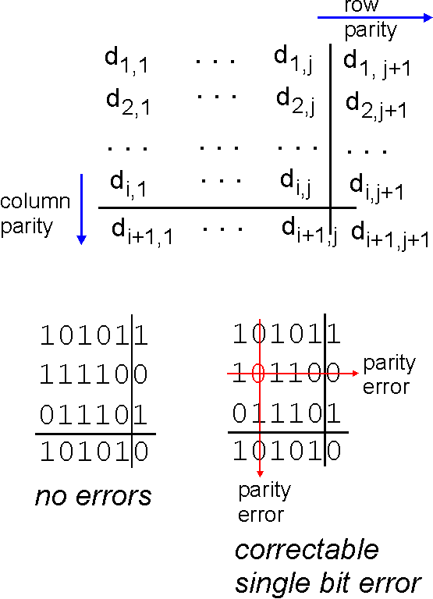
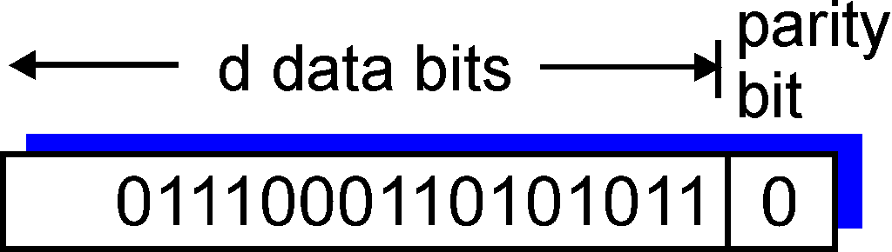
Parity Checking
Single Bit Parity:
Detect single bit errors
Two Dimensional Bit Parity:
Detect and correct single bit errors
0
0

Slide 32
Internet checksum
Goal: detect “errors” (e.g., flipped bits) in transmitted packet (note: used at transport layer only)
Sender:
treat segment contents as sequence of 1bit integers
checksum: addition (1’s complement sum) of segment contents
sender puts checksum value into UDP checksum field
Receiver:
compute checksum of received segment
check if computed checksum equals checksum field value:
NO - error detected
YES - no error detected. But maybe errors nonetheless?
Notes:
Start here March 2nd 2012

Slide 33
Error Detection Code: CRC
CRC means “Cyclic Redundancy Check”.
More powerful than parity.
It can detect various kinds of errors, including 2-bit errors.
More complex: multiplication, binary division.
Parameterized by n-bit divisor P.
Example: 3-bit divisor 101.
Choosing good P is crucial.

Slide 34
CRC with 3-bit Divisor 101
1111
00
0
1001
11
0
CRC
Parity
1111000
same check bits from Parity,
but different ones from CRC
1001000
Multiplication by 2³
D2 = D * 2³
Binary Division by 101
CheckBit = (D2) rem (101)
Add three 0’s at the end
Kurose p478 §5.2.3
Peterson p97 §2.4.3

Slide 35
The divisor (G) – Secret sauce of CRC
If the divisor were 100, instead of 101, data 1111 and 1001 would give the same check bit 00.
Mathematical analysis about the divisor:
Last bit should be 1.
Should contain at least two 1’s.
Should be divisible by 11.
ATM, HDLC, Ethernet each use a CRC with well-chosen fixed divisors
Divisor analysis keeps mathematicians in jobs
(a branch of pure math: combinatorial mathematics)

Slide 36
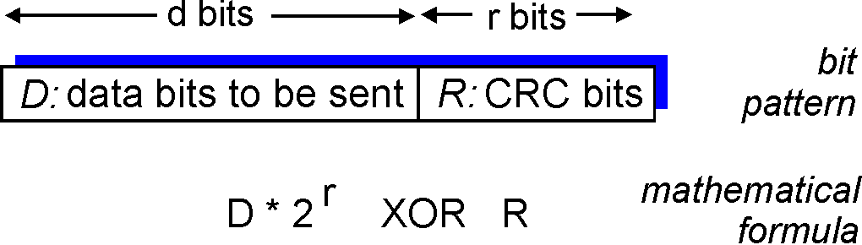
Checksumming: Cyclic Redundancy Check recap
view data bits, D, as a binary number
choose r+1 bit pattern (generator), G
goal: choose r CRC bits, R, such that
<D,R> exactly divisible by G (modulo 2)
receiver knows G, divides <D,R> by G. If non-zero remainder: error detected!
can detect all burst errors less than r+1 bits
widely used in practice (Ethernet, 802.11 WiFi, ATM)

Slide 37
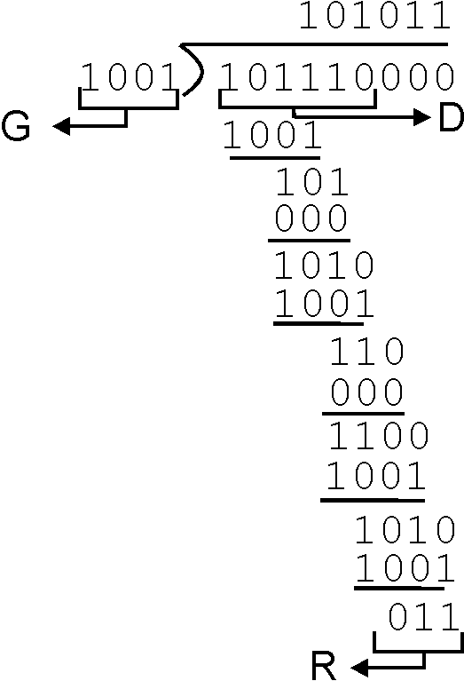
CRC Another Example – this time with long division
Want:
D.2^{r} XOR R = nP
equivalently:
D.2^{r} = nP XOR R
equivalently:
if we divide D.2^{r} by P, want remainder R
P
D.2^{r}
P
R = remainder[ ]
FYI: in K&R P is called the Generator: G

Slide 38
Error Detection Code becomes….
Sender:
Y = generateCheckBit(X);
send(XY);
Receiver:
receive(X1Y1);
Y2=generateCheckBit(X1);
if (Y1 != Y2) ERROR;
else NOERROR
Noise
==

Slide 39
Forward Error Correction (FEC)
Sender:
Y = generateCheckBit(X);
send(XY);
Receiver:
receive(X1Y1);
Y2=generateCheckBit(X1);
if (Y1 != Y2) FIXERROR(X1Y1);
else NOERROR
Noise
!=

Slide 40
Forward Error Correction (FEC)
Sender:
Y = generateCheckBit(X);
send(XY);
Receiver:
receive(X1Y1);
Y2=generateCheckBit(X1);
if (Y1 != Y2) FIXERROR(X1Y1);
else NOERROR
Noise
==

Slide 41
Basic Idea of Forward Error Correction
Replace erroneous data
by its “closest” error-free data.
Good
Good
00
000
10
101
3
2
Bad
Bad
Bad
11
101
01
000
10
110
4
01
011
1
11
110
Good
Good

Slide 42
Error Detection vs Correction
Error Correction:
Cons: More check bits. False recovery.
Pros: No need to re-send.
Error Detection:
Cons: Need to re-send.
Pros: Less check bits.
Usage:
Correction: A lot of noise. Expensive to re-send.
Detection: Less noise. Easy to re-send.
Can be used together.

Slide 43


Multiple Access Links and Protocols
Two types of “links”:
point-to-point
point-to-point link between Ethernet switch and host
broadcast (shared wire or medium)
old-fashioned wired Ethernet (here be dinosaurs – extinct)
upstream HFC (Hybrid Fiber-Coax – the Coax may be broadcast)
802.11 wireless LAN
humans at a
cocktail party
(shared air, acoustical)
shared wire (e.g.,
cabled Ethernet)
shared RF
(e.g., 802.11 WiFi)
shared RF
(satellite)

Slide 44
Multiple Access protocols
single shared broadcast channel
two or more simultaneous transmissions by nodes: interference
collision if node receives two or more signals at the same time
multiple access protocol
distributed algorithm that determines how nodes share channel, i.e., determine when node can transmit
communication about channel sharing must use channel itself!
no out-of-band channel for coordination

Slide 45
Ideal Multiple Access Protocol
Broadcast channel of rate R bps
1. when one node wants to transmit, it can send at rate R
2. when M nodes want to transmit, each can send at average rate R/M
3. fully decentralized:
no special node to coordinate transmissions
no synchronization of clocks, slots
4. simple

Slide 46
MAC Protocols: a taxonomy
Three broad classes:
Channel Partitioning
divide channel into smaller “pieces” (time slots, frequency, code)
allocate piece to node for exclusive use
Random Access
channel not divided, allow collisions
“recover” from collisions
“Taking turns”
nodes take turns, but nodes with more to send can take longer turns

Slide 47
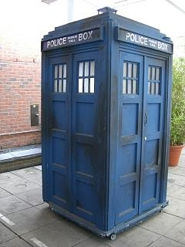
Channel Partitioning MAC protocols: TDMA (time travel warning – we mentioned this earlier)
TDMA: time division multiple access
access to channel in "rounds"
each station gets fixed length slot (length = pkt trans time) in each round
unused slots go idle
example: station LAN, 1,3,4 have pkt, slots 2,5,6 idle
slot
frame
1
3
4
1
3
4

Slide 48
Channel Partitioning MAC protocols: FDMA (time travel warning – we mentioned this earlier)
FDMA: frequency division multiple access
channel spectrum divided into frequency bands
each station assigned fixed frequency band
unused transmission time in frequency bands go idle
example: station LAN, 1,3,4 have pkt, frequency bands 2,5,6 idle
time
frequency bands
FDM cable

Slide 49
“Taking Turns” MAC protocols
channel partitioning MAC protocols:
share channel efficiently and fairly at high load
inefficient at low load: delay in channel access, 1/N bandwidth allocated even if only 1 active node!
Random access MAC protocols
efficient at low load: single node can fully utilize channel
high load: collision overhead
“taking turns” protocols
look for best of both worlds!

Slide 50
“Taking Turns” MAC protocols
Polling:
master node “invites” slave nodes to transmit in turn
typically used with “dumb” slave devices
concerns:
polling overhead
latency
single point of failure (master)
data
poll
master
data
slaves

Slide 51
“Taking Turns” MAC protocols
Token passing:
control token passed from one node to next sequentially.
token message
concerns:
token overhead
latency
single point of failure (token)
concerns fixed in part by a slotted ring (many simultaneous tokens)
T
(nothing
to send)
T
Cambridge students – this is YOUR heritage
Cambridge RING, Cambridge Fast RING,
Cambridge Backbone RING, these things gave us ATDM (and ATM)
data

Slide 52
ATM
In TDM a sender may only use a pre-allocated slot
slot
frame
1
3
4
1
3
4
In ATM a sender transmits labeled cells whenever necessary
1
1
3
4
4
3
1
ATM = Asynchronous Transfer Mode – an ugly expression
think of it as ATDM – Asynchronous Time Division Multiplexing
That’s PACKET SWITCHING to the rest of us – just like Ethernet
but using fixed length slots/packets/cells
Use the media when you need it, but
ATM had virtual circuits and these needed setup….
Worse ATM had an utterly irrational size

Slide 53

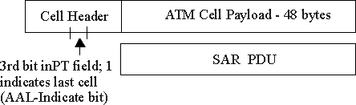
ATM Layer: ATM cell (size = best known stupid feature)
48-byte payload
Why?: small payload -> short cell-creation delay for digitized voice
halfway between 32 and 64 (compromise!)
5-byte ATM cell header (10% of payload)
Cell header
Cell format

Slide 54
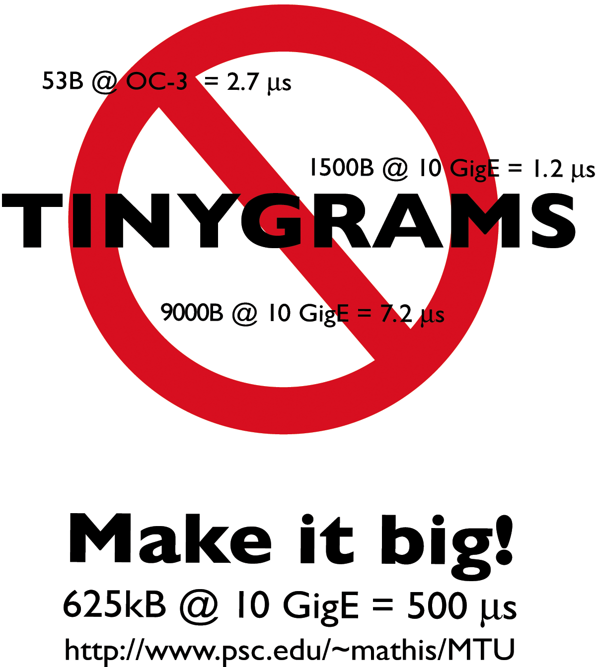
ATM – redux, the irony (a 60 second sidetrack)
Size issues once plagued ATM
- too little time to do useful work
now plague the common Internet MTU
Even jumbo grams (9kB) are argued as not big enough
Consider issues
default Ethernet CRC not robust for 9k packets
IPv6 checksum implications
MTU discovery ugliness
(discovering MTU is hard anyway)
Is time-per-packet a sensible justification?

Slide 55
None of these are the “Internet way”… (Bezerkely, 60’s, free stuff, no G-man)
Seriously; why not?
What’s wrong with
TDMA
FDMA
Polling
Token passing
ATM
Turn to random access
Optimize for the common case (no collision)
Don’t avoid collisions, just recover from them….
Sound familiar?
What could possibly go wrong….
Management. Suites. Rules. Schedules.
Signs, signs, everywhere a sign….

Slide 56
Random Access Protocols
When node has packet to send
transmit at full channel data rate R.
no a priori coordination among nodes
two or more transmitting nodes ➜ “collision”,
random access MAC protocol specifies:
how to detect collisions
how to recover from collisions (e.g., via delayed retransmissions)
Examples of random access MAC protocols:
ALOHA and slotted ALOHA
CSMA, CSMA/CD, CSMA/CA

Slide 57
Random Access MAC Protocols
When node has packet to send
Transmit at full channel data rate
No a priori coordination among nodes
Two or more transmitting nodes ⇒ collision
Data lost
Random access MAC protocol specifies:
How to detect collisions
How to recover from collisions
Examples
ALOHA and Slotted ALOHA
CSMA, CSMA/CD, CSMA/CA (wireless)

Slide 58
Key Ideas of Random Access
Carrier sense
Listen before speaking, and don’t interrupt
Checking if someone else is already sending data
… and waiting till the other node is done
Collision detection
If someone else starts talking at the same time, stop
Realizing when two nodes are transmitting at once
…by detecting that the data on the wire is garbled
Randomness
Don’t start talking again right away
Waiting for a random time before trying again

Slide 59

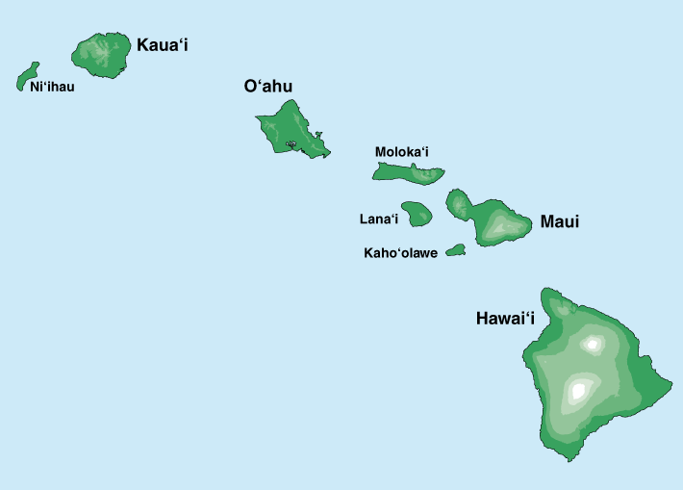
Where it all Started: AlohaNet
Norm Abramson left Stanford to surf
Set up first data communication system for Hawaiian islands
Hub at U. Hawaii, Oahu
Had two radio channels:
Random access:
Sites sending data
Broadcast:
Hub rebroadcasting data
Notes:
Brilliant person + practical problem = interesting development

Slide 60
Aloha Signaling
Two channels: random access, broadcast
Sites send packets to hub (random)
If received, hub sends ACK (random)
If not received (collision), site resends
Hub sends packets to all sites (broadcast)
Sites can receive even if they are also sending
Questions:
When do you resend? Resend with probability p
How does this perform? Need a clean model….

Slide 61
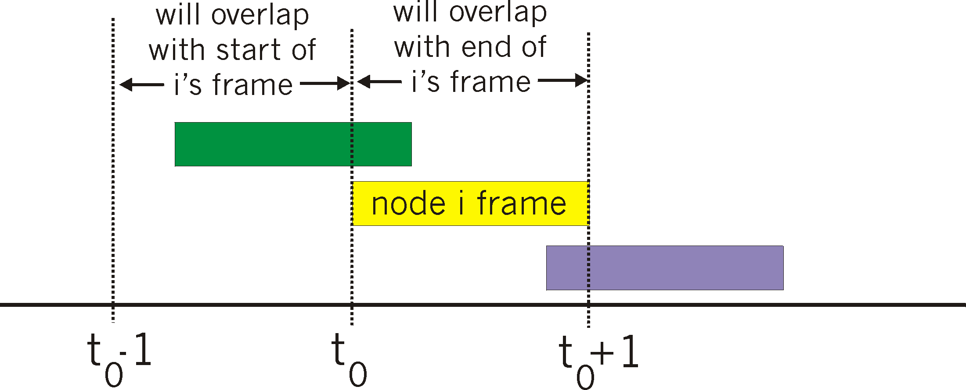
Pure (unslotted) ALOHA
unslotted Aloha: simple, no synchronization
when frame first arrives
transmit immediately
collision probability increases:
frame sent at t₀ collides with other frames sent in [t₀-1,t₀+1]

Slide 62
Pure Aloha efficiency
P(success by given node) = P(node transmits) .
P(no other node transmits in [p₀-1,p₀] .
P(no other node transmits in [p₀-1,p₀]
= p . (1-p)^{N-1 .} (1-p)^{N-1}
= p . (1-p)^{2(N-1)}
… choosing optimum p and then letting n -> ∞ ...
^{= 1/(2e) = .18}
Best described as unspectacular; but better than what went before.

Slide 63
Slotted ALOHA
Operation
When node gets fresh data, transmits in next slot
No collision: success!
Collision: node retransmits with probability p until success
Assumptions
All frames same size
Time divided into equal slots (time to transmit a frame)
Nodes are synchronized
Nodes begin to transmit frames only at start of slots
If multiple nodes transmit, nodes detect collision

Slide 64
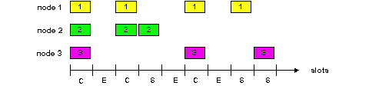
Slot-by-Slot Example

Slide 65
Efficiency of Slotted Aloha
Suppose N stations have packets to send
Each transmits in slot with probability p
Probability of successful transmission: by a particular node i: S_{i} = p (1-p)^{(N-1)} by any of N nodes: S= N p (1-p)^{(N-1)}
What value of p maximizes prob. of success:
For fixed p, S ➔ 0 as N increases
But if p = 1/N, then S ➔ 1/e = 0.37 as N increases
Max efficiency is only slightly greater than 1/3!

Slide 66
Pros and Cons of Slotted Aloha
Pros
Single active node can continuously transmit at full rate of channel
Highly decentralized: only need slot synchronization
Simple
Cons
Wasted slots:
Idle
Collisions
Collisions consume entire slot
Clock synchronization
Notes:
Why is clock synchonization necessary?
It isn’t, but if we get rid of it, efficiency goes down…

Slide 67
Improving on Slotted Aloha
Fewer wasted slots
Need to decrease collisions and empty slots
Don’t waste full slots on collisions
Need to decrease time to detect collisions
Avoid need for synchronization
Synchronization is hard to achieve
Notes:
Which of these are the most important!

Slide 68
CSMA (Carrier Sense Multiple Access)
CSMA: listen before transmit
If channel sensed idle: transmit entire frame
If channel sensed busy, defer transmission
Human analogy: don’t interrupt others!
Does this eliminate all collisions?
No, because of nonzero propagation delay
Notes:
end here 2nd Mar Fri

Slide 69
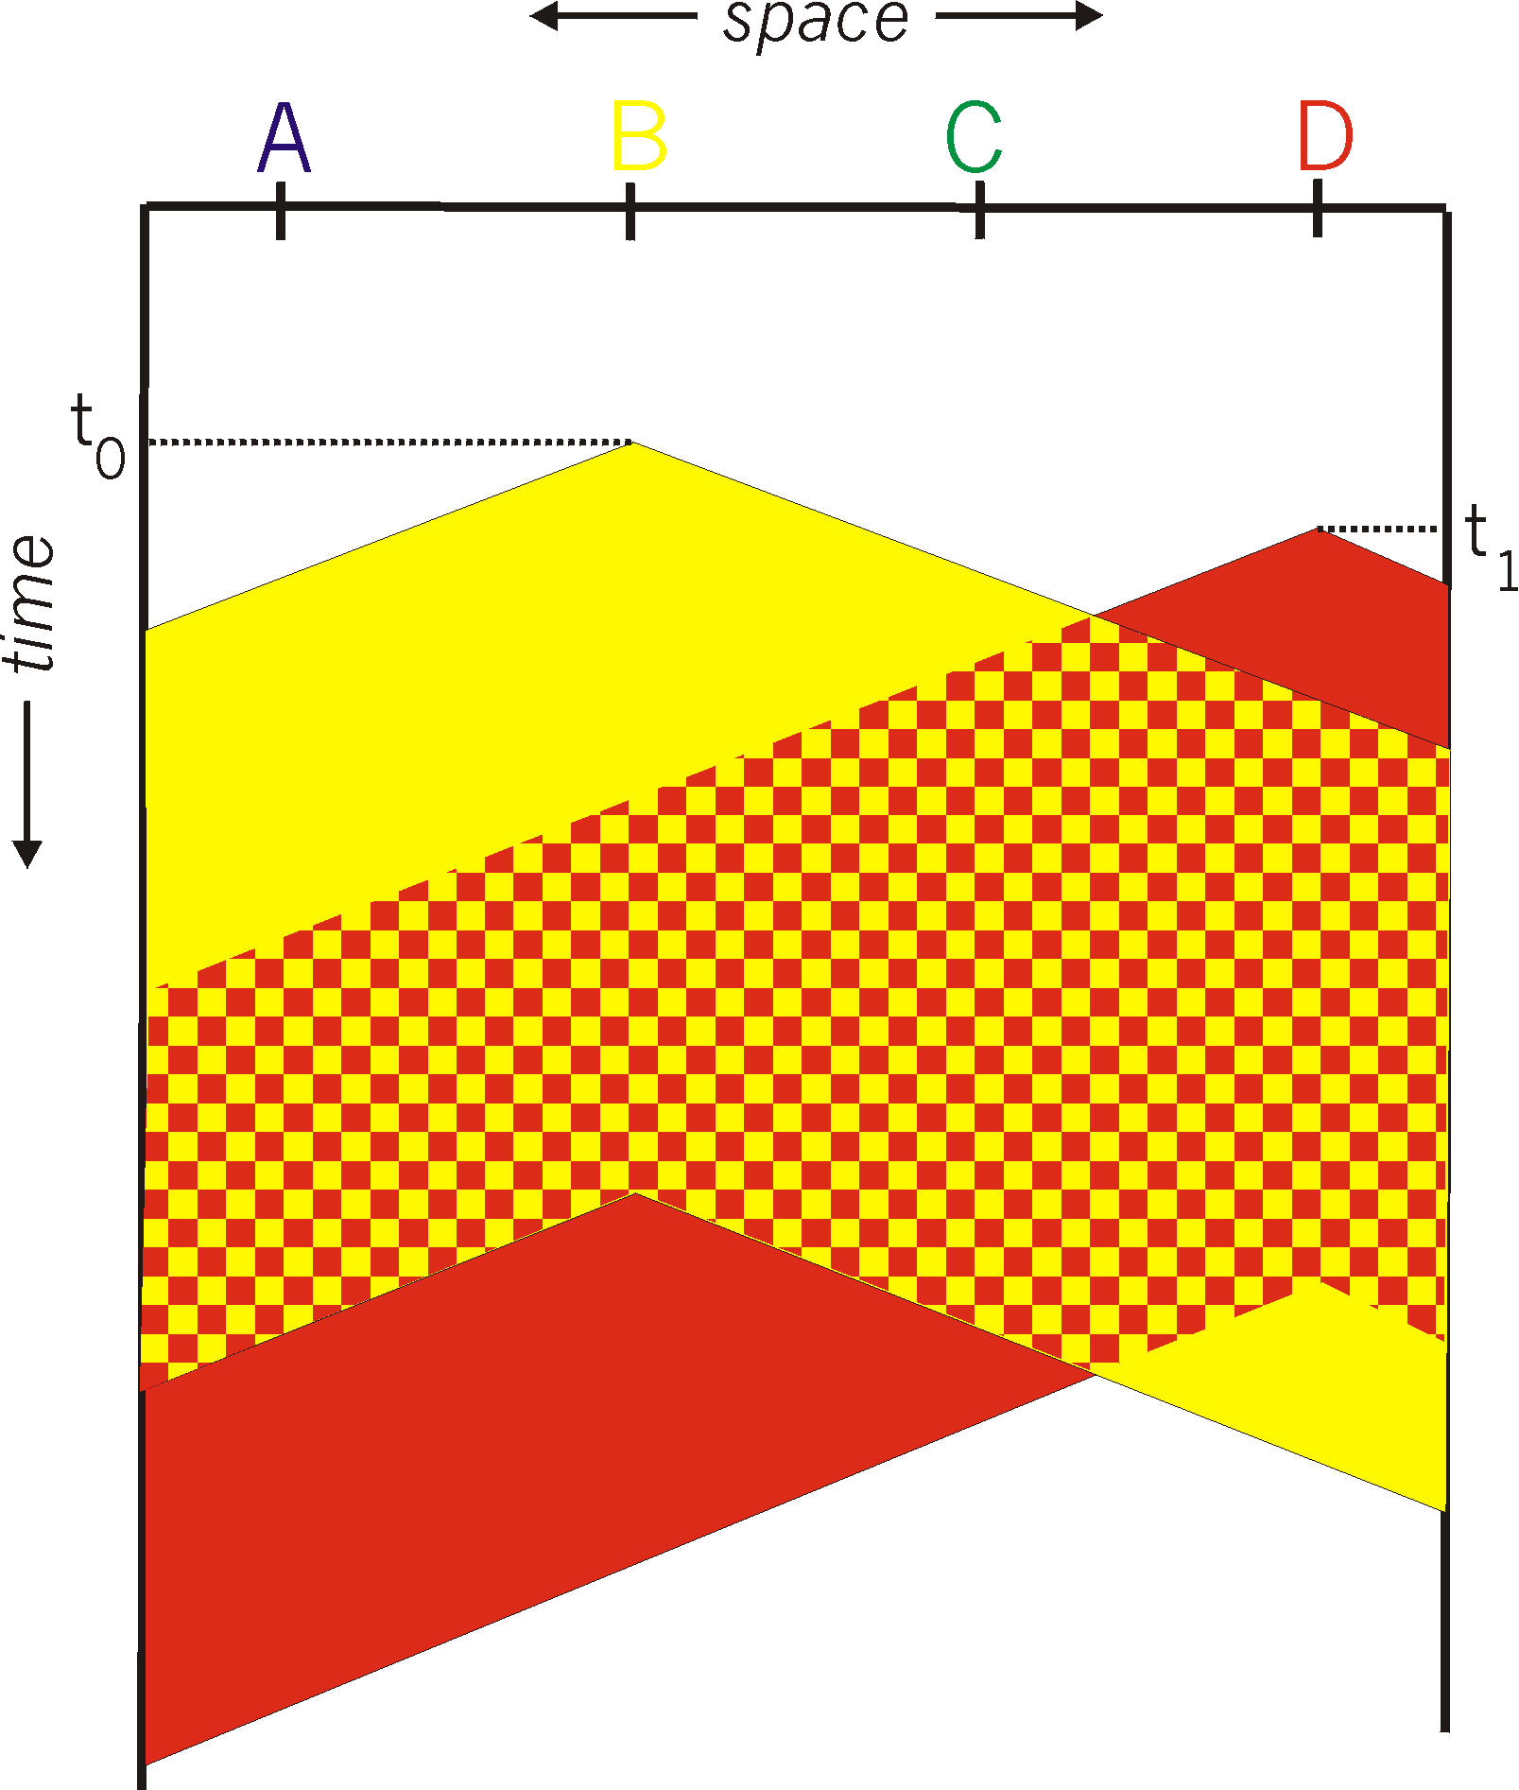
CSMA Collisions
Propagation delay: two nodes may not hear each other’s before sending.
Would slots hurt or help?
CSMA reduces but does not eliminate collisions
Biggest remaining problem?
Collisions still take full slot!
How do you fix that?
Notes:
Ask: who knows? (from knowing ethernet)?
Someone who doesn’t, how to do this?
Listen before sending to detect possible collision
Why not listen to detect current collision!

Slide 70
CSMA/CD (Collision Detection)
CSMA/CD: carrier sensing, deferral as in CSMA
Collisions detected within short time
Colliding transmissions aborted, reducing wastage
Collision detection easy in wired LANs:
Compare transmitted, received signals
Collision detection difficult in wireless LANs:
Reception shut off while transmitting (well, perhaps not)
Not perfect broadcast (limited range) so collisions local
Leads to use of collision avoidance instead (later)

Slide 71
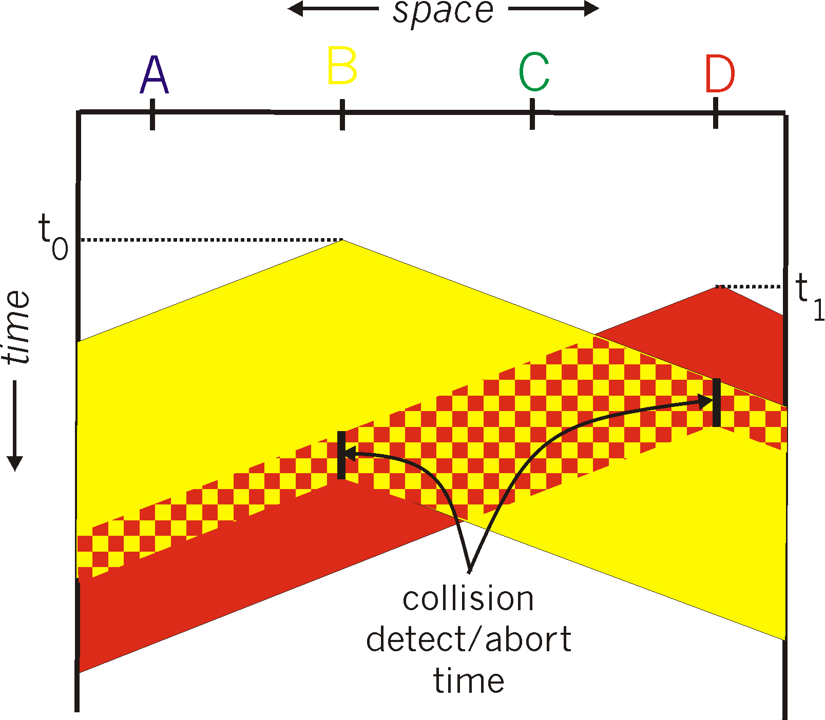
CSMA/CD Collision Detection
B and D can tell that collision occurred.
Note: for this to work, need restrictions on minimum frame size and maximum distance. Why?
Notes:
Draw failed collision detection….

Slide 72
Limits on CSMA/CD Network Length
A
B
latency d
Latency depends on physical length of link
Time to propagate a packet from one end to the other
Suppose A sends a packet at time t
And B sees an idle line at a time just before t+d
… so B happily starts transmitting a packet
B detects a collision, and sends jamming signal
But A can’t see collision until t+2d

Slide 73
Limits on CSMA/CD Network Length
A
B
latency d
A needs to wait for time 2d to detect collision
So, A should keep transmitting during this period
… and keep an eye out for a possible collision
Imposes restrictions. E.g., for 10 Mbps Ethernet:
Maximum length of the wire: 2,500 meters
Minimum length of a frame: 512 bits (64 bytes)
512 bits = 51.2 μsec (at 10 Mbit/sec)
For light in vacuum, 51.2 μsec ≈ 15,000 meters vs. 5,000 meters “round trip” to wait for collision
What about 10Gbps Ethernet?
Notes:
10Gbps is switched, doesn’t have this problem!!!

Slide 74

Performance of CSMA/CD
Time wasted in collisions
Proportional to distance d
Time spend transmitting a packet
Packet length p divided by bandwidth b
Rough estimate for efficiency (K some constant)
Note:
For large packets, small distances, E ~ 1
As bandwidth increases, E decreases
That is why high-speed LANs are all switched
Notes:
K represents number of collisions per transmission….

Slide 75
Benefits of Ethernet
Easy to administer and maintain
Inexpensive
Increasingly higher speed
Evolvable!

Slide 76
Evolution of Ethernet
Changed everything except the frame format
From single coaxial cable to hub-based star
From shared media to switches
From electrical signaling to optical
Lesson #1
The right interface can accommodate many changes
Implementation is hidden behind interface
Lesson #2
Really hard to displace the dominant technology
Slight performance improvements are not enough

Slide 77
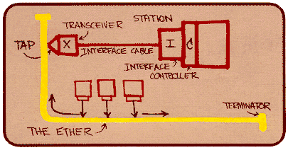
Ethernet: CSMA/CD Protocol
Carrier sense: wait for link to be idle
Collision detection: listen while transmitting
No collision: transmission is complete
Collision: abort transmission & send jam signal
Random access: binary exponential back-off
After collision, wait a random time before trying again
After m^{th} collision, choose K randomly from {0, …, 2^{m}-1}
… and wait for K*512 bit times before trying again
Using min packet size as “slot”
If transmission occurring when ready to send, wait until end of transmission (CSMA)

Slide 78
Binary Exponential Backoff (BEB)
Think of time as divided in slots
After each collision, pick a slot randomly within next 2^{m} slots
Where m is the number of collisions since last successful transmission
Questions:
Why backoff?
Why random?
Why 2^{m}?
Why not listen while waiting?
Notes:
How would listening help?

Slide 79
Behavior of BEB Under Light Load
Look at collisions between two nodes
First collision: pick one of the next two slots
Chance of success after first collision: 50%
Average delay 1.5 slots
Second collision: pick one of the next four slots
Chance of success after second collision: 75%
Average delay 2.5 slots
In general: after m^{th} collision
Chance of success: 1-2^{-m}
Average delay (in slots): ½ + 2^{(m-1)}

Slide 80
BEB: Theory vs Reality
In theory, there is no difference between theory and practice. But, in practice, there is.

Slide 81
BEB Reality
Performs well (far from optimal, but no one cares)
Large packets are ~23 times as large as minimal slot
Is now mostly irrelevant
Almost all current ethernets are switched

Slide 82
BEB Theory
A very interesting algorithm
Stability for finite N only proved in 1985
Ethernet can handle nonzero traffic load without collapse
All backoff algorithms unstable for infinite N (1985)
Poisson model: infinite user pool, total demand is finite
Not of practical interest, but gives important insight
Multiple access should be in your “bag of tricks”
Notes:
e.g., know most important way to spread a rumor…

Slide 83
Question
Two hosts, each with infinite packets to send
What happens under BEB?
Throughput high or low?
Bandwidth shared equally or not?

Slide 84
MAC “Channel Capture” in BEB
Finite chance that first one to have a successful transmission will never relinquish the channel
The other host will never send a packet
Therefore, asymptotically channel is fully utilized and completely allocated to one host

Slide 85
Example
Two hosts, each with infinite packets to send
Slot 1: collision
Slot 2: each resends with prob ½
Assume host A sends, host B does not
Slot 3: A and B both send (collision)
Slot 4: A sends with probability ½, B with prob. ¼
Assume A sends, B does not
Slot 5: A definitely sends, B sends with prob. ¼
Assume collision
Slot 6: A sends with probability ½, B with prob. 1/8
Conclusion: if A gets through first, the prob. of B sending successfully halves with each collision

Slide 86
Another Question
Hosts now have large but finite # packets to send
What happens under BEB?
Throughput high or low?

Slide 87
Answer
Efficiency less than one, no matter how many packets
Time you wait for loser to start is proportion to time winner was sending….

Slide 88
Different Backoff Functions
Exponential: backoff ~ a^{i}
Channel capture?
Efficiency?
Superlinear polynomial: backoff ~ i^{p} p>1
Channel capture?
Efficiency?
Sublinear polynomial: backoff ~ i^{p} p≤1
Channel capture?
Efficiency?

Slide 89
Different Backoff Functions
Exponential: backoff ~ a^{i}
Channel capture (loser might not send until winner idle)
Efficiency less than 1 (time wasted waiting for loser to start)
Superlinear polynomial: backoff ~ i^{p} p>1
Channel capture
Efficiency is 1 (for any finite # of hosts N)
Sublinear polynomial: backoff ~ i^{p} p≤1
No channel capture (loser not shut out)
Efficiency is less than 1 (and goes to zero for large N)
Time wasted resolving collisions

Slide 90
Summary of MAC protocols
channel partitioning, by time, frequency or code
Time Division, Frequency Division
random access (dynamic),
ALOHA, S-ALOHA, CSMA, CSMA/CD
carrier sensing: easy in some technologies (wire), hard in others (wireless)
CSMA/CD used in Ethernet
CSMA/CA used in 802.11
taking turns
polling from central site, token passing
Bluetooth, FDDI, IBM Token Ring

Slide 91
MAC Addresses (and ARP) or How do I glue my network to my data-link?
32-bit IP address:
network-layer address
used to get datagram to destination IP subnet
MAC (or LAN or physical or Ethernet) address:
function: get frame from one interface to another physically-connected interface (same network)
48 bit MAC address (for most LANs)
burned in NIC ROM, also sometimes software settable

Slide 92
LAN Address (more)
MAC address allocation administered by IEEE
manufacturer buys portion of MAC address space (to assure uniqueness)
analogy:
(a) MAC address: like Social Security Number
(b) IP address: like postal address
MAC flat address ➜ portability
can move LAN card from one LAN to another
IP hierarchical address NOT portable
address depends on IP subnet to which node is attached

Slide 93
LAN Addresses and ARP
Each adapter on LAN has unique LAN address
1A-2F-BB-709-AD
Ethernet
Broadcast address =
FF-FF-FF-FF-FF-FF
LAN
(wired or
wireless)
= adapter
71-6F7-2B-08-53
58-23-D7-FA-20-B0
0C-C4-11-6F-E3-98

Slide 94
Address Resolution Protocol
Every node maintains an ARP table
<IP address, MAC address> pair
Consult the table when sending a packet
Map destination IP address to destination MAC address
Encapsulate and transmit the data packet
But: what if IP address not in the table?
Sender broadcasts: “Who has IP address 1.2.3.156?”
Receiver responds: “MAC address 58-23-D7-FA-20-B0”
Sender caches result in its ARP table
Notes:
Wed 7th start here.

Slide 95
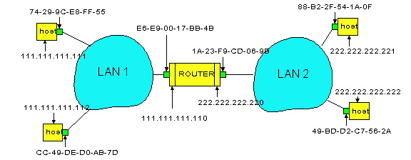
Example: A Sending a Packet to B
How does host A send an IP packet to host B?
A
R
B

Slide 96
Example: A Sending a Packet to B
How does host A send an IP packet to host B?
A
R
B
1. A sends packet to R. 2. R sends packet to B.

Slide 97
Host A Decides to Send Through R
Host A constructs an IP packet to send to B
Source 111.111.111.111, destination 222.222.222.222
Host A has a gateway router R
Used to reach destinations outside of 111.111.111.0/24
Address 111.111.111.110 for R learned via DHCP/config
A
R
B

Slide 98
Host A Sends Packet Through R
Host A learns the MAC address of R’s interface
ARP request: broadcast request for 111.111.111.110
ARP response: R responds with EE9-00-17-BB-4B
Host A encapsulates the packet and sends to R
A
R
B

Slide 99
R Decides how to Forward Packet
Router R’s adaptor receives the packet
R extracts the IP packet from the Ethernet frame
R sees the IP packet is destined to 222.222.222.222
Router R consults its forwarding table
Packet matches 222.222.222.0/24 via other adaptor
A
R
B

Slide 100
R Sends Packet to B
Router R’s learns the MAC address of host B
ARP request: broadcast request for 222.222.222.222
ARP response: B responds with 49-BD-D2-C7-52A
Router R encapsulates the packet and sends to B
A
R
B

Slide 101

Security Analysis of ARP
Impersonation
Any node that hears request can answer …
… and can say whatever they want
Actual legit receiver never sees a problem
Because even though later packets carry its IP address, its NIC doesn’t capture them since not its MAC address

Slide 102
Key Ideas in Both ARP and DHCP
Broadcasting: Can use broadcast to make contact
Scalable because of limited size
Caching: remember the past for a while
Store the information you learn to reduce overhead
Remember your own address & other host’s addresses
Soft state: eventually forget the past
Associate a time-to-live field with the information
… and either refresh or discard the information
Key for robustness in the face of unpredictable change

Slide 103
Why Not Use DNS-Like Tables?
When host arrives:
Assign it an IP address that will last as long it is present
Add an entry into a table in DNS-server that maps MAC to IP addresses
Answer:
Names: explicit creation, and are plentiful
Hosts: come and go without informing network
Must do mapping on demand
Addresses: not plentiful, need to reuse and remap
Soft-state enables dynamic reuse
Notes:
Two key points

Slide 104
Hubs
… physical-layer (“dumb”) repeaters:
bits coming in one link go out all other links at same rate
all nodes connected to hub can collide with one another
no frame buffering
no CSMA/CD at hub: host NICs detect collisions
Co-ax or twisted pair
hub

Slide 105
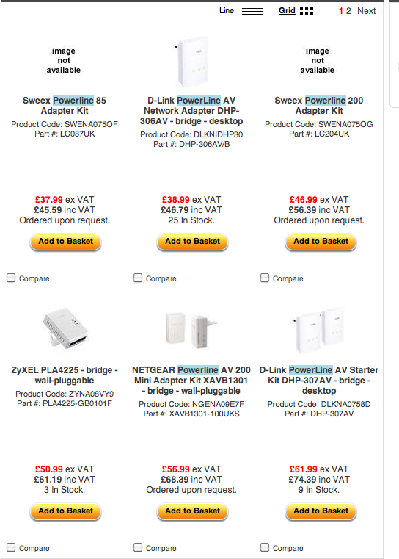

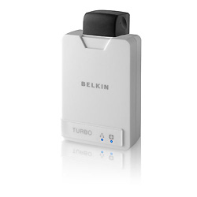
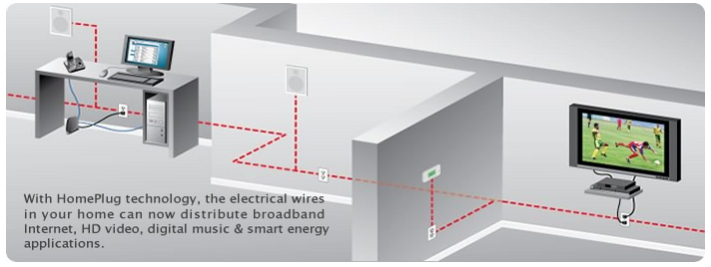
CSMA/CD Lives….
Home Plug and similar Powerline Networking….

Slide 106
Switch (like a Hub but smarter)
link-layer device: smarter than hubs, take active role
store, forward Ethernet frames
examine incoming frame’s MAC address, selectively forward frame to one-or-more outgoing links when frame is to be forwarded on segment, uses CSMA/CD to access segment
transparent
hosts are unaware of presence of switches
plug-and-play, self-learning
switches do not need to be configured

Slide 107
Switch: allows multiple simultaneous transmissions
A
hosts have dedicated, direct connection to switch
switches buffer packets
Ethernet protocol used on each incoming link, but no collisions; full duplex
each link is its own collision domain
switching: A-to-A’ and B-to-B’ simultaneously, without collisions
not possible with dumb hub
C’
B
1
2
6
3
5
4
C
B’
A’
switch with six interfaces
(1,2,3,4,5,6)

Slide 108
Switch Table
A
Q: how does switch know that A’ reachable via interface 4, B’ reachable via interface 5?
A: each switch has a switch table, each entry:
(MAC address of host, interface to reach host, time stamp)
looks like a routing table!
Q: how are entries created, maintained in switch table?
something like a routing protocol?
C’
B
1
2
6
3
5
4
C
B’
A’
switch with six interfaces
(1,2,3,4,5,6)

Slide 109
Switch: self-learning (recap)
Source: A
Dest: A’
A
A A’
switch learns which hosts can be reached through which interfaces
when frame received, switch “learns” location of sender: incoming LAN segment
records sender/location pair in switch table
C’
B
1
2
6
3
5
4
C
B’
A’
MAC addr interface TTL
A
1
60
Switch table
(initially empty)

Slide 110
Switch: frame filtering/forwarding
When frame received:
1. record link associated with sending host
2. index switch table using MAC dest address
3. if entry found for destination then {
if dest on segment from which frame arrived then drop the frame
else forward the frame on interface indicated
}
else flood
forward on all but the interface
on which the frame arrived

Slide 111
Self-learning, forwarding: example
Source: A
Dest: A’
A
A A’
C’
B
frame destination unknown:
1
2
flood
6
3
A A’
A A’
A A’
A A’
A A’
5
4
destination A location known:
C
selective send
A’ A
B’
A’
MAC addr interface TTL
A
1
60
Switch table
(initially empty)
A’
4
60

Slide 112
Interconnecting switches
switches can be connected together
S₄
S₁
S₃
A
S₂
F
I
B
C
D
E
G
H
Q: sending from A to G - how does S₁ know to forward frame destined to F via S₄ and S₃?
A: self learning! (works exactly the same as in single-switch case – flood/forward/drop)

Slide 113
Flooding Can Lead to Loops
Flooding can lead to forwarding loops
E.g., if the network contains a cycle of switches
“Broadcast storm”

Slide 114

Solution: Spanning Trees
Ensure the forwarding topology has no loops
Avoid using some of the links when flooding
… to prevent loop from forming
Spanning tree
Sub-graph that covers all vertices but contains no cycles
Links not in the spanning tree do not forward frames
Graph Has Cycles!
Graph Has No Cycles!

Slide 115
What Do We Know?
Shortest paths to (or from) a node form a tree
So, algorithm has two aspects :
Pick a root
Compute shortest paths to it
Only keep the links on shortest-path

Slide 116
Constructing a Spanning Tree
Switches need to elect a root
The switch w/ smallest identifier (MAC addr)
Each switch determines if each interface is on the shortest path from the root
Excludes it from the tree if not
Messages (Y, d, X)
From node X
Proposing Y as the root
And the distance is d
root
One hop
Three hops

Slide 117
Steps in Spanning Tree Algorithm
Initially, each switch proposes itself as the root
Switch sends a message out every interface
… proposing itself as the root with distance 0
Example: switch X announces (X, 0, X)
Switches update their view of the root
Upon receiving message (Y, d, Z) from Z, check Y’s id
If new id smaller, start viewing that switch as root
Switches compute their distance from the root
Add 1 to the distance received from a neighbor
Identify interfaces not on shortest path to the root
… and exclude them from the spanning tree
If root or shortest distance to it changed, “flood” updated message (Y, d+1, X)

Slide 118
Example From Switch #4’s Viewpoint
Switch #4 thinks it is the root
Sends (4, 0, 4) message to 2 and 7
Then, switch #4 hears from #2
Receives (2, 0, 2) message from 2
… and thinks that #2 is the root
And realizes it is just one hop away
Then, switch #4 hears from #7
Receives (2, 1, 7) from 7
And realizes this is a longer path
So, prefers its own one-hop path
And removes 4-7 link from the tree
1
3
5
2
4
6
7

Slide 119
Example From Switch #4’s Viewpoint
Switch #2 hears about switch #1
Switch 2 hears (1, 1, 3) from 3
Switch 2 starts treating 1 as root
And sends (1, 2, 2) to neighbors
Switch #4 hears from switch #2
Switch 4 starts treating 1 as root
And sends (1, 3, 4) to neighbors
Switch #4 hears from switch #7
Switch 4 receives (1, 3, 7) from 7
And realizes this is a longer path
So, prefers its own three-hop path
And removes 4-7 Iink from the tree
1
3
5
2
4
6
7

Slide 120
Robust Spanning Tree Algorithm
Algorithm must react to failures
Failure of the root node
Need to elect a new root, with the next lowest identifier
Failure of other switches and links
Need to recompute the spanning tree
Root switch continues sending messages
Periodically reannouncing itself as the root (1, 0, 1)
Other switches continue forwarding messages
Detecting failures through timeout (soft state)
If no word from root, times out and claims to be the root
Delay in reestablishing spanning tree is major problem
Work on rapid spanning tree algorithms…

Slide 121
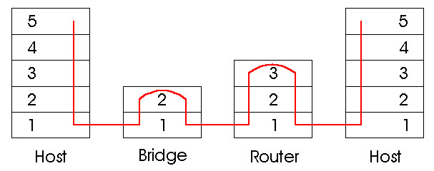
Switches vs. Routers Summary
both store-and-forward devices
routers: network layer devices (examine network layer headers)
switches are link layer devices
routers maintain routing tables, implement routing algorithms
switches maintain switch tables, implement filtering, learning algorithms
Notes:
FINAL SLIDE IN PART 5

Slide 122
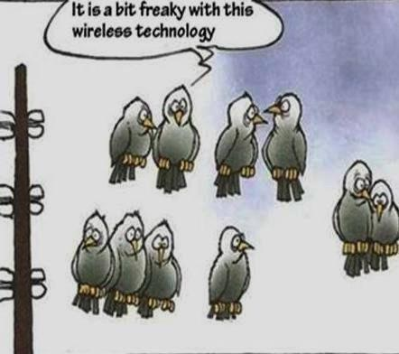
Wireless

Slide 123
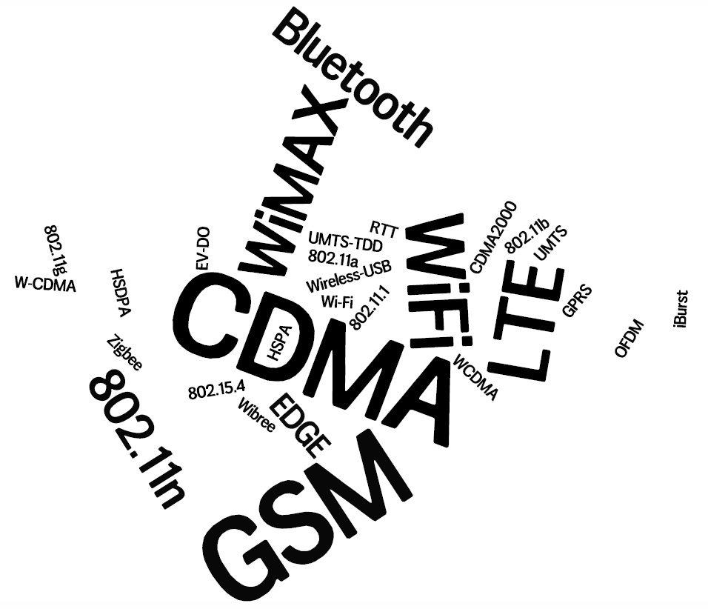
Notes:
Rapid evolution in the wireless eco-system – hard to keep up.
Both technologies and business-models

Slide 124

Metrics for evaluation / comparison of wireless technologies
Bitrate or Bandwidth
Range - PAN, LAN, MAN, WAN
Two-way / One-way
Multi-Access / Point-to-Point
Digital / Analog
Applications and industries
Frequency – Affects most physical properties: Distance (free-space loss) Penetration, Reflection, Absorption Energy proportionality Policy: Licensed / Deregulated
Line of Sight (Fresnel zone)
Size of antenna
Determined by wavelength – )
Notes:
Bitrate or Bandwidth
Range - PAN, LAN, MAN, WAN
Two-way / One-way
Multi-Access / Point-to-Point
Digital / Analog
Applications and industries
Frequency – Affects most physical properties: Distance (free-space loss) Penetration, Reflection, Absorption Energy proportionality Policy: Licensed / Deregulated
Line of Sight (Fresnel zone)
Size of antenna
(determined by wavelength – )

Slide 125
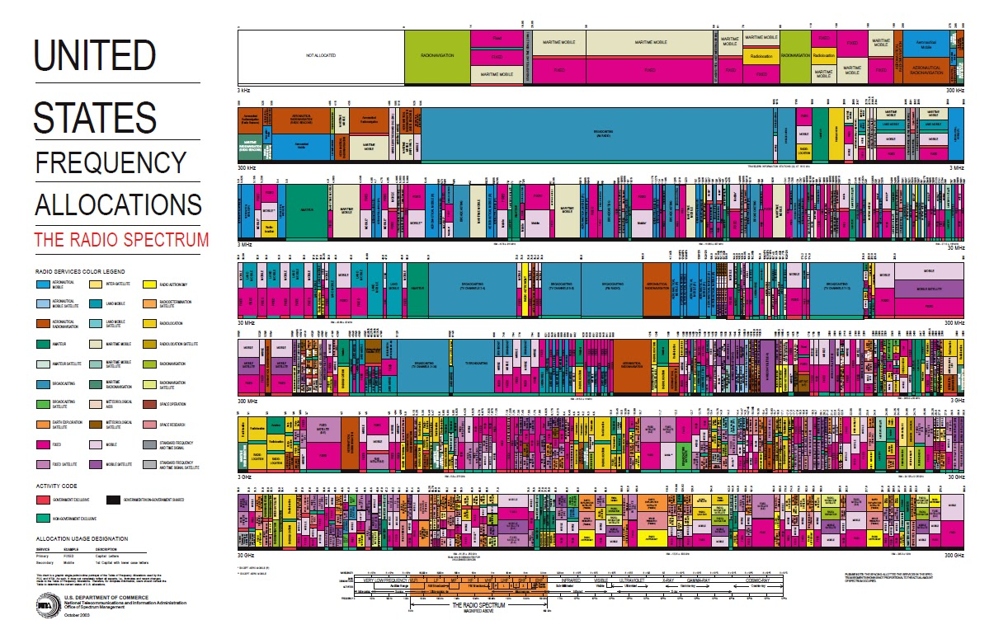
Modern art?
Notes:
Allocated to license holders.
Occasionally (rarely) a chunk gets offered for bidding – for billions of dollars.

Slide 126
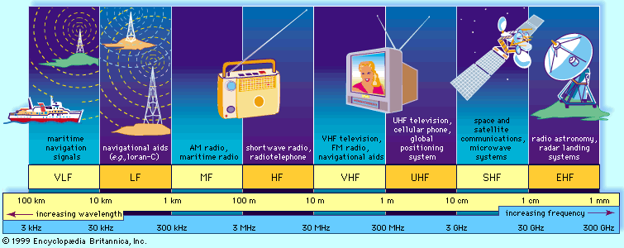
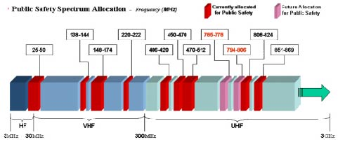
The Wireless Spectrum
Notes:
FCC allocates spectrum to users – who are these?
Govt. itself (various agencies), military.
Public-safety.
Broadcasters
Telecommunications providers (aka operators) – license holders.
Different bands behave differently …
Most wave propagation properties are frequency/wave-length dependent:

Slide 127
Wireless Communication Standards
Cellular (800/900/1700/1800/1900Mhz):
2G: GSM / CDMA / GPRS /EDGE
3G: CDMA2000/UMTS/HSDPA/EVDO
4G: LTE, WiMax
IEEE 802.11 (aka WiFi):
b: 2.4Ghz band, 11Mbps (~4.5 Mbps operating rate)
g: 2.4Ghz, 54-108Mbps (~19 Mbps operating rate)
a: 5.0Ghz band, 54-108Mbps (~25 Mbps operating rate)
n: 2.4/5Ghz, 150-600Mbps (4x4 mimo).
IEEE 802.15 – lower power wireless:
802.15.1: 2.4Ghz, 2.1 Mbps (Bluetooth)
802.15.4: 2.4Ghz, 250 Kbps (Sensor Networks)
127
Notes:
start from here 9 March

Slide 128
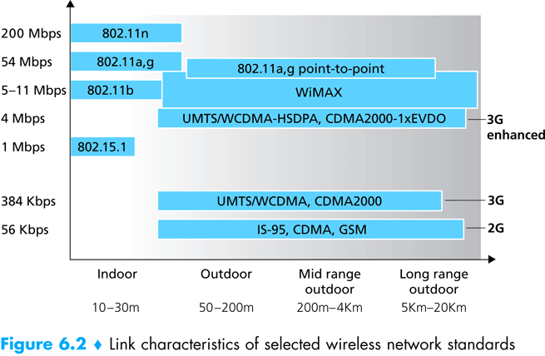
Wireless Link Characteristics
(Figure Courtesy of Kurose and Ross)
128
Notes:
Naturally – there exist technologies for longer distances…
Also – we already have affordable off-the-shelf gear for gigabit+ speeds…
Why not use any of the outdoors technologies also indoors – surely it would work…?
802.11n can do much faster today – 600Mbps (4x4 MIMO)…
This demonstrates the openness and flexibility of the standard, which mostly deals with link-layer elements while allowing diversity of underlying physical layer technologies.

Slide 129
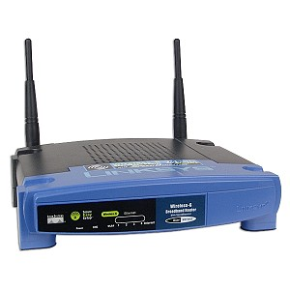
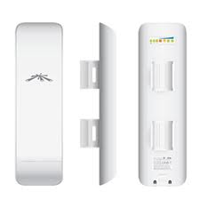
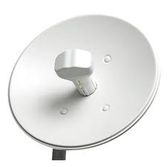
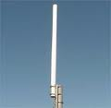
Antennas / Aerials
An electrical device which converts electric currents into radio waves, and vice versa.
2-3dB 8-12dB 15-18dB 28-34dB
Q: What does “higher-gain antenna” mean?
A: Antennas are passive devices – more gain means focused and more directional.
Directionality means more energy gets to where it needs to go and less interference everywhere.
What are omni-directional antennas?
Notes:
What antennas are inside a cell-phone?

Slide 130
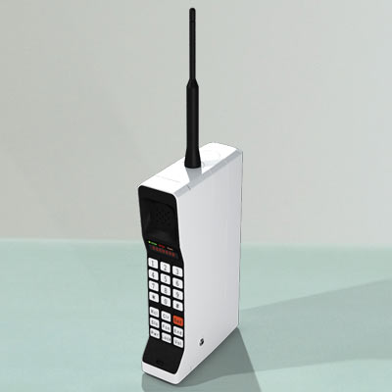
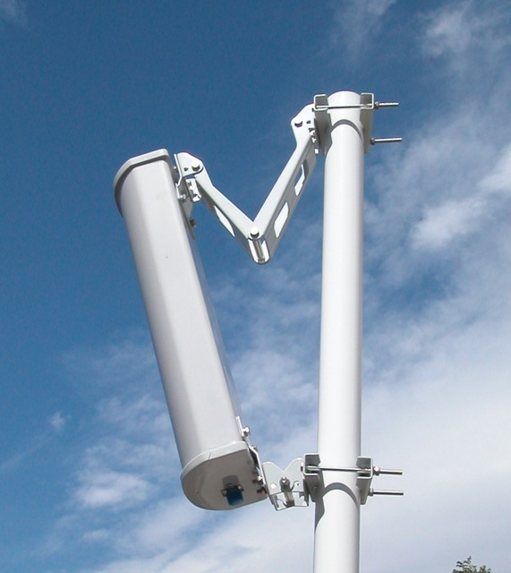
What has changed?
Notes:
I used to make calls from 40 miles away – not anymore…
Cellular towers climbed down from the mountain-tops and attempt to reduce/contain their footprint.

Slide 131
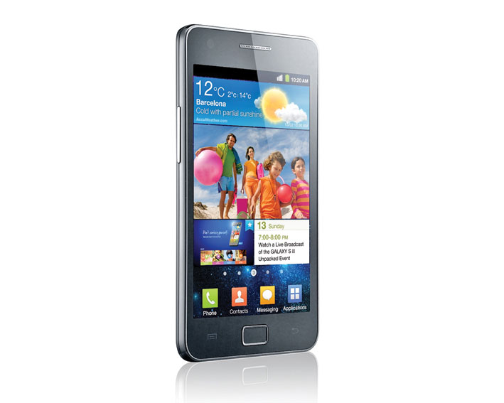
How many radios/antennas ?
WiFi 802.11n (maybe MiMo?)
2G - GSM
3G – HSDPA+
4G – LTE
Bluetooth (4.0)
NFC
GPS Receiver
FM-Radio receiver (antenna is the headphones cable)

Slide 132
What Makes Wireless Different?
Broadcast and multi-access medium…
Just like AlohaNet – isn’t this where we came in?
Signals sent by sender don’t always end up at receiver intact
Complicated physics involved, which we won’t discuss
But what can go wrong?

Slide 133
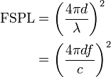
Path Loss / Path Attenuation
Free Space Path Loss:
d = distance
λ = wave length
f = frequency
c = speed of light
Reflection, Diffraction, Absorption
Terrain contours (Urban, Rural, Vegetation).
Humidity
Notes:
reduction in power density (attenuation) of an electromagnetic wave as it propagates through space.
Path loss may be due to many effects, such as free-space loss,refraction, diffraction, reflection, aperture-medium coupling loss, and absorption. Path loss is also influenced by terrain contours, environment (urban or rural, vegetation and foliage), propagation medium (dry or moist air), the distance between the transmitter and the receiver, and the height and location of antennas.

Slide 134
Multipath Effects
Ceiling
S
R
Floor
Signals bounce off surface and interfere with one another
Self-interference
134

Slide 135
Ideal Radios (courtesy of Gilman Tolle and Jonathan Hui, ArchRock)

Slide 136
Real Radios (courtesy of Gilman Tolle and Jonathan Hui, ArchRock)

Slide 137
The Amoeboed “cell” (courtesy of David Culler, UCB)
Signal
Noise
Distance
137
Notes:
137

Slide 138
Interference from Other Sources
External Interference
Microwave is turned on and blocks your signal
Would that affect the sender or the receiver?
Internal Interference
Hosts within range of each other collide with one another’s transmission
We have to tolerate path loss, multipath, etc., but we can try to avoid internal interference

Slide 139
SNR – the key to communication:
Signal to Noise Ratio
Bitrate (aka data-rate)
The higher the SNR –
the higher the (theoretical) bitrate.
Modern radios use adaptive /dynamic bitrates.
Q: In face of loss, should we decrease or increase the bitrate?
A: If caused by free-space loss or multi-path fading -lower the bitrate.
If external interference - often higher bitrates (shorter bursts) are probabilistically better.

Slide 140
Wireless Bit Errors
The lower the SNR (Signal/Noise) the higher the Bit Error Rate (BER)
We could make the signal stronger…
Why is this not always a good idea?
Increased signal strength requires more power
Increases the interference range of the sender, so you interfere with more nodes around you
And then they increase their power…….
How would TCP behave in face of losses?
TCP conflates loss (congestion) with loss local errors
Local link-layer Error Correction schemes can correct some problems (should be TCP aware).
140

Slide 141
802.11
aka - WiFi …
What makes it special?
Deregulation > Innovation > Adoption > Lower cost = Ubiquitous technology
141
Notes:
141
JUST LIKE ETHERNET – not lovely but sufficient

Slide 142
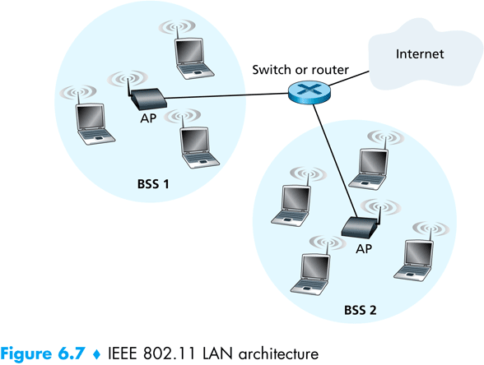
802.11 Architecture
Designed for limited area
AP’s (Access Points) set to specific channel
Broadcast beacon messages with SSID (Service Set Identifier) and MAC Address periodically
Hosts scan all the channels to discover the AP’s
Host associates with AP
802.11 frames exchanges
802.3 (Ethernet) frames exchanged
142

Slide 143
Wireless Multiple Access Technique?
Carrier Sense?
Sender can listen before sending
What does that tell the sender?
Collision Detection?
Where do collisions occur?
How can you detect them?
Notes:
stopped here 9 mar

Slide 144
Hidden Terminals
A
B
C
transmit range
144
A and C can both send to B but can’t hear each other
A is a hidden terminal for C and vice versa
Carrier Sense will be ineffective
Notes:
144

Slide 145
Exposed Terminals
Exposed node: B sends a packet to A; C hears this and decides not to send a packet to D (despite the fact that this will not cause interference)!
Carrier sense would prevent a successful transmission.
A
B
C
D
145
Notes:
145

Slide 146
Key Points
No concept of a global collision
Different receivers hear different signals
Different senders reach different receivers
Collisions are at receiver, not sender
Only care if receiver can hear the sender clearly
It does not matter if sender can hear someone else
As long as that signal does not interfere with receiver
Goal of protocol:
Detect if receiver can hear sender
Tell senders who might interfere with receiver to shut up

Slide 147
Basic Collision Avoidance
Since can’t detect collisions, we try to avoid them
Carrier sense:
When medium busy, choose random interval
Wait that many idle timeslots to pass before sending
When a collision is inferred, retransmit with binary exponential backoff (like Ethernet)
Use ACK from receiver to infer “no collision”
Use exponential backoff to adapt contention window
Notes:
Why do we wait?
Why not just send right away as medium becomes clear?

Slide 148
CSMA/CA -MA with Collision Avoidance
sender
receiver
other node in
sender’s range
RTS
CTS
data
ACK
Before every data transmission
Sender sends a Request to Send (RTS) frame containing the length of the transmission
Receiver respond with a Clear to Send (CTS) frame
Sender sends data
Receiver sends an ACK; now another sender can send data
When sender doesn’t get a CTS back, it assumes collision
148
Notes:
148

Slide 149
CSMA/CA, con’t
receiver
other node in
sender’s range
sender
RTS
CTS
data
data
If other nodes hear RTS, but not CTS: send
Presumably, destination for first sender is out of node’s range …
149
Notes:
149

Slide 150
CSMA/CA, con’t
sender
receiver
other node in
sender’s range
RTS
CTS
data
ACK
If other nodes hear RTS, but not CTS: send
Presumably, destination for first sender is out of node’s range …
… Can cause problems when a CTS is lost
When you hear a CTS, you keep quiet until scheduled transmission is over (hear ACK)
150
Notes:
150

Slide 151
RTS / CTS Protocols (CSMA/CA)
B sends to C
RTS
A
B
C
D
Overcome hidden terminal problems with contention-free protocol
B sends to C Request To Send (RTS)
A hears RTS and defers (to allow C to answer)
C replies to B with Clear To Send (CTS)
D hears CTS and defers to allow the data
B sends to C
CTS
151
Notes:
151
Does not solve the exposed terminal problem.
High overhead and especially increase latency.
assumes symmetric signal qualities - if node A hears node B - than also node B hears node A. - not always the case. (Especially local interference at receiver).

Slide 152
Preventing Collisions Altogether
Frequency Spectrum partitioned into several channels
Nodes within interference range can use separate channels
Now A and C can send without any interference!
Most cards have only 1 transceiver
Not Full Duplex: Cannot send and receive at the same time
Aggregate Network throughput doubles
B
A
C
D
152

Slide 153
802.11: advanced capabilities
Rate Adaptation
base station, mobile dynamically change transmission rate (physical layer modulation technique) as mobile moves, SNR varies
10⁻¹
10⁻²
10⁻³
BER
10⁻⁴
10⁻⁵
10⁻⁶
10⁻⁷
10
20
30
40
SNR(dB)
1. SNR decreases, BER increase as node moves away from base station
QAM256 (8 Mbps)
QAM16 (4 Mbps)
2. When BER becomes too high, switch to lower transmission rate but with lower BER
BPSK (1 Mbps)
operating point

Slide 154
802.11: advanced capabilities
Power Management
node-to-AP: “I am going to sleep until next beacon frame”
AP knows not to transmit frames to this node
node wakes up before next beacon frame
beacon frame: contains list of mobiles with AP-to-mobile frames waiting to be sent
node will stay awake if AP-to-mobile frames to be sent; otherwise sleep again until next beacon frame

