Slide 1
Computer Networking
Lent Term M/W/F 11-midday
LT1 in Gates Building
Slide Set 1
Andrew W. Moore
andrew.moore@cl.cam.ac.uk
January 2013

Slide 2
Topic 1 Foundation
Administrivia
Multiplexing
Abstraction
Layering
Layers and Communications
Entities and Peers
Channels
The Internet
What is a protocol?
Network edge; hosts, access net, physical media
Network core: packet/circuit switching, Internet structure
Performance: loss, delay, throughput

Slide 3



Course Administration
Commonly Available Texts
Computer Networking: A Top-Down Approach
Kurose and Ross, 6th edition 2013, Addison-Wesley
(5th edition is also commonly available)
Computer Networks: A Systems Approach
Peterson and Davie, 5th edition 2011, Morgan-Kaufman
Other Selected Texts (non-representative)
Internetworking with TCP/IP, vol. I + II
Comer & Stevens, Prentice Hall
UNIX Network Programming, Vol. I
Stevens, Fenner & Rudoff, Prentice Hall

Slide 4
Thanks
Slides are a fusion of material from
Ian Leslie, Richard Black, Jim Kurose, Keith Ross, Larry Peterson, Bruce Davie, Jen Rexford, Ion Stoica, Vern Paxson, Scott Shenker, Frank Kelly, Stefan Savage, Jon Crowcroft , Mark Handley and Adam Greenhalgh (and to those others I’ve forgotten, sorry.)
Supervision material is largely drawn from
Stephen Kell, Andy Rice
Practical material remains Beta for this year
But would be impossible without Nick McKeown, David Underhill, Andrew Ryrie and Antanas Uršulis
Finally thanks to the Part 1b students past and Andrew Rice for all the tremendous feedback.

Slide 5
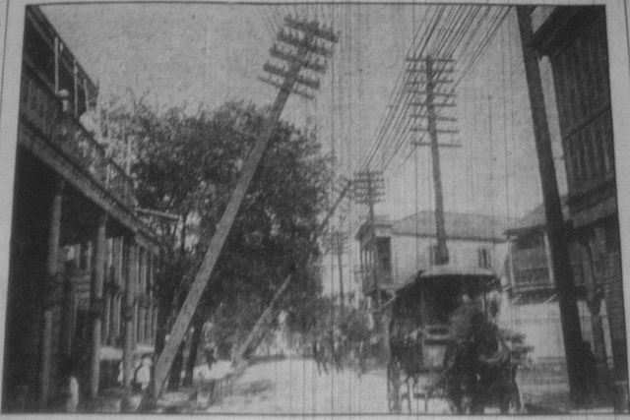
Multiplexing
Sharing makes things efficient (cost less)
One airplane/train for 100 people
One telephone for many calls
One lecture theatre for many classes
One computer for many tasks
One network for many users

Slide 6
Multiplexing
Disadvantages of Multiplexing?
Might have to wait
Might not know how long you have to wait
Might never get served
Multiplexing is the action of sharing of resources
in contrast
Concurrency is all about how resources are shared

Slide 7
Abstraction
A mechanism for breaking down a problem
what not how
eg Specification versus implementation
eg Modules in programs
Allows replacement of implementations without affecting system behavior
Vertical versus Horizontal
“Vertical” what happens in a box “How does it attach to the network?”
“Horizontal” the communications paths running through the system
Hint: paths are build on top of (“layered over”) other paths

Slide 8
Layering
A restricted form of abstraction: system functions are divided into layers, one built upon another
Often called a stack; but not a data structure!

Slide 9
Layers and Communications
Interaction only between adjacent layers
layer n uses services provided by layer n-1
layer n provides service to layer n+1
Bottom layer is physical media
Top layer is application

Slide 10
Entities and Peers
Entity – a thing (an independent existence)
Entities interact with the layers above and below
Entities communicate with peer entities
same level but different place (eg different person, different box, different host)
Communications between peers is supported by entities at the lower layers

Slide 11
Entities and Peers
Entities usually do something useful
Encryption – Error correction – Reliable Delivery
Nothing at all is also reasonable
Not all communications is end-to-end
Examples for things in the middle
IP Router – Mobile Phone Cell Tower
Person translating French to English

Slide 12
Channels (This channel definition is very abstract)
Peer entities communicate over channels
Peer entities provide higher-layer peers with higher-layer channels
A channel is that into which an entity puts symbols and which causes those symbols (or a reasonable approximation) to appear somewhere else at a later point in time.

Slide 13
Channel Characteristics
Symbol type: bits, packets, waveform
Capacity: bandwidth, data-rate, packet-rate
Delay: fixed or variable
Fidelity: signal-to-noise, bit error rate, packet error rate
Cost: per attachment, for use
Reliability
Security: privacy, unforgability
Order preserving: always, almost, usually
Connectivity: point-to-point, to-many, many-to-many
Examples:
Fibre Cable
1 Gb/s channel in a network
Sequence of packets transmitted between hosts
A telephone call (handset to handset)
The audio channel in a room
Conversation between two people

Slide 14
Layering and Embedding
In Computer Networks we often see higher-layer information embedded within lower-layer information
Such embedding can be considered a form of layering
Higher layer information is generated by stripping off headers and trailers of the current layer
eg an IP entity only looks at the IP headers
BUT embedding is not the only form of layering
Layering is to help understand a communications system
NOT
determine implementation strategy

Slide 15
Internet protocol stack
application: supporting network applications
FTP, SMTP, HTTP
transport: process-process data transfer
TCP, UDP
network: routing of datagrams from source to destination
IP, routing protocols
link: data transfer between neighboring network elements
Ethernet
physical: bits “on the wire”
application
transport
network
link
physical

Slide 16
ISO/OSI reference model
presentation: allow applications to interpret meaning of data, e.g., encryption, compression, machine-specific conventions
session: synchronization, checkpointing, recovery of data exchange
Internet stack “missing” these layers!
these services, if needed, must be implemented in application
needed?
application
presentation
session
transport
network
link
physical

Slide 17
Internet protocol stack versus OSI Reference Model

Slide 18
Example Embedding (also called Encapsulation)
source
message
M
application
transport
network
link
physical
segment
H_{t}
M
H_{t}
datagram
H_{n}
H_{n}
H_{t}
M
frame
H_{l}
H_{n}
H_{t}
M
link
physical
switch
destination
H_{n}
H_{t}
M
network
link
physical
M
application
transport
network
link
physical
H_{l}
H_{n}
H_{t}
M
H_{n}
H_{t}
M
H_{t}
M
H_{n}
H_{t}
M
H_{l}
H_{n}
H_{t}
M
router

Slide 19
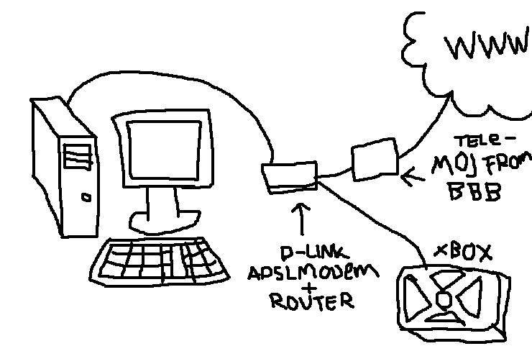




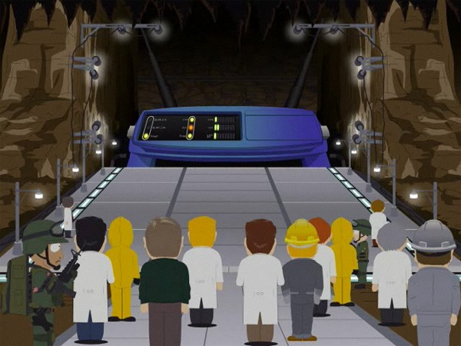

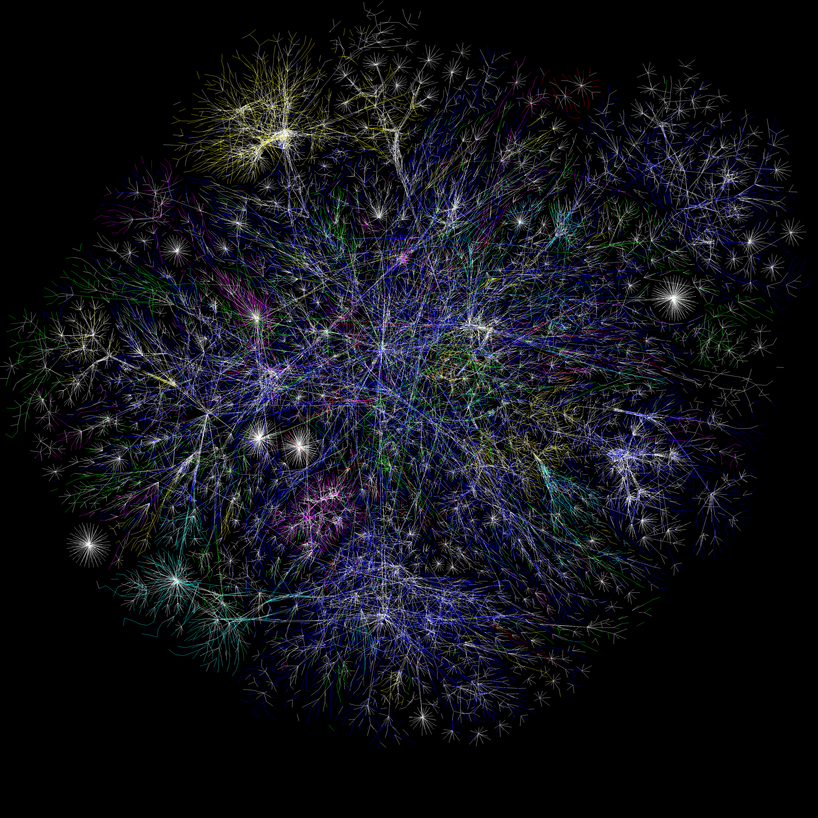
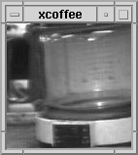
What is the Internet: general public
Web-enabled toaster +
weather forecaster
An Early Internet device….
The Computer Lab Coffee Pot
http://www.cl.cam.ac.uk/coffee/coffee.html

Slide 20

What is the Internet: “nuts and bolts” view
PC
millions of connected computing devices: hosts = end systems
running network apps
Mobile network
server
Global ISP
wireless
laptop
cellular
handheld
Home network
communication links
fiber, copper, radio, satellite
transmission rate = bandwidth
National ISP
access
points
Institutional network
wired
links
routers: forward packets (chunks of data)
router

Slide 21
What is the Internet: “nuts and bolts” view
protocols control sending, receiving of msgs
e.g., TCP, IP, HTTP, Skype, Ethernet
Internet: “network of networks”
loosely hierarchical
public Internet versus private intranet
Internet standards
RFC: Request for comments
IETF: Internet Engineering Task Force
Mobile network
Global ISP
Home network
National ISP
Institutional network

Slide 22
What is the Internet: a service view
communication infrastructure enables distributed applications:
Web, VoIP, email, games, e-commerce, file sharing
communication services provided to apps:
reliable data delivery from source to destination
“best effort” (unreliable) data delivery

Slide 23
What is a protocol?
human protocols:
“what’s the time?”
“I have a question”
introductions
… specific msgs sent
… specific actions taken when msgs received, or other events
network protocols:
machines rather than humans
all communication activity in Internet governed by protocols
protocols define format, order of msgs sent and received among network entities, and actions taken on msg transmission, receipt

Slide 24


What is a protocol?
a human protocol and a computer network protocol:
Hi
TCP connection
request
Hi
TCP connection
response
Got the
time?
GET http://www.cl.cam.ac.uk/index.html
2:00
<file>
time
Q: Other human protocols?
Notes:
Lecture (Question by hands)
Traffic lights/driving

Slide 25
A closer look at network structure:
network edge: applications and hosts
access networks, physical media: wired, wireless communication links
network core:
interconnected routers
network of networks

Slide 26
The network edge:
end systems (hosts):
run application programs
e.g. Web, email
at “edge of network”
peer-peer
client/server model
client host requests, receives service from always-on server
e.g. Web browser/server; email client/server
client/server
peer-peer model:
minimal (or no) use of dedicated servers
e.g. Skype, BitTorrent

Slide 27
Access networks and physical media
Q: How to connect end systems to edge router?
residential access nets
institutional access networks (school, company)
mobile access networks
Keep the channel in mind:
Access bandwidth?
shared or dedicated?

Slide 28
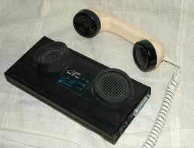
Dial-up Modem (archeology – unless you travel a lot)
central office
telephone
network
Internet
home
PC
home dial-up
modem
ISP modem
(e.g., AOL)
Uses existing telephony infrastructure
Home is connected to central office
up to 64Kbps direct access to router (often less)
Can’t surf and phone at same time: not “always on”
Notes:
Multiplex phone service by time in increments of 10s of minutes

Slide 29
Digital Subscriber Line (DSL)
Existing phone line: 0-4KHz phone; 4-50KHz upstream data; 50KHz-1MHz downstream data
Internet
home
phone
DSLAM
telephone
network
splitter
DSL
modem
central
office
home
PC
Also uses existing telephone infrastruture
up to 1 Mbps upstream (today typically < 256 kbps)
up to 8 Mbps downstream (today typically < 1 Mbps)
dedicated physical line to telephone central office

Slide 30
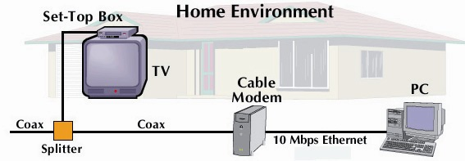
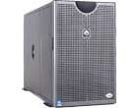

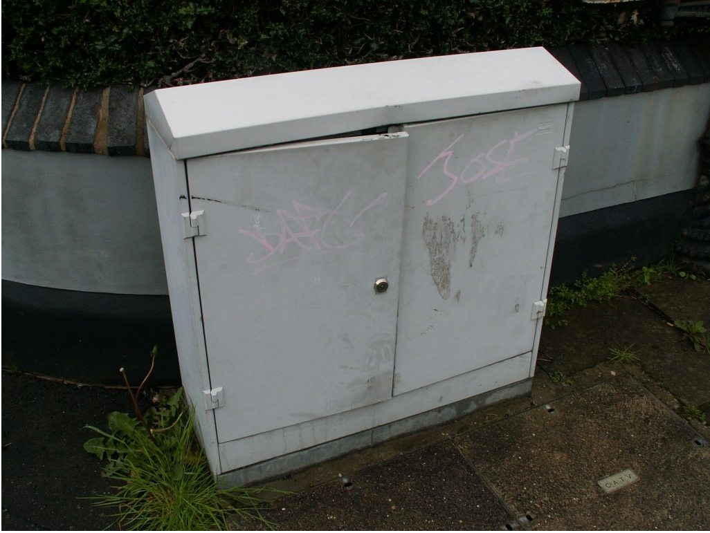
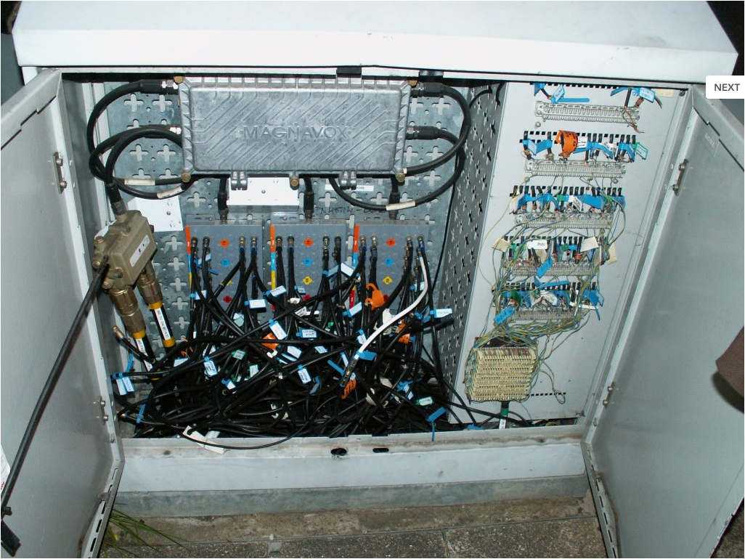
Cable Network Architecture: Overview
server(s)
cable headend
home
cable distribution network (simplified)
HFC: fiber to street and
then cable to home (premises)

Slide 31
Cable Network Architecture: Overview
Frequency Division Multiplexing
(more in a layer Topic):
C
O
N
T
R
O
L
V
I
D
E
O
V
I
D
E
O
V
I
D
E
O
V
I
D
E
O
V
I
D
E
O
V
I
D
E
O
D
A
T
A
D
A
T
A
1
2
3
4
5
6
7
8
9
Channels
cable headend
home
cable distribution network (simplified)
HFC: fiber to street and
then cable to home (premises)

Slide 32
Fiber to the Home
ONT
Internet
optical fibers
optical fiber
ONT
OLT
optical
splitter
central office
ONT
Optical links from central office to the home
Two competing optical technologies:
Passive Optical network (PON)
Active Optical Network (PAN)
Much higher Internet rates; fiber also carries television and phone services

Slide 33

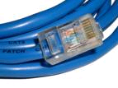
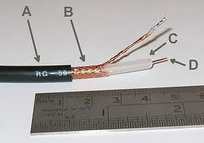


Physical Channels also known as Physical Media
Twisted Pair (TP)
two insulated copper wires
Category 3: traditional phone wires, 10 Mbps Ethernet
Category 6: 1Gbps Ethernet
Shielded (STP)
Unshielded (UTP)
Coaxial cable:
two concentric copper conductors
bidirectional
baseband:
single channel on cable
legacy Ethernet
broadband:
multiple channels on cable
HFC (Hybrid Fiber Coax)
Fiber optic cable:
high-speed operation
point-to-point transmission
(10’s-100’s Gps)
low error rate
immune to electromagnetic noise

Slide 34
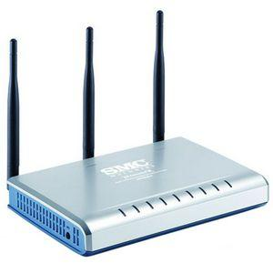
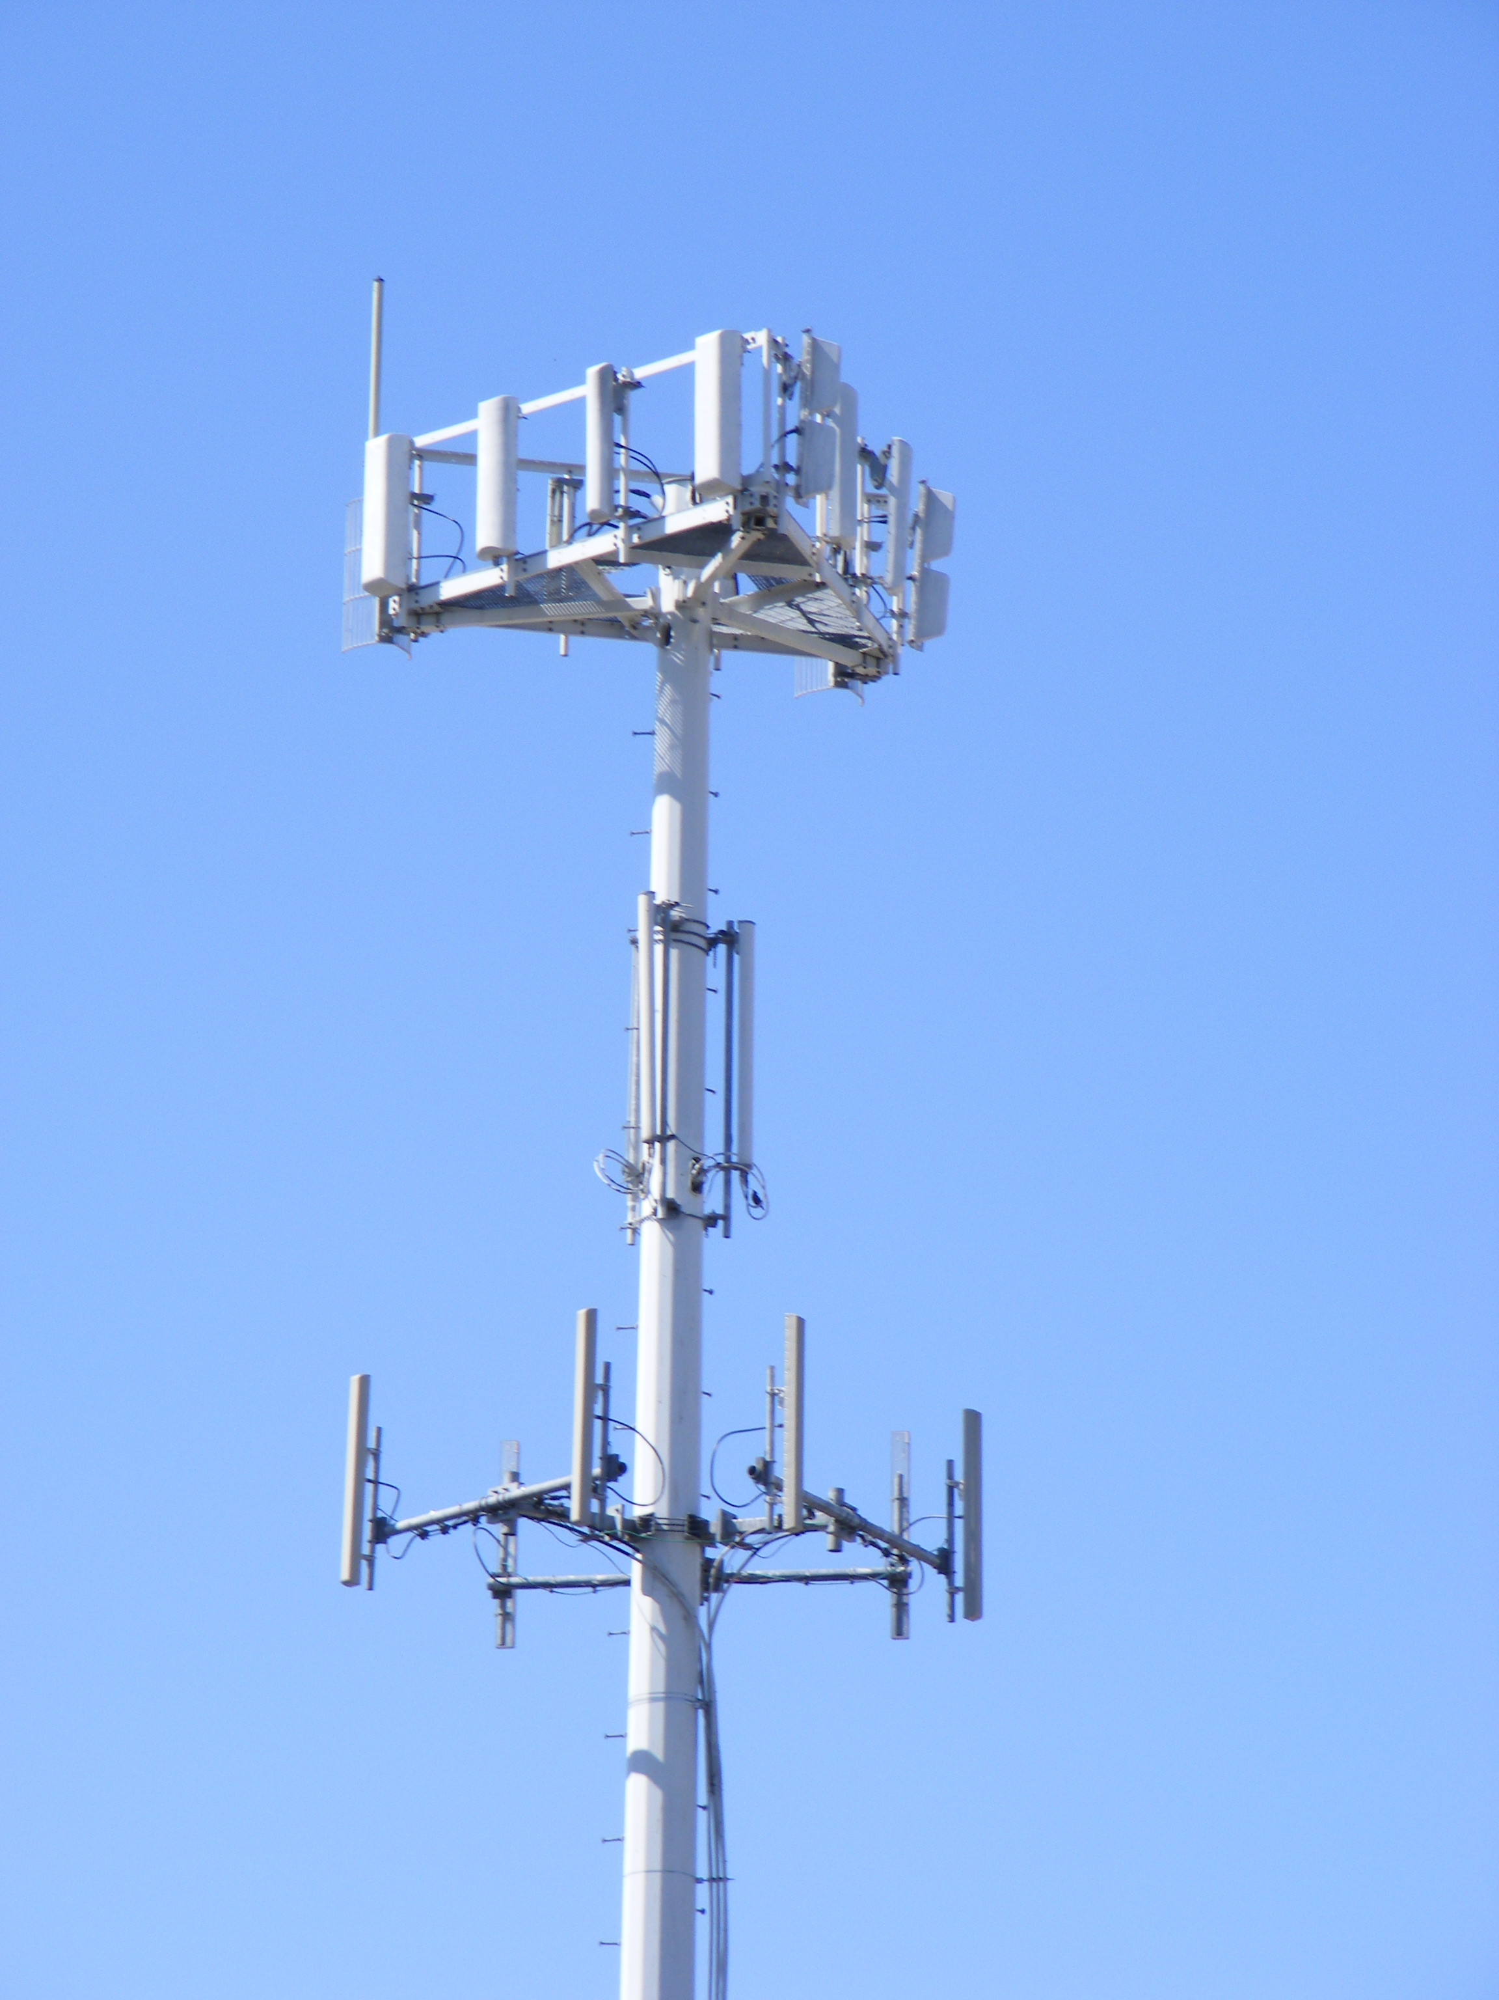
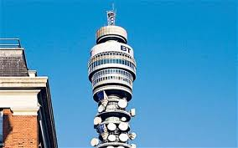
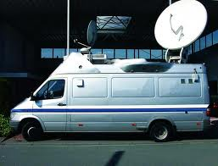
Physical media: radio
Bidirectional and multiple access
propagation environment effects:
reflection
obstruction by objects
interference
Radio link types:
terrestrial microwave
e.g. 45 Mbps channels
LAN (e.g., Wifi)
11Mbps, 54 Mbps, 200 Mbps
wide-area (e.g., cellular)
3G cellular: ~ 1 Mbps
satellite
Kbps to 45Mbps channel (or multiple smaller channels)
270 msec end-end delay
geosynchronous versus low altitude
Notes:
Think of the CHANNEL between entities.
----- Meeting Notes (20/01/2012 10:56) -----
20/Jan end

Slide 35
The Network Core
mesh of interconnected routers
the fundamental question: how is data transferred through each channel?
circuit switching: dedicated circuit per call: telephone net
packet-switching: data sent thru net in discrete “chunks”: postal service
Packet-switching = Asynchronous Time Division Multiplexing
Notes:
CORE = everything that is not EDGE
INTERNET CORE = every router!
Network CORE = everything that interconnects every edge host/server/device

Slide 36
Network Core: Circuit Switching
End-end resources reserved for “call”
link bandwidth, switch capacity
dedicated resources: no sharing
circuit-like (guaranteed) performance
call setup required
network resources (e.g., bandwidth)
are divided into “pieces”
pieces allocated to calls
resource piece idle if not used
by owning call (no sharing)
How?
frequency division multiplexing
time division multiplexing
Notes:
End-to-End assumes a channel END-TO-END

Slide 37
Circuit Switching: FDM and TDM
Example:
Frequency Division Multiplexing
4 users
Radio2 88.9 MHz
Radio3 91.1 MHz
Radio4 93.3 MHz
RadioX 95.5 MHz
frequency
time
Time Division Multiplexing
Radio Schedule
…,News, Sports, Weather, Local, News, Sports,…
frequency
time
Notes:
Can use more than one!

Slide 38
Numerical example
How long does it take to send a file of 640,000 bits from host A to host B over a circuit-switched network?
All links are 1.536 Mbps
Each link uses TDM with 24 slots/sec
500 msec to establish end-to-end circuit
Let’s work it out!
1 / 24 * 1.536Mb/s = 64kb/s
640,000 / 64kb/s = 10s
10s + 500ms = 10.5s
Notes:
640,000b * (1/24) * 1/536Mbps + 500ms
640,000b @ 64kbps = 10s
PLUS 500ms setup

Slide 39
Network Core: Packet Switching
each end-end data stream divided into packets (datagrams)
user A&B packets share network resources
each packet uses full link bandwidth
resources used as needed
resource contention:
aggregate resource demand can exceed amount available
congestion: packets queue, wait for link use
store and forward: packets move one hop at a time
Node receives complete packet before forwarding
Fun new problems/properties
How does a program(mer) compute available resources e.g., bandwidth, delay, variation in delay (jitter)?
Sharing resources (contention-resolution) is now done by protocol (and precedent) – and all that this implies...
Notes:
Pcket Switching – Asynchronous Time Division Multiplexing

Slide 40
Packet switching versus circuit switching
Packet switching may (does!) allow more users to use network
1 Mb/s link
each user:
100 kb/s when “active”
active 10% of time
circuit-switching:
10 users
packet switching:
with 35 users, probability > 10 active at same time is less than .0004
N users
1 Mbps link
Q: how did we get value 0.0004?

Slide 41
Packet switching versus circuit switching
Q: how did we get value 0.0004?
1 Mb/s link
each user:
100 kb/s when “active”
active 10% of time
circuit-switching:
10 users
packet switching:
with 35 users, probability > 10 active at same time is less than .0004
HINT: Binomial Distribution

Slide 42
Packet Switching: Statistical Multiplexing
100 Mb/s
Ethernet
A
C
statistical multiplexing
1.5 Mb/s
B
queue of packets
waiting for output
link
D
E
Sequence of A & B packets does not have fixed pattern, bandwidth shared on demand ➔ statistical multiplexing.
(Recall in TDM: each host gets same slot in revolving TDM frame)
Notes:
Cheap UNRELIABLE data
Guarantees are statistical – based on longer-term assumptions mean traffic, etc.
Service guarantees do not exist.

Slide 43
Packet Switching: store-and-forward
L
L
L
L
L
L
L
R
R
R
takes L/R seconds to transmit (push out) packet of L bits on to link at R bps
store and forward: entire packet must arrive at each hope before it can be transmitted on next link
delay = 3L/R (assuming zero propagation delay)
Example:
L = 7.5 Mbits
R = 1.5 Mbps
transmission delay = 15 sec
more on delay shortly …

Slide 44
Packet switching versus circuit switching
Is packet switching a “slam dunk winner?”
great for bursty data
resource sharing
simpler, no call setup
excessive congestion: packet delay and loss
protocols needed for reliable data transfer, congestion control
Q: How to provide circuit-like behavior?
bandwidth guarantees needed for audio/video apps
still a problem (KR: Ch7 PD: Sec 6.5)
Q: human analogies of reserved resources (circuit switching) versus on-demand allocation (packet-switching)?
Notes:
COST COST COST

Slide 45
Internet structure: network of networks
roughly hierarchical
at center: “tier-1” ISPs (e.g., Verizon, Sprint, AT&T, Cable and Wireless), national/international coverage
treat each other as equals
Tier-1 providers interconnect (peer) privately
Tier 1 ISP
Tier 1 ISP
Tier 1 ISP

Slide 46
Tier-1 ISP: e.g., Sprint
POP: point-of-presence
to/from backbone
…
peering
….
…
…
…
to/from customers
Notes:
Switched Private Network Telecommunications
South Pacific Railway
-=-=-
End of lecture 23rd Jan 2012

Slide 47
Internet structure: network of networks
“Tier-2” ISPs: smaller (often regional) ISPs
Connect to one or more tier-1 ISPs, possibly other tier-2 ISPs
Tier-2 ISPs also peer privately with each other.
Tier-2 ISP pays tier-1 ISP for connectivity to rest of Internet
tier-2 ISP is customer of
tier-1 provider
Tier-2 ISP
Tier-2 ISP
Tier 1 ISP
Tier 1 ISP
Tier 1 ISP
Tier-2 ISP
Tier-2 ISP
Tier-2 ISP

Slide 48
Internet structure: network of networks
“Tier-3” ISPs and local ISPs
last hop (“access”) network (closest to end systems)
local
ISP
Tier 3
ISP
local
ISP
local
ISP
local
ISP
Local and tier- 3 ISPs are customers of
higher tier ISPs
connecting them to rest of Internet
Tier-2 ISP
Tier-2 ISP
Tier 1 ISP
Tier 1 ISP
Tier 1 ISP
Tier-2 ISP
Tier-2 ISP
Tier-2 ISP
local
ISP
local
ISP
local
ISP
local
ISP

Slide 49
Internet structure: network of networks
a packet passes through many networks!
local
ISP
Tier 3
ISP
local
ISP
local
ISP
local
ISP
Tier-2 ISP
Tier-2 ISP
Tier 1 ISP
Tier 1 ISP
Tier 1 ISP
Tier-2 ISP
Tier-2 ISP
Tier-2 ISP
local
ISP
local
ISP
local
ISP
local
ISP

Slide 50
“Real” Internet delays and routes
traceroute: gaia.cs.umass.edu to www.eurecom.fr
Three delay measurements from
gaia.cs.umass.edu to cs-gw.cs.umass.edu
1 cs-gw (128.119.240.254) 1 ms 1 ms 2 ms
2 border1-rt-fa5-1-0.gw.umass.edu (128.119.3.145) 1 ms 1 ms 2 ms
3 cht-vbns.gw.umass.edu (128.119.3.130) 6 ms 5 ms 5 ms
4 jn1-at1-0-0-19.wor.vbns.net (204.147.132.129) 16 ms 11 ms 13 ms
5 jn1-so7-0-0-0.wae.vbns.net (204.147.136.136) 21 ms 18 ms 18 ms
6 abilene-vbns.abilene.ucaid.edu (198.32.11.9) 22 ms 18 ms 22 ms
7 nycm-wash.abilene.ucaid.edu (198.32.8.46) 22 ms 22 ms 22 ms
8 62.40.103.253 (62.40.103.253) 104 ms 109 ms 106 ms
9 de2-1.de1.de.geant.net (62.40.96.129) 109 ms 102 ms 104 ms
10 de.fr1.fr.geant.net (62.40.96.50) 113 ms 121 ms 114 ms
11 renater-gw.fr1.fr.geant.net (62.40.103.54) 112 ms 114 ms 112 ms
12 nio-n2.cssi.renater.fr (193.51.206.13) 111 ms 114 ms 116 ms
13 nice.cssi.renater.fr (195.220.98.102) 123 ms 125 ms 124 ms
14 r3t2-nice.cssi.renater.fr (195.220.98.110) 126 ms 126 ms 124 ms
15 eurecom-valbonne.r3t2.ft.net (193.48.50.54) 135 ms 128 ms 133 ms
16 194.214.211.25 (194.214.211.25) 126 ms 128 ms 126 ms
17 * * *
18 * * *
19 fantasia.eurecom.fr (193.55.113.142) 132 ms 128 ms 136 ms
trans-oceanic
link
* means no response (probe lost, router not replying)
Notes:
Where did the delay come from??

Slide 51
Four sources of packet delay
Per-packet processing:
errors check & lookup output link
depends on per-packet overhead
Queuing delay:
time waiting for output link
(depends on link-congestion)
Transmission delay:
packet length / link bandwidth
Propagation:
length of physical link /
propagation speed in medium
(e.g. 2x10⁸ m/sec)
Transmission delay
A
Propagation
B
Per-packet
processing
Queuing

Slide 52
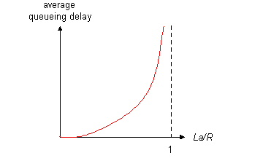
2. Queuing delay
R=link bandwidth (bps)
L=packet length (bits)
a=average packet arrival rate
traffic intensity = La/R
La/R ~ 0: average queuing delay small
La/R -> 1: delays become large
La/R > 1: more “work” arriving than can be serviced, average delay infinite!

Slide 53
Queuing Delay
Does not happen if
packets are evenly spaced
And arrival rate is less than service rate
Smooth Arrivals = No Queuing Delays
La/R ~ 0: average queuing delay small

Slide 54
Queuing Delay
Queuing delay caused by “packet interference”
Burstiness of arrival schedule
Variations in packet lengths
There is significant queuing delay even though link is underutilized

Slide 55
Queuing Delay
Does not happen if packets are evenly spaced
And arrival rate is less than service rate
Queuing delay caused by “packet interference”
Burstiness of arrival schedule
Variations in packet lengths
Made worse at high load
Less “idle time” to absorb bursts
Think about traffic jams in rush hour….

Slide 56
Jitter
Difference between minimum and maximal delay
Latency plays no role in jitter
Nor does transmission delay for same sized packets
Jitter typically just differences in queuing delay
Why might an application care about jitter?

Slide 57
Packet Loss
Packet Loss due to a full queue
Statistical Multiplexing at High Load may lead to packet loss
Packet Loss due to corruption
Recall the delay due to per-packet processing;
This processing detect/discards corruption

Slide 58
Throughput
throughput: rate (bits/time unit) at which bits transferred between sender/receiver
instantaneous: rate at given point in time
average: rate over longer period of time
link capacity
R_{s} bits/sec
link capacity
R_{c} bits/sec
server, with
file of F bits
to send to client
pipe that can carry
fluid at rate
R_{s} bits/sec)
pipe that can carry
fluid at rate
R_{c} bits/sec)
server sends bits
(fluid) into pipe

Slide 59
Throughput (more)
R_{s} < R_{c} What is average end-end throughput?
R_{s} bits/sec
R_{c} bits/sec
R_{s} > R_{c} What is average end-end throughput?
R_{s} bits/sec
R_{c} bits/sec
bottleneck link
link on end-end path that constrains end-end throughput

Slide 60
Throughput: Internet scenario
R_{s}
per-connection end-end throughput: min(R_{c},R_{s},R/10)
in practice: R_{c} or R_{s} is often bottleneck
R_{s}
R_{s}
R
R_{c}
R_{c}
R_{c}
10 connections (fairly) share backbone bottleneck link R bits/sec

Slide 61
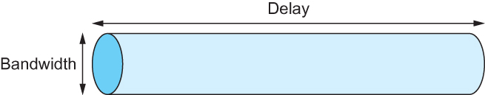
(Propagation) Delay × Bandwidth also called Bandwidth Delay Product
Consider the channel between entities as a pipe
Properties:
Propagation delay due to length of the pipe, and
Bandwidth aka the width of the pipe
Delay of 50 ms and bandwidth of 45 Mbps
50 x 10⁻³ seconds x 45 x 10⁶ bits/second
2.25 x 10⁶ bits = 280 KB data
Notes:
You may wish to consider what PRESSSURE is – if you’re an engineering geek.
Links ARE storage
Bits have length….

Slide 62
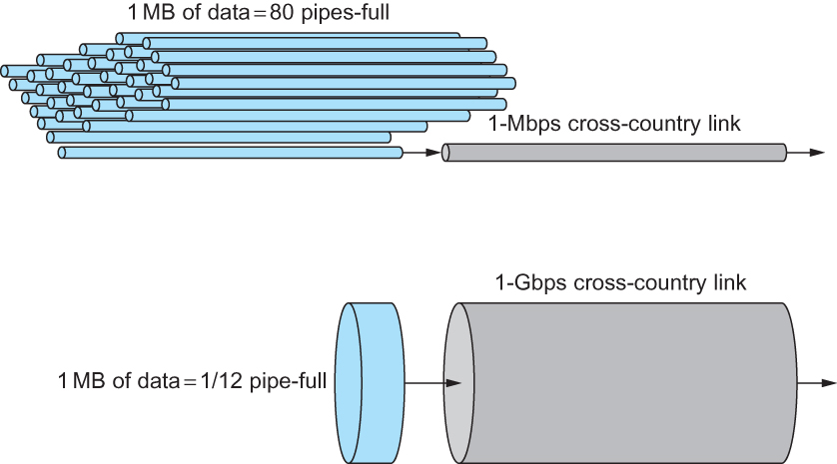
Relationship between bandwidth and link-latency
A MB file would fill the Mbps link 80 times,
but only fill the Gbps link 1/12 of one time
62

Slide 63





Performance
Second order effects
Image/Audio quality
Other metrics…
Network efficiency (good-put versus throughput)
User Experience? (World Wide Wait)
Network connectivity expectations
Others?

Slide 64
Lessons to take away
Multiplexing is the key
Lots of ‘definitions’
Consider the Task not the Technology
Internet is an example of a packet network
Why are we waiting? – Delay
Where did my data go? – Loss
Bandwidth vs Throughput
Bandwidth delay product

