Slide 1
Software Defined Radio – SDR
The Future of Wireless
Paul Tindall
Head of Software
SDR - "Radio in which some or all of the physical layer functions are software defined“
- Wireless Innovation Forum

Slide 2



Future of Wireless
Complexity:
  “I need to support 10 Radio bands a 8 standards/modes to make a phone that works anywhere on the Vodafone network” - Trevor Gill, Chief Scientist Vodafone
Post Production Flexibility
  “I wish I could change the radio filter in the Heathrow ATC RADAR so I can use the adjacent spectrum”
  “I’d prefer totally dynamic spectrum assignment” – Graham Louth – Ofcom : UK regulator
Dynamic Behaviour
  Cognitive radio is required to manage licensed and unlicensed spectrum
  Terminals will sense and reconfigure themselves according to location/environment –Jussi Kahtava

Slide 3


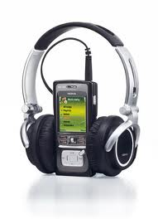

Open Systems – Lessons from History
Creating Apps is easy. They are downloaded after the phone leaves the factory
£
Open FFOS
Android/I-Phone
In Volume
Bespoke Framework
Voice
Camera
Media
Smart
Complexity

Slide 4

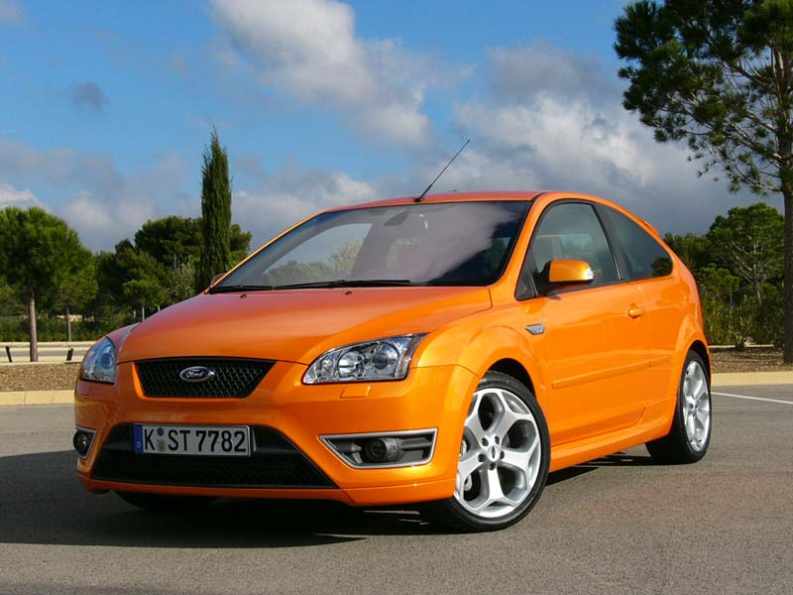
Automotive Market
Instead of you carrying the mobile;
the mobile carries you
Or considerably longer ☺
Long product lifetime: >10 years
Networks and spectrum allocations will change
Manufactured for a global market
A great Mimo Platform
GSM
WCDMA
CDMA2000/EVDO
HSPA
LTE
TD-LTE
WiMax
LTE-A
WhiteSpace
WiFi
TETRA

Slide 5
Designing Modems
L1/PS
The SDR Way
Replace bespoke hardware with a general purpose “Wireless Computer “
Create a Modem Specific OS
  To mop up/factor out common services
  Hide/abstract the underlying h/w complexity
  Publish the modem developer an API
  Add Modem ‘waveform’ deployment and management functions
Create tools (like the Android SDK) to develop, simulate and test modem apps
GSM
RTOS
Power Saving
PS
PS
Power Management and control
PS
3G
L1
DeviceMan
Companies have ‘Velcro’ed modems together
(investment in legacy high) BUT
The future predicts greater complexity
Lack of reuse costs
  Si area
  SW dev time
  Maintenence
LTE
RLC/Mac
RTOS
Device Ctrl
DeviceMan
DSP
DSP
SDMOS
Channel Measurements
Control Loops
RTOS
L1
Speech Codecs
OS
Speech
Control loops
L1
Device Drivers
L1
L1
Modem Computer
L1
Cipher
Equalser
Radio I/F
Power Controller
Mimo RF
Radio Controller
Mimo RF
Demapper
Mimo RF
Mimo RF
Channel Codec
Timebase Counters
Timing Gen
Eq
Rake
System Time Controller
FFT
Mimo RF

Slide 6
The Complexity Problem

Slide 7
Many Modes in the same box
 | GSM | 3G HSPA | LTE | WiFi | GPS | FM | BT
GSM |  | M | M | Y | Y | Y | Y
3G HSPA | M |  | M | Y | Y | Y | Y
LTE | M | M |  | Y | Y | Y | Y
WiFi | Y | Y | Y |  | Y | Y | Y
GPS | Y | Y | Y | Y |  | Y | Y
FM | Y | Y | Y | Y | Y |  | Y
BT | Y | Y | Y | Y | Y | Y
(M = measurement)

Slide 8
The Scaling Problem
LTE-A
1Gbps
3GPP R10
164Mbps
LTE R8/R9
3GPP R9
150Mbps
84Mbps
500Mbps
3GPP R8
3GPP R7 HSPA+
42Mbps
28Mbps
3GPP R5 HSDPA
3GPP R6 HSUPA
3GPP 99
EDGE
GPRS
GSM
11Mbps
23Mbps
50Mbps

Slide 9
SDR Types/Flexibility
Complex
Flexible
Dynamic
Permit innovation
Efficient
Field Upgradable
Reasonable Cost
Scalable
General Purpose
SDM Platform
Hardwired , specialised processors
Processor
Assisted H/W
Hardware only
Flexibility

Slide 10
LTE FDD, MIMO
SDR starts at the Digital I/Q interface
Analogue Domain
Digital Domain
agc_man
COMM
afc_man
cell_
search
Cell ID
Slot Timing
Frame Timing
Freq. Offset
RX₁
Processes were mapped to h/w blocks running in parallel;
Now mapped to sw running on a processor
Ser
A/D
DMA
rx_front
ofdm_
demux
chan_est
data_dec
DL-SCH
PCH
BPF
metrics
symbol_detect
RX₂
LO
Ser
A/D
DMA
rx_front
ofdm_
demux
chan_est
control_
dec
CFI
DCI
HARQ N/ACK
BCH
BPF
TX
Rank CQI
PMI
Ser
D/A
DMA
tx_front
mod_
map
uplink_
enc
BPF
PA
UL-SCH
CQI
RI
PMI
HARQ N/ACK
TSCU
timing_man
prach_
gen
UE Params.
GPIO

Slide 11
Using SDR to Innovate in the RF

Slide 12
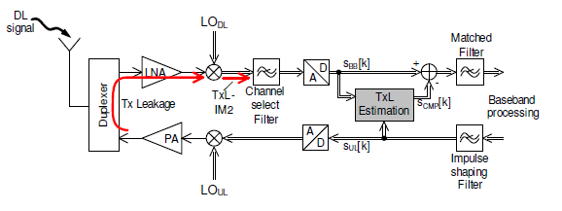
If you can’t filter, cancel it...
Digital cancellation of leakage signal
Source: Frotscher & Fettweiss; IEEE VTC’08
Note: Sample rate processing will already be present in the BB
  This functionality may be merged with other ‘kernels’ to minimise processing cost

Slide 13
LTE FDD with PA Envelope Tracking Support
Analogue Domain
Digital Domain
agc_man
COMM
afc_man
cell_
search
Cell ID
Slot Timing
Frame Timing
Freq. Offset
RX₁
Ser
A/D
DMA
rx_front
ofdm_
demux
chan_est
data_dec
DL-SCH
PCH
BPF
metrics
symbol_detect
RX₂
LO
Ser
A/D
DMA
rx_front
ofdm_
demux
chan_est
control_
dec
CFI
DCI
HARQ N/ACK
BCH
BPF
TX
Rank CQI
PMI
Ser
D/A
DMA
tx_front
mod_
map
uplink_
enc
BPF
PA
UL-SCH
Ser
D/A
DMA
CQI
RI
PMI
HARQ N/ACK
ET MOD
TSCU
Envelope
tracking
prach_
gen
UE Params.
GPIO
timing_man

Slide 14
Tx I/Q and Envelope Interface for 3G
Initial design to 1st implementation on an SDR platform < 1week
Shaping block calculation accuracy and precision can be manipulated by changing the polynomial order and the calculation complexity
Tx I/Q and Envelope data are calculated ahead of time
Whole sample delay for I/Q and envelope traffic are realised with Envelope Start Tick and SubFrame/Slot Start Tick generated from Timing Unit (TSCU)
Envelope Generation Process can be implemented as standalone kernel or integrated into RRC Filter
Shaping Type
Fractional Delay Value
Env Start Tick
Shaping Function Coeff. Calculation
Fractional Delay Coeff. Calculation
Sampling Clk
Shaping Coeffs.
Delay Coeffs.
Env DMA
Env DAC
Synch.
Shaping
Env
Amplitude Calculation
Fractional Delay
Tx Envelope
Buffer
Envelope Generation Process
Tx DAC
Tx DMA
I/Q
RRC Filter
From Combined Uplink Processing
Synch.
Tx I/Q Buffer
Sampling Rate 15.36Msps
Chip Rate 3.84Msps
SubFrame/Slot
Start Tick
Sampling Clk

Slide 15
The VSP – a key enabling technology

Slide 16
The VSP – 3 forms of Parallelism
So can’t be interrupted – run to completion
Connection Network
Like a ‘Dragster’ – incredible quick in a straight line
Register File
SIMD Unit
FU
FU
Control Unit
Scalar unit
FU
FU
Instruction Level Parallelism
  VLIW – eg 256, 512 ... bits
  Several ‘Functional Units’ work in parallel
  Register and memory accesses/write-backs are pipelined
  Pipeline is exposed to the Compiler
  The Compiler analyses the control and data dependencies of the whole program
  The Compiler converts eg ‘C’ to an execution schedule by reordering the program
  Parallelising compilers are well understood and mature
Data Parallelism
  Add 1 or more SIMD units (Single Instruction Multiple Data)
  Wide Data paths eg 512 bit
  SIMD (Vector) widths eg 64 lanes - ie 64 MAC operations in 1 cycle
  Requires Algorithms to be expressed correctly to exploit vector processing:

Slide 17
The VSP – 3 forms of Parallelism
Multi-threaded Sequencer Unit
Interconnect
FU
U
FU
U
FU
U
FU
U
U
U
Task Level Parallelism
  Using multi-threaded cores
  Eg: Multiple VSP cores
    Interconnected with dedicated pipes, shared memories etc
    A variety of topologies
  Some form of high level sequencing mechanism
  High Level Tool support (or even new languages) required

Slide 18
SDR Scalable H/W architecture
Control processor
Programmable
Sequencer
Co-proc
scale
VSP
Vsp interconnect
Power Control
Programmable ‘soft’
Timing unit
scale
Rf if

Slide 19
The SDR Platform
Domain Specific OS
  Factored out modem services
  h/w platform abstraction
  Common APIs
Modems are Applications
Waveform/Modem lifecycle
3G
Multi-mode resource management
  Coordinated and uncoordinated modems
LTE
LTE-TDD
BT
Wfi
Galileo
Dynamic Modem management
  Sense
  lookup
GPS
Modem OS
Modem Domain Specific Model Driven Development Tools
SDR Debug Tools
Common compliance methodology
Control processor
Programmable
Scheduler
Co-proc
VSP
scale
Vsp interconnect
Power Control
Programmable ‘soft’
Timing unit
scale
Rf if

Slide 20
An example Multi-Core methodology
Using UML

Slide 21
Activity Specifications eg HSDPA RRC Filter:
IQBuffer
ConditionedIQBuffer
DownlinkRRCFilter
p_RawIQInput
p_ConditionedIQOutput
bufferSize
p_filterCoeff
numCoeff
p_RRCFilterParams
p_RRCFilterCommonParams
void DownlinkRRCFilter( const CmplxVec_t * restrict p_RawIqInput,
CmplxVec_t * restrict p_ConditionedIQOutput,
const RRCFilterParams_t * p_RxRRCFilterParams,
const RxRRCFilterCommonParams_t * p_RxRRCFilterCommonParams );

Slide 22
UML Activity Diagrams
Signal Proc Task running on a VSP
Control Signal Output
Conditional path
Merge flows
Buffer Allocated
inputBuffer
outputBuffer
Control Signal
<<VSP>>
FFT
Start Node
p_Input0
p_Output0
decisionParam
[1]
[0]
<<VSP>>
Filter
H/W ‘Engine’
DMA transfer
Fork 2 activities
p_Input1
p_Output1
ControlSignal
<<HW_RFDMA>>
Activity 2
source
triggerSource
destinationAddr
destBuffer
Control Signal Input
size
transferSize
Synchronise
flows
Finish Node

Slide 23
The Sequencer: Instruction Set
Sequencer
Conditional
Join
VSP
Sequencer
Instruction
set
DMA
Fork
Other Procs
Synchronise
Invoke
Complete

Slide 24
A Real Platform

Slide 25
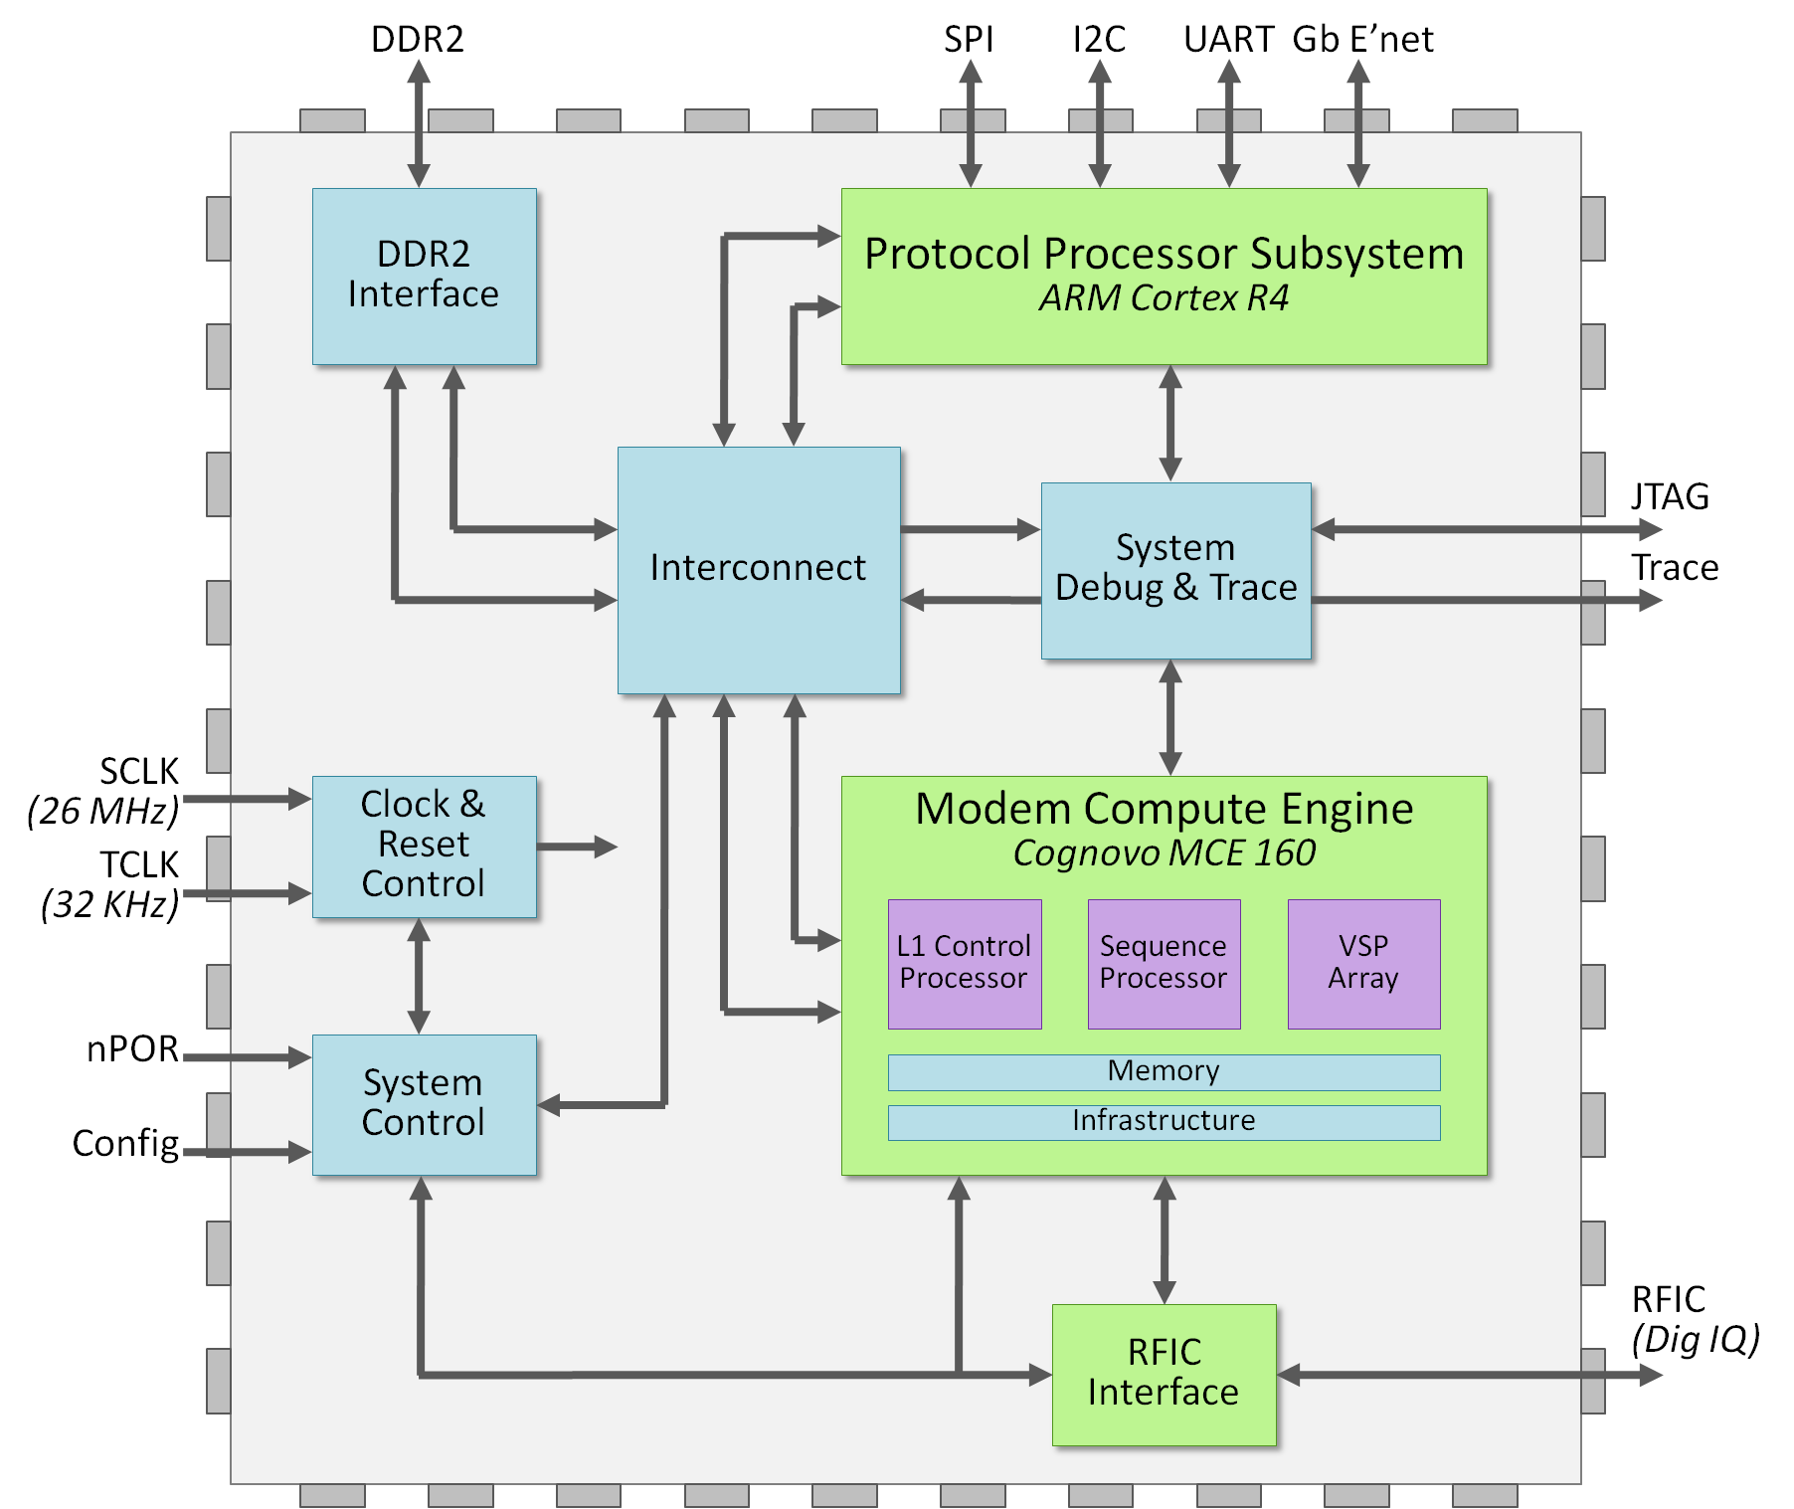
CDC Architecture
Protocol Stack Domain
  ARM Cortex R4 CPU for L2/3 Protocol S/W
  Interface Peripherals and Boot ROM
ARM Coresight Debug
  Combined Debug and Trace
DDR2 Interface
  32bit, 200MHz
Ethernet Interface
  1 Gbit/s
MCE Contains:
  Cortex R4 CPU
  6 VSP Cores
  2x Turbo Engine
RF Interface
  Up to 4RX + 2TX
Power Domains
  System Controller – 35 domains
  Supports Deep Sleep Power Down

Slide 26
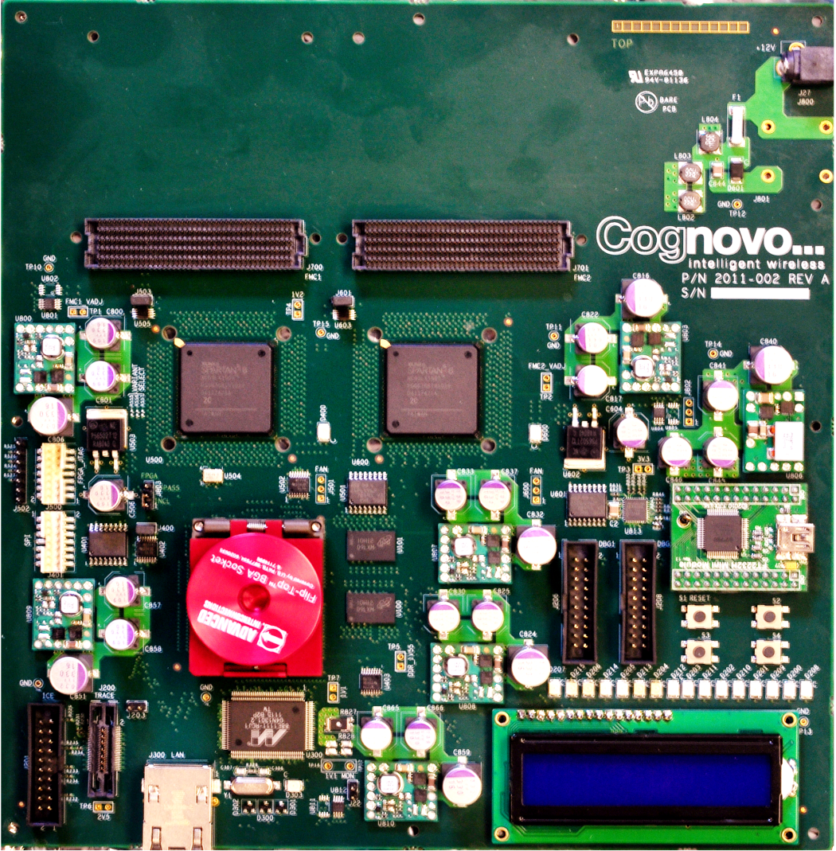
CDP-2 Board
14 Layers PCB
FPGA Mezzanine Card (FMC) Interface
12V DC Power input
Main and Auxiliary FPGAs
SMPS Modules
Main
PGA
Auxiliary
PGA
26.0MHz VXCO
Serial to USB Module
567pin PBGAH package
ZIF Socket for
Cognovo CDC
GPIO connectors
ARM® Trace-ICE Port
General Purpose Buttons
16 LEDs
RJ45 Ethernet Connector
Gigabit Ethernet chip
256MBytes DDR2 SDRAM
Dot Matrix Display

Slide 27
Final Thoughts
SDR platforms will deliver our wireless future
BUT it is potentially disruptive:
  Who owns the Standards/waveforms – OEM, Google, Sky, ETSI, Qualcomm, IP companies, new entrants?
  Separating the h/w and standardising it disrupts the Si supply chain
  How is compliance tested – who is responsible now?
  How is Essential IPR paid/managed?

