Slide 1
Topical Issues:
Designing a Wireless LAN Protocol
CST Part II
Easter 2012
Bogdan Roman

Slide 2
Medium Access Control
☺ Full freq b/w,
suitable for digital
☹ Time sync
☺ Simple, higher SNR
☹ Guard bands, filters
☺ Simultaneous Tx,
suitable for cellular
☹ Tight sync, power
control, complex
☺ No central station
☹ Collisions
WLAN
In ideal conditions all have the same capacity!
T/F/CDMA inefficient for sporadic access: assigned resource (time, freq, code) is wasted if user is idle.

Slide 3
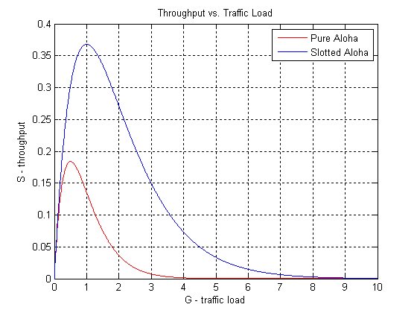
Medium Access Control for WLANs
First, there was ALOHA – late 60’s
  First demonstration of a wireless data network (1971)
  Oddly enough, has no access control at all (18.4% max efficiency)
  Variations, e.g. slotted ALOHA (36.8% max efficiency)
    Still being used (GSM setup, satellite comms, RFID etc.)
Carrier Sense Multiple Access (CSMA)
  Listen before transmit
  Variations (1-persistent, p-persistent etc.)
CSMA with Collision Avoidance
  Randomized backoff (used also in Ethernet)
IEEE 802.11 aka WiFi (1999)
  CSMA/CA with binary exponential backoff (BEB)
  4-way handshaking
  Channel reservation (virtual carrier sensing)

Slide 4
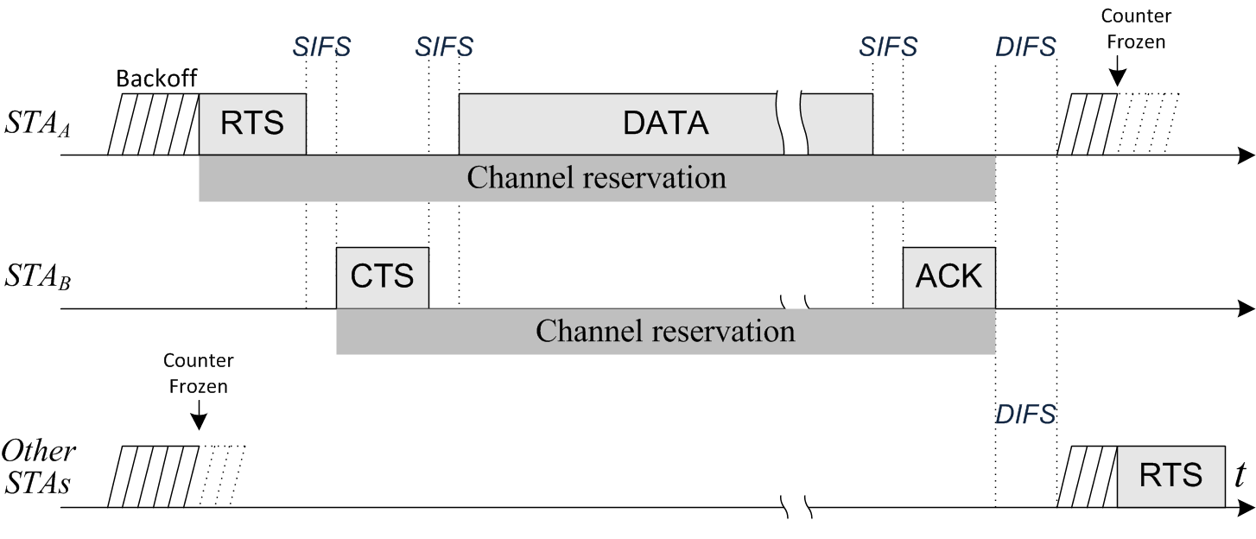
IEEE 802.11 a.k.a. WiFi
Uses CSMA/CA, very similar to Ethernet’s CSMA/CD
  Ethernet’s success due to the fact that “it was incredibly simple, elegant and robust” (Ronald Schmidt)
Distributed: tech advances made possible
and more sense to move more intelligence
from infrastructure into terminals
Distributed Coordination Function (DCF)
Notes:
The reason Ethernet prevailed was because it was simple, elegant and robust … on wire
4

Slide 5
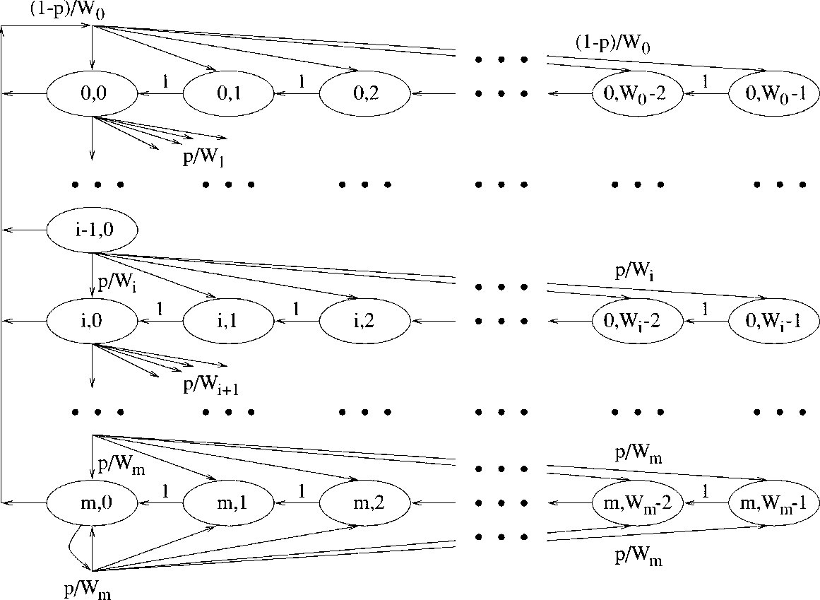

The Bianchi model for DCF
The 3rd most cited IEEE JSAC paper (5000+ citations in 12 years)
  2-dim Markov chain, variable time slot duration, decoupling assumption
  Assumes saturation, ideal channels, unlimited nr of retries
  It is in fact based on renewal theory arguments
The DCF BEB at a glance
Reset contention window to $W=W_{0}$
Init timer randomly in $\left[0..W−1\right]$
Sense channel every 9 μs (OFDM)
  If busy, freeze timer
  If idle, decrement timer
When timer == 0, tx data (RTS)
  If no ACK (CTS) received, assume lost or collision, double window $W←2W$ (up to a maximum $W_{m}=2^{m}W_{0}$), and goto 2.
  If ACK (CTS) received or if max nr of retries reached, goto 1.
G. Bianchi, “Performance analysis of the IEEE 802.11 distributed coordination function,” IEEE Journal on Selected Areas in Communications, vol.18, no.3, pp.535-547, Mar 2000

Slide 6

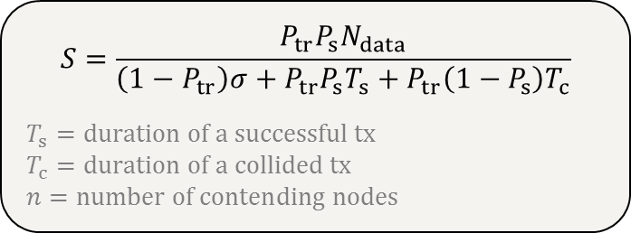
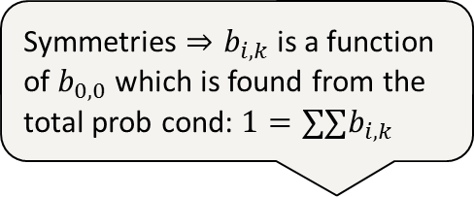
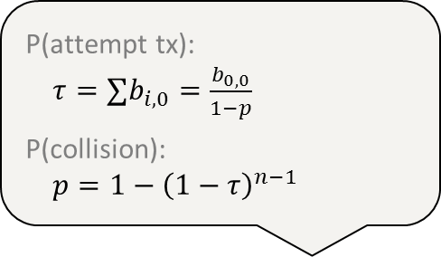
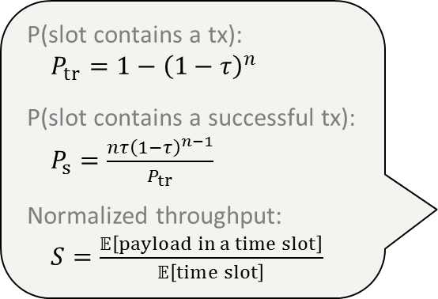
The Bianchi model - Analysis
Symmetries $⇒b_{i,k}$ is a function of $b_{0,0}$ which is found from the total prob cond: ${1=∑∑b}_{i,k}$
P(attempt tx):
${τ=∑b}_{i,0}=\frac{b_{0,0}}{1−p}$
P(collision):
$p=1−{\left(1−τ\right)}^{n−1}$
P(slot contains a tx):
$P_{tr}=1−{\left(1−τ\right)}^{n}$
P(slot contains a successful tx):
$P_{s}=\frac{{nτ\left(1−τ\right)}^{n−1}}{P_{tr}}$
Normalized throughput:
$S=\frac{𝔼\left[payload in a time slot\right]}{𝔼\left[time slot\right]}$
$$S=\frac{P_{tr}P_{s}N_{data}}{\left(1−P_{tr}\right)σ+P_{tr}P_{s}T_{s}+P_{tr}\left(1−P_{s}\right)T_{c}}$$
$$T_{s}=duration of a successful tx \\ T_{c}=duration of a collided tx \\ n=number of contending nodes$$

Slide 7
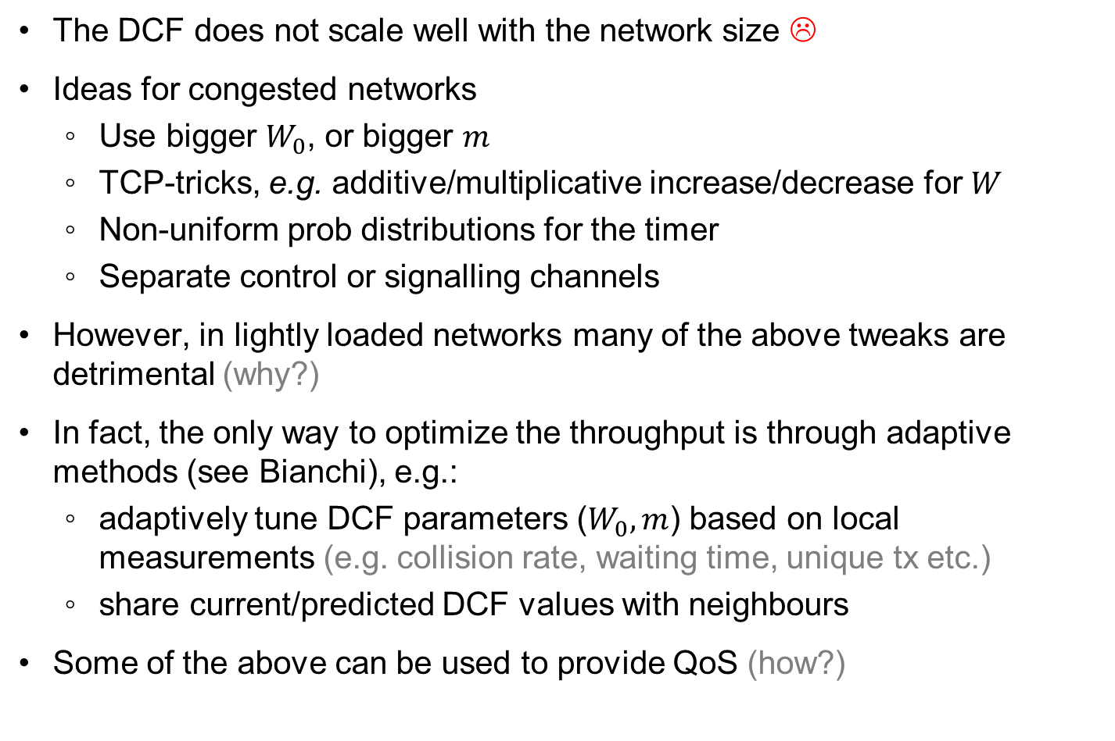
Improvements for the 802.11 DCF / BEB
The DCF does not scale well with the network size ☹
Ideas for congested networks
  Use bigger $W_{0}$, or bigger $m$
  TCP-tricks, e.g. additive/multiplicative increase/decrease for $W$
  Non-uniform prob distributions for the timer
  Separate control or signalling channels
However, in lightly loaded networks many of the above tweaks are detrimental (why?)
In fact, the only way to optimize the throughput is through adaptive methods (see Bianchi), e.g.:
  adaptively tune DCF parameters ($W_{0}, m$) based on local measurements (e.g. collision rate, waiting time, unique tx etc.)
  share current/predicted DCF values with neighbours
Some of the above can be used to provide QoS (how?)

Slide 8
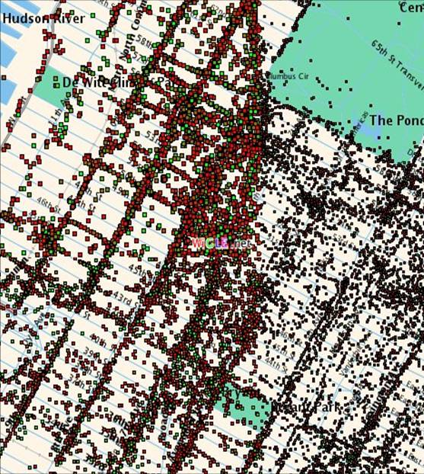
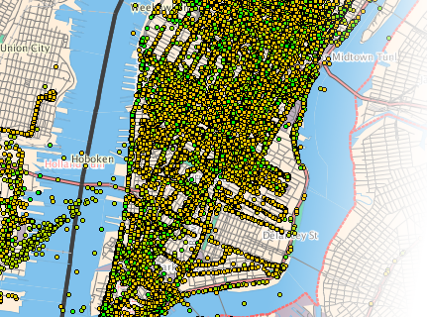
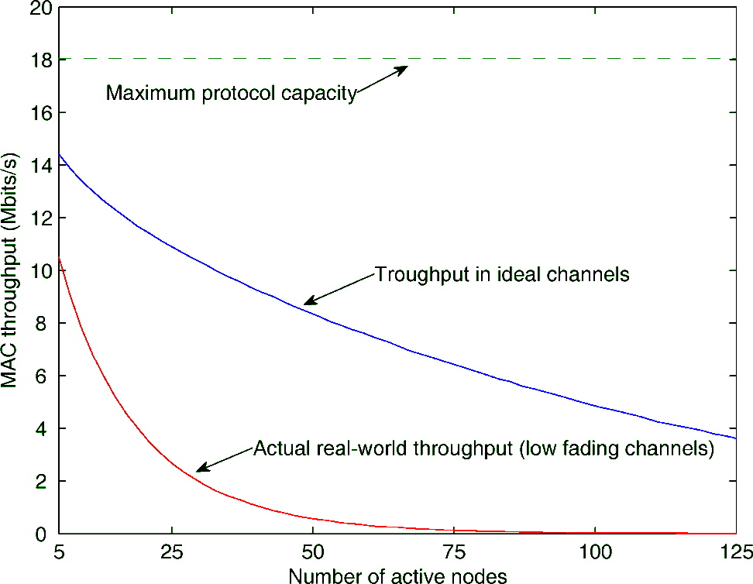
Challenges
A lot of research into QoS, security, improving efficiency, tweaking the DCF, multi-hop, routing etc.
In the meantime…
Manhattan 2008

Slide 9
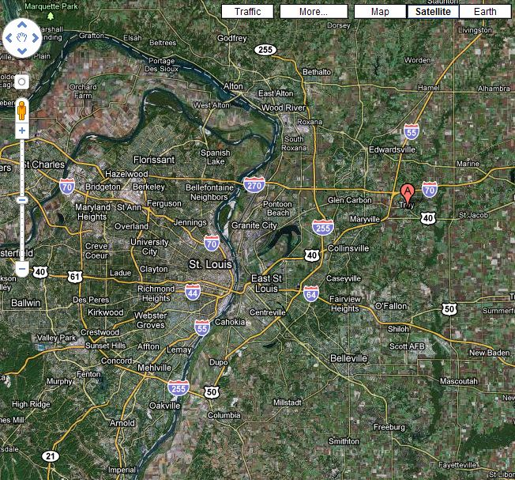
Challenges
Troy, small city near St Louis, Illinois, US

Slide 10
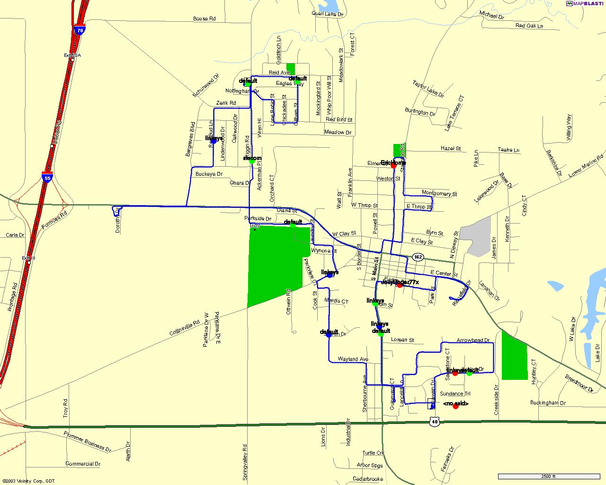
Challenges
Troy, small city near St Louis, Illinois, US
Nov 2003

Slide 11
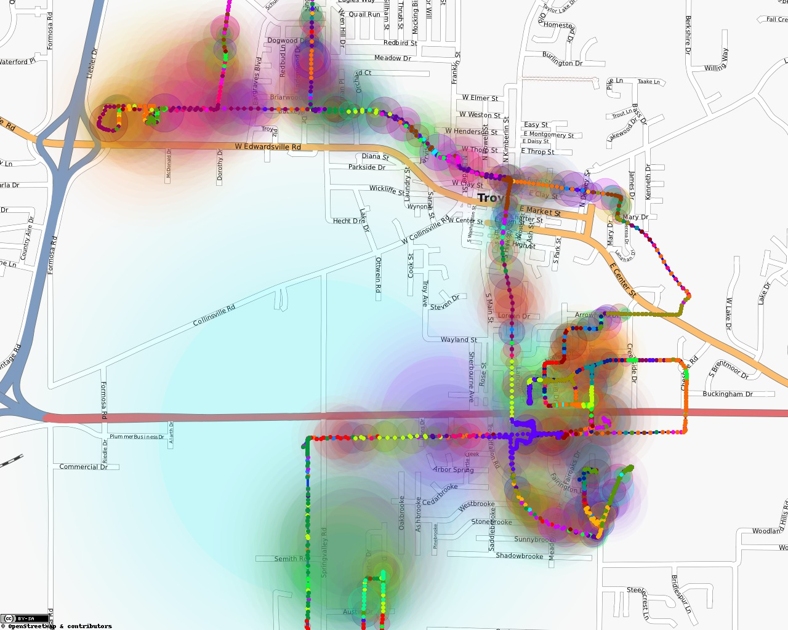
Challenges
Troy, small city near St Louis, Illinois, US
Dec 2009

Slide 12
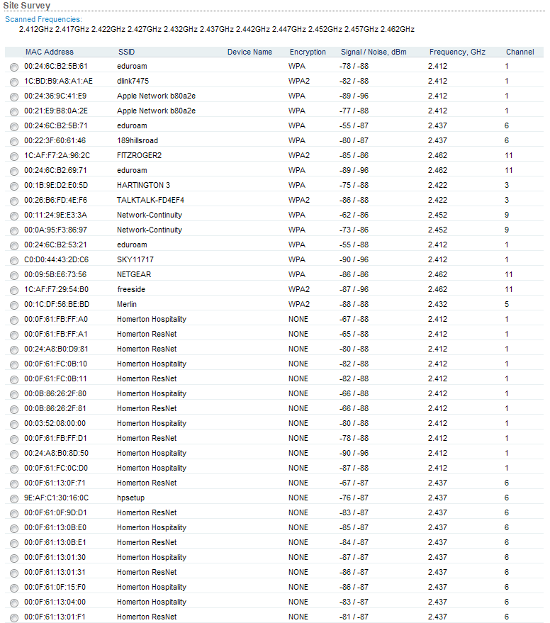
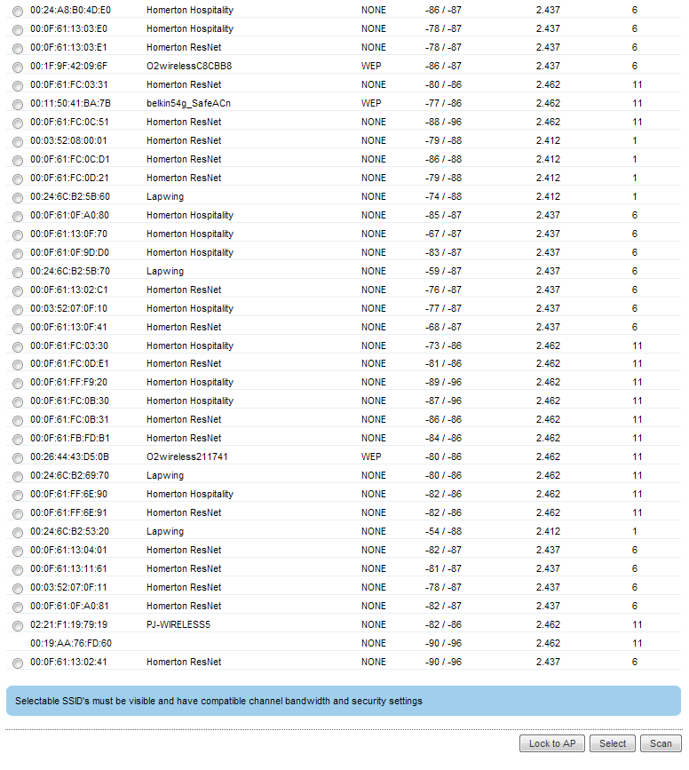
Challenges
Cambridge, Hills Road (from my old flat)

Slide 13
Hidden nodes
Devices that cannot hear each other can cause interference at receivers
Using RTS/CTS would help mitigate this problem ☺
  Almost all devices have RTS/CTS disabled by default ☹ → less power hungry in theory but now devices waste power resolving collisions and retransmitting

Slide 14
Channel capture (a.k.a. near-far problem)
Devices that are closer can capture the channel
  Other devices are perceived as harmless noise

Slide 15
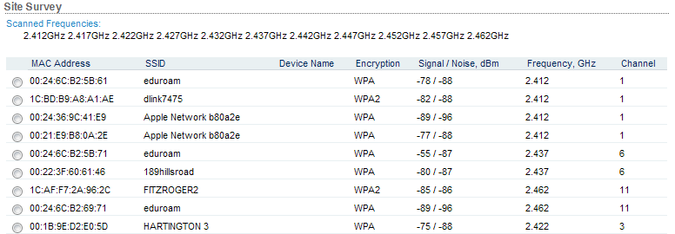
Channels
There are 13 channels to choose from. Problem solved?
  Not really … they overlap, only 3 non-overlapping

Slide 16
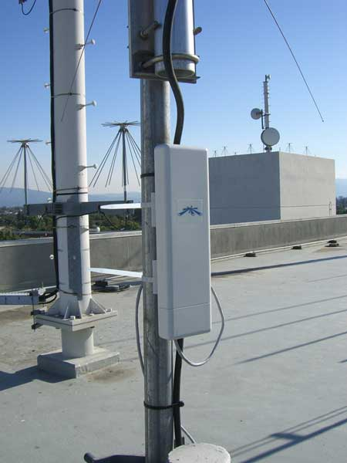
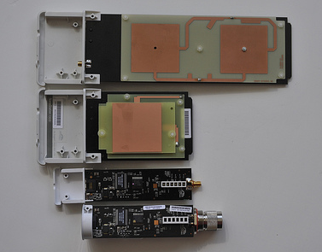
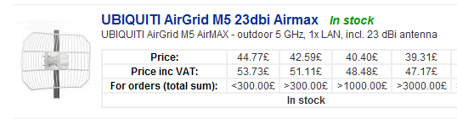
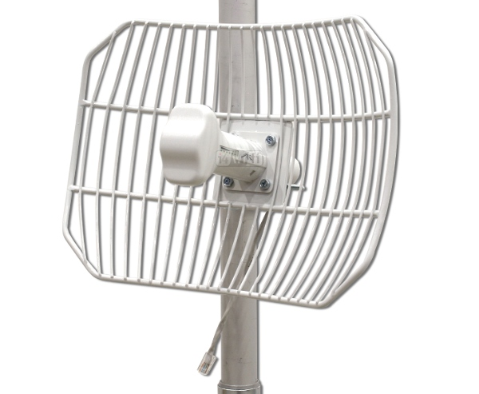
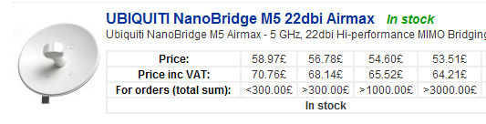
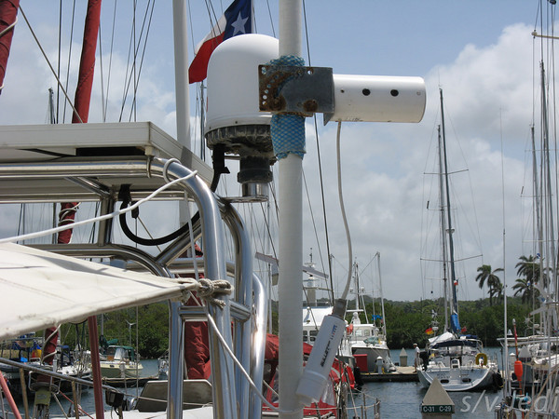
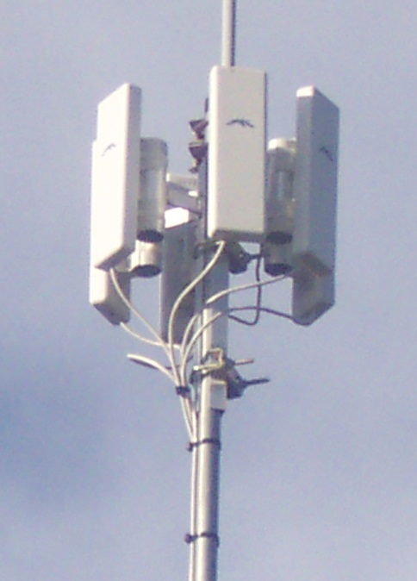
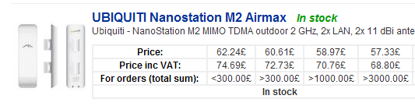
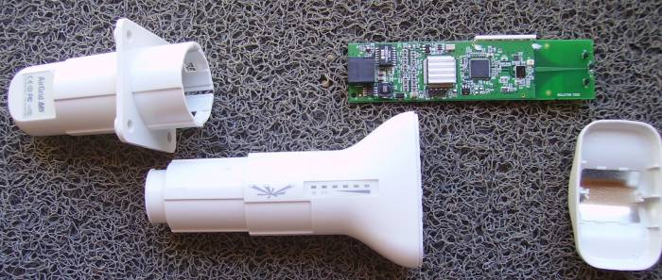
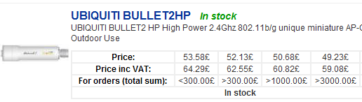
High Tx power, directional antennas
High Tx power and/or directional antennas can drastically increase the received signal strength → leakage, capture, high noise floor etc.
Small-size devices with tons of capability and power in an all-in-one package
  400/680 MHz CPU, 32/64 MB RAM, tweaked OS for wireless and routing performance
Up to 30 dBm (1000 mW) transmit power !
Up to 50 km !
EU tx power limit is approx 10 dBm (10 mW)
WISPs (Wireless ISP)
(google “wifi for boats”)

Slide 17
High Tx power, directional antennas
Such devices can silence other networks (capture the channel)

Slide 18
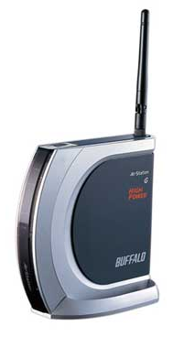
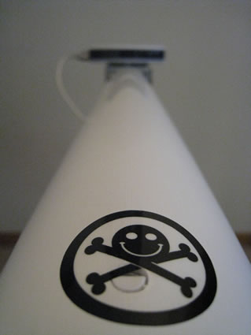
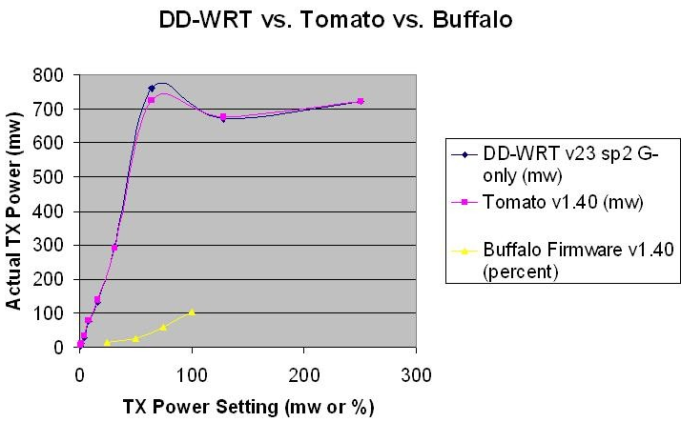
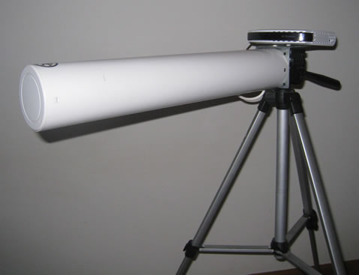
DIY
About £50 to get the following:
  Buffalo WRT-HP-G54 router
  18 dBi Yagi antenna
  Cheap tripod
DD-WRT or Tomato firmware
  29 + 18 = 47 dBm EIRP !!!
  (EU EIRP limit is 20 dBm)
Blast your neighbours into oblivion …
  … and get some good throughput too

Slide 19
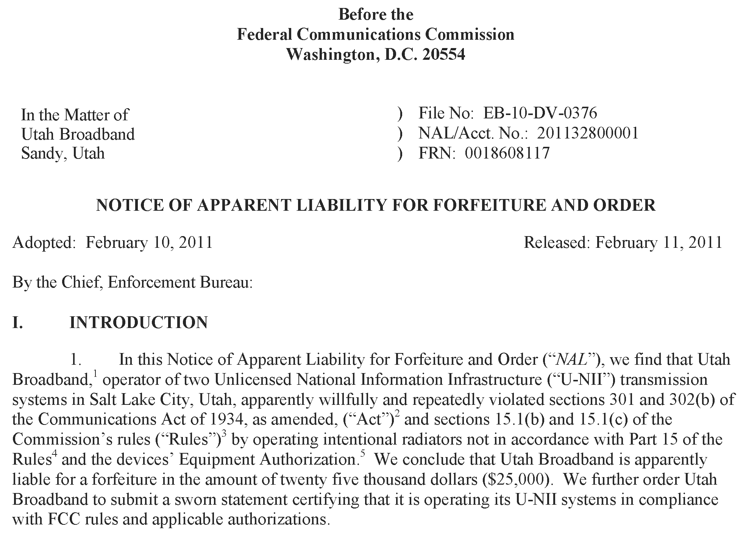
If you’re not careful …

Slide 20
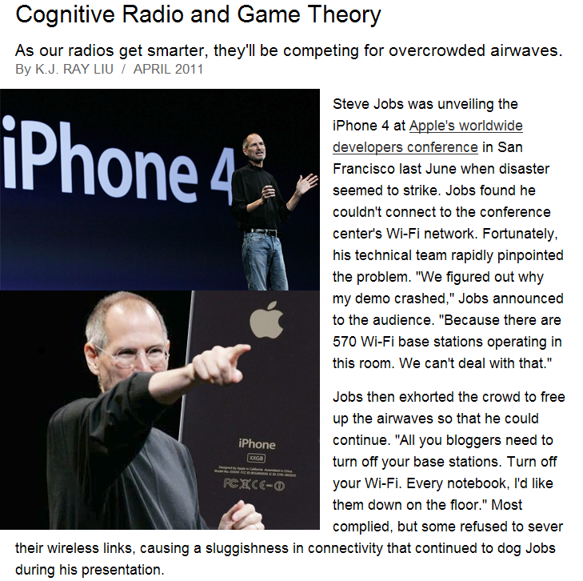
Node density is a real problem
IEEE Spectrum, April 2011
(except pictures)

Slide 21
Power consumption
Tx and Rx power consumptions are similar
  More processing takes place at Rx than Tx

Slide 22
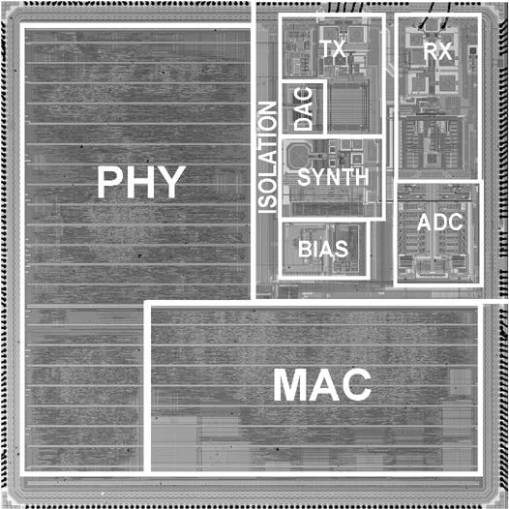
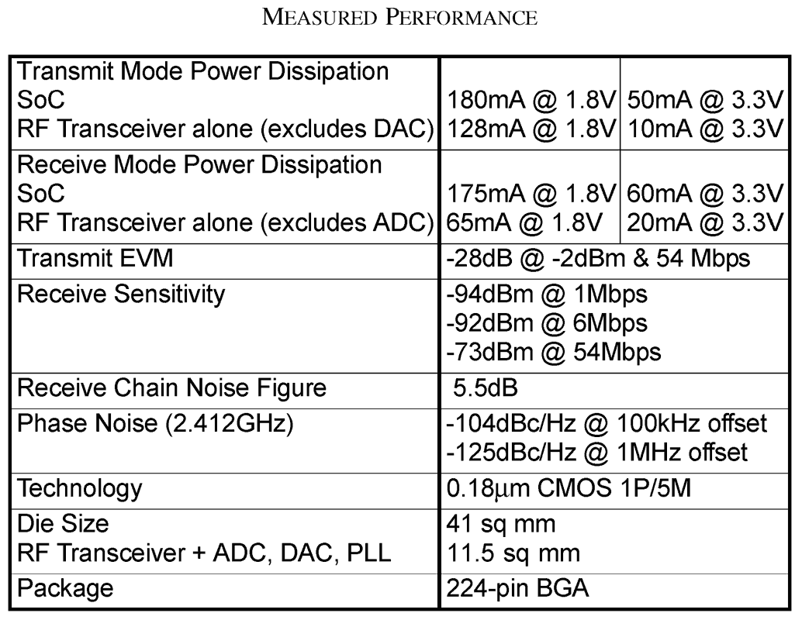
Power consumption
Tx and Rx power consumptions are similar
  So is channel sensing in many cases (power detection vs. preamble detection)
Atheros Communications Inc.
S. Mehta et al., “An 802.11g WLAN SoC,” in IEEE Journal of Solid-State Circuits, vol. 40, no. 12, pp. 2483-2491, Dec 2005

Slide 23
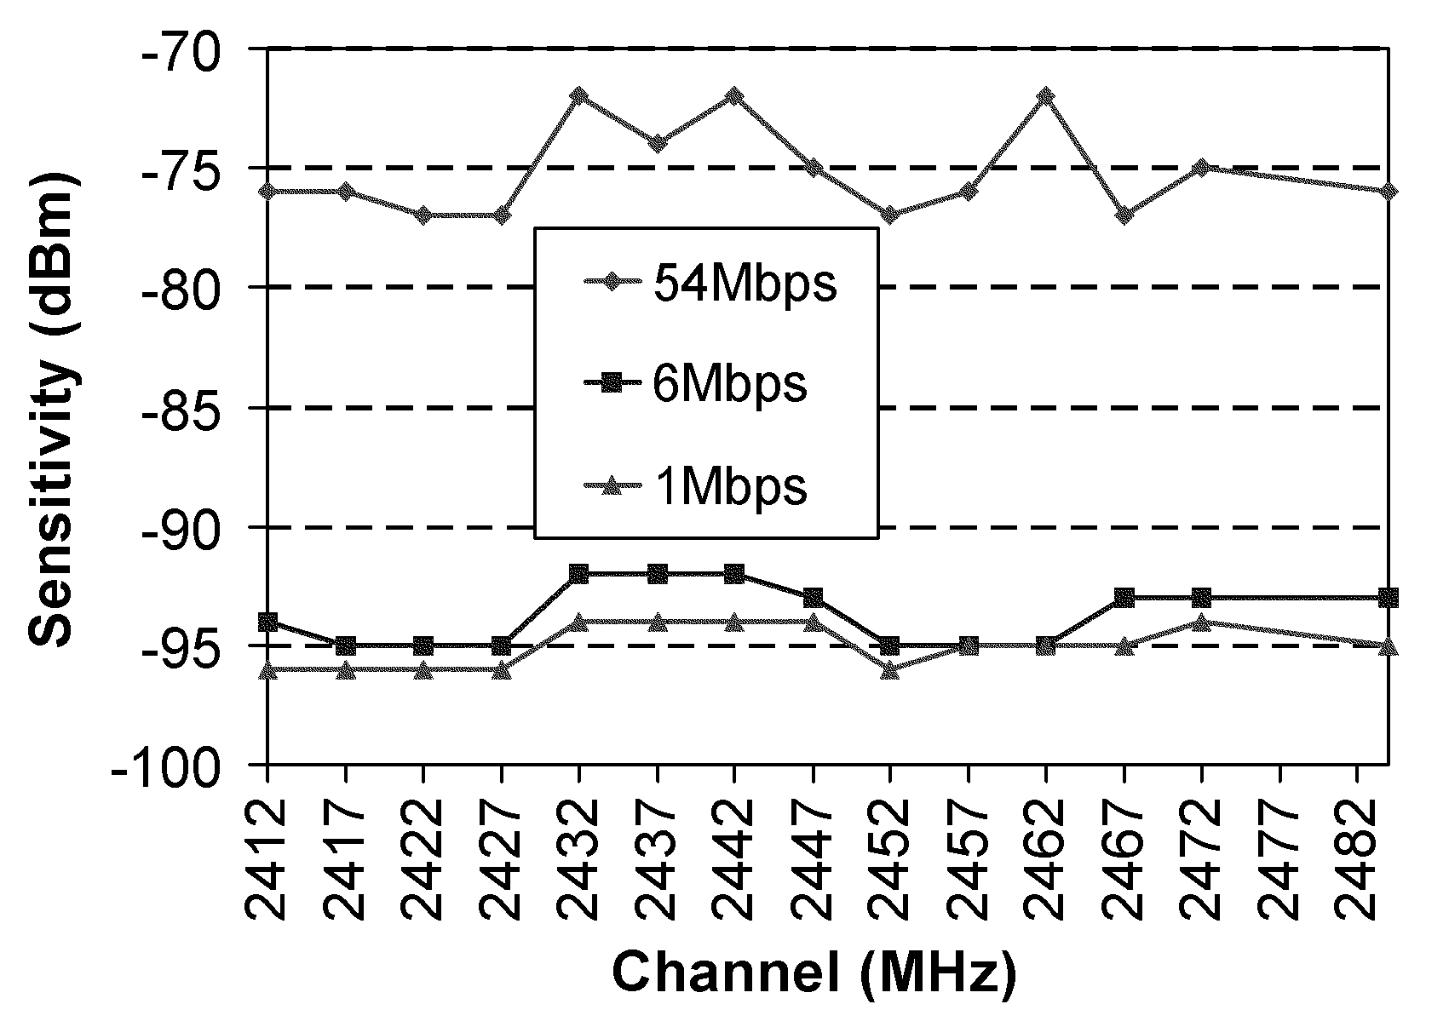
Power consumption
Rx sensitivity is not (always) constant across the spectrum!
Atheros Communications Inc.
S. Mehta et al., “An 802.11g WLAN SoC,” IEEE Journal of Solid-State Circuits, vol. 40, no. 12, pp. 2483-2491, Dec 2005

Slide 24
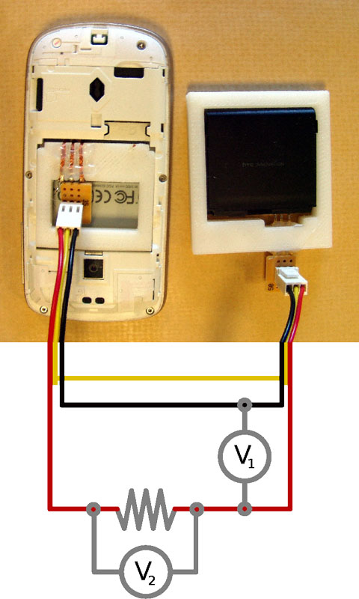
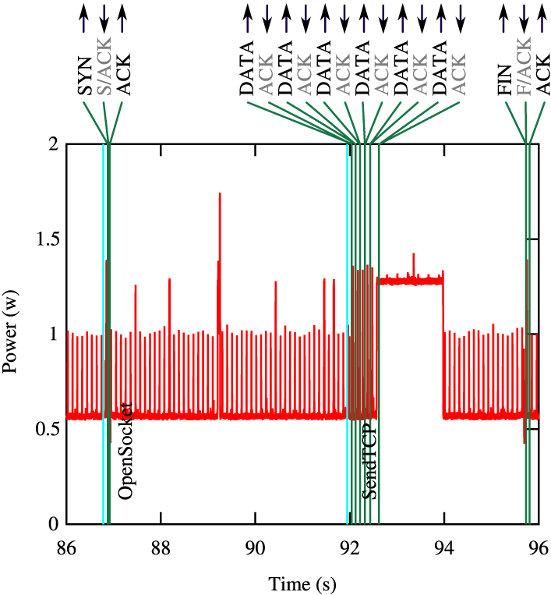
Power consumption
Tx and Rx power consumptions are similar
  So is channel sensing in many cases (power detection vs. preamble detection)
0.02 Ω
A. Rice and S. Hay, “Measuring mobile phone energy consumption for 802.11 wireless networking,” Pervasive and Mobile Computing, vol., no. 6, pp. 593-606, Dec 2010

Slide 25
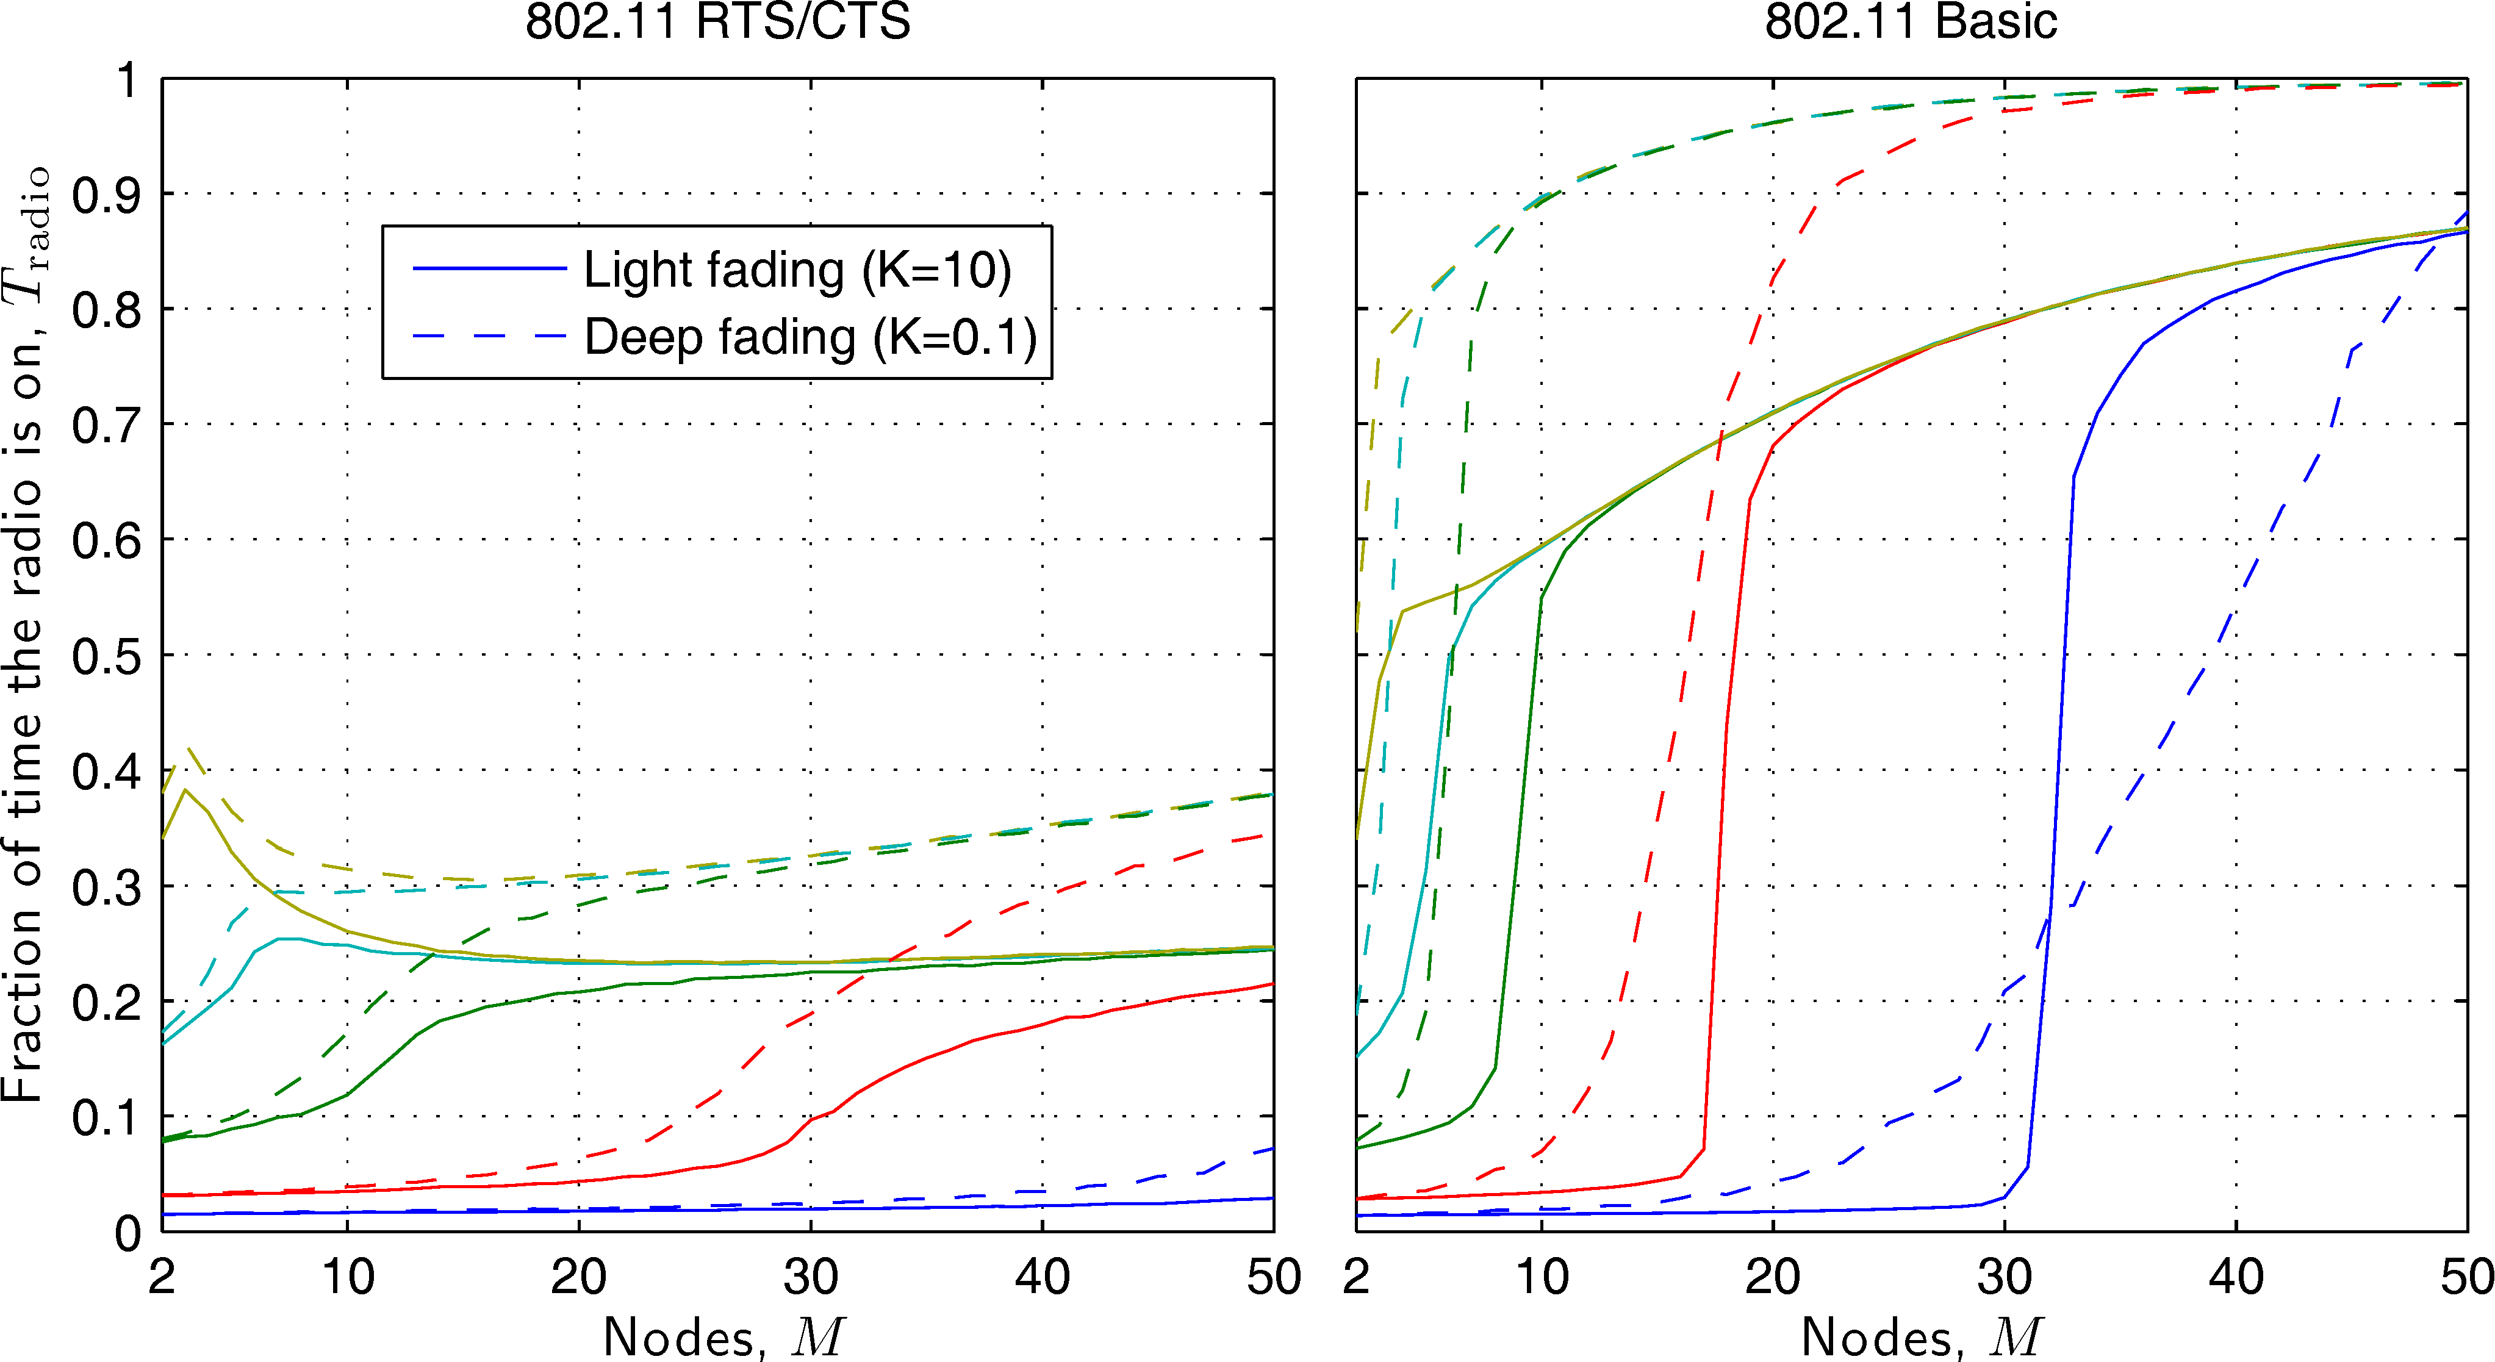
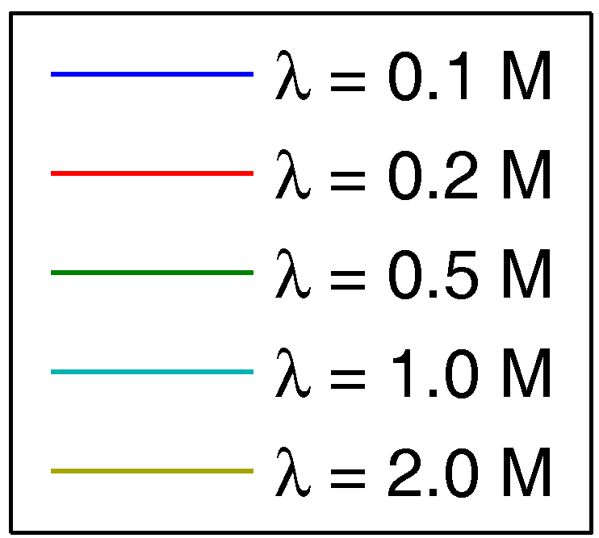
Radio-On time
High nr of active nodes → nodes spend precious time sensing the channel, resolving collisions and retransmitting
  Energy is wasted!
Packetarrival rate

Slide 26
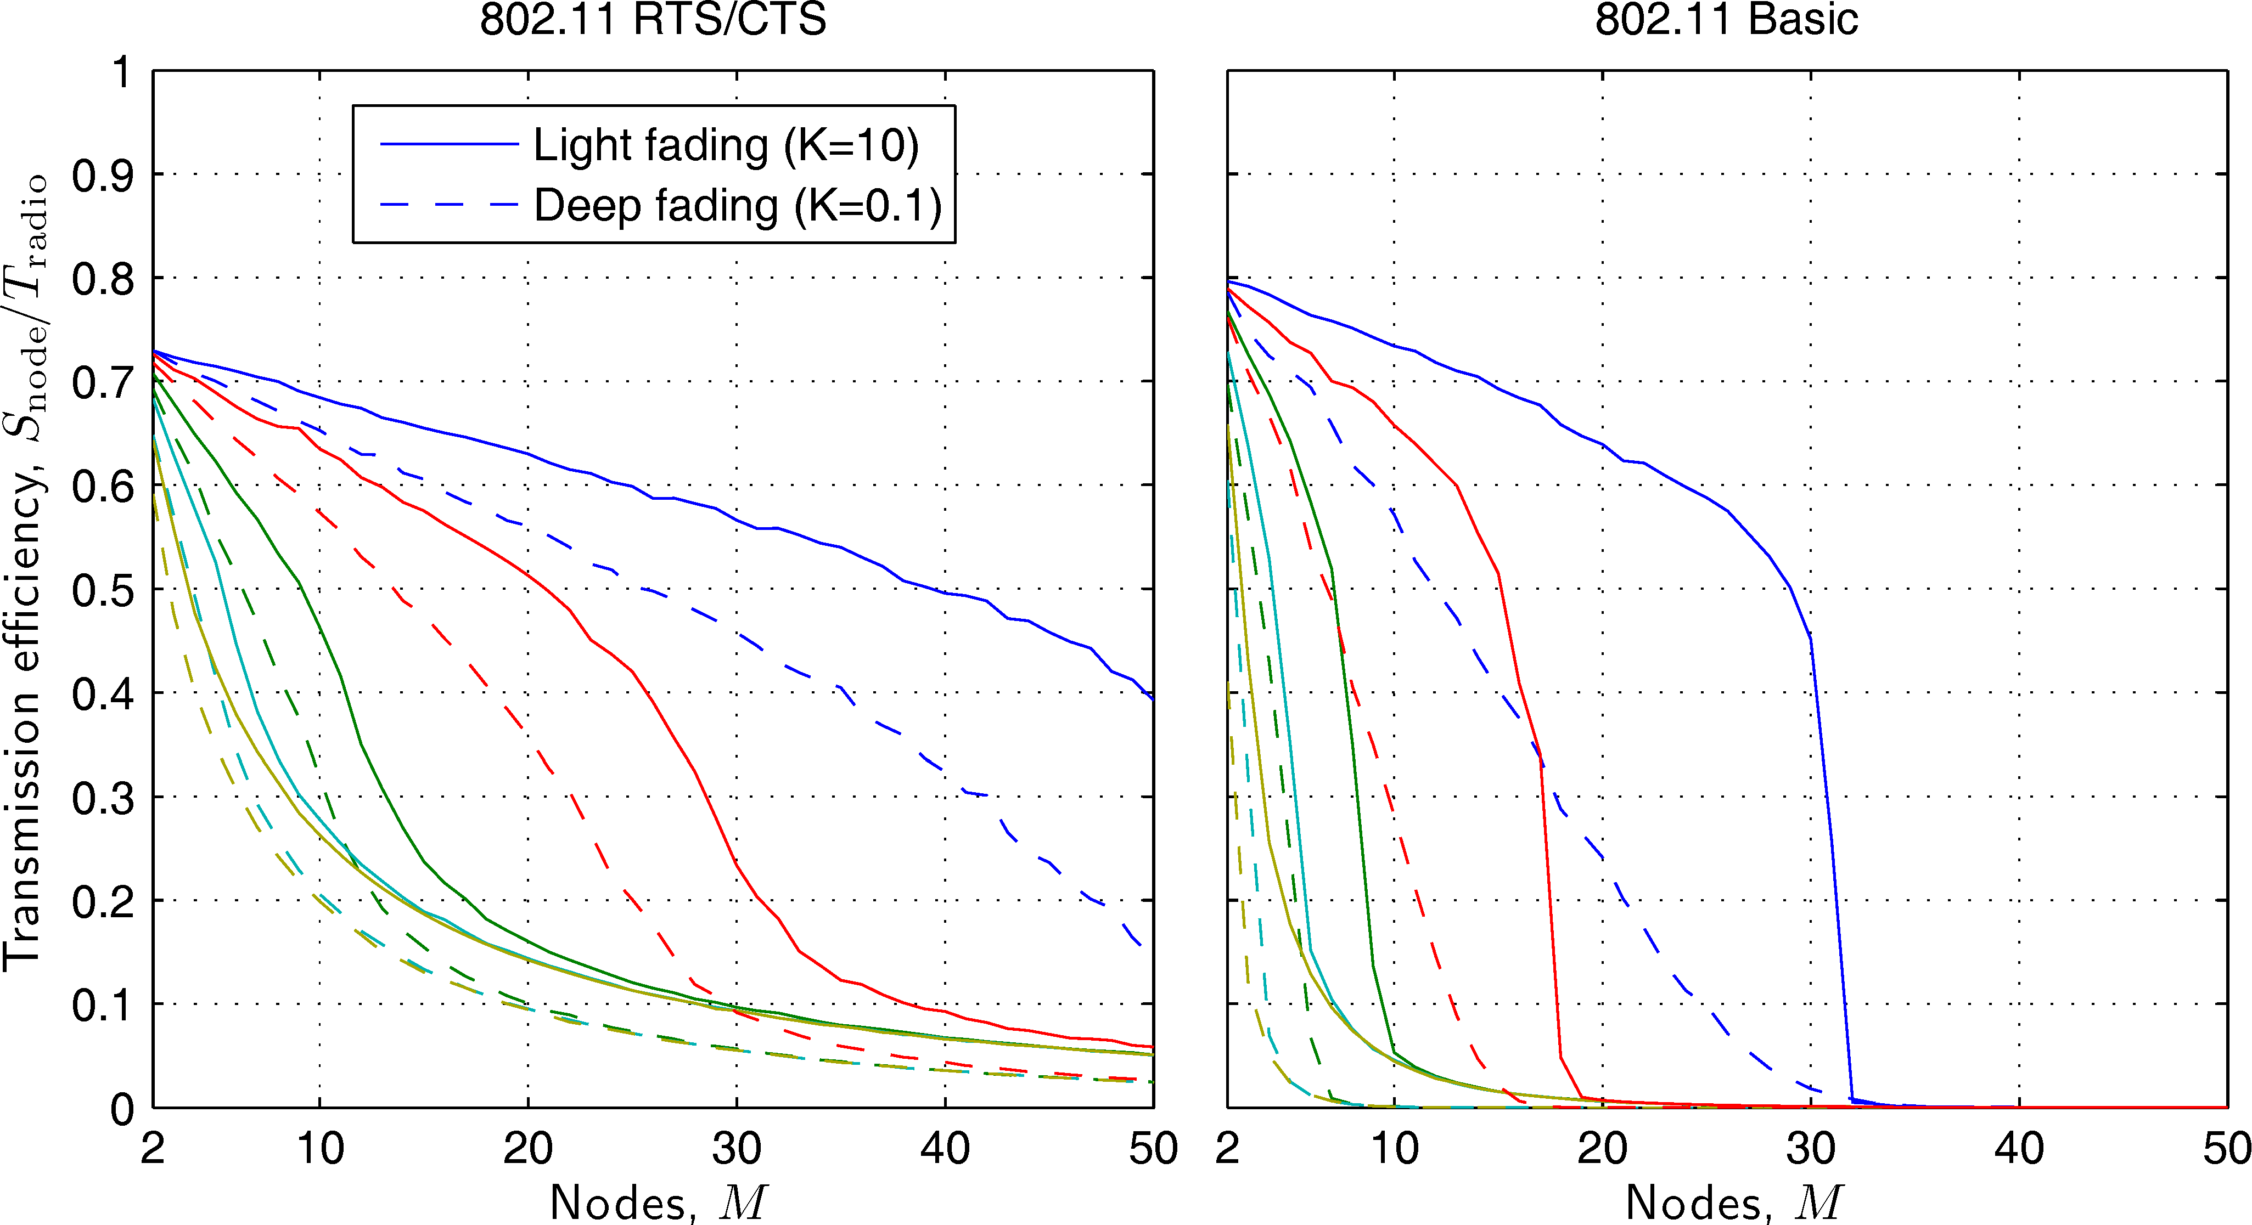
Transmission efficiency
Normalized throughput per Radio-On time

Slide 27
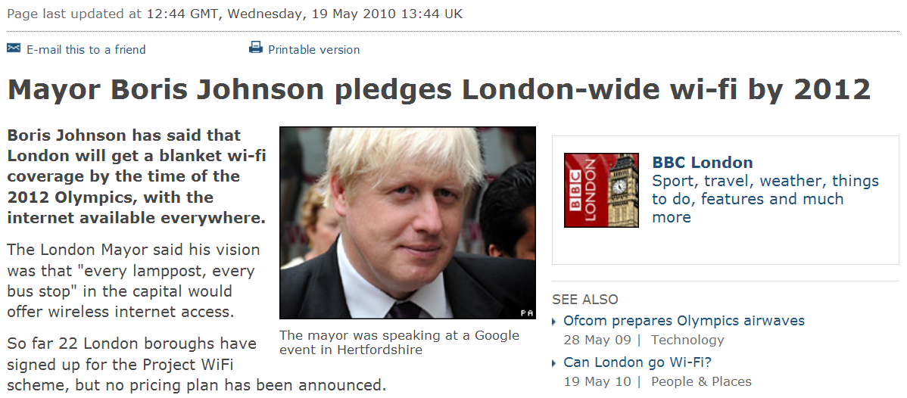
Future?
It’s going to get worse
  WiFi N (MIMO) - double the bandwidth (40 MHz)
  WiFi capability in more devices (HDTVs, consoles, cars, etc.)
  Multi-hop? Routing?
  Qualcomm’s FlashLinq to connect “thousands of devices in range”
  WISPs announced officially!

Slide 28
Multi-Carrier Burst Contention (MCBC)
Designing and implementing a new wireless scheme
  Strive to make it
    Simple and fast (low complexity)
    Support ad hoc and infrastructure
    Extendable (QoS, priority etc.)
    Scalable and Efficient
  Use two dimensions for channel contention
    Time and frequency
  Full randomization in both time and frequency domains to run a leader election algorithm
  Cross-Layer PHY and MAC
    Use simple and unmodulated bursts
  Harness the power of the OFDM PHY
    Use individual subcarriers as well as time slots for channel contention
B. Roman, I. Wassell, I. Chatzigeorgiou, “Scalable Cross-Layer Wireless Access Control using Multi-Carrier Burst Contention,” IEEE Journal on Selected Areas in Communications, vol.29, no.1, pp.113-128, 2011

Slide 29
Multi-Carrier Burst Contention (MCBC)
The goal: obtain a single winner with high probability.
  Imagine a game of dice with 96 players without identity and one referee. A player can only see their own die and has no idea how many other players there are. Referee can see all dice but also has no idea how many players there are.
    All players roll their die and then put it in a pool.
    Referee shouts the highest number.
    Losers (lower number) exit the game.
    Winners (highest number) go into next round and recommence.
6 6
6 6 6
6 6
6 6 6
6 6 6
6 6
6 6
6 6 6
6 6
6 6 6
6 6 6
6 6
2 4 4 4 6 2 2 1 6 4 3 4 4 4 4 5
4 6 2 1 1 1 3 6 3 5 4 5 6 3 2 1
5 1 4 4 6 3 3 5 6 4 3 1 4 2 1 5
2 3 6 3 5 3 6 5 3 1 2 6 2 2 5 3
6 3 5 3 5 5 3 2 5 6 2 5 3 6 5 2
2 5 4 6 4 1 2 3 5 5 6 2 4 1 1 3
2 4 4 4 6 2 2 1 6 4 3 4 4 4 4 5
4 6 2 1 1 1 3 6 3 5 4 5 6 3 2 1
5 1 4 4 6 3 3 5 6 4 3 1 4 2 1 5
2 3 6 3 5 3 6 5 3 1 2 6 2 2 5 3
6 3 5 3 5 5 3 2 5 6 2 5 3 6 5 2
2 5 4 6 4 1 2 3 5 5 6 2 4 1 1 3
2
5
3
3 1
5 6 2
2 4
6 2 4
4 3 1
6 5
5
6
6
6

Slide 30
Multi-Carrier Burst Contention (MCBC)
Take it one step further. Before rolling their die, each player tosses a coin to choose whether to participate in the round.
    Referee no longer needed: players who toss zero will act as referees.
    All toss coin.
    All zeros become referees. The ones now roll their dice.
    Highest number shouted, winners select themselves for next round.
    Repeat with winners from previous round.
    Single winner in 2 rounds.
0 0 1 1 1 0 1 0 1 1 0 1 0 1 1 0
1 0 0 1 0 1 1 1 0 1 0 1 0 0 1 1
1 0 1 1 0 0 1 0 1 0 1 1 0 1 0 0
0 0 0 0 0 0 0 1 0 1 1 0 1 0 0 0
1 1 0 0 1 0 0 0 1 0 0 0 0 1 1 0
1 1 1 0 1 1 0 1 1 1 0 0 0 0 1 0
5 3 5 1 6 5 1 4 3
6 4 3 4 3 3 6 2 5
5 4 1 6 4 4 2 5
1 1 5 2
4 6 2 3 6 4
2 5 2 1 6 3 2 3 1
1
0 1
1
1 0
0
2
4
2
1
4
1 1 1 1 1 1 1 1 1
1 1 1 1 1 1 1 1 1
1 1 1 1 1 1 1 1
1 1 1 1
1 1 1 1 1 1
1 1 1 1 1 1 1 1 1
6
6 6
6
6 6
6
1
1
1
1

Slide 31
Multi-Carrier Burst Contention (MCBC)
  Actual radio: Die face number → frequency sub-channel.
  Die rolls and referee shouts → simple buzz on respective freq.
Notes:
Analogy with a game of dice. How to elect a (single) leader as quickly as possible with very high probability?
Suppose there are 250 players, each with a coin and a die with, say, 4 faces (tetrahedron?)
Suppose there is a referee that has no idea who or how many players there are. He can see the dice when they are rolled but cannot count them.
Each player flips his coin. If it’s heads (nominee) then he rolls his die … roughly half of the players will roll their dice.
The referee sees all dice and will be ale to tell the highest face, in this case 4.
He shouts back to everyone that number 4 is the winner.
The players who rolled 4 will select themselves as round winners and go into the 2nd round. The others lose and exit the game.
Dice faces are individual frequency subcarriers activated by simple bursts. The burst are transmitted simultaneously but this is ok since we are only interested in identifying the frequency (die face) and not the number or the identity of the players. By the end of the 3rd round there is a very high probability that only 1 player is left.

Slide 32
Multi-Carrier Burst Contention (MCBC)
  Actual radio: Die face number → frequency sub-channel.
  Die rolls and referee shouts → simple buzz on respective freq.
Round 1 (feedback): referees select the 34 nominees as winners
Round 2 (contention): 34 contenders flip a coin (probability p_{t})
Round 1 (contention): 250 contenders flip a coin (probability p_{t})
Round 2 (feedback): referees select the 5 nominees as winners
Round 3 (contention): 5 contenders flip a coin (probability p_{t})
Round 3 (feedback): referees select the 1 nominee as winner
Round 1 (contention): 34/132 nominees choose the highest subcarrier
Round 2 (contention): 5/18 nominees choose the highest subcarrier
Round 3 (contention): 1/3 contenders chooses the highest subcarrier
Nominees = 132
Nominees = 3
Nominees = 34
Nominees = 18
Nominees = 5
Nominees = 1
Lost = 118
Lost = 216
Lost = 232
Lost = 245
Lost = 247
Contenders = 250
Lost = 249
Contenders = 34
Contenders = 5
Notes:
Analogy with a game of dice. How to elect a (single) leader as quickly as possible with very high probability?
Suppose there are 250 players, each with a coin and a die with, say, 4 faces (tetrahedron?)
Suppose there is a referee that has no idea who or how many players there are. He can see the dice when they are rolled but cannot count them.
Each player flips his coin. If it’s heads (nominee) then he rolls his die … roughly half of the players will roll their dice.
The referee sees all dice and will be ale to tell the highest face, in this case 4.
He shouts back to everyone that number 4 is the winner.
The players who rolled 4 will select themselves as round winners and go into the 2nd round. The others lose and exit the game.
Dice faces are individual frequency subcarriers activated by simple bursts. The burst are transmitted simultaneously but this is ok since we are only interested in identifying the frequency (die face) and not the number or the identity of the players. By the end of the 3rd round there is a very high probability that only 1 player is left.

Slide 33
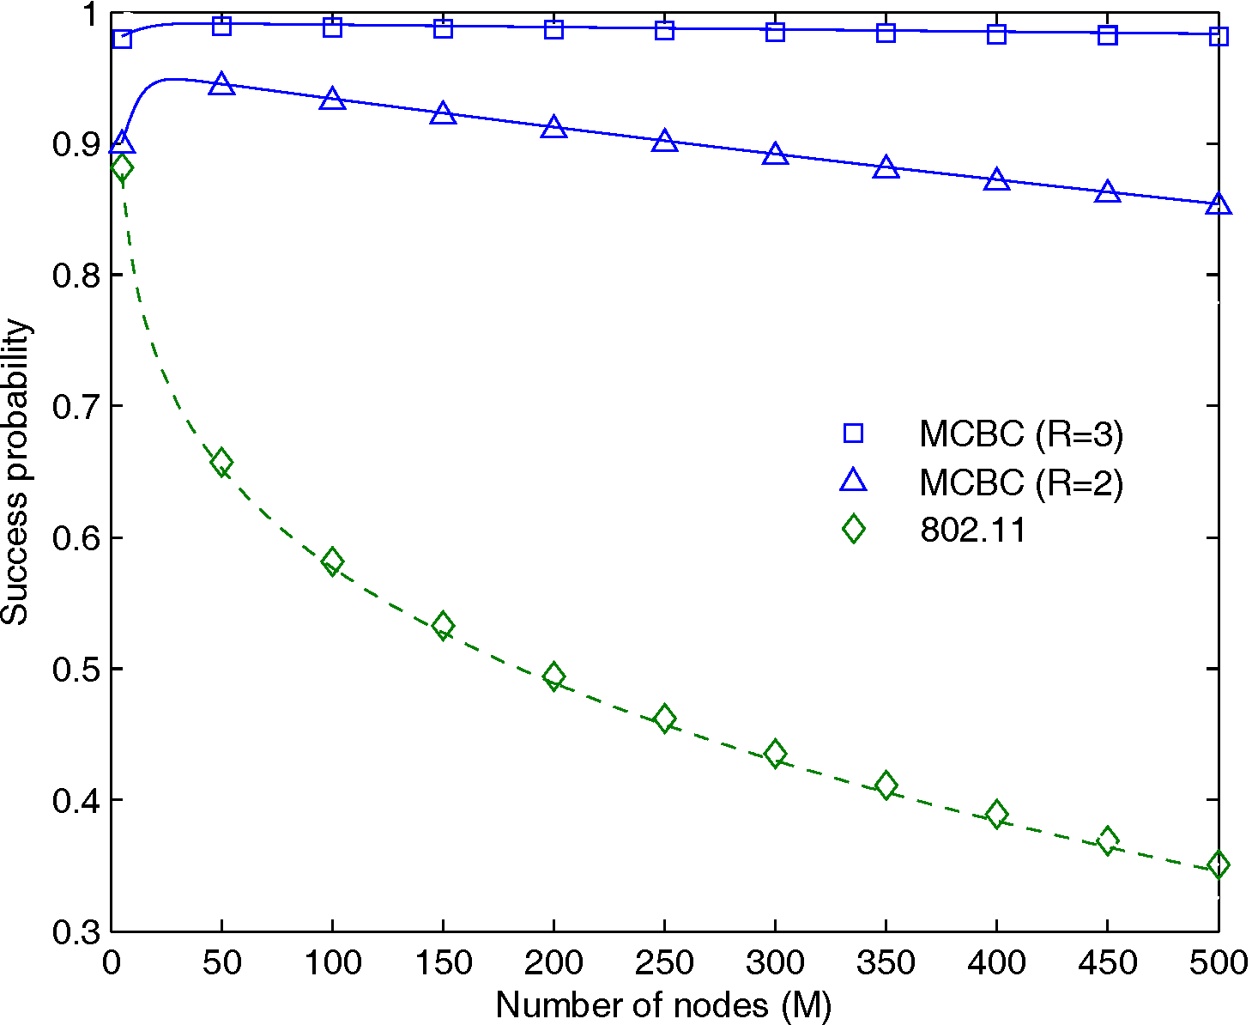
Multi-Carrier Burst Contention (MCBC)
Very efficient (single winner with high prob, always at least 1 winner)
Uses only unmodulated and short bursts (tones)
Simple, no adaptive approach needed (all parameters fixed in h/w)
Works in ad hoc (losers become referees)
Supports QoS and priority access (how?)
Is it actually feasible? Low overhead, low power?

Slide 34
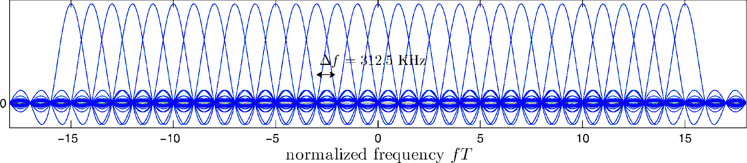
MCBC Challenges: OFDM Physical Layer
64-point IFFT: 64 digital samples (freq) to 64 time samples (analog after IQ mod)
FFT in OFDM only works if transmitter and receiver are synchronised in freq
We can’t afford that in MCBC (would need preambles, too much overhead)
  It would actually be impossible (why?)

Slide 35
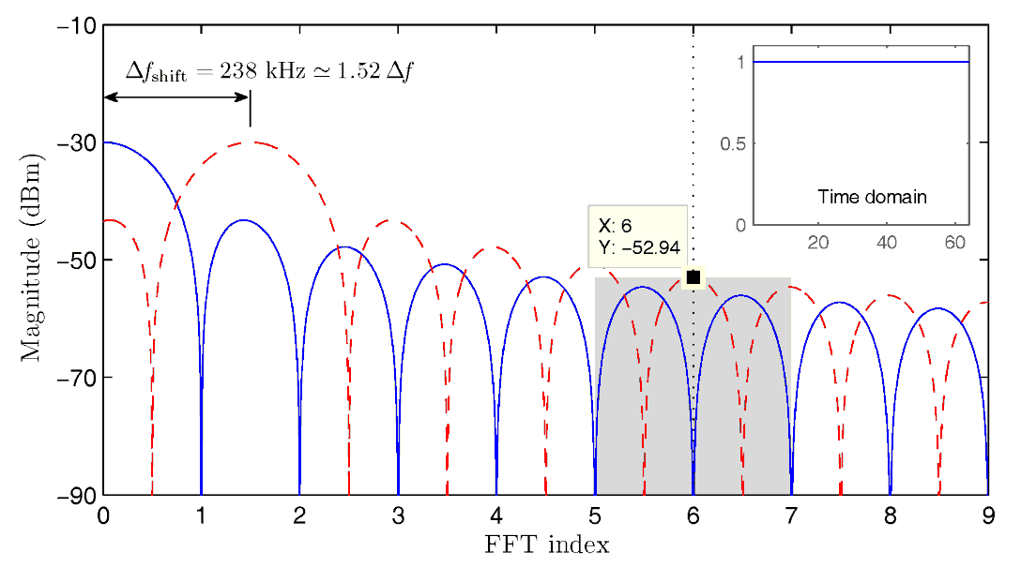
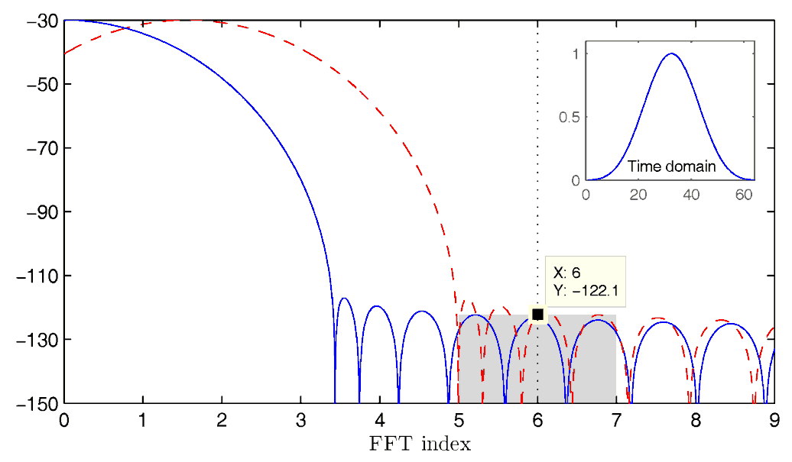
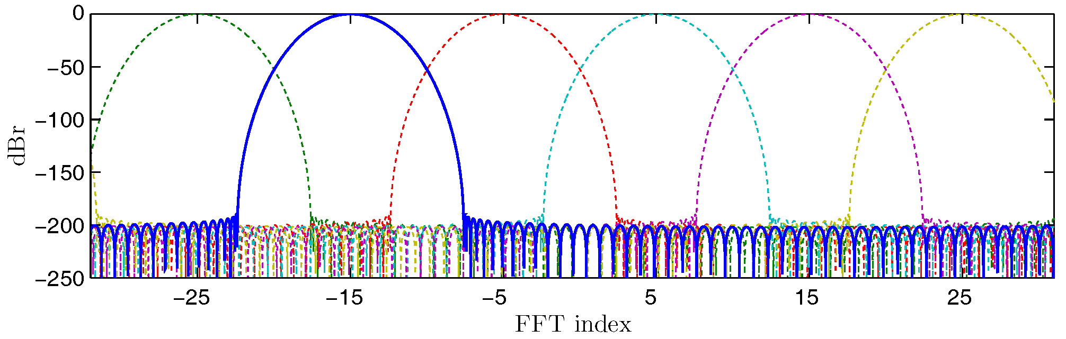
MCBC Challenges: Frequency shift and ICI
We’re not doing any freq sync so
  Oscillator shift can cause the entire spectrum to shift by up to 1.5Δf
    Receiver will “sample” the wrong frequency bands → false positive
    Terrible inter carrier interference (ICI), a.k.a. FFT leakage
Solutions:
  Use custom time windowing based on (Ultraspherical polynomials)
  Space the subcarriers in frequency (similar to classic FDM)
Default (rectangular)
Ultraspherical 120 dB

Slide 36
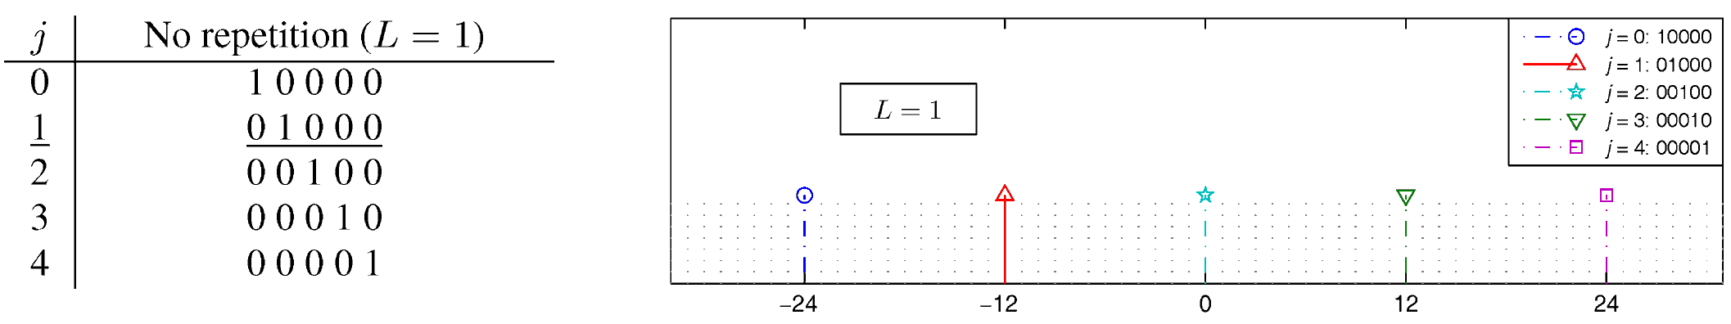
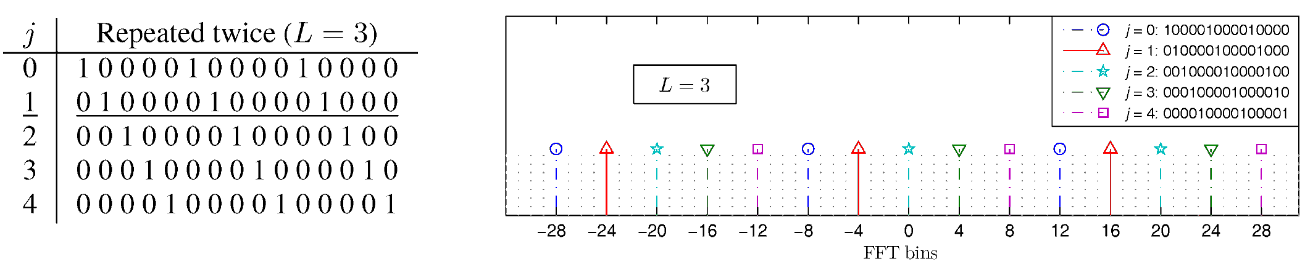
MCBC Challenges: Channel fading
Channel fading, mobility and frequency selectivity
  Some subcarriers are faded (some differently than others) → false negatives
  Equalization not a good idea
Solution: use redundancy techniques

Slide 37



MCBC Challenges: Time offset
If any of the 64 samples are missed then spectral features are invalidated
Propagation time and delay spread become an issue
  150 m gives 500 ns delay already (sample period is only 50 ns)
  WAVE (vehicular) specifies up to 1000 m range (3.333 μs max delay)
Use a cyclic prefix and careful FFT triggering
  New problem: time discontinuity → spectrum expansion
    Solution: optimize Ultraspherical polynomial parameters (hill climbing)

Slide 38

MCBC: How does it look?
Any cool pictures or videos?
  Absolutely! We have an exciting multi-core testbed ☺

Slide 39

MCBC: How does it look?
Any cool pictures or videos?
  Absolutely! 3D oscilloscope with DTS audio showing internal contending nodes.

Slide 40



MCBC: Signals
Time sync
Measured burst Tx spectrum
Theoretical burst Rx spectrum
Measured burst Rx spectrum

Slide 41

MCBC: Performance (simulations)

Slide 42


MCBC: Efficiency (simulations)

Slide 43
A shift in perception
Subject: [IEEE JSAC Special Issue on Vehicular Networks] Your paper #1569028017
From: rajeev.shorey@gm.com
Date: Wed, 13 Jun 2007 23:30:02 -0400
To: Bogdan Roman <abr28@cam.ac.uk>
CC: Frank Stajano <fms27@cam.ac.uk>, rajeev.shorey@gm.com, fanjum@telcordia.com, schoi@snu.ac.kr, gligor@umd.edu, ralf.g.herrtwich@daimlerchrysler.com, prkumar@uiuc.edu, jean-pierre.hubaux@epfl.ch
Dear Mr. Bogdan Roman:
We regret to inform you that your paper #1569028017 ('An Arbitrarily Scalable MAC Protocol for Ad Hoc Wireless Networks') cannot be accepted for publication in the Proceedings of IEEE JSAC Special Issue on Vehicular Networks.
===== Review =====
*** Review score:: Please enter summary rating for the paper. Reject (1)
*** Reviewer's comments:: Reviewer's comments will be made available to the author(s). Please enter comments here to explain your summary rating:
4. The simulation experiments are carried out even in 100s of and 1000s of nodes. I am wondering why we need to consider such a large number of nodes.

Slide 44
A shift in perception
Subject: [IEEE JSAC Special Issue on Vehicular Communications and Networks] Your paper #1569258950
From: Guest-Editors_JSAC-VCN@ieee.org
Date: Tue, 06 Apr 2010 20:30:03 -0400
To: Bogdan Roman <abr28@cam.ac.uk>
CC: Ian James Wassell <ijw24@cam.ac.uk>, Ioannis Chatzigeorgiou <ic231@cantab.net>, cheng-xiang.wang@hw.ac.uk, vasilako@ath.forthnet.gr, eermurch@gmail.com, stuber@ece.gatech.edu, xshen@bbcr.uwaterloo.ca, waichen@ieee.org, Timo.kosch@bmw.de
Dear Mr. Bogdan Roman
The review of your submitted paper #1569258950 ('Scalable Cross-Layer Wireless Access Control using Multi-Carrier Burst Contention') has been completed and you can view the reviewers' comments below […].
Thank you very much for your contribution!
======= Review 1 =======
*** Recommendation: Accept with minor changes (as noted below) (8)
*** Detailed Comments: Please provide detailed feedback to the author(s).
[...] of each other in the simulation. My concern is how more realistic scenarios would affect the performance of the protocol. In other words, if one simulated thousands of nodes densely packed into a road network, how would this density affect the network throughput given this approach. It seems possible that the contention mechanism in

Slide 45
MCBC: Non technical challenges
Will it replace WiFi?
  No (not anytime soon anyway). Adopted standards die very hard without a serious industry push or usage shift.
Will it be used anywhere?
  Can contribute to upcoming standards (e.g. white spaces)
  Contention algorithm is general. Randomized applications requiring a single winner can benefit (e.g. Qualcomm’s FlashLinq)
  Microsoft Research implemented part of it
K. Tan et al., “Fine Grained Channel Access in Wireless LAN,” in ACM SIGCOMM 2010, Aug 2010

Slide 46


Software Defined Radio (SDR) implementation
Many SDR solutions. Microsoft Research created Sora.
  In 2010 we won a number of these from MSR as an award.

Slide 47

Software Defined Radio (SDR) implementation
Ideal SDR: all processing takes place in the PC’s CPU.
Real SDR: some parts are still dedicated h/w, e.g. IQ (de)modulation.
Sora uses PCI-E to connect to the PC → many Gbps bandwidth.

Slide 48



Software Defined Radio (SDR) implementation
  Parts of MCBC were used by MSR when creating the Fine Grained Channel Access scheme. Implemented in Sora.
K. Tan et al., “Fine Grained Channel Access in Wireless LAN,” in ACM SIGCOMM 2010, Aug 2010

Slide 49
Thank you!
Questions?

